Slide 1
Observations of Eyewalls and Rainbands in
Tropical Cyclones
Robert A. Houze, Jr.
Based on work by
Anthony Didlake & Deanna Hence
Wayne Schubert Symposium
100th Annual Meeting of the American Meteorological Society
Boston, 14 January 2020
Notes:
Wayne Schubert is a great theoretician with many protégés…
Dick Johnson asked me for an observational perspective…
This talk will review some of the very detailed observations that we’ve been making during the decades of Wayne’s career
Specifically I’m going to talk about specialized radar observations that were analyzed in the PhD research of two of my students, A and D, who are now themselves professors advising their own students.

Slide 2
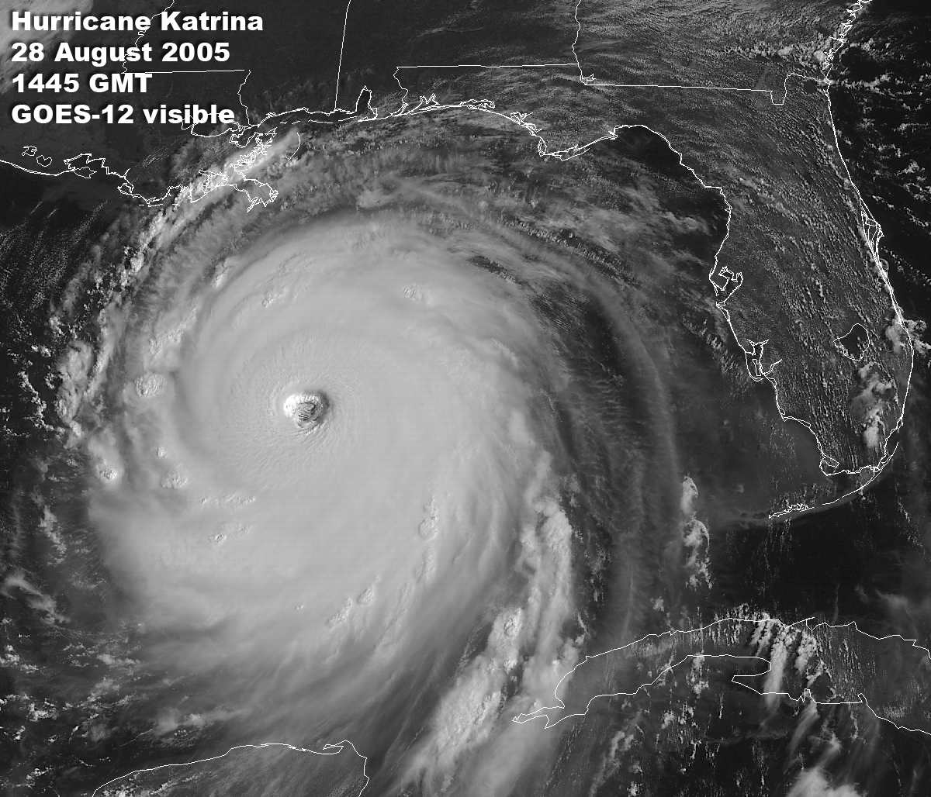
Notes:
These studies deal with the detailed internal structures not seen in satellite IR images such as this one where the shield of Katrina covered much of the Gulf of Mexico

Slide 3
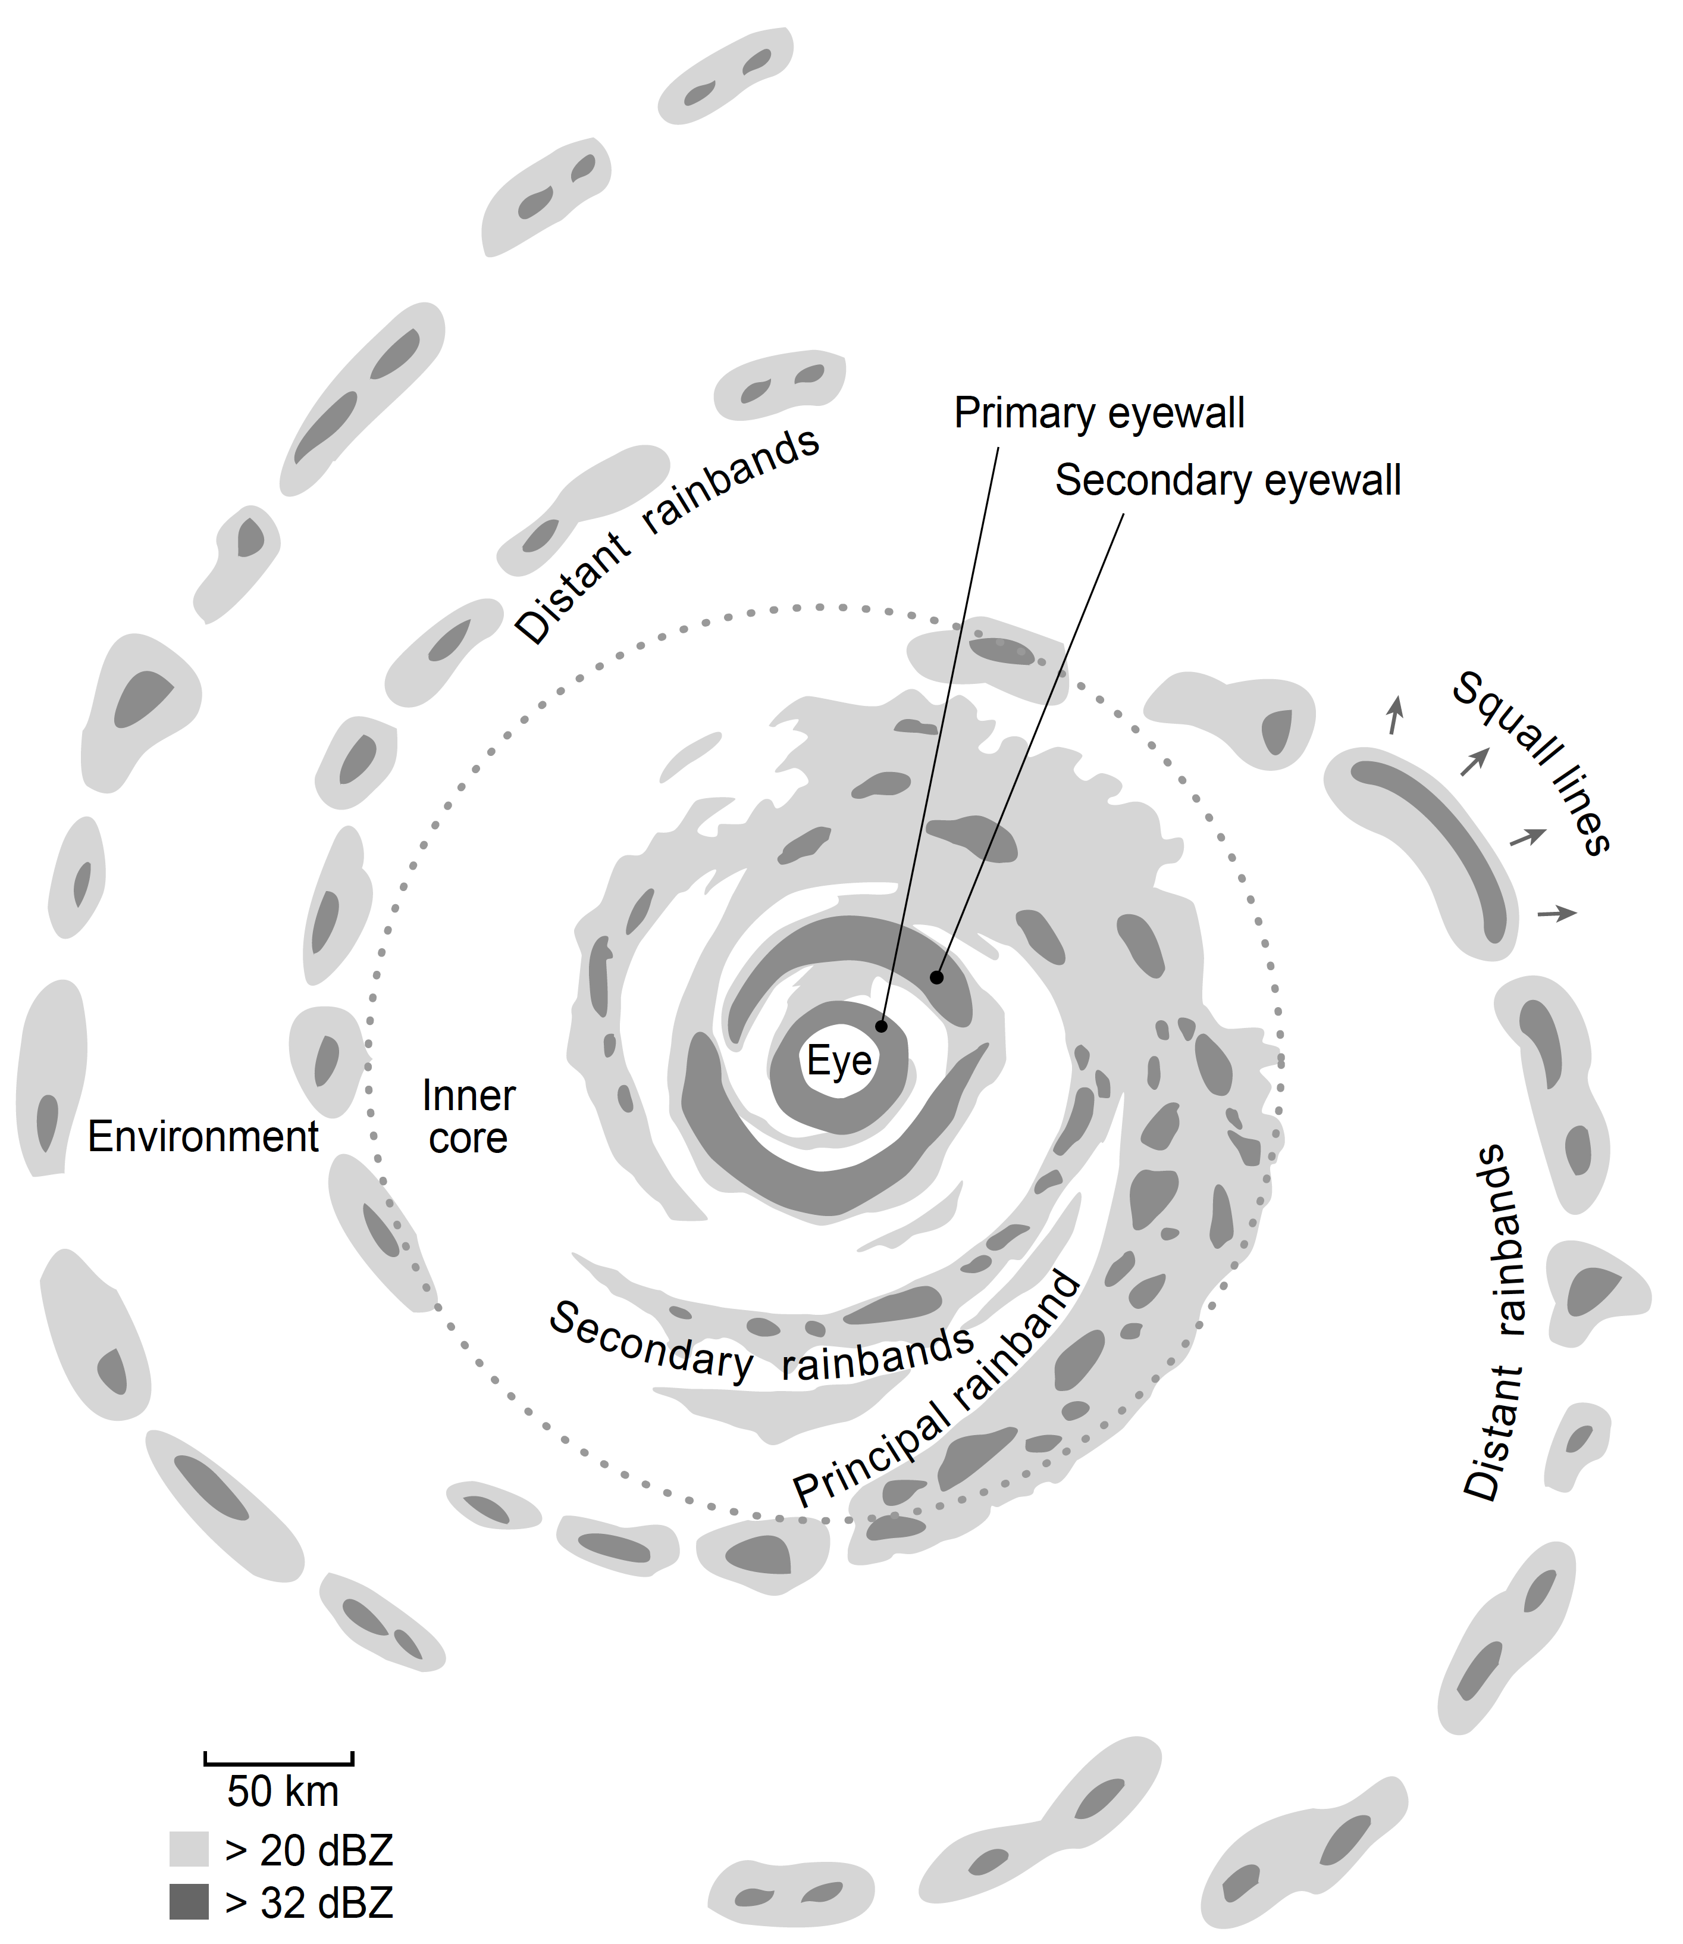
RADAR sees the eyewalls and rainbands in a tropical cyclone
Willoughby 1988
Houze 2010
Notes:
When radars look under the cloud shield several features are typically observed…as first pointed out by Hugh Willoughby back in the 80s
These features are several types of so-called eyewalls and rainbands
Primary
Secondary eyewalls in cases of eyewall replacement
Secondary rainbands
Principal rain band
Distant rain band—which occurs outside the inner core region dominated by cyclone dynamics

Slide 4
Two special radars:
TRMM—Satellite
ELDORA—High resolution dual Doppler
Notes:
I’m going to be talking about observations from two very special radars:
TRMM PR—spaceborne system of 3D reflectivity measurement
NCAR ELDORA system—high spatial resolution dual Doppler radar

Slide 5
Eyewall region
Notes:
I will now move through what we’ve seen in different regions of the storm
First the eyewall region

Slide 6
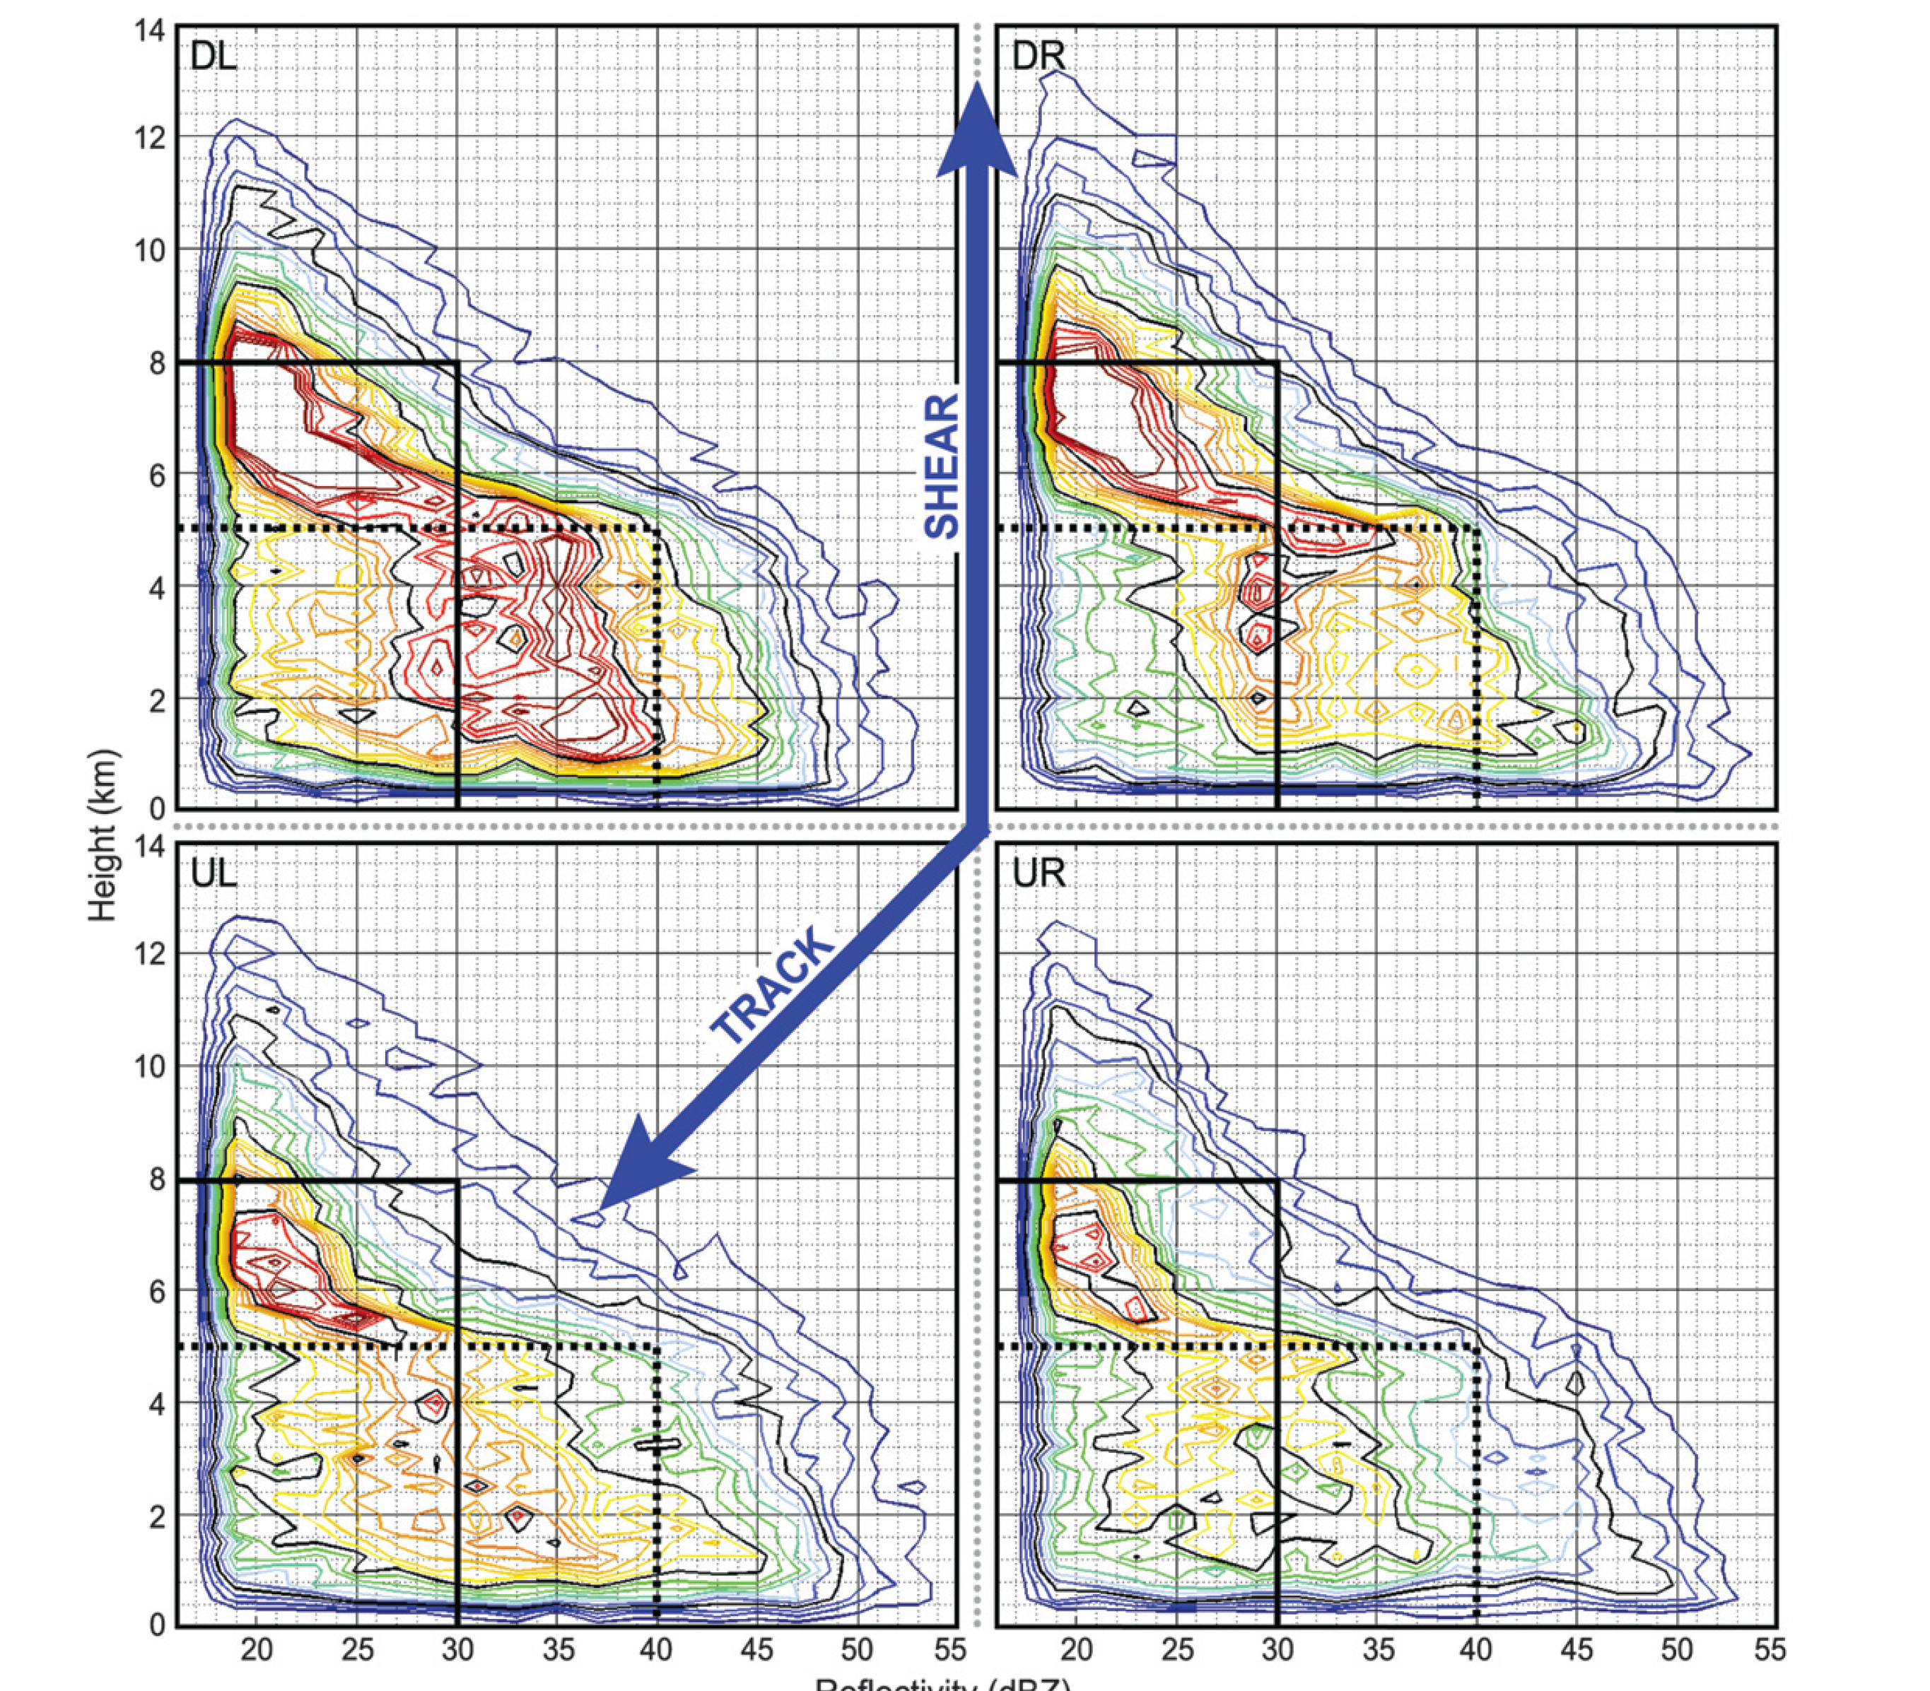
TRMM radar observations of 215 overpasses of Tropical cyclone eyewalls
Maximizing
Growing
Height (km)
Dying
Forming
Reflectivity (dBZ)
Hence & Houze 2011
Notes:
Database was for the first 9 years of TRMM data
These 2D probability distributions of reflectivity by height show how eyewall cellular elements vary in structure by quadrant relative to the environment shear vector

Slide 7
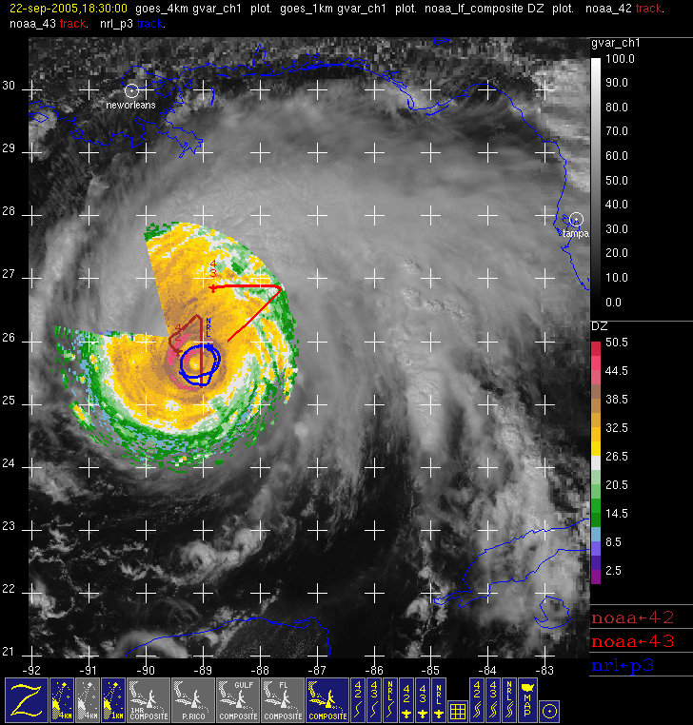
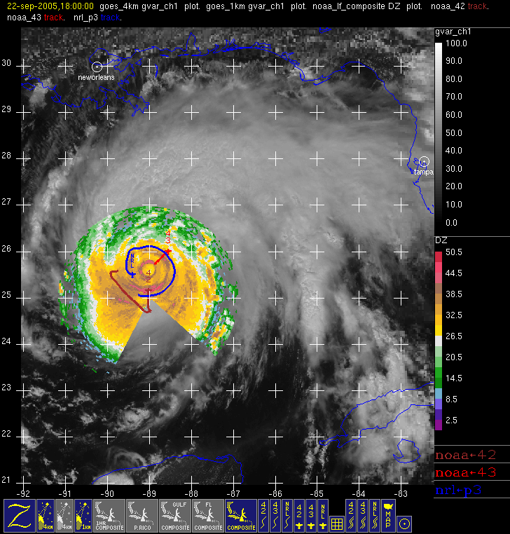
Rita in RAINEX 2005
ELDORA
ELDORA
Flight tracks in Hurricane Rita
Notes:
In RAINEX,
Caught Rita undergoing an eyewall replacement
Throughout RAINEX we flew ELDORA parallel to features rather than across.
This allowed max use of the high res Doppler obs.
Here ELDORA (in blue) was flying alongside the secondary eyewall, first outside then inside
The red flight tracks show the NOAA aircraft flying their typical fig. 4 patterns that cross the rainbands intermittently

Slide 8
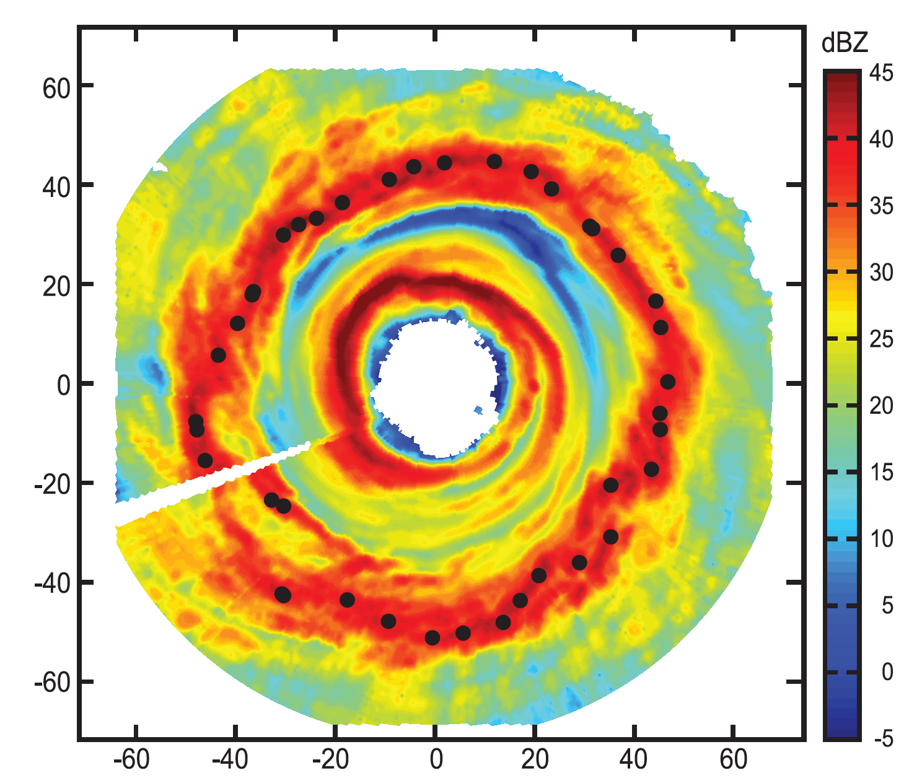
Rita secondary eyewall seen by ELDORA
Didlake & Houze 2011
Notes:
Dots show the locations of intense cells in the 2ndary eyewall
Anthony composited dual Doppler data from all these cells

Slide 9
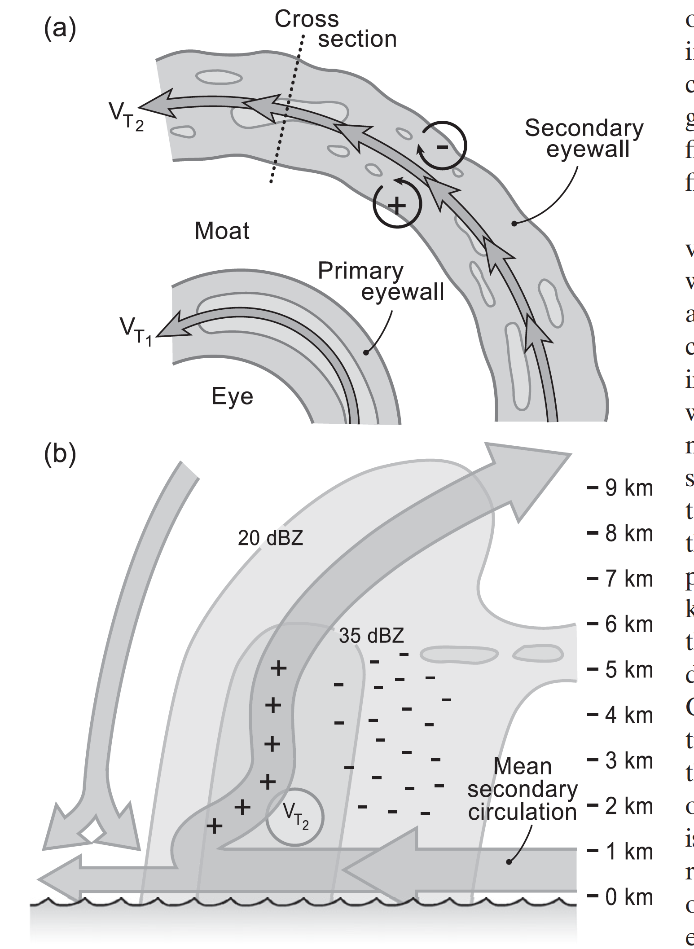
Rita secondary eyewall seen by ELDORA
+/– Vorticity tendency from high-resolution dual-Doppler
Didlake & Houze 2011
Notes:
The secondary eyewall contains a reflectivity tower that
Tilts radially outward
kink associated with supergradient wind above the BL
increased tilt in the upper levels.
Outside of the main reflectivity tower, a bright band indicates the presence of
stratiform precipitation.
Vorticity tendency
+ in the updraft, dominated by the mean flow, primarily via stretching and tilting, inward of VT2
– in strat region, dominated by perturbations, primarily through vertical advection

Slide 10
Inner-core region

Slide 11
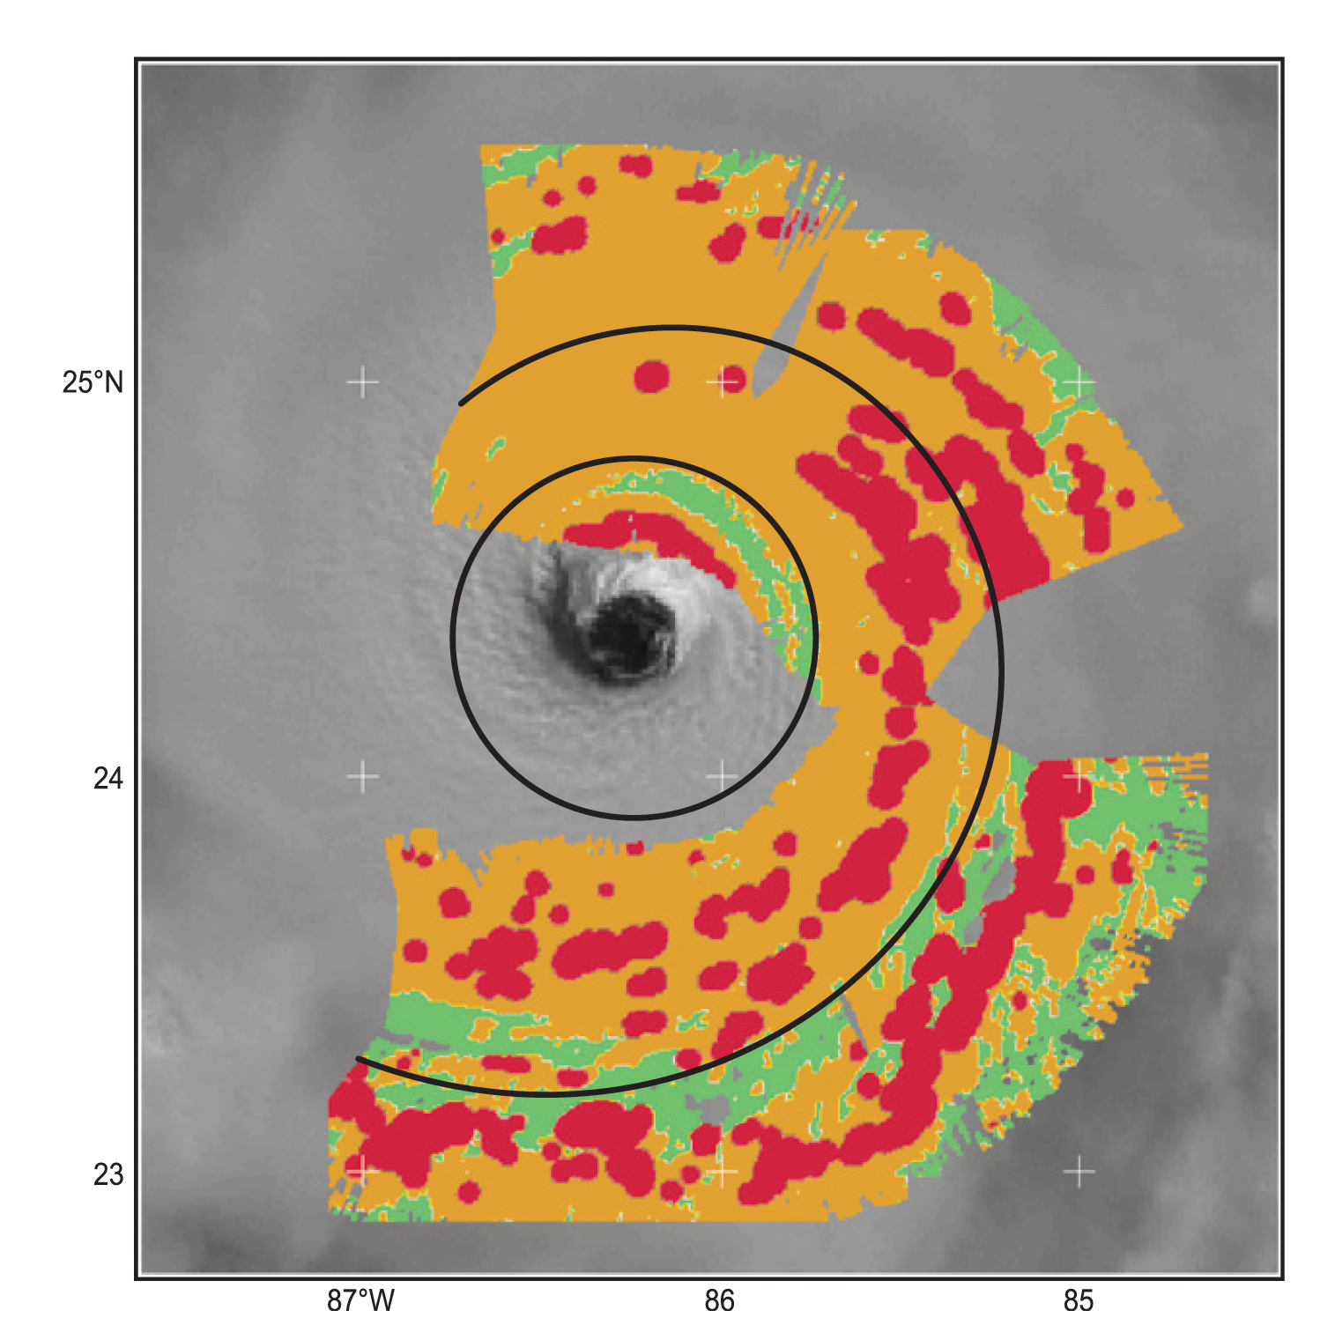
Reflectivity maxima in the inner-core region of Rita 2005
Didlake and Houze 2013a

Slide 12
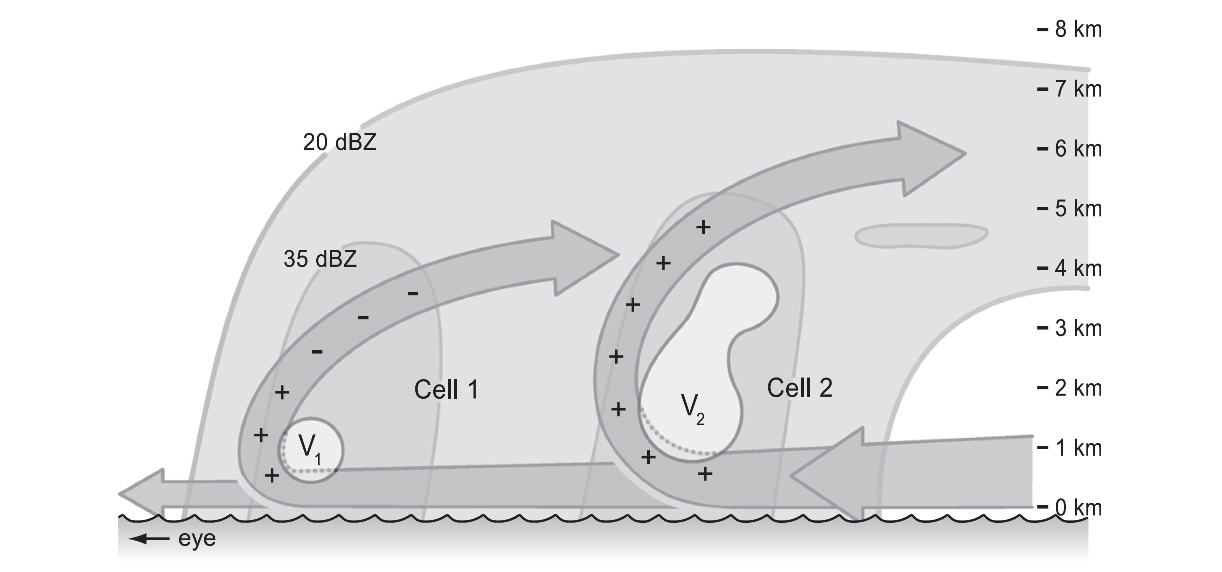
Convection in the inner-core region as a function of storm radius in Rita 2005
+/– tangential momentum tendency from high-resolution dual-Doppler
Didlake and Houze 2013a
Notes:
*This was about 12 h before Rita developed a 2ndary eyewall
Main result here:
Shape & circulation depth is dependent on radius.
The outflow was at a higher (lower) altitude for the outer (inner) cells.
tangential wind maxima just outside the updraft—lower at smaller radius
Cells at smaller radii contained a low-level tangential jet determined largely by tangential acceleration due to angular momentum conservation (uv/r term),
Cells at larger radii contained a low-to-mid level jet determined jointly by the uv/r and vertical advection terms.

Slide 13
Principal rainband

Slide 14
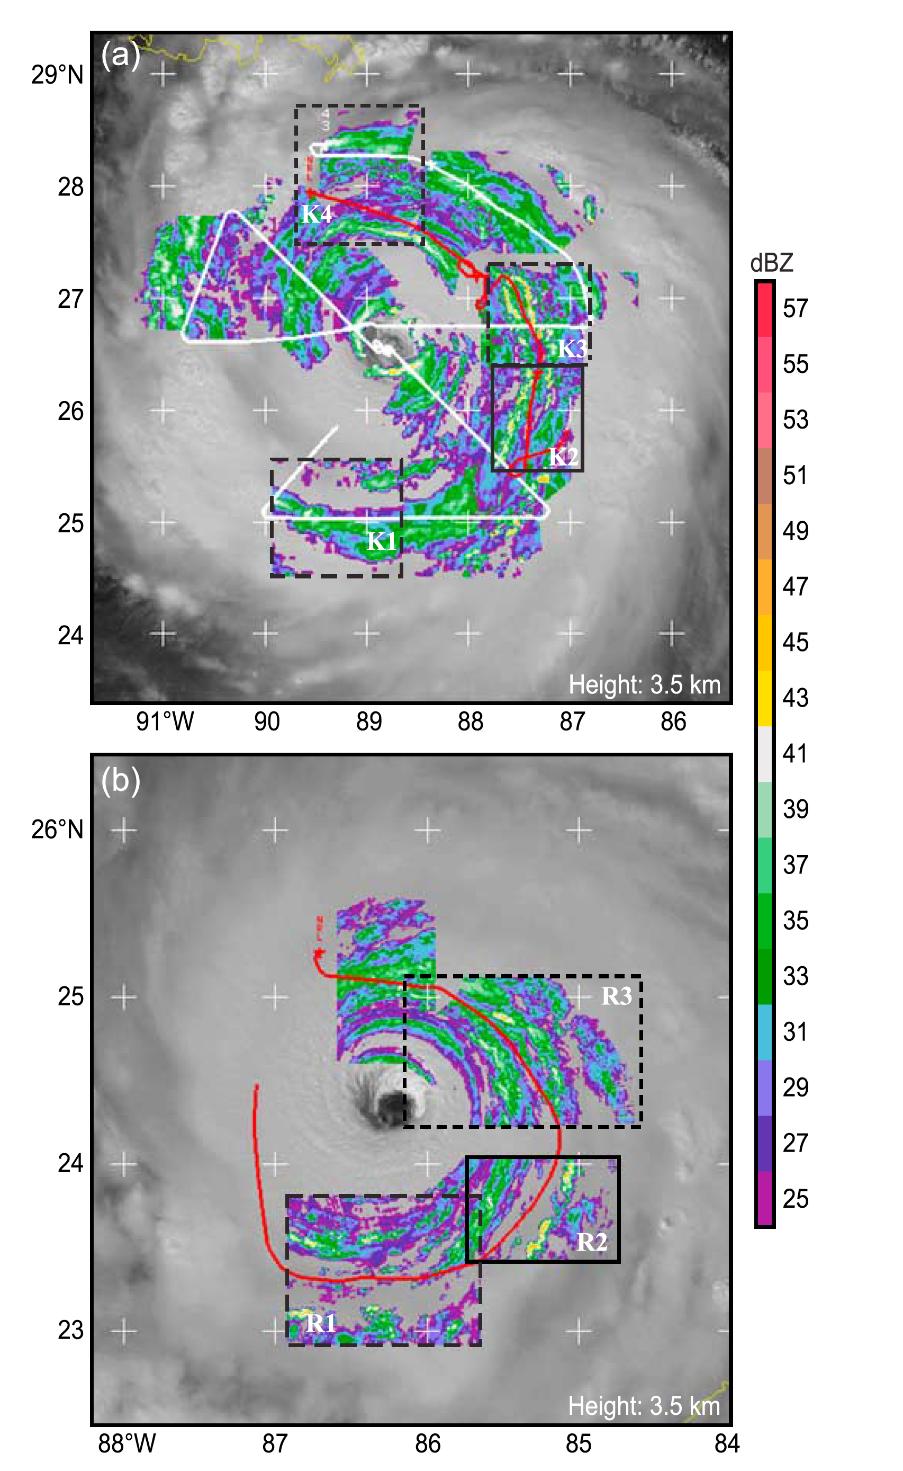
Principal rainband flights with ELDORA radar in RAINEX
Katrina
2005
Rita
2005
Hence & Houze 2008

Slide 15
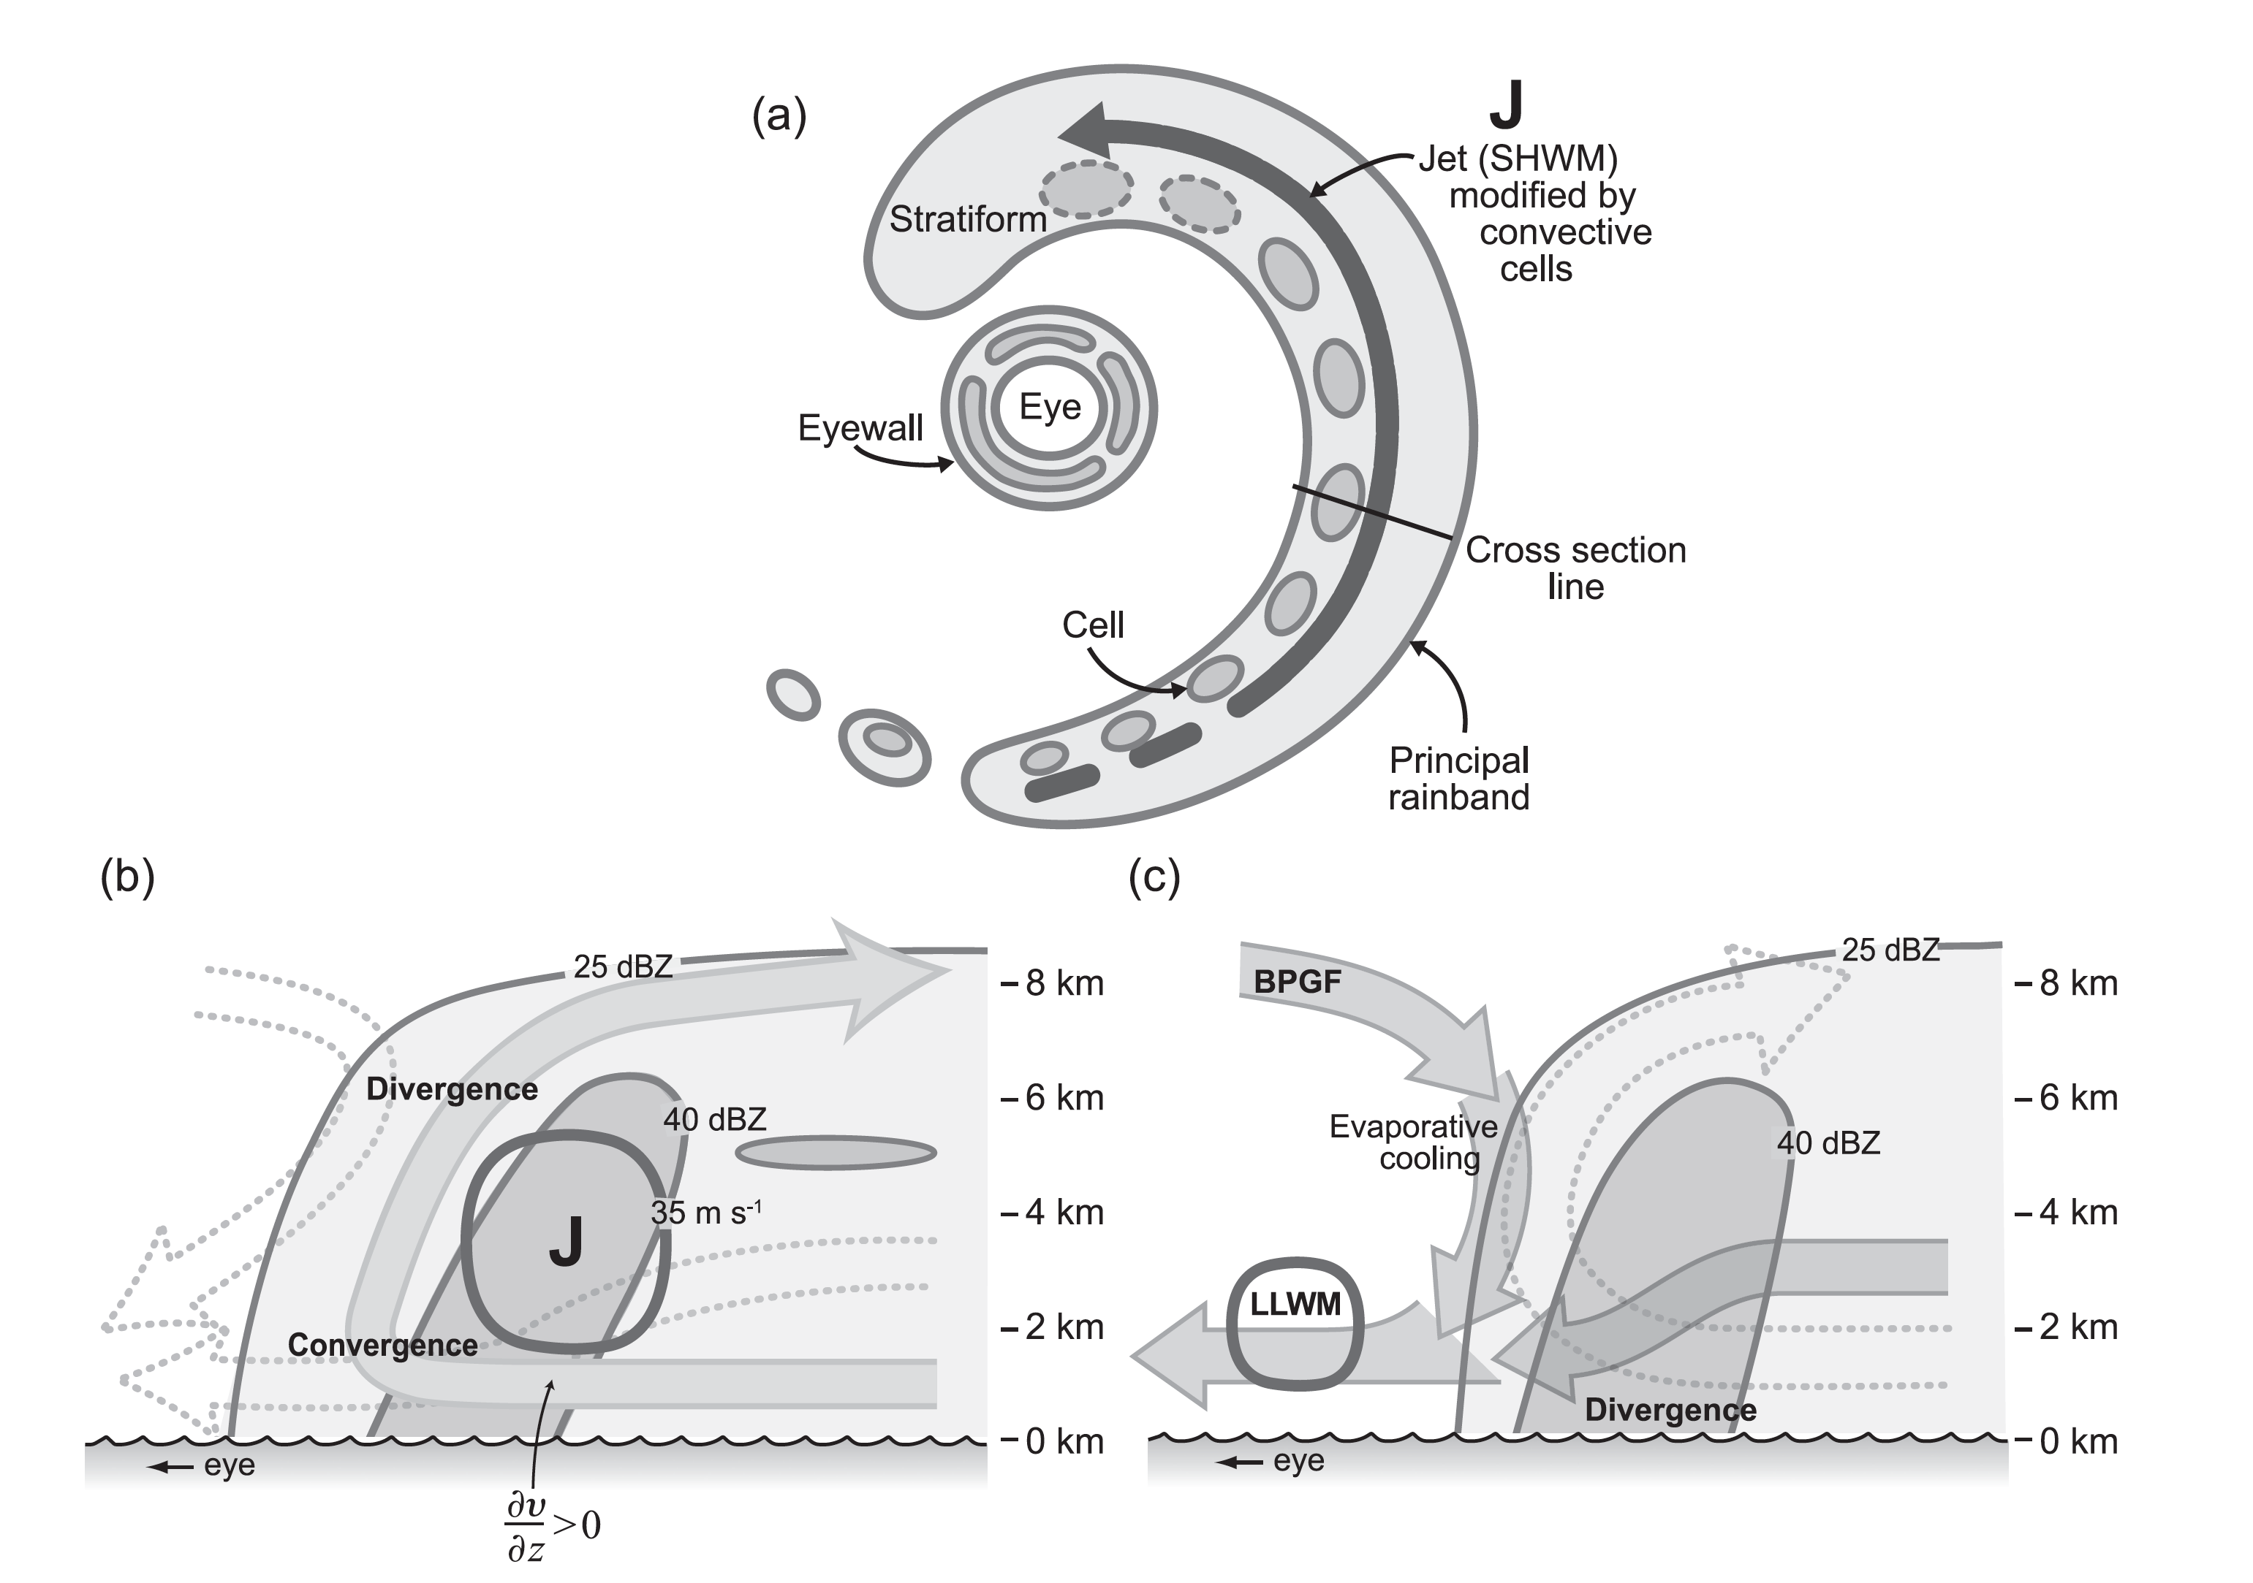
Principal rainbands of Katrina and Rita
Hence and Houze 2008
Didlake and Houze 2009
Notes:
Principal rainband
Has tangential wind max continuously down its middle
Most convective upwind
Turns stratiform downwind
Here we show cross sections across a typical cell in the middle of the principal rainband—as shown by ELDORA
Deanna studied the updraft over turning, which comes in under the jet and slopes up and out
Anthony focussed on the downrafts
One comes in at midlevels in outer stratiform precipitation and runs under the updraft
Another downdraft initiates in stable air at upper levels as a BPGF response to the updraft—or grav wave response
IED is evaporatively cooled and transports neg vorticity downward→LLWM
(a) Plan view of the principal band within an idealized mature tropical cyclone. A jet is located along the axis of the rainband (heavy arrow). Embedded convective cells are located on the radially inward side of the jet. Shading indicates precipitation in dBZ (light shading 25 dBZ, dark shading 40 dBZ). The size of the convective cells indicates the level of maturity, with the dashed border indicating collapsing cells. (b) Cross section across the middle portion of the rainband, emphasizing the updraft structure. Wide arrow indicates the in, up, and out circulation of the convective-scale updraft. Low-level convergence, vertical convergence of vorticity flux, and midlevel divergence regions are indicated. The symbol J indicates the location of the jet along the rainband axis, with the associated low-level shear. Dotted arrows in the background indicate nearby downdrafts slightly outside the plane of the cross section. @Fζ=@z is the vertical divergence of the vertical flux of vorticity Fζ . @v=@z is the vertical shear of the mean tangential wind v. (c) Schematic of the possible convective motions along the cross section of a mature principal rainband, emphasizing the downdraft structures. The series of solid arrows originating in the upper levels indicates an inner edge downdraft (IED) that is labeled by the two forcing mechanisms that drive it, the Buoyancy Pressure-Gradient Acceleration (BPGA) field and evaporative cooling, passing through a region of vertical convergence of negative vorticity flux as indicated. The solid arrow originating in the lower levels indicates the low-level downdraft (LLD) that creates a region of divergence within the rainband as indicated. The dotted arrow in the background indicates the overturning updraft that passes through a region of vertical convergence of positive vorticity flux. The circled region indicates the low-level wind maximum (LLWM) that is impacted by the IED. From Didlake and Houze (2009). Republished with permission of the American Meteorological Society. See also Hence and Houze (2008).

Slide 16
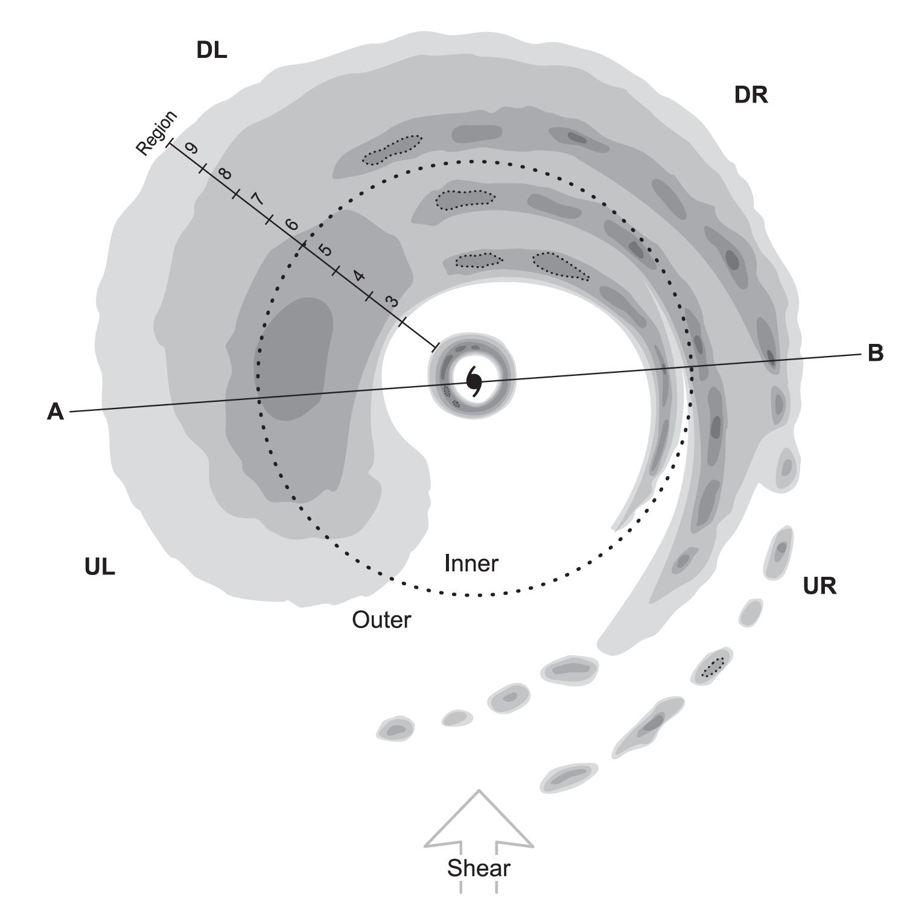
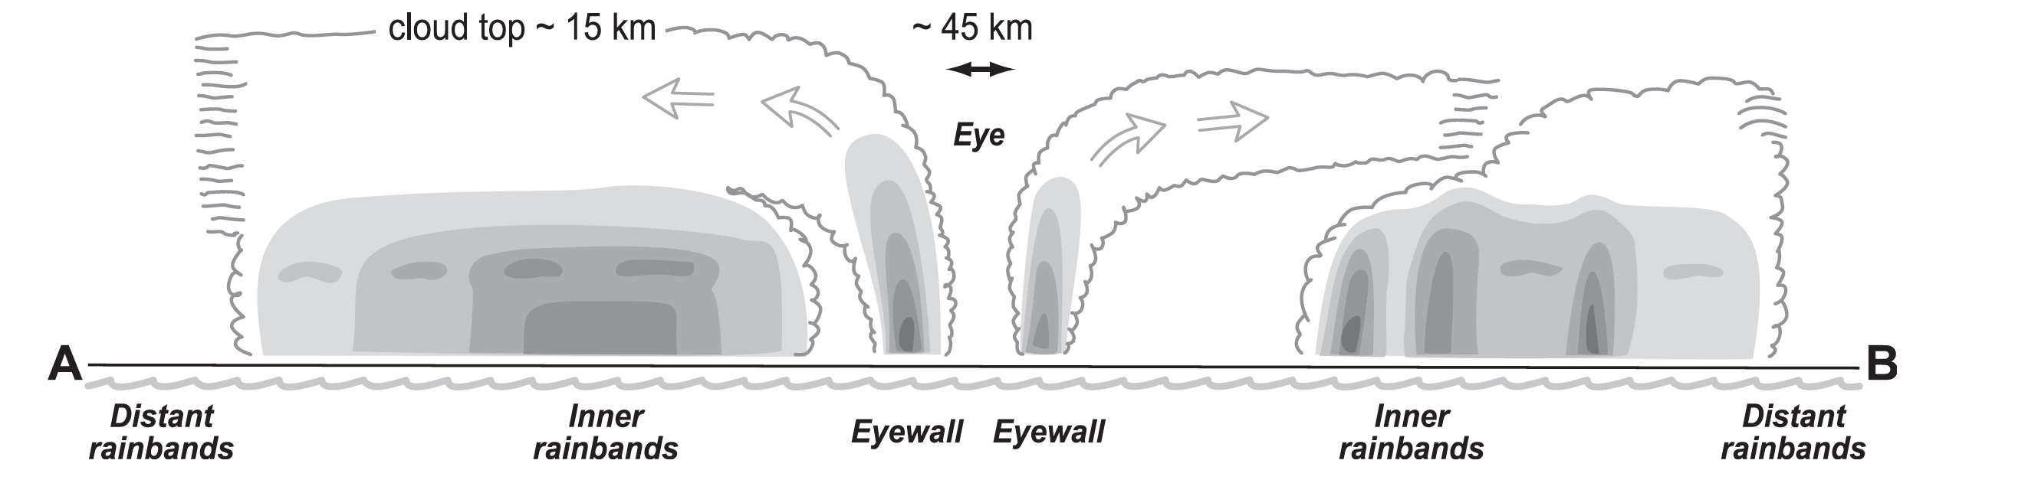
Hundreds of TRMM overpasses show stratiform downshear left, convective upshear right
Hence and Houze 2012b
Shear
Shear
Notes:
TRMM overpasses show the consistent formation of sf precipitation on the downwind end of the PRB—in the downshear left quadrant of the storm

Slide 17
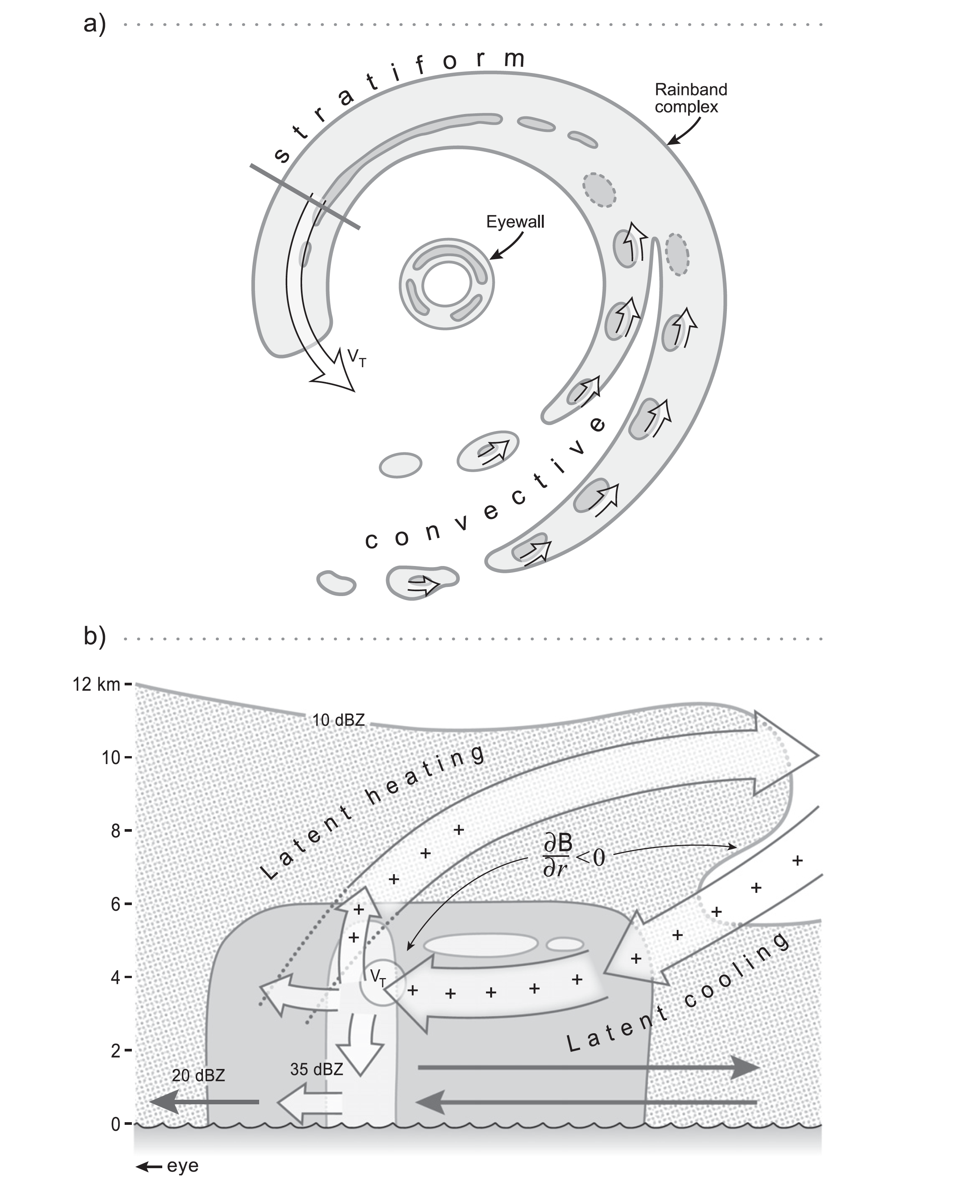
Principal rainband of Rita shown by RAINEX flights
+ indicates increasing tangential velocity
Didlake and Houze 2013b
Notes:
The ELDORA radar flights in Rita showed some interesting aspects of the circulation in the downwind SF zone of the PRB
The bright band was stretched out into a long thin pattern
ELDORA shows a mesoscale circulation associated with this stratiform feature
The +’s indicate where a tangential momentum budget computed from the ELDORA data show increasing VT
Midlevel air cooled by sublimation and evaporation under the anvil formed by the radial outflow
Cooled air combines with the buoyant radial outflow to generate horizontal vorticity on the mesoscale
The observed secondary circ would have been helping to maintain the PRB jet
And the subsiding branch was systematically advecting the air of increasing VT into the center of the PRB

Slide 18
Distant rainbands
Notes:
Finally a few words about the Distant RBs
The occur outside the inner-core region where vortex dynamics dominate
They occur in high theta-e air
They occur in spiral configuration as a result of confluence of the winds spiraling in toward the storm
Some of the convective elements form squall lines, like ordinary deep convection in shear

Slide 19
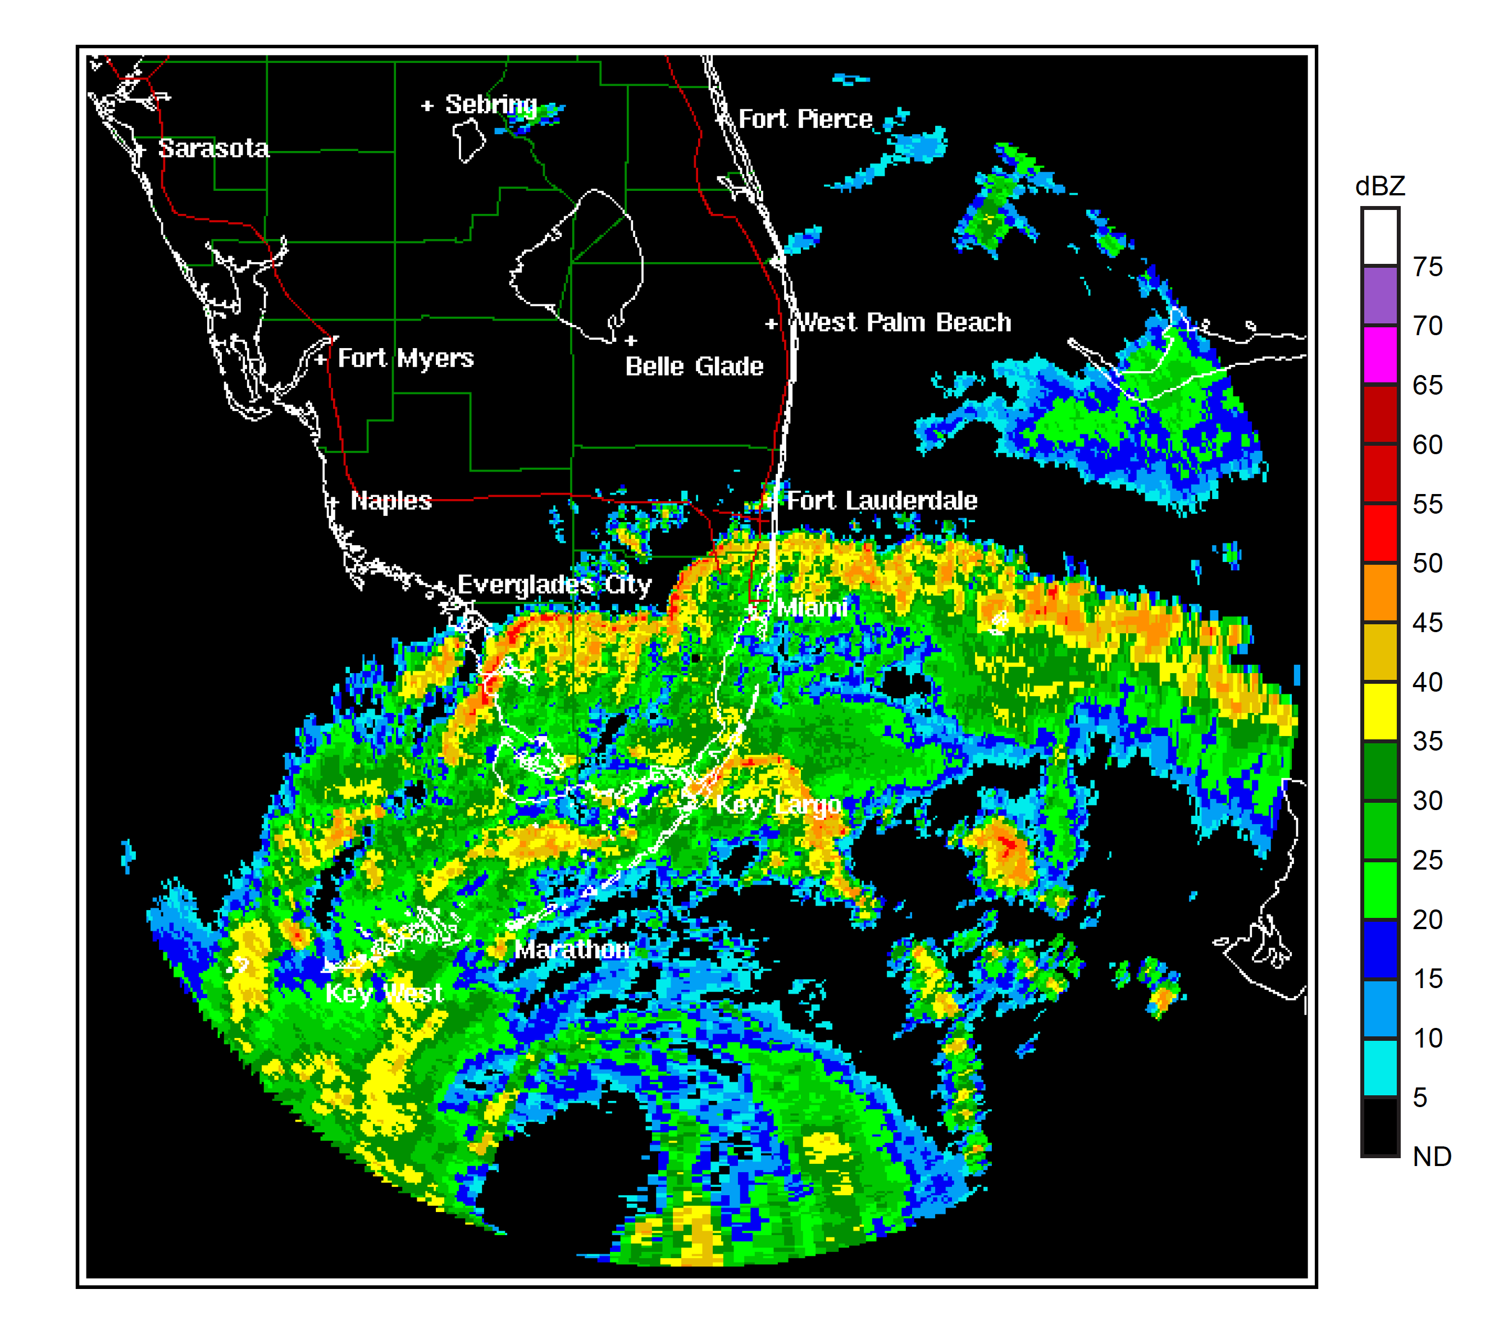
Distant rainbands in Rita 2005
I was here
Miami
Notes:
This example shows several squall lines crossing south Florida distant from the center of Hurricane Rita

Slide 20
Conclusions
High resolution airborne Doppler and composite satellite radar data have documented a lot of detailed structure of eyewalls and rainbands that have yet to be fully understood or simulated
Much left to be learned in the domain of theoretical dynamics (including microphysics) to fully understand these observations
Wayne Schubert Symposium
100th Annual Meeting of the American Meteorological Society
Boston, 14 January 2020

Slide 21
End
Wayne Schubert Symposium
100th Annual Meeting of the American Meteorological Society
Boston, 14 January 2020

