Slide 1
Key mechanisms in understanding warm-season extreme convective rainfall in mountainous terrain
Robert Houze
Professor Emeritus
University of Washington
NASEM Orographic Precipitation Workshop, November 4, 2025
Notes:
I am retired and haven’t been involved directly in research for seven years. However, I’ve written extensively on orographic clouds and precipitation and can draw on that experience. My focus here will be on the mechanisms by which mountains and hills can contribute to heavy precipitation in the warm season.

Slide 2

Starting points for this talk:
Houze, R. A., Jr., 2012: Reviews of Geophysics,
“Orographic Effects on Precipitating Clouds”
Houze, R. A., Jr., 2014: Cloud Dynamics, 2nd Ed.
“Clouds and Precipitation Associated with Hills and Mountains”
Chapter 12
Notes:
The starting point for my preparation has been my 2012 review paper on this subject and Chapter 12 of my book, especially Chapter 12, dealing with clouds and precipitation associated with hills and mountains.

Slide 3
Most “Orographic” Precipitation is due to the occurrence over or near mountains of
      Deep convective clouds
      Cyclonic storms of tropical origin
      Frontal systems
Simple cross barrier flow is seldom a cause of a major rain event
Frontal systems have been studied in detail and are usually not a factor in warm seasons
Notes:
An important point is that simple cross barrier flow is seldom if ever associated with major “orographic precipitaton events. Instead, they occur nearly exclusively when some storm of non-orographic nature occurs over or near mountains or hills.

Slide 4
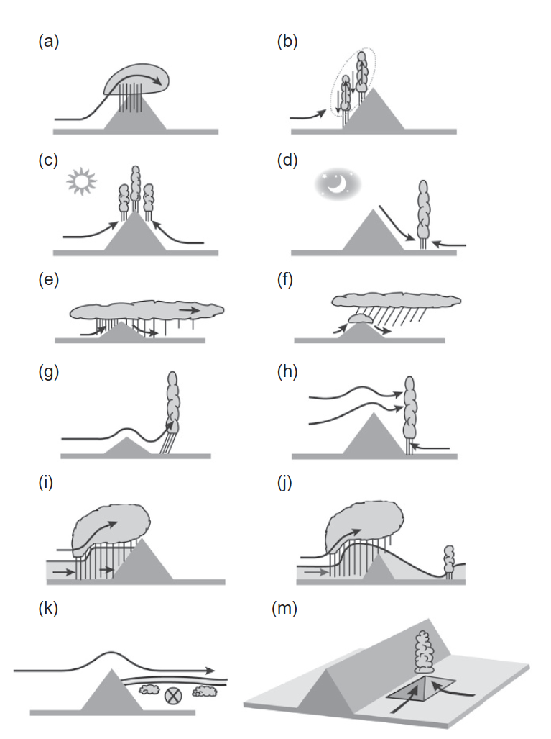
Basic scenarios by which hills and mountains affect precipitating clouds
Upslope flow with moist unstable or neutral static stability
Leeside capping, moist jet, and small-scale triggering
Notes:
In Chapter 12, I detail all the known scenarios where mountains affect precipitating clouds over mountains. I will come back to the lower one later in the talk. I want to focus on the first one--flow of a layer of moist unstable flow over sloping terrain.
One very important case is when this type of flow interacts with a convective storm occurring for unrelated reasons over high terrain.

Slide 5
Examples of convection over mountains fed by upslope moist potentially unstable flow driven by synoptic-scale conditions
Notes:
I’ll refer to two examples.

Slide 6
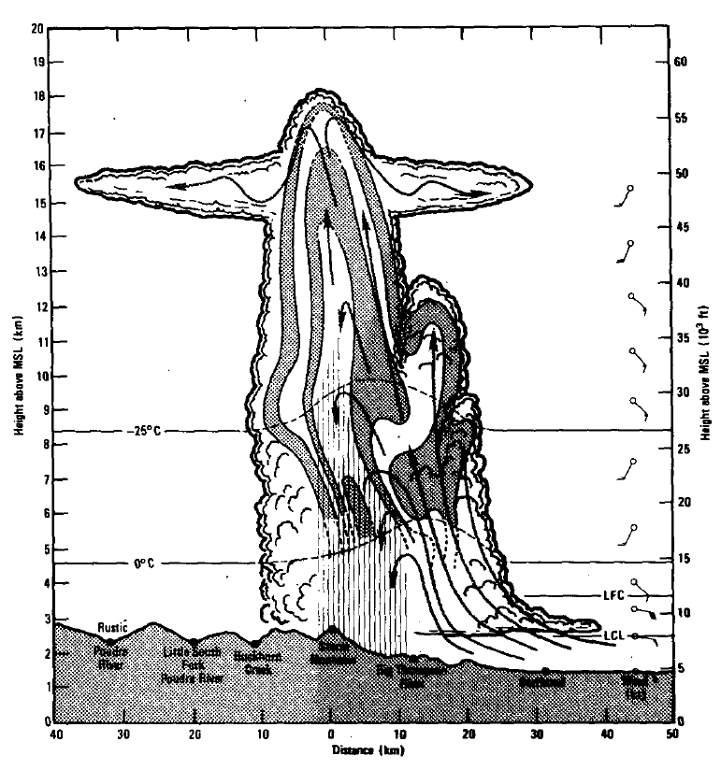
Colorado’s Big Thompson Canyon flood, 1976, 139 fatalities
(Caracena et al. 1979)
Deep moist potentially unstable synoptic-scale driven upslope flow
Notes:
The first is the Big Thompson Canynon flood storm of 1976. 139 people died in the flash flooded canyon. (I was in the Rockies the night of this storm, but thankfully not near the Big Thompson Canyon.) This flood occurred when a layer of upslope moist unstable flow was driven up the slope of the Rockies by a persistent and increasing E-W synoptic-scale pressure gradient. The main convective element got into a synergistic relationship with the convective strom circulation.
FIG. 15 of Caracena et al. 1979. Physical model of one of the initial cells of the Big Thompson storm complex. LCL, LFC, winds and levels of 0°C and -25°C isotherms are from interpolated Loveland, Colorado, sounding. Grover 0045 GMT radar reflectivity are shown with IO dBZ contours beginning with 15 dBZ level.

Slide 7
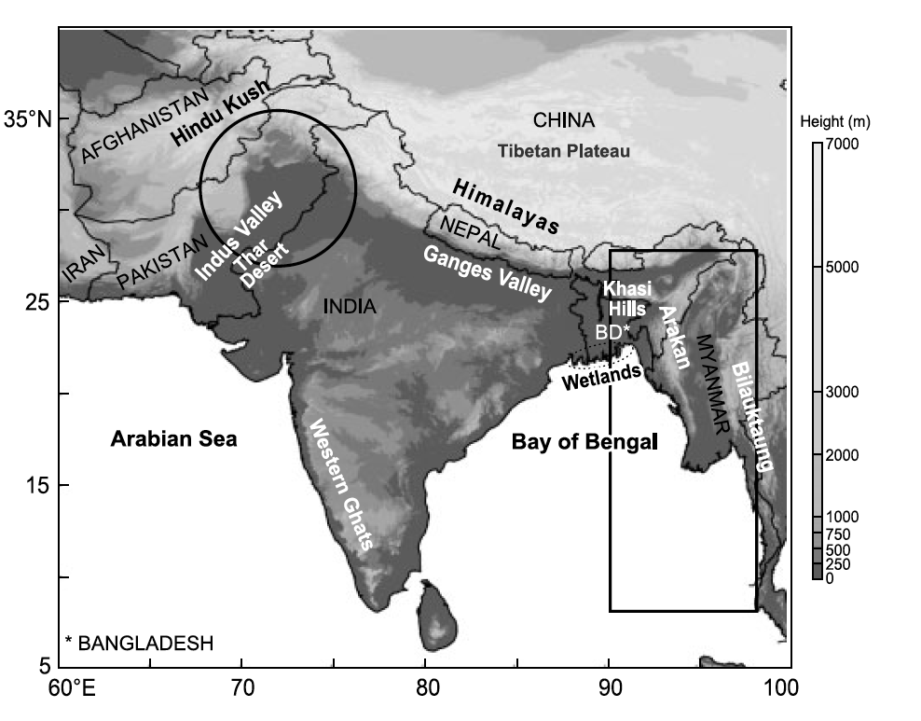
South Asia:
A region where the ingredients for orographic rain and flooding are extremely well-defined
Notes:
The next example if from South Asia, where much of my research experience with extreme orographic storms was focused. This region is a natural laboratory for studying these prccesses. Note:
Mountains of Afghanistan and Pakistan
Himalayas
Tibetan Plateau
Arabian Sea and Bay of Bengal

Slide 8
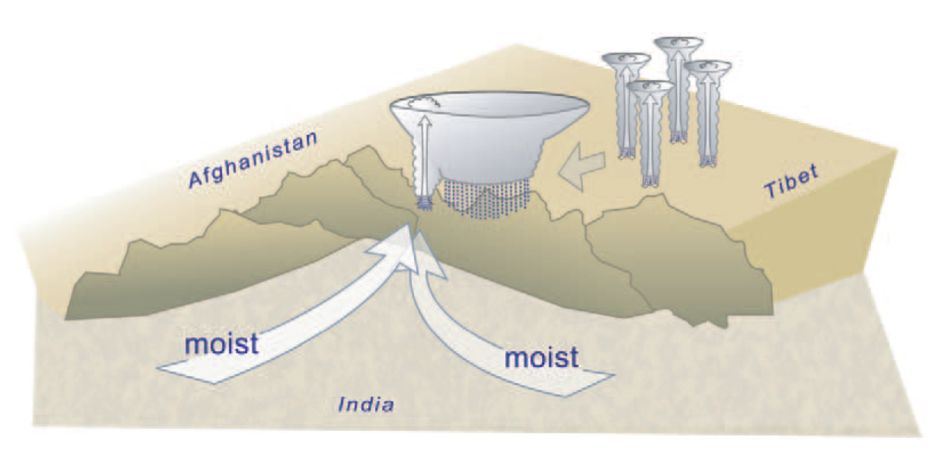
The Leh flood of 2010. A flash flooding storm at the steep edge of high terrain. 193 know fatalities, hundreds missing.
(Rasmussen and Houze, 2011
Low-level moist flow driven into the region by large-scale synoptic conditions.
Notes:
A storm somewhat like the Big Thompson storm was the Leh flood case of 2010.
Convective storms over the Tibetan Plateau aggregated into an MCS (a very rare occurrence).
The MCS moved to the edge of the steep Himalayan massif.
Most low-level flow was driven into the region from synoptic scale lows over both the Arabian Sea and Bay of Bengal
When the MCS reached the edge of the plateau, low-level moist unstable flow from both the Arabian Sea and Bay of Bengal began feeding the MCS and creating a much more productive storm.
Flooding and mudslides ensued killing 200+ people
Note both this and Big Thompson involved the occurrence of convection over the mountain not fundamentally orographic in nature by became synergistic with synoptically driven low-level moist flows.

Slide 9
Examples of flood events fed by upslope moist potentially unstable flow driven by synoptic-scale conditions without pre-existing convection over the mountains
Notes:
Disastrously heavy rains can occur even without the independently occurring storms over the high terrain if the synoptic-scale driver of moist unstable flow over a mountaiun barrier is stroing enough.
Usually, the synoptic-scale driver is a cyclonic storm of tropical origin
Let’s look briefly at an example from South Asia

Slide 10
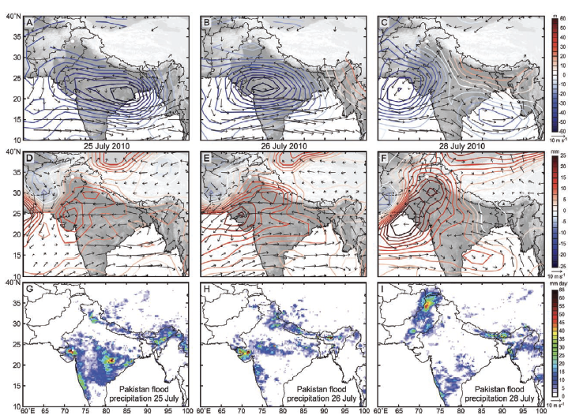
The Pakistan flood of the Indus River in 2010: 20M people affected, ~2000 died
One of the worst humanitarian disasters in history.
(Houze et al. 2011)
700 mb
The monsoon low moved westward. Nearly saturated slightly moist unstable air was driven over the bare mountains of Pakistan, Afghanistan, and India. MCS precipitation was perpetuated for hours at the headwaters of the Indus river
500 mb
PW
Rain
Notes:
The U.N. Secretary General called the 2010 flood in Pakistan one of the worst humanitarian disasters in recent memory
The mountains of Pakistan are arid; steady rains rare
A monsoon low over the Bay of Bengal is a region where MCSs form
In this case, the monsoon low, usually stationary over the Bay of Bengal. moved westward
A deep layer of moist unstable air, supporting MCSs, reached the intersection of the Pakistan mountains and Himalayas
A period steady MCS-type rain occurred over the headwaters of the Indus River that flows through Pakistan to the Arabian Sea

Slide 11
Details of the terrain
Notes:
It is important to note that it isn’t just the broad barrier-scale lifting that is important

Slide 12
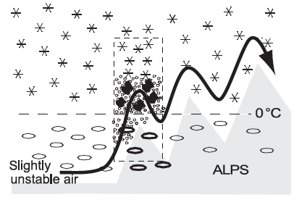

Heaviest rain-producing convection occurring over the first sharp peak
Medina and Houze 2003
Notes:
In a study of flood-producing rain over the European Alpss, we found that the convection producing much of the heavy rain was triggered by the first sharp rise in the terrain, which is always jagged in mountainous regions

Slide 13
Other scenarios by which small-scale hills and mountains affect precipitating clouds
Upslope flow with moist unstable or neutral static stability
Leeside capping, moist jet, and small-scale triggering
Notes:
To further illustrate the importance of the sub-barrier-scale terrain, I return to the last highlighted scenario in this figure.
In this scenario, leeside subsidence caps convection
A moist jet runs parallel to the broad mountain barrier’
Convection breaking the cap is triggered over small-scale foothill terrain

Slide 14
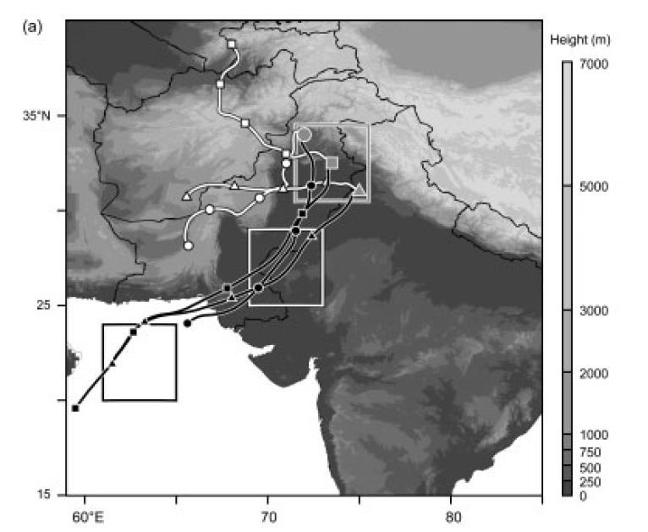
From a WRF simulation of a major convective storm showed capping
Upper-level trajectories
Arabian Sea
Low-level trajectories
Medina et al. (2010)
Notes:
In this example from South Asia:
Low-level moist flow was coming from the Arabian Sea
Upper level flow over Afghanistan was capping convection
Importantly, we found that the instability was increased by boundary-layer processes
LH flux over the ocean
SH flux over the desert
Convection and a major storm occurred when the low-level jet hit a small foot hill inside the red box
Figure 7. FNL backward trajectories coinciding with the occurrence of a system containing intense convective echoes. (a) Trajectories for parcels reaching
the locations indicated by the grey symbols at 1800 UTC 3 September 2003 at 3.0 km AGL (white trajectories) and 1.0 km AGL (black trajectories). The
circle, square and triangle markers are used to identify each trajectory. The time elapsed between markers is 24 h. The large squares identify the regions of
the Arabian Sea, the Thar Desert, and the western terrain indentation used in Figure 10. (b)–(d) Time series of temperature, water vapour mixing ratio,
and equivalent potential temperature, respectively, for the low-level trajectories shown in (a). The solid symbols identify the period when the low-level
trajectories were over the Thar Desert.

Slide 15
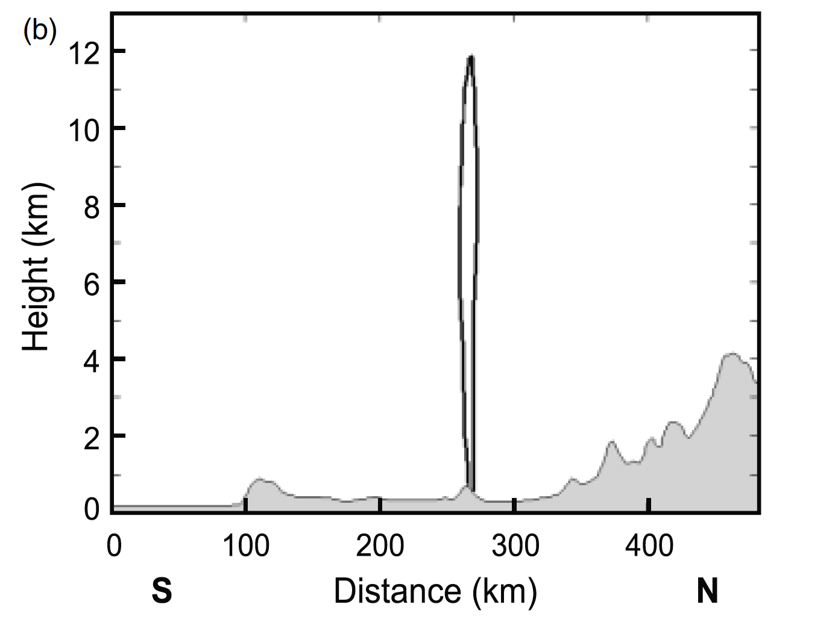
Convection triggered over a very low-level sharp ridge in the foothills
Mixing ratio of precipitating hydrometeors shortly after the convection was triggered.
Himalayas
Notes:
The exact location where convection initiated in relation
to the terrain, as well as the life cycle of the system, is
shown in Figure 11. Convection formed at 1900 UTC (0000
LST) over the easternmost edge of a relatively small ridge
at ∼72◦E, 33.8◦N (thick solid contour in Figure 11(a)).
The area of intense rainfall increased by 2000 UTC (short
dashed contour). In the subsequent 2–3 hours the system
moved toward the east-southeast (long dashed and thin
solid contours, respectively). A vertical cross-section along
the north–south line in Figure 11(a) indicates that the
convection first appeared over a relatively small (<0.5 km)
but sharp peak of the terrain (at distance = 270 km in
Figure 11(b)).

Slide 16
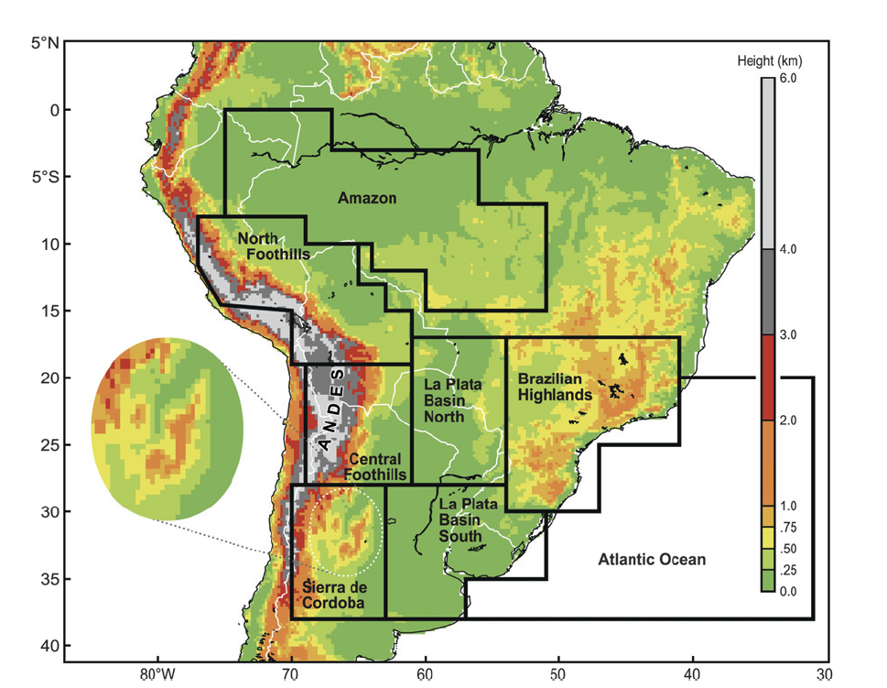
The relatively small Sierra de Cordoba range is the primary trigger spot in the lee of the Andes
Notes:
FIG. 1. Topographical map of South America showing the Andes mountain range and associated
terrain features. Selected regions for this study are outlined in black and labeled.
Circular inset highlights the Sierra de Cordoba range that is of particular importance to this
study.

Slide 17
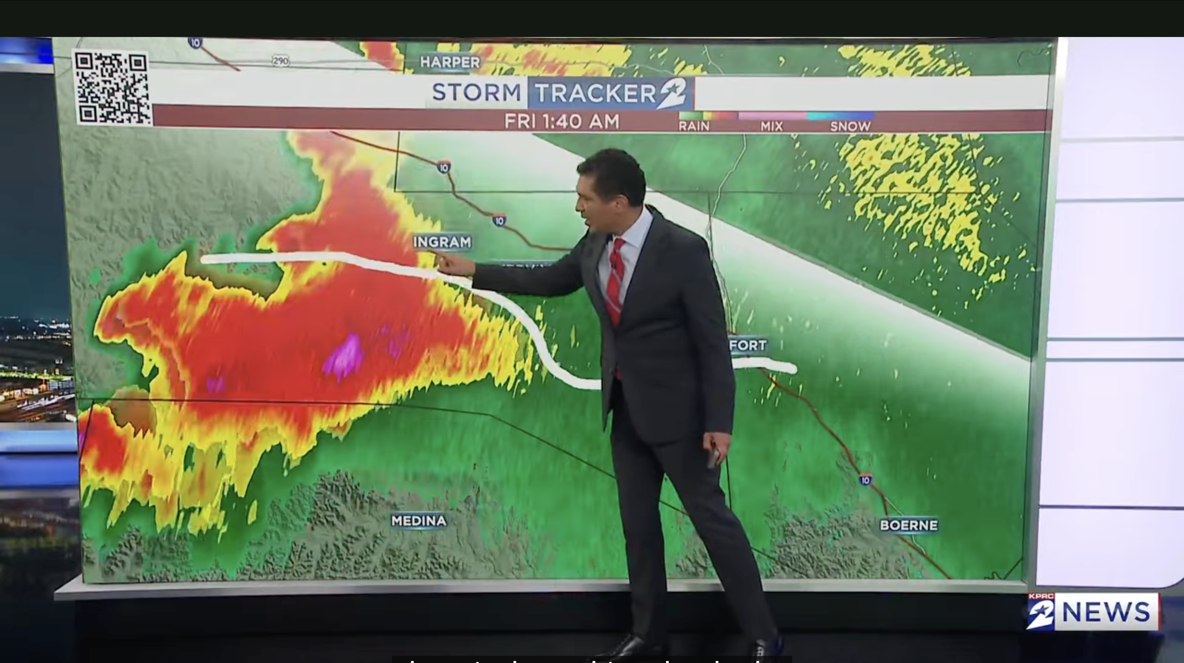
Triggering in the Hill Country flood storm?
KPRC TV Houston

Slide 18
Summary
Predicting major precipitation events near a mountain range depend on accurate representation of:
  The type of rain-producing storm
    Cyclone—especially of tropical origin
    Convection—especially pre-existing storms over the high terrain
  Low-level moist flow in the vicinity of a mountain range
    Including surface and boundary layer conditions affecting the low-level flow
  The multi-scale boundary conditions determined by the terrain
    Barrier scale
    Sub-barrier scale—important for triggering

Slide 19
End

Slide 20
Extra slides

Slide 21
Basic factors at play when hills and mountains affect precipitating clouds
Microphysics
Water Vapor
Cross barrier flow speed and shear
Static stability
Height of the terrain
Jaggedness of the terrain
Triggering of convection

