Slide 1

The Ongoing Saga of Atmospheric Convection in Weather and Climate
Cumulonimbus
Cumulus congestus
Robert Houze
Univ. of Washington
PNNL
Small cumulus

Slide 2
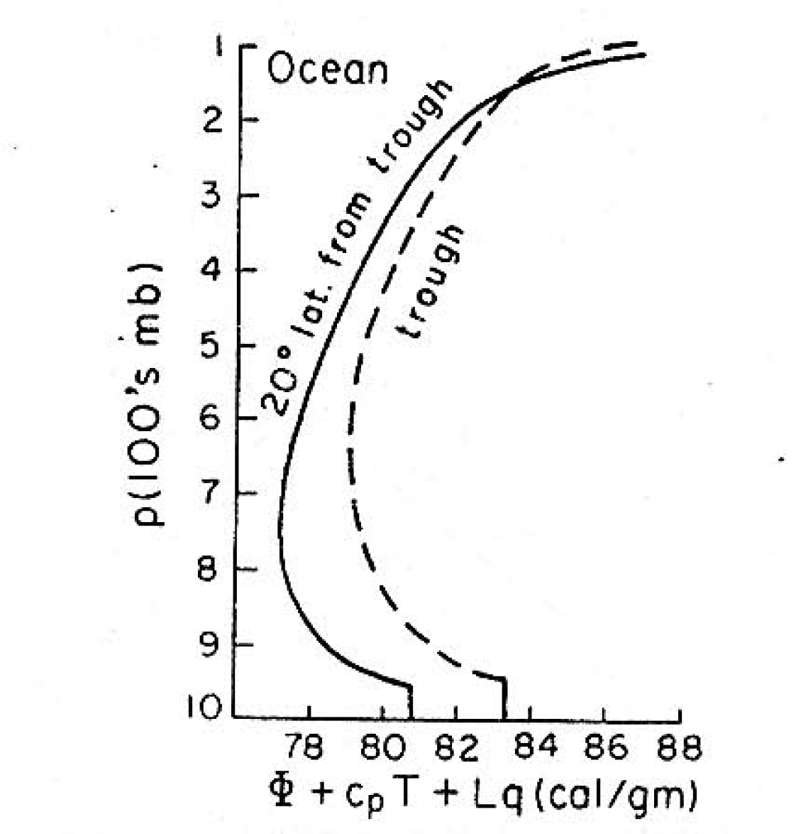
1950s: Radiosonde data in the tropics
“Hot tower hypothesis”
Riehl & Malkus 1958

Slide 3
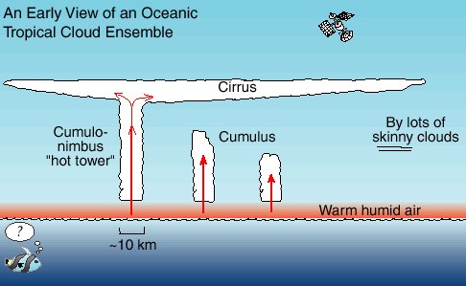
Satellites provided a new view of tropical convection in early 1970’s
Satellite view of the tropical cloud population

Slide 4
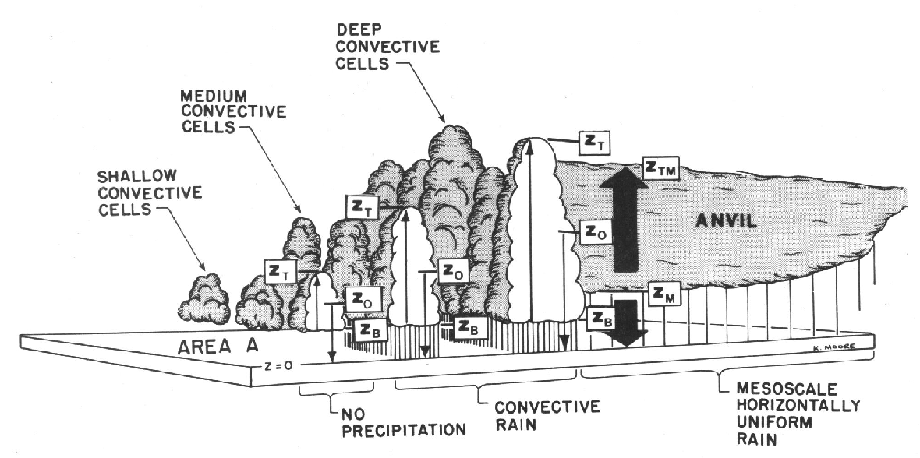

Radar over the Years
2000s—TRMM, CloudSat, GPM
Mapping
*
ANVIL
CUMULUS
DYNAMO—2011:
MM-WAVELENGTH
Non-precipitating Cumulus
GATE—1974:
CM-WAVELENGTH
Precipitation
DYNAMO—2011:
MM-WAVELENGTH
Anvil cloud
TOGA COARE:1992-3:
DOPPLER
Air motions
DYNAMO 2011-12:
POLARIMETRY
Microphysics

Slide 5
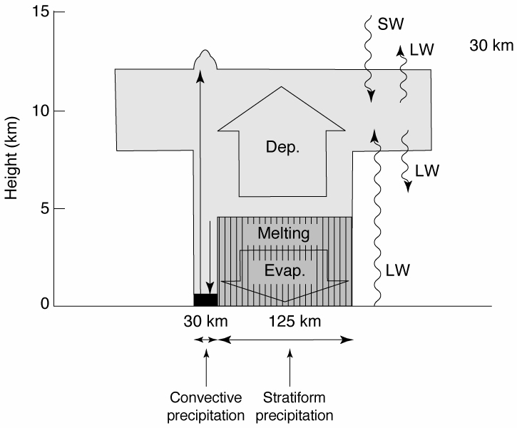
Heating and cooling processes in a mesoscale convective system
Houze 1982
Notes:
Top heavy

Slide 6
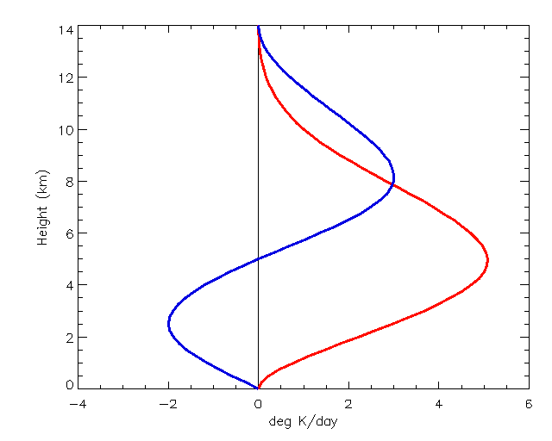
Simplified Mesoscale System Heating Profiles
Stratiform
Height (km)
Convective
Schumacher et al. 2004
Deg K/day
Houze 1982
Notes:
The blue curve is applied to the stratiform fraction of the precipitation at the given pixel. Go to next slide.

Slide 7
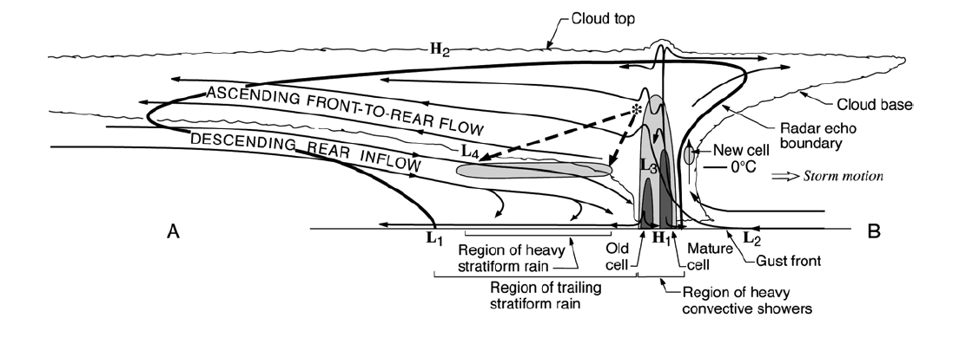
Details learned from many field projects
Notes:
The basic components of an MCS can be simplified into 3 main features, which can be identified and MEASURED by satellite. The combination of these three properties can be used to identify an MCS if they satisfy certain criteria. Thus we can determine when and where MCSs occur around the globe. In addition we can determine how the properties of these three components vary from region to region. How big and wide is the cold top; how big and intense is the raining core; how thick are the anvils; and what are the characteristics of their internal structure. And how do these properties vary around the globe? One cannot holistically determine the properties of MCSs by identifying one of these properties alone. It’s important to see and evaluate all 3.

Slide 8
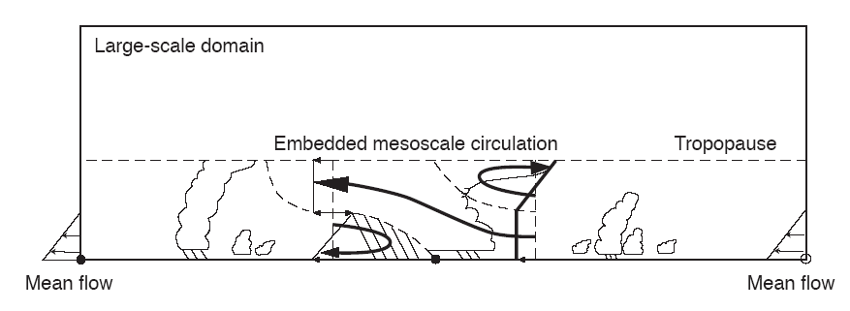
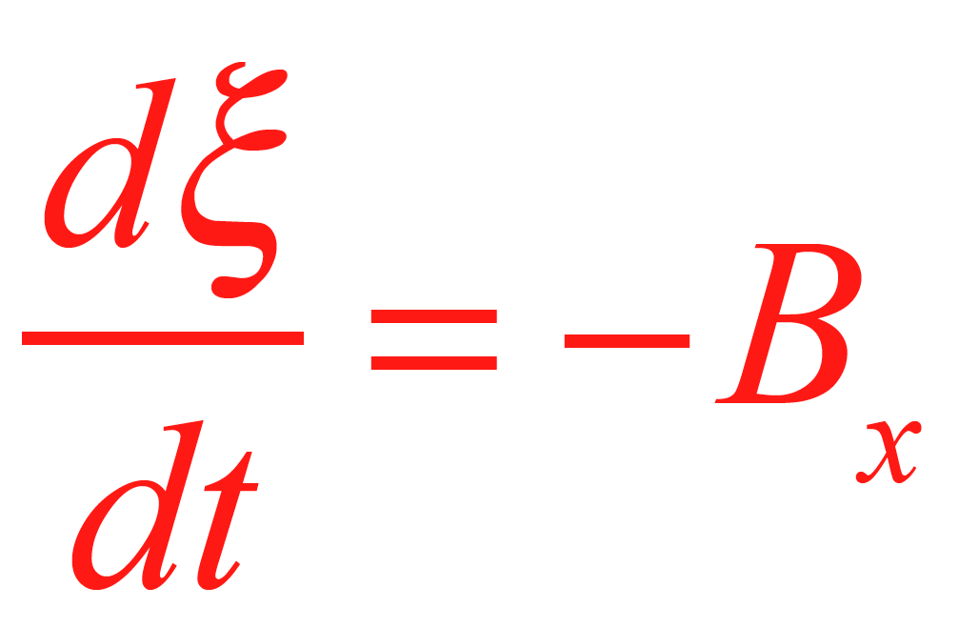
Moncrieff’s Mesoscale Layer Model of Tropical Convection
Shear
B>0
x
→
Moncrieff 92

Slide 9
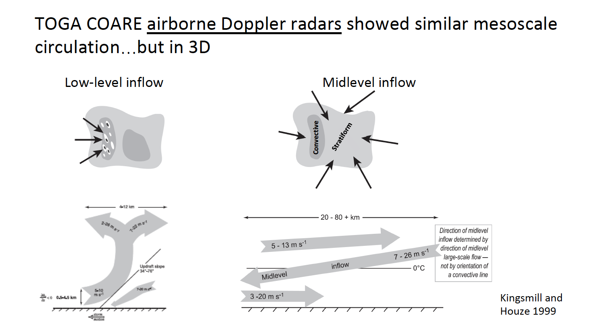
TOGA COARE 1992-3
Three Doppler Radar-equipped Aircraft
25 cases of low-level inflow
25 cases of mid-level inflow
Kingsmill and Houze 1998

Slide 10
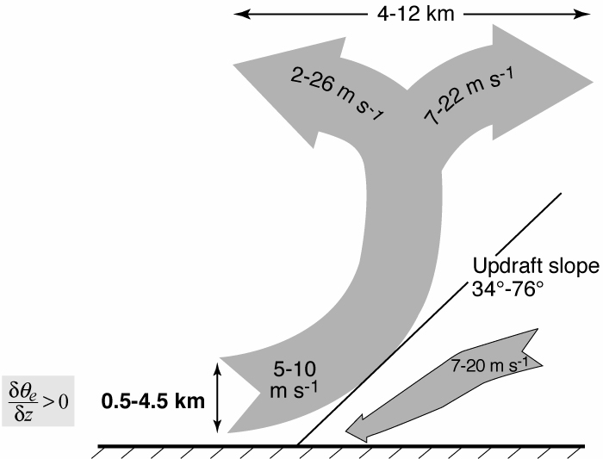
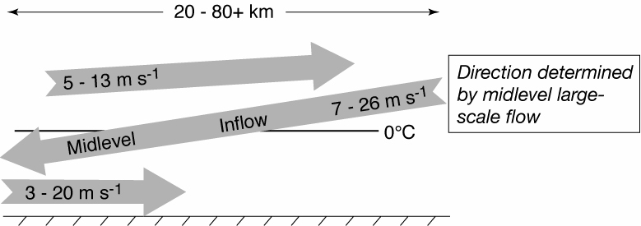
Empirical Model of a Mesoscale Convective System
Midlevel inflow
What about microphysics?
Layer inflow
Notes:
From the distributin of heating and cooling in the sf region we expect mid level convergence.

Slide 11
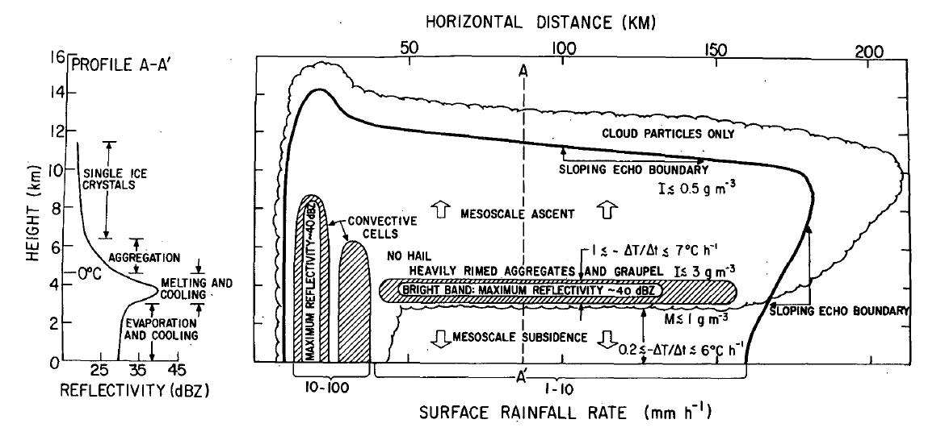
Leary and Houze’s (1979) GATE study
Inferred from radar and measurements of raindrop sizes

Slide 12
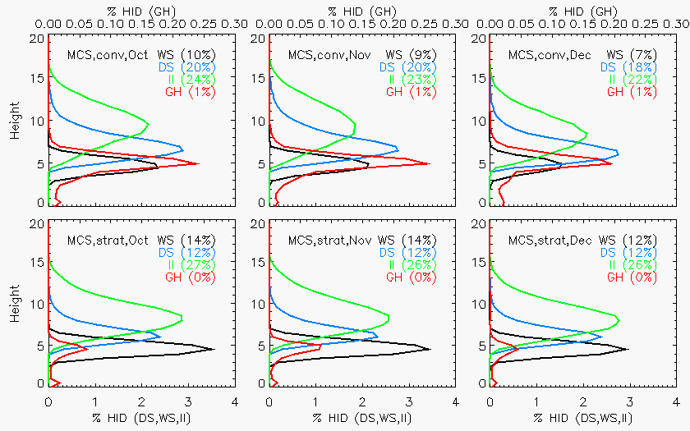
DYNAMO—Dual Polarization Radar
October 2011
November 2011
December 2011
Convective
Convective
Convective
Small ice
Non-oriented ice
Dry aggregates
Graupel
Wet aggregates
Dry snow
Melting snow
Graupel
Stratiform
Stratiform
Stratiform
Bright band
Rowe and Houze 1982

Slide 13
As radar technology has advanced we have learned:
Mesoscale Convective Systems result from combined scales:
  Mesoscale
  Convective
  Microphysical.
Top-heavy heating profiles due to interconnected latent and radiative heating result from these combined scales.

Slide 14
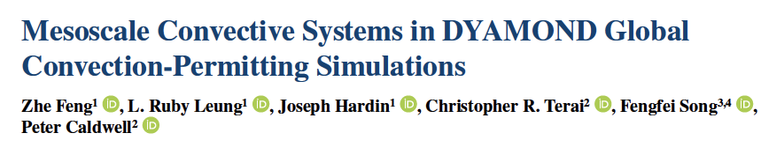
Can MCSs be included in climate models?
Most general circulation models with coarse horizontal resolution (∼100 km) and parameterized convection cannot simulate aspects of MCSs that affect the large-scale circulation.
Can high-resolution global models yield better representations of MCSs?
Tested six models with 3-5 km resolution.
Feng et al. 2023

Slide 15
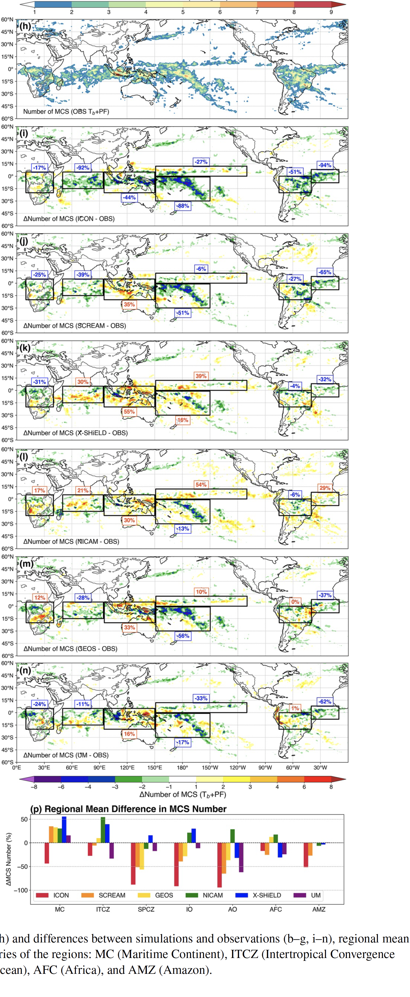
Observed
(Satellite Mapping)
Worst match
Best match
Feng et al. 2023

Slide 16
Summary of Feng et al.
Diurnal cyles of MCSs well represented
BUT…
Locations not accurate
Stratiform underestimated and deep convection overestimated
Effects over time in climate simulations probably significant
Higher resolution and better microphysics needed

Slide 22
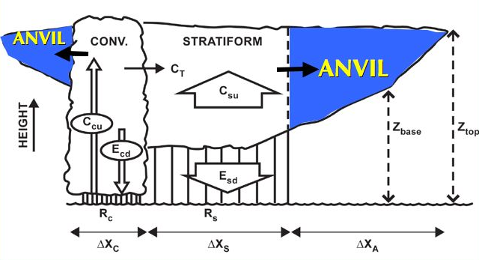
The microscale anvil problem
Mesoscale Convective System
Need to understand how anvil is related to the raining region
Extensively studied

Slide 23
Mesoscale Convective System Components
But the anvil is closely related to the raining region
Extensively studied

Slide 24
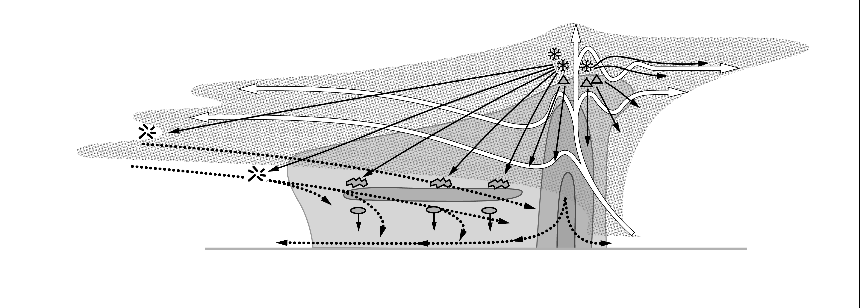

Conceptual Model of Anvil Microphysics
graupel
snow
convective rain
stratiform rain
Notes:
WAVELENGTH: W-band, 3 mm wavelength
THIN ANVILS:
1) LEADING—higher -- comes directly from convective updraft
2) TRAILING—occur at more levels -- moisten a deeper layer
THICK ANVILS:
3) LEADING—stronger-larger particles -- graupel

Slide 25
What is the relationship of MCSs to larger scales of motion?
“We speculate that there is a natural selection in the atmosphere for wave packets whose phase structure produces a local, Eulerian sequence of cloud zone-supporting anomalies that aligns with the convective cloud system life cycle.”
Mapes et al. 2006

Slide 26
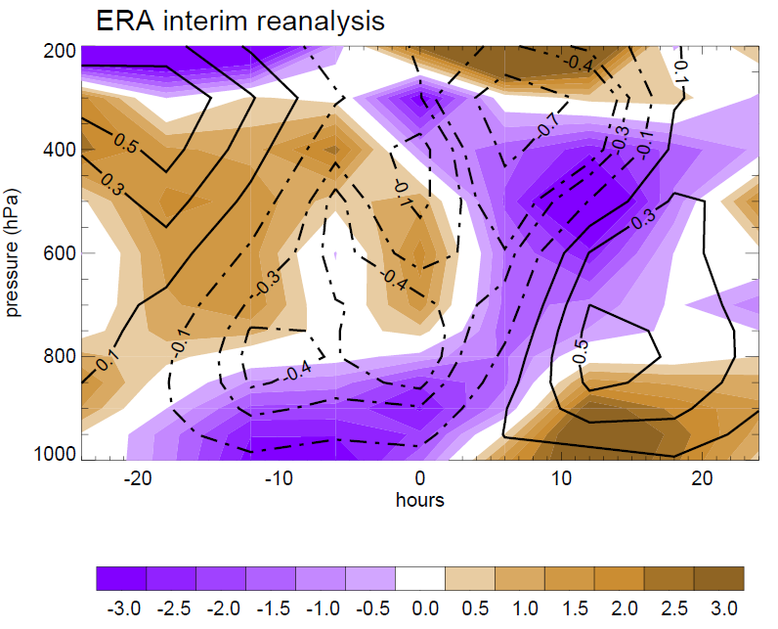
DYNAMO: Composite large-scale divergence and vertical motion during 2-day rainfall episodes
Zuluaga and Houze 2013

Slide 27
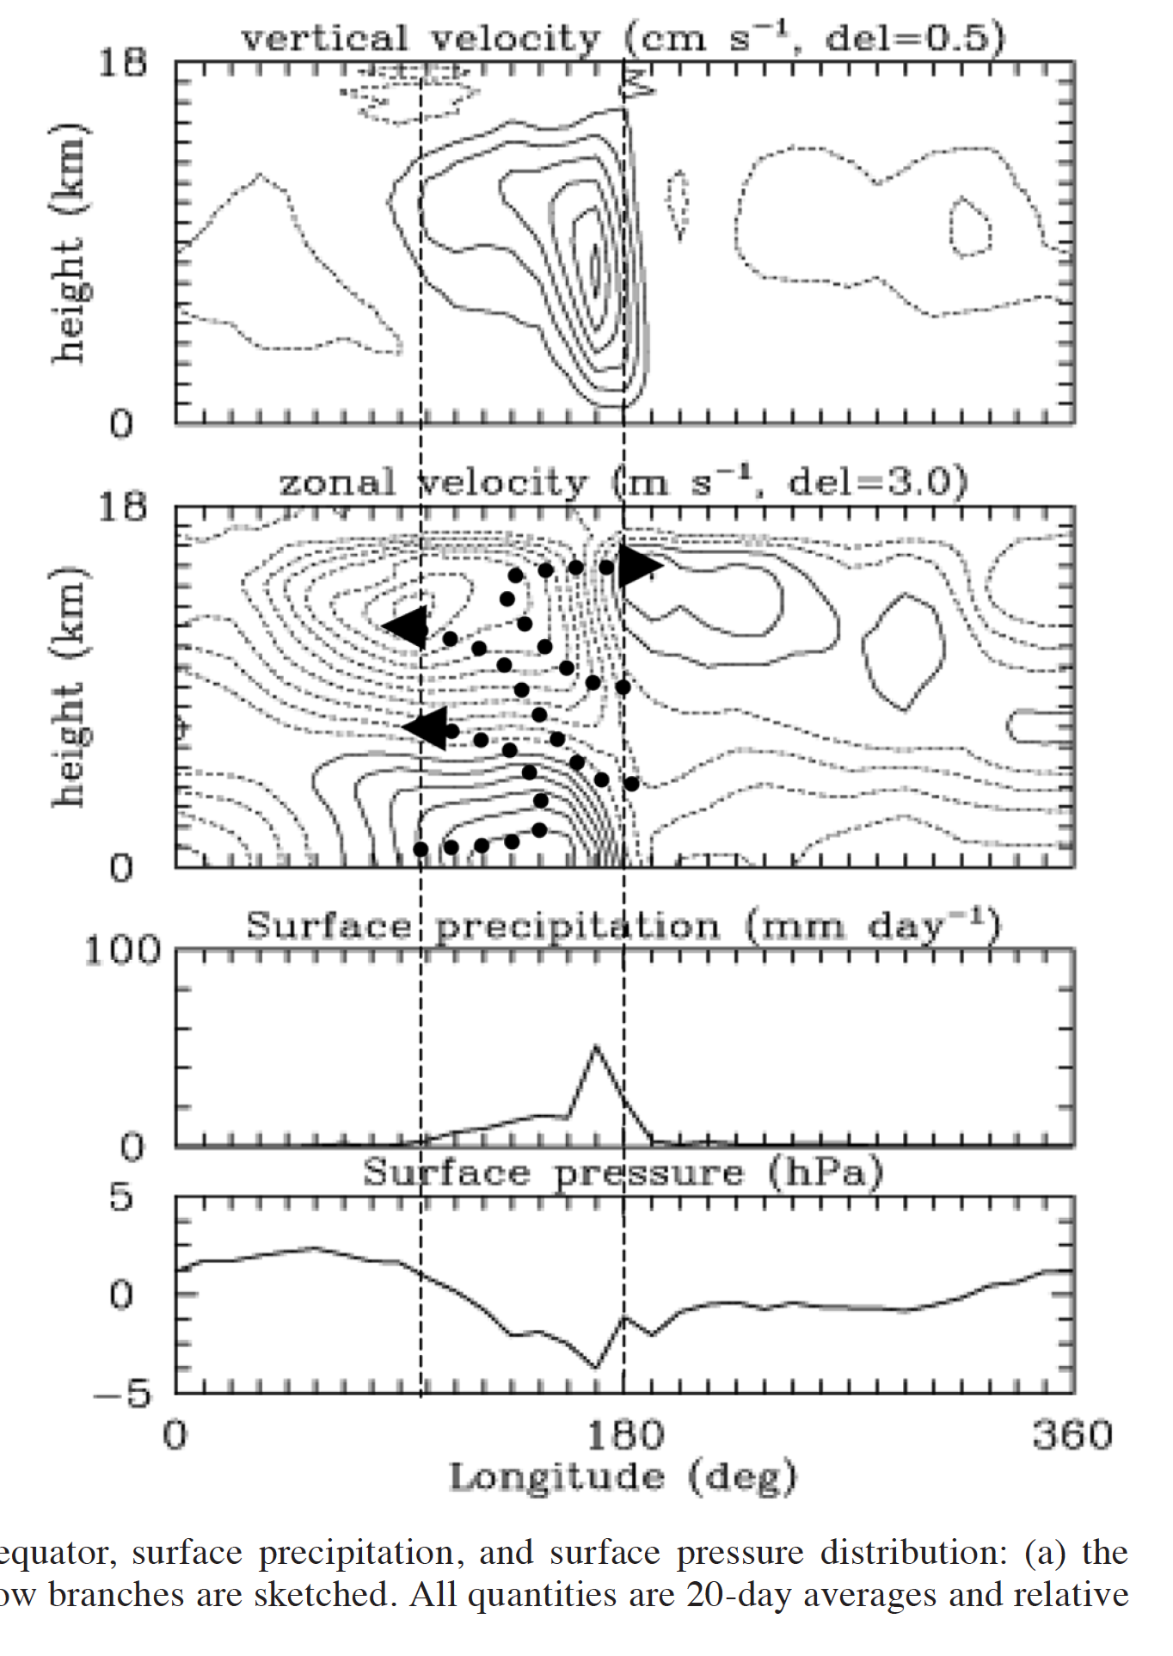
Vertical structure of the MJO
Moncrieff 2004

Slide 28
What atmospheric
phenomena constitute
“convection?”
Microphysical
Scales
Turbulence
Scales
~10^{–6} m
Dynamic Scales
~10^{–3} m
~100 m
  Fair weather cumulus
  Cumulus congestus
  Cumulonimbus
    Single cell
    Multicell
    Supercell
    (severe tornadoes,
    extra large hail)
Mesoscale convective systems
Layered overturning
Stratiform precipitation
Extensive anvil clouds
~100 m
~10⁶ m
Is there a common
denominator?
Notes:
trillion

Slide 29
TOGA COARE Airborne Doppler Observations of MCSs…
25 convective region flights
<
Kingsmill & Houze 1999
Notes:
KH studied data from ___ flights around the conv regions of MCSs and found a deep layer of uplift. The layer lifting consisted of pot. Unstable air.

Slide 30
TOGA COARE Airborne Doppler Observations of MCSs…
25 stratiform region flights
Kingsmill & Houze 1999
Notes:
The midlevel inflow to the sf region is an imp part of the MCS circulation.

Slide 31
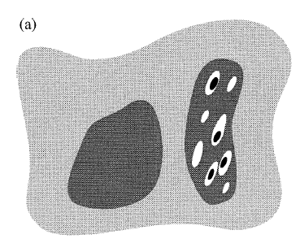
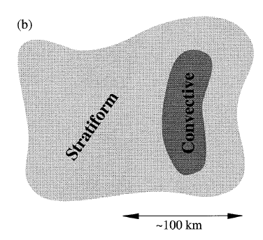
Inflow can come from any direction
Possible inflows to convective regions
Possible Inflows to stratiform regions
“rear inflow”
100 km

Slide 32
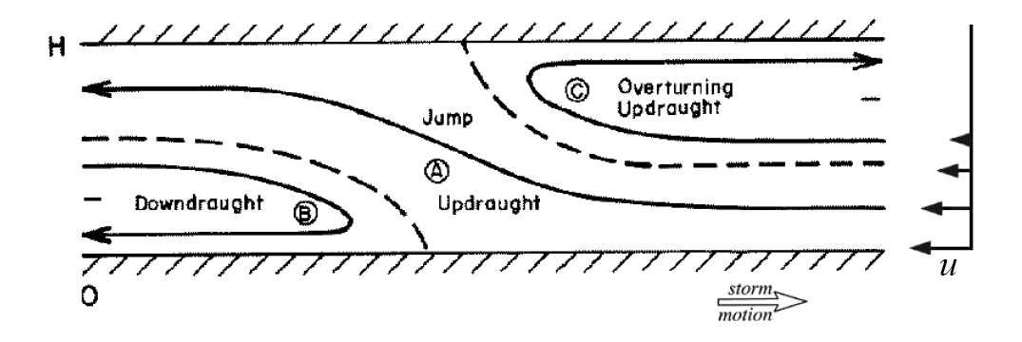
When an MCS forms in a sheared environment,
solutions to 2D vorticity equation look like this:
Joint adjustment to the thermal and wind stratification
of the environment
Shear
B>0
Moncrieff 1992 & others

Slide 33
Post-GATE view of the tropical cloud population
Houze et al. (1980)

Slide 34
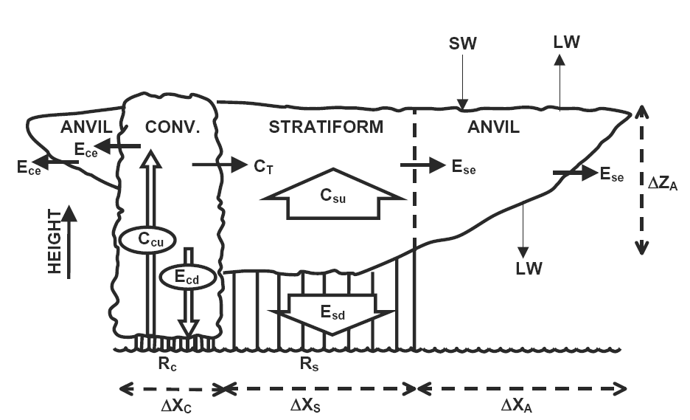
ΔZ_{AC}
IWC
A_{c}
A_{s}
IWC
A_{s}
ΔX_{AC}
Water budget underlies all the heating effects on the environment
Don’t know this numbers for any cloud systems! No baseline knowledge.
For net effects, need mass flux, not w
For microphysics, need the spectrum of w
Need to know N(w)dw, dimensions of all features, ice contents
Notes:
ARM Radiative Heating Profile Workshop, 8-9 January 2007, San Diego, CA, USA

Slide 35
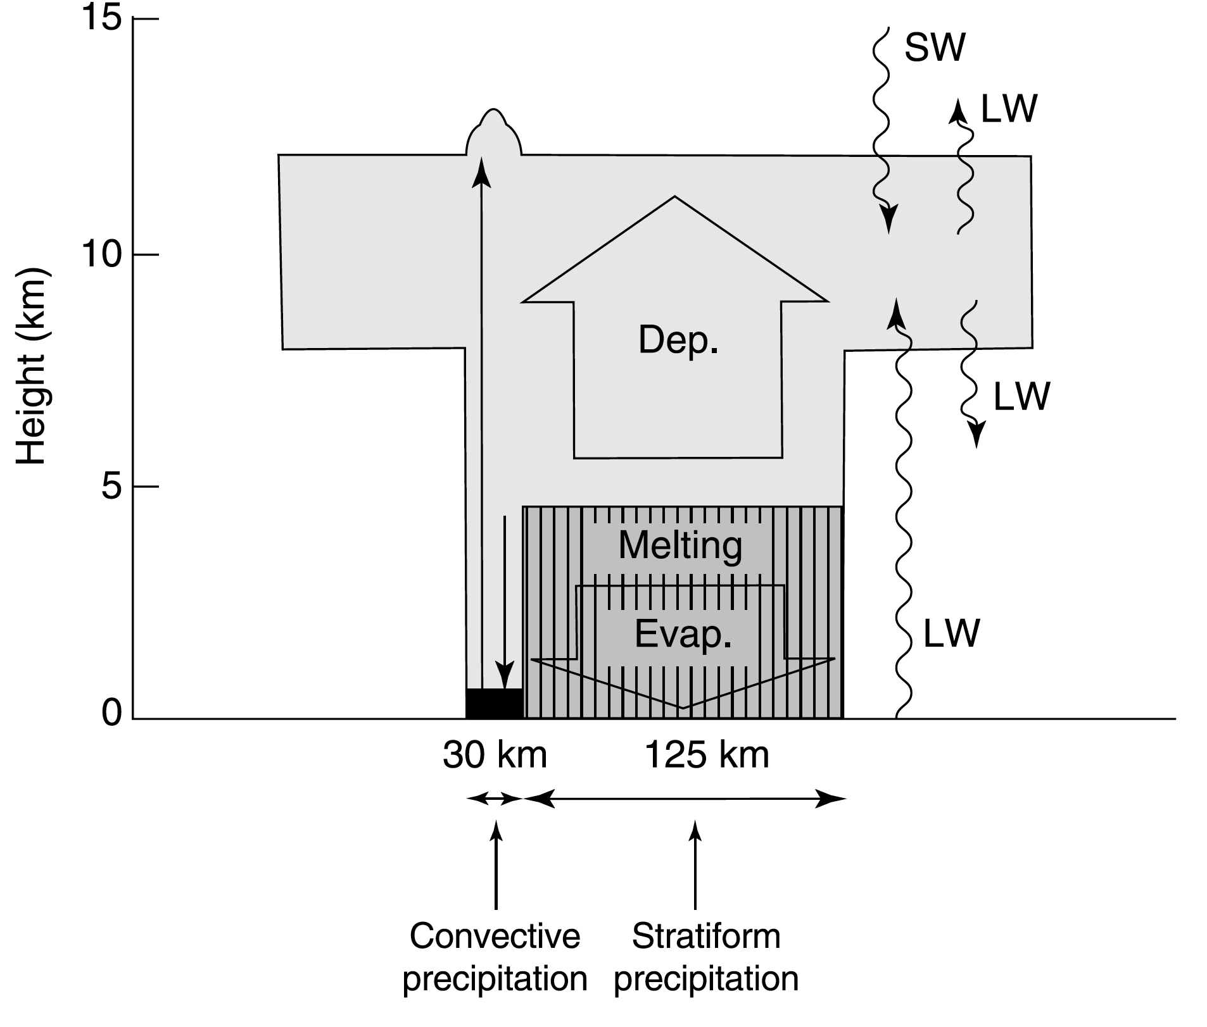
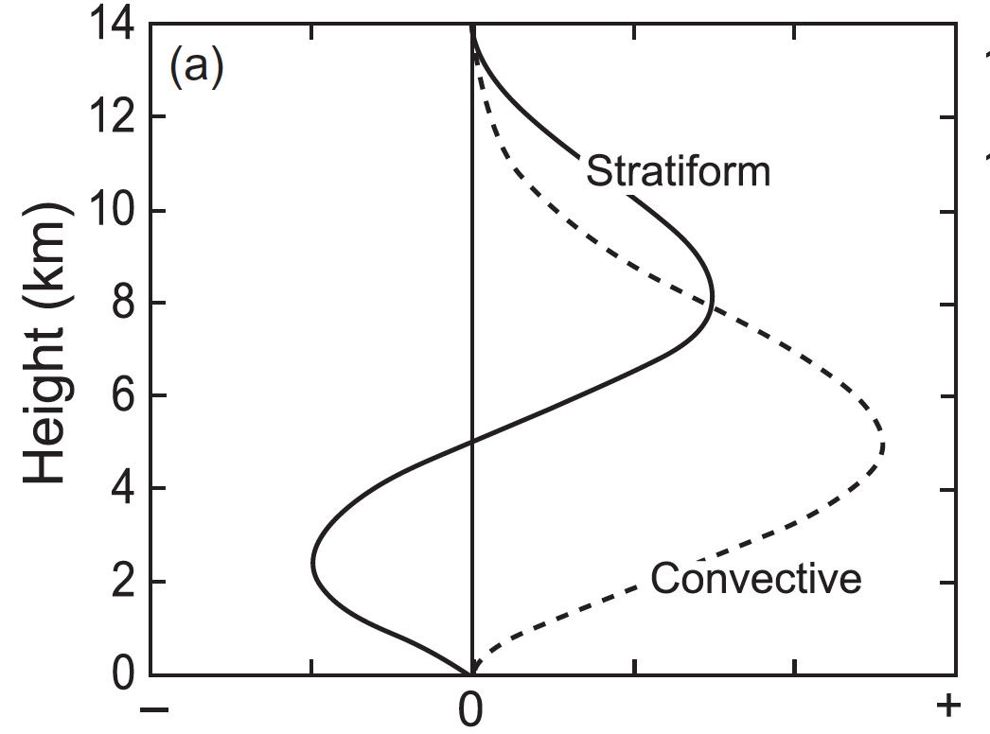

Convective, stratiform, and anvil components
Houze (1982, 1989)
MCSs have top-heavy heating because of their stratiform precipitation zones
=> Potential Vorticity Generation in midlevels
Non-dimensional heating rate

Slide 36
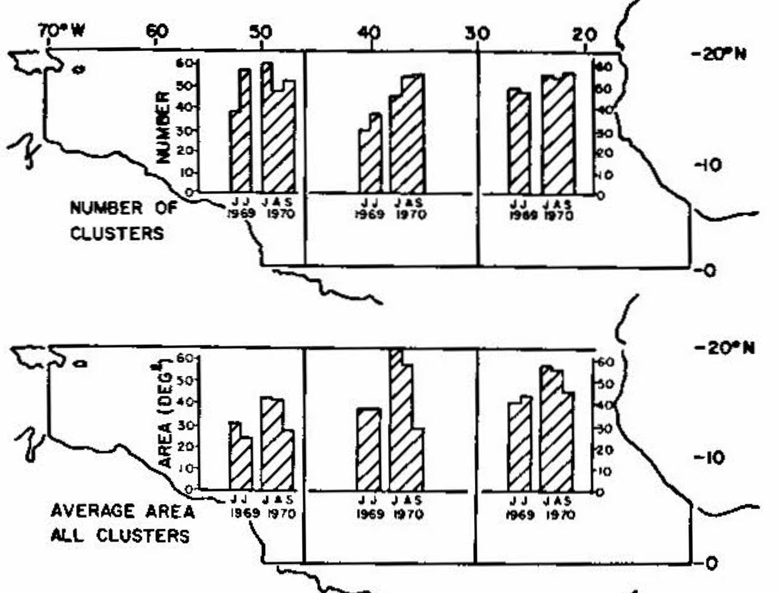
“Cloud Clusters” discovered in early visible satellite imagery
Martin and Karst (1969)
Martin and Suomi (1972)
Analyzed digitally enhanced visible images
Clusters identified as trackable patches of high cloud, averaging
  3000-7000 km in scale
  3-6 days
Bright cores within clusters
  300-700 km in scale
  1-4 hours
  Validated against radar data
  Moved slower than clusters
  Banding noted
Notes:
Visible imagery

Slide 37
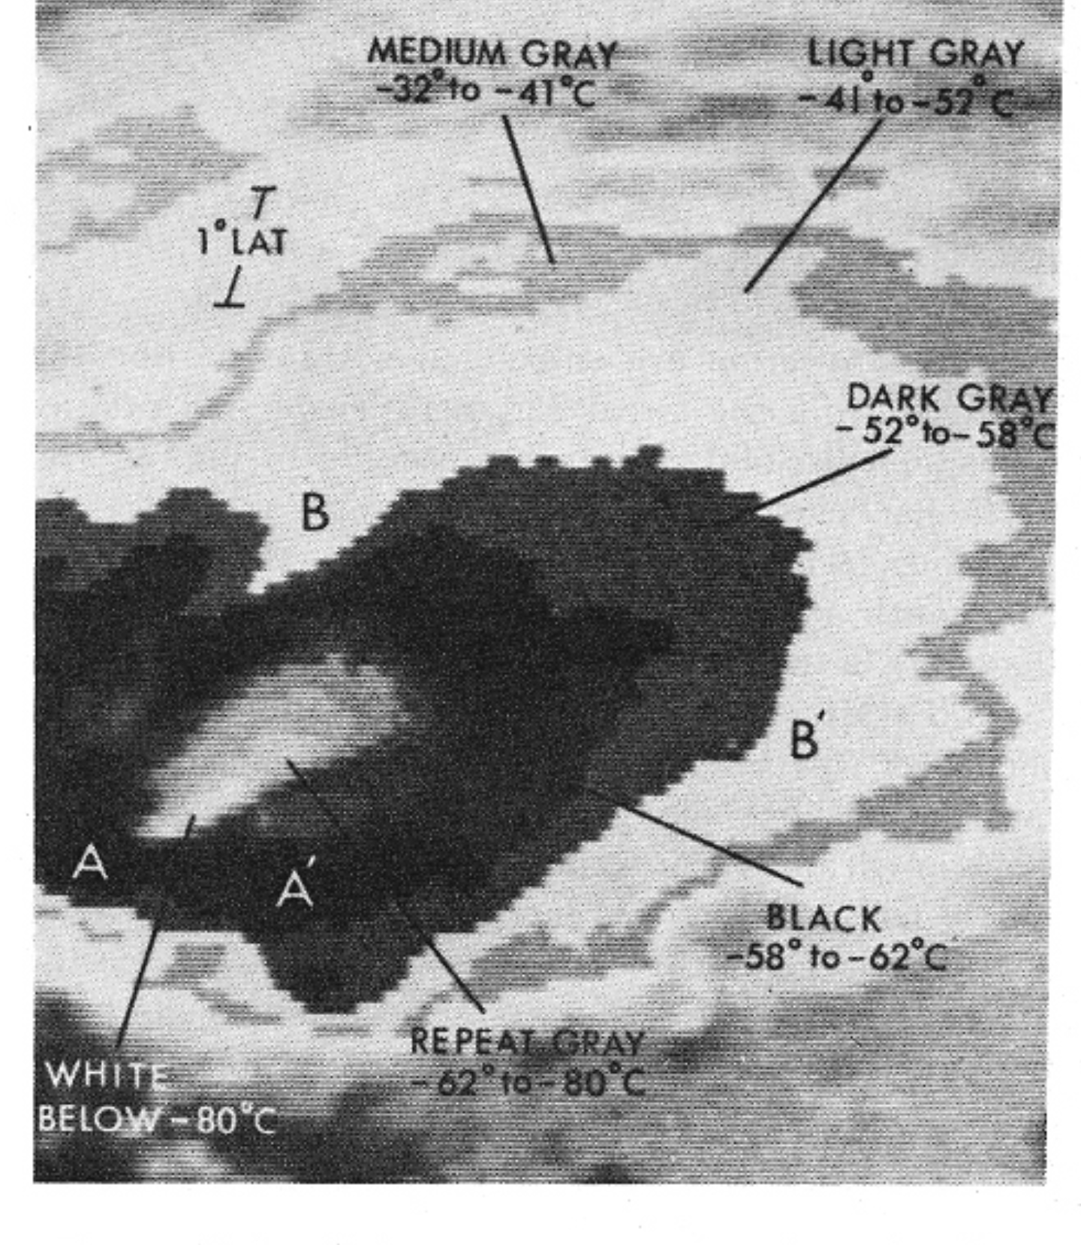
“Mesoscale Convective Complexes (MCCs)” ” identified in early IR imagery
Maddox (1980)
Used IR imagery
Large, circular, cold tops
–32°C over 100,000 km²
–52°C over 50,000 km²
Notes:
MCSs were brought to prominence by Maddox in the early days of satellite meteorology. In the

Slide 38
Convective, stratiform, and anvil components
Houze (1982, 1989)
MCSs have top-heavy heating because of their stratiform precipitation zones
=> Potential Vorticity Generation in midlevels
Non-dimensional heating rate

Slide 39
Moncrieff’s Model of MCS Layered Airflow
Moncrieff (1992), and several of his earlier and later papers)
Mesoscale layered overturning
Simultaneous adjustment to stability and shear of the environment

Slide 40
Multiscale Airflow
Often MCSs have these sloping structures, but with convective elements superimposed
Cold pool
Layer of inflow
Gust front
Storm motion
Sheared flow leads to older convective elements being advected rearward SF precipitation area is to the rear.
Houze et al. (1989)
Houze et al. 1989

Slide 41
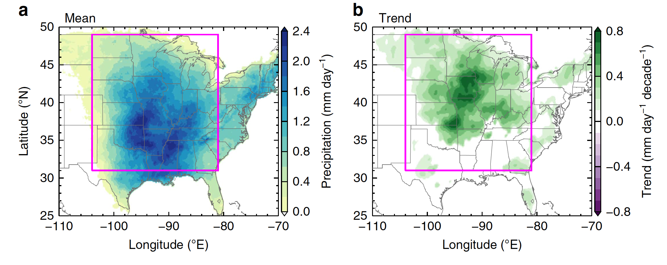
Trend of MCS rainfall over the central U.S.
Feng et al. (2016)

Slide 42
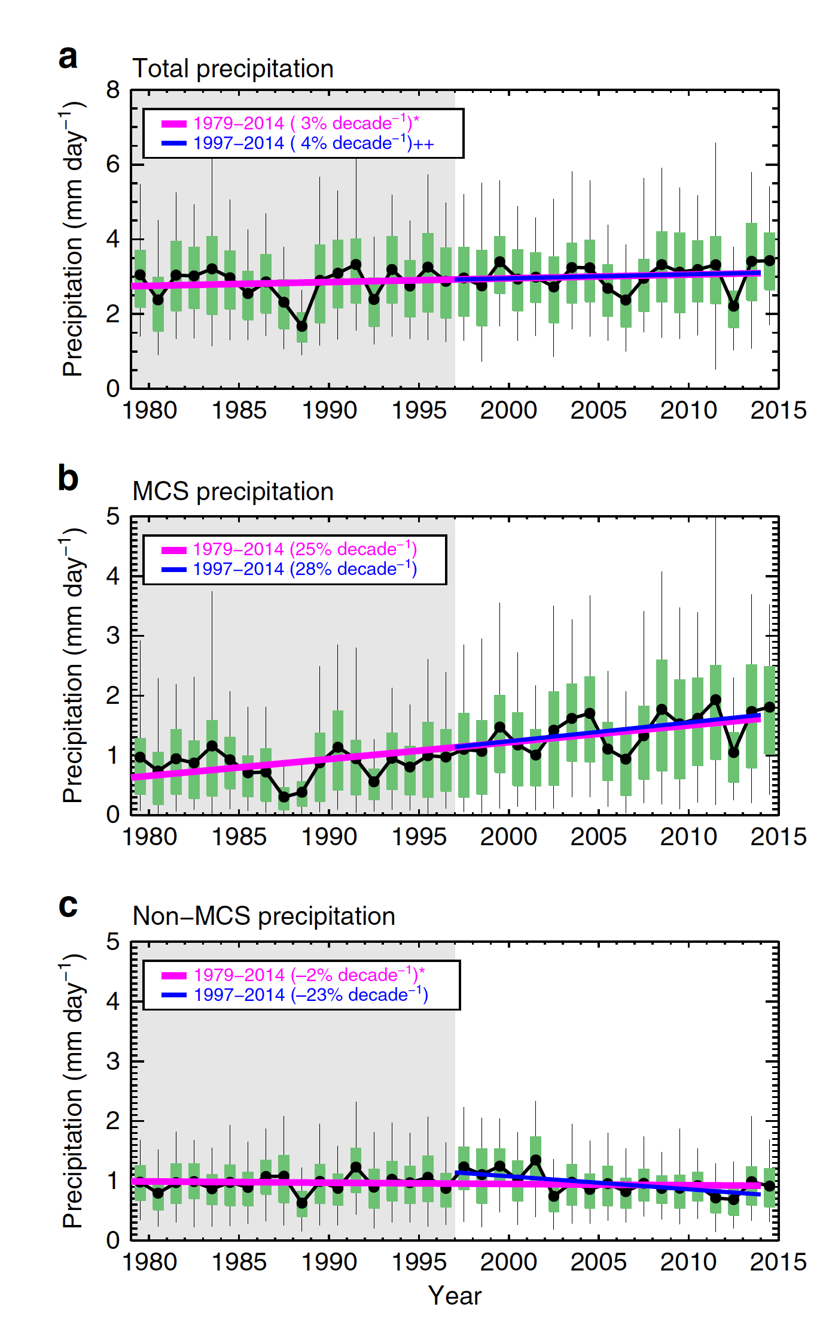
Trends over the central U.S.
Feng et al. (2016)

Slide 43
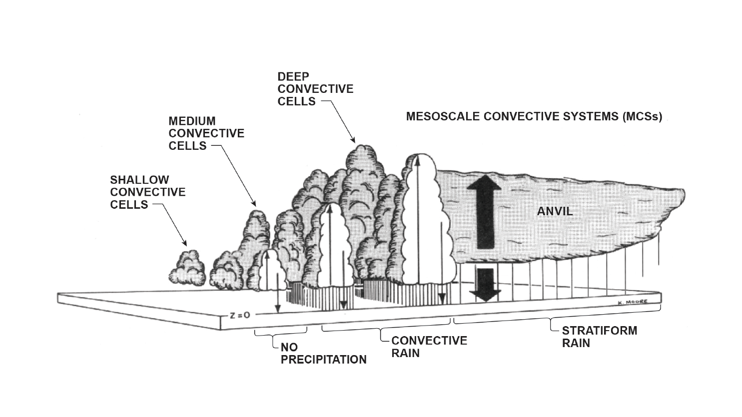

Slide 44
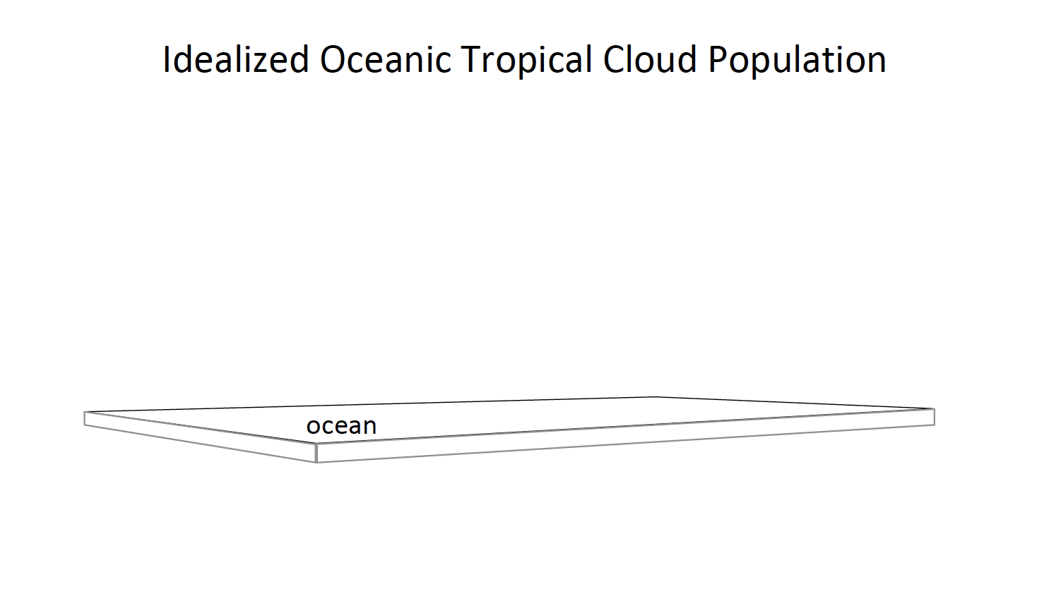

Slide 45
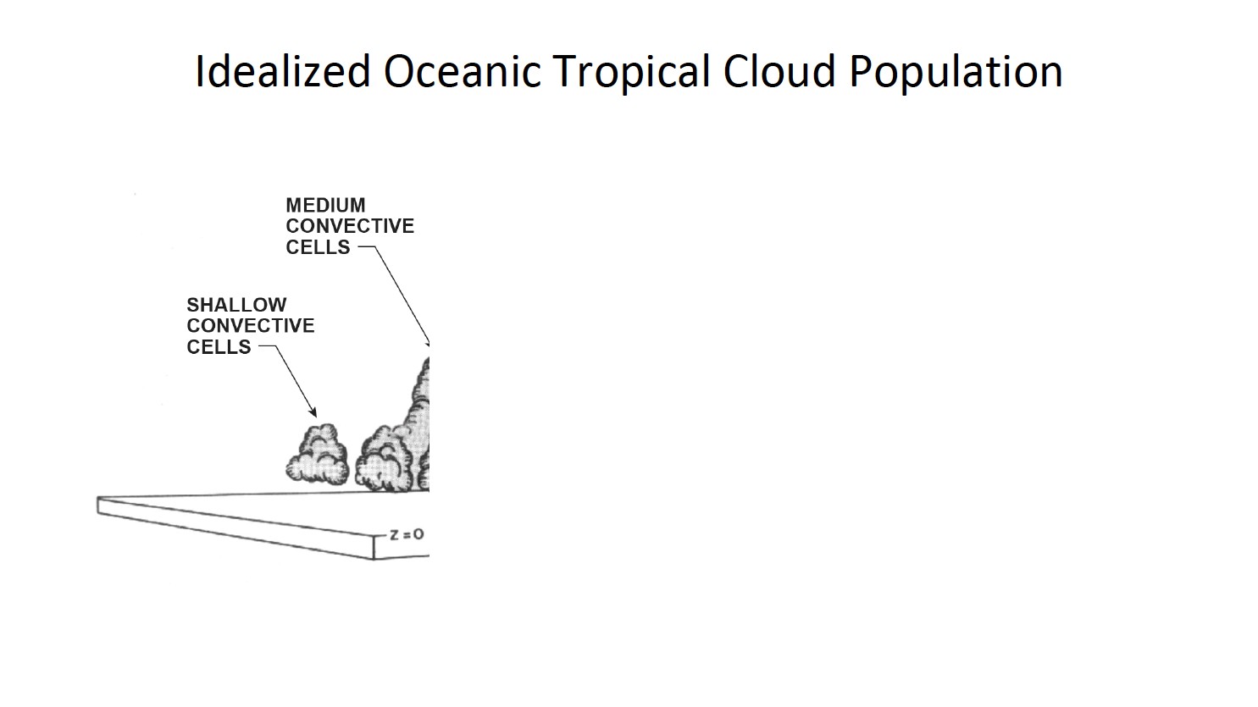

Slide 46
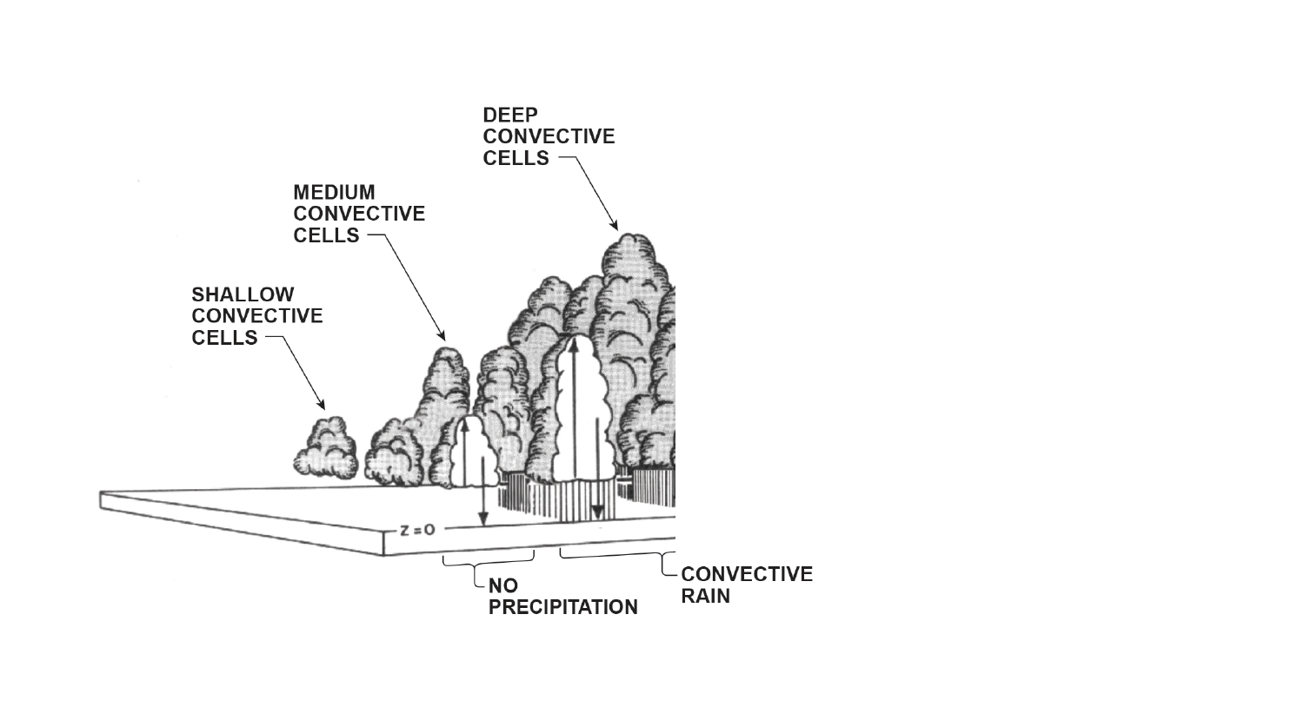

Slide 49
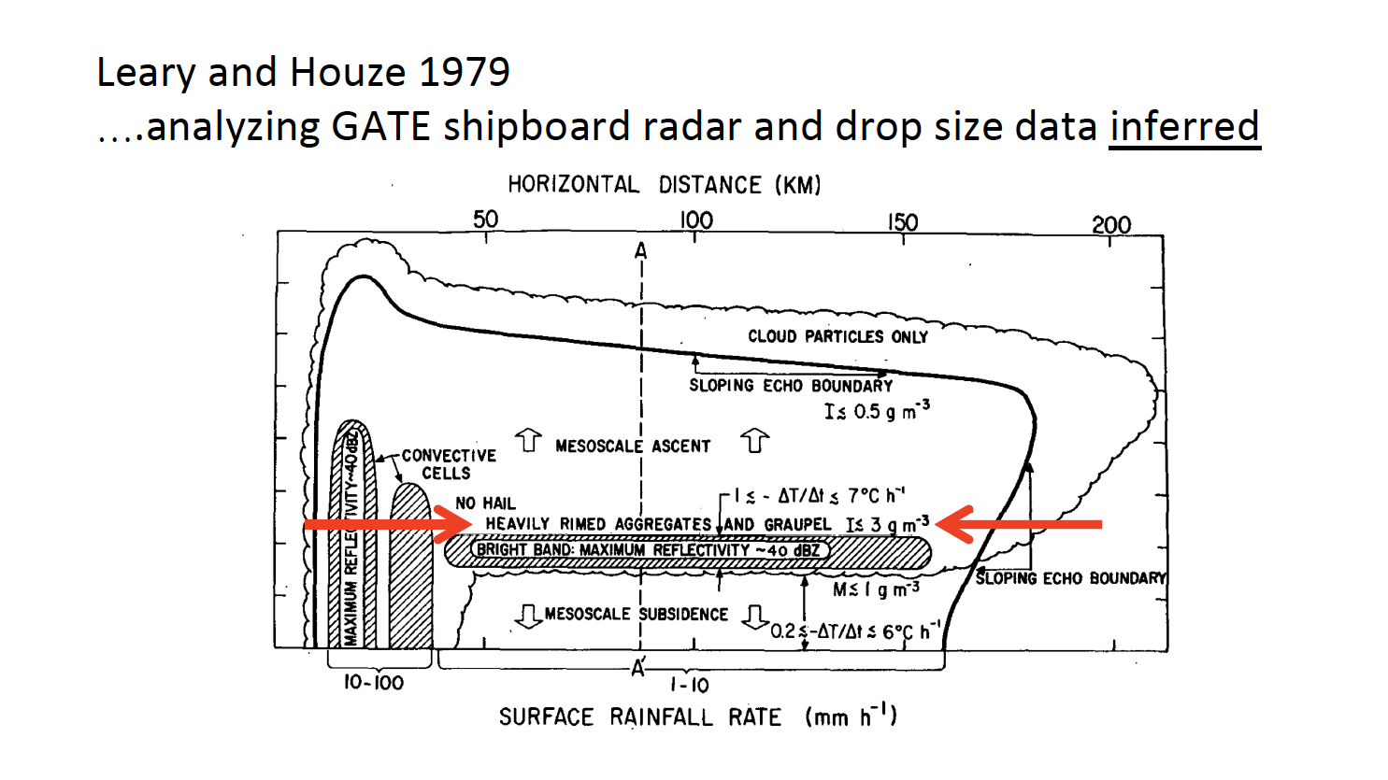

Slide 50
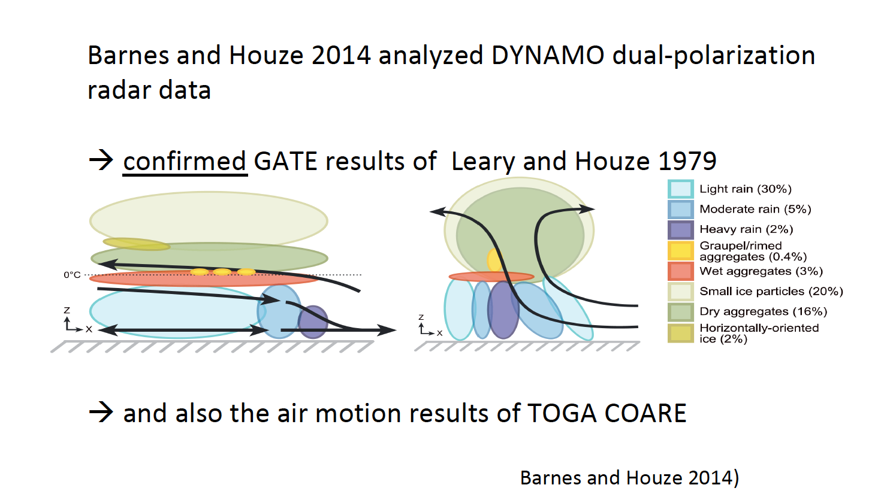

Slide 51


Slide 53
TOGA COARE
Airborne Doppler Observations of MCSs
25 convective region flights
<
Kingsmill & Houze (1999)

Slide 54
TOGA COARE
Airborne Doppler Observations of MCSs
25 stratiform region flights
Direction of inflow determined by direction of large-scale flow—not orientation of a convective line
Kingsmill & Houze (1999)

Slide 55
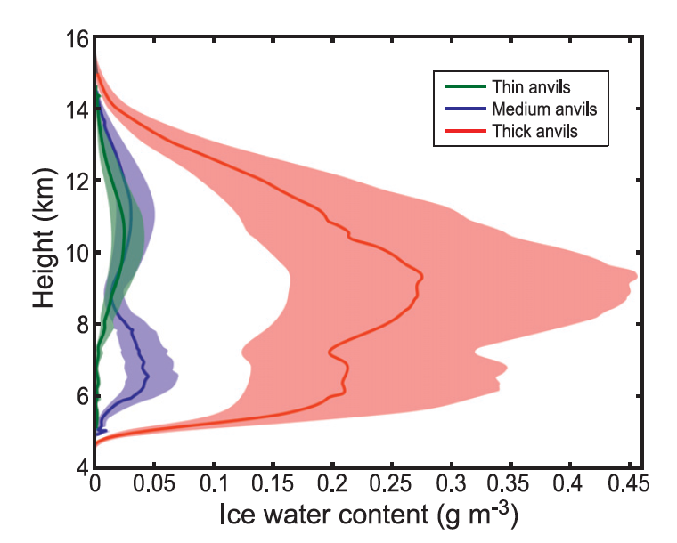
Anvil clouds observed by WACR at Niamey
Huge uncertainty!
This isn’t good enough!
From Powell et al. 2012,
based on Protat et al. 2007
Notes:
From Powell et al. 2012

Slide 57
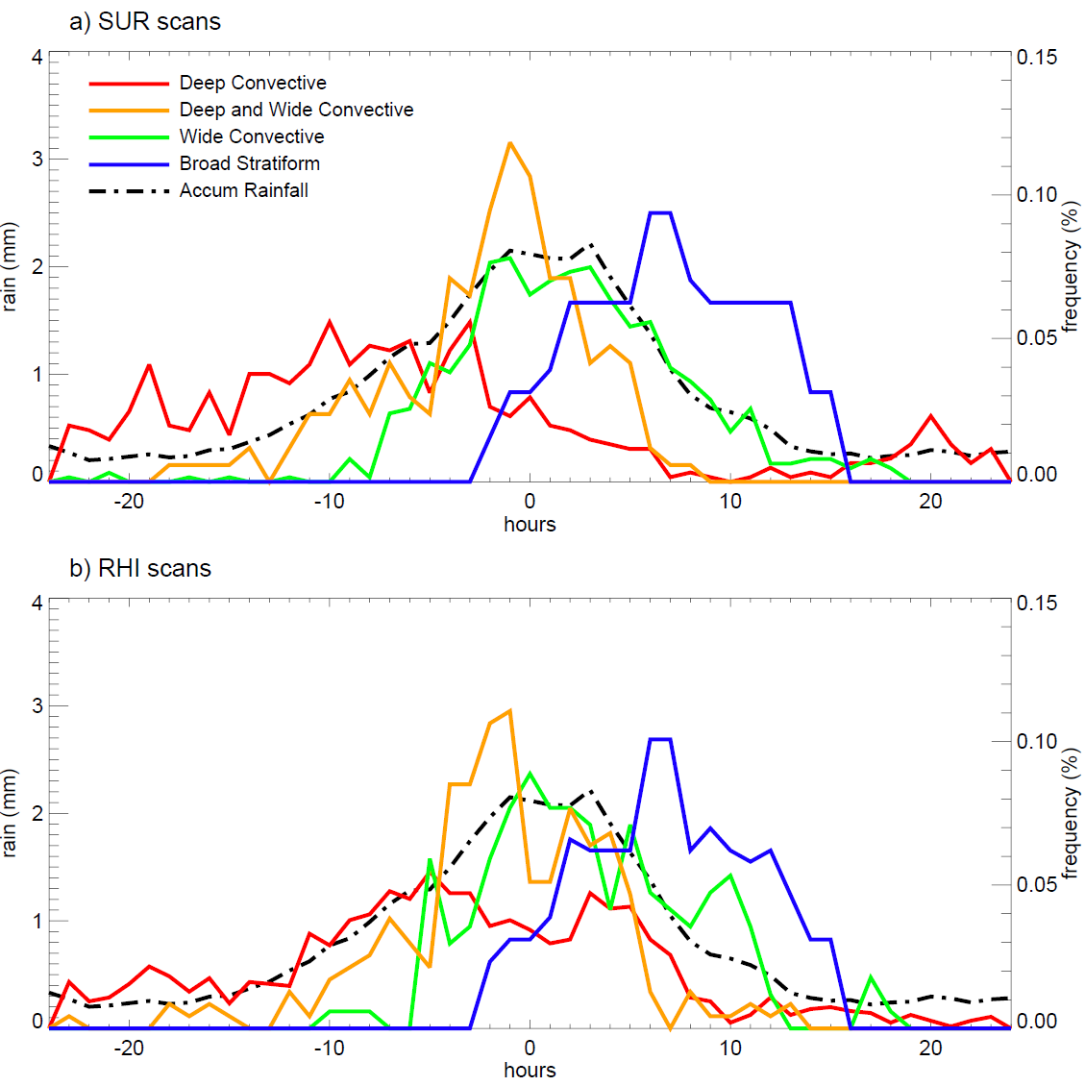
Variation of the DYNAMO radar echo population
Composite of all 2-day rainfall episodes

Slide 58
Composite large-scale divergence and vertical motion during 2-day rainfall episodes
Zuluaga and Houze 2013

Slide 59
What’s the PDF of the members of the population?
Use 3D radar data to identify:
Shallow isolated echoes (3D convective echo with top < 5 km )
Deep convective cores (3D convective echo >30 dBZ, tops >8 km)
Wide convective cores (3D convective echo >30 dBZ, area >800 km²)
Broad stratiform area (stratiform echo > 50 000 km²)
Use 3D radar data to identify:
Shallow isolated echoes (3D convective echo with top < 5 km )
Deep convective cores (3D convective echo >30 dBZ, tops >8 km)
Wide convective cores (3D convective echo >30 dBZ, area >800 km²)
Broad stratiform area (stratiform echo > 50 000 km²⁾

Slide 60
What’s the PDF of the members of the population?
Houze et al. (1980)

Slide 61
What’s the PDF of the members of the population?
Use 3D radar data to identify:
Shallow isolated echoes (3D convective echo with top < 5 km )
Deep convective cores (3D convective echo >30 dBZ, tops >8 km)
Wide convective cores (3D convective echo >30 dBZ, area >800 km²)
Broad stratiform area (stratiform echo > 50 000 km²)
Use 3D radar data to identify:
Shallow isolated echoes (3D convective echo with top < 5 km )
Deep convective cores (3D convective echo >30 dBZ, tops >8 km)
Wide convective cores (3D convective echo >30 dBZ, area >800 km²)
Broad stratiform area (stratiform echo > 50 000 km²⁾

Slide 62
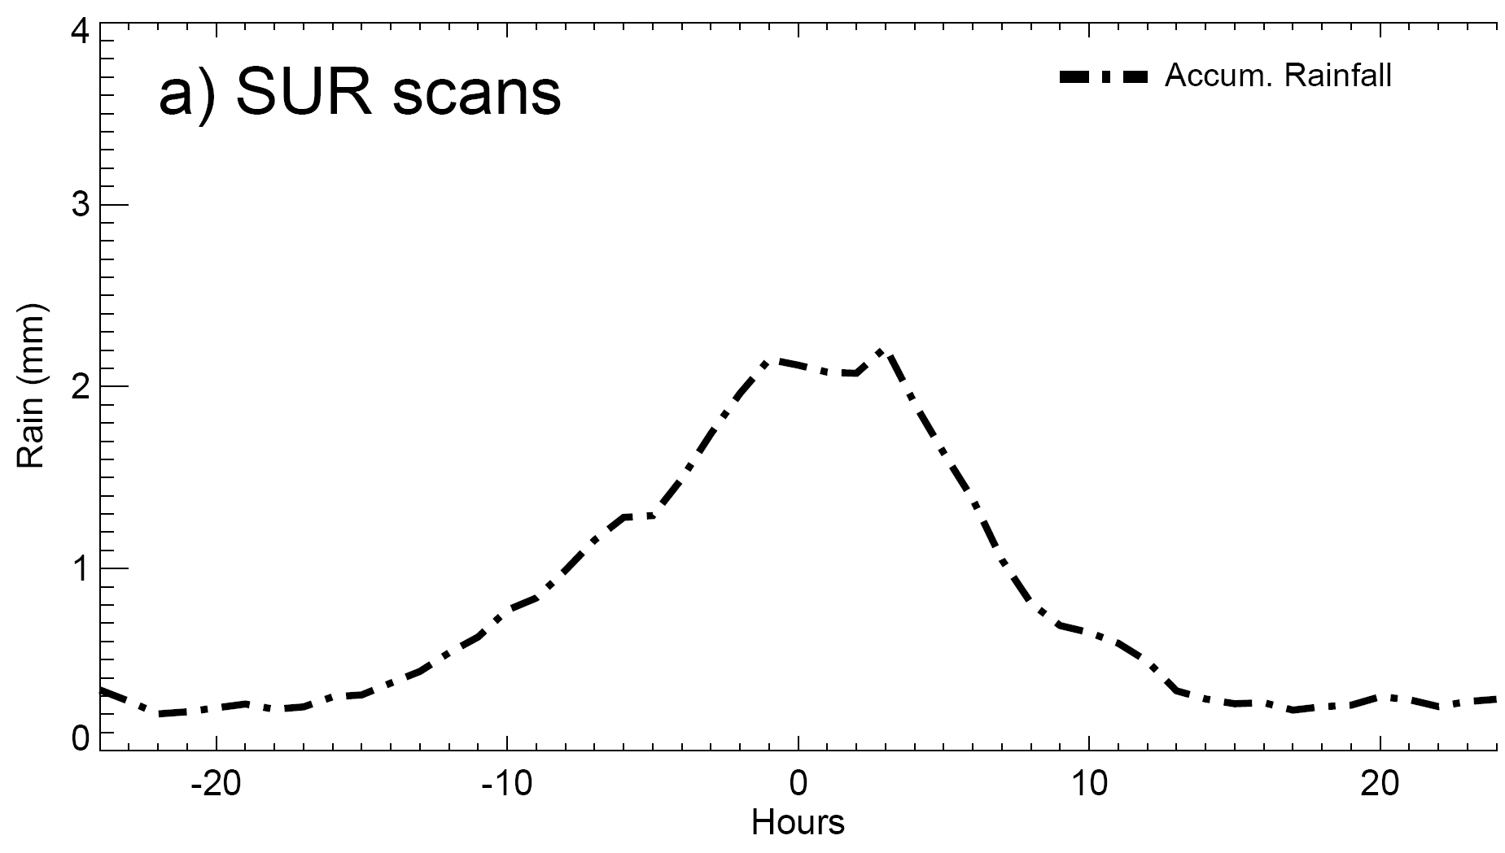
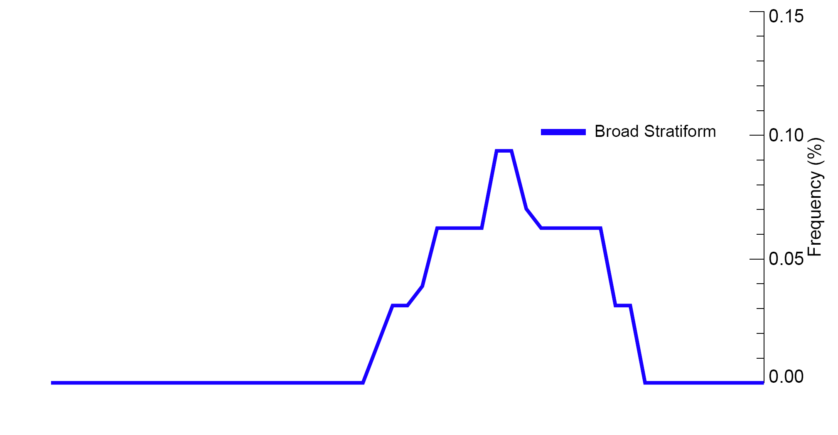
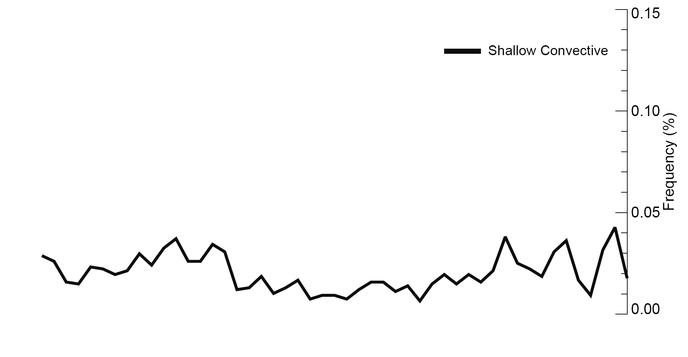
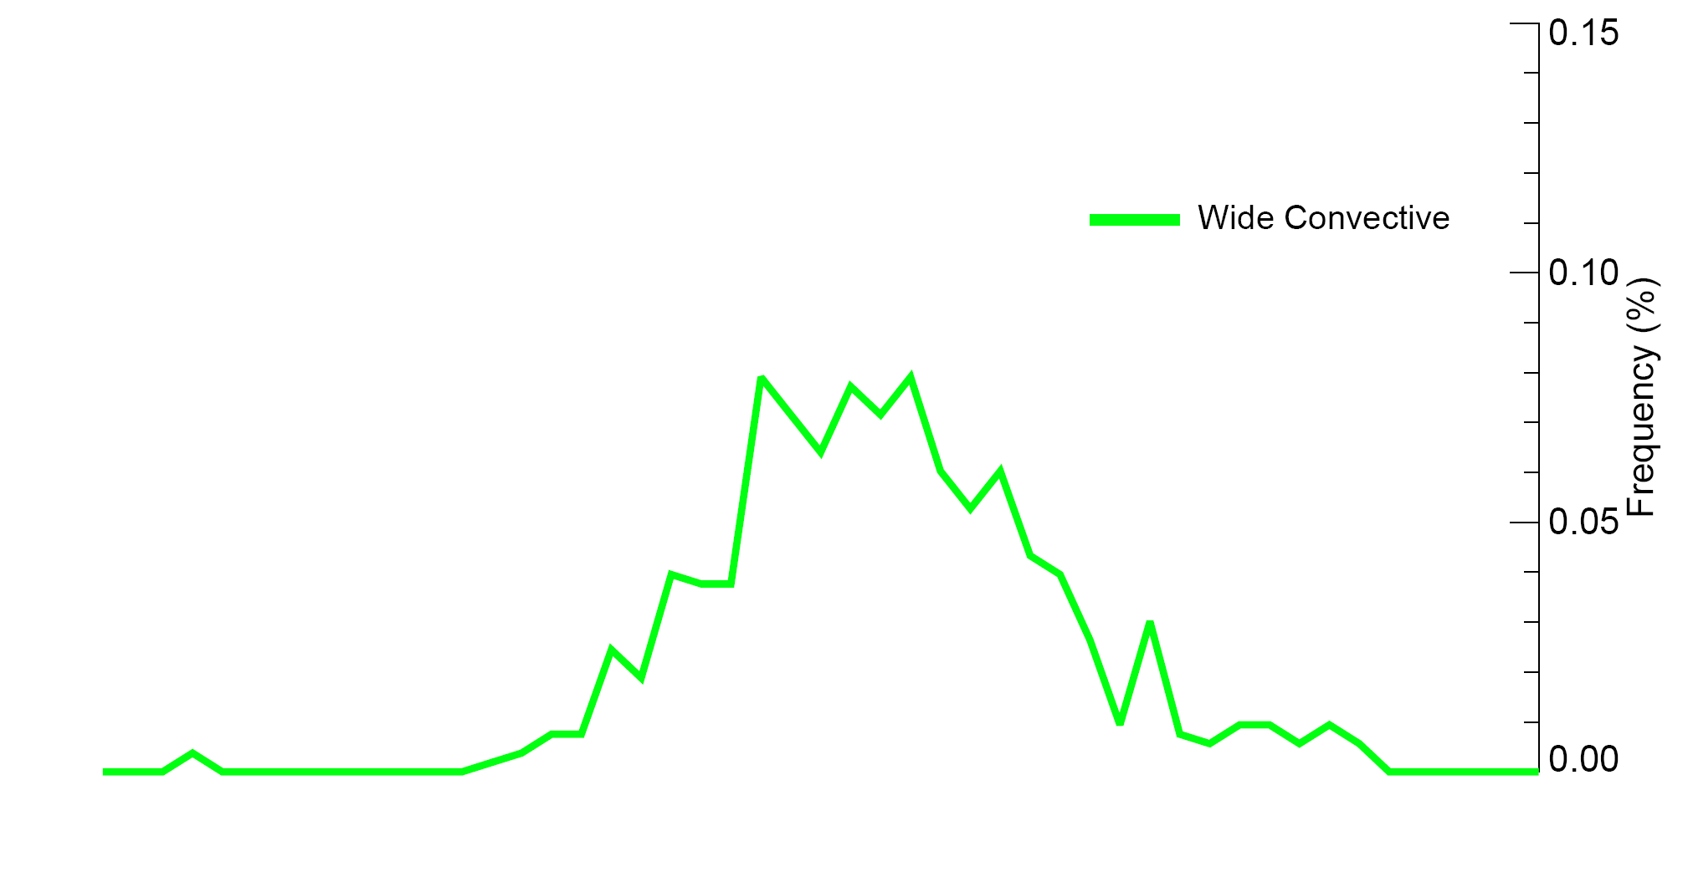
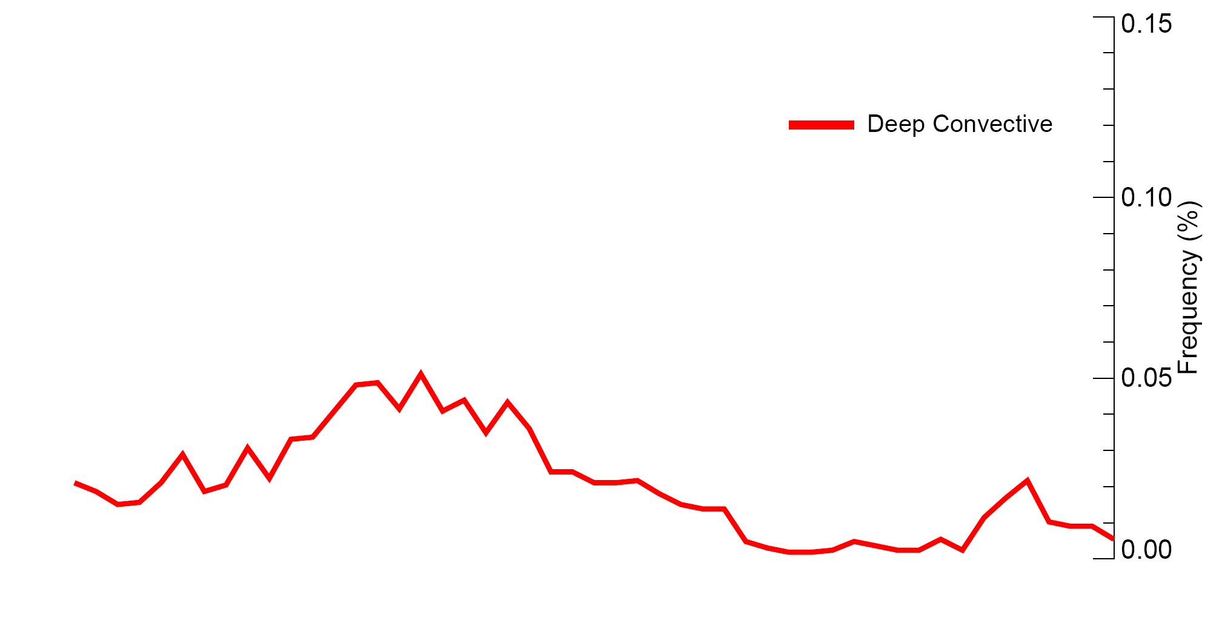
Variation of the DYNAMO radar echo population during a rain episode
Composite of all 2-day rainfall episodes
Zuluaga and Houze 2013

Slide 63
Basic components of an MCS
Cold top
Anvil
Anvil
Raining core
Houze et al. 1989
A-Train sees all of these elements
Notes:
The basic components of an MCS can be simplified into 3 main features, which can be identified and MEASURED by satellite. The combination of these three properties can be used to identify an MCS if they satisfy certain criteria. Thus we can determine when and where MCSs occur around the globe. In addition we can determine how the properties of these three components vary from region to region. How big and wide is the cold top; how big and intense is the raining core; how thick are the anvils; and what are the characteristics of their internal structure. And how do these properties vary around the globe? One cannot holistically determine the properties of MCSs by identifying one of these properties alone. It’s important to see and evaluate all 3.

Slide 64
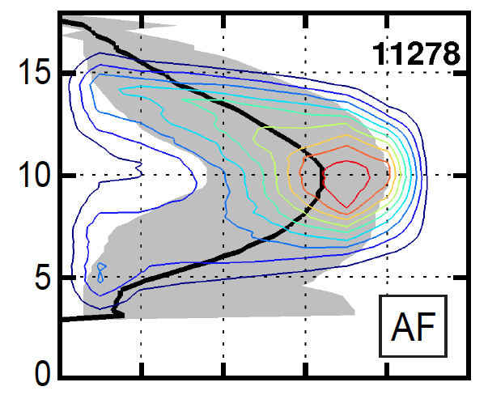
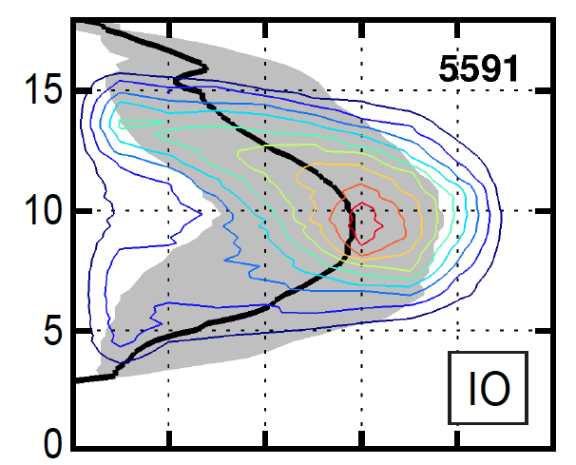

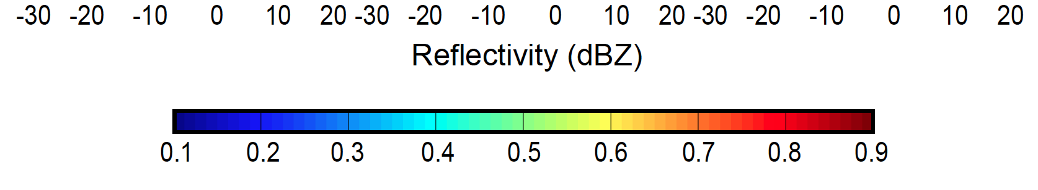
Internal structure of MCS anvils
Africa
Indian Ocean
Yuan, Houze, and Heymsfield 2011
Notes:
Black curves are medians

Slide 65
All Cumulus and Cumulonimbus
Buoyancy phenomena
Microphysics
Turbulent
Vorticity
Condensation
level
Aerosol

Slide 66
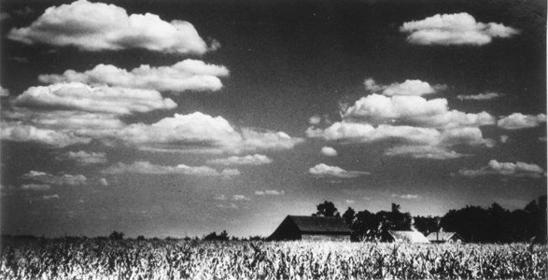
Cumulus
Condensation level
Buoyant
Updraft
Fair weather type

Slide 67
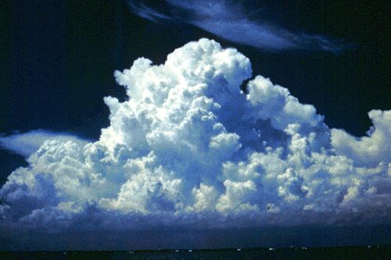
Cumulus congestus

Slide 68
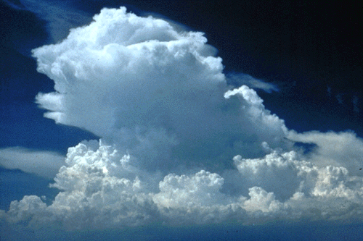
Glaciation and Anvil Formation

Slide 69
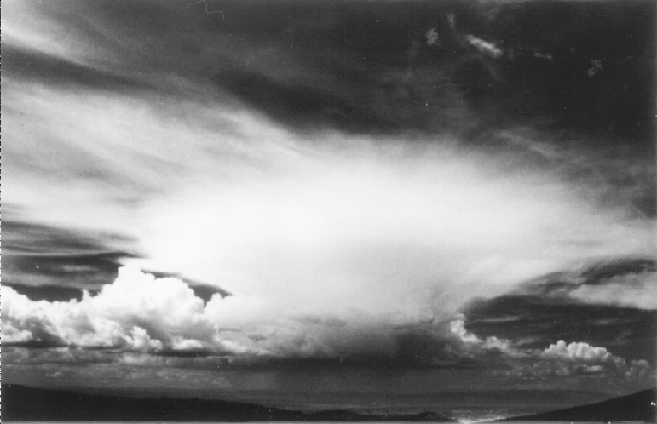
Cumulonimbus with an older anvil
The cumulonimbus produces a layer of cirrostratus

Slide 70
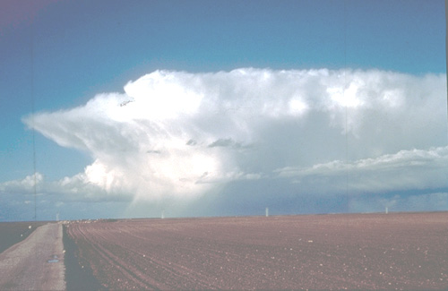
Cumulonimbus with Anvil
Hail
Rain

Slide 71

Cumulonimbus anvils viewed from space
100 km

Slide 72

Mesoscale Convective System (“MCS”)
~500 km

Slide 73


Composite microphysics in an individual MCS
Stratiform
region
Convective
region
Barnes and Houze 2014

Slide 74
Basic components
Cold top
Stratiform
Convective
Anvil
Anvil
Raining core
Houze et al. 1989
TRMM separates the convective and stratiform echoes
Notes:
The basic components of an MCS can be simplified into 3 main features, which can be identified and MEASURED by satellite. The combination of these three properties can be used to identify an MCS if they satisfy certain criteria. Thus we can determine when and where MCSs occur around the globe. In addition we can determine how the properties of these three components vary from region to region. How big and wide is the cold top; how big and intense is the raining core; how thick are the anvils; and what are the characteristics of their internal structure. And how do these properties vary around the globe? One cannot holistically determine the properties of MCSs by identifying one of these properties alone. It’s important to see and evaluate all 3.

Slide 75


Composite MCS Lightning in the MJO
Separated
ACTIVE
Separated
SUPPRESSED
Notes:
Size of MCS is size of cold cloud top. To qualify as MCS, must have large cold cloud top, large rain area, and some heavy rain. This figure shows spatial distribution of active MCSs. Color of each point shows the number of active MCSs found within a circular area with radius of five degrees centered on that point. (a) Small separated MCSs (<12,000km2; i.e., the smallest 25%) in DJF, (b) large separated MCS (>40,000km2; i.e., the largest 25%) in DJF, (c) connected MCS in DJF, (d)-(f) same as (a)-(c) except for JJA.

Slide 76



TOGA COARE → Doppler radar sampling relative to the MJO
Rossby
Gyres
Kelvin Wave
Convergence
Houze et al. (2000)

Slide 77
Post-GATE view of the tropical cloud population
Houze et al. (1980)

Slide 78

Stretched Building Block Hypothesis
Mapes et al. 2006
Cloud population at three different times
Large-scale wave structure at the same times

