Slide 1

March 2022
Presented at American Meteorological Society Annual Meeting, February 1, 2024

Slide 2

1970a

Slide 3
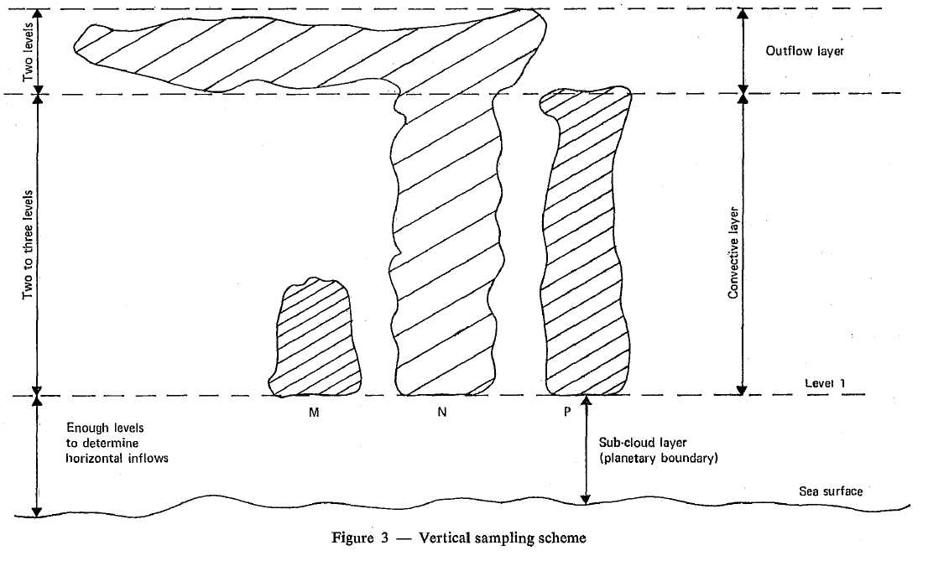
GARP Report #4, 1970
Tropical Oceanic Convective Clouds
Boundary layer
Warm tropical ocean

Slide 4
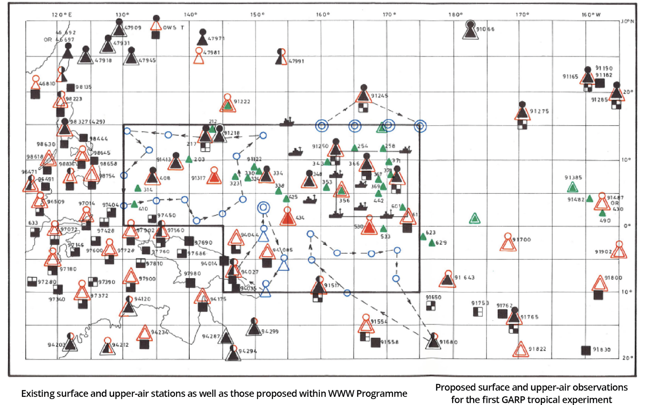
China
Western Pacific Ocean
“TROMEX”
Papua
New
Guinea
Australia

Slide 5
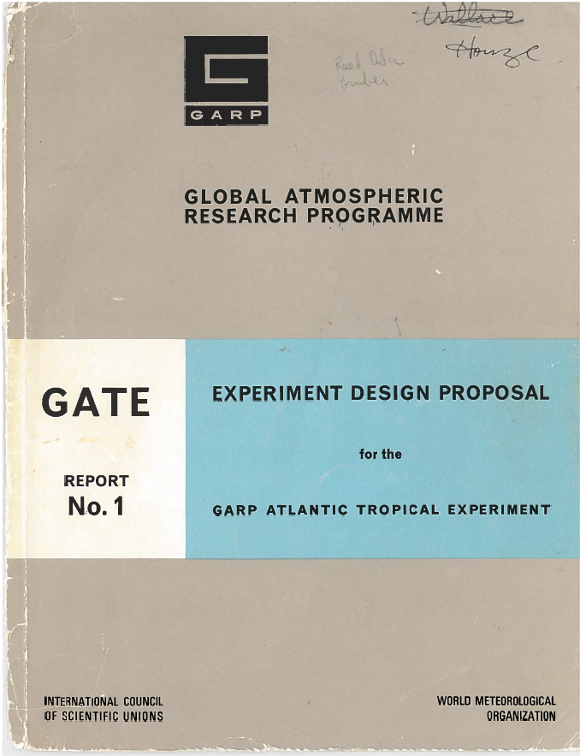
1972

Slide 6
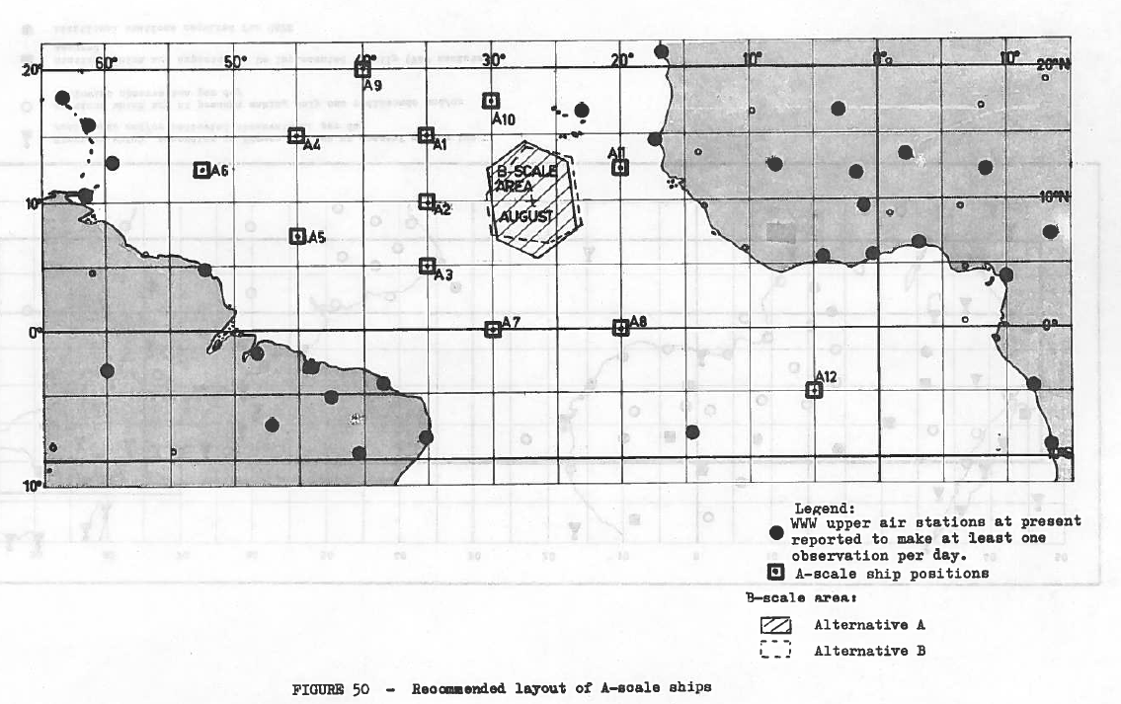
Africa
South America

Slide 7
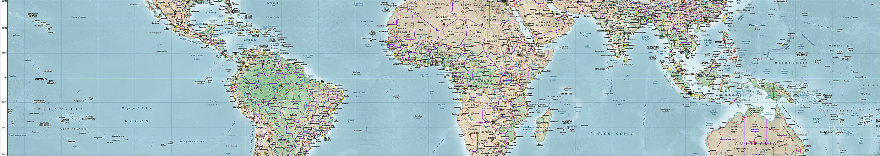
Switcharoo!!
“GATE”
“TROMEX”
20 N
EQ
20 S
150 W
120
90
60 W
30
0
30
60
90
120
150
1972
GATE Rep. #1
1970a
GARP Rep. #4

Slide 8
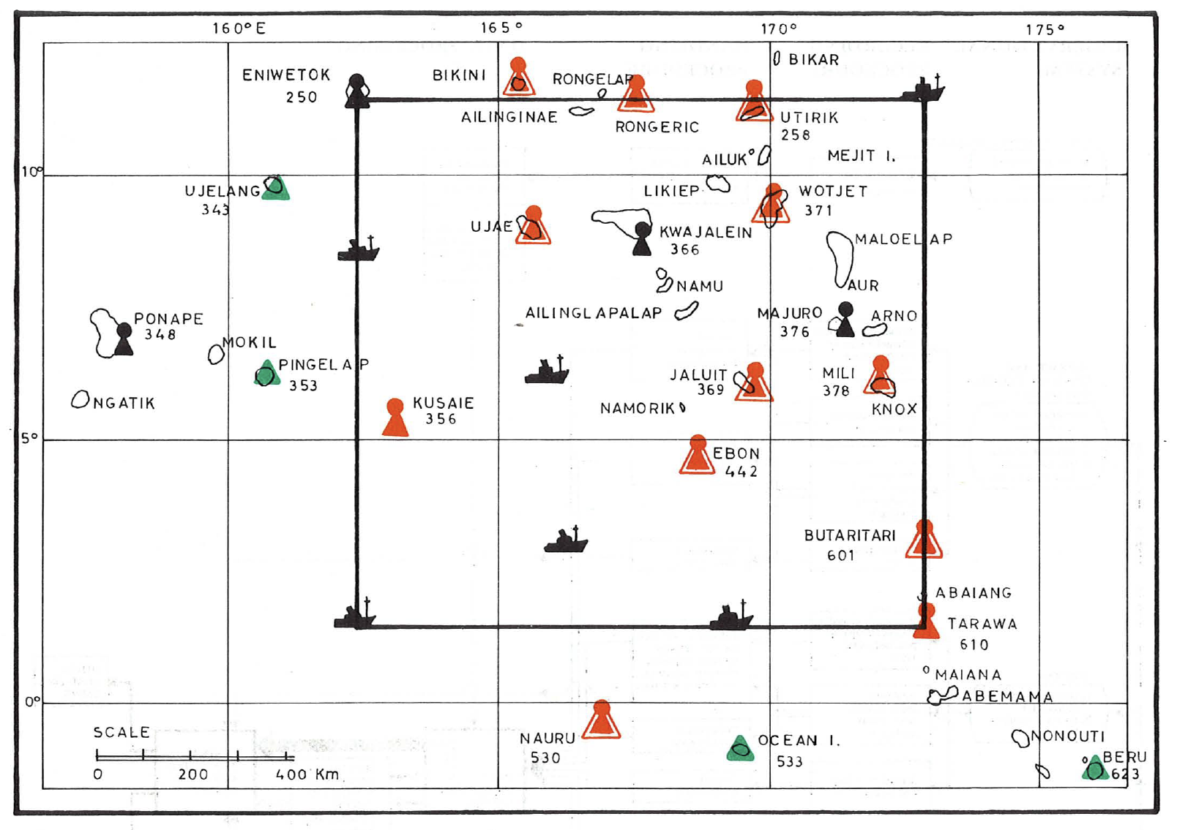
Kwajalein:
Ronald
Reagan
Ballistic
Missile
Defense
Test Site
Notes:
24 nuclear weapons detonated at Bikini atoll.
43 at Eniwetok
U. S. Army base at Kwajalein was then and now known as the Ronald Reagan Reagan Ballistic Missile Defense Test Site

Slide 9

84 Attendees
Charney
Robert M. White
Fjortoft
Sawyer
Sutcliffe
Smagorinsky
Ogura
Mason
…
“…there would probably not be sufficient international support for an experiment in the Marshall Islands by 1974”
1970b

Slide 10
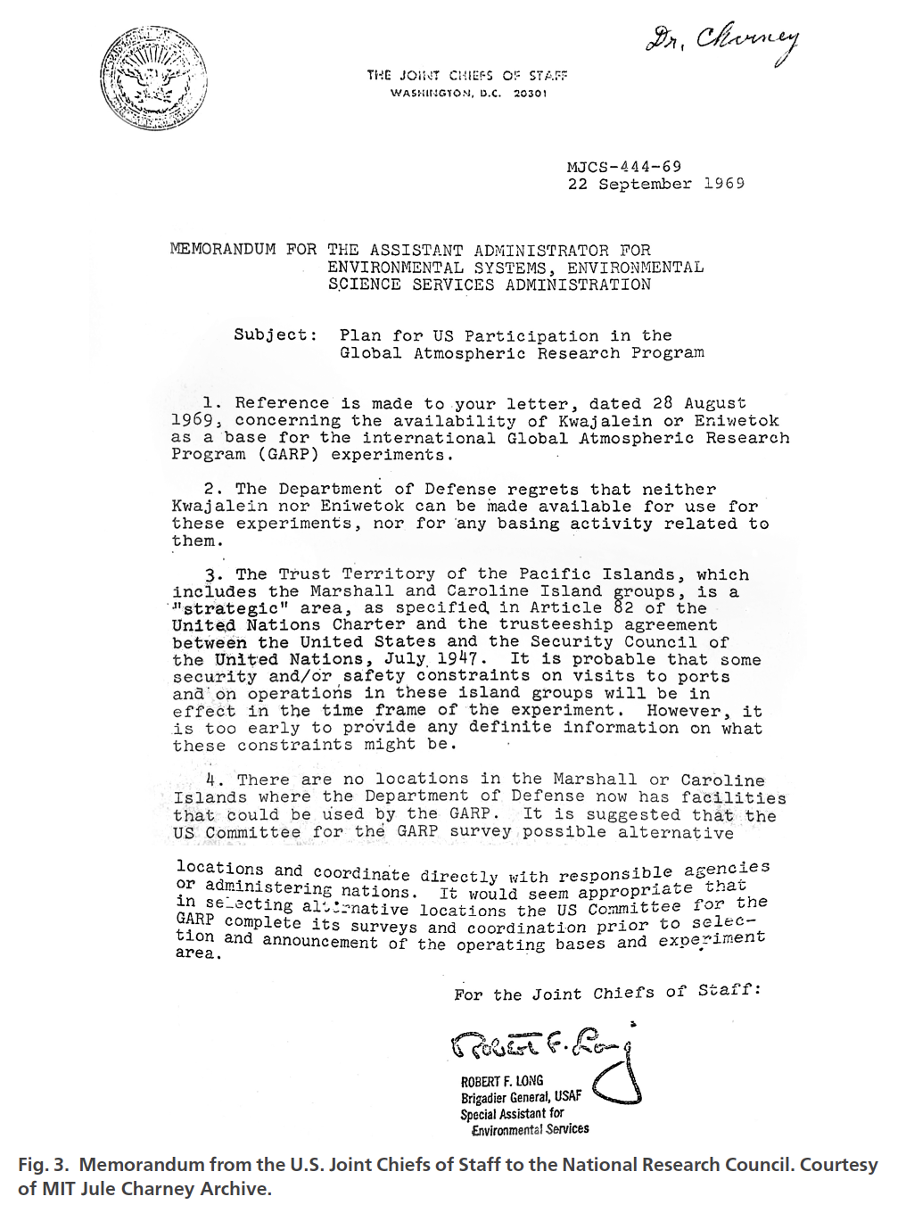

Slide 13
Postscript
20 N
EQ
20 S
150 W
120
90
60 W
30
0
30
60
90
120
150
GATE
1974
13 Aircraft
39 Ships
DYNAMO
2011-12
2 Aircraft
5 Ships
TOGA-
COARE
1992-93
7 Aircraft
9 Ships

Slide 14
End

