Slide 1
Dick Johnson’s Early Work on Mesoscale Convective Systems
Robert Houze
Richard Johnson Symposium, 102nd AMS Annual Meeting, January, 2022

Slide 2
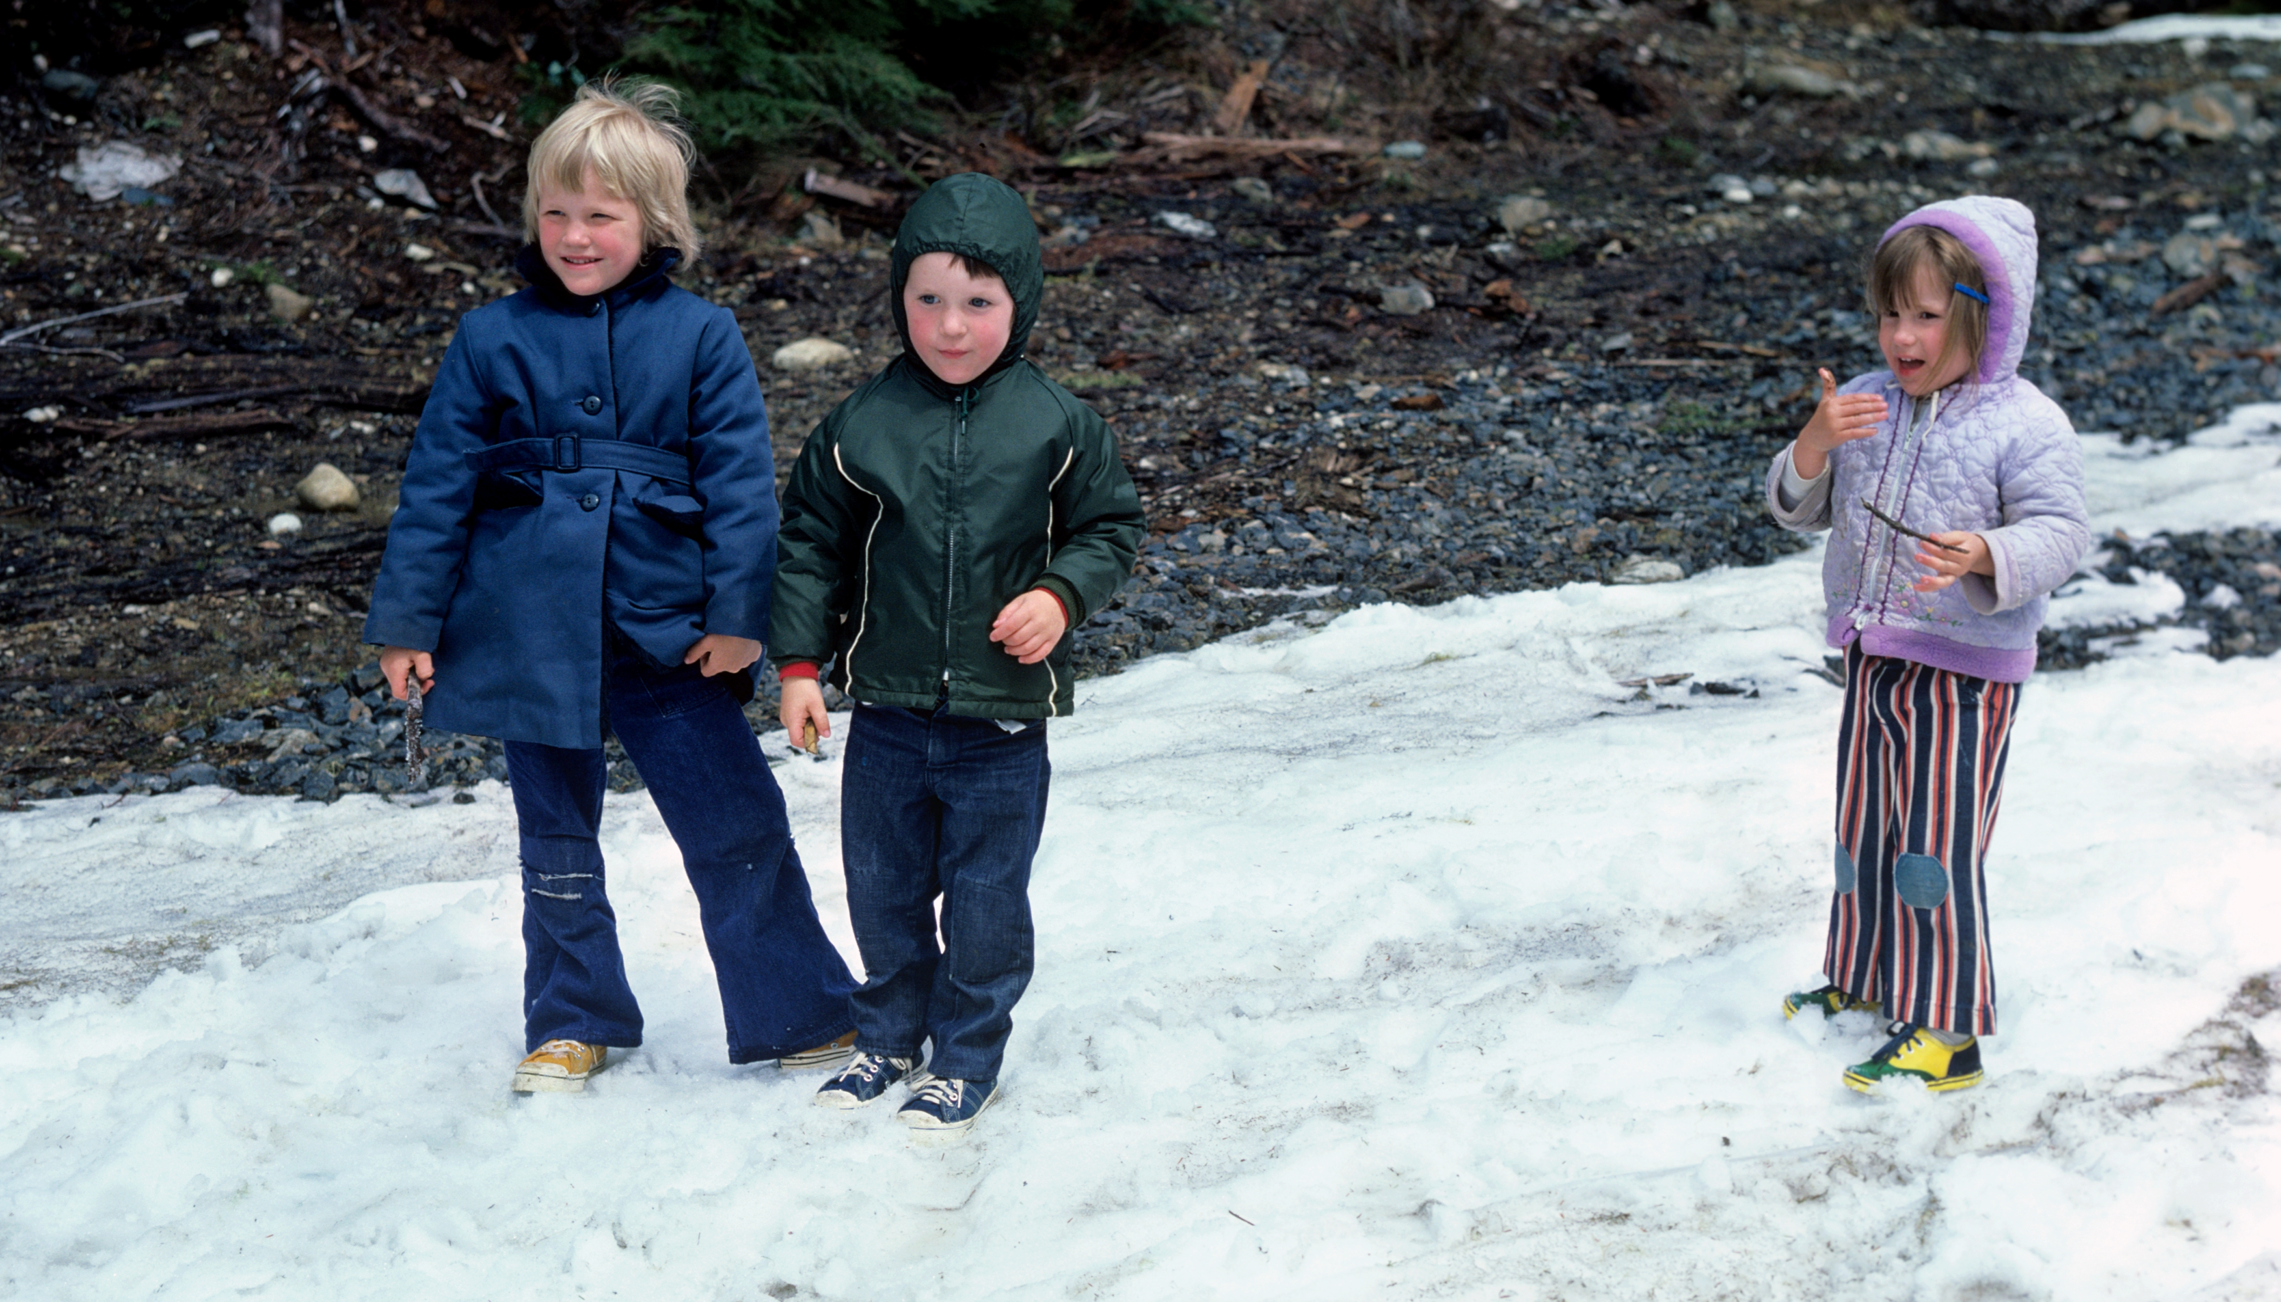
Houze
daughter
Johnson
children
1974

Slide 3

1975
Dick with 2nd Houze daughter

Slide 4
Since those early days, Dick’s work has contributed greatly to the current understanding of mesoscale convective systems (MCSs)

Slide 5
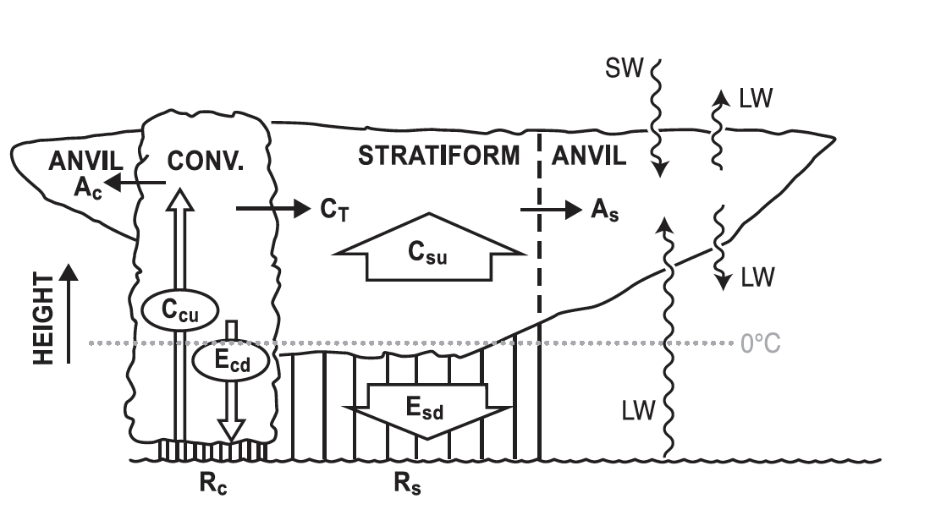
Current View of the Components of an MCS
Houze 2018

Slide 6
In the 1970s we weren’t sure about this part
Houze 2018

Slide 7
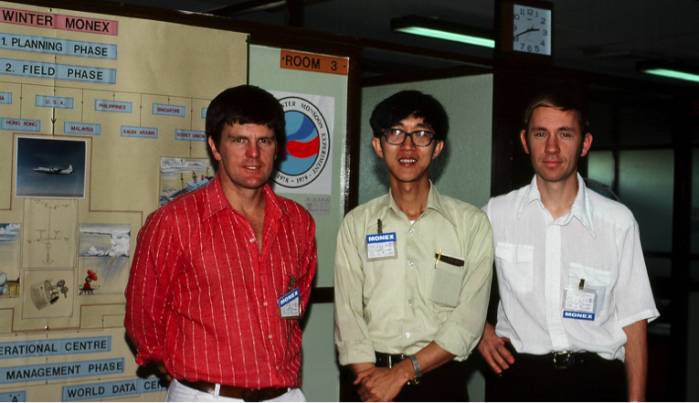
Winter MONEX 1978

Slide 8
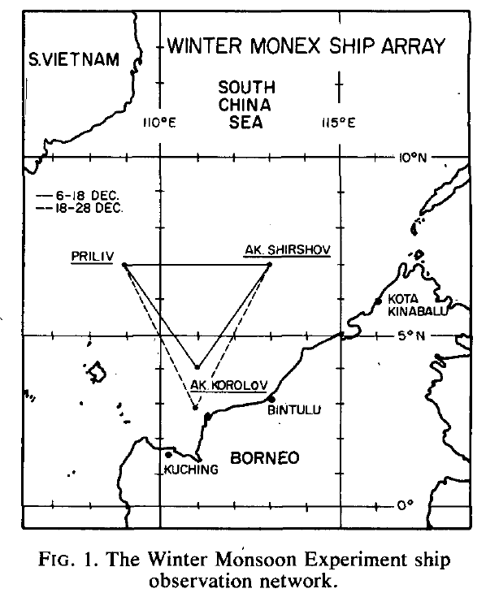
Soviet ships launching rawinsondes in Winter MONEX
Johnson and Priegnitz 1981
Bintulu

Slide 9
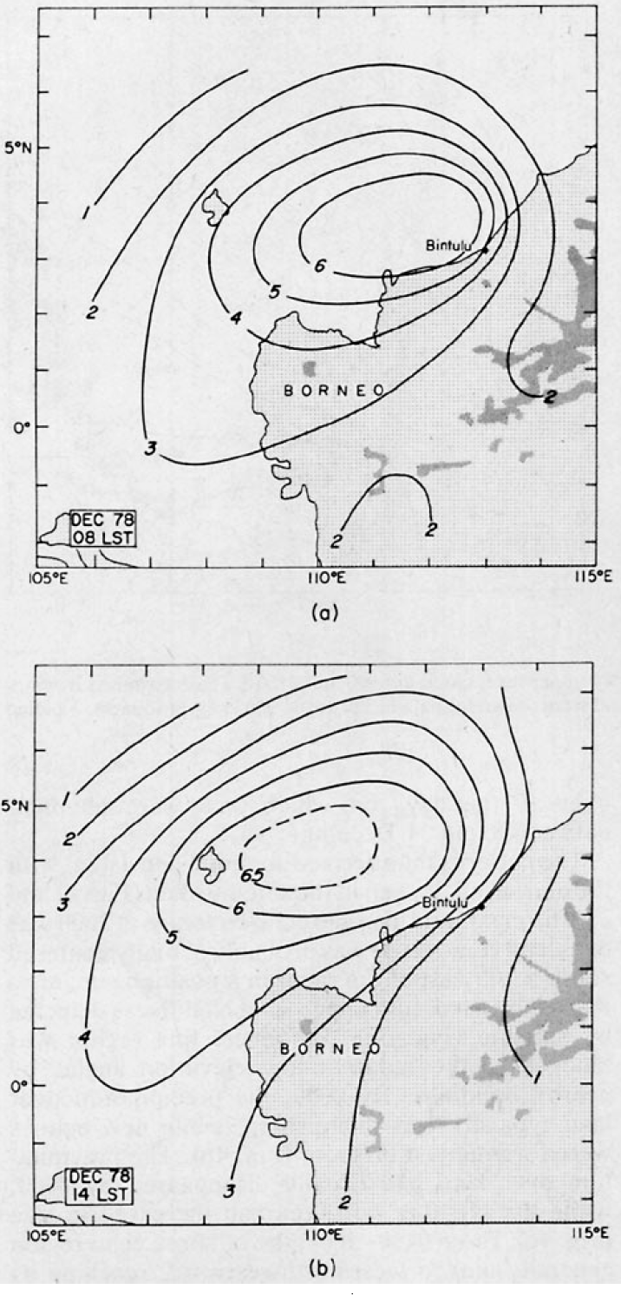
Winter MONEX ship array relative to satellite climatology of MCSs during midday
Bintulu
Houze et al. 1981

Slide 10
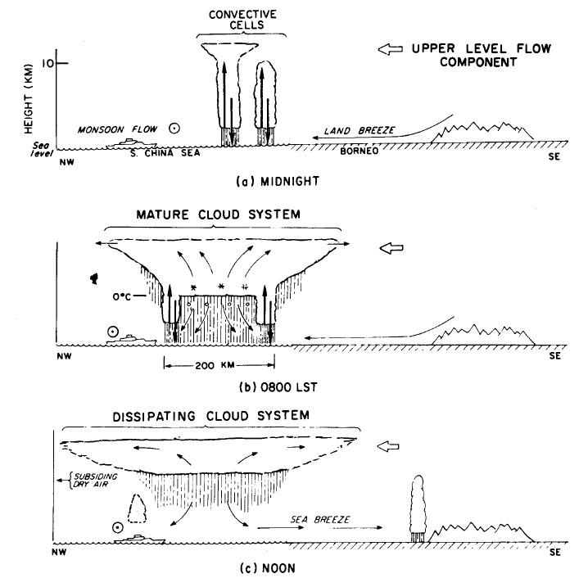

S. CHINA SEA
BORNEO
The Bintulu radar showed that MCS became dominated by its stratiform component as it moved out over the ship array
Bintulu
Stratiform Precipitation

Slide 11
Dick’s analysis of the vertical air motions in the Winter MONEX sounding network
84
Johnson 1982
84

Slide 12
Dick’s analysis of the vertical air motions in the Winter MONEX sounding network
84
First indication of upward motion in stratiform regions
Johnson 1982
84

Slide 13
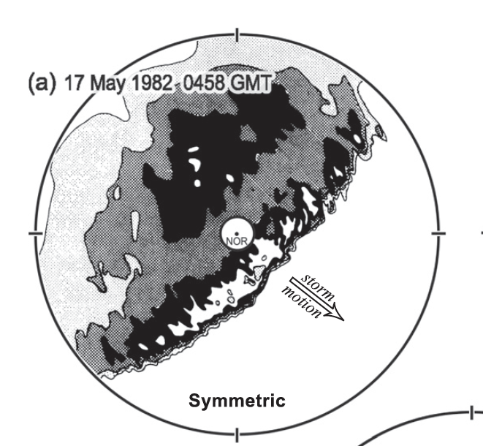
Leading-line/trailing stratiform structure of MCSs
240 km

Slide 14
Leading-line/trailing stratiform structure of MCSs
Cross section
240 km

Slide 15
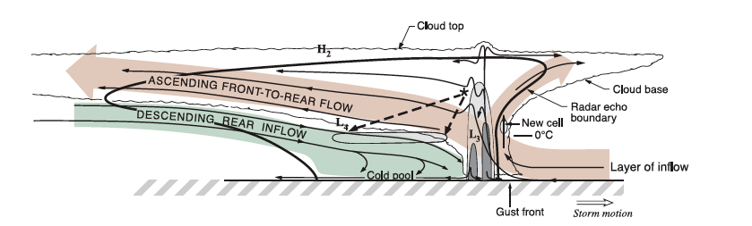
2D air motions in the cross section plane, circa 1990

Slide 16
Johnson’s work filled in 3D dynamics of stratiform region
240 km

Slide 17
2D air motions in the cross section plane, circa 1990
Boundary Layer

Slide 18
Boundary layer dynamics below the stratiform zone
Johnson and Hamilton 1988

Slide 19
The Midlevel Mesoscale Convective Vortex (MCV)
MCV

Slide 20
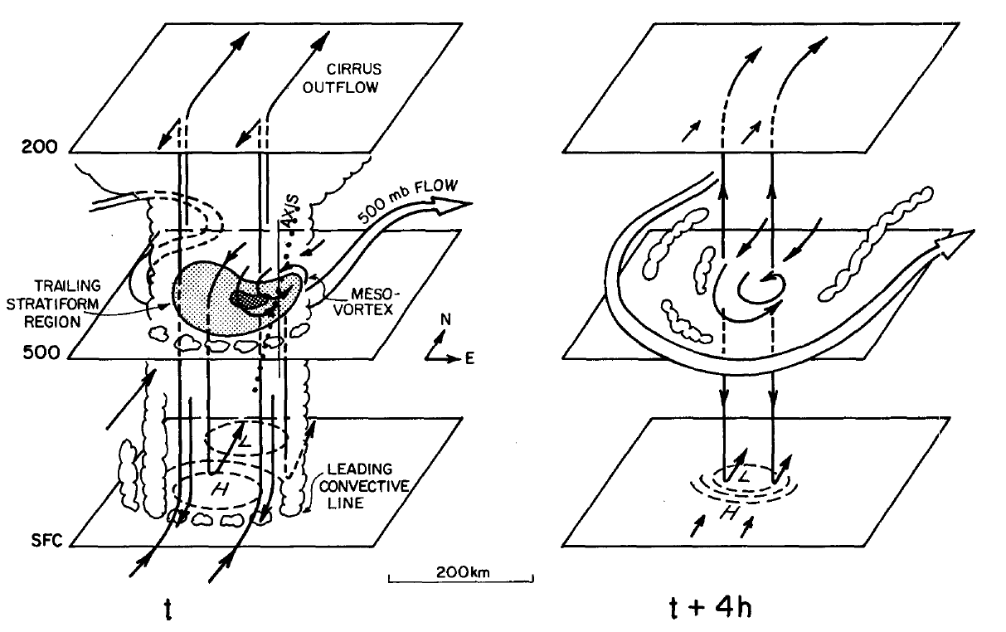
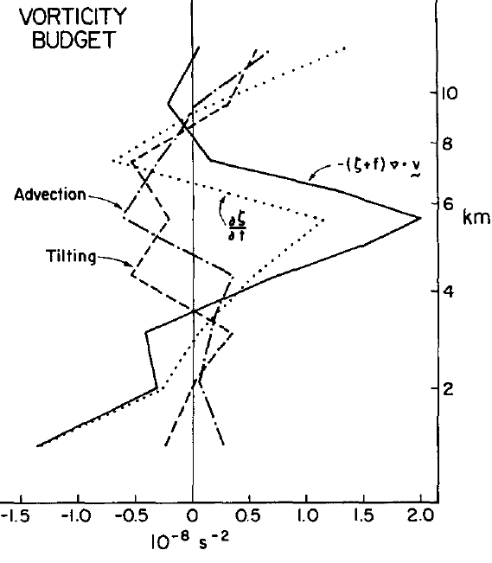
PRESTORM (1985)—Johnson and Bartels document an MCV
0°C

Slide 21
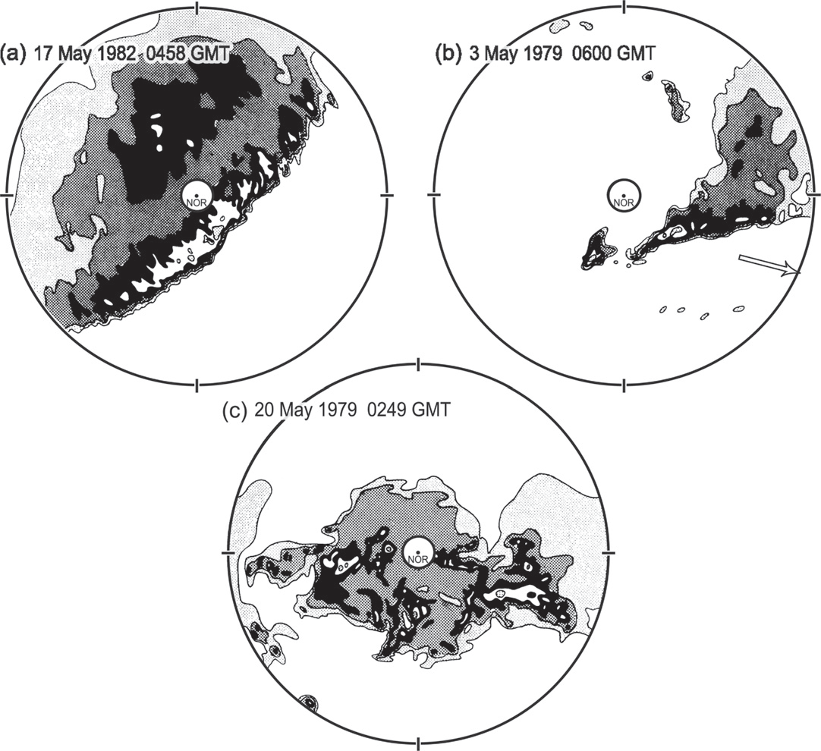
Houze et al. 1990
Various snapshots of convective and stratiform structure in midlatitude MCSs

Slide 22
Parker and Johnson 2000
Evolution of convective and stratiform structure in MCSs

Slide 23

Winter MONEX, 1978

Slide 24
Winter MONEX, 1978
Mesoscale Convective Systems
Cumulus Congestus
Trade Cumulus

Slide 25
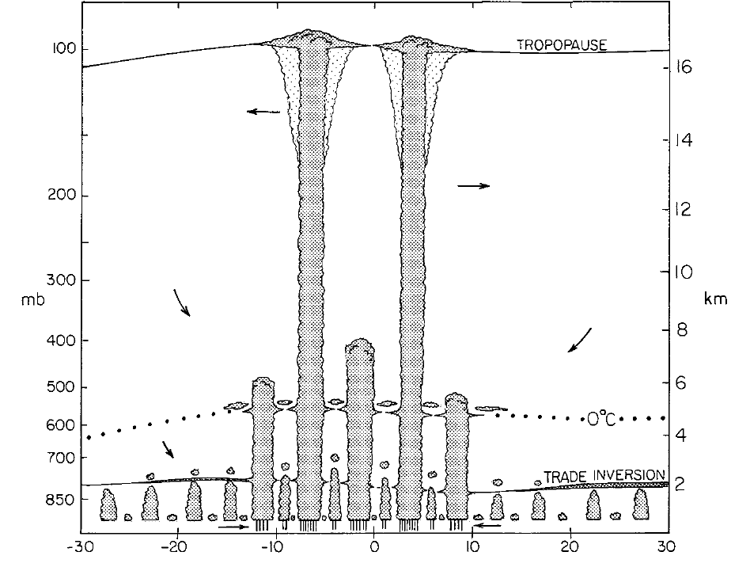
TOGA COARE 1992-3
Johnson et al. 1999 analyzed data from the sounding array from TOGA COARE 1992-3 to show the “trimodality” of tropical convection
MCSs
Congestus
Trade cumulus

Slide 26
These are just some examples of how Dick Johnson beginning with his earliest work nearly 50 years to a clearer and more quantitative view of mesoscale convective systems and their role in the overall spectrum of convective clouds

Slide 27
So…my thanks to Dick Johnson…for
Adding so much to our knowledge and understanding of mesoscale convective systems
Half a century of friendship

