Slide 1
Airborne Platform Requirements for Advancing Dynamics and Physics of Weather Forecasts
Robert Houze
University of Washington
NAS Future of NASA Aircraft Meeting, July 29-31, 2020
Notes:
I’ve been asked to set the stage for a discussion of the kind of aircraft that will be needed in the foreseeable future for research that will help numerical weather prediction…

Slide 2
My Experience
Field projects
ocean, land, tropics, midlatitudes, mountains
convection, tropical cyclones, fronts, orographic precipitation
A/C used
P3s, Electra, DC-8, Citation, ER-2, Global Hawk, + others
Satellites
TRMM, GPM, CloudSat
Notes:
My remarks are based on a half century of experience in observational research on high-impact weather systems around the world. I’ve done field projects over all the tropical oceans, over plains, over mountains, on three continents and both low and midlatitudes. I’ve used all the major aircraft platforms, and working with satellite programs understand how these field programs relate to remote sensing from space…

Slide 3
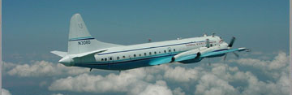
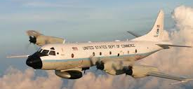
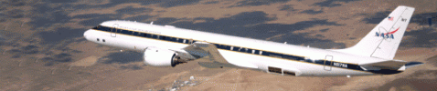
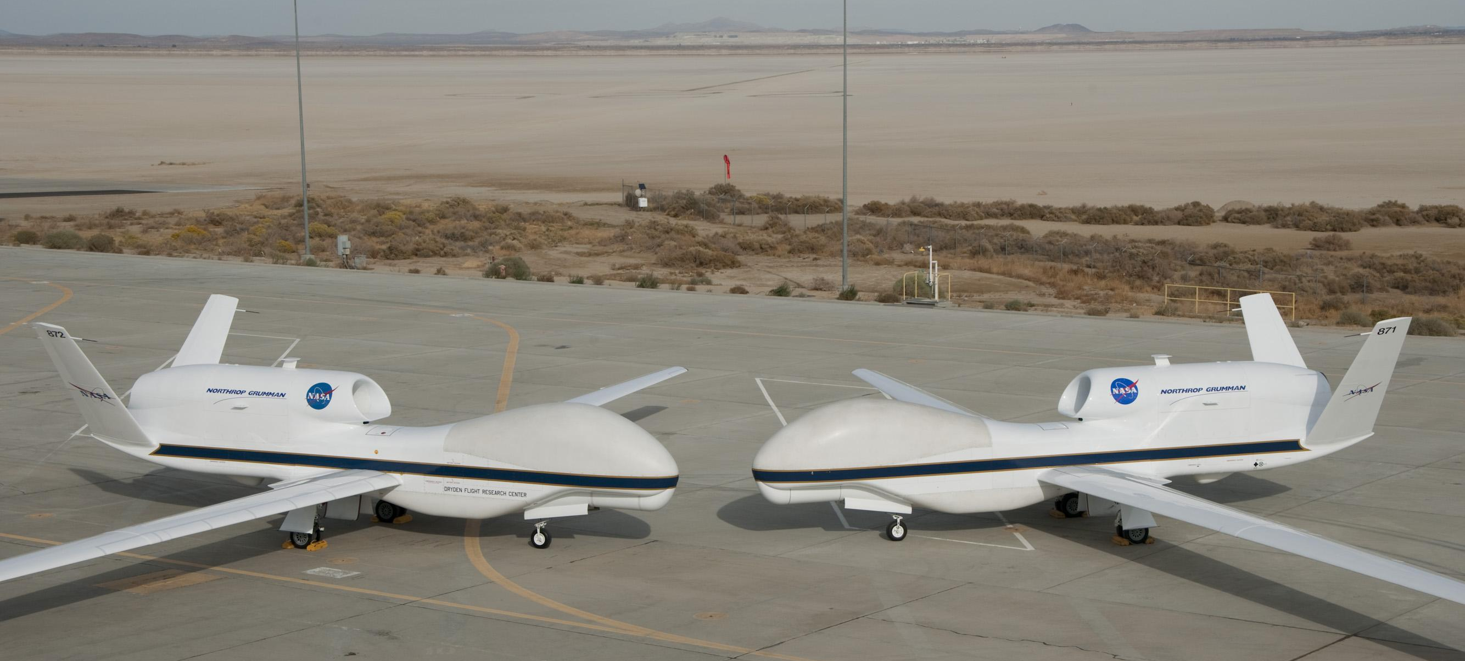


The Aircraft I have used
NOAA P3
NCAR Electra
NASA DC-8
NASA Global Hawk
NASA ER-2
North Dakota
Citation

Slide 4
Questions Regarding NASA Airborne Platforms to Advance Earth Science
What emerging science/research questions can be best addressed with large platforms as the airborne component for the integrated studies?
Which of these science questions might be well-suited to combinations of smaller platforms for their airborne component should a large platform not be available? What is the loss to science if the airborne component needed to be done through a combination of one or more smaller-sized aircraft?
How might newly available suborbital platforms (especially UASs and advanced technology balloons) similarly contribute to integrated studies addressing these scientific questions?
Notes:
These bullet points are the mandates for the committee organizing today’s workshop that relate to different types of aircraft and pose the question whether large aircraft are needed. They are, as you will see…

Slide 5
Aircraft Required for High-impact Weather Systems
Notes:
I’ve divided the discussion into two categories of problems of weather prediction: High-impact weather phenomena and Boundary layer weather phenomena…

Slide 6
Weather systems producing precipitation and severe weather
  Large convective clouds
  Mesoscale convective systems (MCSs)
  Tropical cyclones
  Frontal cloud systems
Notes:
I think it’s fair to say that these are the most prominent categories of high impact weather, which are all handled roughly well in numerical forecasting but are all in need of refinement in detail.

Slide 7
Outstanding questions affecting precise prediction of weather systems producing precipitation and severe weather:
  What factors determine sizes and lifetimes of storms?
  How are mesoscale motions induced within storms?
  What factors control the microphysical growth and fallout of precipitation particles?
  How do aerosols affect the structures and intensities of predicted storms?
Need comprehensive observations of weather systems to test prediction accuracy
Notes:
These are some outstanding questions that need addressing by aircraft

Slide 8
Scales of Weather Systems
Weather Phenomenon | Height Scale | Horizontal Scale | Time Scale
Convective cloud | 10-15 km | 10s of km | Hours Evolving ~ minutes
MCS | 10-15 km | 100s of km | 10s of hours, evolving ~ 1-10 minutes
Eyewall/rainband | 10-15 km | 100s of km | 10s of hours → day evolving ~ 1-10s of minutes
Frontal system | 10-15 km | 10-1000 km | 1-10 hours Evolving, 10s of minutes
Altitude range
1-15+ km
Flight duration
~10 hours
Notes:
To understand the essential characteristics of the A/C needed to document and study these systems, we have to consider the time and space scales of the phenomena…

Slide 9
Types of in situ measurements required
  T, p
  Water vapor—problematic but critical
  u, v
  w—very problematic, only can get extremes
  Drop size
  Ice particle types, sizes, and concentrations
    Ice crystal habits
    Aggregates (snow)
    Graupel
    Hail
Simultaneous in-cloud sampling
Robust A/C for icing, hail, lightning, turbulence
Notes:
Fundamental to A/C studies of these systems is in situ sampling of fundamental variables, which are interrelated and must be sampled simultaneously. E.g., note that the microphysical parameters are sensitive functions of T, that water vaper is needed to get the in cloud value of theta-e, and that as important as vertical velocity is, it is very difficult to measure when the values drop below 1-2 m/s, and most w’s in storms are of these lower values. A/C must be robust for in cloud sampling.

Slide 10
Types of remote sensing measurements required
  Targeting—
    On board radar
    Ground-based radar
    Satellite imagery
  Spatial distributions—
    Precipitation particles (X, Ku, Ka band radars)
    Cloud particles (W band radar)
    Wind components (u, v, w Doppler radar)
    Particle types (dual-polarized radar)
Payload sufficient for radars
Notes:
In situ sampling only provides occasional spot values of variables. To put the in situ data into the context of the overall storm remote sensing by radar is essential. Payloads must include radars.

Slide 11
DC-8 flight with APR3 radar over the Olympic Mountains in OLYMPEX in 2015
Three different radar frequencies used to show how mountains affected the frontal storm
Provided context for smaller citation aircraft to sample microphysics at different altitudes

Slide 12
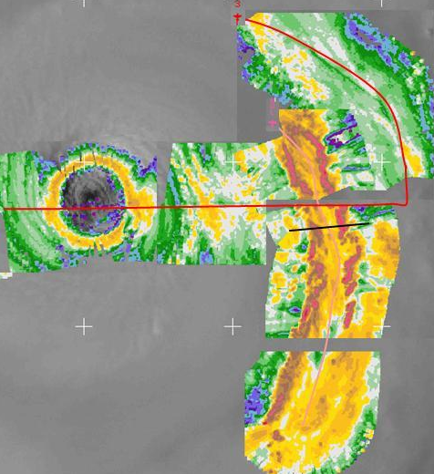
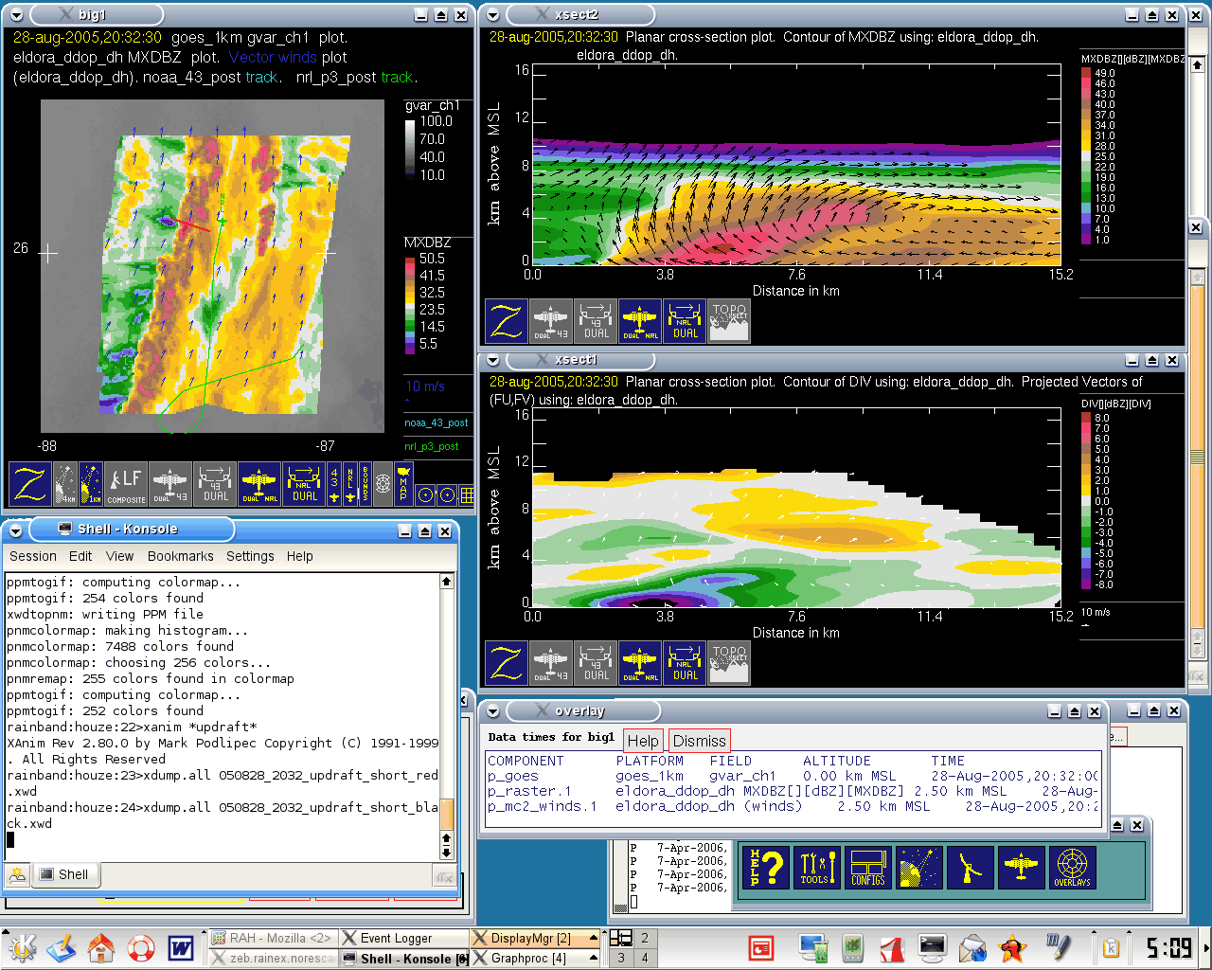
Two P3s flying in Hurricane Katrina (2005)
Scanning radars on the NOAA P3 targeted the principal rainband
Guided by targeting of the scanning radars, the NCAR Eldora radar on a Navy P3 provided unprecedented documentation of the rainband
NOAA P3
ELDORA data
Eldora radar cross section
Eldora

Slide 13
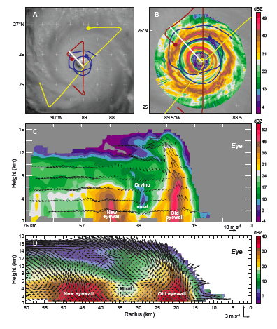
Three P3s flying in Hurricane Rita during eyewall replacement
Scanning radars on the NOAA P3s targeted the eyewall replacement
Guided by targeting of the scanning radars, the NCAR Eldora radar on a Navy P3 provided unprecedented documentation of the eywall replacement

Slide 14
Types of environmental measurements required
  Dropsondes
  Aerosol sampling
  Lidar for aerosol spatial distribution and concentration
  Lidar for environmental air motions
  Boundary layer T, water vapor, turbulence
Payload sufficient for lidars & aerosol sampling
Notes:
Sampling of storms without knowing the environment characteristics is of reduced value. Therefore the environmental profiles of thermo, wind, and aerosol are needed. The environment below cloud base is also needed, especially for convection and TCs

Slide 15
Summary for High-Impact Weather Aircraft
Types of research aircraft required for high-impact weather systems
  Long duration (~10 hour flights)
  Wide range of altitude capability (up to at least 15 km)
  Robust airframe (flying in icing and turbulent conditions)
  Payload capable of handling radars and lidars
Important supplementary roles for smaller aircraft
Penetration of very intense updrafts and downdrafts
Sampling of hail
  Sampling of environmental aerosol
  Sampling of sub-cloud layer phenomena (e.g., cold pools)
Notes:
To summarize….
Note that the primary, essential large A/C can be usefully supplemented by highly specialized smaller A/C

Slide 16
Aircraft Required for Boundary-layer Weather Events
Notes:
Now, let’s look at what A/C are needed for BL weather…

Slide 17
Boundary-layer phenomena challenges in weather prediction
  Large oceanic stratus fields
  Arctic stratus
  Fog episodes
  Aerosol concentration and types
  Sub-cloud layer turbulence in areas of convective clouds
  Sea-spray and turbulence in tropical cyclones
  Air pollution events
Notes:
Several kinds of important weather forecast challenges are found in BL weather…

Slide 18
Aircraft requirements for boundary layer weather phenomena
  Altitude
    Only about 1-2 km
  Flight duration
    Large range required, ~10 hour flights
  Payload
    Radiation measurement
    Turbulence
    Radar
    Lidar
    Cloud microphysical sampling
    Aerosol sampling—type, concentrations
  Potentially harsh flight conditions
    Possible icing in some situations
    Turbulence in tropical cyclone boundary layer
Notes:
More will be discussed on this topic in a later talk by Rob Wood, but we can note here that except for altitude the requirements for a large A/C are similar to those for high-impact weather events.

Slide 19
Summary for Boundary-layer Weather Aircraft
Types of research aircraft required for boundary-layer weather systems
  Long duration (~10 hour flights)
  Robust airframe (flying in icing and turbulent conditions)
  Payload capable of handling radars and lidars
  Low-altitude flying
Important supplementary roles for smaller aircraft or UASs
  Radiation
  Profiling of T and water vapor
Notes:
To summarize, large A/C is needed for BL weather systems. But there are important supplementary roles for smaller A/C or UASs.

Slide 20
Take Home Message from RAH
Large A/C are necessary for duration, altitude, targeting, and payload requirements
Smaller A/C are important for supplementary roles
Notes:
To summarize, large A/C is needed for BL weather systems. But there are important supplementary roles for smaller A/C or UASs.

Slide 21
Discussion Topics
How best to do targeting to optimize measurements
Should NASA think of large a/c for remote sensing and smaller a/c for:
  Low level boundary layer sampling
  Penetration of upper level clouds for microphysics and vertical velocity measurement
Notes:
To summarize, large A/C is needed for BL weather systems. But there are important supplementary roles for smaller A/C or UASs.

Slide 22
