Slide 1
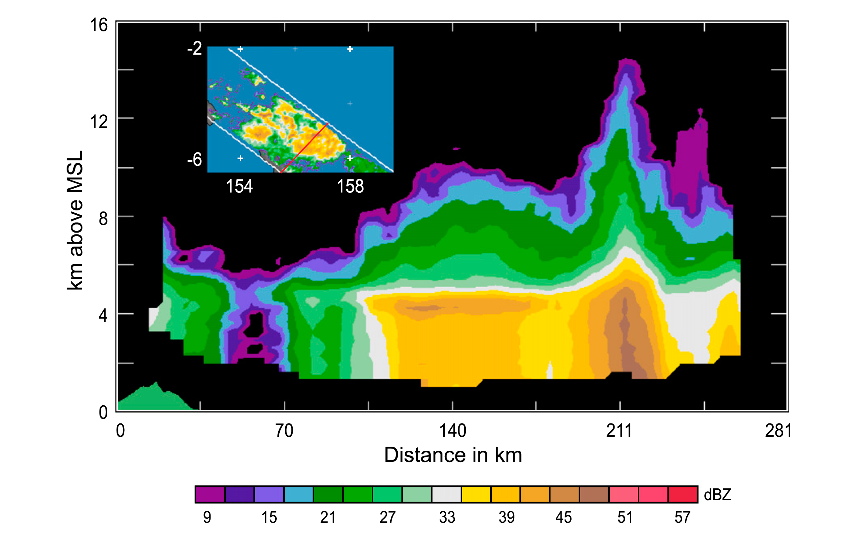
100 Years of Research on Mesoscale Convective Systems
Robert A. Houze, Jr.
100th Annual Meeting, American Meteorological Society, Boston, 14 January 2020
Notes:
To talk about the history of MCS research, we first must…define an MCS

Slide 2
What is an MCS?
Notes:
…define an MCS

Slide 3
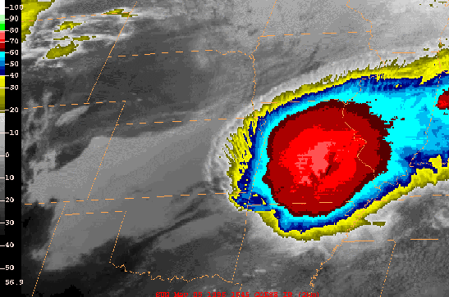
“Big as Iowa”
lowa
Nebraska
MCS
Kansas
Missouri
Oklahoma
Arkansas
Notes:
Size of state of Iowa…~500 km
Such systems turn out to be major rain producers
And play and important role in heating of the upper troposphere.
(this example is from May 5, 1996)

Slide 4
This talk:
Observational History of MCSs
Notes:
The story begins in a work of quasi-fiction…

Slide 5
1883
Notes:
The story begins in a work of quasi-fiction…

Slide 6

“The fifth night below St. Louis we had a big storm after midnight, with a power of thunder and lightning, and the rain poured down in a solid sheet.”…Mark Twain
Notes:
Mark Twain worked on a riverboat on the Mississippi River.
We now know that MCSs have a diurnal cycle over the central U.S. where they form east of the CD and move out at night over the Midwest

Slide 7
1945
WWII Nigeria
Notes:
For the more scientific documentation we jump to WWII

Slide 8
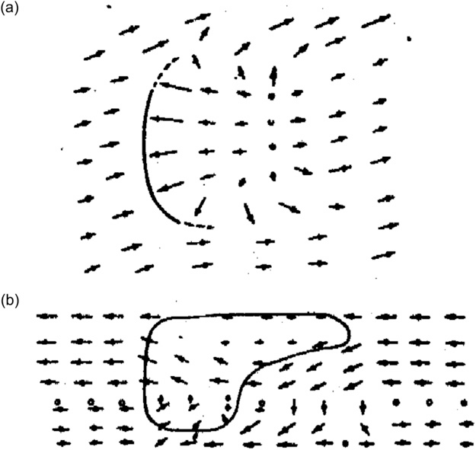
Hamilton and Archbold 1945
Horizontal
mesoscale circulation
Vertical
~100+ km
Notes:
H and A recognized that some convective systems had a circulation on the mesoscale

Slide 9
1950’s
Frontal Confusion in the U.S.
Notes:
In the early 50s—polar front theory was dominating meteorology and since MCSs were often triggered by or near fronts—the literature was pretty confused until…

Slide 10
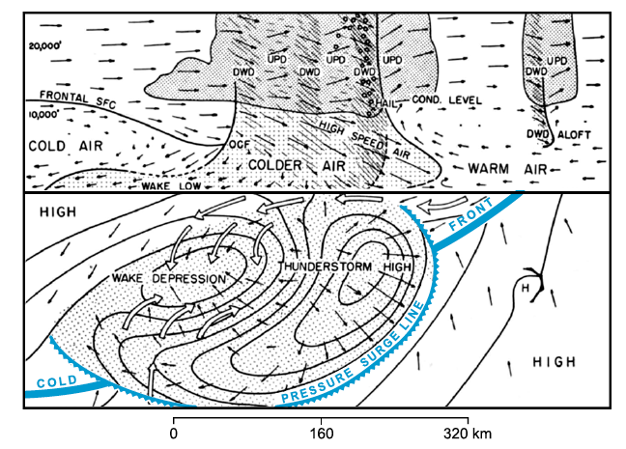
Fujita 1955
Notes:
Fujita noted that fronts triggered MCSs along fronts
Once formed—MCS dynamics dominated that portion of the synoptic system

Slide 11
Also in the 1950’s:
Radar comes of age
Notes:
Also in the 1950’s…radar came of age as a meteorological tool

Slide 12
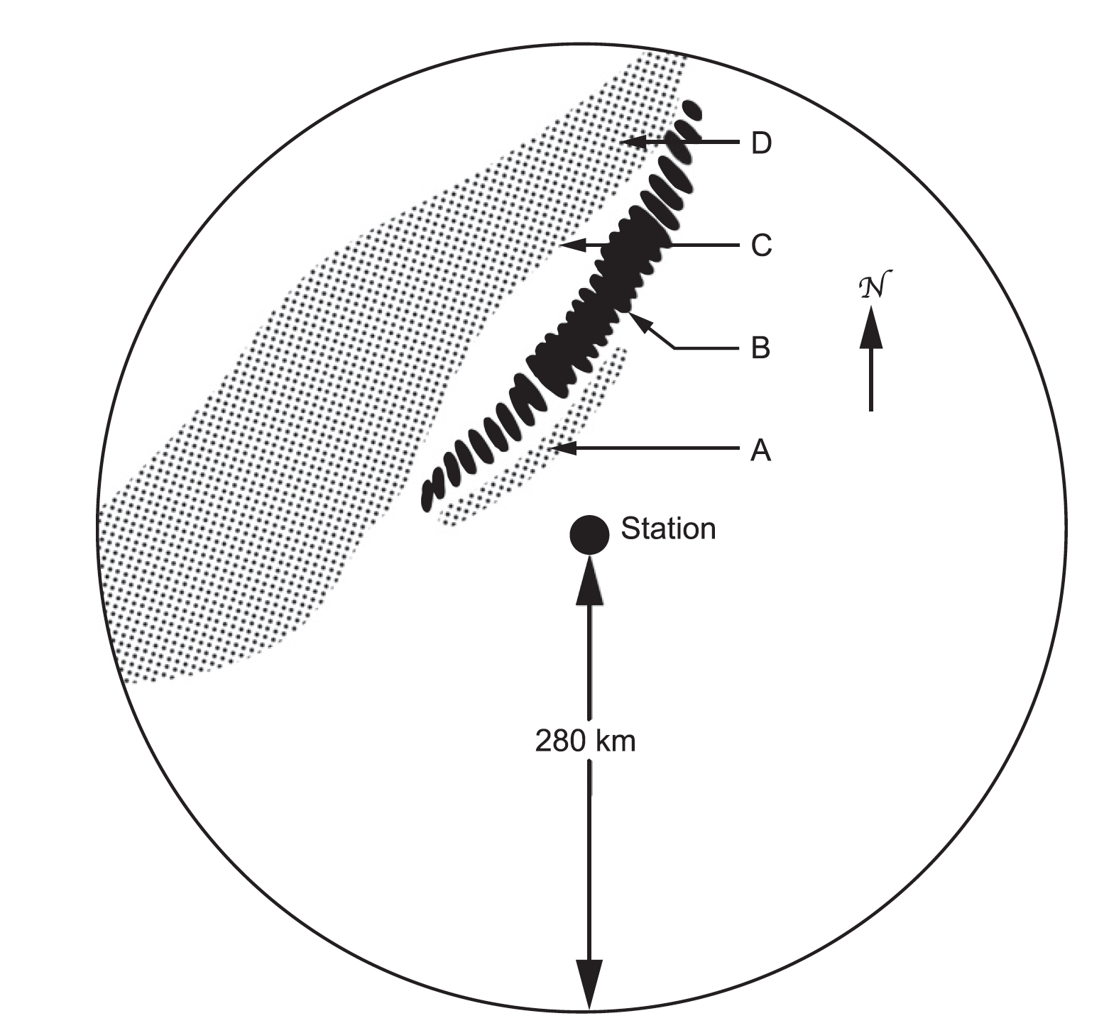
M. G. H. Ligda 1956
Convective line
From the proceedings of a conference of glider pilots!
Fine line
Stratiform region
Notes:
One of the least recognized figures in radar and meso meteorology was Myron G. H. Ligda…

Slide 13
Early 1960’s-early 1980’s:
Satellite era begins

Slide 14
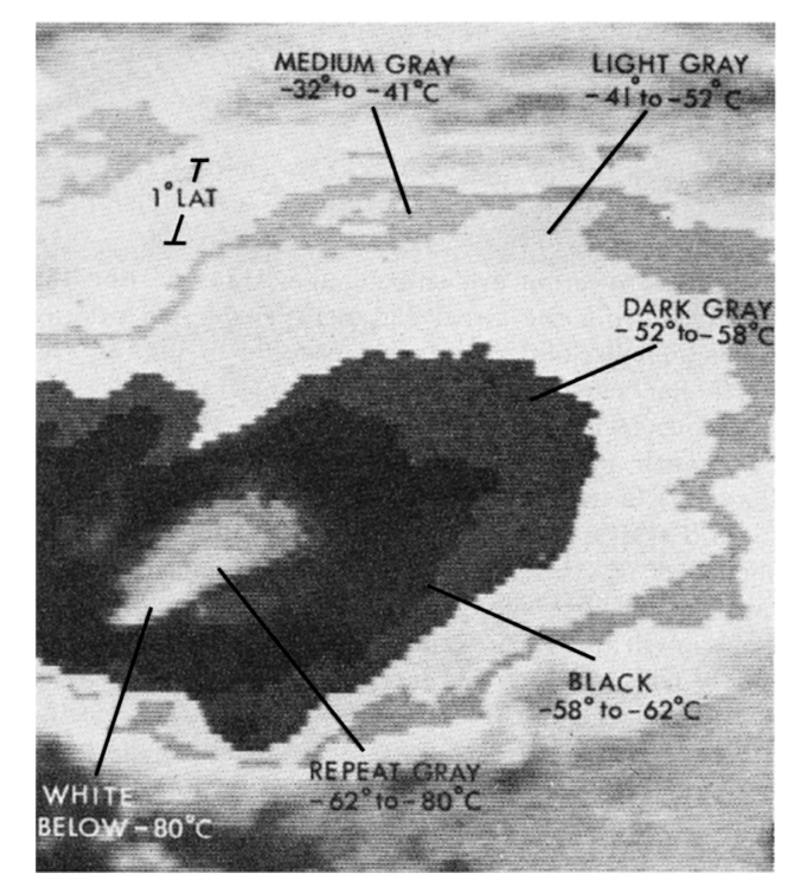
Maddox 1980
“MCC”
The coldest & widest of the MCS family
Notes:
One of the first to capitalize on satellite obs was Bob Maddox
Identified the coldest and widest—i.e. most extreme of the MCS family

Slide 15
1974
The Global Atmospheric Research Programme’s Atlantic Tropical Experiment (GATE)
Notes:
By 1974 radars and satellites were established just in time for the most massive field program ever in atmospheric sciences—GATE
And much of what we now know about MCSs was established in that project

Slide 16
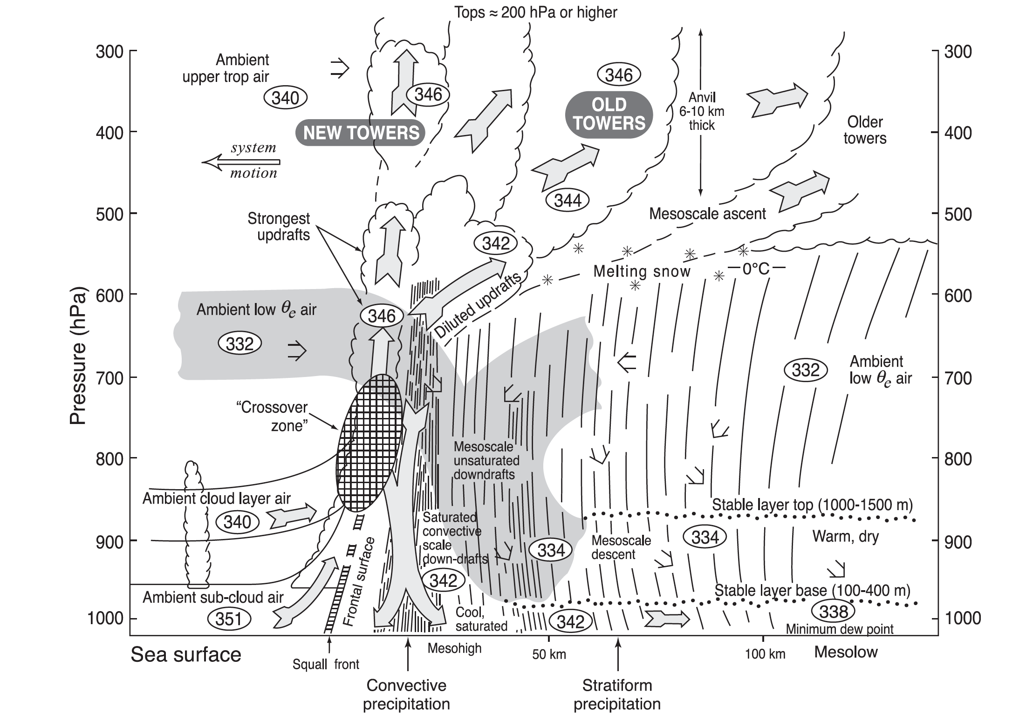
Zipser 1977
Cloud base
Notes:
Zipser created this classic portrait of an MCS based on GATE data
The conceptual model identifies a key element that came to be appreciated in GATE—”stratiform precipitation” extending over a wide portion of the MCS

Slide 17
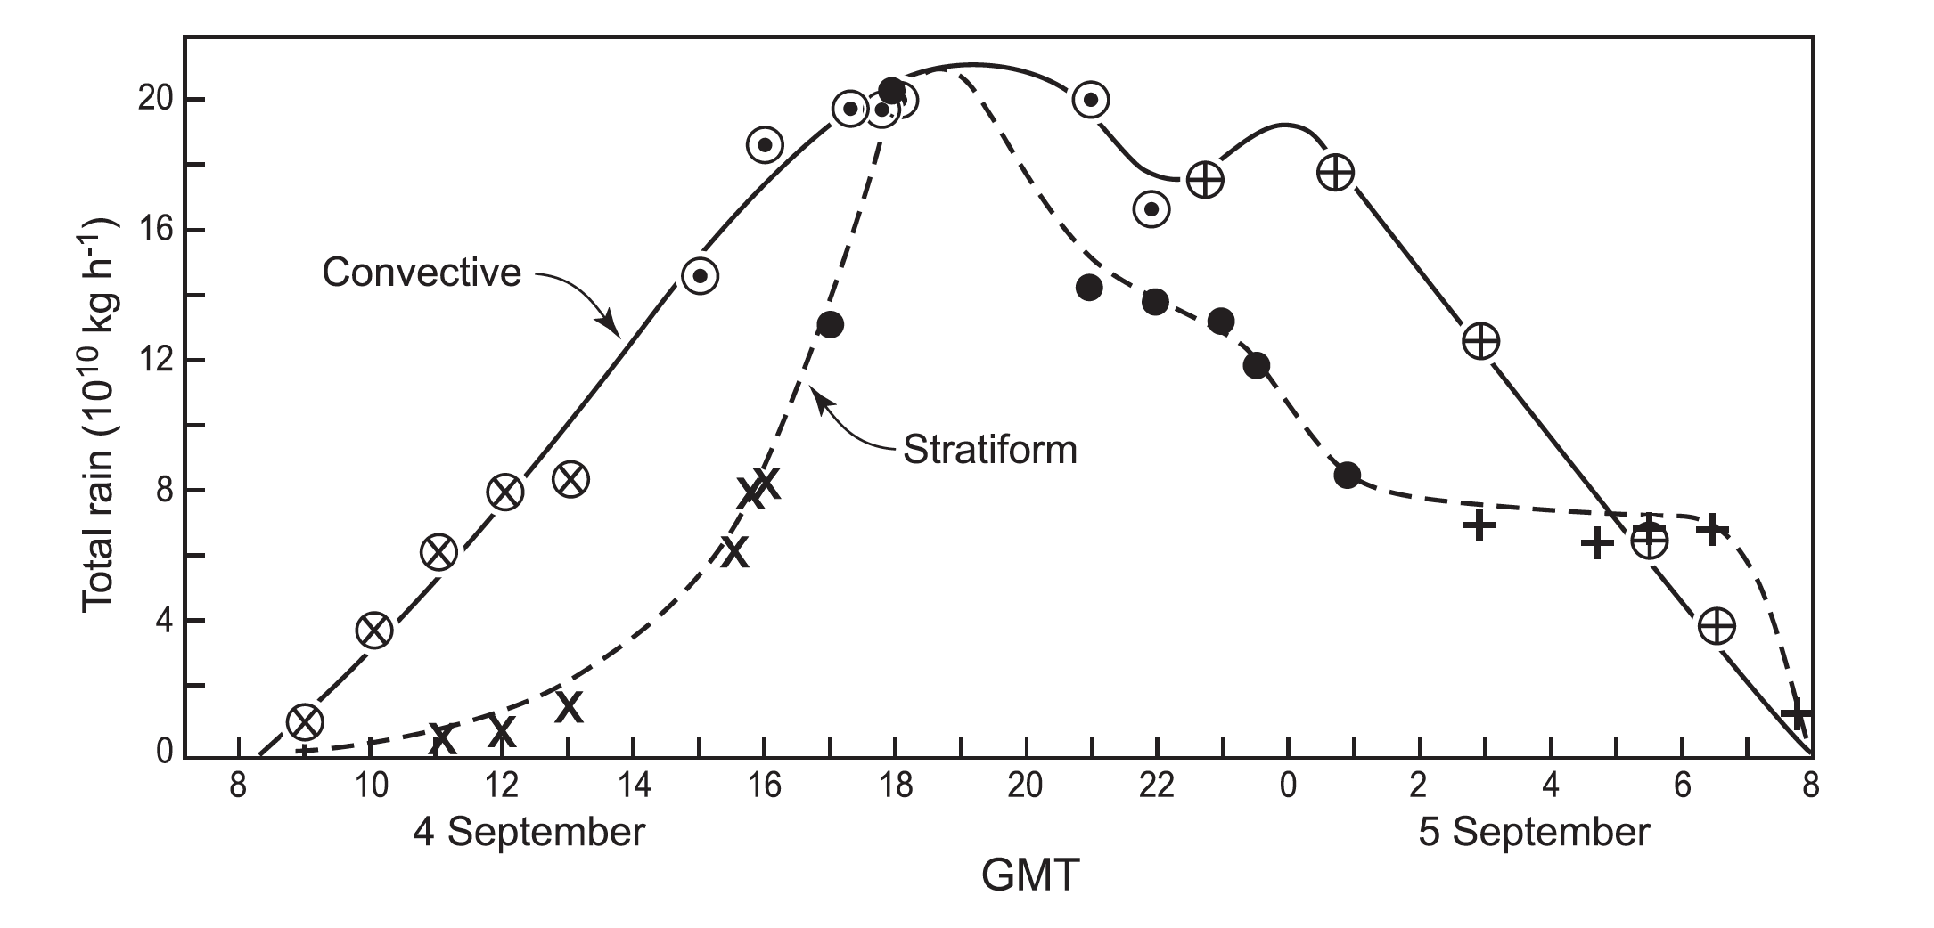
Houze 1977
The stratiform precipitation is quantitatively as important as the convective precipitation!
Notes:
The shipboard radars were able to determine that the stratiform component was a quantitatively important
As in the example shown here, ~50% of the rain from an MCSs could be and often was stratiform

Slide 18
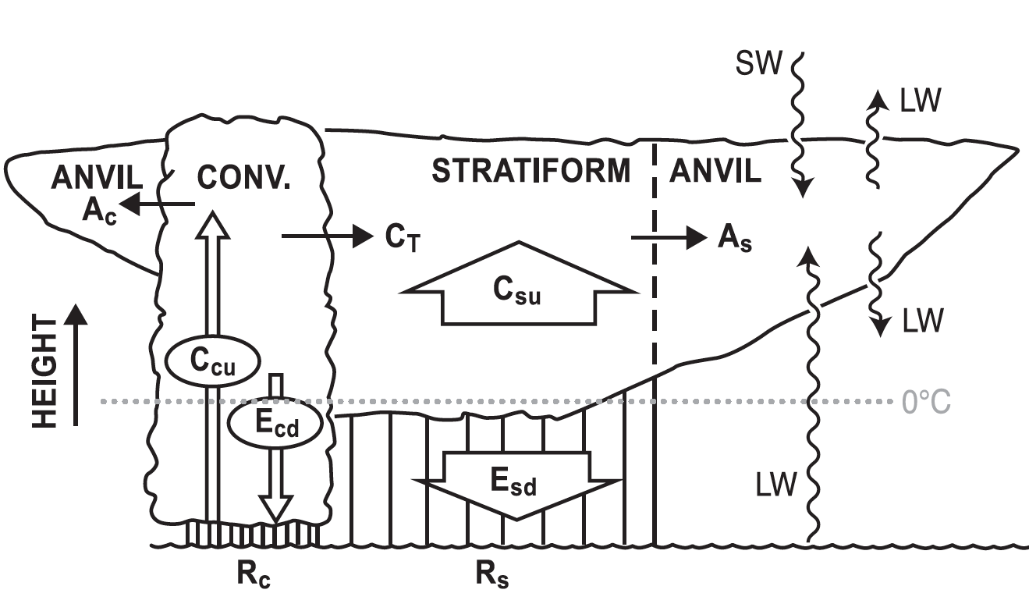
PV Generation
Heating concentrated aloft
Based on Houze et al. 1980
Notes:
This is important because in the SF region the latent and radiative heating is concentrated aloft

Slide 19
1980’s-1990’s
The era of Doppler radar
Notes:
The 80s and 90s were the period in which Doppler radar observations came of age and added information beyond that from GATE

Slide 20
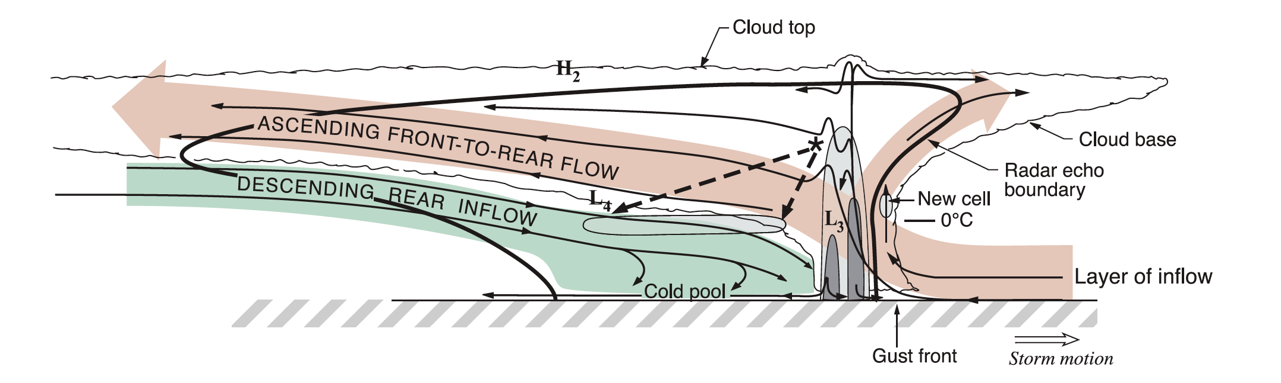
Mesoscale Overturning
Based on results from the 1985 PRESTORM Project
Houze et al. 1989
Notes:
Doppler data showed that the circulation in an MCS is fundamentally mesoscale, which deep convective elements superimposed.
This mesoscale circulation was what had been demonstrated by Moncrieff to be a simultaneous adjustment of the MCS to the profiles of temperature, moisture, and wind in the environment
Often this picture is interpreted as fundamentally 2D…..HOWEVER….

Slide 21
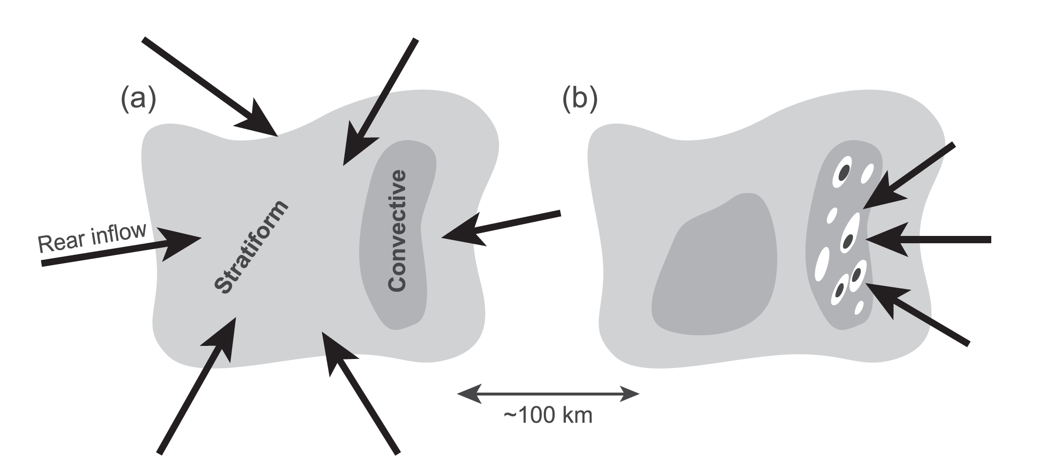
Three dimensionality
Based on results from the 1992-3 TOGA COARE Project
Houze 1997
Notes:
In the 1992-3 TOGA COARE project, ship and aircraft dual Doppler measurements showed that the mesoscale circulation in an MCS was often #D, with the midlevel inflow into the SF region coming from whatever direction was dictated by the large-scale environment

Slide 22
21st Century

Slide 23
Satellite-borne sensors on TRMM and A-Train

Slide 24
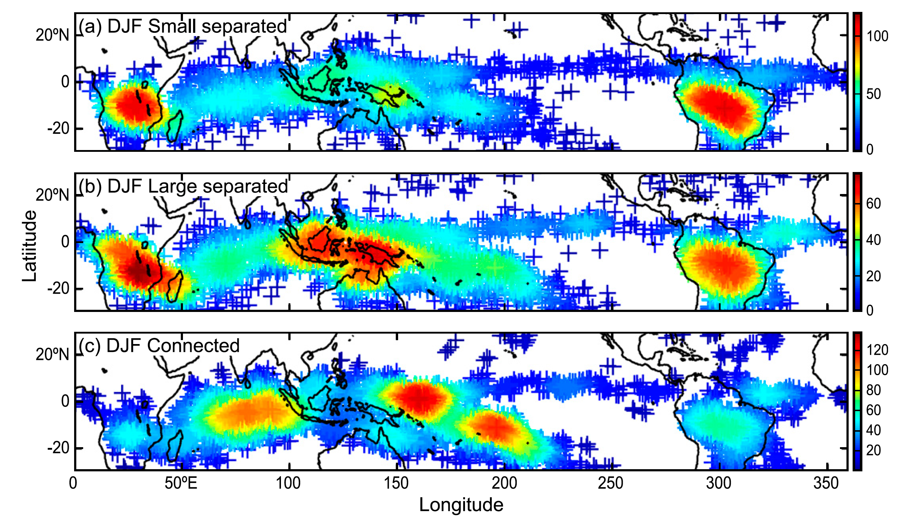
A-Train showed patterns of MCS occurrence
IR cloud plus Passive Microwave precipitation sensors
Yuan and Houze 2010
Notes:
Implies the PV generation have global influence

Slide 25
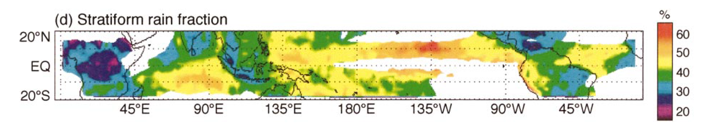
TRMM precipitation radar mapped the stratiform rain fraction
Implied PV generation in SF regions could have global influence
Schumacher and Houze 2003

Slide 26
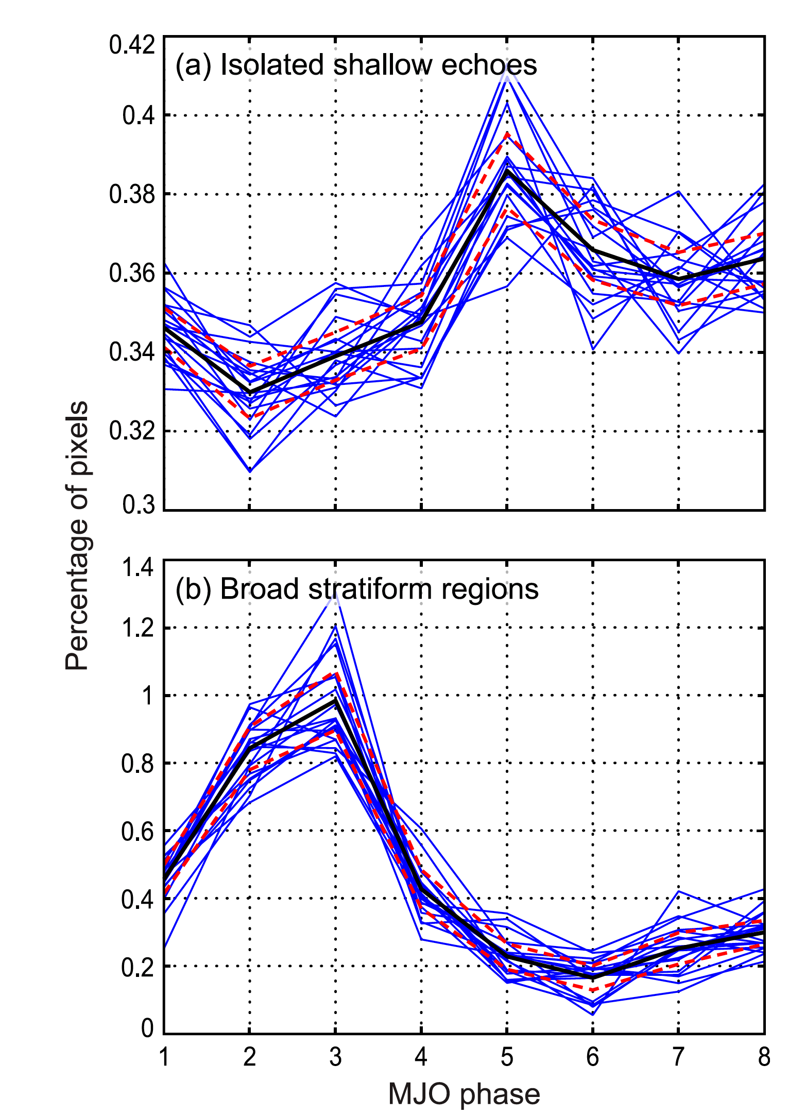
MCSs and the MJO
Percentage of pixels
Active
Suppressed
Barnes and Houze 2013
MJO Phase

Slide 27
Observations that I don’t have time to discuss
Ocean/land differences
Boundary layer interactions
Midlatitude vs tropics
Implications for severe weather and hydrology
MCSs in tropical cyclogenesis
Relationship to mountain ranges
MCSs in the Asian monsoon
Diurnal cycle effects
Cloud and precipitation microphysics

Slide 28
This talk has illustrated how…
Like many phenomena in science the knowledge of MCSs has followed the progression of observational technology
Following the observations have come…
Detailed modeling and insightful theory to better understand these phenomena

Slide 29
Future challenges for modeling and theory:
Inclusion of MCSs and their effects in global models
Changes in patterns of occurrence of MCSs
Aerosol effects on MCSs
Thank you!

Slide 30
Thank you!

Slide 33
Extra Slides

Slide 34
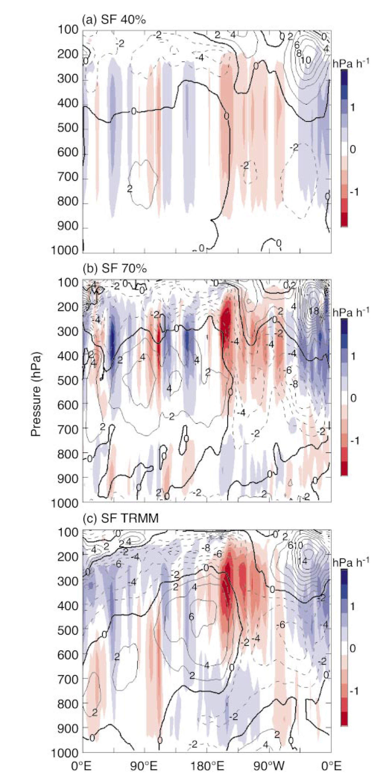
MCSs and 1998 El Niño
Horizontally uniform heating pattern
Heating profile variation across tropics—as suggested by TRMM
From Schumacher et al. 2004

Slide 35
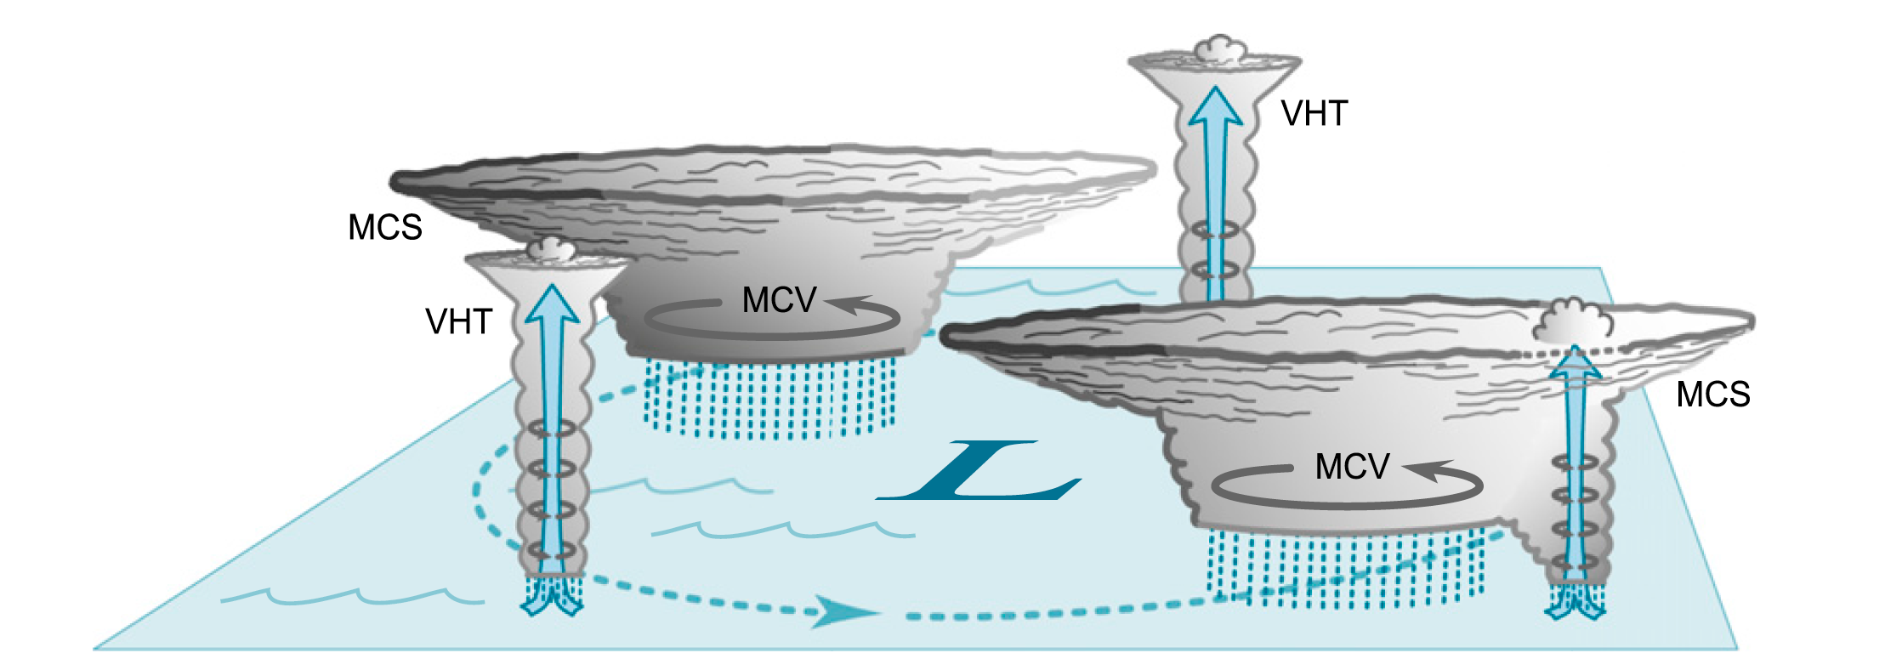
MCSs and tropical cyclones
Houze et al. 2009

Slide 36
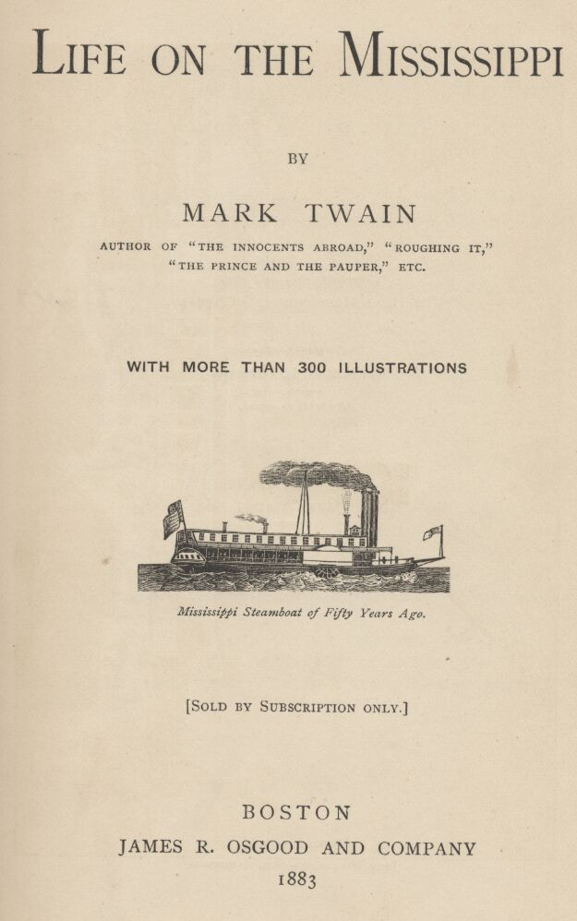
“The fifth night below St. Louis we had a big storm after midnight, with a power of thunder and lightning, and the rain poured down in a solid sheet.”…Mark Twain

Slide 37
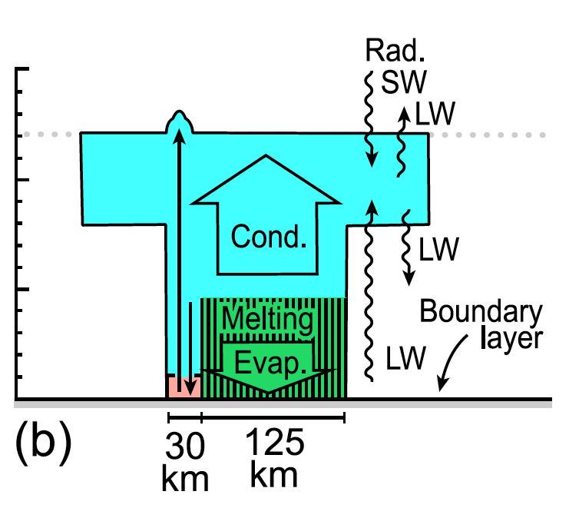

Slide 38
Doppler, Midlevel Inflow, Mesoscale Overturning, PV generation, Boundary Layer

Slide 39
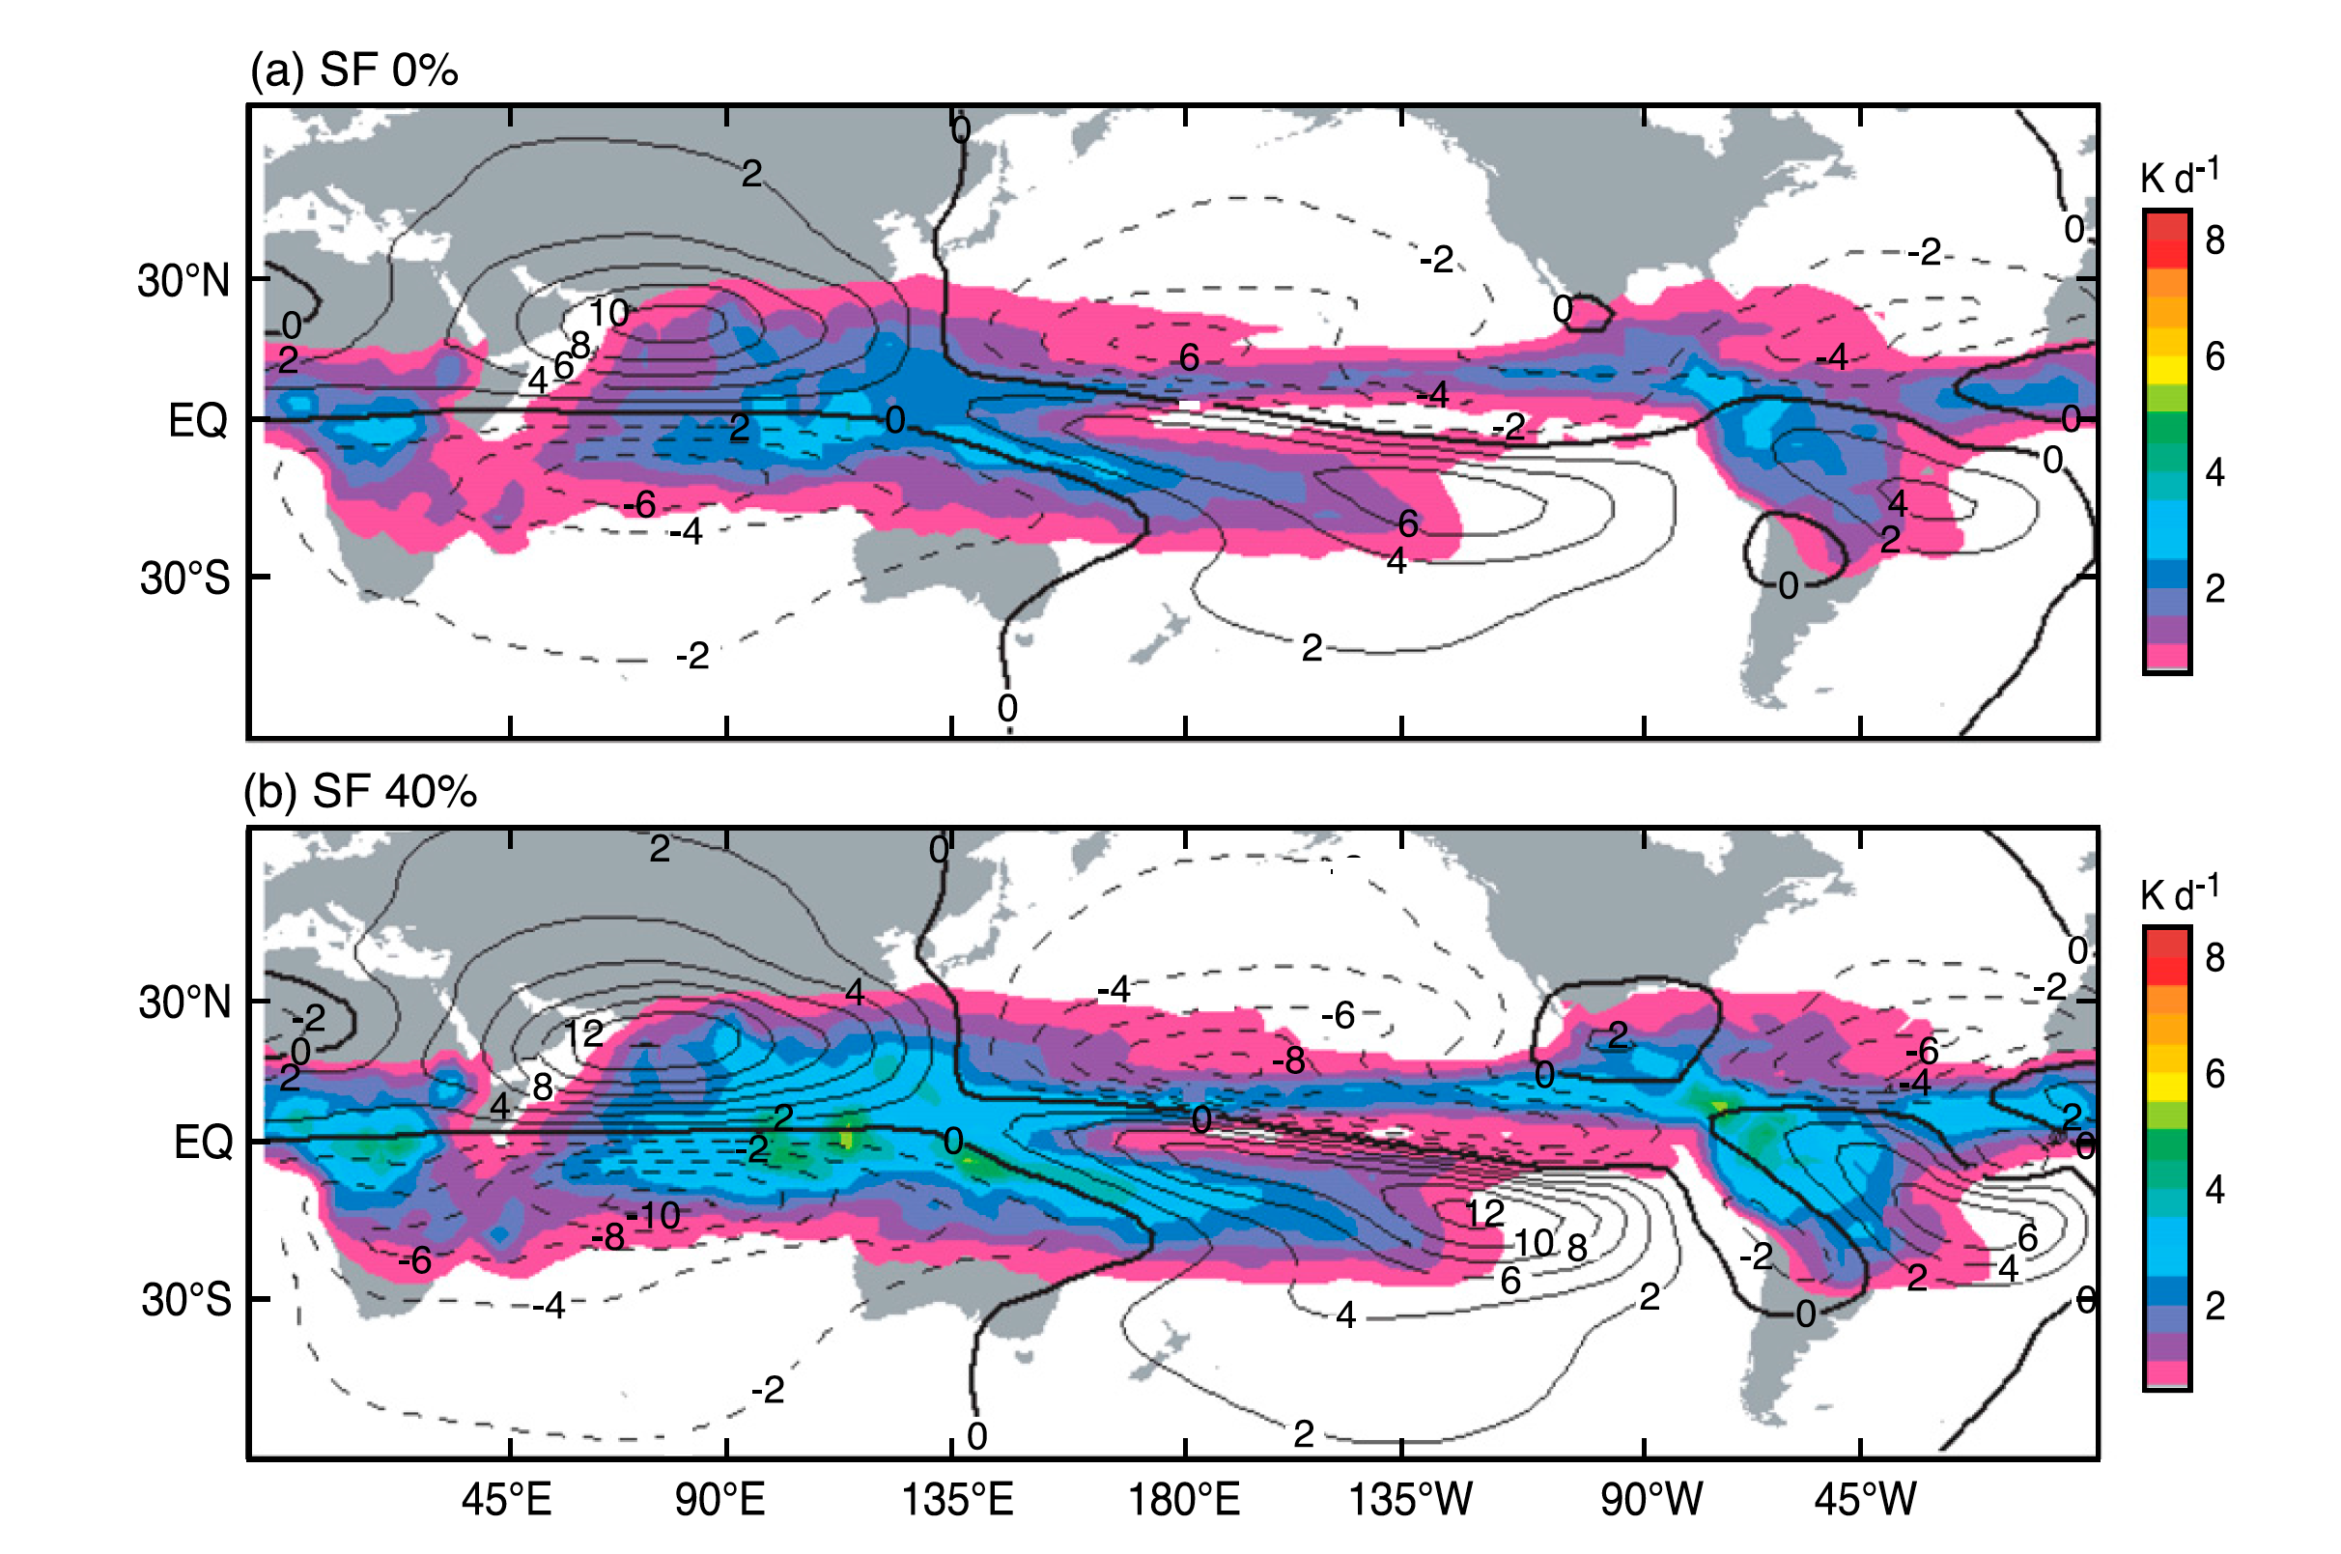

Slide 40
1998 JFMA El Niño circulation under different heating profile assumptions
Using horizontally uniform heating pattern
Using TRMM observed SF precipitation to estimate heating profile in JFMA 1998 El Niño
From Schumacher et al. 2004

Slide 41
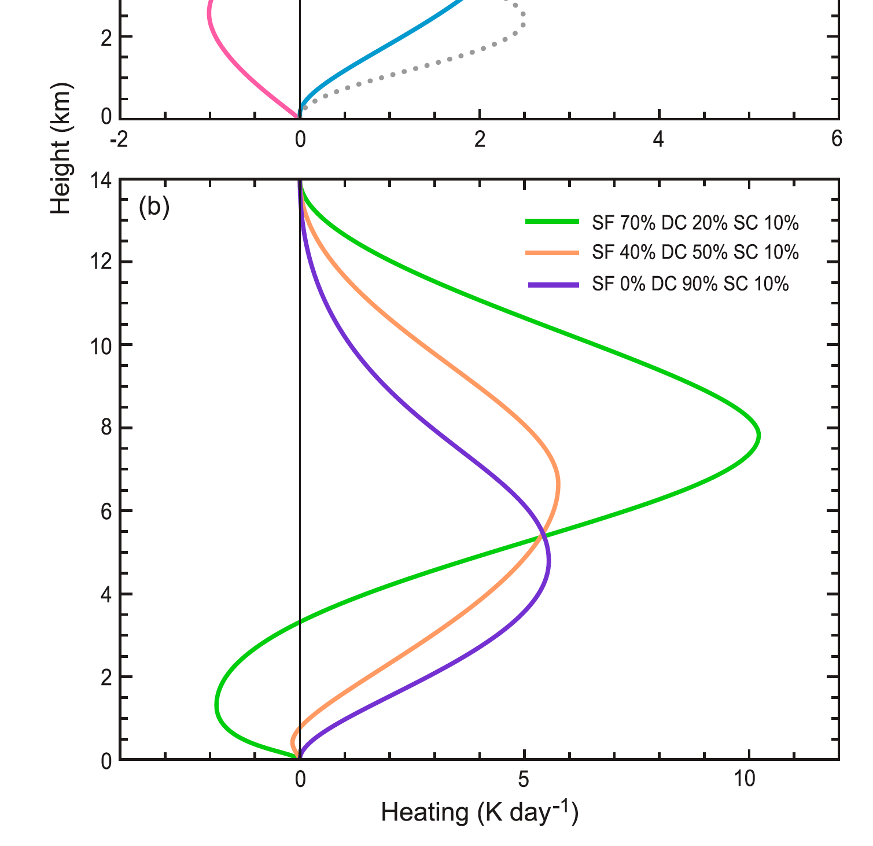
“Top Heavy Heating”
PV generation in midlevels
Houze 1982; Schumacher et al. 2004

Slide 42
ENSO—Schumacher et al. 2004
MJO—Barnes, Yuan
Tropical cyclones—Houze et al. 2009

