Slide 1
BAMS 2020
Cloud and Weather Symbols in the Historic Language of Weather Map Plotters
Robert A. Houze, Jr., University of Washington
Rebecca Houze, Northern Illinois University
AMS Annual Meeting, Boston, January 13, 2020
Notes:
This is a brief summary of a paper coming out in BAMS
It is a collaboration between a meteorologist and an art historian

Slide 2
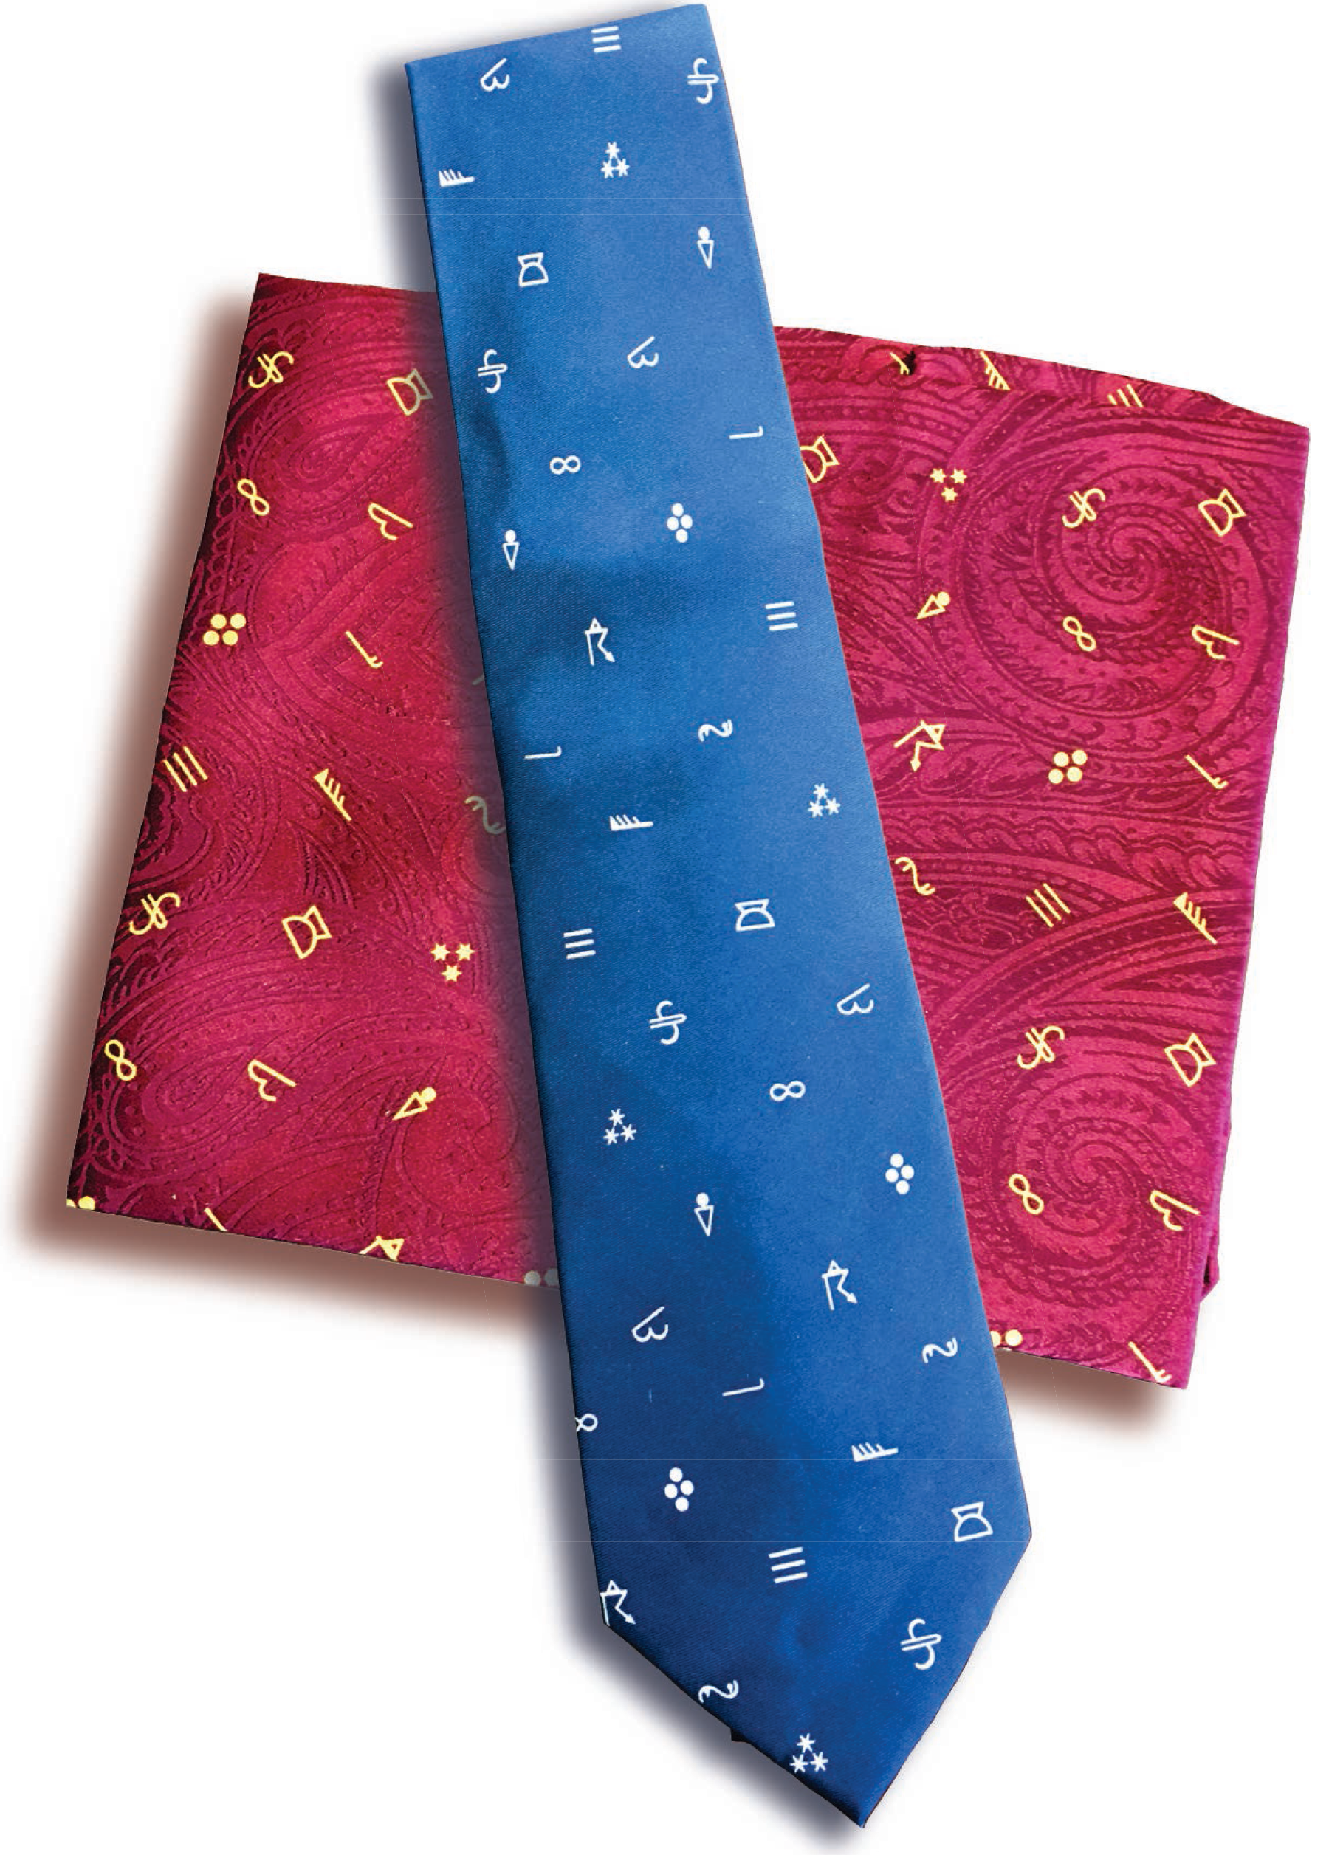
Notes:
We were motivated because the AMS has these attractive and popular souvenirs and I’ve been noticing that not all our AMS members know the meaning behind all the little symbols on these products

Slide 3
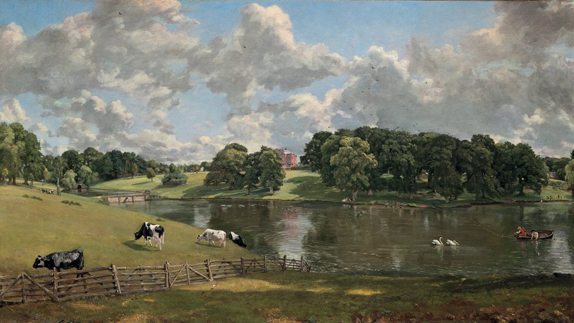
John Constable. Wivenhoe Park, Essex. 1816. Oil on canvas.
National Gallery of Art, Washington, D.C.
Notes:
Our story begins in the early 19th century when clouds could still only be seen by looking up at the sky—long before, airplanes and satellites.
In the early 1800s, painters began taking an interest in depicting natural landscapes, which included clouds. One of the most notable was John Constable, whose painting here includes a sky occupied by fair weather cumulus clouds.

Slide 4
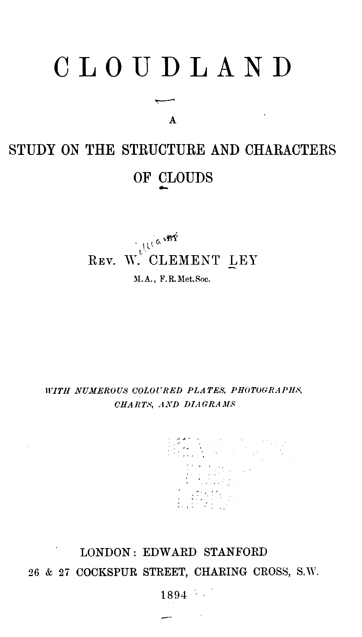
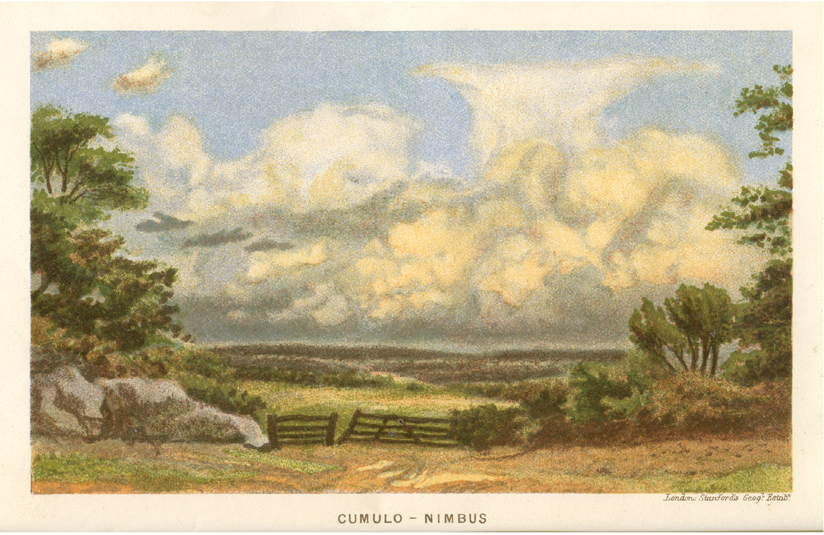
Frontispiece to Cloudland: Study on the Structure and Characters of Clouds,
Rev. W. Clement Ley, 1894.
Artwork printed by Standford’s Geographical Establishment, London.
Notes:
By the late 19th century cloud atlases attempting a taxonomy of clouds began appearing. This one by Clement Ley was an extensive treatise including not only pictures but long verbal descriptions of clouds. It relied heavily on paintings like this one on the frontispiece of the book, which was clearly inspired by Constable’s famous painting. Over the last 100+ years cloud atlases have continued to be produced, and it’s interesting to follow their evolution

Slide 5
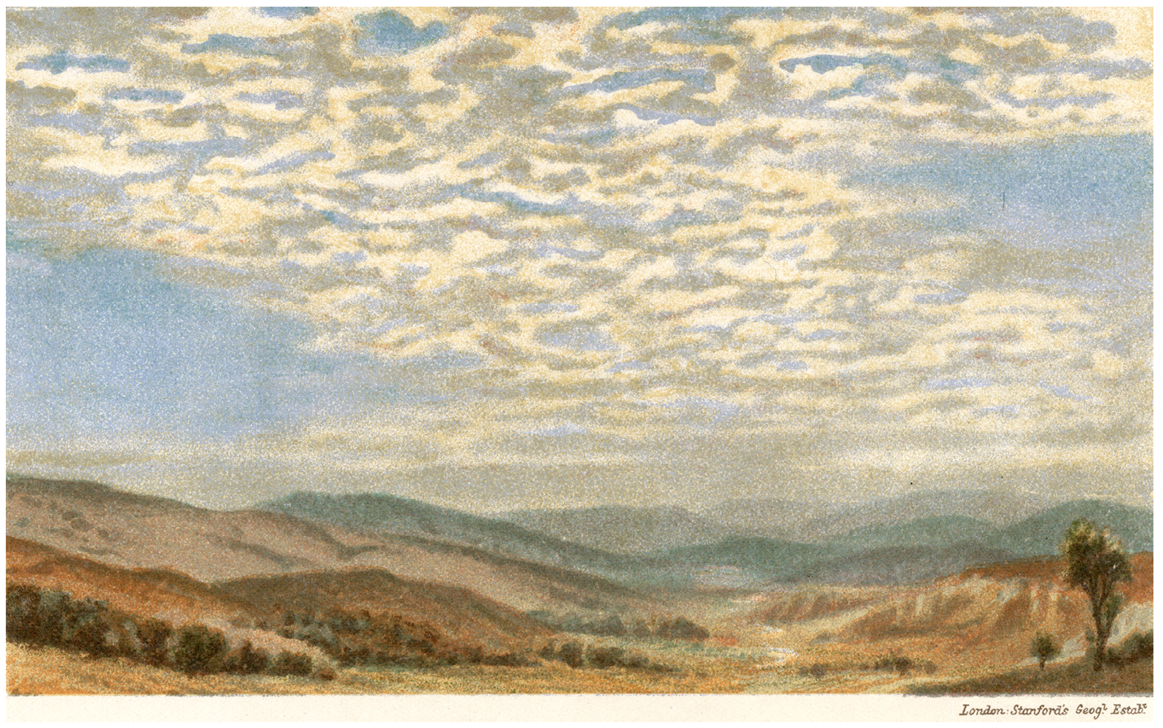
Altocumulus.
In W. Clement Ley, Cloudland: Study on the Structure and Characters of Clouds, 1894.
Notes:
To illustrate this evolution we will use altocumulus cloud. Here is Ley’s rendition. Note the foreground of landscape that provides perspective.

Slide 6
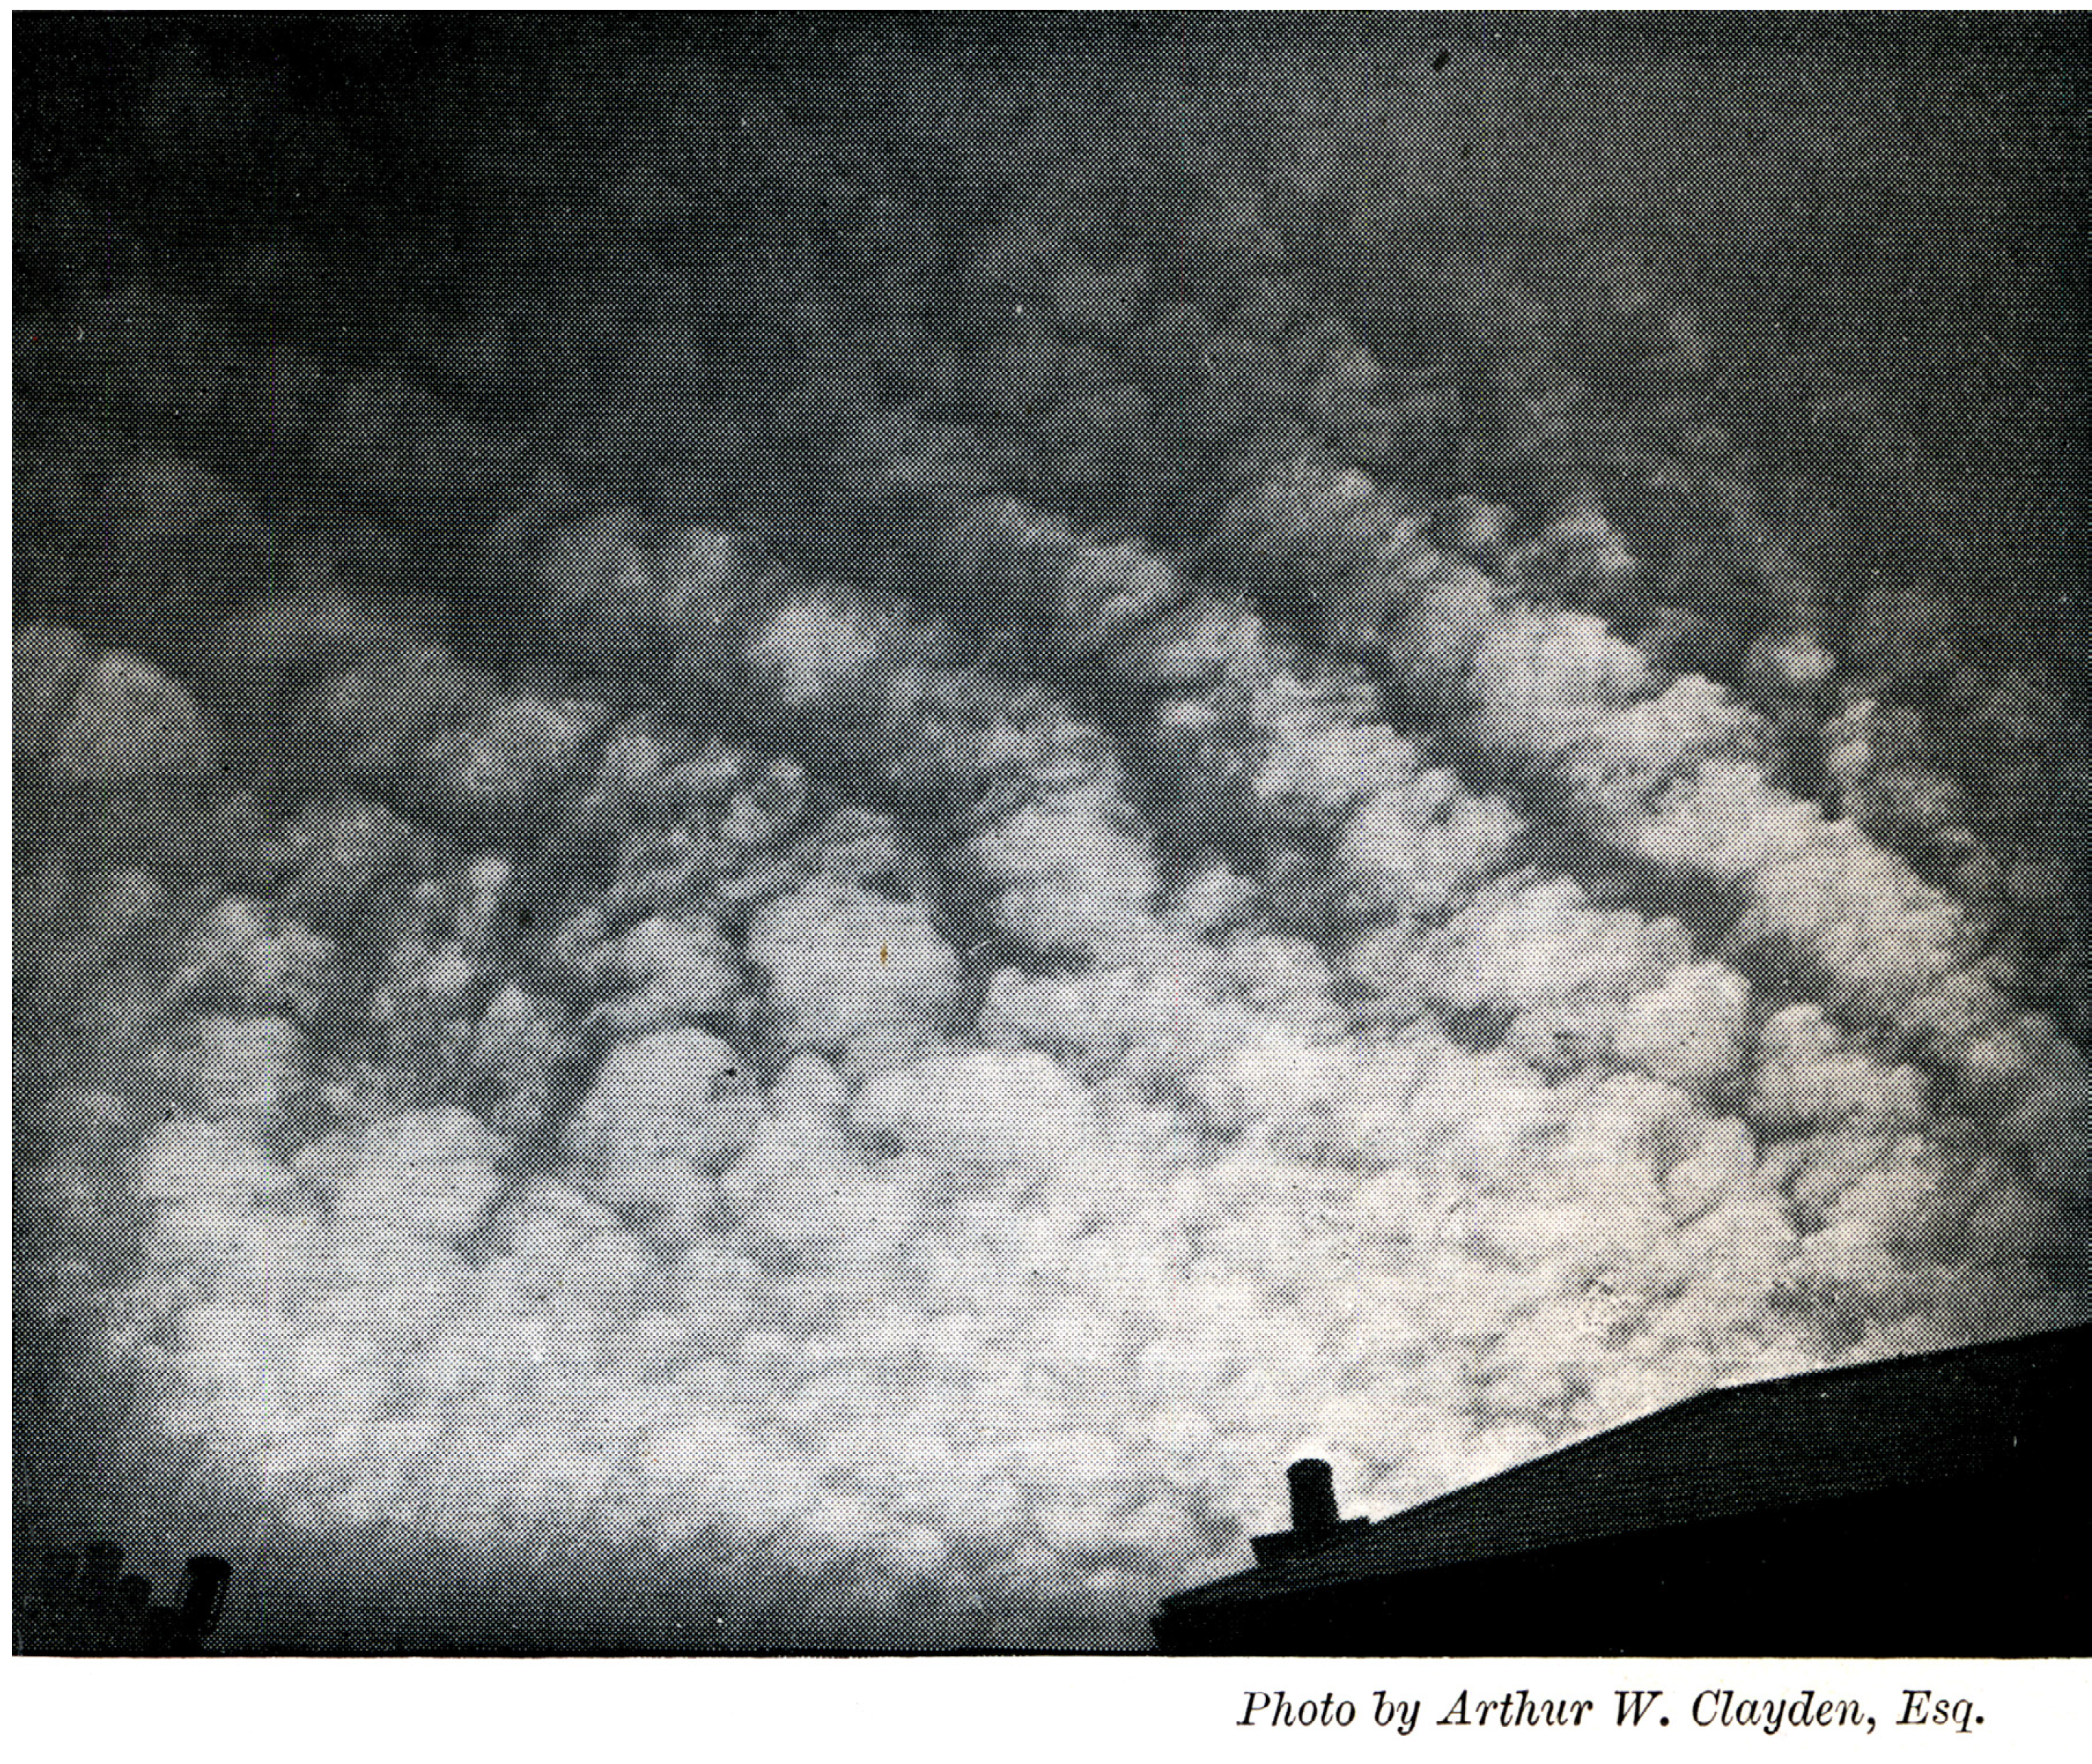
In Ley’s Cloudland
1894
Notes:
Photography was still fairly challenging in the late 19th century, , but Ley managed to include a few early B&W photos—again with some foreground for perspective

Slide 7
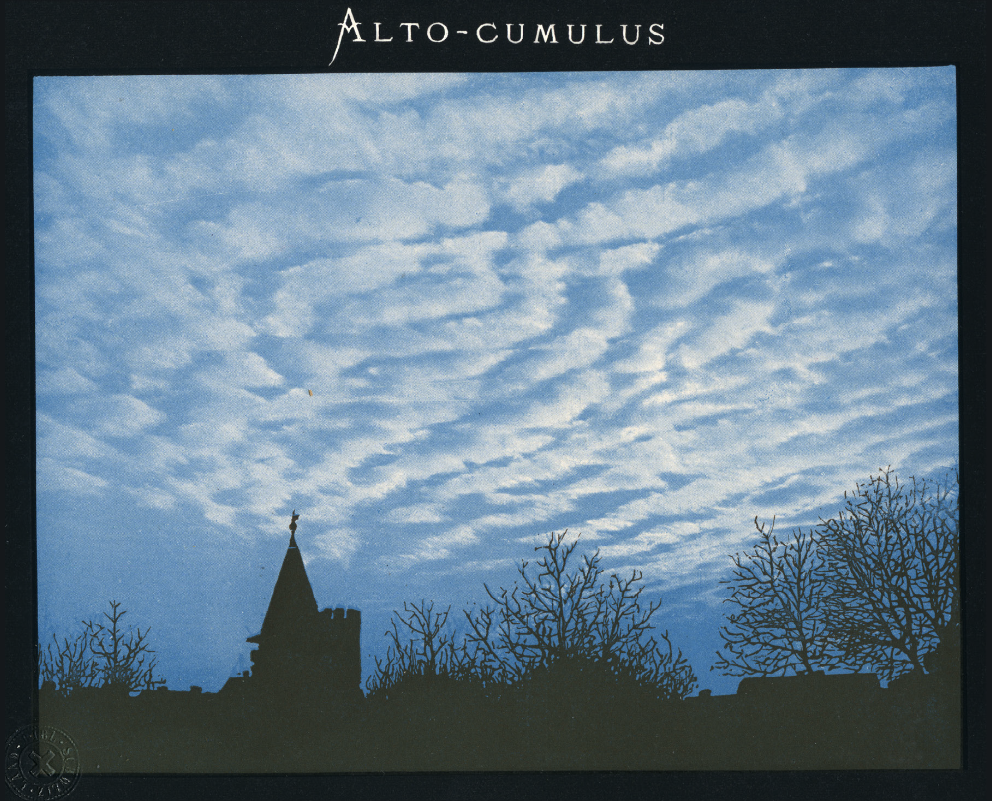
Hildebrandsson, Riggenbach, and de Bort, 1896, International Cloud Atlas
Notes:
Hildebrandsson’s next effort was especially interesting because of the desire for color. So they employed an industrial technique to colorize B&W photos of clouds.

Slide 8
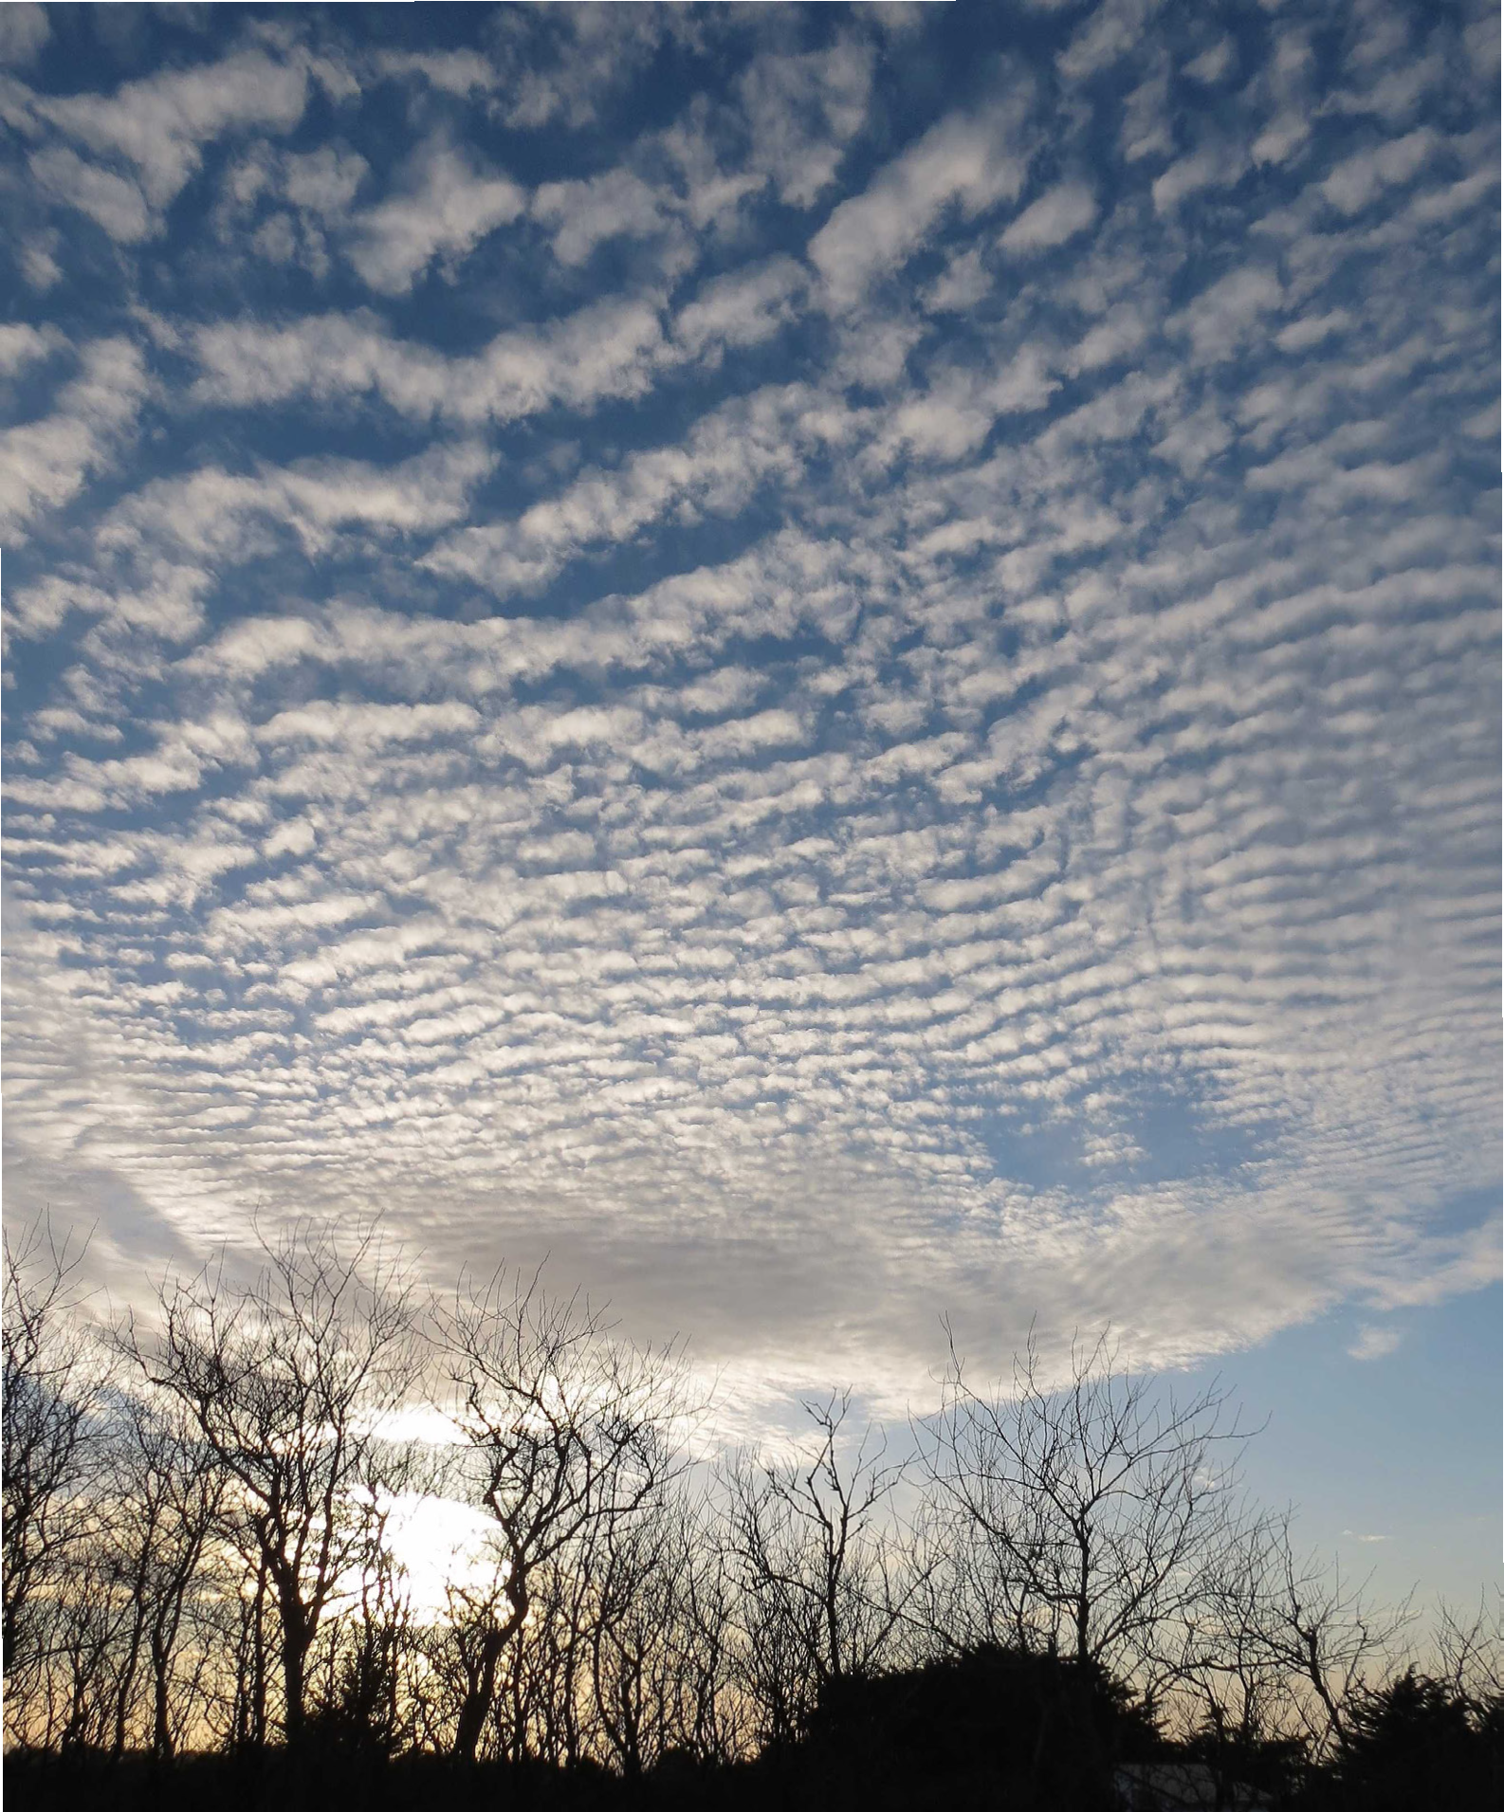
International Cloud Atlas
WMO 2017
Notes:
Today, high resolution color photography has made the WMO’s Intl. Cloud Atlas rather spectacular.

Slide 9
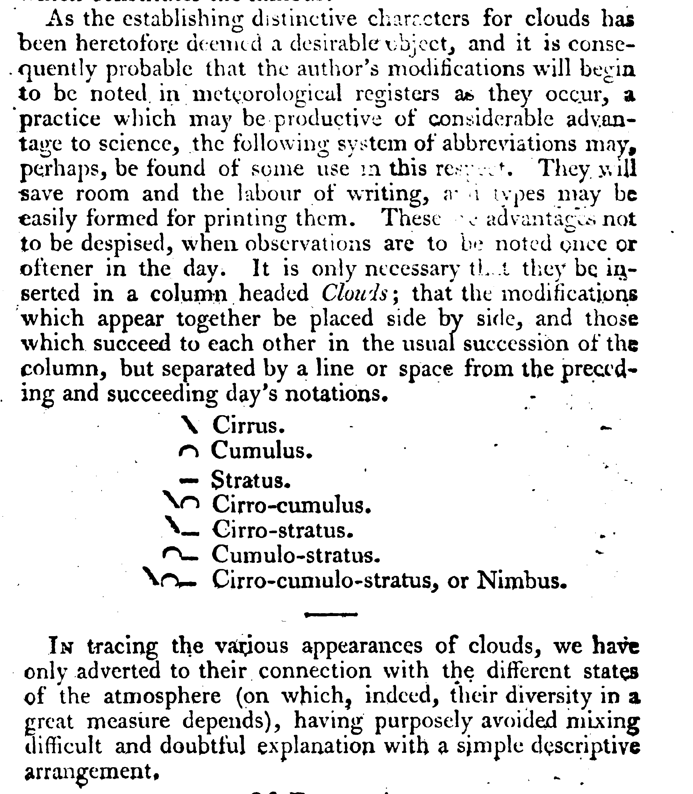
Luke Howard
“On the Modification of Clouds,”
The Philosophical Magazine,
1803
Notes:
Now, let’s drop back to the early 19th century, about the time that Constable was active, Luke Howard was beginning to attempt the taxonomy of clouds without much other than his own eyes and a few known paintings.
As he went about his identification work, he suggested little iconic symbols as shorthand for certain cloud forms—sloping line for cirrus, hump for cumulus, line for stratus, etc.
Why he felt the need to do this—probably in making his hand entered spreadsheets compact, to keep his column entries from being cluttered with long words—there were no weather maps at this time.
Luke Howard
“On the Modification of Clouds,”
The Philosophical Magazine,
vol. 16-17
(Jul – Oct, 1803): 97-107, 344-357.

Slide 10
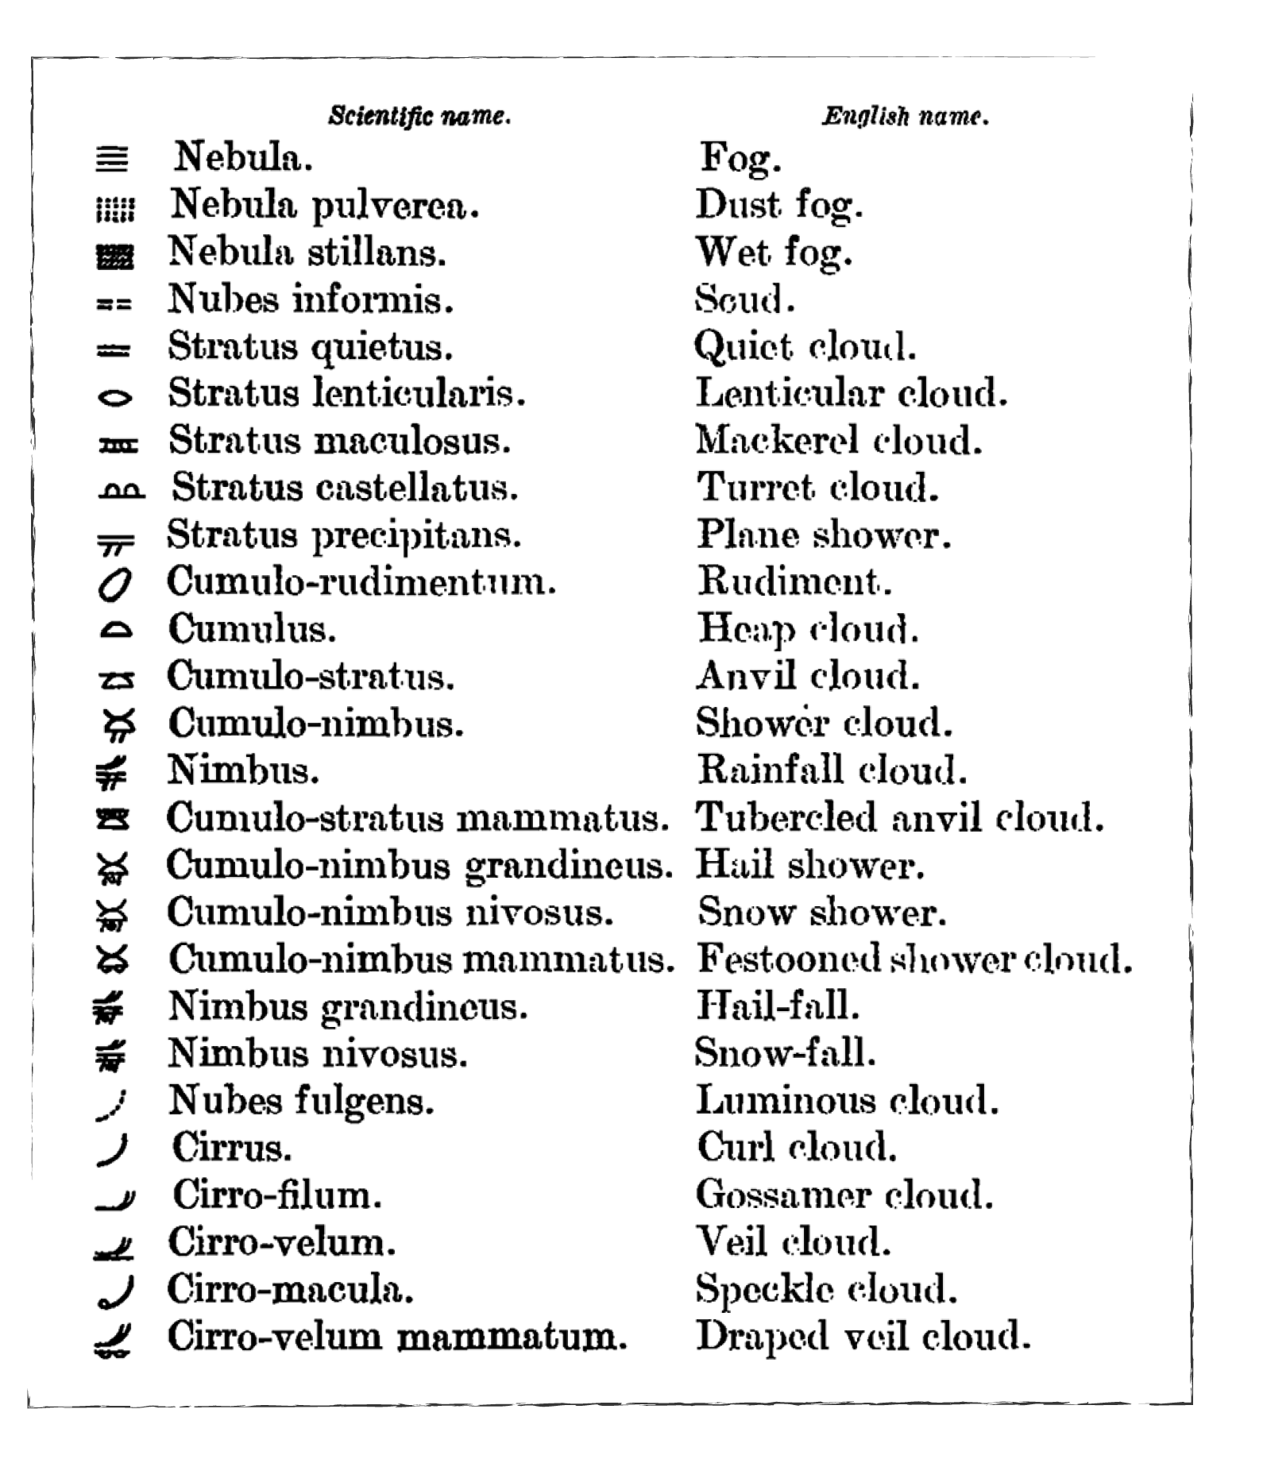
1894
Variations on Luke Howard’s cloud types:
suggested by W. Clement Ley in Cloudland.
Notes:
But sky’s are very complex with different variations on the basic cloud forms identified by Howard. By the end of the 19th century Ley came up with many more symbols, which were essentially variations on Howard’s themes

Slide 11
Ralph Abercromby (1887)
Hugo H. Hildebrandsson (1887)
The 10 basic cloud types
Stratus
Stratocumulus
Nimbostratus
Cumulus
Cumulonimbus
Altostratus
Altocumulus
Cirrus
Cirrostratus
Cirrocumulus
Notes:
At this time, a very important figure emerged—the Scottish meteorologist Ralph Abercromby, a fascinating man on whom I could base a whole lecture.
Abercromby in parallel with Hildebrandsson boiled cloud forms down to 10 basic types, which are still in use today.
Abercromby and Hildebrandsson were, however, rivals, and the names we use now are mostly Abercromby’s

Slide 12
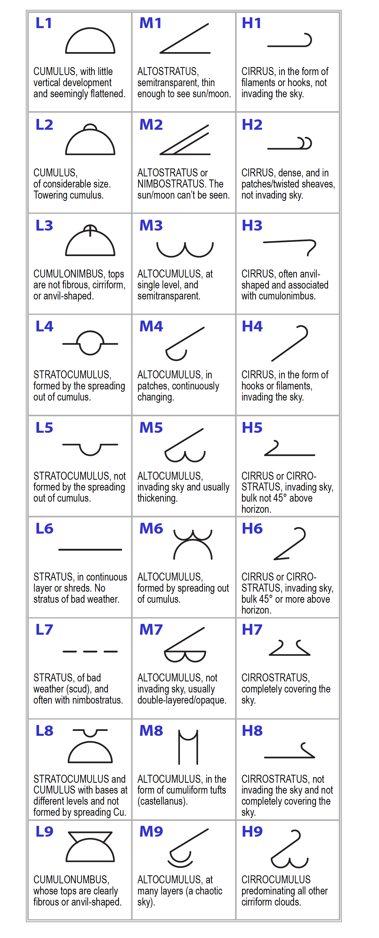
Cloud Symbols in the International Cloud Atlas and the WMO 2017 Manual of Codes
Notes:
The WMO’s current, Manual of Codes uses 27 symbols.
Same as on the ties and scarves

Slide 13
Important Meteorological Language
“Clouds”
--state of the sky overhead
“Weather”
--what’s happening near or on the ground
Notes:
It’s important to remember that an observe on the ground can see two types of things
--clouds occur in the sky over head…that has been the focus of the presentation up to now
--weather is what is happening near the ground where the observer is standing…these include rain, snow, hail, fog, pollution, tornadoes and various other things
Neither can be measured as a number and hence is represent by symbols
We’ve only been talking about the symbols for clouds, but there are a large number of symbols for weather phenomena

Slide 14
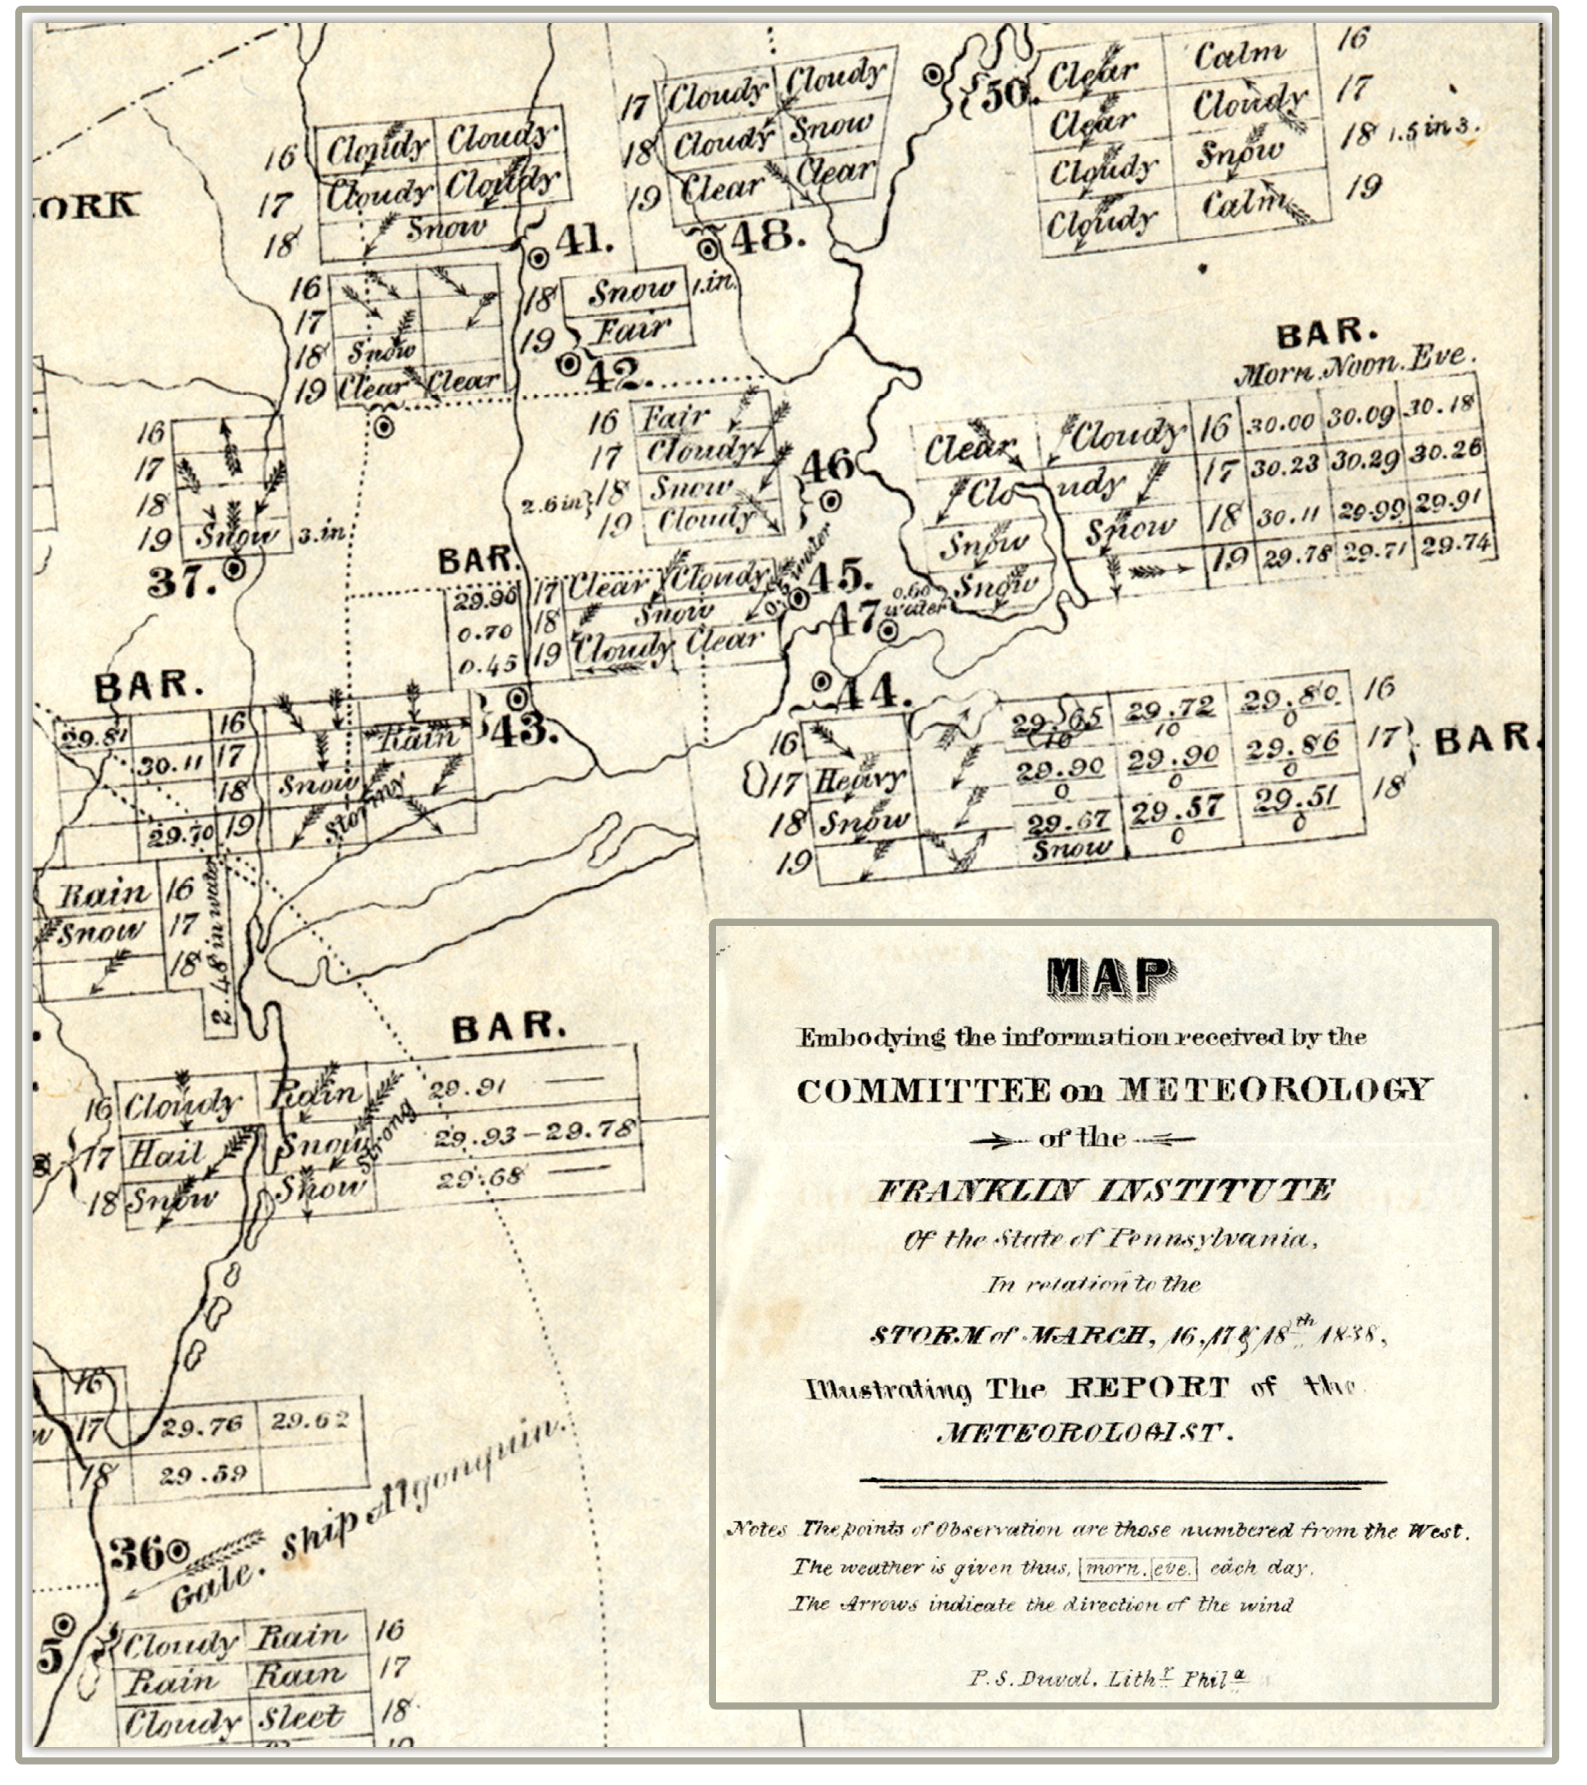
1838 meteorological map showing conditions over the U.S.
Notes:
In the 1830s, telegraph was invented and weather conditions observed at different locations were sent out and maps could be created to show these conditions. This very early map was such an attempt, but you can see the problem
--writing out the weather and cloud conditions as words took up a lot of space and made for a messy hard to read map
--this map could only be interpreted by an English speaker
These problems could be eliminated by using symbols that could be understood by anyone—much like international road signs

Slide 15
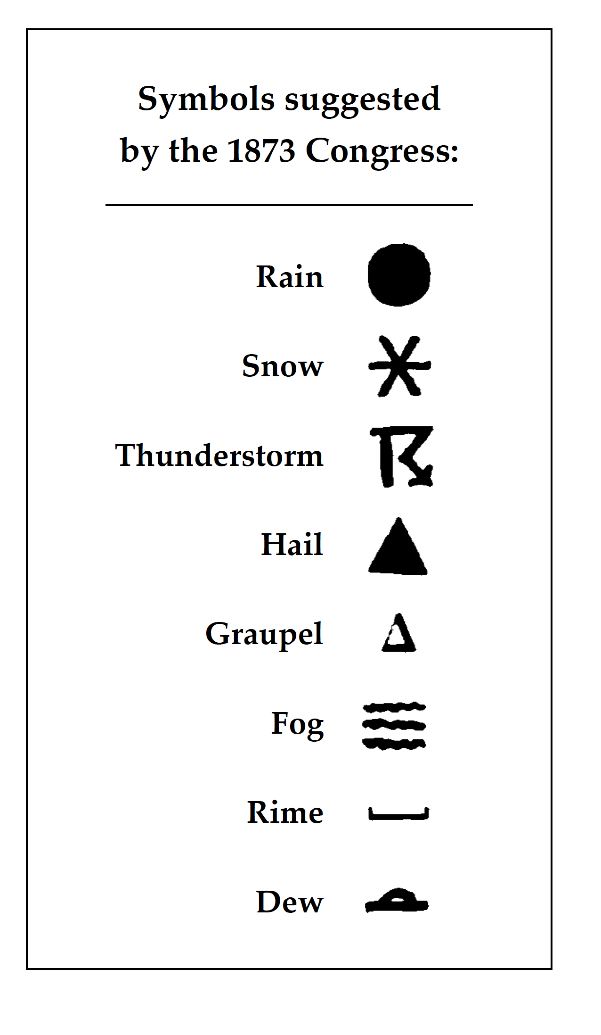
Vienna 1873
Vienna was the capital of the Austria-Hungary, a Dual Monarchy encompassing many cultures and language groups.
One of the first major International Meteorological Congresses was held there in 1873, the year of Vienna’s World Fair.
Notes:
These problems festered for some time.
By 1873, telegraph was increasingly providing weather conditions at far flung locations to be known in real time
But in that year a major event happened in Vienna
Vienna was the center of a huge empire of many languages and cultures, which were being celebrated in a World’s Fair
In that context, the first International meteorological congress was held—it was the precursor of the WMO.
A major issue at the conference was the effort to adopt weather symbols to mitigate linguistic and other individual practices from country to country
Eight symbols were adopted for use among countries in attendance at the congress.
They clearly derive from Lambert’s suggestions 100 years before

Slide 16
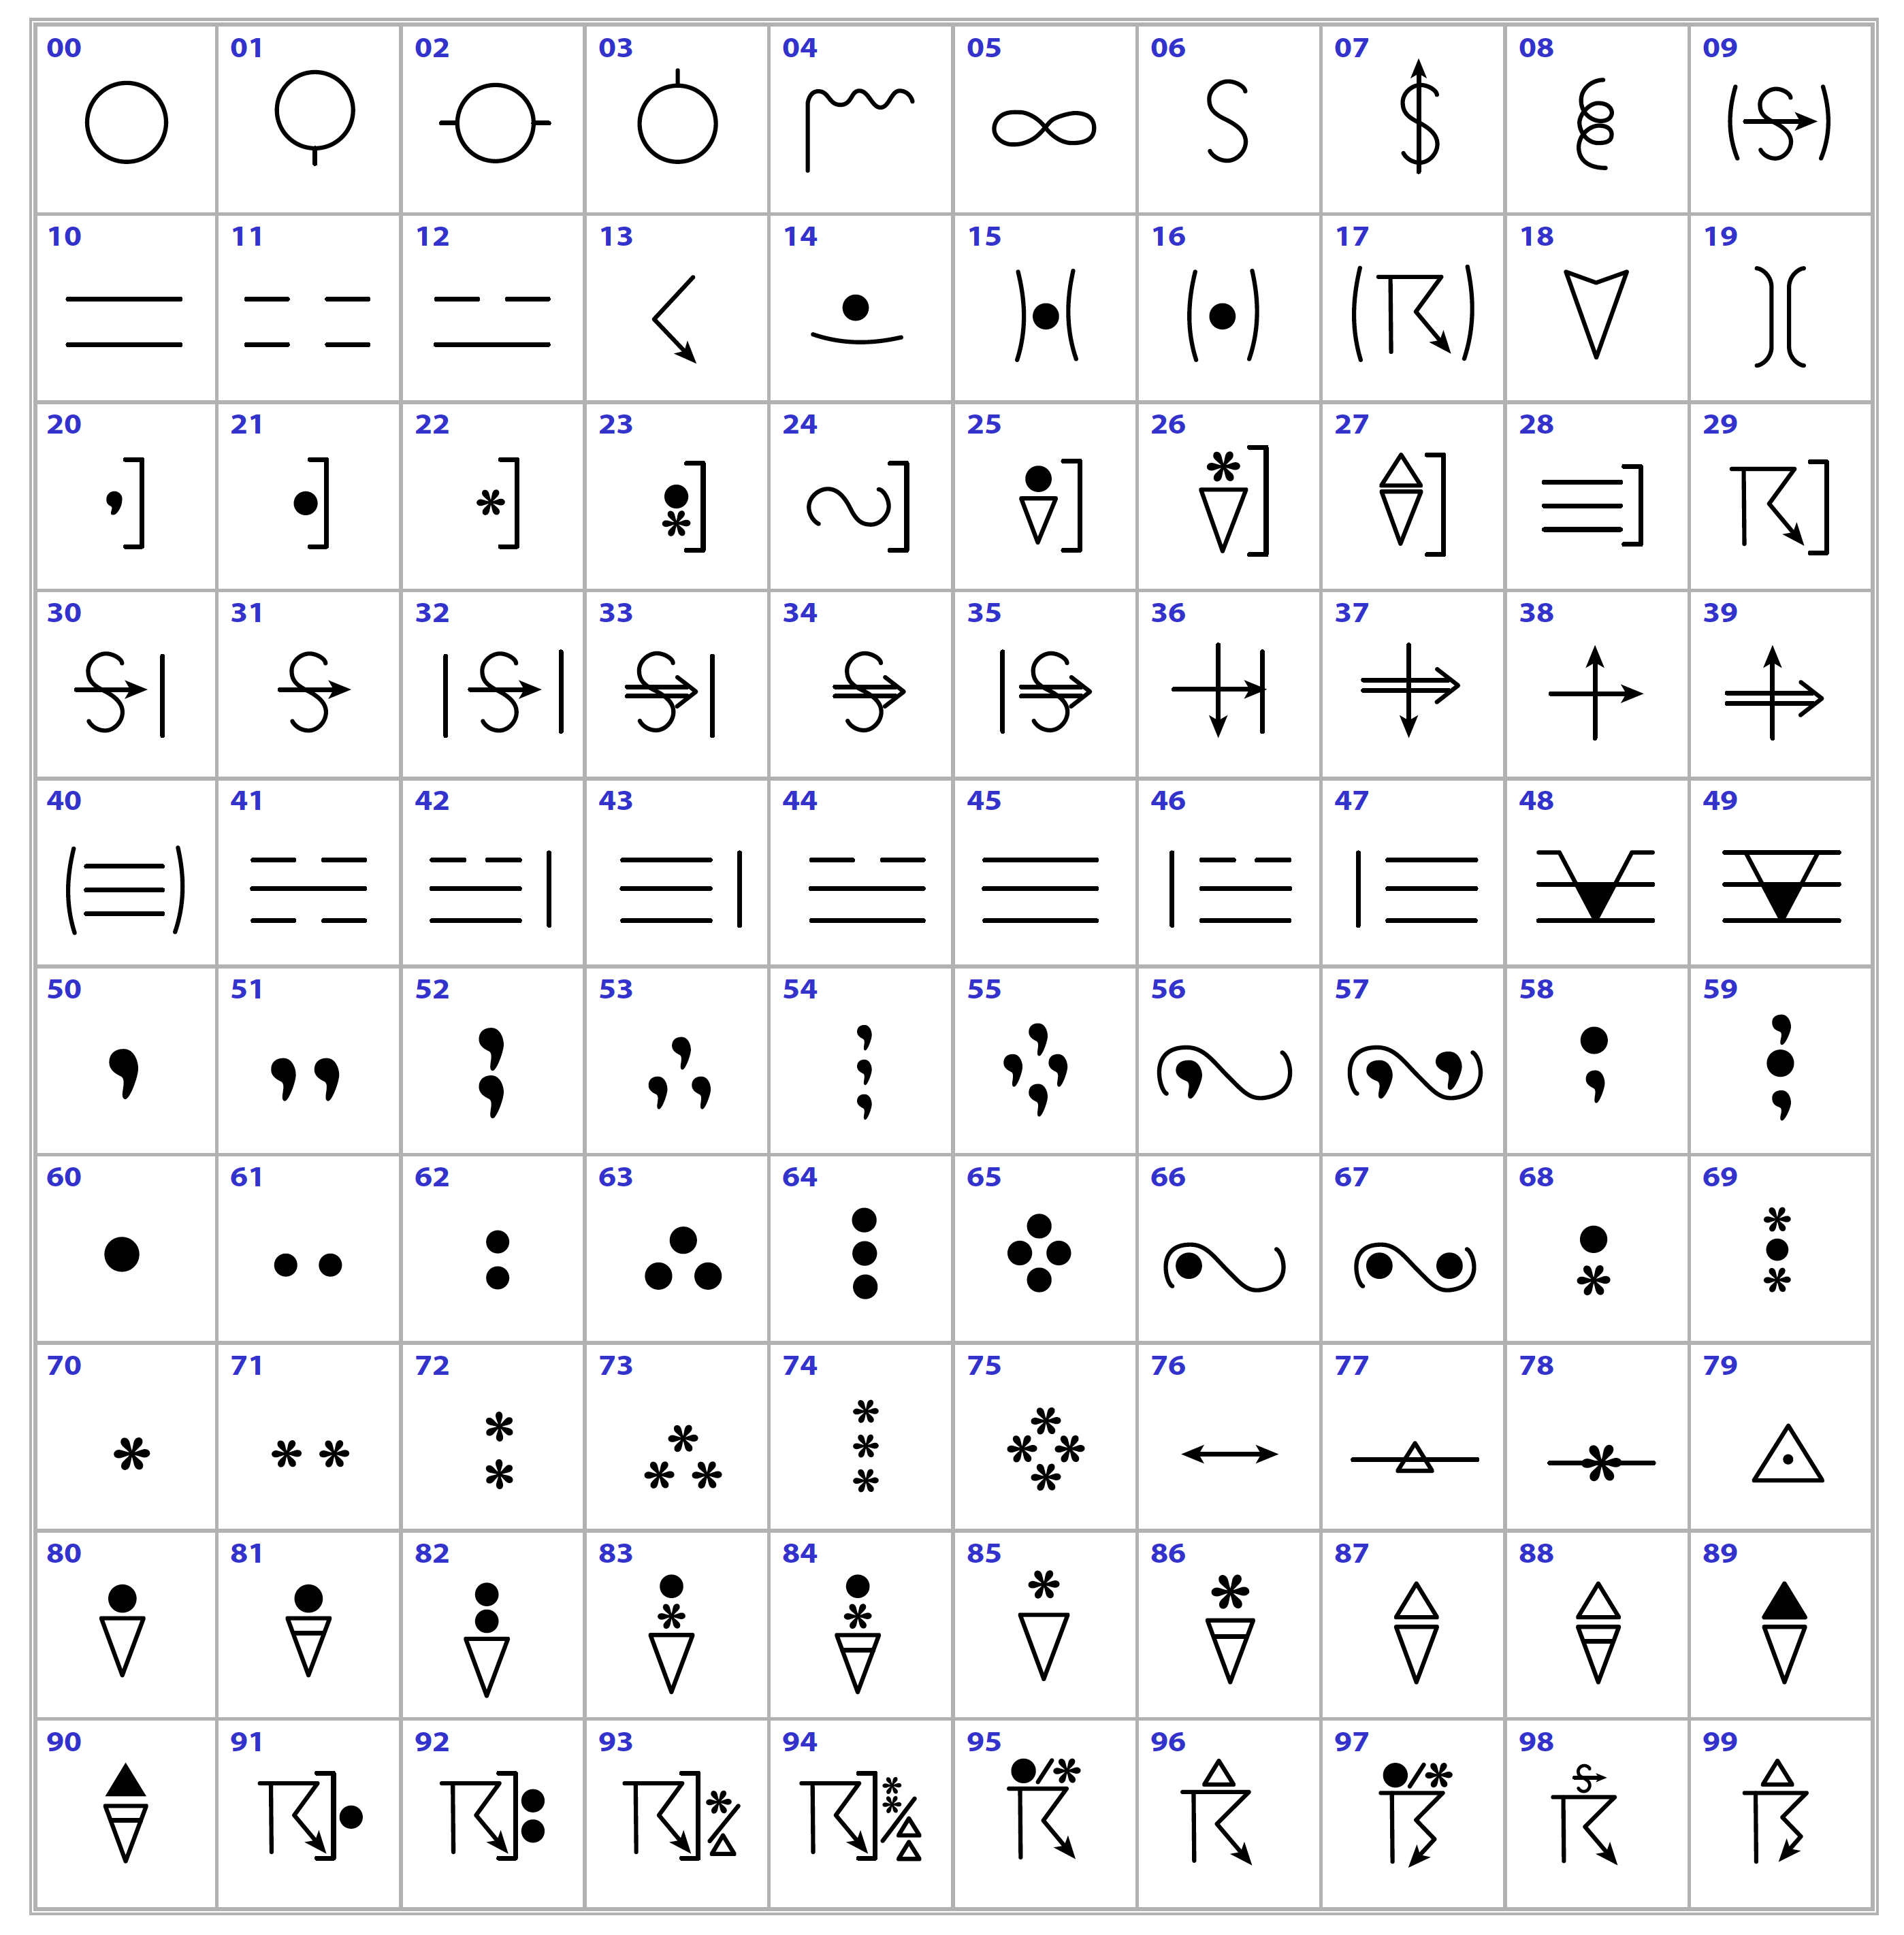
WMO 2017 Manual of Codes
Notes:
The symbols used now by the WMO are an elaboration of the 1873 symbols. have been unchanged

Slide 17
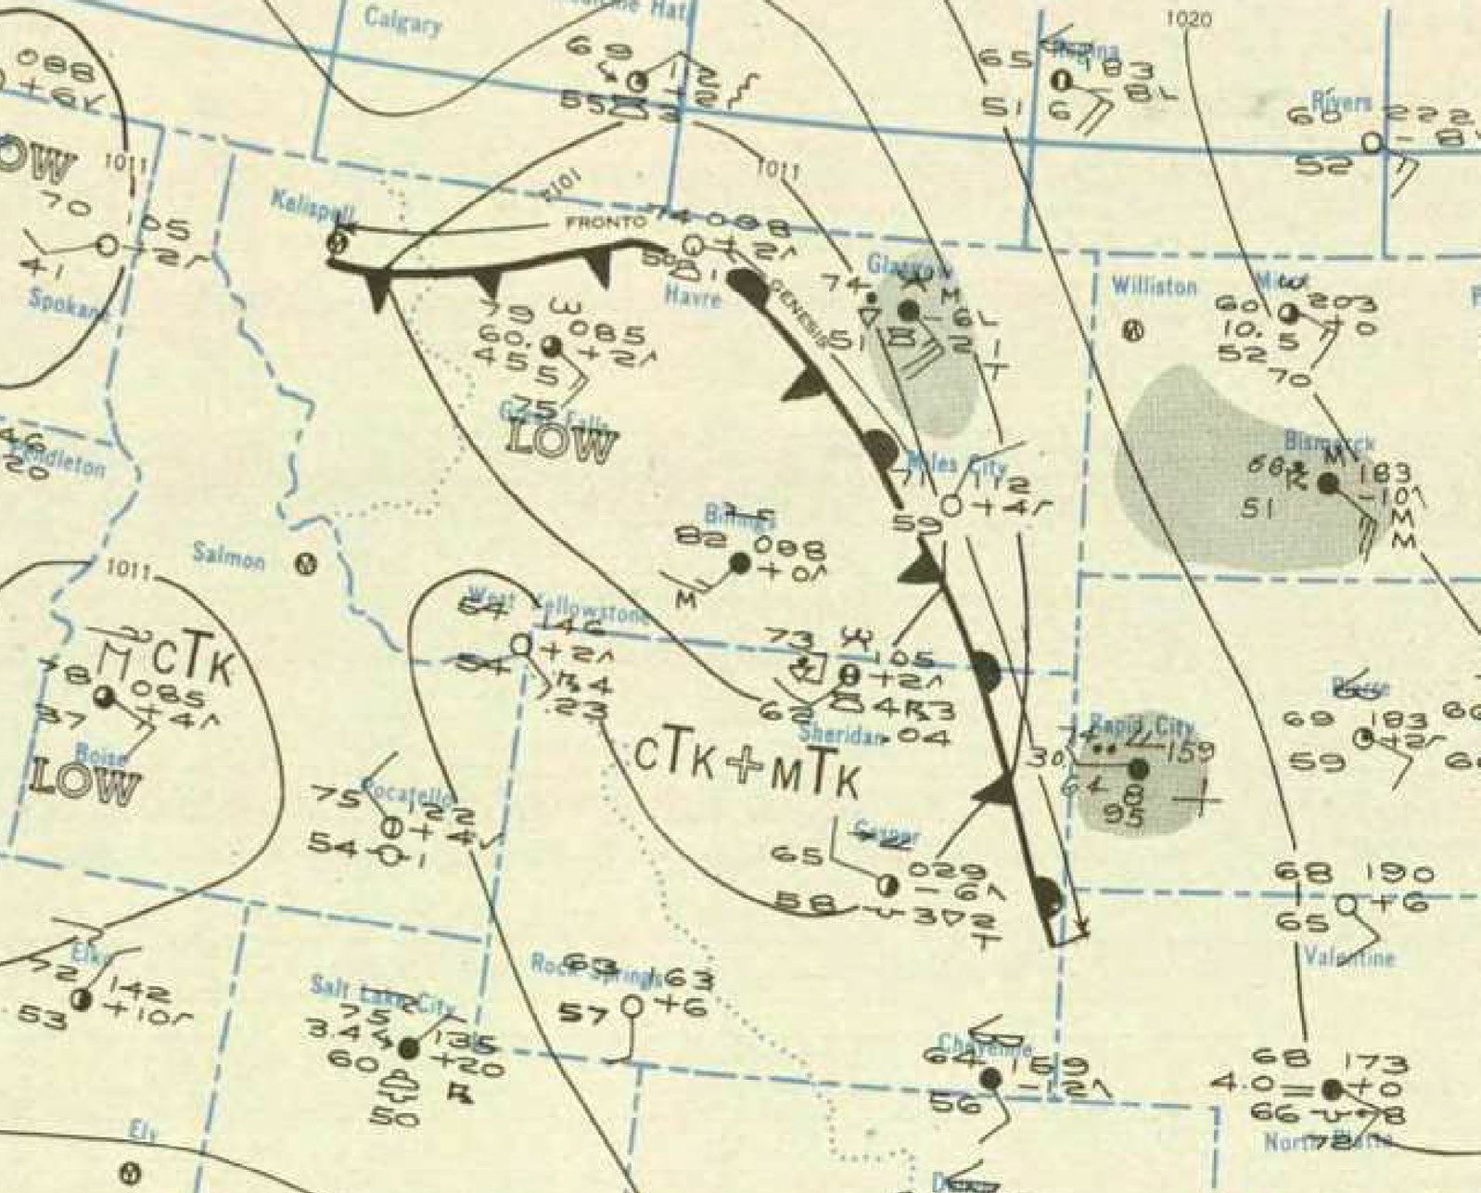
Mid-century Meteorology
Observations
Plotting observations on a map
Analyzing the plotted map
Forecasting & other applications
Notes:
To understand why these cloud and weather symbols were important, one needs to recall how meteorology worked before satellites, numerical models, and automation of weather stations. This type of meteorology peaked in the mid 20th century. At official government weather stations observers recorded observations that included the present weather at the ground and the state of the sky. These observations were transmitted by teletype so observations at all stations were known. But a map PLOTTER had to transcribe the teletype reports onto maps by plotting the information by hand. (I did this.) Then an analyst drew lines on the maps that interpolated the data so that atmospheric conditions could be known over a wide area. Forecasters and other used the analyzed maps to formulate forecasts, etc. The symbols were the plotters shorthand for indicating the clouds and weather at a station. For example on this map…

Slide 18
August 3, 1945
Notes:
Point out examples

Slide 19
In summary…
The symbols on the AMS ties & scarves evolved along with developments in art and photography to make a symbolic language that allowed meteorologists—before the era of satellites and numerical models—to translate weather observations into analyzed maps
The AMS ties and scarves celebrate that era
Thank You!
Notes:
To summarize…..

Slide 20
Extra Slides

Slide 21
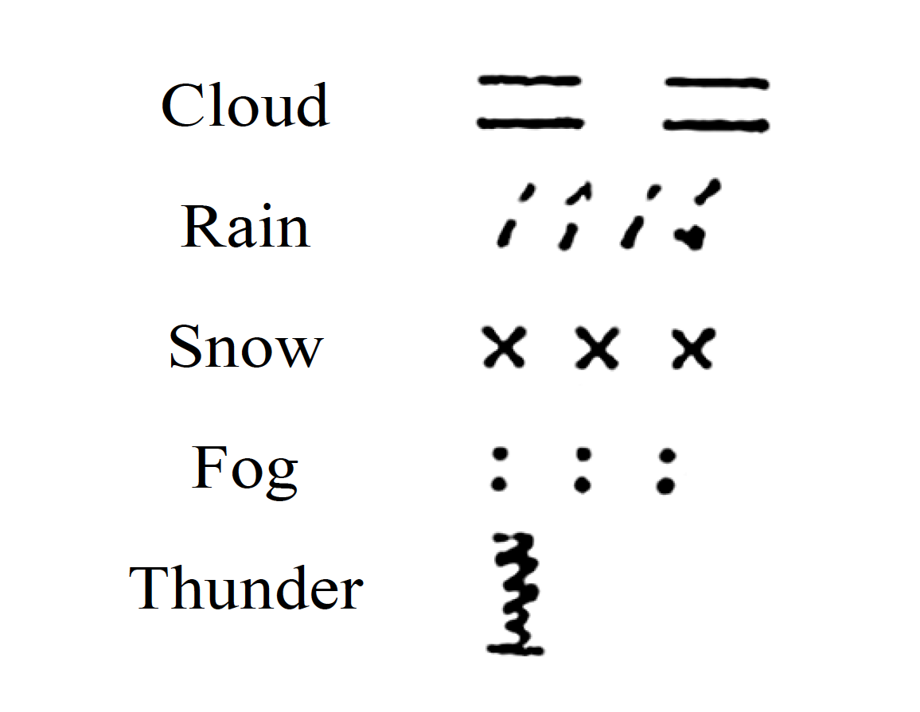
Weather symbols suggested by Johann Heinrich Lambert in 1771:
Notes:
The weather symbols go back even farther in time.
In 1771 Lambert suggested these basic symbols
They are very different in style from the cloud symbols, which are strokes of a pen that evoke certain shapes of clouds
These weather symbols seem to come less from art and more from writing or printing—dashes, apostrophes, x’s, periods—though thunder was a squiggle suggestive of lightning which was associated with the thunder heard by an observer
Lambert, J. H., 1771: “Exposé de quelques observations qu’on pouroit faire pour répandre du jour sur la Météorologie.” Nouveaux Mémoires de l’Académie Royale Des Sciences et Belle-Lettres de Berlin, 60–66.

