Slide 1
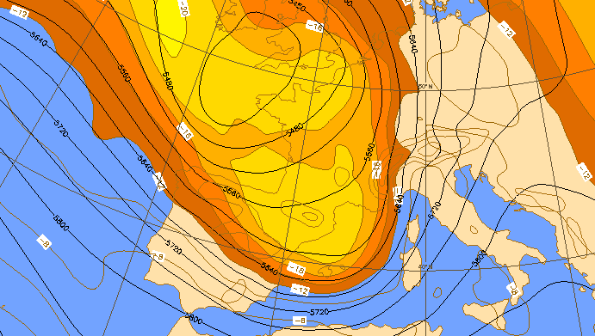
Rich Rotunno in the Mesoscale Alpine Programme (MAP, 1999)
Innsbruck
Robert Houze
(with help from Peggy LeMone)
Milan
35th International Conference on Alpine Meteorology
2-6 September 2019, Riva del Garda, Italy

Slide 2
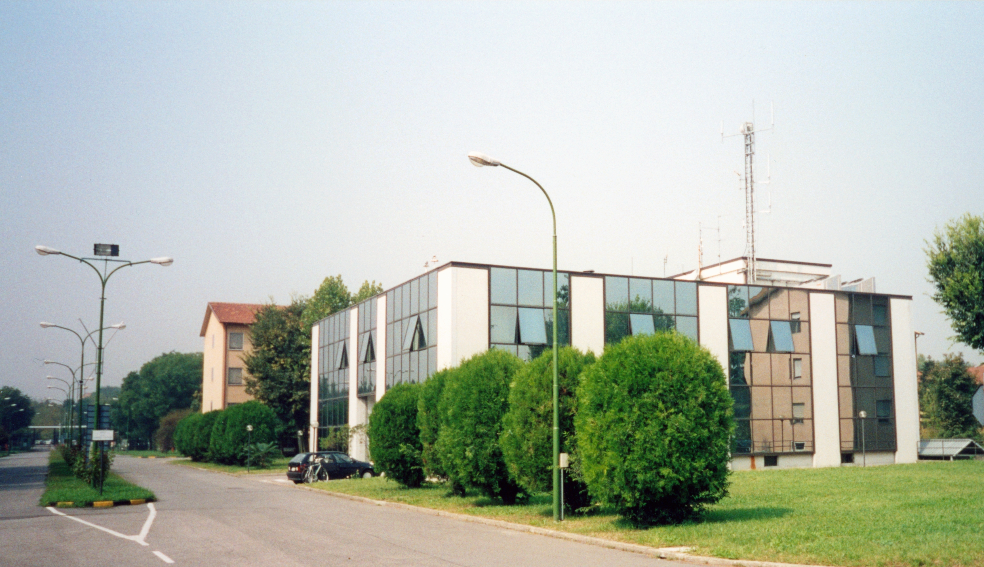
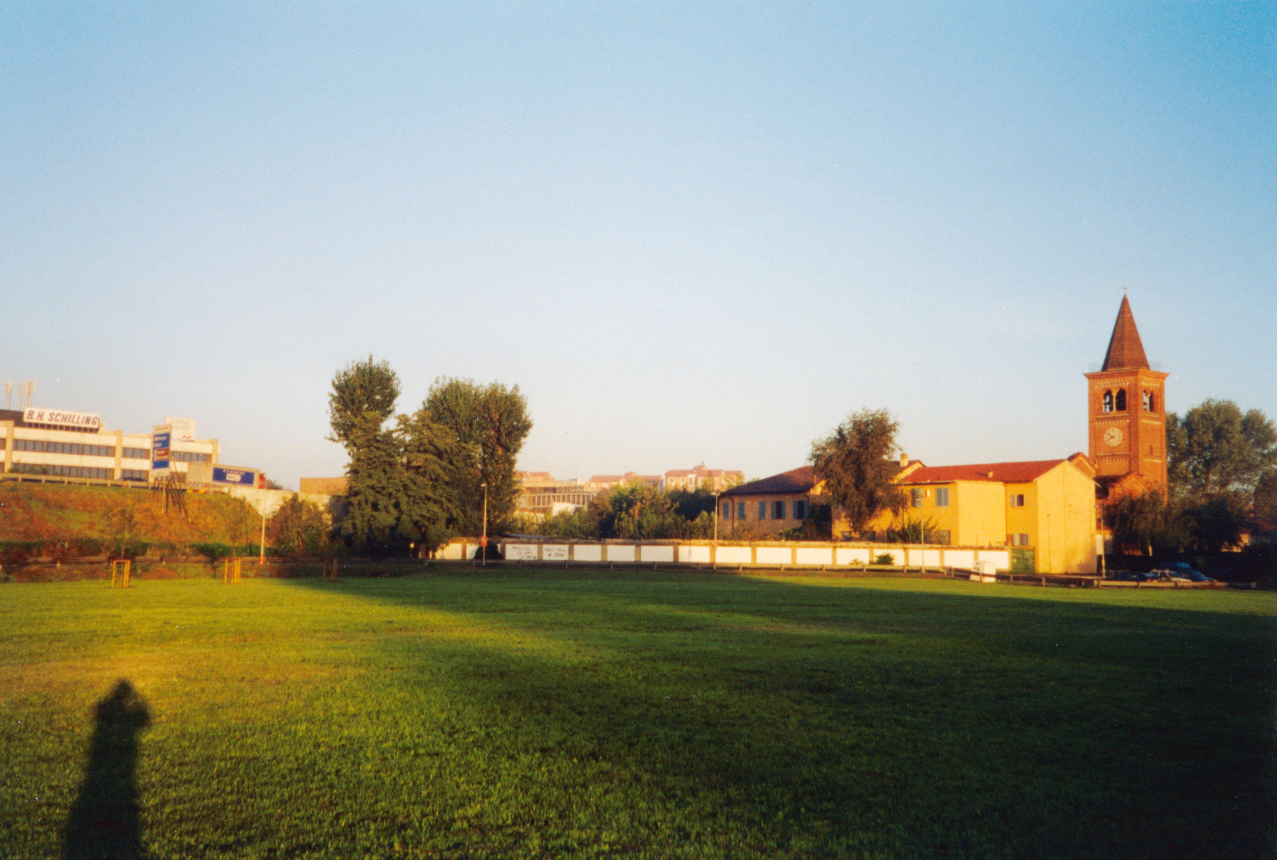
“Wet” MAP Operation Center
Regional Meteorological Center of Milano Linate
MAP morning bike ride
Chiesa di
San Lorenzo
Parco Monluè

Slide 3
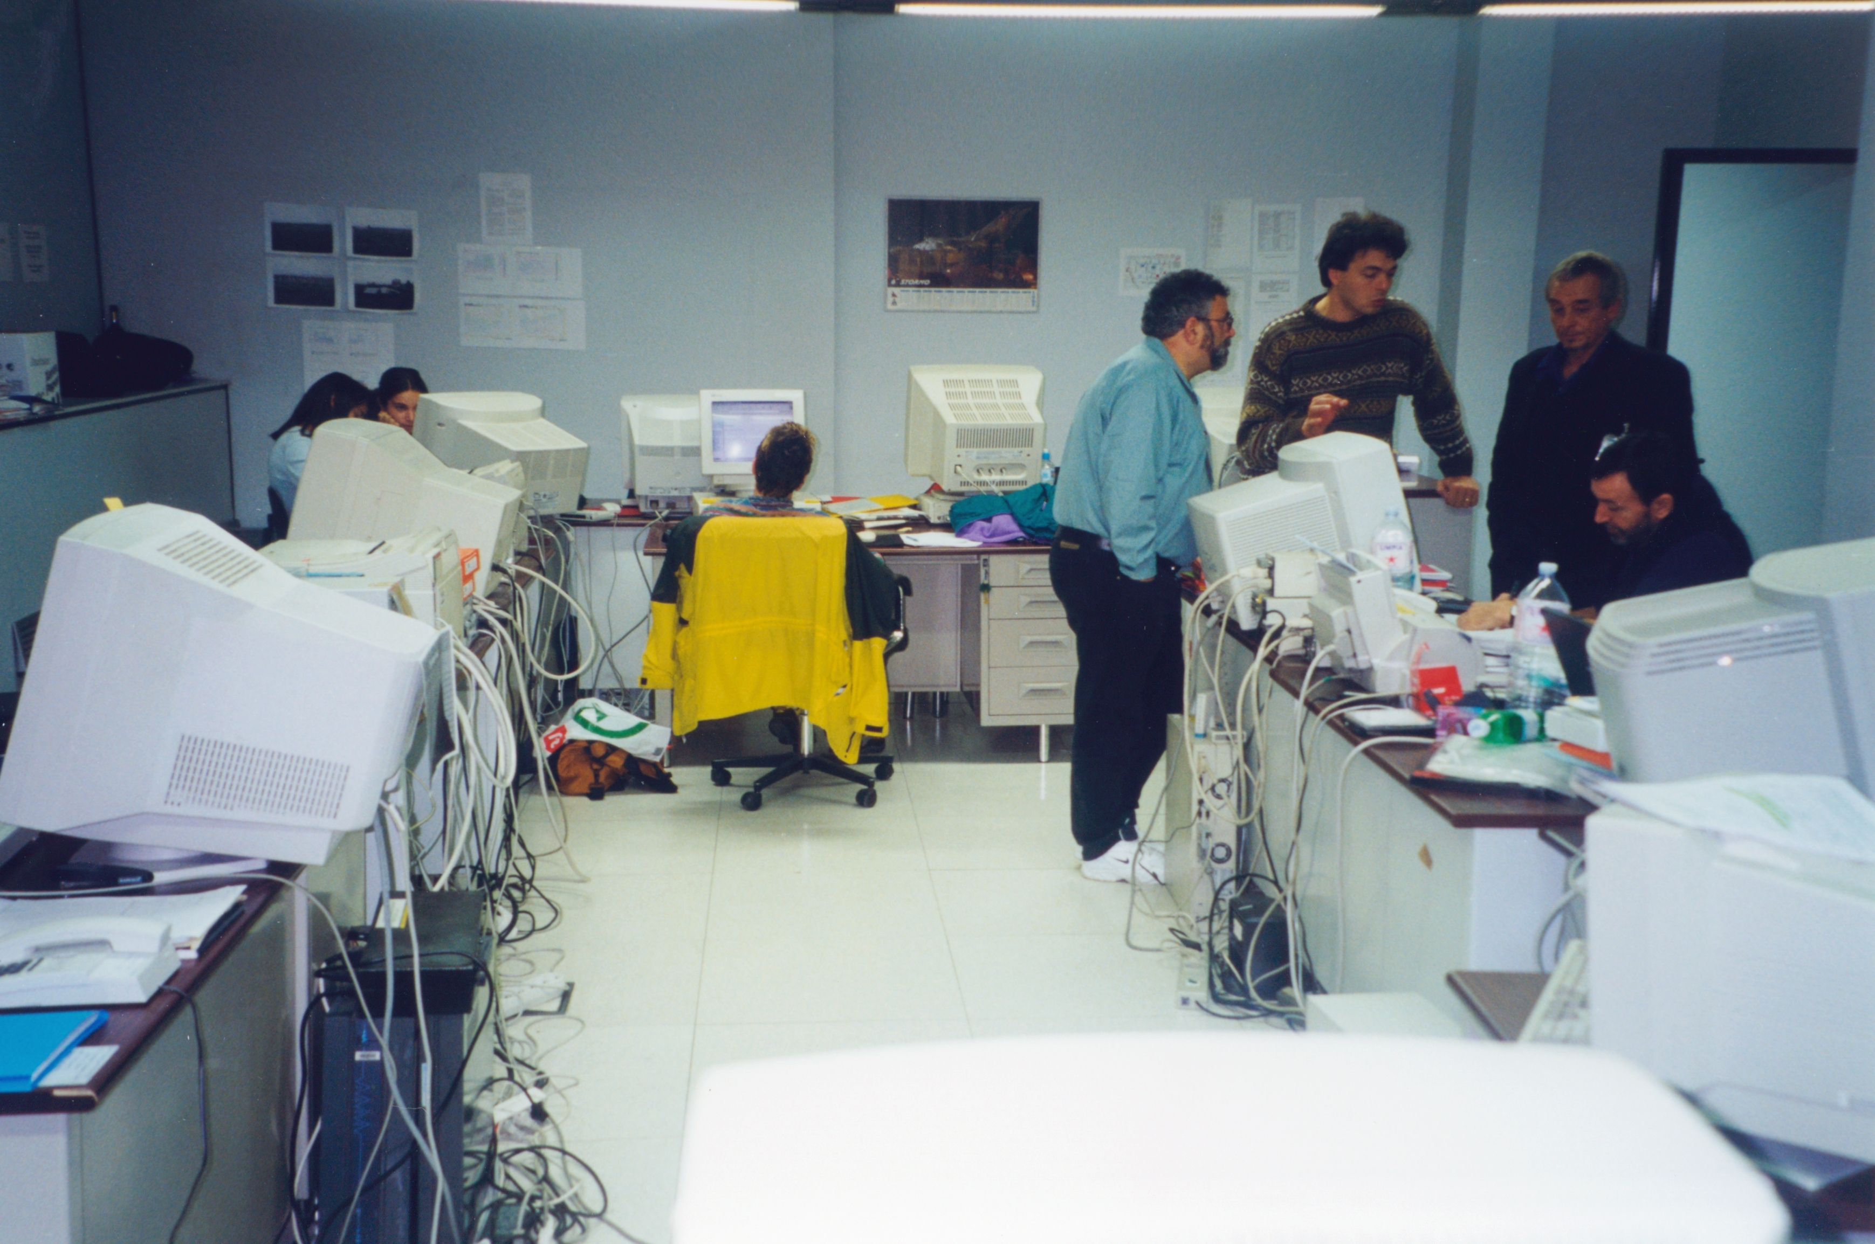
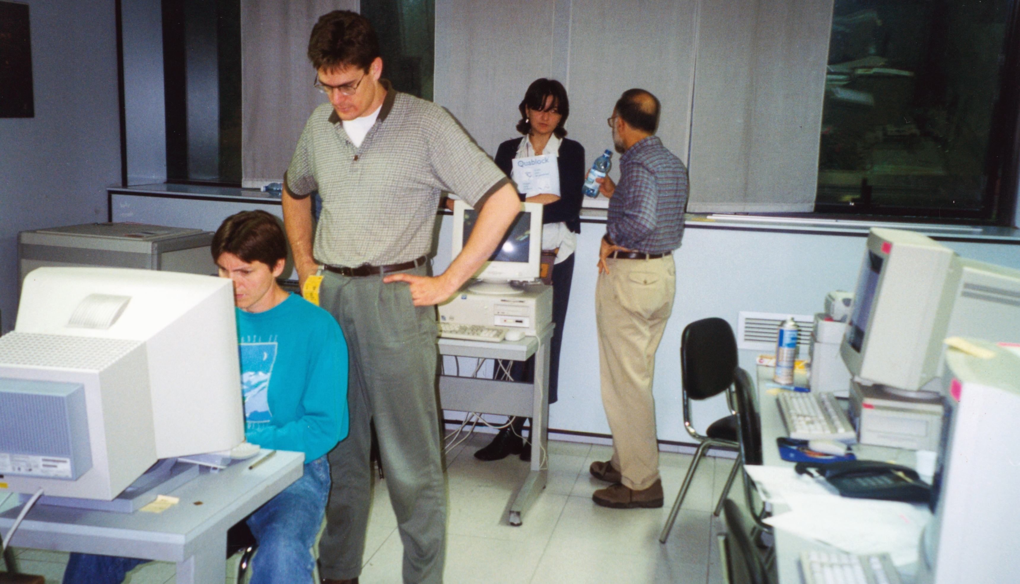

Slide 4
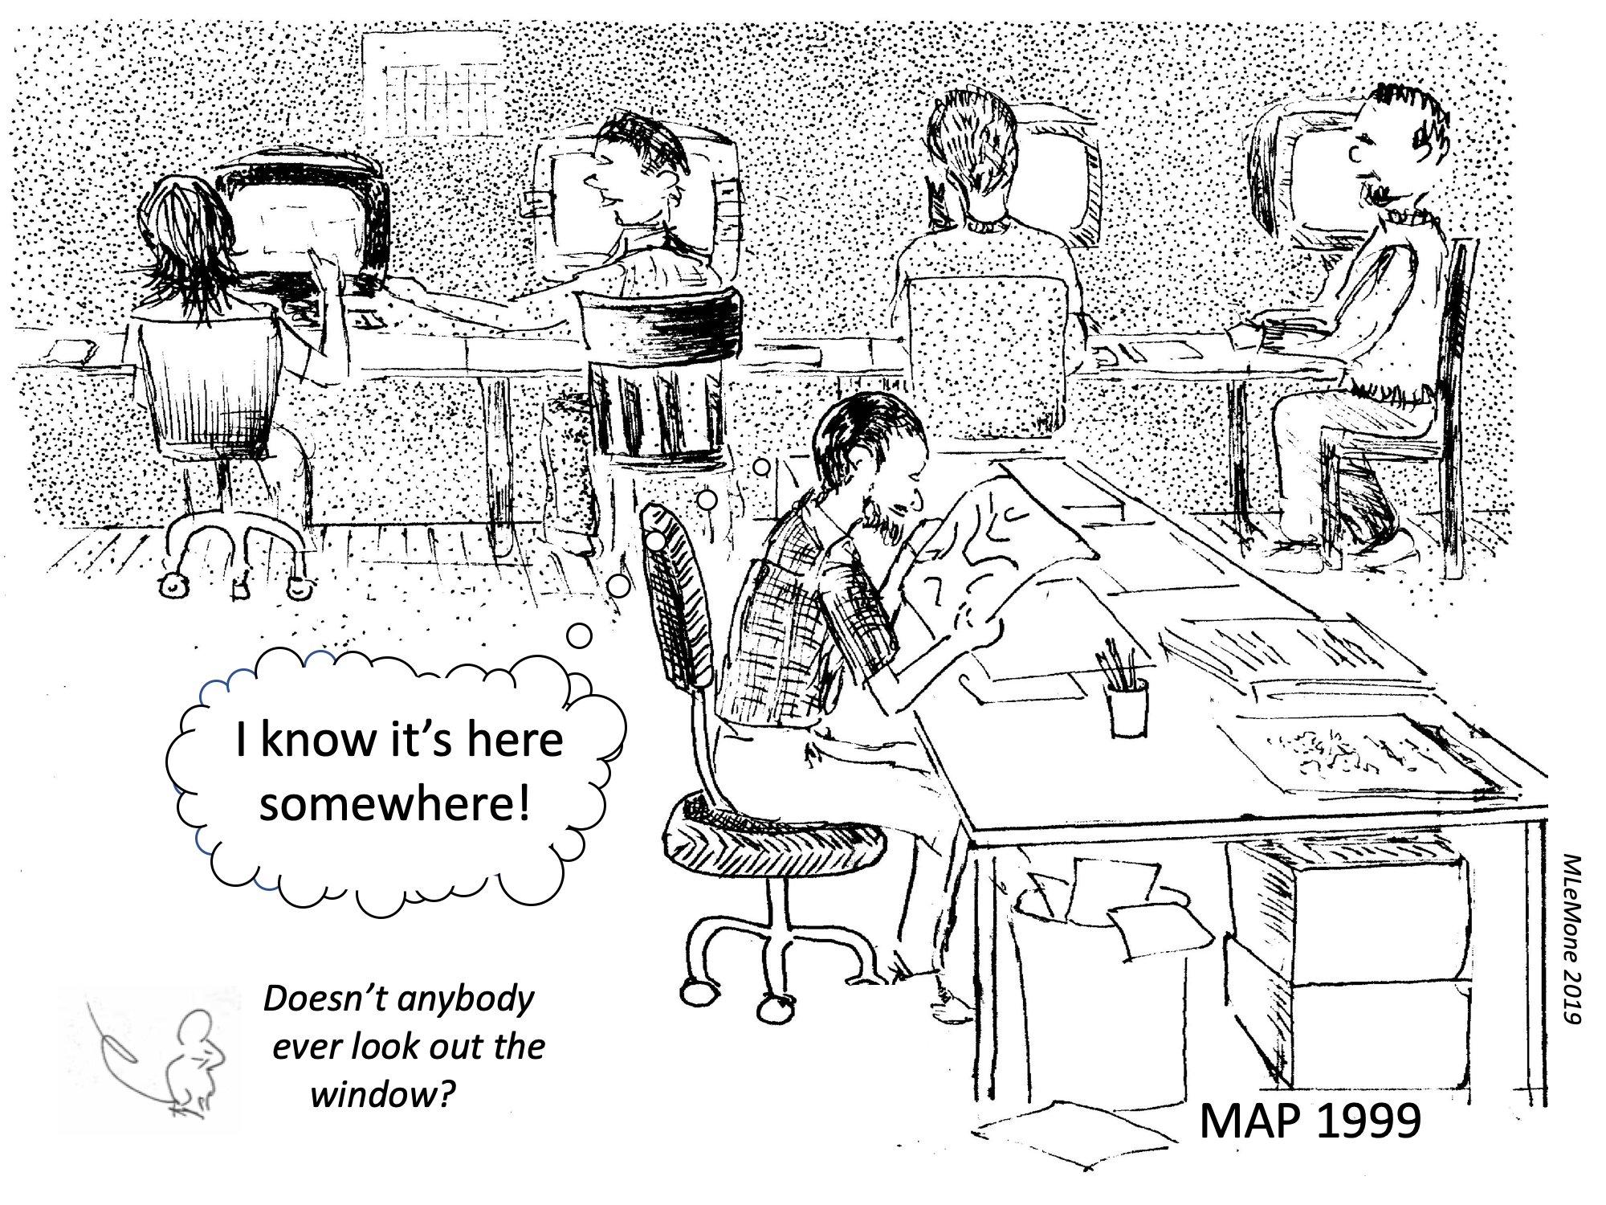

Slide 5
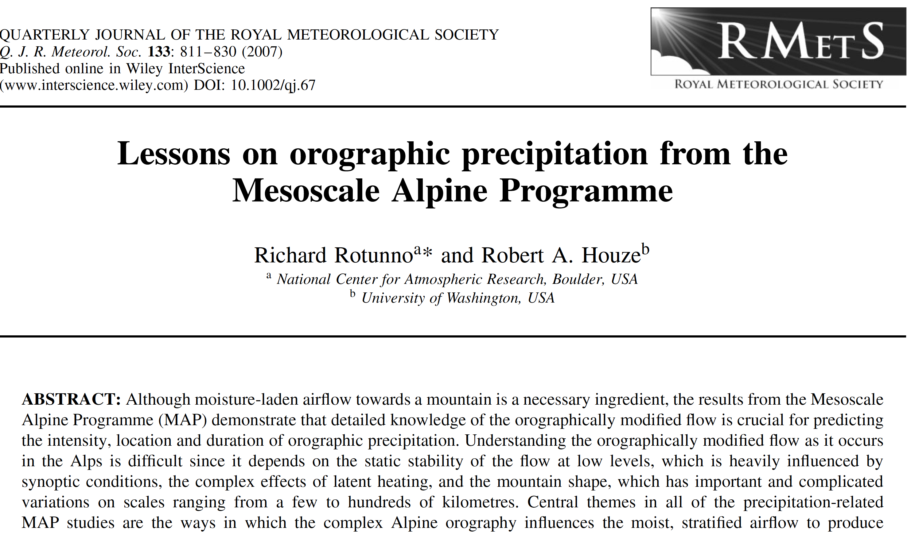

Slide 6
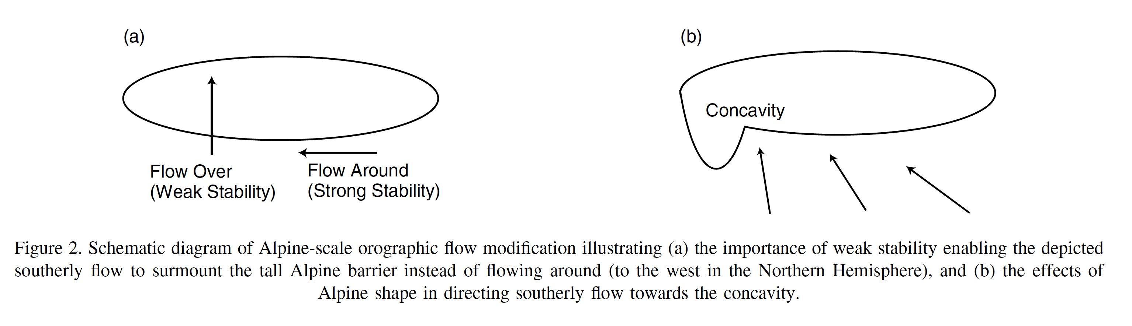
Rich’s Idea

Slide 7
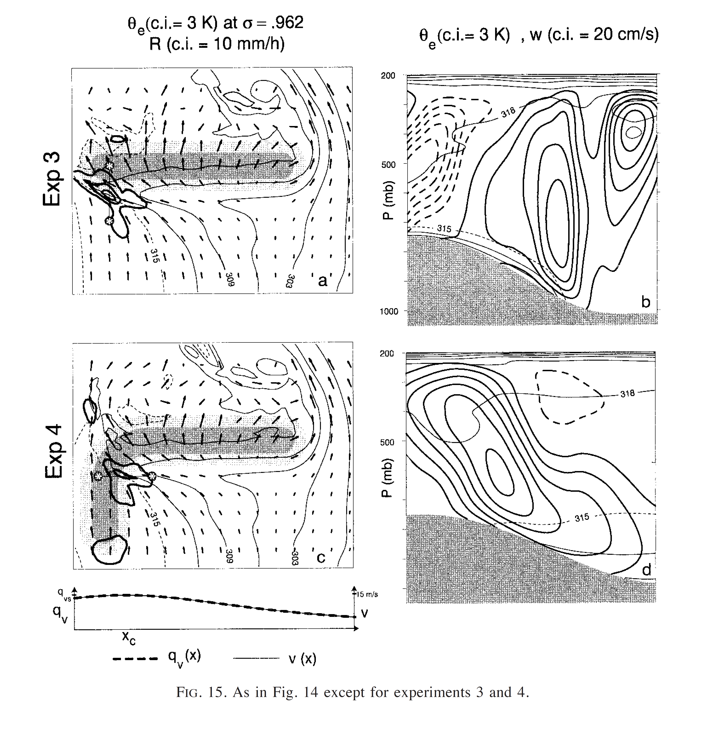
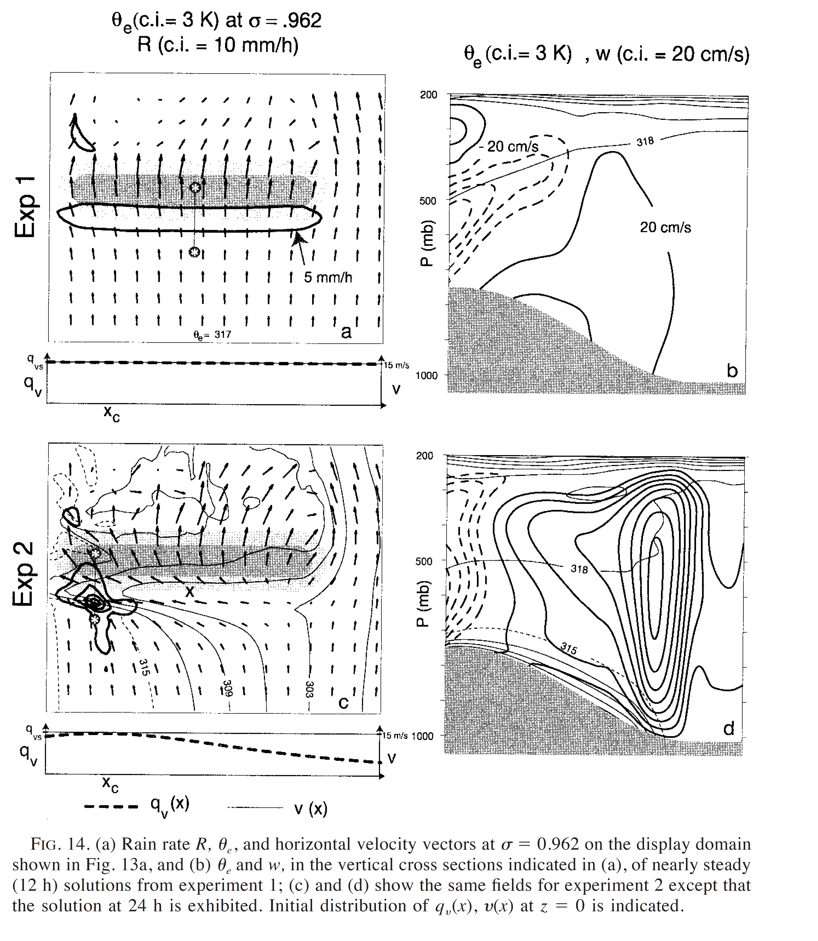
Rotunno and
Ferretti 2001

Slide 8
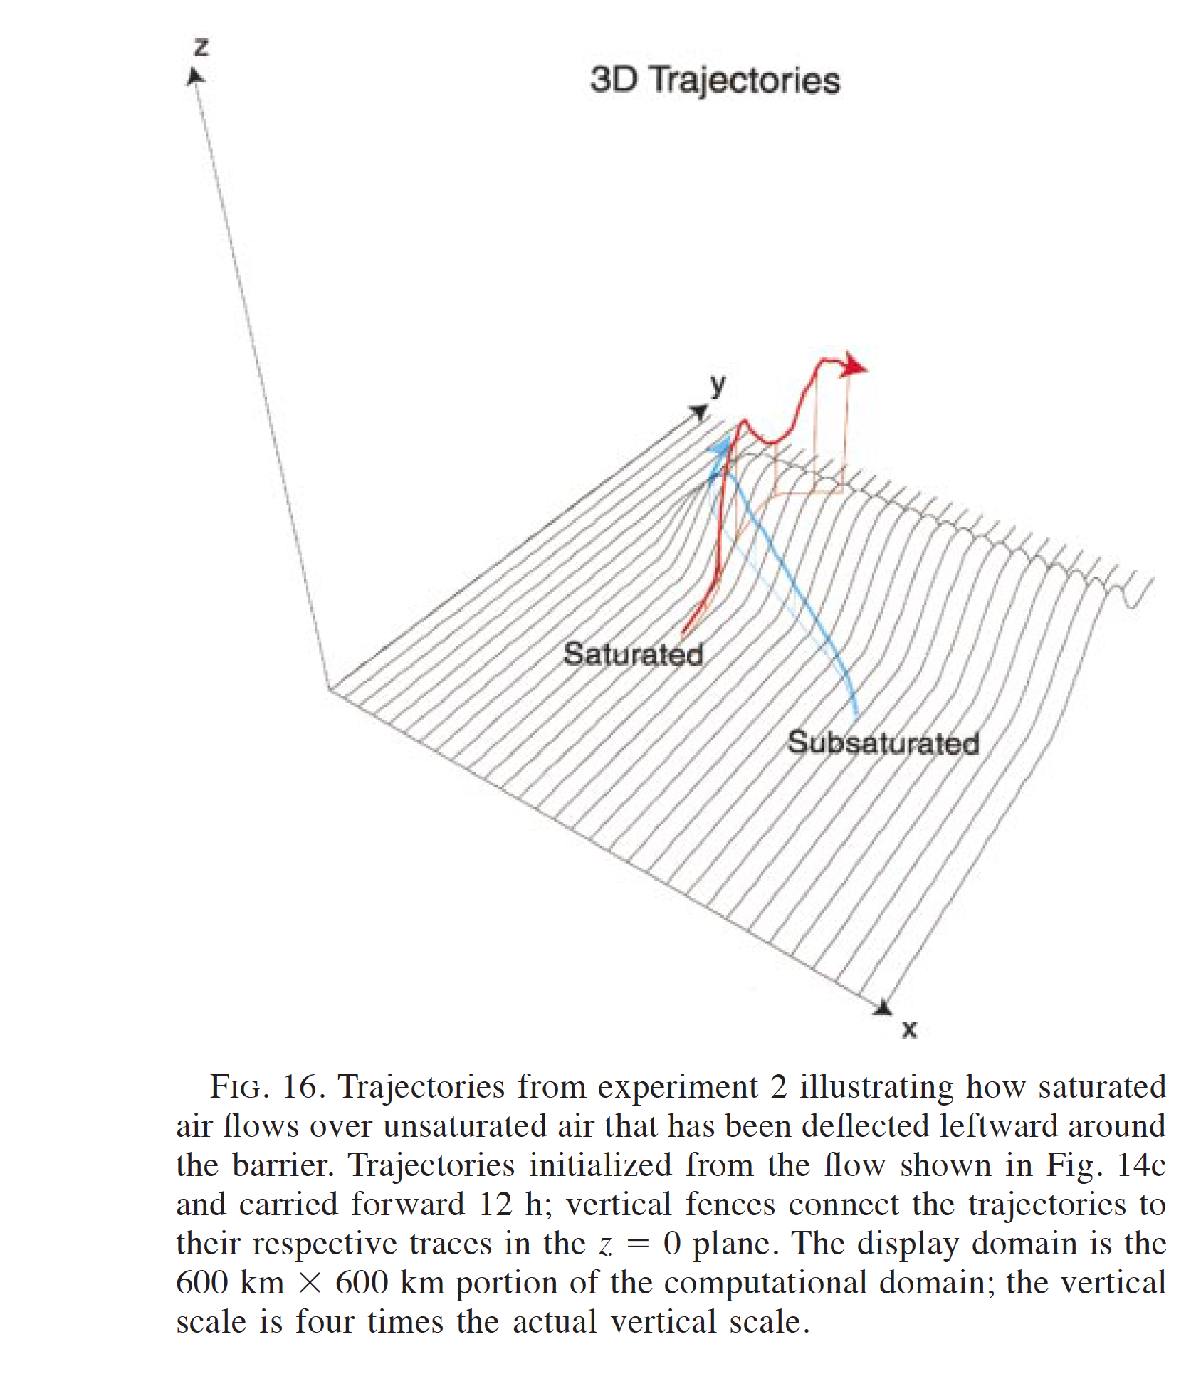
Rotunno and
Ferretti 2001

Slide 9
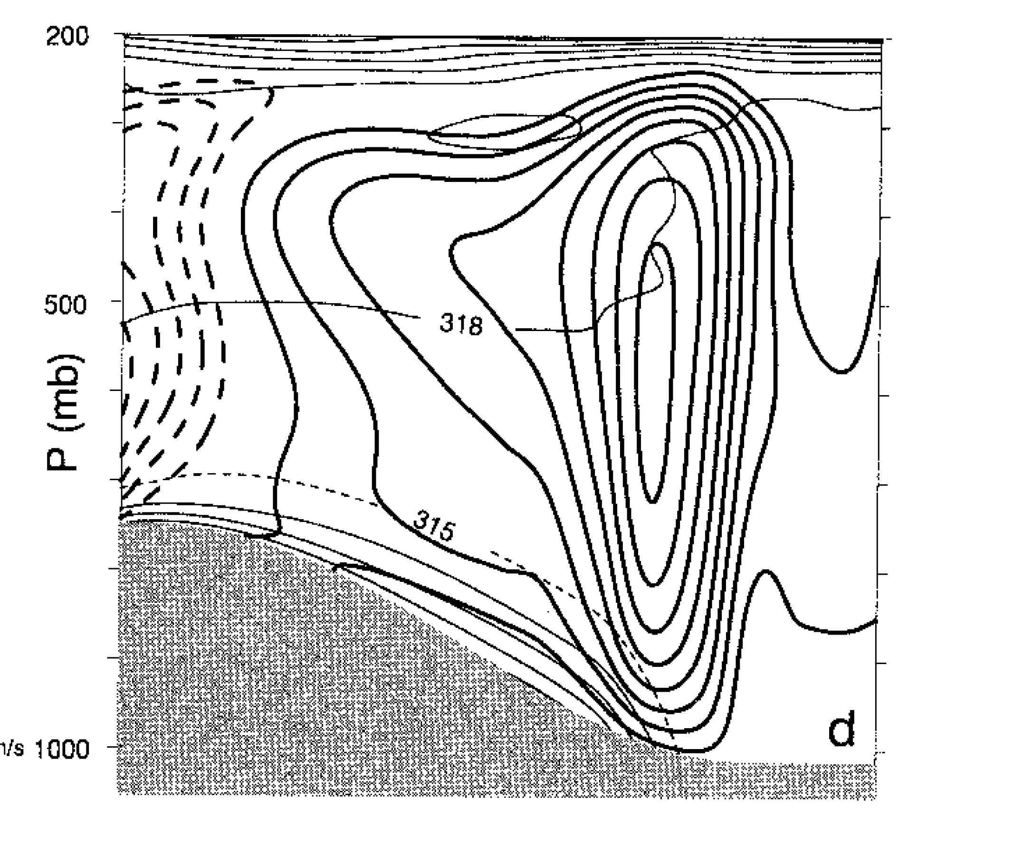
Rotunno and
Ferretti 2001

Slide 10
MAP
IOP2b and IOP8

Slide 11
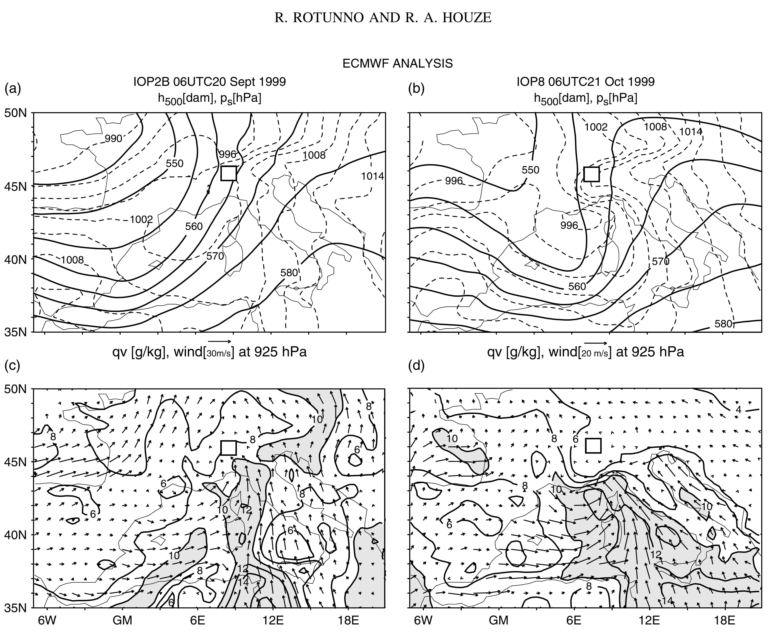
500 hPa
Height &
SLP
IOP 2b
IOP 8
925 hPa
Wind and
qv
Rotunno and Ferretti 2003

Slide 12
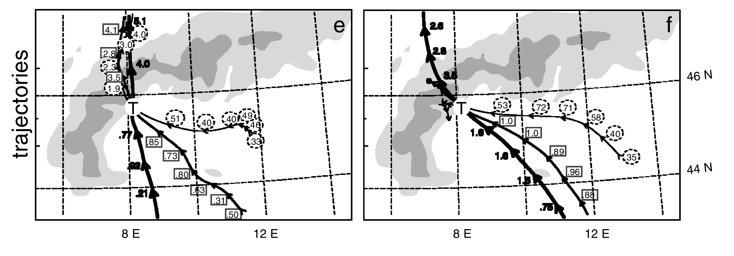
Rotunno and Ferretti 2003
IOP 2b
IOP 8
Alps
Alps
low
low
middle
middle
high
high
Trajectories passing through target area

Slide 13
MAP Radars

Slide 14
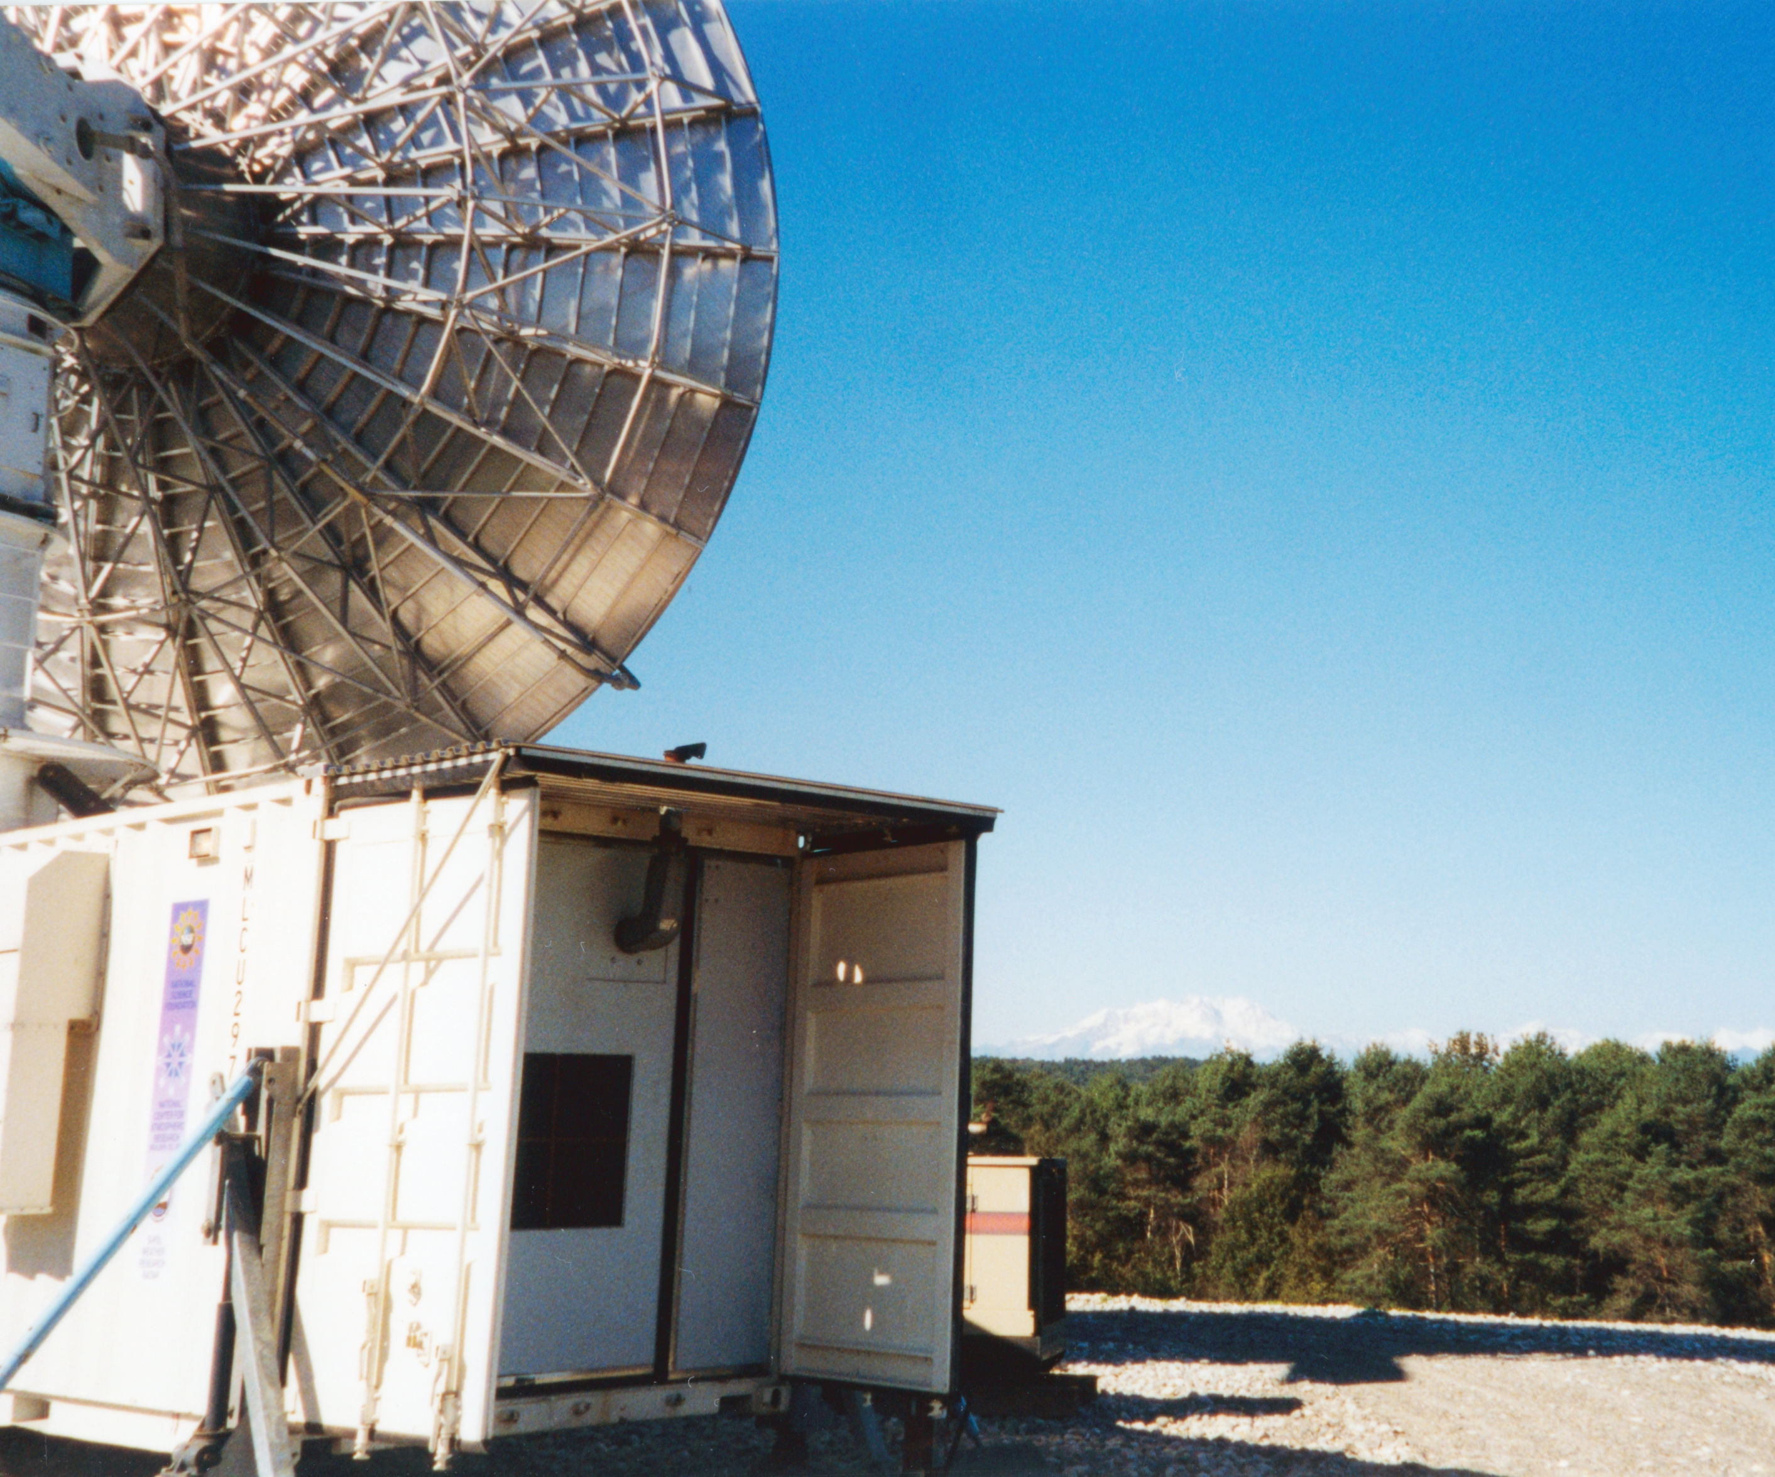

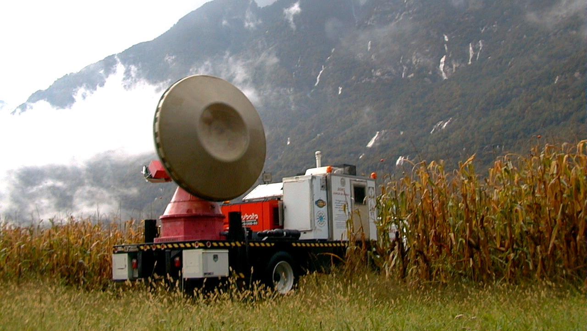
NOAA P3
NCAR S-Pol Radar
DOW radar
ETH VP radar

Slide 15
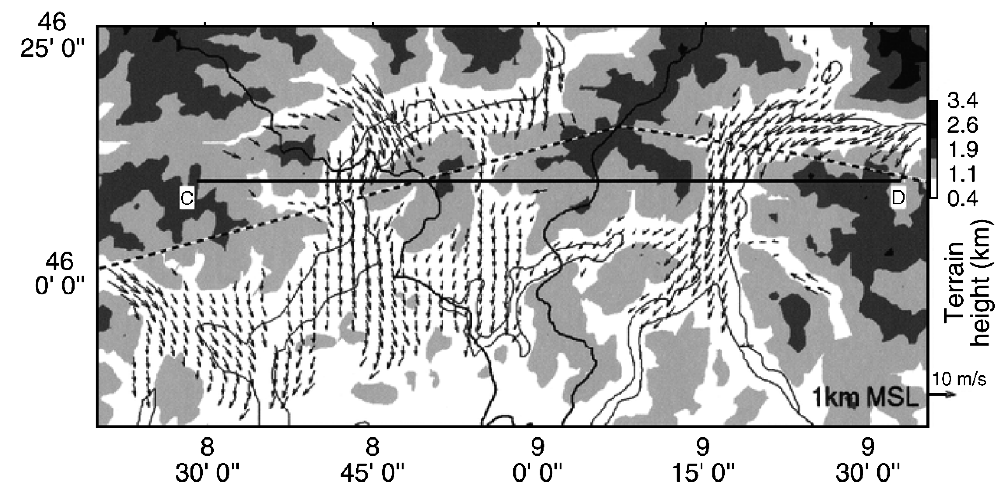
Bousquet and Smull 2003
IOP 8

Slide 16
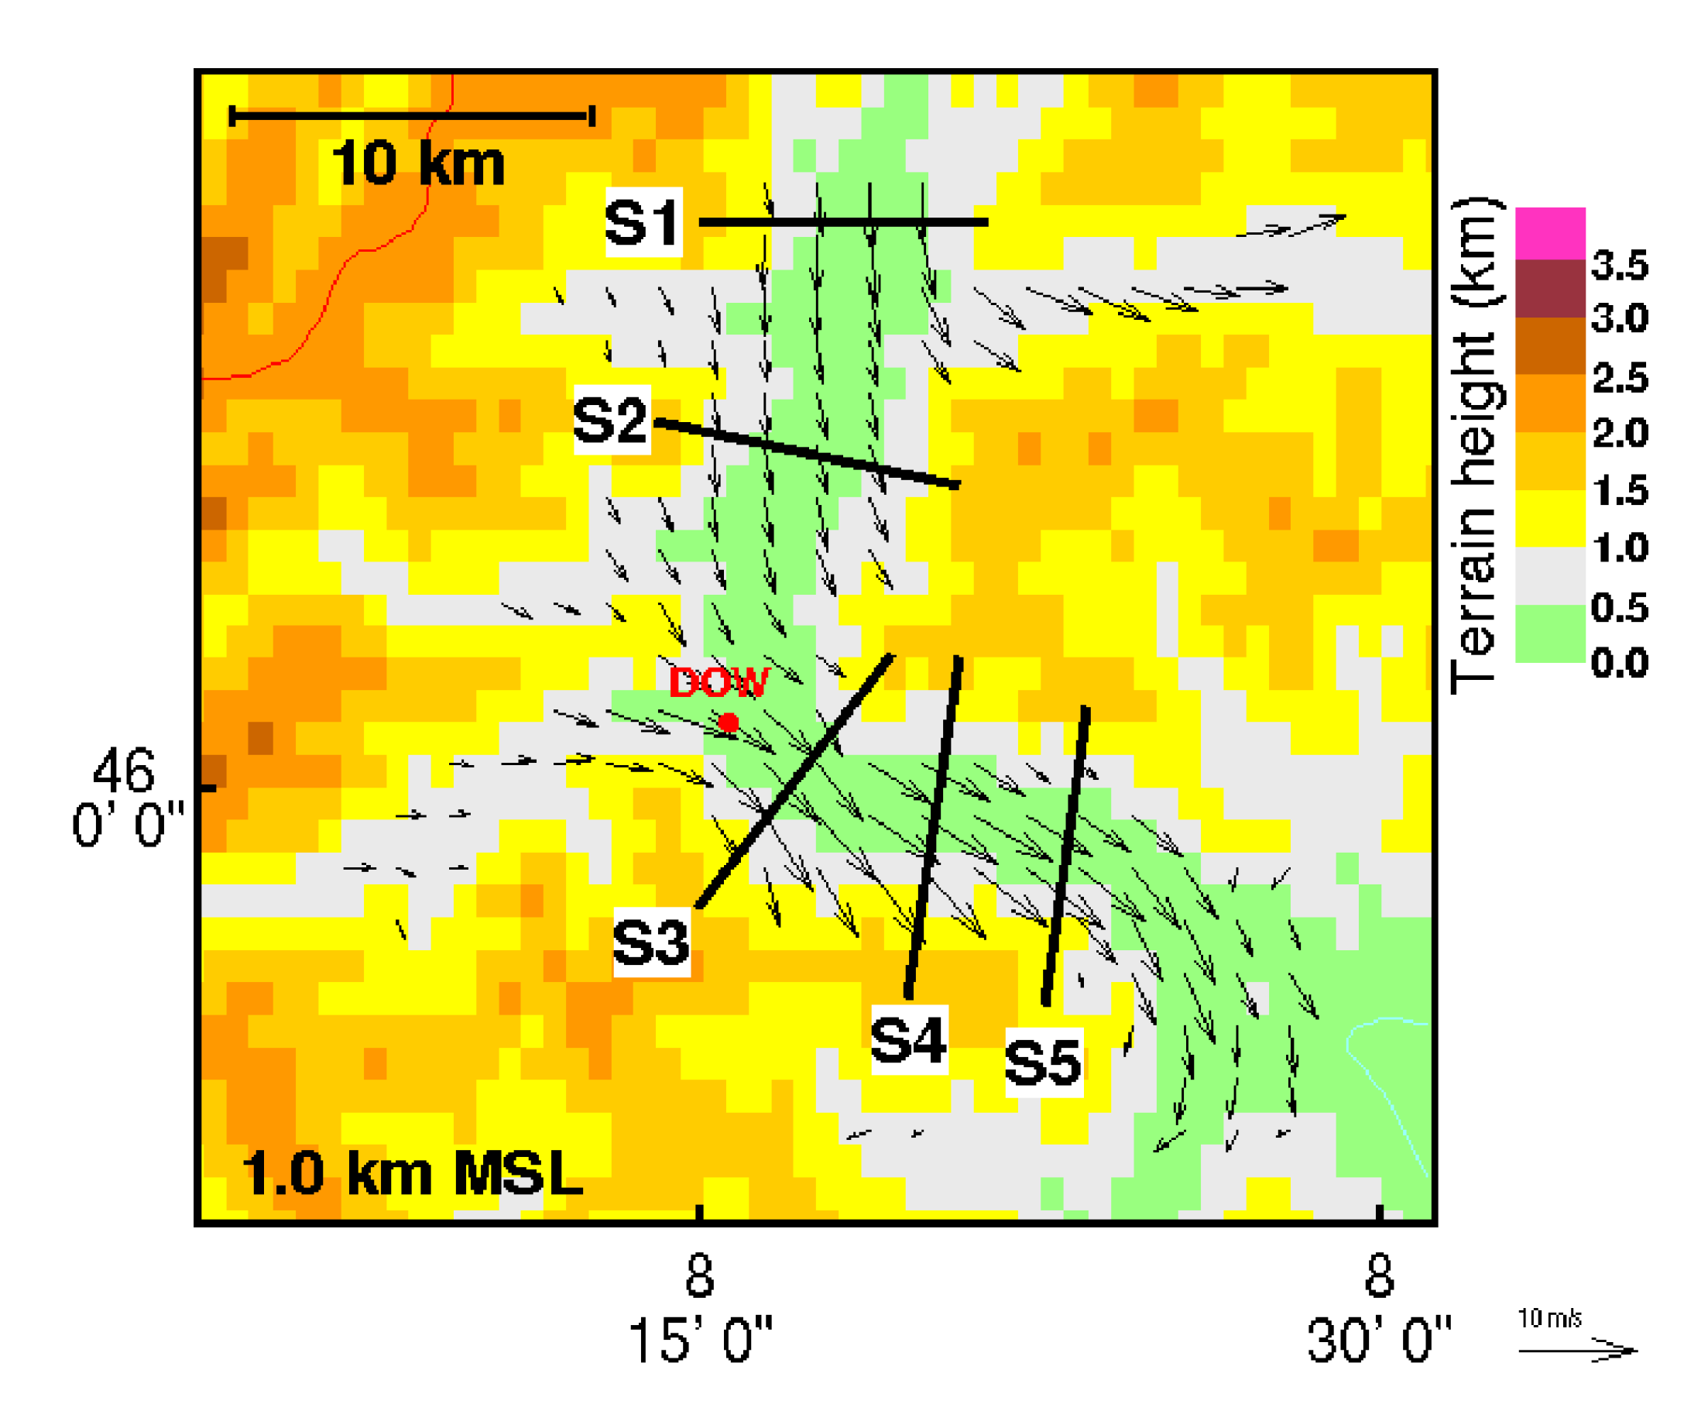
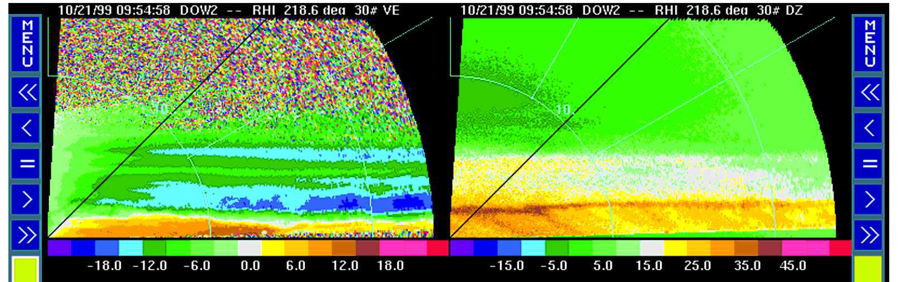
IOP 8
DOW radar was scanning up and down the valley
Radial Velocity
Reflectivity
Steiner et al. 2003

Slide 17
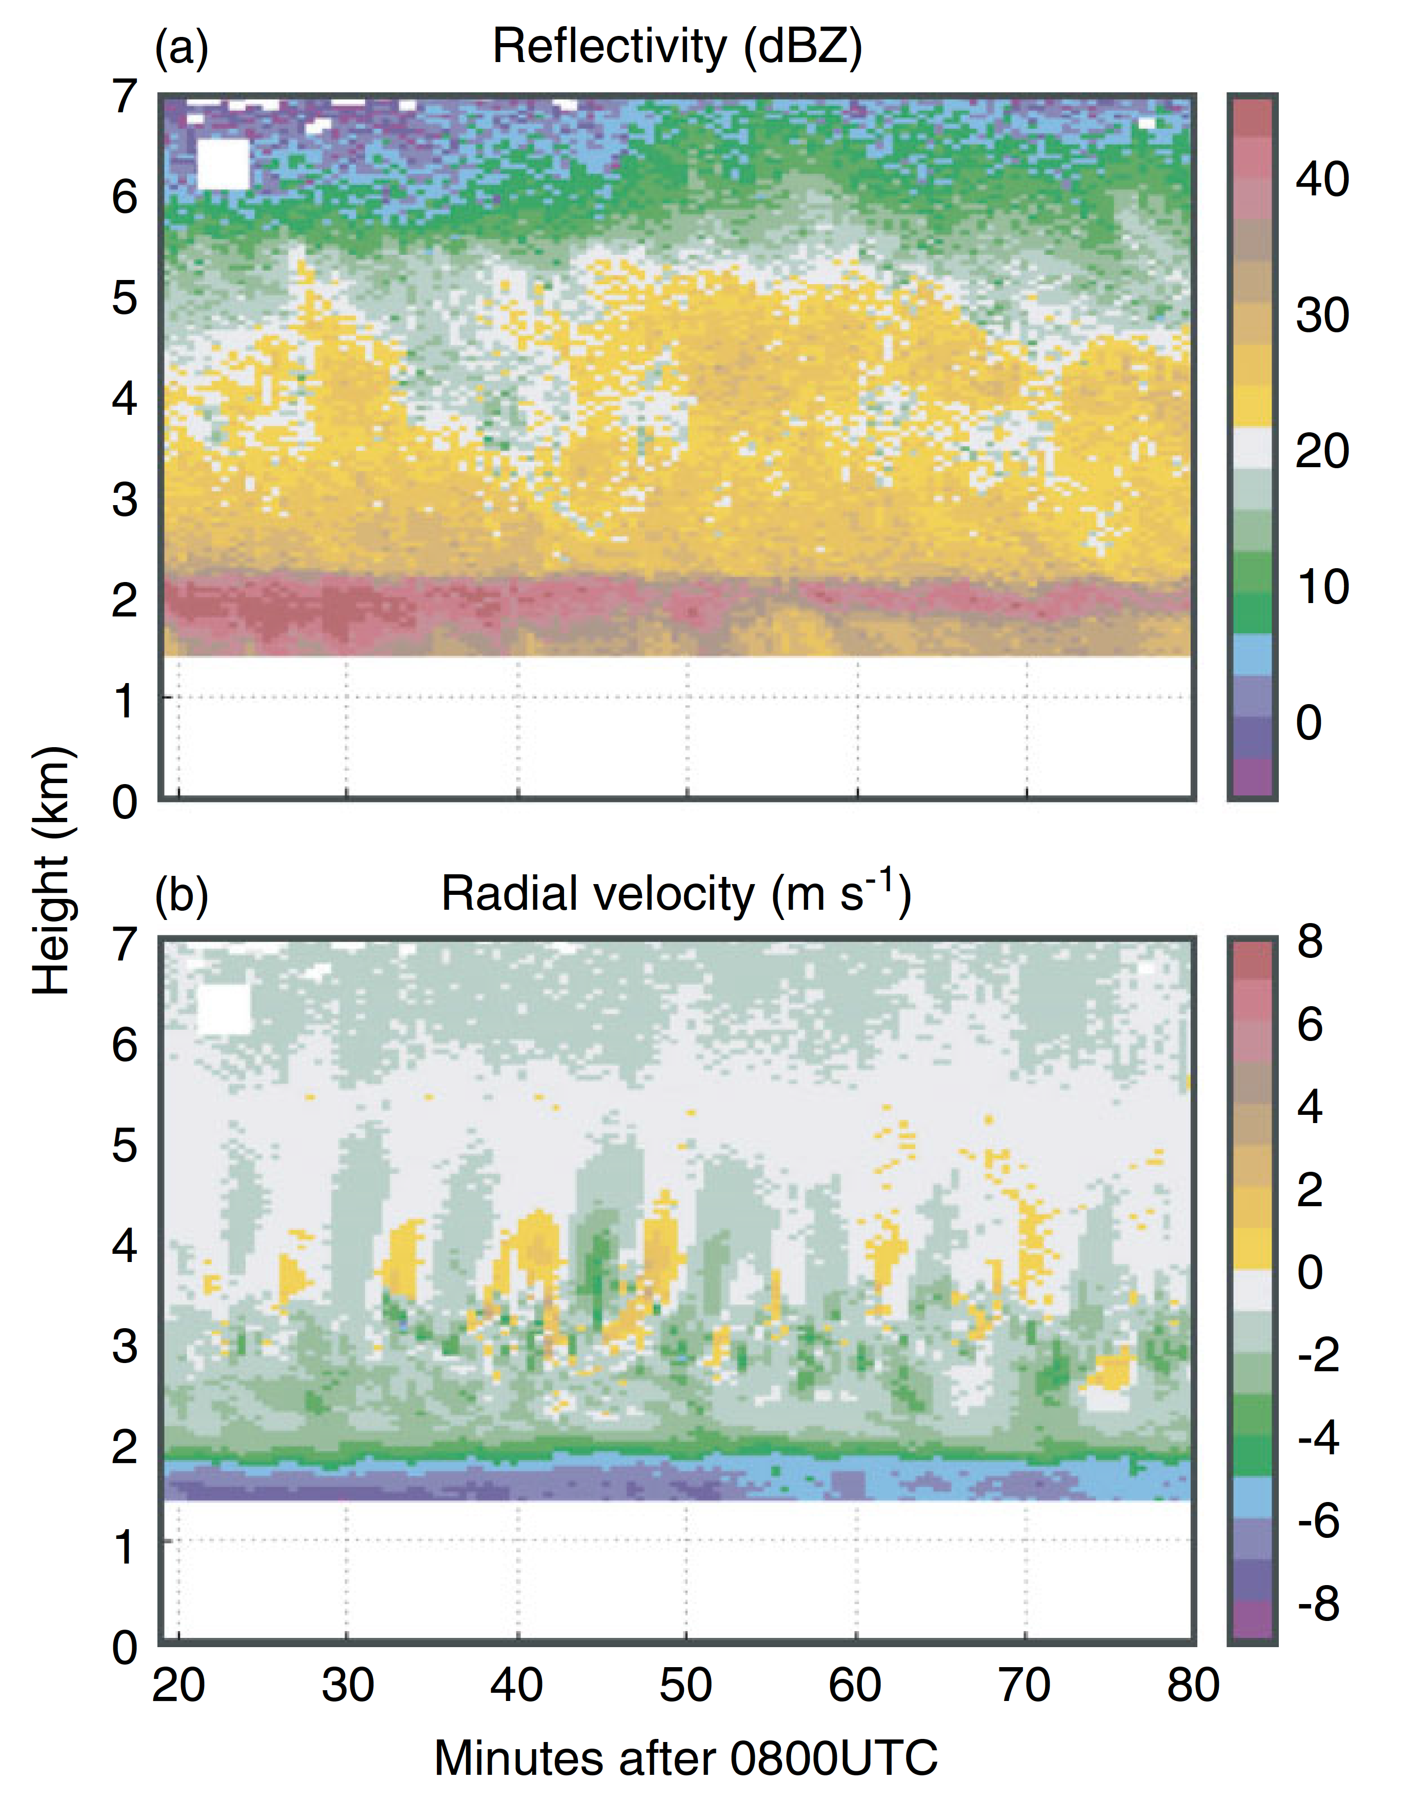
IOP 8
ETH Vertically Pointing X-band Radar
Houze and Medina 2005

Slide 18
OLYMPEX 2015

Slide 19
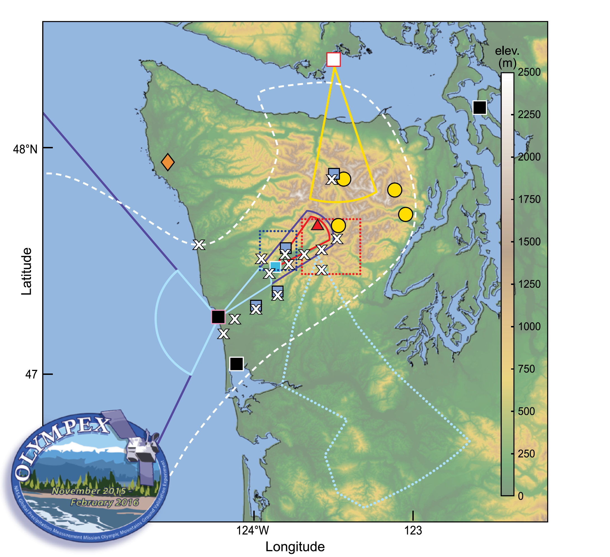
3 Research radars on the coast
DOW in valley
Canada C-band on leeside
NASA APR3 radar on DC-8
ND Citation doing in situ microphysics
NASA ER-2 doing remote sensing
Ground based network of particle sizes
+ other things
Houze et al. 2017

Slide 20
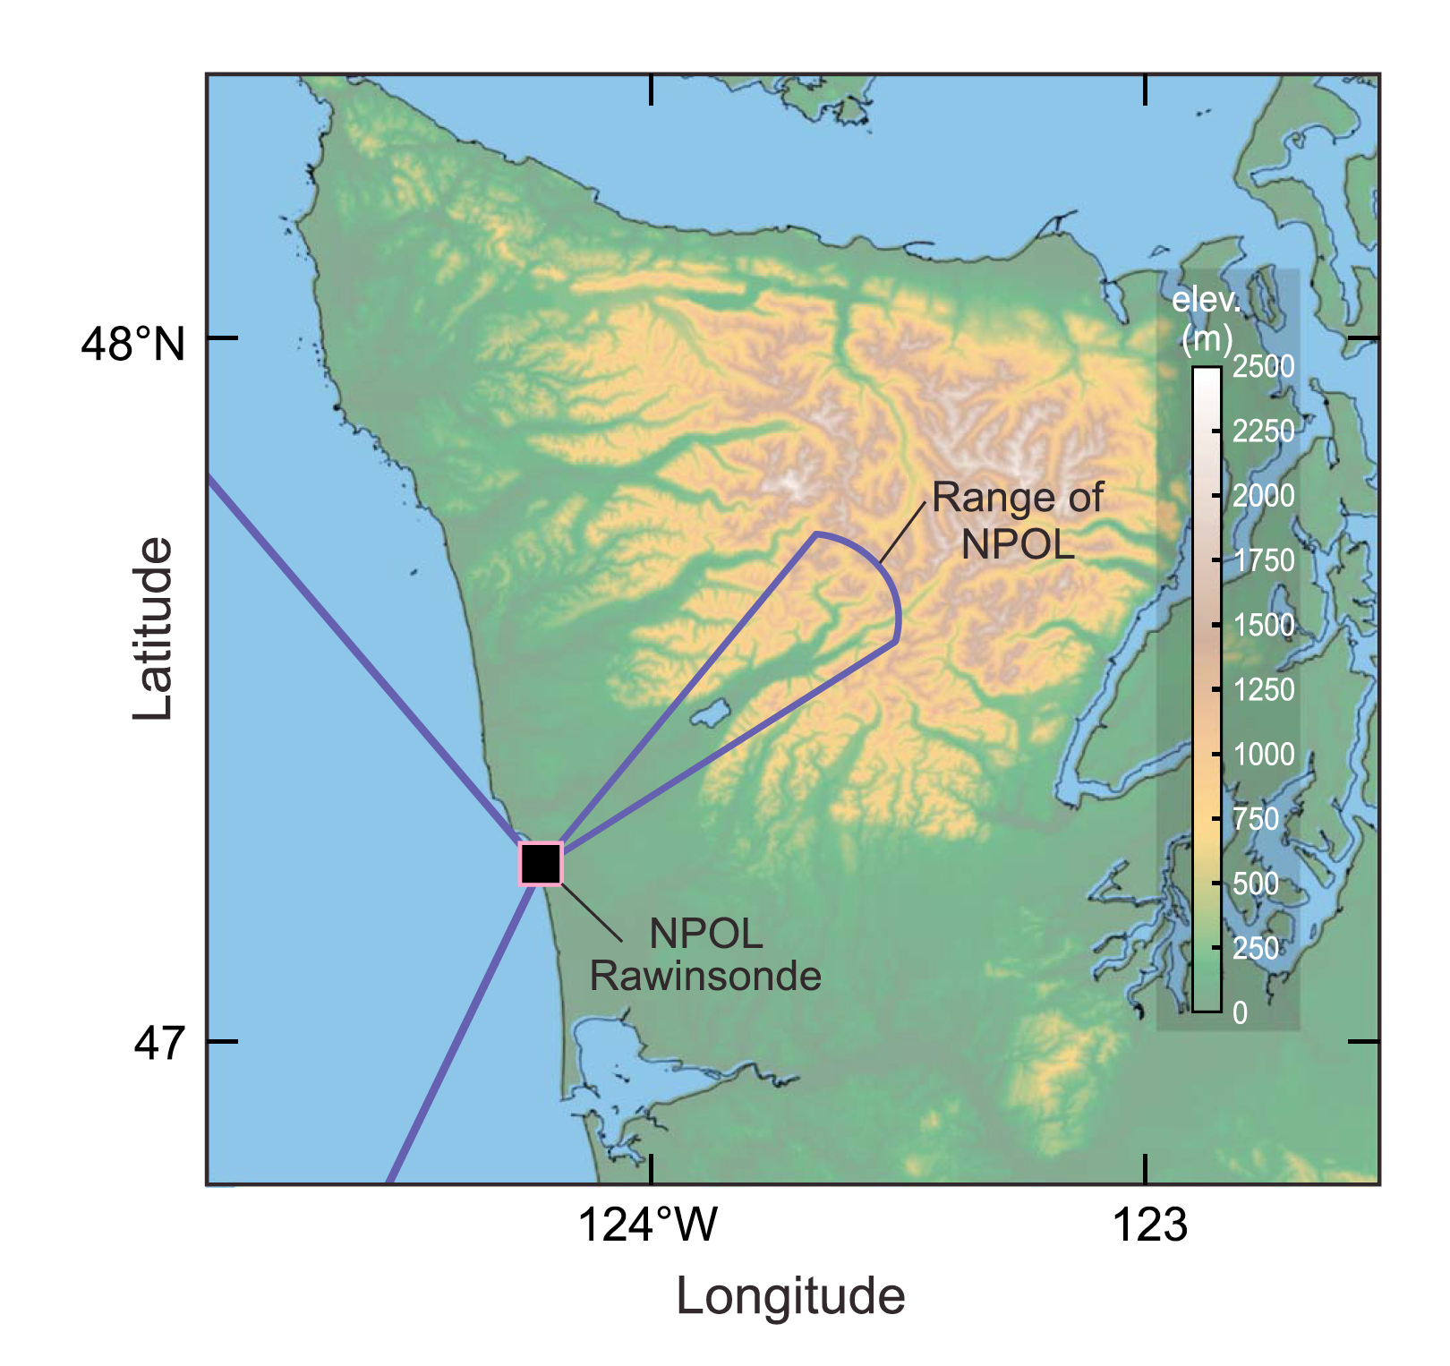
NPOL RHI scanning pattern in OLYMPEX

Slide 21
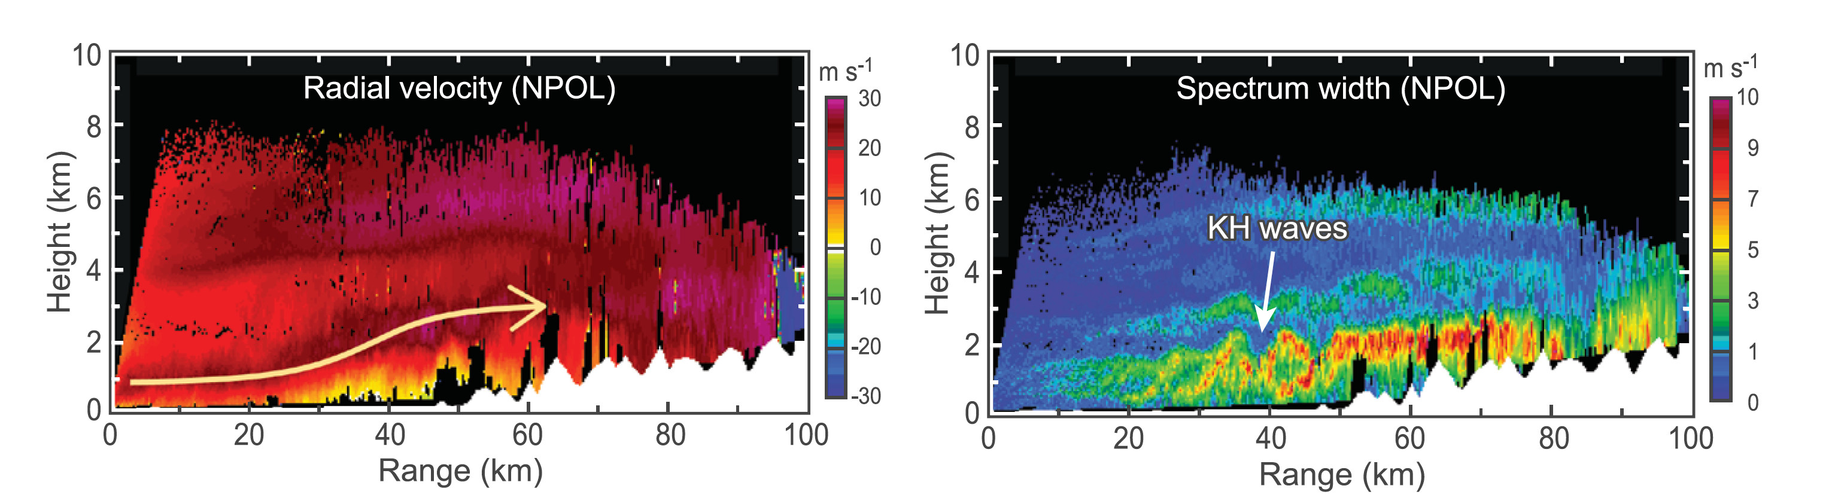
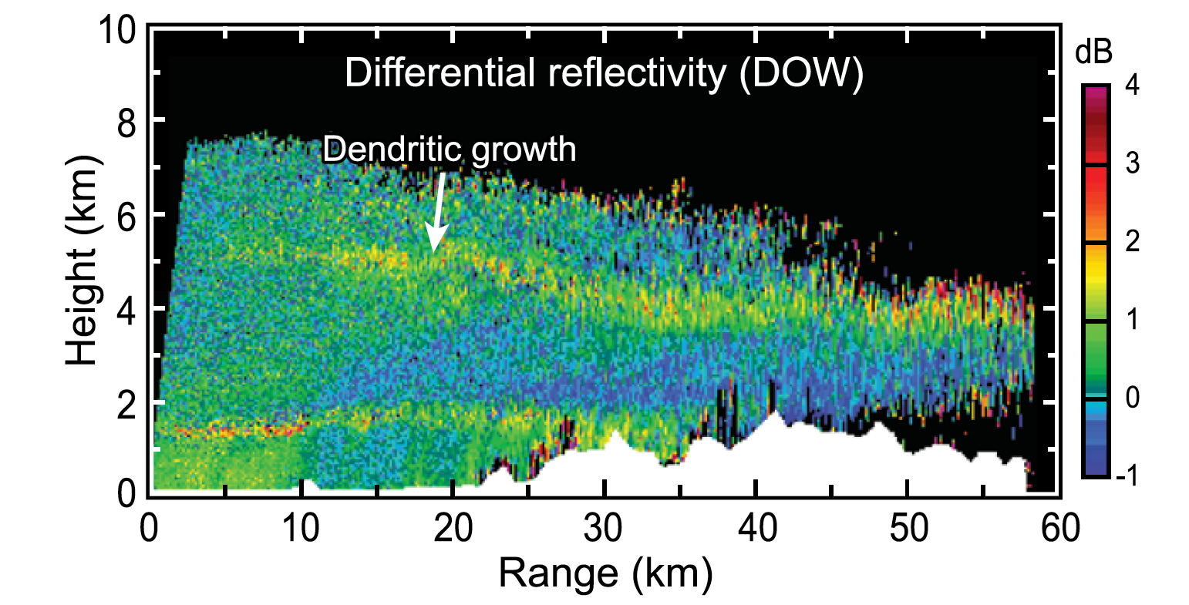
Example RHI data from NPOL
Houze et al. (2017)

Slide 22
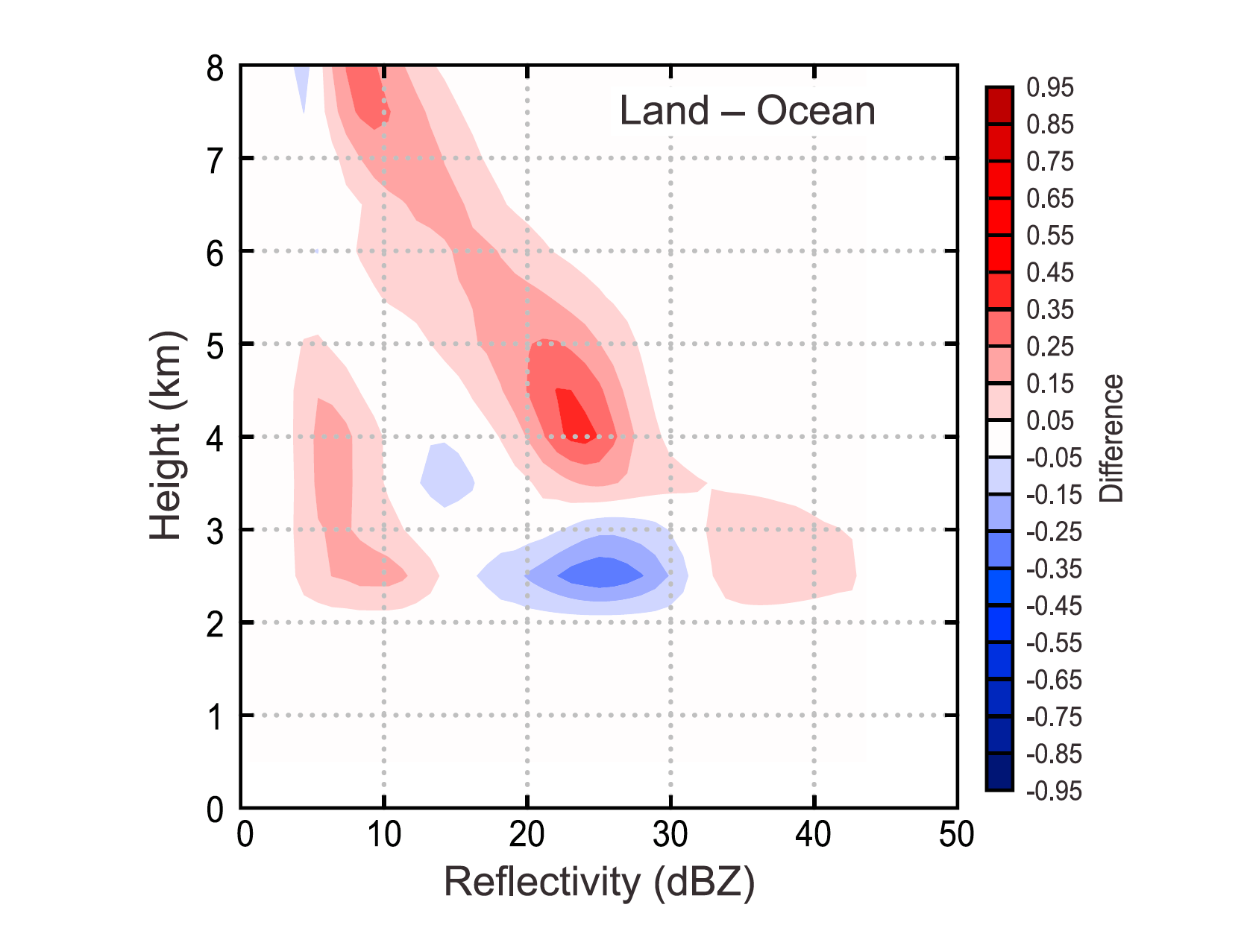
OLYMPEX measured precipitation enhancement
at all levels
0°C
McMurdie et al. (2018)

Slide 23
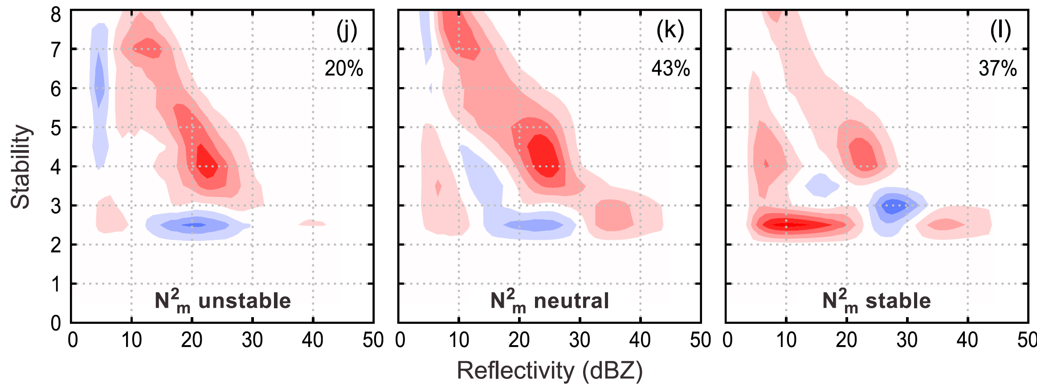
Variation of enhancement with low-level stability
N²_{m} = Moist Brunt-Väisälä frequency
In 850-950 hPa layer
Unstable: N²_{m} < –.25 x 10⁴ s^{–2}
Neutral: –.25 x 10⁴ s^{–2} < N²_{m} < +.25 x 10⁴ s^{–2}
Unstable: N²_{m} > +.25 x 10⁴ s^{–2}
McMurdie et al. (2018)

Slide 24
Let’s revisit Rich

Slide 25

He’s just had his next great idea!

Slide 26
Conclusion
Thanks, Rich, for your many great ideas over the years
Especially the role of low level stability in storms passing over mountains!

Slide 27

Chapters 7-9
Convective storms
Chapter 10
Tropical cyclones
Chapter 11
Frontal systems
Chapter 12
Orography

Slide 28
The End

