Slide 1
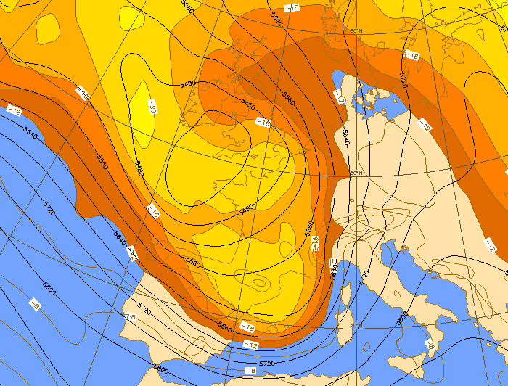
Rich Rotunno in the Mesoscale Alpine Programme (MAP, 1999)
Robert Houze
(with help from Peggy LeMone)
Innsbruck
Milan
35th International Conference on Alpine Meteorology
2-6 September 2019, Riva del Garda, Italy

Slide 2
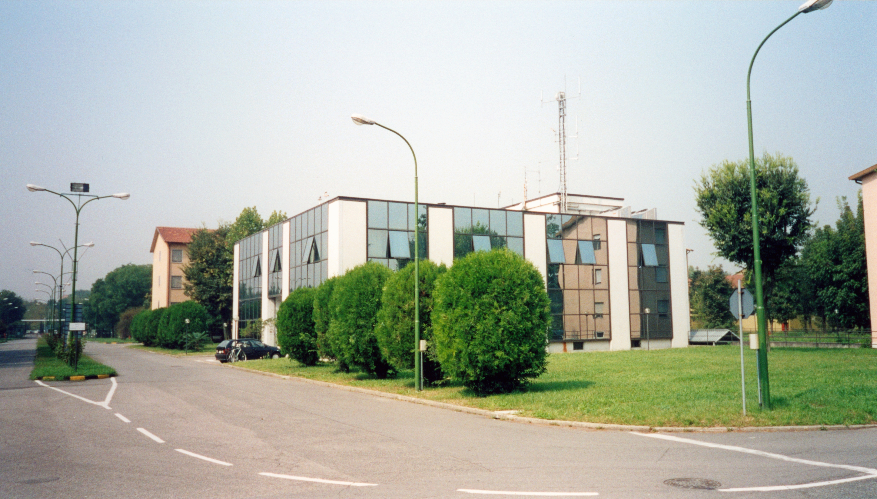
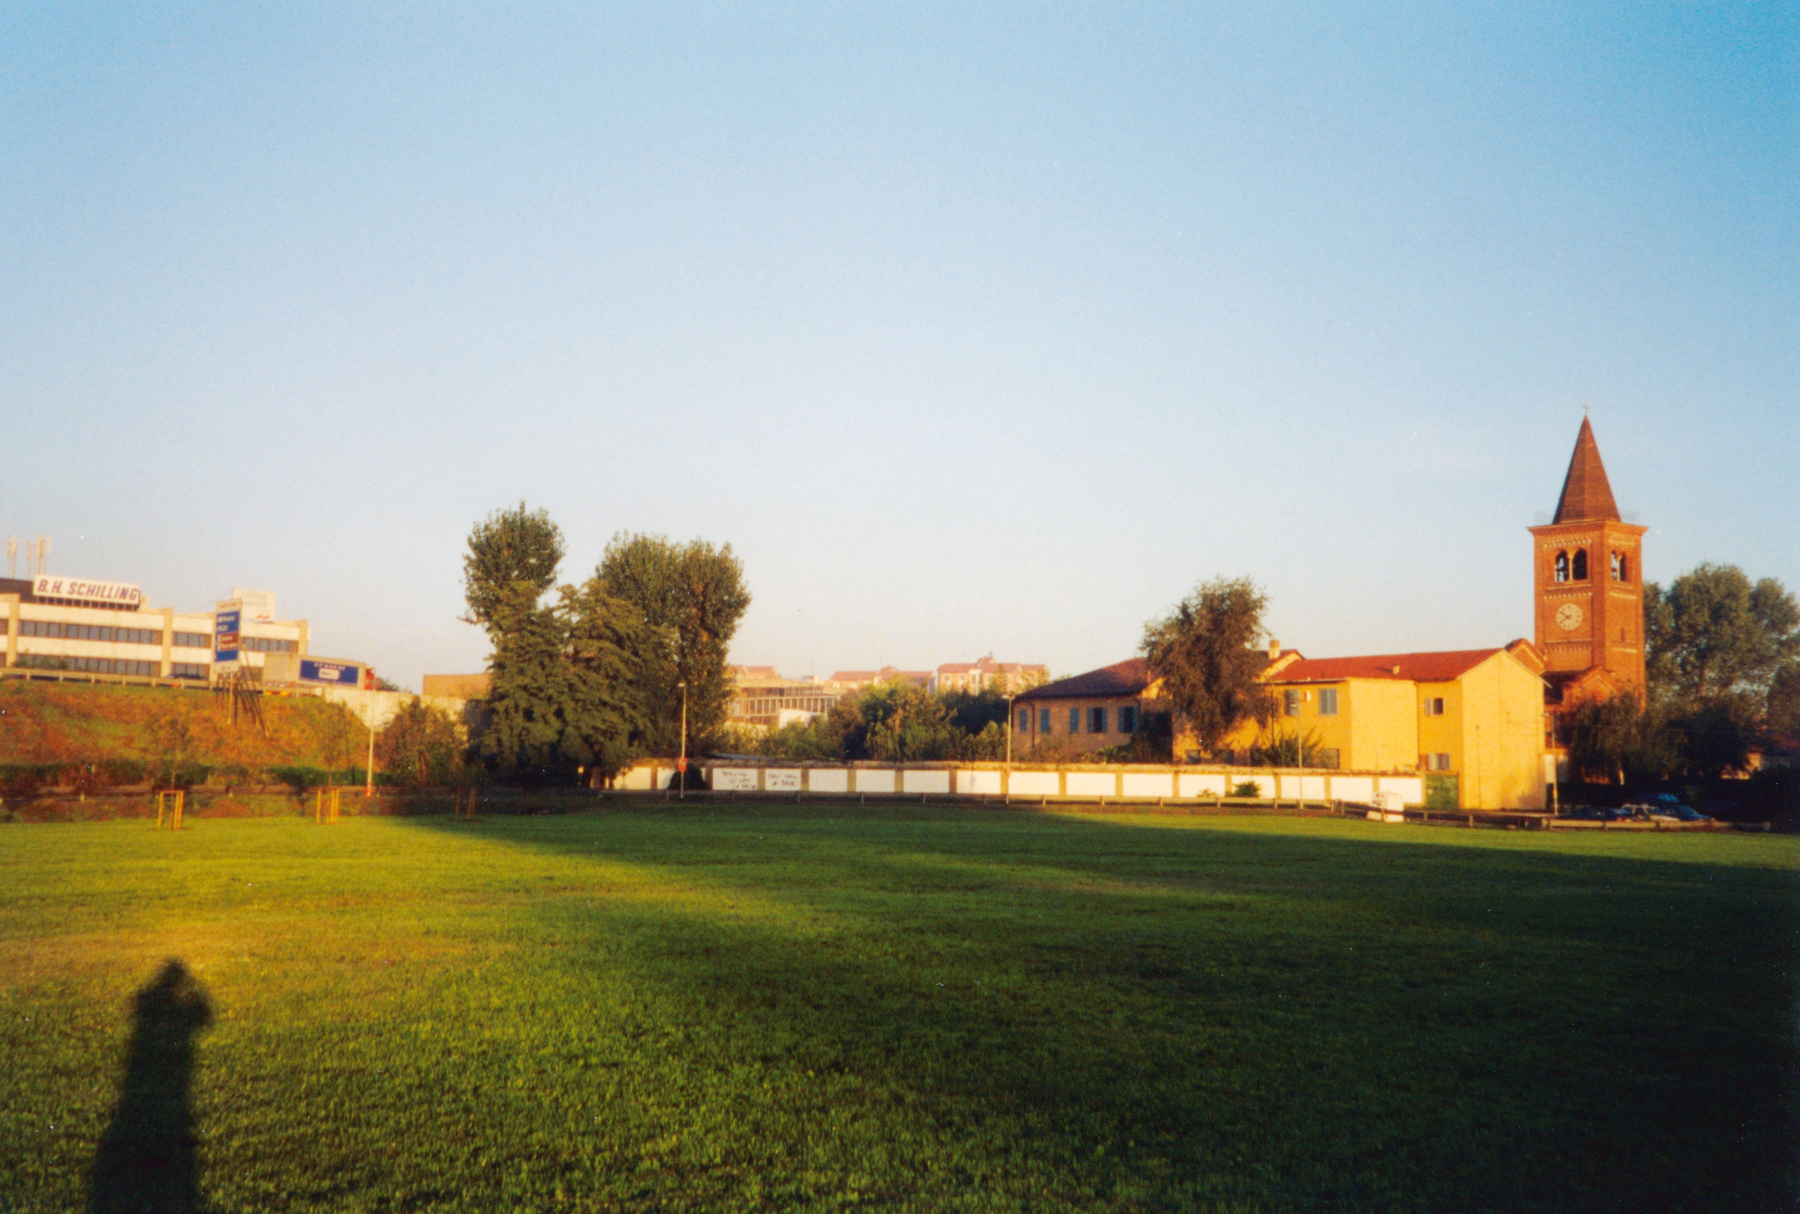
“Wet” MAP Operation Center
Regional Meteorological Center of Milano Linate
MAP morning bike ride
Chiesa di San Lorenzo
Parco Monluè

Slide 3
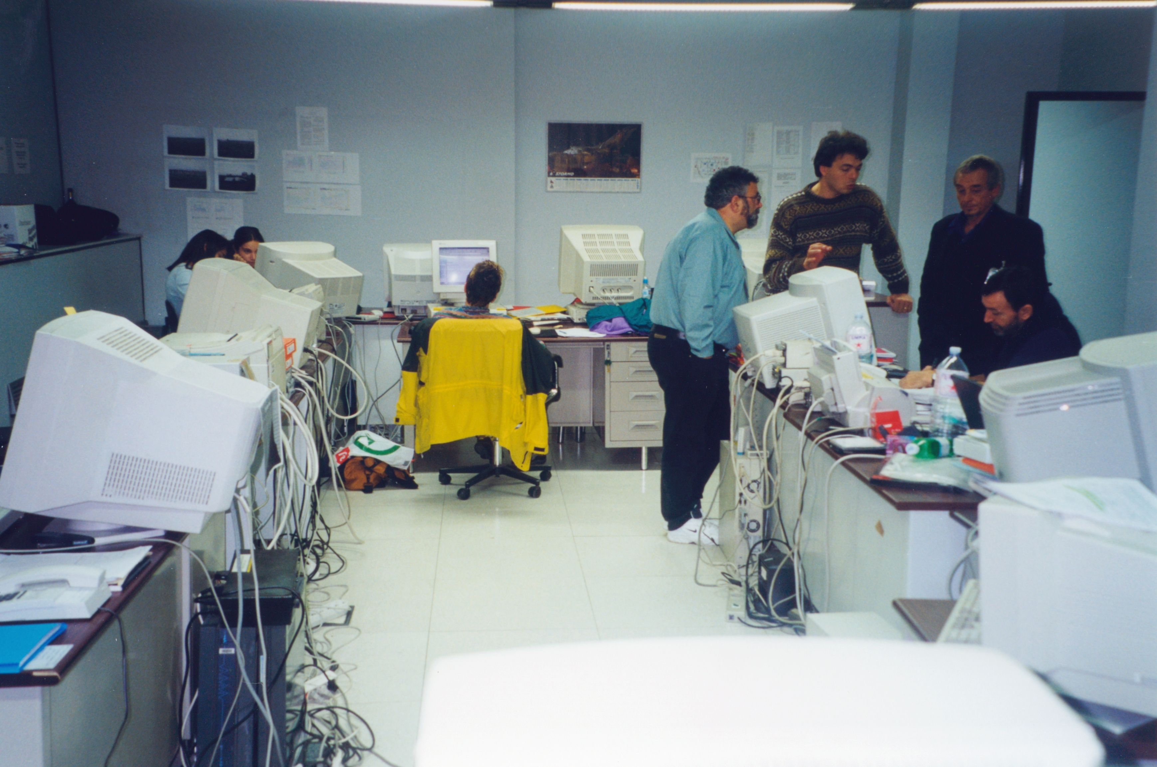
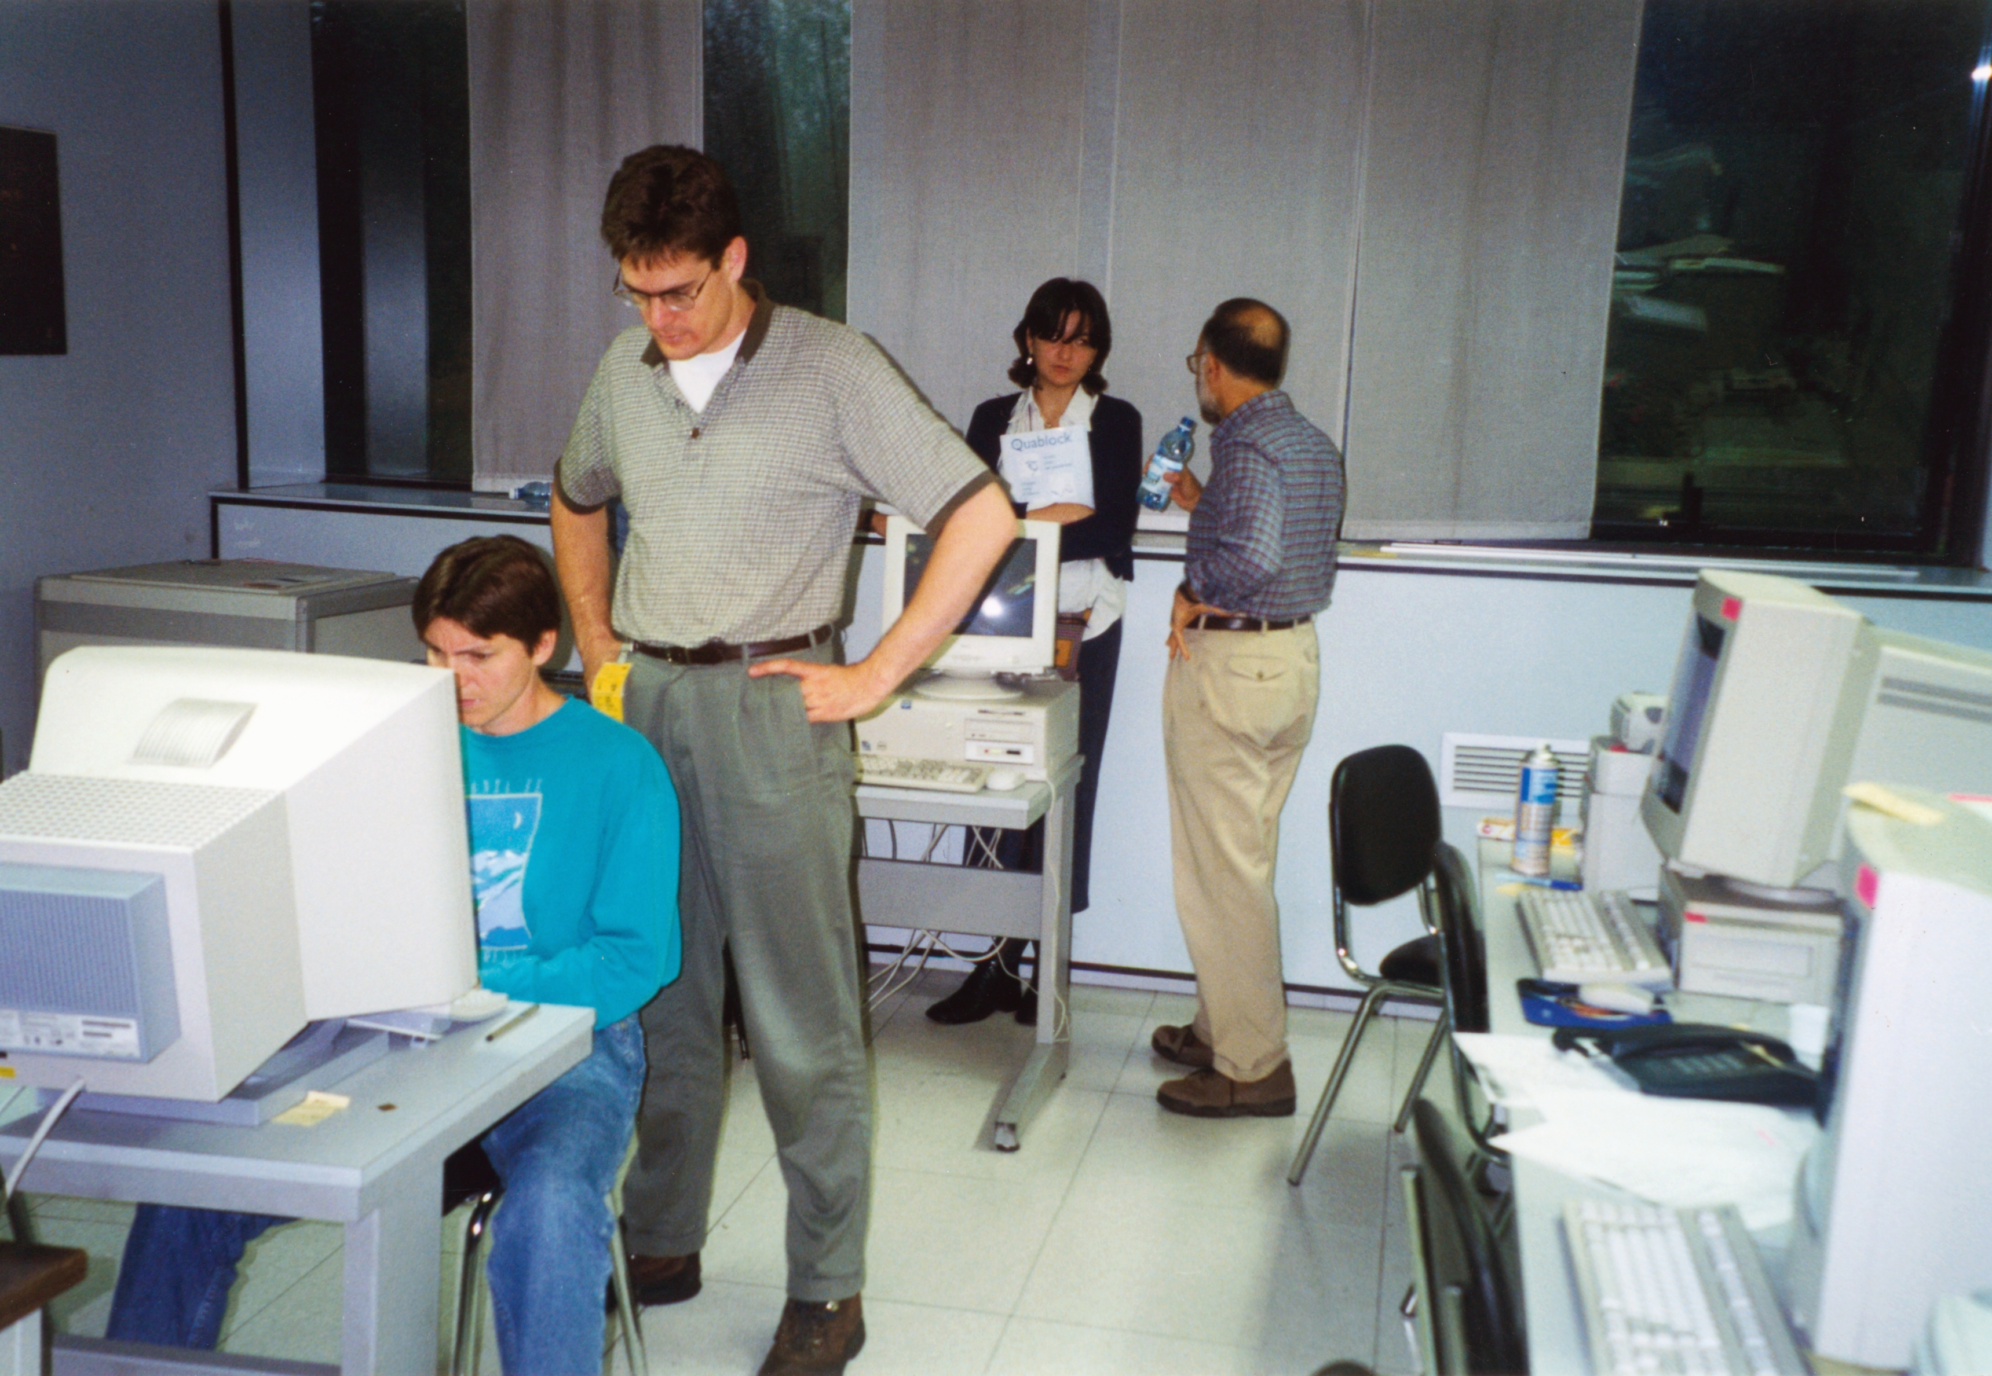

Slide 4
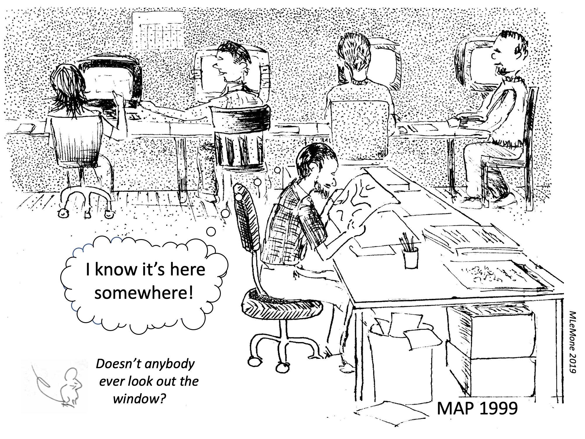

Slide 5
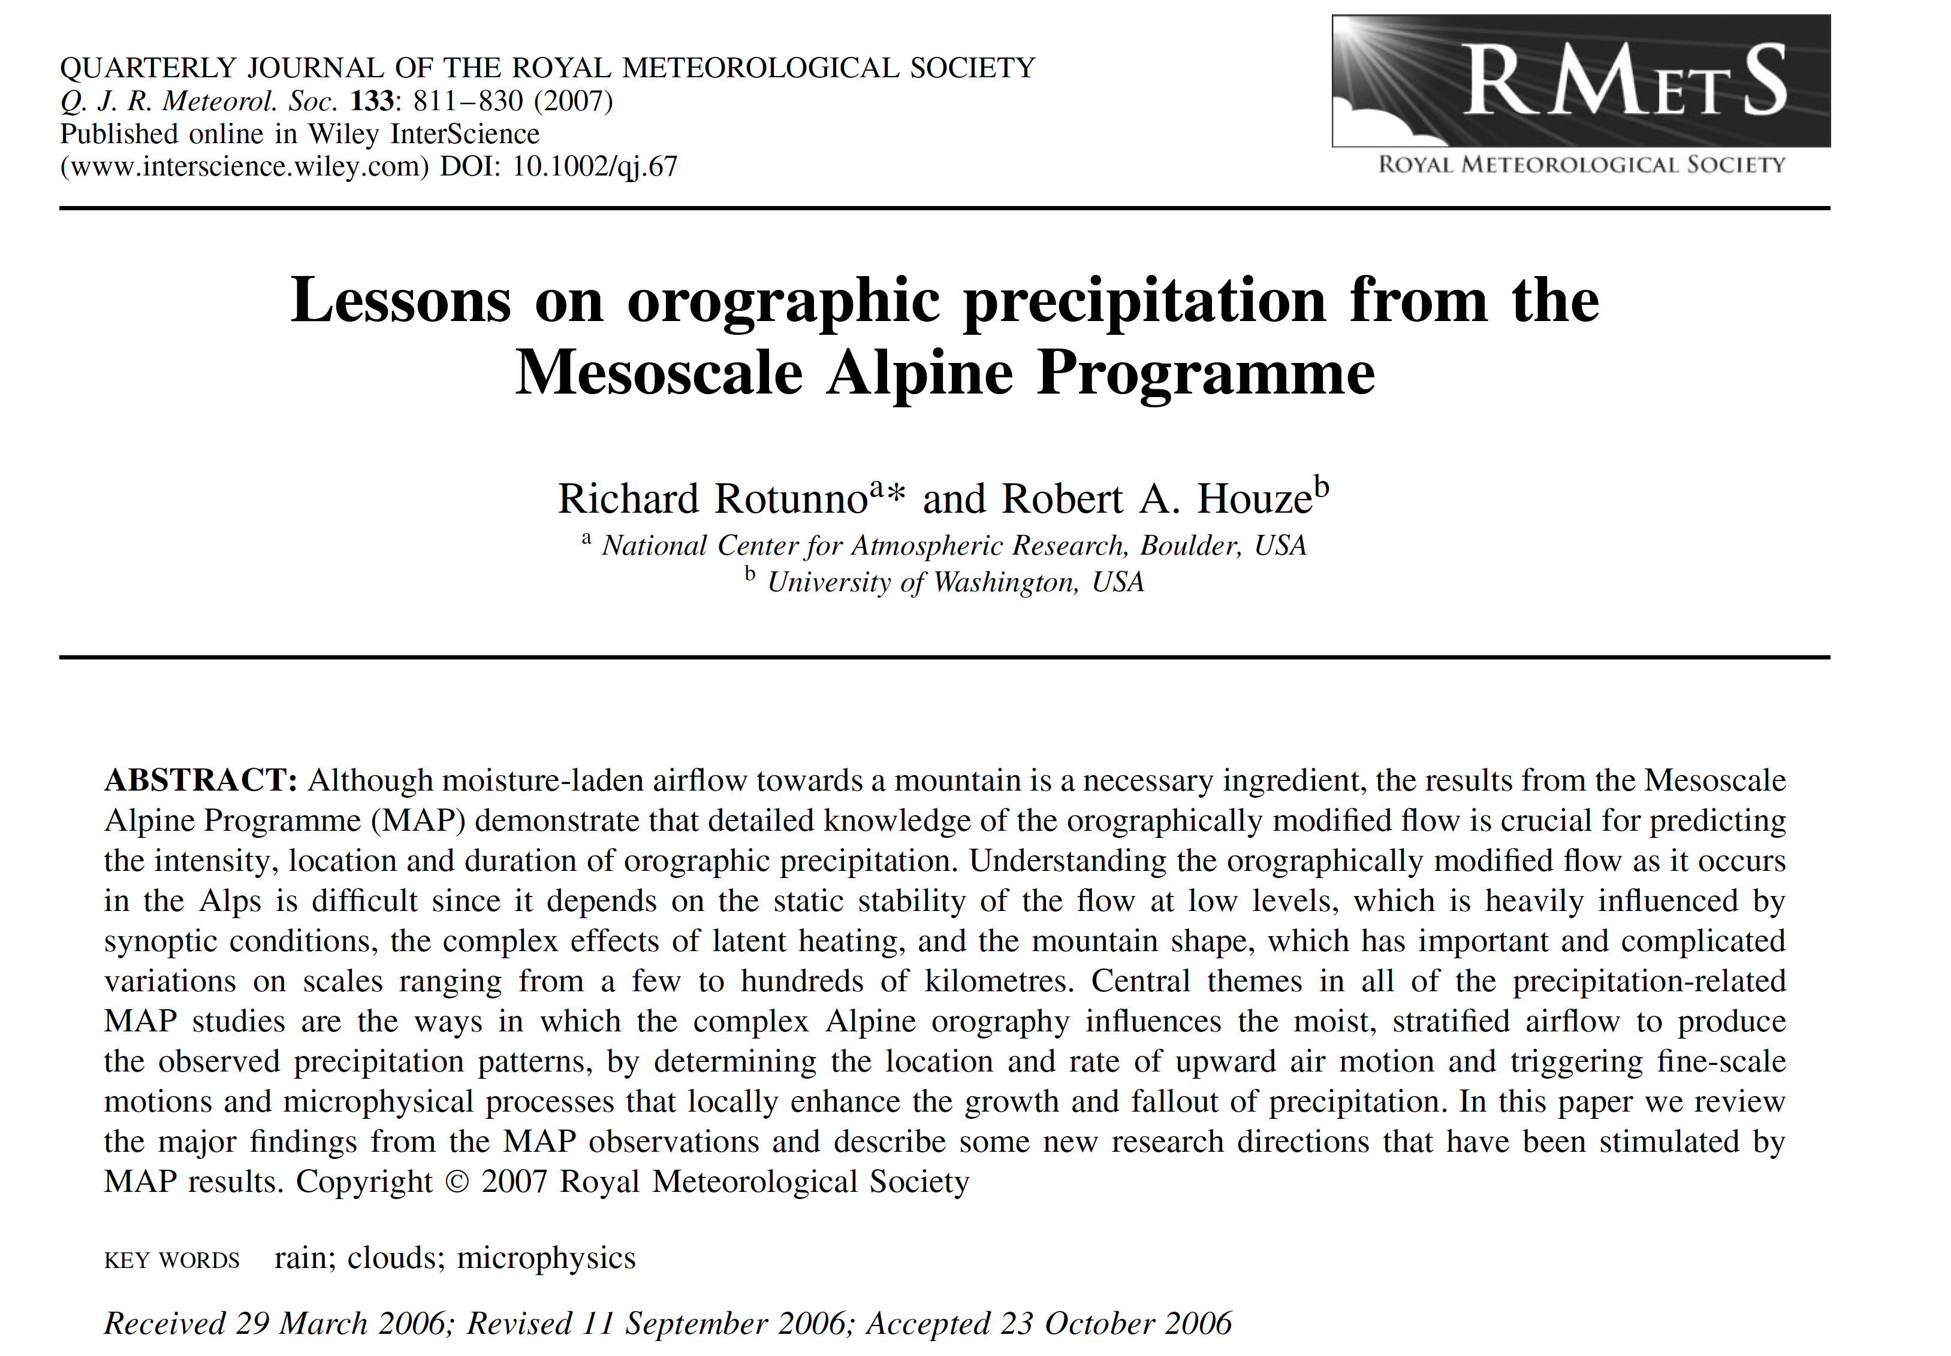

Slide 6
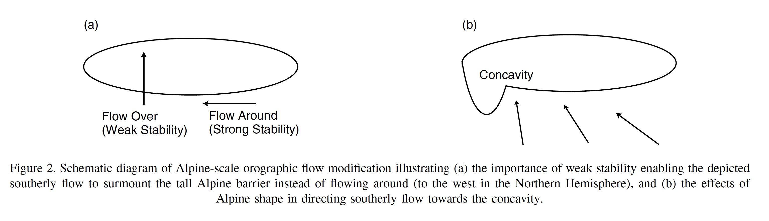
Rich’s Idea

Slide 7
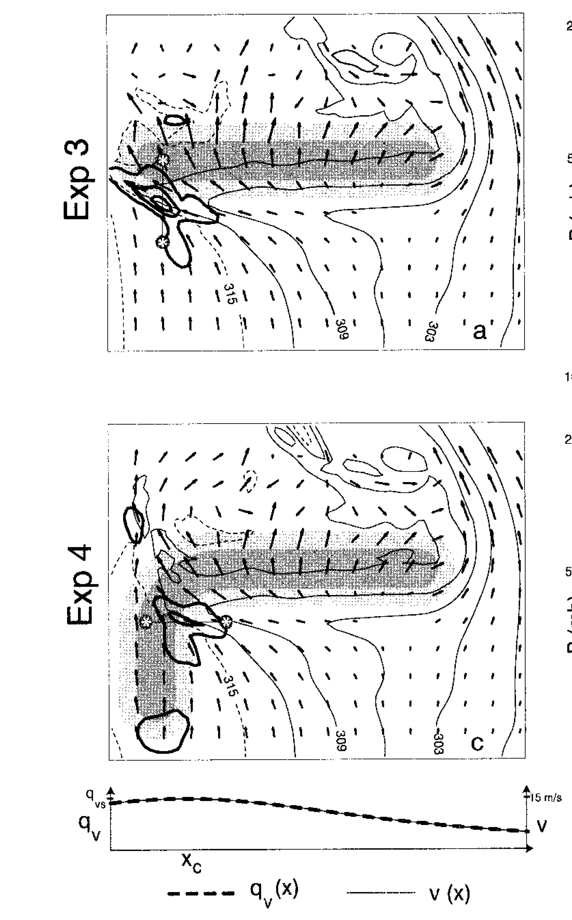
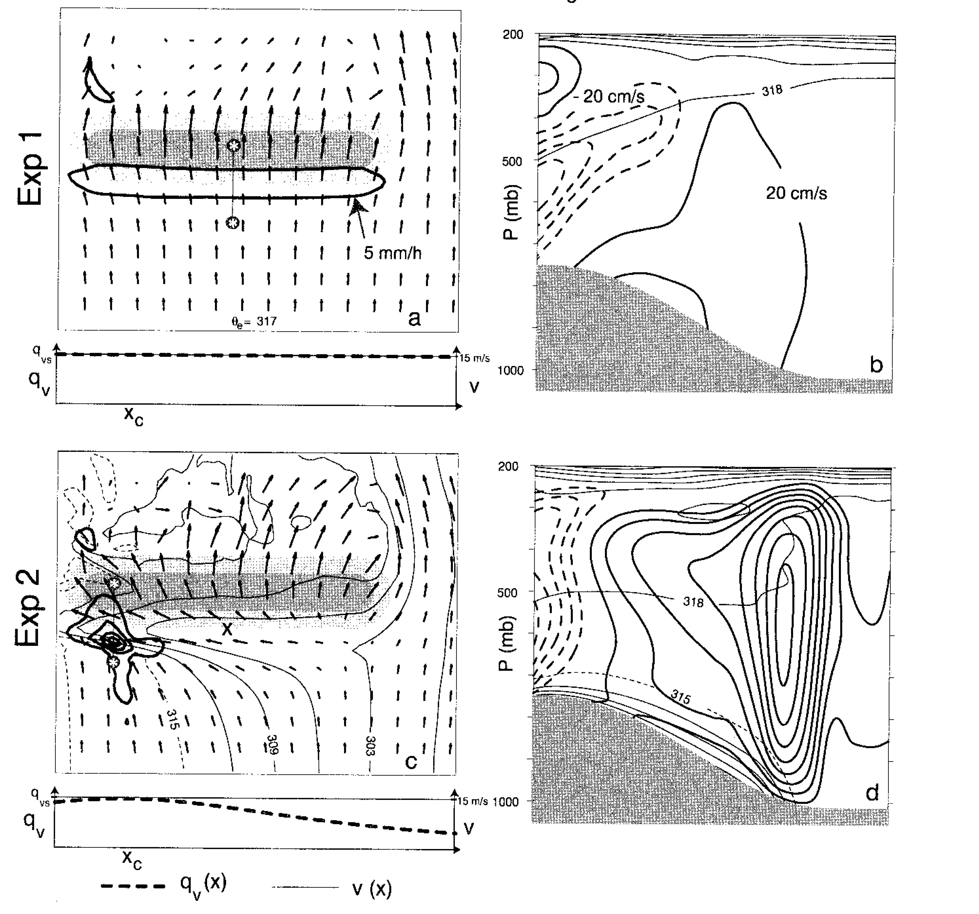
Rotunno and Ferretti 2001
Saturated
Sat.
Dry
Sat.
Dry
Sat.
Dry

Slide 8
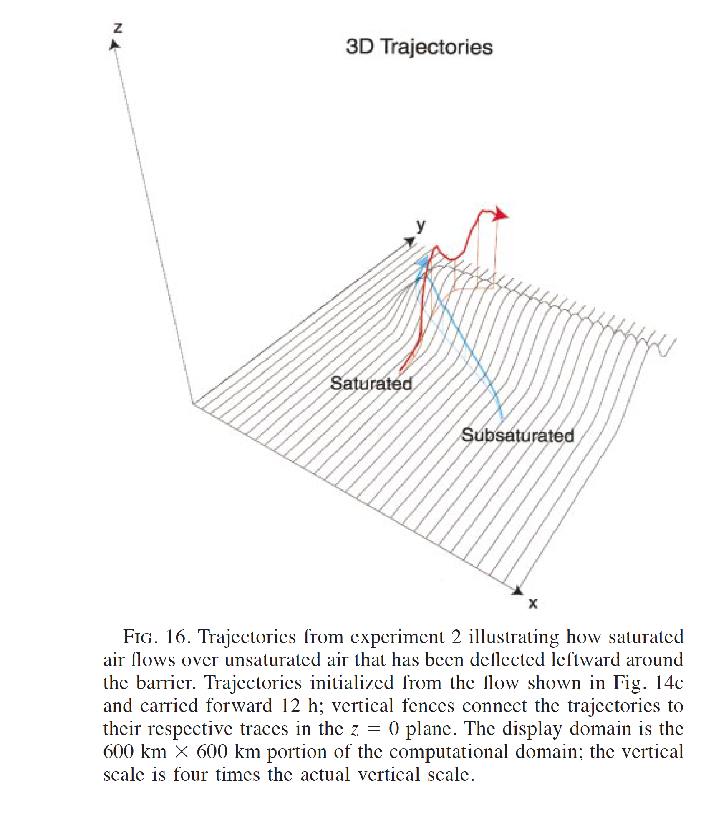
Rotunno and Ferretti 2001

Slide 9
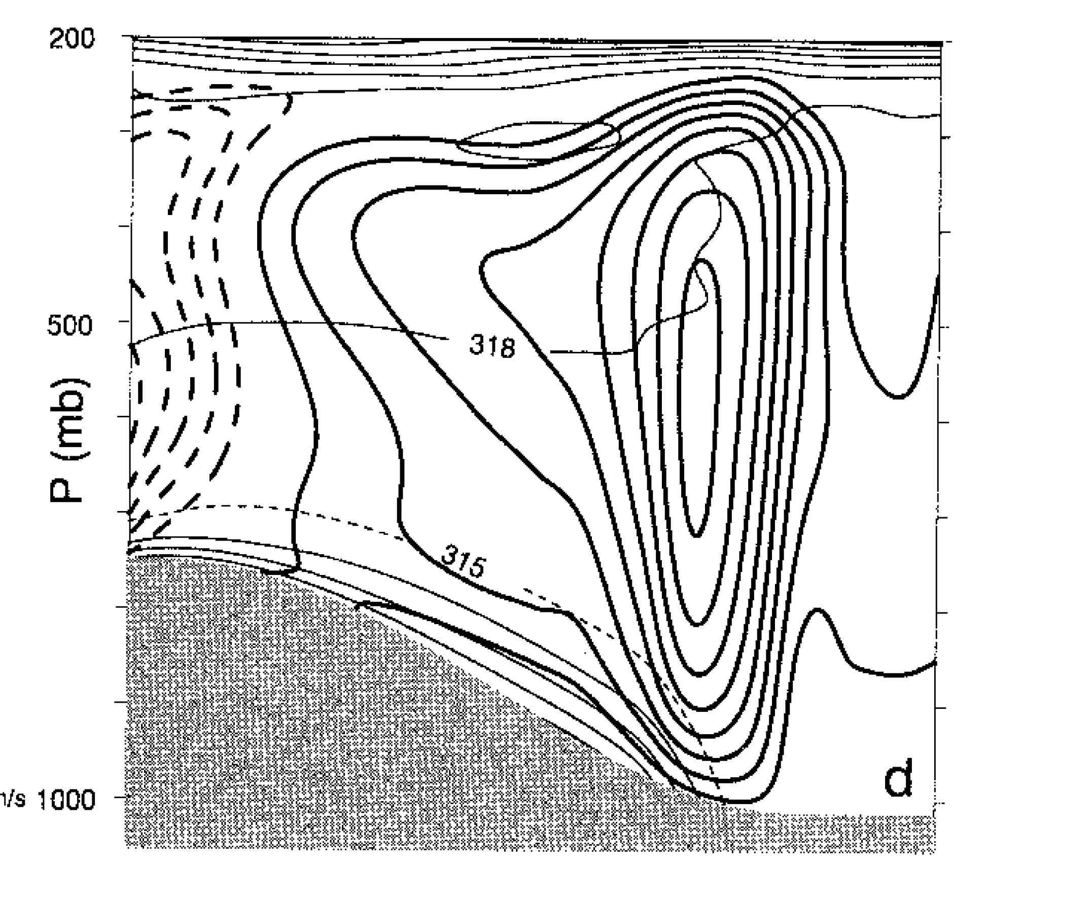
Rotunno and Ferretti 2001

Slide 10
MAP
IOP2b and IOP8

Slide 11
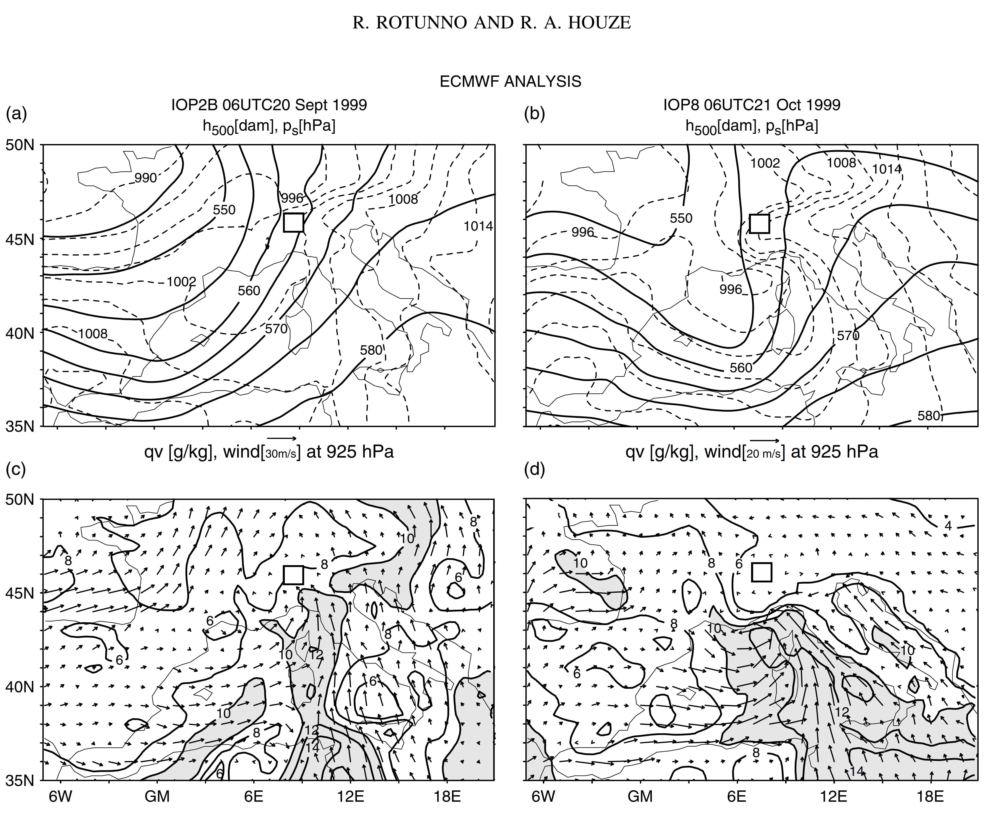
Rotunno and Ferretti 2003
IOP 2b
IOP 8
Notes:
Water vapor mixing ratio shaded

Slide 12
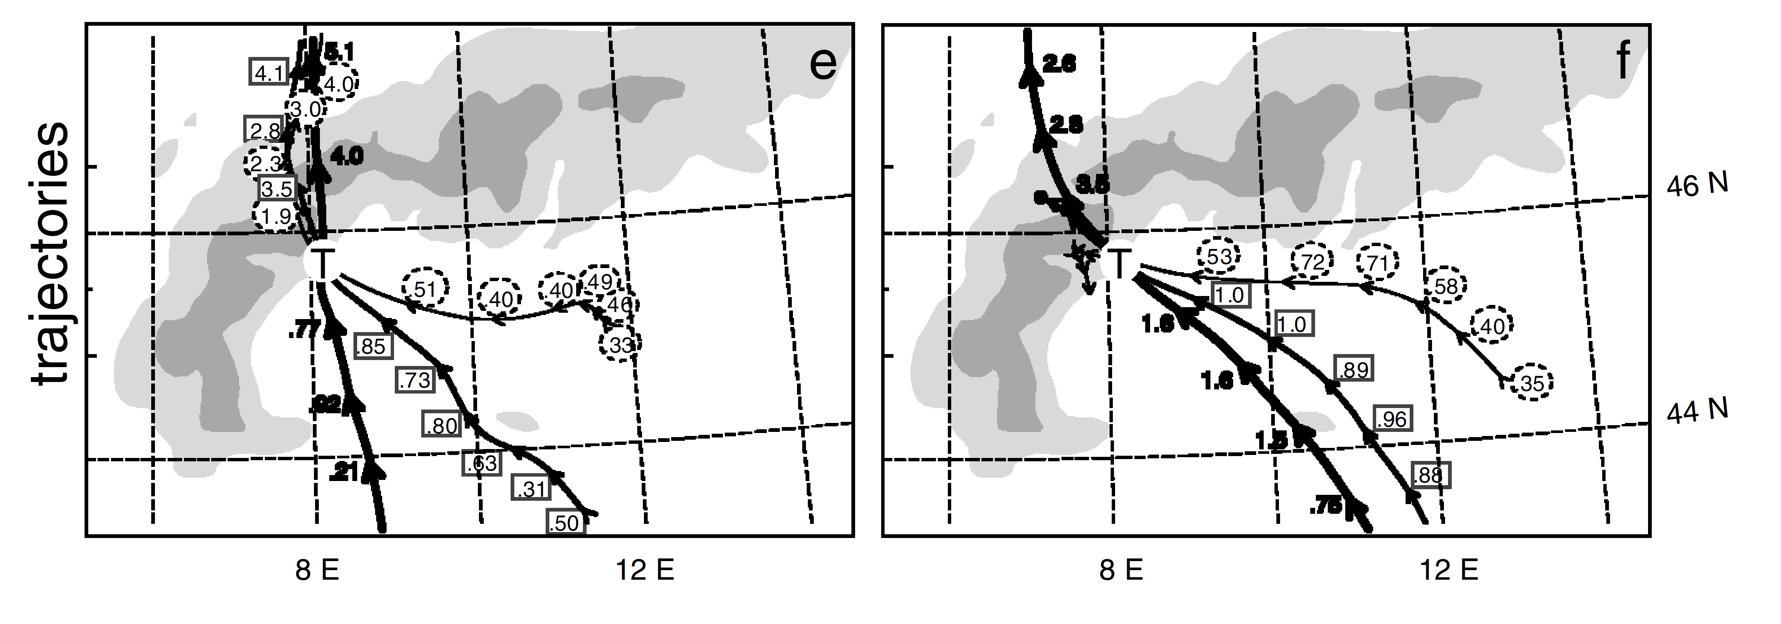
Rotunno and Ferretti 2003
IOP 2b
IOP 8
Alps
Alps
low
low
middle
middle
high
high
Trajectories passing through target area
Notes:
….T marks location of the airparcels at 12 UTC whose trajectories are plotted forward and backward from z=1.5 km(thin lines), z-2.25 km (medium lines, and z=3.0 km (thick lines); height given every hour and sense of flow given by arrows.

Slide 13
MAP Radars

Slide 14
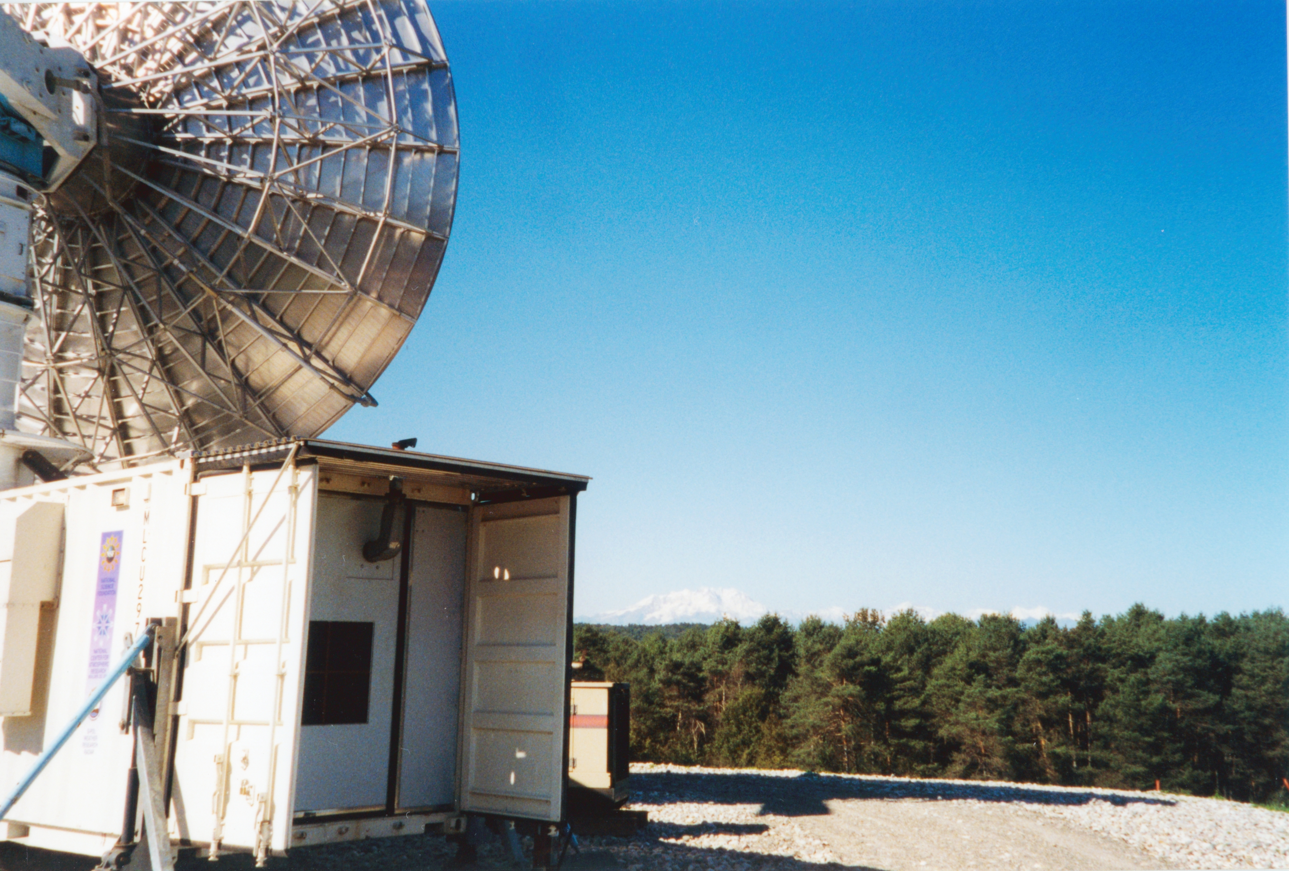

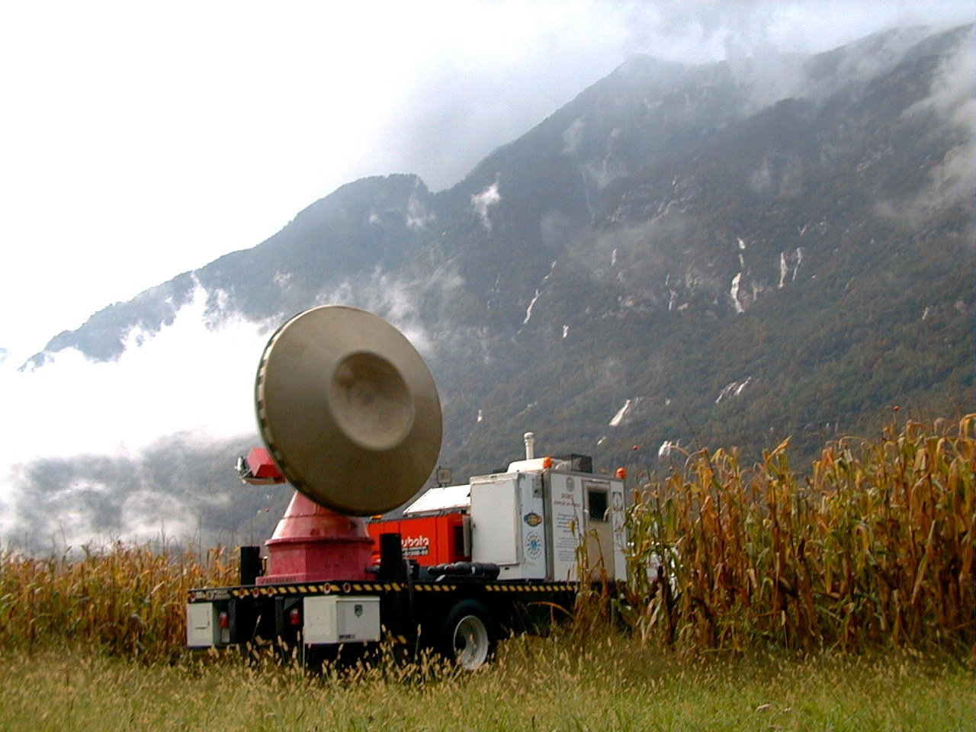
NOAA P3
NCAR S-Pol Radar
DOW radar
ETH VP radar

Slide 15
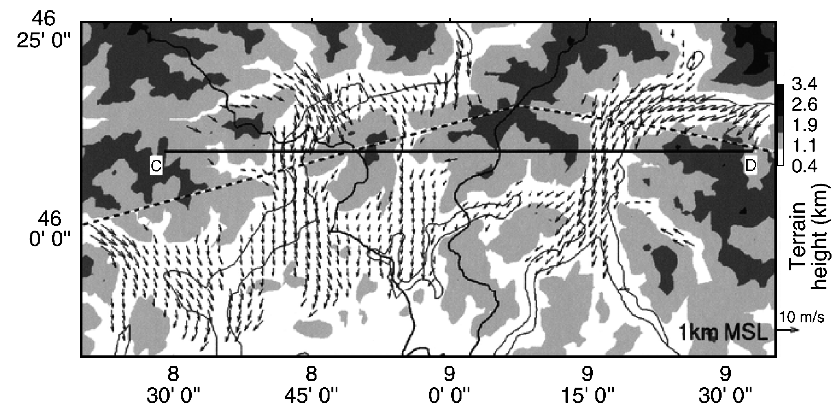
Bousquet and Smull 2003
IOP 8

Slide 16
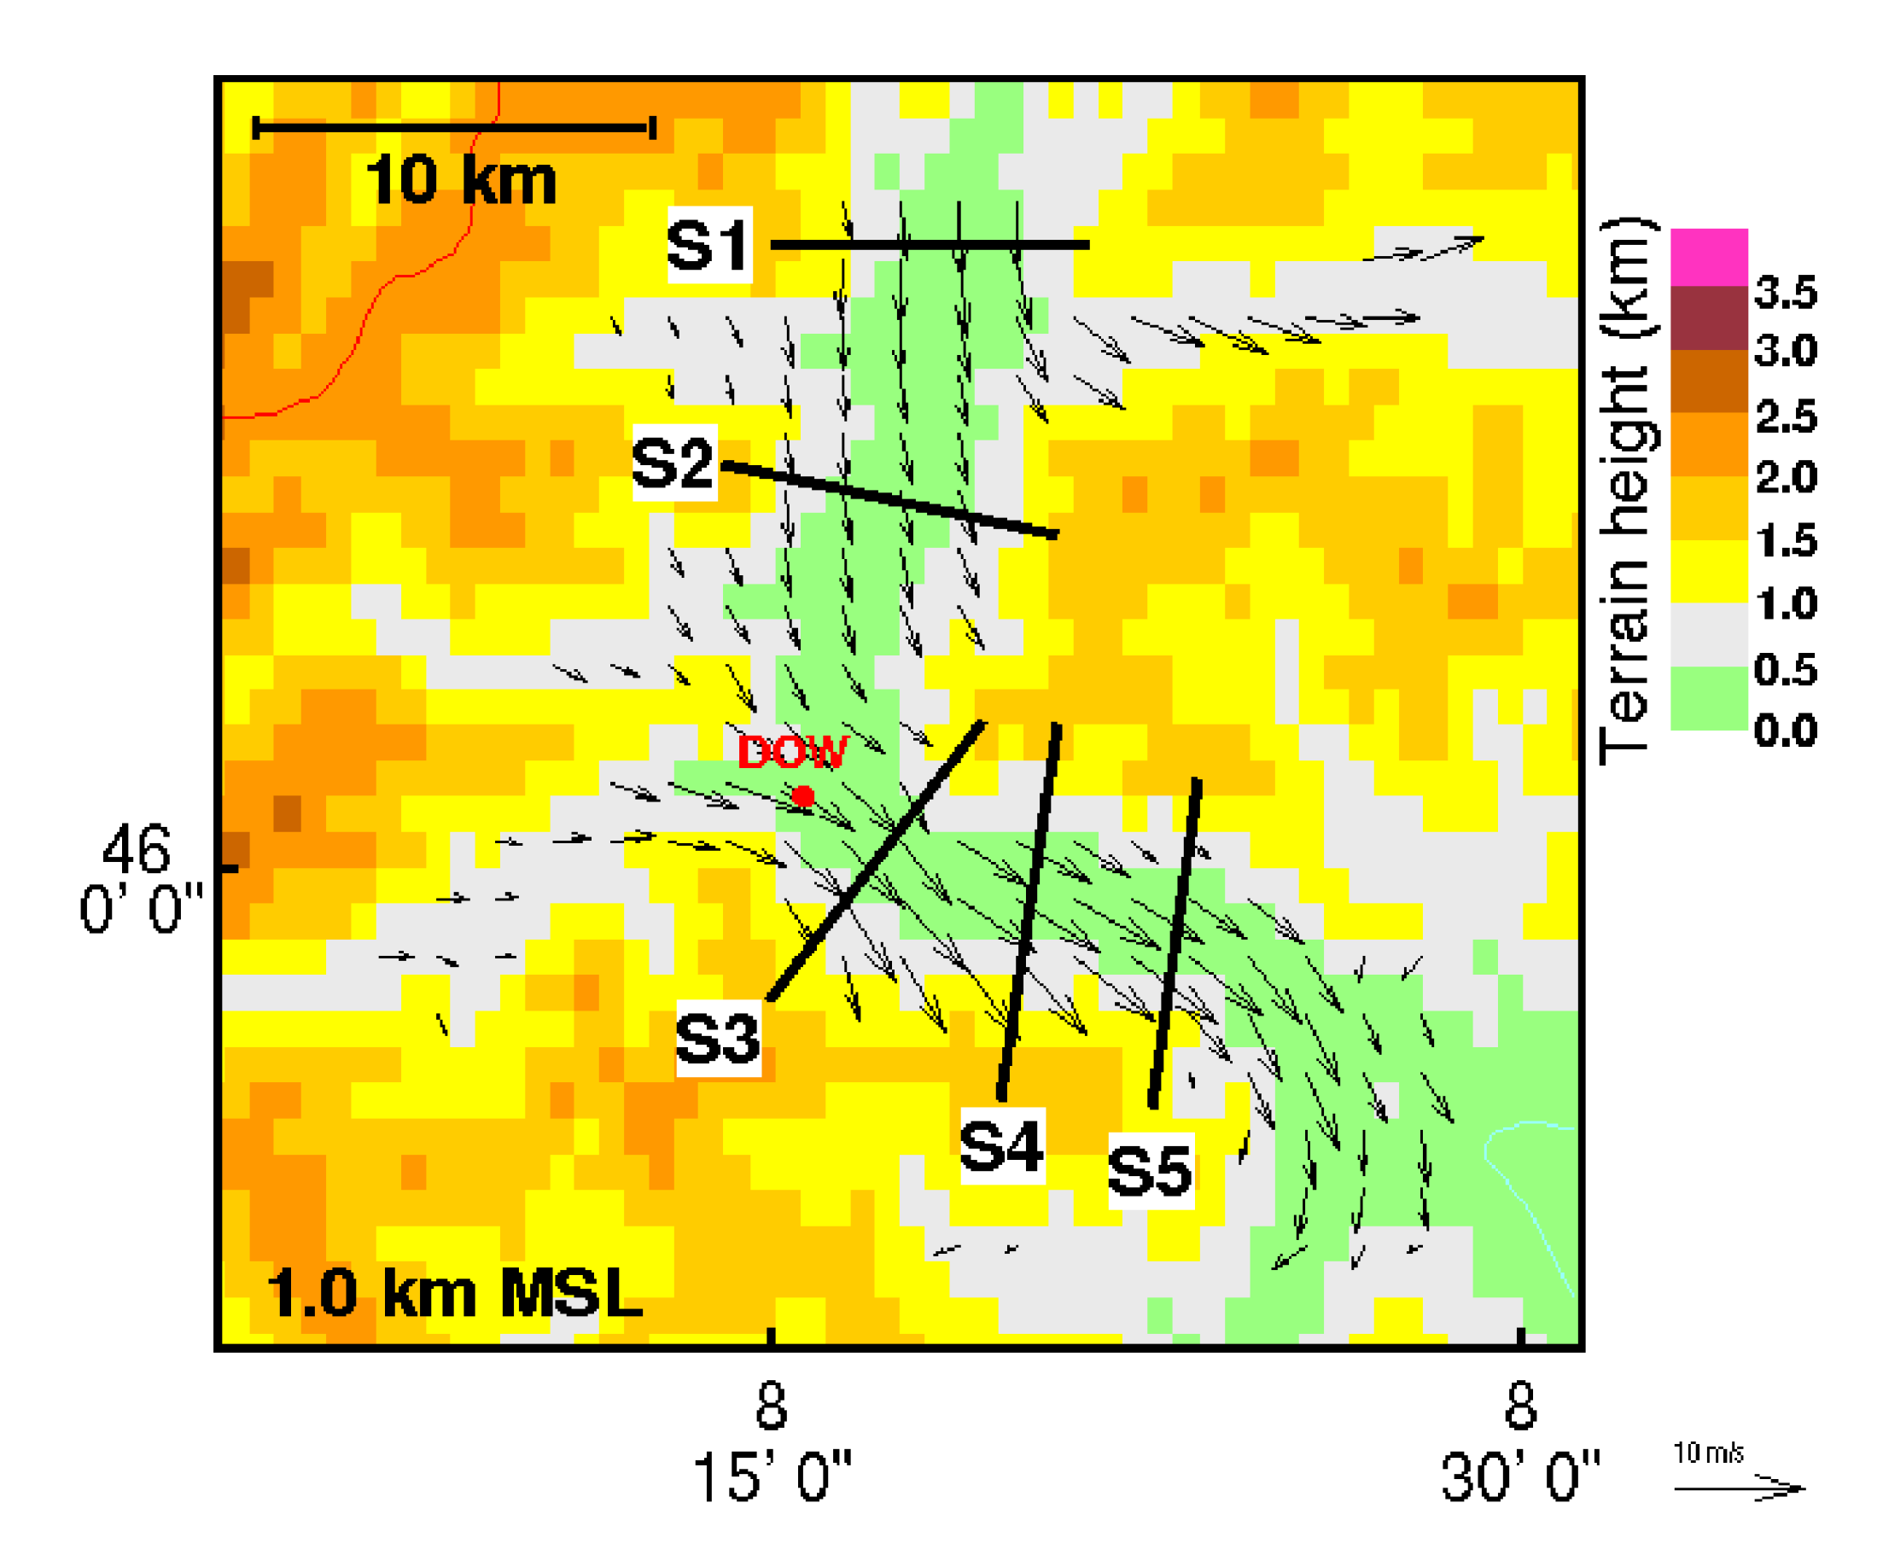
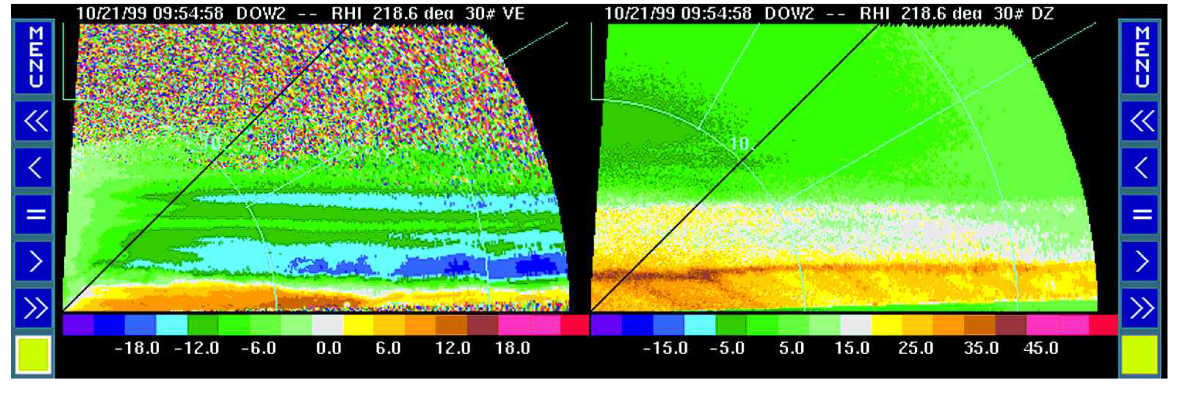
IOP 8
DOW radar was scanning up and down the valley
Radial Velocity
Reflectivity

Slide 17
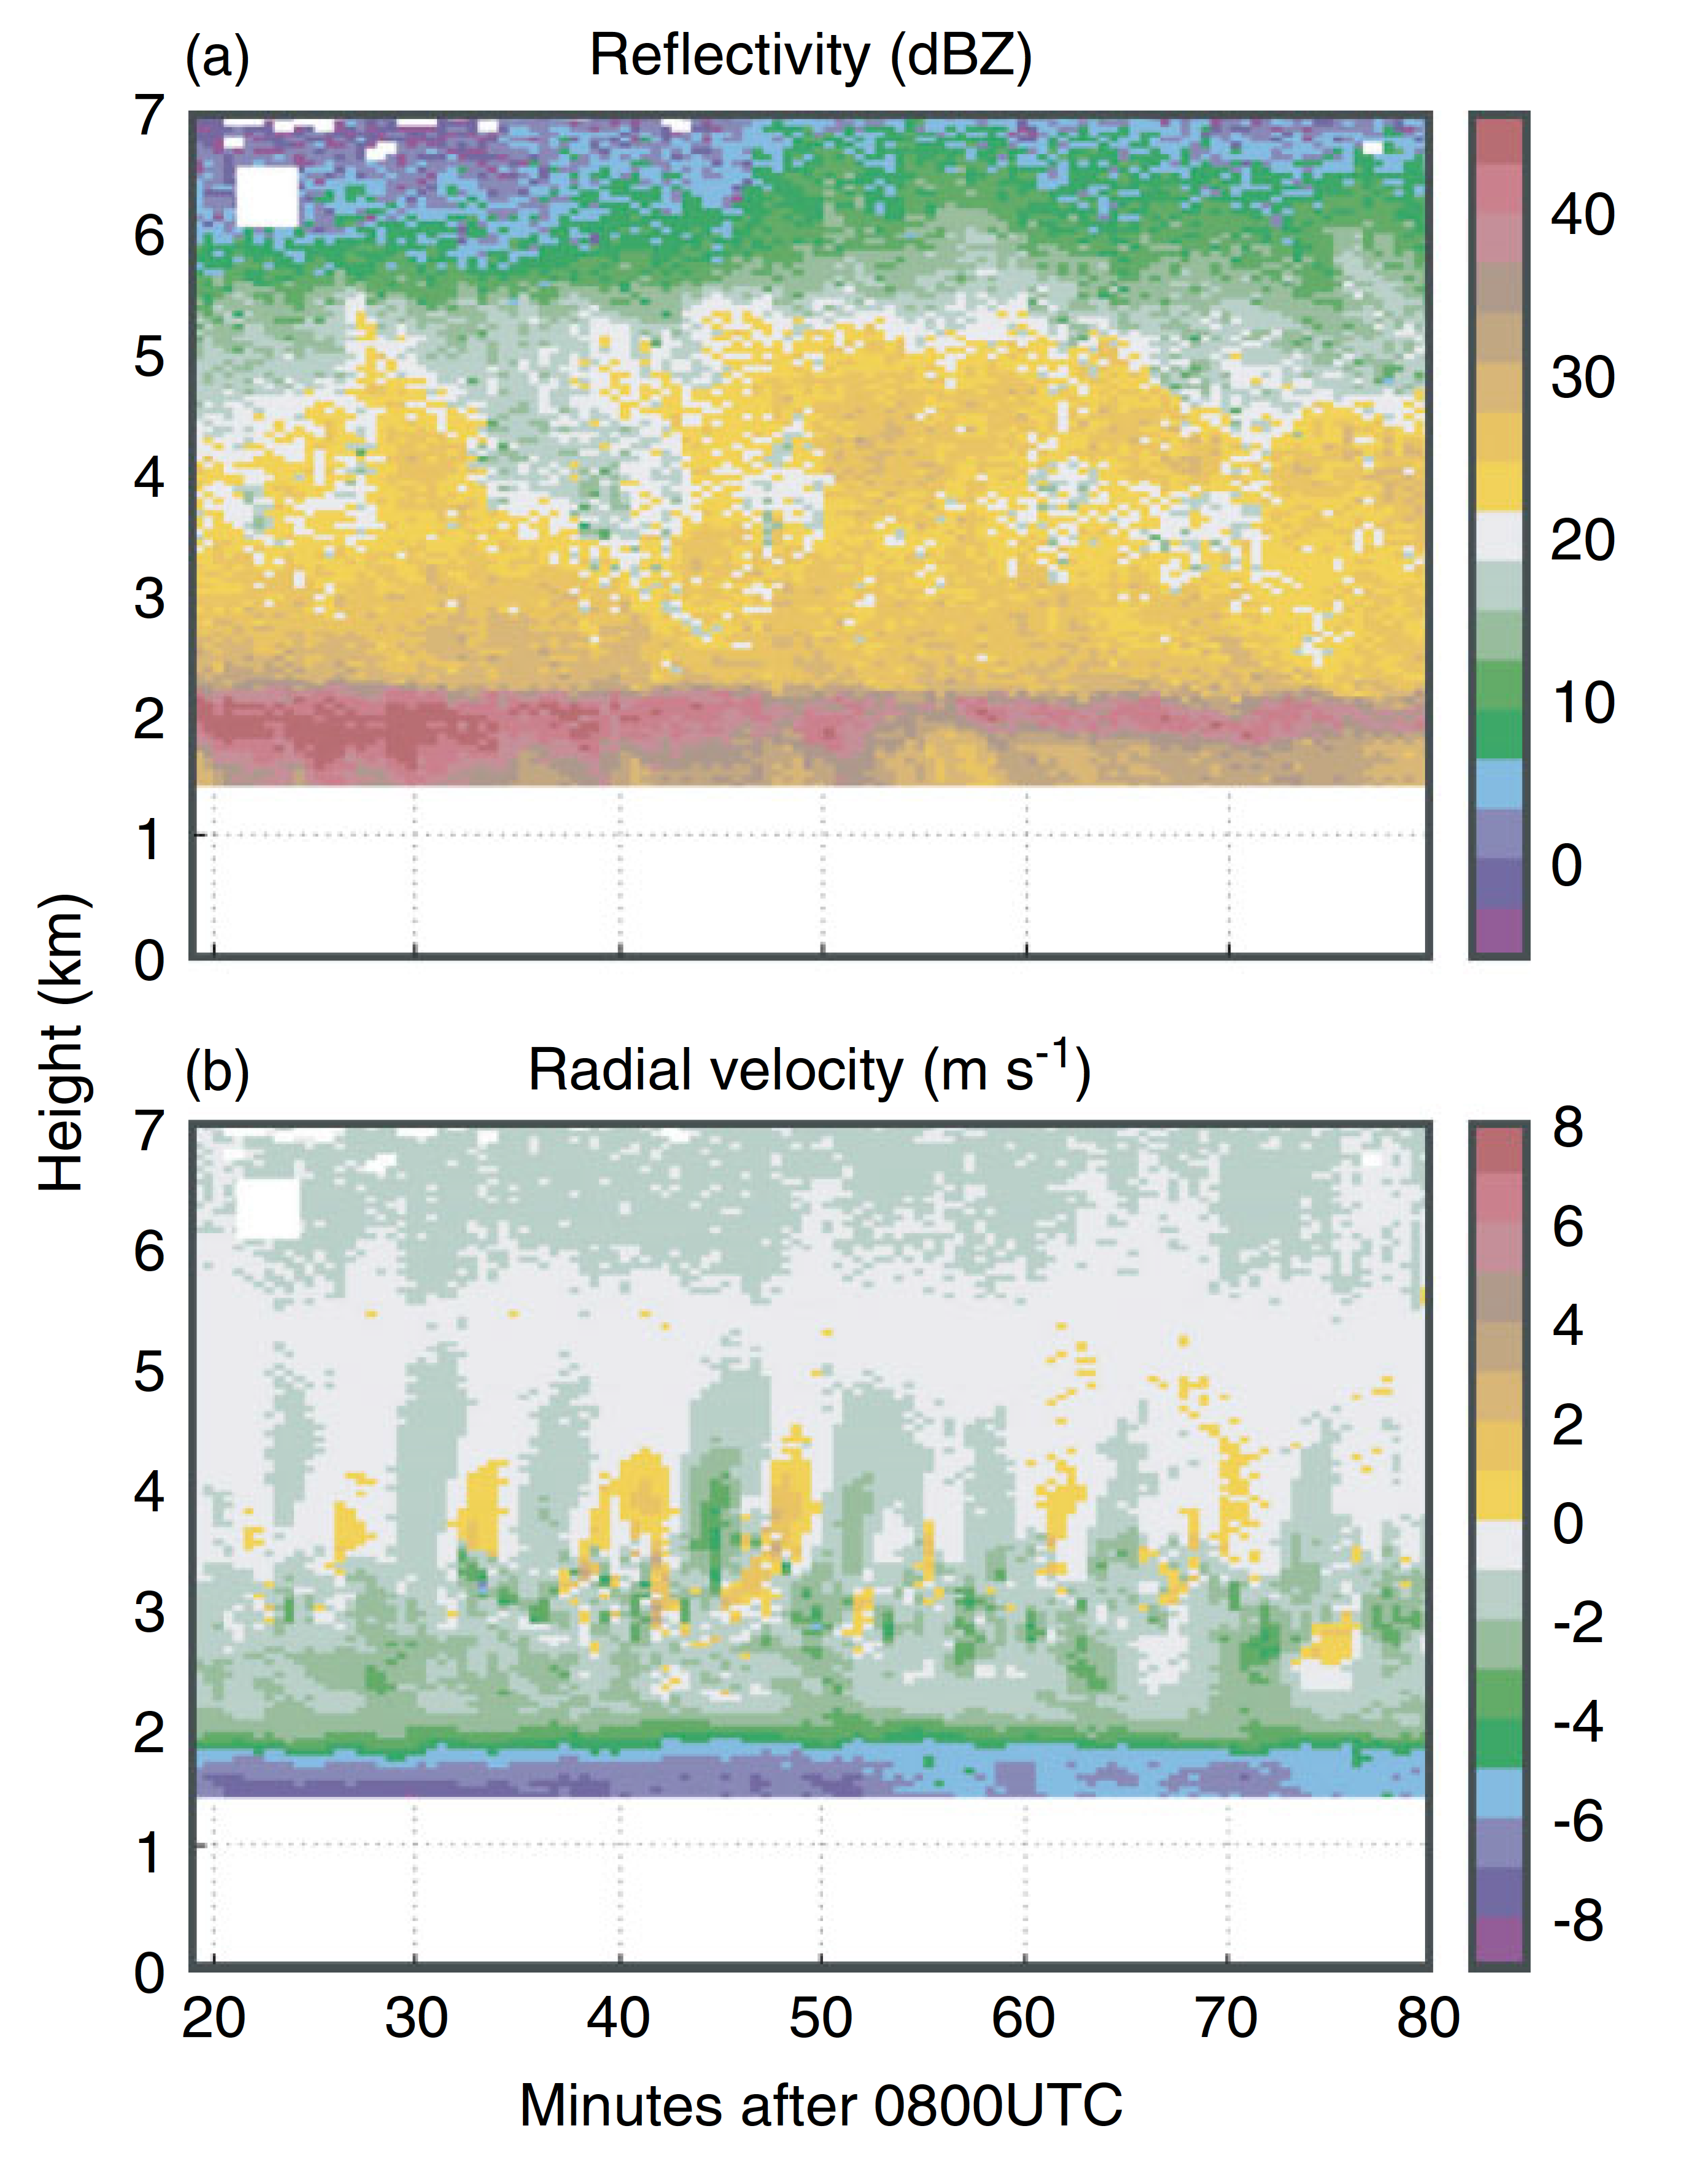
IOP 8
ETH Vertically Pointing X-band Radar
Houze and Medina 2005

Slide 18
OLYMPEX 2015

Slide 19
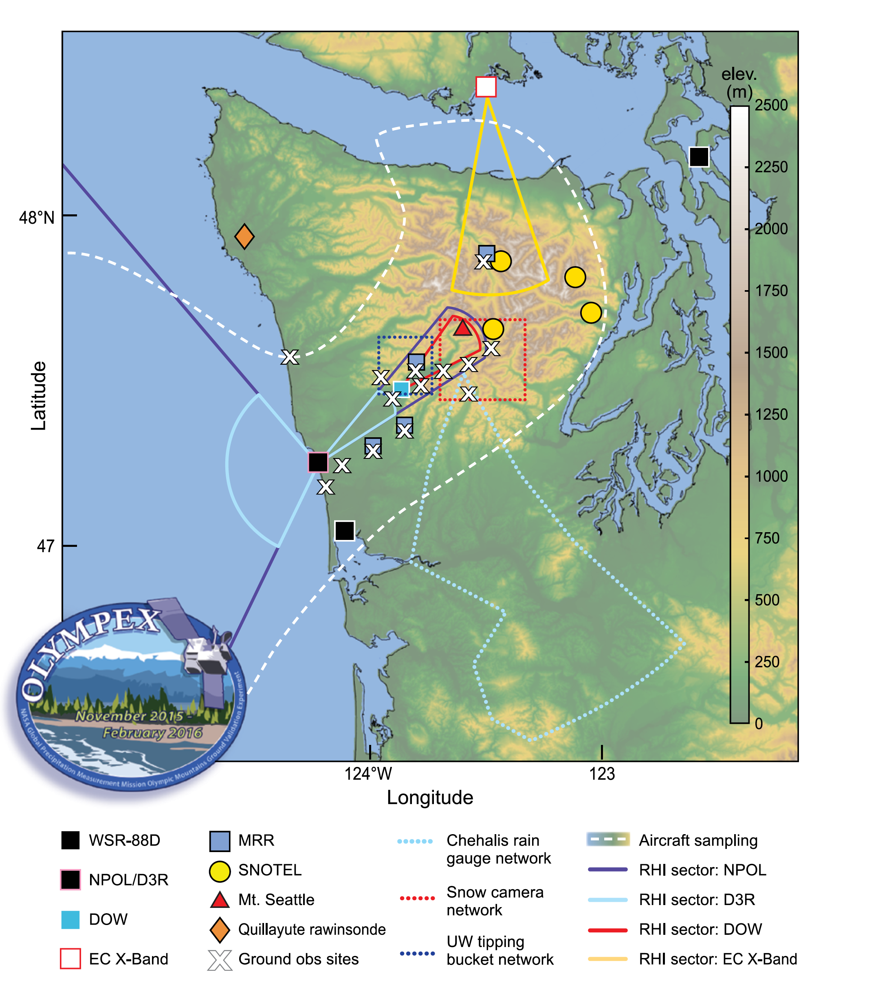
3 Research radars on the coast
DOW in valley
Canada C-band on leeside
NASA APR3 radar on DC-8
NC Citation doing in situ microphysics
NASA ER-2 doing remote sensing
Ground based network of particle sizes
+ other things
(Houze et al. 2017)

Slide 20
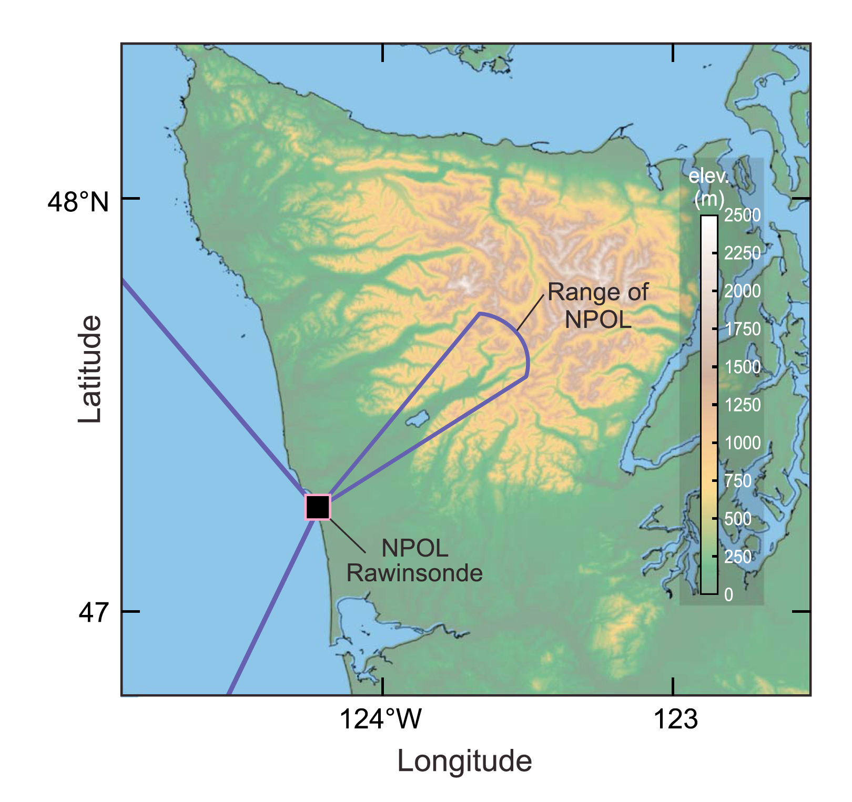
NPOL RHI scanning pattern in OLYMPEX
DOW

Slide 21
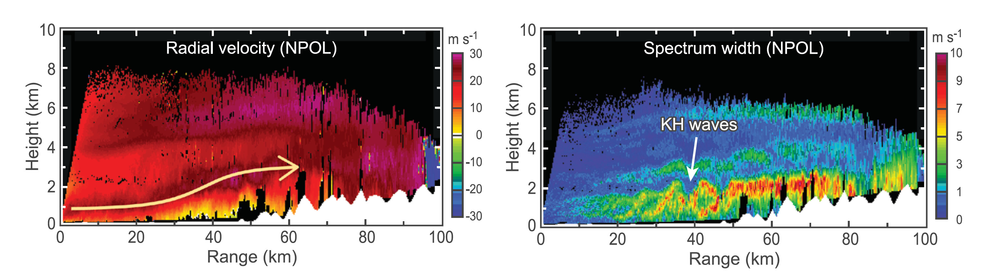
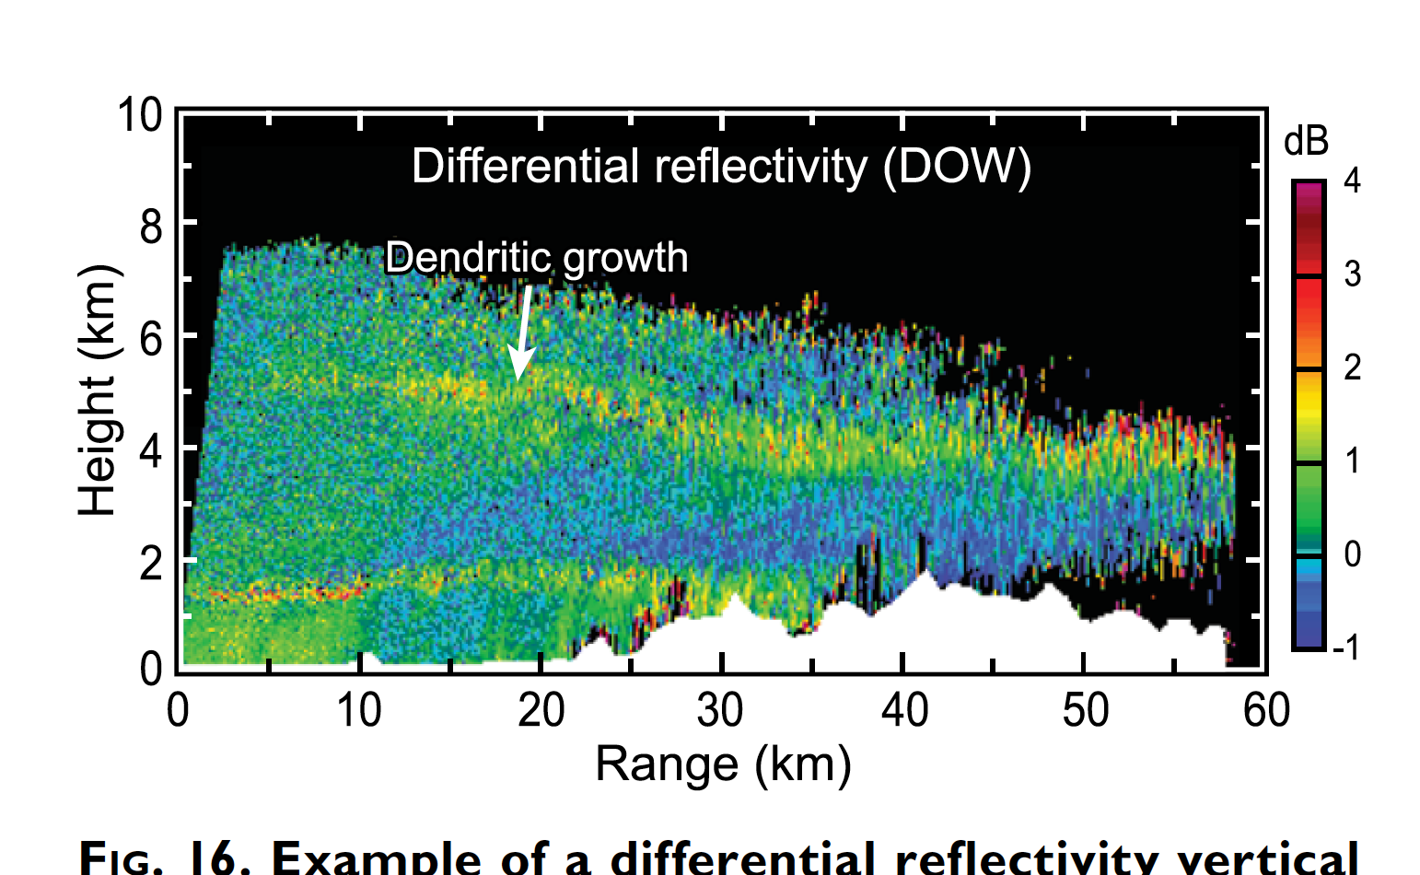
Example RHI data from NPOL
Houze et al. (2017)

Slide 22
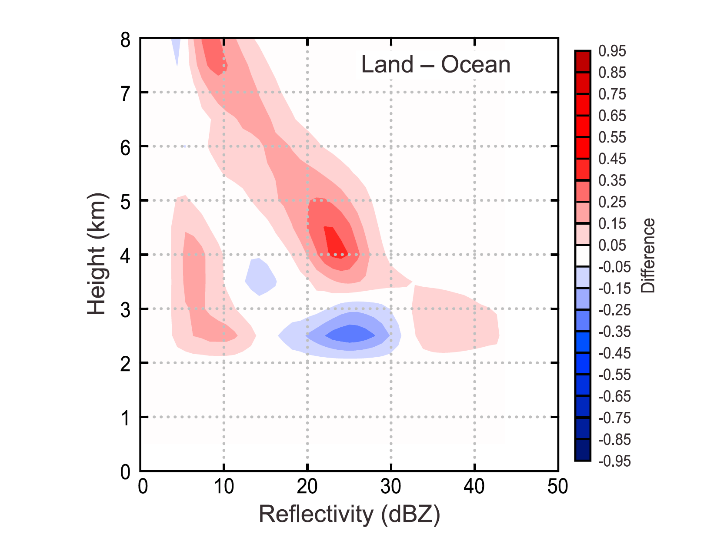
OLYMPEX measured precipitation enhancement
at all levels
0°C
McMurdie et al. (2018)

Slide 23
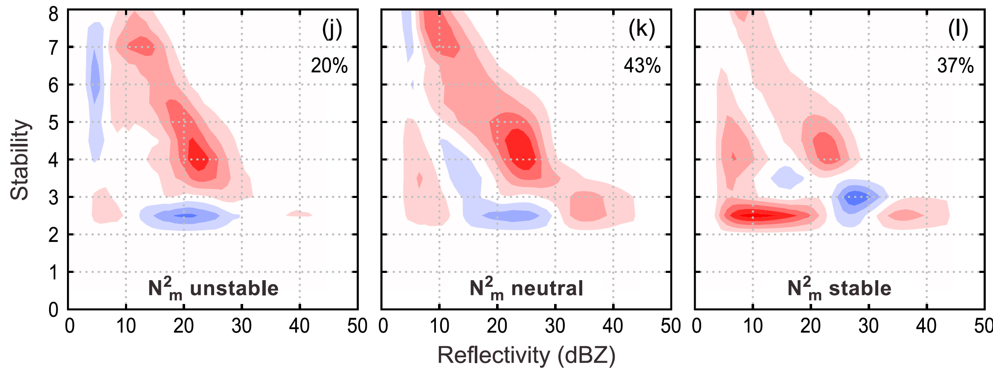
Variation of enhancement with low-level stability
N²_{m} = Moist Brunt-Väisälä frequency
In 850-950 hPa layer
Unstable: N²_{m} < –.25 x 10⁴ s^{–2}
Neutral: –.25 x 10⁴ s^{–2} < N²_{m} < +.25 x 10⁴ s^{–2}
Unstable: N²_{m} > +.25 x 10⁴ s^{–2}
McMurdie et al. (2018)

Slide 24
Let’s revisit Rich

Slide 25

He’s just had his next great idea!

Slide 26
Conclusion
Thanks, Rich, for your many great ideas over the years
Especially the role of low level stability in storms passing over mountains!

Slide 27
Extra Slides

Slide 28
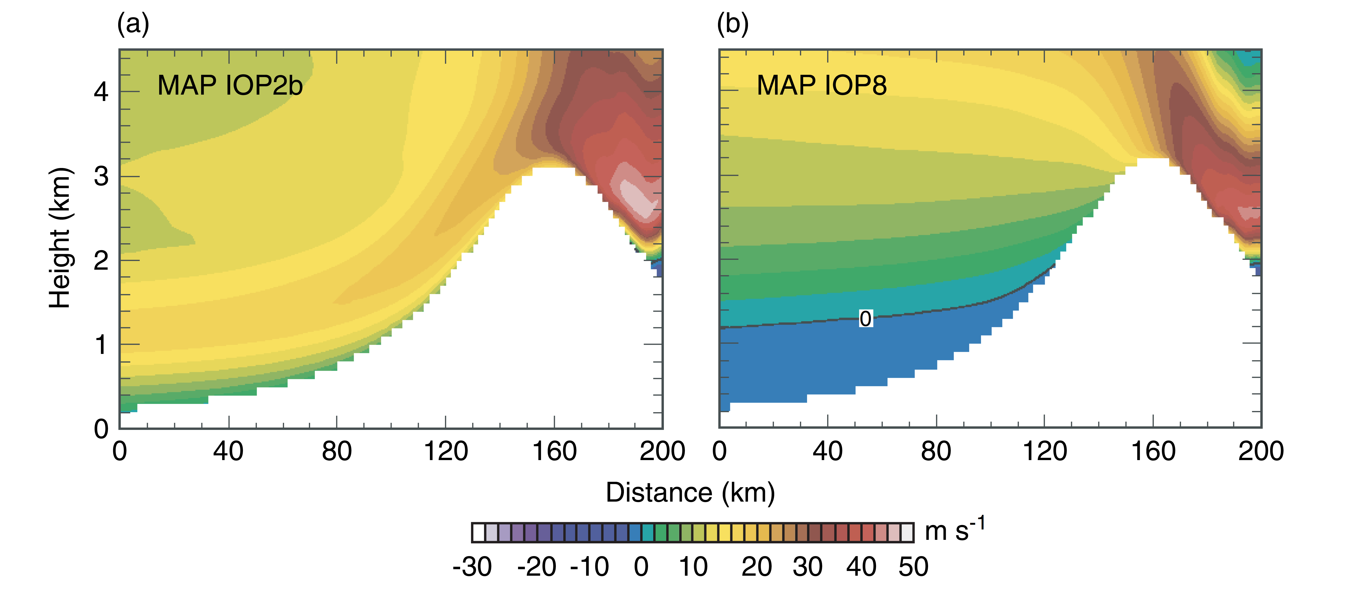
Medina et al. 2005
Idealized model calculation
IOP 2b
IOP 8

Slide 29
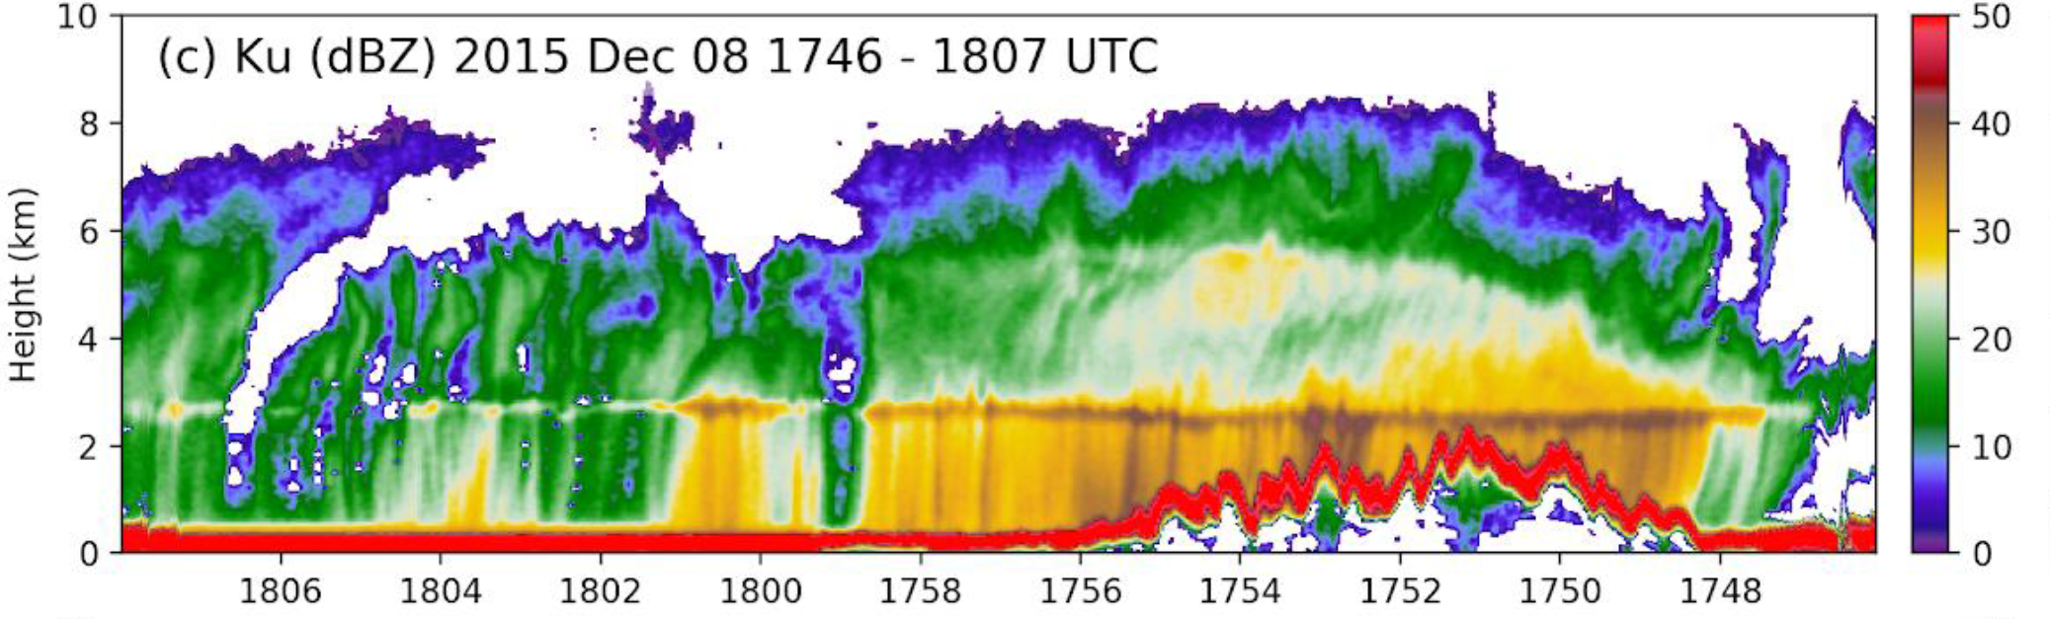
NASA DC8 APR3 Radar
Zagrodnik et al. 2018

Slide 30
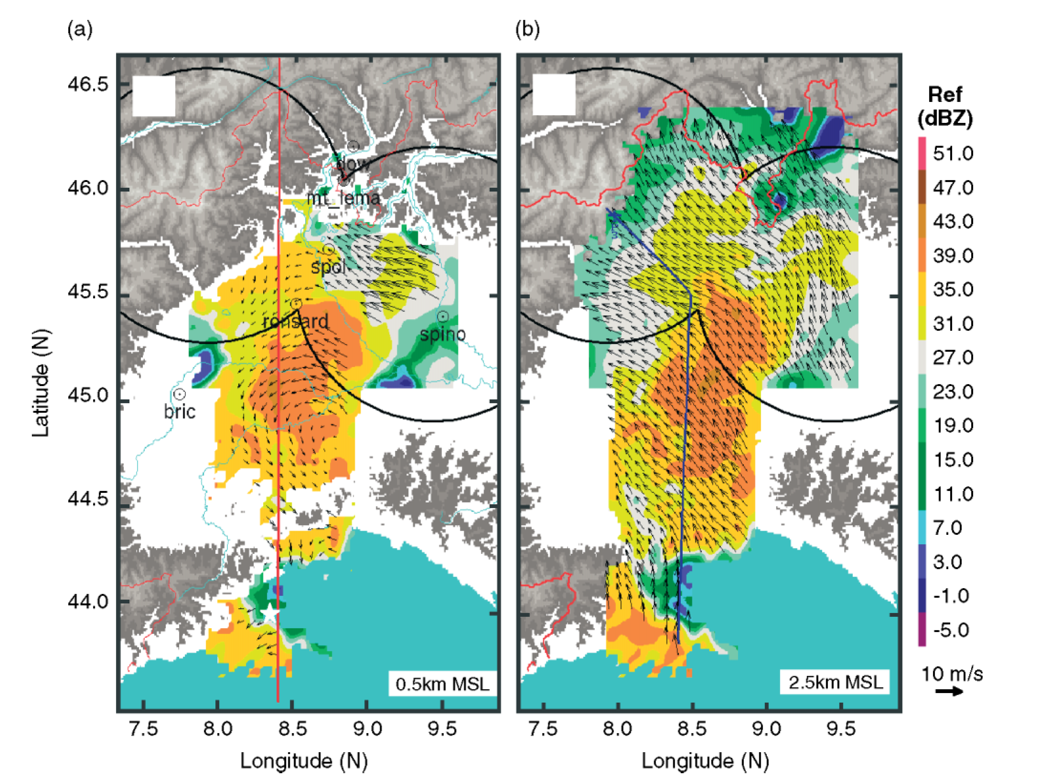
Bousquet and Smull 2003—airborne P3 radar
IOP 2b
IOP 8

Slide 31
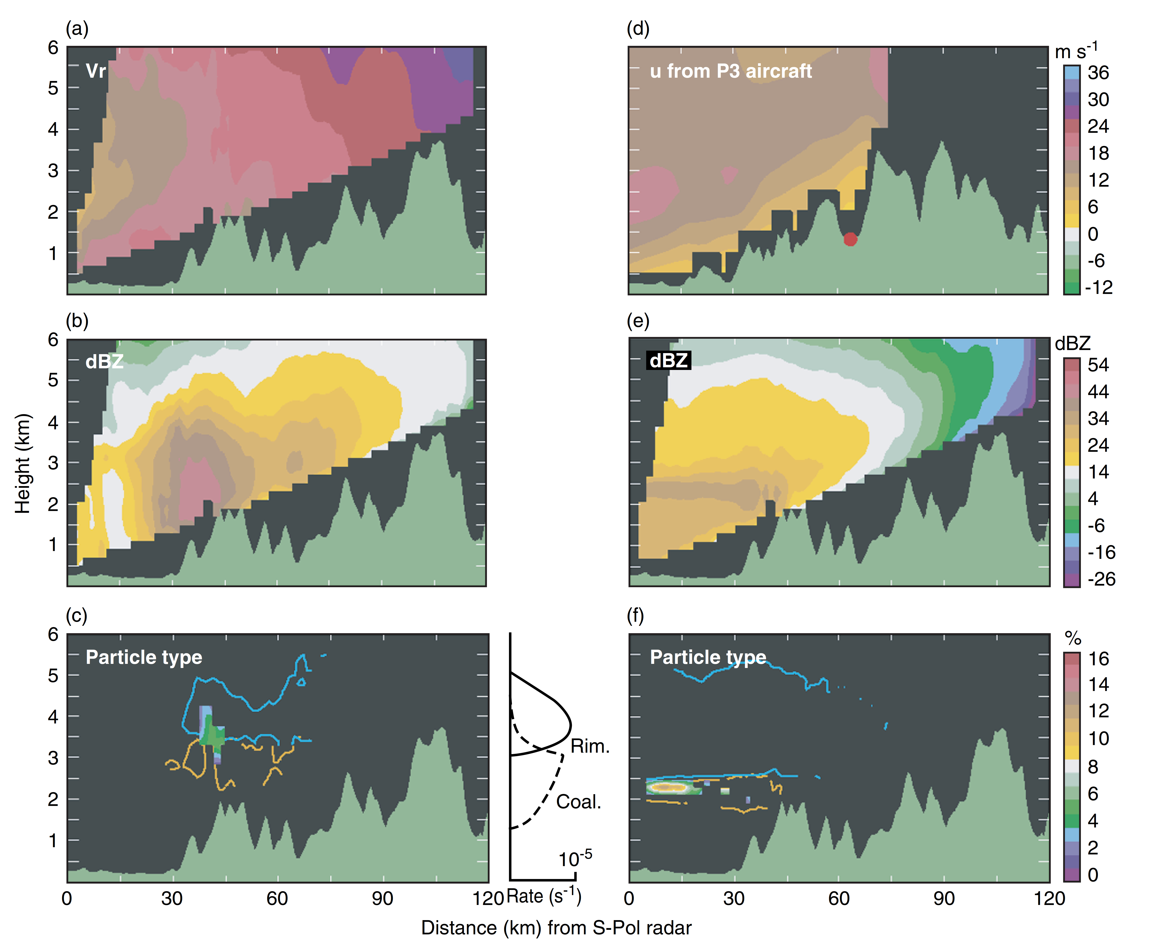
S-Pol
and
P3 radar
data
cross
sections
S-Pol
IOP 2b
IOP 8
Adapted from
Yuter and Houze 2003 and Medina 2005

Slide 32
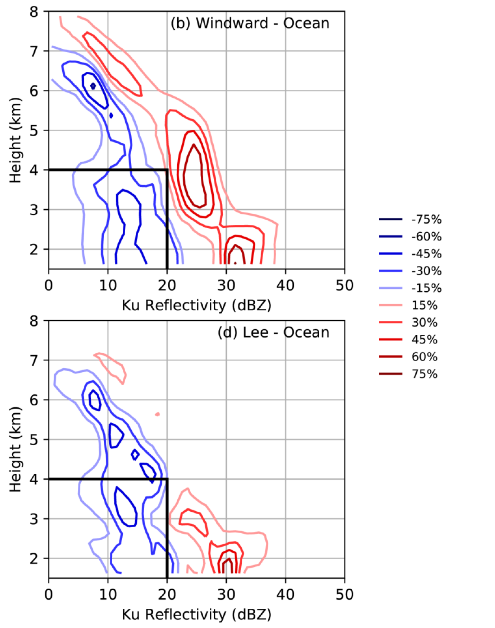
Zagrodnik et al. 2018 analyzed the airborne Ku band radar data from the NASA DC-8
To measure both upper-level enhancement on the windward side and upper-level suppression on the leeside.
Notes:
The higher frequency of reflectivities
greater than 35 dBZ and lower frequency of reflectivities less than 30 dBZ
between 2 and 3 km over the land suggests a shift toward an increase in
radar brightband intensity over the windward slopes as well.

