Slide 1





Vertical Structure and Microphysical Characteristics of Precipitation over a Three-Dimensional Coastal Mountain Range
Joe Zagrodnik
Lynn McMurdie, Robert A. Houze, Simone Tanelli
AGU Fall Meeting
Washington DC, 14 December 2018
NNX16AD75G
NNX16AK05G 80NSSC17K0279
AGS-1503155
AGS-1657251

Slide 2
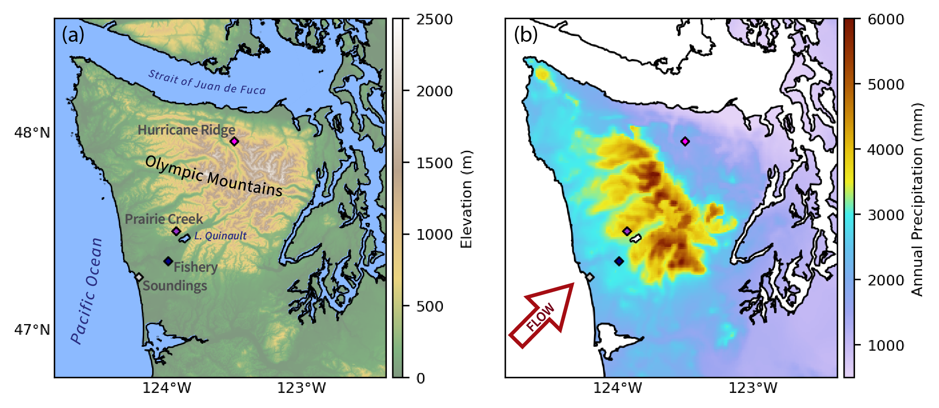
Olympic Mountains Annual Precipitation Climatology
High terrain – lee side precip diminishment
Very strong downward precipitation gradient
Poorly observed by ground-based observations
Annual Precipitation (PRISM)
Topography
Windward precipitation enhancement
2500-6000 mm/year
Lots of research attention
What dynamic and microphysical processes control the diminishment of precipitation on the high terrain and lee side?
Notes:
Few orographic precipitation studies have considered high terrain/leeside due to lack of observations

Slide 3

NASA 3rd-Gen Airborne Precipitation Radar (APR-3)
Flies on NASA DC-8
Triple-frequency (Ku/Ka/W-band)
30 m vertical resolution
0.2 Hz measurement frequency (~0.2 km resolution)
Key benefit: full transects of Olympic Mountains with same instrument package!

Slide 4
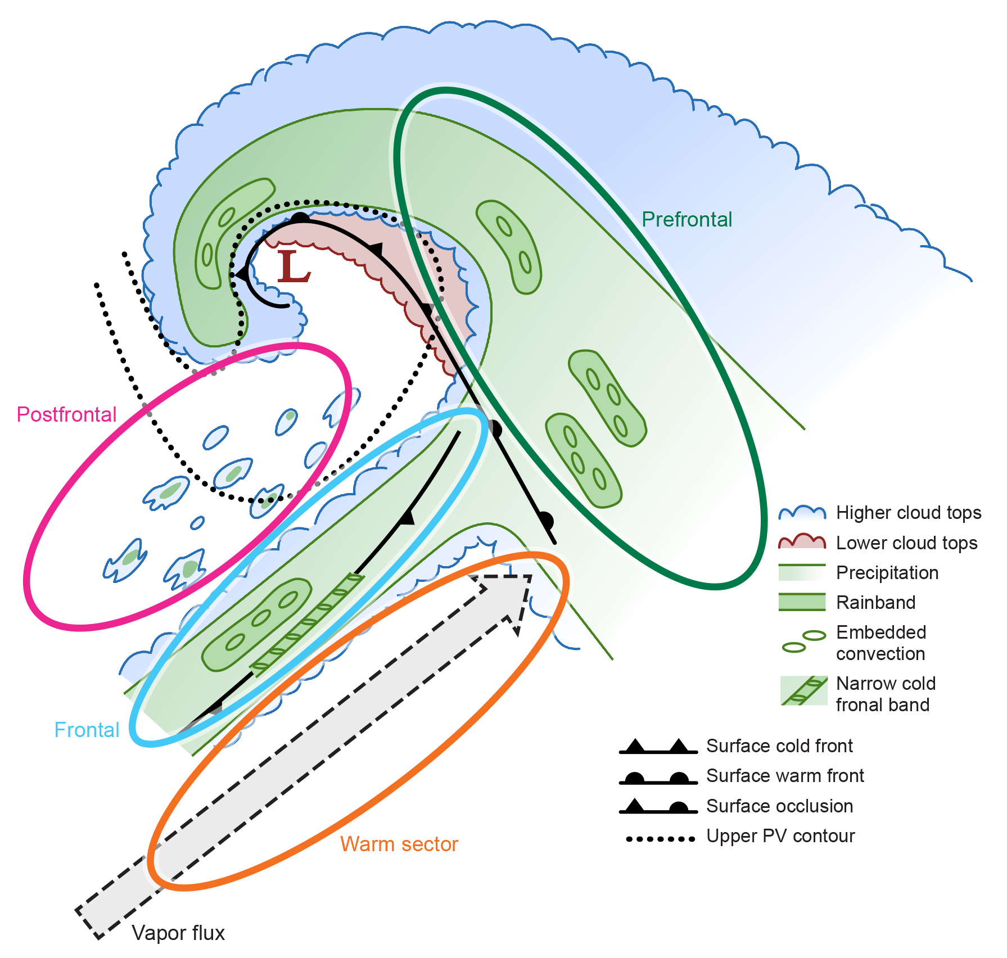
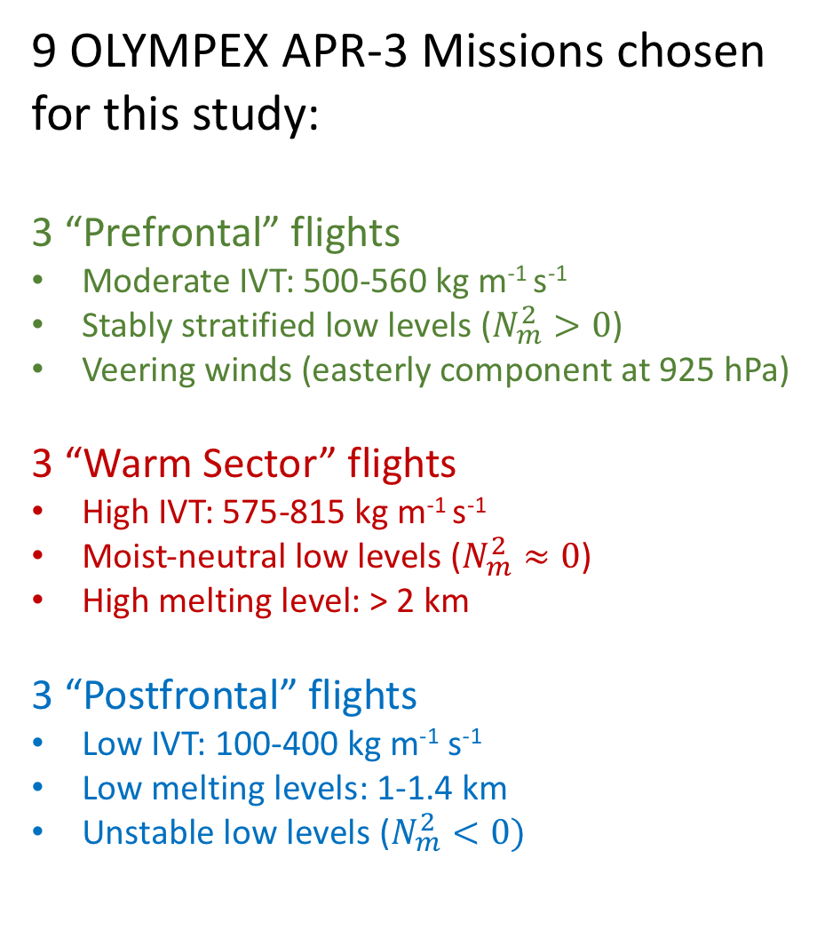
9 OLYMPEX APR-3 Missions chosen for this study:
3 “Prefrontal” flights
Moderate IVT: 500-560 kg m⁻¹ s⁻¹
Stably stratified low levels ($N_{m}^{2}>0$)
Veering winds (easterly component at 925 hPa)
3 “Warm Sector” flights
High IVT: 575-815 kg m⁻¹ s⁻¹
Moist-neutral low levels ($N_{m}^{2}≈0$)
High melting level: > 2 km
3 “Postfrontal” flights
Low IVT: 100-400 kg m⁻¹ s⁻¹
Low melting levels: 1-1.4 km
Unstable low levels ($N_{m}^{2}<0)$
Notes:
From theory, we know that the response of precipitating clouds to a mountain range is controlled by the characteristics of the upstream flow—especially the flow and stability which are often characterized in the Froude number. The essential components—flow and stability—are determined by the “sector” of the midlatitude cyclone.

Slide 5
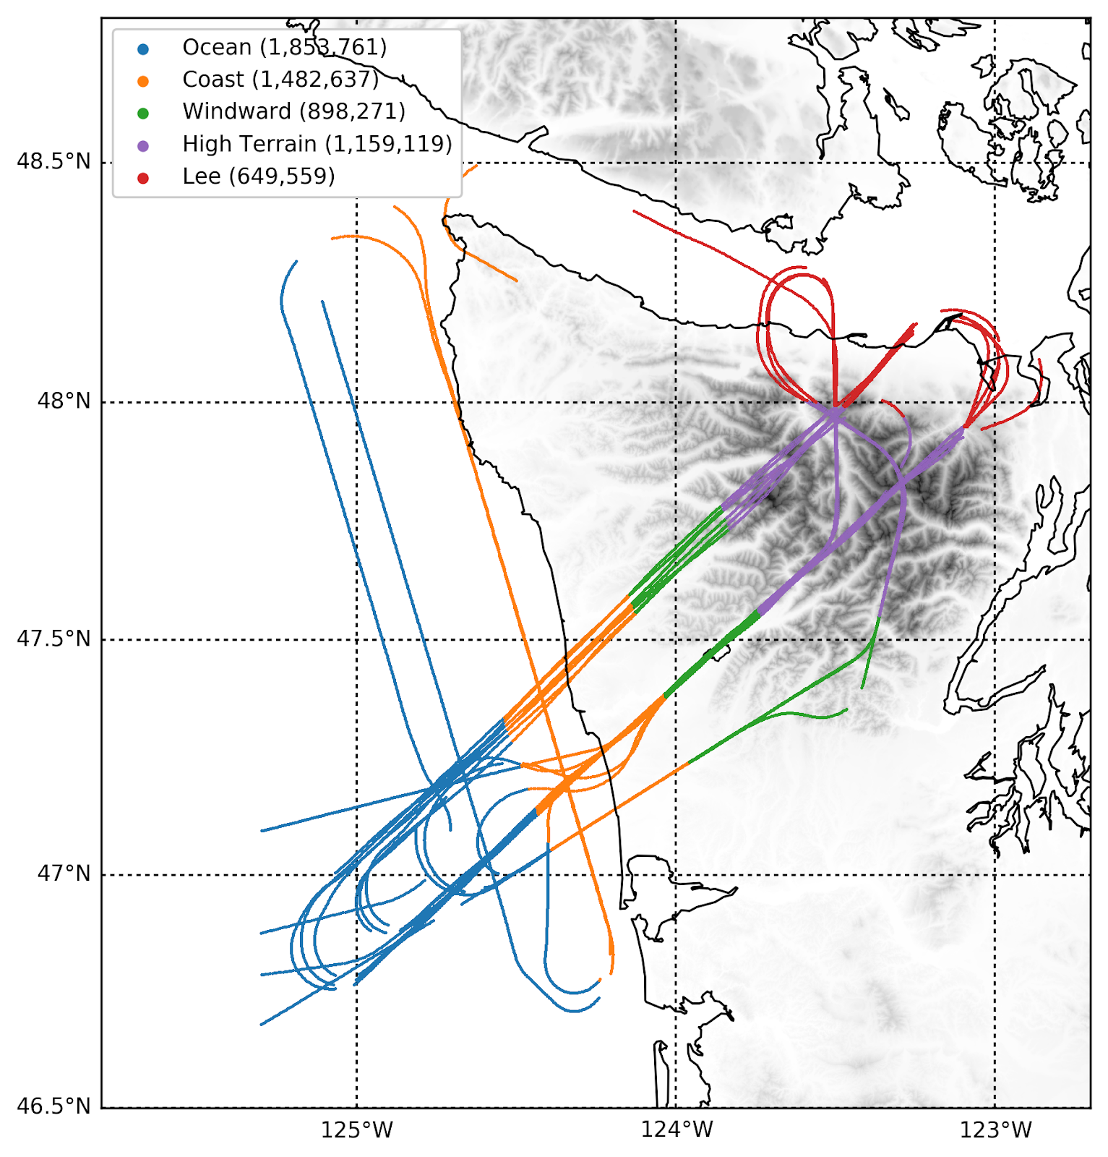
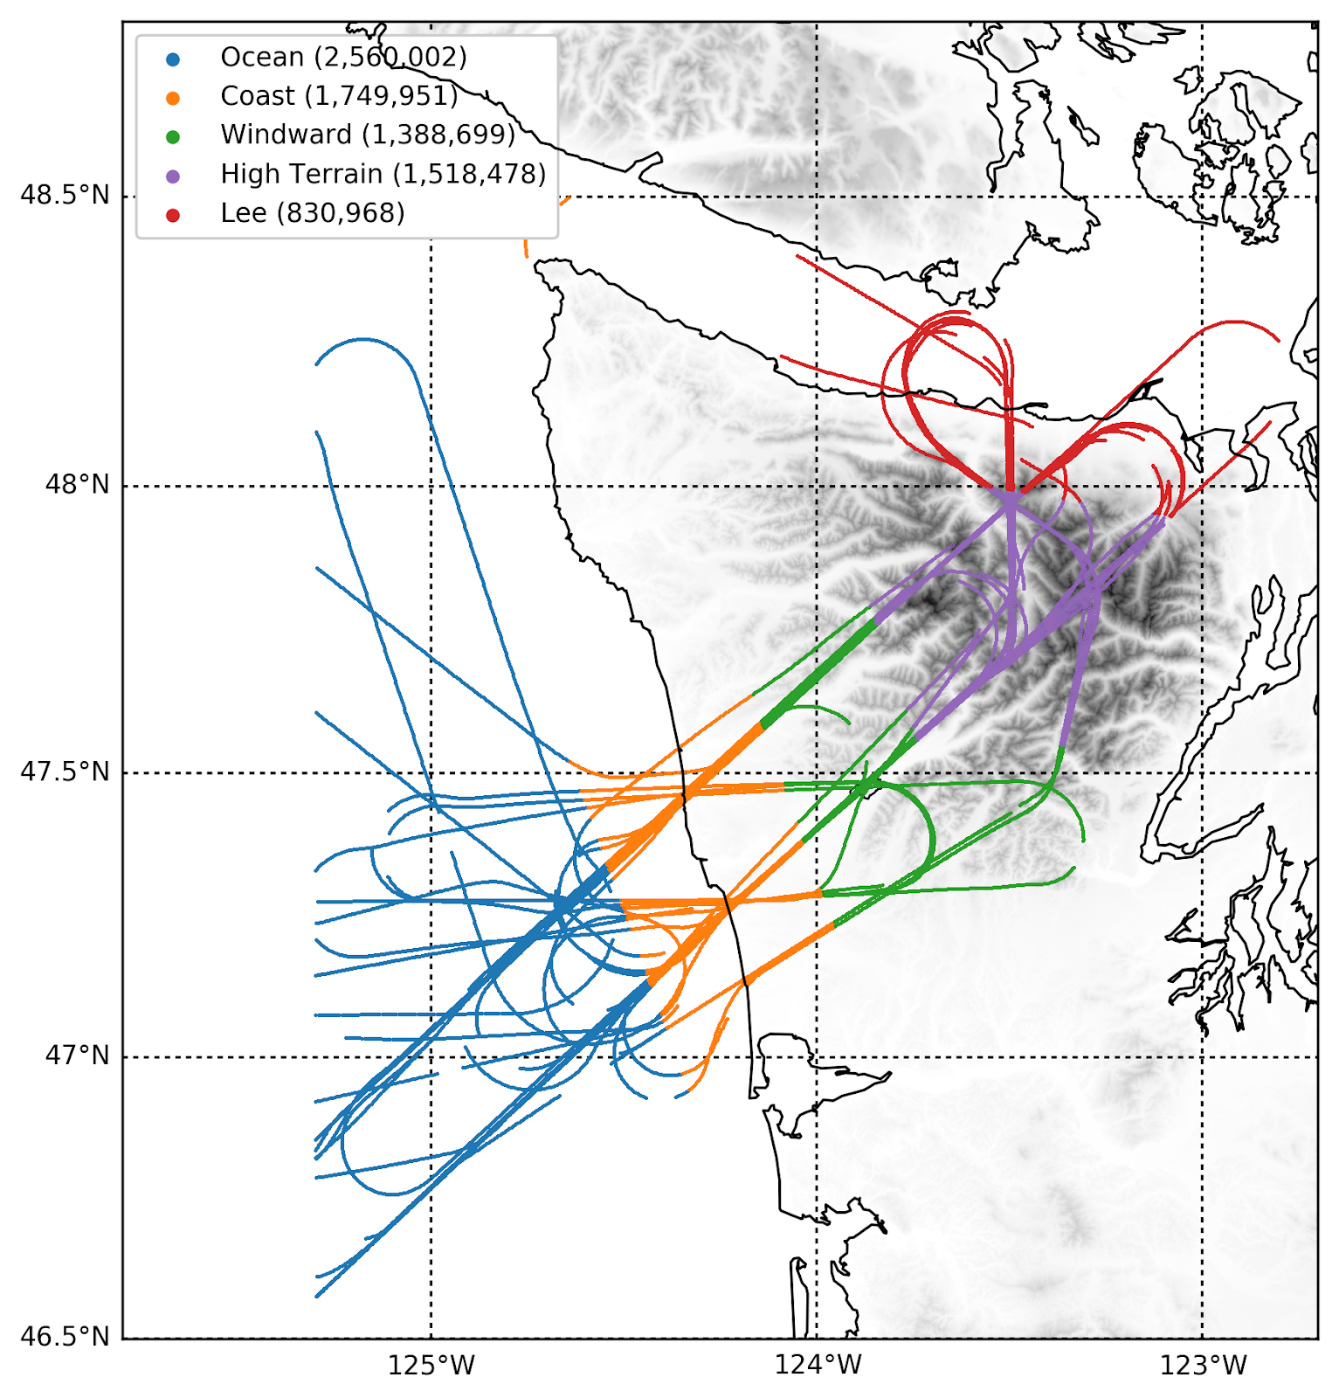
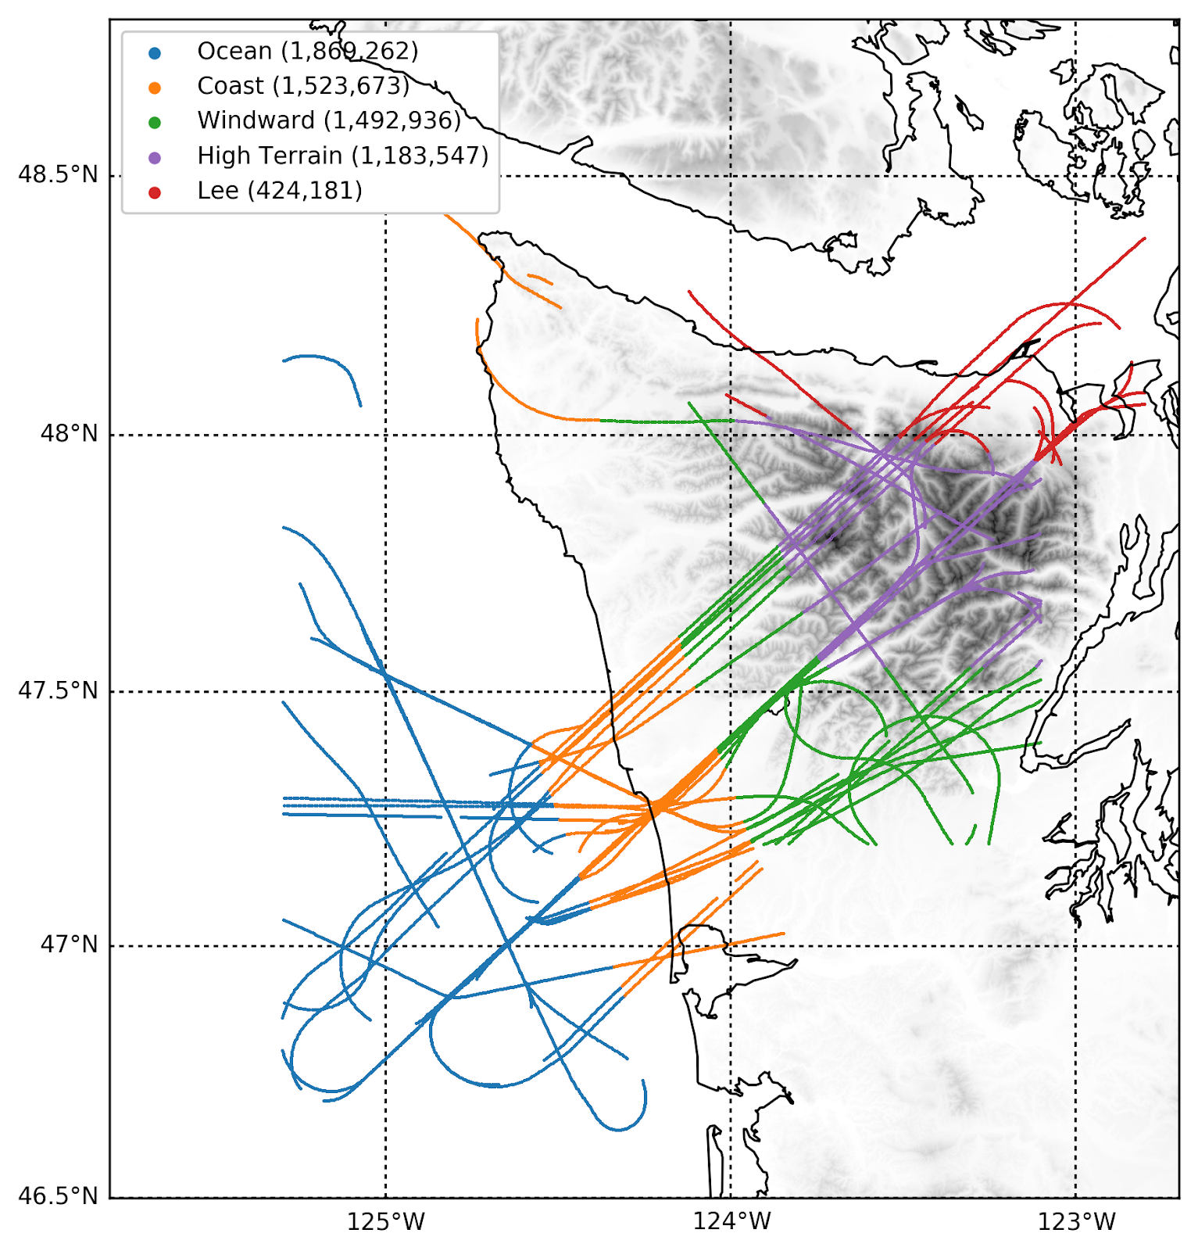
Flight tracks divided by storm sector and geographic region:
Ocean Coast Windward High Terrain Lee Side
~30 total measurement hours
Prefrontal
Warm Sectors
Postfrontal

Slide 6
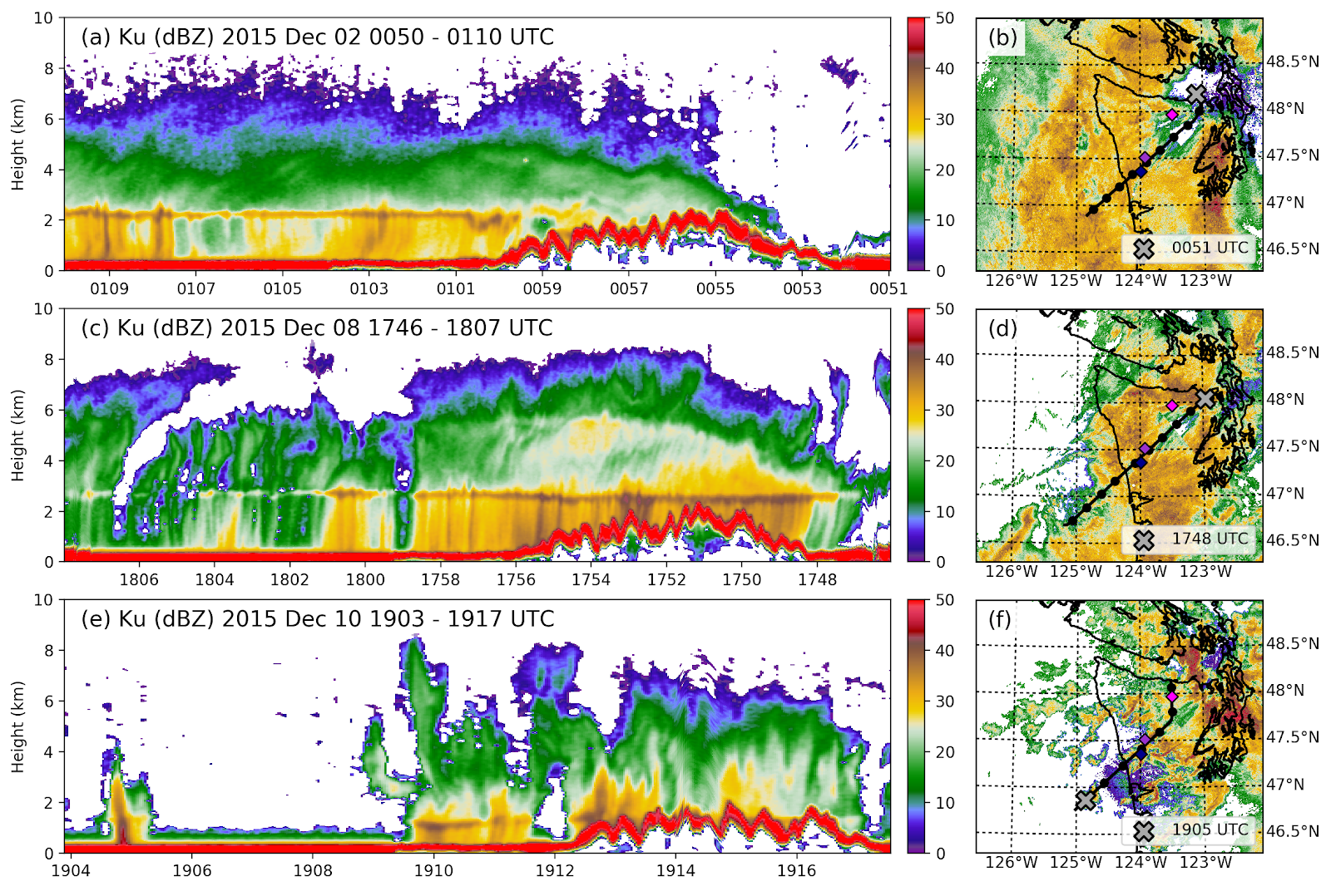
Flight track + NEXRAD radar
Example APR-3 transects of Ku- reflectivity
Prefrontal
Warm Sector
Postfrontal
Note: the red stripe
(> 50dBZ)
is the ocean/land surface signature
Notes:
Prefrontal: broad stratiform precip, rapid diminishment over high terrain/lee
Eye candy slide
Warm sector: isolated over ocean, deep cloud centered over land, lots of ice-phase enhancement
Postfrontal: isolated convection over ocean, broader but less intense cores over land

Slide 7
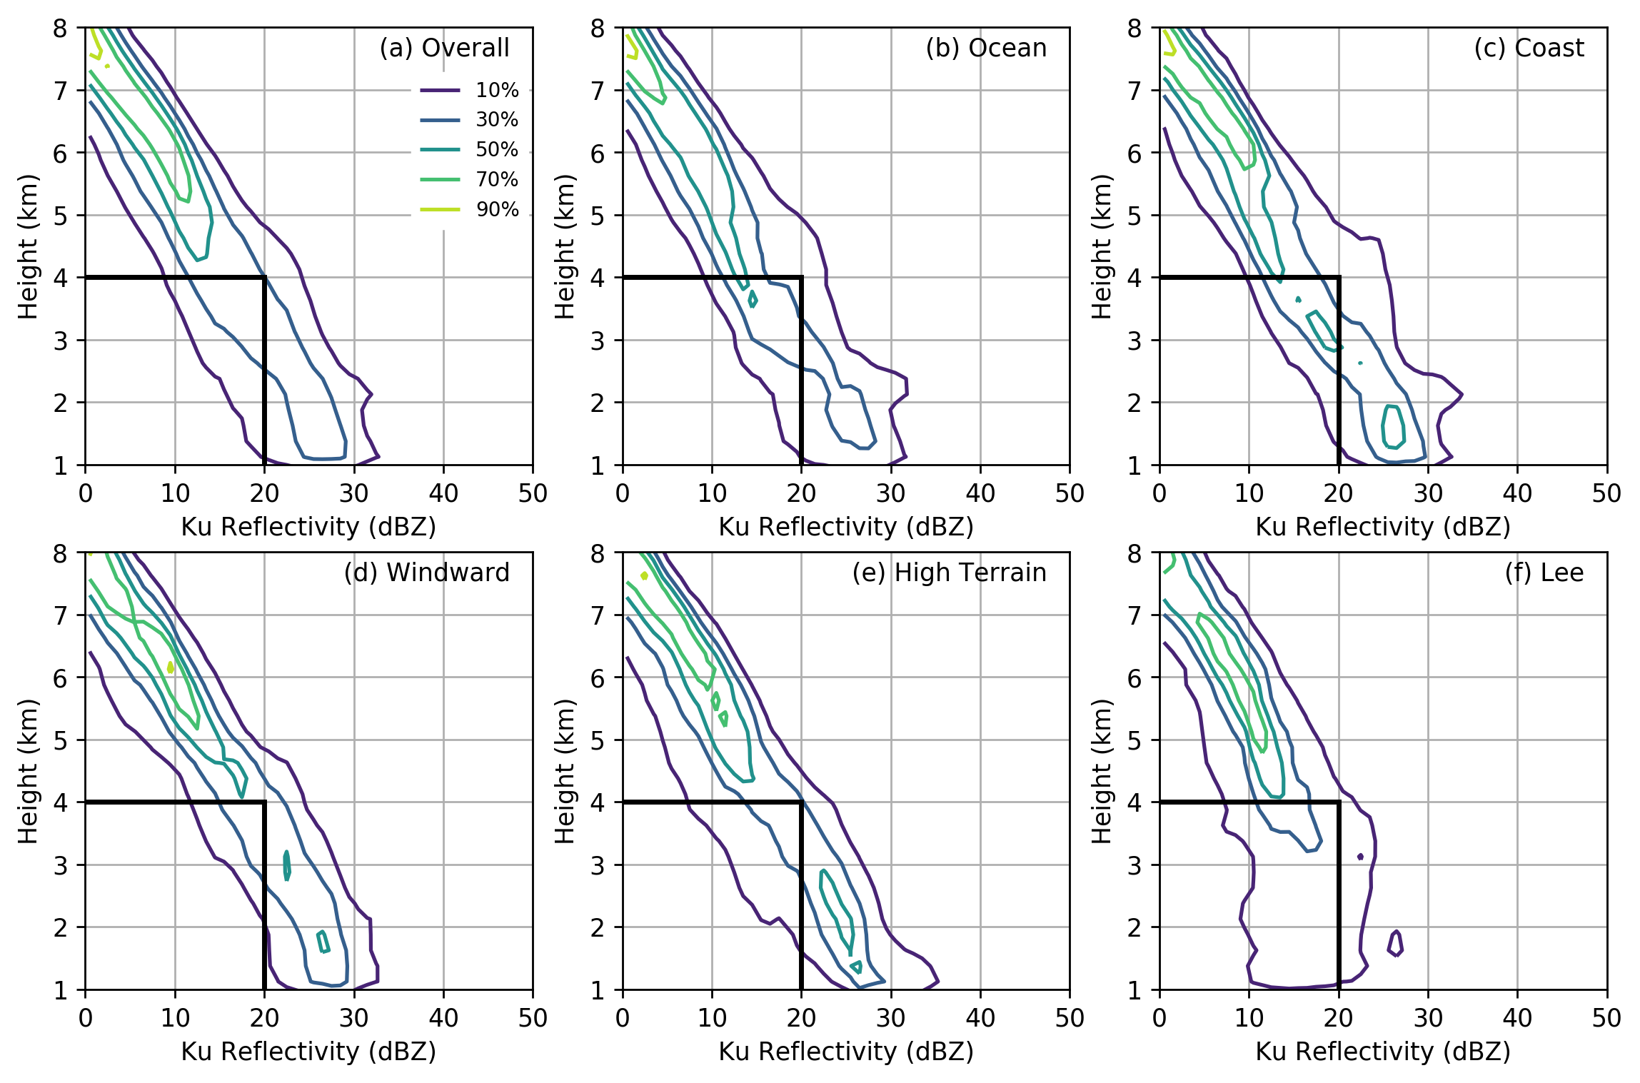
Prefrontal Normalized Contoured Frequency by Altitude Diagrams (CFADs)
Methodology:
Each CFAD individually normalized so that 100% = maximum bin (independent of level)
Notes:
Not much spread or difference between regions

Slide 8
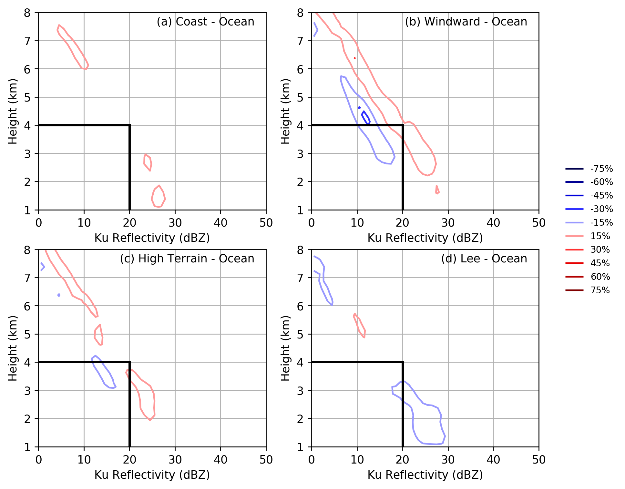
Prefrontal CFAD differences (relative to OCEAN)
Windward: Modest enhancement upstream of high terrain
Blue: higher frequency over ocean
Red: higher frequency over comparison region
Lee: diminishment at low levels
(often no reflectivity)
Notes:
Mountain wave response under stably stratified environmental conditions

Slide 9
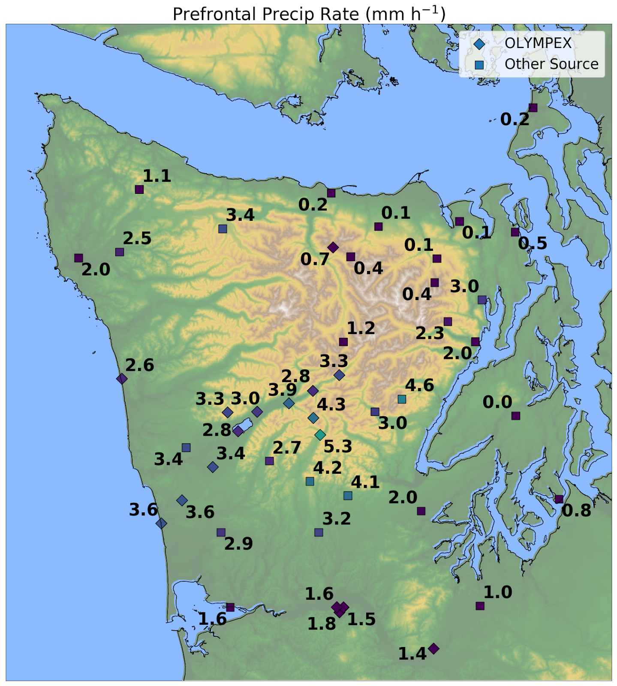
Uniform 3-4 mm h⁻¹ over coast and windward side.
Rapid decline to < 1 mm h⁻¹ at windward/high terrain boundary.
Nearly complete “rain shadow” in lee.
Average precipitation rate (mm h⁻¹) during prefrontal flights
Notes:
Presumably some ice is advected to lee side—disdrometers show high

Slide 10
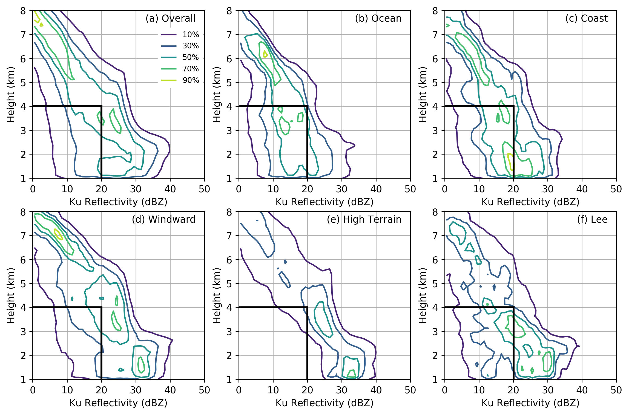
Warm Sector CFADs by geographic region
Notes:
Complexity—variety of precipitation types combined---deep stratiform cloud, signatures of mid-level and low-level enhancement

Slide 11
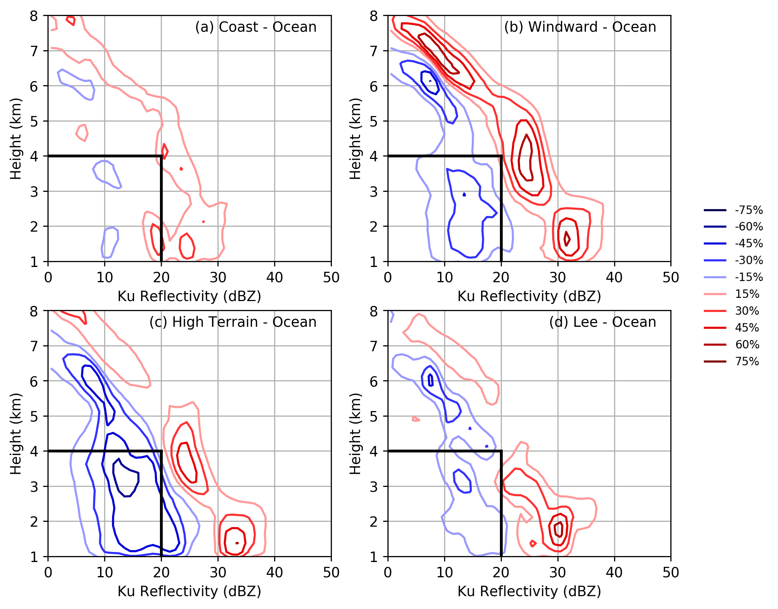
Warm Sector CFAD differences (relative to OCEAN)
Windward: Deep enhancement over full vertical profile
(consistent with McMurdie et al. 2018)
Blue: higher over ocean
Red: higher over comparison region
Lee: Enhancement most pronounced near/below bright band--suggests spillover

Slide 12
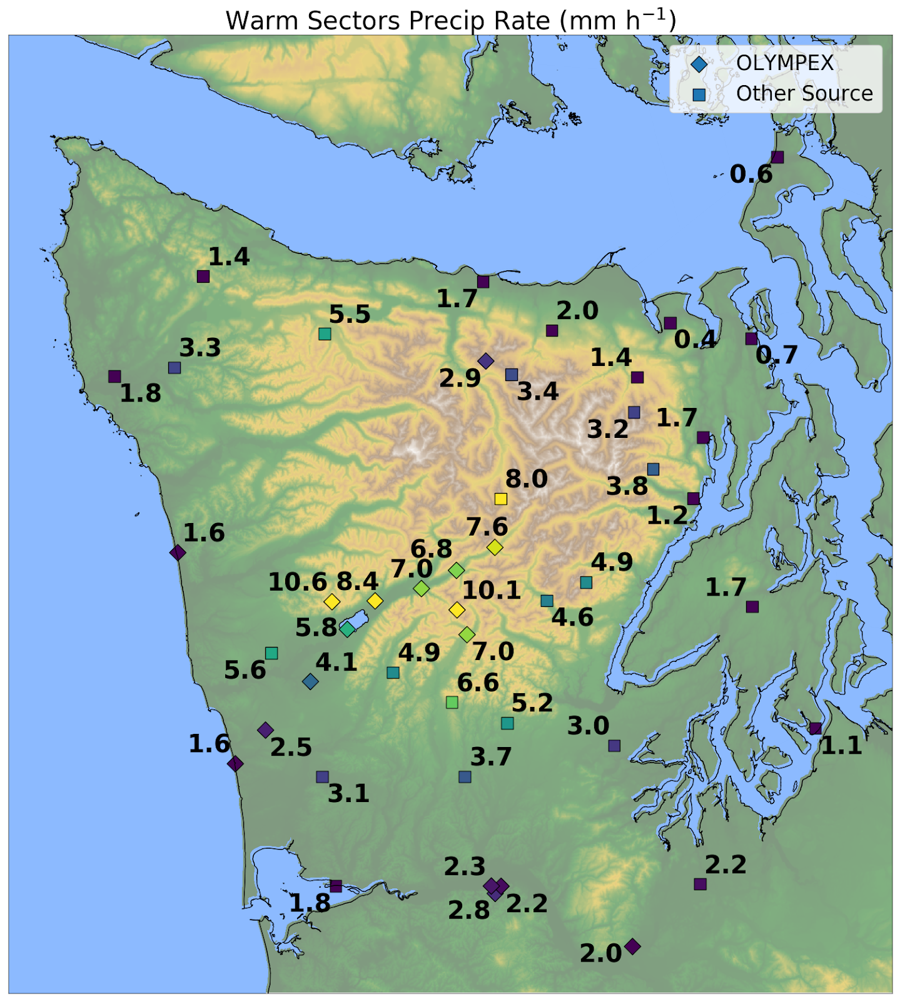
Factor of 6-8 times more precip on windward slopes than coast.
(see Zagrodnik et al. 2018 JAS)
Sharp diminishment is located directly over high terrain, similar to climatology.
More precipitation reaches lee side.
Average precipitation rate (mm h⁻¹) during warm sector flights

Slide 13
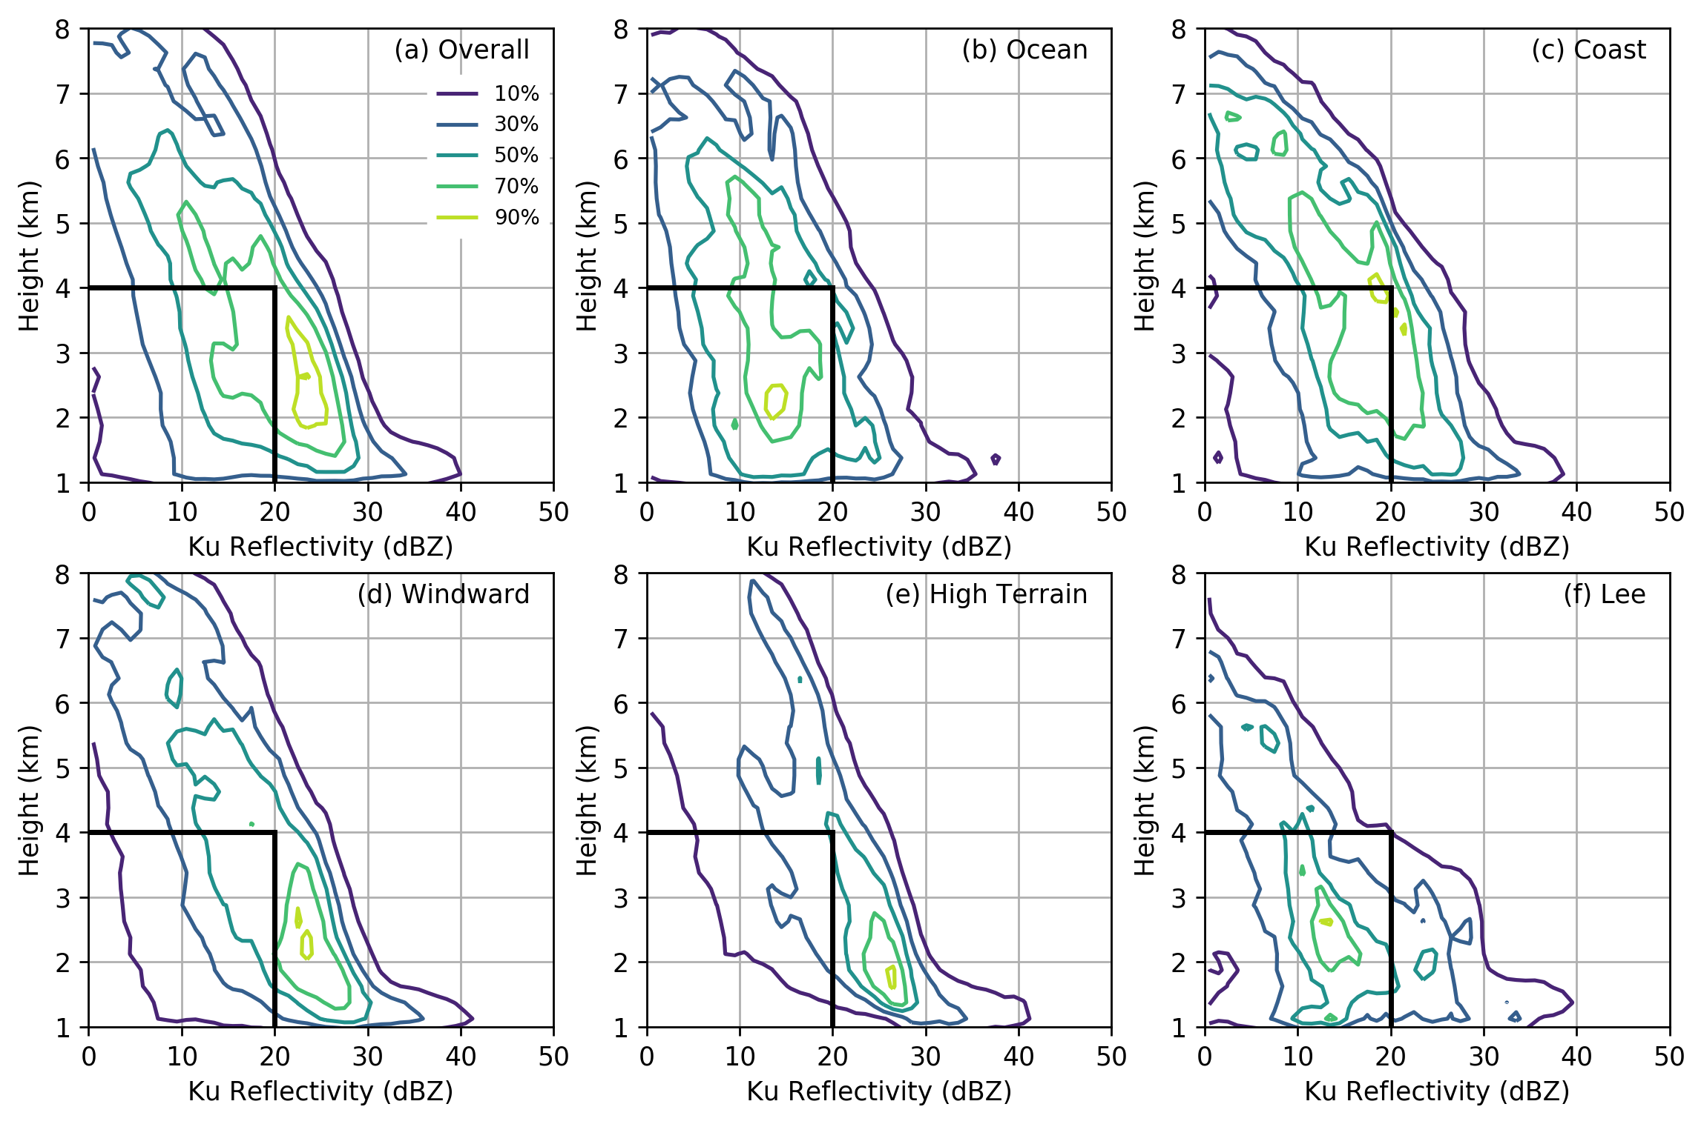
Postfrontal CFADs by geographic region
Generally shallower and more convective in nature than other storm sectors
Notes:
Looking mostly at ice
Click 1: more variable and weaker over ocean, more uniform over high terrain
Click 2: but doesn’t trail w/height as fast as prefrontal or warm sectors (suggests strong vertical ascent)

Slide 14
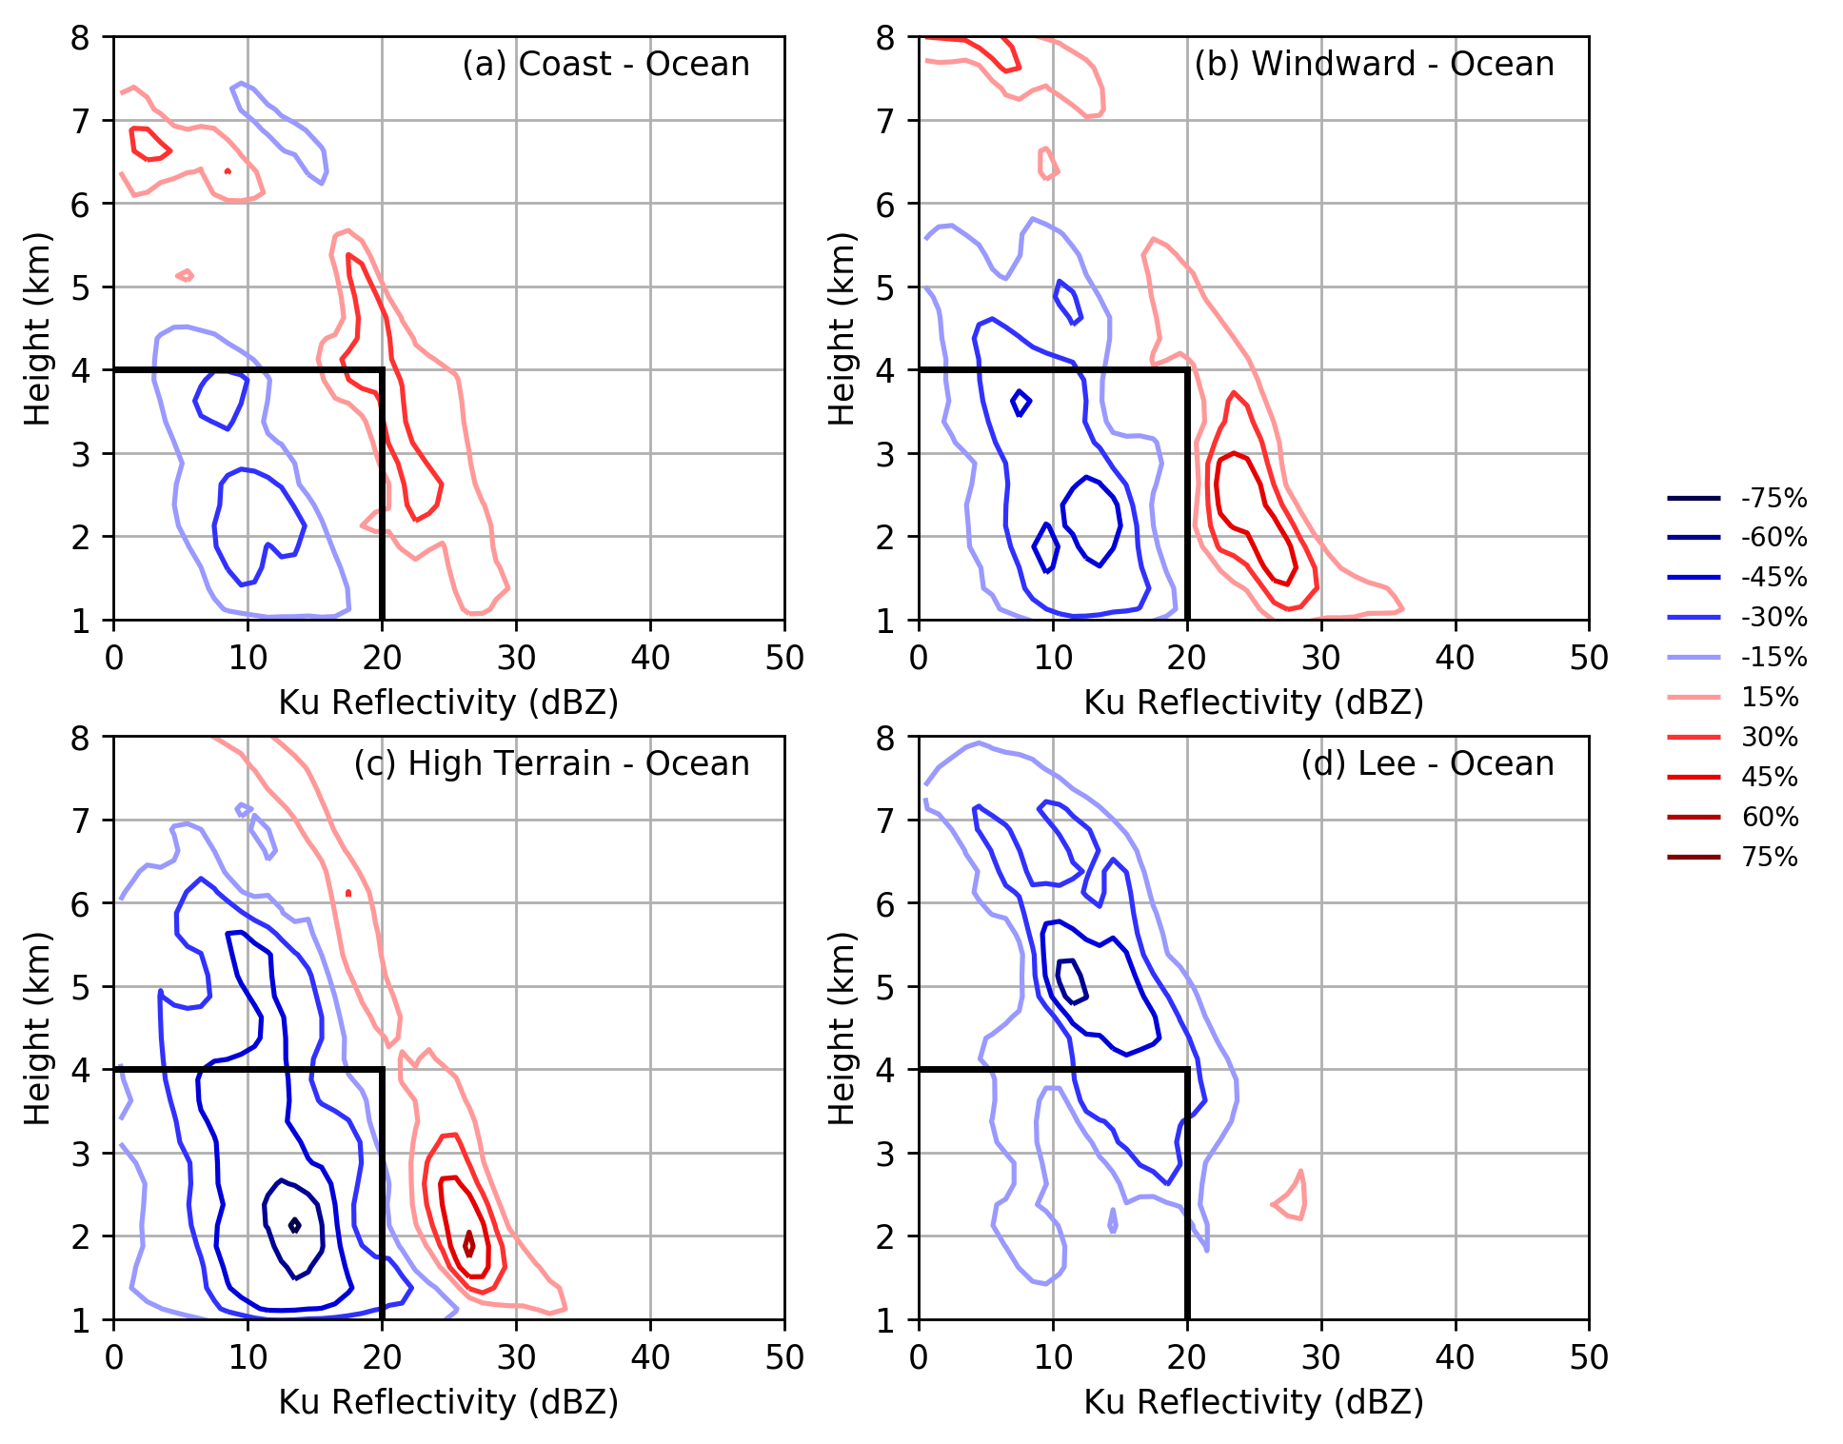
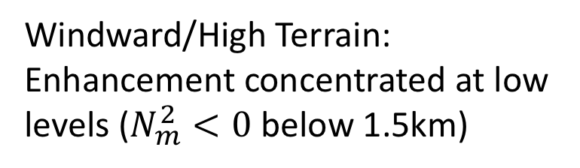
Postfrontal CFAD differences (relative to OCEAN)
Windward/High Terrain: Enhancement concentrated at low levels ($N_{m}^{2}<0$ below 1.5km)
Blue: higher over ocean
Red: higher over comparison region
Lee: Diminished echo at higher levels, shallow showers at low levels

Slide 15

Windward maximum
(present in all 3 sectors).
Weaker gradient of diminishment over high terrain/lee than prefrontal.
Considerable snow accumulation in postfrontal sector (low melting level + long event duration).
Average precipitation rate (mm h⁻¹) during postfrontal flights

Slide 16
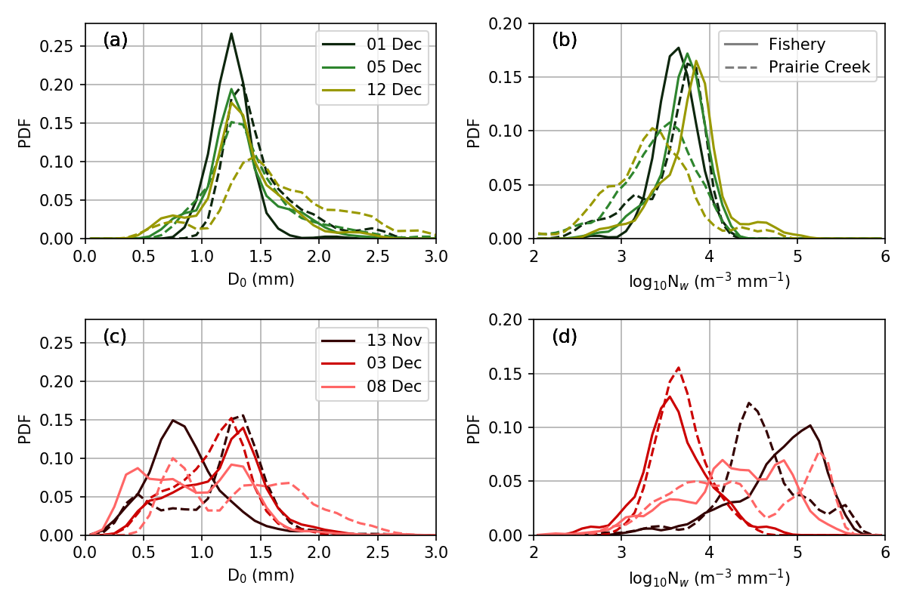
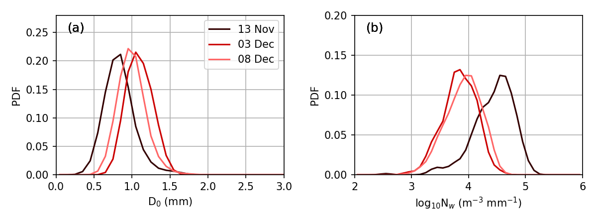
Near-coastal (Fishery) and Windward (Prairie Creek)
Drop Size Distributions (DSDs)
Prefrontal
Sample time resolution: 1 minute
Prefrontal
Not much variability in prefrontal sector
(stratiform precipitation dominates)
Disdrometer: Parsivel²
Warm Sectors
Warm Sectors
Coastal/windward warm sectors are influenced by both ice processes and low-level warm processes
Median Drop Size (D_{o})
Normalized Intercept (N_{w})
High Terrain-Lee (Hurricane Ridge)
Disdrometer: PIP
Warm Sectors
Warm Sectors
Warm sector observations at Hurricane Ridge (high terrain/lee boundary) suggest particle segregation during spillover reduces DSD variability
Median Drop Size (D_{o})
Normalized Intercept (N_{w})
Notes:
Each sector has a unique distribution of PSDs

Slide 17
Conclusions
Spatial distribution of precipitation modification (in horizontal and vertical) was strongly dependent on the large-scale environment associated with different synoptic storm sectors.
Windward enhancement and leeside diminishment were omnipresent but details were highly variable:
  Prefrontal: enhancement shifted upstream, near-complete lee rain shadow
  Warm sector: deep, intense enhancement over mountains spilled over to lee
  Postfrontal: shallow enhancement concentrated over terrain
In warm sectors, spillover to the high terrain/lee side appears to segregate particles, leading to less DSD variability than the windward side.
Notes:
All three sectors come together for climatology

