Slide 1
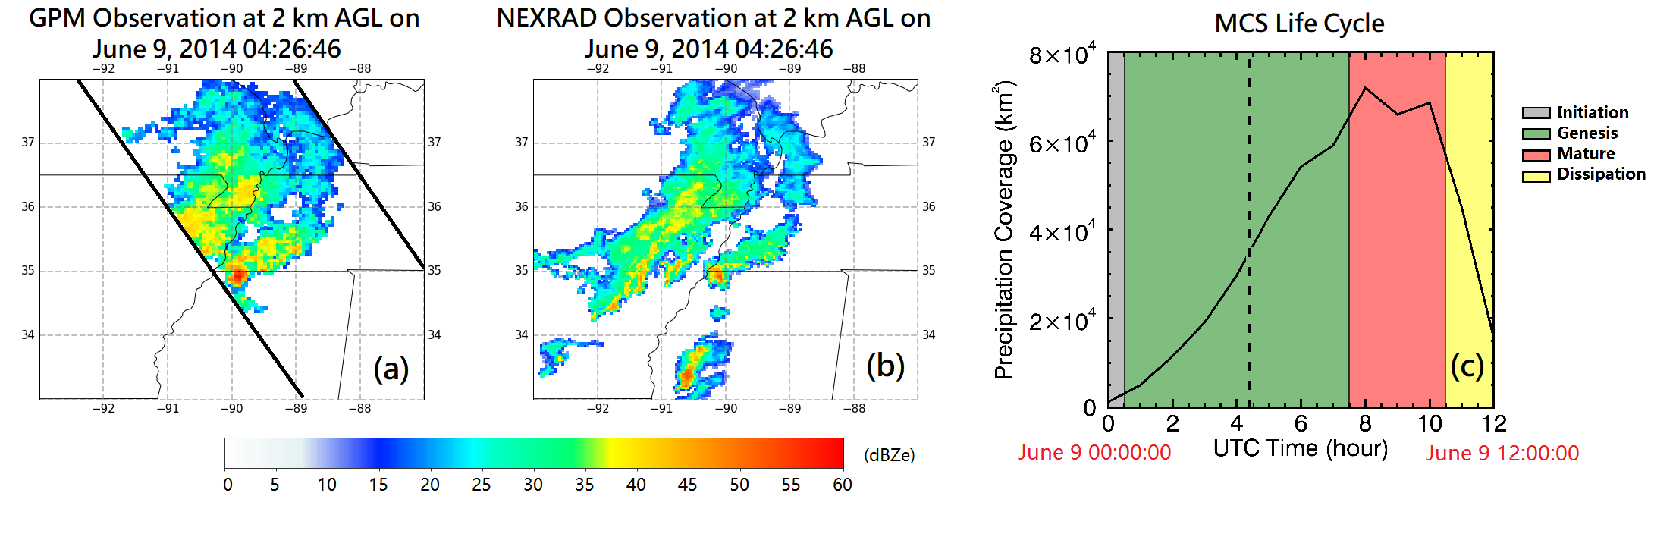
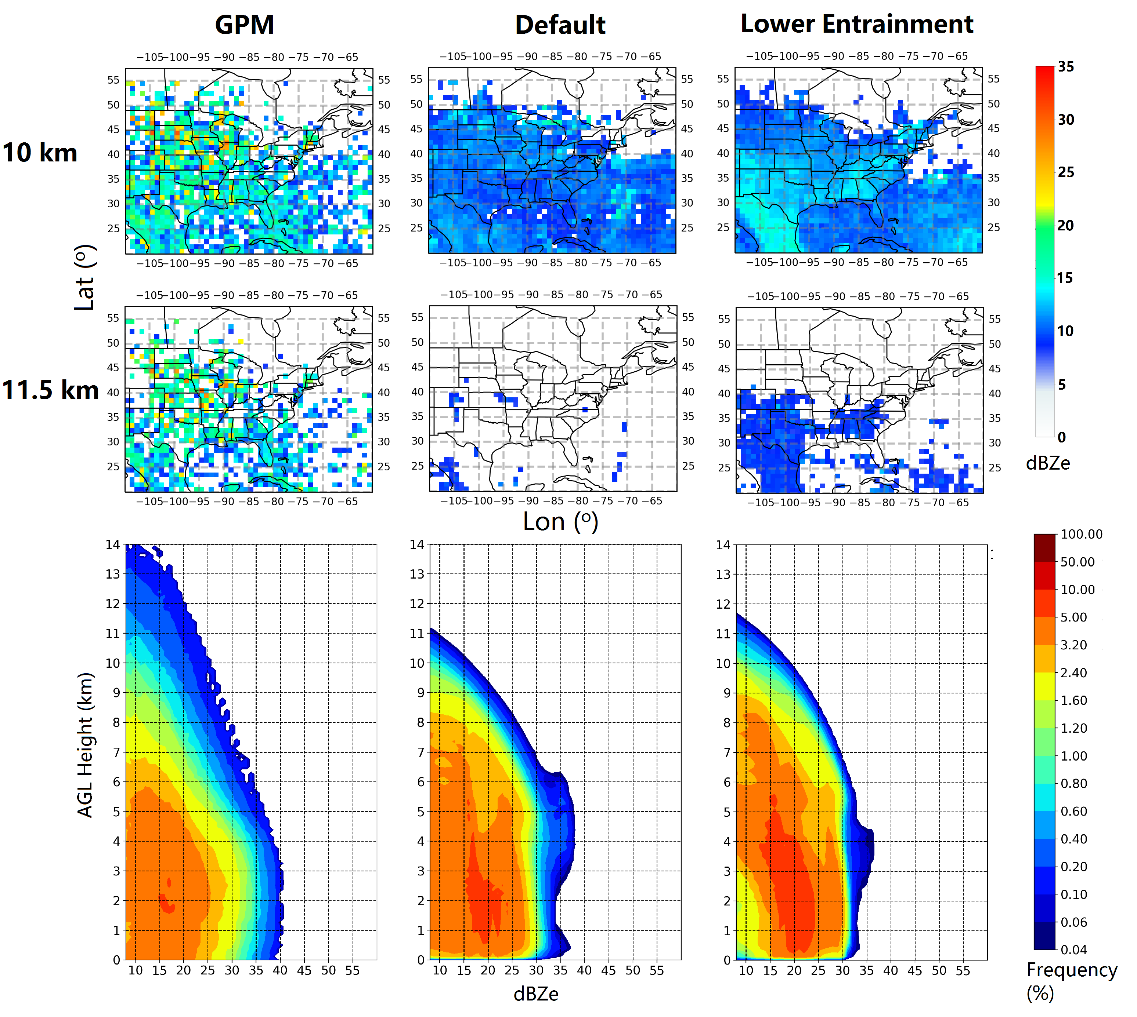
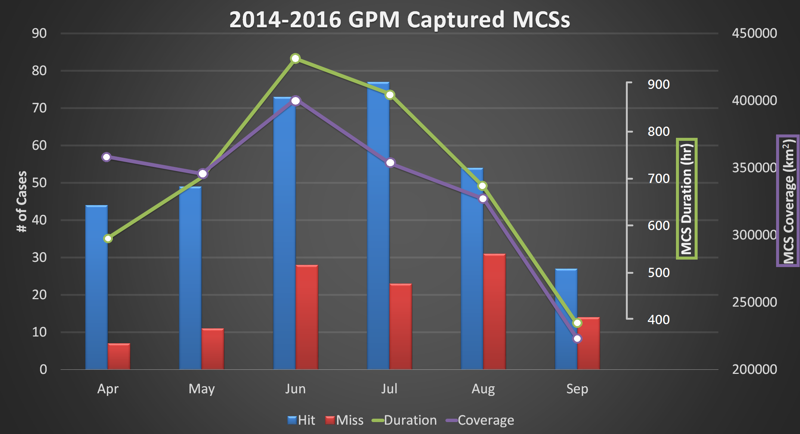
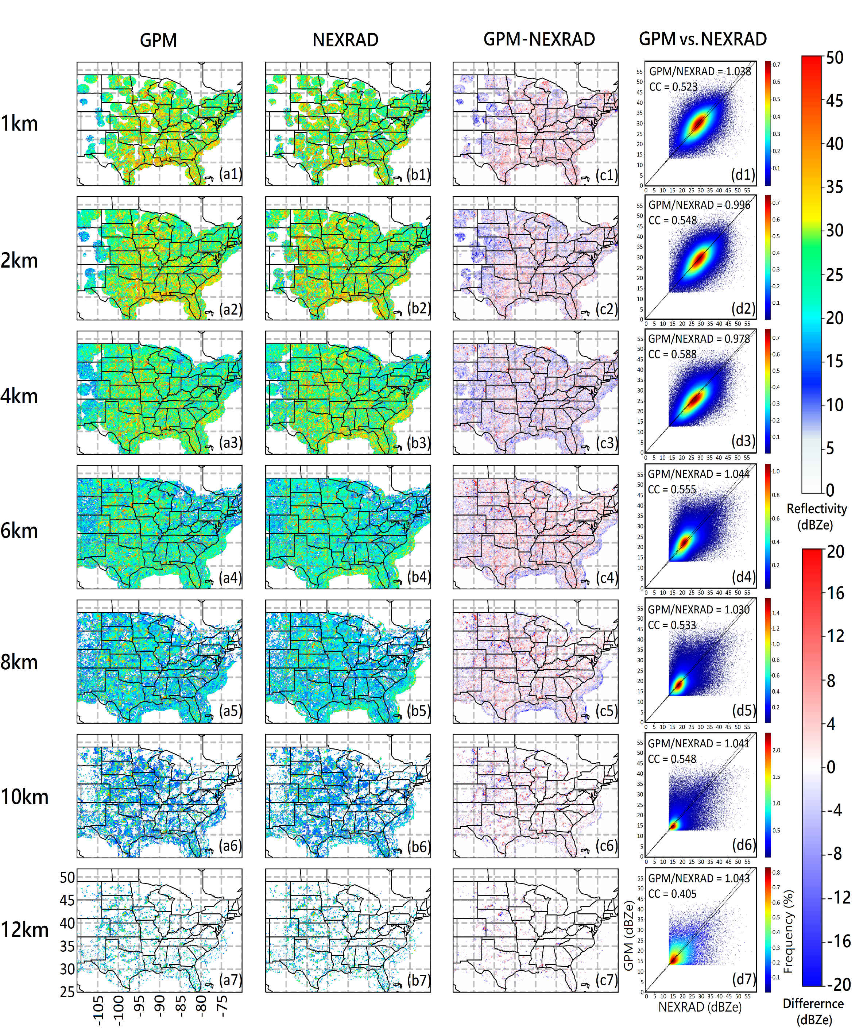
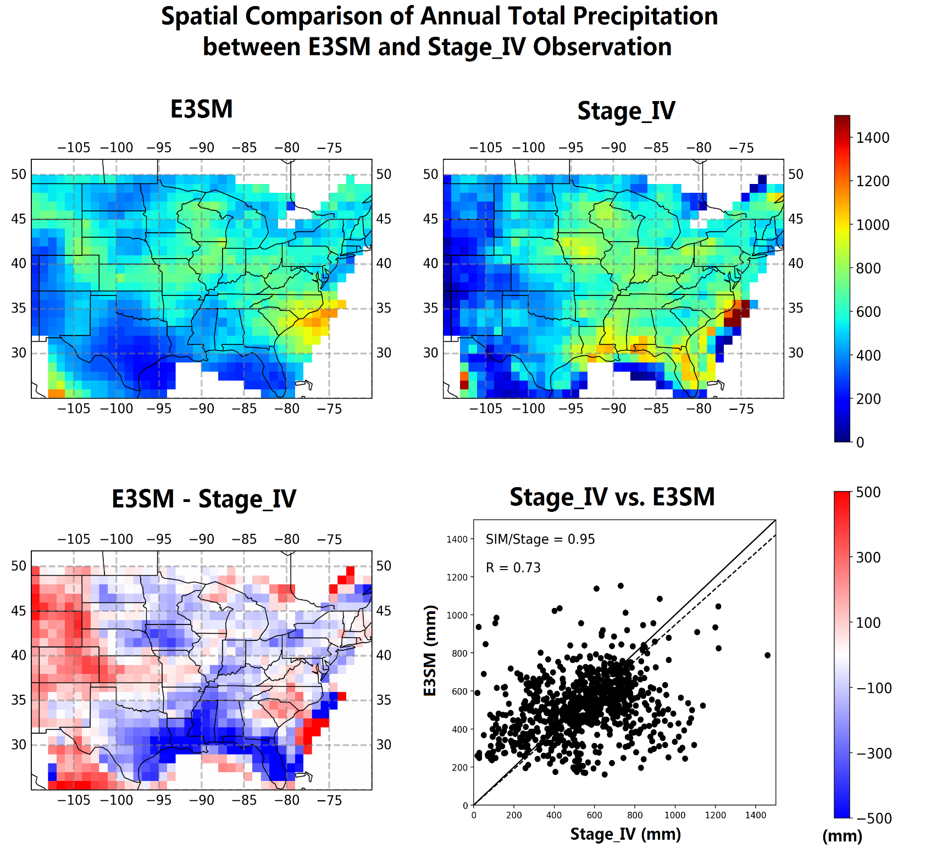
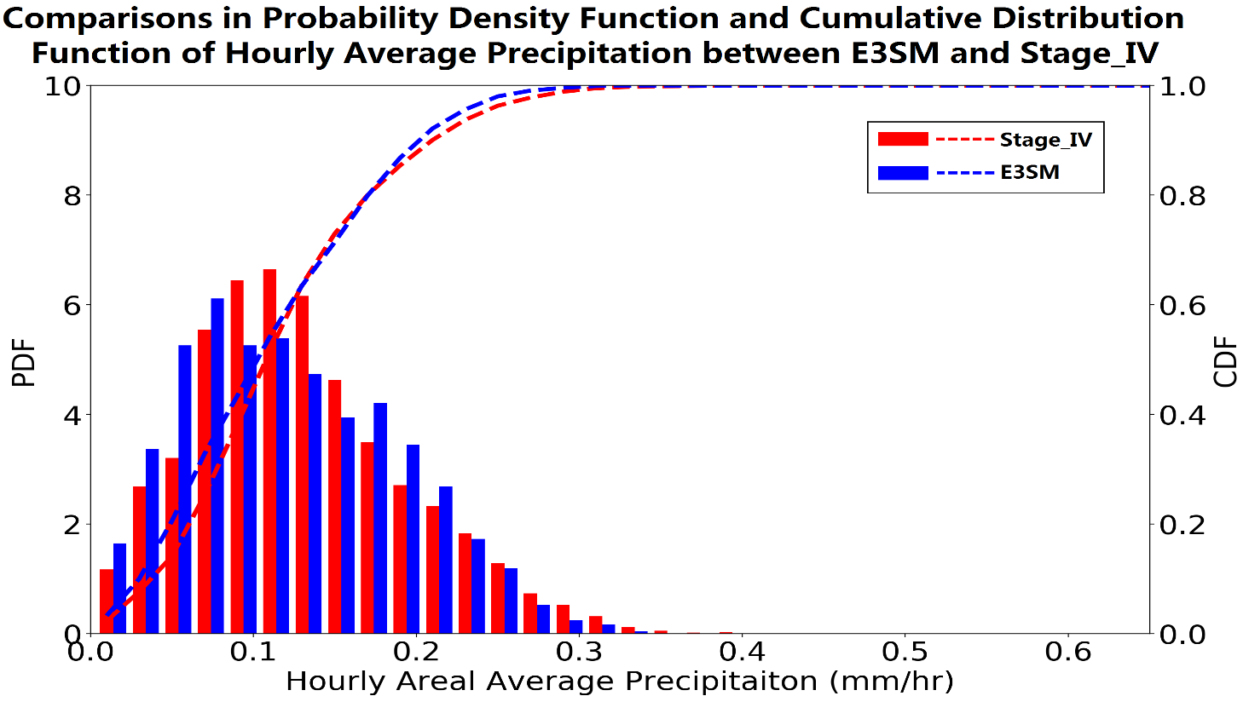
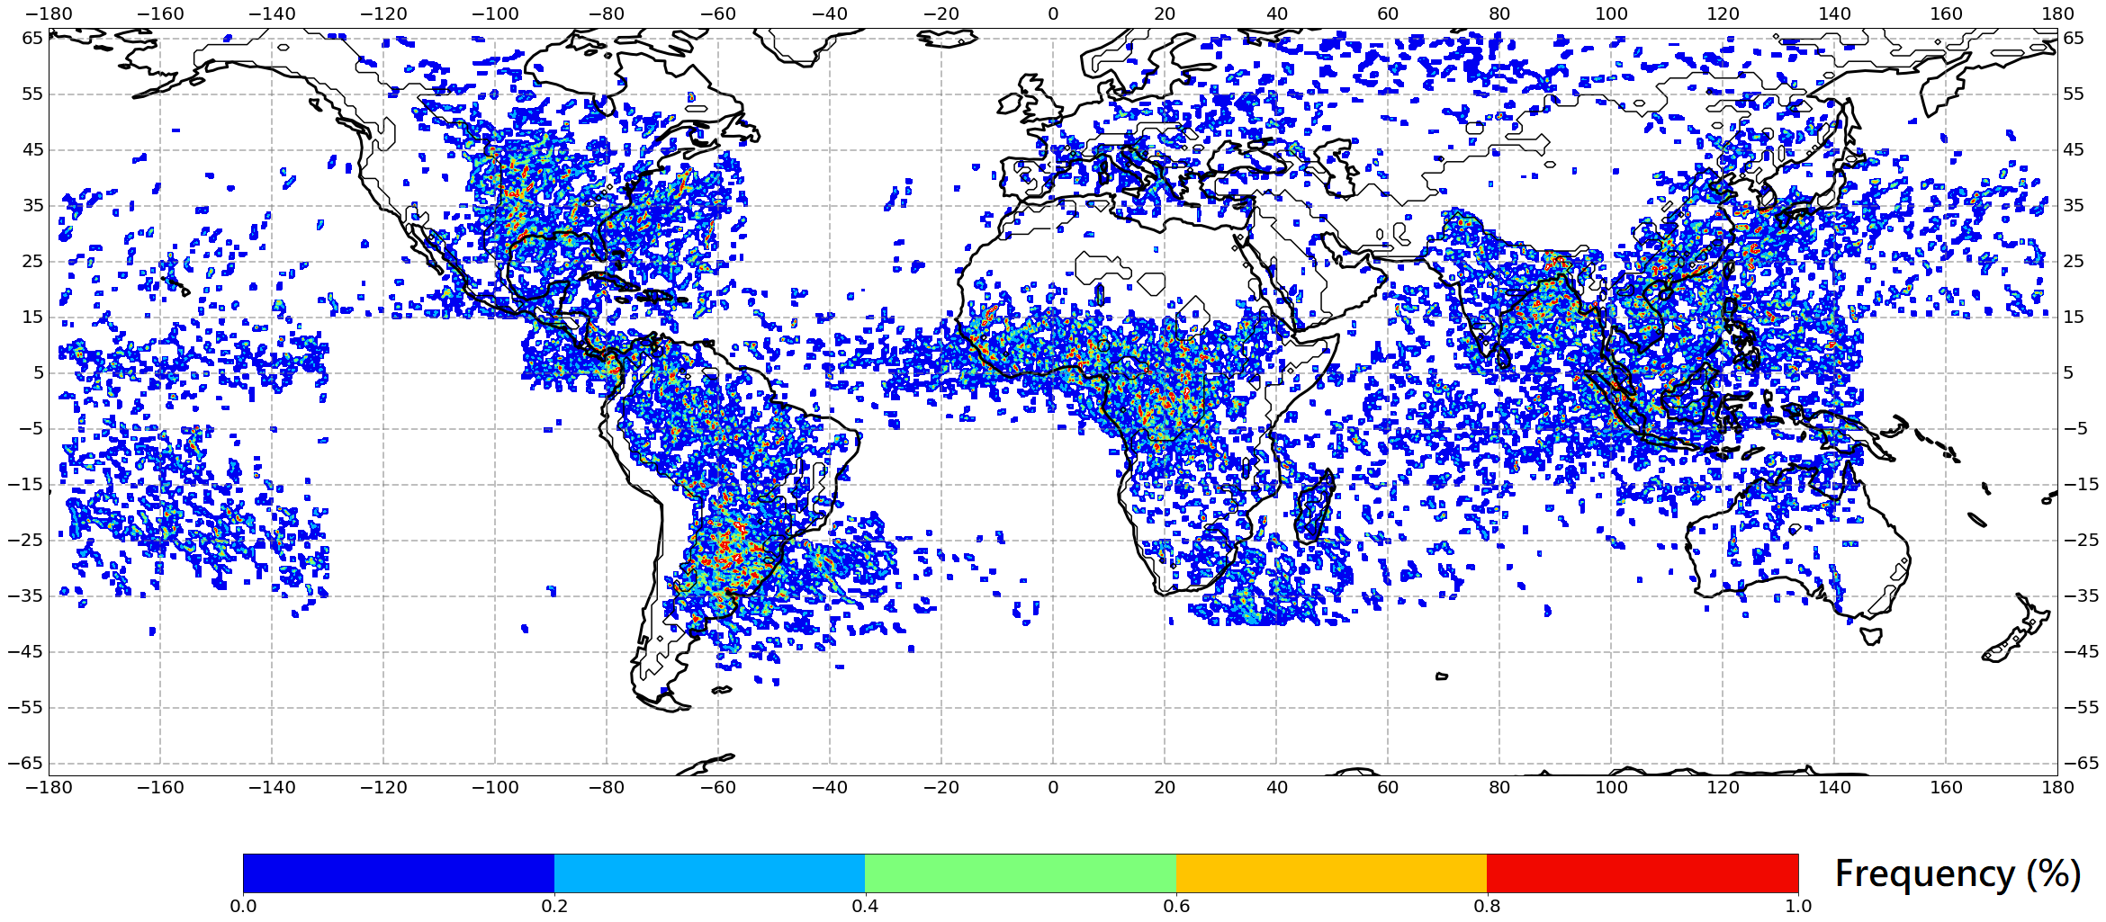
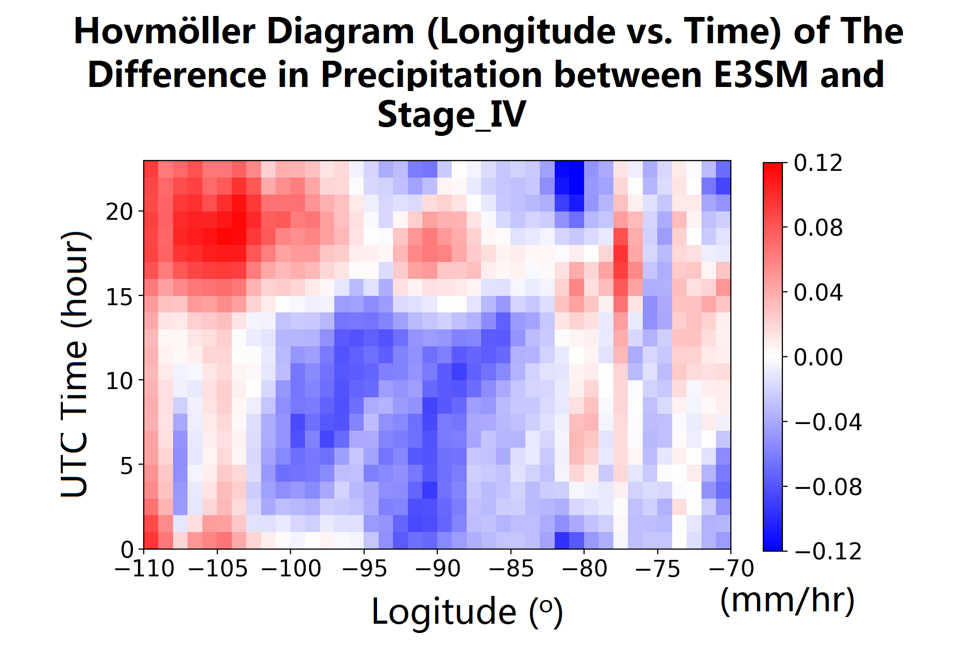
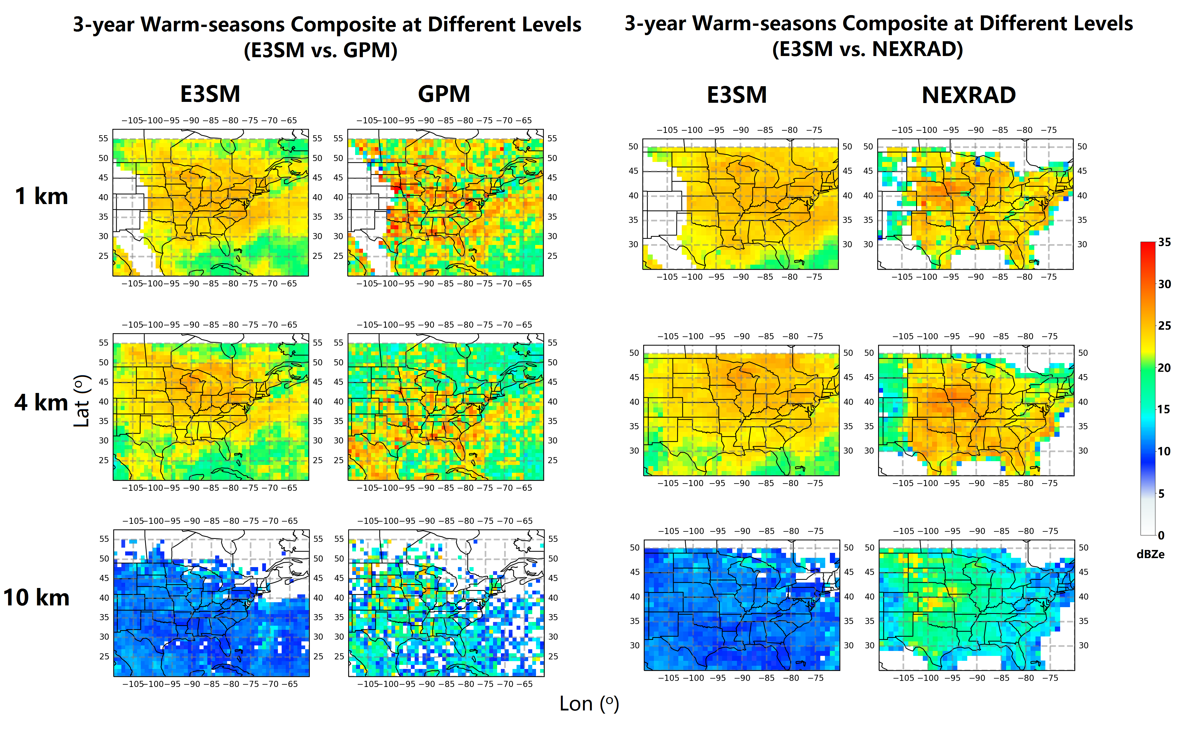
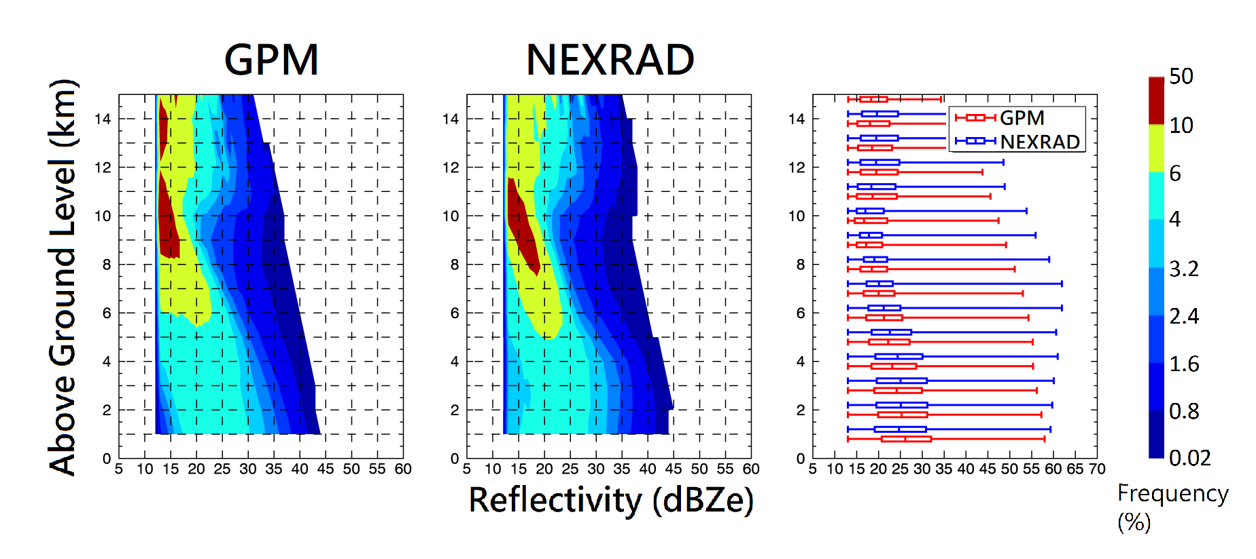

Evaluation of GPM Ku-band Radar Reflectivity Observation and E3SM Simulation Using NEXRAD Network over the Continental U.S. in warm seasons Jingyu Wang¹, R. A. Houze, Jr.^{1,2}, Jiwen Fan¹, S. R. Brodzik², and Zhe Feng¹
¹Pacific Northwest National Laboratory; ²University of Washington
Introduction
Global observation and model simulation of clouds and precipitation have been challenging
GPM can provide the near-global coverage of 3D radar reflectivity and E3SM is designed to address the challenges in simulating water cycle globally and regionally
This study uses NEXRAD to evaluate GPM observation and E3SM performance in simulating warm season cloud structure and precipitation over the U.S.
Evaluation of GPM’s capability of MCS detection
Sensitivity tests to improve the echo top height
One example of GPM detected Deep-Wide-Convection (DWC, featuring greater than 40 dBZe area exceeding 1000 km² and echo top higher than 10 km, left) coincides with NEXRAD tracked MCS object (middle), and the overpass time (dash-line) in the MCS’s life cycle (right)
Experiment Design
Domain/Period:. CONUS East of Rocky’s/2014-2016 (Apr-Sep)
Simulation: E3SM V1 (hourly, 1º, 72 levels), radar reflectivity is simulated by COSP with 50 sub-columns
Observation: GPM Ku-band (6 overpasses per day, 245 km swath width, 5 km/250 m horizontal/vertical resolutions), GridRad based on NEXRAD (hourly update, CONUS coverage, 4 km/1 km horizontal/vertical resolution), and Stage_IV precipitation observation (hourly, 4 km resolution)
More than 70% of GPM detected MCSs with wide convection feature are validated by ground-based tracking
For the MCSs with large coverage and long duration observed from NEXRAD, GPM has a better detection.
Sensitivity tests show the lower Zhang-McFarlane entrainment rate can only increase the echo height by 500 m
Other factors including autoconversion rate, Bergeron efficiency, evaporation rate, removal of equilibrium level, etc. even have less impact.
Results
Quantitative evaluation of GPM spatial reflectivity fields
Global distribution of GPM detected MCSs
Evaluation of precipitation
GPM overall agrees with consistent with NEXRAD except:
Negative biased over mountainous regions below 4 km
Underestimation along the east coastal line in upper levels
High frequency of MCSs mainly occur over land (North America, South America, Africa, India, East Asia) and Maritime Continent
E3SM simulated surface precipitation is overestimated over east of the Rocky Mountains (especially in the afternoon) and underestimates along the Gulf Coast (especially at night). This result indicates that E3SM is not robust enough to handle different climatic regimes.
Evaluation of spatial patterns simulated by E3SM using GPM/NEXRAD
Conclusions
Simulated liquid/mixed phase reflectivity (< 6 km) is in a good agreement
Reflectivity at high-levels (> 6 km) has a severe underestimation
GPM agrees well with NEXRAD in 3D radar reflectivity field, and more than 70% of GPM defined MCS can be validated by ground-based tracking.
Comparison of E3SM reflectivity with GPM and NEXRAD observations shows E3SM radar echo distribution is narrower but is centered at higher modal values at low levels, and the echo height is underestimated by ~ 3 km.
Rainfall biases in E3SM output differ strongly between climatic regimes.
Changing physical parameters does not lead to significant improvement in echo height or rainfall amount.
CFADs comparison for vertical cloud structure
GPM’s short wavelength has trouble detecting > 60 dBZe reflectivity
Slight over (under)-estimation below 4 km (above 12 km)
File Name // File Date // PNNL-SA-#####
Acknowledgements: DOE Climate Model Development and Validation – Mesoscale Convective Systems (CMDV-MCS); RAH was supported partially by NASA grant NNX16AD75G.
Contact: Jingyu Wang, jingyu.wang@pnnl.gov
Notes:
NOTE: Print this poster file at 100% SCALE to result in a physical print measuring 48” wide x 42” tall. All type size notations shown above are based on the final printed size of the poster.
• Contact Digital Duplicating (375-2969, http://digitalduplicating.pnl.gov) to order poster printing and finishing services for your completed poster design.
• Remember to have your poster cleared for public display/distribution through the Information Release system (http://informationrelease.pnl.gov).
• Sidebar “About PNNL” box is considered optional, and can be removed if space is needed for technical content.

