Slide 1


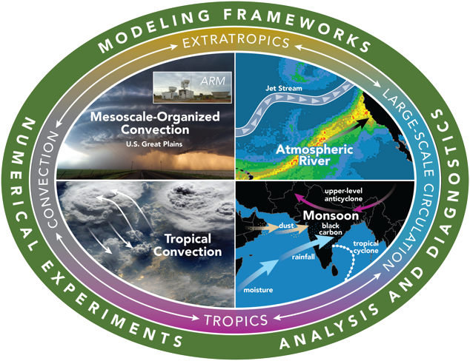
3-D Characteristics of MCSs East of the Rocky Mountains and Their Large-scale Environments
Zhe Feng
Contributions:
Robert A. Houze Jr., Ruby Leung, Joseph Hardin, Jingyu Wang, Fengfei Song, Cameron Homeyer
Funding acknowledgement: DOE BER

Slide 2
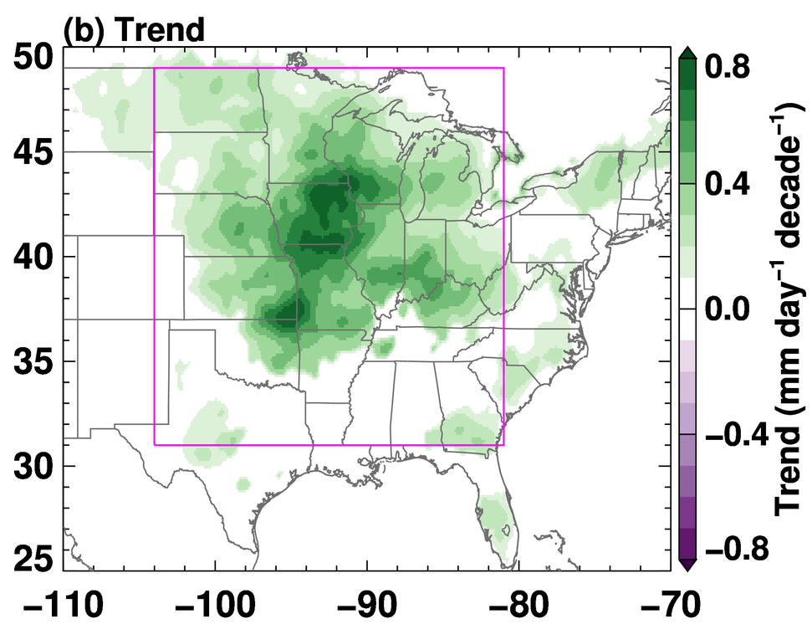
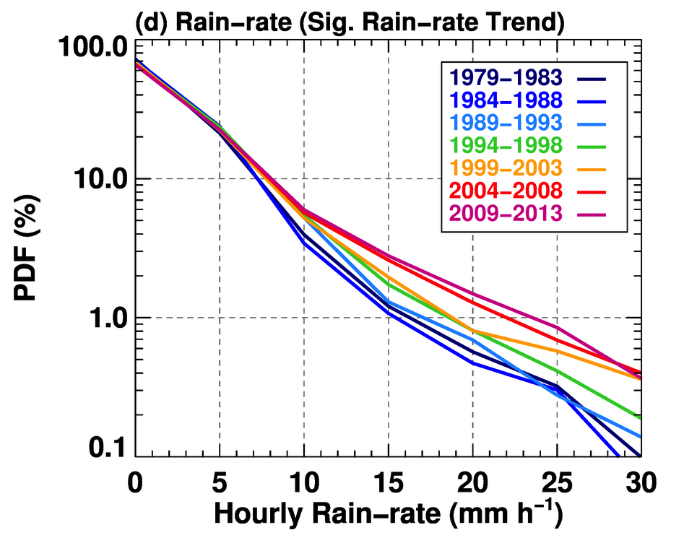
Importance of MCS in the Hydrologic Cycle
MCSs play a critical role in producing heavy rainfall and severe weather in the mid-latitudes during warm seasons
In central US, MCSs contribute 40%-60% of the total warm-season rainfall (Fritsch et al. 1986; Nesbitt et al. 2006)
Long-lived MCS frequency and intensity during spring have been increasing in the past 35-years (Feng et al. 2016 Nat. Commun.)
35-year Spring MCS Precipitation Trend
MCS Rainfall Intensity Trend
2010s
20-40% increase
1980s
Feng et al. (2016) Nat. Commun.

Slide 3
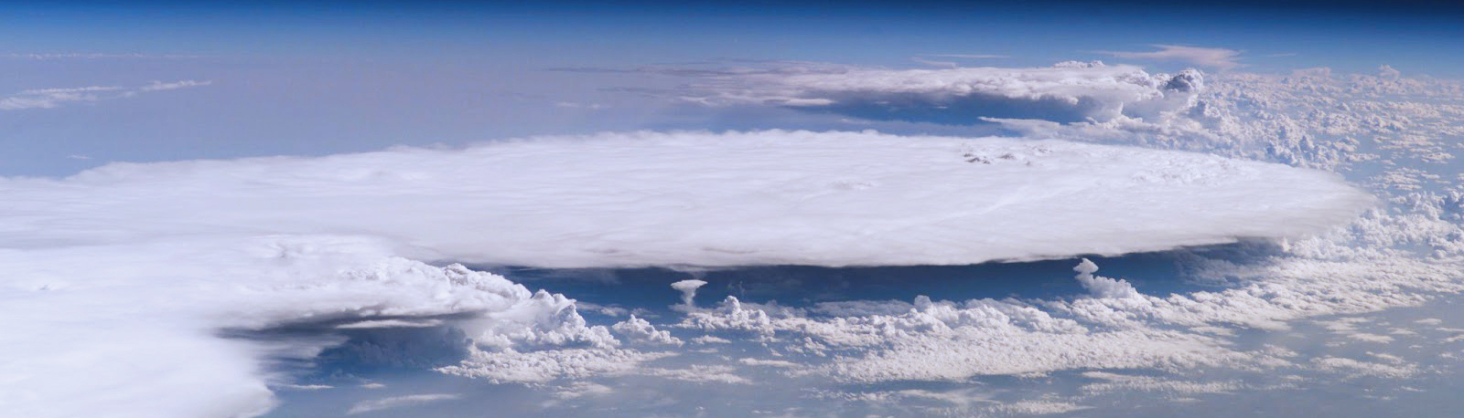
Objectives
Characterize 3-D MCS structures and properties across all seasons east of the Rocky Mountains
Examine large-scale environment patterns that support long-lived and intense MCSs in different regions and seasons
Provide robust statistics for evaluating high-resolution climate modeling
Notes:
As climate models continue to increase in resolution towards convection-permitting scale, we are beginning to see promising improvements in simulating MCSs in recent literatures.
Meanwhile, while most of the past work focuses on MCS in the US Great Plains during the warm season, MCSs outside of the Great Plains and beyond the warm seasons have received much less attention
A systematic survey to characterize MCSs and the large-scale environments that support them across CONUS using modern observations is lacking

Slide 4
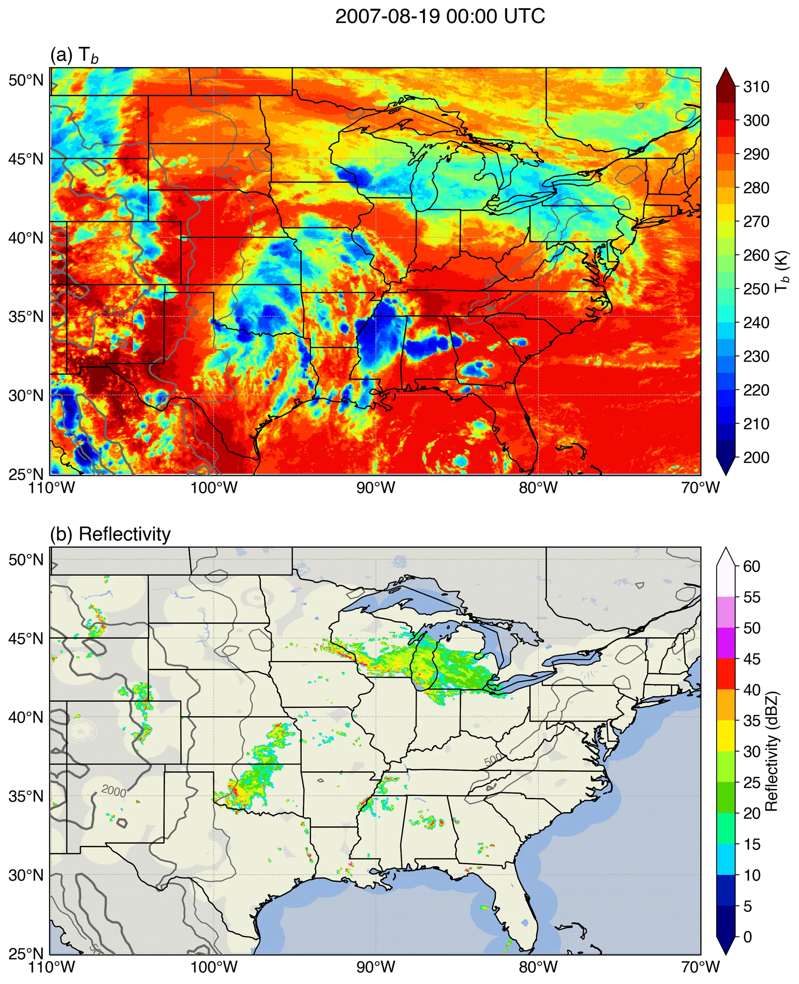

Dataset and Methodology
Study Region
13-year Dataset (2004-2016)
MergedIR global satellite infrared brightness temperature: Δx=4 km, 30 min
GridRad: Δx=2 km, Δz=1 km, hourly
Stage IV precipitation: Δx=4 km, hourly
NARR: Δx=32 km, 3 hourly
Data Processing
GridRad and StageIV dataset (2004-2016) are regridded to satellite 4 km resolution
SL3D (Starzec et al. 2017 MWR) convective/stratiform classification are performed on 4 km GridRad data
http://gridrad.org

Slide 5
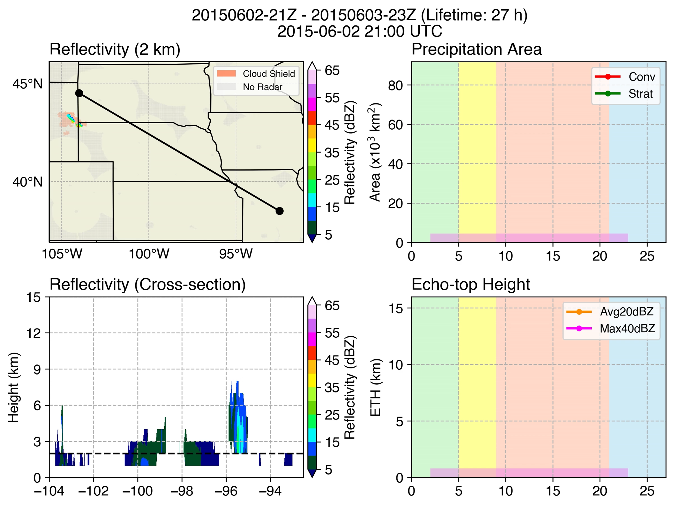
An Example of Tracked MCS
A newly developed MCS tracking algorithm FLEXTRKR is used to track MCSs for all seasons
Tracking uses both satellite T_{b} and 3-D radar echo signatures
Long-lived and intense MCSs: lifetime > 6 h, PF major axis length > 100 km, contains 45+ dBZ convective echoes
FLEXTRKR provides evolution of 3D MCS characteristics, precipitation, propagation speeds for each MCS
SD
WY
NE
KS
MO
MCS Tracking Tool FLEXTRKR (Feng et al. 2018 JAMES)

Slide 6
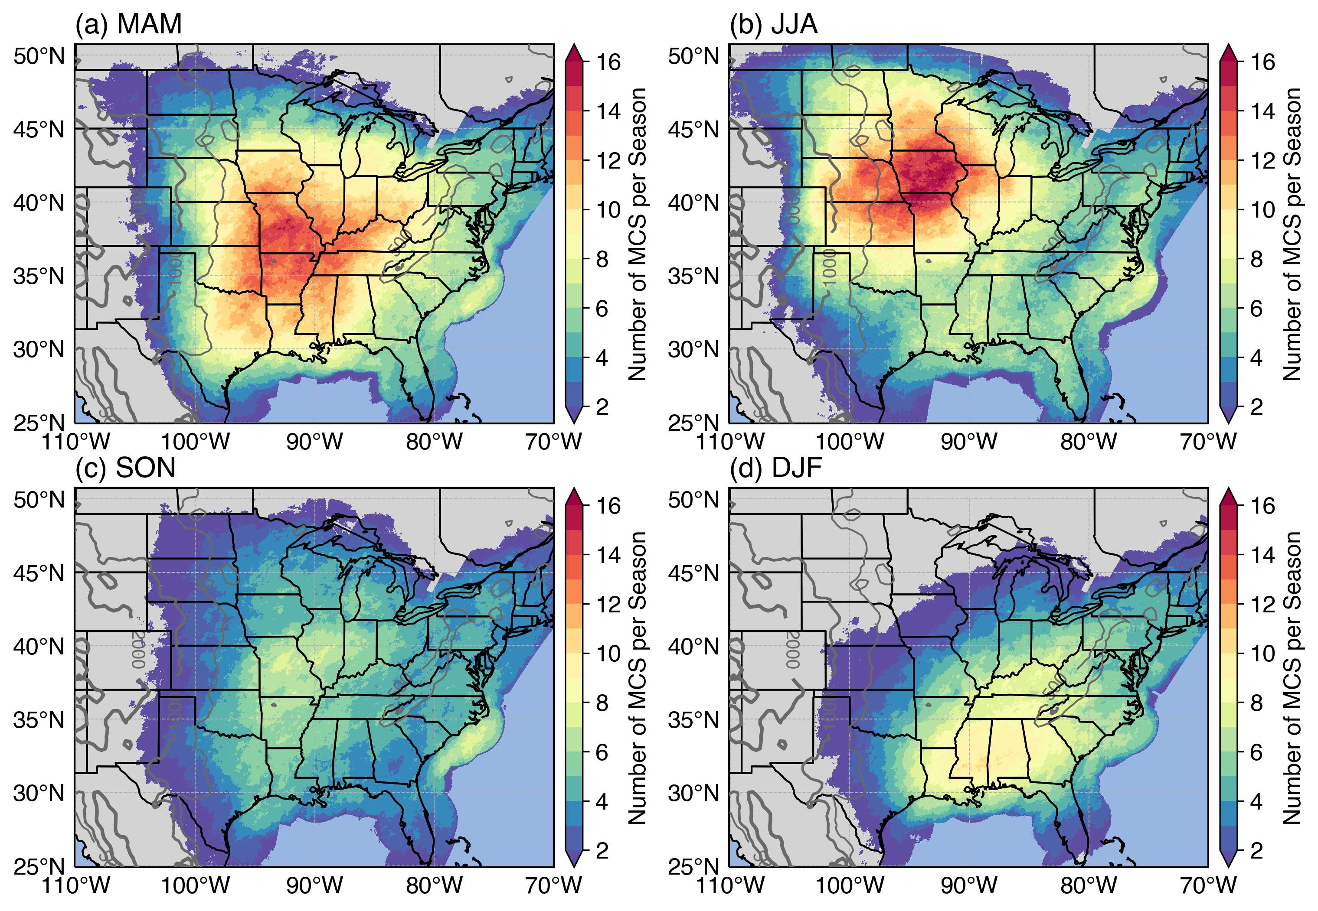
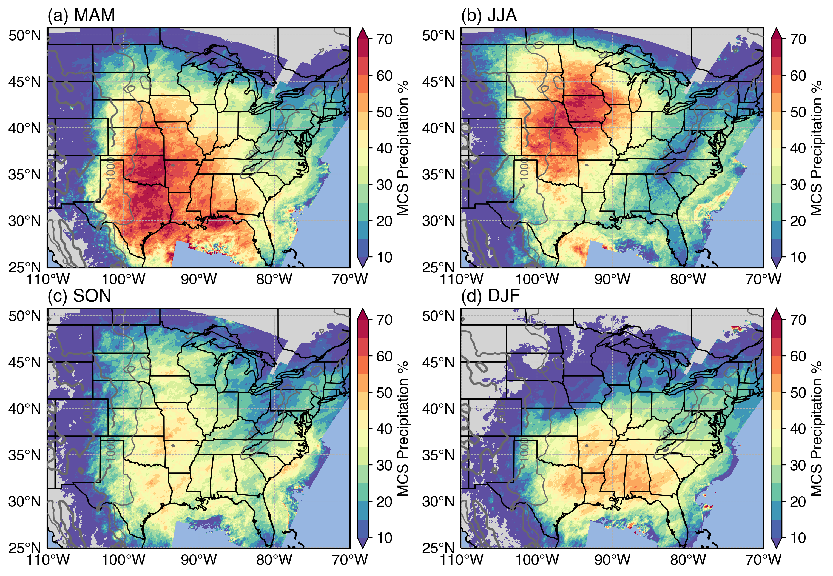
Seasonal Cycle of MCS Frequency and Precipitation
Number of MCS
MCS Precipitation Fraction
Spring
Summer
Spring
Summer
Fall
Winter
Fall
Winter
Spring/summer has highest number of MCSs: averaged 12-16/season, they account for over 60% precipitation
Fall has the lowest number of MCSs and MCS precipitation fraction
Southeast winter still has many MCSs and they account for over 40% precipitation
Notes:
summer has two peaks: central and southeast US

Slide 7
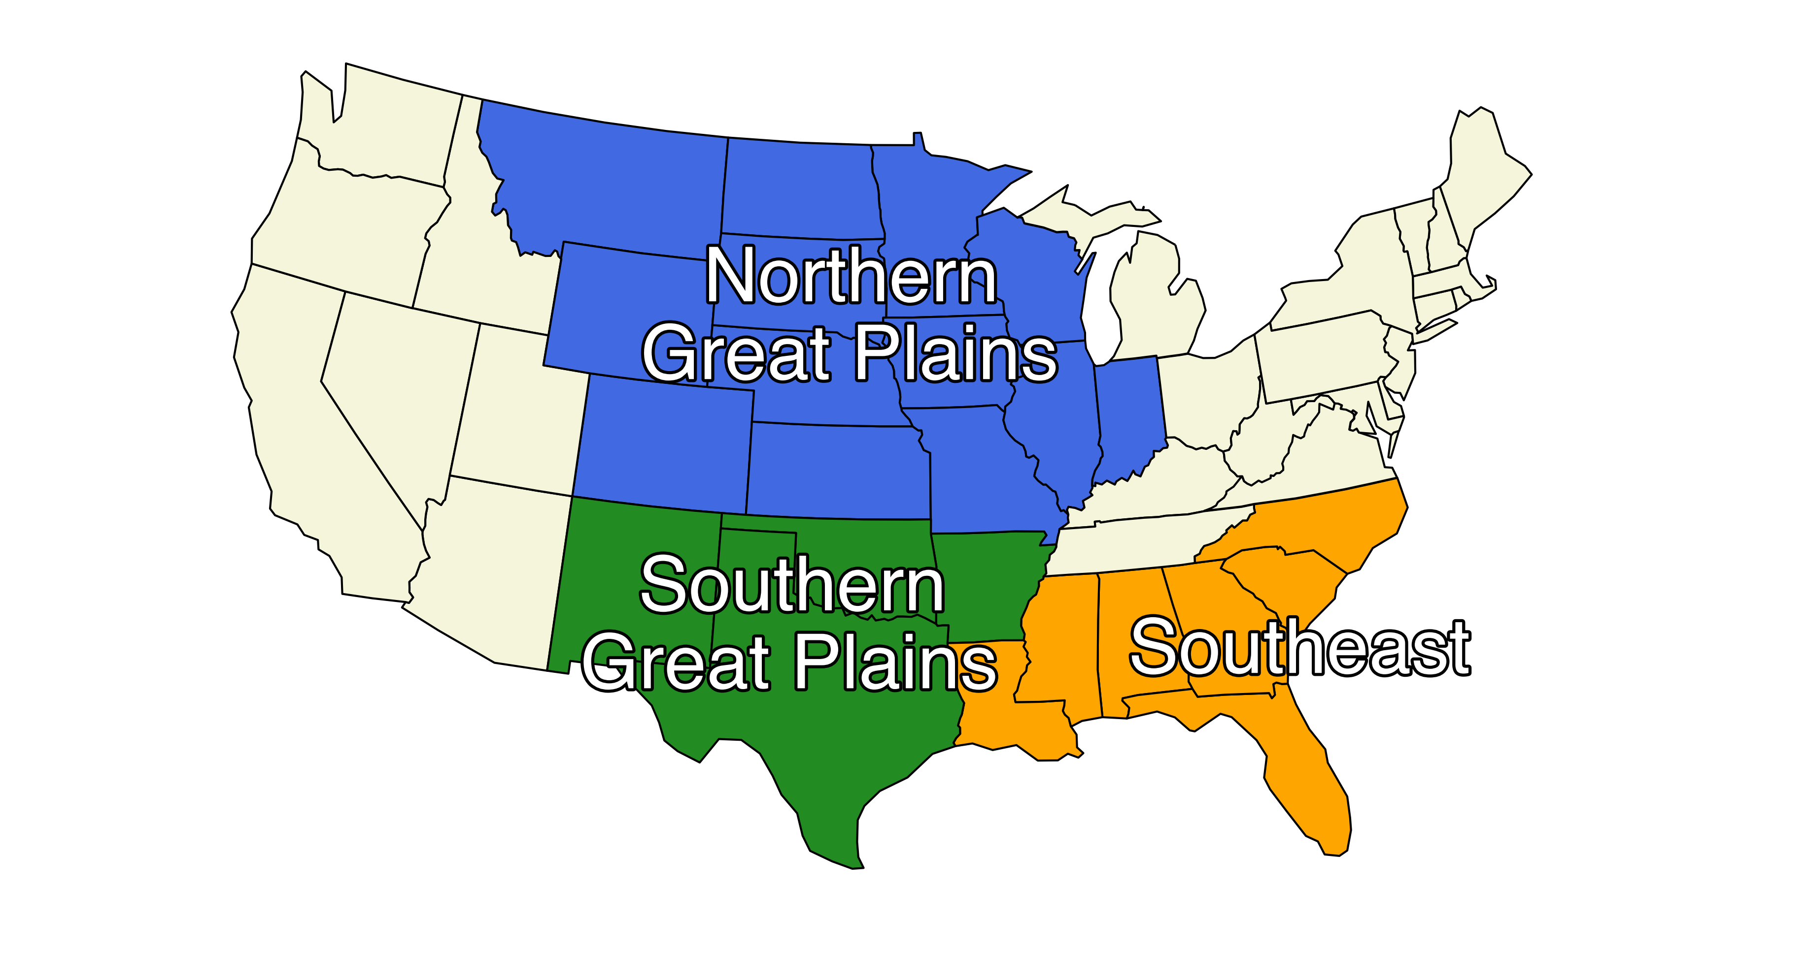
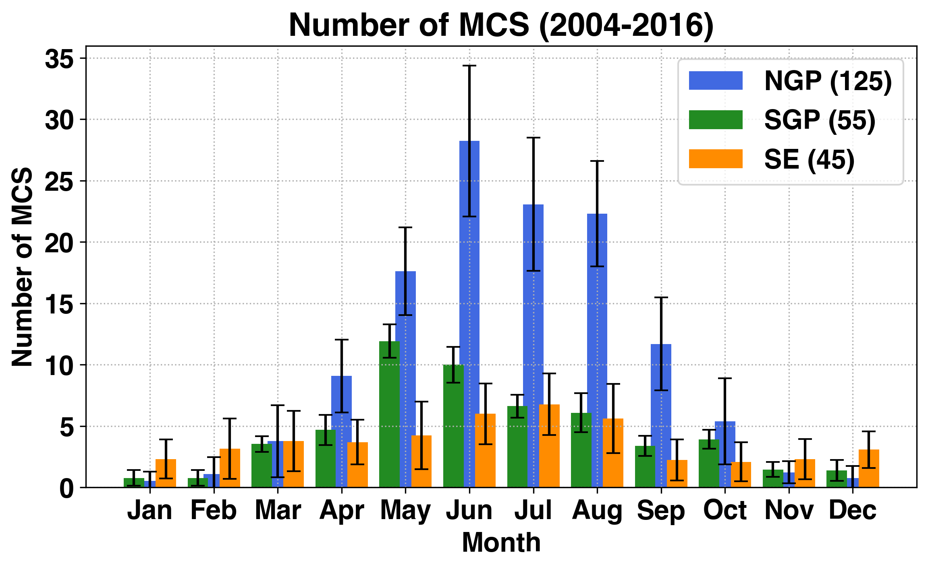
MCS Seasonal Cycle in 3 Climate Regions
The Great Plains has the strongest MCS seasonal cycle, particularly the NGP
MCSs occurrence peak in May in SGP, then in June shifting north to NGP
Southeast MCSs have weak seasonal cycle, peak in July and fewest in the fall; But has the most MCSs in winter
NGP peak
SGP peak
SE peak
*An MCS that spends more than half of its lifetime in a region is counted in that region

Slide 8
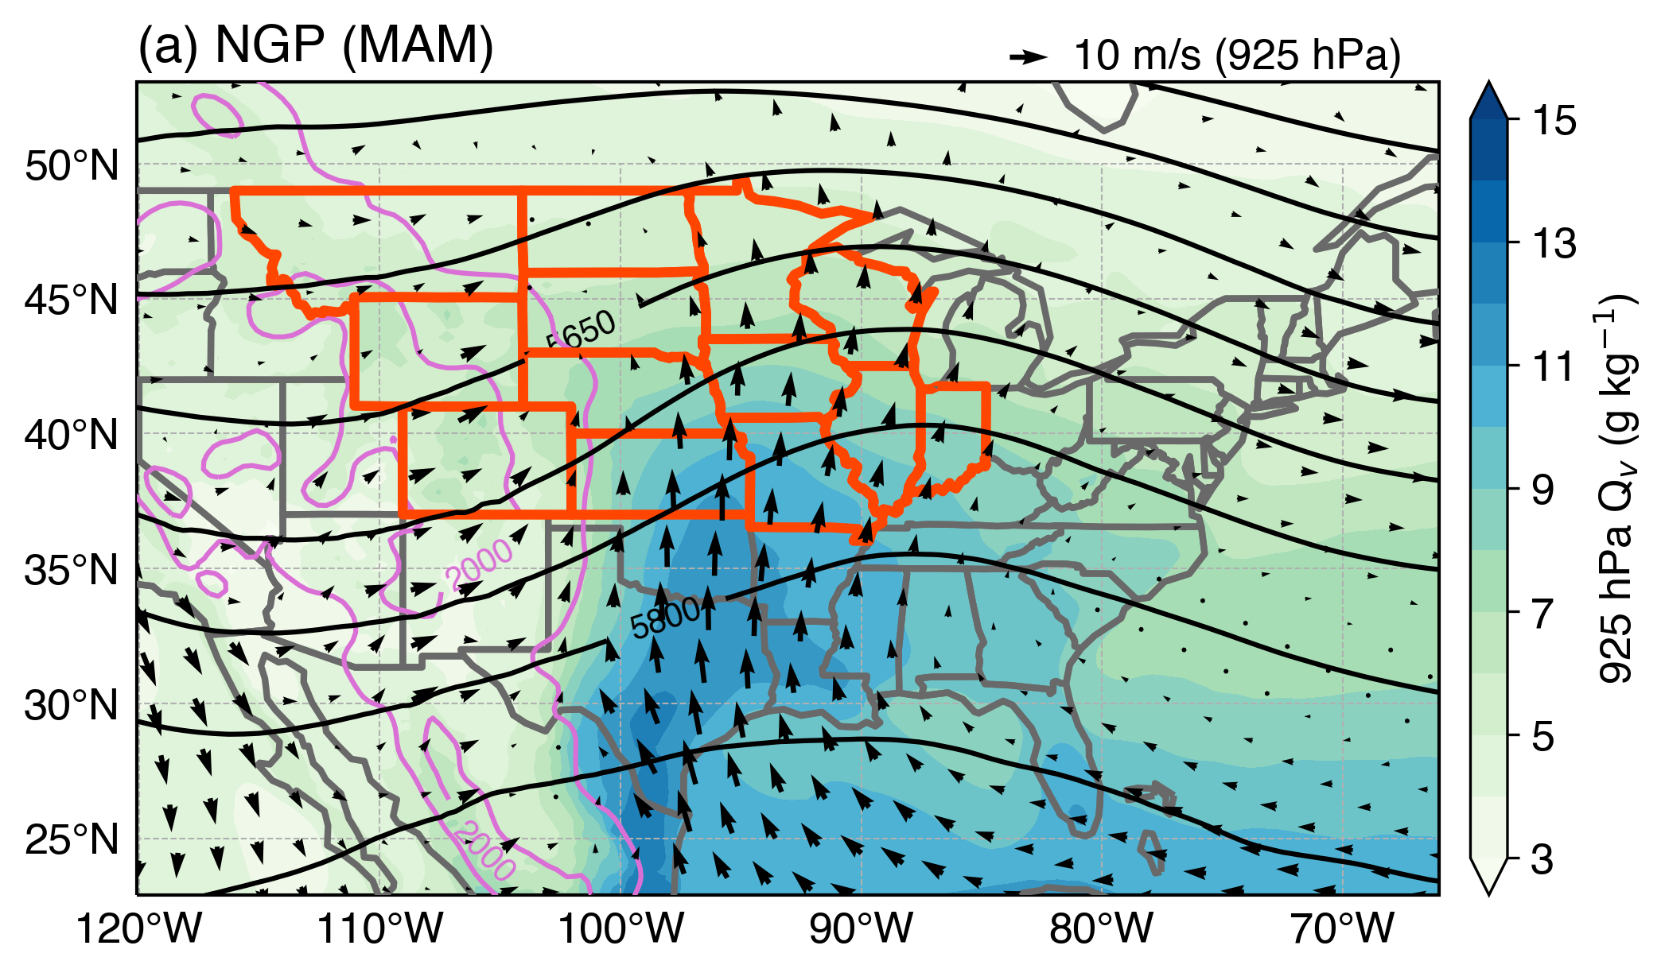
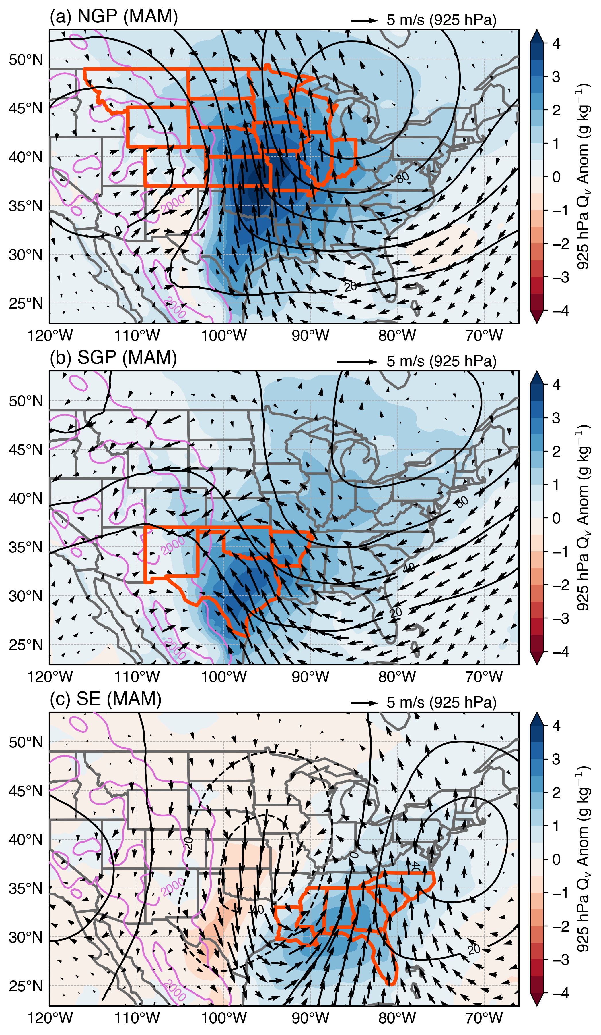
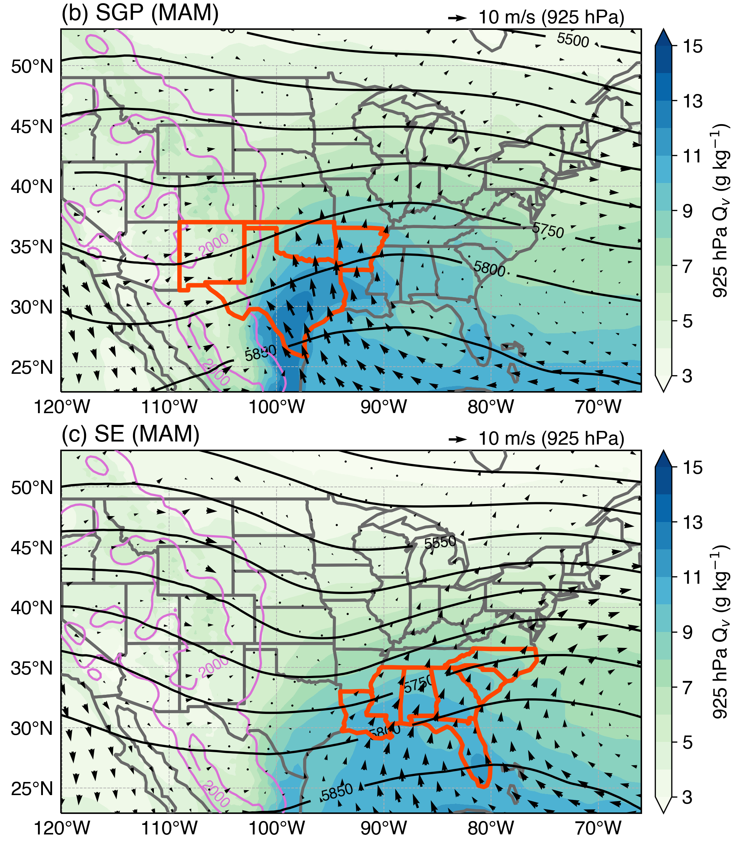
Spring MCS Large-scale Environments
Mean
Anomaly
H’
NARR large-scale environment composites during convective initiation stage that leads to MCSs
Commonality in synoptic patterns:
Ahead of a deep trough associated with baroclinic wave
LLJ transporting large anomalous low-level moisture into the region
Low-level convergence, upper-level divergence (not shown)
Differences across regions
Location of the trough
Location and magnitude of moisture anomaly
H’
L’
H’
Notes:
Fall patterns are quite similar to spring, will skip it

Slide 9
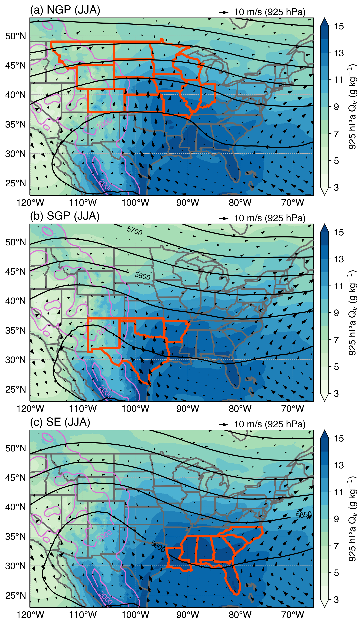
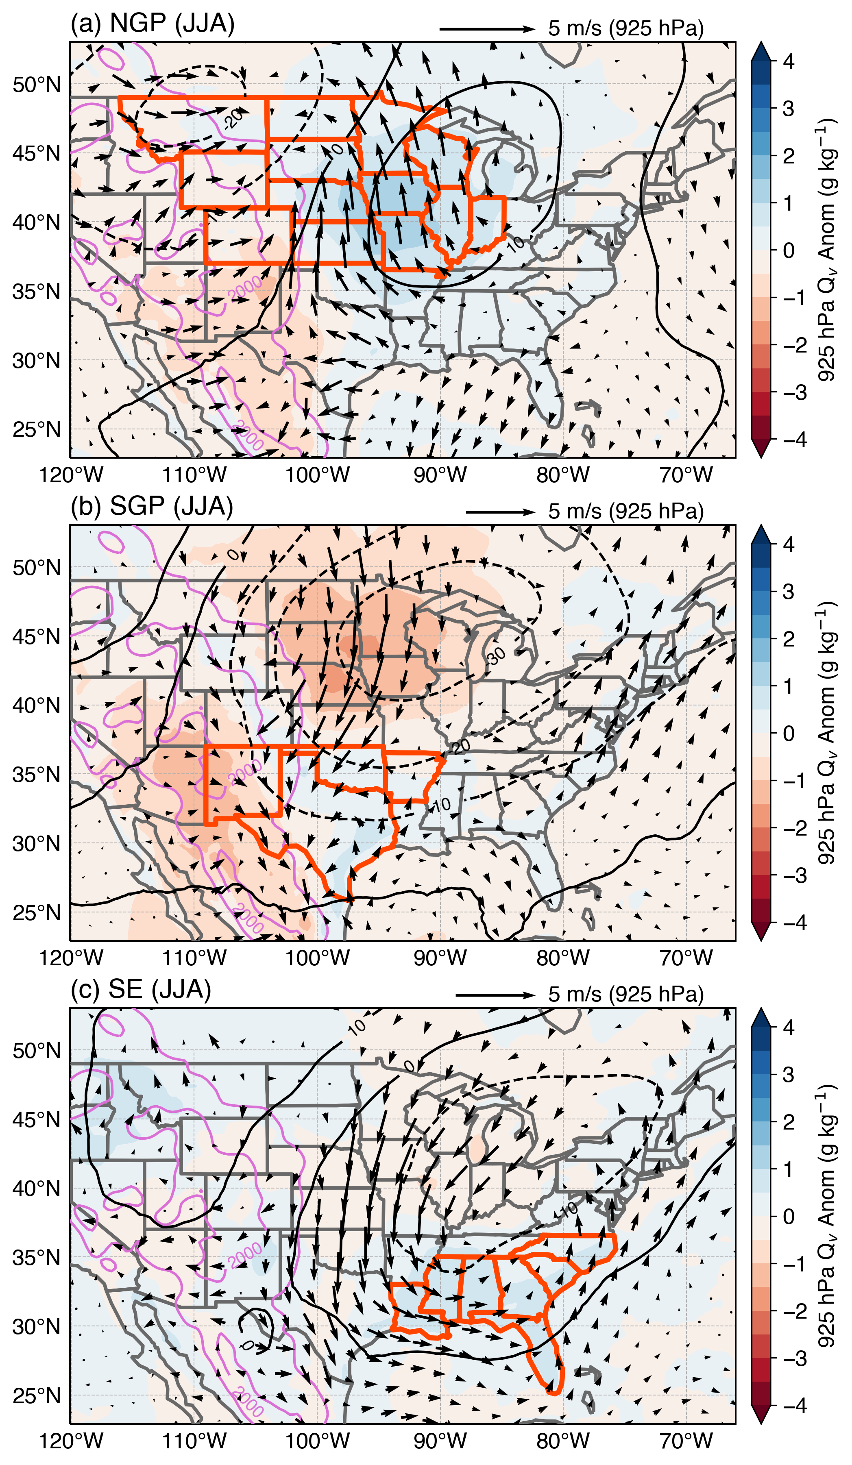
Summer MCS Large-scale Environments
Mean
Anomaly
Commonality in synoptic patterns:
Weakest baroclinic forcing: high pressure ridge dominates CONUS
Favorable thermodynamic environments: large mean low-level humidity with small humidity anomaly across the regions
Weak LLJ and low-level convergence
Differences across regions
Moisture anomaly
Wind anomaly
Convergence
NASH
NASH
NASH

Slide 10
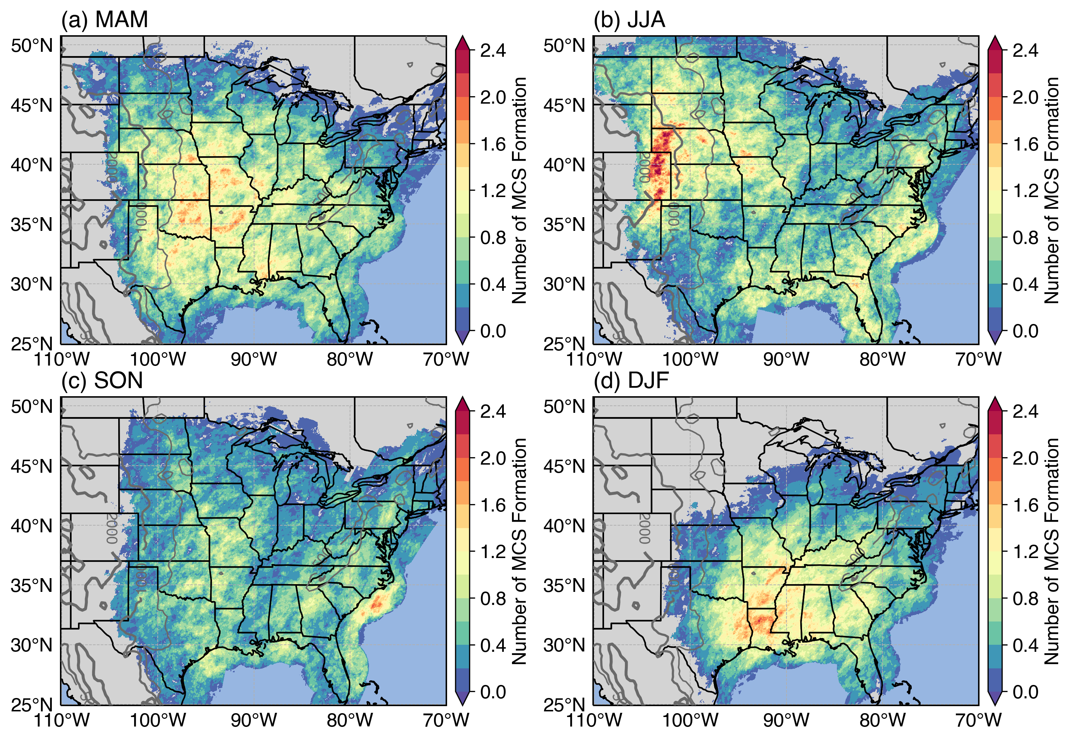
MCS Genesis Locations
MCS Genesis Frequency
MCS genesis: when convective feature first reach 100 km in size
Spring MCS genesis generally occur in the Great Plains
Summer MCS genesis
Primary location concentrated at the Rockies front range (CO, WY) and further east (NE, KS)
Secondary genesis region occur along the southeast coastal region
Fall season MCS genesis location is similar to spring, except with lower frequency
Winter MCS formation mostly occur in southeast (LA, AR, MS)
Spring
Summer
IA
WY
IA
NE
KS
MO
CO
KS
MO
OK
AR
Fall
Winter
AR
MS
LA

Slide 11
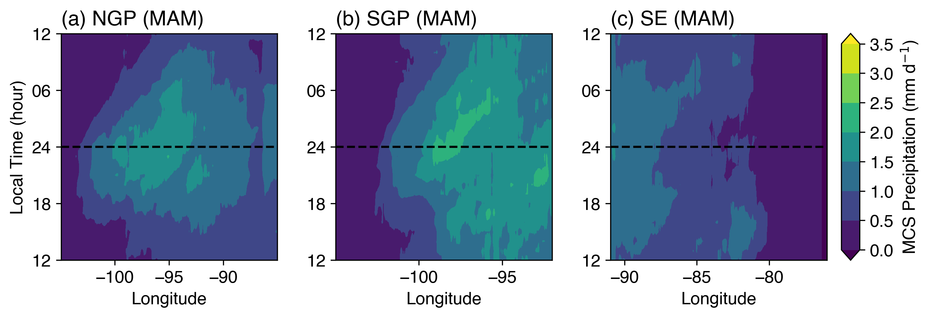
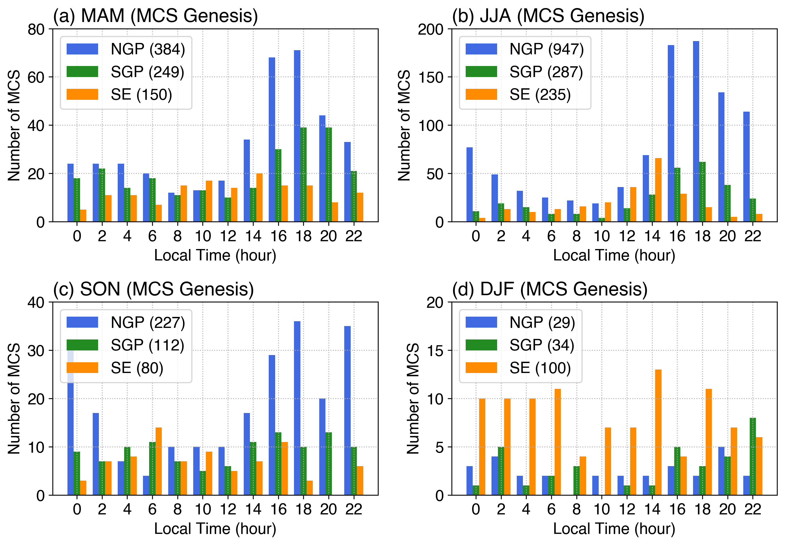
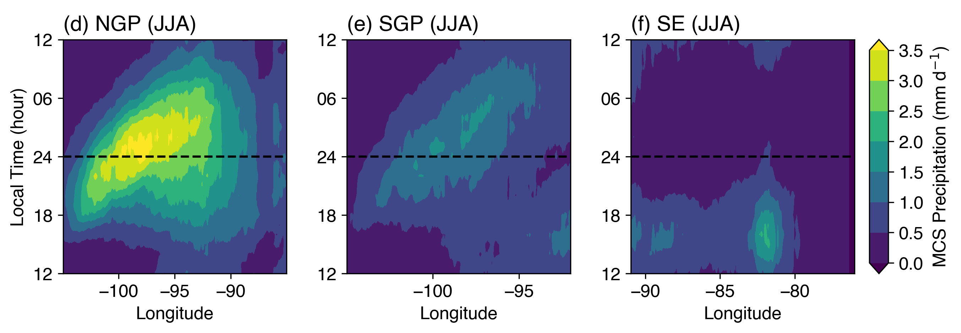
MCS Precipitation Diurnal Cycle During Warm Seasons
Nocturnal peak MCS precipitation dominates in the Great Plains in spring/summer
Spring: passage of baroclinic waves enhances nocturnal LLJ effects on MCS, but convection are not necessarily triggered by surface forcing
MCS Precipitation
Summer: strongest diurnal cycle, convection triggers by daytime surface heating near the Rockies foothill
Great Plains
Great Plains
More frequent genesis
Southeast MCS in summer peak during daytime, are much less frequent and do not show much propagating signal
Less frequent genesis
Great Plains
Great Plains
Daytime
Foothill
Notes:
Fall diurnal cycle is similar to spring with weaker magnitude, winter has no diurnal cycle

Slide 12
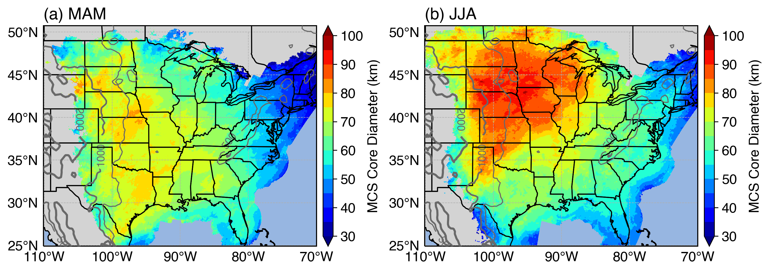

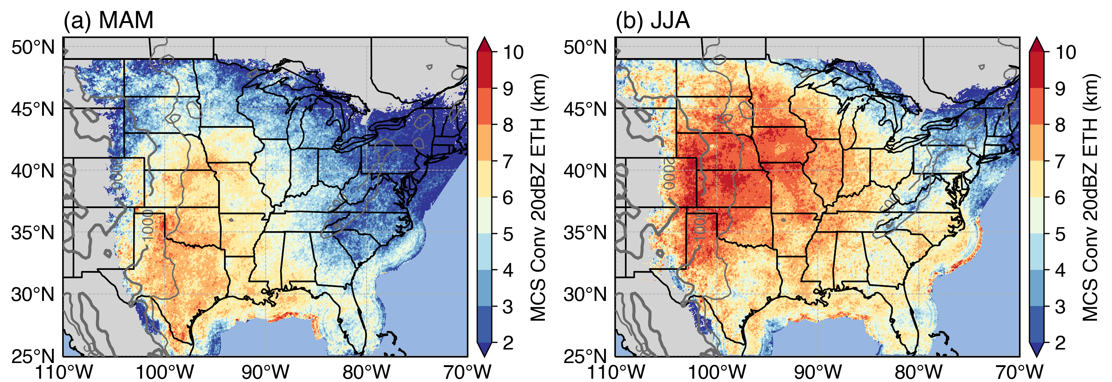
MCS Convective Feature Size and Intensity
Convective Feature Diameter
Spring
Summer
Summer MCS convective features are significantly larger and deeper than spring over the Great Plains
Large convective cores in mature MCSs are generally shallower than initiation/genesis stages near the Rocky Mountain foothills
Diameter
Convective Feature Depth
Spring
Summer
Depth

Slide 13
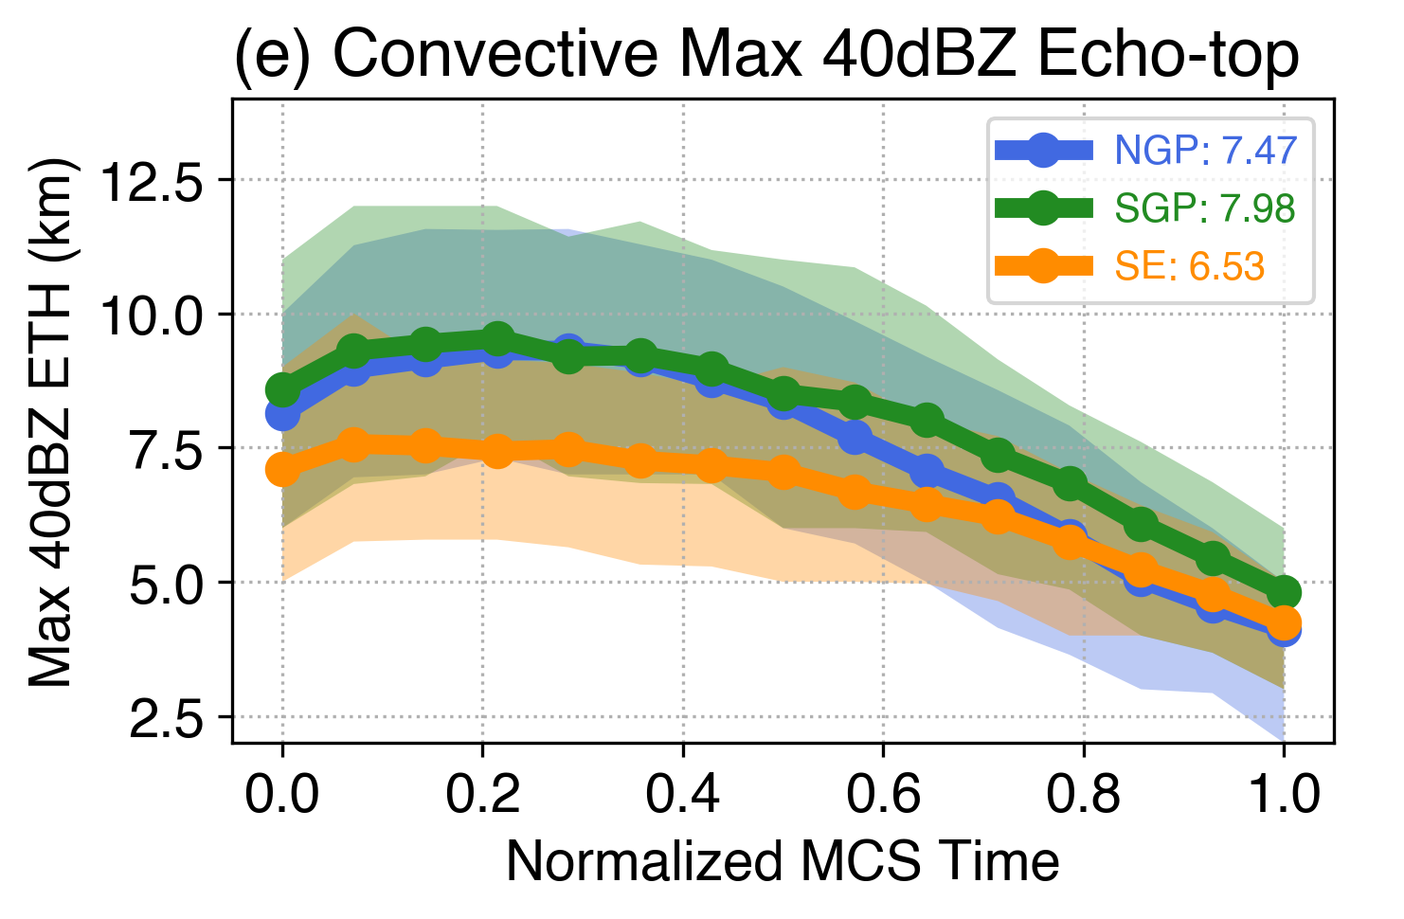
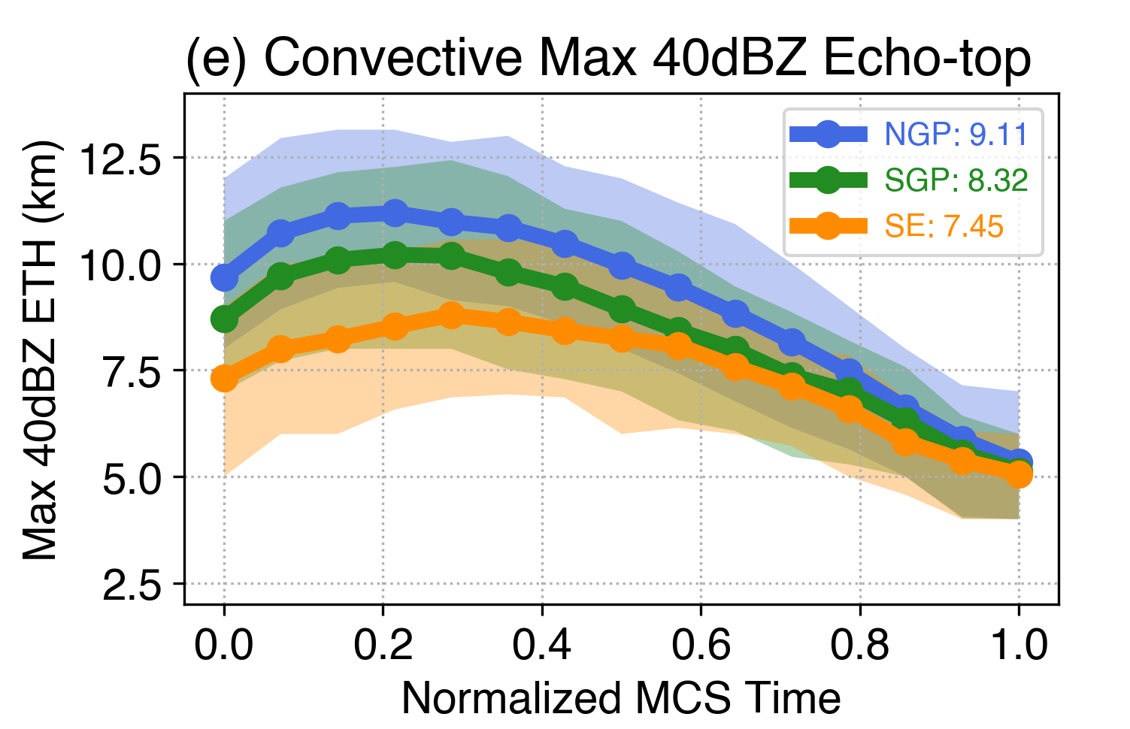
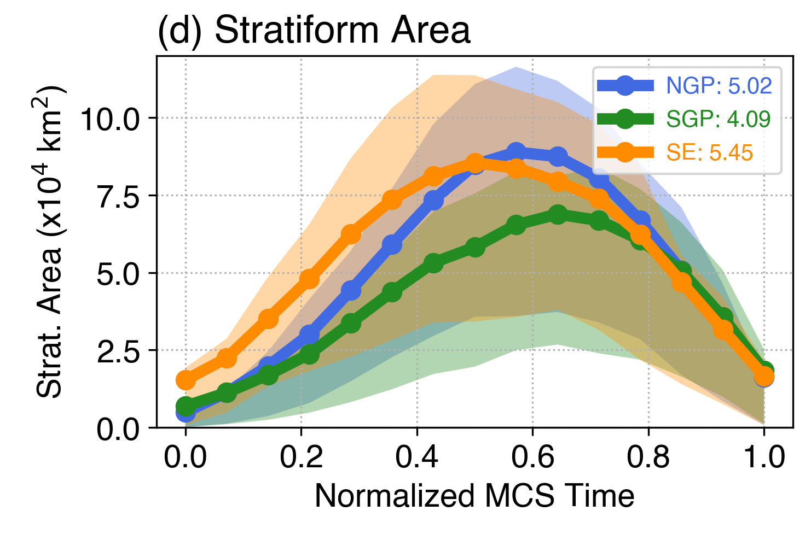
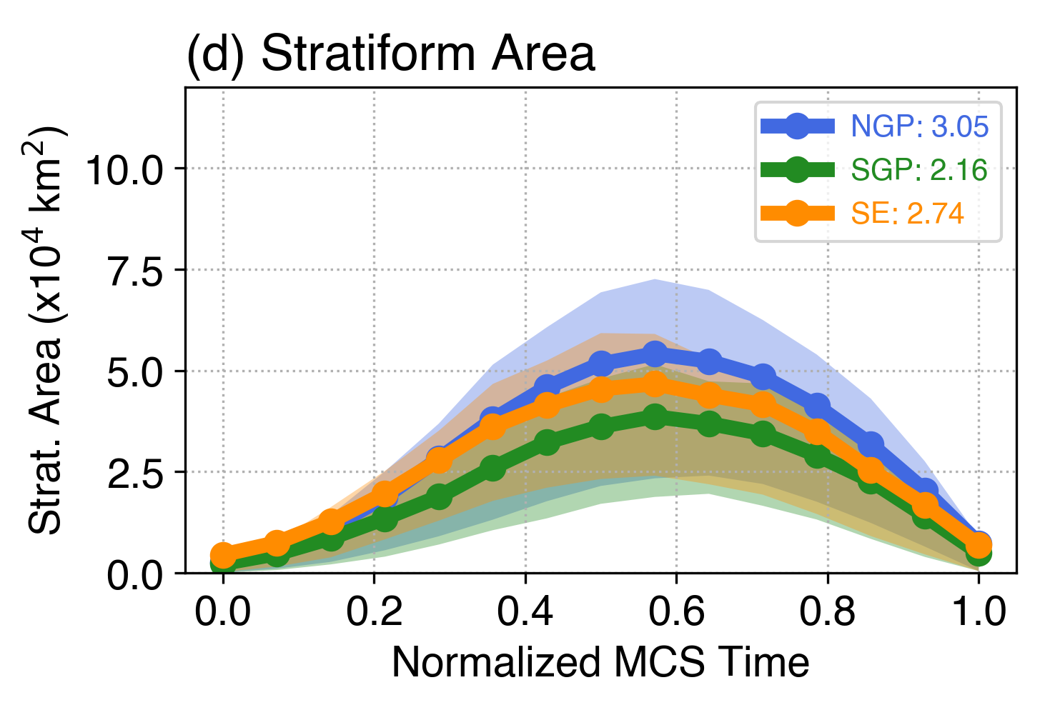
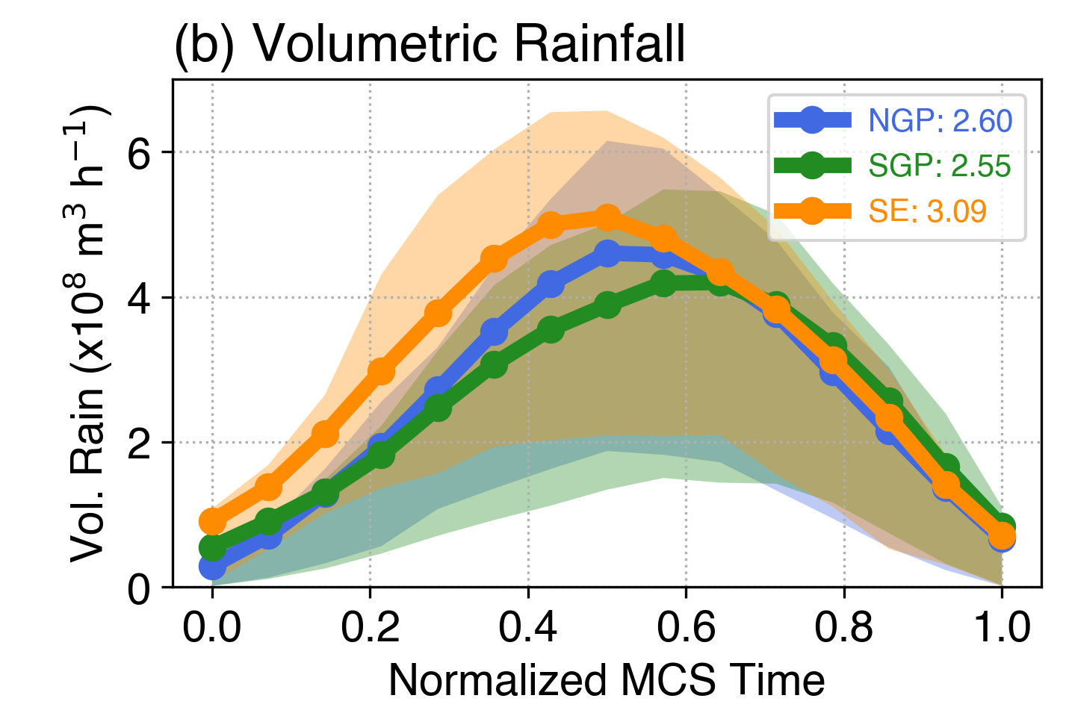
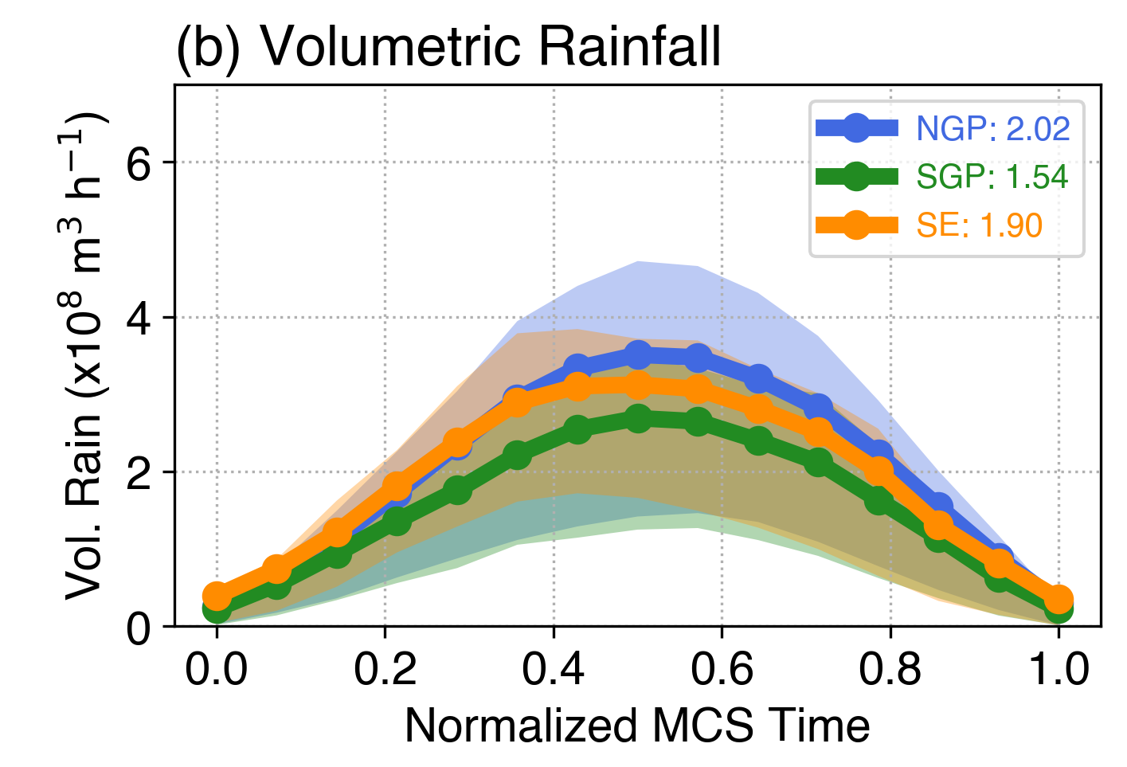
Warm Season MCS Feature Composite Evolution
Spring
Summer
NGP
NGP summer MCSs are deepest at upscale growth and mature stage, SE MCSs are less intense than those in the Great Plains
Spring MCSs have consistently larger stratiform rain area than summer
As a result, spring MCSs produce more volume rainfall per MCS than summer
Convective Depth
NGP
SGP
SGP
SE
SE
Initiation
Time
Decay
Stratiform Area
Volume Rainfall

Slide 14
Summary
Long-lived and intense MCSs can occur in any season, although preferential MCS area has strong seasonal dependence (Great Plains: warm season; Southeast: year round)
 | Large-scale Environments | MCS Diurnal Cycle | Key MCS Characteristics
Spring / Fall | Strong dynamics + thermodynamics: deep trough, strong LLJ moisture transport, low-level convergence | Nocturnal maximum rainfall, convection not always surface triggered | Conv. features: large & deep Strat. area: large Rain volume: high
Summer | Weakest baroclinic forcing: favorable thermodynamic environment | Strongest nocturnal maxima rainfall, surface triggering in afternoon | Conv. features: largest & deepest Strat. area: smallest Rain volume: low
Winter | Strongest dynamic forcing: Strong low-level convergence brings large moisture anomaly to overcome weak thermodynamic support | No diurnal cycle | Conv. features: smallest & weakest Strat. area: largest Rain volume: highest

