Slide 1


Studying Clouds and Precipitation: A Key to Understanding Climate
Robert A. Houze, Jr.
University of Washington and PNNL/ASGCD

Slide 2
Looking out the window

Slide 3
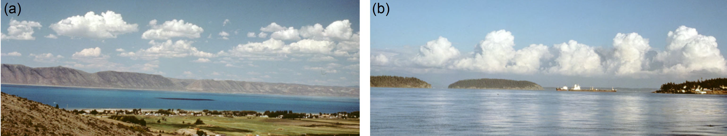
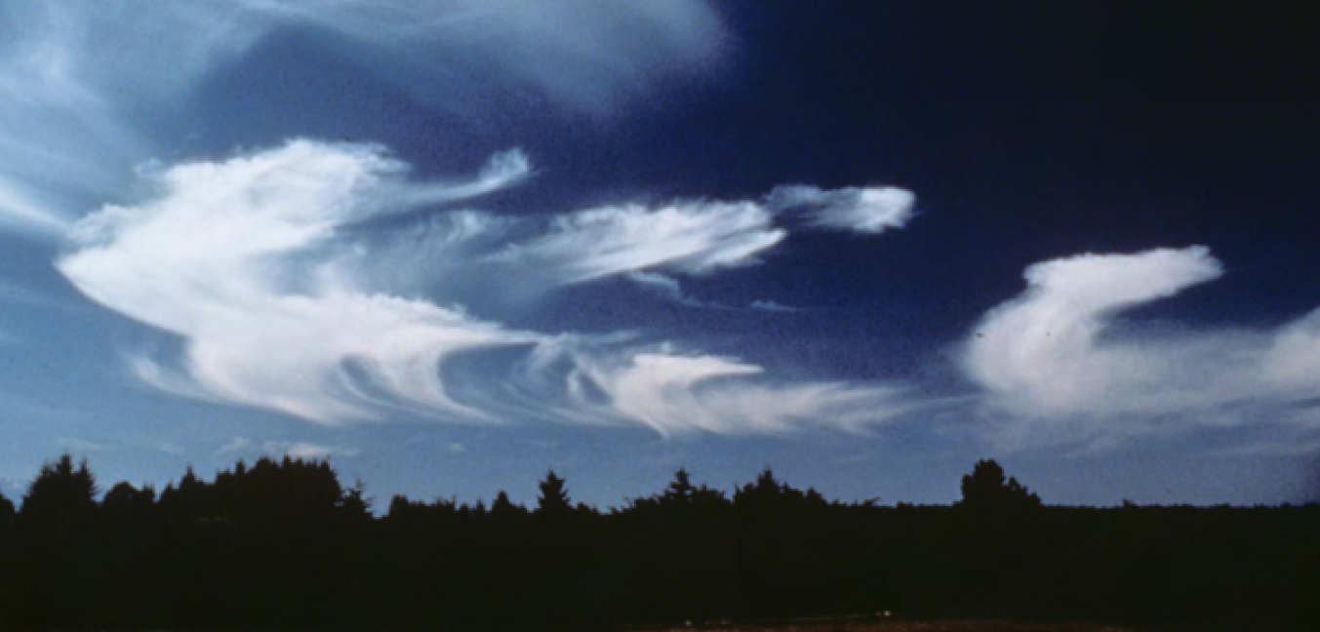
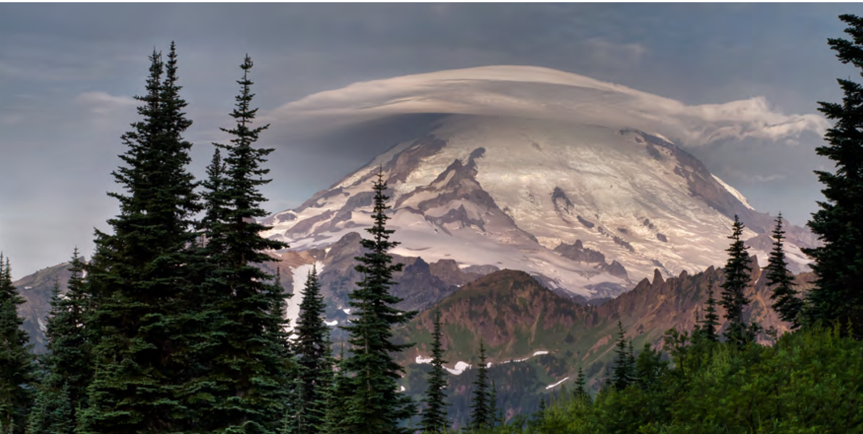
cumulus
cumulus
cirrus
lenticular

Slide 4
Looking down from space

Slide 5
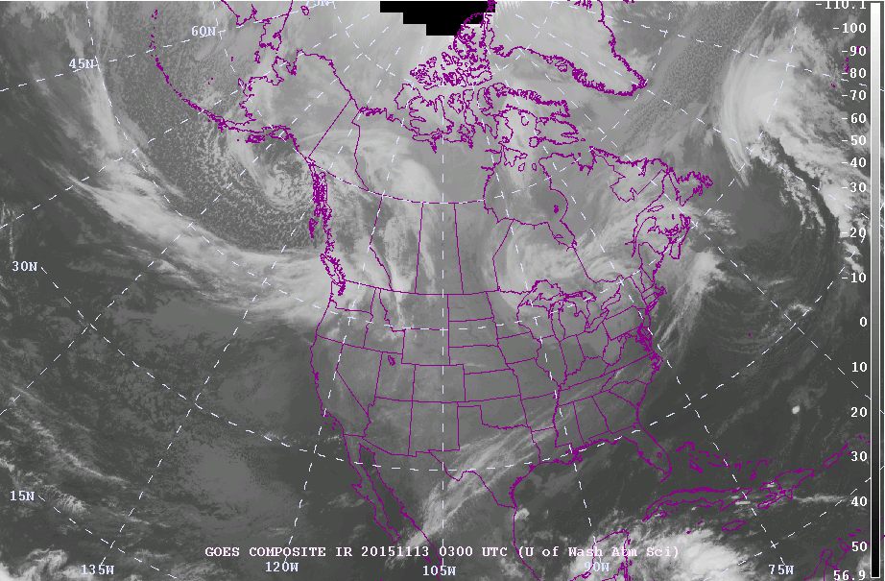

Slide 6
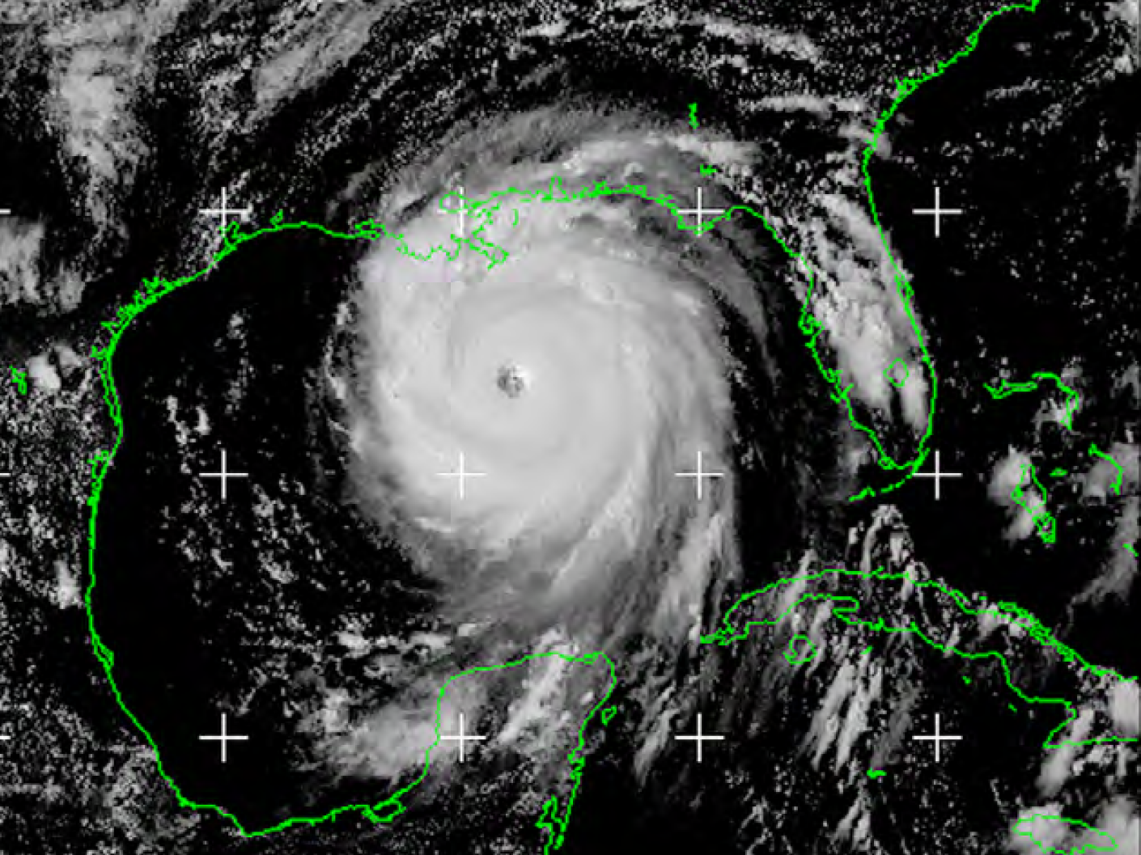

Slide 7
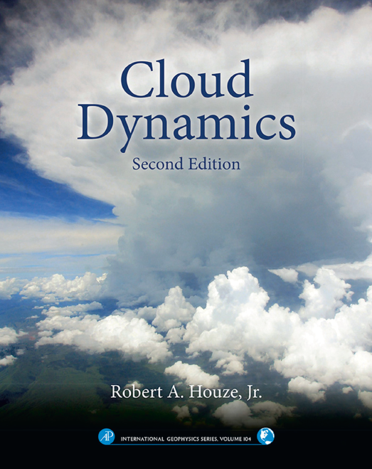
Before satellites:
  Stratus
  Cumulus
  Cirrus
  Lenticular
  Nimbostratus
  Cumulonimbus
After satellites:
  Fronts
  Hurricanes
  “Mesoscale convective systems"
Microphysics
Air motions

Slide 8
What do cloud processes have to do with Earth’s climate?

Slide 9
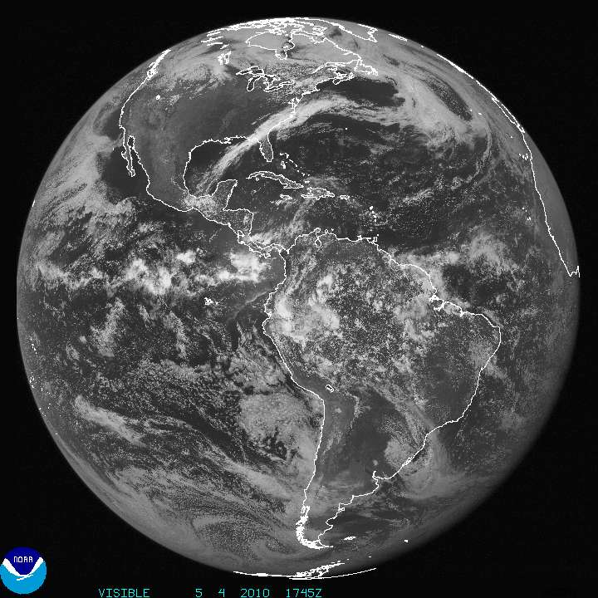
Marine stratocumulus

Slide 10
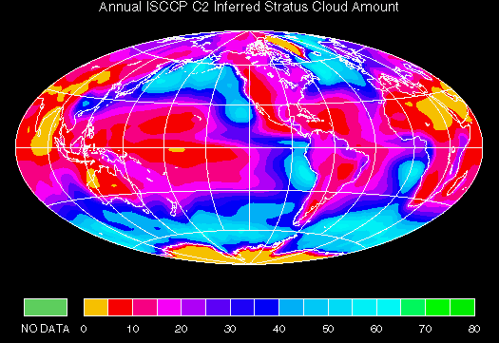
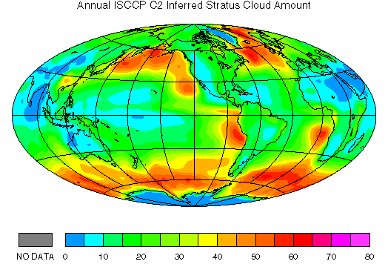
Stratus & Stratocumulus
Stratus & Stratocumulus
Notes:
Stratus and stratocumulus are related to
SST and
LARGE-SCALE CIRC.
See next slides.

Slide 11
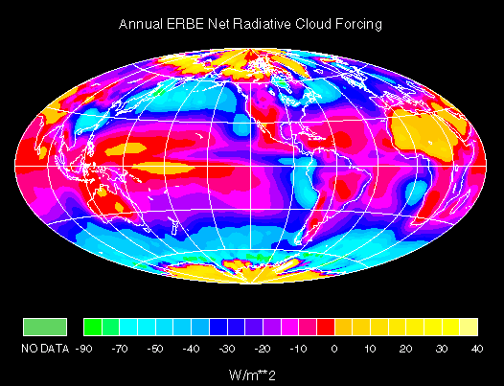
Stratus & Stratocumulus
Stratus & Stratocumulus
Notes:
Stratus and stratocumulus are related to
SST and
LARGE-SCALE CIRC.
See next slides.

Slide 12
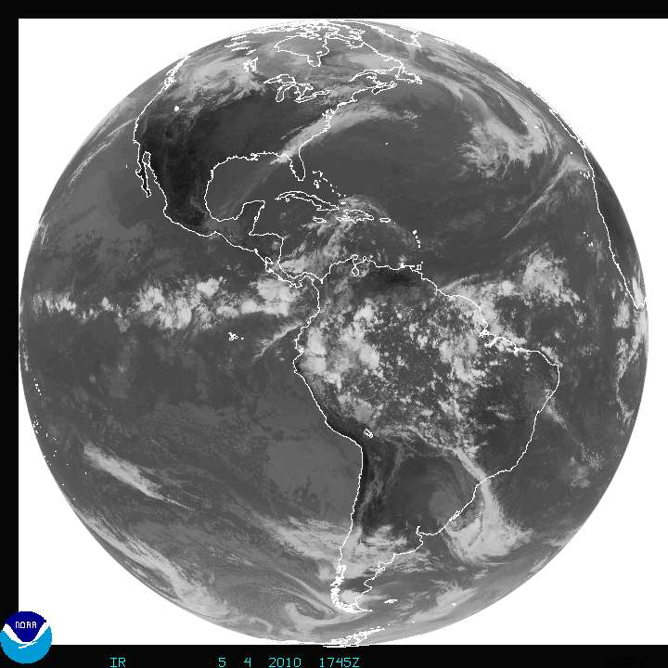
Mesoscale convective systems
Marine stratocumulus

Slide 13
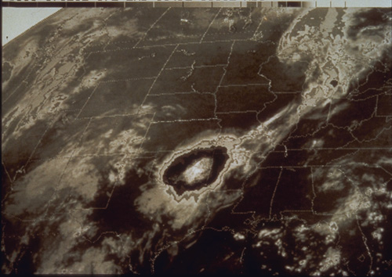
Iowa
High cloud top extends over huge area
Mesoscale Convective System
Cloud is thick, lots of precipitation falling, lots of latent heat being released

Slide 14

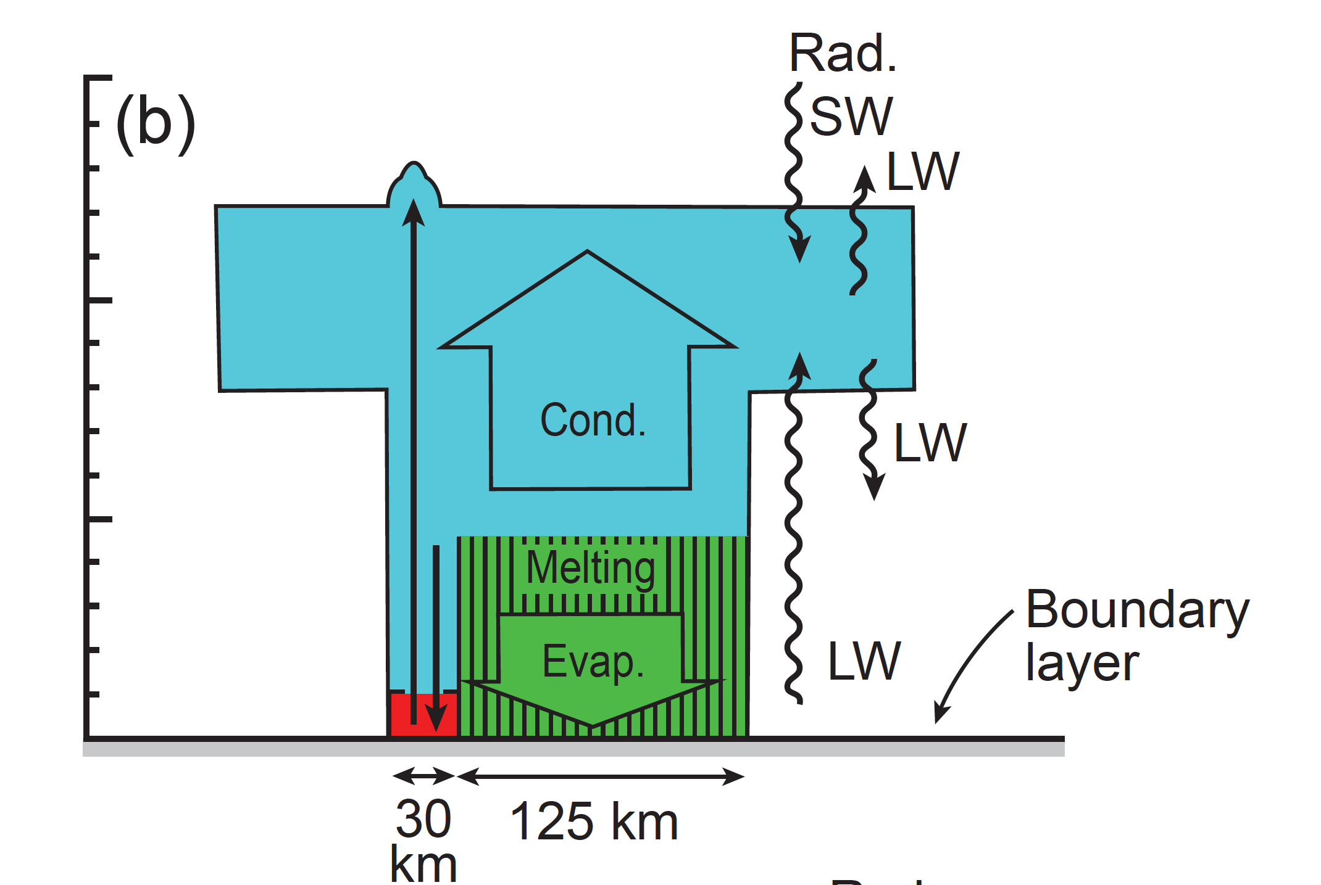
Cross section view of a Mesoscale Convective System
Satellite
15
10
Cond.
MCS concentrates the heating aloft
Height above Sea Level (km)
5
0
Earth surface
“Stratiform region”
“Convective region”

Slide 15
Global Significance of Cumulonimbus and Mesoscale Convective Systems
*Latent Heating of Atmosphere*

Slide 16
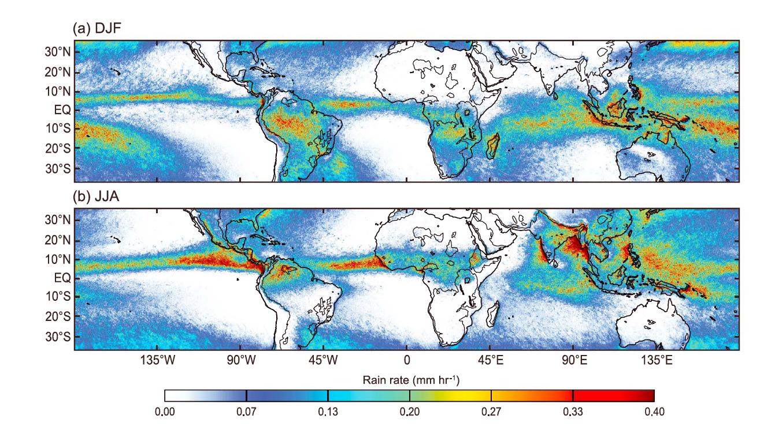
Tropical Precipitation from the TRMM Satellite
Houze et al. (2015)

Slide 17
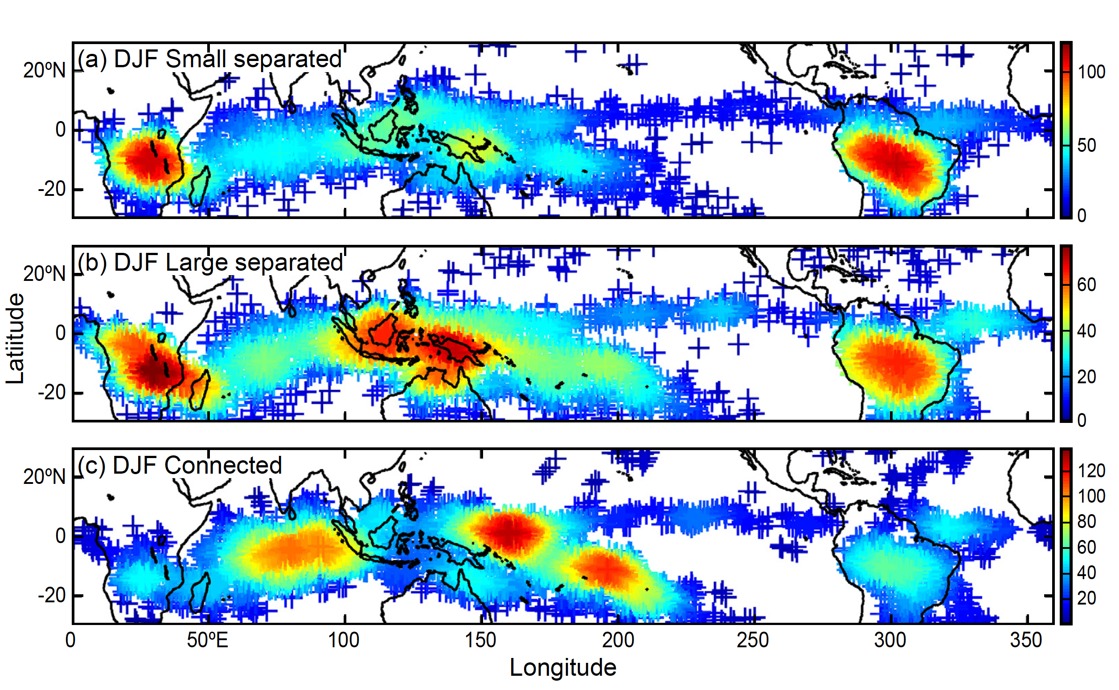
Multi-sensor satellite sensing shows where MCSs occur and account for 57% of latent heating
Yuan and Houze (2010)

Slide 18
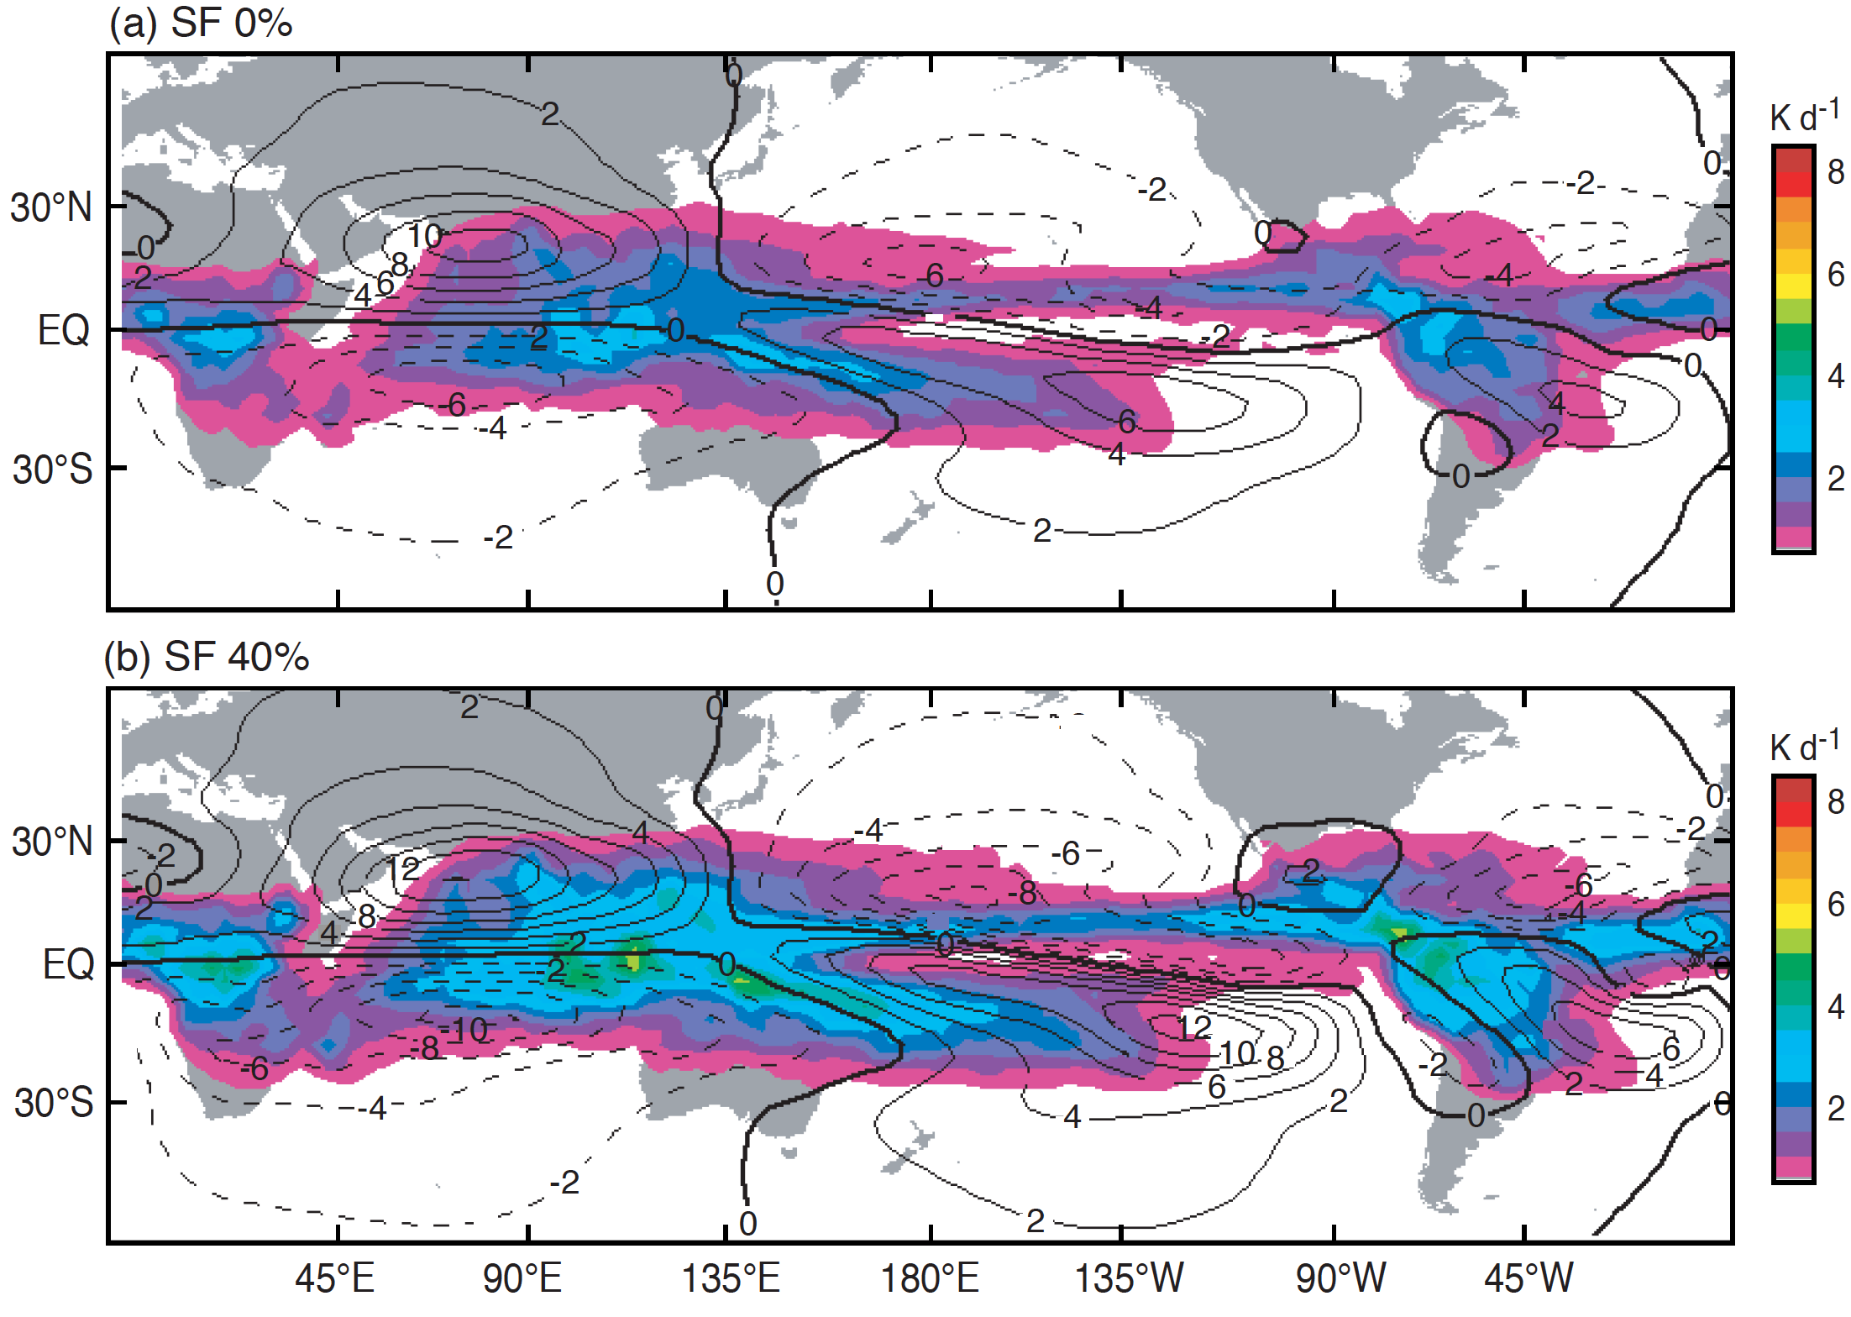
Effect of MCSs on large-scale circulation of the atmosphere
Tropical circulation without top-heavy heating by MCSs
Tropical circulation with top-heavy heating by MCSs
Schumacher et al. (2004)

Slide 19
Some work we are doing in ASGCD on Mesoscale Convective Systems

Slide 20
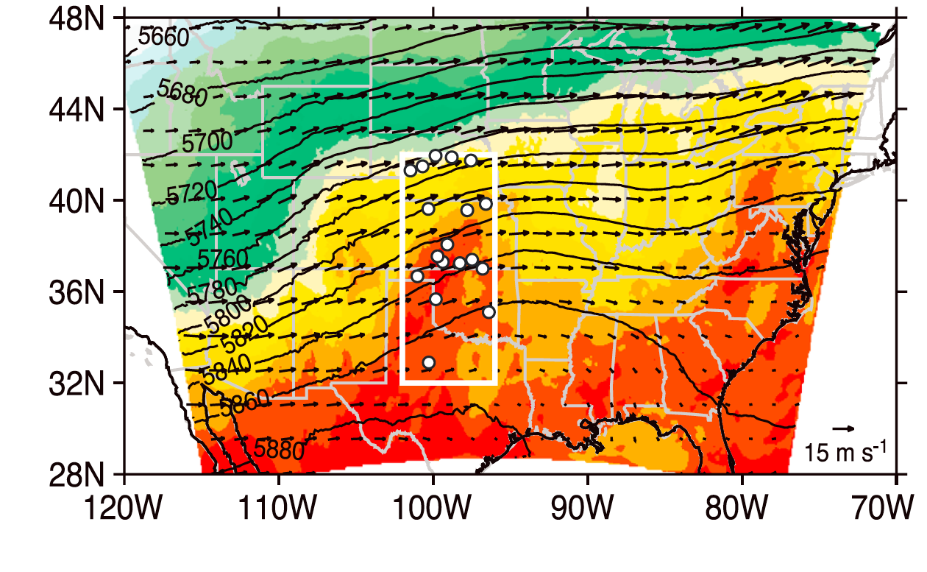
Where MCSs initiate over the U.S. in spring and summer
Winds at 500 hPa (~15,000 feet)
Yang et al. (2017)

Slide 21
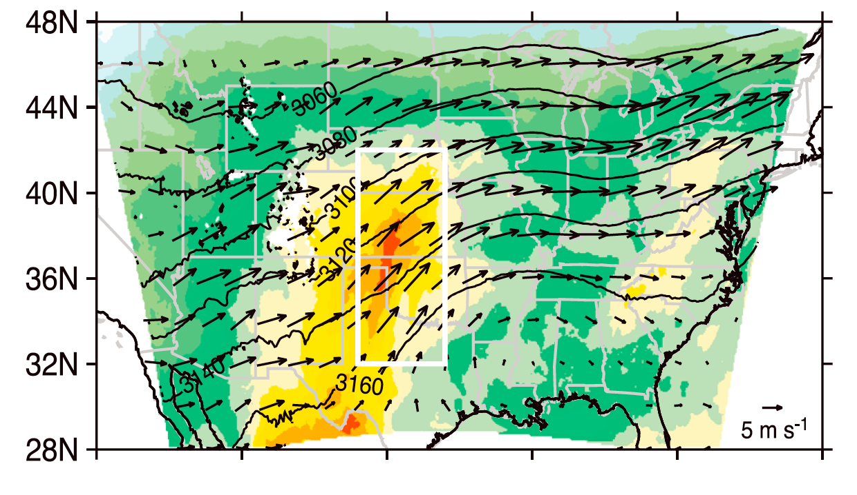
Where MCSs initiate over the U.S. in spring and summer
Winds at 500 hPa (~10,000 feet)
Yang et al. (2017)

Slide 22
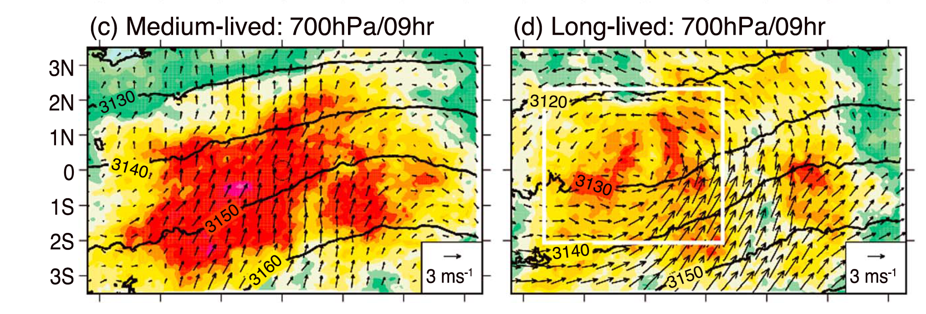
How the wind at ~10,000 feet changes after an MCS has been present for 9 hours
Yang et al. (2017)

Slide 23
Is there an implication for climate change?

Slide 24
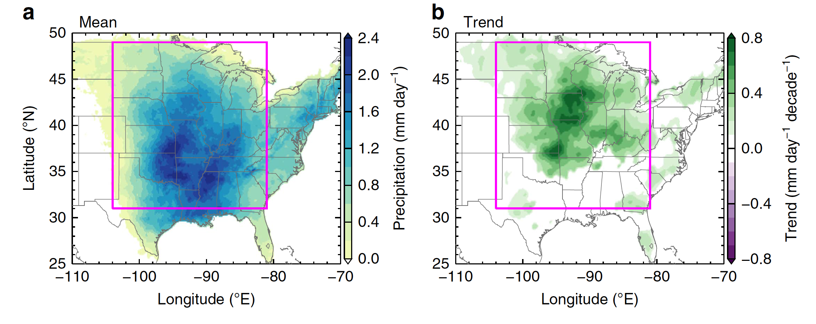
Trend of MCS rainfall over the central U.S.
Feng et al. (2016)

Slide 25
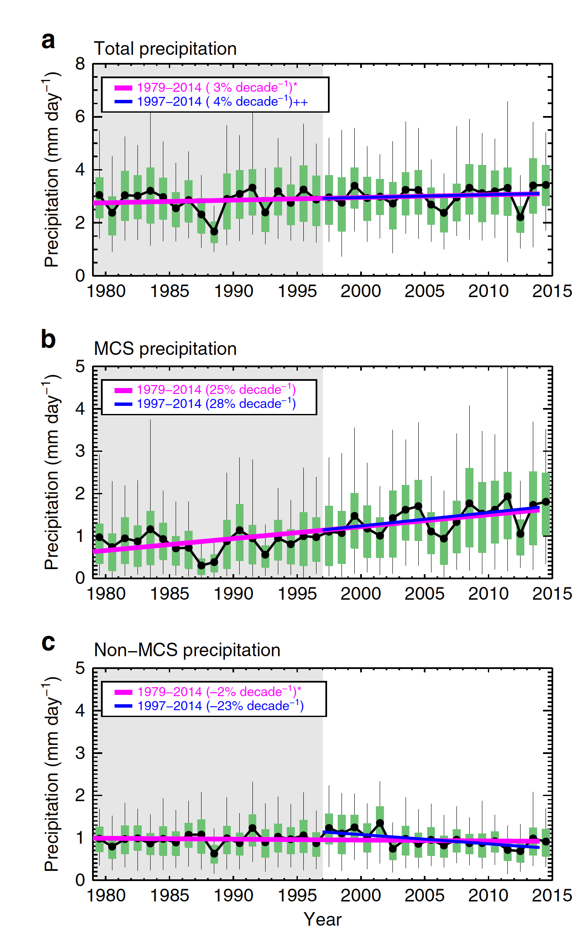
Trends over the central U.S.
Feng et al. (2016)

Slide 26
My role at PNNL
After nearly 50 years of observing precipitating cloud systems around the world by radar, aircraft, and satellite, I’m now working with ASGCD modelers to account for the physical mechanisms by which cloud systems affect the global climate.

