Slide 1
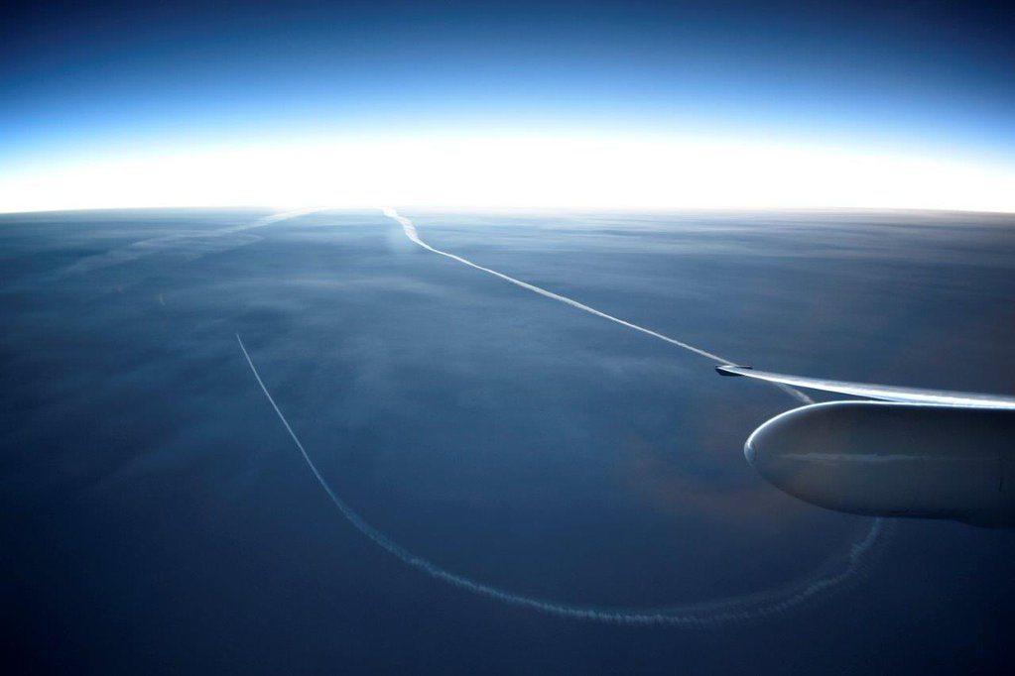




Vertical Structure and Microphysical Characteristics of Precipitation on the High Terrain and Lee Side of the Olympic Mountains As Seen in OLYMPEX
Joe Zagrodnik
Lynn McMurdie, Robert A. Houze
AMS Mountain Meteorology Conference
Santa Fe, NM 26 June 2018
NNX16AD75G
NNX16AK05G 80NSSC17K0279
AGS-1503155
AGS-1657251

Slide 2
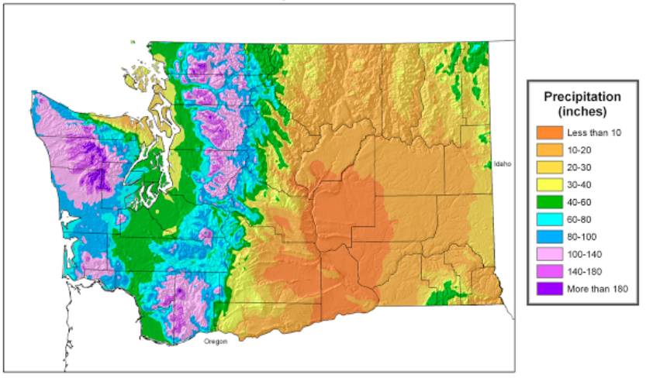
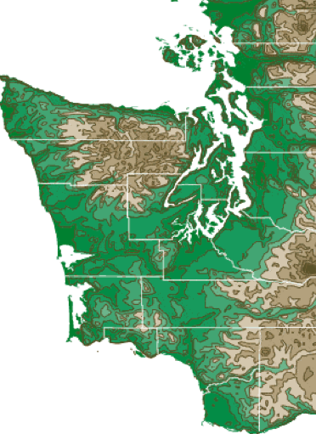
Olympic Mountains Annual Precipitation Climatology
High terrain – lee side precip diminishment
Very strong downward precipitation gradient
Poorly observed by ground-based observations
Topographic map
Windward precipitation enhancement
100-200 inches (2.5-5.0 meters) of precipitation per year
Lots of research attention
What dynamic and microphysical processes control the diminishment of precipitation on the high terrain and lee side?
Notes:
Few orographic precipitation studies have considered high terrain/leeside due to lack of observations

Slide 3

NASA 3rd-Gen Airborne Precipitation Radar (APR-3)
Flies on NASA DC-8
Triple-frequency (Ku/Ka/W-band)
120 m vertical resolution
0.2 Hz measurement frequency (~0.2 km resolution)
Key benefit: full transects of Olympic Mountains with same instrument package!

Slide 4
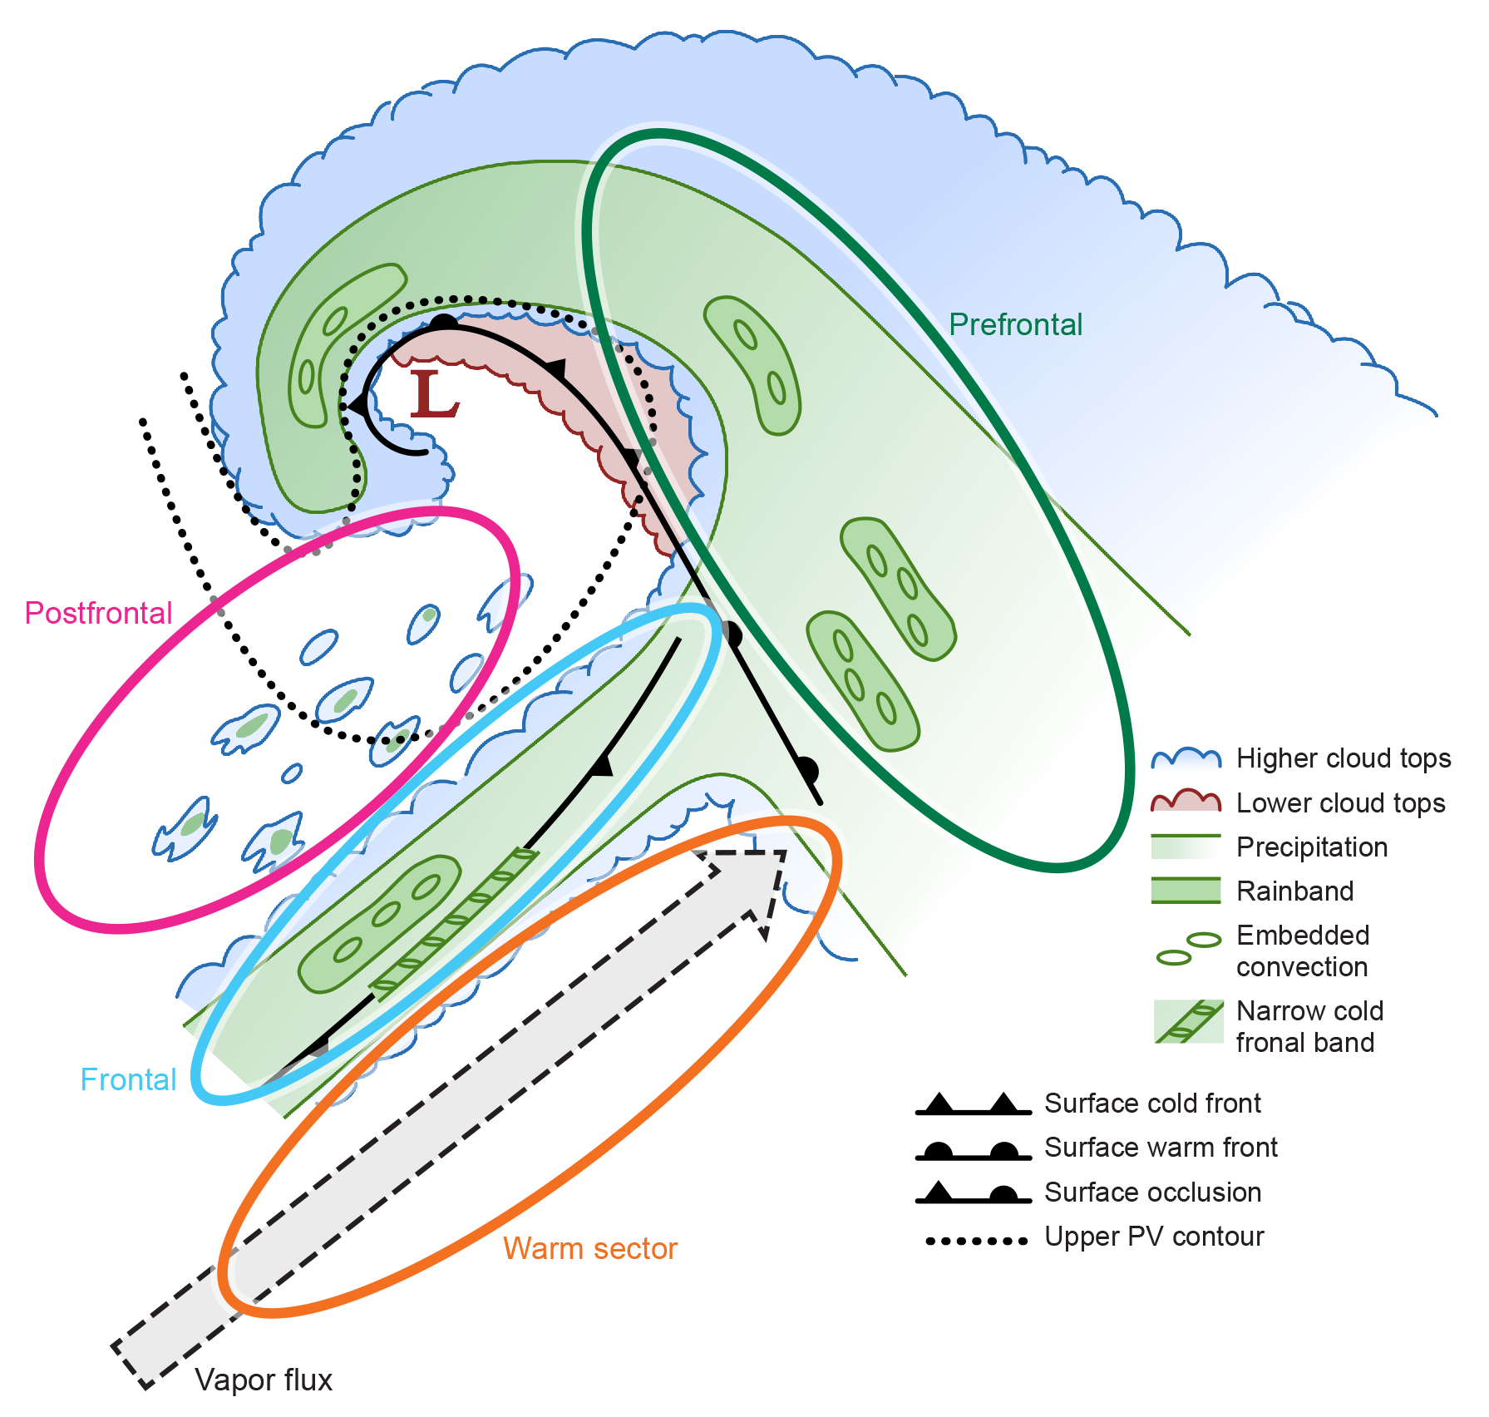
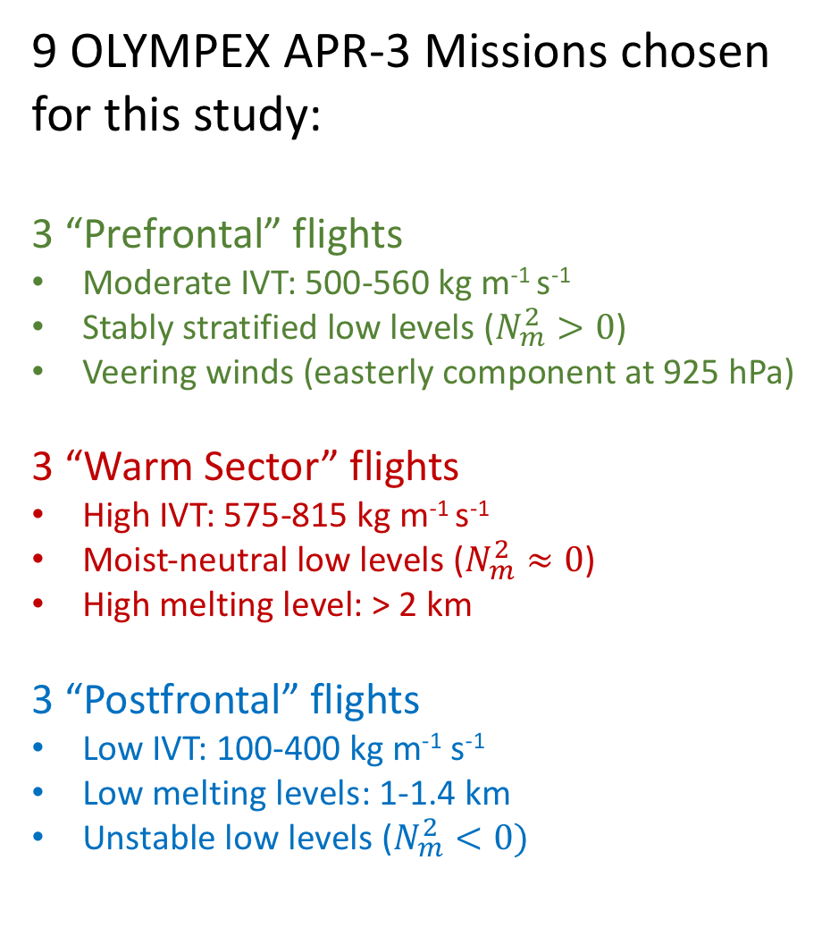
9 OLYMPEX APR-3 Missions chosen for this study:
3 “Prefrontal” flights
Moderate IVT: 500-560 kg m⁻¹ s⁻¹
Stably stratified low levels ($N_{m}^{2}>0$)
Veering winds (easterly component at 925 hPa)
3 “Warm Sector” flights
High IVT: 575-815 kg m⁻¹ s⁻¹
Moist-neutral low levels ($N_{m}^{2}≈0$)
High melting level: > 2 km
3 “Postfrontal” flights
Low IVT: 100-400 kg m⁻¹ s⁻¹
Low melting levels: 1-1.4 km
Unstable low levels ($N_{m}^{2}<0)$
Notes:
From theory, we know that the response of precipitating clouds to a mountain range is controlled by the characteristics of the upstream flow—especially the flow and stability which are often characterized in the Froude number. The essential components—flow and stability—are determined by the “sector” of the midlatitude cyclone.

Slide 5
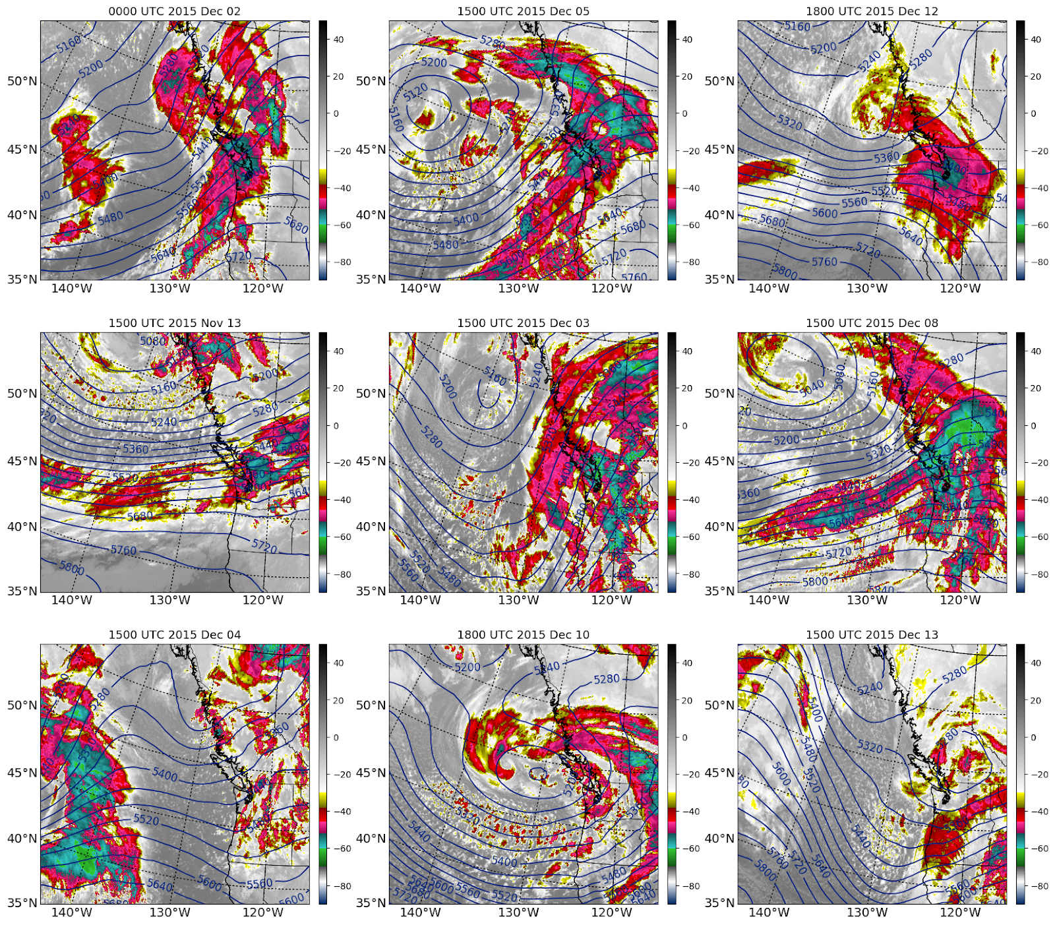
IR Satellite Imagery + 500 hPa heights during flights
Prefrontal
Warm Sectors
Postfrontal
Notes:
-Prefrontal has broad, continuous cloud shields over both ocean and land
-Warm sectors have more broken clouds, especially over ocean. Two southwest, one southerly
-Postfrontal has smaller convective elements and upper-level troughs

Slide 6
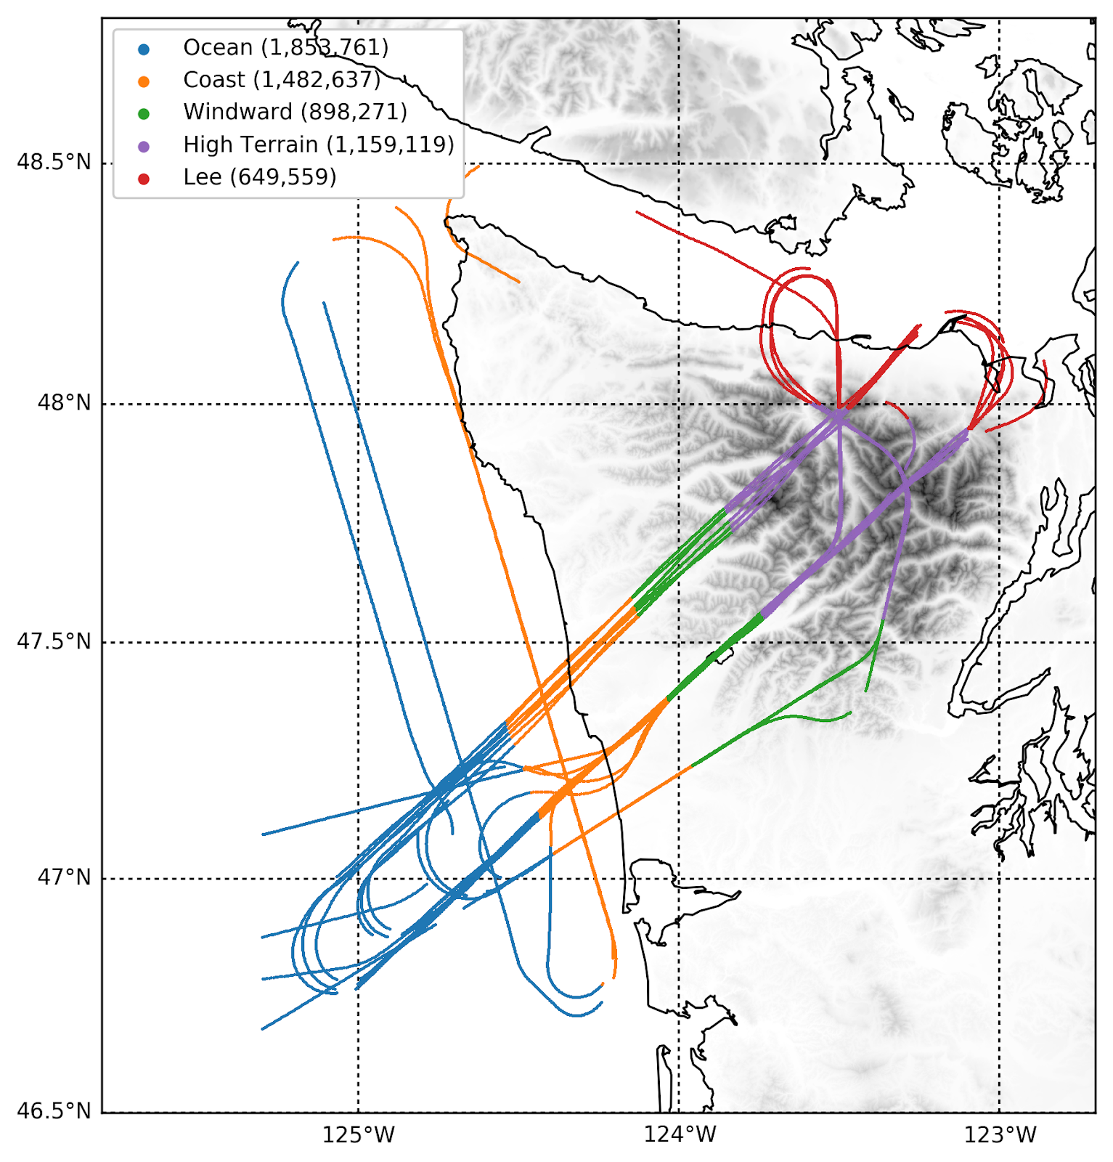
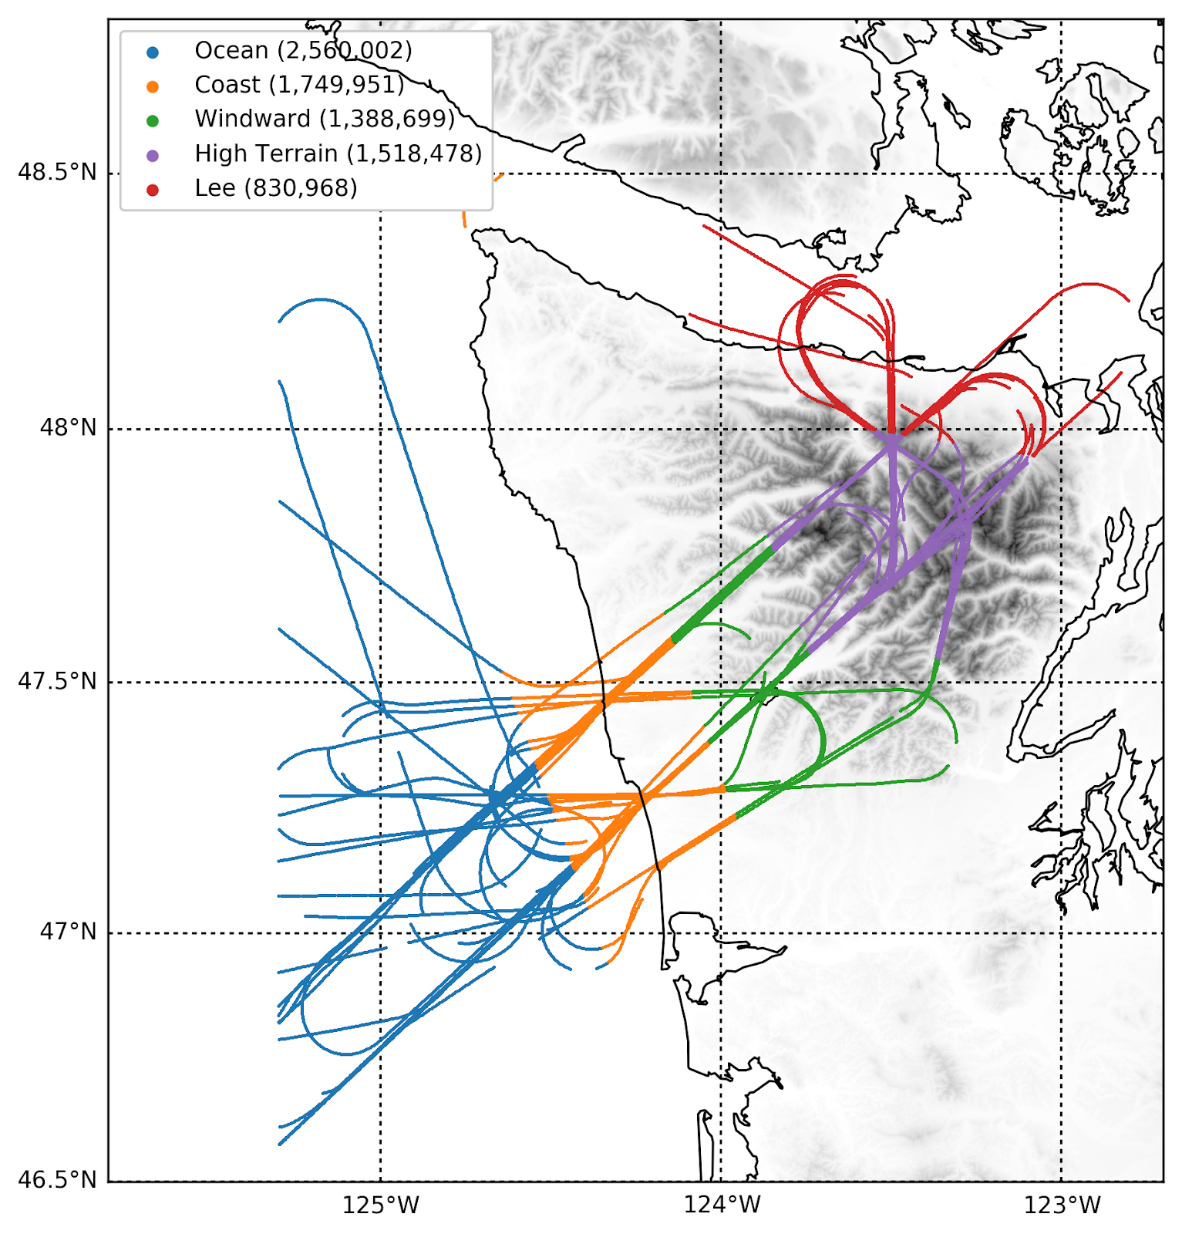
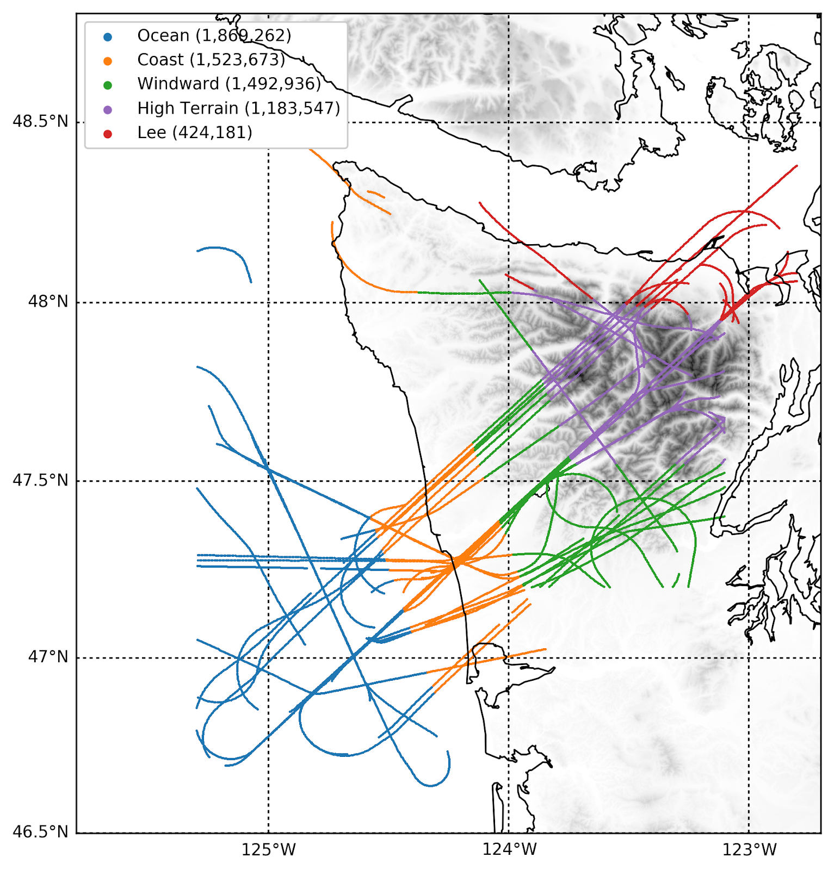
Flight tracks divided by storm sector and geographic region:
Ocean Coast Windward High Terrain Lee Side
~30 total measurement hours
Prefrontal
Warm Sectors
Postfrontal

Slide 7
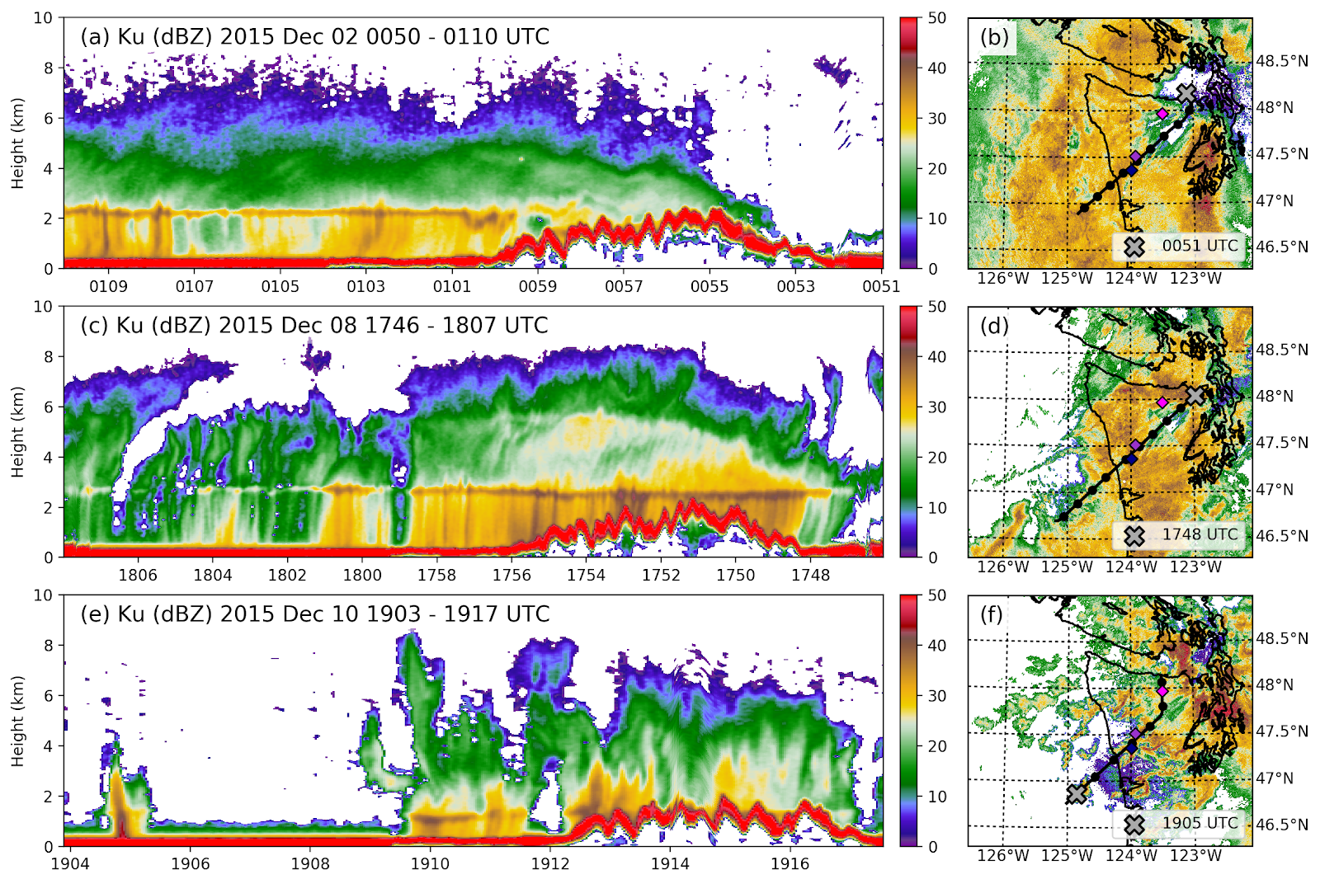
Flight track + NEXRAD radar
Example APR-3 transects of Ku- reflectivity
Prefrontal
Warm Sector
Postfrontal
Note: the red stripe
(> 50dBZ)
is the ocean/land surface signature
Notes:
Prefrontal: broad stratiform precip, rapid diminishment over high terrain/lee
Eye candy slide
Warm sector: isolated over ocean, deep cloud centered over land, lots of ice-phase enhancement
Postfrontal: isolated convection over ocean, broader but less intense cores over land

Slide 8
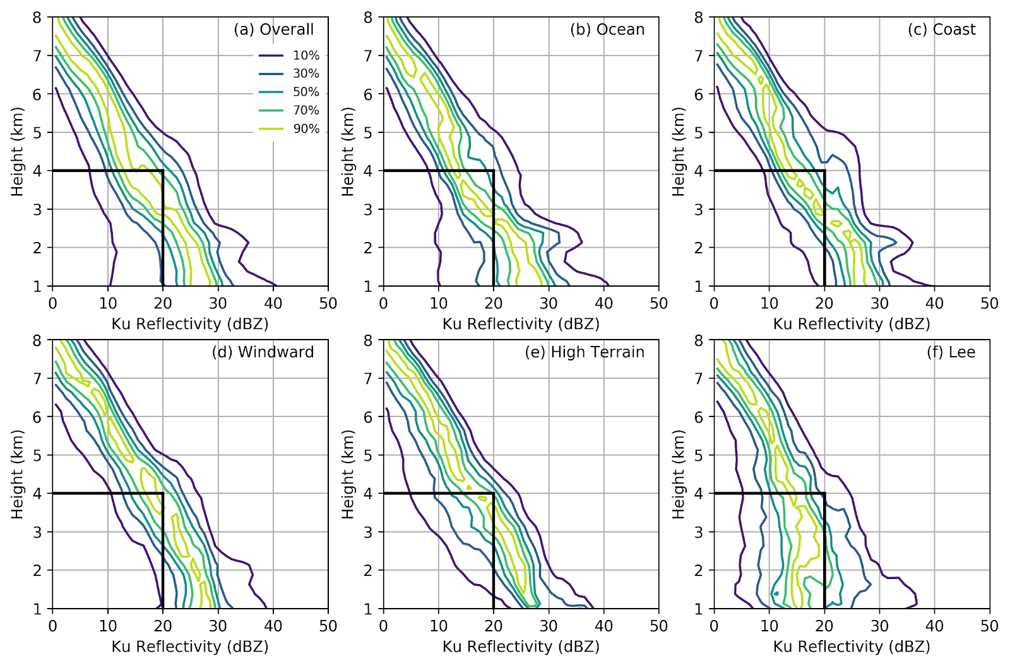
Prefrontal CFADs by geographic region (normalized by level)
Height relative to sea level
Notes:
Not much spread or difference between regions

Slide 9
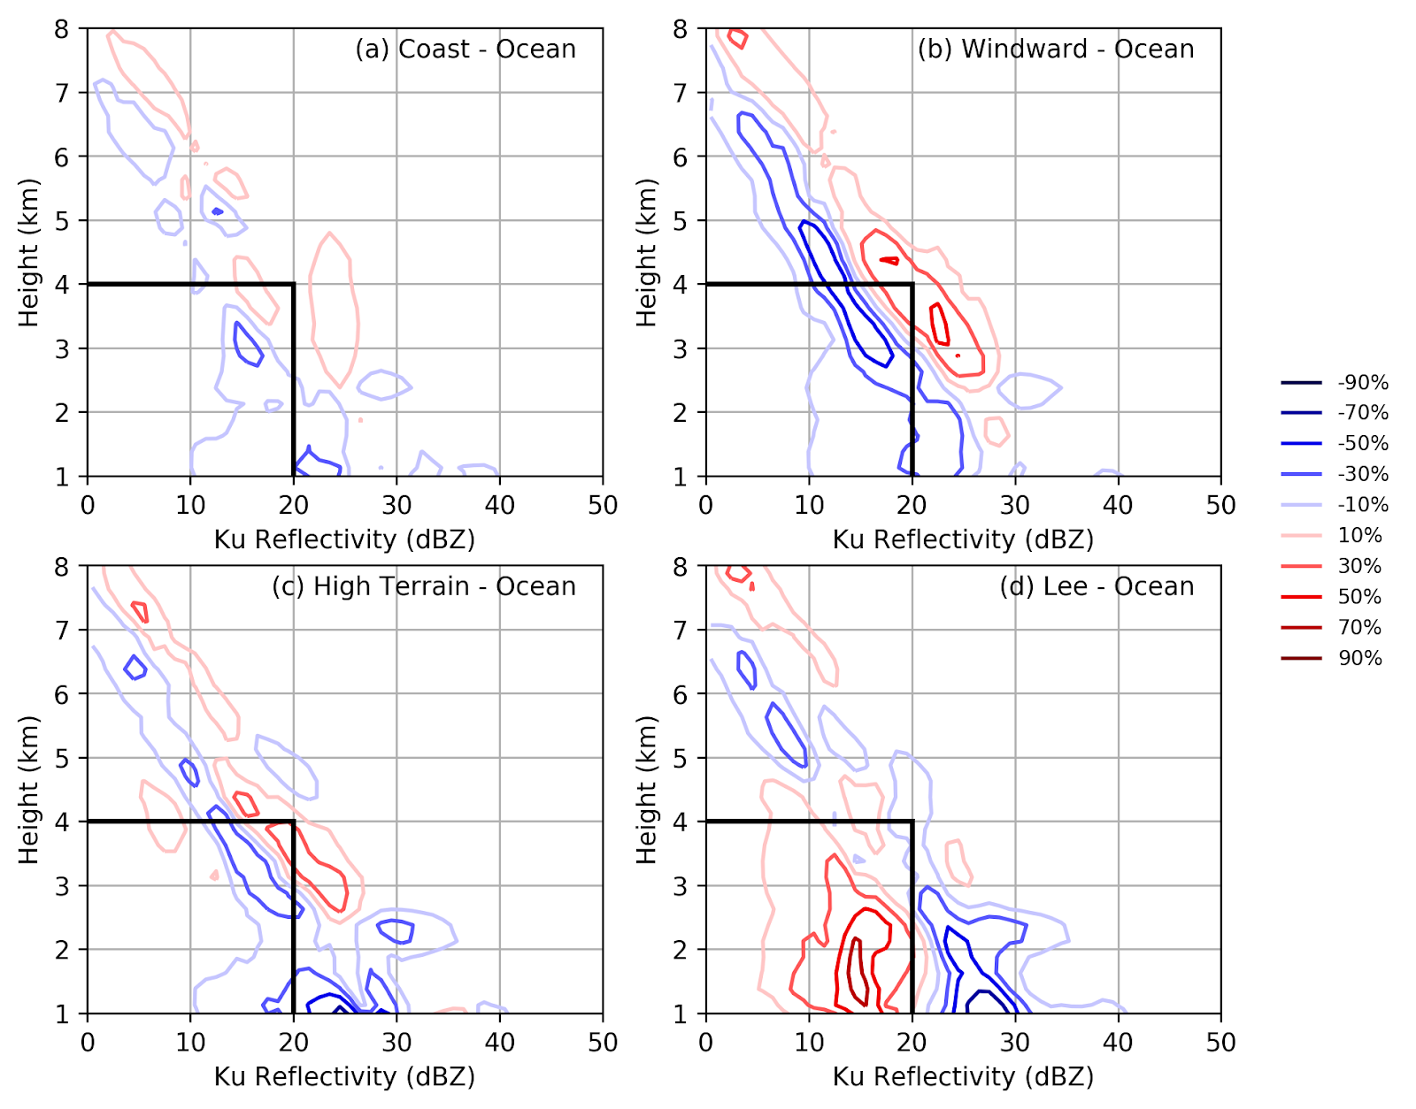
Prefrontal CFAD differences (relative to OCEAN)
Windward: Modest enhancement upstream of high terrain
Blue: higher over ocean
Red: higher over comparison region
Lee: Significant diminishment at low levels
Notes:
Mountain wave response under stably stratified environmental conditions

Slide 10
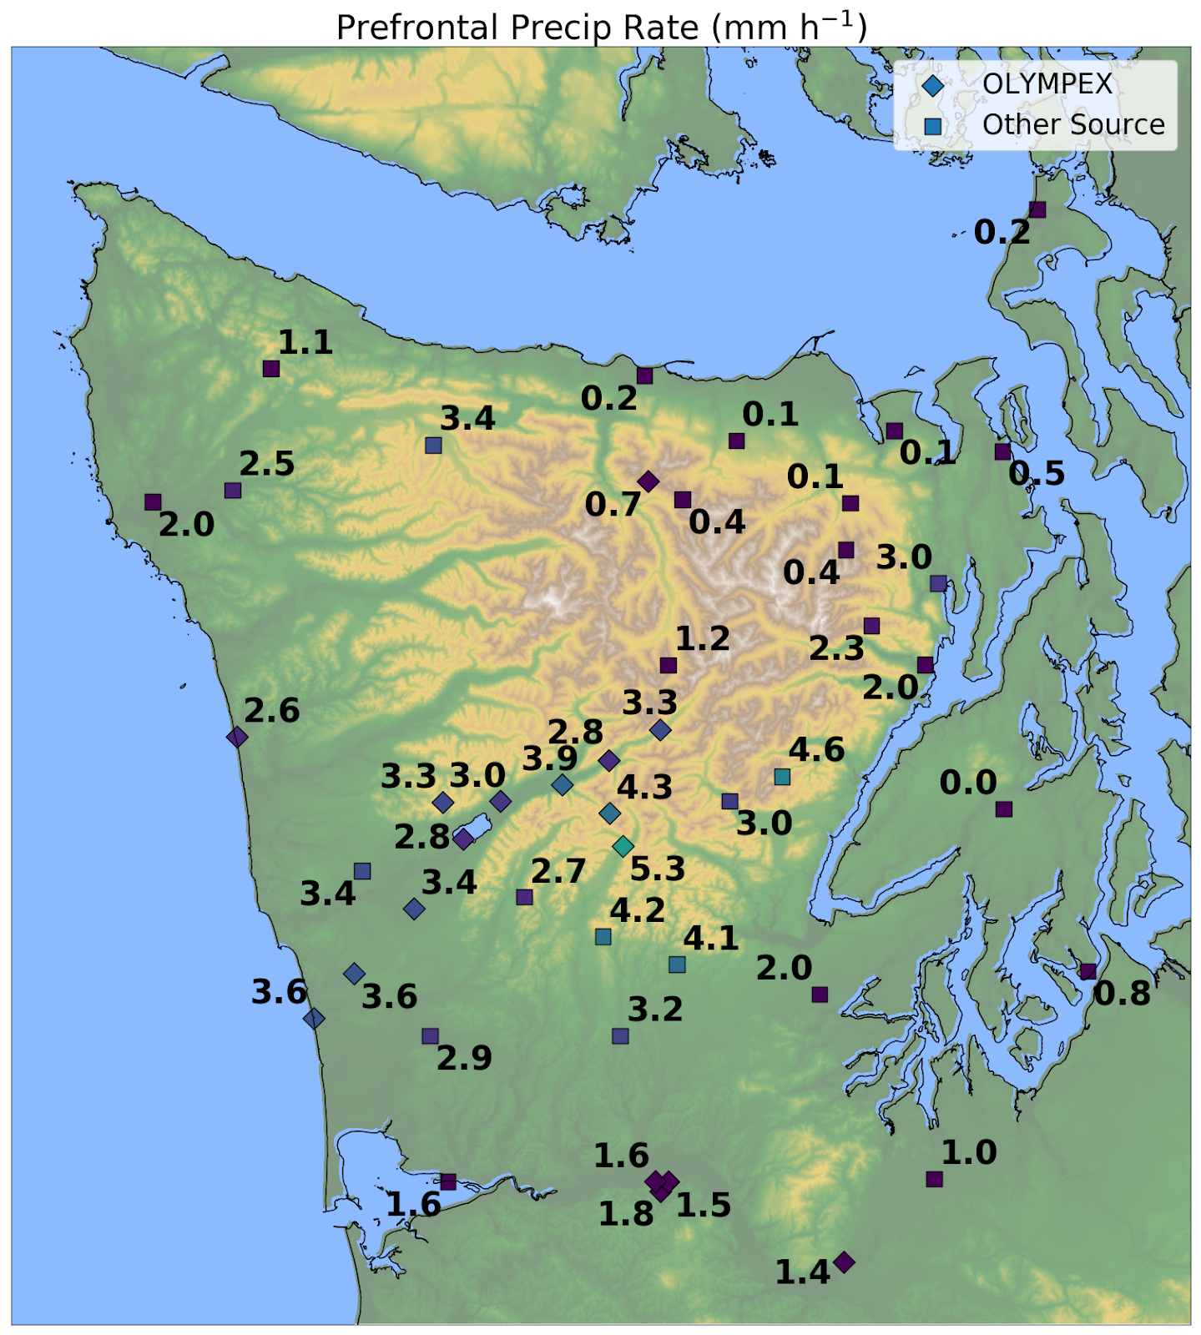
Uniform 3-4 mm h⁻¹ over coast and windward side.
Rapid decline to < 1 mm h⁻¹ at windward/high terrain boundary.
Nearly complete “rain shadow” in lee.
Average precipitation rate (mm h⁻¹) during prefrontal flights
*See poster (McMurdie et al.) for surface
particle size distributions
Notes:
Presumably some ice is advected to lee side—disdrometers show high

Slide 11
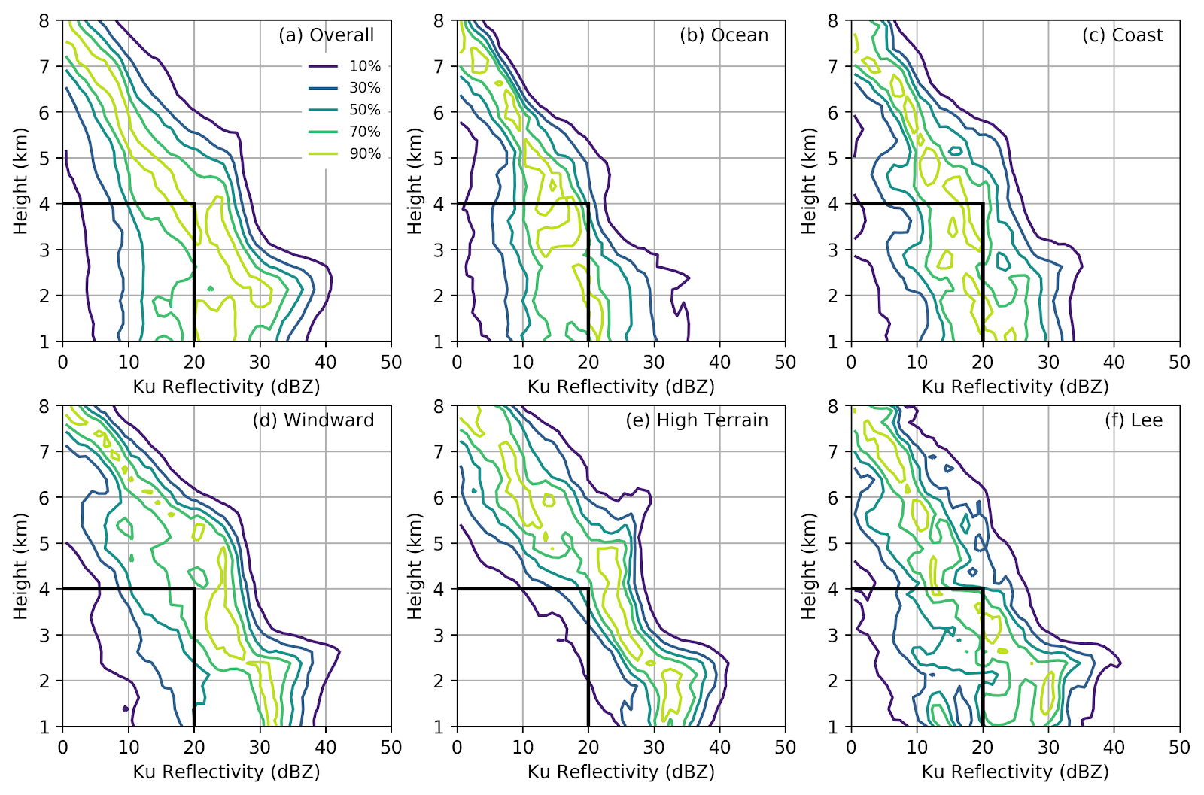
Warm Sector CFADs by geographic region
Notes:
30-40 dBZ in mode over windward/high terrain

Slide 12
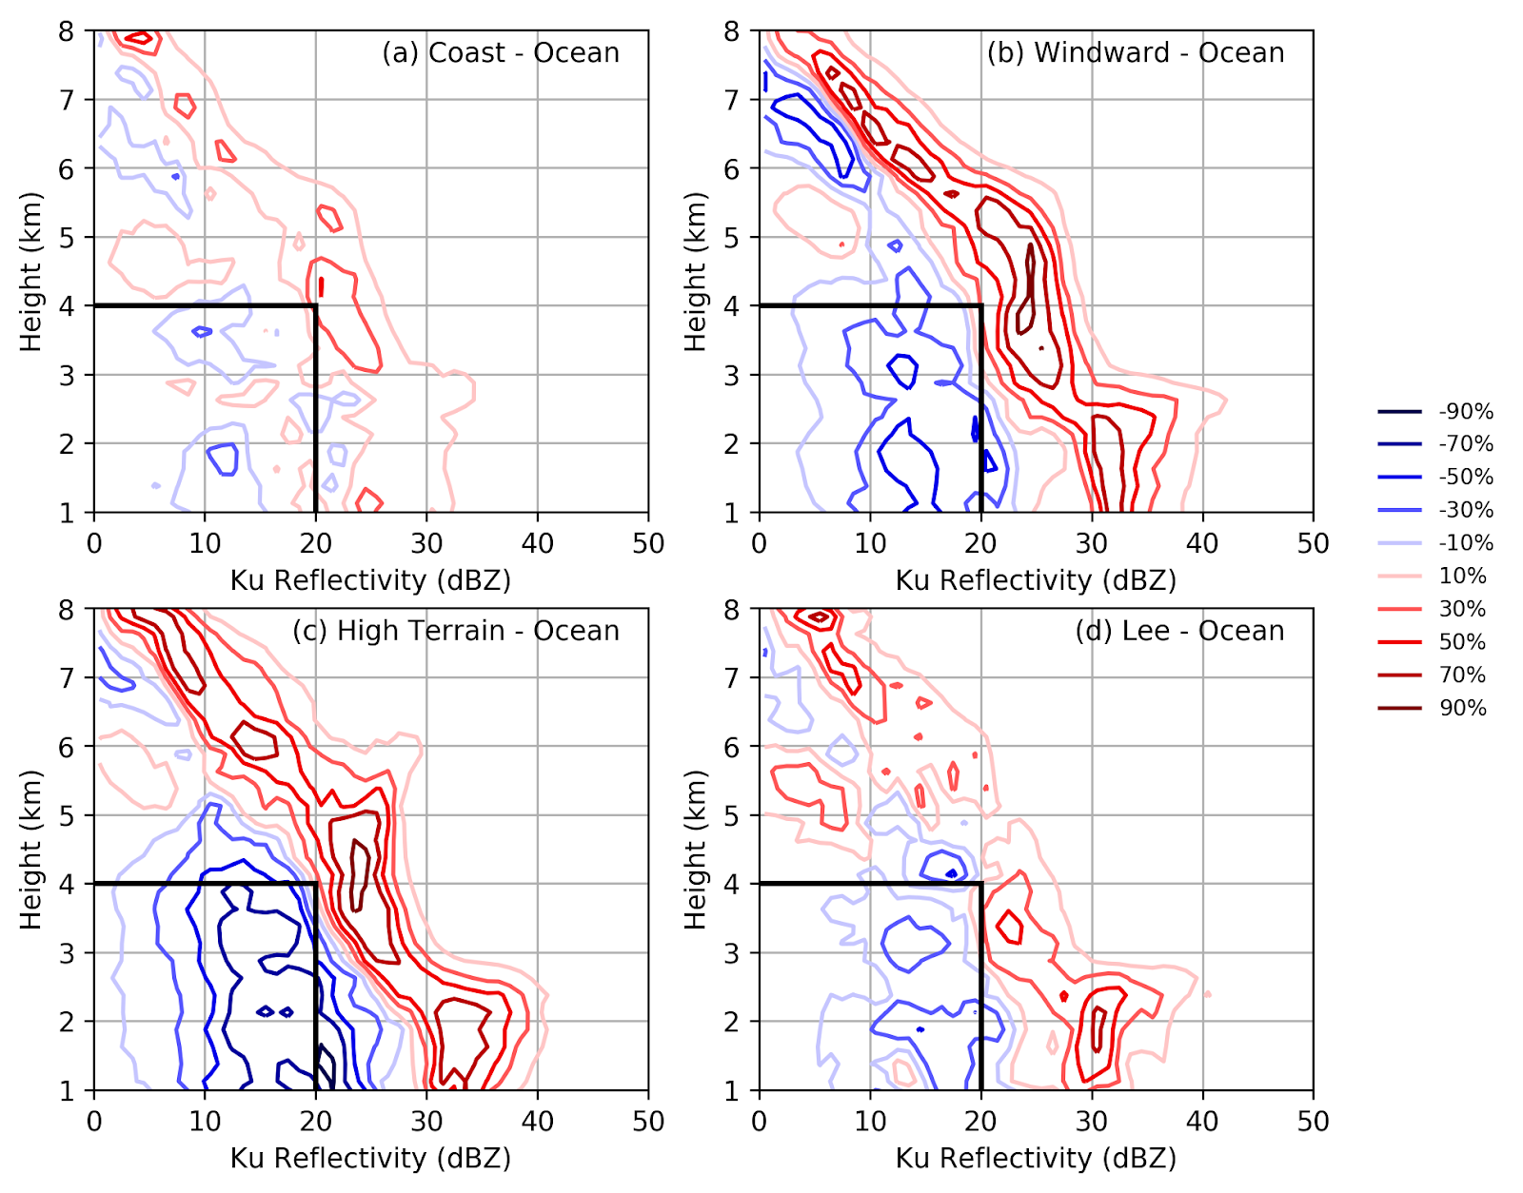
Warm Sector CFAD differences (relative to OCEAN)
Windward/High Terrain: Deep enhancement over full vertical profile (consistent with McMurdie et al. 2018)
Blue: higher over ocean
Red: higher over comparison region
Lee: Enhancement most pronounced near/below bright band--suggests spillover

Slide 13
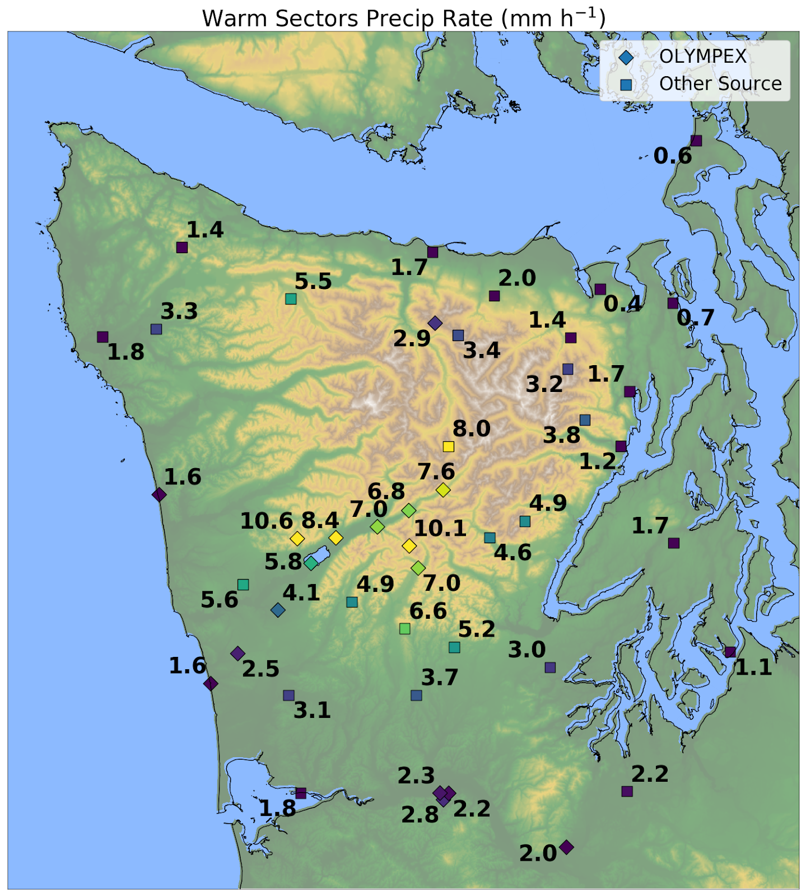
Factor of 6-8 times more precip on windward slopes than coast. (see Zagrodnik et al. 2018 JAS)
Sharp diminishment is located directly over high terrain, similar to climatology.
More precipitation reaches lee side.
Average precipitation rate (mm h⁻¹) during warm sector flights

Slide 14
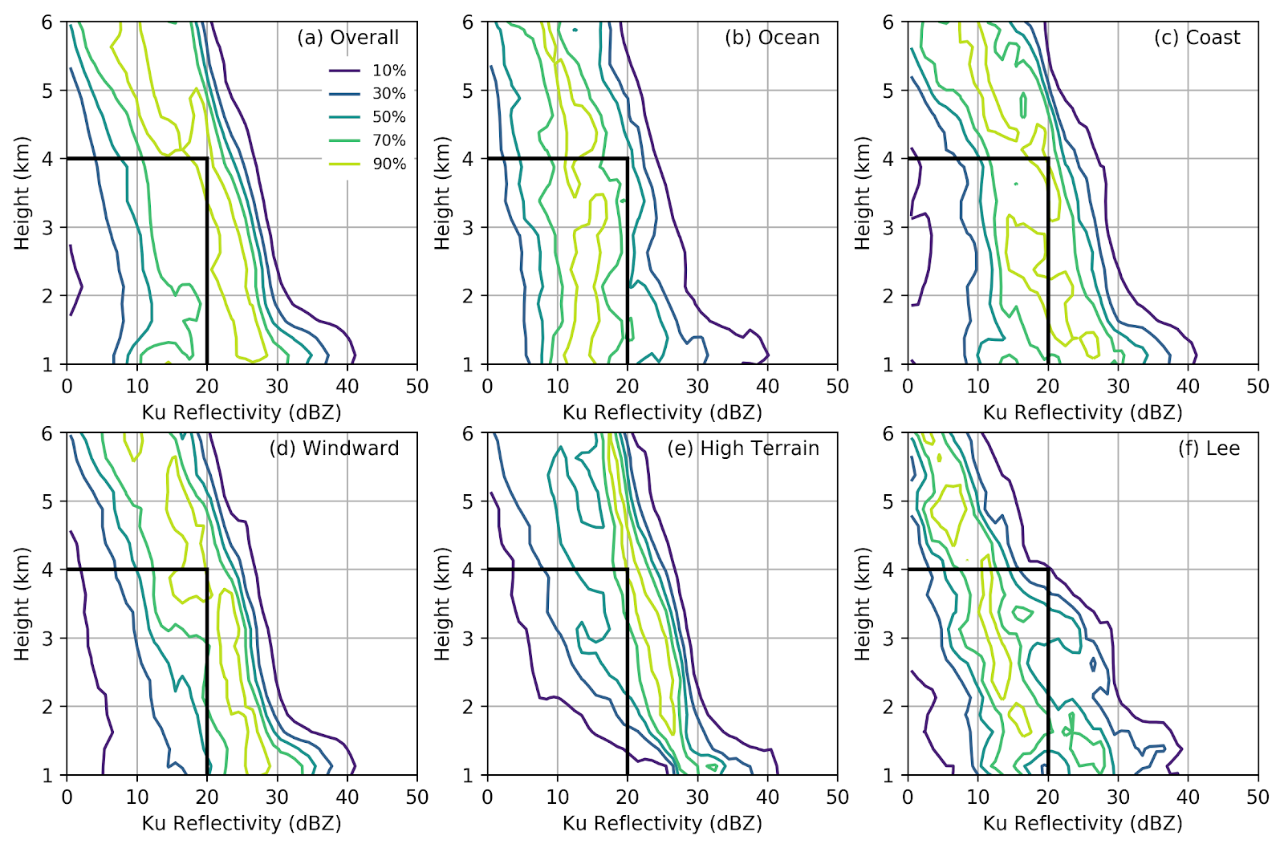
Postfrontal CFADs by geographic region (Note: 6 km max height)
Notes:
Looking mostly at ice
Click 1: more variable and weaker over ocean, more uniform over high terrain
Click 2: but doesn’t trail w/height as fast as prefrontal or warm sectors (suggests strong vertical ascent)

Slide 15
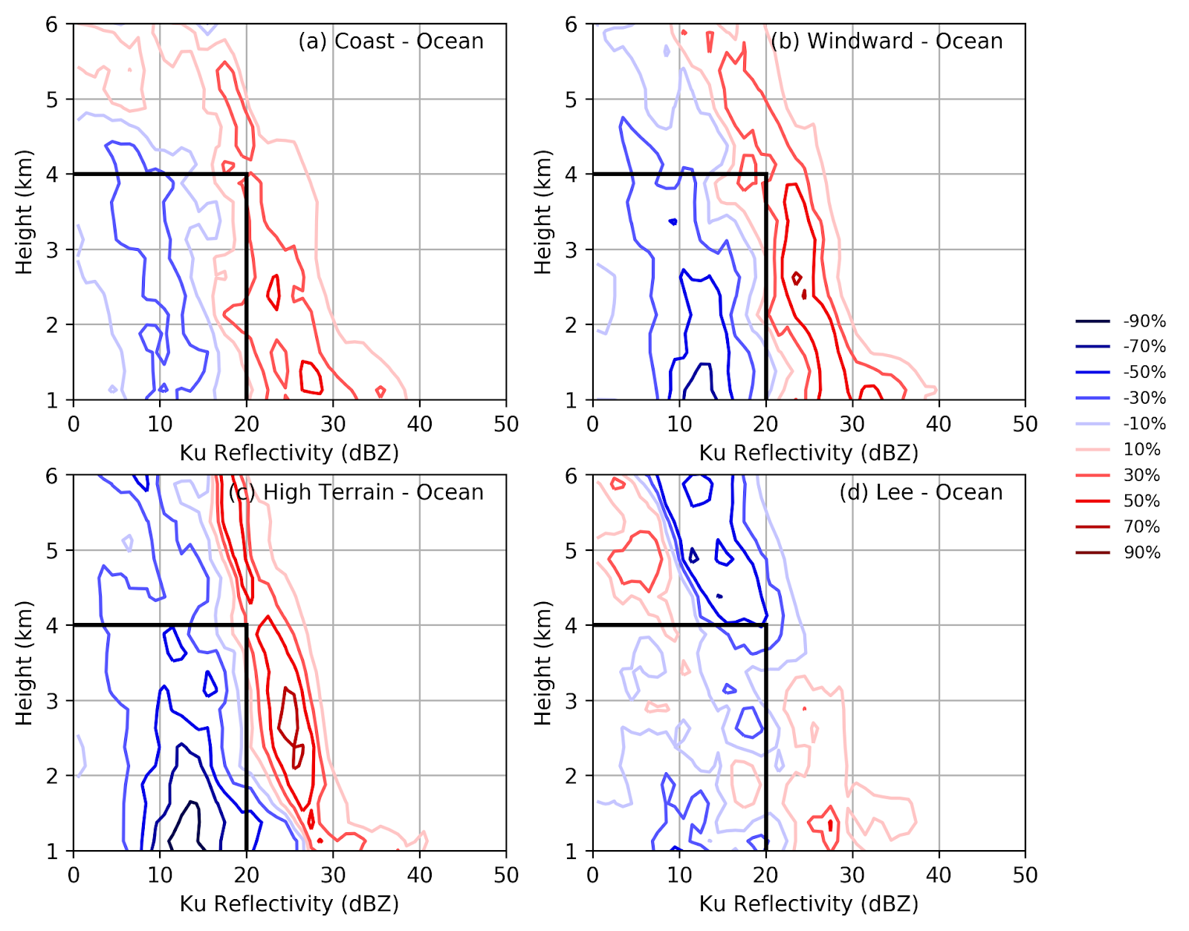
Postfrontal CFAD differences (relative to OCEAN)
Windward/High Terrain: Deep layer of enhancement
Blue: higher over ocean
Red: higher over comparison region
Lee: Diminished echo at higher levels--WNW flow advected shallow showers through Strait of Juan de Fuca

Slide 16

Windward maximum
(present in all 3 sectors).
Weaker gradient of diminishment over high terrain/lee than prefrontal.
Considerable snow accumulation in postfrontal sector (low melting level + long event duration).
Average precipitation rate (mm h⁻¹) during postfrontal flights

Slide 17
Conclusions
Spatial distribution of precipitation modification (in horizontal and vertical) was strongly dependent on the large-scale environment associated with different synoptic storm sectors.
Windward enhancement and leeside diminishment were omnipresent but details were highly variable:
Prefrontal: enhancement shifted upstream, near-complete lee rain shadow
Warm sector: deep, intense enhancement over mountains spilled over to lee
Postfrontal: convective to stratiform transition from coast to mountains
How does the nature of precipitation particles vary by location/sector?
See our poster (#7: McMurdie et al.) for surface particle size distributions!
Notes:
All three sectors come together for climatology

