Slide 1

Terrain-Enhanced Precipitation Processes above the Melting Layer: Results from the Olympic Mountains Experiment (OLYMPEX)
Lynn McMurdie
University of Washington
(co-authors: Angela Rowe, Joe Zagrodnik, Stacy Brodzik, Thomas Schuldt, Robert Houze and, Jamin Rader)
18th AMS Meeting on Mountain Meteorology 26 June 2018

Slide 2
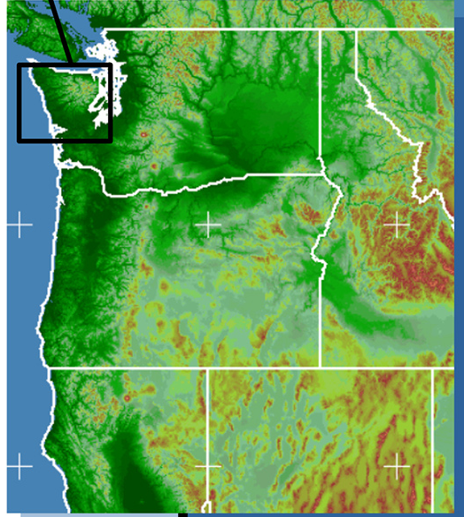
OLYMPEX
Took place on Olympic Peninsula
Full compliment of radars, aircraft, ground network November 2015 – January 2016
Subset of ground network through April 2016
Physical validation of precipitation algorithms for the GPM satellites
Document precipitation processes in winter midlatitude cyclones over complex terrain

Slide 3
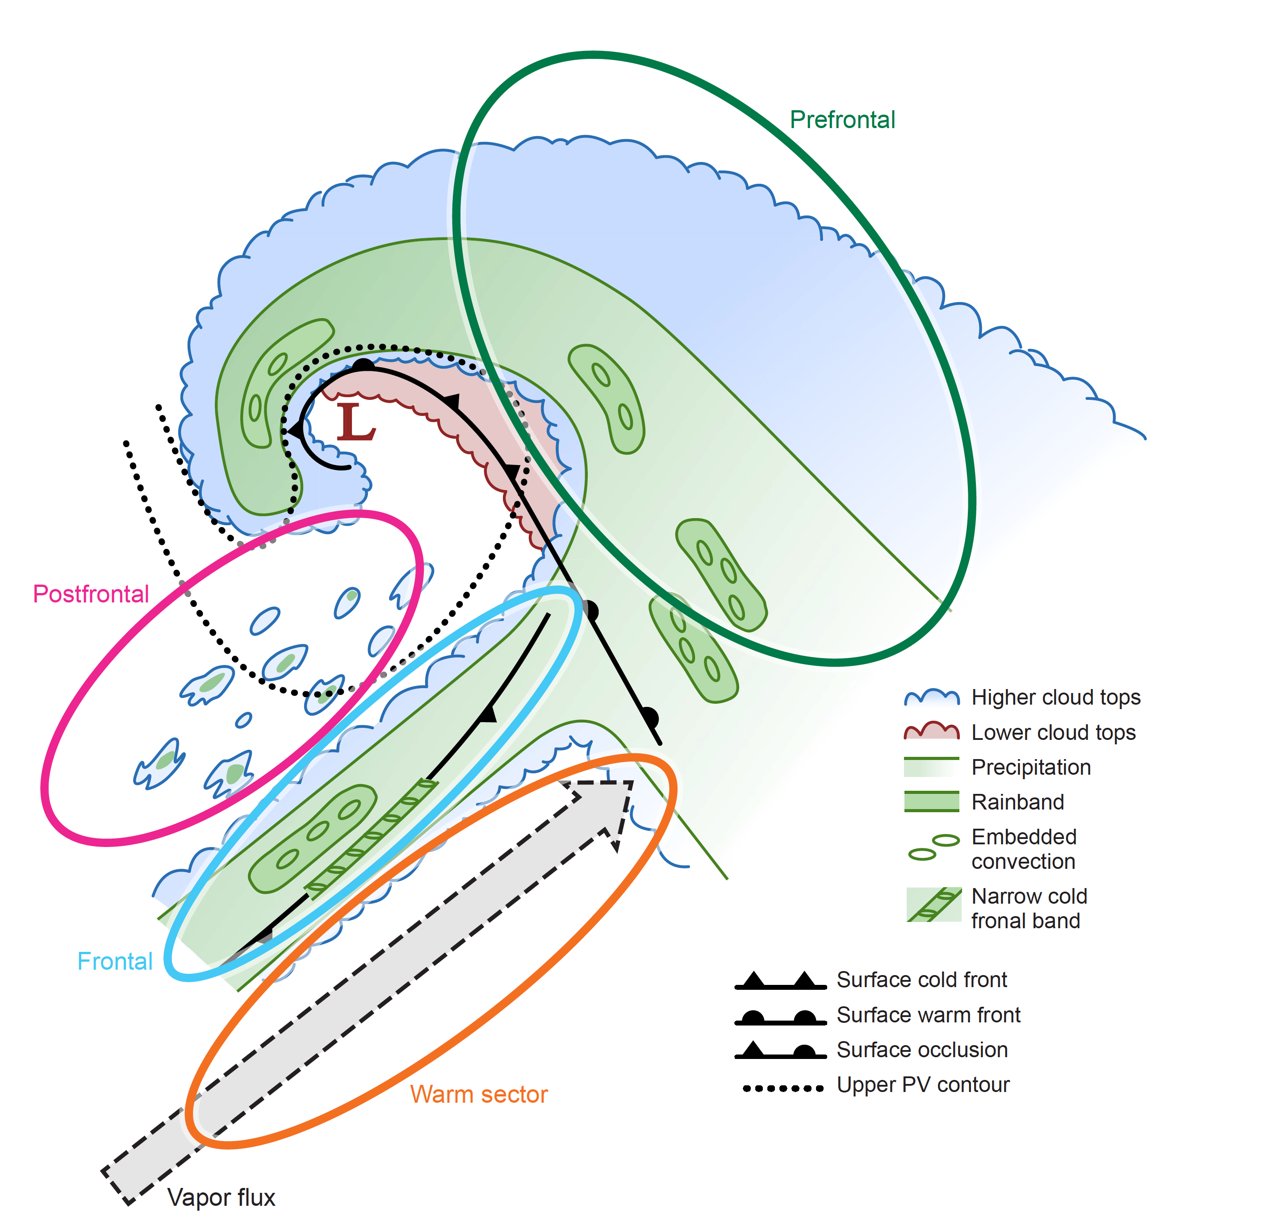
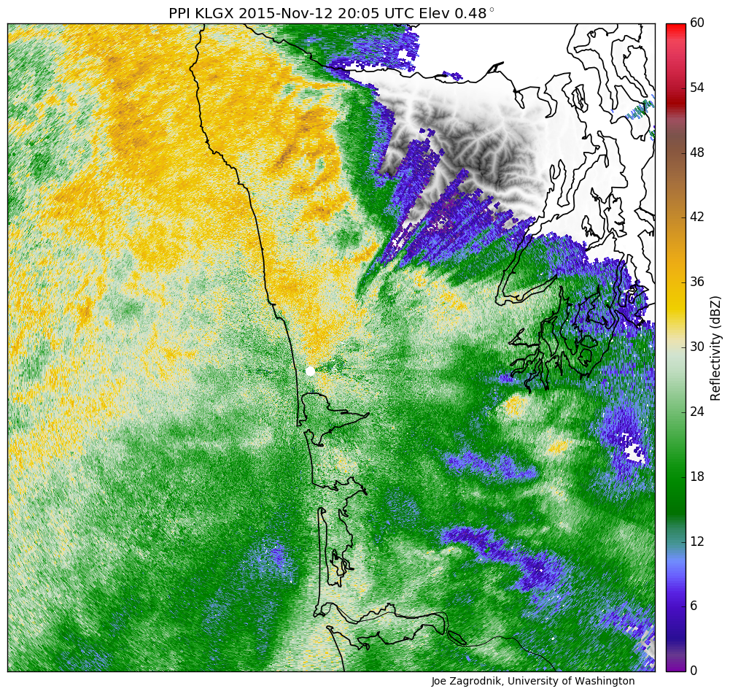
Prefrontal Environmental Characteristics
Warm advection (veering winds)
Stable
Low-level SE flow
IVT variable (can be high)
Increasing Melting Level height

Slide 4
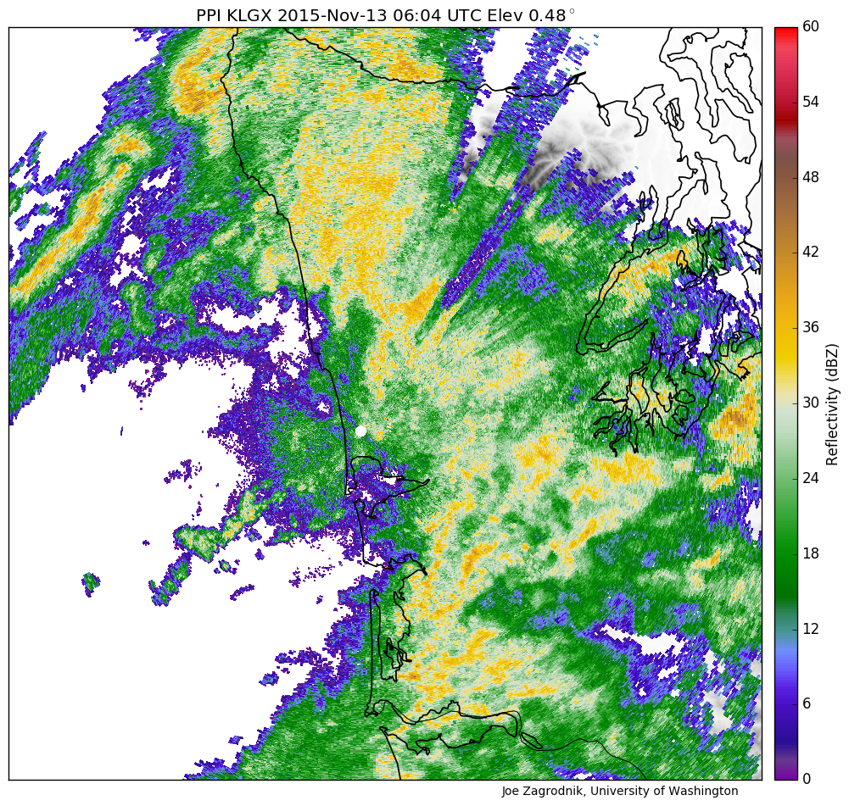
Warm Sector Environmental Characteristics
High IVT
Neutral Stability
SW flow
High melting level

Slide 5
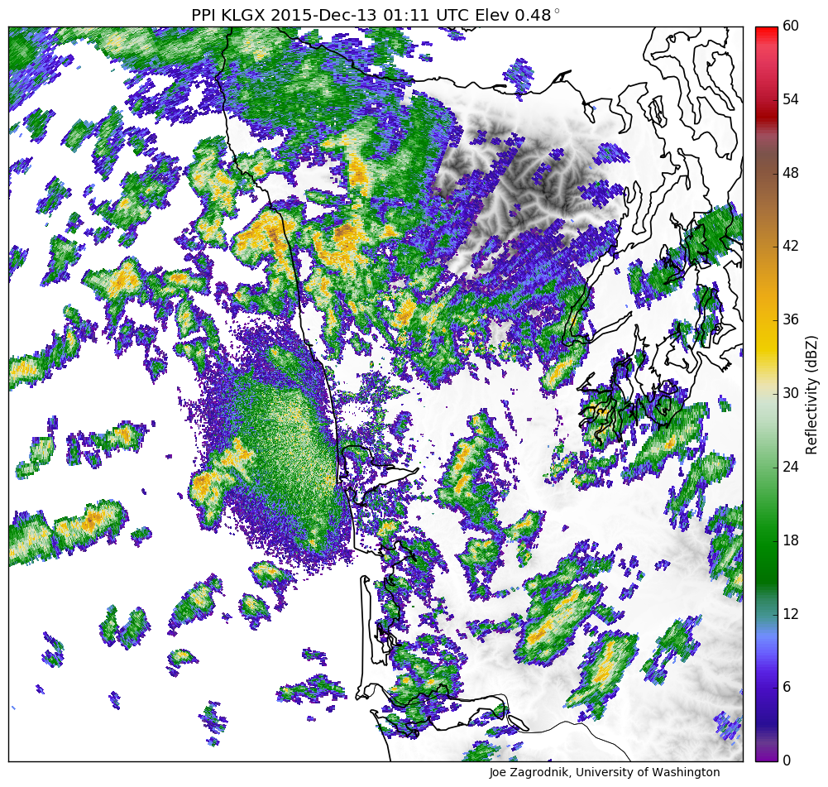
Postfrontal Environmental Characteristics
Cold Advection
Unstable
W or NW flow
Low IVT
Low Melting Level

Slide 6
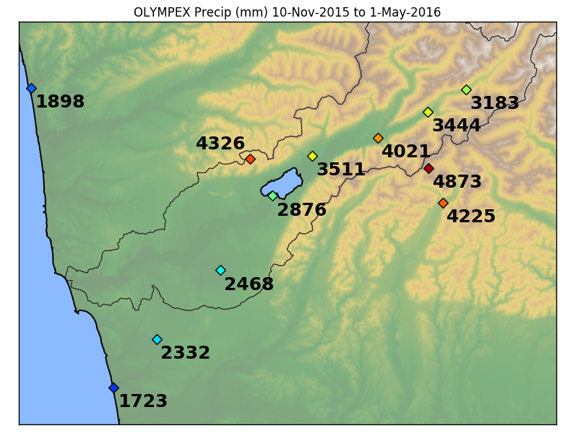
Precipitation distribution is used to describe modification by flow over mountains
Map of precipitation does not tell whole story
What are the processes that create this distribution precipitation?
How are processes above the melting layer modified?
How does the modification vary with environmental conditions?
Seasonal Precipitation Map on windward slopes during OLYMPEX

Slide 7
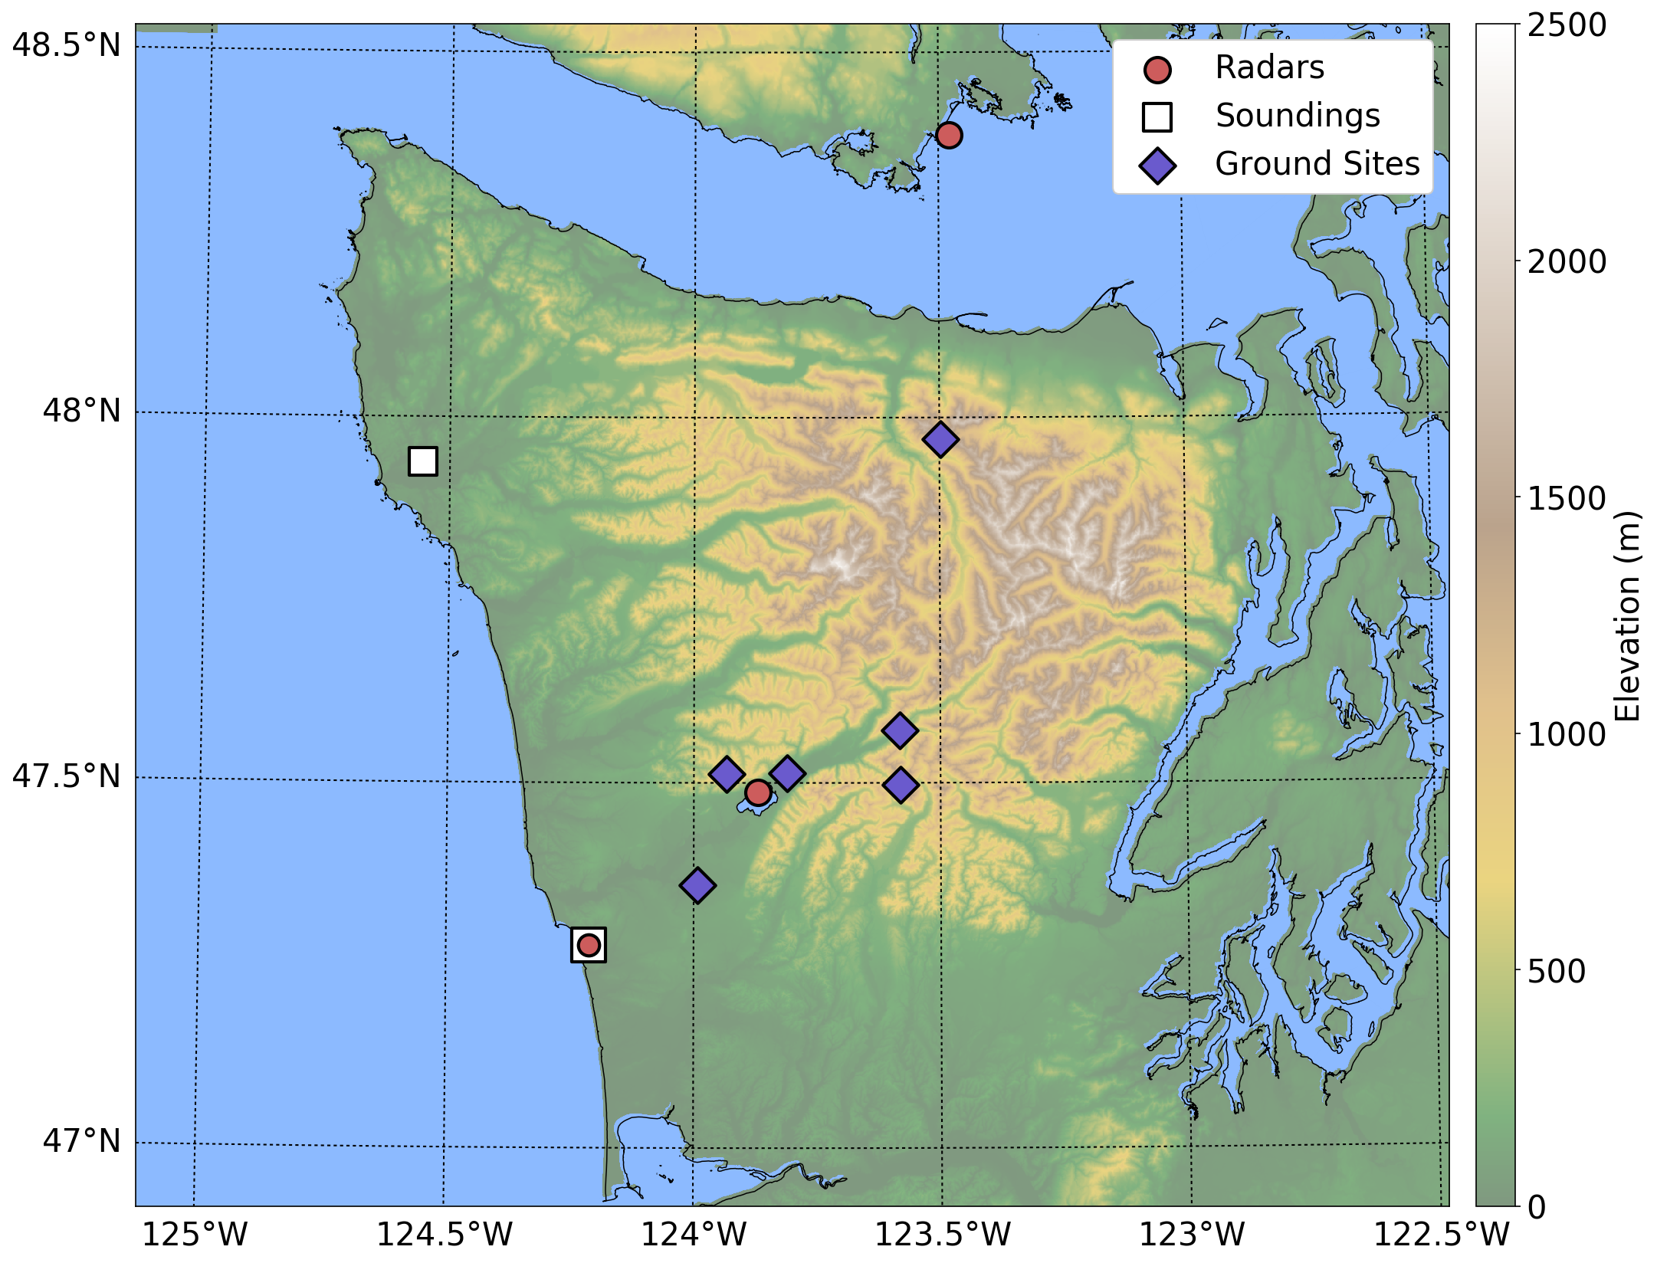
Canadian X-band
Use radar reflectivity to document upper-level enhancement
Variability of enhancement due to different environmental conditions
X-band Sector
Land Sector
Ocean Sector
NPOL S-band

Slide 8
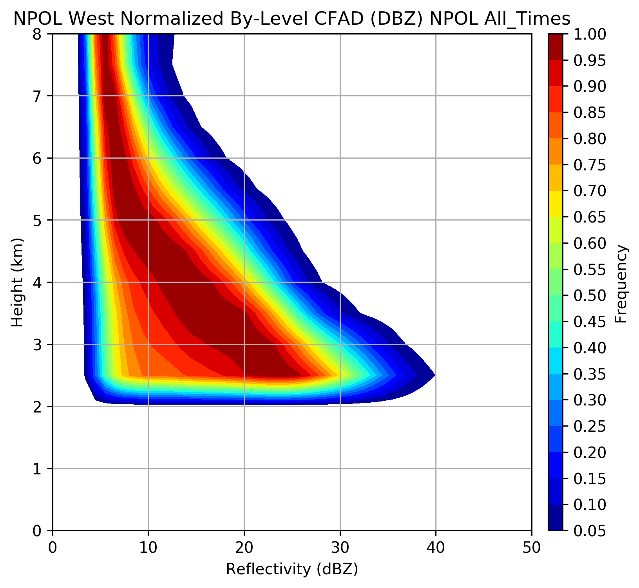
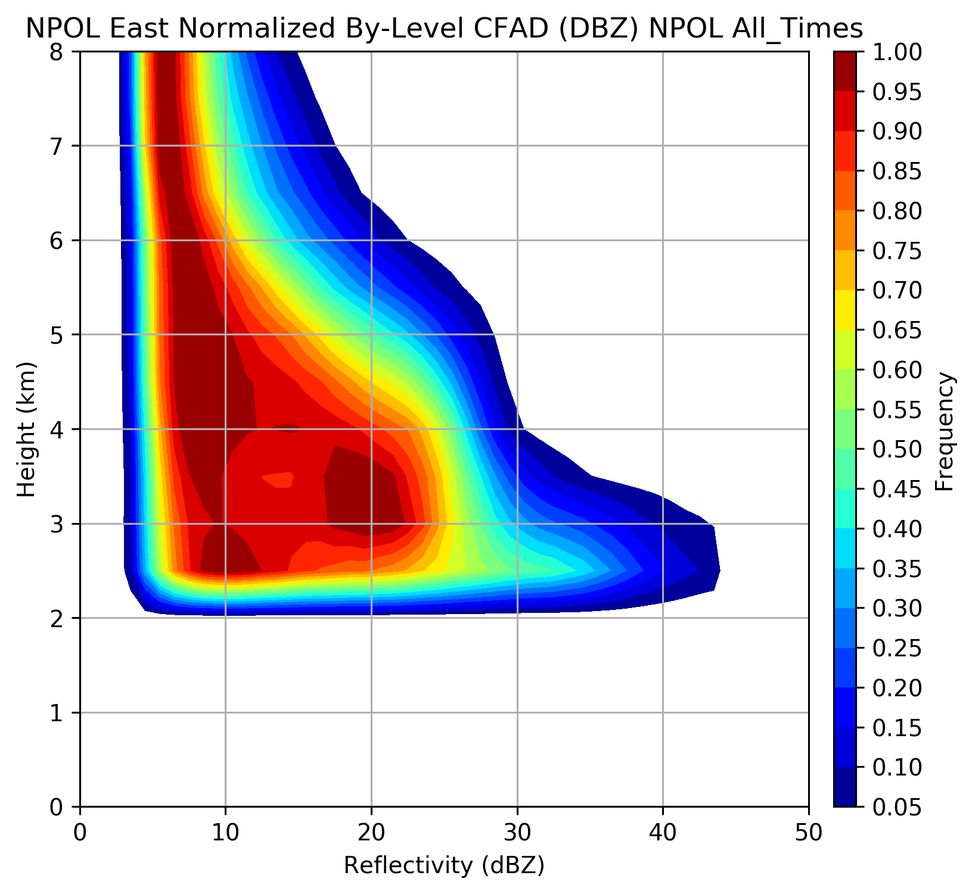
Orographic Enhancement Aloft from Radar
Ocean
Land – Windward Slopes
Reflectivity (dBZ)
Reflectivity (dBZ)
Contoured Frequency by Altitude Diagrams
Frequencies normalized by level for all NPOL RHI data over ocean and land above 2 km height

Slide 9
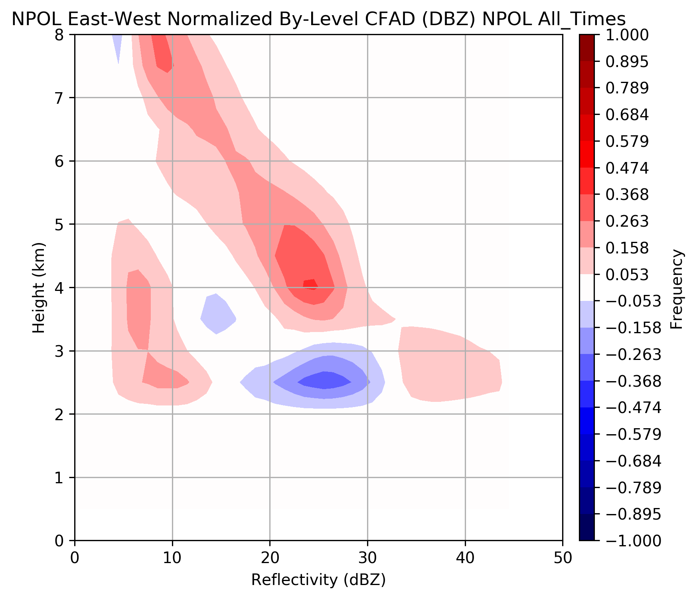
Orographic Enhancement Aloft from Radar
Land – Ocean Difference CFAD
Greater frequency of higher reflectivities at all levels over windward slopes. Maximum at 4-5 km range.
Shift to higher reflectivity near melting level (2-3 km during warm events)

Slide 10
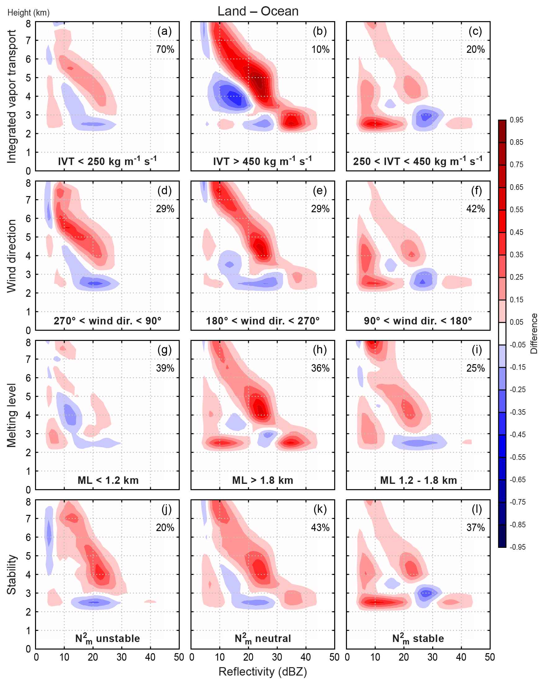
~Warm sector
~Post frontal
~Pre-frontal

Slide 11
Land - Ocean
Height km
~Warm sector
~Post frontal
~Pre-frontal

Slide 12
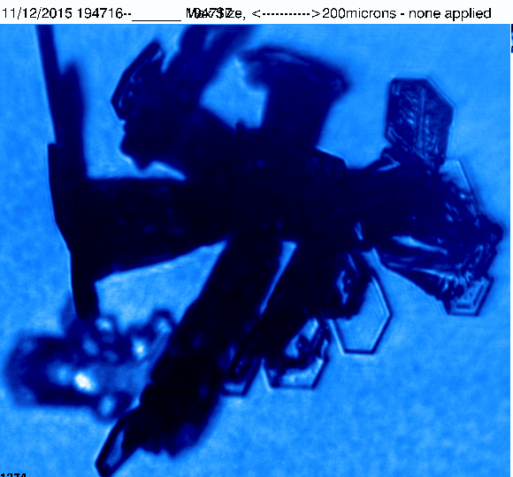
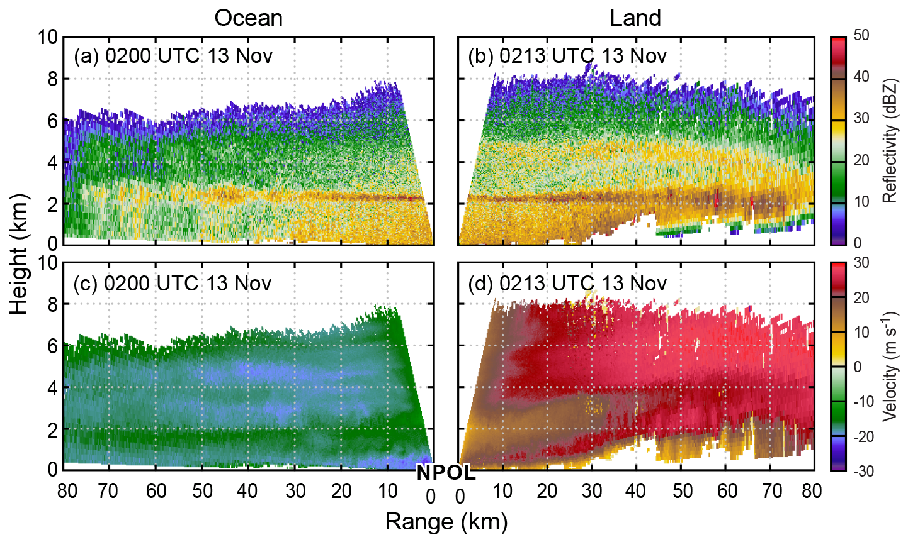
Come see poster #7
km
Warm Sector – 13 November 2015 – IVT high, melting level high, neutral, SW winds

Slide 13
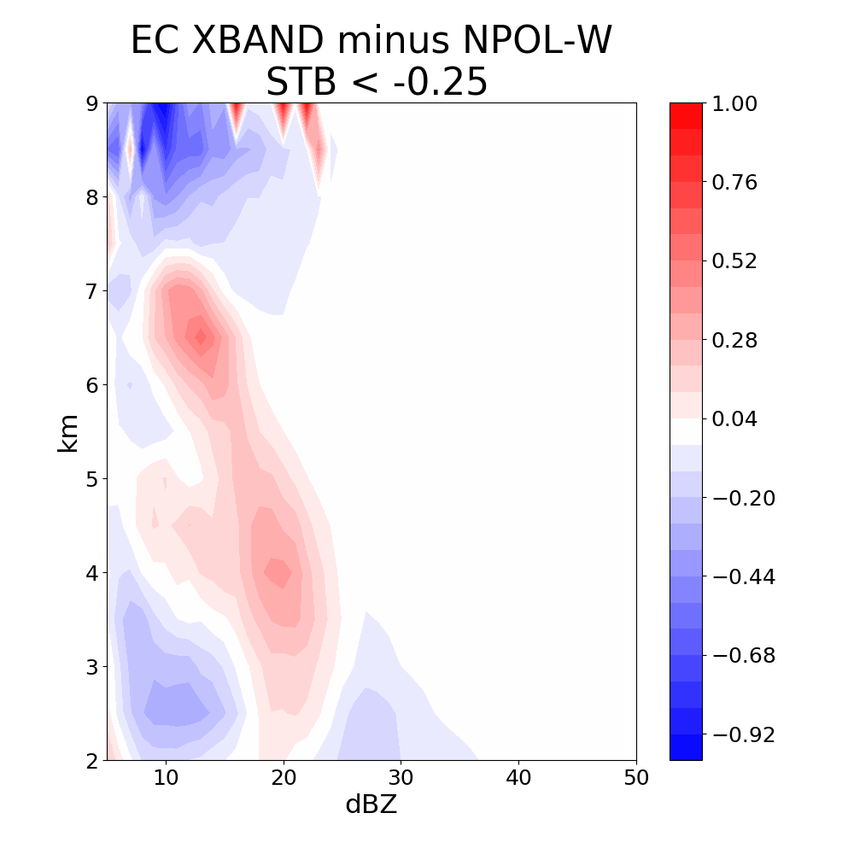
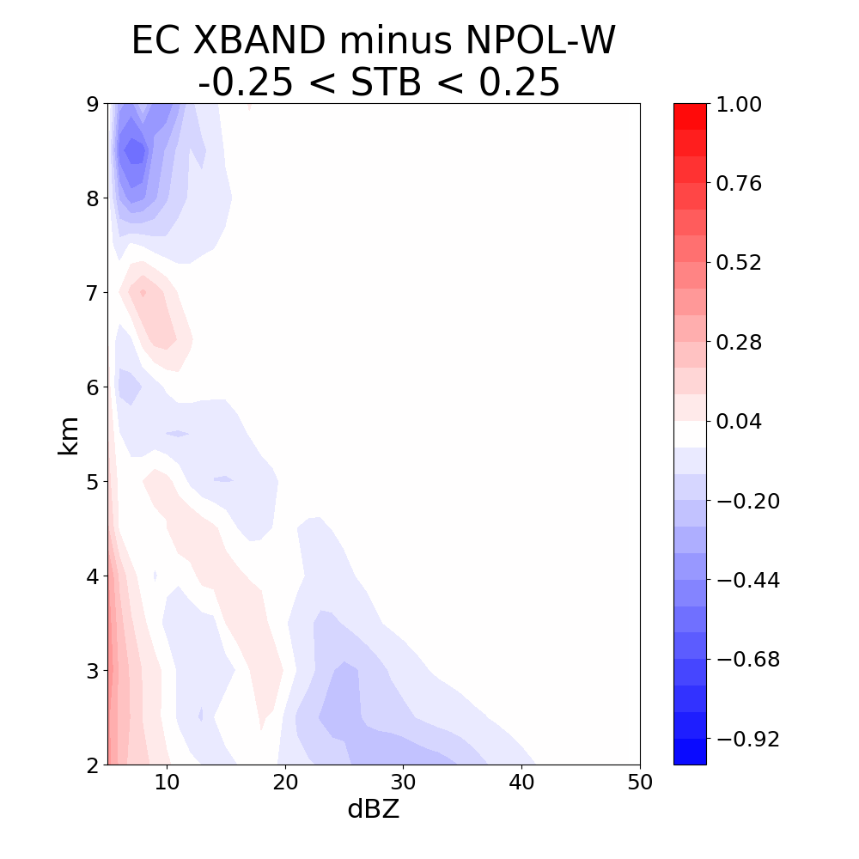
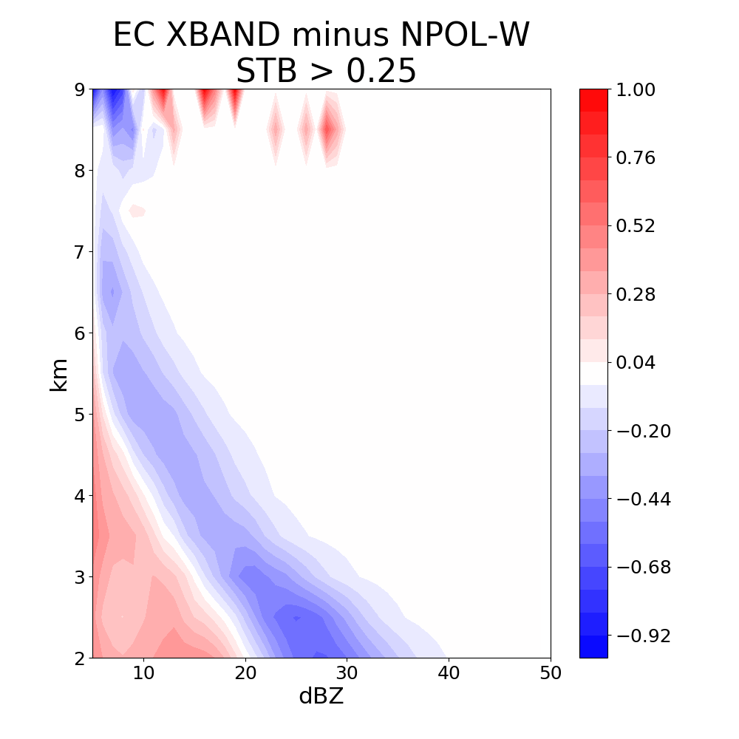
CFAD Difference between
NPOL Ocean sector and EC X-band Leeside
Unstable
Neutral
Stable
Post-frontal: winds W, NW, not leeside
Some diminishment of precipitation but some gets across
Precipitation particles cannot get across high terrain, blocking?

Slide 14
Terrain-Enhanced Precipitation Processes above the Melting Layer
Enhancement of the precipitating cloud system occurs aloft
Synoptic and environmental conditions affect the degree of enhancement
Enhancement on windward slopes greatest during warm, strongly forced events
Things I couldn’t show
This same pattern of enhancement seen by the DPR on the GPM satellite
Warm rain processes below bright band also important during atmospheric river like conditions
Come see poster #7!!!!!!!

Slide 15
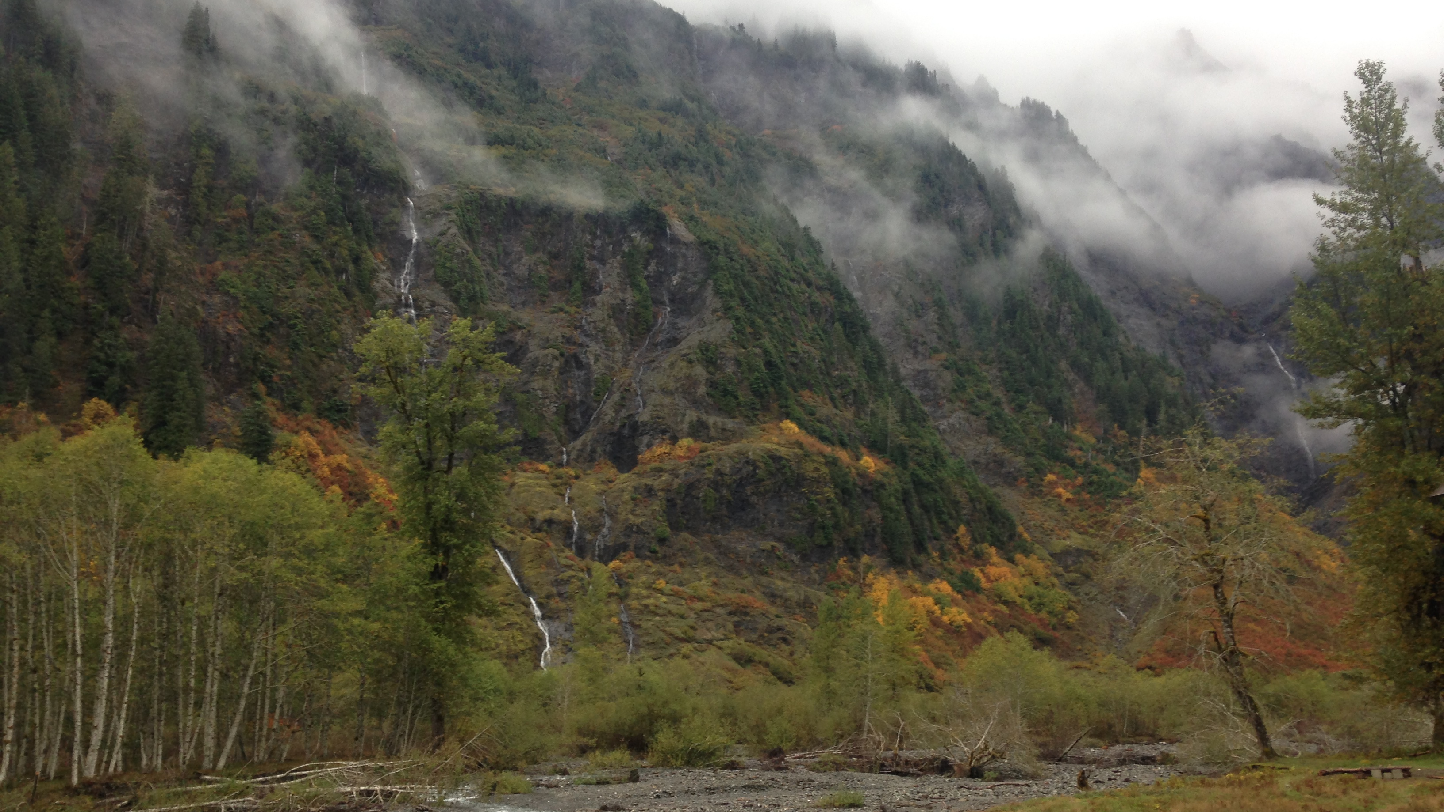
Acknowledgements
Work Supported by:
NASA grants: NNX16AD75G, NNX16AK05G, 80NSSC17K0279
NSF grants: AGS-1503155, AGS-1657251
AMS 18th Mountain Meteorology Conference Santa Fe, 26 June 2018

