Slide 1
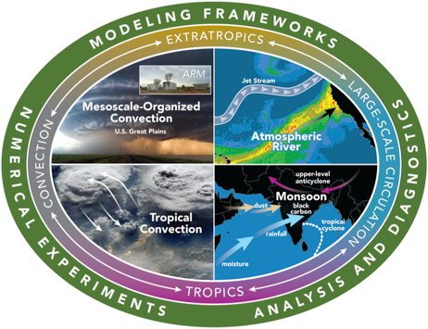





Systematic Assessment of Mesoscale Convective Systems in MPAS Variable Resolution Climate Simulations over North America
Zhe Feng, Koichi Sakaguchi, L. Ruby Leung, Robert A. Houze Jr., Fengfei Song
Pacific Northwest National Laboratory, Richland, WA
AOGS Conference. June 6, 2018
Funding Acknowledgement: DOE WACCEM SFA, CMDV-MCS

Slide 2
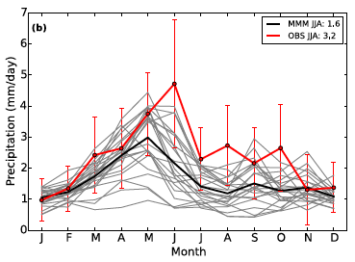
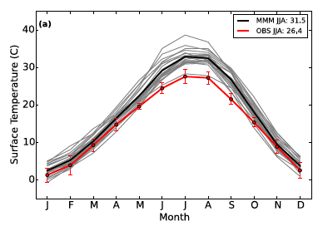
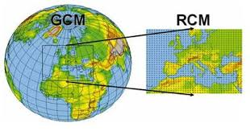
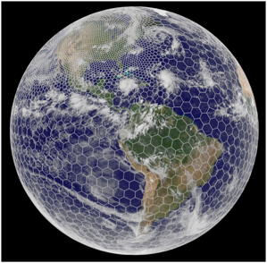
Modeling MCSs and their large-scale environments
Chengzhu Zhang (LLNL)
Precipitation
Most climate models with parameterized convection fail to represent MCSs, as reflected in precipitation biases
Three modeling approaches with computational requirements within reach:
Limited area models
Global variable resolution models
Multiscale modeling framework (MMF)
Diurnal cycle of precipitation
OBS
2m Temperature
VanWeverberg et al. (2018) JGR

Slide 3
Convection permitting modeling using MPAS
In a variable resolution domain with a transition across the grey zone, a scale-aware convection parameterization is needed to represent deep convection outside the convection permitting region
Use initialized hindcasts to compare simulations:
Zhang and McFarlane (ZM) – not scale aware
No convection parameterization (CP)
Grell-Freitas (GF) – scale aware
32km
Transition
4km

Slide 4
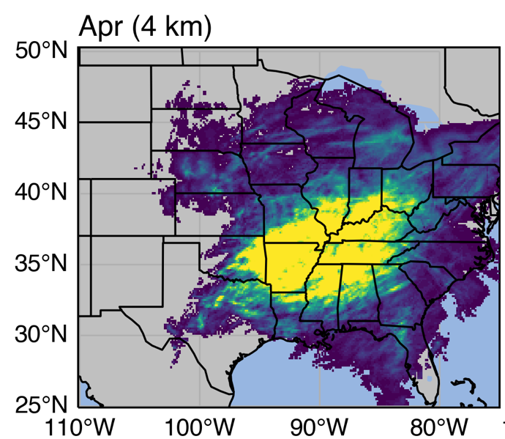
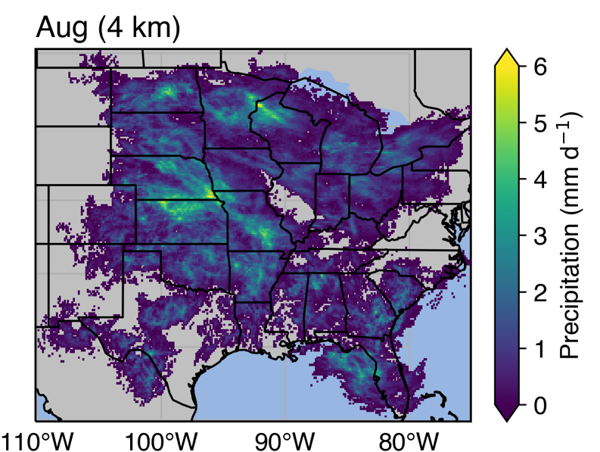
Numerical experiments
MPAS with CAM5.4 physics and CLM4 land model
Three variable resolution configurations: 25-100 km, 12-46 km, and 4-32 km
Hindcast simulations: 7 days, with first 2 days removed from analysis of each 5-day non-overlapping segments
Initial conditions: atmosphere (ERAI), land (from a continuous climate run)
Simulations: April and August for contrasting spring and summer
April
August
Observed MCS Precipitation in 2011

Slide 5
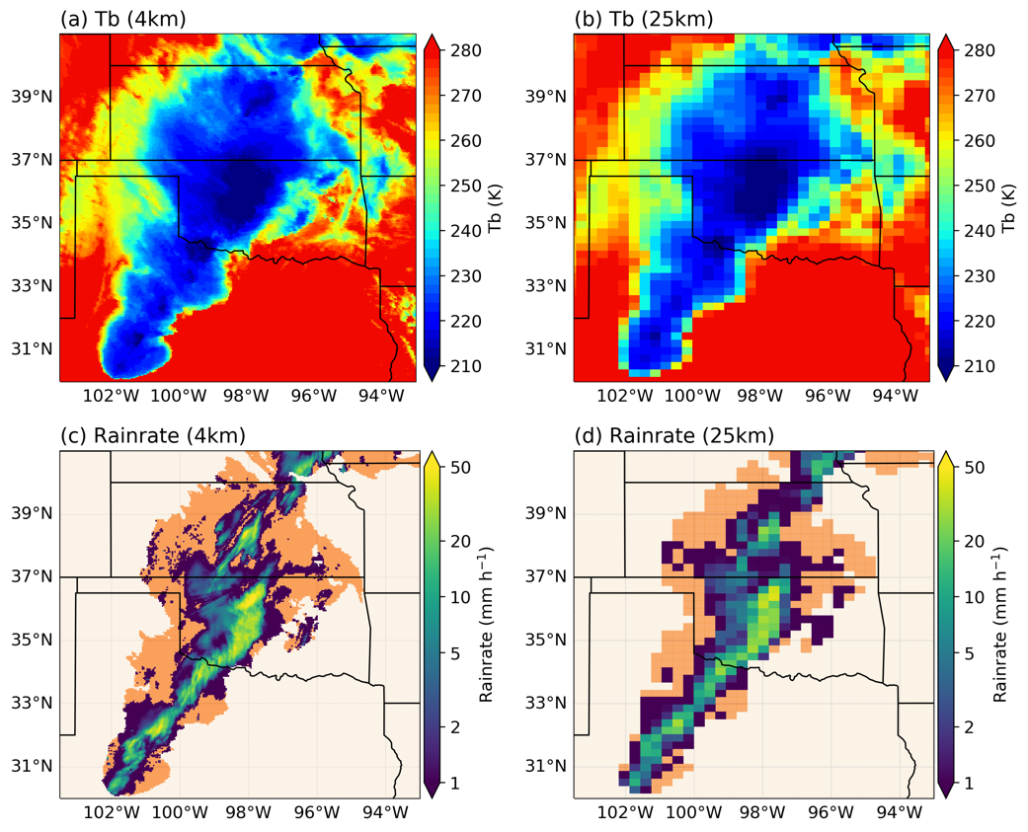
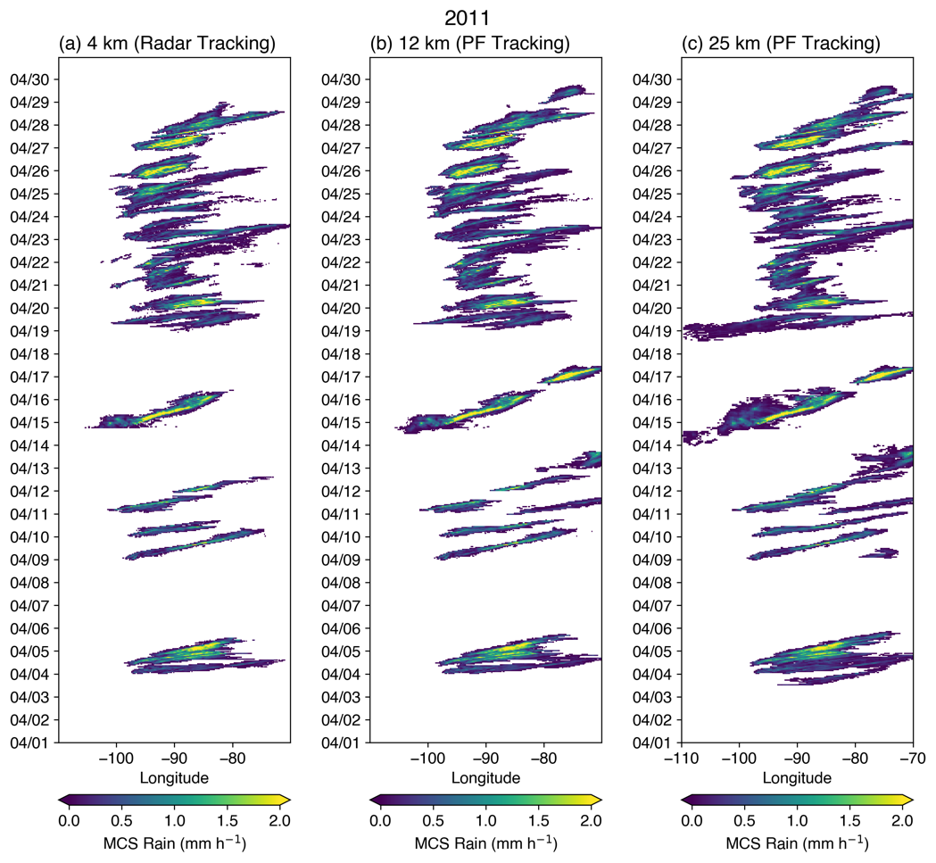
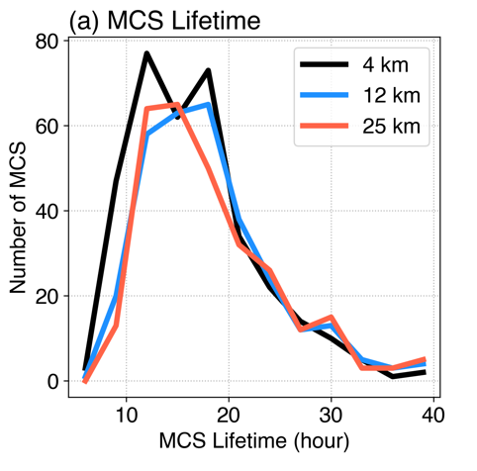
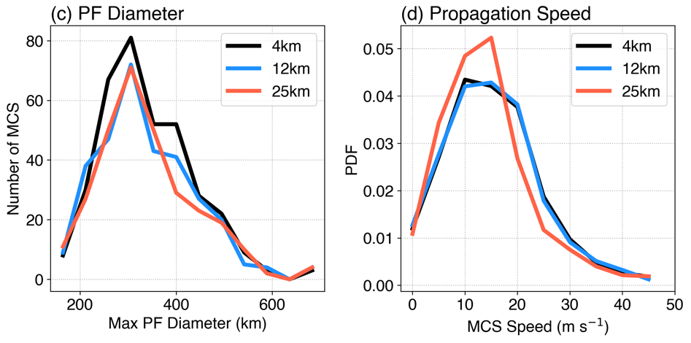
New MCS Tracking Algorithm (FLEXTRKR) for Evaluating Climate Model Simulations
4 km
25 km
New MCS tracking algorithm (FLEXTRKR) is developed for next-generation climate models (∆x = 12 km, 25 km)
Input variables: OLR, precipitation (hourly)
FLEXTRKR provides consistent MCS statistics across resolutions
FLEXTRKR is applied to MPAS simulations to track MCSs
Down-sample
4 km
12 km
25 km
MCS mask
Down-sample
Most MCS events are captured consistently across resolutions
Consistent MCS lifetime, size, speed across resolutions

Slide 6
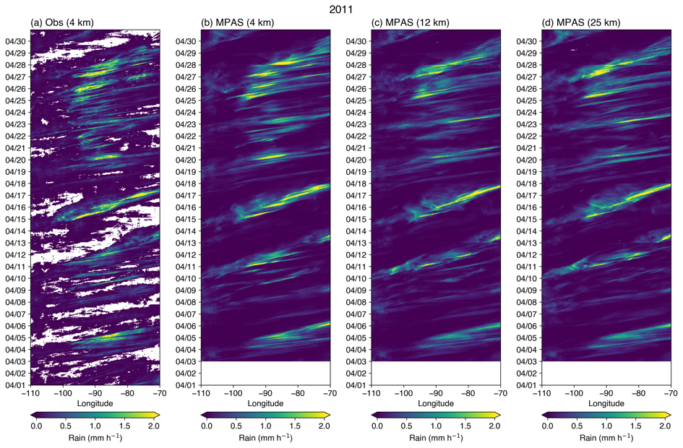
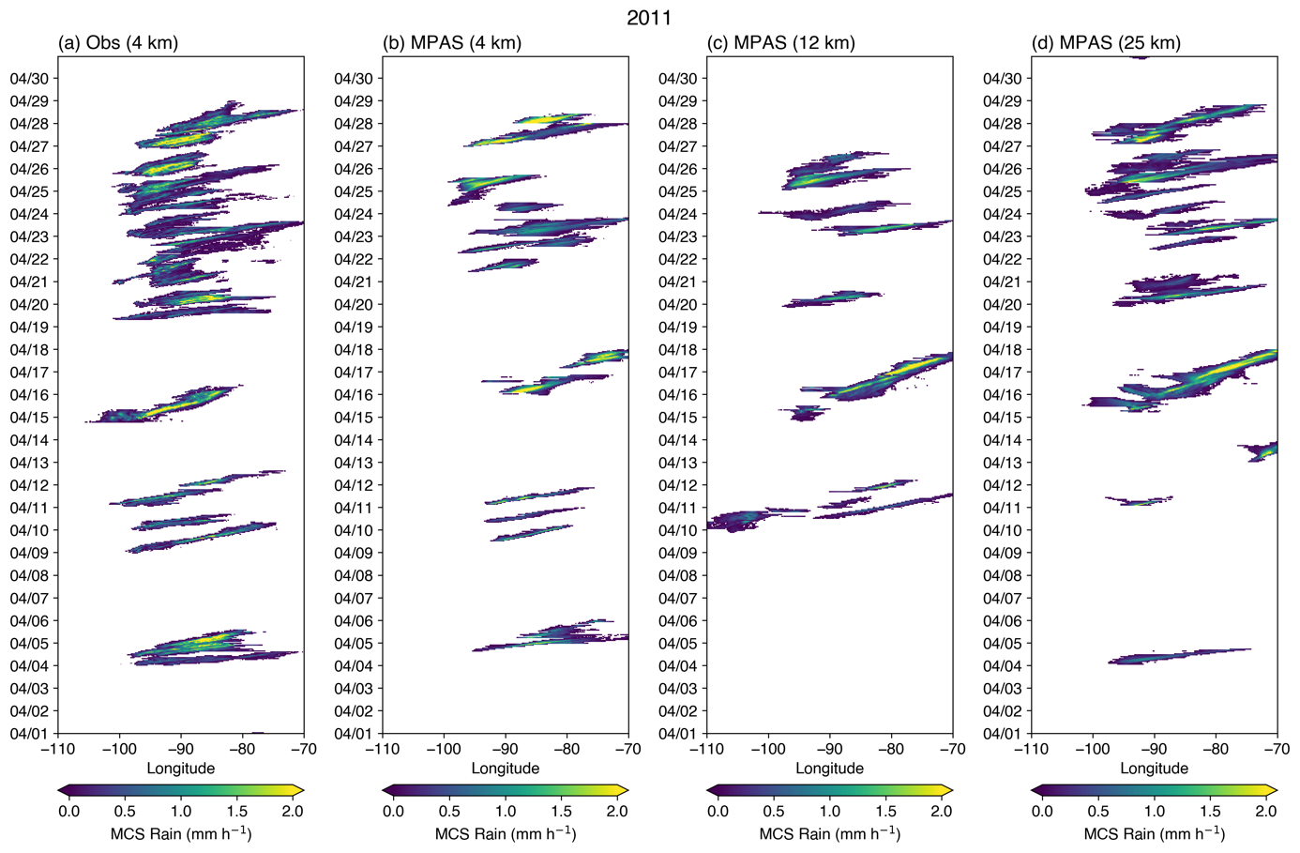
MCSs in April
Large precipitation events and some MCSs embedded within are well captured even at 12 km and 25 km resolution
Total precipitation
MCS precipitation
OBS
4 km
12 km
25 km
OBS
4 km
12 km
25 km

Slide 7
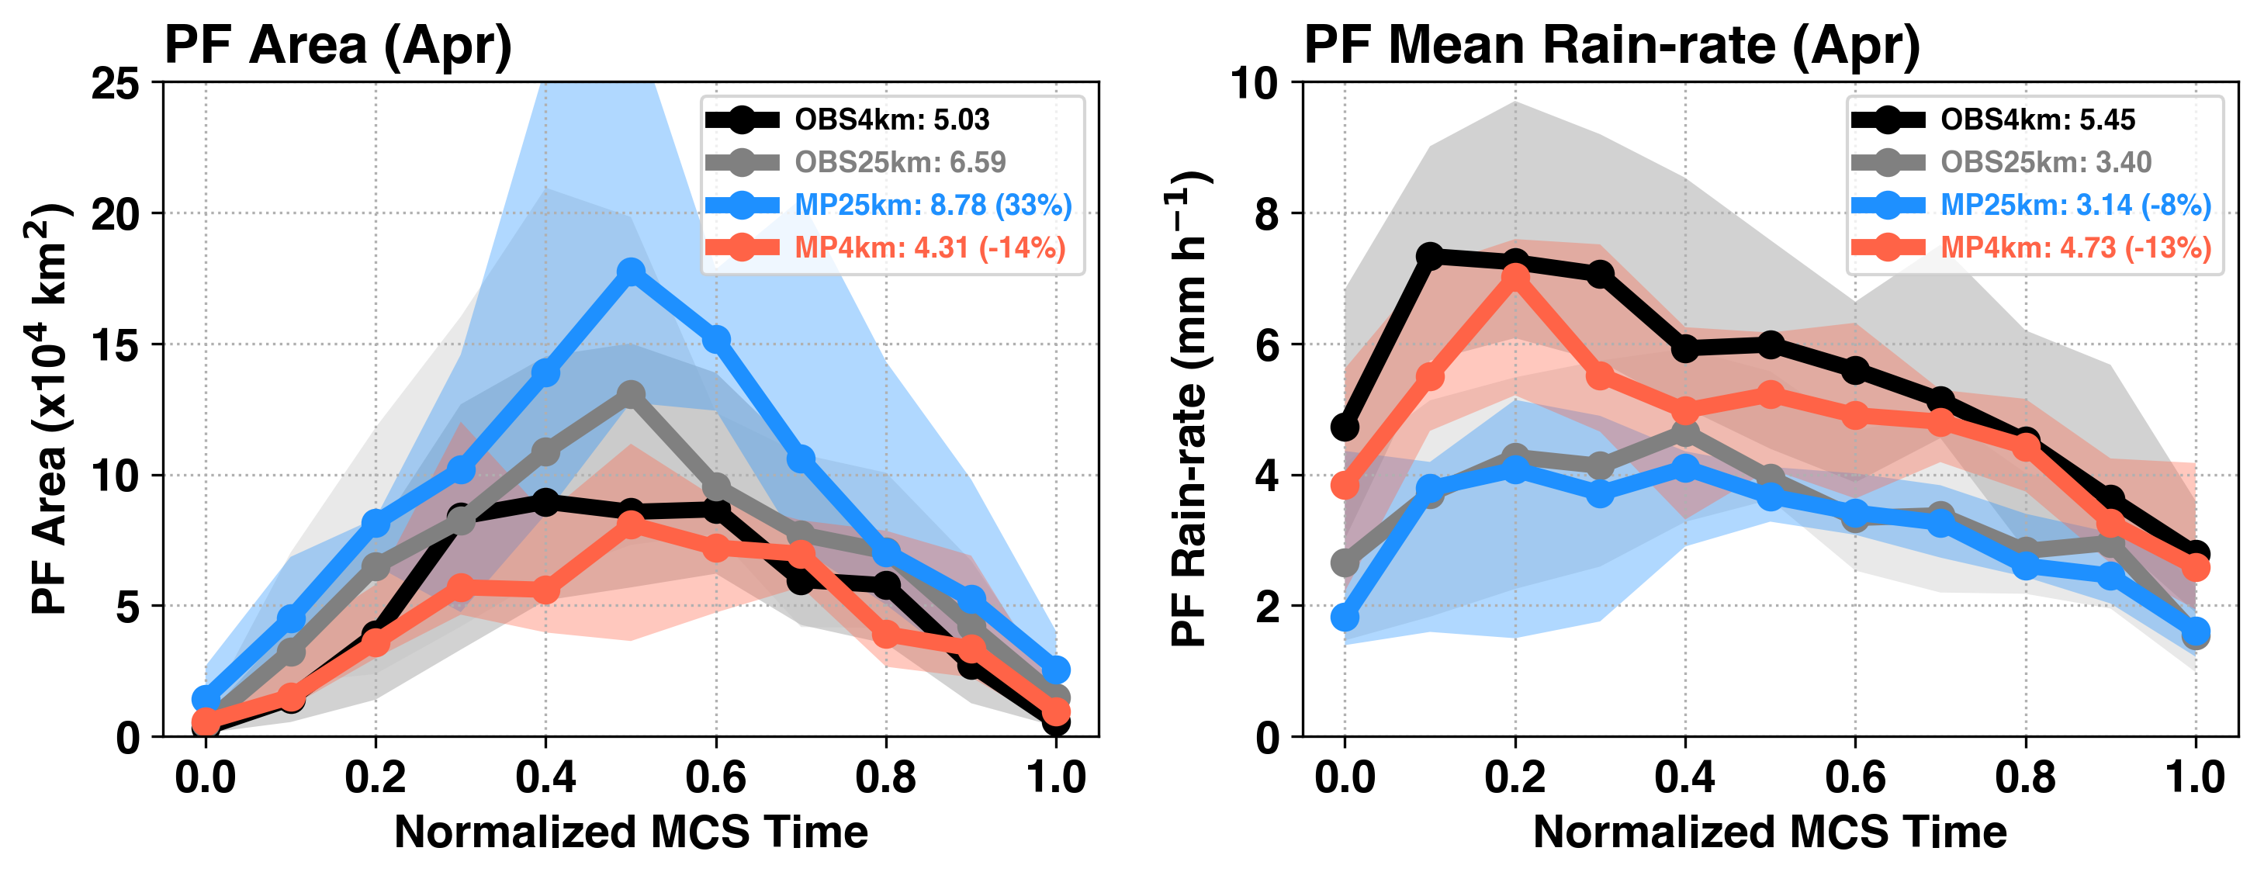
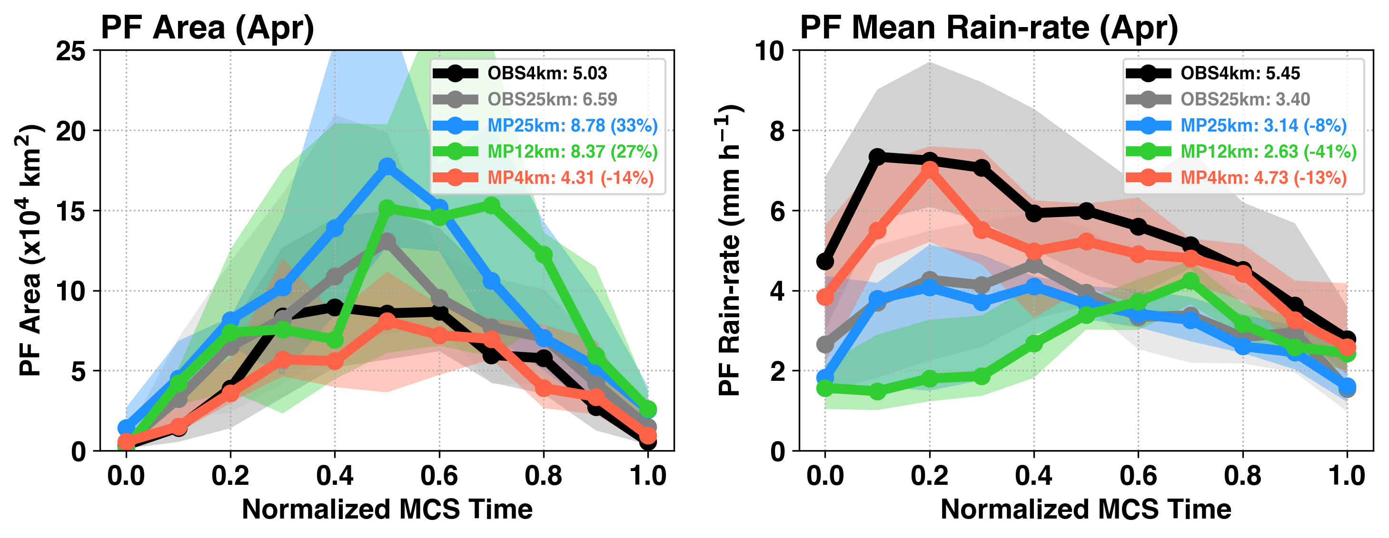
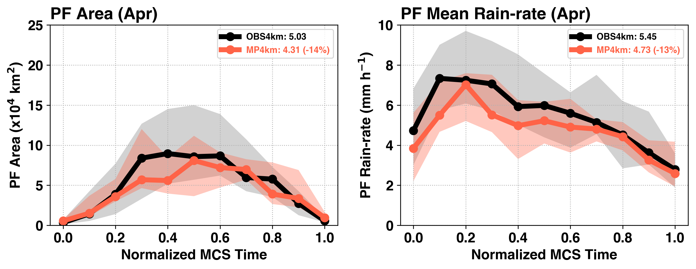
Composite MCS Precipitation Feature Evolution in April
4 km simulated MCS PFs evolution agree well with observations
25 km MCS-like PFs are larger and weaker
12 km simulations have largest bias, could be due to small samples
Initiation
Decay
Time

Slide 8
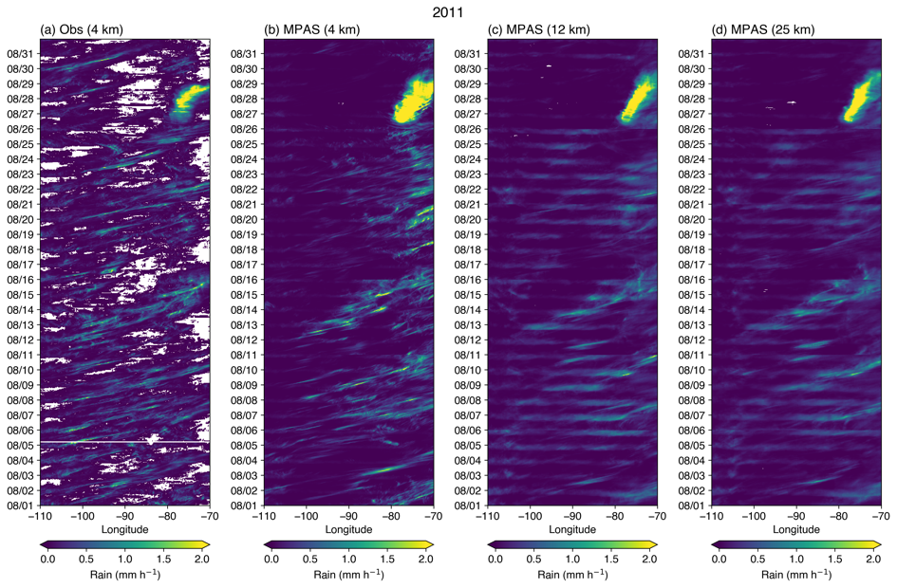
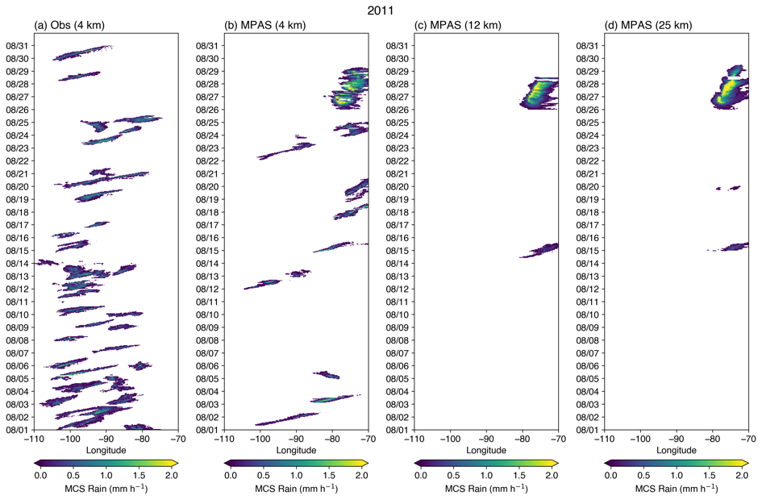
MCSs in August
MCSs are much weaker in August; simulations at 4 km are significantly better in capturing the propagating events than simulations at 12 km and 25 km resolution
Hurricane Irene
Total precipitation
MCS precipitation
OBS
4 km
12 km
25 km
OBS
4 km
12 km
25 km
No MCSs!
8

Slide 9
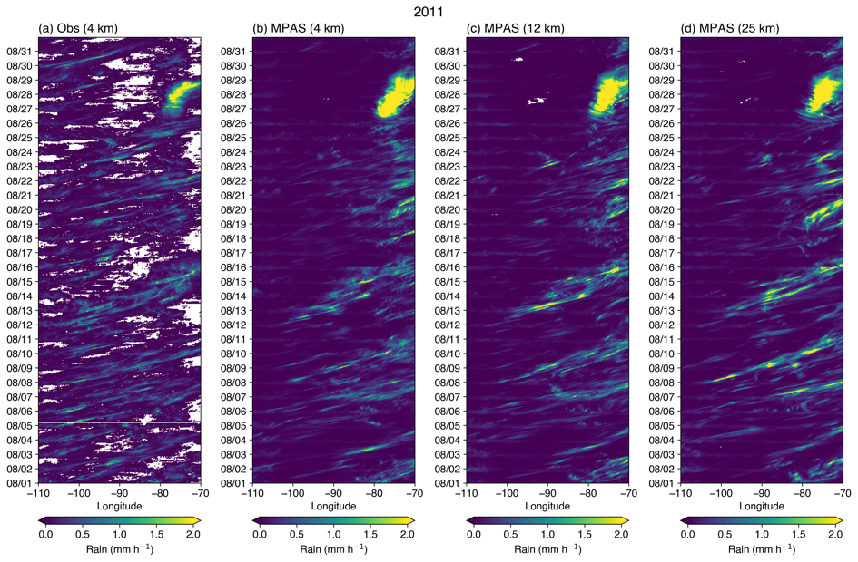
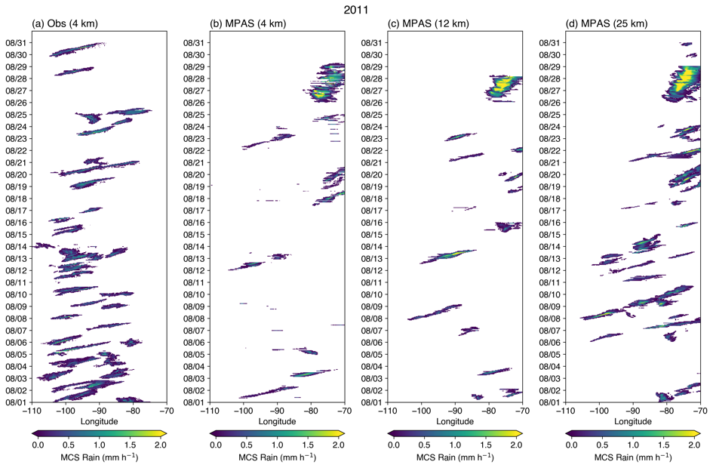
MCSs in August (ZM Off)
Turning off the convection scheme increases the number of MCSs in the simulations at 12 km and 25 km resolution (MCS detection criteria are relaxed)
Hurricane Irene
Total precipitation
MCS precipitation
OBS
4 km
12 km
25 km
OBS
4 km
12 km
25 km
9

Slide 10
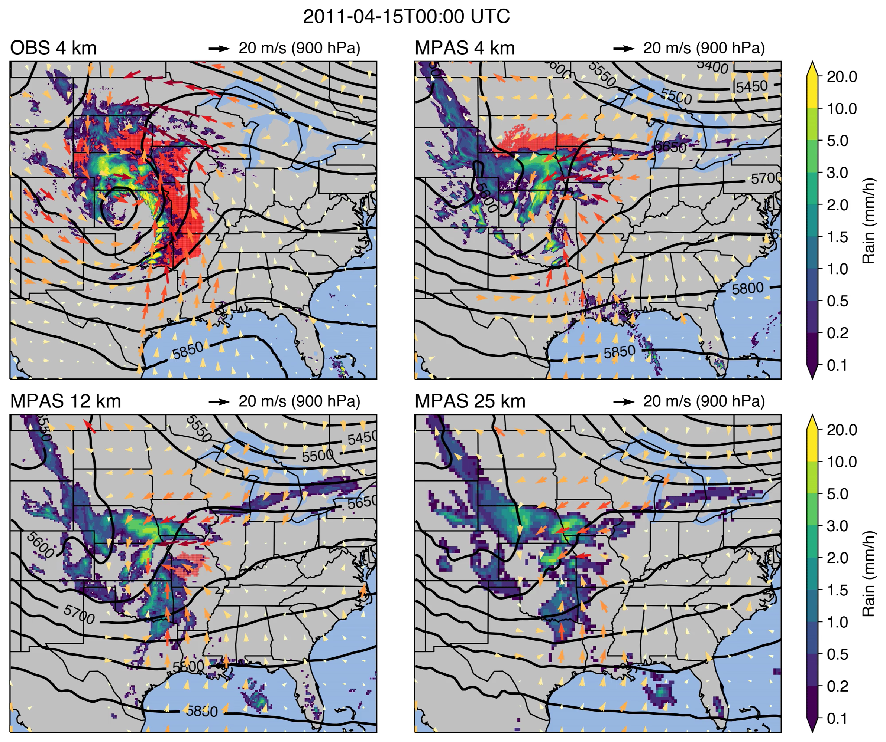
An MCS event in April
Strong synoptic scale forcing associated with baroclinic waves, strong LLJ and moisture supply from the Gulf
OBS
4 km
12 km
25 km
Contour: 500 hPa geopotential
Vector: 900 hPa wind
Red shading: MCS cloud shield
Color shading: precipitation

Slide 11
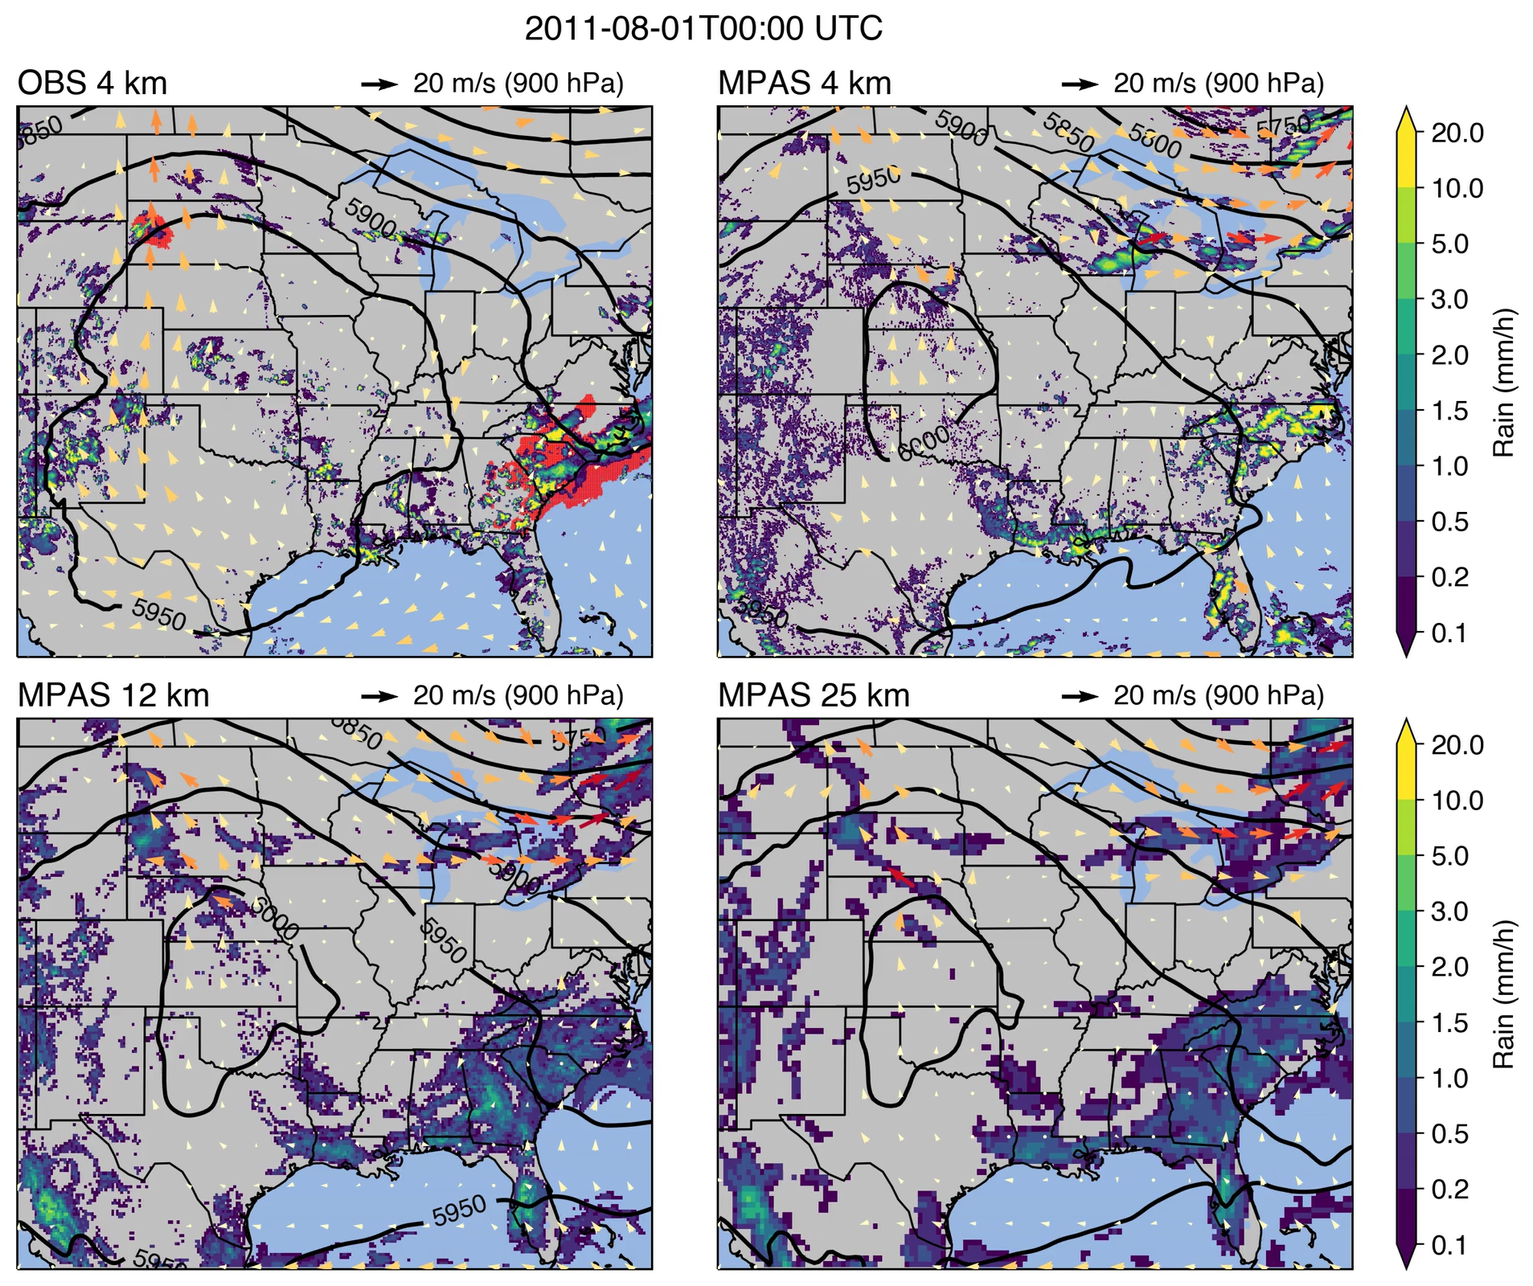
An MCS event in August
High pressure over the Great Plains
Weaker nocturnal LLJ
Convection initiates ahead of shortwave trough, feeding from LLJ and propagate along the ridge
OBS
4 km
H
H
12 km
25 km
H
H
Contour: 500 hPa geopotential
Vector: 900 hPa wind
Red shading: MCS cloud shield
Color shading: precipitation

Slide 12
Large-scale environment for MCSs
Using self-organizing map (SOM) to determine the large-scale environmental patterns of MCSs in ERAI - much weaker large-scale environment for MCSs during JJA than MAM
925 hPa wind and moisture anomaly of four SOM nodes
Spring (MAM)
Summer (JJA)

Slide 13
Large-scale environment predictability
Lower predictability of the large-scale environment in August than April for the first 5 days
RMSE of 850 hPa humidity comparing MPAS with ERAI
APR
AUG
August
25-100 km
12-46 km
4-32 km
RMSE (kg/kg)
Statistics domain
April
(both ocean and land)
Analysis Period

Slide 14
Summary
Regional convection permitting modeling is a viable approach for modeling MCS changes, but multiscale interactions are limited by the one-way coupled modeling framework
We are exploring non-hydrostatic global variable resolution models with regional refinement at convection permitting scale for modeling MCSs and their large-scale environment
MCSs are larger in spring than summer, supported by stronger synoptic environment → less predictability of MCSs during summer
Simulations with convective parameterization turned off perform better
Scale-aware physics are needed for modeling across the grey zone

Slide 15
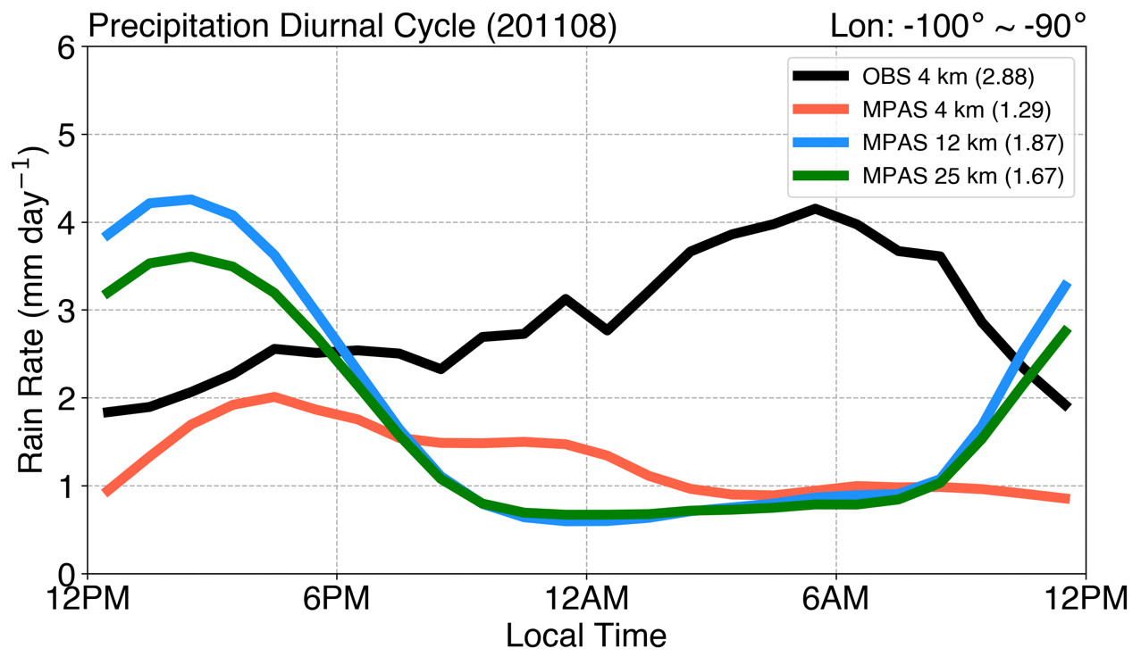
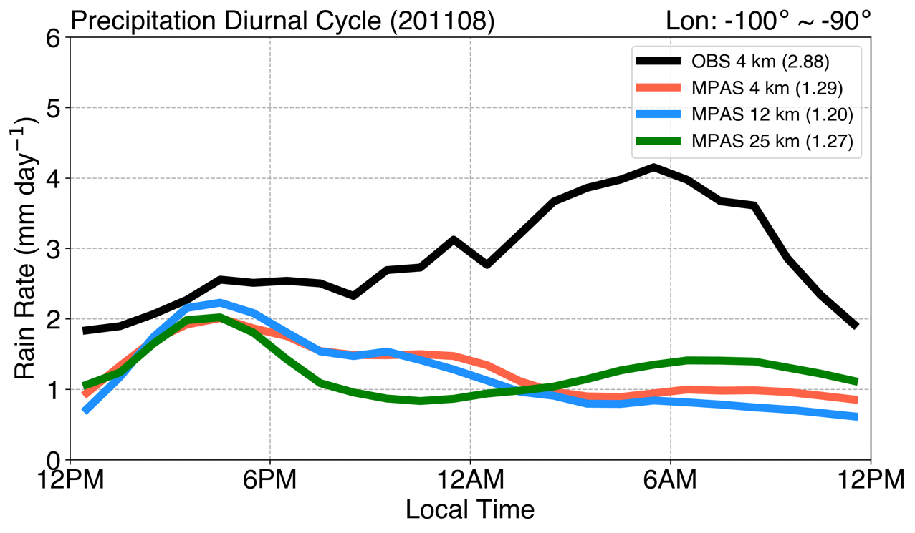
Precipitation diurnal cycle in August
Significant dry bias exists across all resolutions, particularly at night; diurnal cycle of precipitation completely out of phase with observation
Turning off ZM convection scheme:
Reduces early afternoon high precipitation biases
Increases nocturnal precipitation mildly but still largely underestimated
ZM On
ZM Off
Afternoon
Nocturnal

