Slide 1
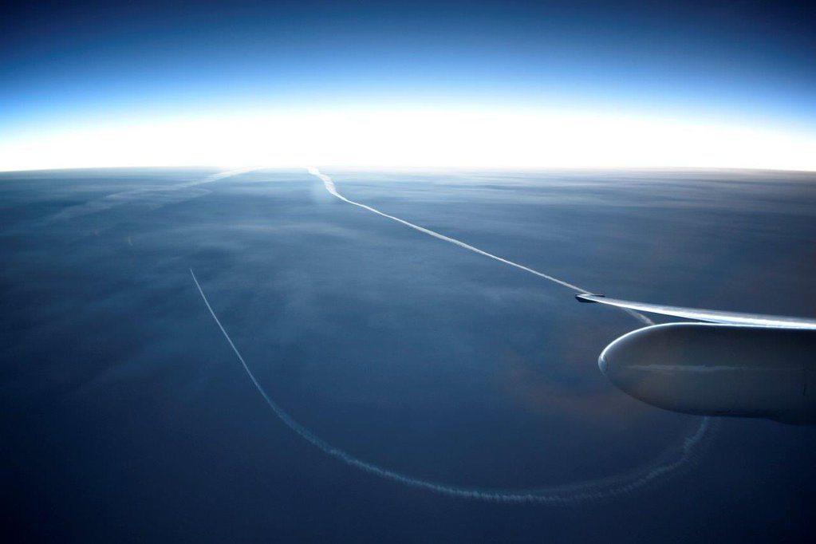




Airborne Radar Observations of frontal and post-frontal precipitation during OLYMPEX
Joe Zagrodnik
Lynn McMurdie, Robert A. Houze
Pacific Northwest Weather Workshop
27 April 2018
NNX16AD75G
NNX16AK05G 80NSSC17K0279
AGS-1503155
AGS-1657251

Slide 2
Shifting focus over the less-observed high terrain and lee side…
Minimal small drop production
???
What processes control the de-enhancement of precipitation on the high terrain and lee side?
Considerable small drop production
???
Notes:
Few orographic precipitation studies have considered high terrain/leeside due to lack of observations

Slide 3
NASA 3rd-Gen Airborne Precipitation Radar (APR-3)
Flies on NASA DC-8
Triple-frequency (Ku/Ka/W-band)
120 m vertical resolution
0.2 Hz measurement frequency (~0.2 km resolution)
Key benefit: full transects of Olympic Mountains with same instrument package!

Slide 4
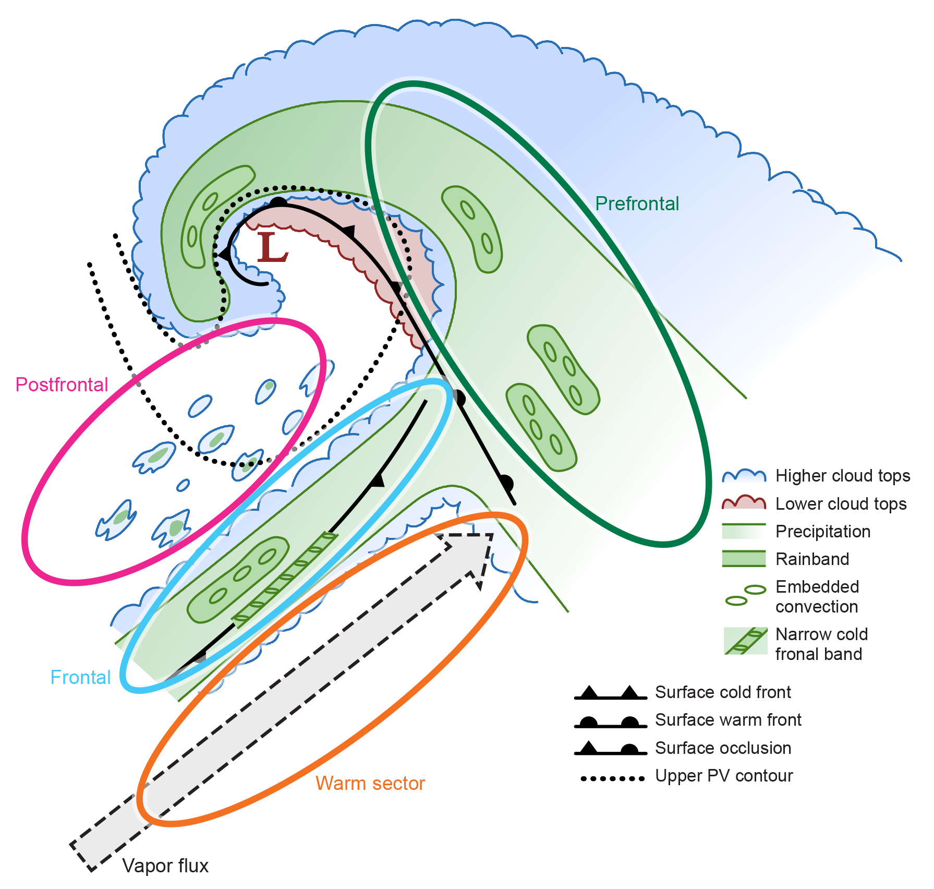
9 OLYMPEX APR-3 Missions chosen for this study:
3 “Prefrontal” flights
3 “Warm Sector” flights
3 “Postfrontal” flights

Slide 5
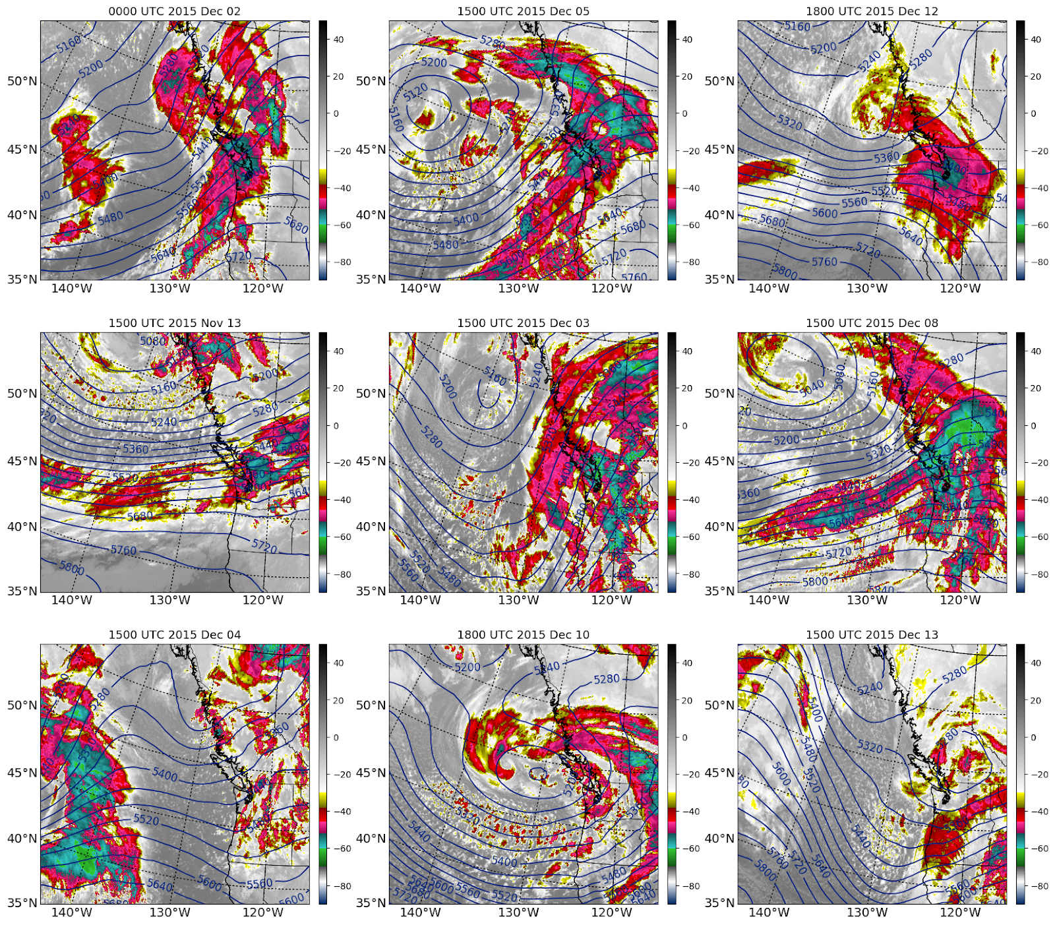
IR Satellite Imagery + 500 hPa heights during flights
Prefrontal
Warm Sectors
Postfrontal
Notes:
-Prefrontal has broad, continuous cloud shields over both ocean and land
-Warm sectors have more broken clouds, especially over ocean. Two southwest, one southerly
-Postfrontal has smaller convective elements and upper-level troughs

Slide 6
NPOL Sounding Parameters
Classification | Case | NPOL Sounding (UTC) | IVT (kg/m/s) | Melting Level (m) | 950-850 hPa Moist Static Stability | 925 hPa Wind Direction (º)
Prefrontal | 1-2 Dec 2015 | 2317 | 500 | 2103 | 1.06 | 166
Prefrontal | 5-Dec-2015 | 1514 | 560 | 2031 | 0.98 | 160
Prefrontal | 12-Dec-2015 | 1914 | 529 | 879 | 1.31 | 158
Warm Sector | 13-Nov-2015 | 1632 | 575 | 2583 | 0.19 | 240
Warm Sector | 3-Dec-2015 | 1516 | 784 | 2150 | -0.21 | 172
Warm Sector | 8-Dec-2015 | 1515 | 815 | 2769 | 0.64 | 214
Postfrontal | 04-Dec-2015 | 1517 | 99 | 1219 | -0.68 | 235
Postfrontal | 10-Dec-2015 | 1736 | 393 | 1344 | -0.82 | 233
Postfrontal | 13-Dec-2015 | 1516 | 187 | 1027 | -0.47 | 289
Question to ponder…
Prefrontal periods can have high melting levels and high IVT—does it translate to heavy precipitation?

Slide 7
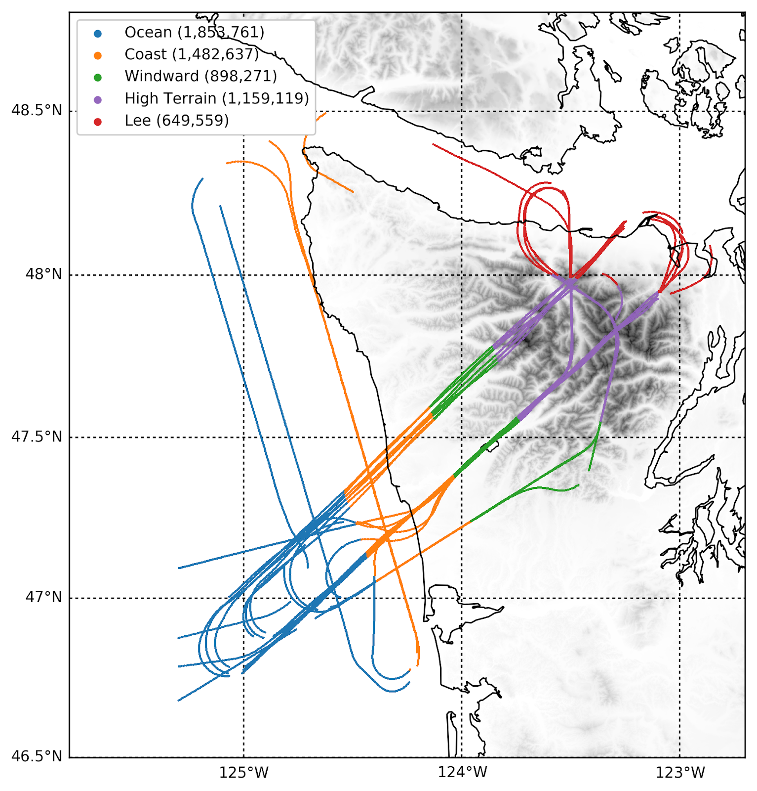
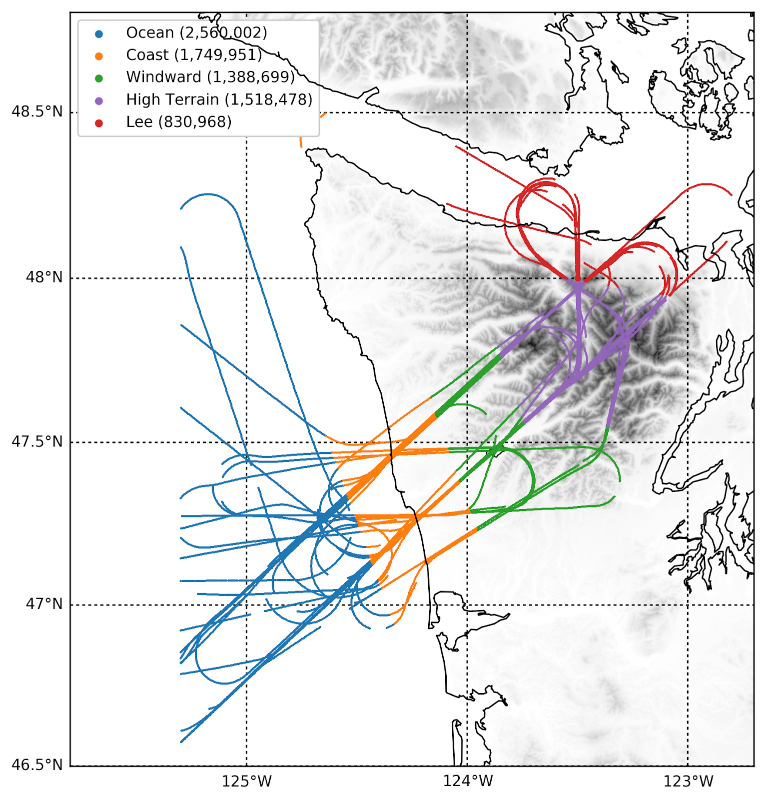
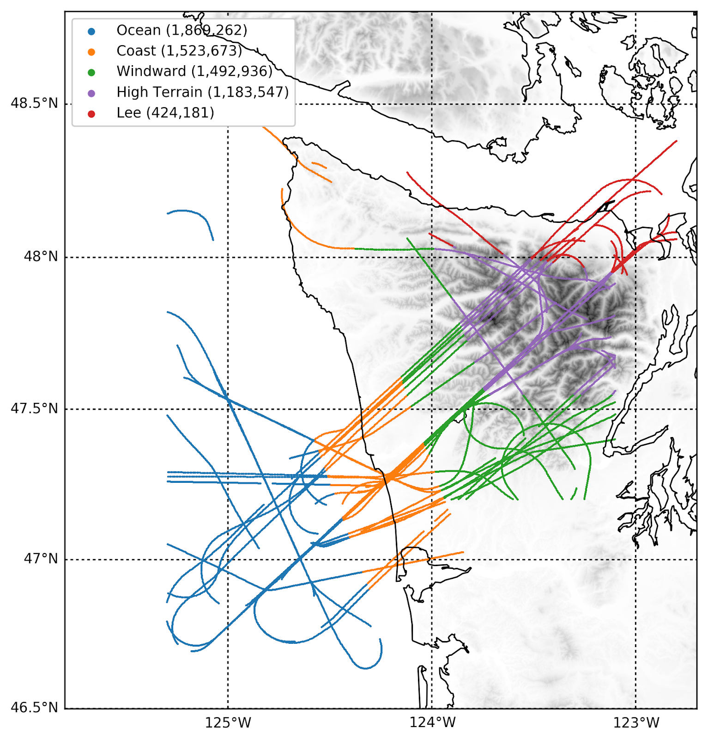
Flight tracks divided by storm sector and geographic region:
Ocean
Coast
Windward
High Terrain
Lee Side
Prefrontal
Warm Sectors
Postfrontal

Slide 8
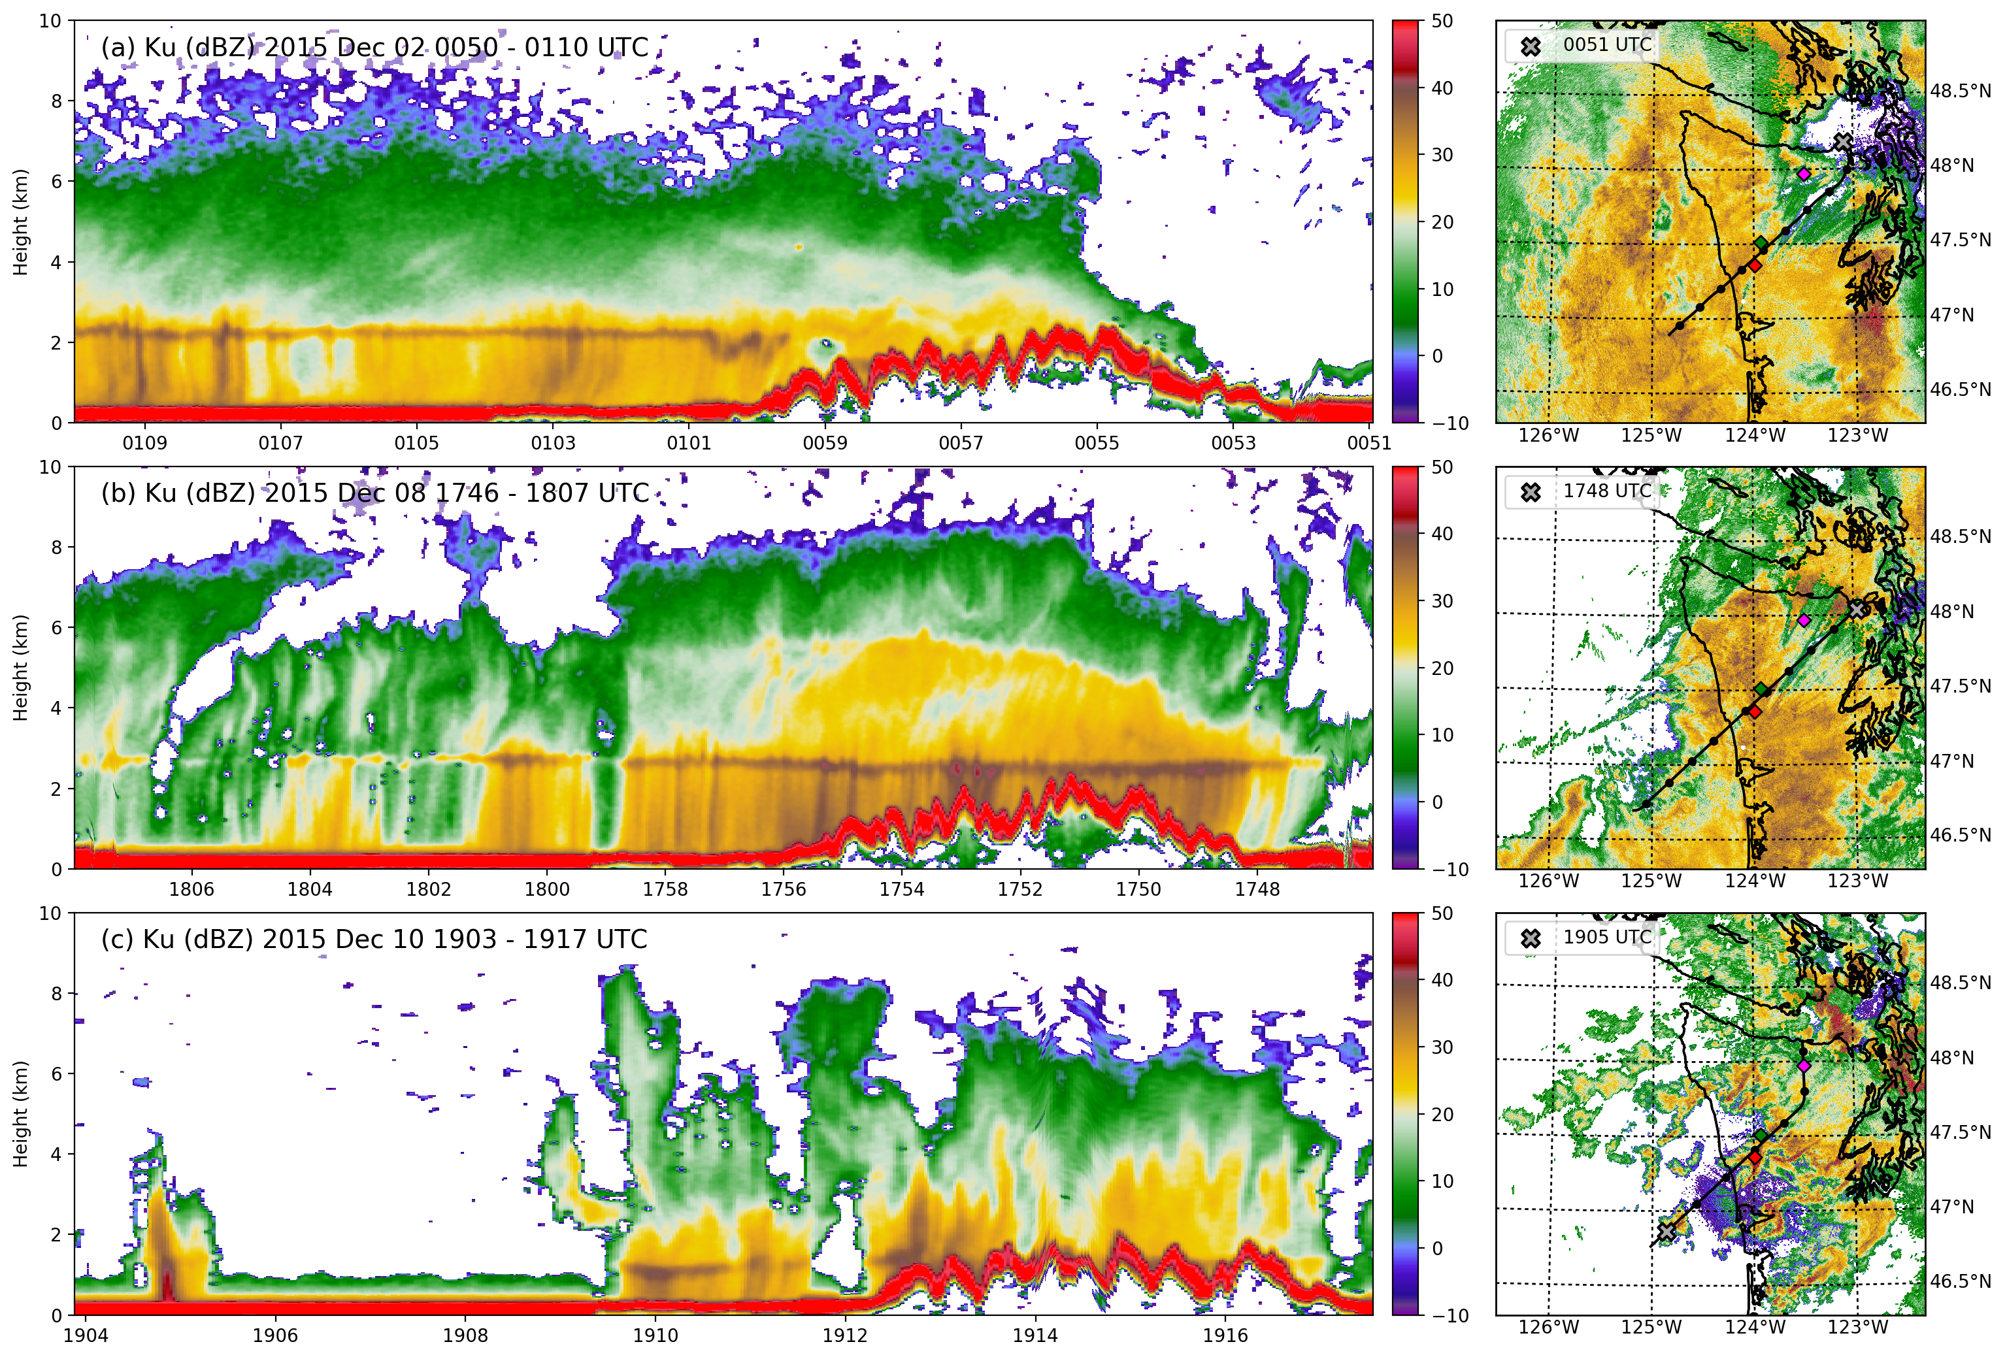
Example APR-3 transects—Ku reflectivity
Flight track + NEXRAD radar
Prefrontal
Warm Sector
Postfrontal
Note: the red stripe (> 50dBZ) is the ocean/land surface signature
Notes:
Prefrontal: precip over ocean, lower melting level over mountains, rain shadow
Warm sector: isolated over ocean, deep cloud centered over land
Postfrontal: isolated convection over ocean, more uniform over land

Slide 9
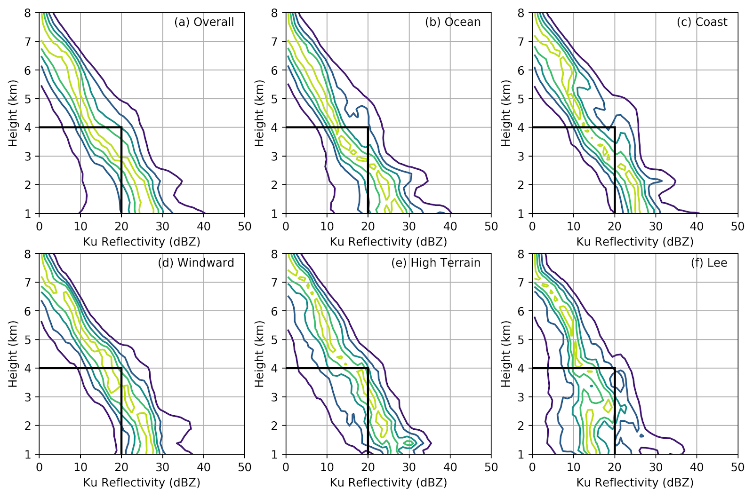
Prefrontal CFADs by geographic region
Contours at 10%, 30%, 50%, 70%, 90%

Slide 10
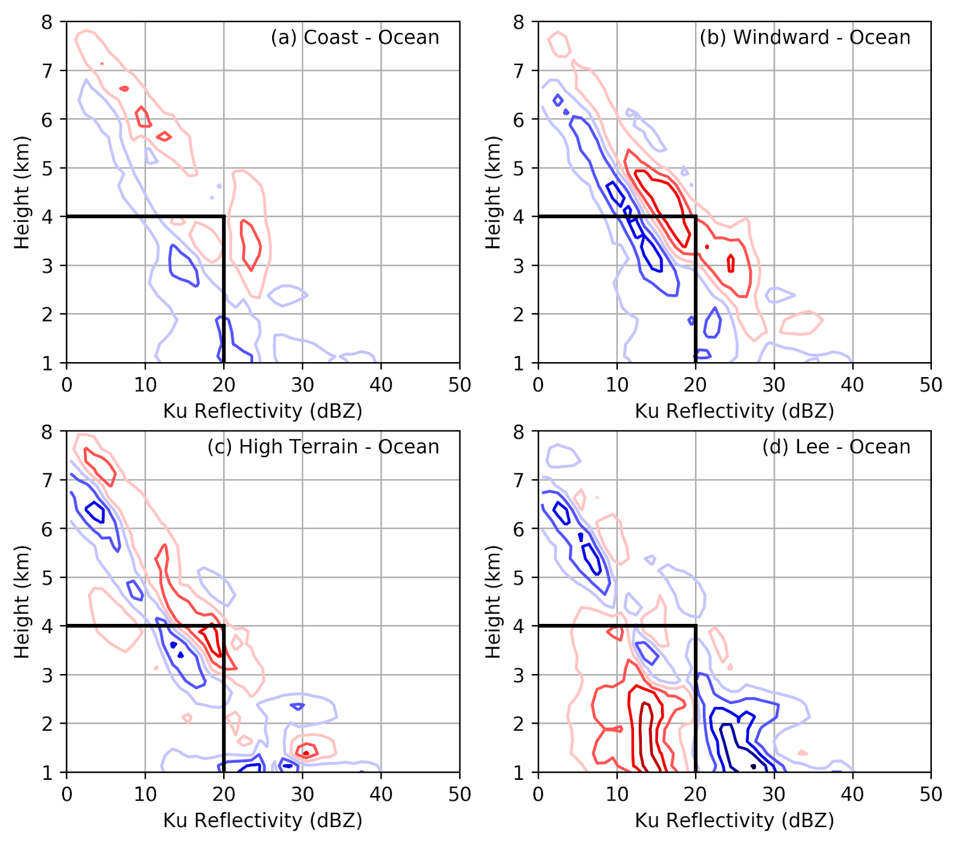
Prefrontal CFAD differences (relative to OCEAN)
Blue: higher over ocean
Red: higher over comparison region
Contours at +/- 10%, 30%, 50%, 70%, 90%.
Notes:
Some mid-level enhancement over windward, less over high terrain. Shift to the left over lee side, especially at low levels!

Slide 11
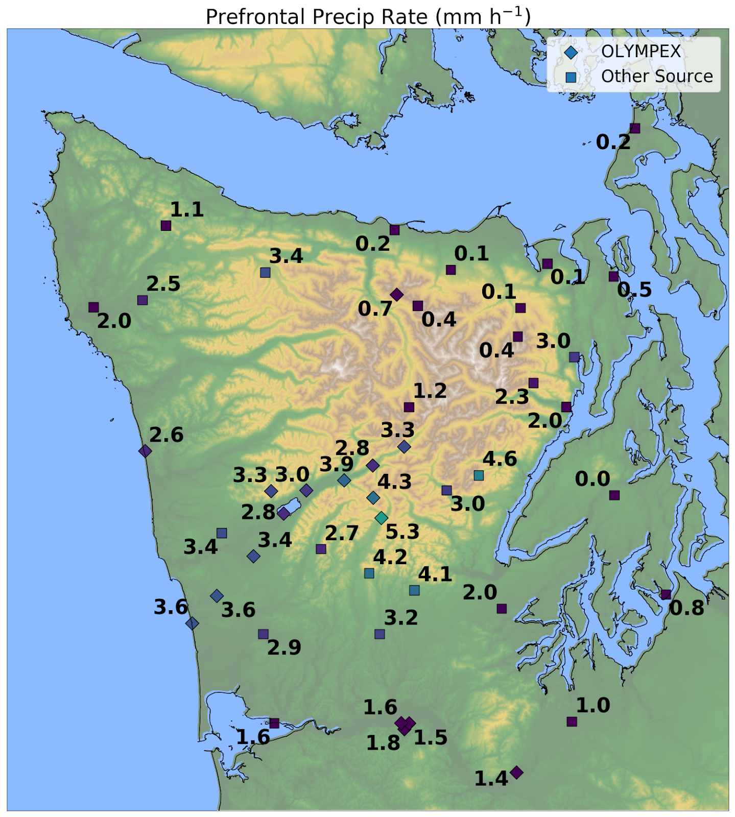

Slide 12
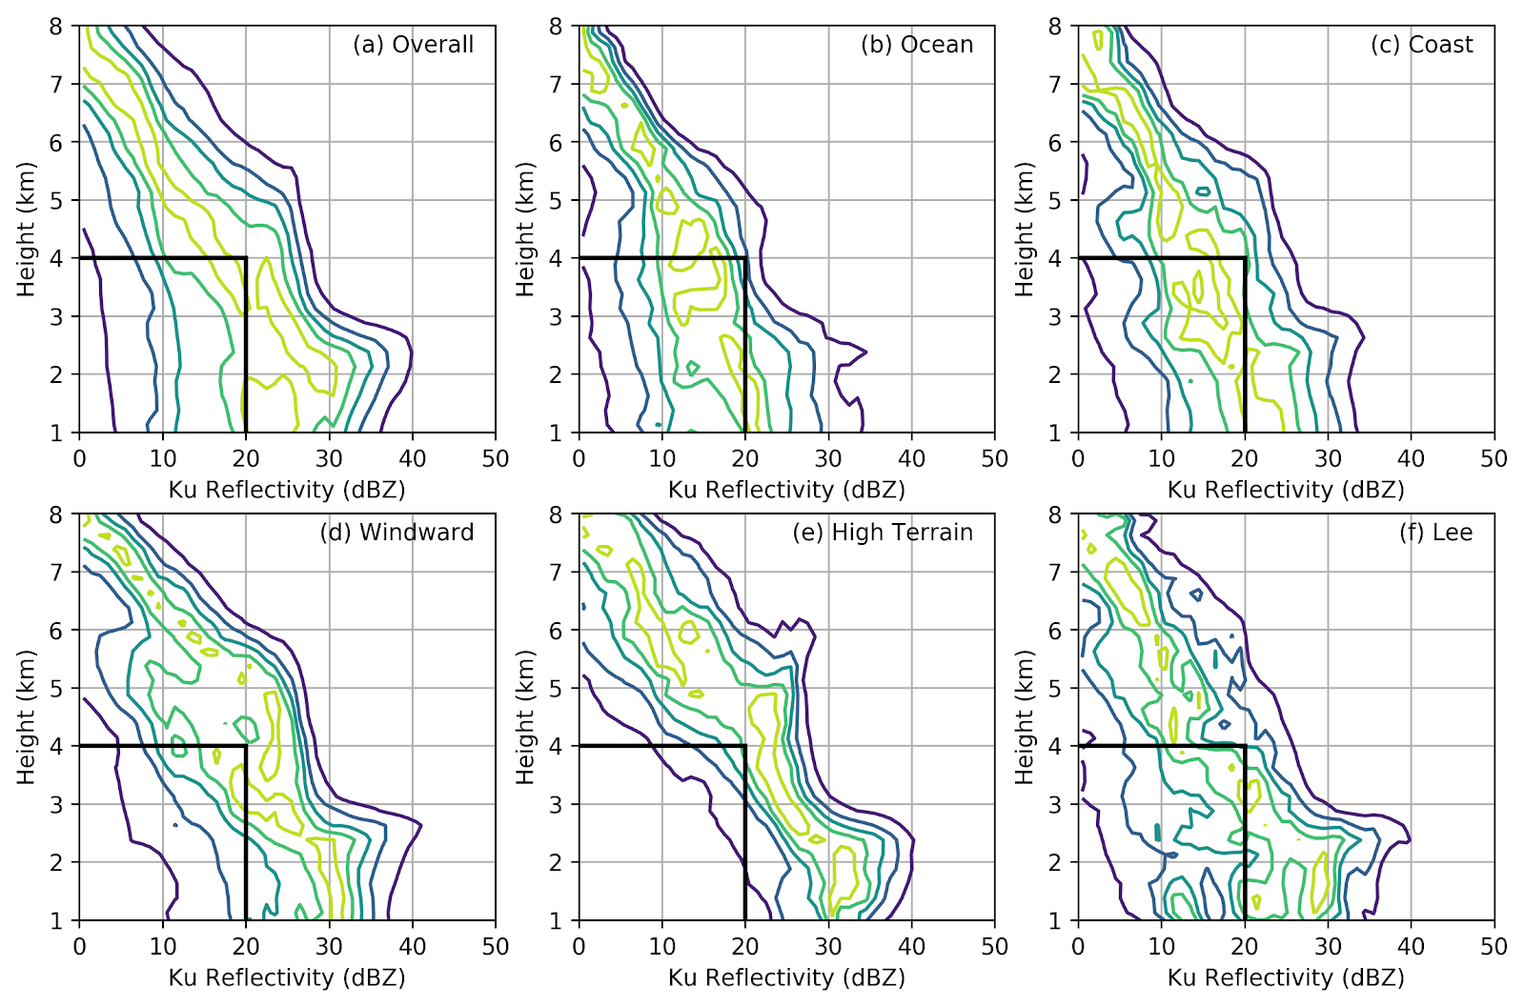
Warm Sectors CFADs by geographic region

Slide 13
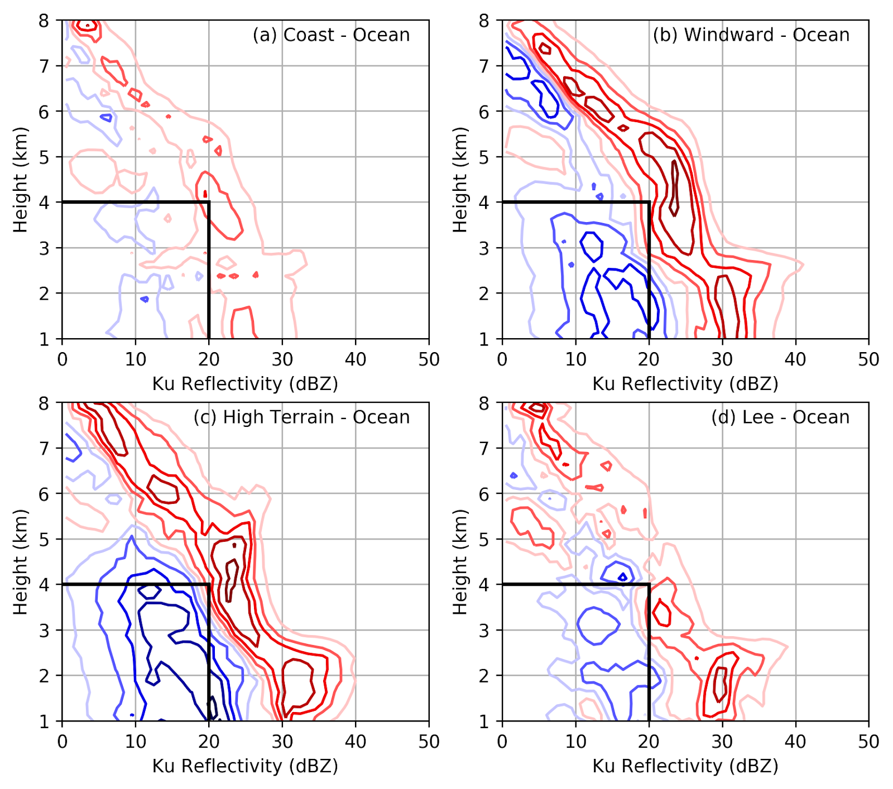
Warm Sector CFAD differences (relative to OCEAN)
Blue: higher over ocean
Red: higher over comparison region

Slide 14
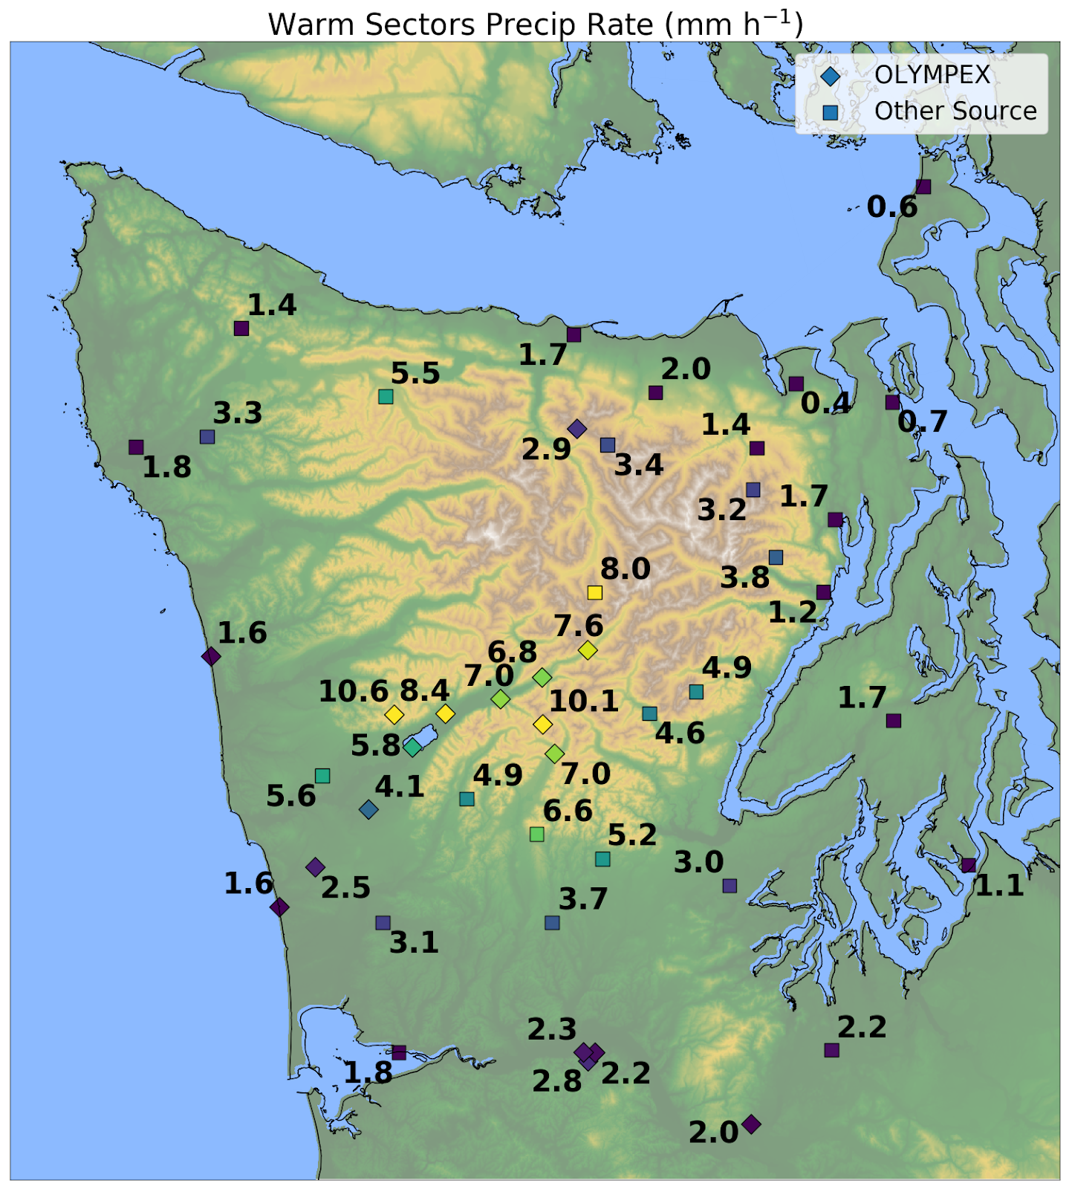

Slide 15
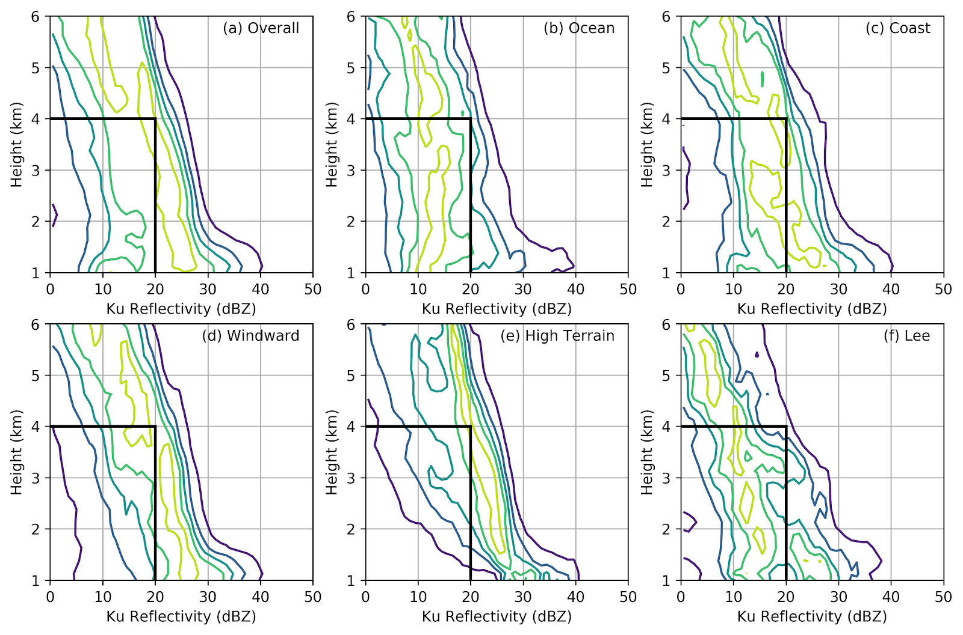
Postfrontal CFADs by geographic region

Slide 16
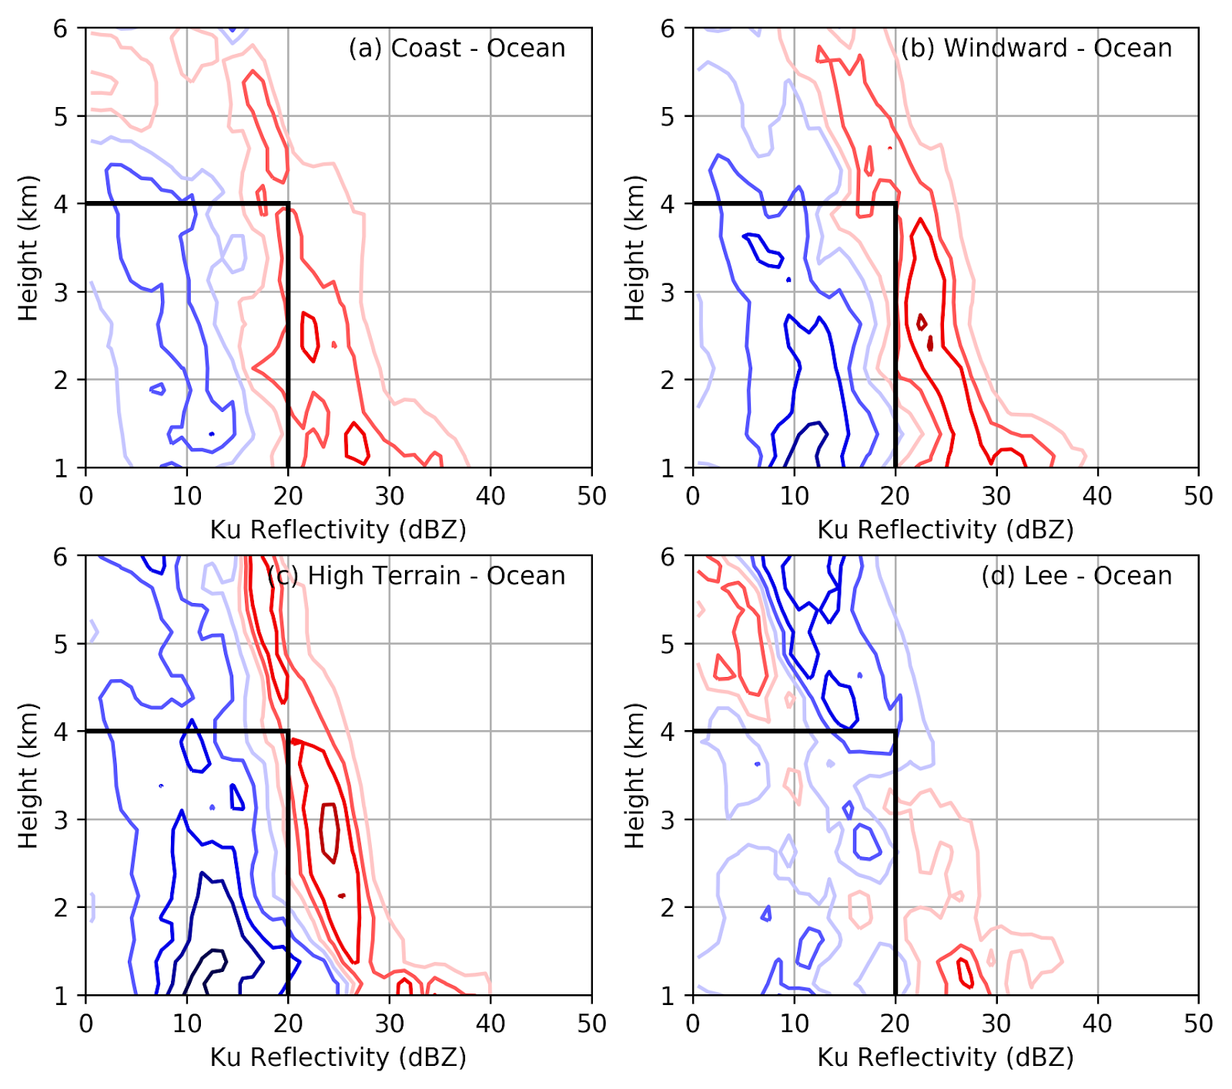
Postfrontal CFAD differences (relative to OCEAN)
Blue: higher over ocean
Red: higher over comparison region

Slide 17


Slide 18
Conclusions
Enhancement and de-enhancement spatial distribution (in horizontal and vertical) and intensity are strongly dependent on the large-scale environment associated with different synoptic storm sectors.
Prefrontal systems: enhancement is modest (despite high IVT) and shifted upstream of high terrain. Strong rain shadow.
Warm sectors: greatest enhancement on windward side, more spillover to lee than other sectors.
Postfrontal systems: isolated convective cells become widespread stratiform over windward and high terrain. Shallow showers on lee side.

Slide 19
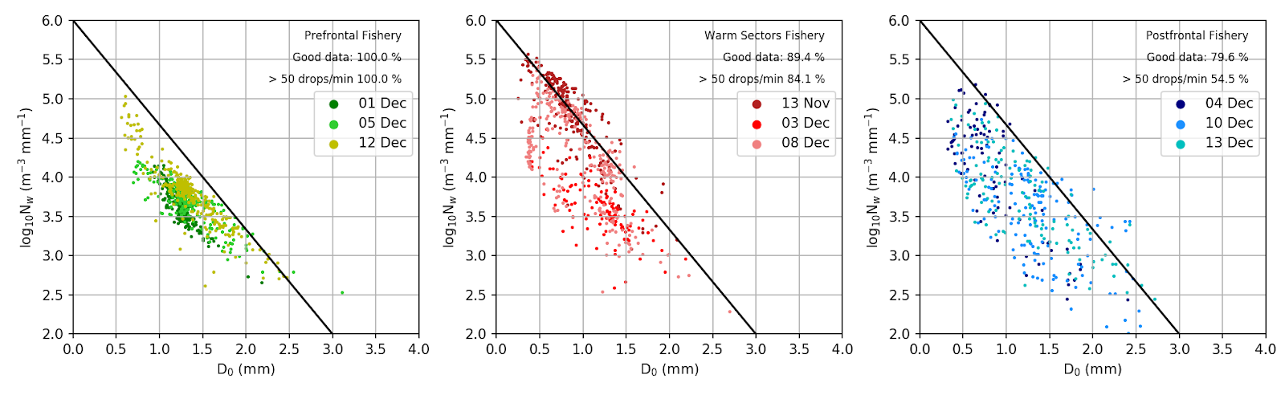
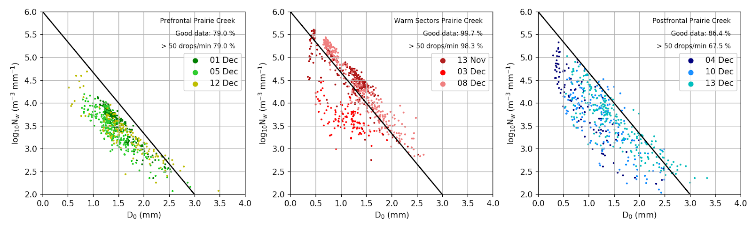
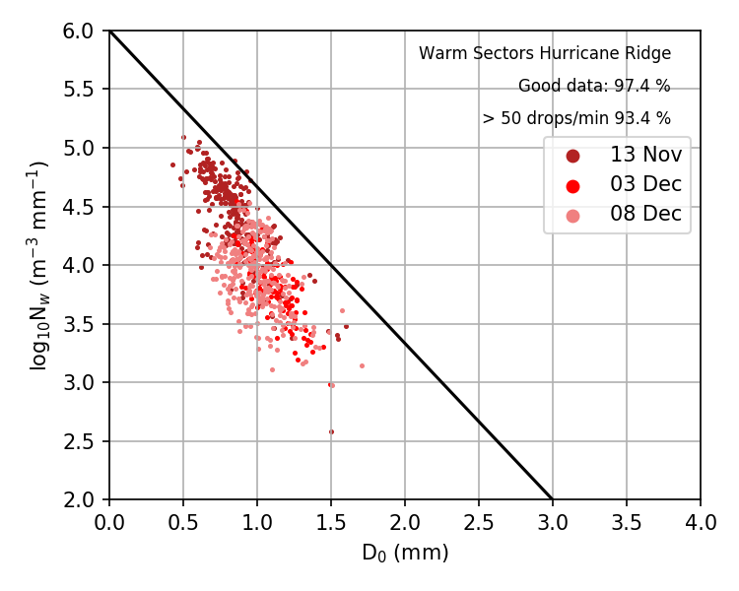
DSDs
Fishery
Prairie Creek
Hurricane Ridge

Slide 20
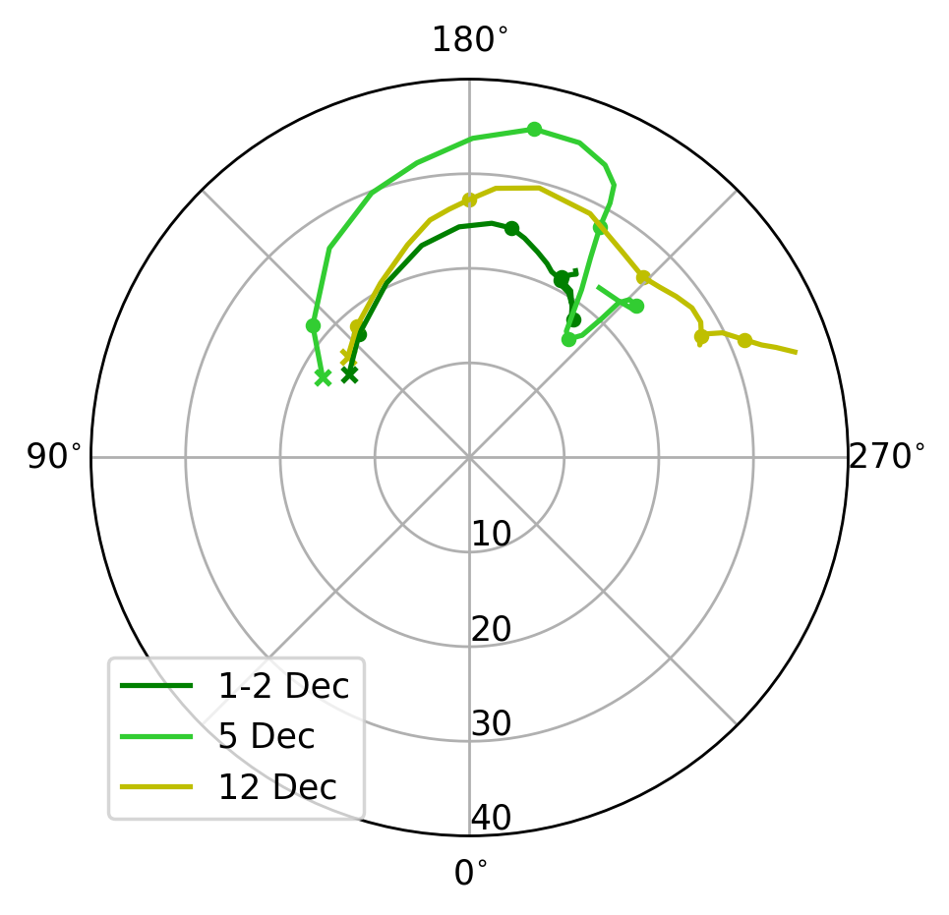
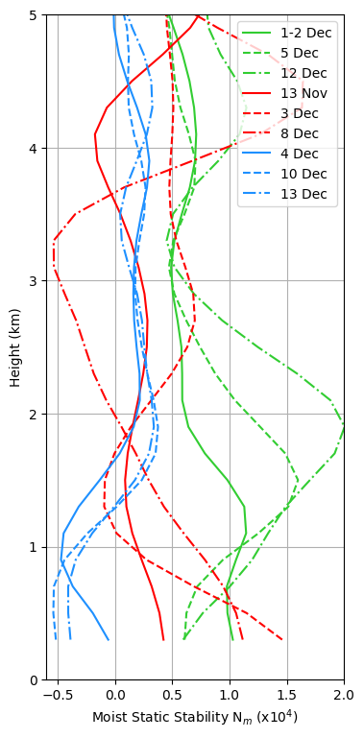
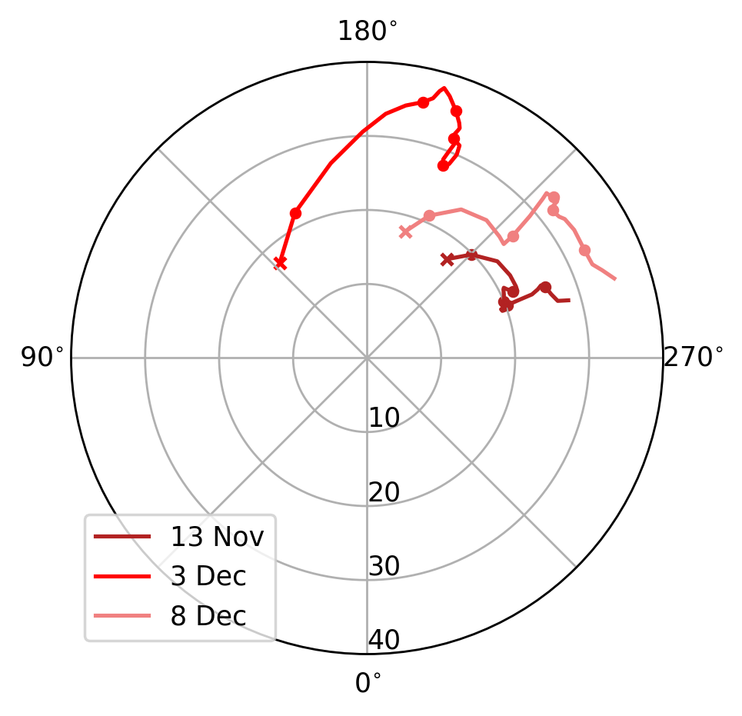
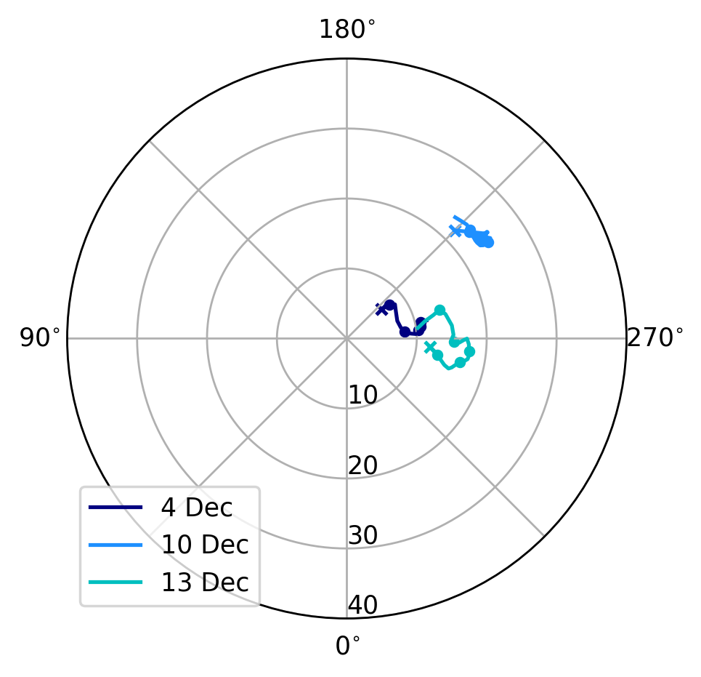
0-5 km Moist Static Stability (N_{m})
0-5 km Hodographs
Prefrontal:
-Low level stability (N_{m} > 0)
-Strongly veering flow
(SE at surface-->SW at 4 km)
Surface
5 km
Warm Sectors:
-Moist-neutral low levels (N_{m} near 0)
-Slight veering flow
Surface
5 km
Postfrontal:
-Conditionally unstable low-levels (N_{m} < 0)
-Slight backing flow
(from soundings taken near Taholah)
Notes:
Key point: each storm sector associated with different large-scale environment forced by large-scale synoptic pattern

Slide 21
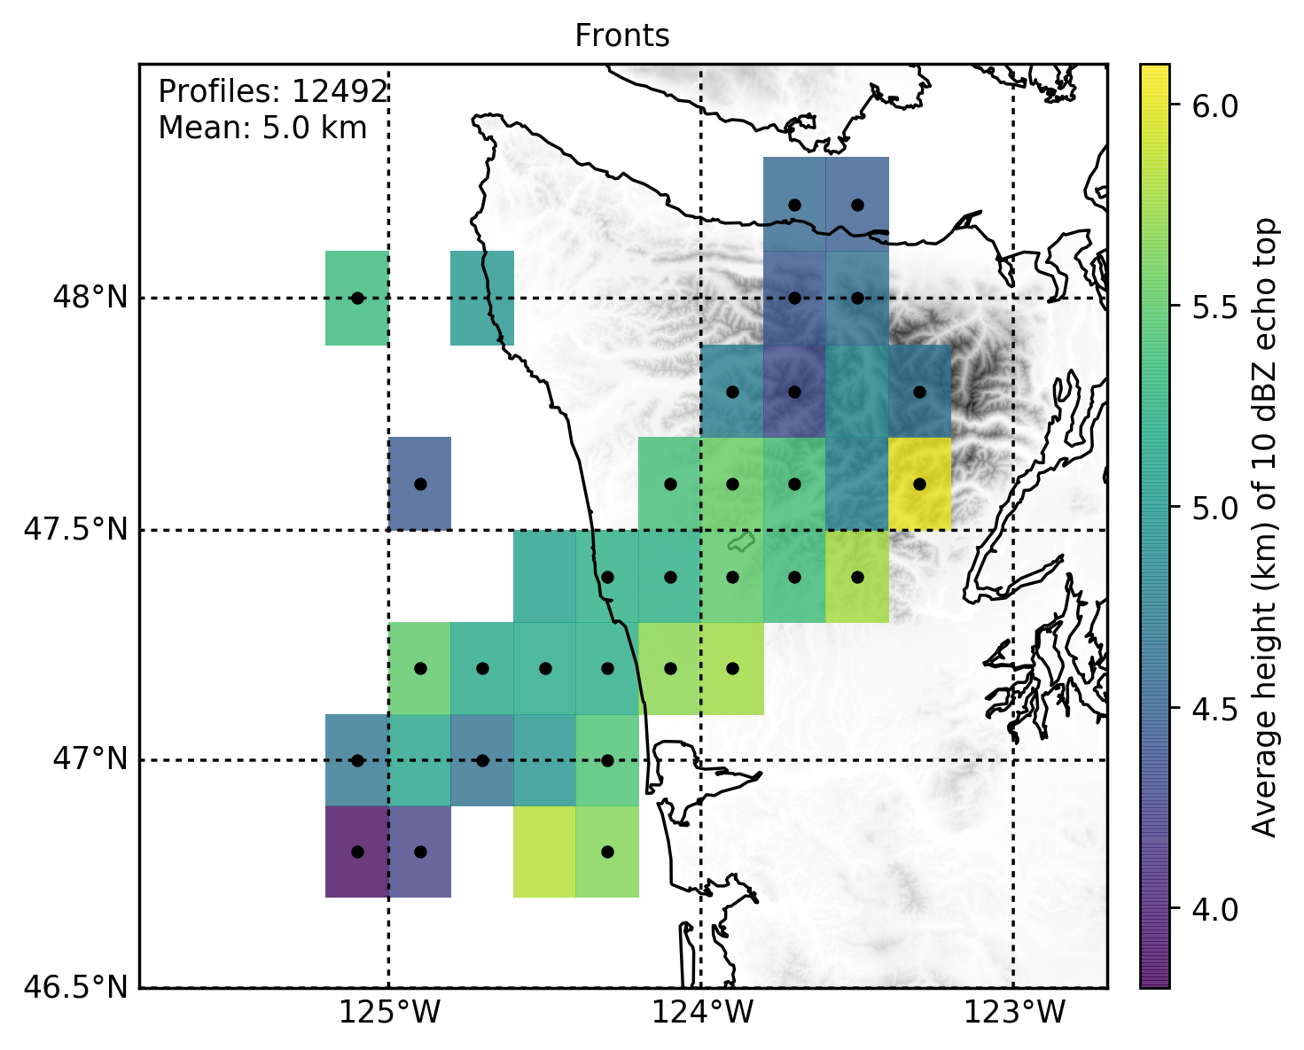
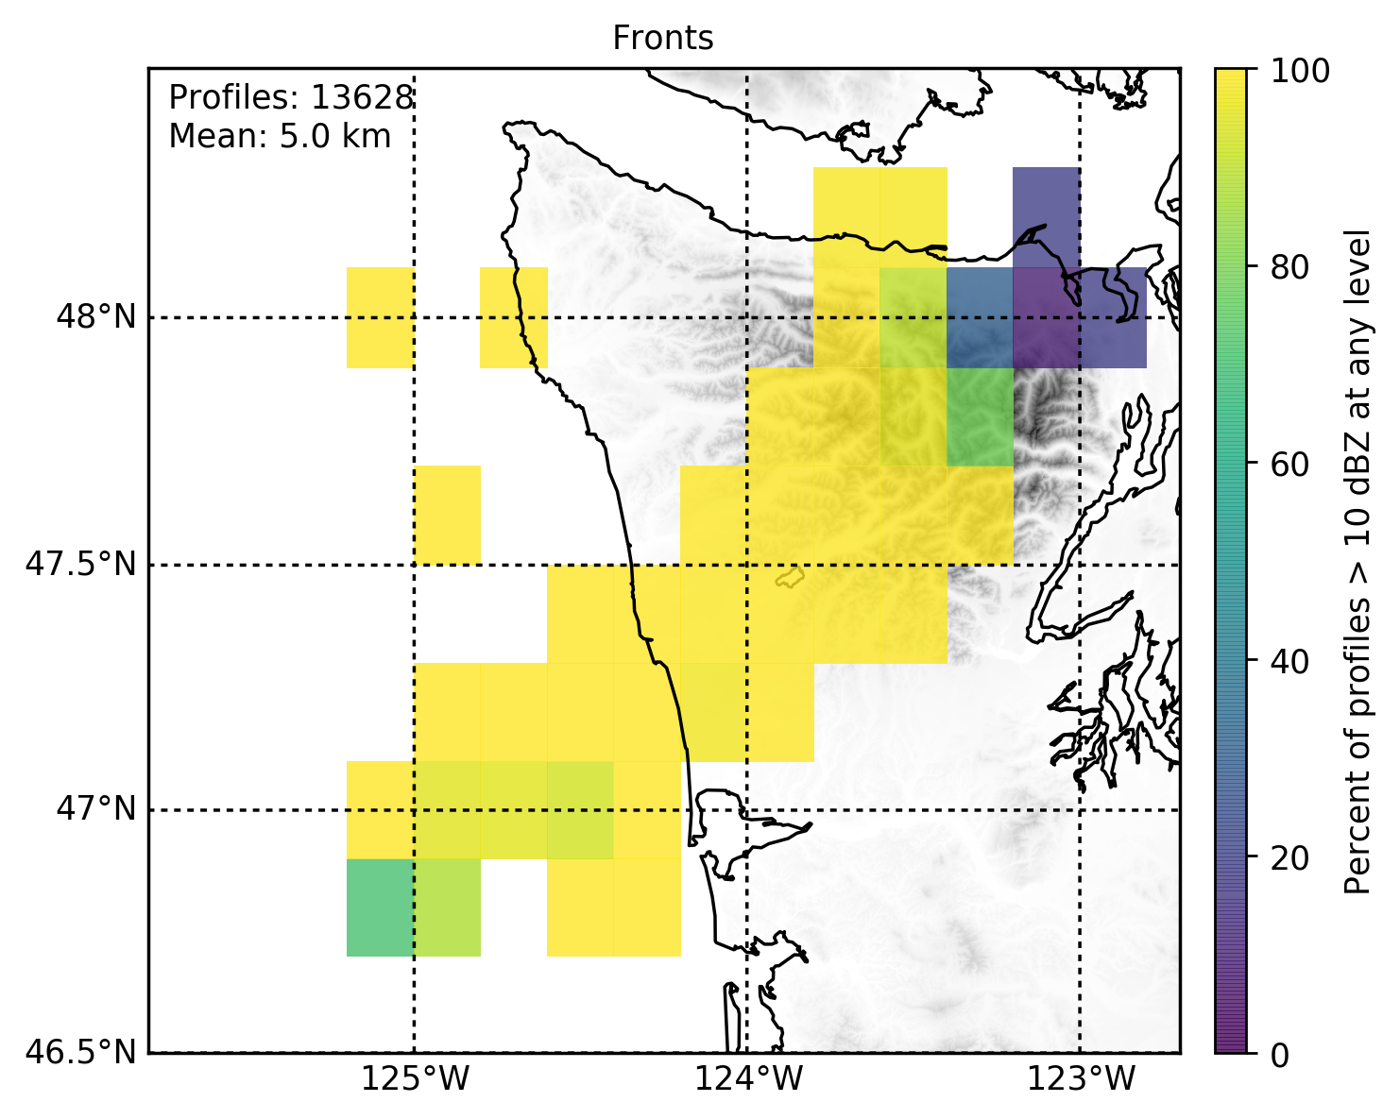
Prefrontal spatial distribution
Highest radar echoes occur upstream of high terrain
Consistent with linear mountain wave theory
Abrupt decrease in coverage over lee where flow descends.
Average height of 10 dBZ echo top
Coverage of 10 dBZ echo
Dots: passed statistical significance testing
(relative to mean, p < 0.01)

Slide 22
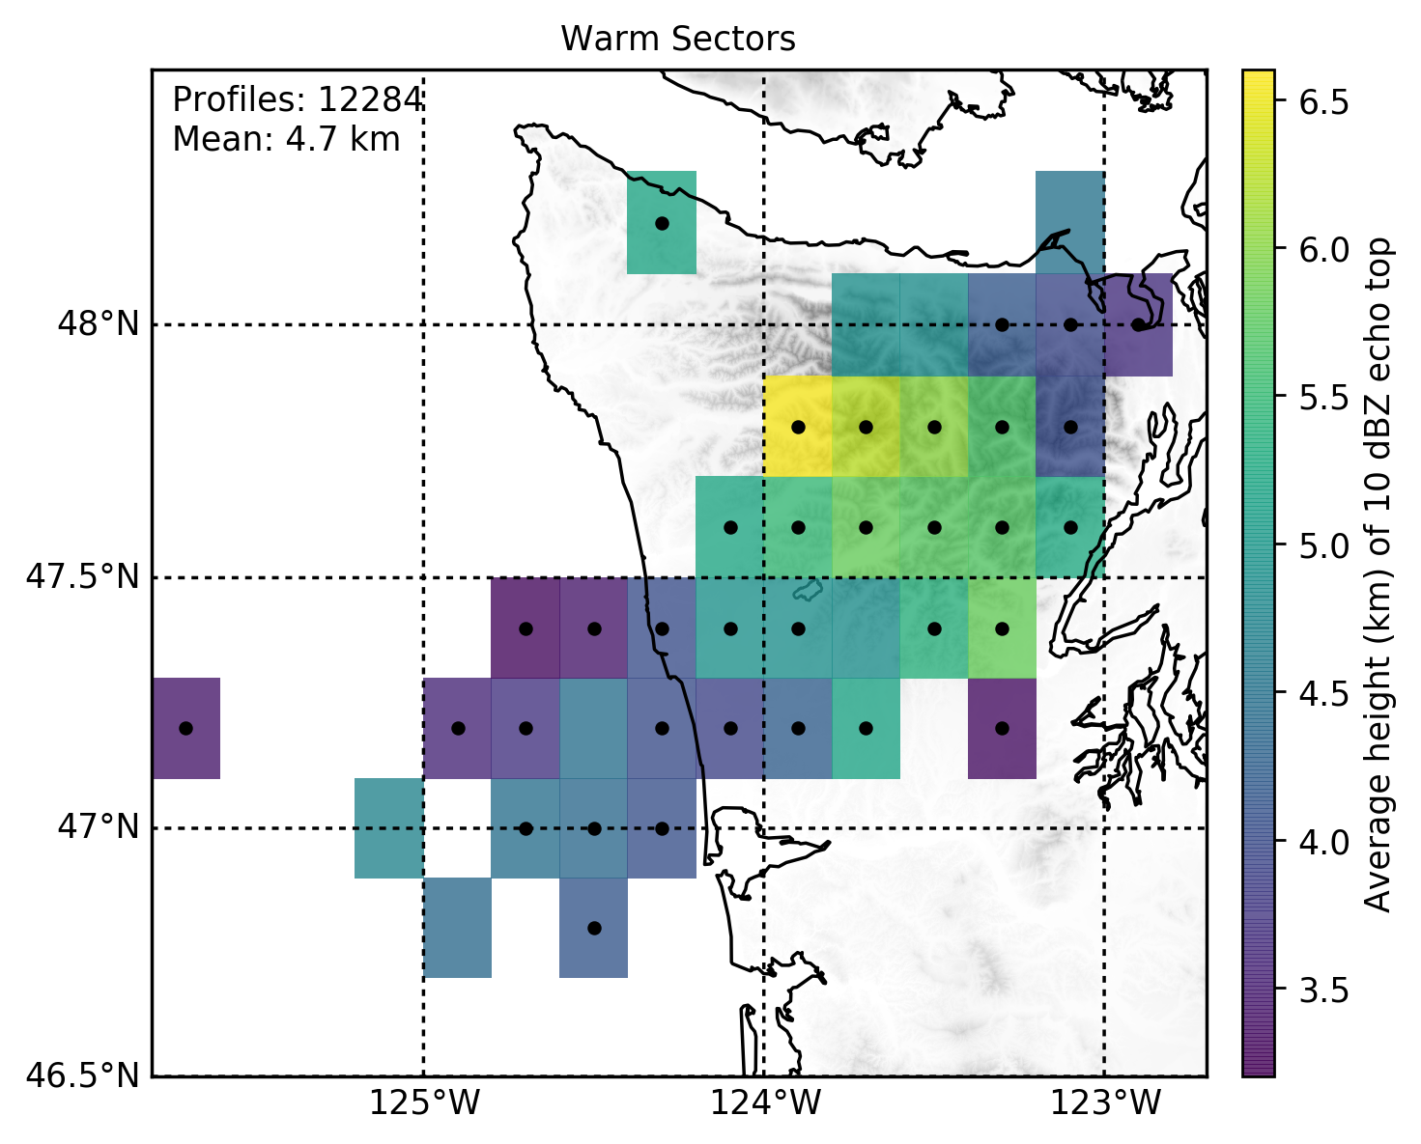
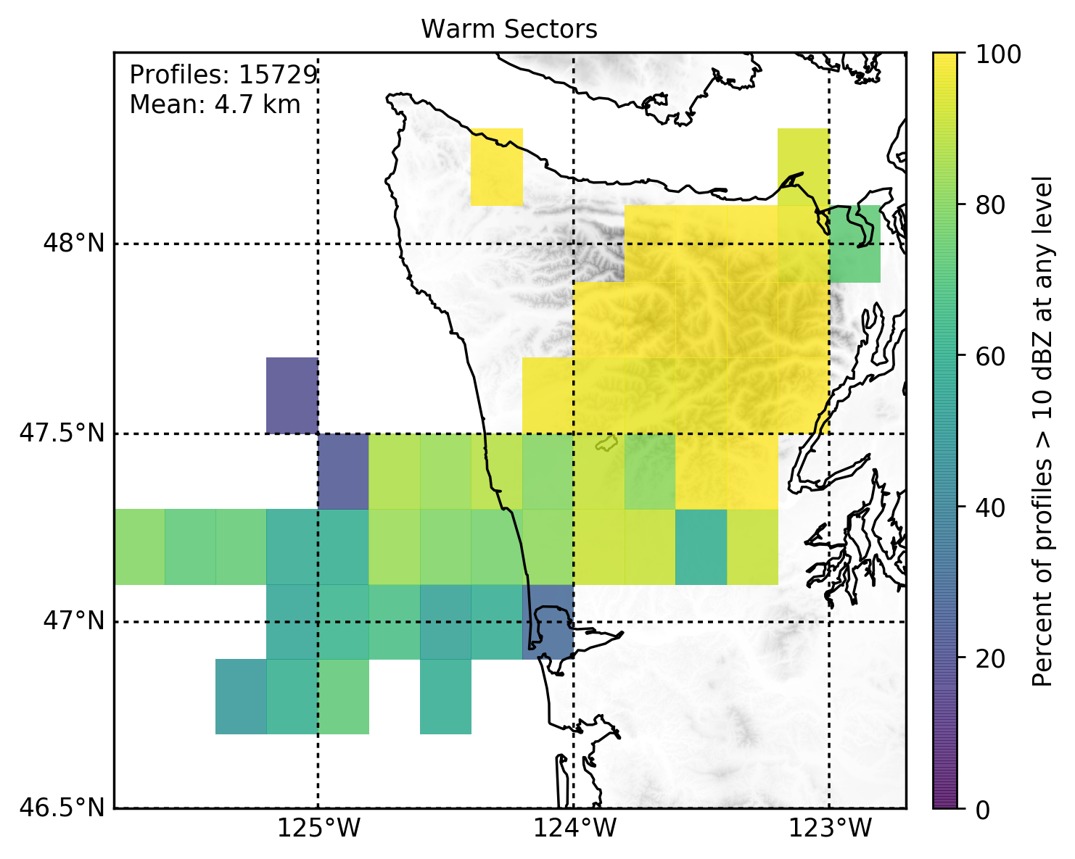
Warm Sectors spatial distribution
Less coverage upstream of mountains (ocean/coast)
Deepest echo and highest coverage over high terrain
More precipitation makes it to the lee side
Average height of 10 dBZ echo top
Coverage of 10 dBZ echo
Dots: passed statistical significance testing
(relative to mean, p < 0.01)

Slide 23
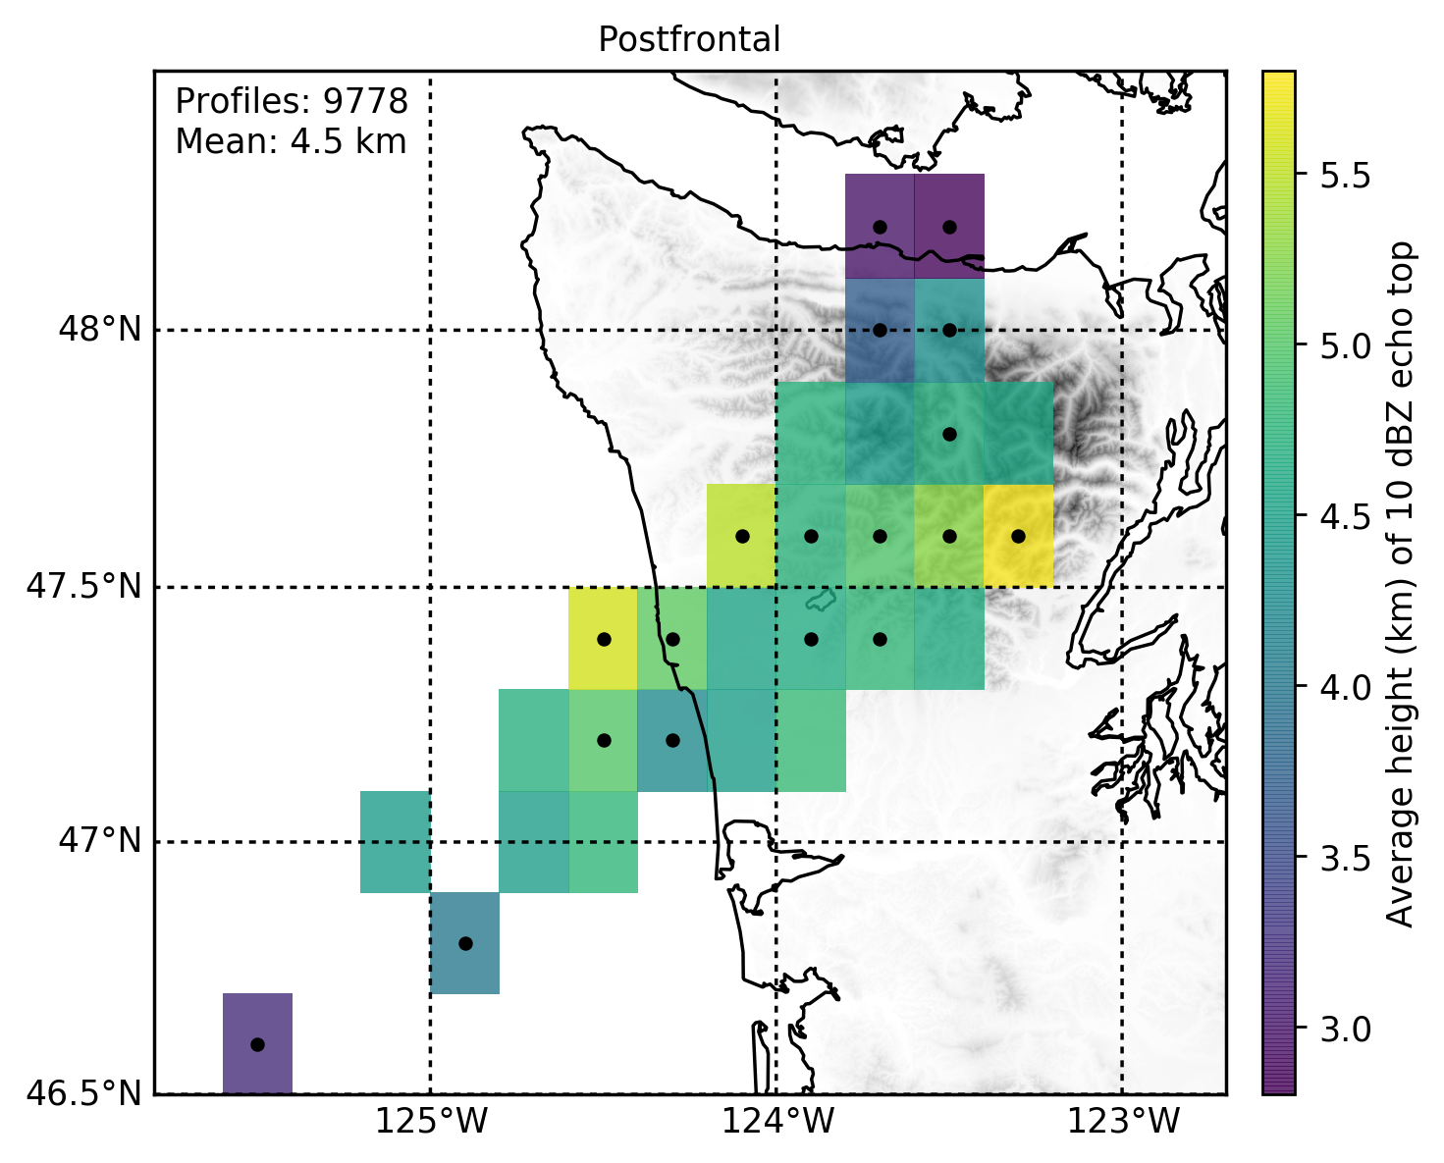
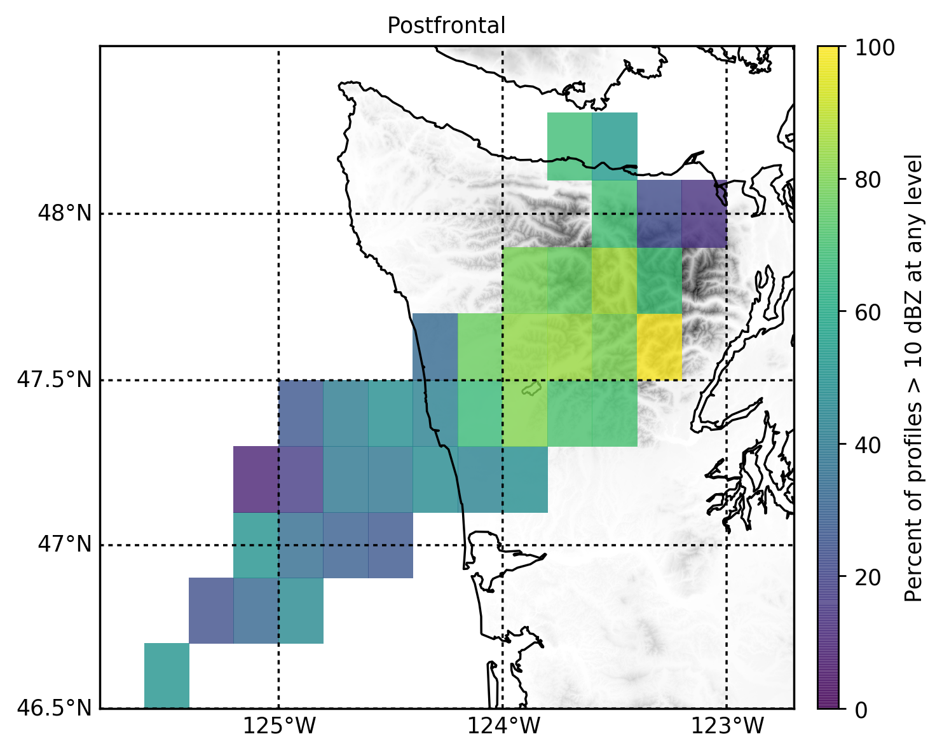
Postfrontal spatial distribution
Average echo top is more uniform everywhere except lee
Increased coverage over windward and high terrain (as cells transition from convective to stratiform)
Average height of 10 dBZ echo top
Coverage of 10 dBZ echo
Dots: passed statistical significance testing
(relative to mean, p < 0.01)

