Slide 1




Atmospheric River Events as observed using the ground network in OLYMPEX
Joe Zagrodnik
Lynn McMurdie, Robert A. Houze
Pacific Northwest Weather Workshop
27 April 2018
NNX15AL38G NNX16AK05G NNX16AD75G
AGS-1503155
AGS-1657251

Slide 2
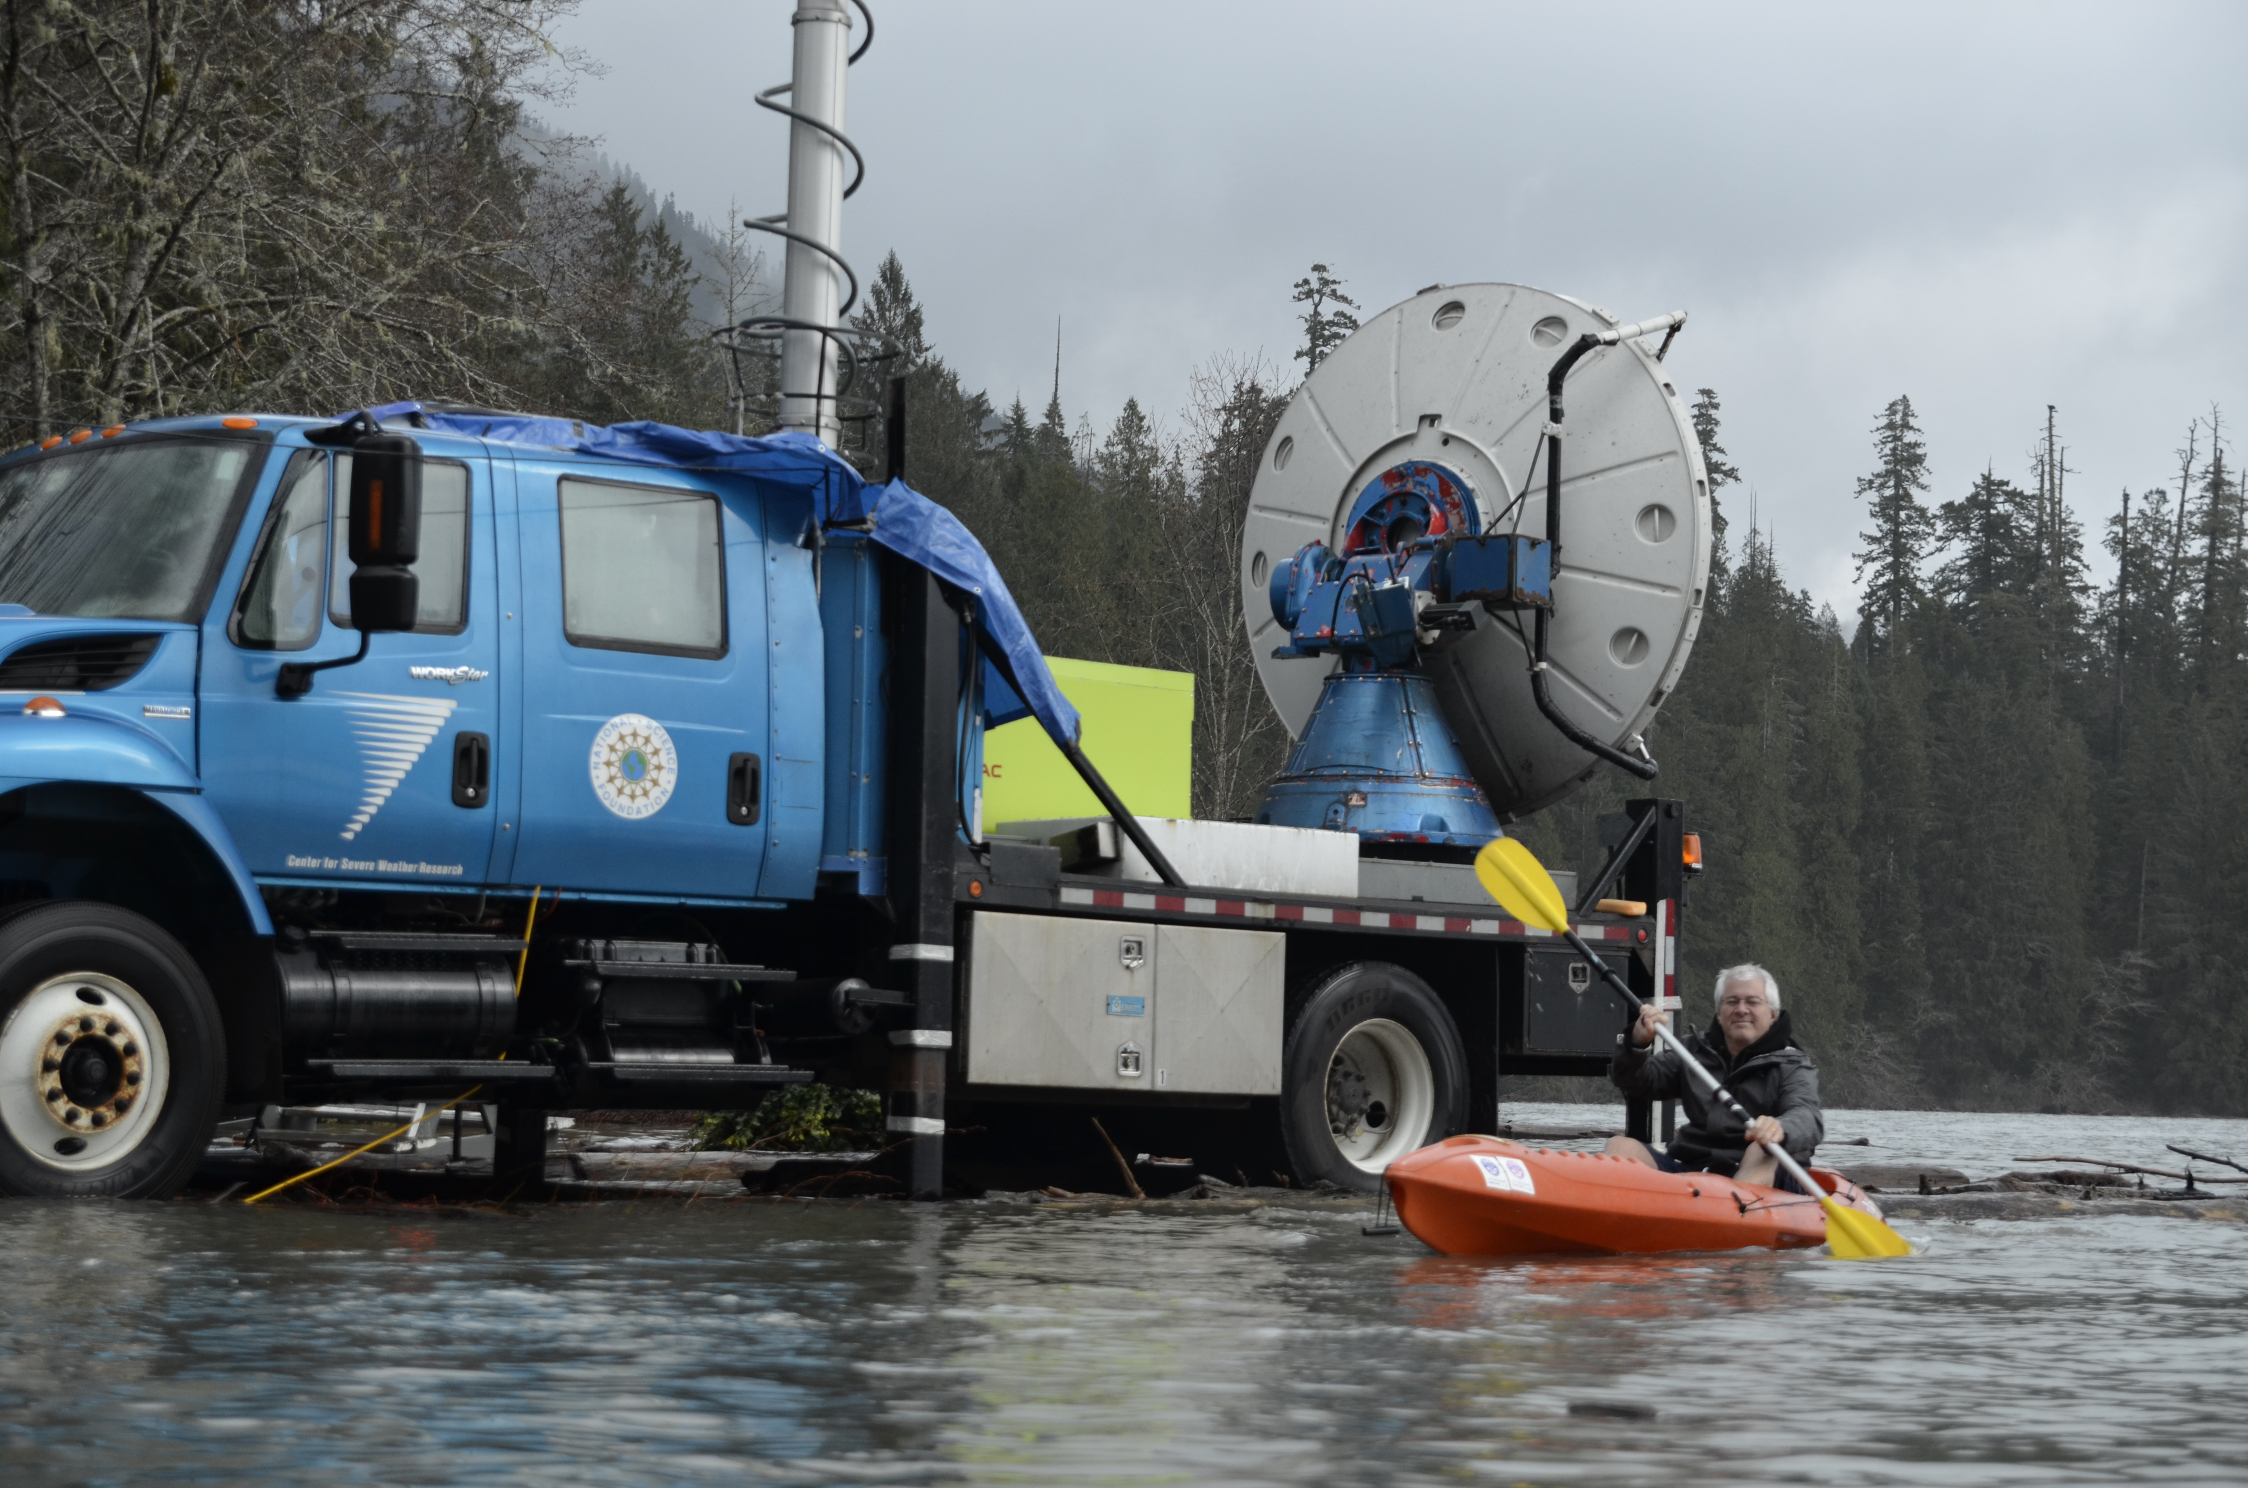
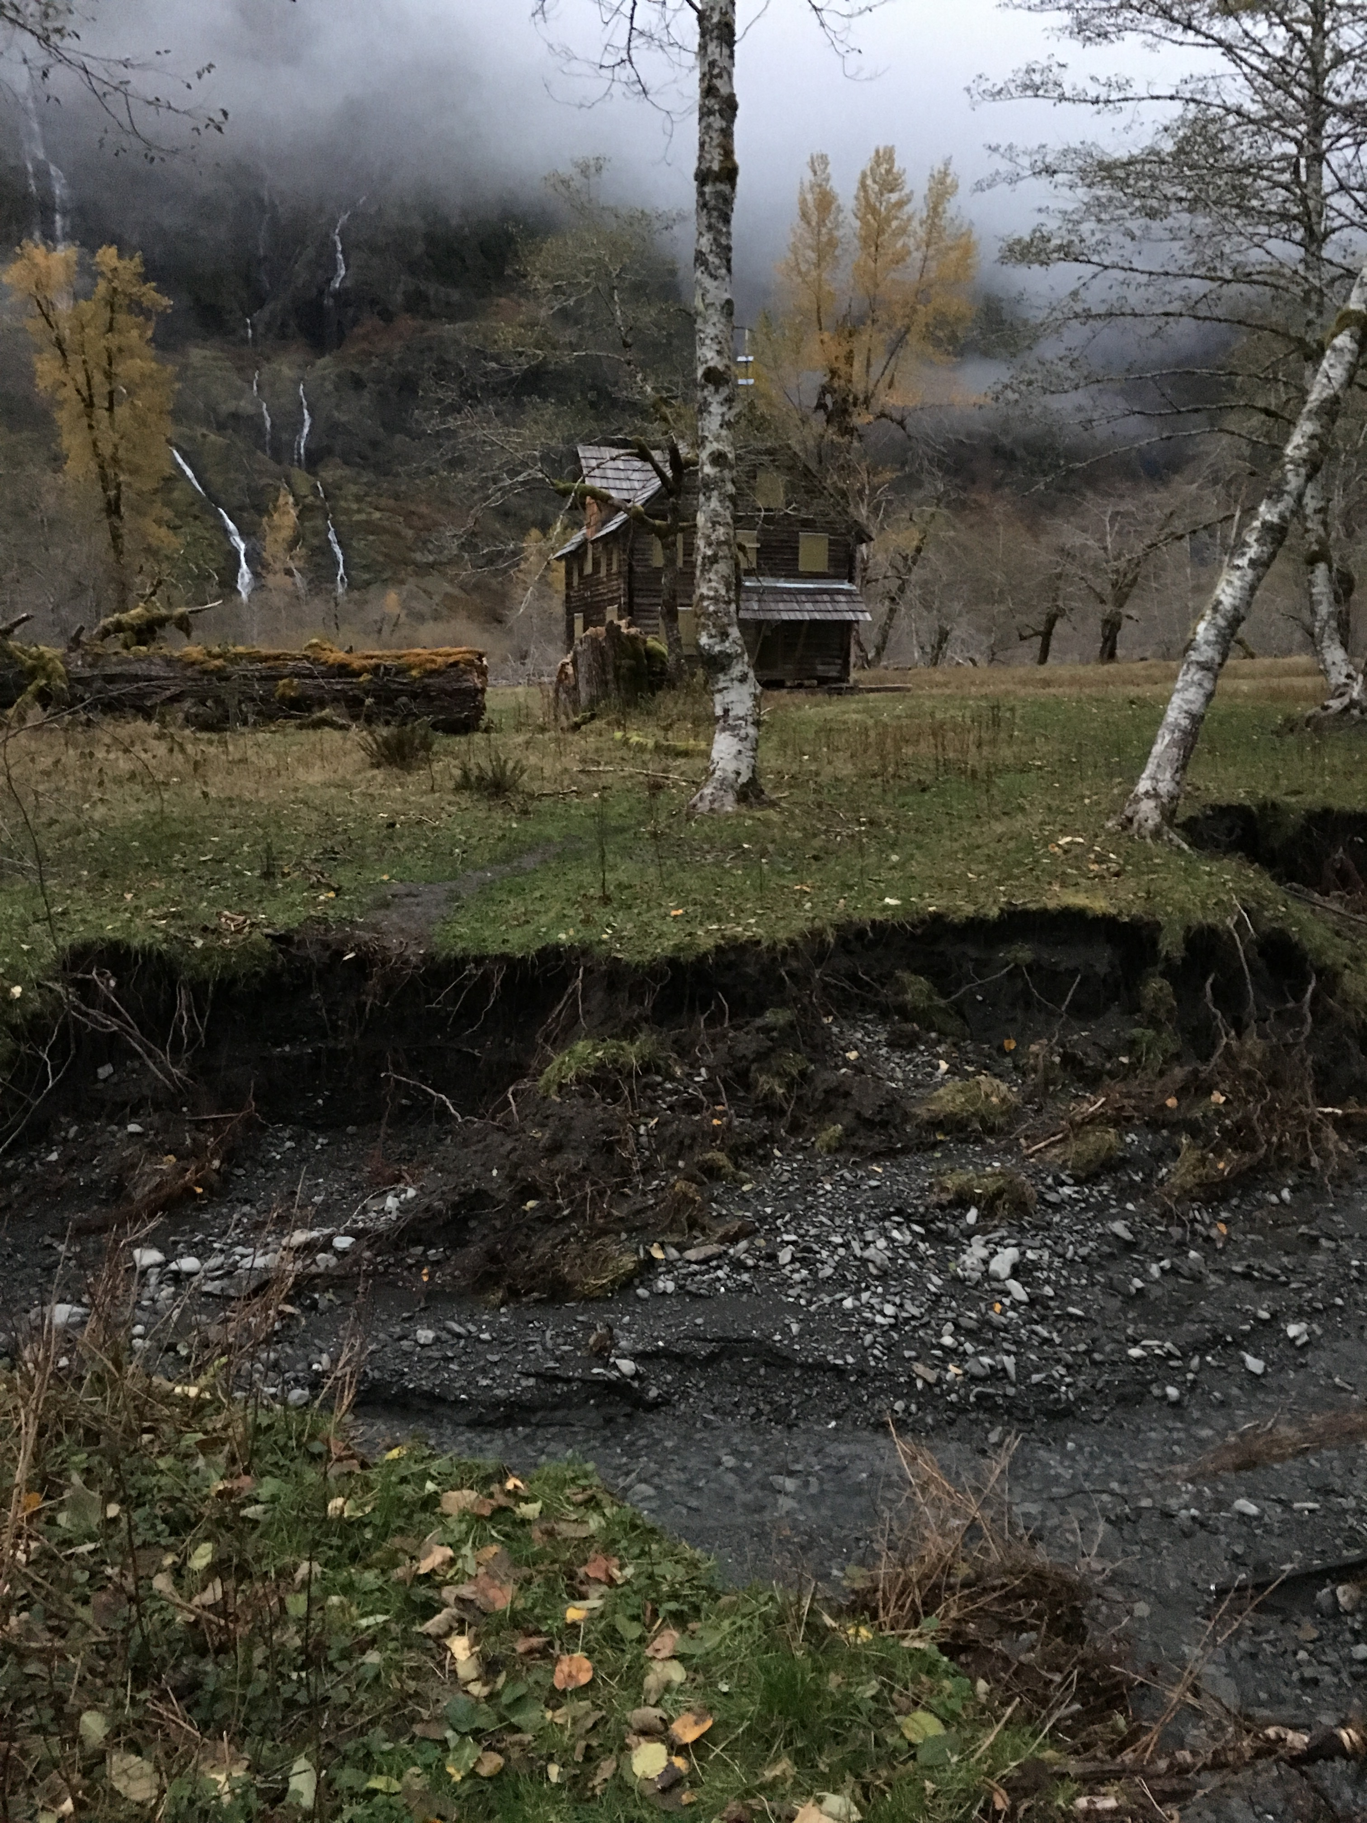
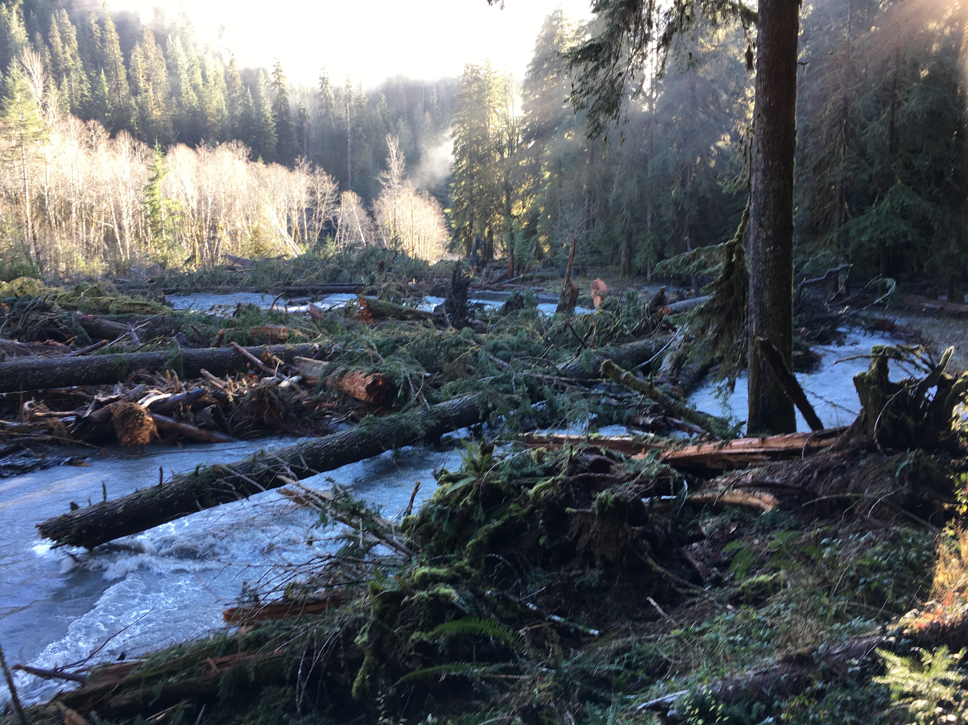
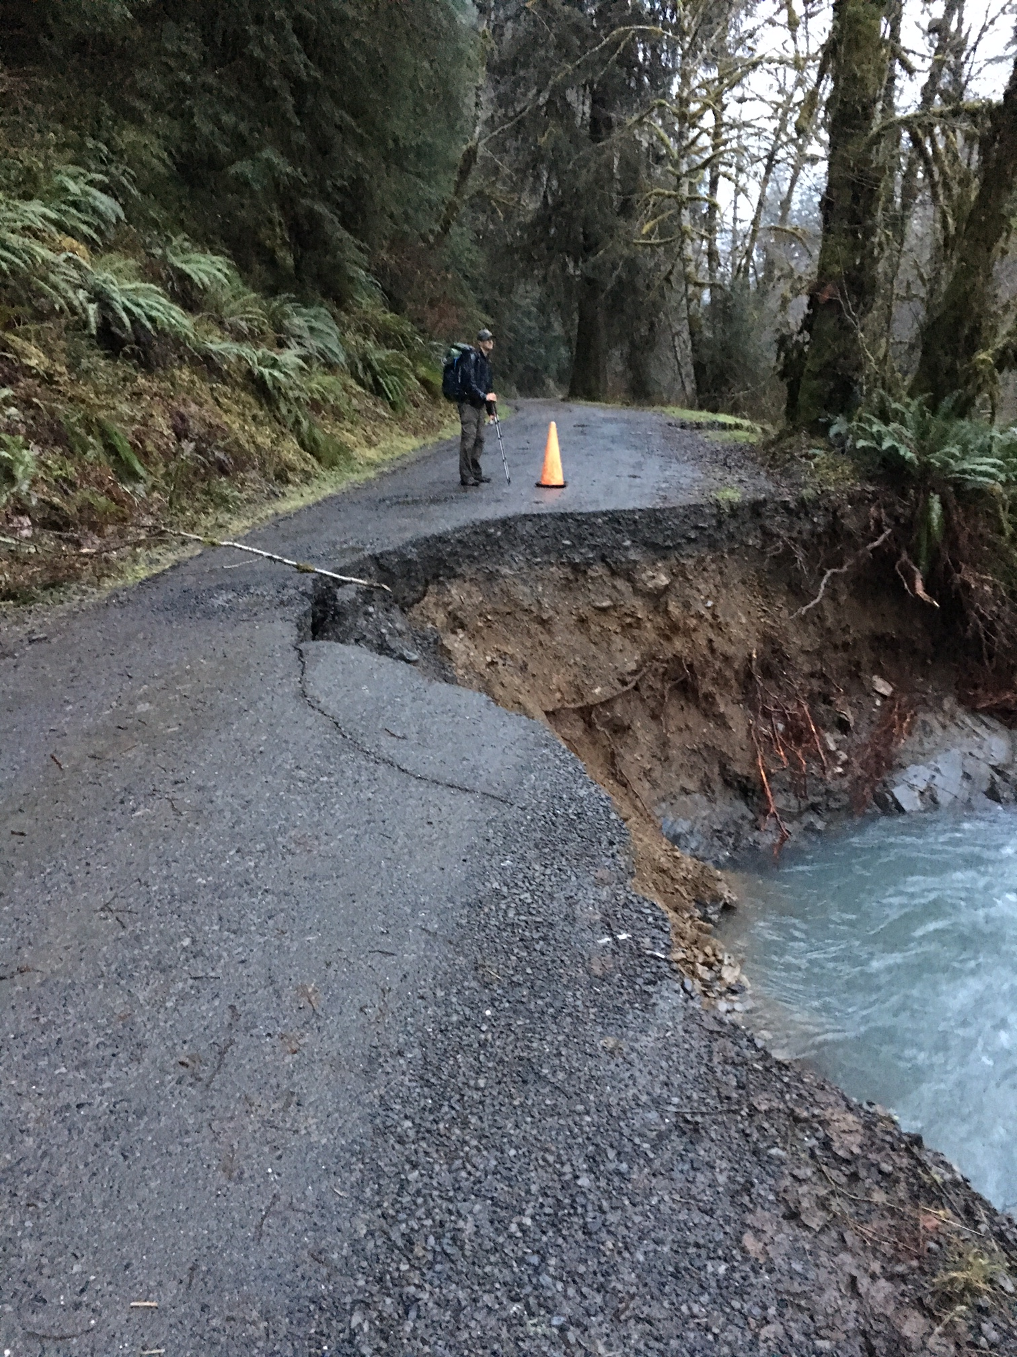
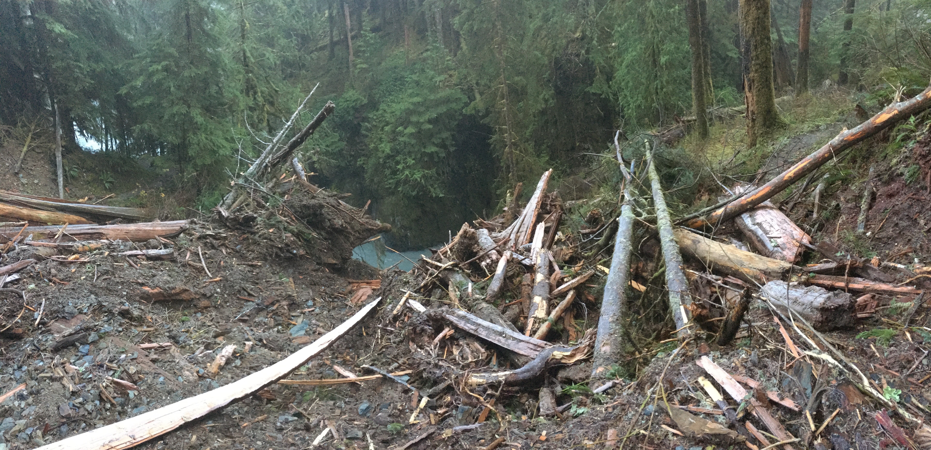
Three major “Atmospheric River” events observed during OLYMPEX (Nov 12-13, Nov 16-17, Dec 8-9 2015).
Over 1 foot of rain per storm near Lake Quinault. Associated with significant impacts.
Trail damage
Erosion
Lake Quinault Flood Dec 8, 2015
Quinault log jam/flood
Landslide in Olympic National Park
Nov 17, 2015
Graves Creek Road

Slide 3
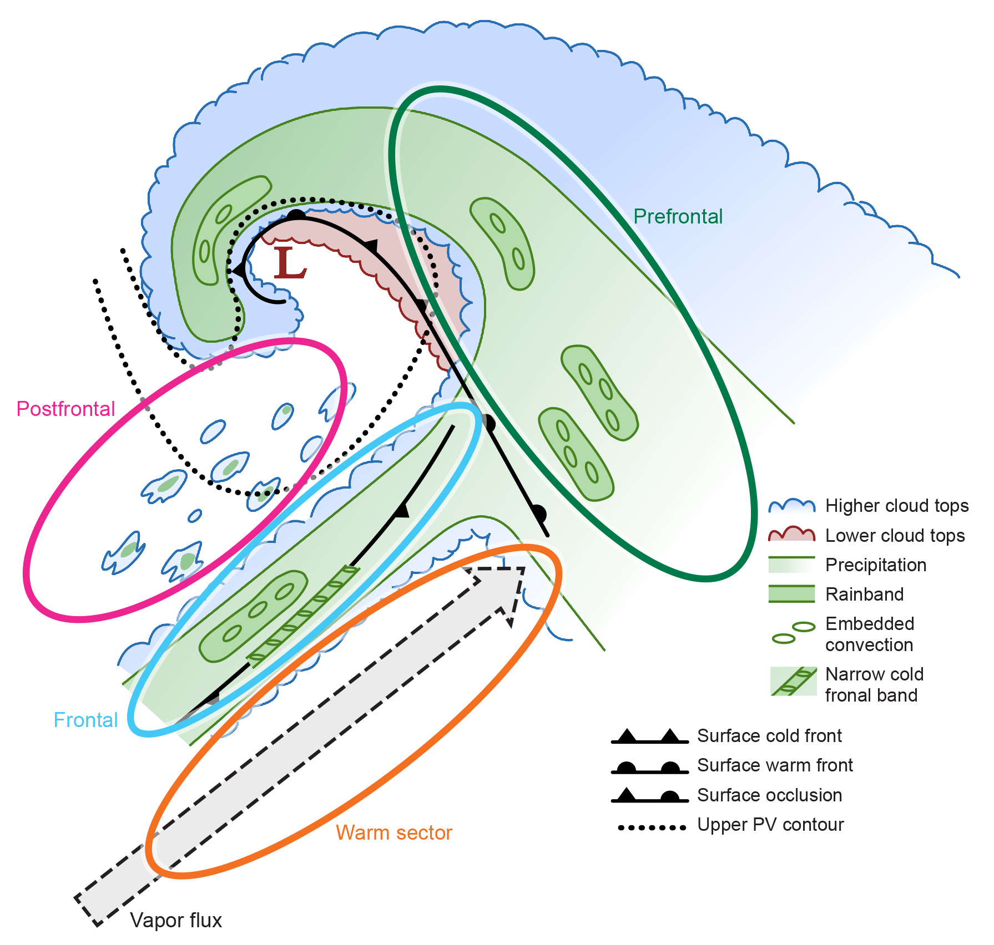
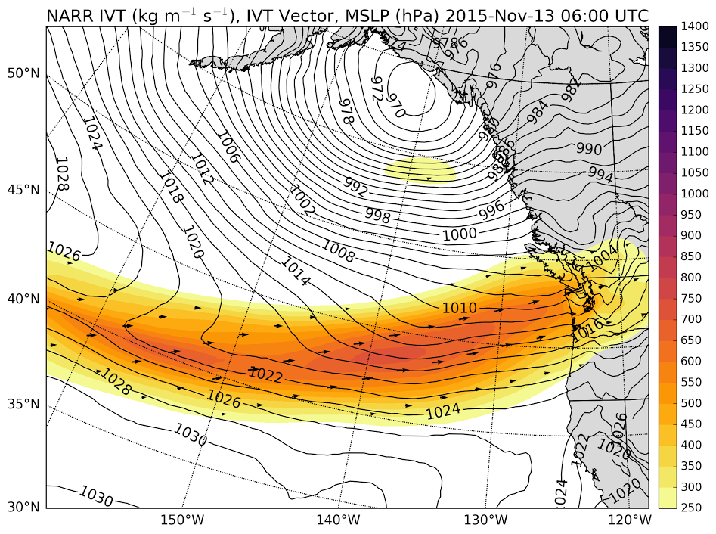
What defines an “Atmospheric River”?
Flow:
Low-level moisture transport: high Integrated Vapor Transport (IVT)
Thermodynamics:
High melting level
Moist-neutral static stability
Cloud/Precipitation Microphysics:
To be explored in this presentation using OLYMPEX ground observations
Notes:
The term is somewhat of a misnomer—we think of them in context of mid-latitude cyclones—a moist low-level jet in the warm sector ahead of the cold front.
What is the role of warm and cold microphysical processes in contributing to orographic enhancement in these events?

Slide 4
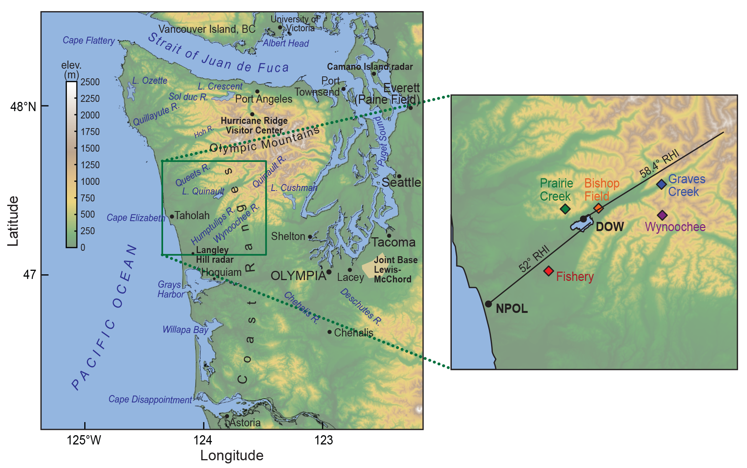
Site Locations
Ground Site | Elevation (m)
Fishery | 52
Bishop Field | 85
Prairie Creek | 543
Graves Creek | 180
Wynoochee | 1020

Slide 5
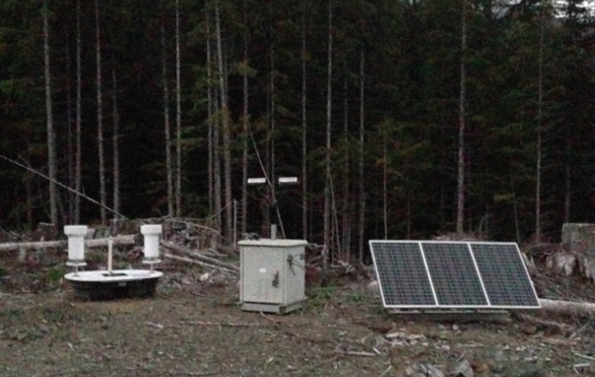
Statistical Analysis
All storms Oct 2015 – Apr 2016
Postfrontal and < 1 mm h⁻¹ rain rates removed
Divide everything into 3-hour periods centered on North American Regional Reanalysis (NARR) times (00, 03, 06 UTC etc)
Drop size distribution (DSD) at Prairie Creek
Precipitation gauges at 5 ground sites with varying elevation/distance from coast
Parsivel disdrometer and dual tipping bucket gauge at Prairie Creek

Slide 6
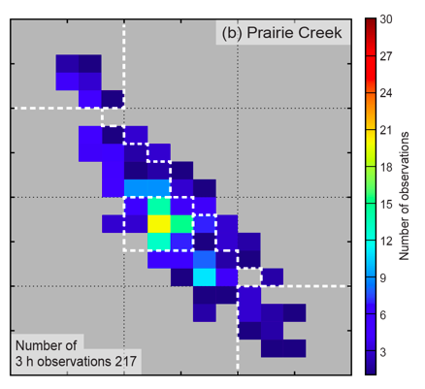
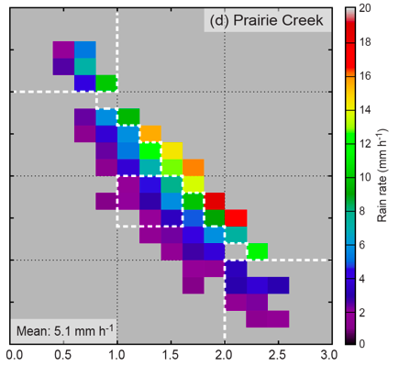
Drop Size Distribution at Prairie Creek
Histograms of Drop Diameter vs. Drop Number:
Frequency
Rain rate
Increase in size and/or number
Heavy rain
Number of Drops (N_{W})
Most frequent DSD
Average Rain Rate
Median Drop Size (D₀)
Median Drop Size (D₀)
Similar DSD at near-coastal site (Fishery) but less outliers weaker rain rates
Notes:
-Wide range of possibilities
-Most frequent regime: modest size and number, light rain rate (near climatology)
-Heavy rain regime: increased size and number (some variability), max observed rain rates

Slide 7
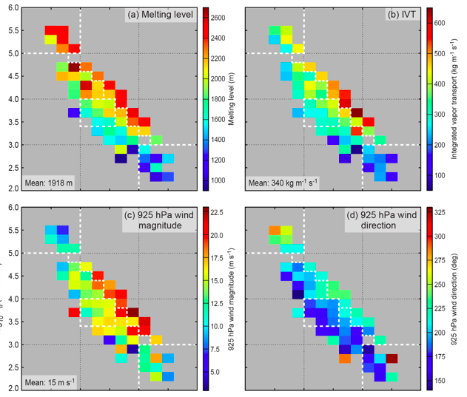
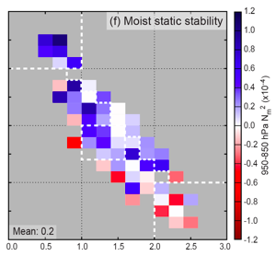
Prairie Creek DSD vs. Synoptic Environment
Number of Drops (N_{W})
Median Drop Size (D₀)
Heavy Rain
Median Drop Size (D₀)
Notes:
Several different regimes—focus on this ‘heavy rain regime’

Slide 8
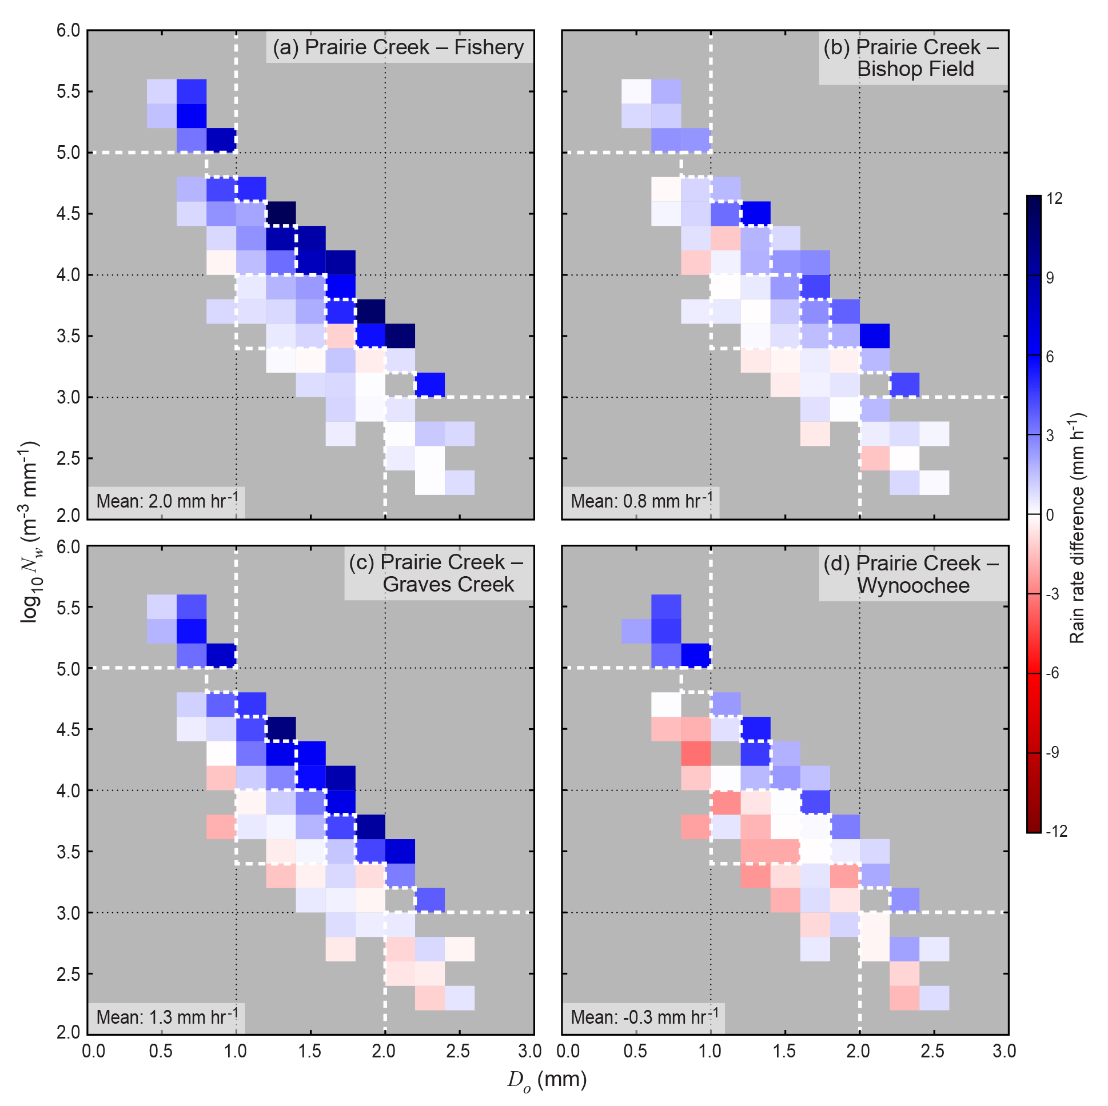
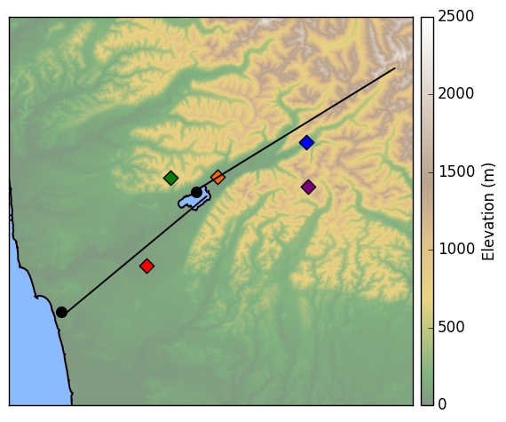
Prairie Creek DSD vs. Orographic Enhancement
Graves Creek
Bishop Field
Prairie Creek
Wynoochee
Fishery
Number of Drops (N_{W})
For a given Prairie Creek DSD:
Blue = more precip at Prairie Creek
Red = less precip at Prairie Creek
White = same at both sites
Median Drop Size (D₀)
More total precip at Wynoochee
Notes:
Most frequent DSD = Very little difference in rainfall, except at highest elevation. Dominates in seasonal statistics

Slide 9
Case Study: Nov 12-13, 2015
Integrated Vapor Transport (IVT)
Nov 12-13, 2015 “Atmospheric River”
High melting level
Strong 925 hPa winds and IVT
Moist-Neutral Stability

Slide 10
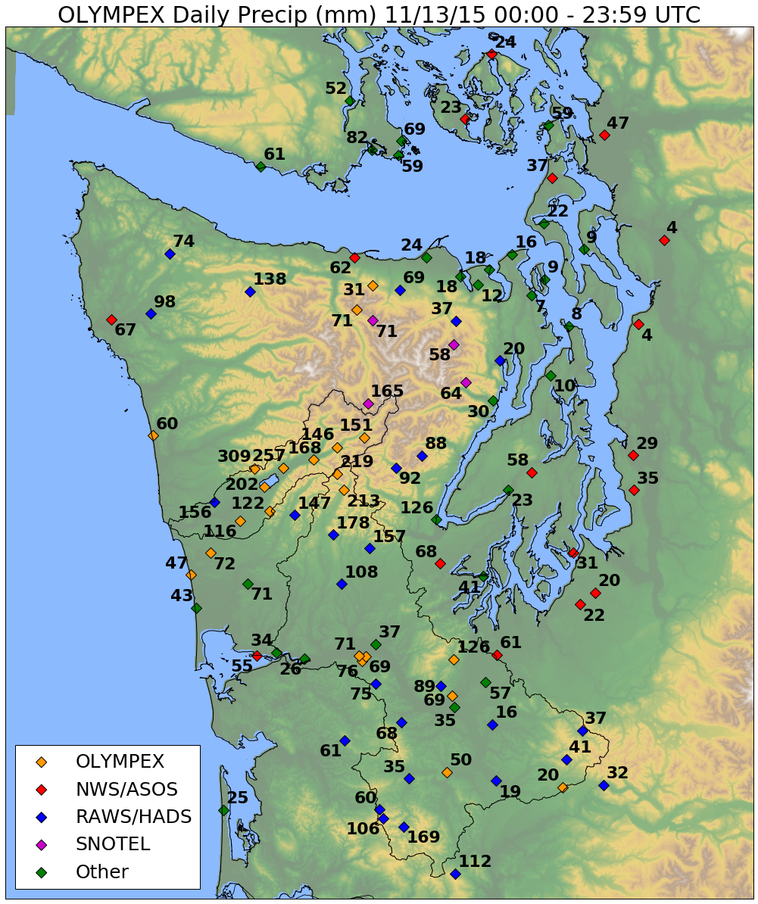
High terrain less than windward slopes
Factor of 4-5 enhancement between coast and Lake Quinault
Different than climatology!

Slide 11
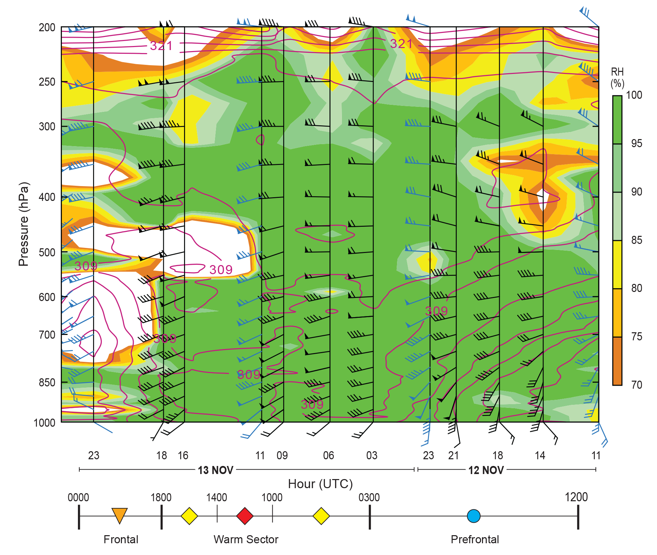
Cross-section of radiosonde observations at the coast
Relative Humidity (%)

Slide 12
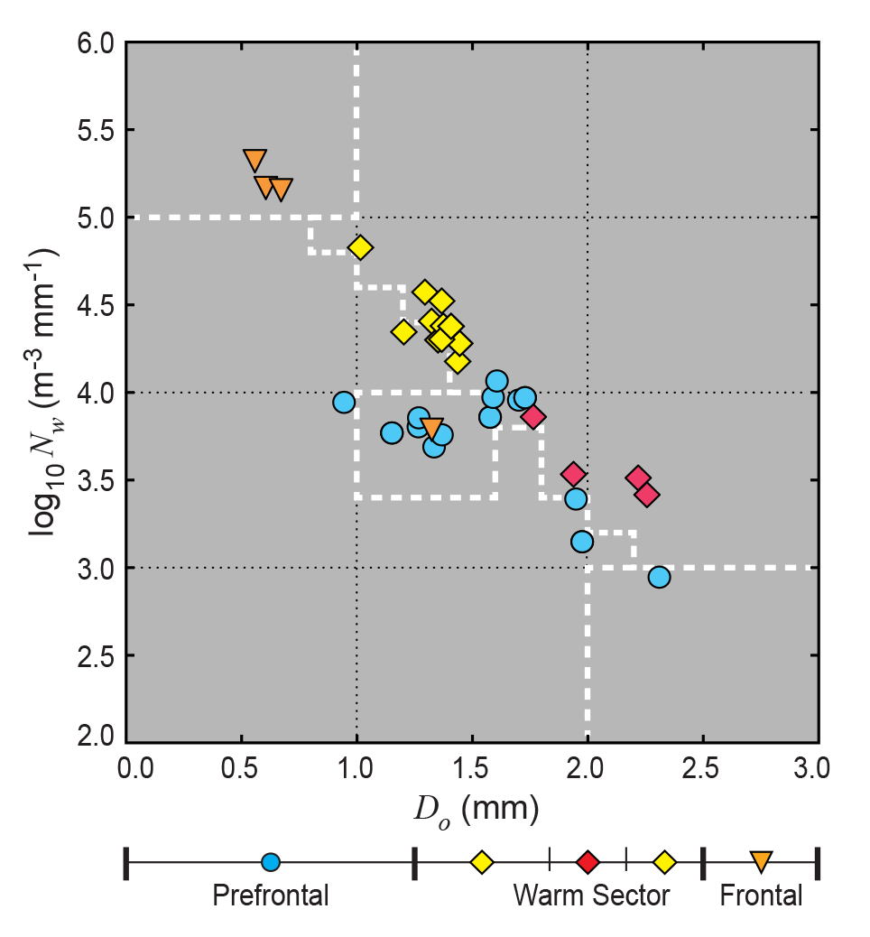
Prairie Creek 1-hour DSDs
Transitions in DSDs matched changes in storm sector (Prefrontal -> Warm Sector -> Frontal)

Slide 13
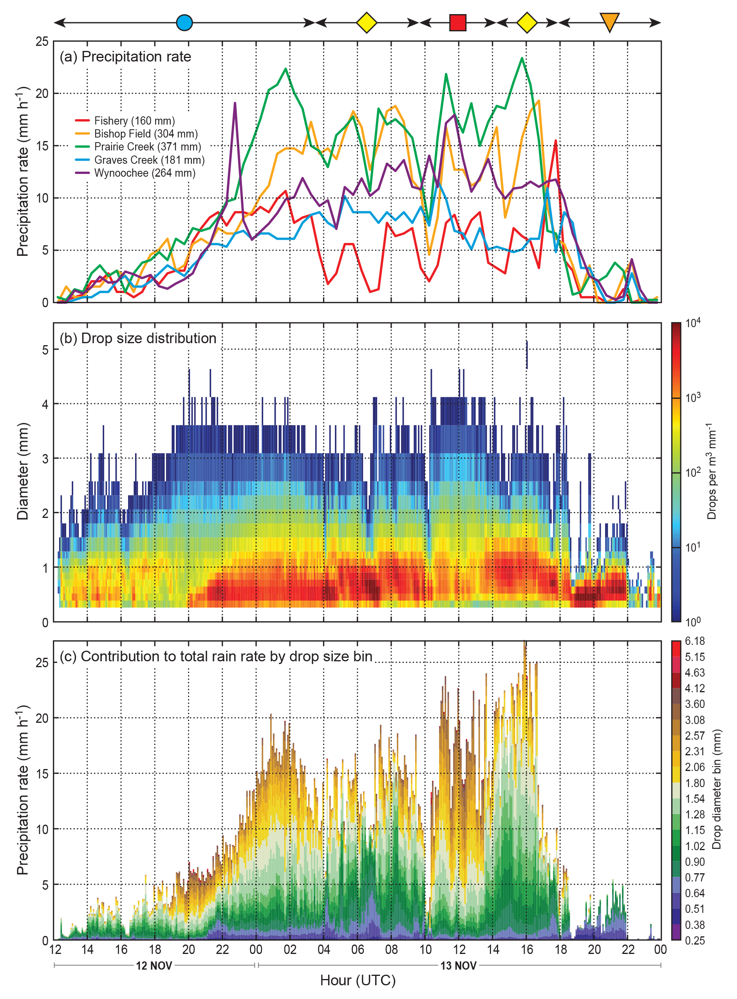
Time Series
Precip Rate
Warm Sector
Long period of orographic enhancement associated with warm sector
Event begins with most frequent DSD. No orographic enhancement
Prairie Creek DSD
RHI 1
RHI 2
RHI 3
Drops per m³ mm⁻¹
Interesting period of larger drops in warm sector
Small-to-medium drops become dominant during transition to warm sector
Contribution to rain rate by drop size bin
Drop Diameter Bin (mm)

Slide 14
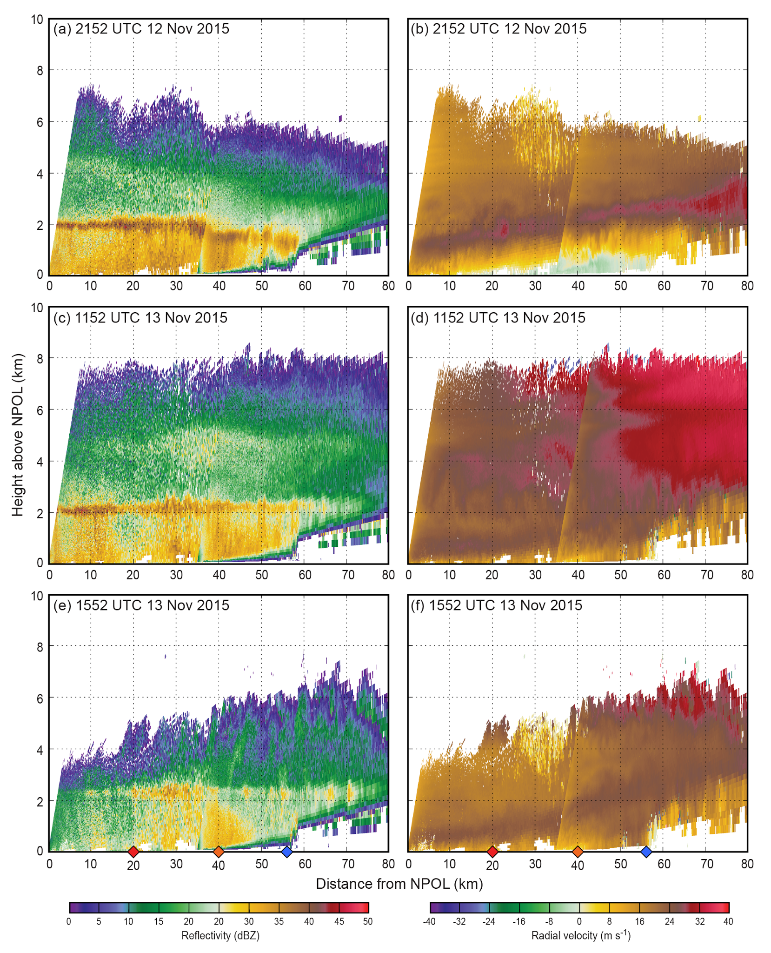
Note: these images combine the NPOL and DOW radars
Reflectivity
Radial Velocity
RHI 1
Light Rain
Most Frequent DSD
RHI 2
Heavy Rain
Mostly big drops
RHI 3
Heavy Rain
Mostly small to medium drops
Coast
Mountains
Coast
Mountains
Prairie Creek
Notes:
Low level jet
Low-level reflectivity
Depth of cloud

Slide 15
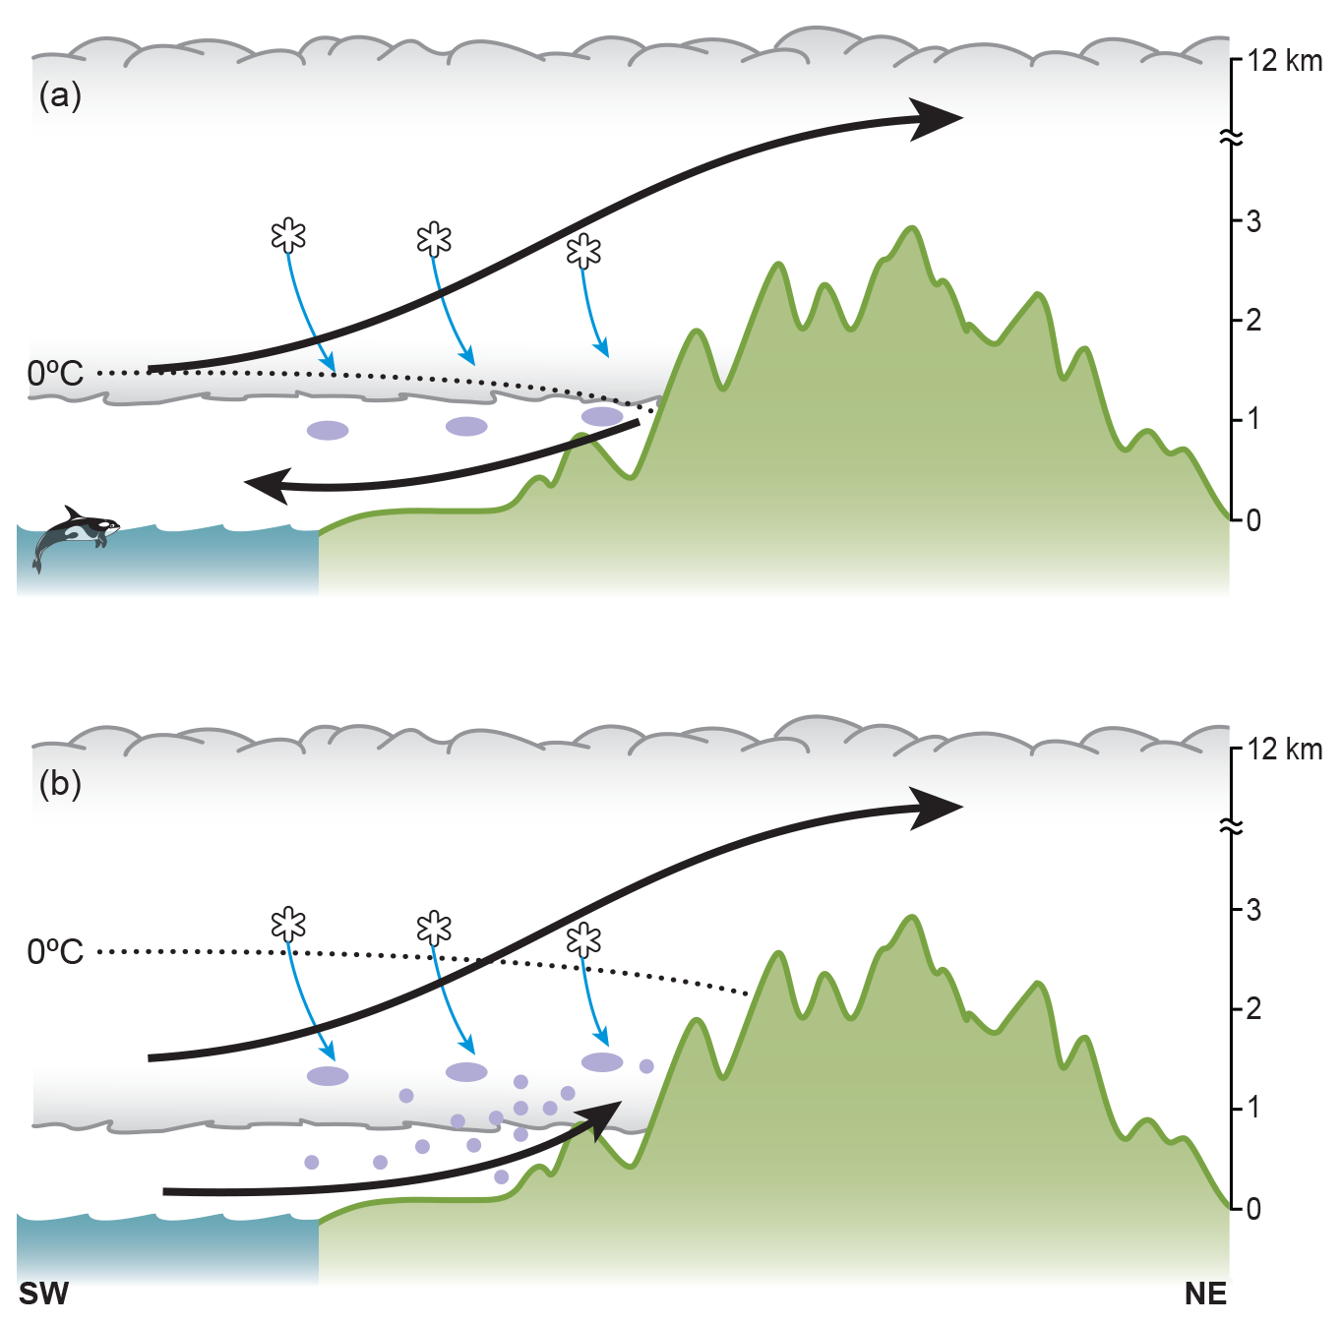
Summary
Minimal small drop production
Atmospheric Rivers have most precip at low-to-mid elevations
Mostly small-to-medium drops
Quick formation and fallout
Related to moist-neutral lifting of low-level jet
Surprising result: warm precipitation processes can generate heavy rain without significant contributions from seeding by ice crystals (seeder-feeder) and shear-generated turbulence!!!
Considerable small drop production
For more details, see Zagrodnik et al. (2018), JAS

