Slide 1
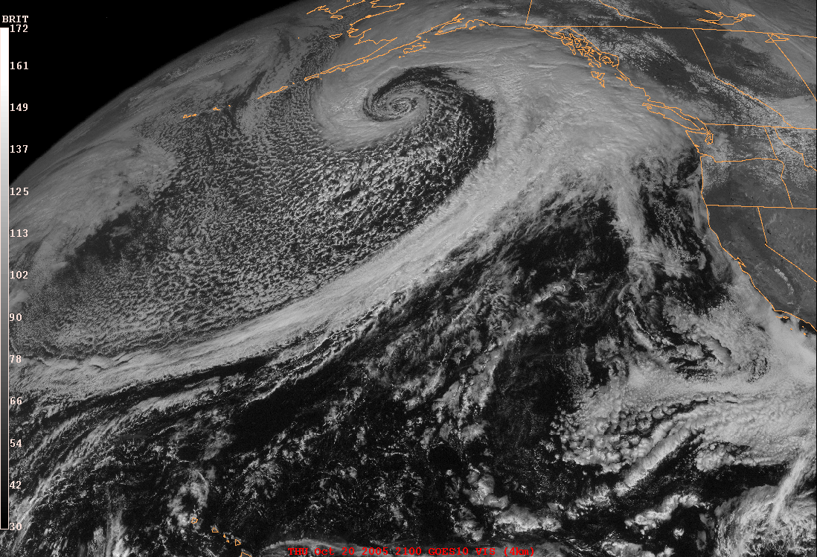


The Olympic Mountains Experiment (OLYMPEX): Overview and Status
Lynn McMurdie
University of Washington
(co-authors: Joe Zagrodnik, Angela Rowe, Jamin Rader, Thomas Schuldt, Robert Houze and Stacy Brodzik)
Pacific Northwest Weather Workshop, Seattle, 27 April 2018

Slide 2
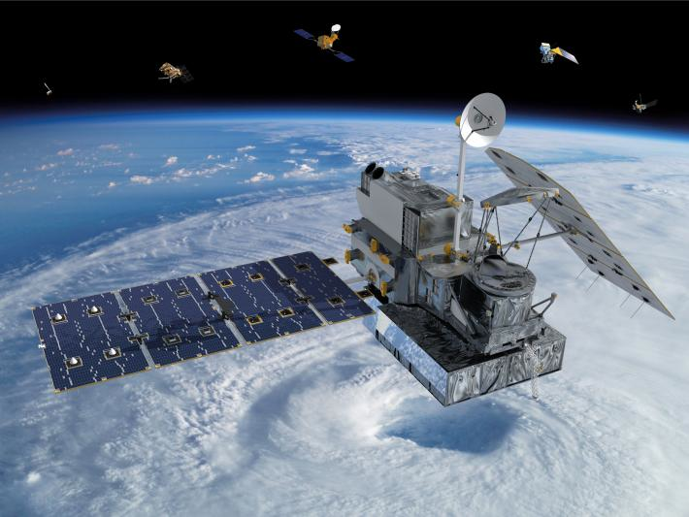
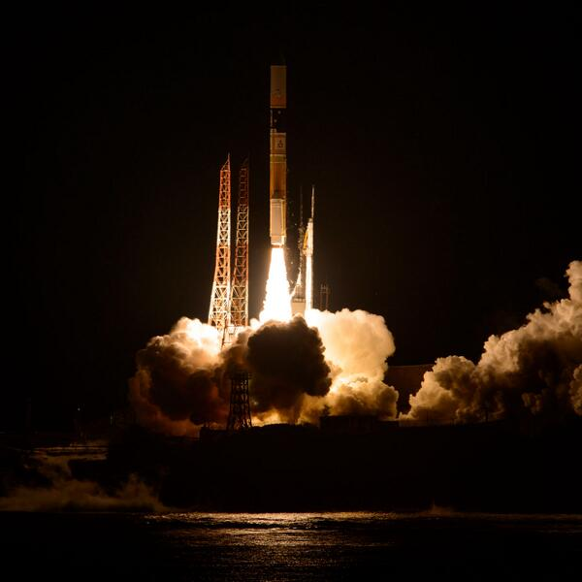
Goals
Physical validation to support GPM algorithms for measuring precipitation from space
Launched 28 Feb 2014 from Tanegashima Space Flight Center in Japan
The GPM satellite – measuring precipitation from space with an active Radar and passive microwave imager

Slide 3
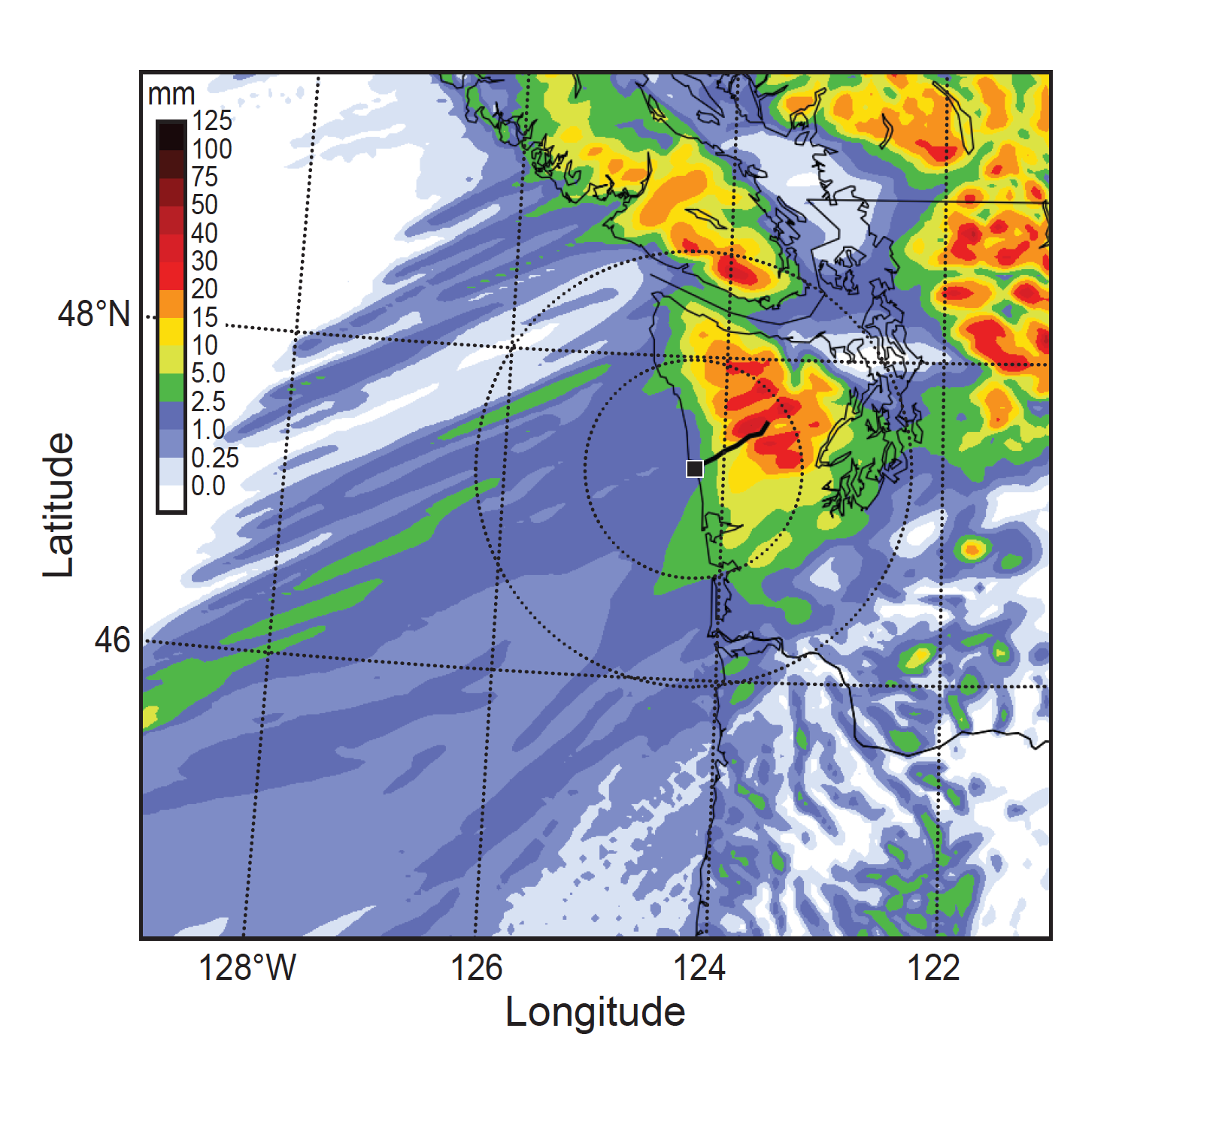
Goals
Physical validation to support GPM algorithms
Orographic effects on frontal precipitation

Slide 4
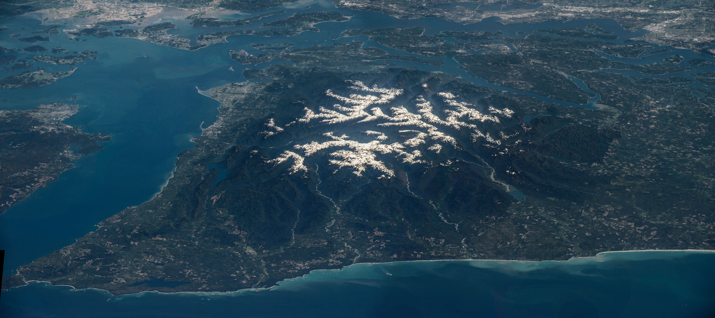
Regions of the Olympic Peninsula
Leeside
High Terrain
Windward Slopes
Coast
Ocean
Mean low-level winds from the Southwest

Slide 5
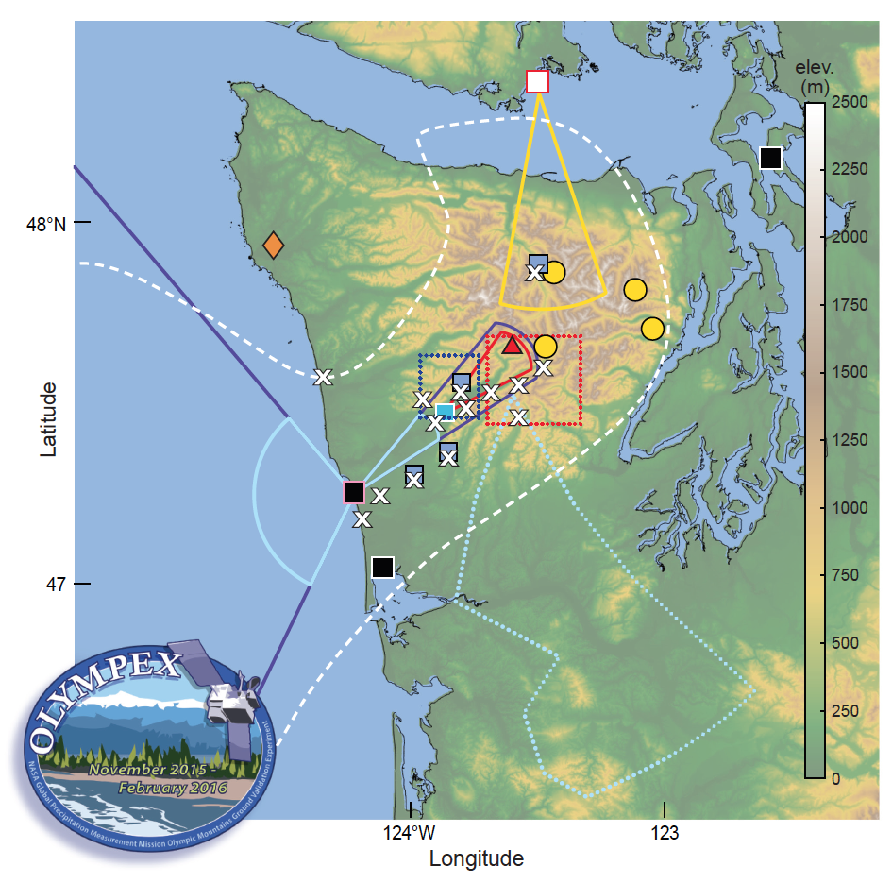
OLYMPEX: Precipitation Processes in wintertime Midlatitude Cyclones over complex terrain
Aircraft
DC-8
ER-2
Citation
Radars
NPOL
D3R
DOW
EC X-band
MRRs
WSR-88D
Soundings
KUIL
NPOL
EC X-band
Ground Network
Rain Gauges
Disdrometers
PIP
Snow Cameras
Nov – Dec 2015
Oct 2015 –
May 2016

Slide 6
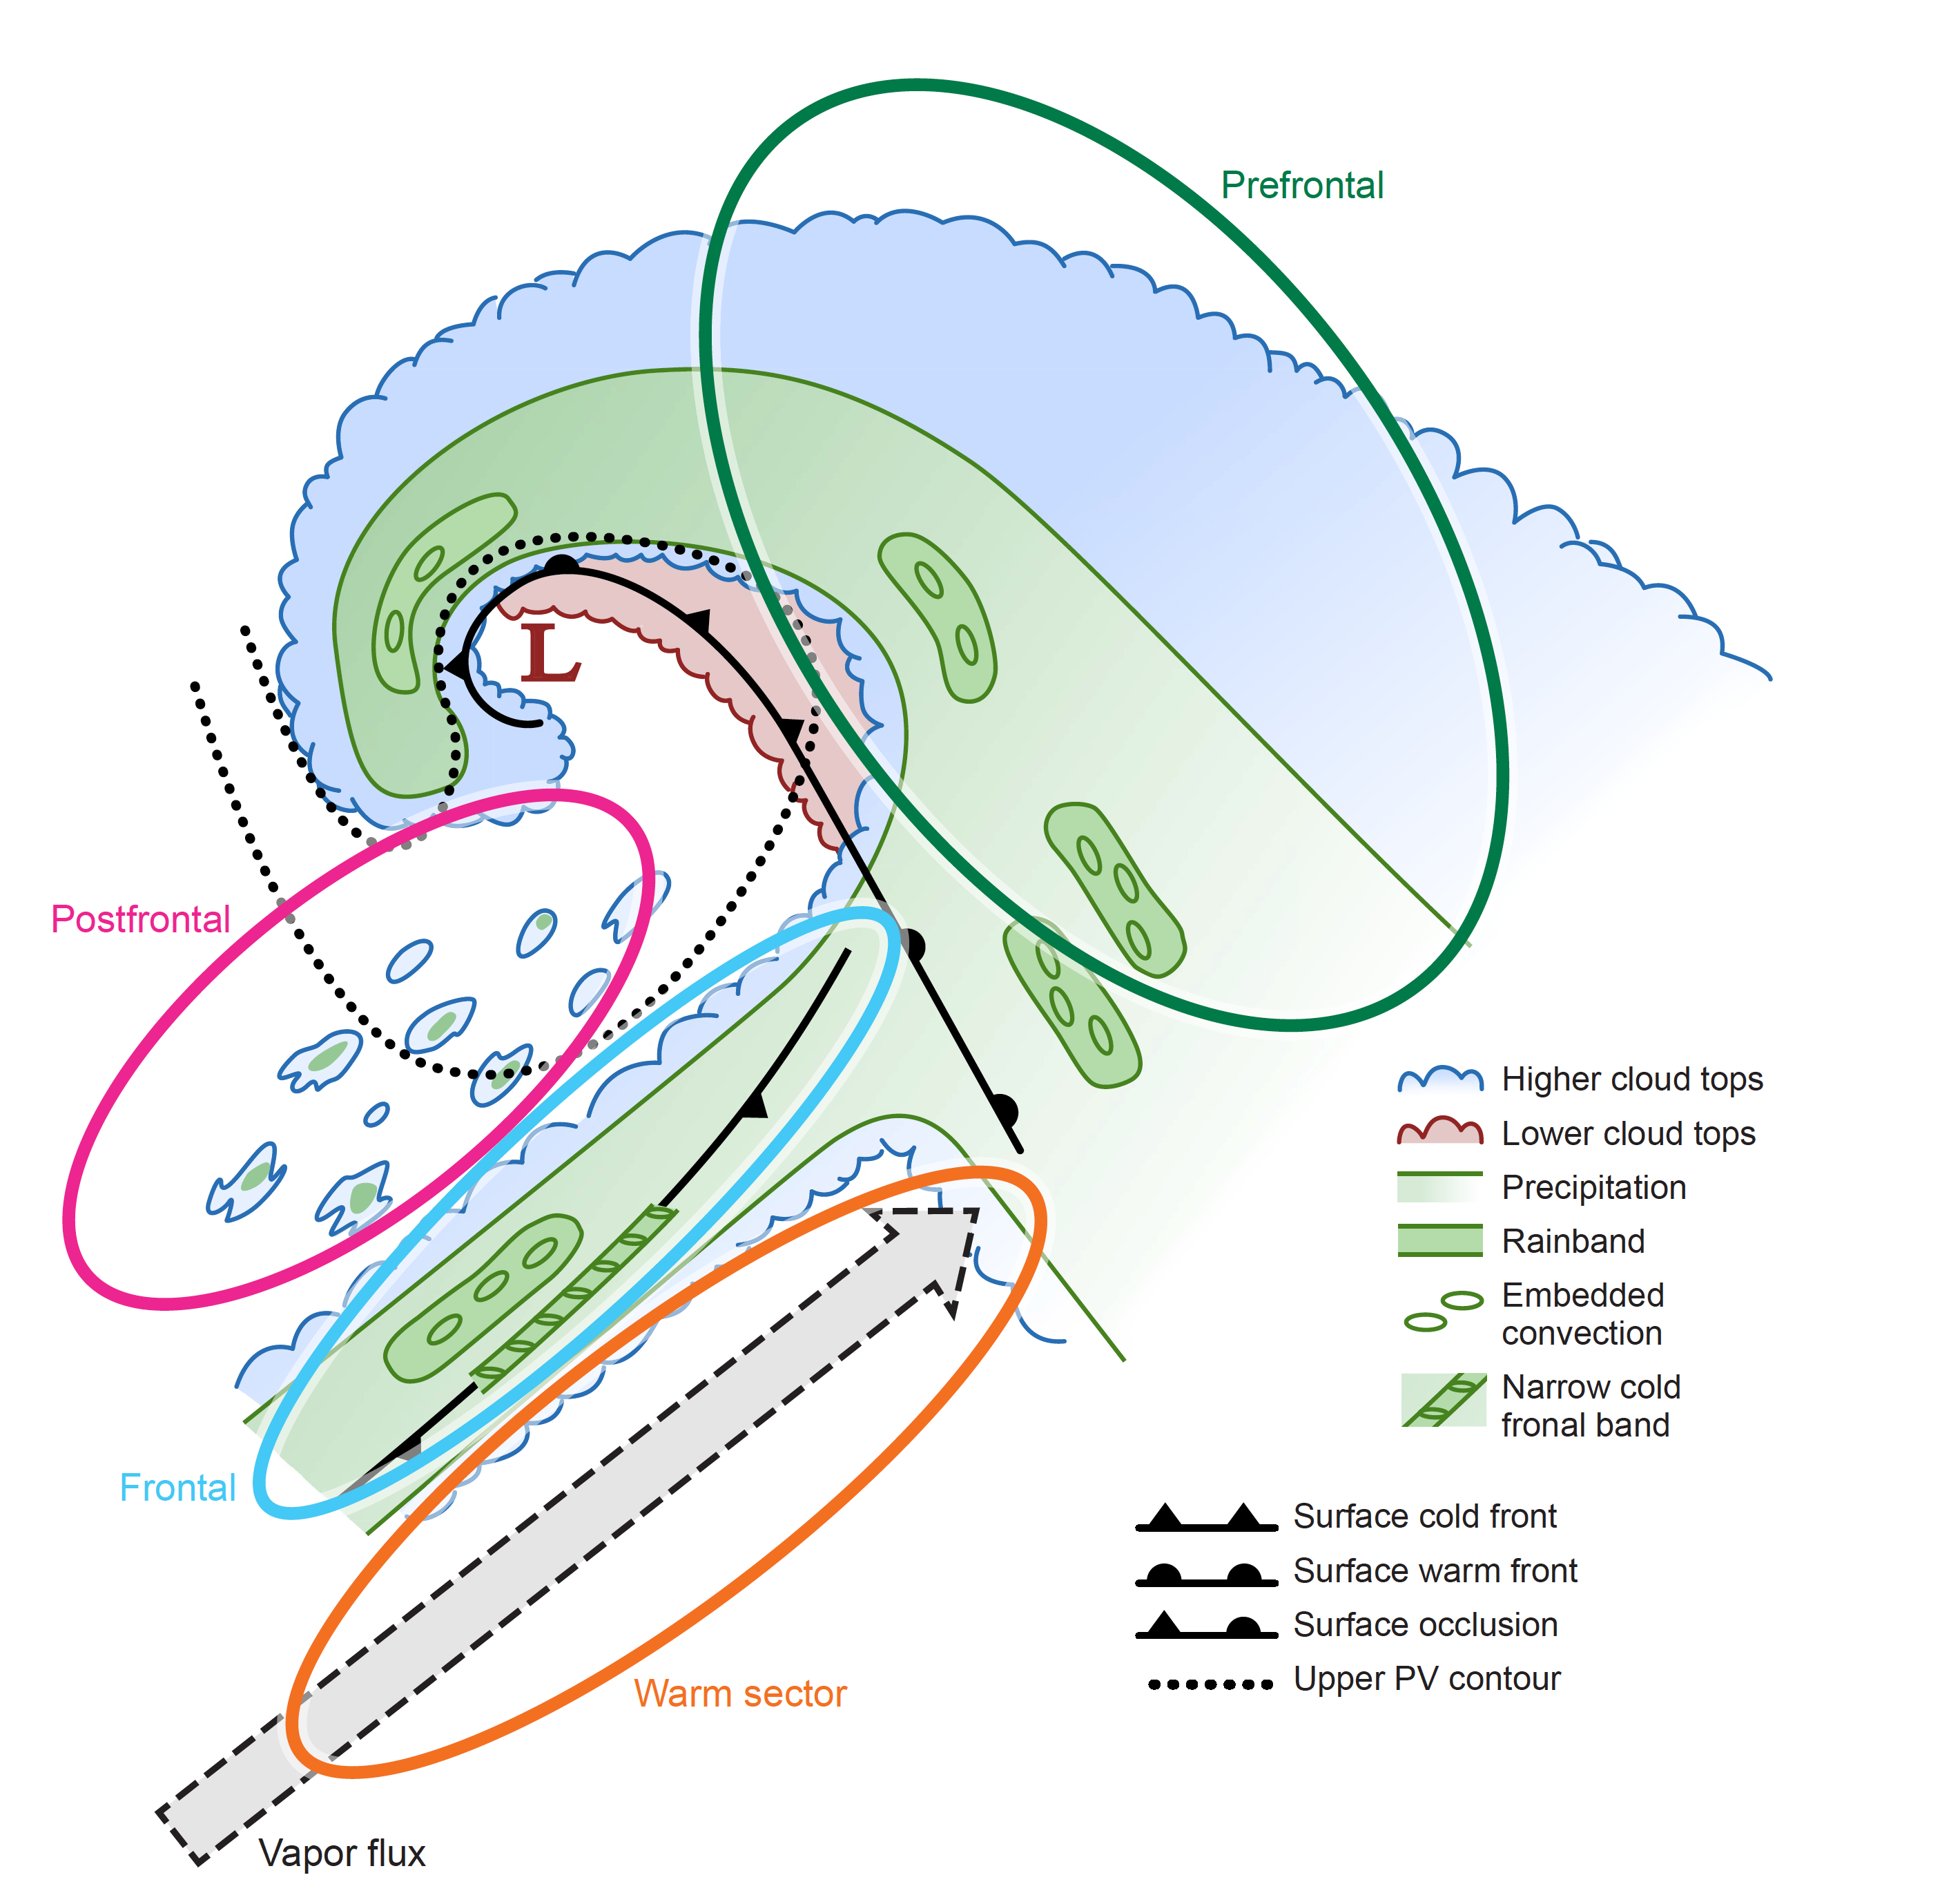
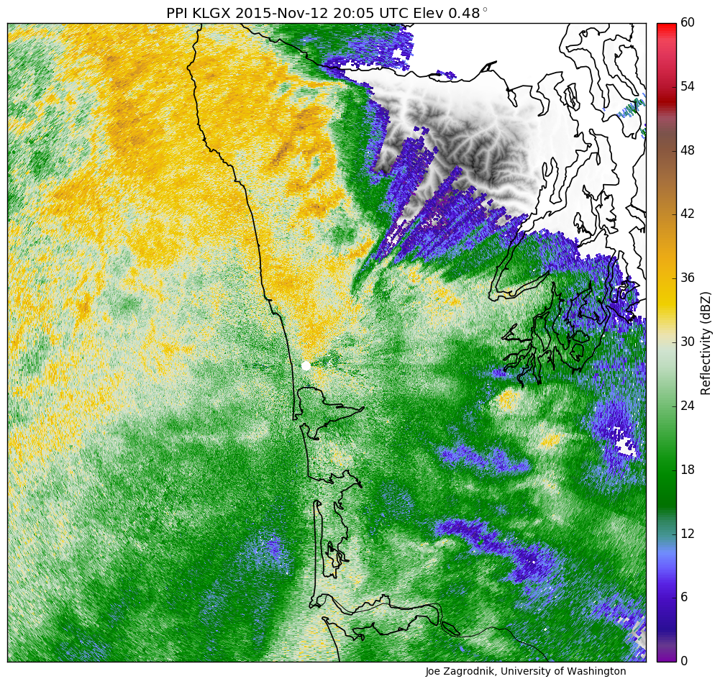
Prefrontal Environmental Characteristics
Warm advection
Stable
Low-level SE flow
IVT variable (can be high)
Increasing Melting Level height
Notes:
The dataset collected was not only huge…but also…homogeneous…facilitating…statistics
Storms passing over the OLYMPEX area all had a variation of this idealized structure…consisting of characteristic sectors…(describe)

Slide 7
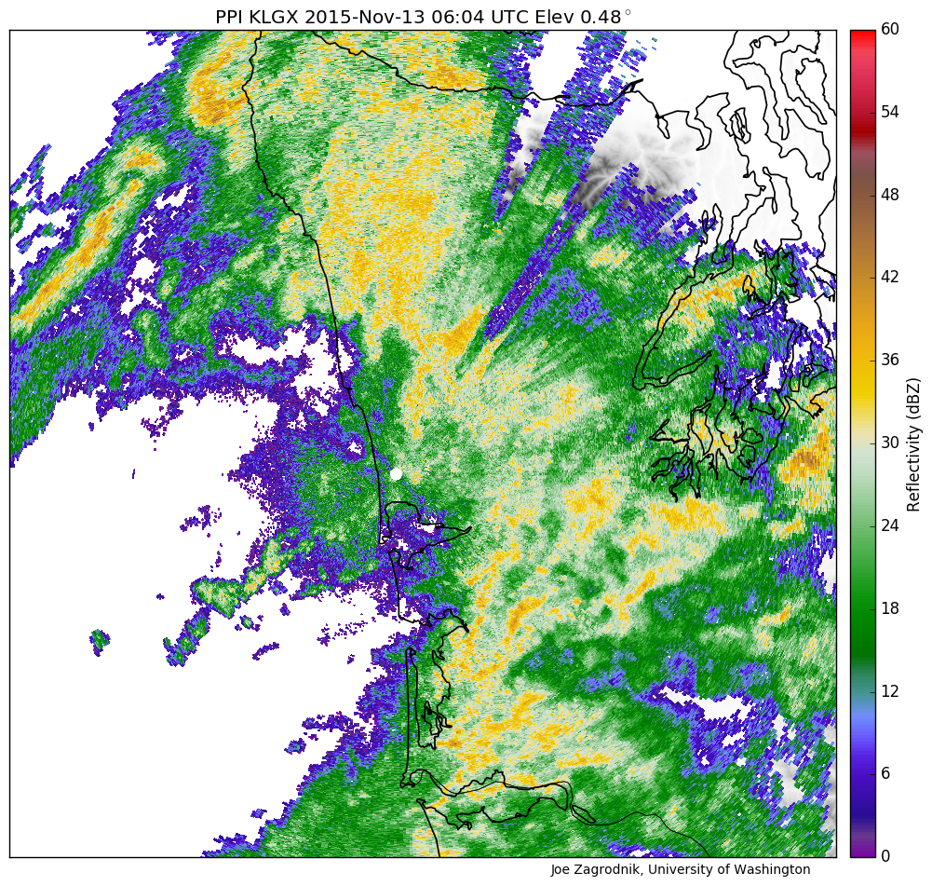
Warm Sector Environmental Characteristics
High IVT
Neutral Stability
SW flow
High melting level
Notes:
The dataset collected was not only huge…but also…homogeneous…facilitating…statistics
Storms passing over the OLYMPEX area all had a variation of this idealized structure…consisting of characteristic sectors…(describe)

Slide 8
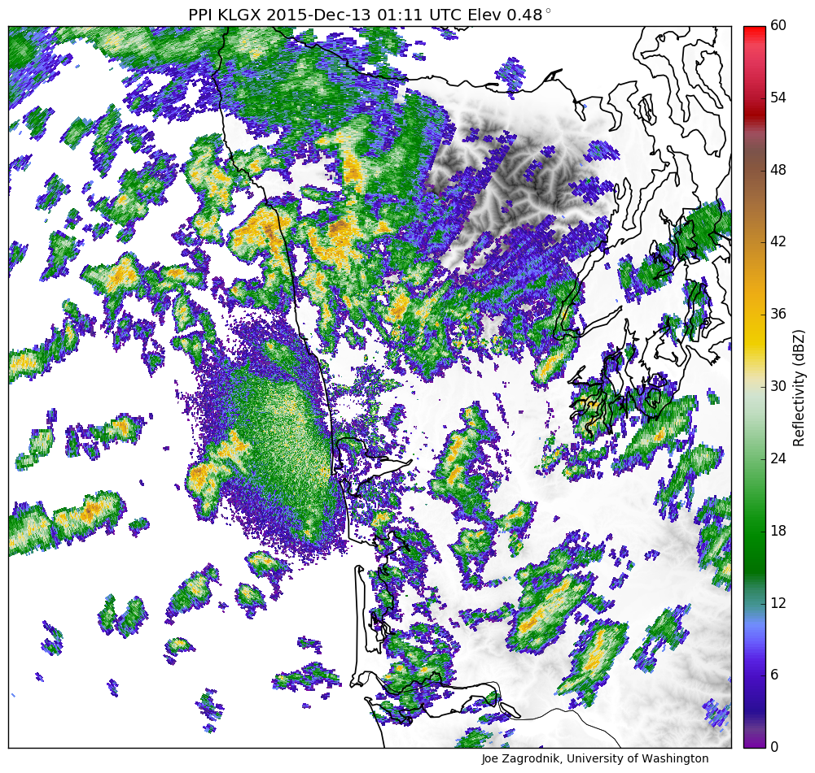
Postfrontal Environmental Characteristics
Cold Advection
Unstable
W or NW flow
Low IVT
Low Melting Level
Notes:
The dataset collected was not only huge…but also…homogeneous…facilitating…statistics
Storms passing over the OLYMPEX area all had a variation of this idealized structure…consisting of characteristic sectors…(describe)

Slide 9
Orographic Enhancement of Precipitation Structure Seasonal Statistics
from Rain Gauges
from Radar

Slide 10
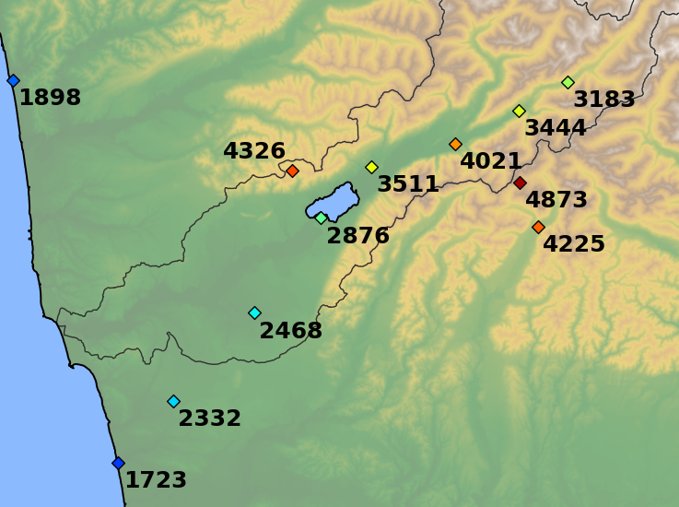
OLYMPEX Precipitation
Prairie Creek
Elevation 540m
Fisheries
Elevation 50 m
Accumulated precipitation (mm)
10 Nov 2015 – 1 May 2016
~ from 65 frontal systems
How does this pattern vary? With storm sector? Environmental conditions?

Slide 11
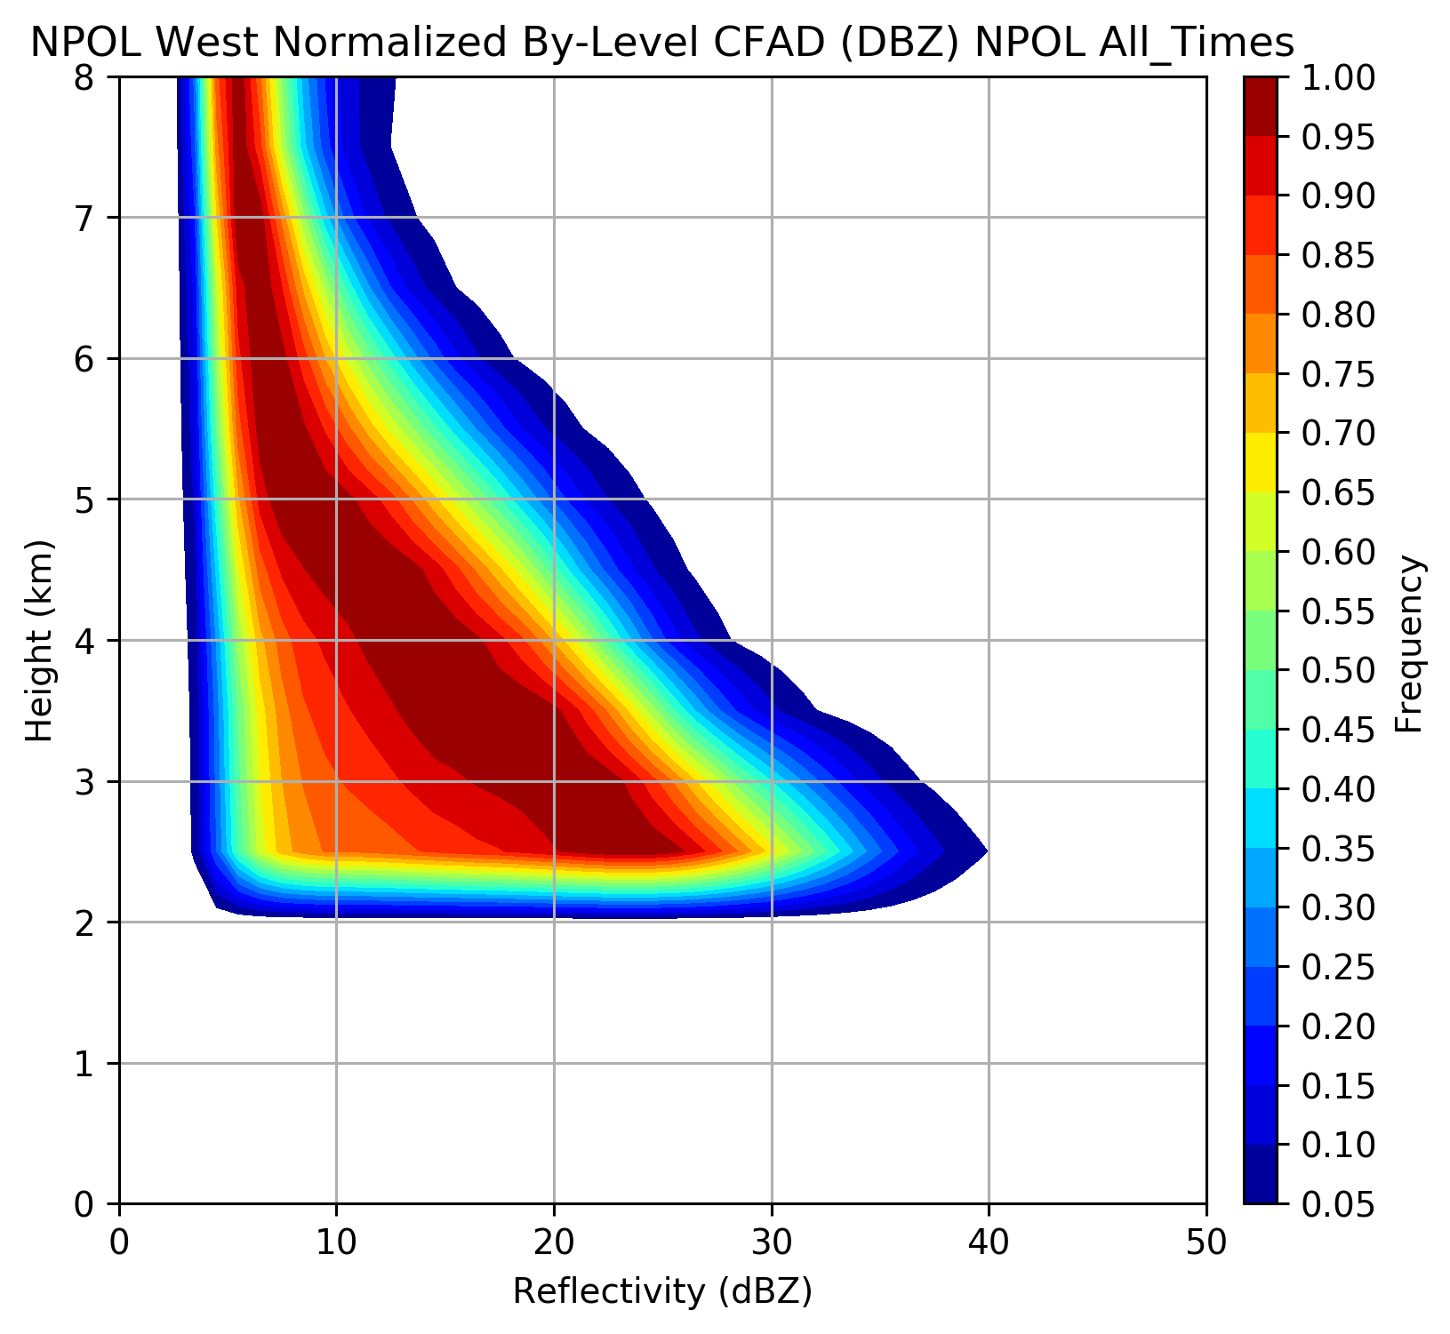
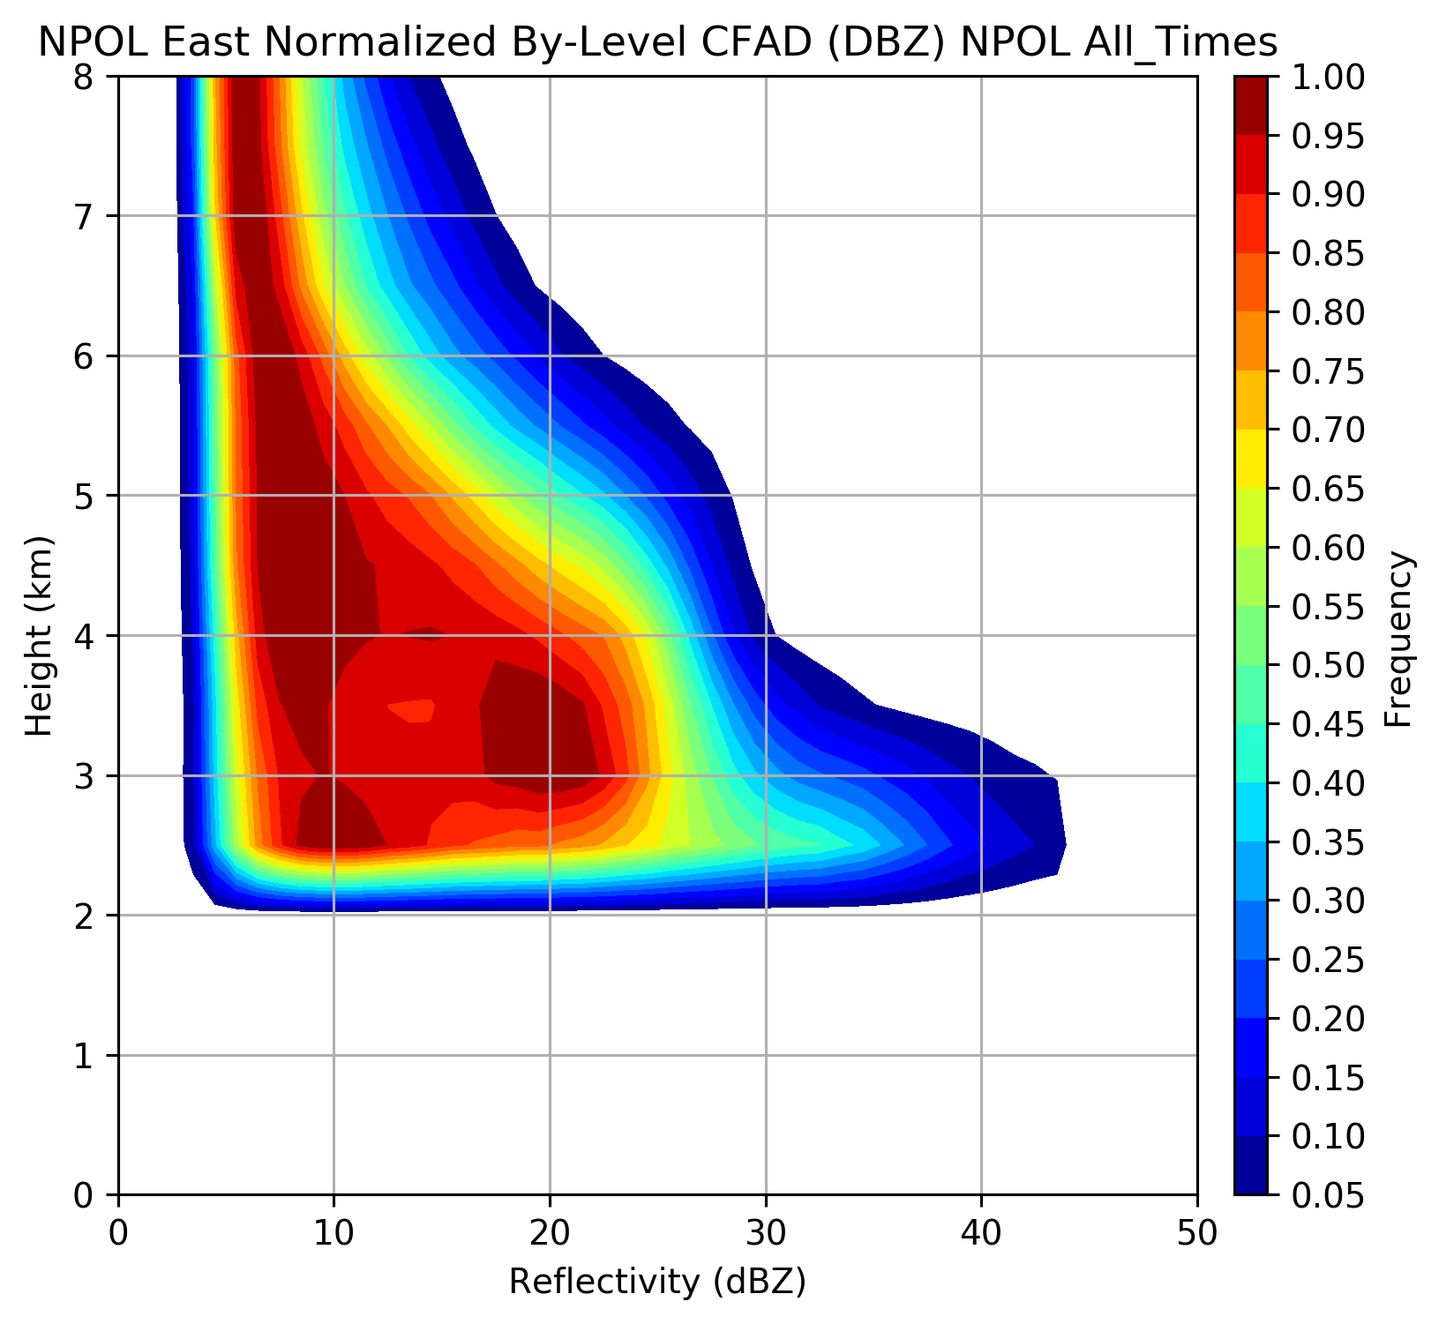
Orographic Enhancement Aloft from Radar
Ocean
Land – Windward Slopes
Height (km)
Reflectivity (dBZ)
12 Nov – 18 Dec, 3-15 Jan
Contoured Frequency by Altitude Diagrams
Frequencies normalized by level for all NPOL RHI data over ocean and land above 2 km height
Rowe et al., in prep

Slide 12
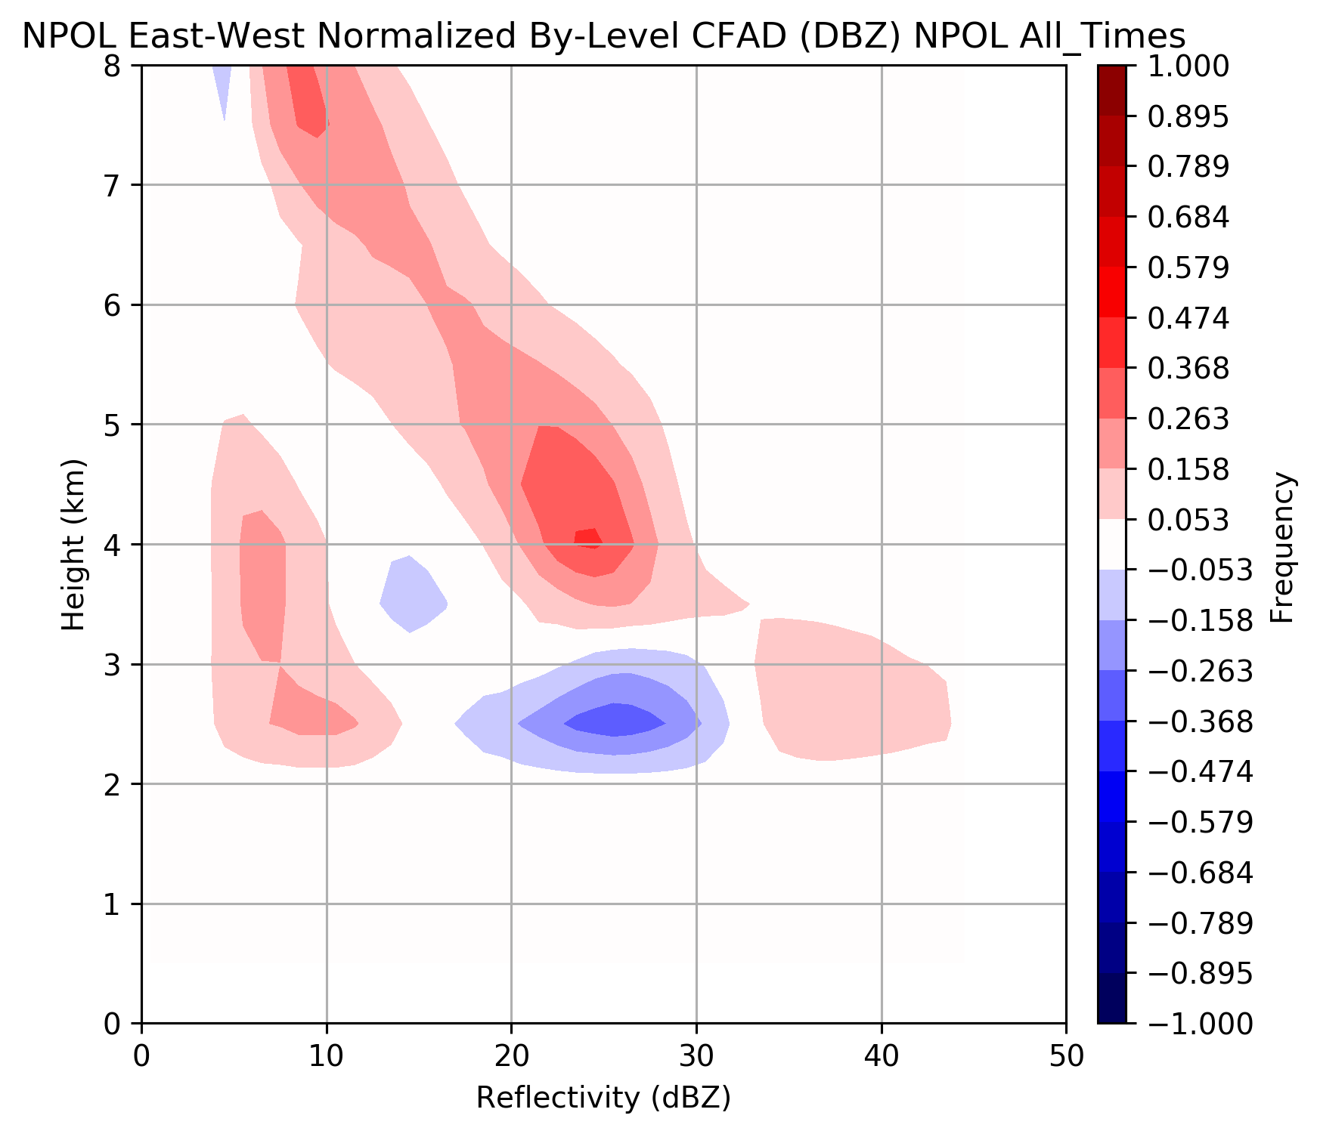
Orographic Enhancement Aloft
Land – Ocean Difference CFAD
Greater frequency of higher reflectivities at all levels over windward slopes
Shift to higher reflectivity near melting level (2-3 km during warm events)
Rowe et al., in prep

Slide 13
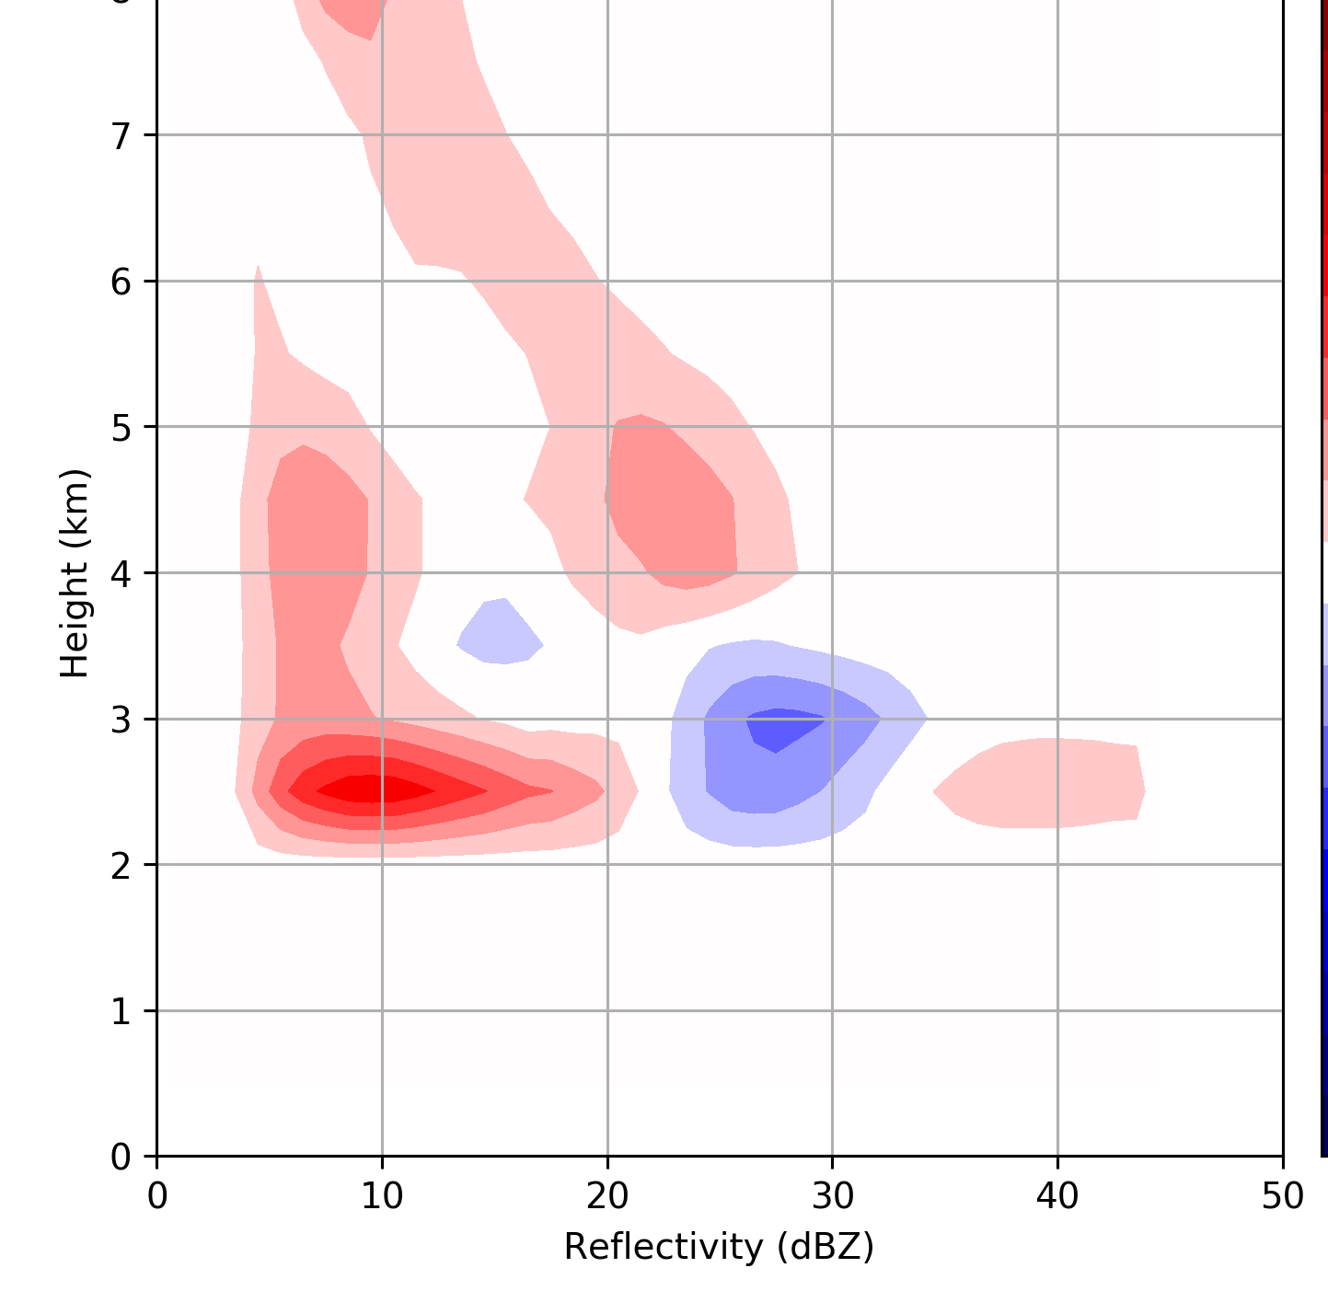
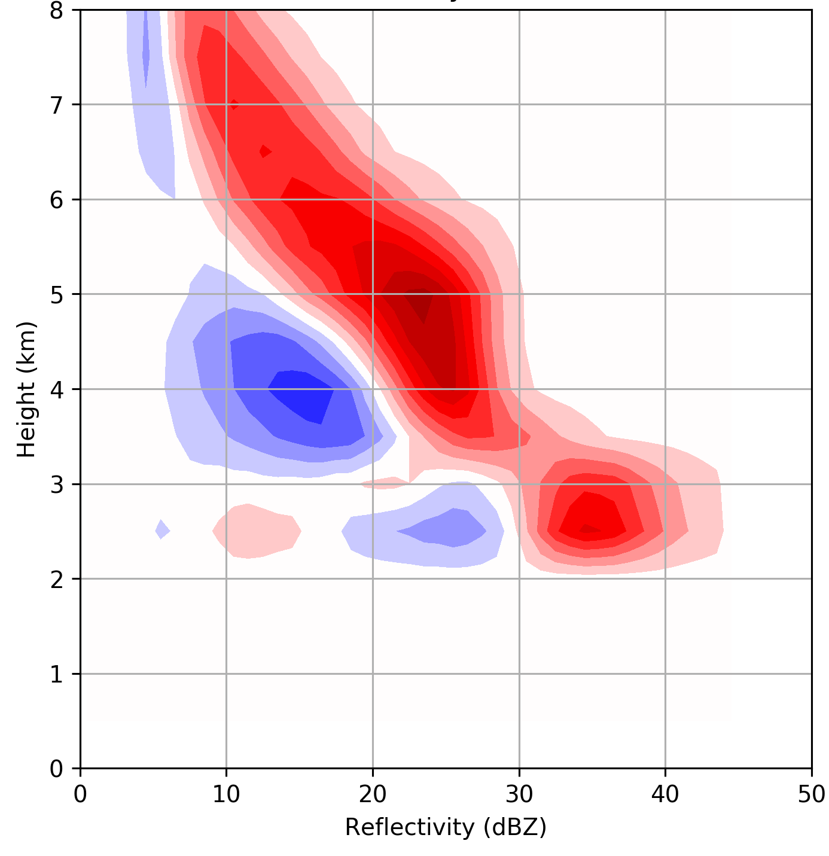
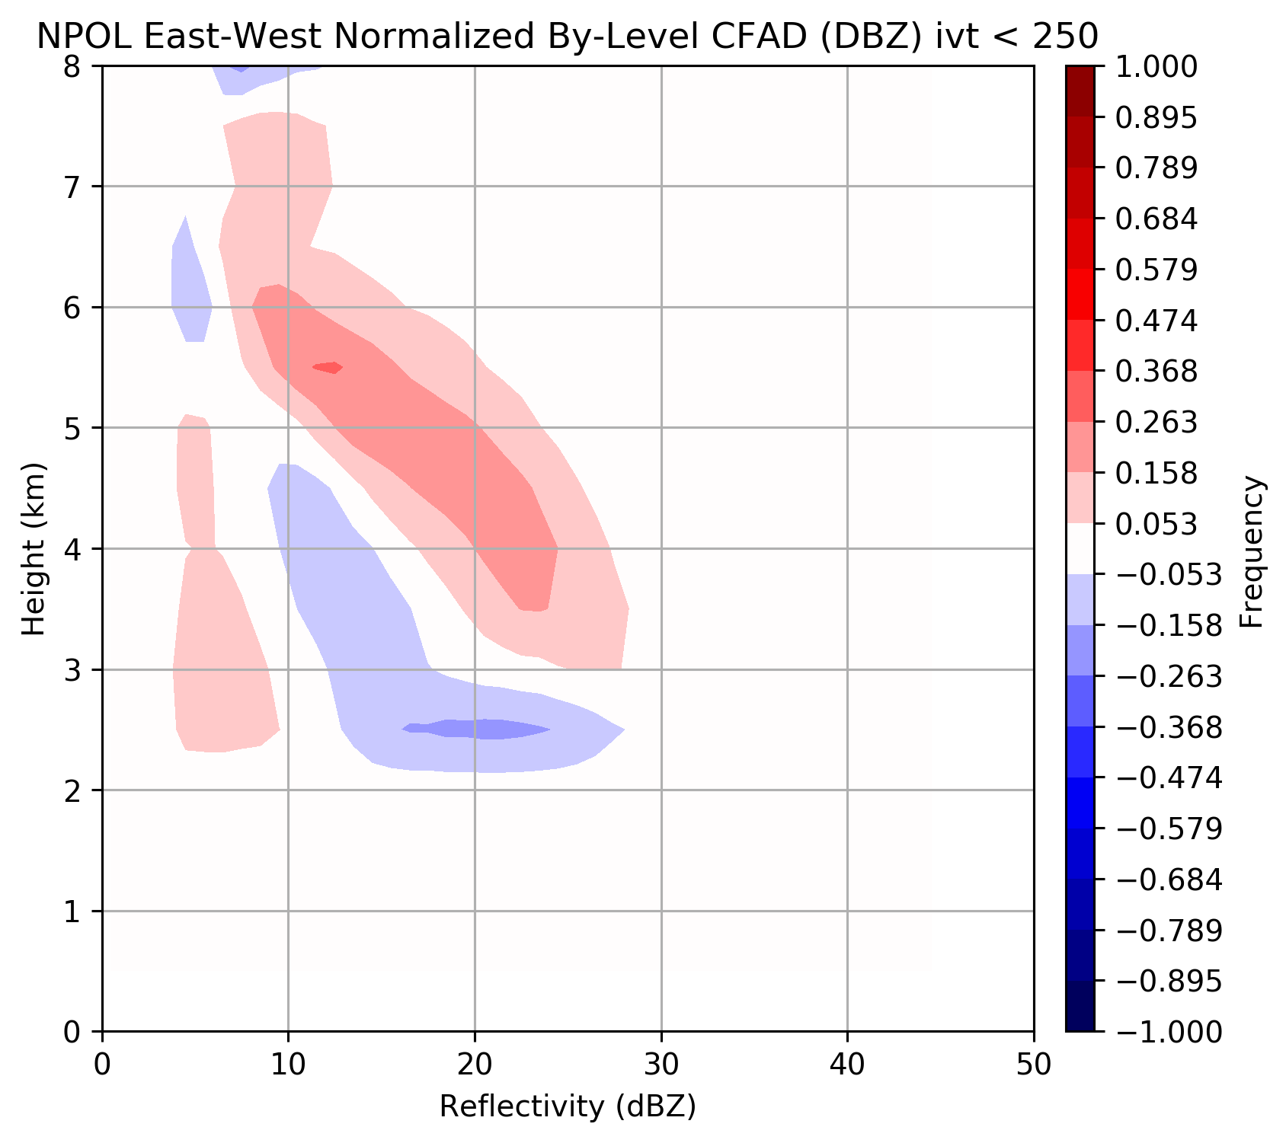
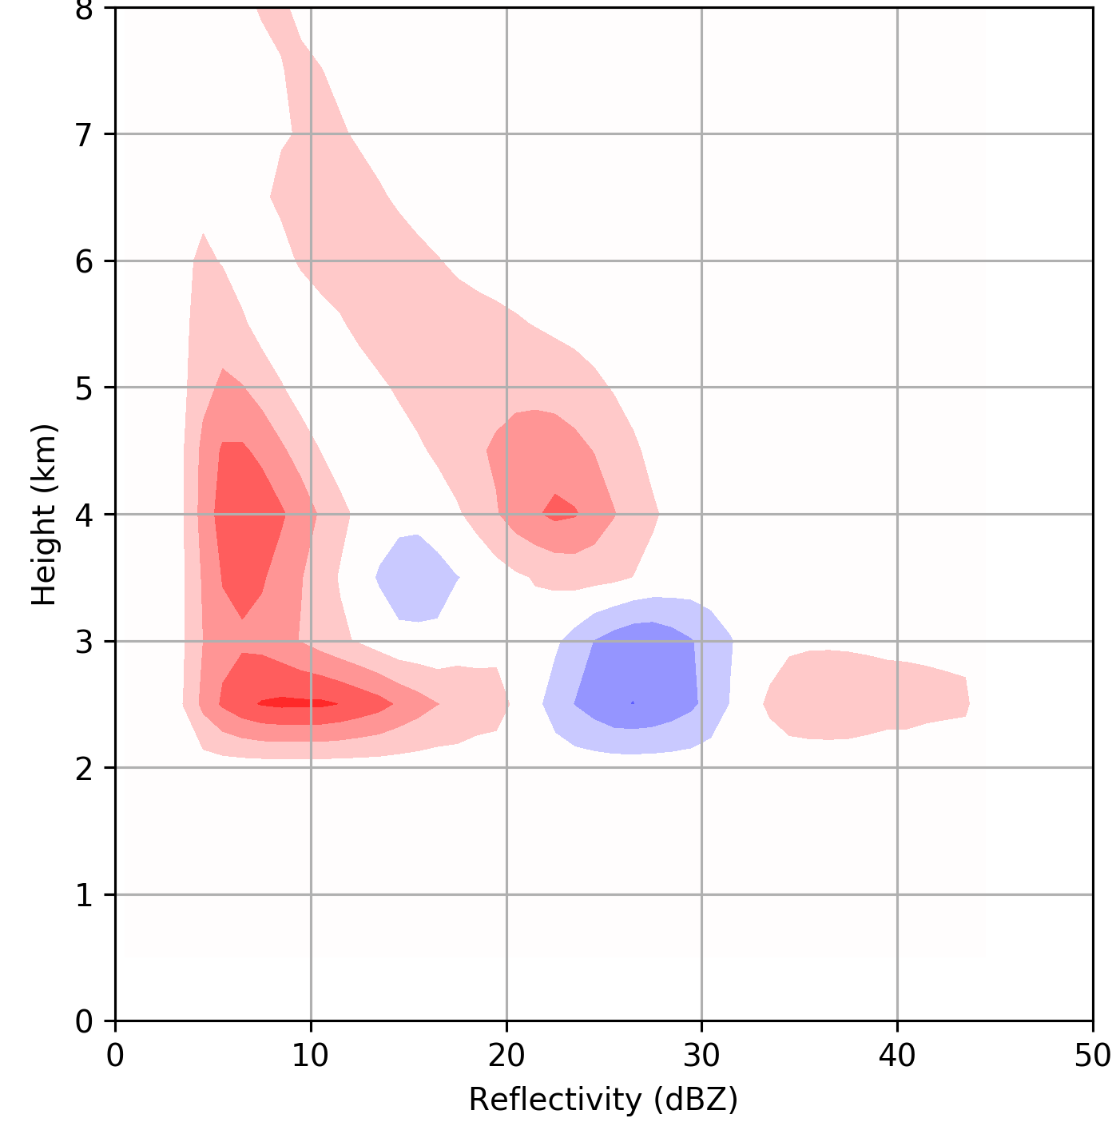
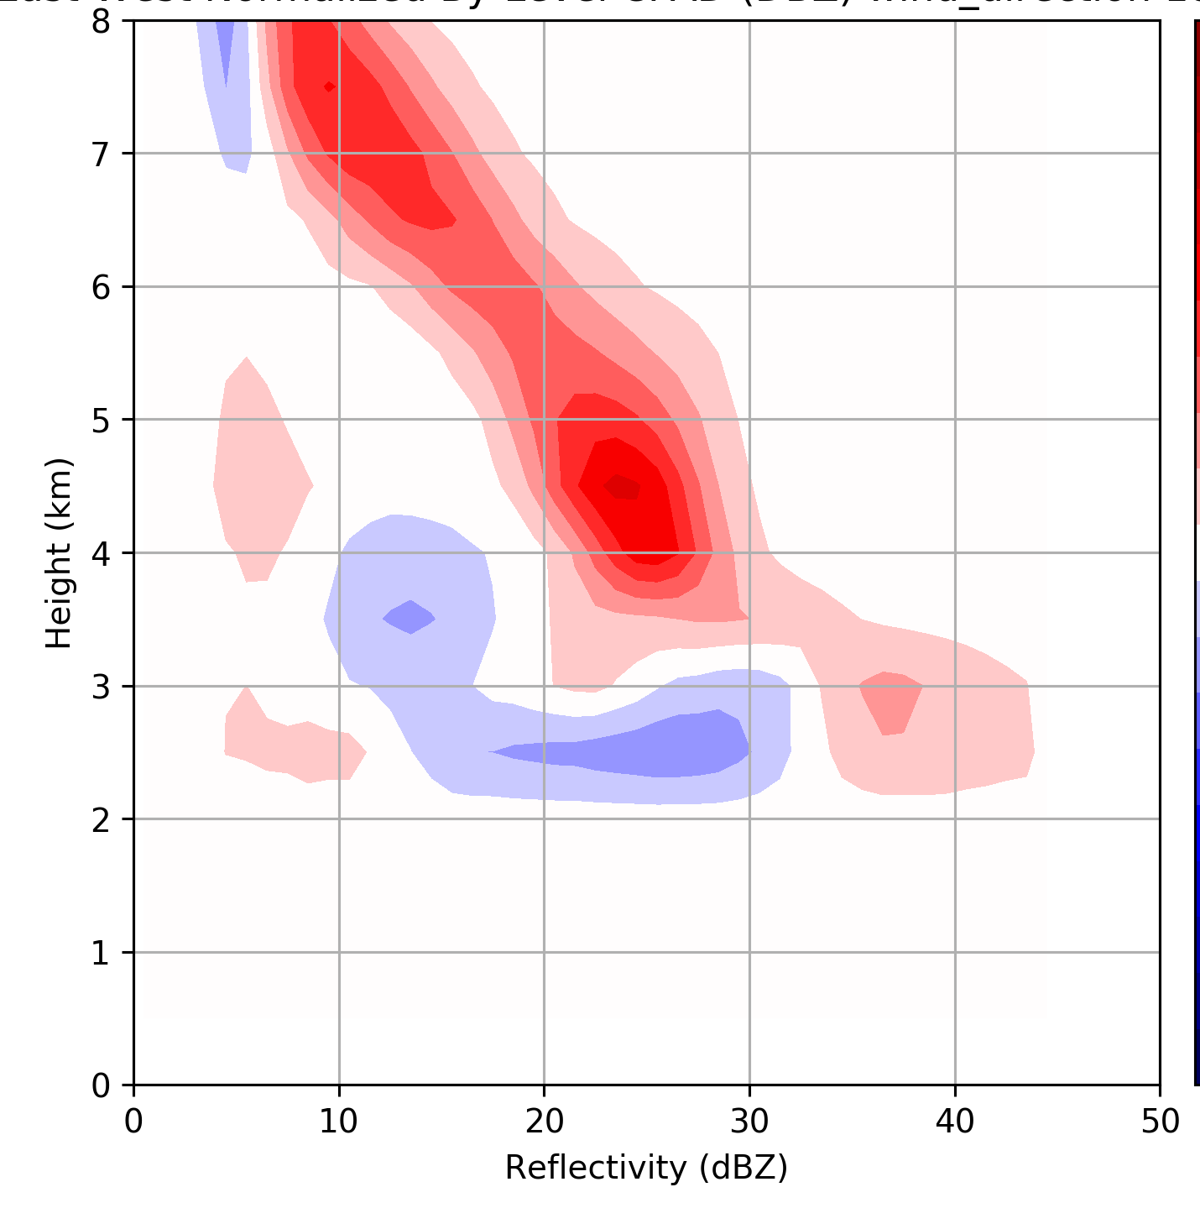
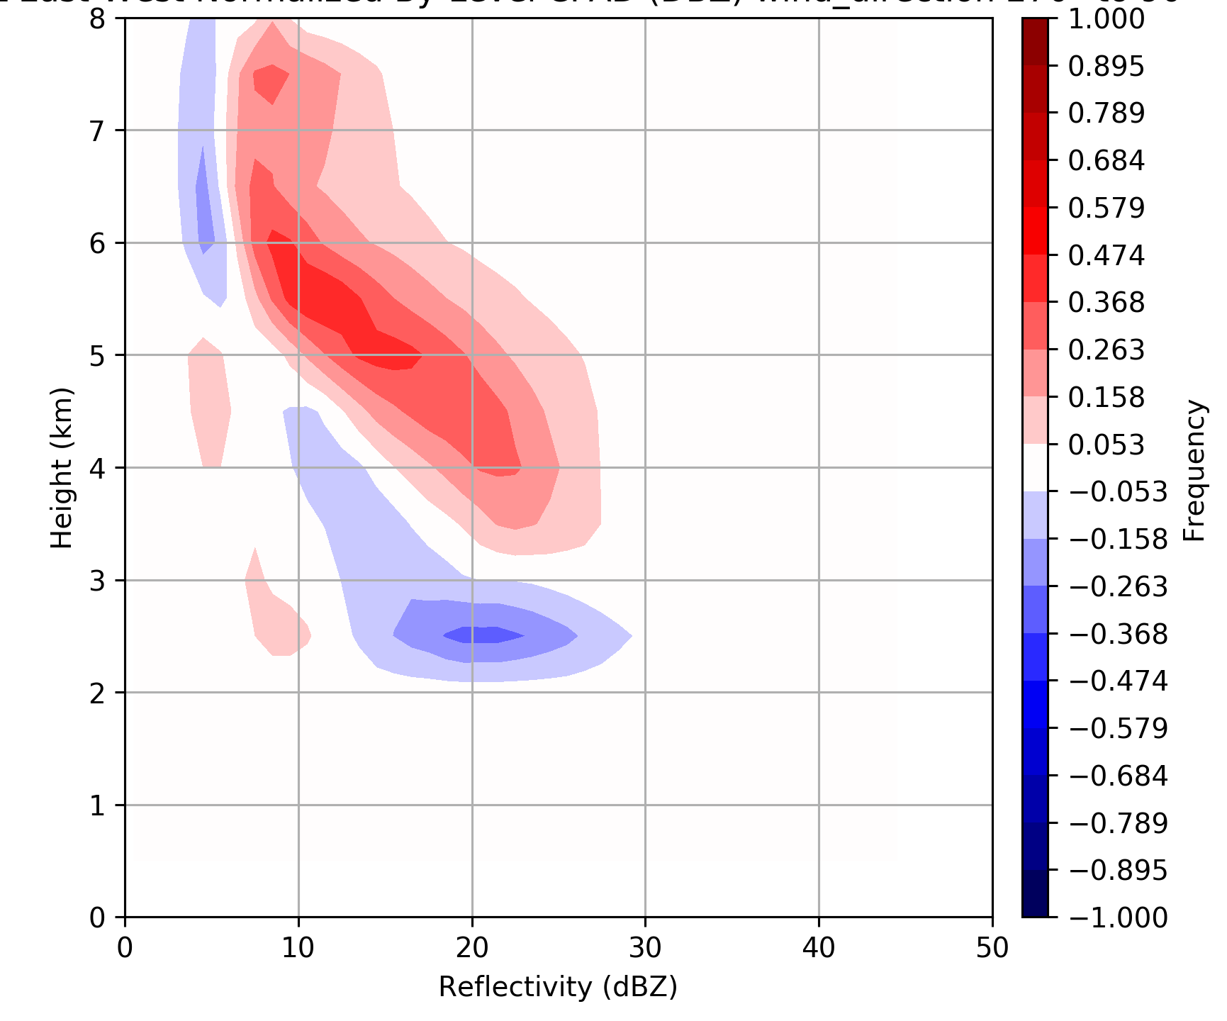
~Pre-frontal
~Warm sector
~Post frontal
20% of time
10% of time
70% of time
250 < IVT < 450 kg m⁻¹ s⁻¹
IVT > 450 kg m⁻¹ s⁻¹
IVT < 250 kg m⁻¹ s⁻¹
42% of time
29% of time
29% of time
90° < wind dir. < 180°
180° < wind dir. < 270°
270° < wind dir. < 90°
Rowe et al., in prep
Rowe et al., in prep

Slide 14
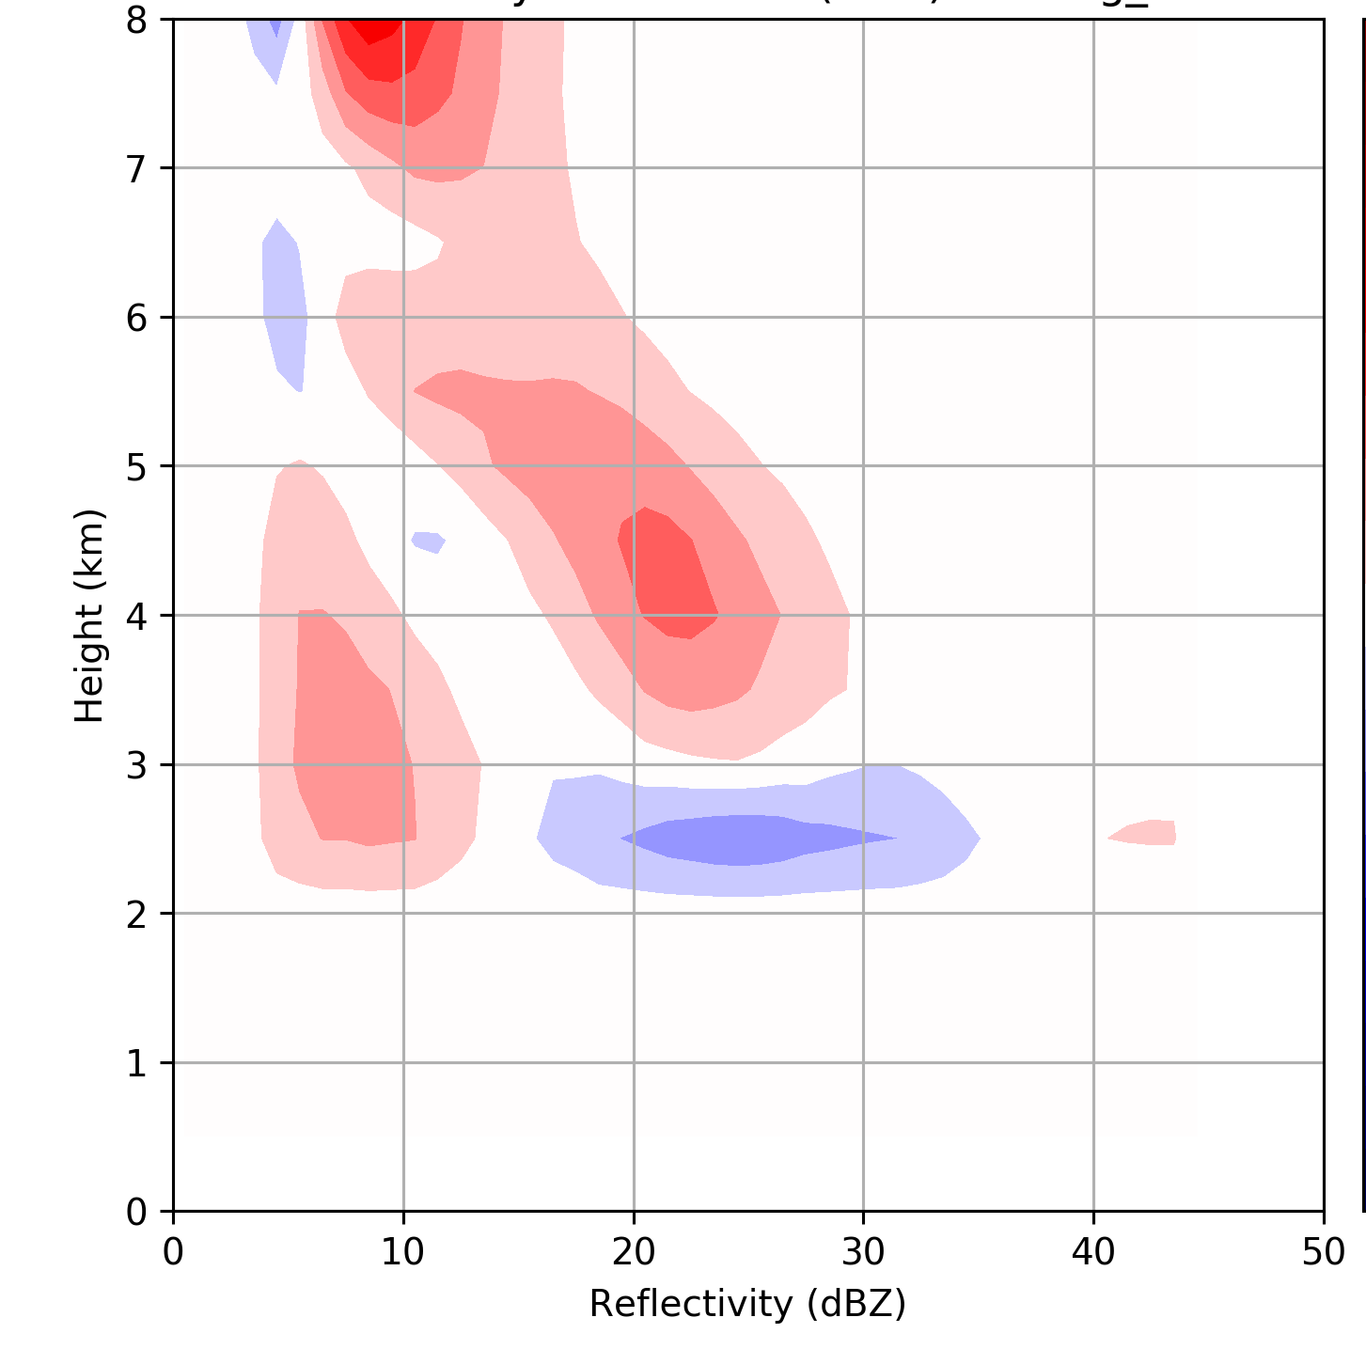
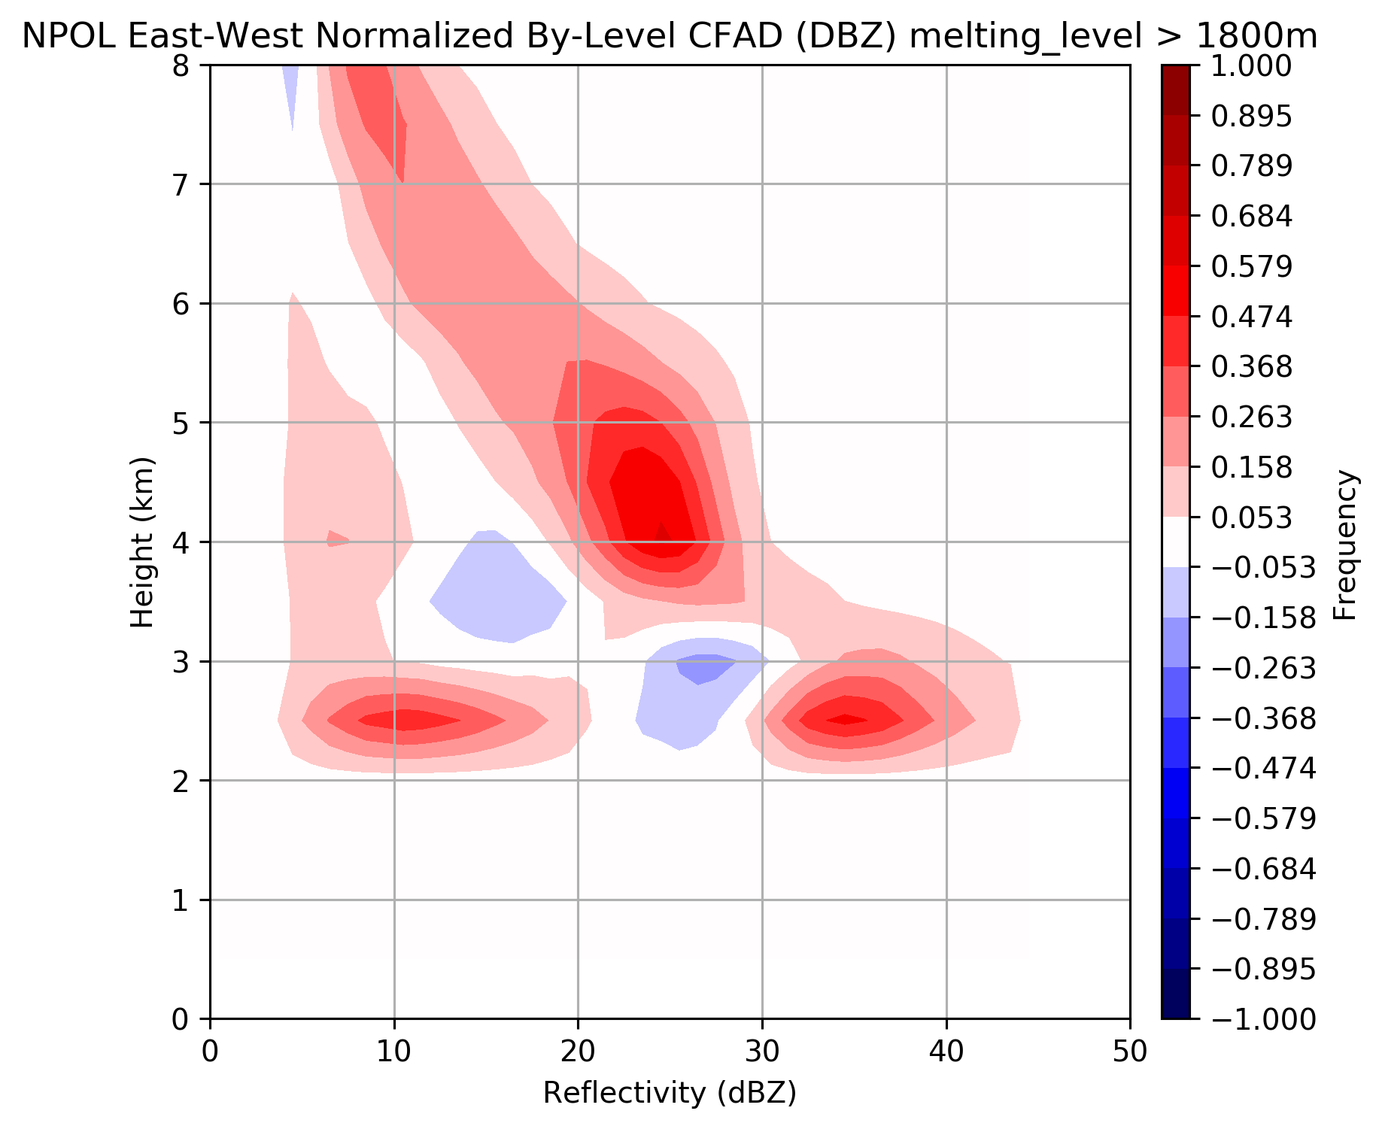
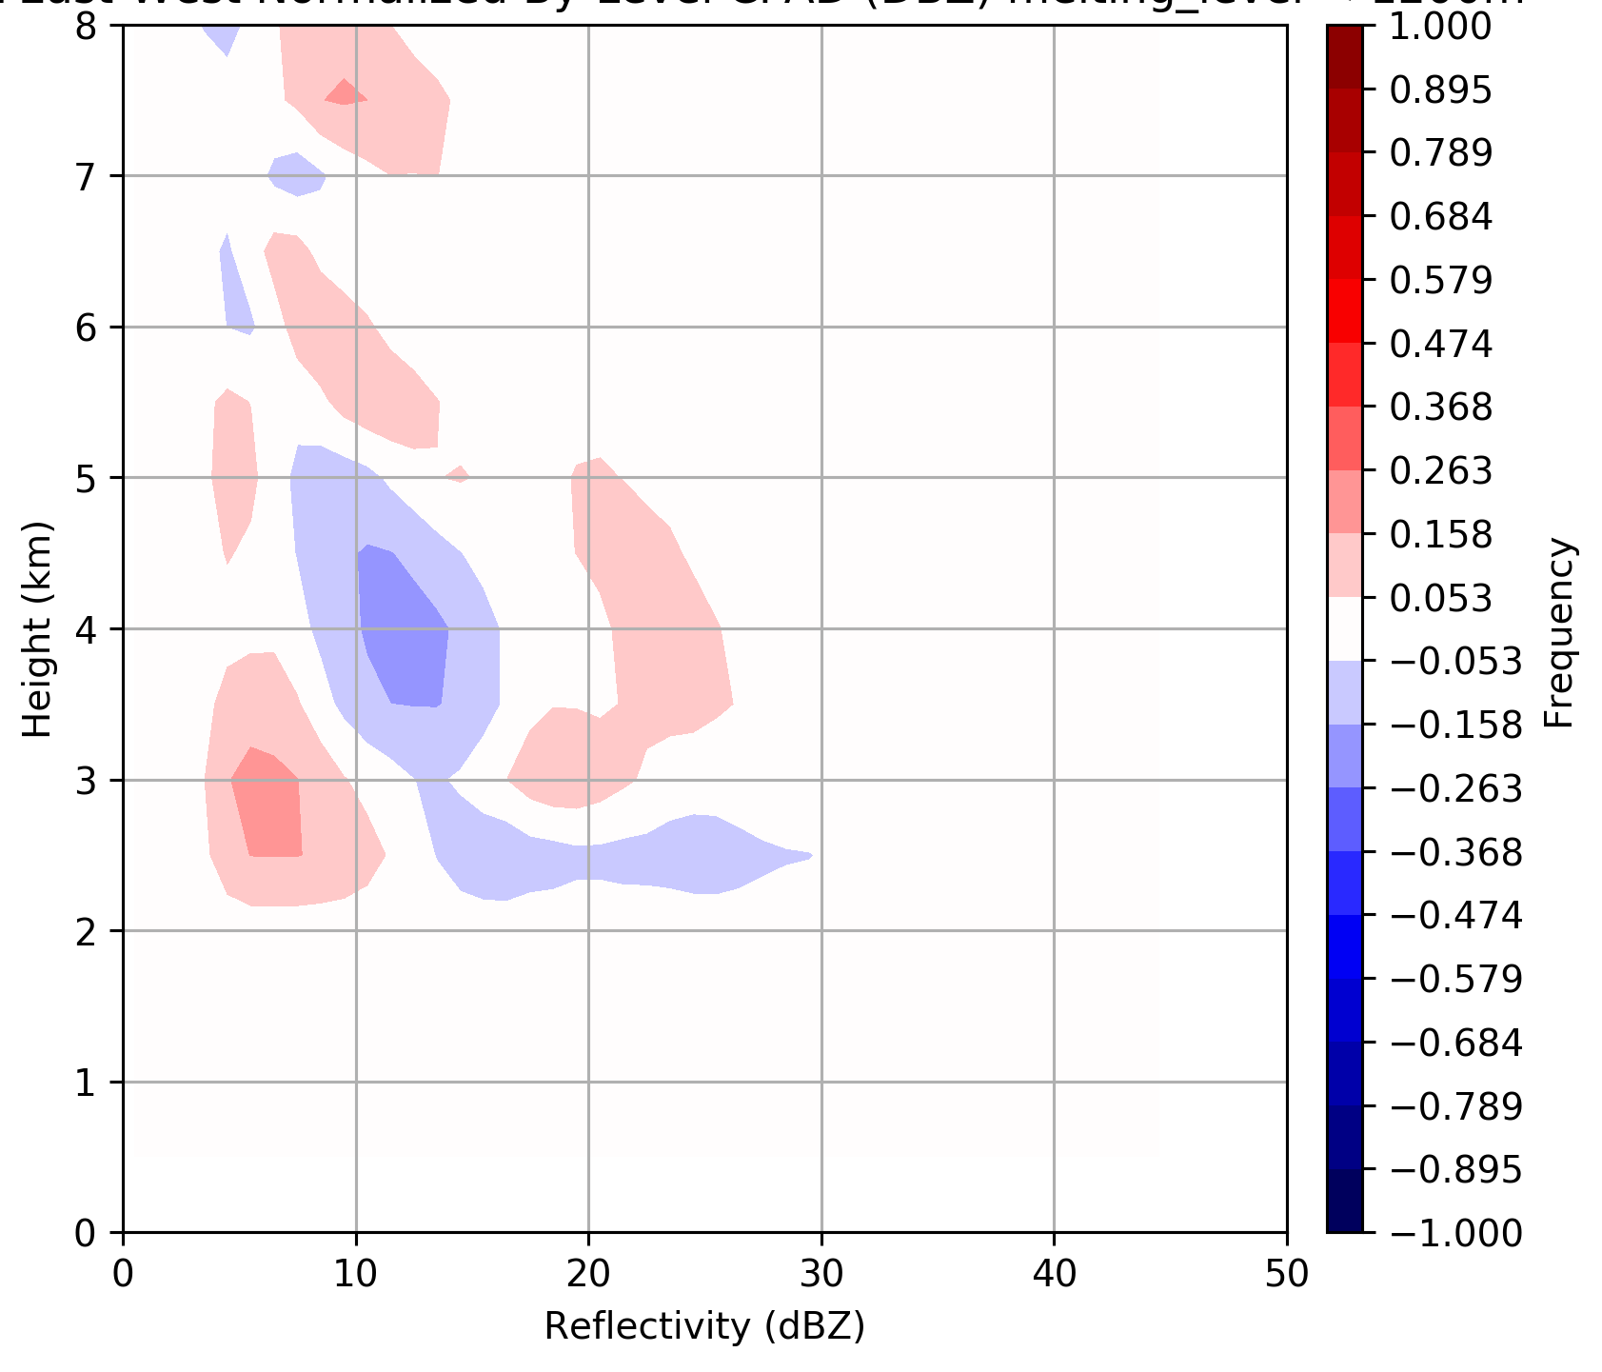
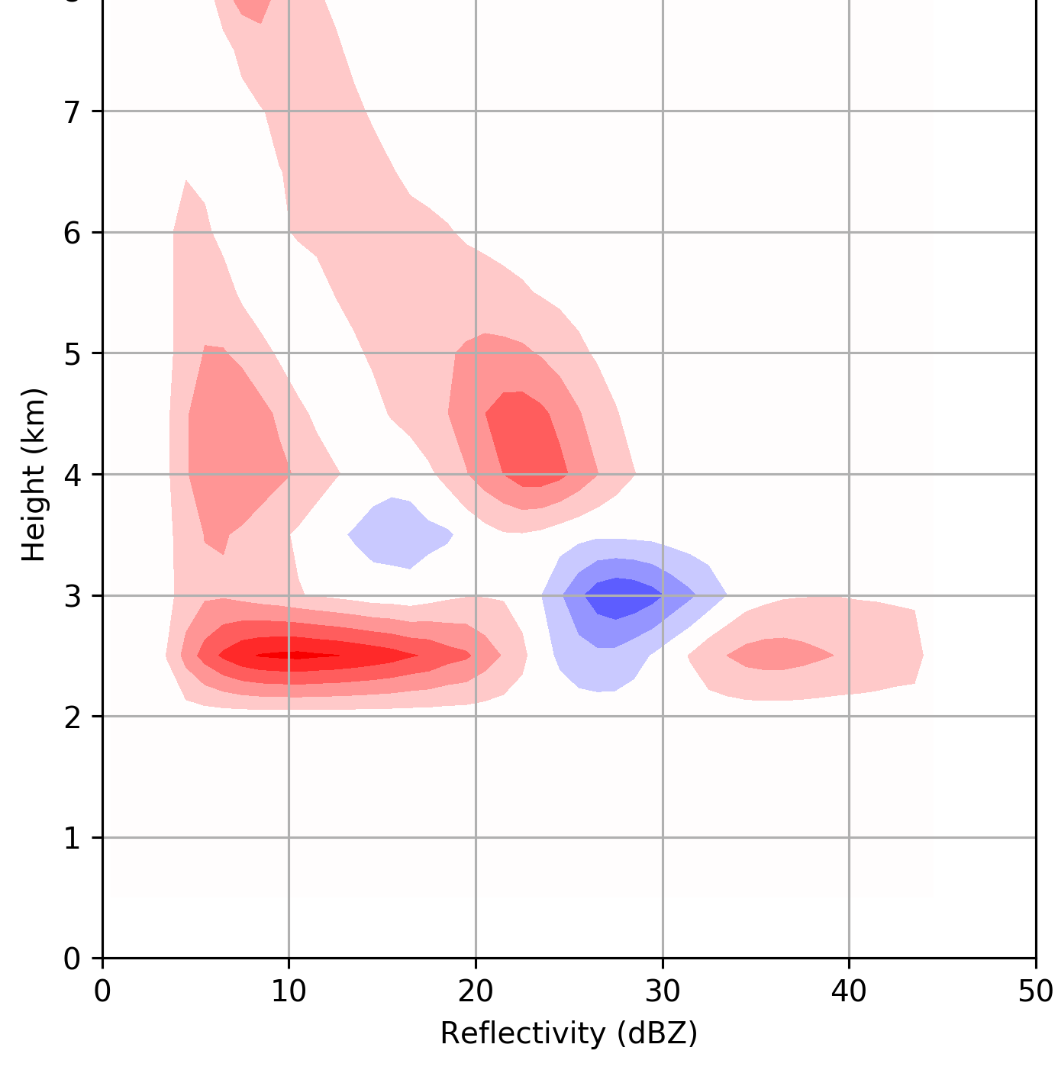
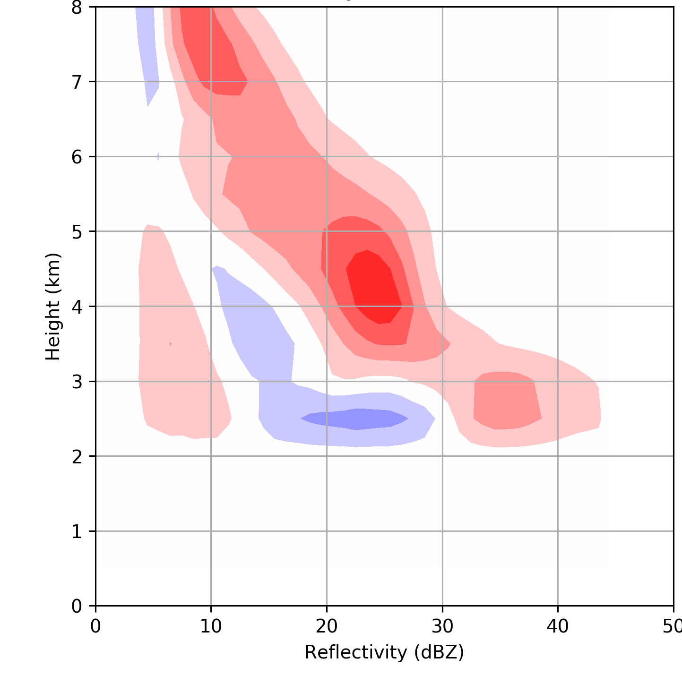
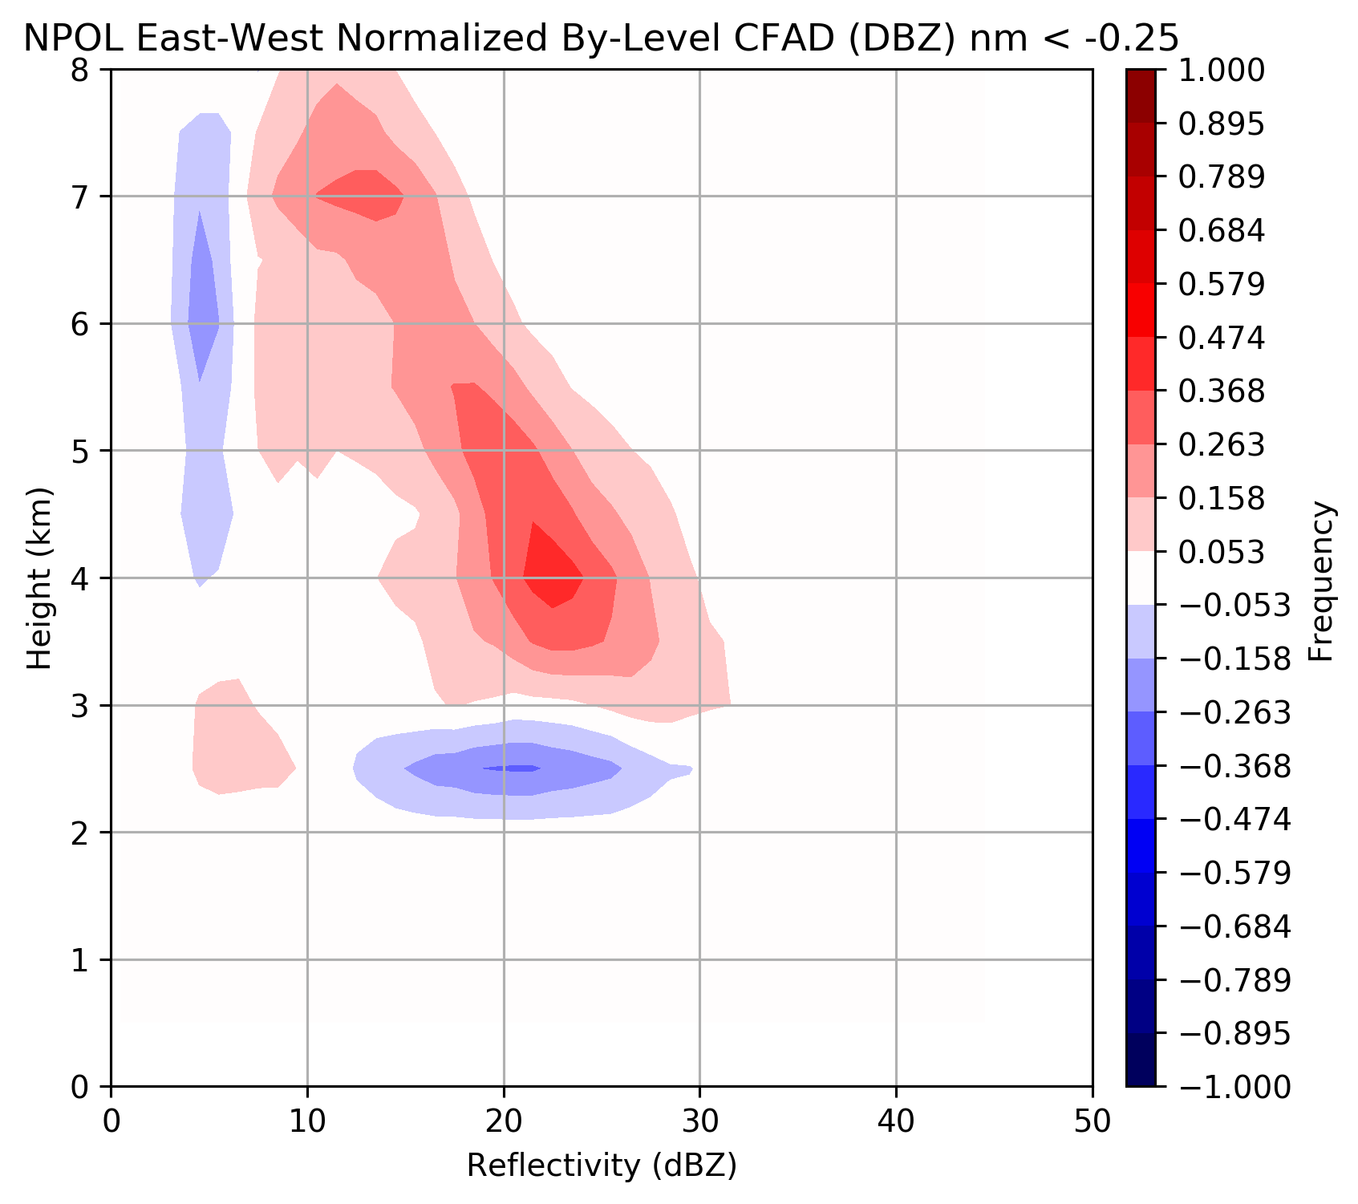
~Pre-frontal
~Warm sector
~Post frontal
25% of time
36% of time
39% of time
Melting level 1.2-1.8 km
ML > 1.8 km
ML < 1.2 km
37% of time
43% of time
20% of time
Nm stable
Nm neutral
Nm unstable
Rowe et al., in prep
Strongest enhancement during in warm sector with atmospheric river like conditions

Slide 15
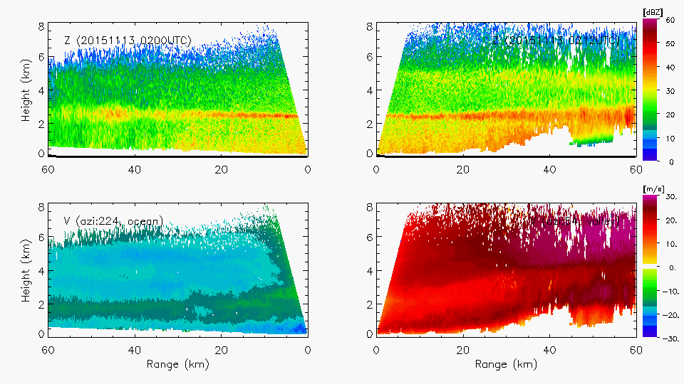
Enhancement at both upper and lower levels
Ocean
Land
Reflectivity (dBZ)
Reflectivity (dBZ)
Radial Velocity(dBZ)
Radial Velocity(dBZ)
Warm Sector – 13 November 2015
Notes:
Shows both lower and upper level enhancement. Midlevel flow lifting as well as low-level.

Slide 16
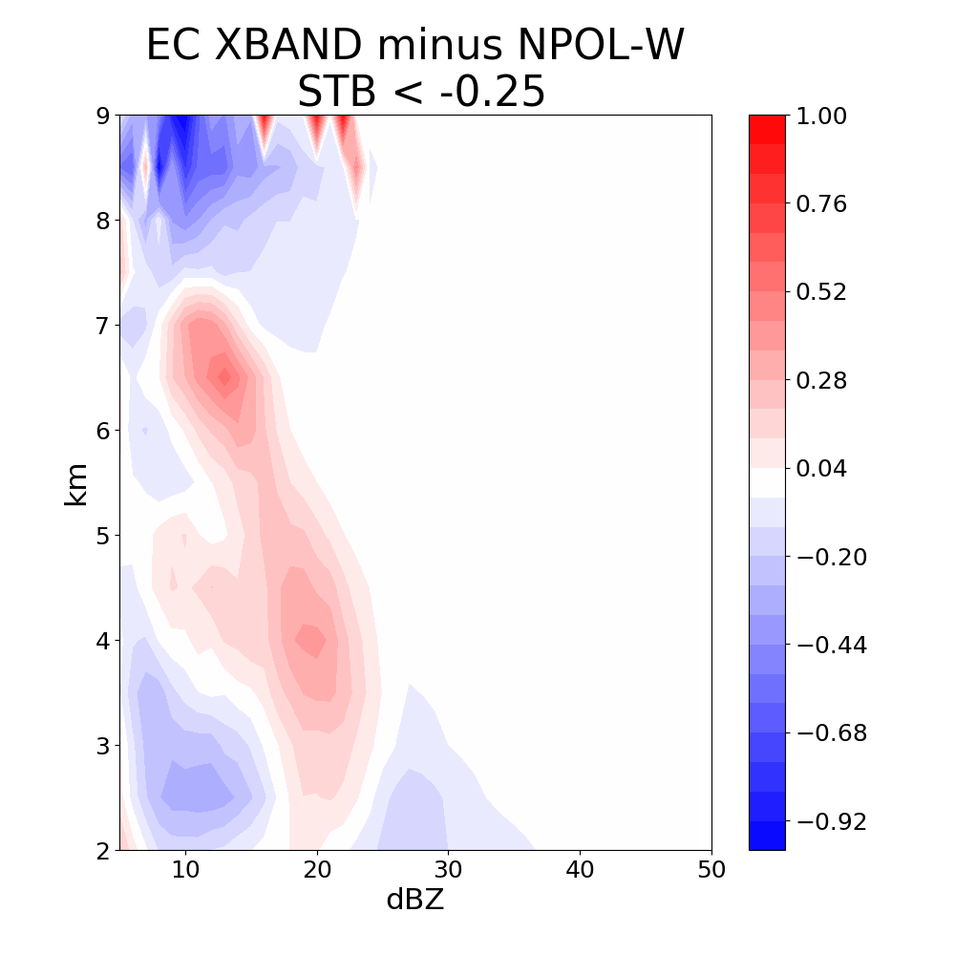
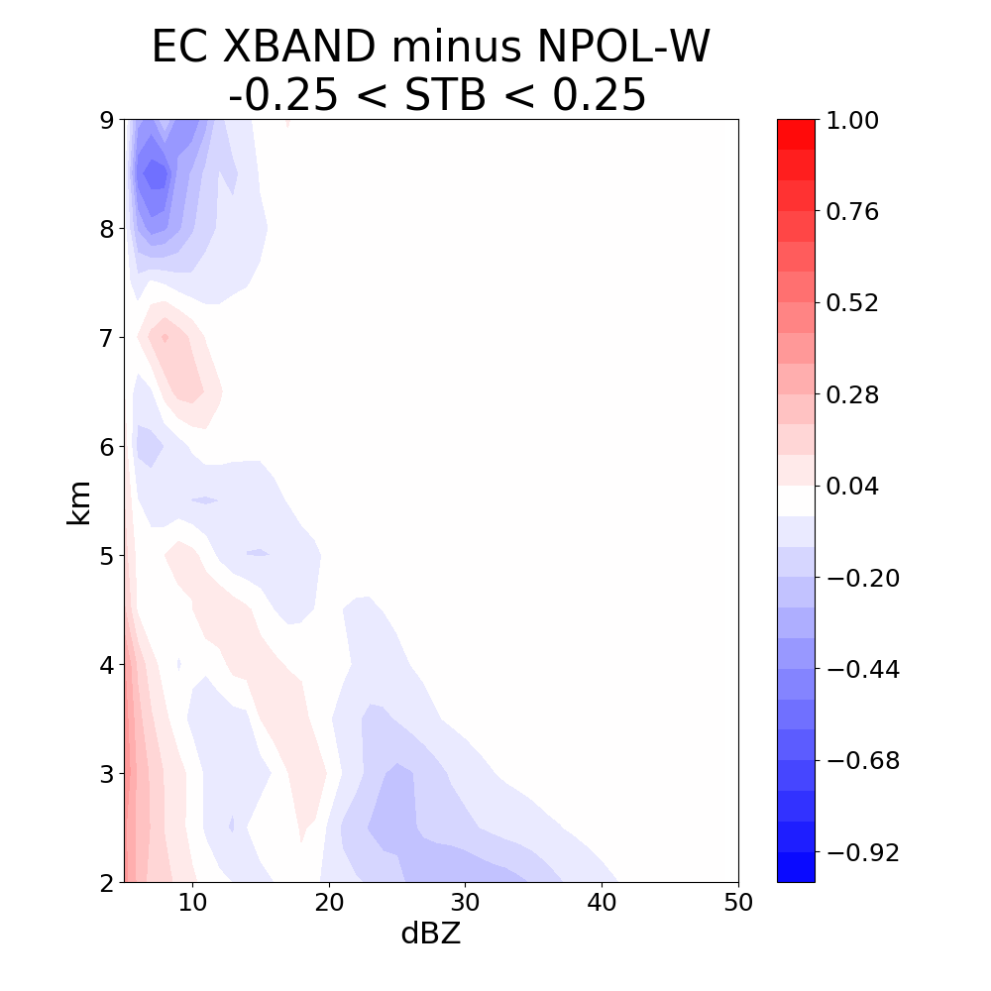
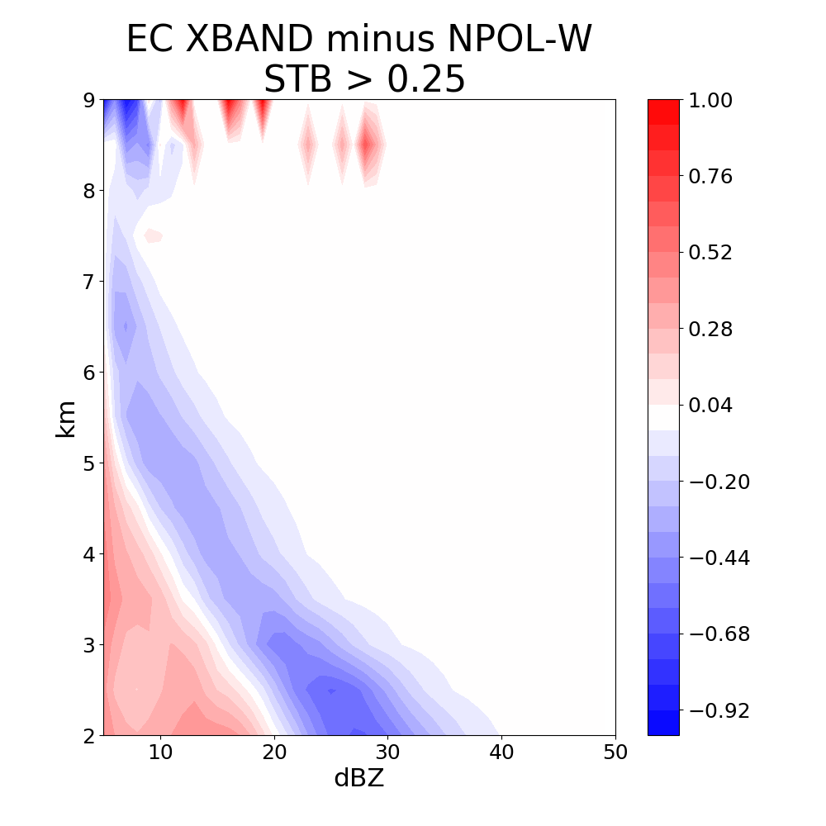
NPOL Ocean Difference
EC X-band CFAD Leeside
Unstable
Neutral
Stable
Leeside – not always the lee side in Post-frontal environment
Some ‘de-enhancement’, but some precip gets across
Precipitation particles cannot get across high terrain

Slide 17
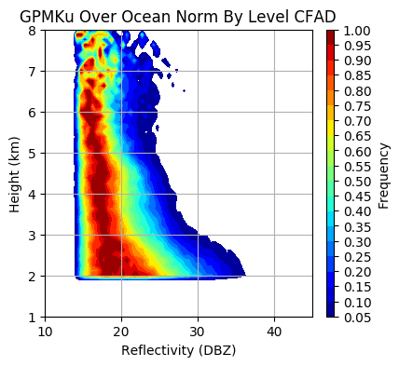
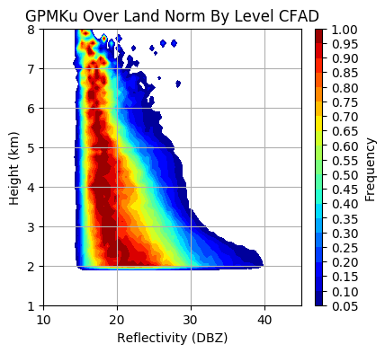
Can enhancement aloft can be seen GPM
Ocean
Land
Shift to higher reflectivity
Used all GPM overpasses since launch and during cold season NDJFM
Ocean box (46.5—48.6°N 126.4—124.7°W)
Land box (46.5—48.6°N 124.3—122.6°W) Olympic Peninsula

Slide 18
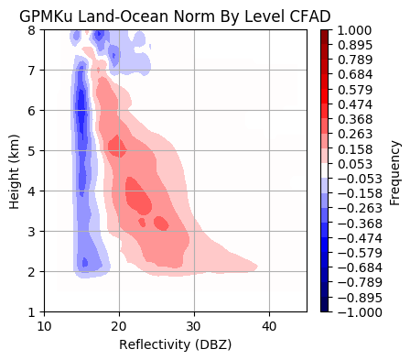
Can enhancement aloft can be seen GPM
Land minus Ocean
Shift to higher reflectivity
Used all GPM overpasses since launch and during cold season NDJFM
Ocean box (46.5—48.6°N 126.4—124.7°W)
Land box (46.5—48.6°N 124.3—122.6°W) Olympic Peninsula

Slide 19
What we are learning from OLYMPEX
Enhancement of the precipitating cloud system occurs aloft
Synoptic and environmental conditions affect the degree of enhancement
Enhancement on windward slopes greatest during warm, strongly forced events
More details up next
  Joe – Atmospheric Rivers
  Angela – Enhancement aloft (microphysics from aircraft)
  Robert – High resolution modeling and KH waves
  Joe – Cloud and precipitation structure across all regions (ocean → windward → high terrain → leeside)

Slide 20
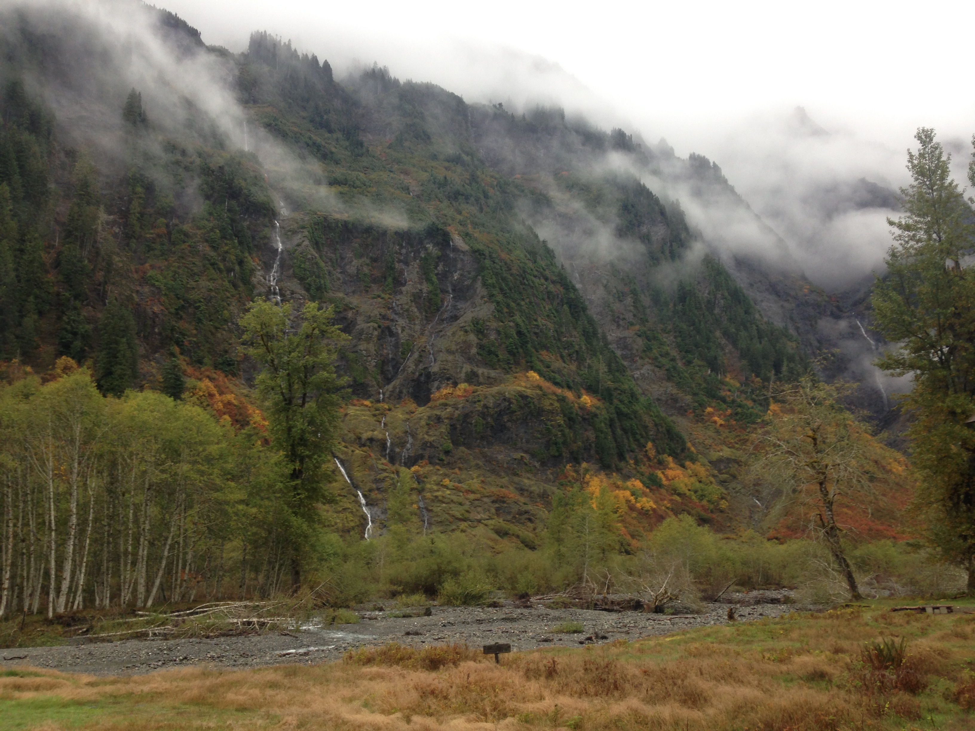
Acknowledgements
Work Supported by:
NASA grants: NNX16AD75G, NNX16AK05G, 80NSSC17K0279
NSF grants: AGS-1503155, AGS-1657251
Pacific Northwest Weather Workshop, Seattle, 28 April 2018

