Slide 1
Patrik Bohlinger Ph. D. Defense
Introduction by
R. A. Houze
University of Bergen
March 23 2018

Slide 2
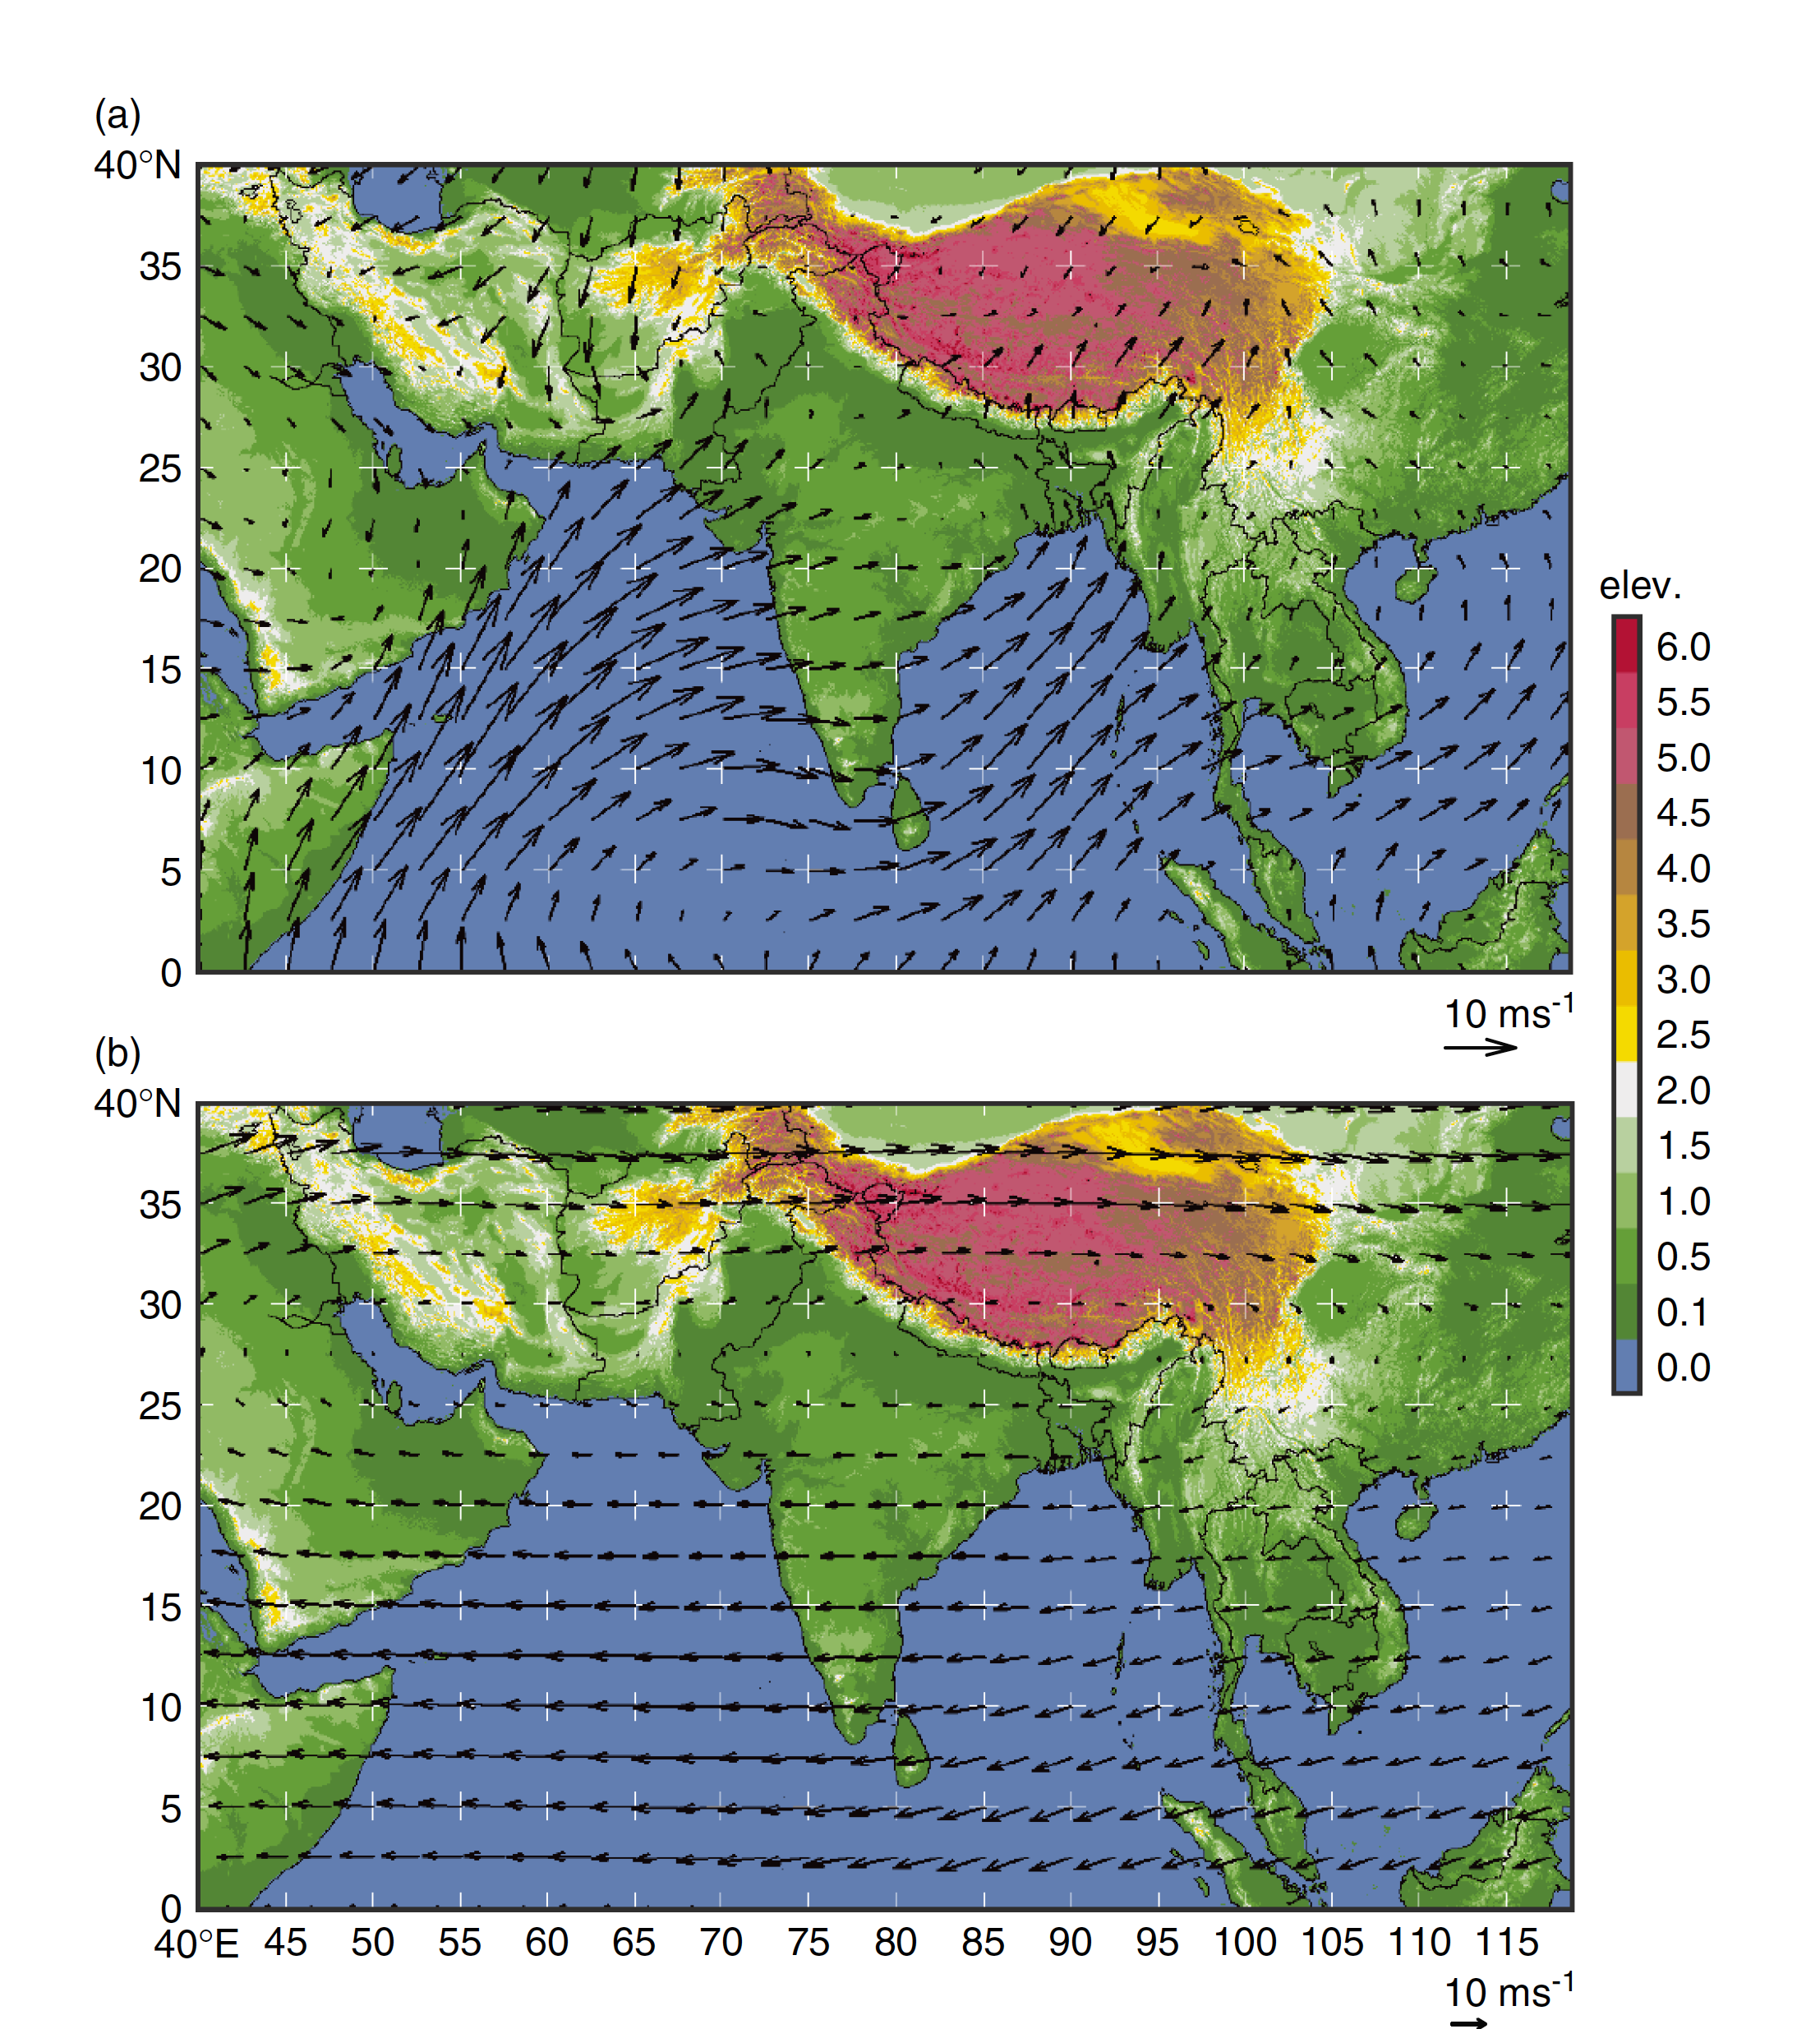
The South Asian Monsoon
1000 hPa
200 hPa

Slide 3
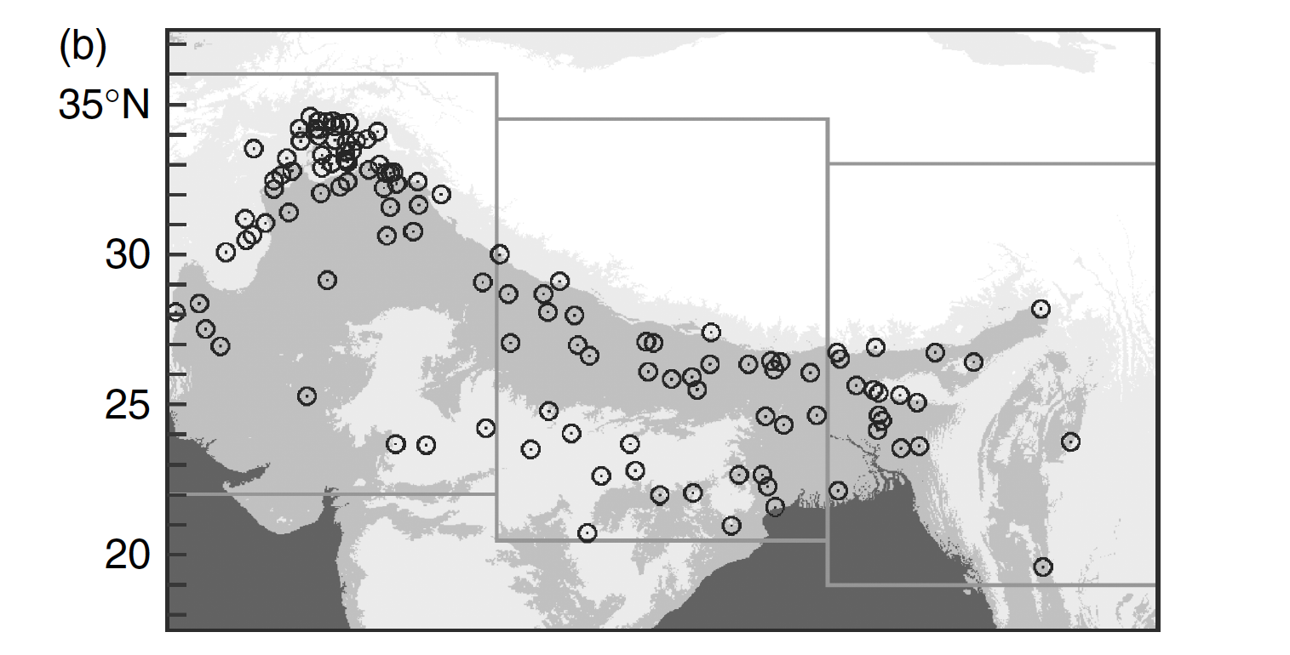
Early TRMM results: Where extreme mesoscale deep convection occurs over South Asia
Houze et al. 2007
West
Central
East
Sawyer 1947
Medina et al. 2010
Houze et al. 2011
Rasmussen & Houze 2012
Rasmussen et al. 2015
Romatschke et al. 2010
Romatschke & Houze 2011 Vellore et al. 2015
  Ranalkar et al. 2016
  Houze et al. 2017
  Bohlinger 2018
Medina et al. 2010

Slide 4
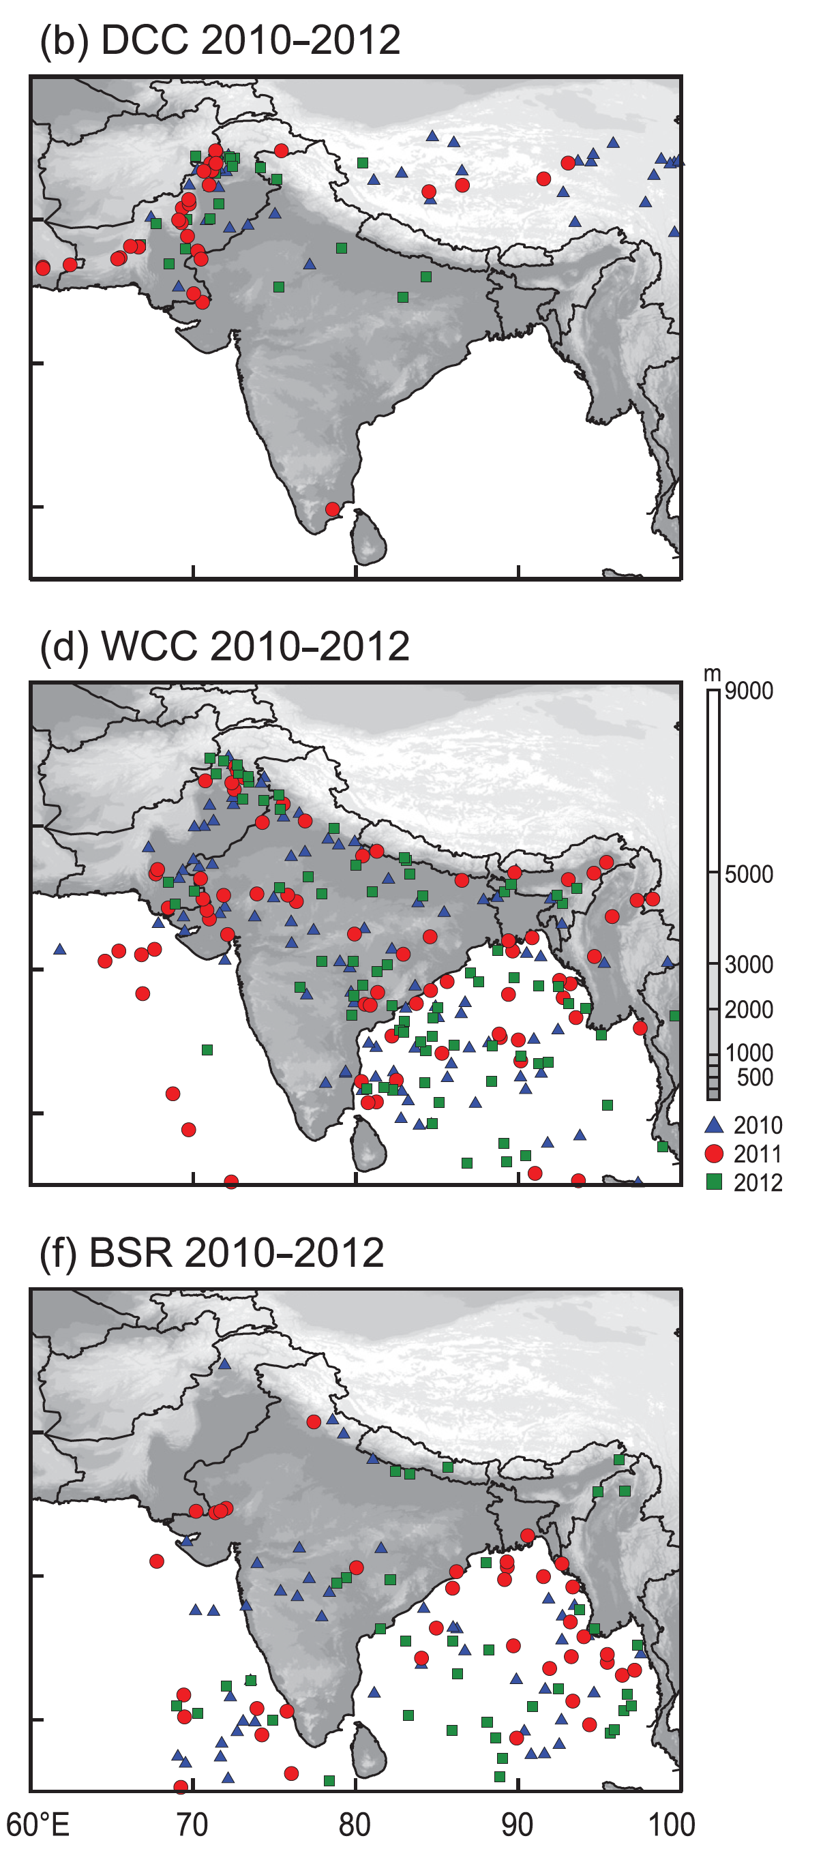
In the monsoon seasons of 2010-2012 there were several major floods
--TRMM radar data showed the extreme rainstorms in 2010-2012
Deep convective
Deep & mesoscale
Mesoscale with large stratiform
Rasmussen et al. 2015

Slide 5
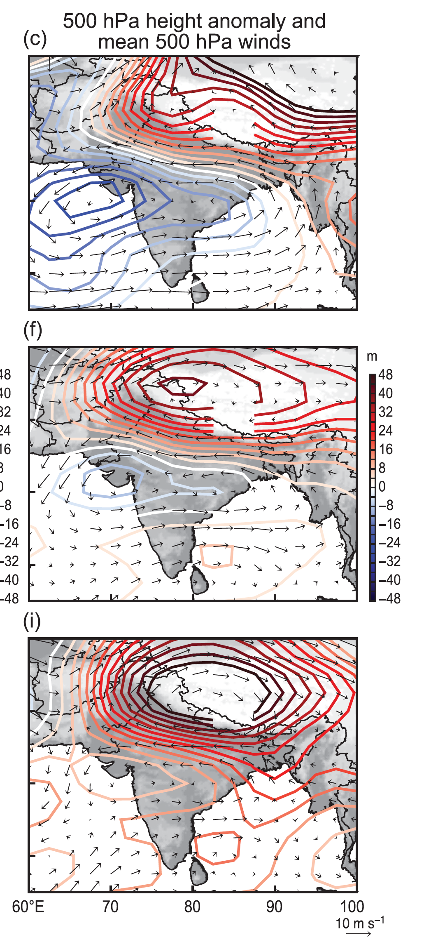
For all the major floods of 2010-2012 there was an strong ridge over the Tibetan Plateau
…these floods all were due to deep and mesoscale storms
Rasmussen et al. 2015

Slide 6
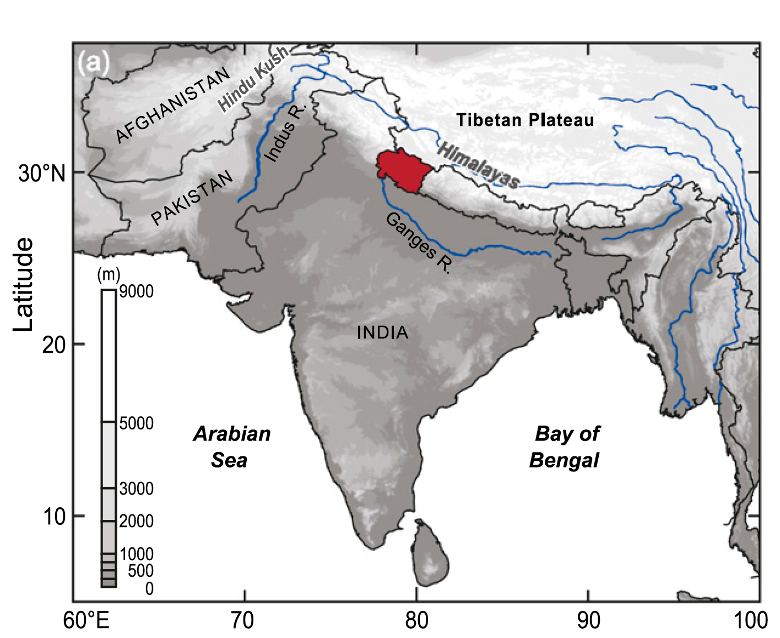
The Uttarakhand Flood of 2013

Slide 7
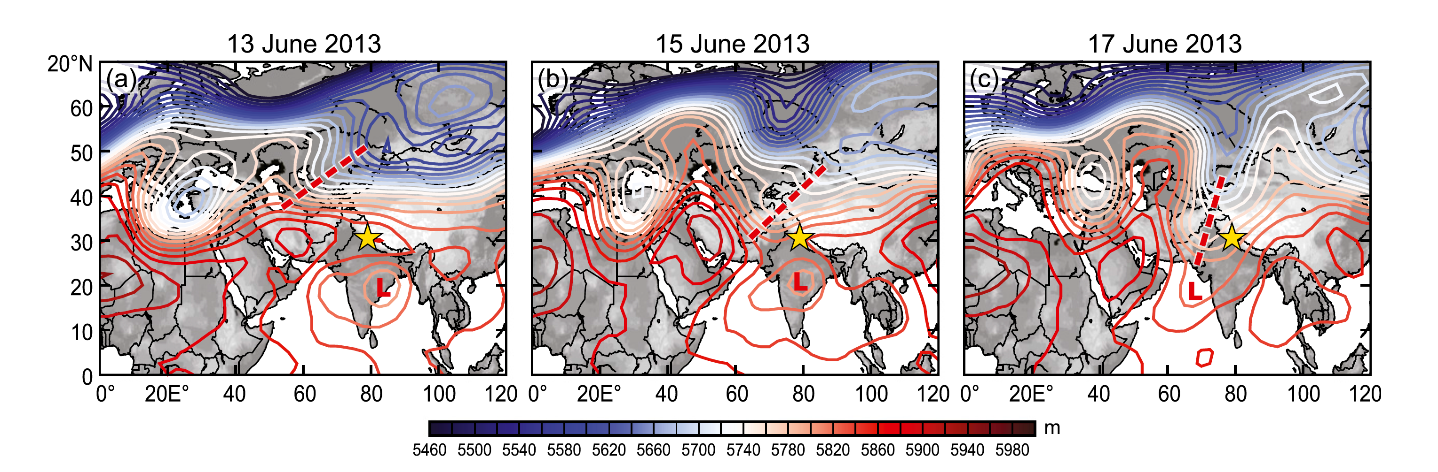
500 hPa flow in the Uttarakhand flood case
A trough, not a ridge
Precipitation was orographic with only weak embedded convection
  Vellore et al. 2015 and Ranalkar et al. 2016 have shown that the trough events have been associated with Himalayan floods repeatedly over the years
70
Houze et al. 2017

Slide 8
Patrik Bohlinger Ph. D. Defense
New Insights:
Climatology of extreme precipitation events differ between E. and W. Nepal
Characteristics of extremes haven’t changed over recorded time
Extreme rains can occur occur with similar probability in Active and Break periods of the monsoon (very important insight)
Extreme rains in Nepal are systematically of the subclass of storms associated with westerly troughs extending southward

Slide 9
Patrik Bohlinger Ph. D. Defense
My Criticisms:
Trajectory methodology may have led to an incorrect conclusion.
  Assumes parcel retains its integrity for 6 hours or more
  Horizontal mixing ignored
  Unlikely that uptake wet land surface can explain the extreme rain
  Need to show quantitatively that surface fluxes are strong enough
  Needs to be dealt with in a revision of paper 3
Stability of the upstream flow needs to be analyzed

Slide 10
This work was supported by the University of Bergen,by NASA grant NNX16AD75G, and NSF grant AGS-150315

