Slide 1
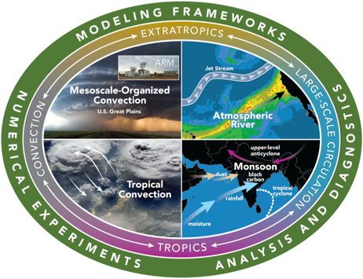





Towards Better Understanding and Simulating Changes of
Mesoscale Convective Systems
Under Climate Change
Zhe Feng
University of Arizona. Feb 15, 2018
  Contributions:
  Ruby Leung, Robert Houze, Samson Hagos, Joseph Hardin, Casey Burleyson, Qing Yang
Funding Acknowledgement: WACCEM SFA, CMDV-MCS
and NASA Grant NNX16AD75G

Slide 2
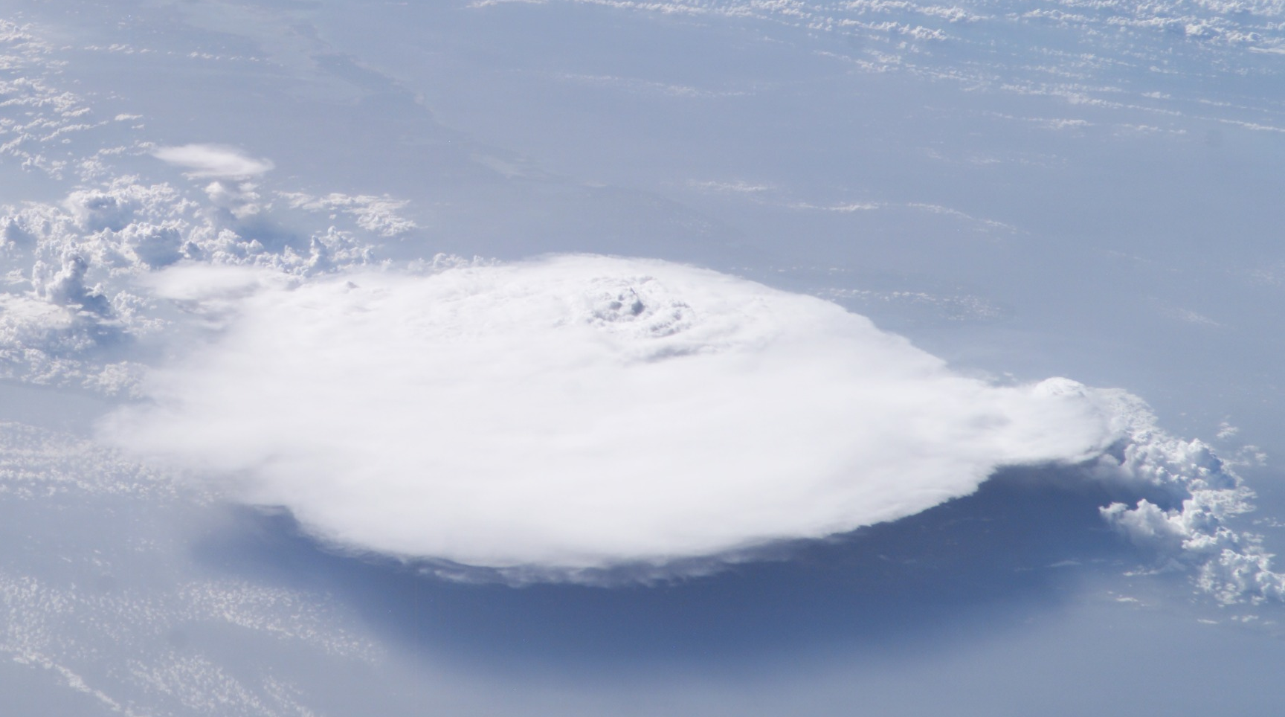
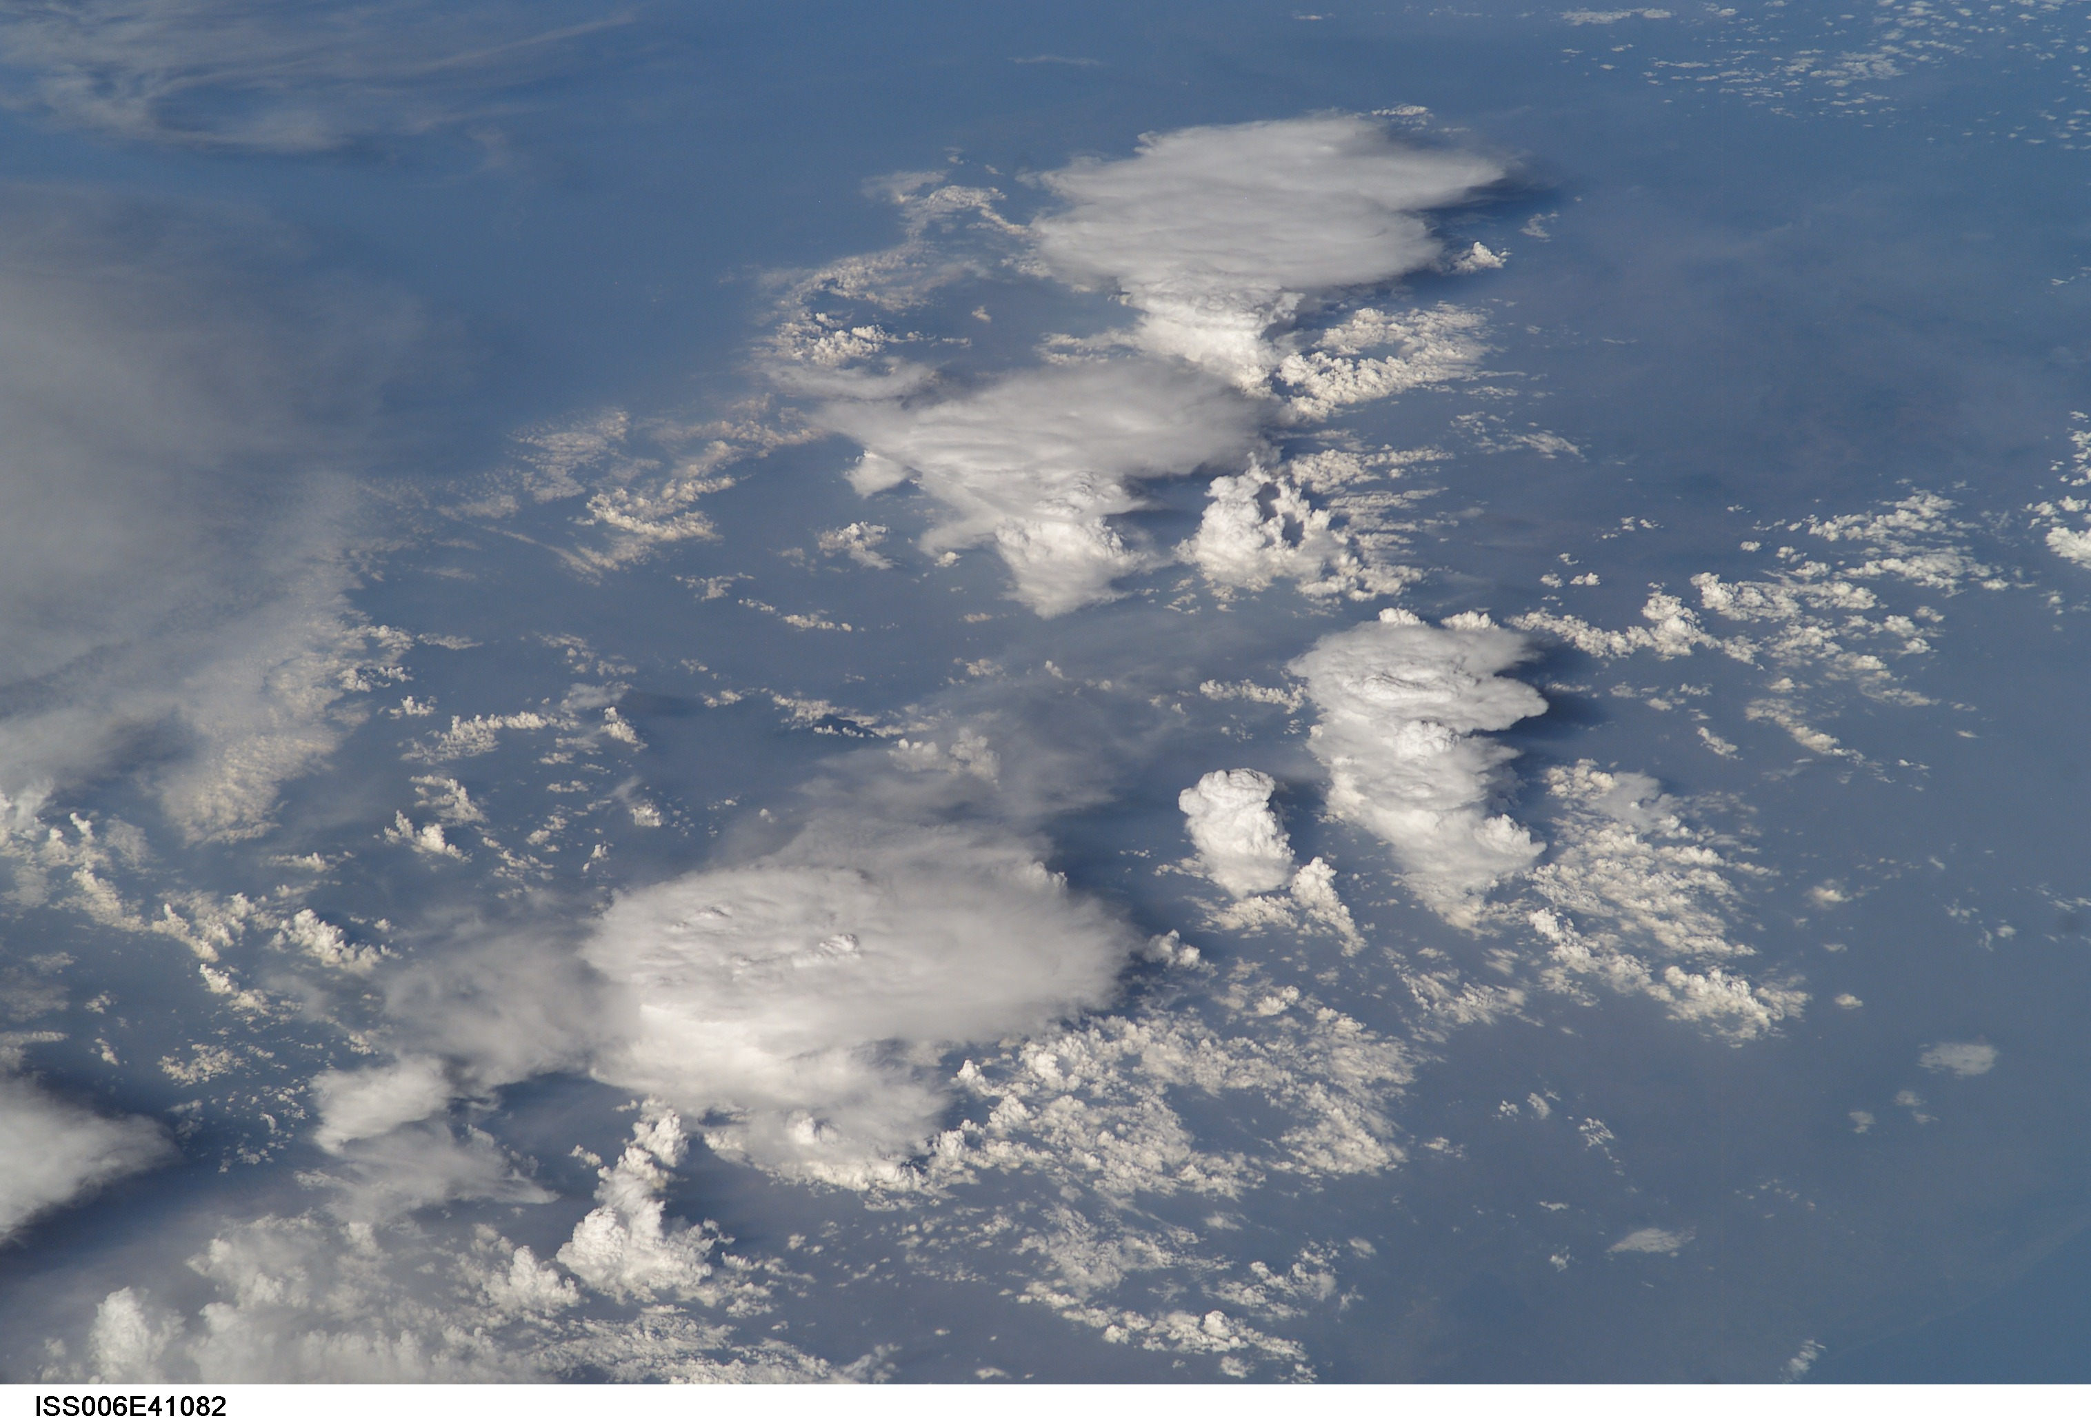
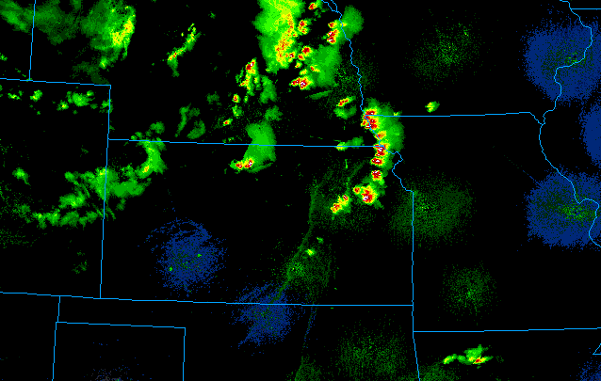
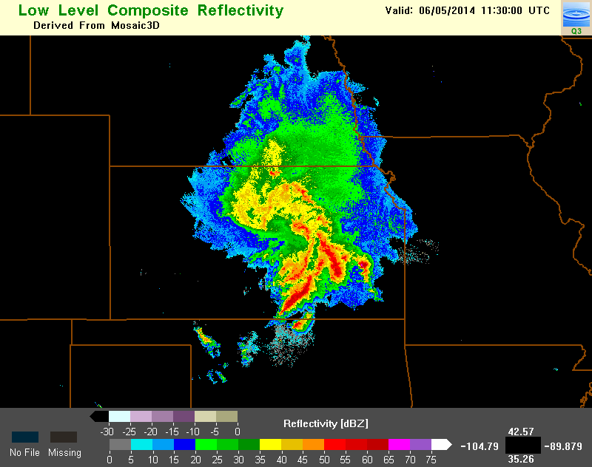
What is a Mesoscale Convective System (MCS)?
Isolated Thunderstorm
Mesoscale Convective System
ISS Photo
Courtesy: CIMSS
Radar Rainfall
L < 50 km
L > 600 km
Kansas
Kansas
Courtesy: UCAR
Courtesy: NSSL
Usually last 1-3 hour
Usually last 6-24 hour
Notes:
Instantaneous and spatially uniform data: sparse rain gauge data is not sufficient

Slide 3
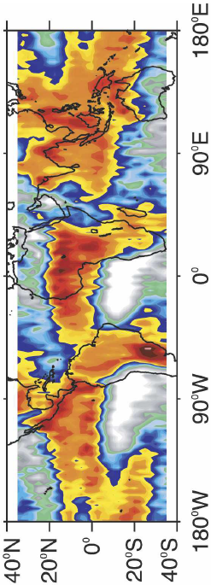

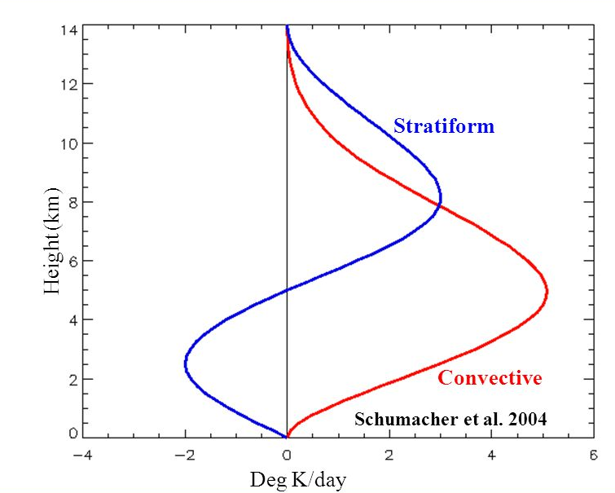
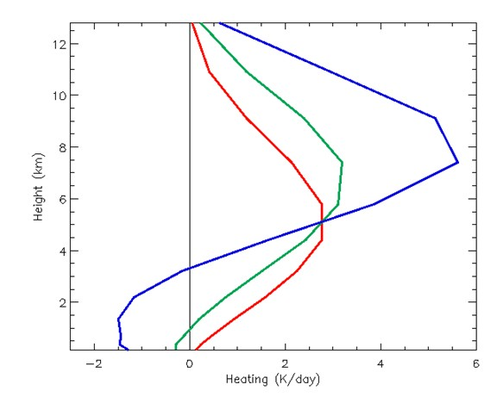
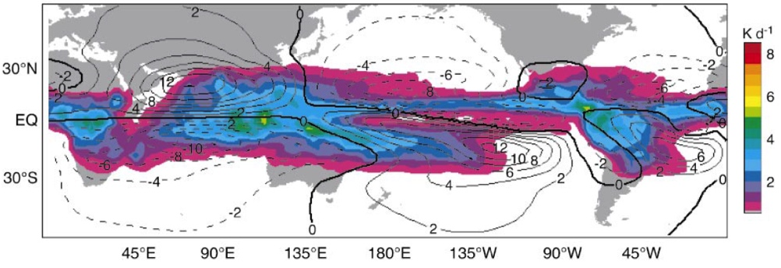
Global Perspective on MCS
MCS Contribution to Rainfall
MCS account for over 50% of tropical rainfall in most regions (Nesbitt et al. 2006)
40-60% of MCS precipitation are from stratiform (Virts and Houze 2015)
Global circulation responds significantly to elevated heating from stratiform precipitation (Schumacher et al. 2004)
MCSs are important to hydrological cycle and general circulation
70% stratiform
40% stratiform
Nesbitt et al. (2016) MWR
0% stratiform
250hPa circulation response to SF heating
Schumacher et al. (2004) JAS

Slide 4
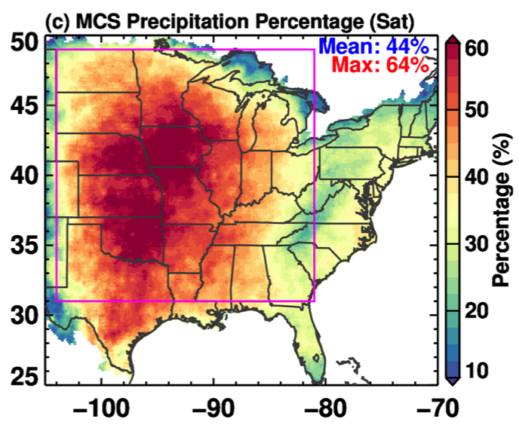
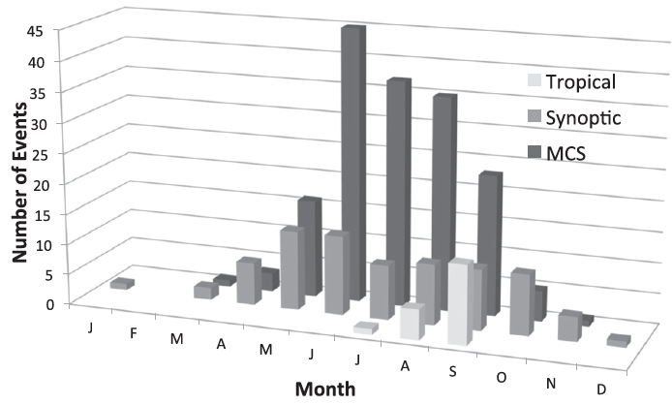
Impact of MCS to Precipitation in U.S.
15-year MCS precipitation climatology
MCSs play a critical role in producing heavy rainfall in the mid-latitudes during warm seasons
In central US, MCSs contribute 40%-60% of the total warm-season rainfall (Feng et al. 2016)
Most of 100-yr, 24-h extreme rainfall events were caused by MCSs in the warm season (Stevenson & Schumacher 2014)
Feng et al. (2016) Nature Commun.
Extreme Event Types
MCS
Stevenson & Schumacher (2014) MWR

Slide 5


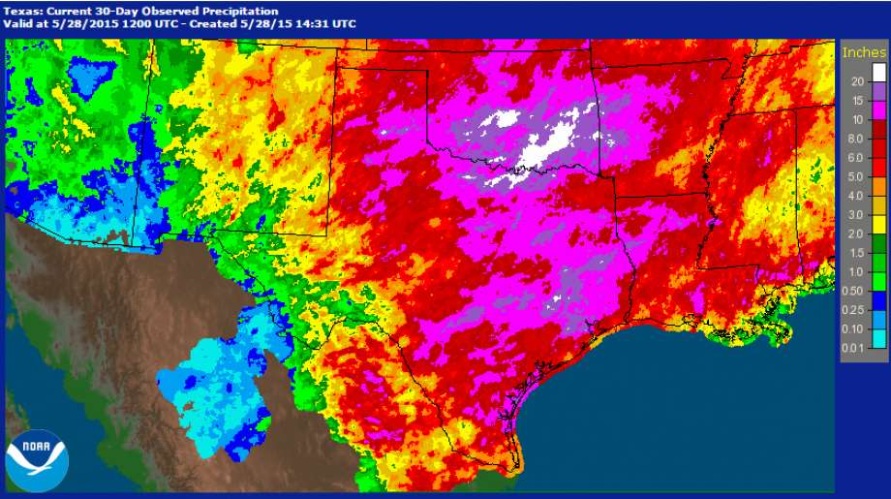

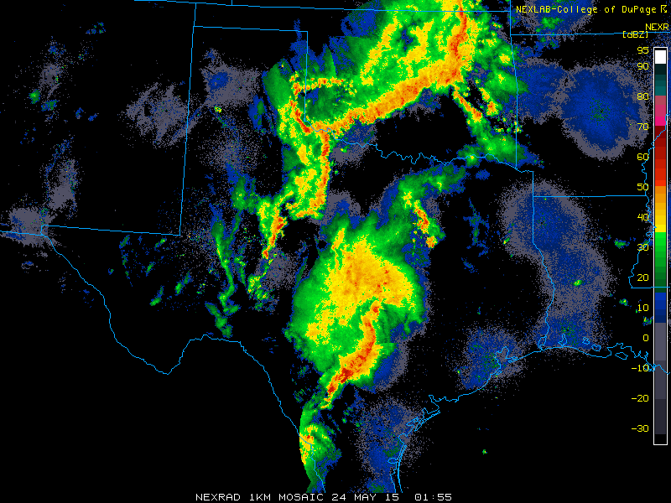
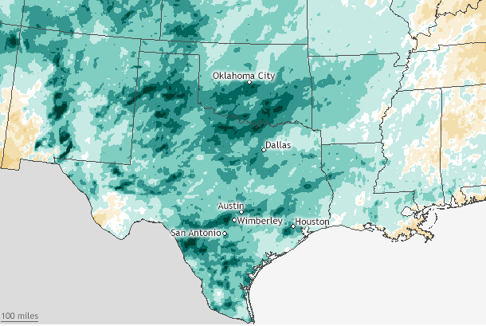
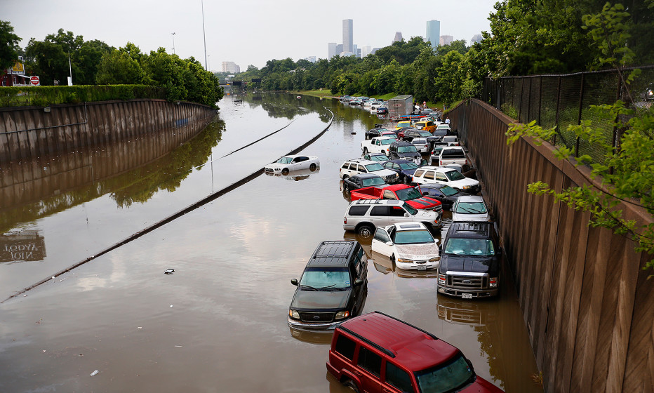
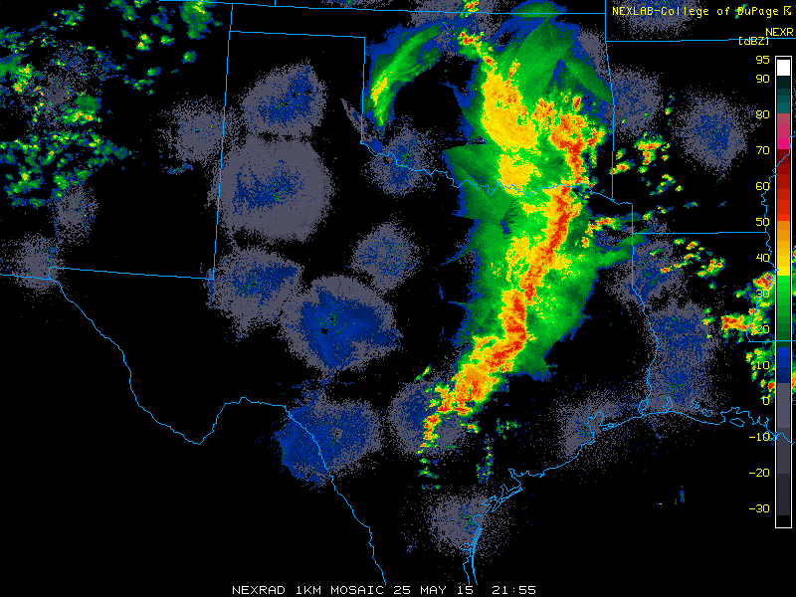

19’’
Texas/Oklahoma record breaking flood in May 2015
OK City: 19.48’’ in May (all-time record)
Dallas: 16.96’’ in May (wettest May record)
Caused by successive MCS events
18’’
16’’
10-15’’
Dallas
May 24 02Z
May 2015
400% above normal
Houston
May 25 22Z

Slide 6
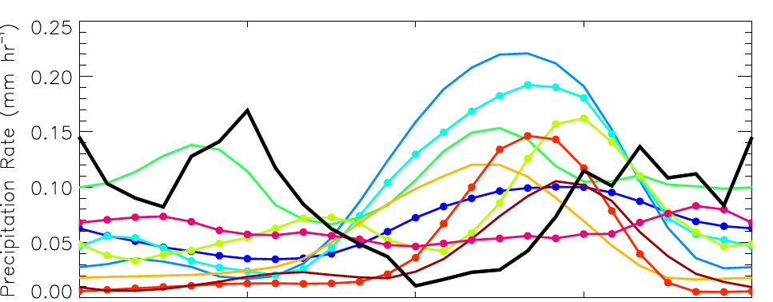

Climate Model Biases in Summer over U.S. Southern Great Plains
2m Temperature Bias
CMIP5 models have systematic warm and dry bias in the warm season
Diurnal cycle of precipitation in CMIP5 is poorly simulated
Implications: biases in surface energy budget, soil moisture, land-atmosphere coupling → positive feedbacks further degrade the simulations
One potential cause: climate models with parameterized convection mostly fail to represent MCSs
Precipitation Bias
Lin et al. (2017)
Precipitation Diurnal Cycle in SGP
OBS
VanWeverberg et al. (2017) Submitted

Slide 7
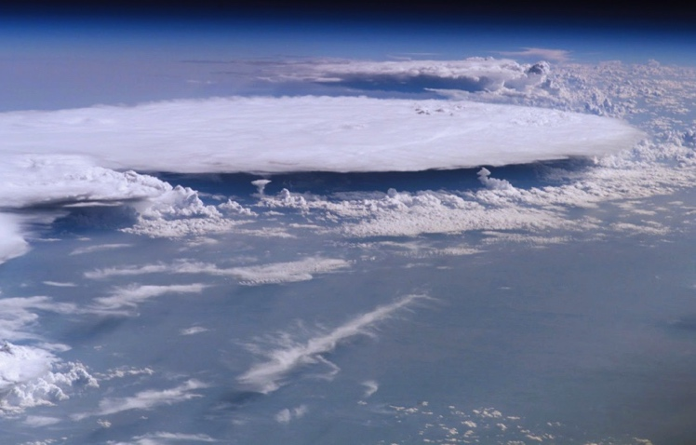
Science Questions
What are the observed MCS changes in recent decades and their potential cause?
Can regional climate model simulate observed MCS characteristics and precipitation?
What environmental conditions support long-lived MCS and how do MCS interact with the environment?
L > 600 km
Kansas
Courtesy: NASA
Courtesy: NSSL

Slide 8
Roadmap
Observed changes of MCS in the past 35 years
  Trends in MCS precipitation
  Large scale environmental changes
Fidelity of CPM in simulating MCSs
  Regional precipitation and diurnal cycle
  MCS characteristics
MCS environments and feedbacks
  Environments supporting long-lived MCSs
  MCS feedbacks and impact of microphysics

Slide 9
Roadmap
Observed changes of MCS in the past 35 years
  Trends in MCS precipitation
  Large scale environmental changes
Fidelity of CPM in simulating MCSs
  Regional precipitation and diurnal cycle
  MCS characteristics
MCS environments and feedbacks
  Environments supporting long-lived MCSs
  MCS feedbacks and impact of microphysics

Slide 10
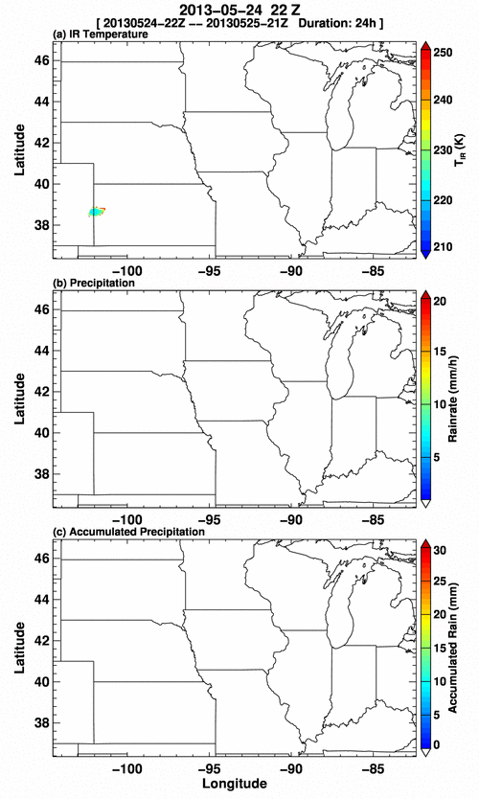
New MCS detection algorithm using precipitation features
Cloud
Identify MCS using only PF
  Track clouds and identify MCS using satellite data (Sat algorithm)
  Develop and train a Precipitation Feature (PF) algorithm to identify the same MCSs using NLDAS hourly precipitation data alone
  Validate PF algorithm against Sat algorithm
Precipitation Feature
Training
Sat Algorithm
PF Algorithm
Accumulated Rainfall
Optimize
MCS Database
MCS Database
Validation
*PF: contiguous rain area > 1 mm/h

Slide 11
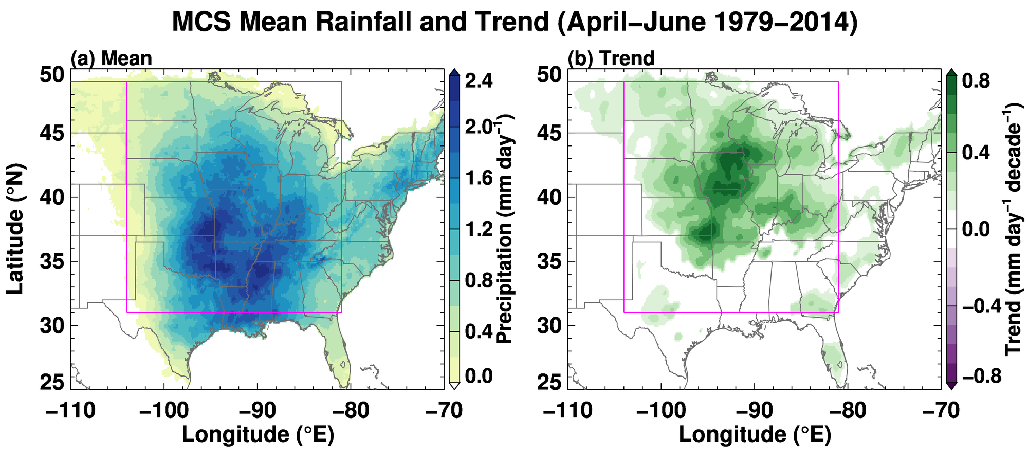
MCS Precipitation Increases in Central and Northern Plains in Spring
20-40% increase
Change in MCS precipitation expands into central and northern plains, where they used to have less MCS
Some regions in Midwest experiences 0.4-0.8 mm day⁻¹ (20-40%) increase
*Only significance at 95% are shown

Slide 12
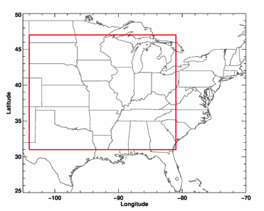
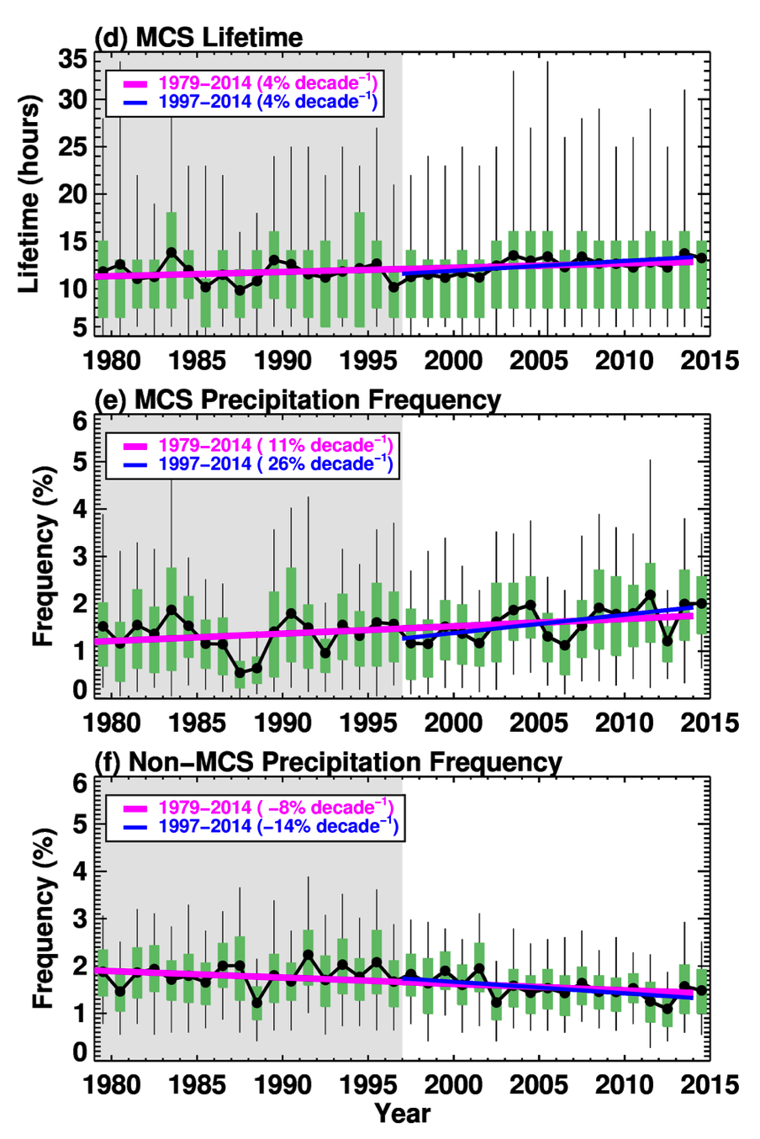
Increases in MCS lifetime cause more frequent MCS precipitation
Results region
Radar era
Averaged MCS lifetime increases by 4% dec⁻¹, long-lasting MCS increases by 7% dec⁻¹
MCS precipitation frequency increases (11% dec⁻¹), drives precipitation increase
Non-MCS precipitation frequency decreases (-8% dec⁻¹)
At a given location, probability of precipitation from MCS increases, while that from unorganized convection decreases
Lifetime
MCS
Non-MCS
*Frequency computed by R > 1mm/h, removing weak rain accounts for NLDAS dataset changes

Slide 13
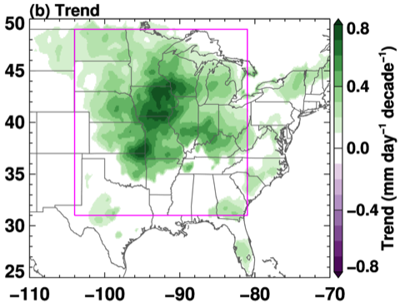
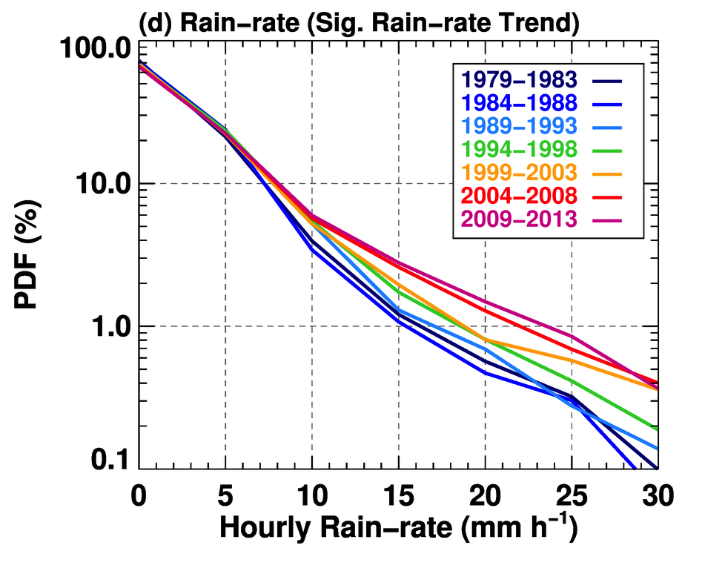
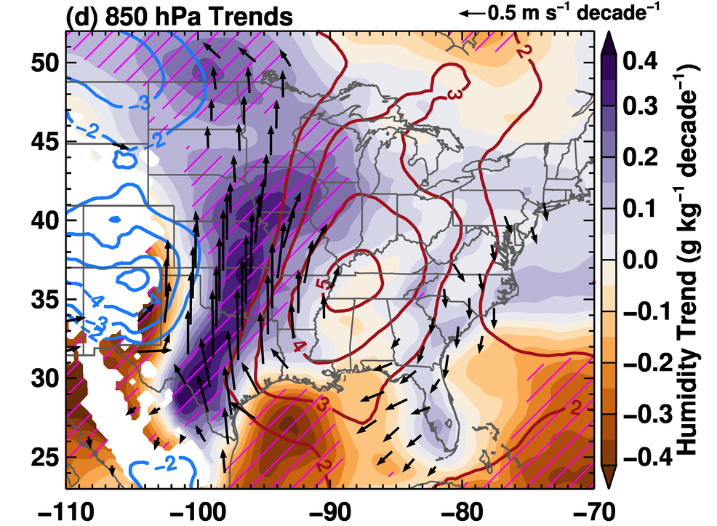
MCS Rainfall Intensity Increases Associated with Stronger LLJ
Rainfall Intensity Trend
850 hPa Environment Trend
2010s
L–
H+
1980s
Moderate to heavy rain-rate (5-30 mm h⁻¹) become more frequent
Low-level moistening associated with enhanced GPLLJ moisture transport, facilitating more intense MCS precipitation

Slide 14
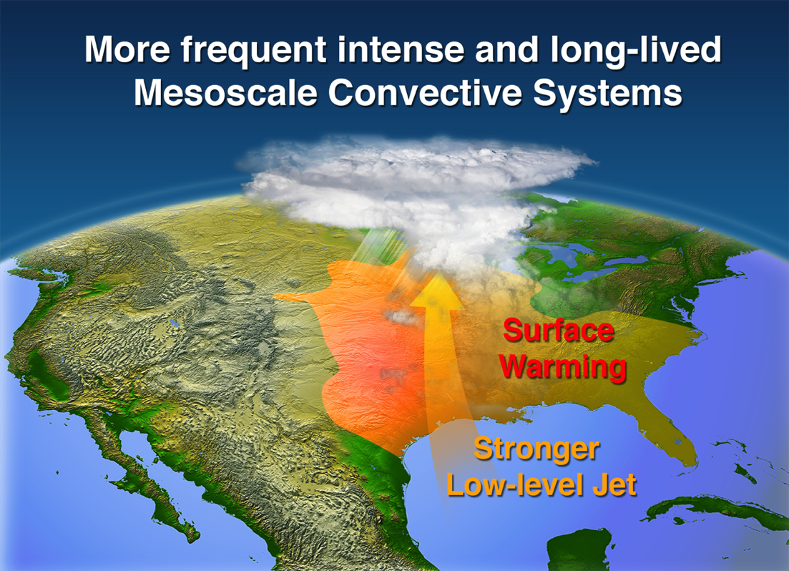
Summary 1: Observed MCS Changes
Long-lasting MCS frequency and intensity dominate the observed increase in springtime total and extreme rainfall
Surface warming enhances Great Plain Low Level Jet moisture transport to support long-lasting MCSs
Climate models need to represent MCSs to better project future changes in hydrological extremes
Feng et al. (2016) Nature Commun.

Slide 15
Roadmap
Observed changes of MCS in the past 35 years
  Trends in MCS precipitation
  Large scale environmental changes
Fidelity of CPM in simulating MCSs
  Regional precipitation and diurnal cycle
  MCS characteristics
MCS environments and feedbacks
  Environments supporting long-lived MCSs
  MCS feedbacks and impact of microphysics

Slide 16
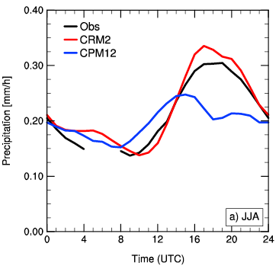
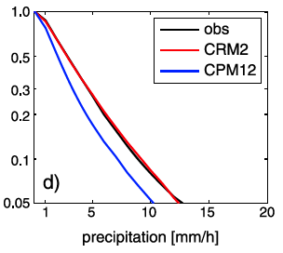
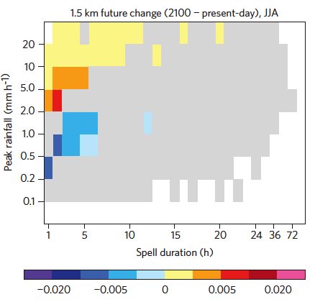
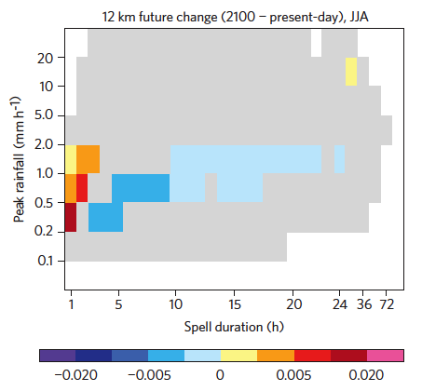
Value of CPM in Regional Climate Modeling
Precipitation Diurnal Cycle
Precipitation Intensity
Obs
CPM
Convection Permitting Model (CPM) benefits (Prein et al. 2015):
  More realistic summertime diurnal cycle of precipitation
  Better representation of extreme hourly precipitation
CPM projects more short-duration summertime heavy precipitation in future climate (Europe), such change is absent in coarse resolution model
GCM
Ban et al. (2014) JGR
Change in CPM
Change in GCM
More frequent short-duration heavy rain
No change in GCM
Max Rainfall (mm h⁻¹)
Max Rainfall (mm h⁻¹)
Rainfall Duration (hour)
Rainfall Duration (hour)
Kendon et al. (2014) NCC

Slide 17
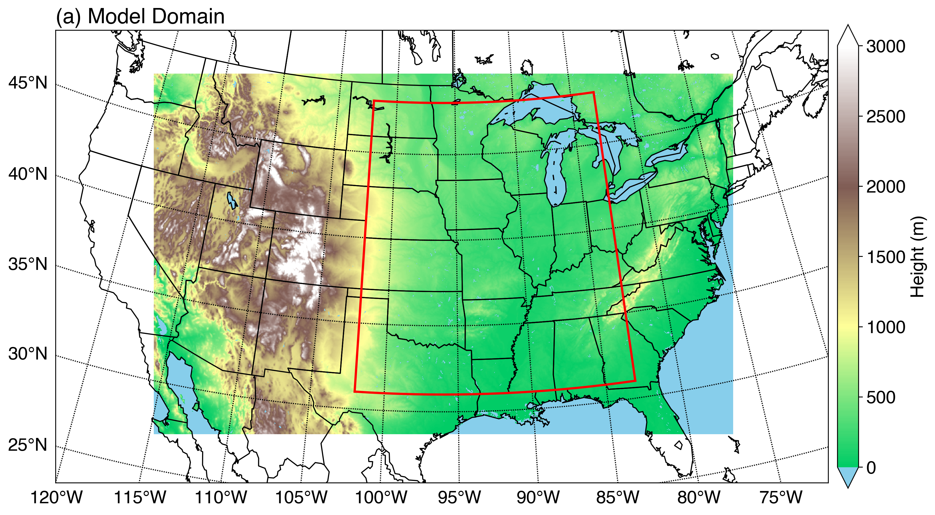
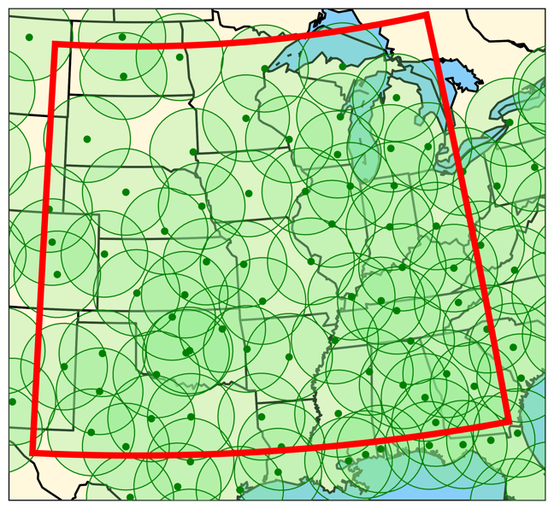
WRF Model Setup and
Observational Datasets
Model Domain
Model domain: 3800x2400 km
Initialized on May 1, continuous run
Resolution | 4 km
Period | May-Aug, 2011
Microphysics (MP) | Morrison, Thompson
Lateral forcing | GFS final analysis
Evaluation Area
GOES satellite data
  Δx = 4 km, 30 min T_{IR}
NSSL MRMS National Radar Product
  3-D Mosaic Reflectivity data
  Δx = 1 km, 31 vertical level: 0.5-18km
  Q2 gauge bias-adjusted 1-hourly rainfall
  All radar data regridded to 4 km
Radar Coverage
Radar data provided by Prof. Xiquan Dong

Slide 18
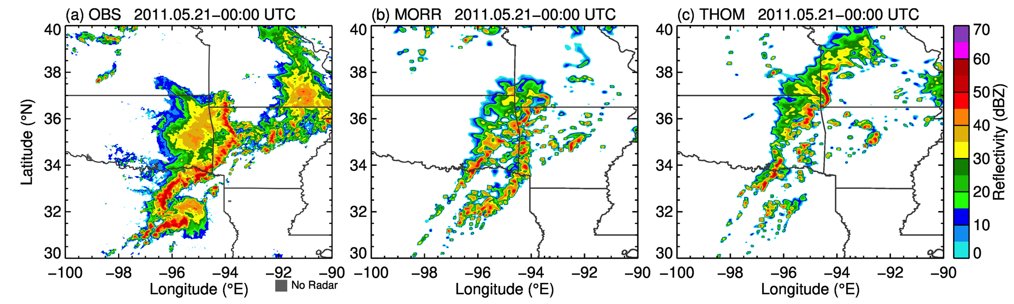
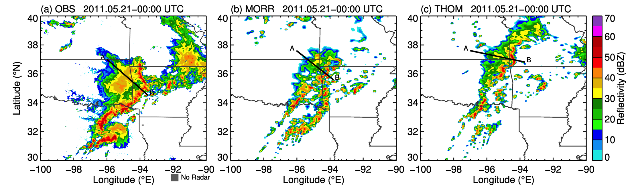
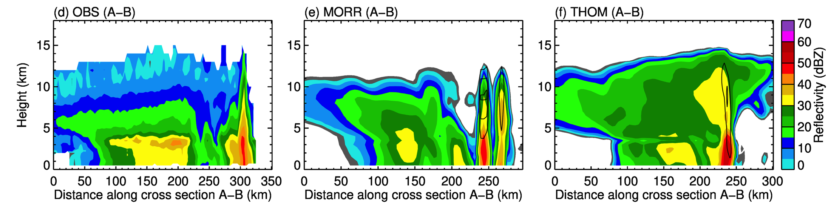
Example of MCS Structure
Model is able to simulate convective/stratiform aspects of MCS with varying level of details
Observation
Morrison
Thompson
Convective
Convective
Convective
Stratiform
Stratiform
Stratiform
Notes:
Somewhat randomly selected MCS, ~20 days into the simulation

Slide 19
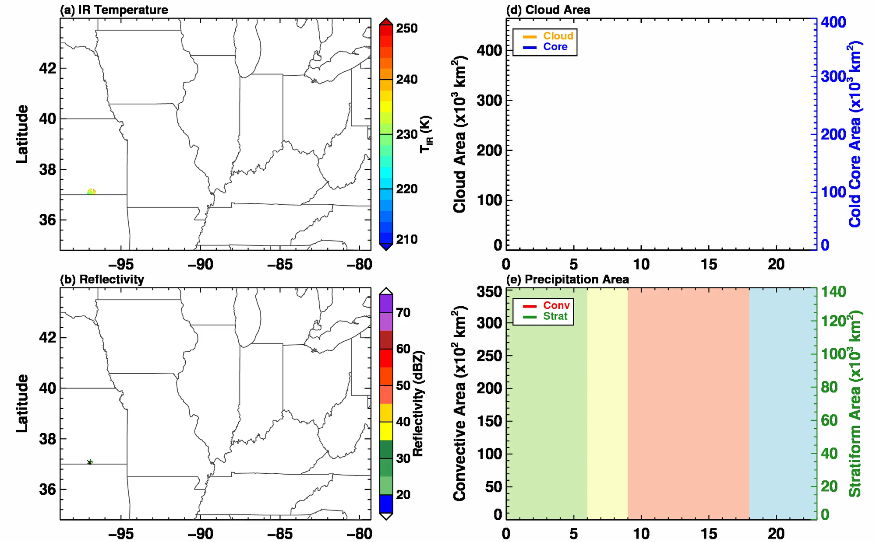
Identify and Track Robust MCSs
Example MCS Event
Satellite T_{b}
Cloud Shield Area
Snap-shots
Time Series
Radar Reflectivity
Precip. Area
Pre-Conv
Genesis
Mature
Decay
Longitude
Time (hour)
Feature tracking using satellite cloud shield and radar reflectivity
Obtain evolution of convective/stratiform structure, precipitation
Notes:
Evolution of conv/strat structure, precip. obtained for each MCS, allowing some detail evaluation of MCS properties

Slide 20
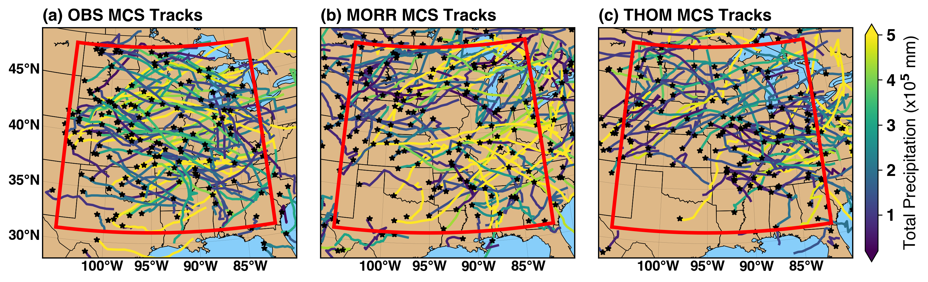
MCS Tracks Comparison
Observation
Morrison
Thompson
Tracks colored by accumulated precipitation
Morr produces a few more high precipitation MCSs than Thom
Thom has fewer MCSs in Southern Great Plains
Notes:
Thom has fewer MCSs in SGP region

Slide 21
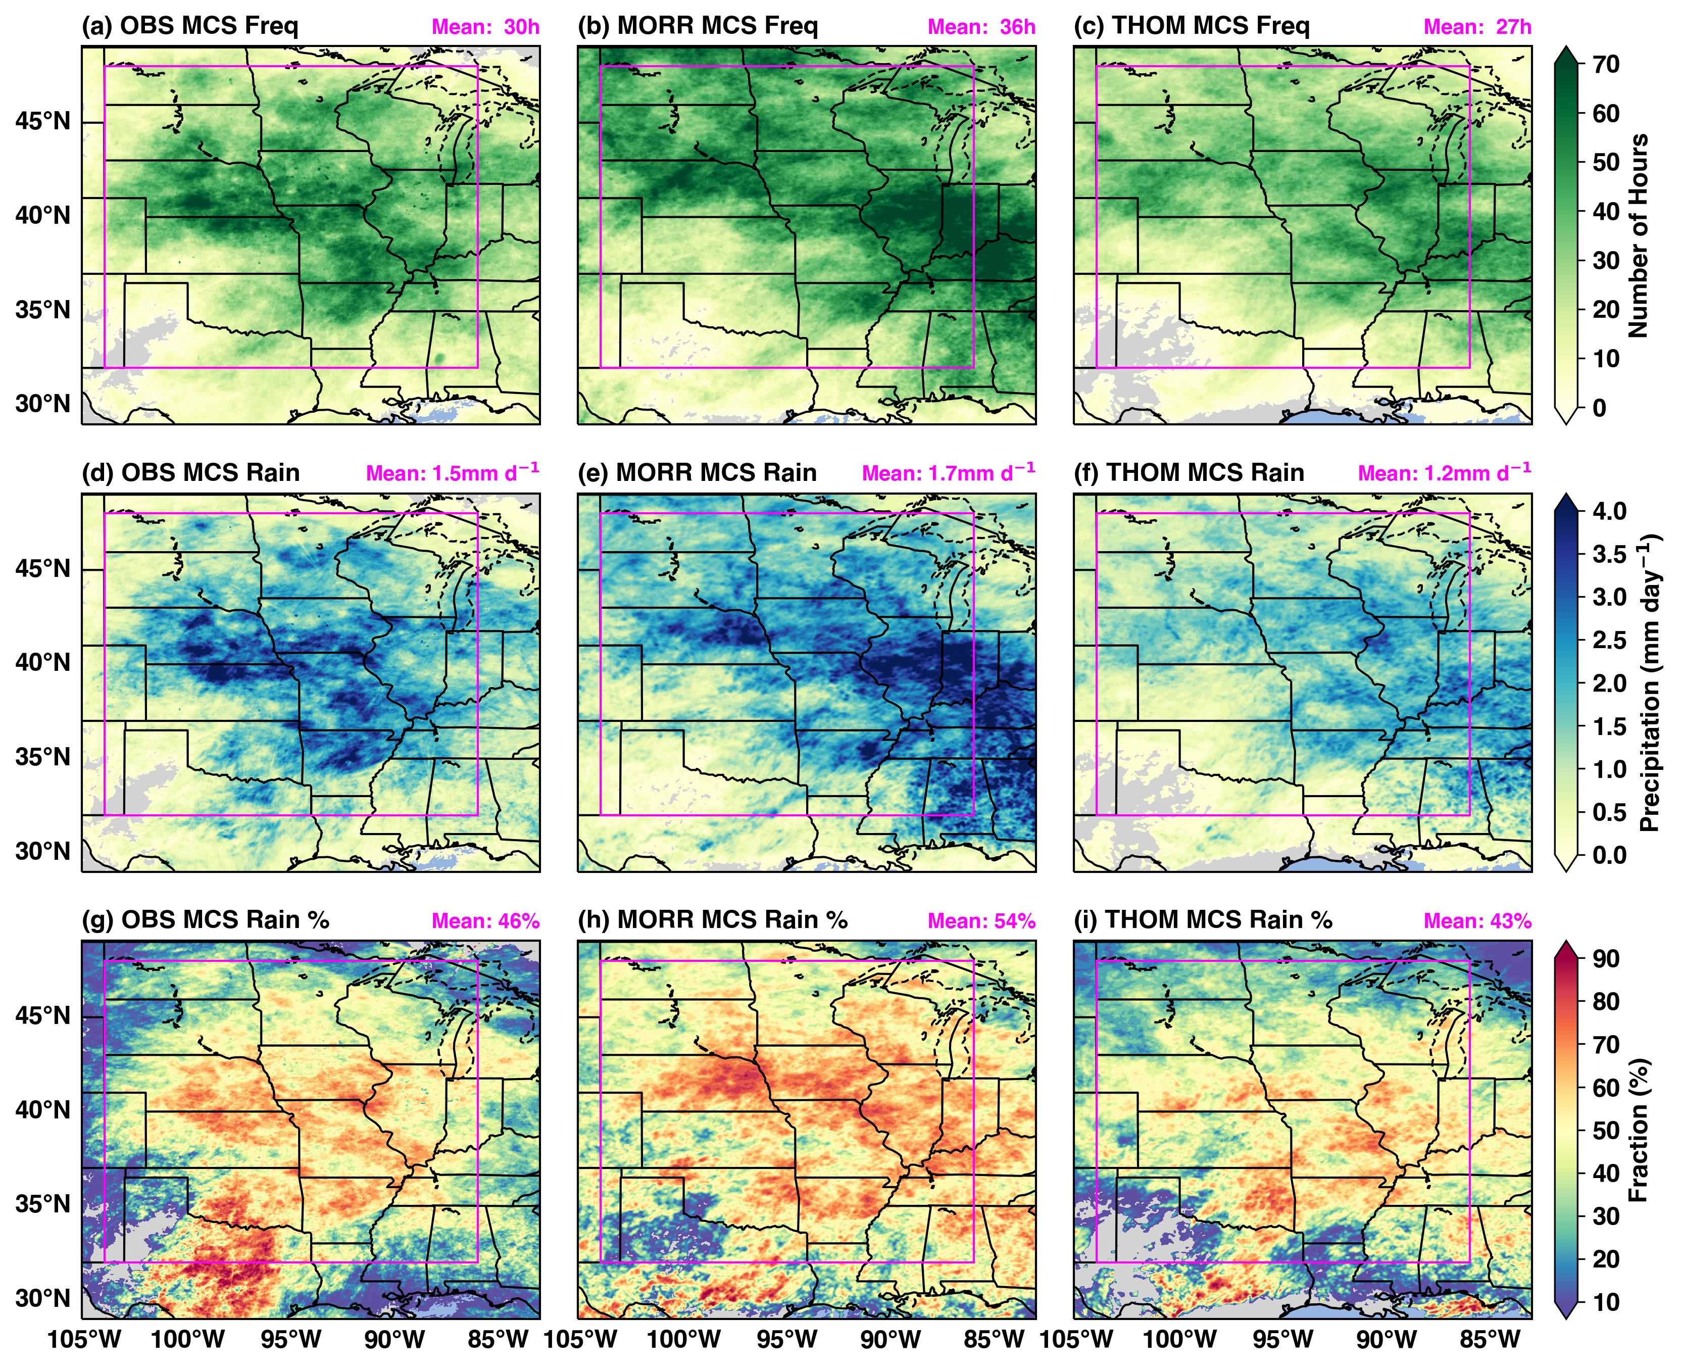
Seasonal MCS Rain Amount Comparable to Observations
Observation
Morrison
Thompson
Rain Amount
% Total Rainfall
MCS rainfall amount: Morr: +13%, Thom: -20%
MCS rainfall % to total: Obs: 46%, Morr: 54%, Thom: 43%

Slide 22
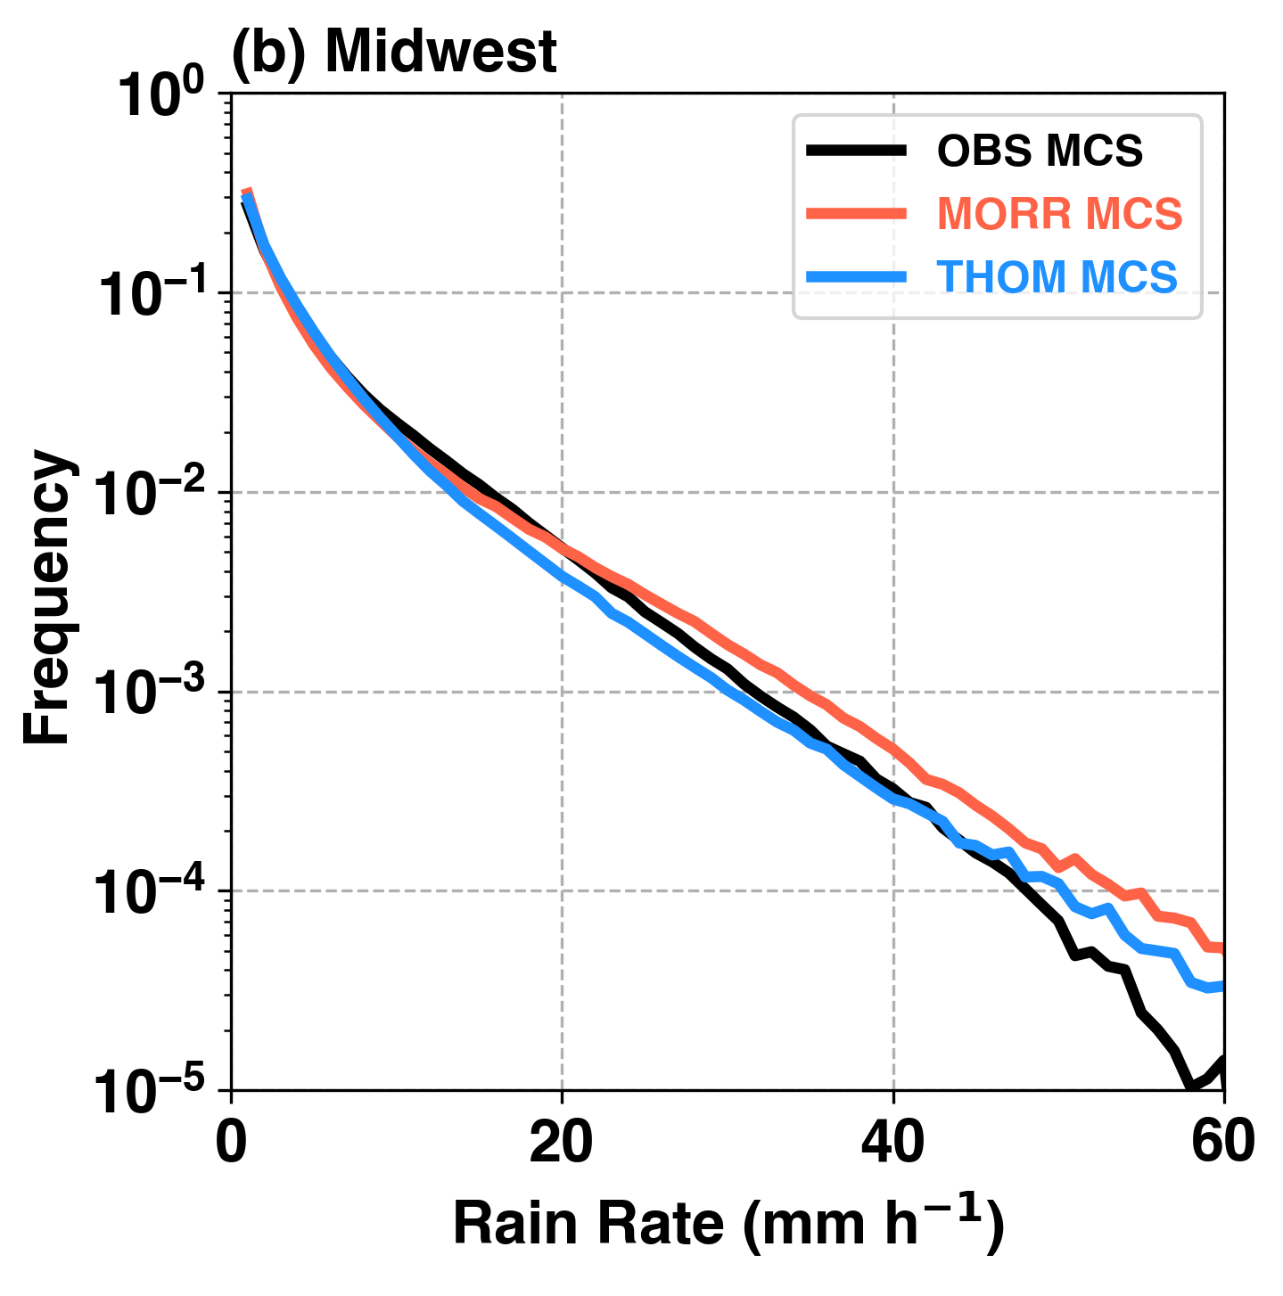
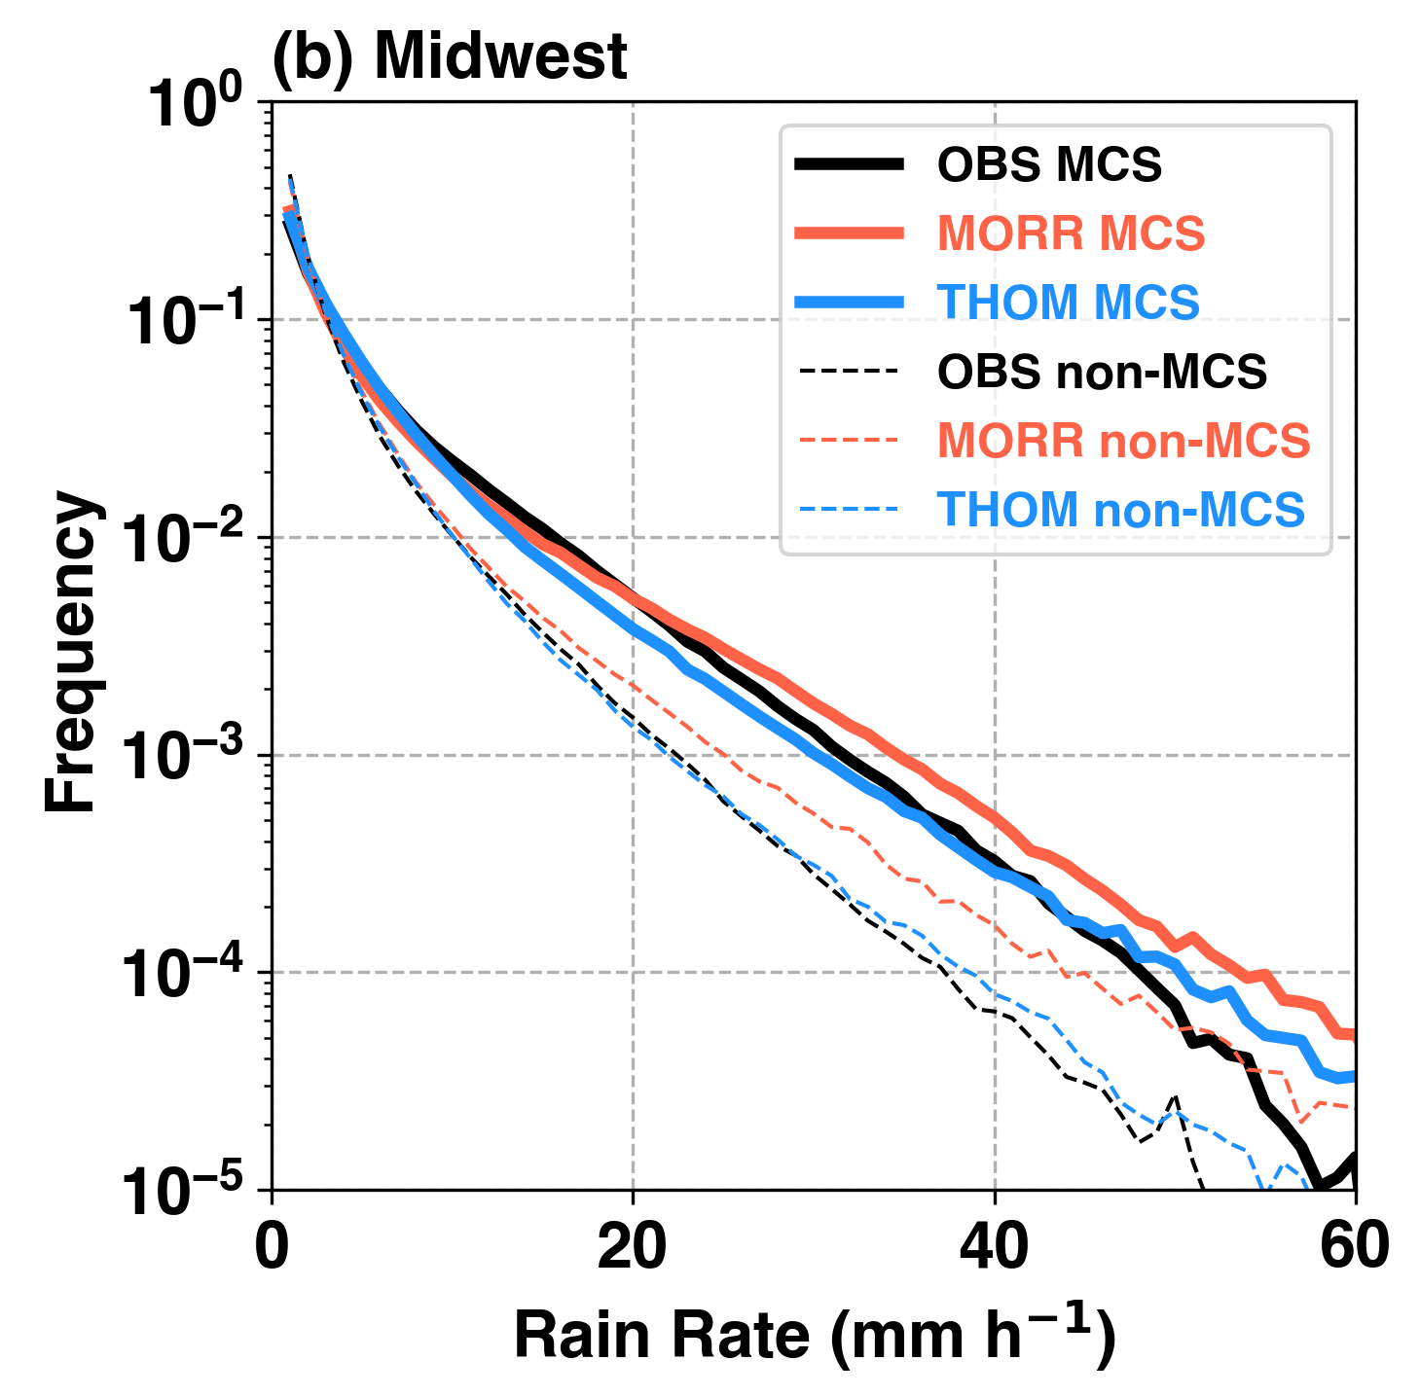
MCS Extreme Precipitation on Hourly Time-scale are Reproduced
PDF of MCS precipitation intensity generally agrees well with observations across various regions of central U.S.
Tendency for MCS to produce more frequent extreme rainfall intensity than non-MCS is captured by the model
MCS
Isolated

Slide 23
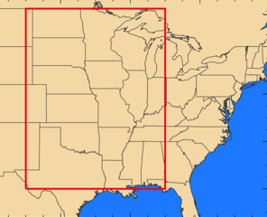
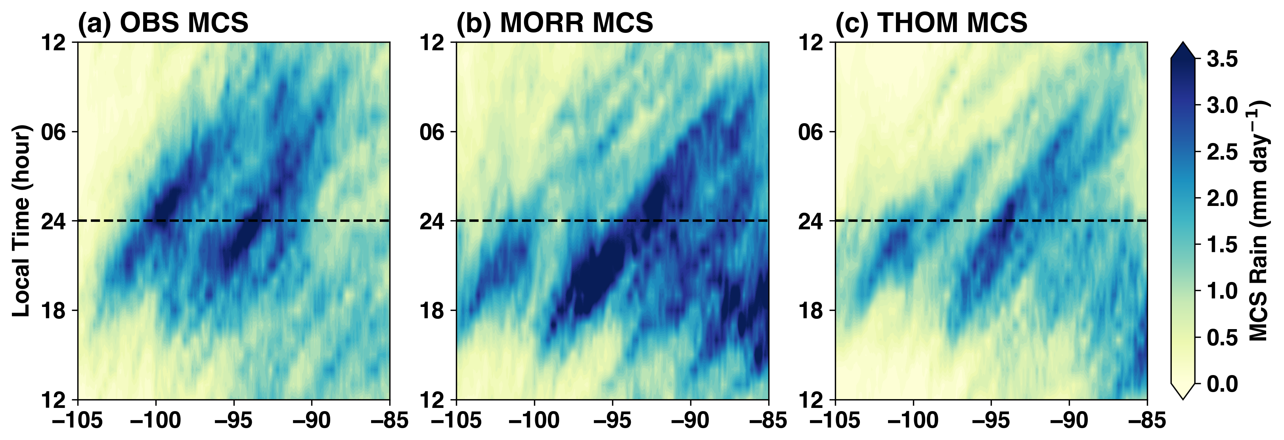
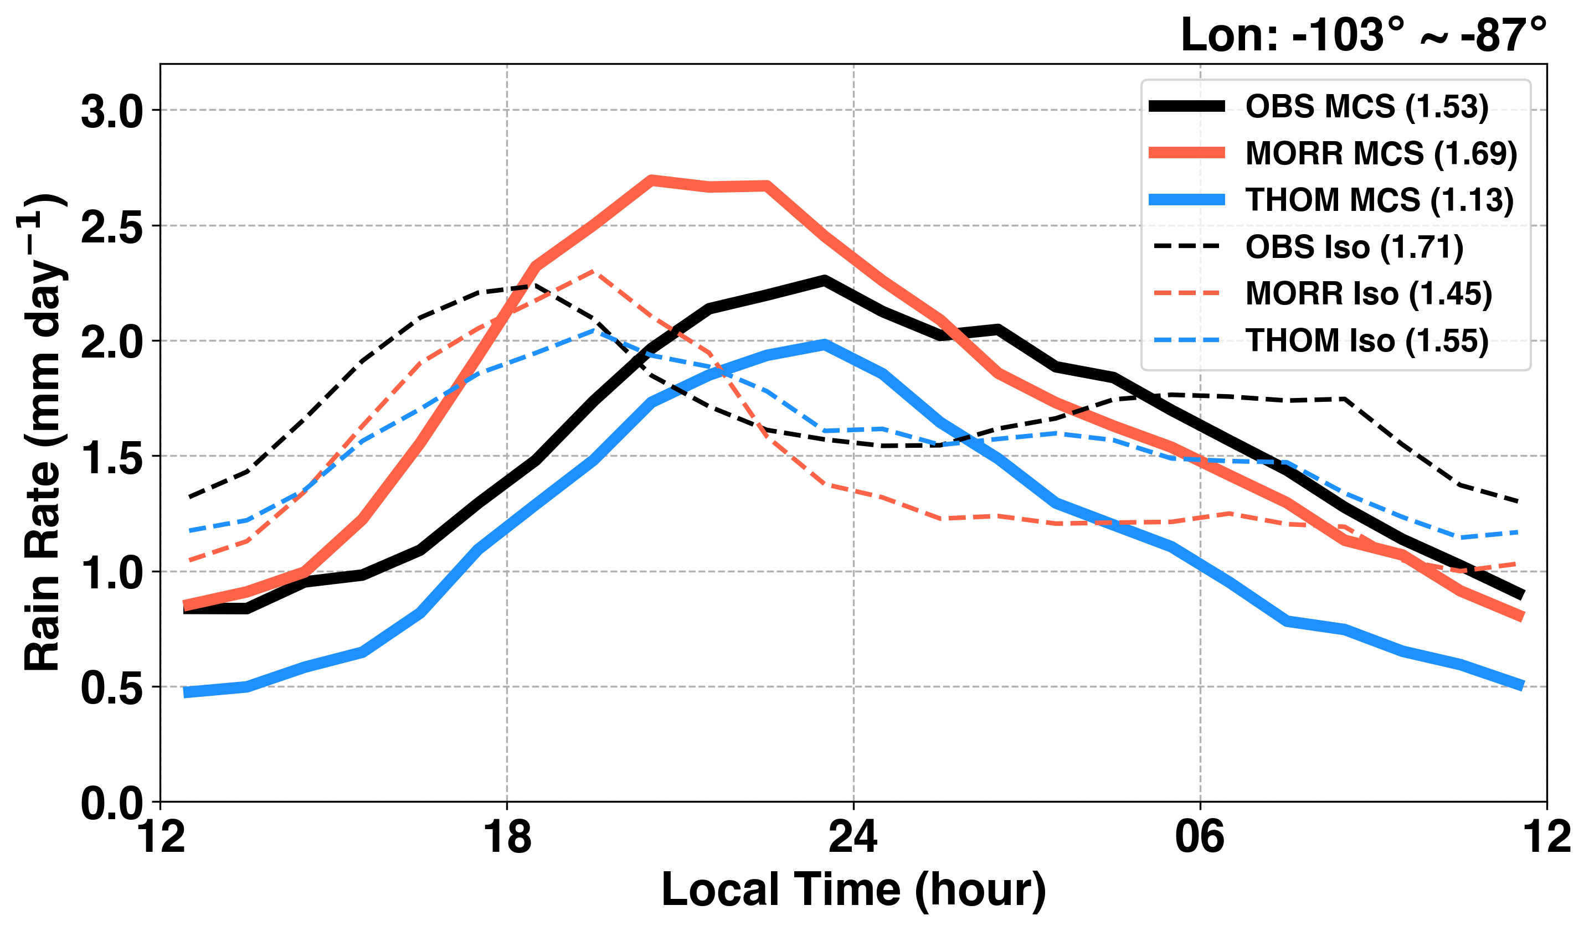
Precipitation Diurnal Cycle is Comparable with Observations
Averaged Area
OBS
Morrison
Thompson
Model captures MCSs propagation
MCS rainfall from 2 simulations straddle Obs.
Morr MCS rainfall peak 2h earlier than Thom and Obs.
MCS
Isolated

Slide 24
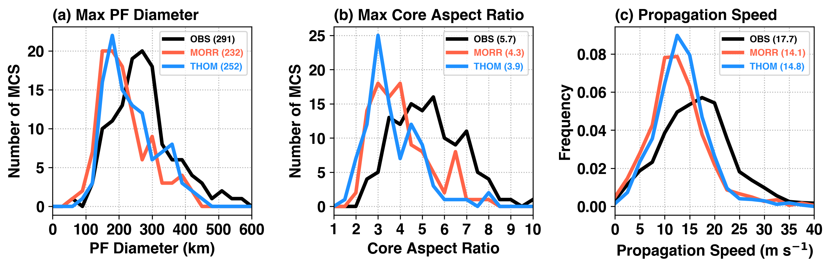
MCS Characteristics Comparison
Model Precipitation Features (PF) are smaller than observed by 13%-20%, THOM bias is slightly smaller
Model MCS propagate slower than observed by 20%-28%, THOM bias during MCS mature stage is smaller
Implications on storm rainfall and flooding potentials
Notes:
*If squall line definition: AR >= 5
OBS is ~50%
MORR: <20%, THOM: <10%

Slide 25
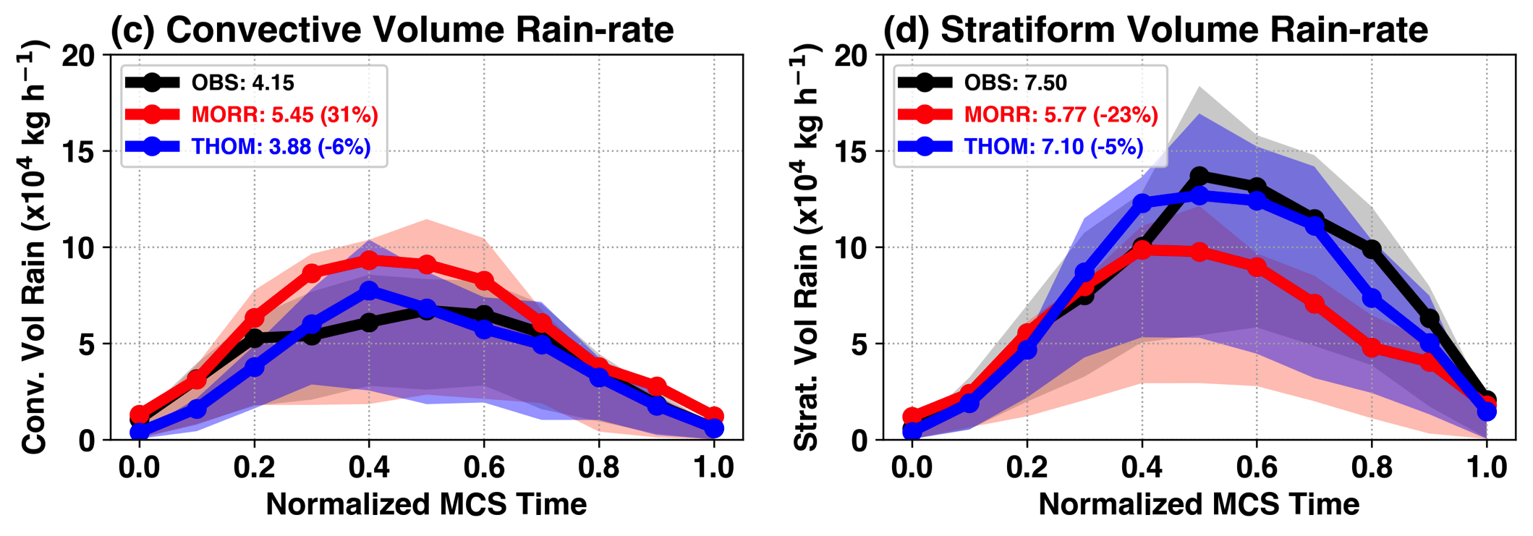
Composite Volume Rainfall Evolution
Convective Volume Rain
Stratiform Volume Rain
Initiation
Decay
Time
Convective Vol_{rainrate}: Morr: +31%, Thom:-6%
Stratiform Vol_{rainrate}: Morr: -23%, Thom: -5%
Notes:
Explain composite: x-axis is relative time from MCS initiation to decay
Composite of ~100 medium-to-long lasting MCSs
Morr (Red) has 33% more convective rainfall, partly due to larger convective area
For stratiform, OBS says 62% total rain volume is from stratiform, Morr underestimate
Not shown but both simulations underestimate stratiform rain area 30-40%, common problem in bulk microphysics parameterizations, but Morr bias is larger

Slide 26
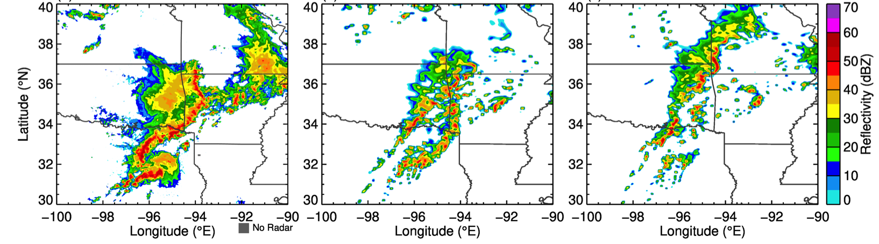
Summary 2: CPM Performance in Simulating MCSs
Convection permitting WRF model run at regional climate mode is able to capture the salient statistical features of MCSs
Sensitivities to microphysics mainly manifested:
  Regional MCS frequency, precipitation amount
  MCS structures, precipitation type
Observation
Morrison
Thompson
Smaller
More convective rain
Comparable size
More stratiform rain

Slide 27
Roadmap
Observed changes of MCS in the past 35 years
  Trends in MCS precipitation
  Large scale environmental changes
Fidelity of CPM in simulating MCSs
  Regional precipitation and diurnal cycle
  MCS characteristics
MCS environments and feedbacks
  Environments supporting long-lived MCSs
  MCS feedbacks and impact of microphysics

Slide 28
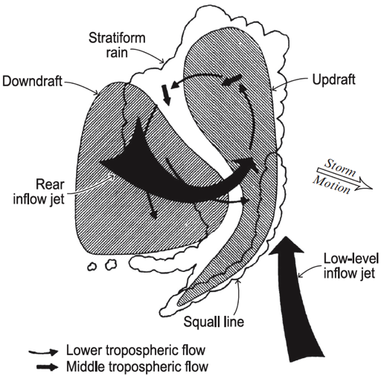
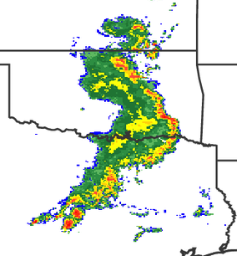
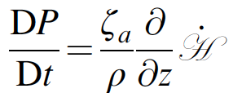
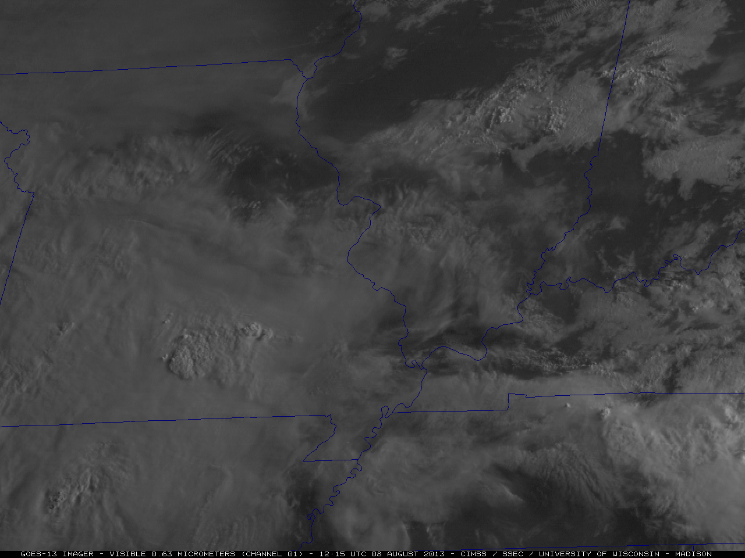

MCS and Mesoscale Convective Vortex
MCS are known to have a top-heavy diabatic heating profile
Such heating promotes PV generation and convergence at mid-troposphere
MCV
MCV
Diabatic heating
Brandes (1990)
Squall Line MCS
Houze (2014)
MCV (~10 hour)
Mesoscale Convective Vortex (MCV) is formed in response, and induces vertical motion around the vortex, creating a more favorable environment for new convection
MCV is quasi-balanced and long-lived, thus help prolonging the MCS lifetime
Pressure (hPa)
MCV
Chen and Frank (1993)
Courtesy: CIMSS
Notes:
Mid-level inflow through stratiform rain area sinks due to evaporative cooling
Downward slopping inflow fuels generation of cold pools ahead of convection and help maintains the MCS

Slide 29


Environment Anomaly Associated with MCSs (6 hour after initiation)
MCS centroid
Short-lived
Medium-lived
Long-lived
700hPa
850hPa
Yang et al. (2017) JGR
Compared to short-lived MCSs, long-lived MCSs have clear MCV signature at mid-to-low level, associated with unstable high-Θ_{e} air
Trough is strengthened by the the MCV
Notes:
Large-scale environments centered at the centroid location of MCS precipitation feature are extracted, monthly mean over the specific hour is removed
MCSs have largest impact on large-scale flow when they are long-lived, because they generate a quasi-balanced circulation at mid-levels as a result of the top-heavy diabatic heating profile

Slide 30

Environment Anomaly Associated with MCSs (12 hour after initiation)
Short-lived
Medium-lived
Long-lived
MCS centroid
700hPa
850hPa
Yang et al. (2017) JGR
More robust stratiform regions in long-lived and larger MCSs continue to strengthen the MCV and LLJ transport of high-Θ_{e} air from the Gulf of Mexico, sustaining active convective updrafts
Notes:
Large-scale environments centered at the centroid location of MCS precipitation feature are extracted, monthly mean over the specific hour is removed
MCSs have largest impact on large-scale flow when they are long-lived, because they generate a quasi-balanced circulation at mid-levels as a result of the top-heavy diabatic heating profile

Slide 31



Composite Latent Heating Profiles
Elevated stratiform heating
Stronger gradient
Composites from medium-to-long-lasting MCSs
THOM produces more stratiform rain → sharper vertical gradient of diabatic heating at mid-level → further strengthens MCV
Notes:
Heating profiles from medium to long lasting MCSs
Thom (blue) stronger gradient in mid-troposphere
Breakdown conv/strat, conv is similar
Thom elevated stratiform heating, explain PV
Consistent with Thom having more medium-long lasting MCSs

Slide 32


Comparison of MCV during Mature Stage of Long-lived MCSs
Morrison
Thompson
600hPa
850hPa
Thompson MCVs at mid-level is stronger than Morrison →
Stronger enhancement of the trough and westerly cool/dry air advection into MCS center → enhances the rear-to-front sloping of the mesoscale downdrafts

Slide 33

Robust MCV Produces Stronger Westerly Cool/Dry Air Advection
600hPa
Morrison
Thompson
Stronger westerly cool/dry air advection into MCS center → enhances the rear-to-front sloping of the mesoscale downdrafts
Promote cold pool generation and initiation of new convection ahead of MCSs, prolonging their lifetimes
θ Anomaly (K)
Dry Air
MCV
Fovell (1990)

Slide 34


Long-lived MCSs are Important for Hydrological Cycle
Because of positive feedback from MCS to the circulation, Thompson has more long-lived MCSs than Morrison (15h-25h), and these MCSs produce 2-3 times rainfall compared to short-lived ones
Microphysics alter MCS macrophysical properties that ultimately matter for characteristics that are important for water cycle (lifetime and precipitation)
Notes:
Thom has slightly more long lasting MCSs between 15-25 hour range

Slide 35
Summary
Long-lived MCS frequency and intensity dominate the observed increase in springtime total and extreme rainfall; change is potentially linked to surface warming and stronger GPLLJ
CPM regional climate simulation is able to capture the salient statistical features of MCSs. Sensitivities to microphysics mainly manifested in MCS structure, precipitation type and amount
Microphysics with more stratiform rainfall produce more elevated diabatic heating and stronger mesoscale convective vortex, helps prolonging MCS lifetime

Slide 36
References
Feng, Z., R. Leung, S. Hagos, R. Houze, C. Burleyson, K. Balaguru, 2016: More frequent intense and long-lived storms dominate the springtime trend in central U.S. rainfall, Nat. Commun., 13429 doi: 10.1038/ncomms13429.
Yang, Q., R. A. Houze, R. Leung, Z. Feng, 2017: Environments of Long-lived Mesoscale Convective Systems over the Central United States. J. Geophys. Res. Atmos. 122, doi: 10.1002/2017JD027033.
Feng, Z., R. Leung, R. A. Houze, S. Hagos, J. Hardin, Q. Yang, 2018: Structure and Evolution of Mesoscale Convective Systems over the Central U.S.: Sensitivity to Cloud Microphysics in Convection-Permitting Regional Climate Simulations. In preparation for J. Adv. Model. Earth Syst.

