Slide 1
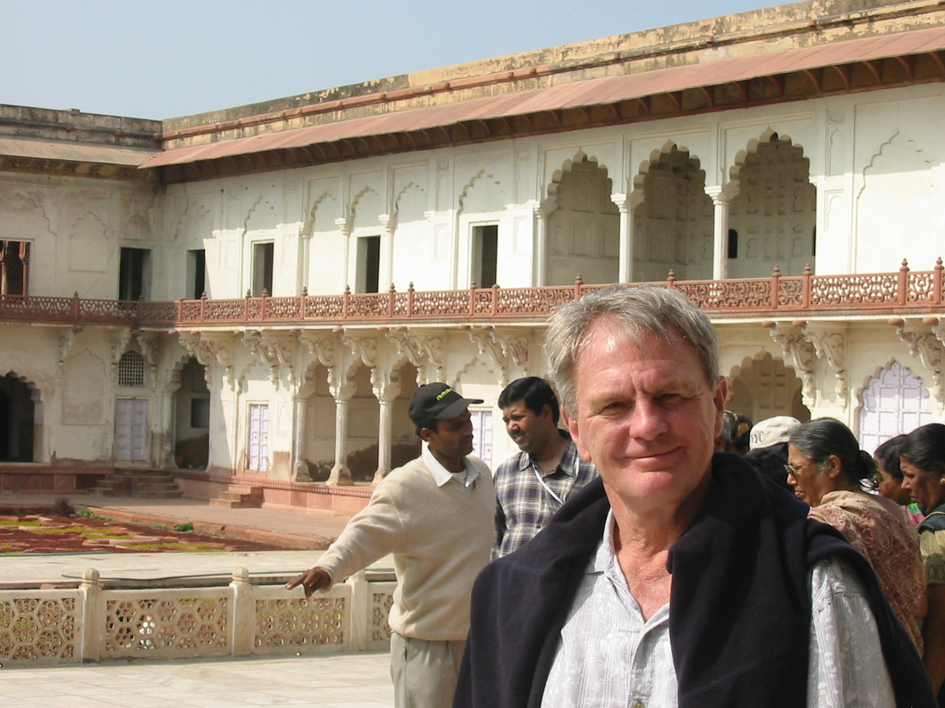
Peter Webster’s Career
Presented by R. Houze
AMS Annual Meeting, Austin, 8 Jan 2018
Notes:
At the Agra Fort

Slide 2
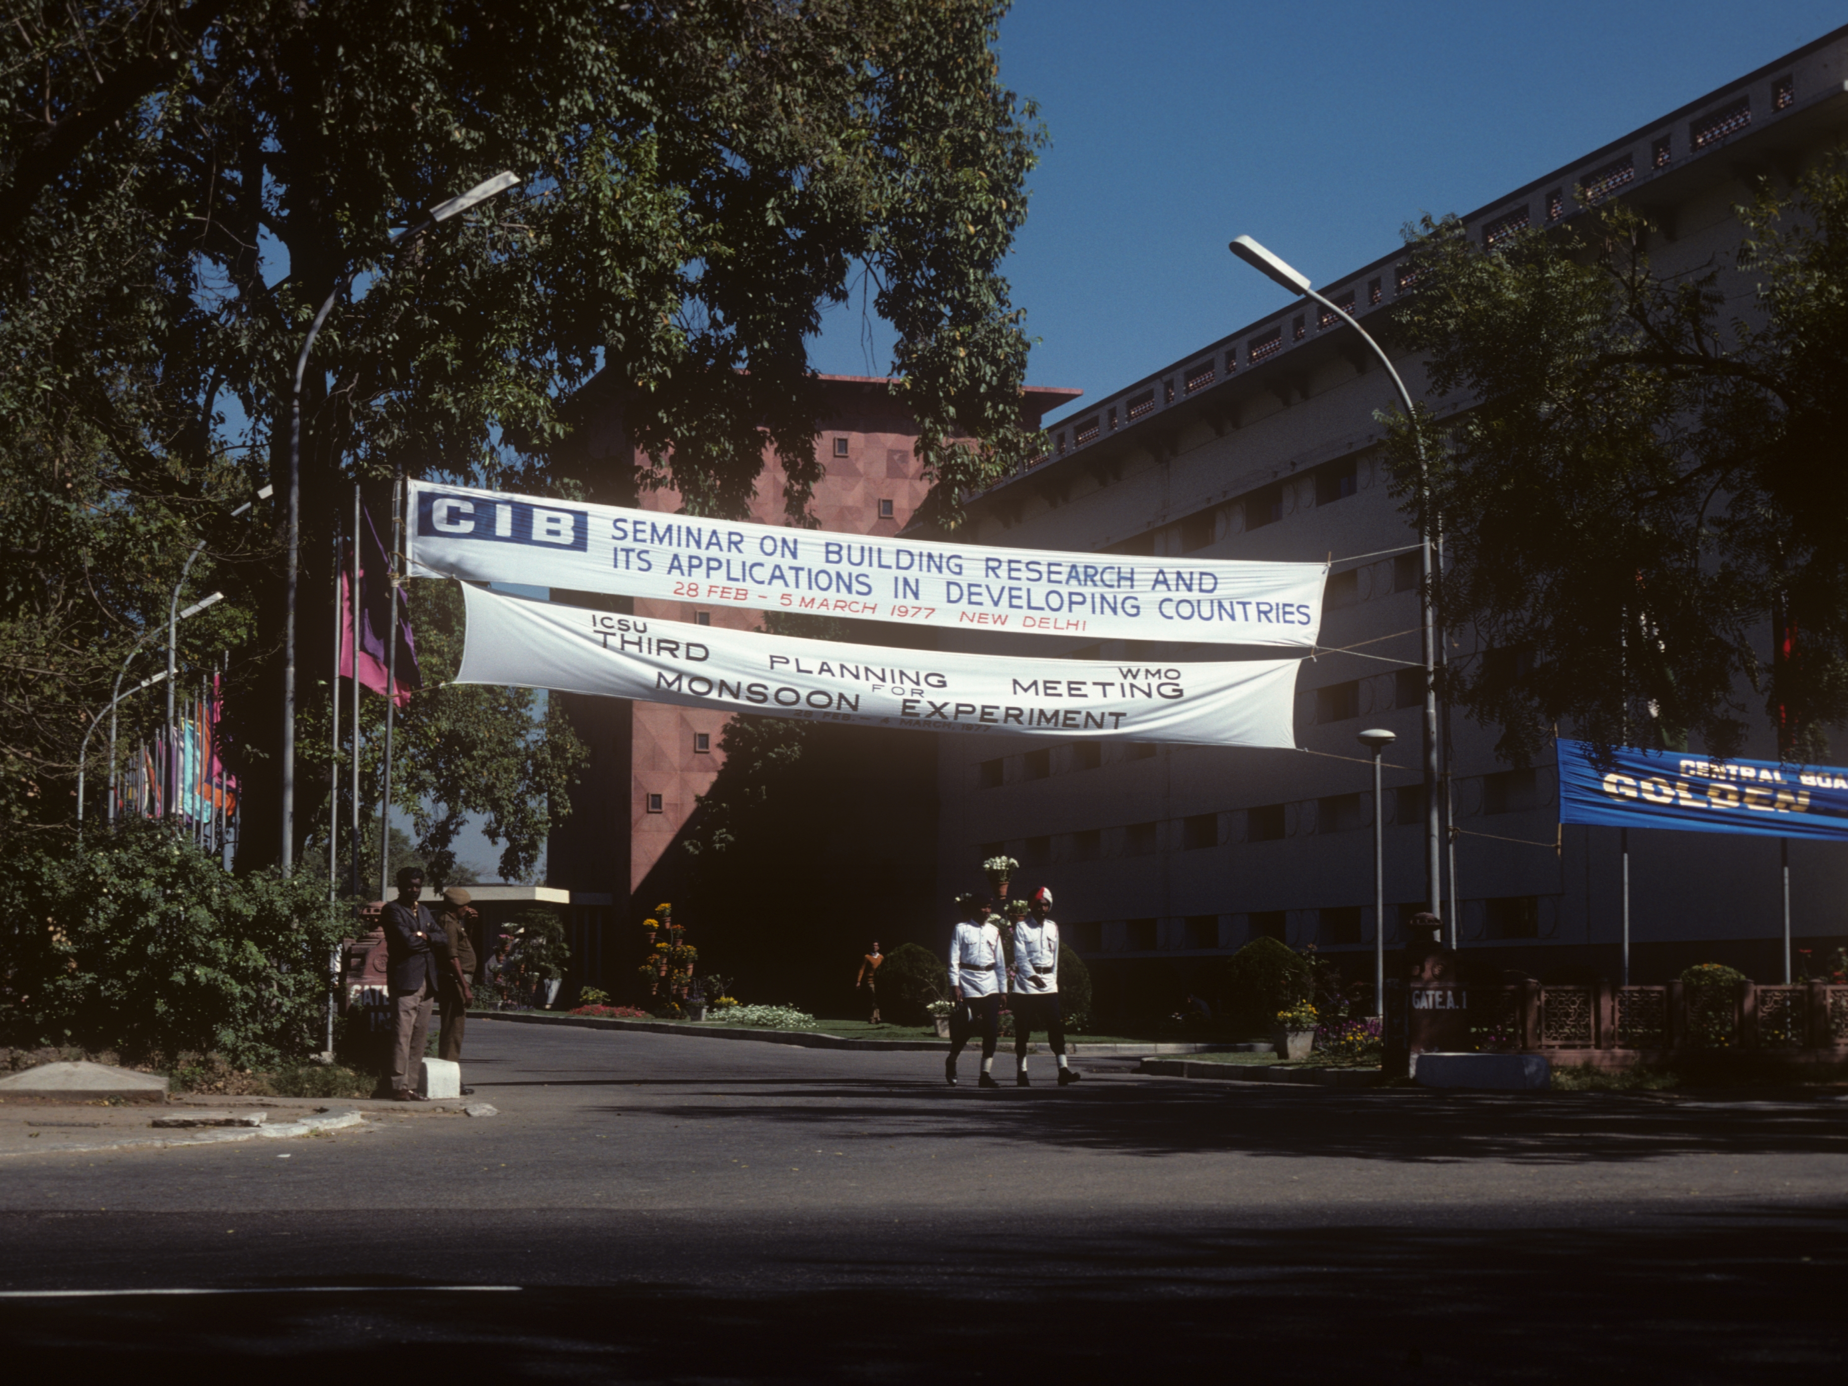
Delhi 1978

Slide 3
Webster’s classic review of the Asian Monsoon
Webster et al. 1998

Slide 4
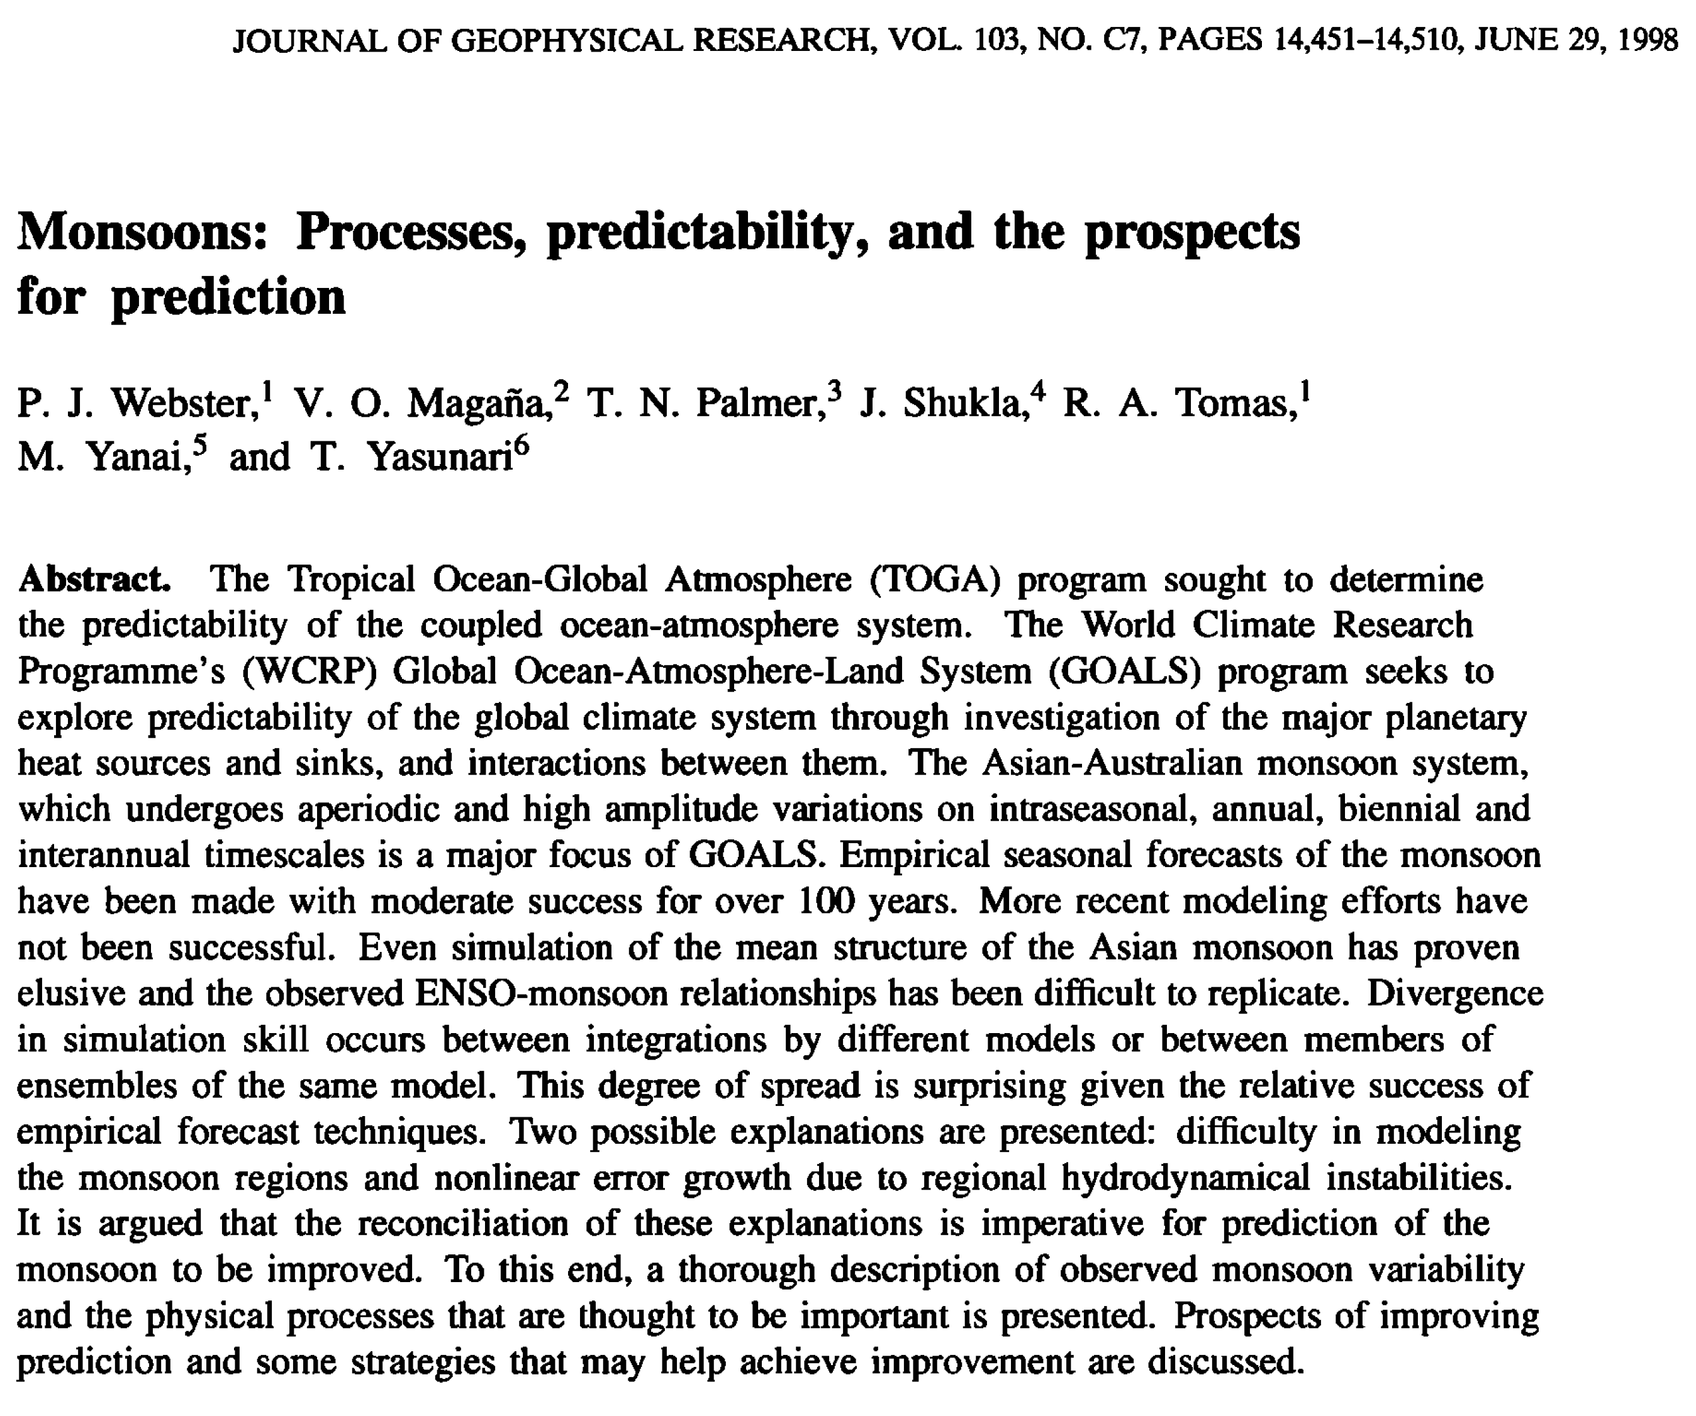

Slide 5
Some highlights of Peter’s theoretical contributions

Slide 6
Active and break periods
of the monsoon: Hydrologic aspects
Webster 1983

Slide 7
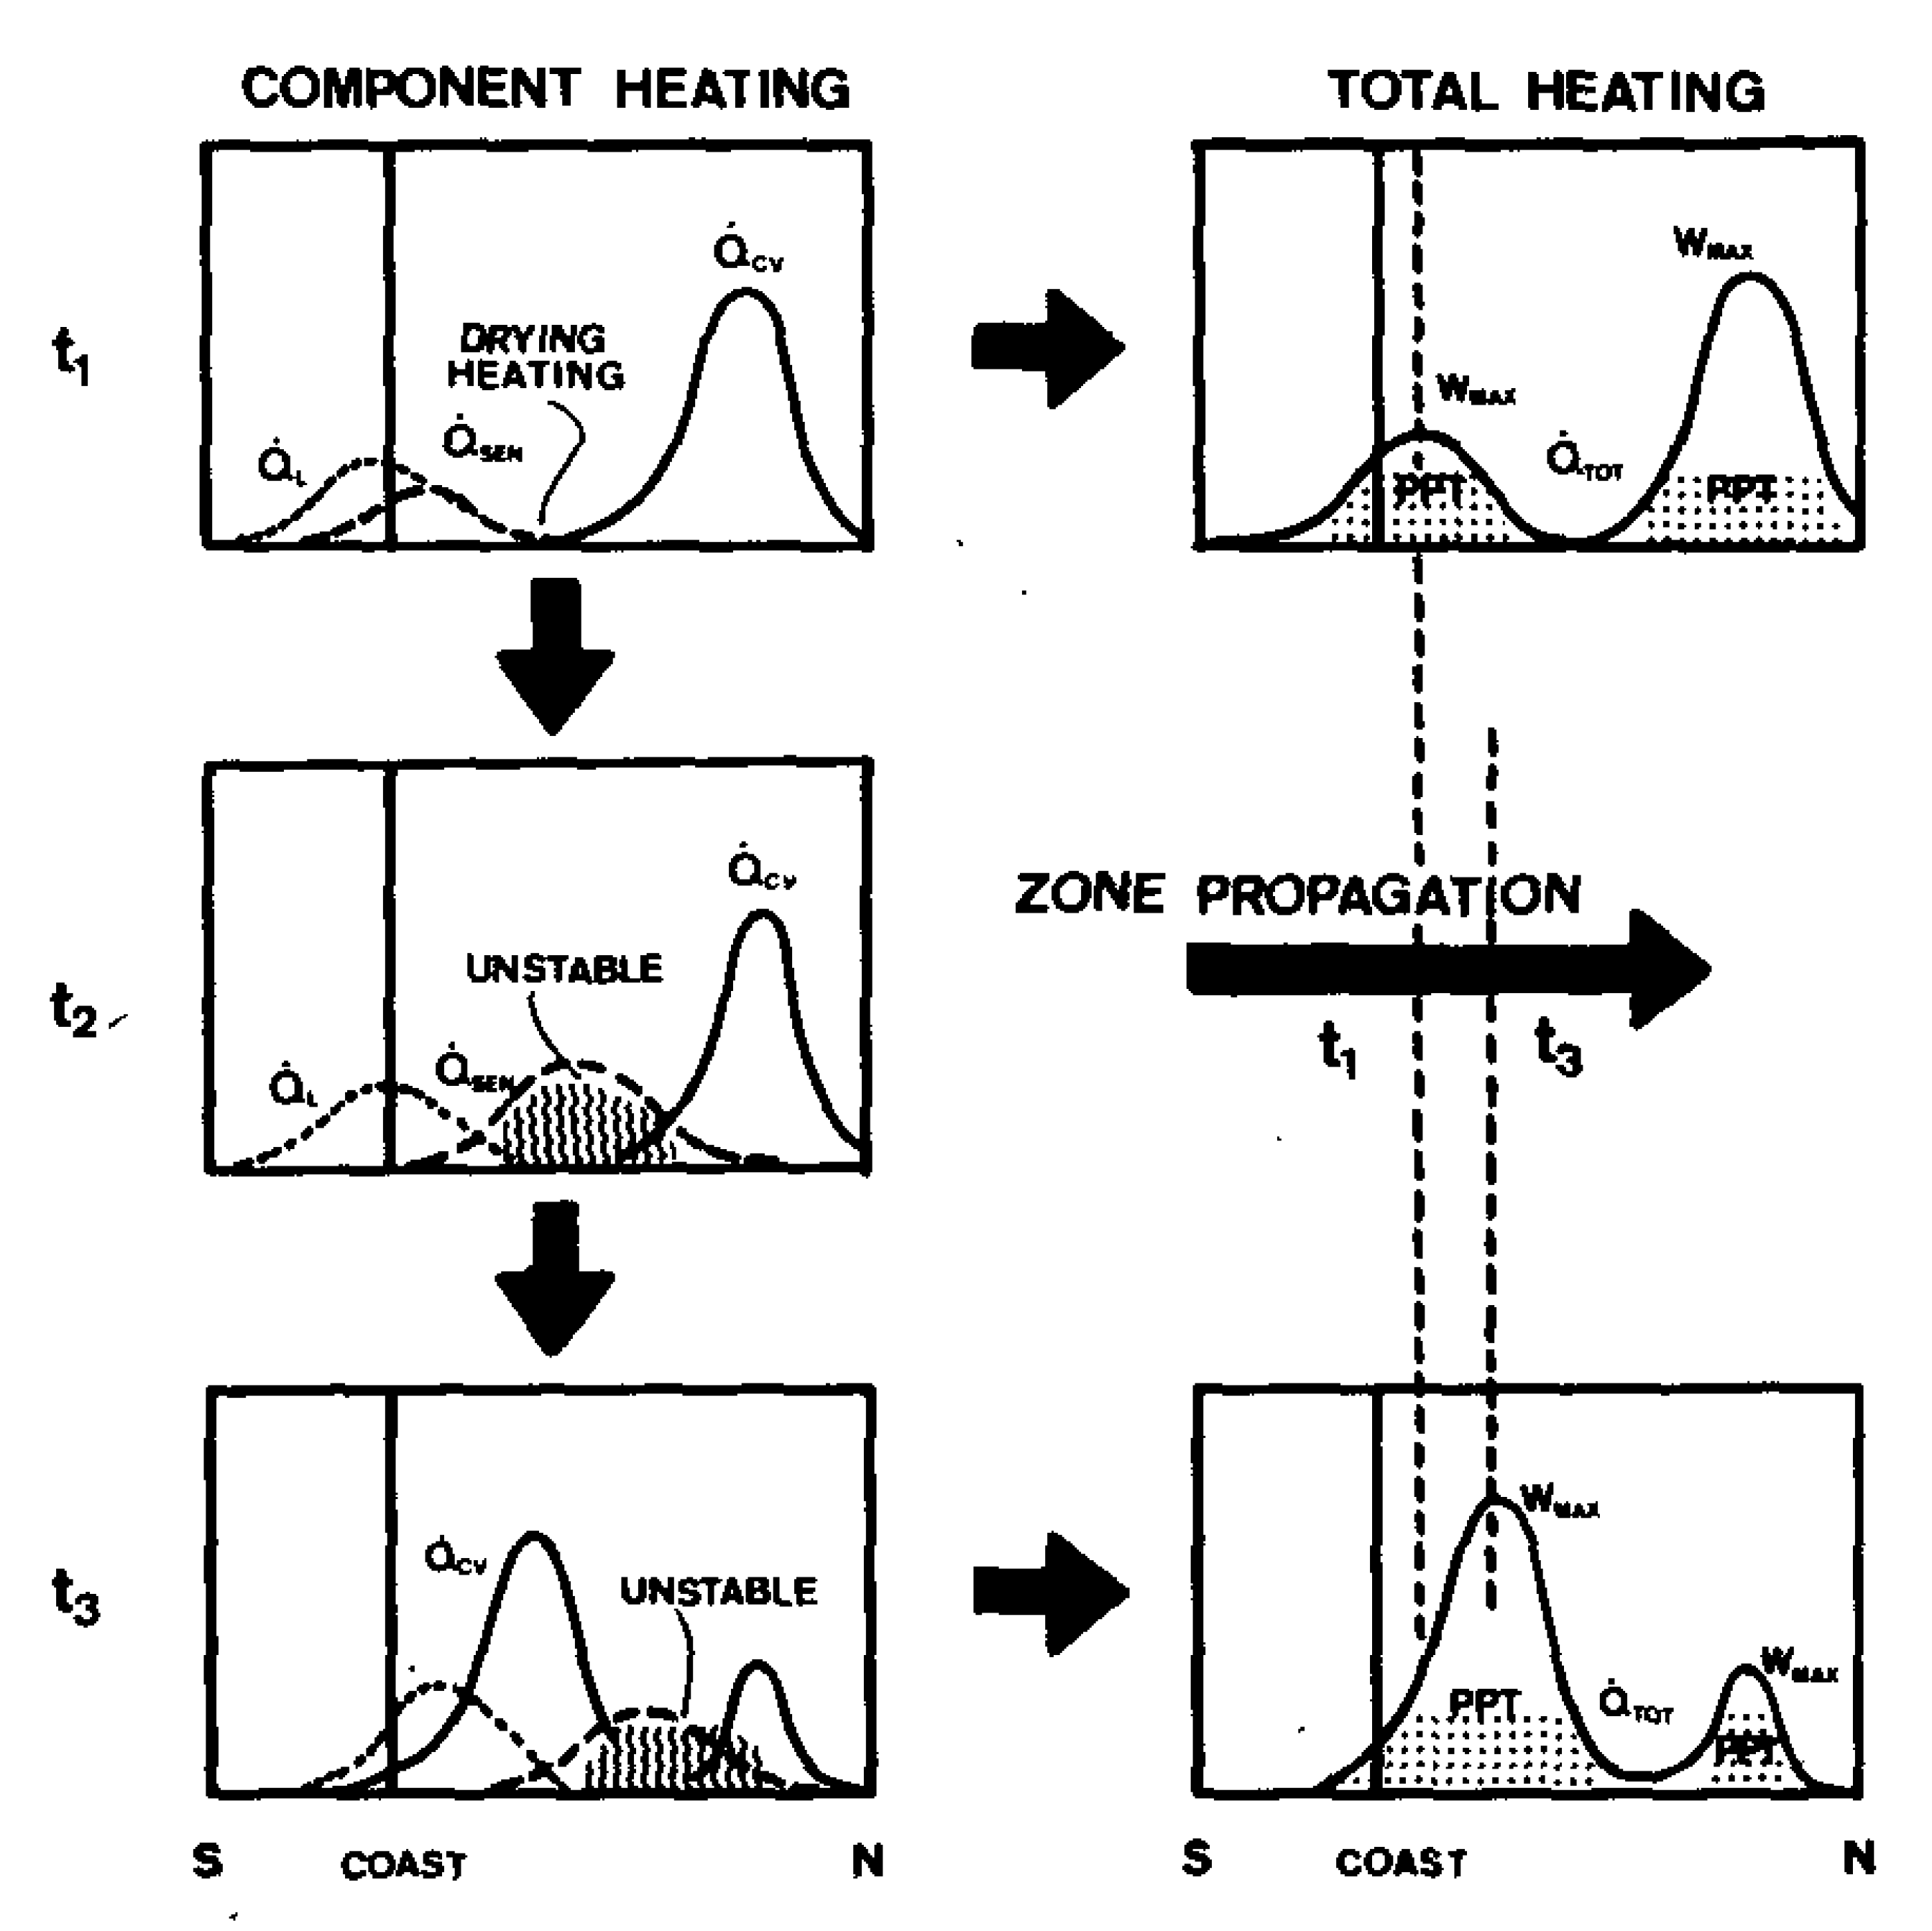
Webster 1983
Importance of land hydrology in the active/break cycle
Surface sensible heat—destabilizes ahead
Evaporation of rain on the ground—stabilizes behind

Slide 8
Thinking out of the box!
The monsoon in global context
Webster 2006
Wang and Webster 2006
Hoyos and Webster 2007
Agudelao et al. 2008

Slide 9
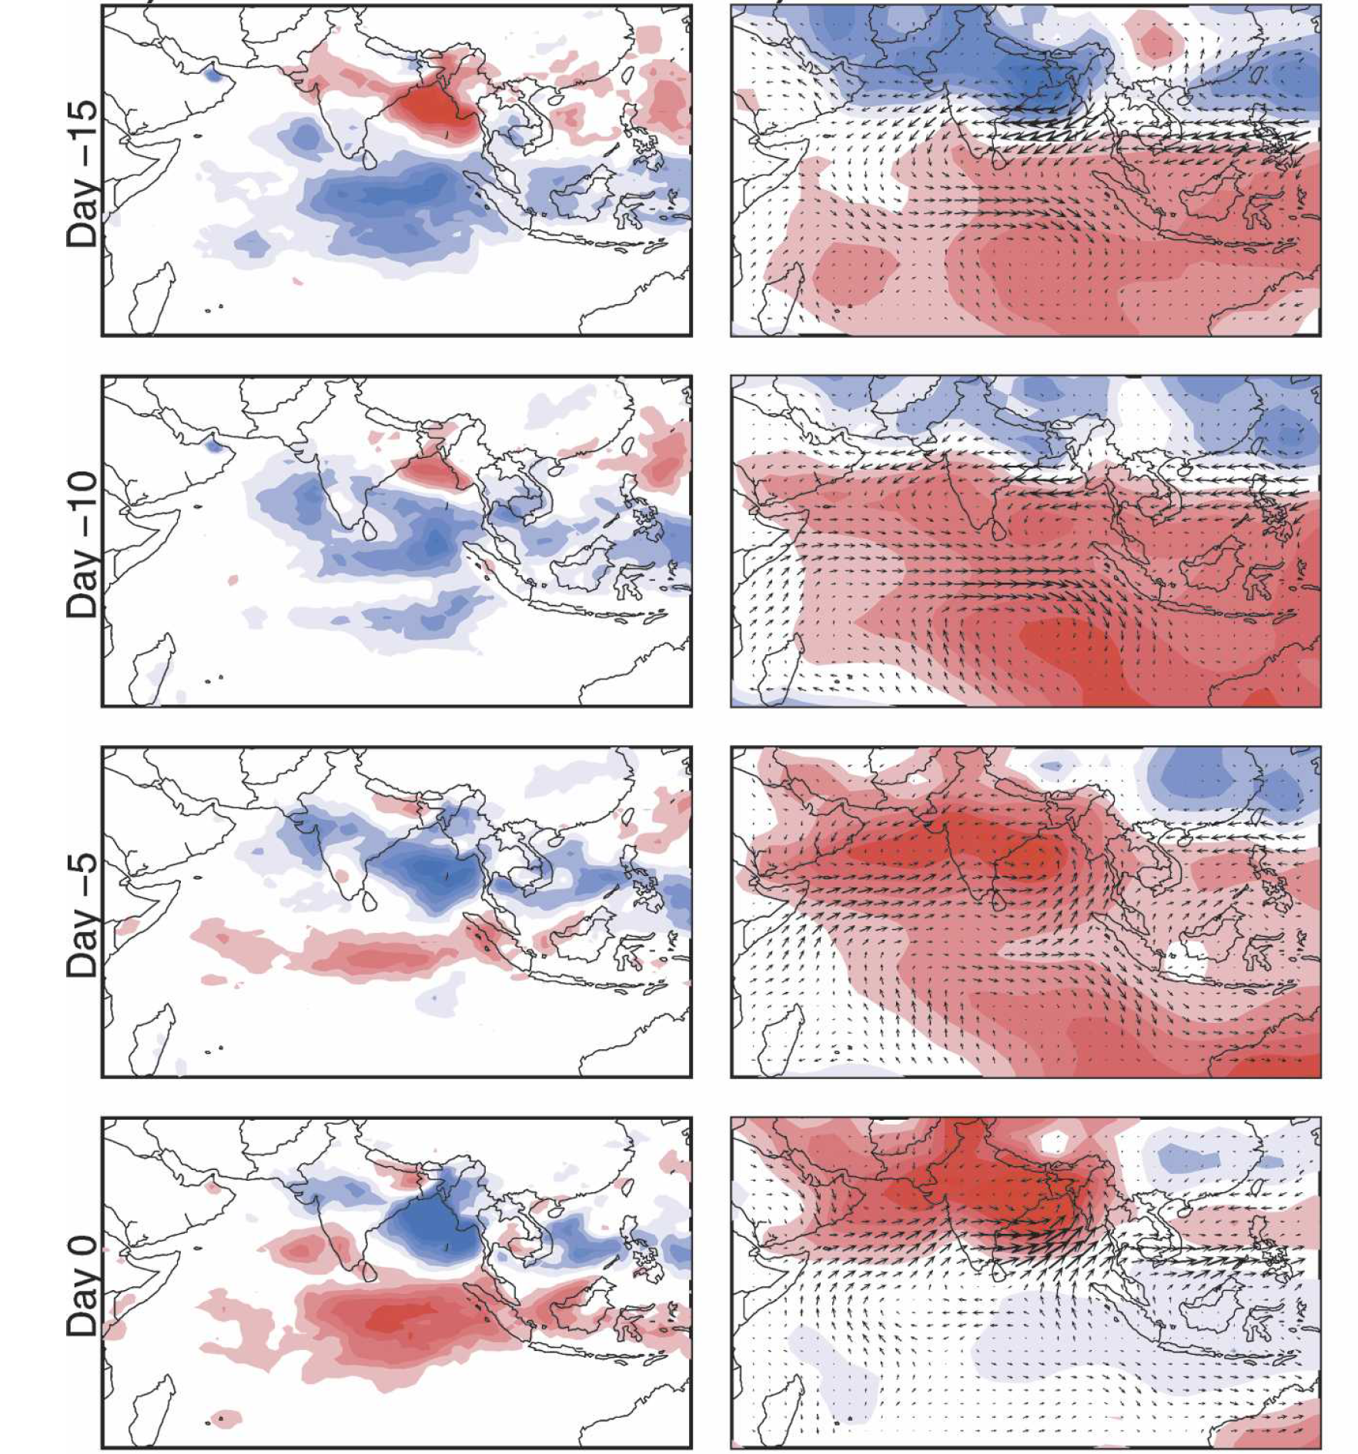
Rain mm)
SLP (hPa) & 925 mb wind
Hoyos and Webster 2007

Slide 10
The monsoon and the ocean: Structural anomalies in the Indian Ocean possibly associated with strong and weak monsoons
Webster et al. 1998
Webster et al. 1999
Webster et al. 2002
Loschnigg et al. 2003

Slide 11
The Webster-Yang Monsoon Index
Webster and Yang (1992)
Cited over 900 times
Used by NOAA and many others

Slide 12
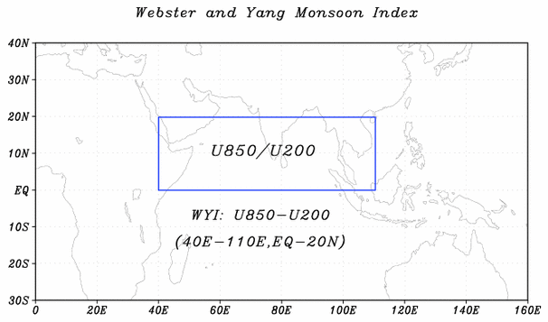
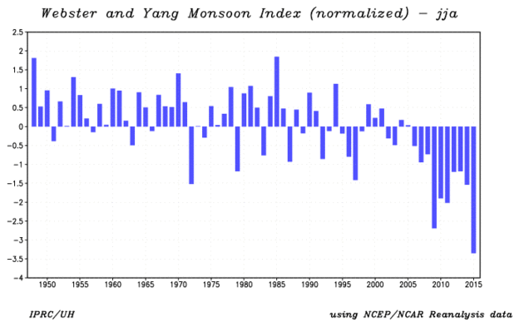
The Webster-Yang index is based on the 850 -200 hPa shear
?

Slide 13
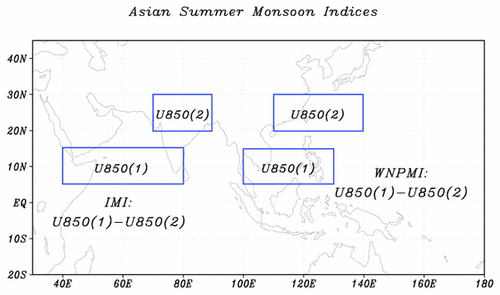
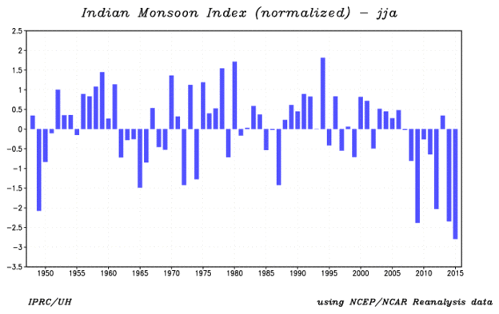
Bin Wang’s Indian Monsoon Index based on 850 hPa only and SW-NE gradient
?
?

Slide 14
Westerly Duct
Webster and Holton (1982)

Slide 15
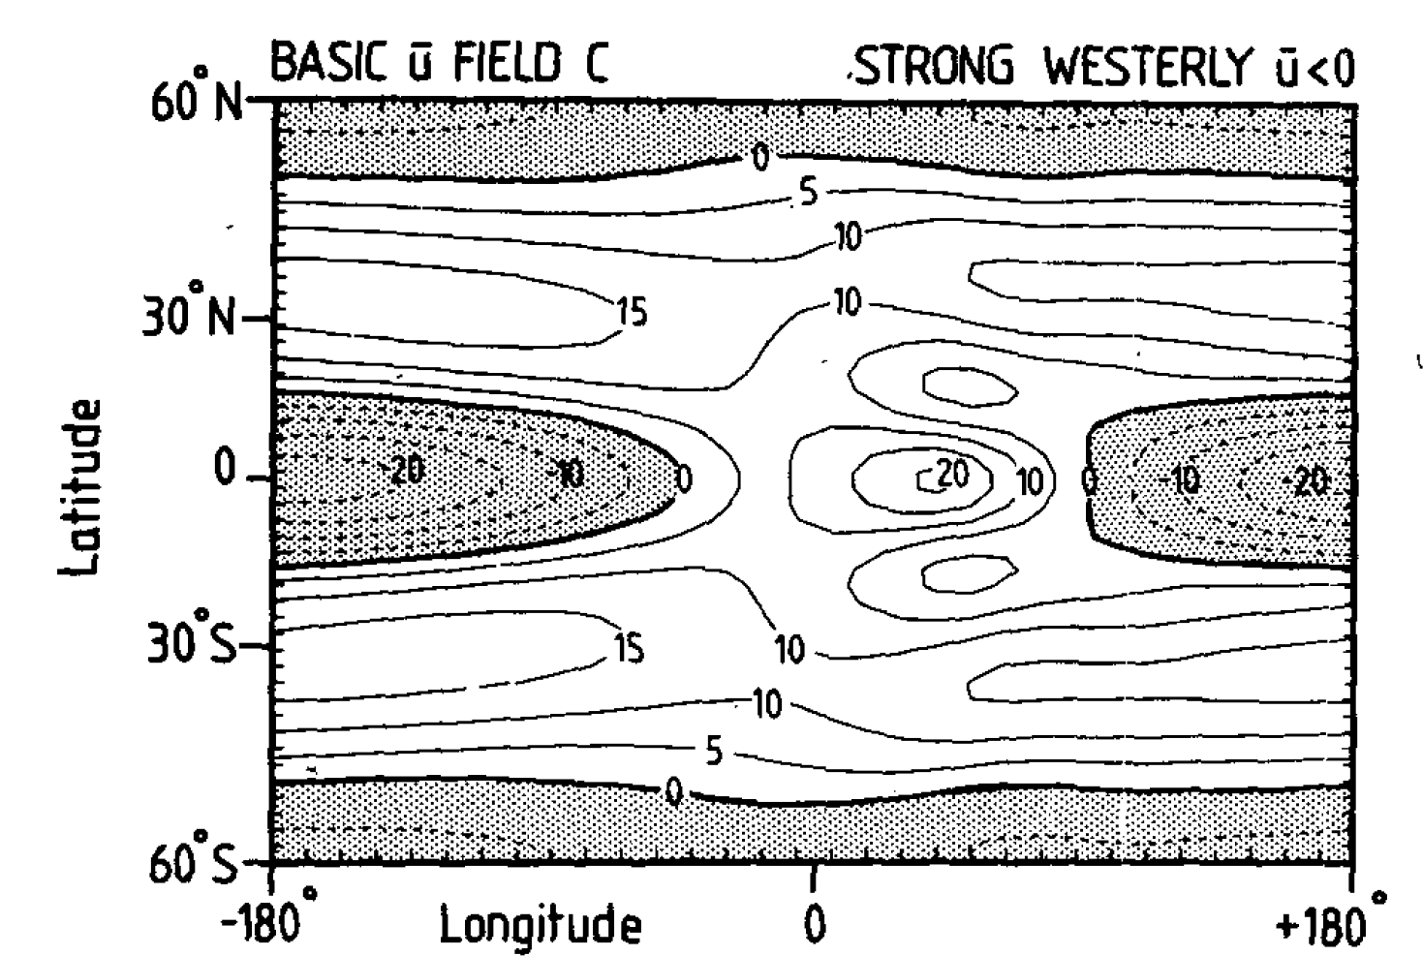
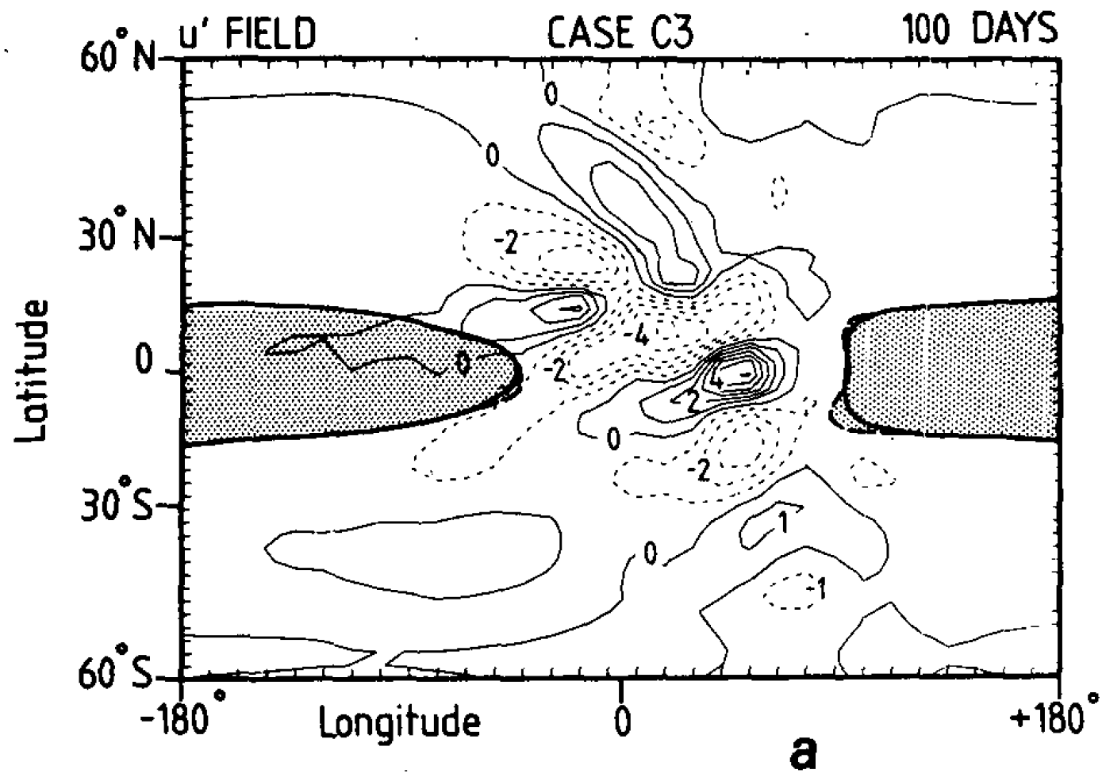
Basic State with a Westerly Duct
Perturbations from Northern Hemisphere
Webster and Holton (1982)

Slide 16
The role of inertial instability near the equator
Tomas and Webster 1997

Slide 17
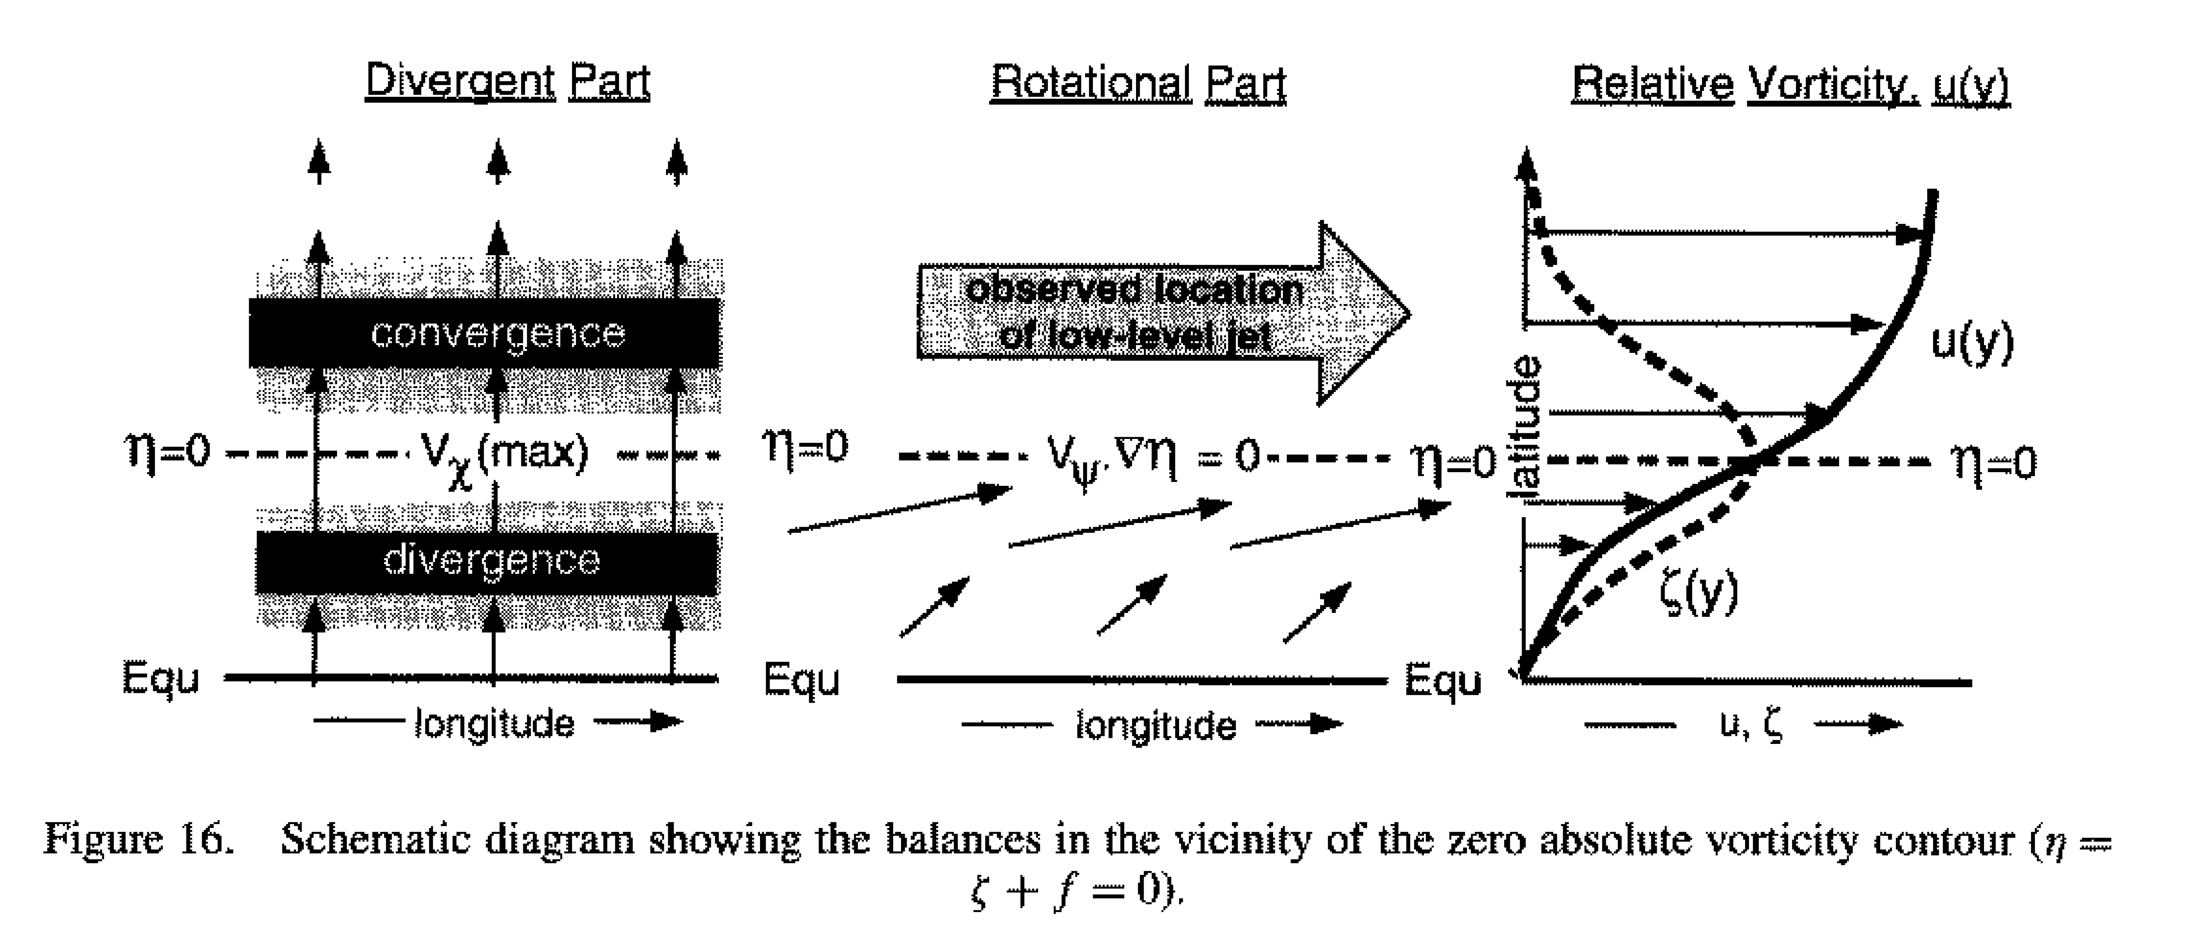
Tomas and Webster 1997
Notes:
Rossby wave propagation, time scale ~few days, could force normal modes, most unstable wavelength
Easterly wave generation

Slide 18
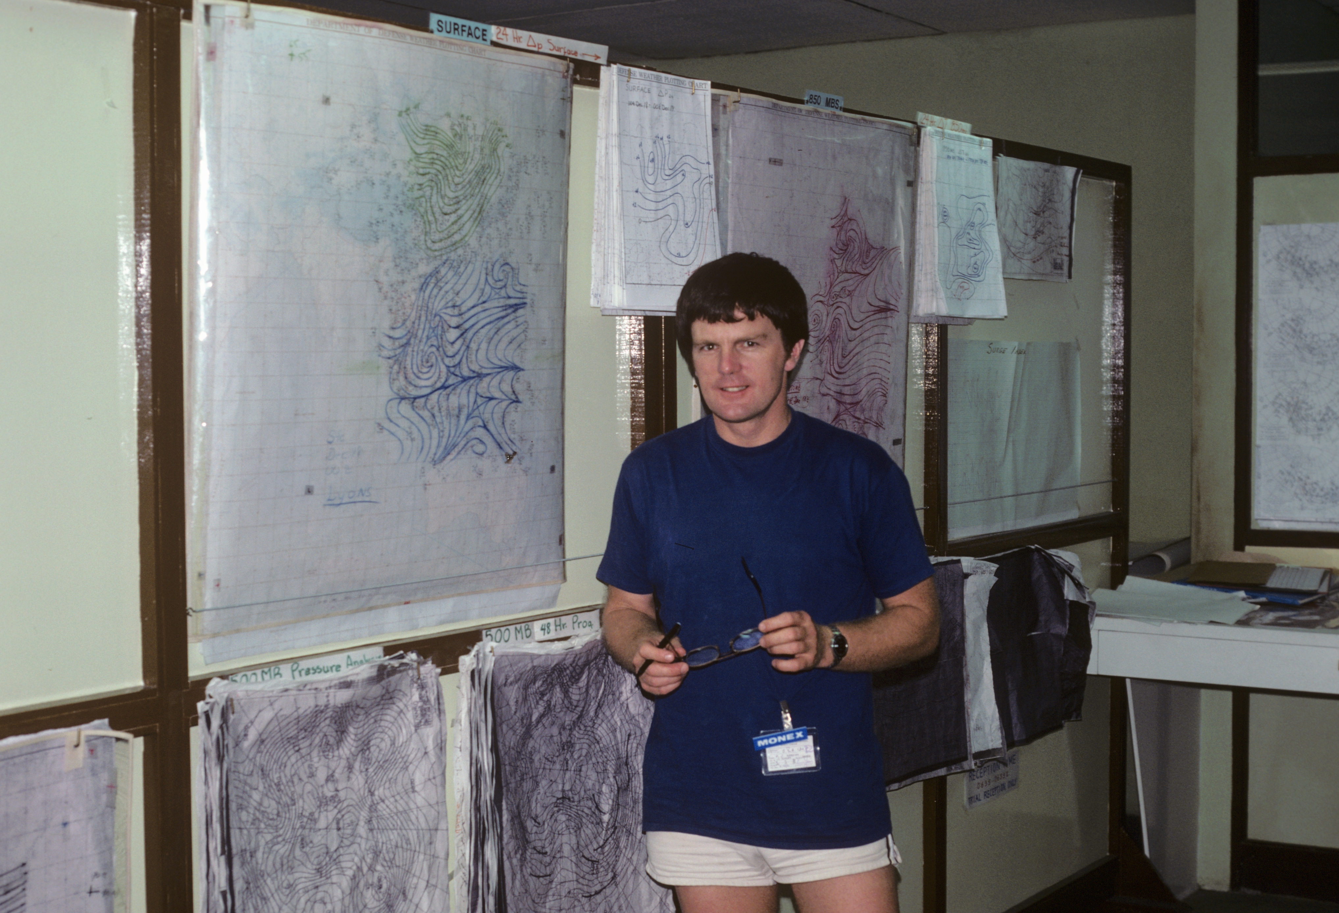
Winter MONEX
1978

Slide 19
Experimental work
MONEX—the Asian Monsoon Experiment
EMEX—the Australian Monsoon Experiment
TOGA COARE—West Pacific Warm Pool
JASMINE—Bay of Bengal during the Asian Monsoon

Slide 20

TOGA COARE
The grandest of Peter’s field experiment leadership
An historical accomplishment
1974 GATE—Eastern Atlantic
1992-93 TOGA COARE—Western Pacific
2011-12: DYNAMO—Central Indian

Slide 21
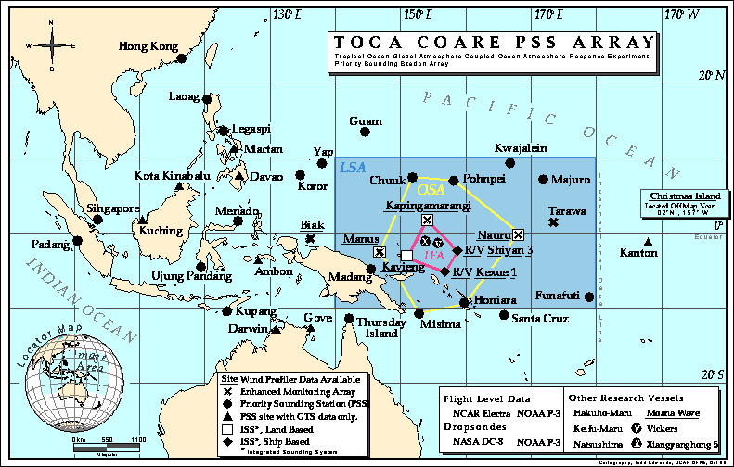

Slide 22
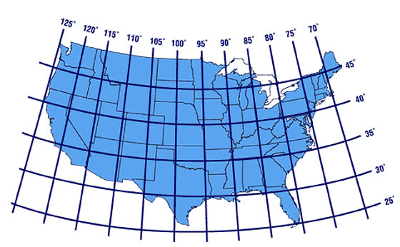
Size of the TOGA COARE ARRAY
TOGA COARE

Slide 24
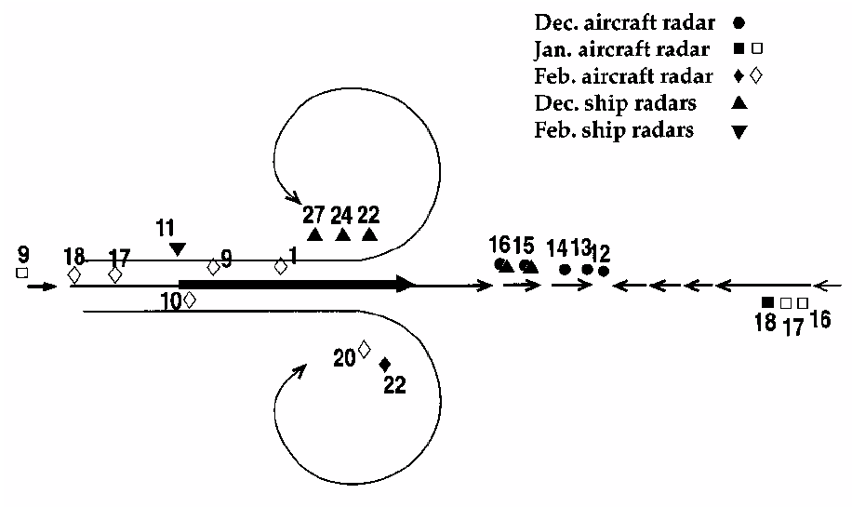
TOGA COARE: Ship and aircraft radar data relative to MJO structure
Low-level flow
Strong westerly region
Westerly onset region
Houze et al. 2000
Notes:
These large MCSs occur in diff synoptic envs.
In TOGA COARE, env characterized by KR wave. Radar data in diff regions showMCSs have a pos feedback to low level mom in in sw region, and neg in westerly onset region.

Slide 25
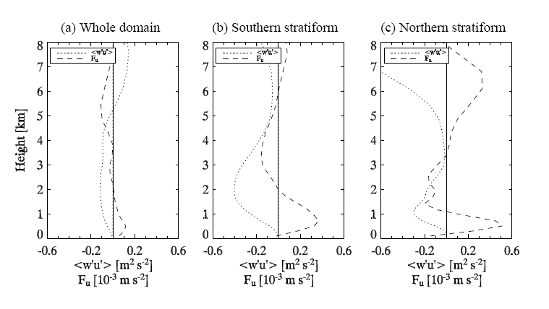
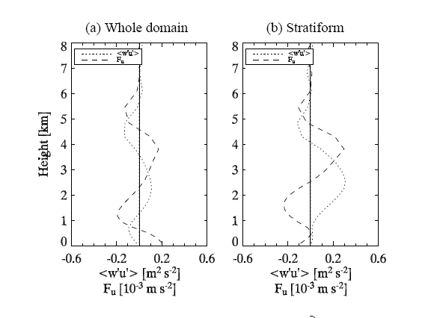
Westerly Momentum
Flux Convergence
400 km
x 600 km
Strong Westerly
Case
Mechem, Houze, & Chen 2006
+ feedback
200 km
x 300 km
Westerly Onset
Case
- feedback

Slide 26
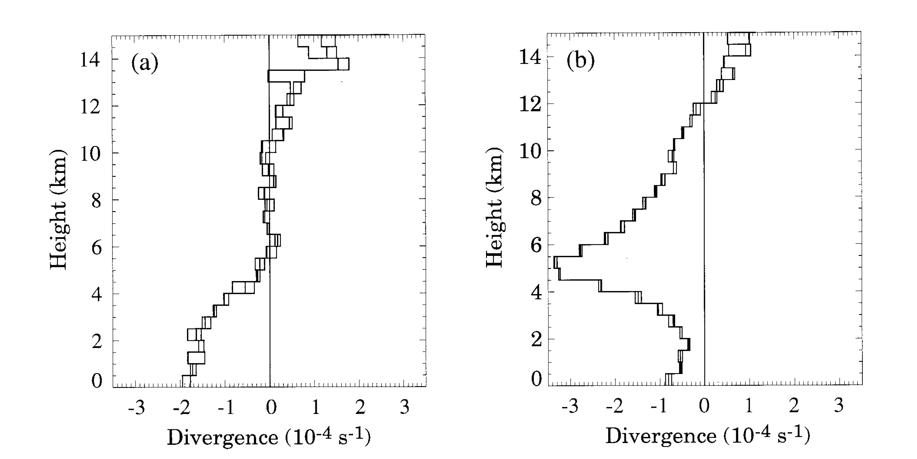
TOGA COARE aircraft sampling proves top-heavy heating
important in MJO convective zones
Convective
Stratiform
Divergence profiles from airborne Doppler radar measurements
Mapes and Houze 1995

Slide 27
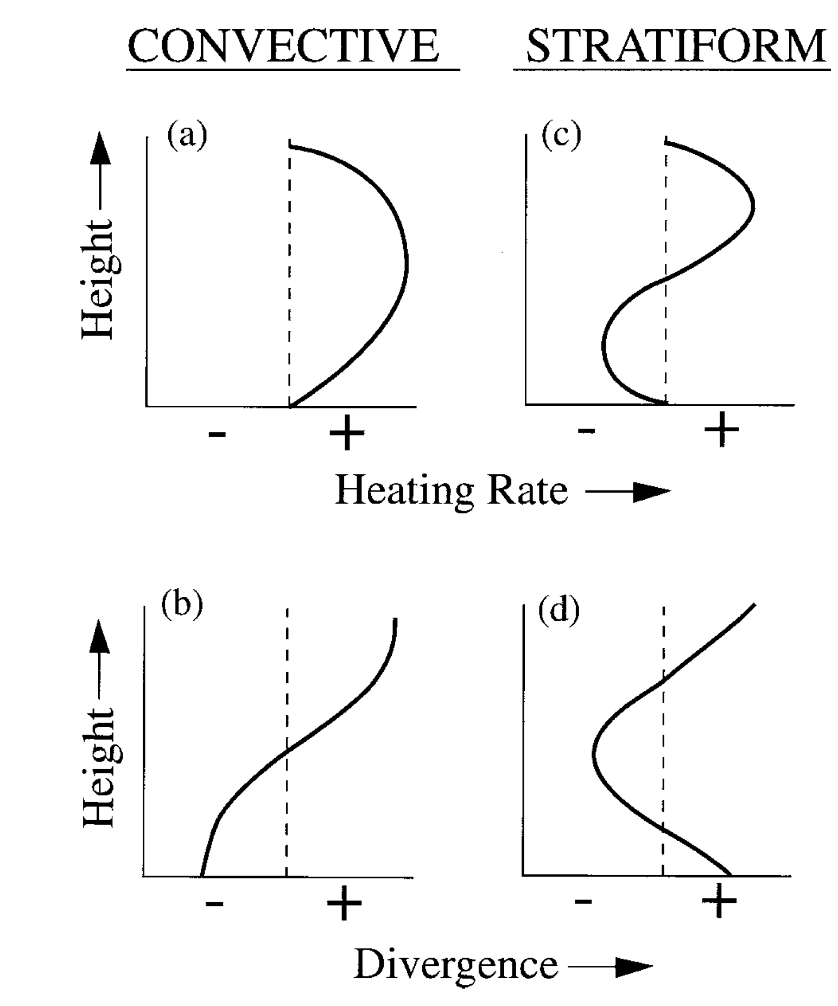
Latent heating profiles become more top-heavy when the convection is organized on the mesoscale with large components of stratiform

Slide 28
Clouds and radiation…seminal work
Webster and Stephens 1980
Stephens and Webster 1981
Houze 1982

Slide 29
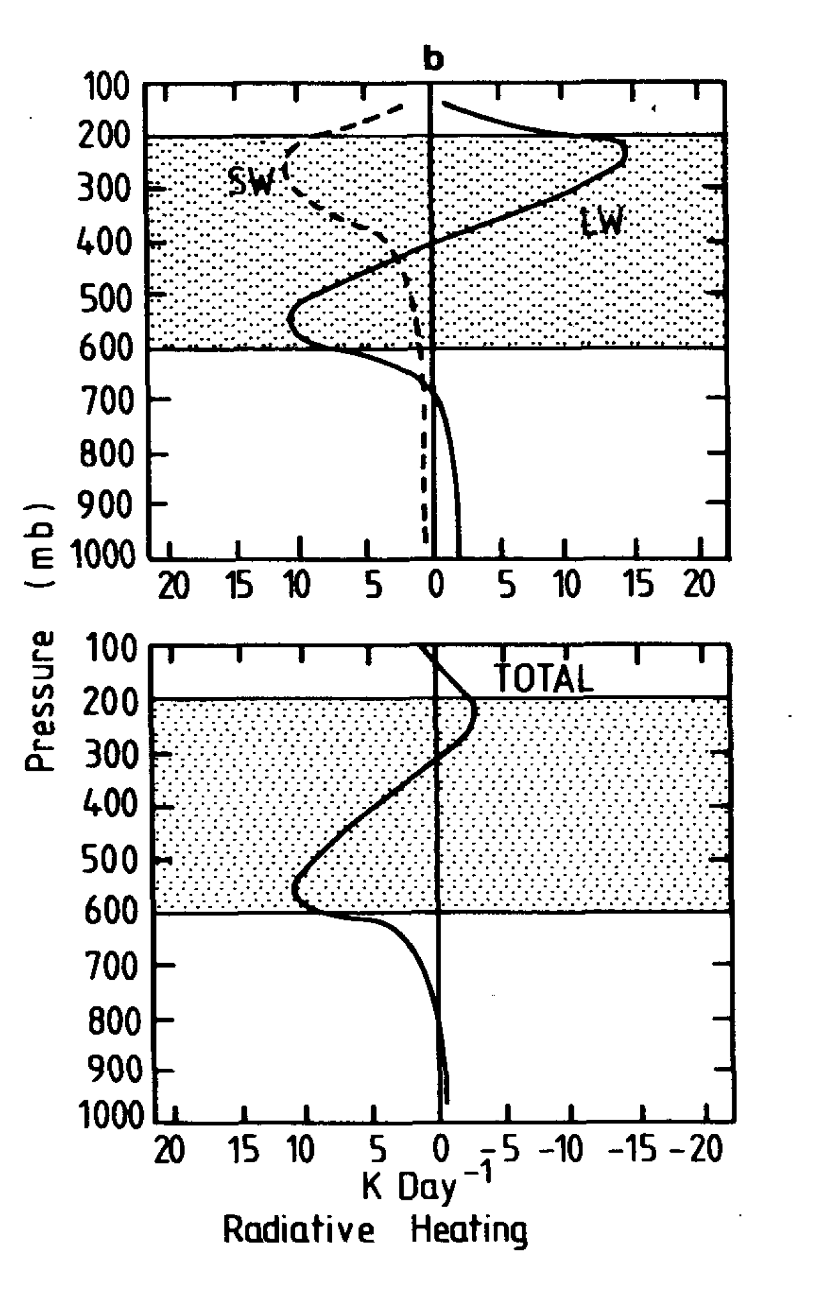
+
–
Webster and Stephens 1980
Net heating in the deep anvil cloud
Nightime destabilization
–
–
–
–
–
+
–

Slide 30
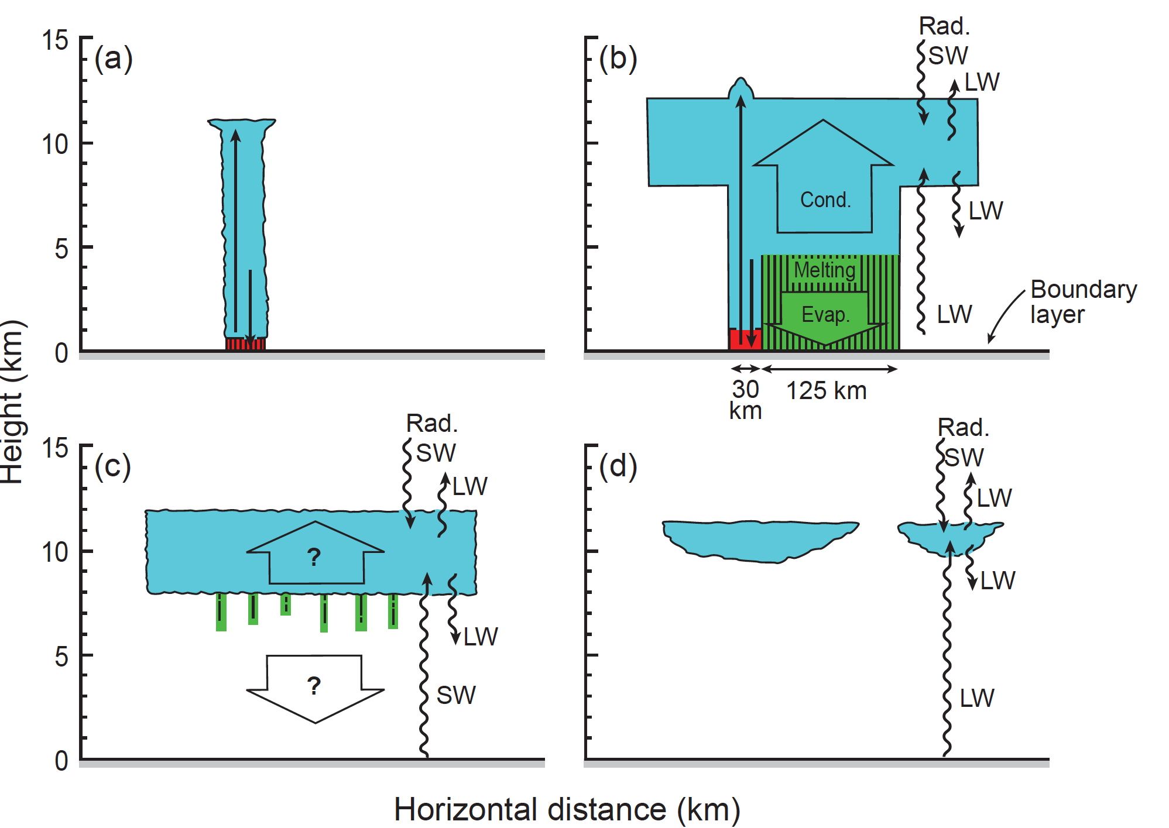
Net heating during mesoscale convective system lifecycle
is top heavy
t₁
t₂
t₃
t₄
The anvil top rises and has diurnal variability
Potential vorticity generated in midlevels
Houze 1982

Slide 31
Application:
Forecasting the monsoon

Slide 32
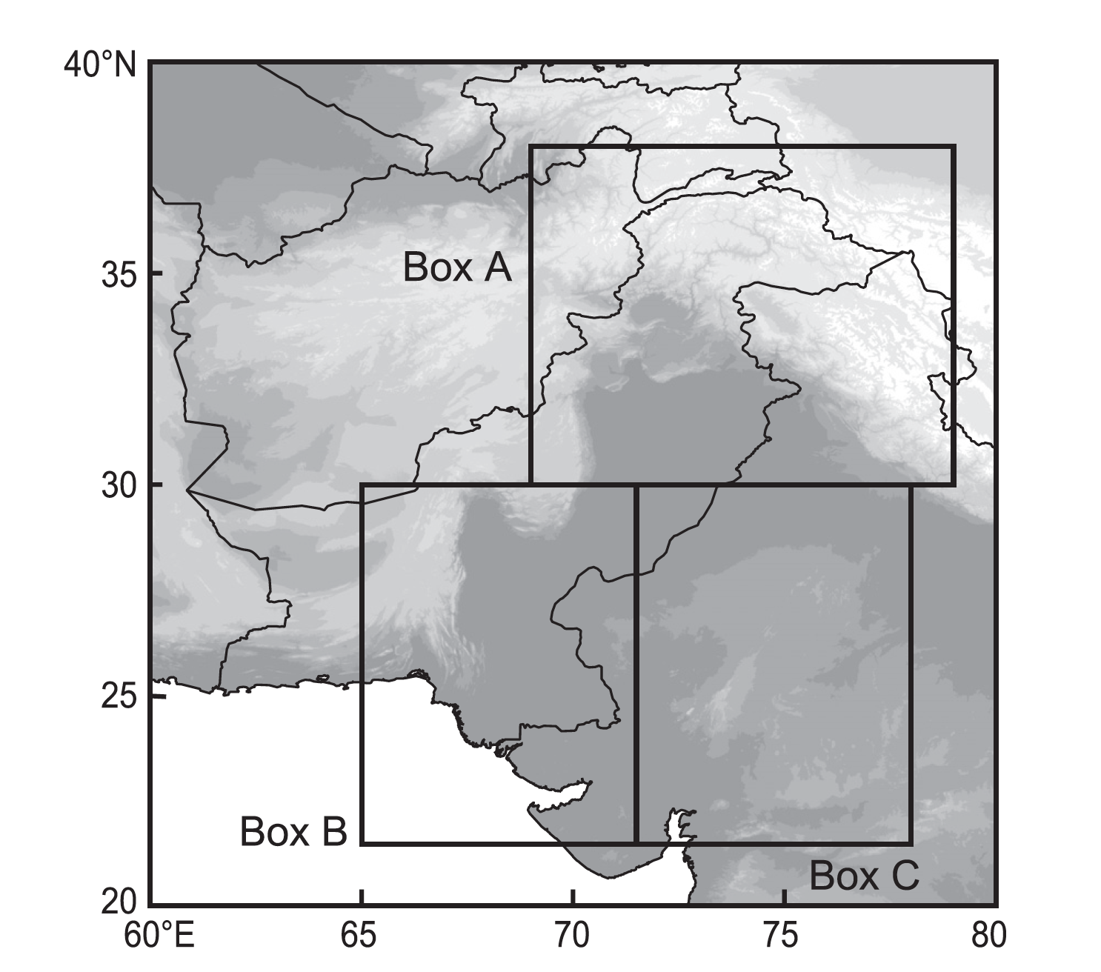
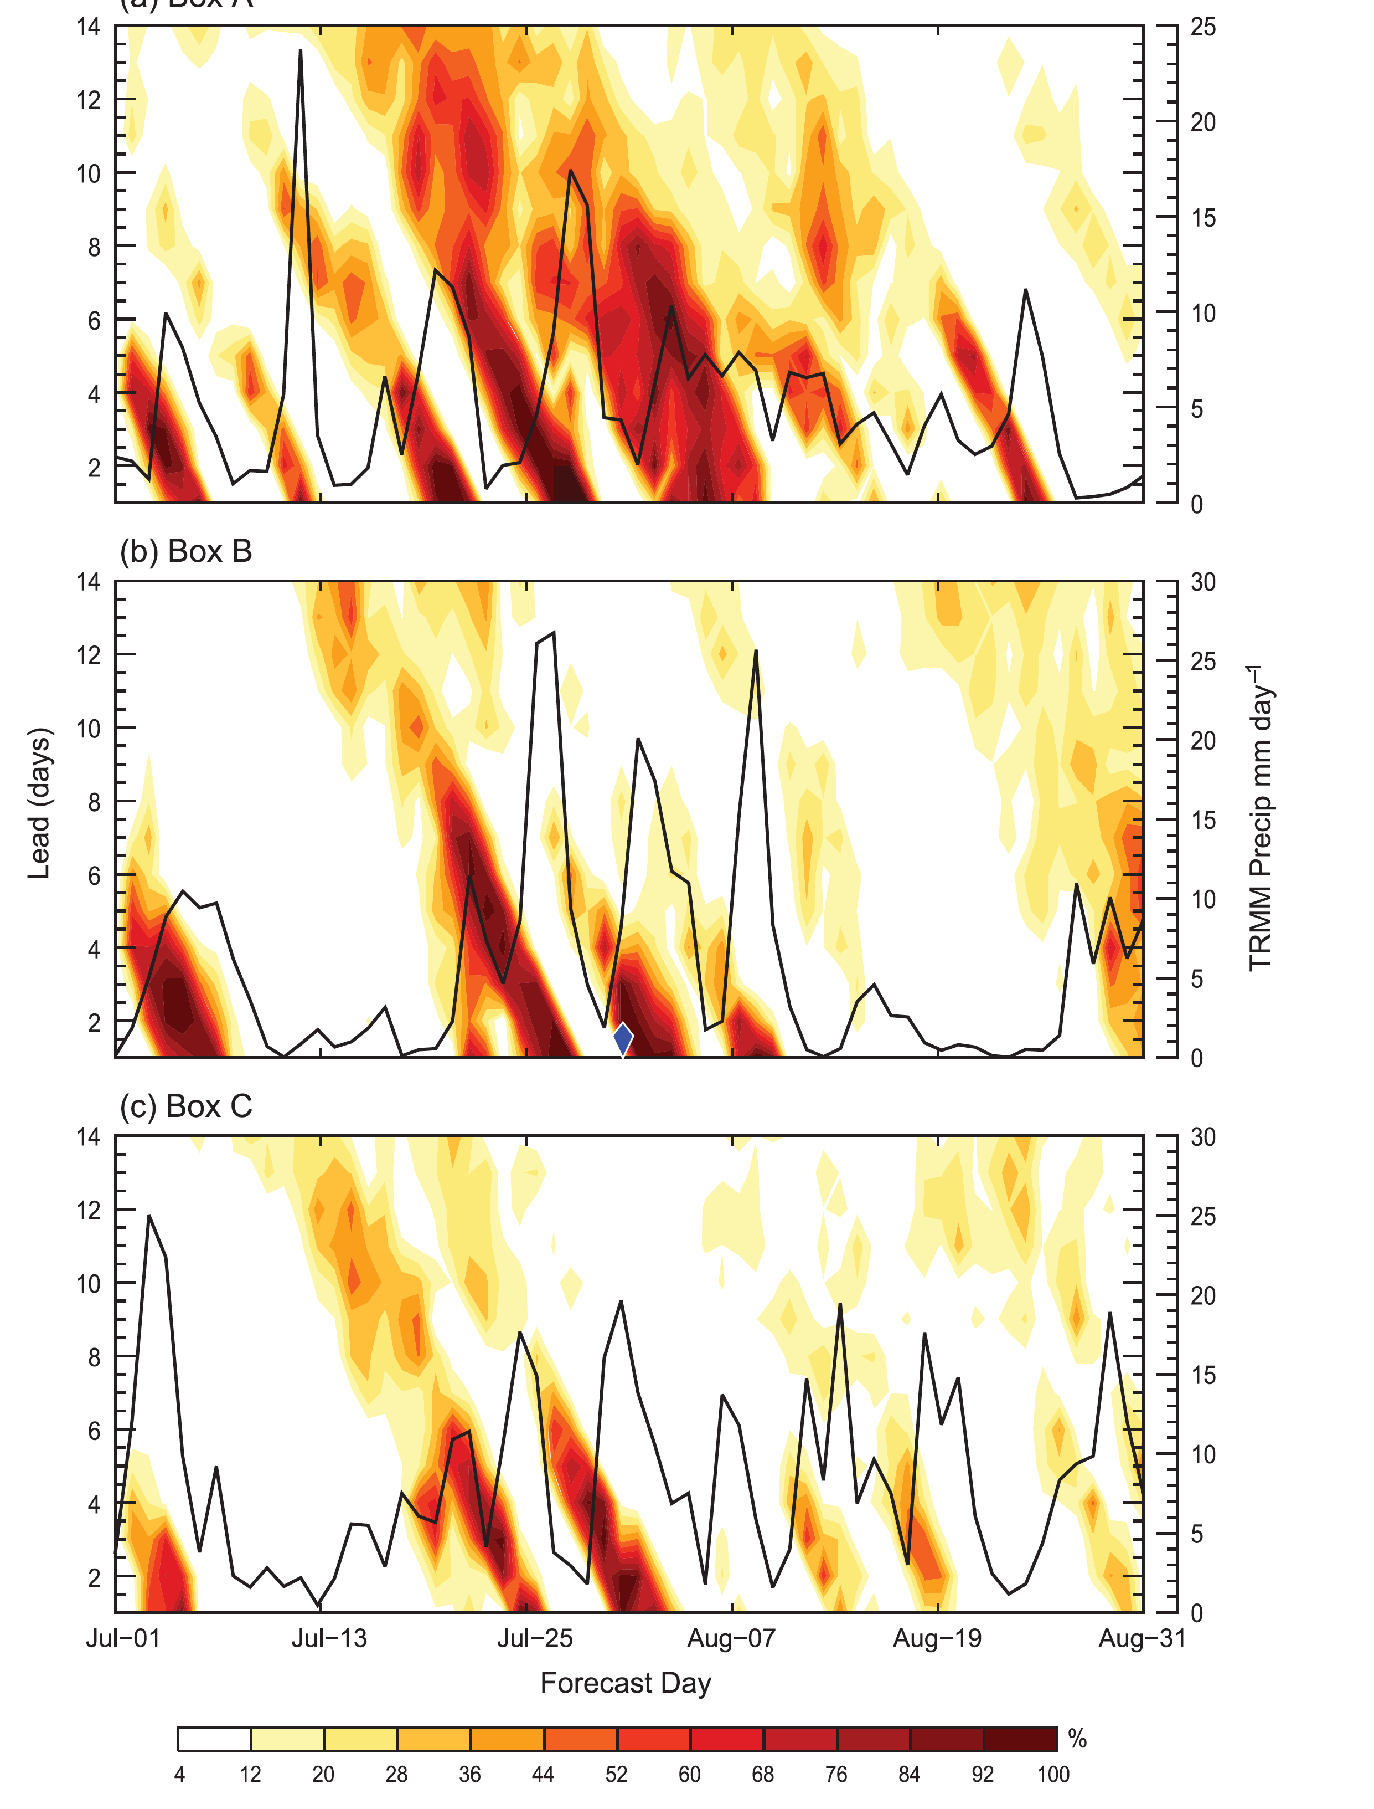
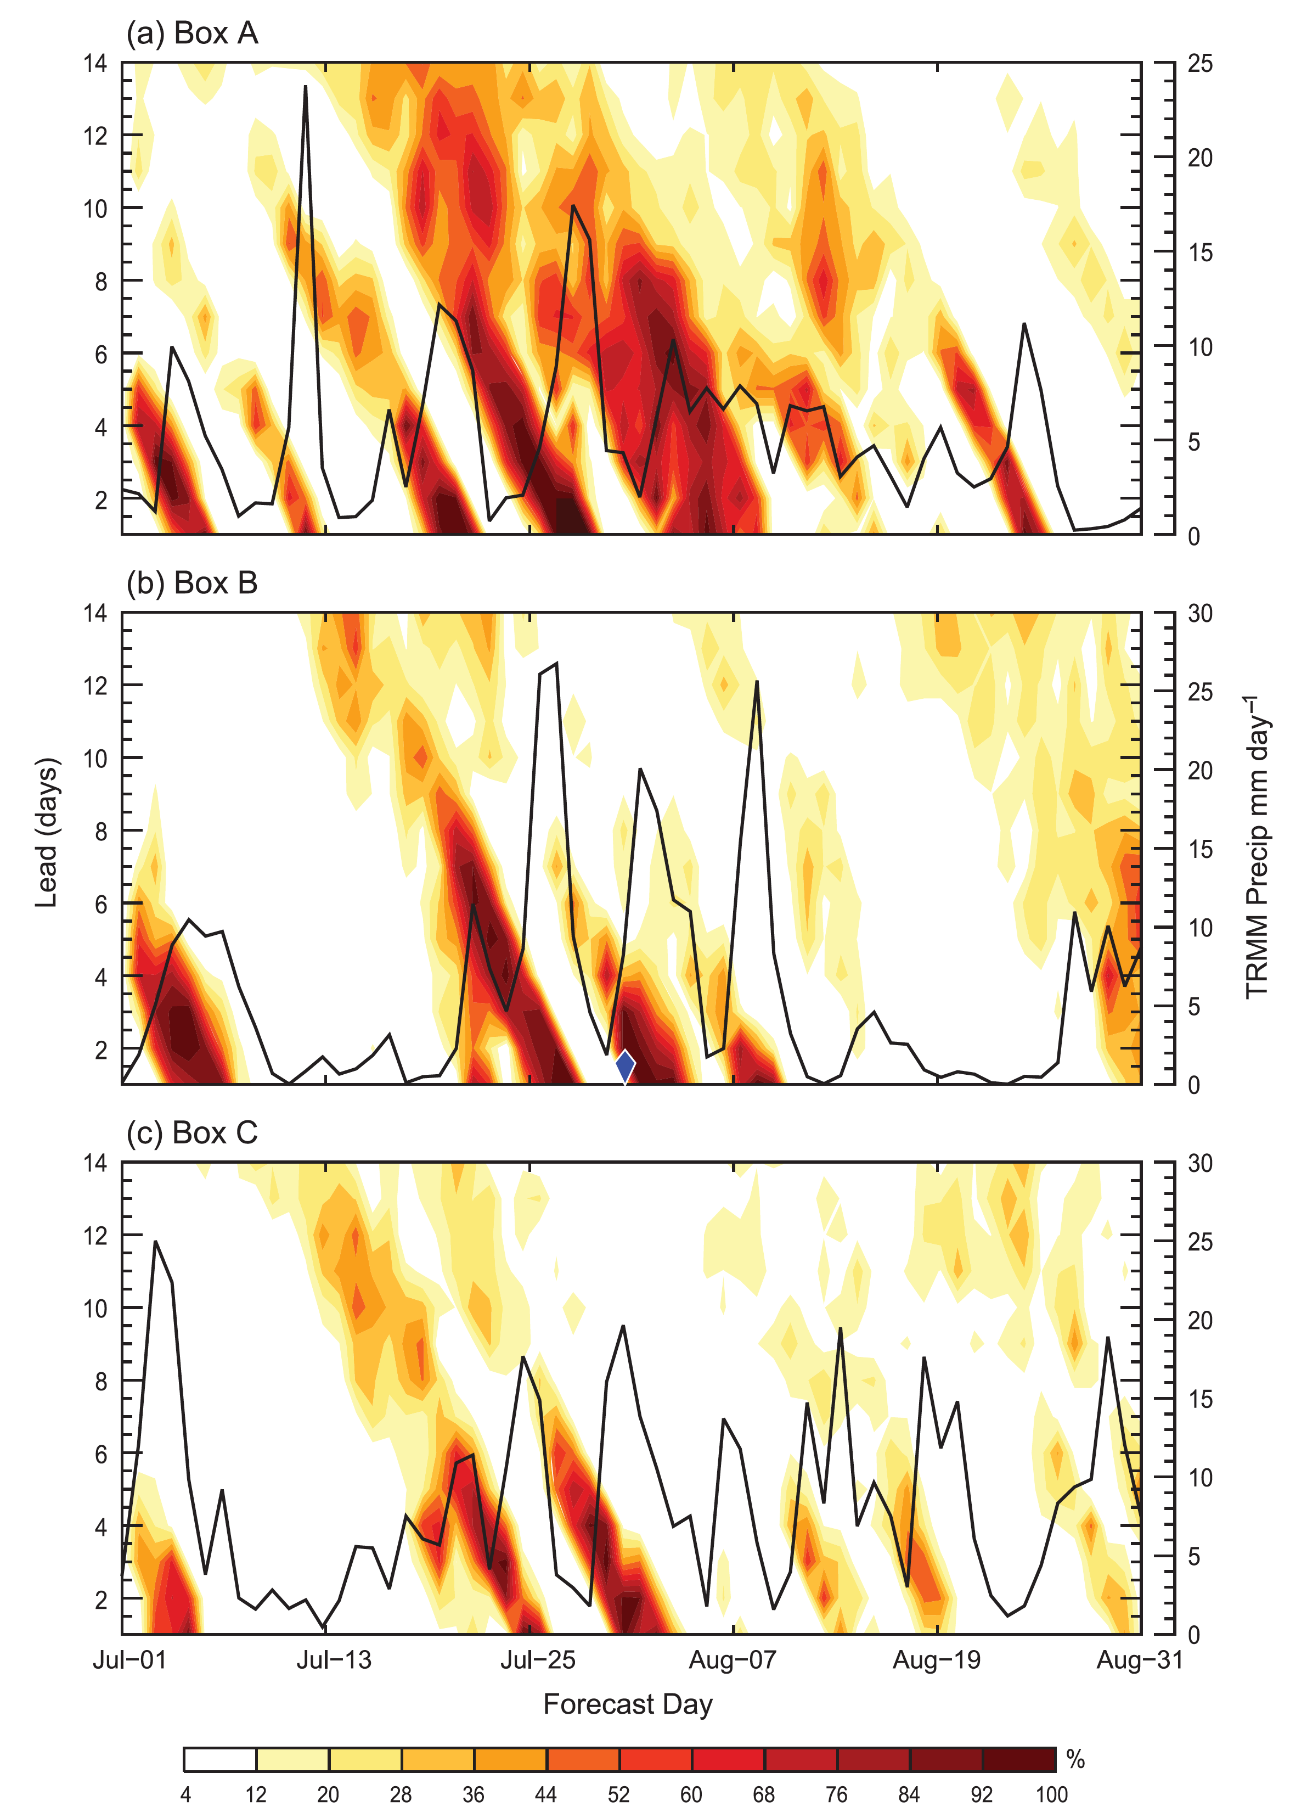
Forecasts of 2010 Himalayan floods
1-2 weeks in advance
Rasmussen et al. 2015

Slide 33
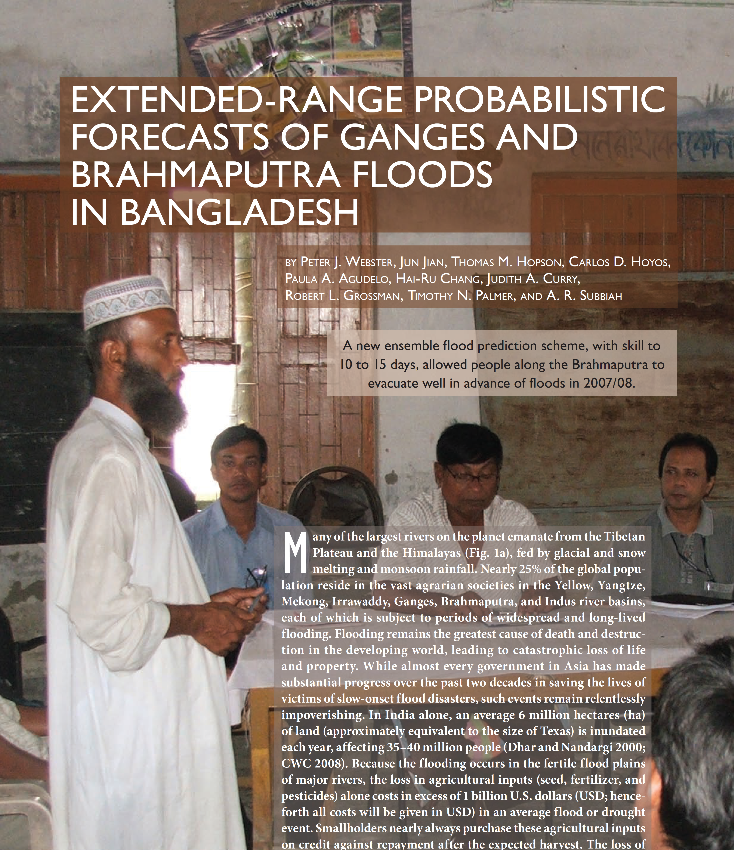
Webster et al. 2010
Success in Bangladesh
Statistical rendering of the EMCWF model
Hydrological modeling
Use of a private company
International NGOs
Emergency management
Cooperation of developed and developing nations

Slide 34
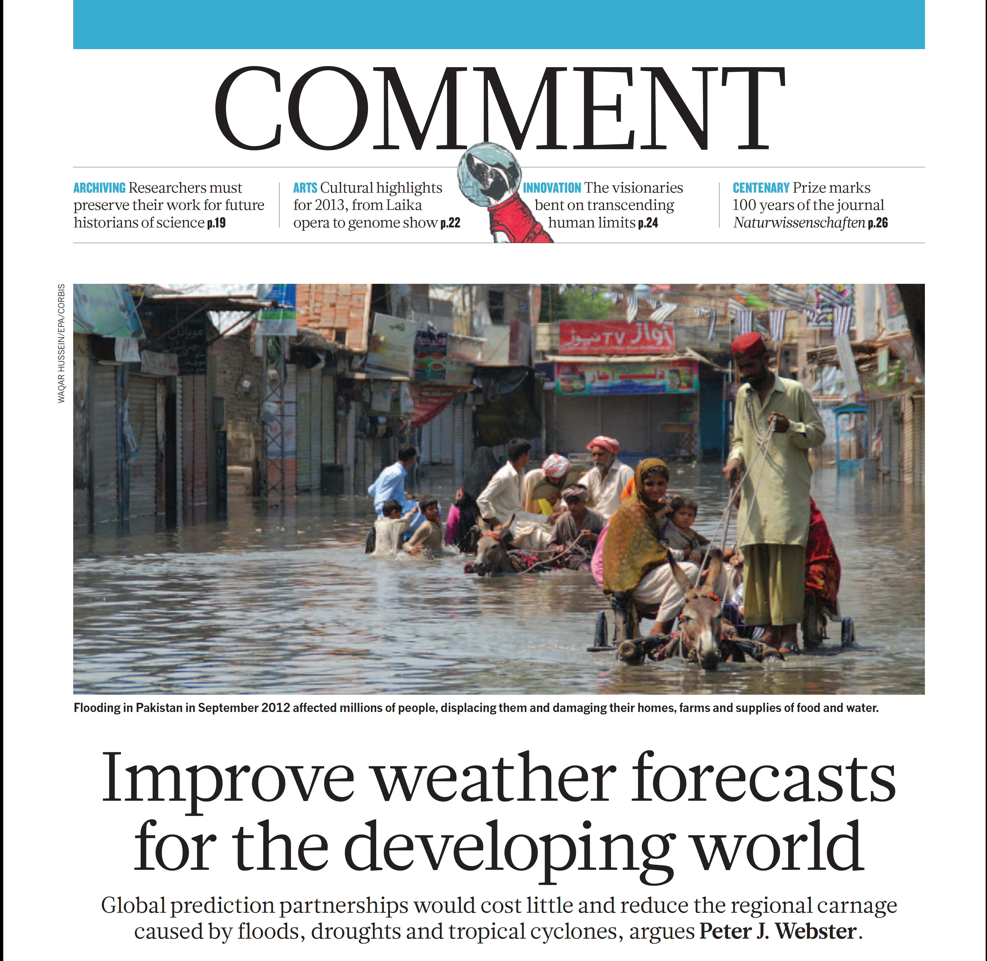
3 JANUARY 2013 | VOL 493 | NATURE
Webster 2013
Argues for global partnership in dealing with disasters such as we see in the Asian monsoon region

Slide 35
Webster’s Prestigious Awards
AMS—Rossby
RMS—Mason
AGU—International Award
Prince Sultan Bin Abdulaziz International Prize for Water

Slide 36
Ascent Award

Slide 37
Summary
Forecaster
Leader in monsoon science
Theoretical science
Experimental science
Application of science to forecasting
Working in private sector and with NGOs to mitigate risks
Advocacy for cooperative forecasting in the developing world
Service to the atmospheric science community
Mentor of a generation of Ph.D.’s and postdocs

Slide 38

2015

