Slide 1
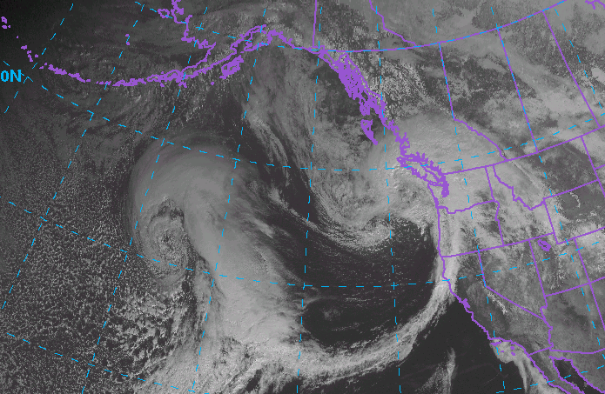


Down-valley flow during OLYMPEX:
Effects on precipitation patterns and microphysics
Joe Zagrodnik
Lynn McMurdie, Robert A. Houze
AGU Fall Meeting
13 December 2017
Supported by:
NASA NNX16AD75G
NASA 80NSSC17K0279
NSF AGS-1503155
NSF AGS-1657251
Notes:
Satellite picture of afronta

Slide 2
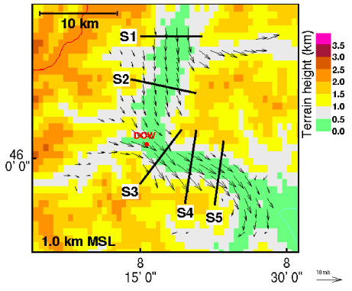
Down-valley flow in precipitating mid-latitude cyclones passing over complex terrain:
Observed in the Alps (Mesoscale Alpine Programme) and in Coast Mountains of British Columbia.
Evidence suggests that diabatic cooling from melting often forces down-valley flow episodes. (Steiner et al. 2003, Asencio and Stein 2006, Thériault et al. 2012)
Some evidence that precipitation patterns are modified by down-valley flow, but “…it remains to be seen how widespread or significant this interesting mechanism is.” (Roe 2005)
Steiner et al. (2003)

Slide 3
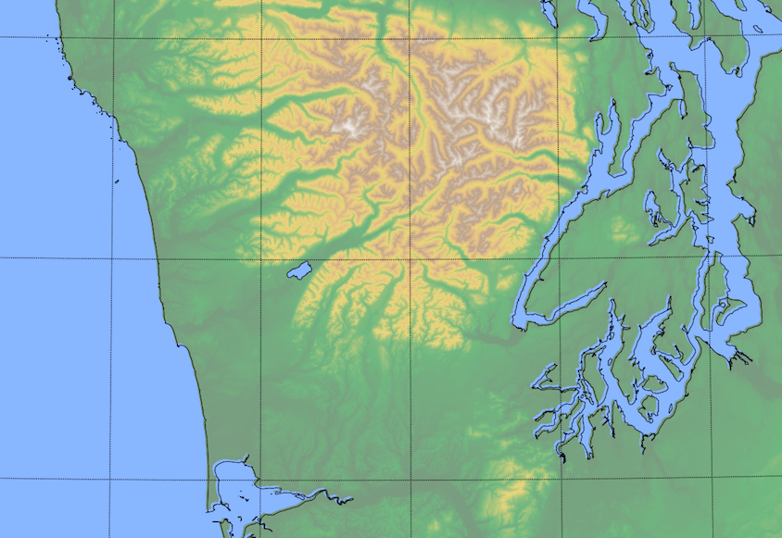
OLYMPEX Field Campaign
3 RHI scans chosen for observing precipitation and flow:
NPOL 270° RHI sees offshore component of flow
DOW 58.4° RHI sees flow within valley
NPOL 50° RHI sees precipitation between coast and valley
SEA-HQM pressure gradient indicates large-scale synoptic forcing
Quinault River Valley
DOW 58.4°
SEA
RHI 50°
DOW
RHI 270°
NPOL
HQM

Slide 4
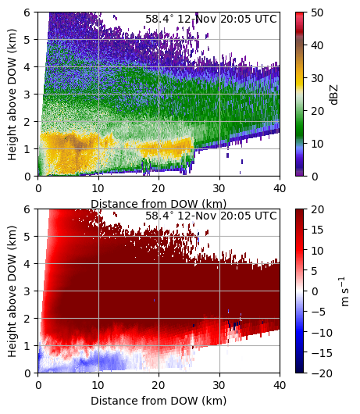
Down-valley flow in Quinault Valley
Example DOW RHI
Frequently observed (80% of the 283 hours that precipitation was occurring w/ radar observations).
1. What are the forcing mechanism(s)?
2. How does it modify precipitation patterns?
3. What microphysical processes are responsible for modifying the precipitation?
Melting Layer
Up-valley
Down-valley

Slide 5
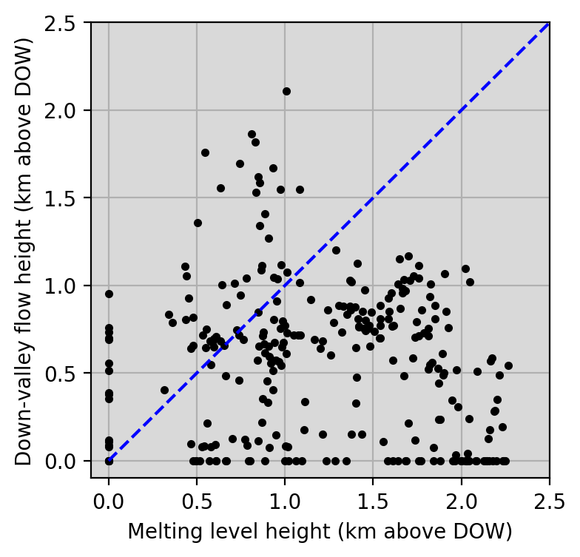
Is down-valley flow driven by thermodynamics or large-scale pressure gradient?
Almost no correlation between down-valley flow height and melting level height.
Non-bright band rain
Extends above the ridgeline of the Quinault Valley
Not true down-valley flow
Deep (500-1200 m) down-valley flow
Shallow (100-300 m) down-valley flow
No down-valley flow
Notes:
1. Widely varying melting level without much change in down-valley flow

Slide 6
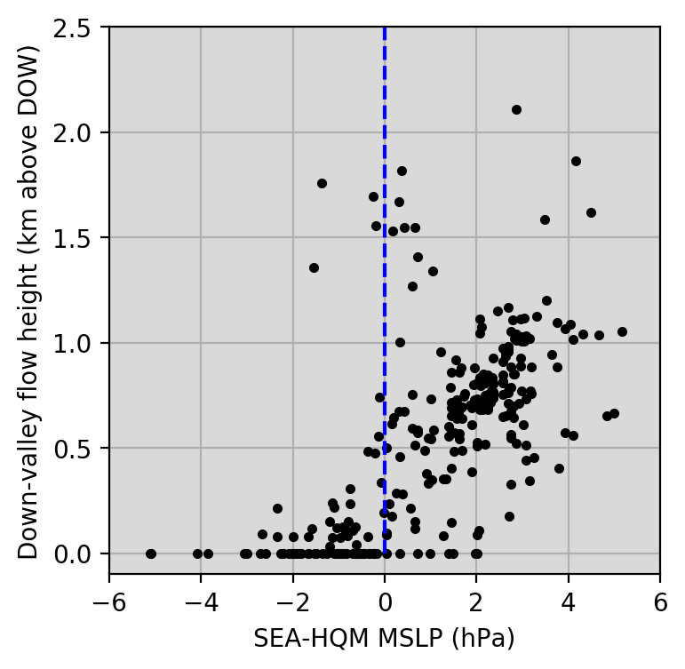
96% down-valley flow
44% down-valley flow
Usually shallow
Best predictor?
SEA-HQM pressure gradient
Indicates that valley flow is responding to large-scale synoptic forcing
Onshore-directed PGF
Offshore-directed PGF
Notes:
Shallow down-valley flow could be driven by diabatic heating
"onshore" vs "offshore"

Slide 7
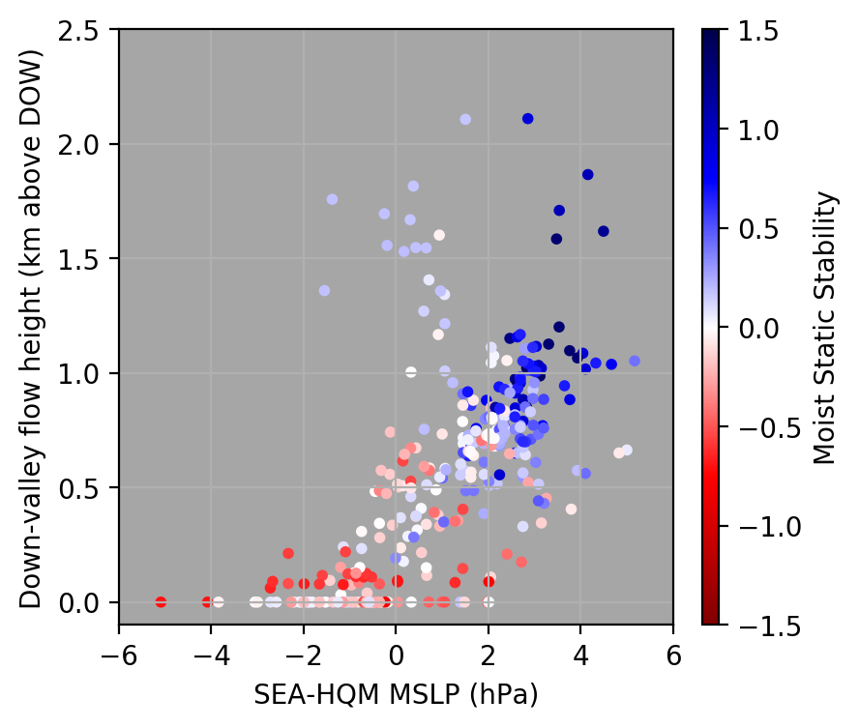
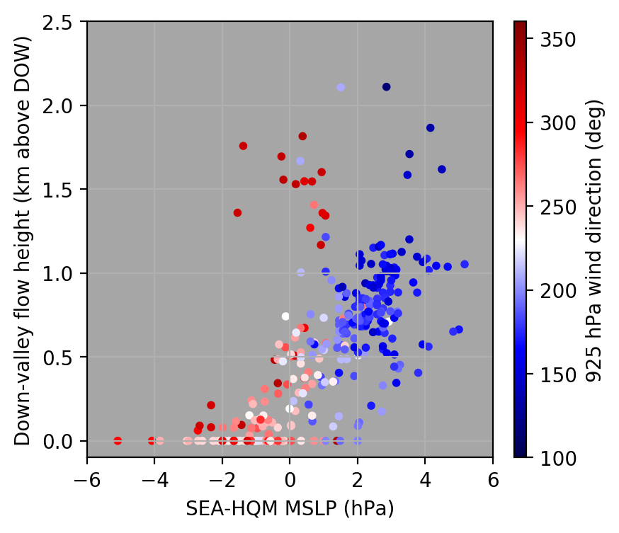
Down-valley flow is also associated with static stability and south-southeasterly flow at low levels
Moist Static Stability
925 hPa Wind Direction
House conceptual model Figure
Stable conditions indicate the potential for large-scale blocking.
Precipitation could be enhanced upstream of the mountains
Data from NARR reanalysis
Notes:
Resembles a ”blocked” flow regime (low-Froude Number)

Slide 8
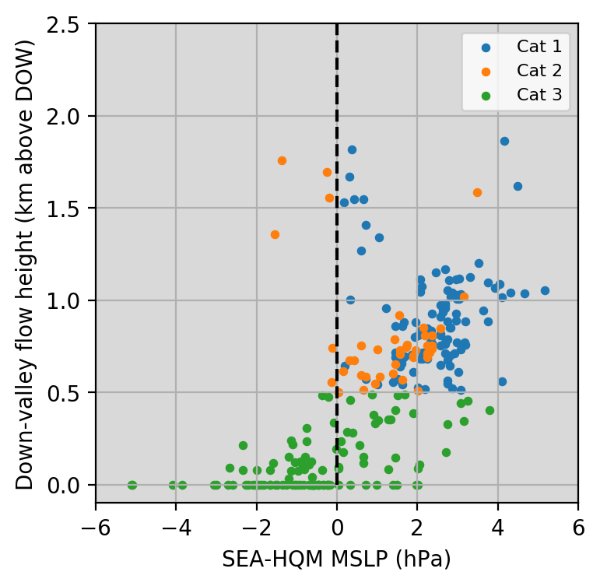
Classifying flow regimes using DOW radar
1. “Deep reversed flow extending offshore” (115 hours) 2. “Deep reversed flow not reaching coast” (42 hours)
3. “Shallow or non-existent reversed flow” (114 hours)
Notes:
19 cases thrown out for having no NPOL data

Slide 9
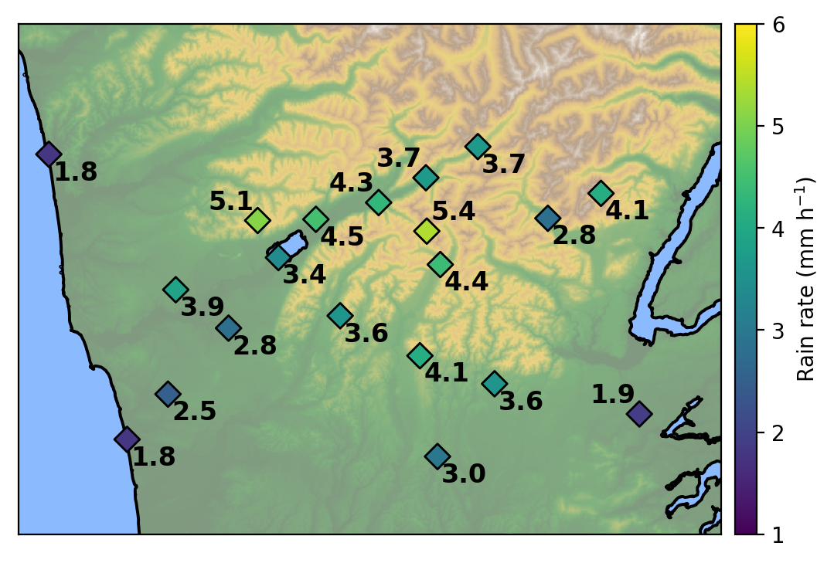
Average Rain Rate (Overall)
Less in interior valley
Next:
Difference between this plot and the three down-valley flow regimes
Highest on ridges
Increases between coast and mountains
Notes:
too small
white is more readable
no numbers
use colorbar
red for more rain
blue for less
step through these

Slide 10
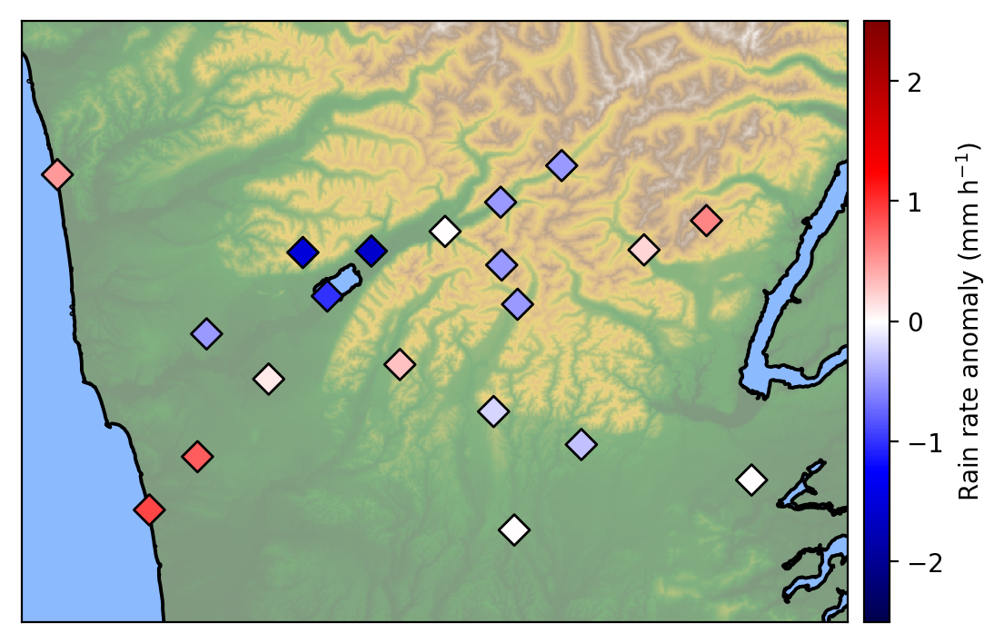
1. Deep reversed flow extending offshore
Heavier rain on SE side of mountains
Lighter rain in valley and at high elevations
Heavier rain near coast

Slide 11
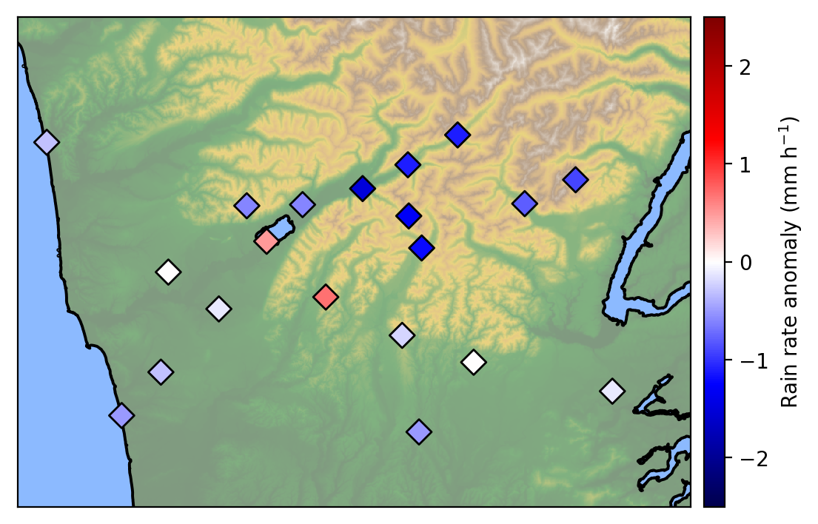
2. Deep reversed flow not reaching coast
Lighter rain in interior valley and high elevations
Heaver rain near SW front slopes
Lighter rain near coast

Slide 12
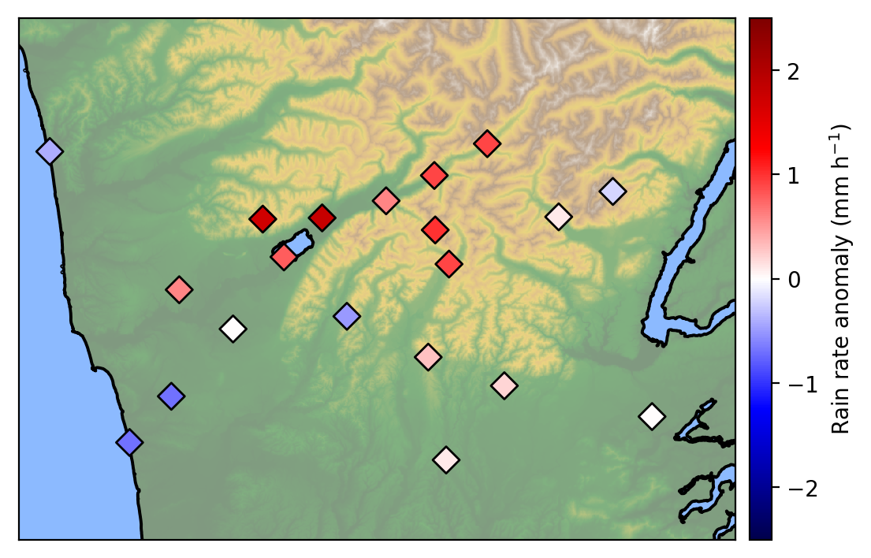
3. Shallow or non-existent reversed flow
Heavier rain in valley and at high elevations
Lighter rain near coast

Slide 13
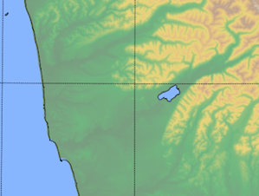
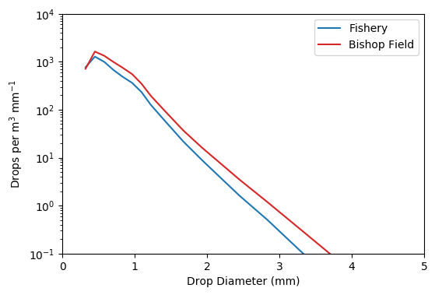
Overall Drop Size Distributions (DSDs)
Bishop Field
Fishery
Bishop shifted slightly to the upper-right indicating more drops of all sizes

Slide 14
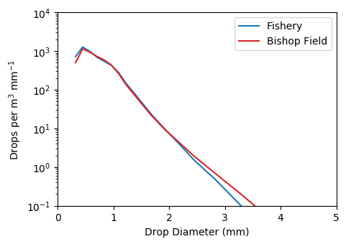
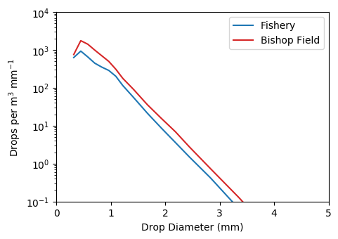
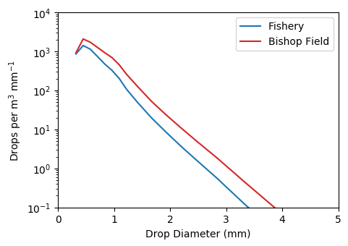
DSDs by flow regime
1. Deep reversed flow extending offshore
All DSDs are dominated by stratiform rain
No strong preference for enhancement of smaller or larger drops
2. Deep reversed flow not reaching coast
3. Shallow or non-existent reversed flow

Slide 15
Conclusions
1. What are the forcing mechanism(s) for down-valley flow? -Large-scale synoptic forcing -Diabatic cooling could still help maintain shallow down-valley flow at times
2. How does down-valley flow modify precipitation patterns? -Heavier rain near coast, lighter in the interior when deep down-valley flow is present.
3. What microphysical processes are responsible for modifying the precipitation? -Inconclusive, likely because other orographic enhancement signals are more important.
Notes:
don't use induces

