Slide 1
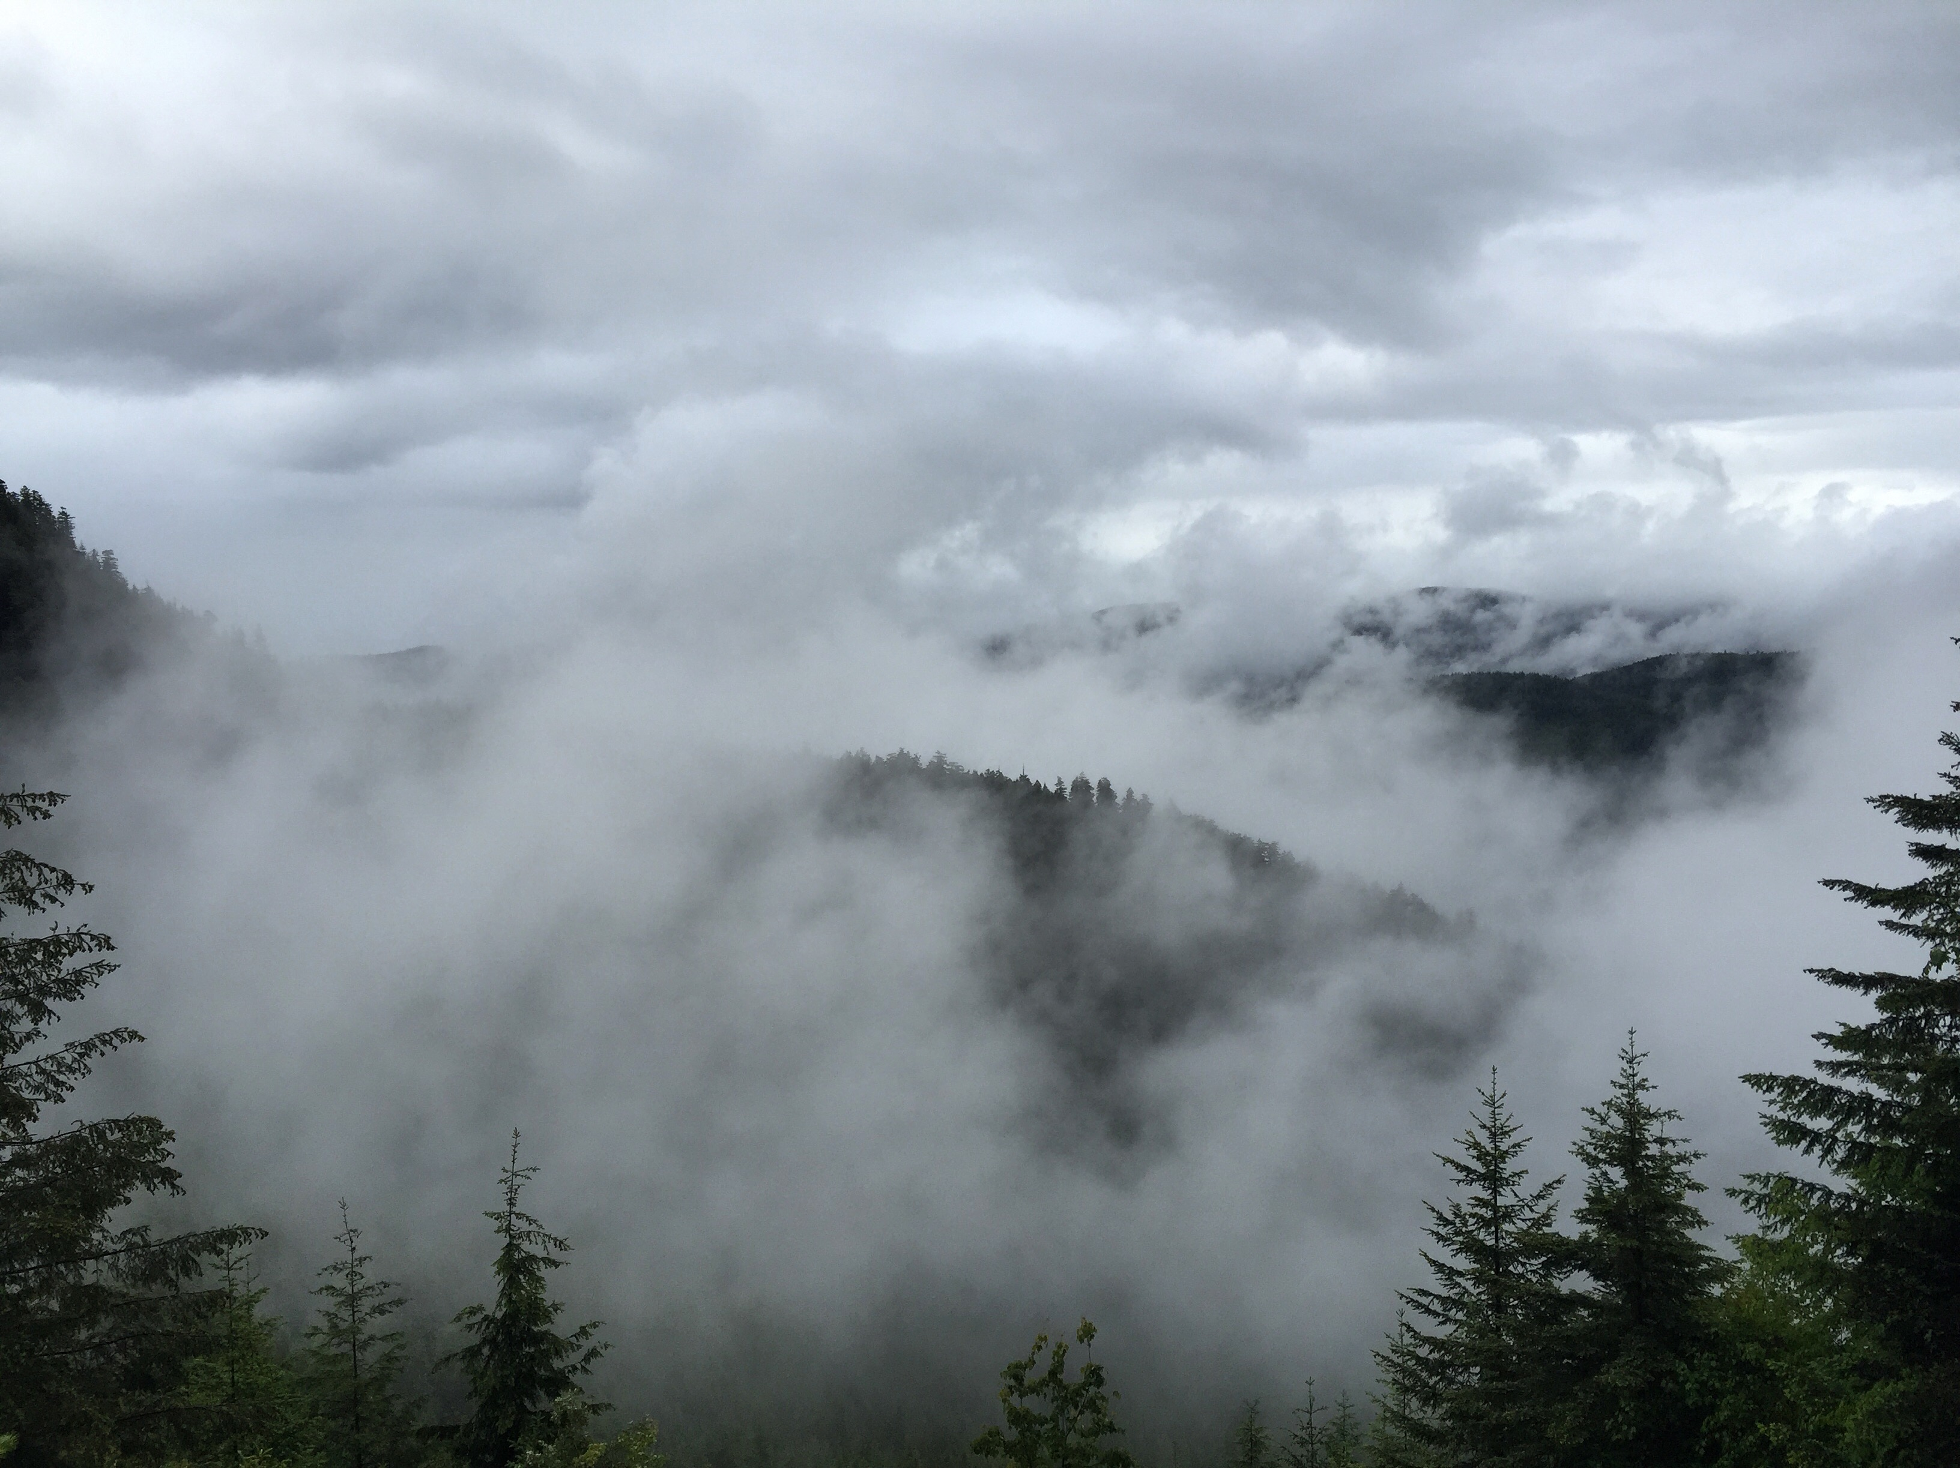
Upper-level enhancement of microphysical processes in extratropical cyclones during OLYMPEX
Angela Rowe
Lynn McMurdie, Robert Houze, Jr.,
Joe Zagrodnik, Thomas Schuldt, Megan Chaplin
University of Washington, Seattle, WA
AGU Fall Meeting
New Orleans, LA
13 December 2017

Slide 2
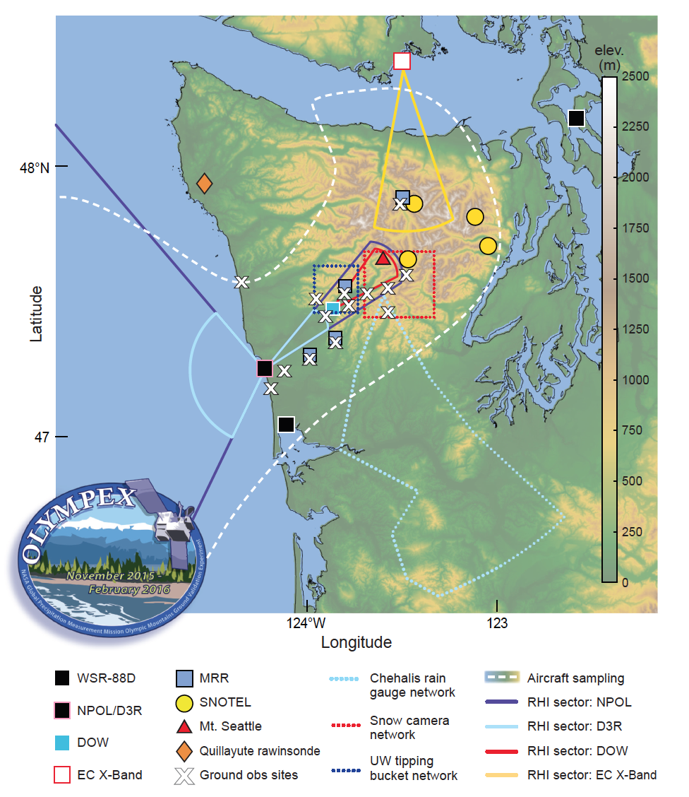
OLYMPEX Overview
PRISM 1971-2000
October 2015 – April 2016
Ground sites (snow, rain)
Soundings
Aircraft (UND Citation, NASA DC-8, ER-2)
Ground-based and airborne radars
Windward, high terrain, leeside
3-D view of storms
Houze et al. (2017)
Notes:
Learn more about OLYMPEX: https://pmm.nasa.gov/olympex

Slide 3
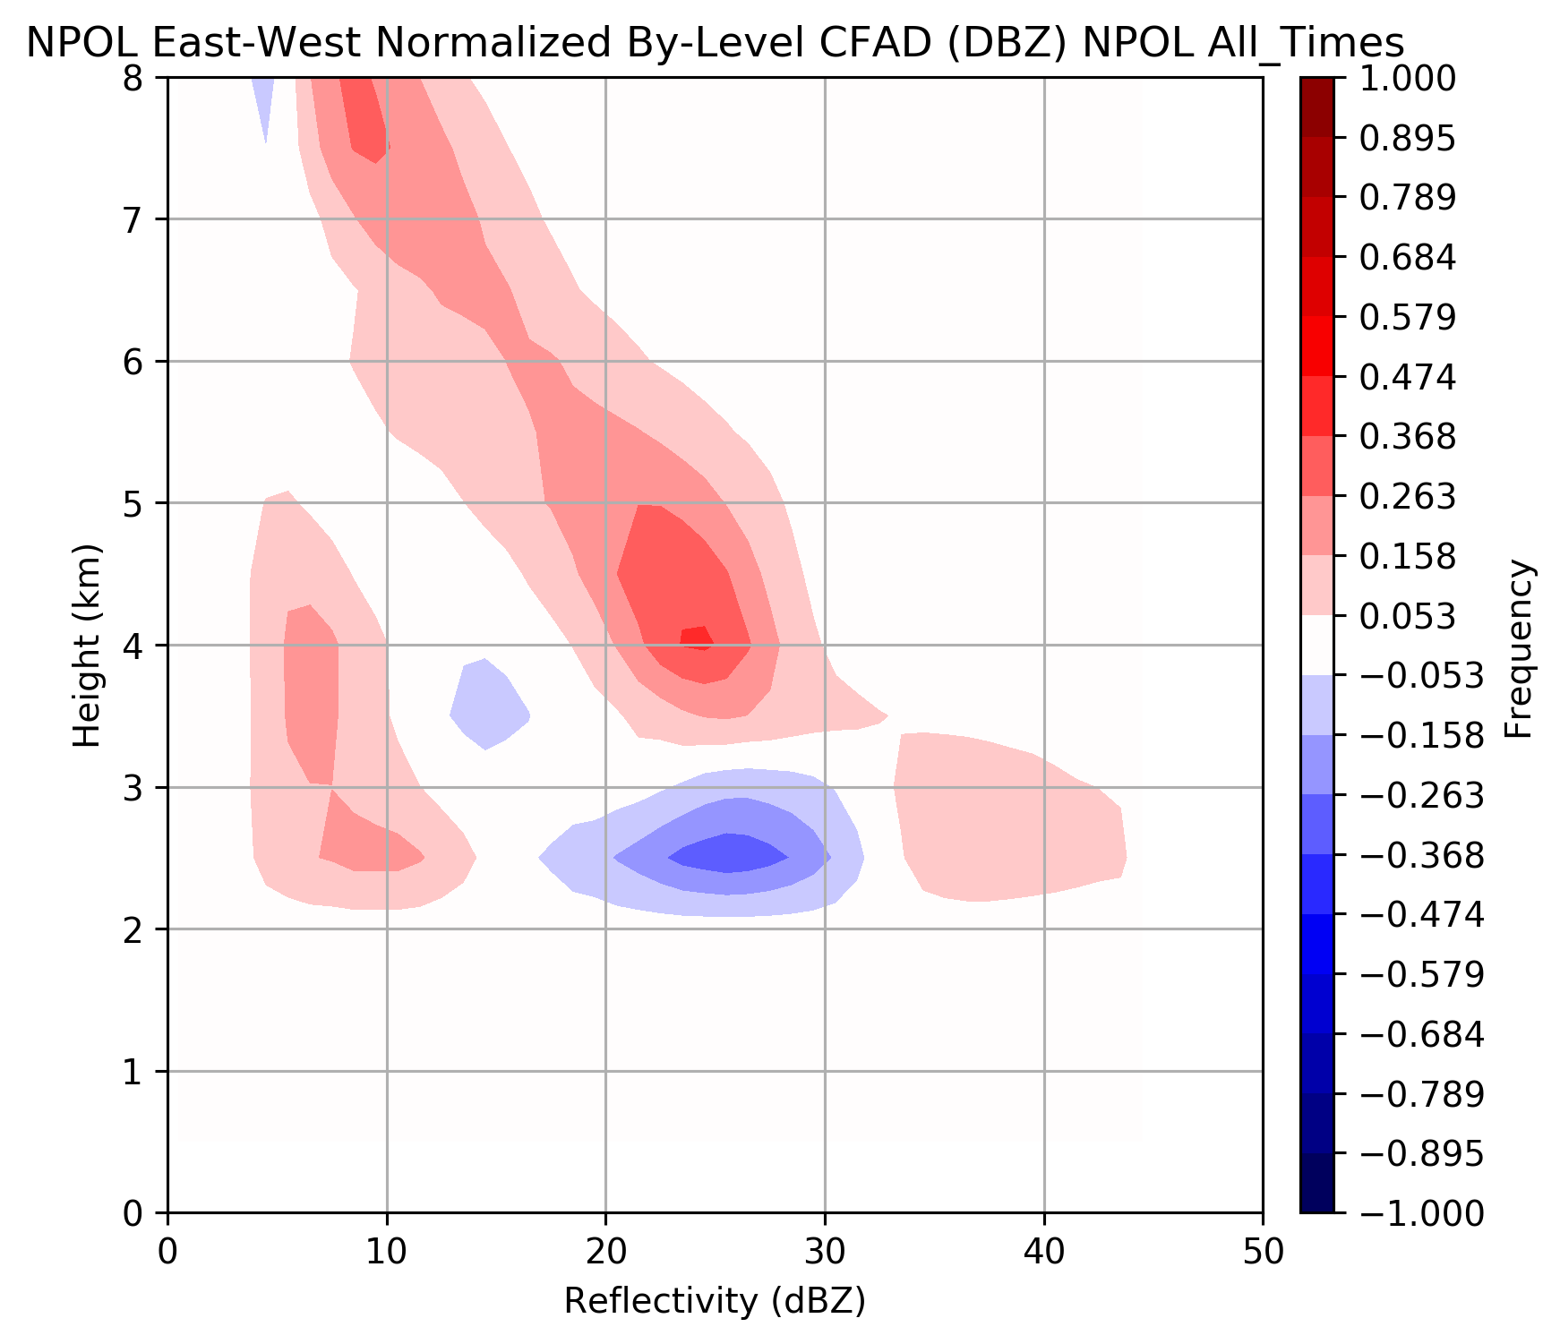
Orographic enhancement
Land – Ocean Difference CFAD
Upper-level enhancement in almost all scenarios, greatest for:
  Large IVT
  High melting level
  Neutral moist stability
  Strong low-level southwesterly winds
  Highest surface rain rates (Zagrodnik et al. 2017)
What are the microphysical processes/ice characteristics associated with this upper-level enhancement?
Greater frequency of higher reflectivities at all levels over windward slopes
McMurdie et al., in prep

Slide 4
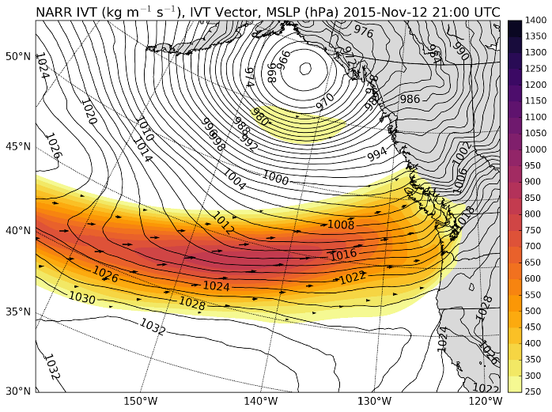
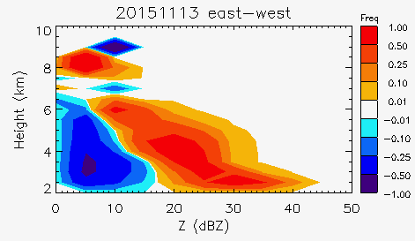
CASE STUDY: 12-13 November 2015
  Large IVT
  High melting level
  Neutral moist stability
  Strong low-level SW flow
IVT
13 Nov Land – Ocean Difference CFAD
  Upper-level reflectivity enhancement
  Surface precipitation enhancement over windward slopes (factor of 4-5)
Notes:
Post-frontal convection
Help of D3R, MRRs

Slide 5
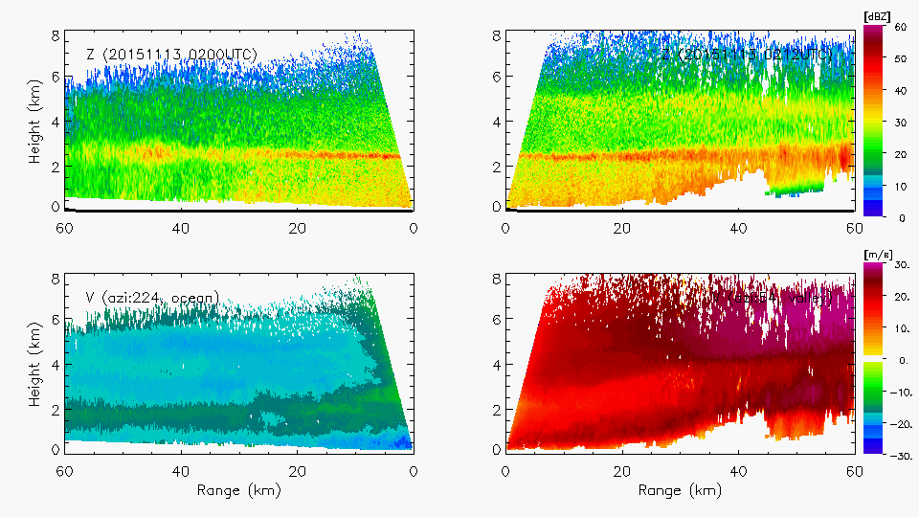
0200 UTC 13 Nov 2015 - NPOL
Ocean
Land
Z_{H}
Height (km)
V_{R}
Range (km)
Rowe et al., in prep

Slide 6
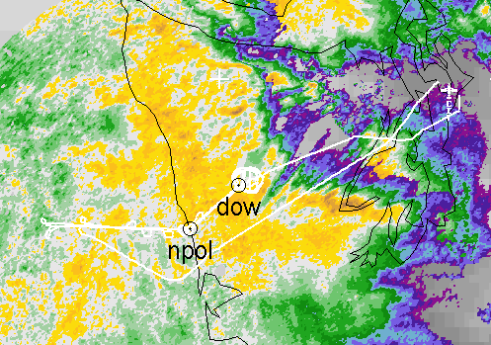
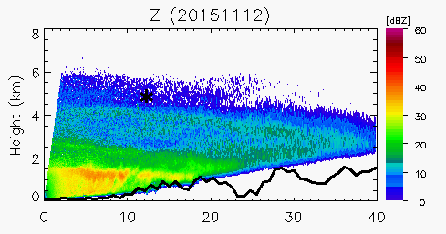
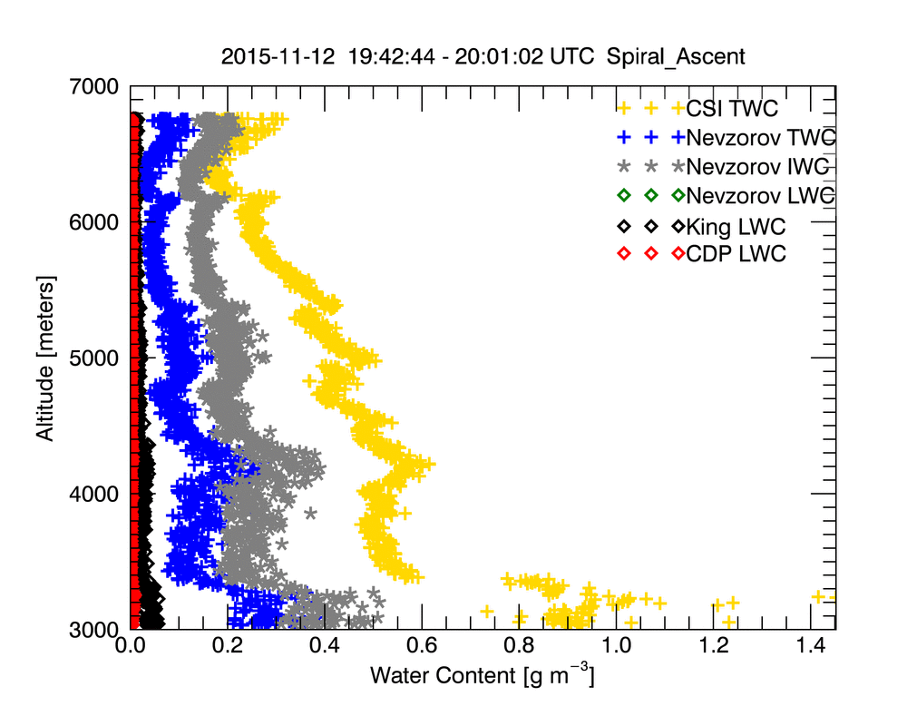
DOW Reflectivity
12 Nov 2015
Citation
(pre-frontal)
Increase in Ice Water Content in region of upper-level reflectivity enhancement
Notes:
Melting level variability (intensity, dipping, rising)
Down-valley flow increasingly shallow
Aggregation but little to no rime ice in Citation data
Joe will talk about evolution of DSD

Slide 7
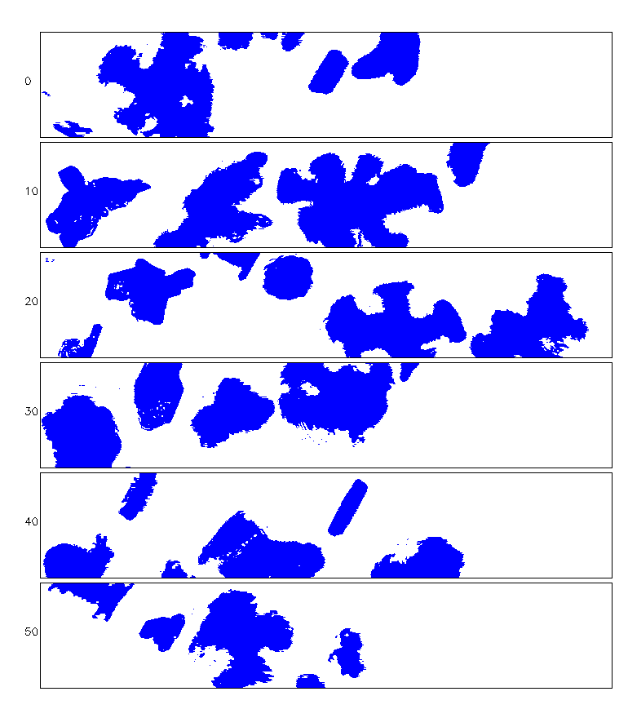
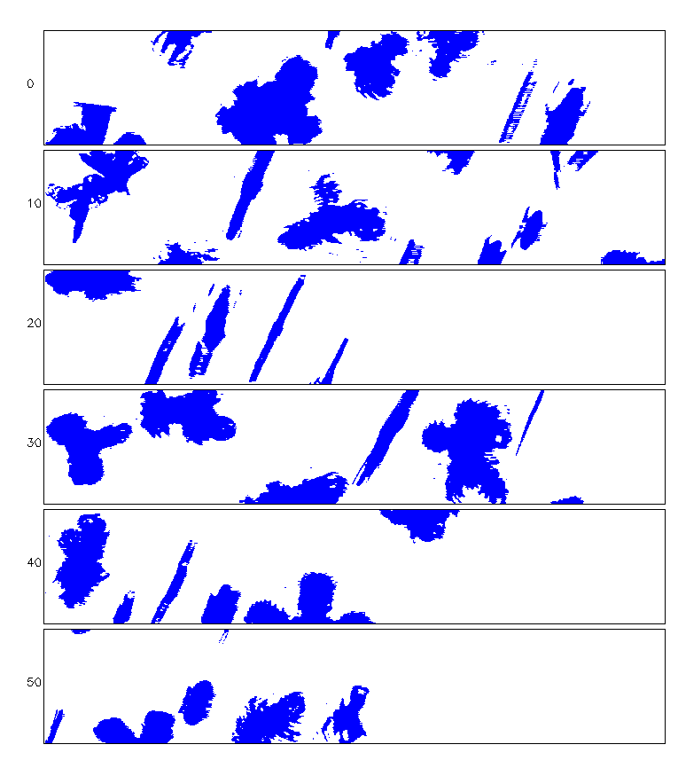
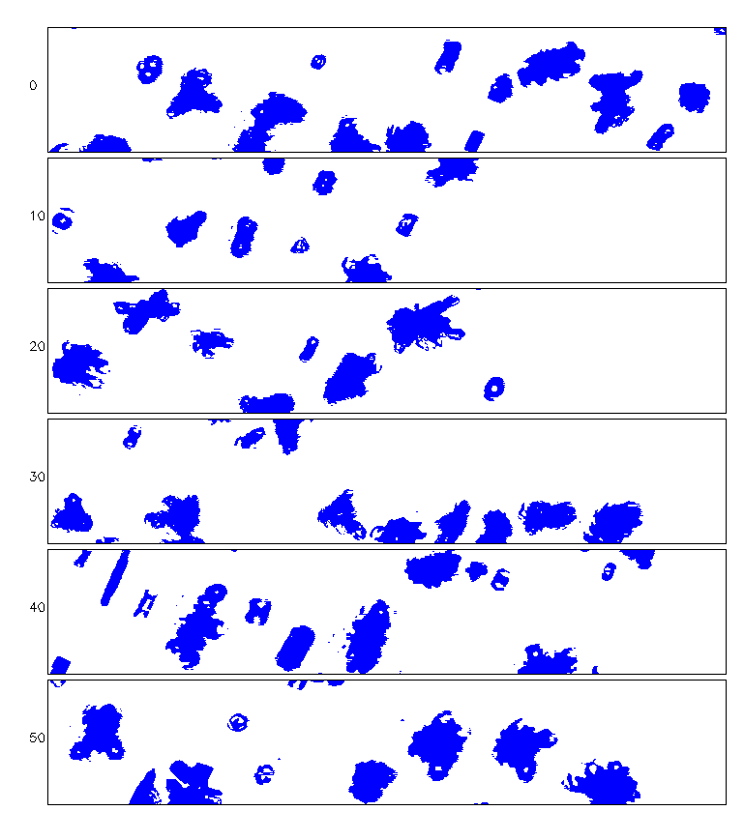
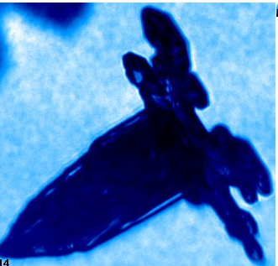
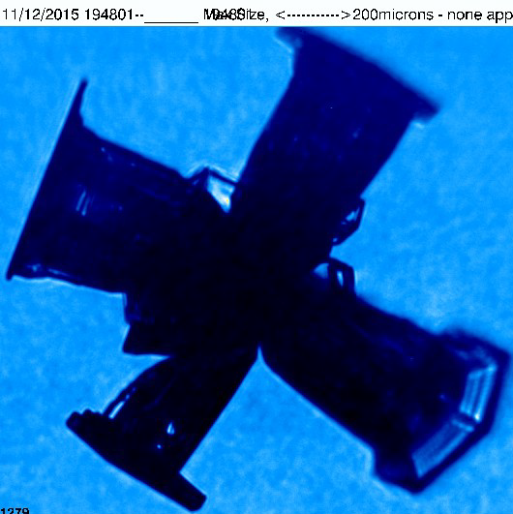
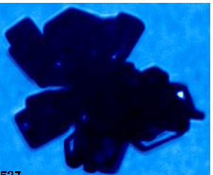
DOW Reflectivity 1948 UTC
12 Nov 2015
Citation
–9°C (4 km)
–17°C (5 km)
–26°C (6 km)
2DS-V
200 µm
CPI
Rowe et al., in prep

Slide 8
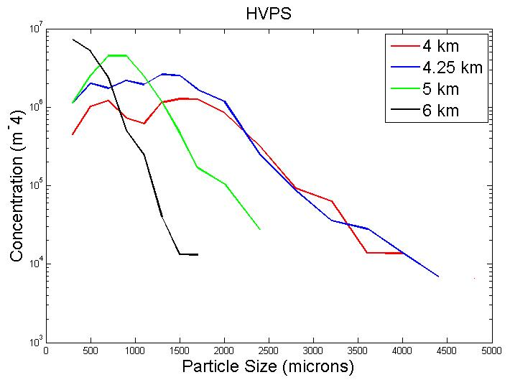
DOW Reflectivity
12 Nov 2015
Citation
HVPS-V
Greater reflectivity
Larger particles
Increased ice water content
Many bullet rosettes
Some aggregating
Concentration (m⁻⁴)
Particle Size (μm)
Notes:
Melting level variability (intensity, dipping, rising)
Down-valley flow increasingly shallow
Aggregation but little to no rime ice in Citation data
Joe will talk about evolution of DSD

Slide 9
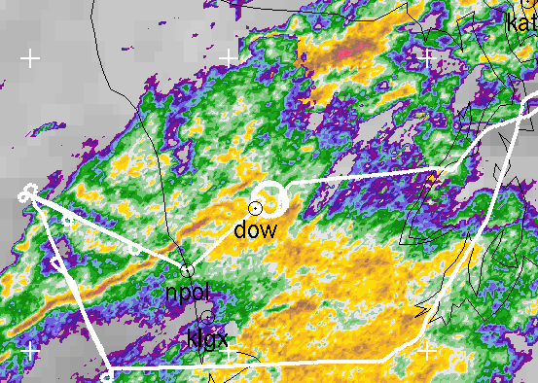
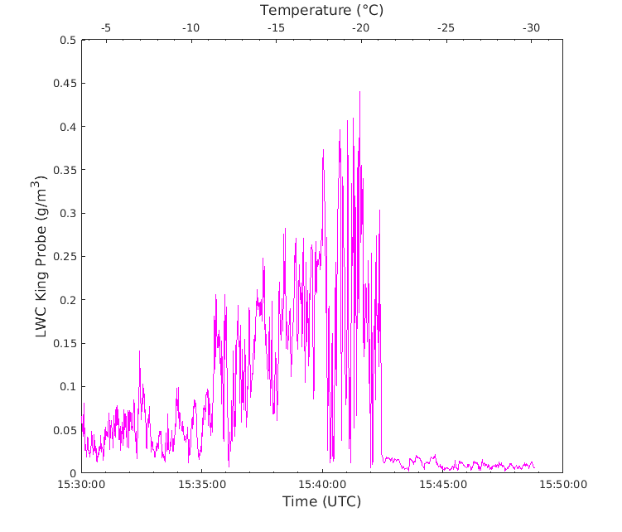
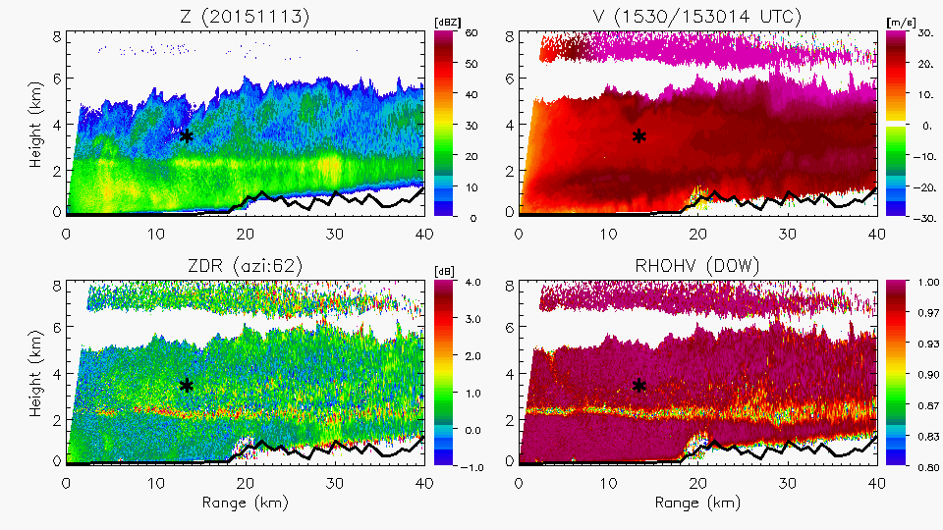
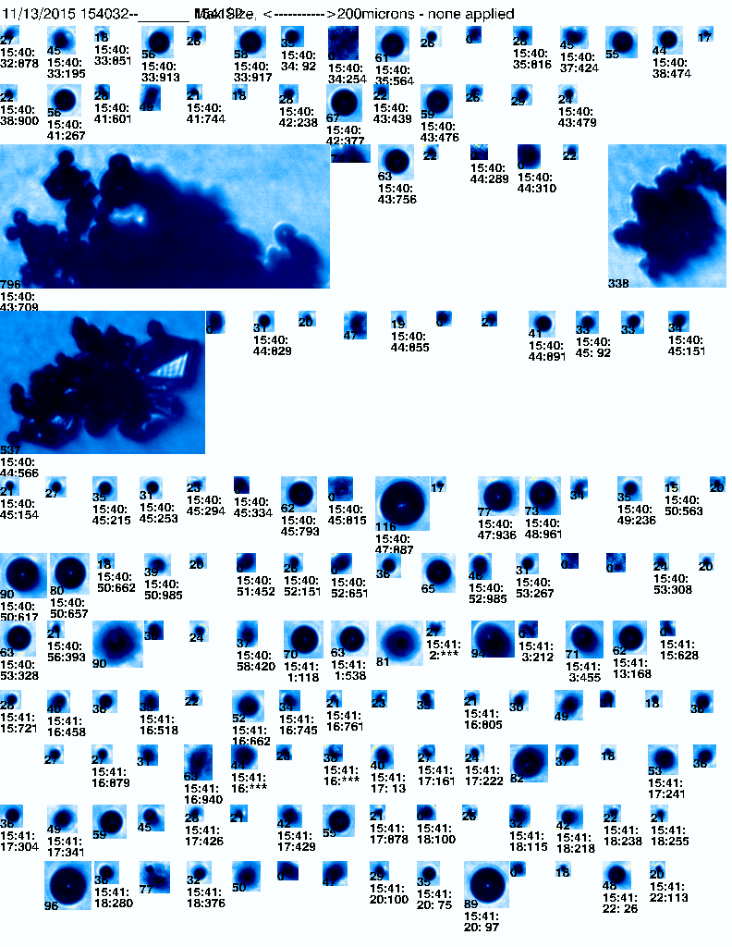
13 Nov 2015
1536 UTC (warm sector)
ASCENT: LWC ~0.45 g m⁻³
LWC (g m⁻³)
DOW Reflectivity 1530-1607 UTC
Time (UTC)
-18°C – In generating cell
Differential Reflectivity
Rowe et al., in prep
200 µm
CPI: 15–2500 μm

Slide 10
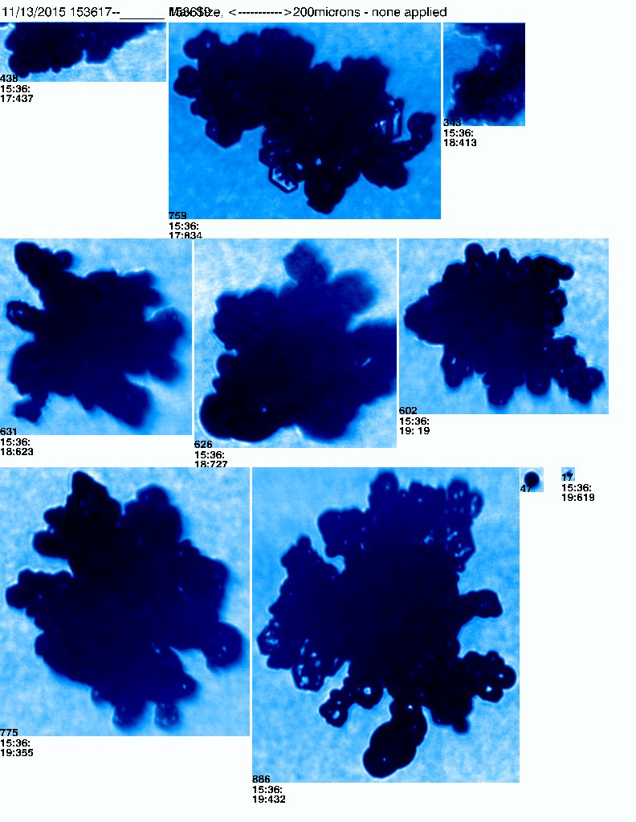
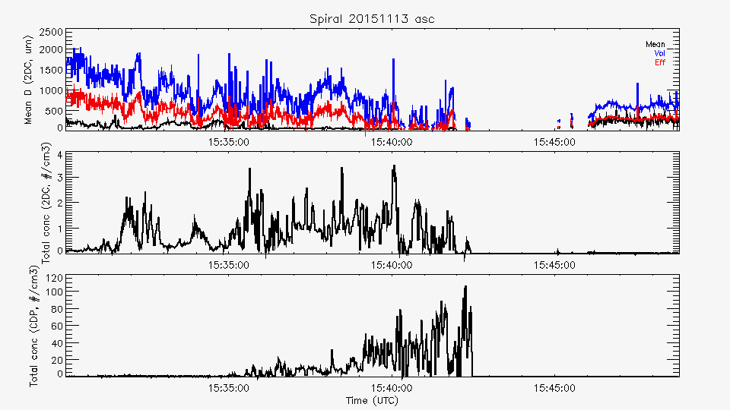
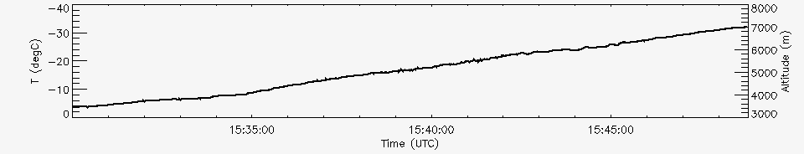
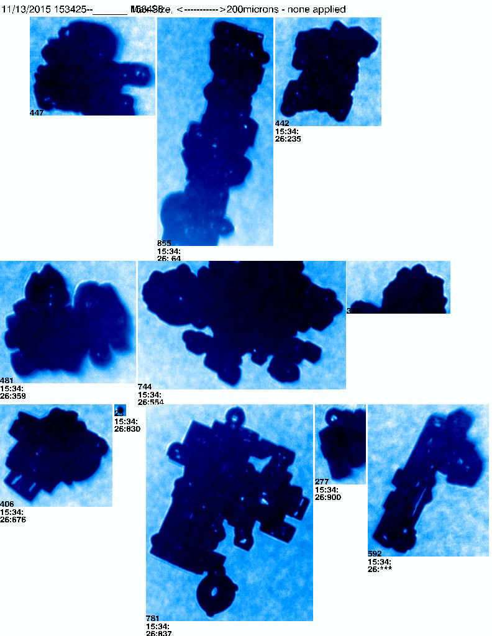
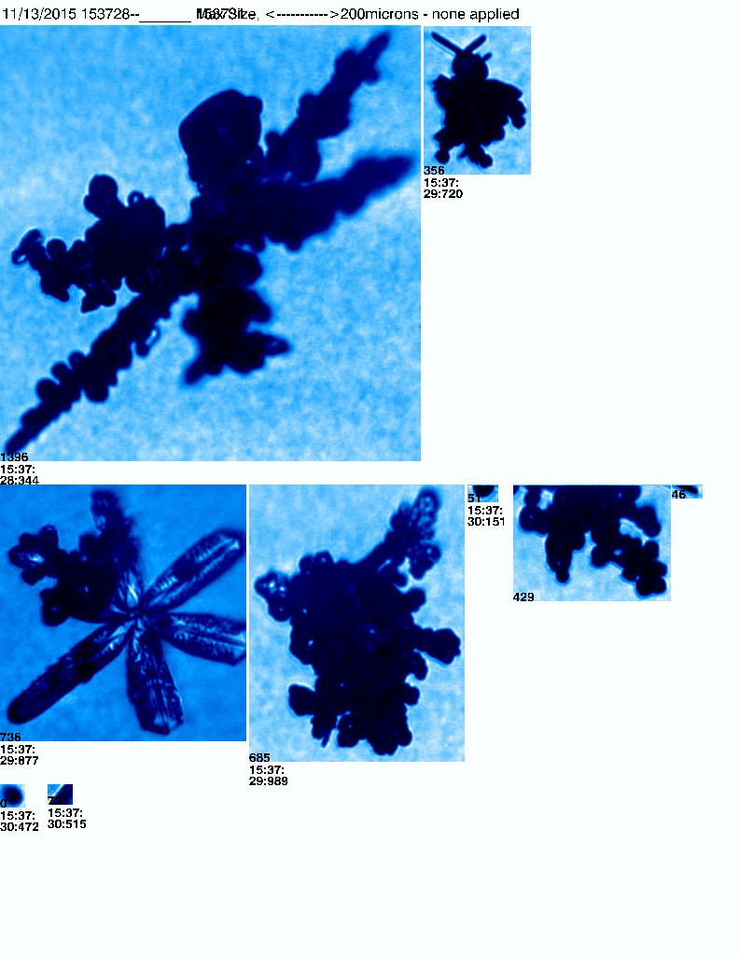
13 Nov 2015 Citation
-12°C
ASCENT
Temperature
Cloud Droplet Probe
Total
Concentration
-9°C
-13°C

Slide 11
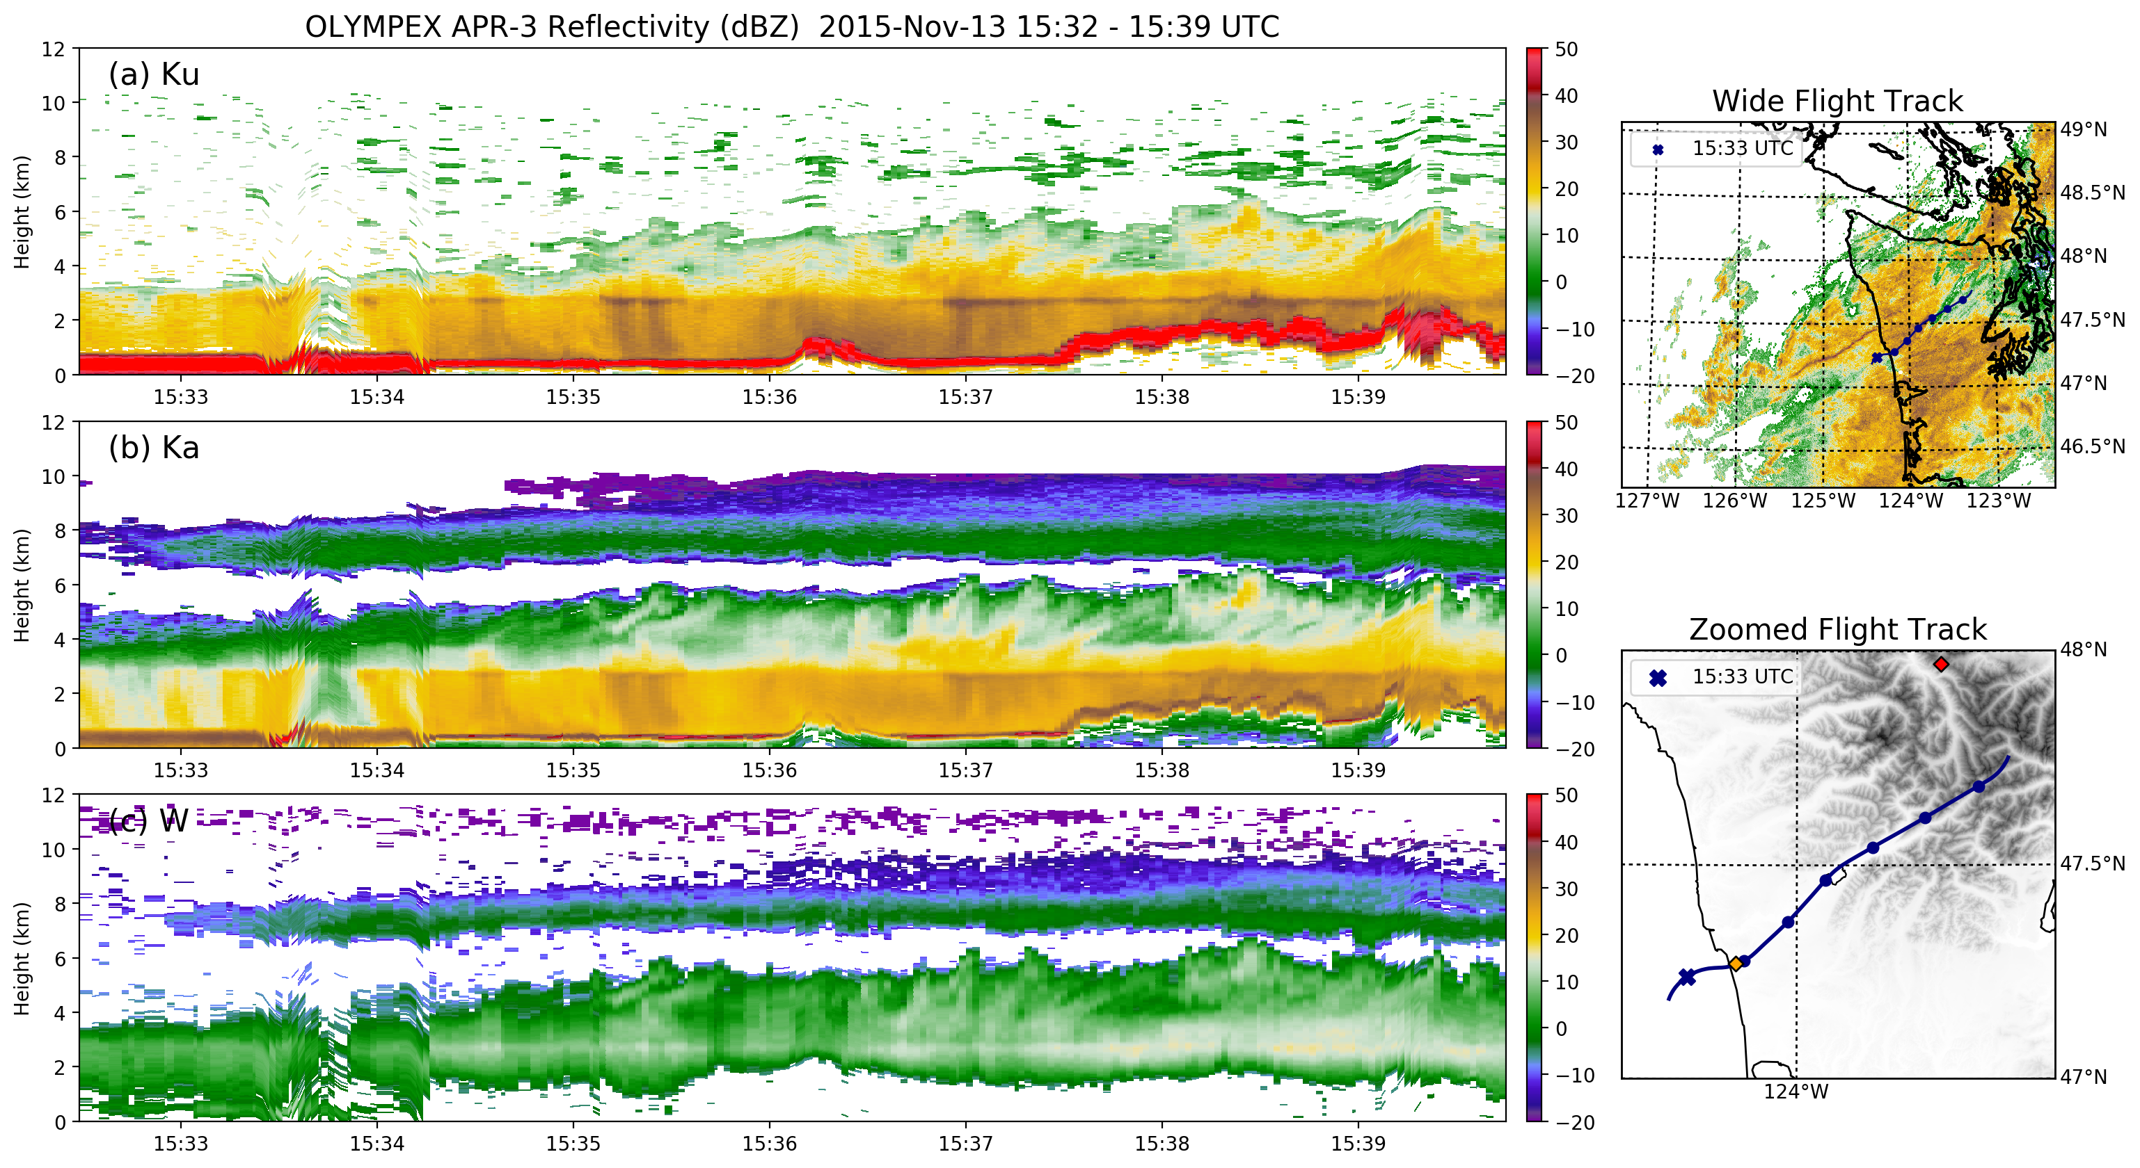
13 Nov 2015 – APR-3
DOW location
Notes:
Melting level variability (intensity, dipping, rising)
Down-valley flow increasingly shallow
Aggregation but little to no rime ice in Citation data
Joe will talk about evolution of DSD

Slide 12
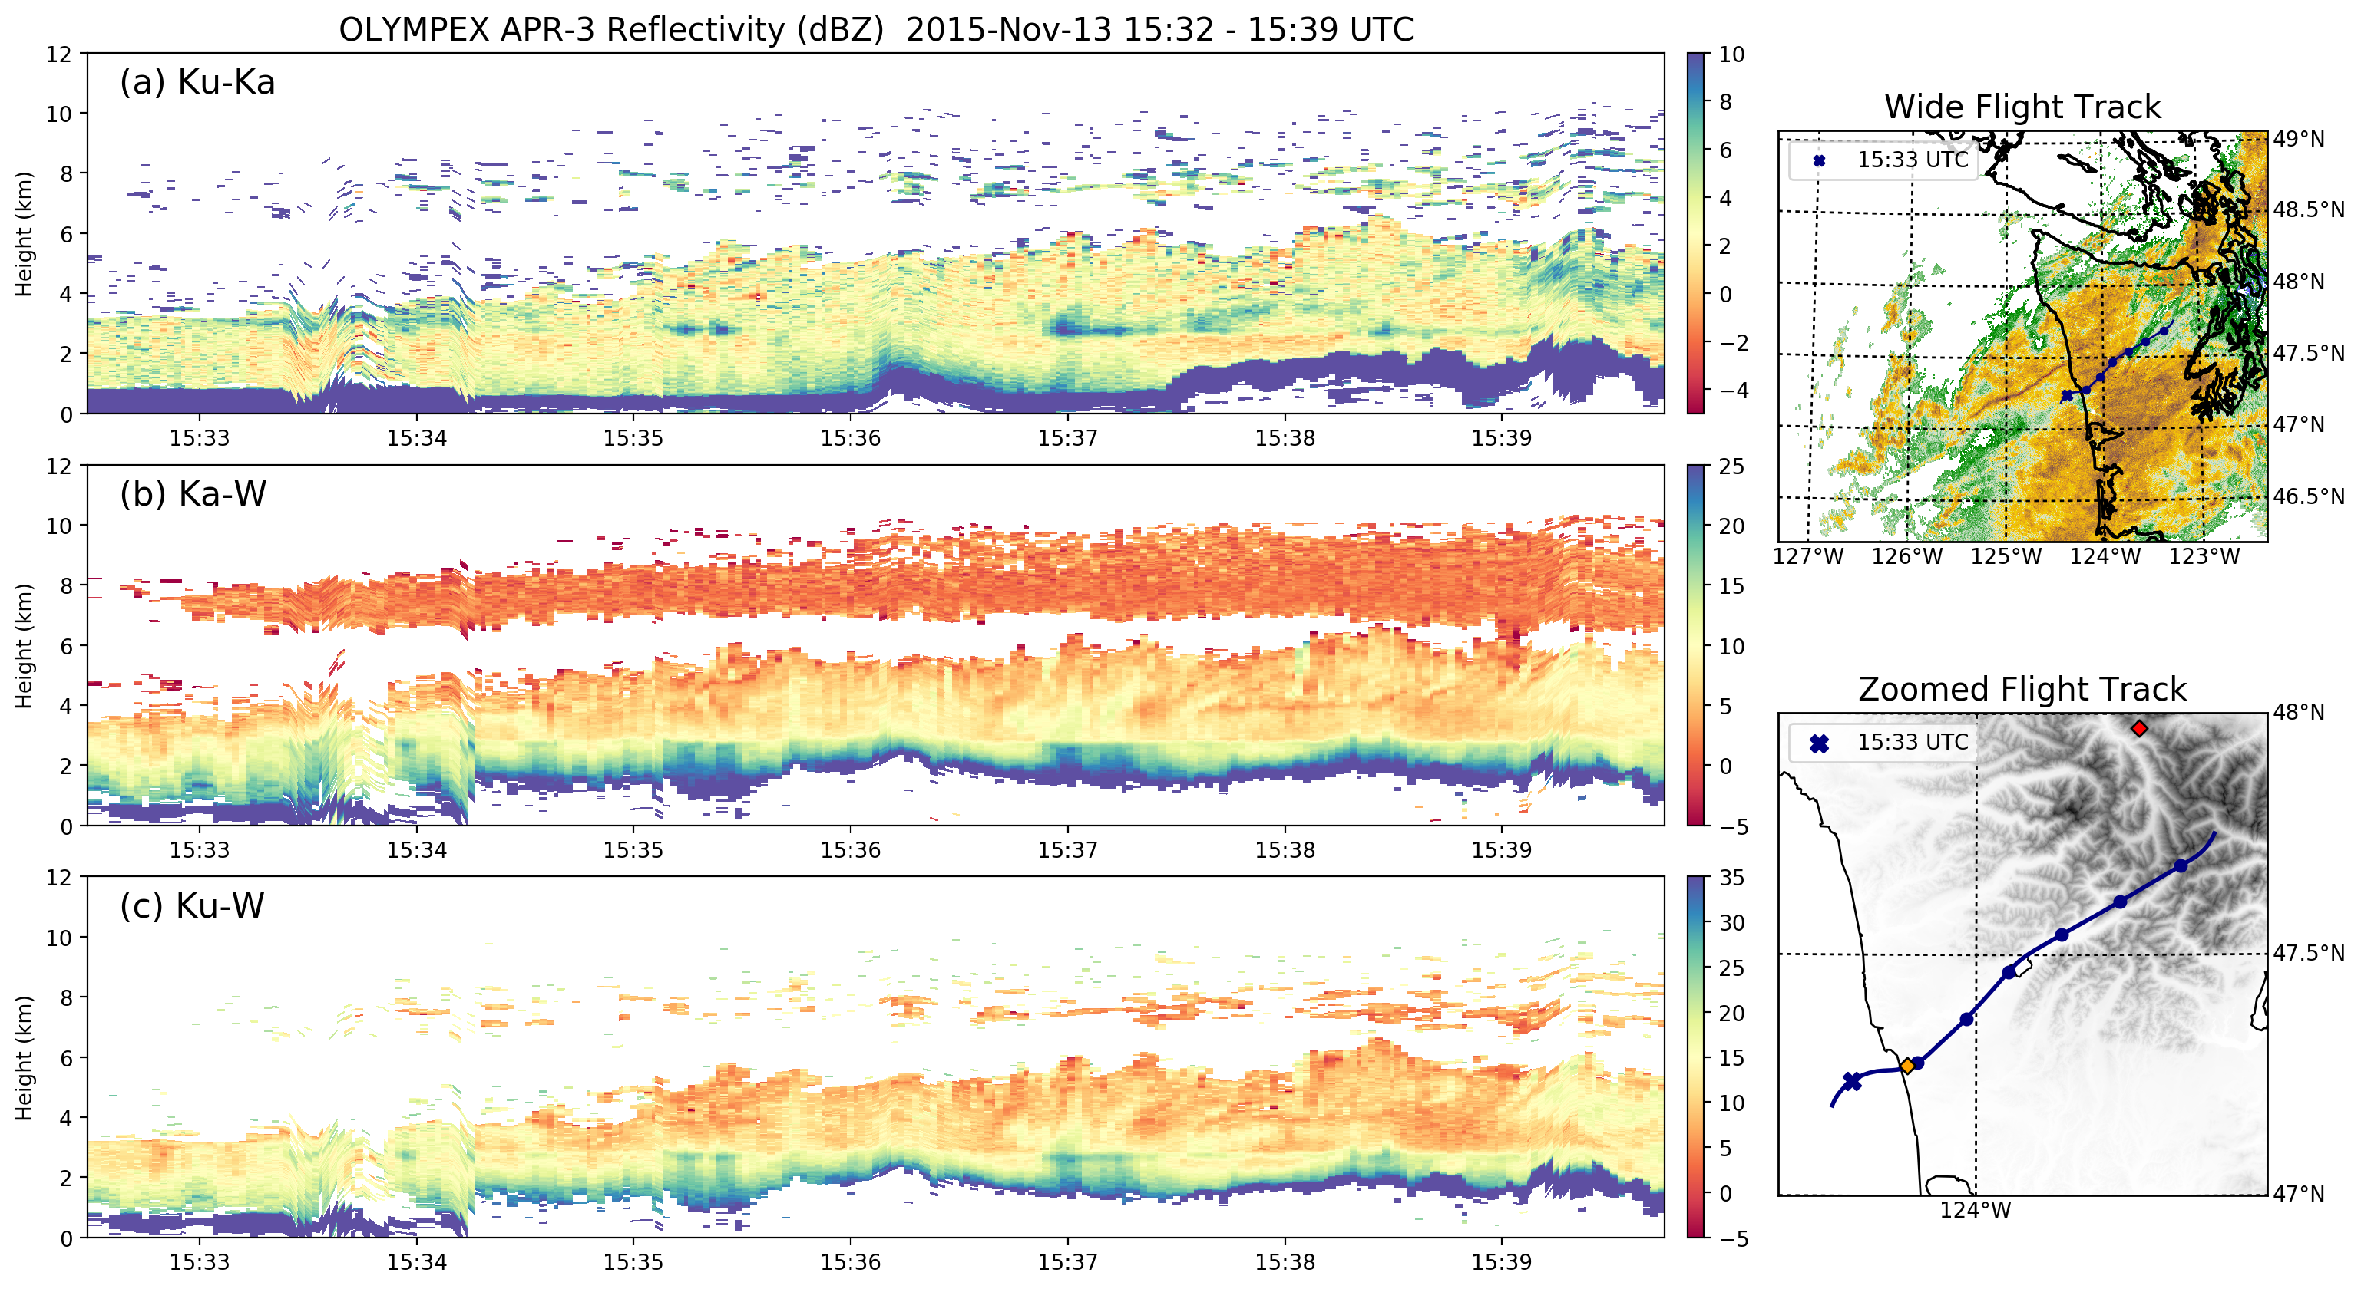
13 Nov 2015 – APR-3
DOW location
Notes:
Melting level variability (intensity, dipping, rising)
Down-valley flow increasingly shallow
Aggregation but little to no rime ice in Citation data
Joe will talk about evolution of DSD

Slide 13
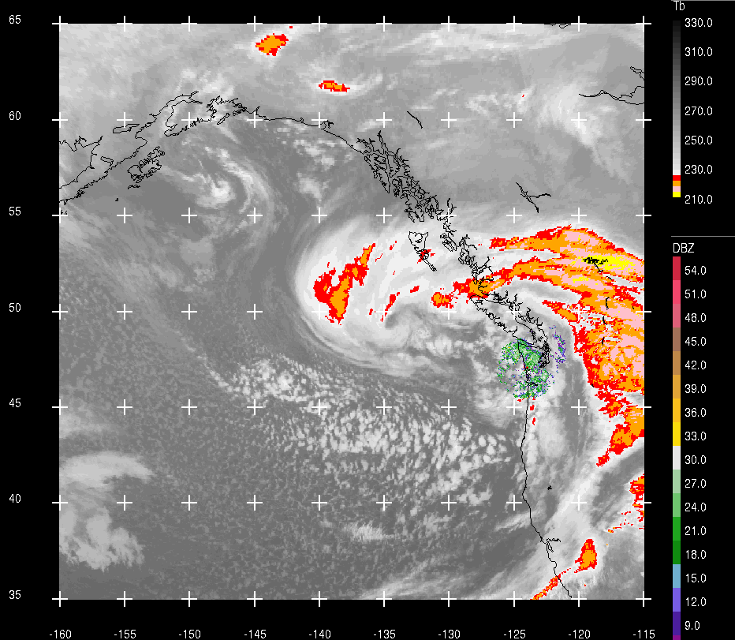
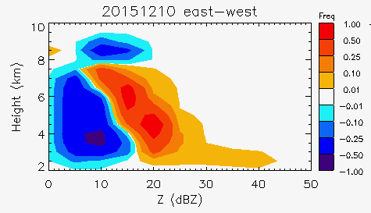
CASE STUDY: 10 December 2015
  Moderate IVT
  Moderate melting level (1.2-1.8 km)
  Neutral moist stability becoming unstable
  Low-level winds out of SE then out of SW
  Upper-level reflectivity enhancement
  Precipitation enhancement over windward slopes
Notes:
Post-frontal convection
Help of D3R, MRRs

Slide 14
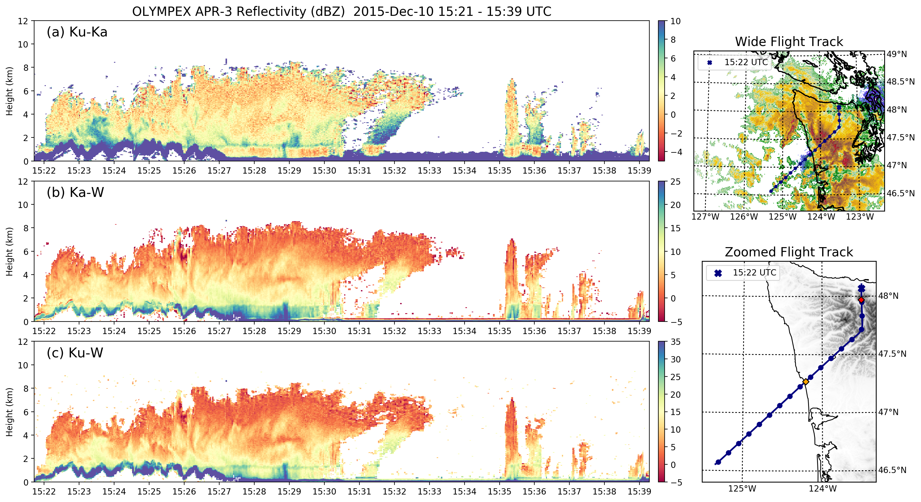
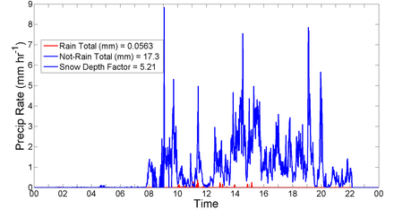
10 Dec 2015 - APR3
Hurricane Ridge PIP
Notes:
Melting level variability (intensity, dipping, rising)
Down-valley flow increasingly shallow
Aggregation but little to no rime ice in Citation data
Joe will talk about evolution of DSD

Slide 15
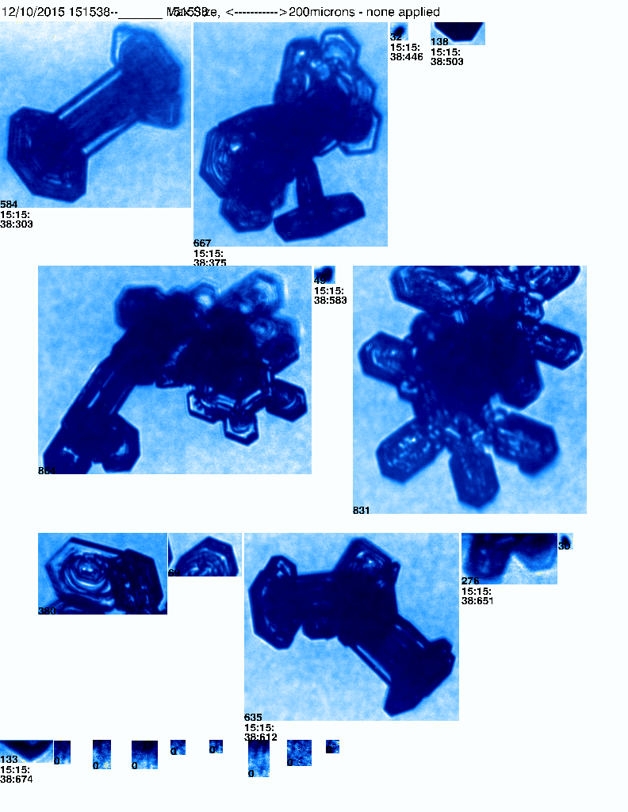
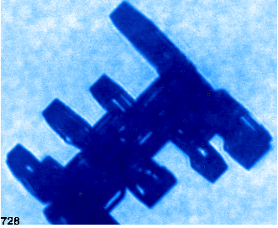
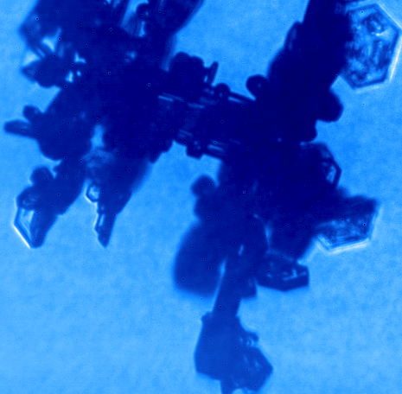
151538:
Capped columns, light turbulence, ~-40°C
10 Dec 2015 – Citation (CPI)
Notes:
Melting level variability (intensity, dipping, rising)
Down-valley flow increasingly shallow
Aggregation but little to no rime ice in Citation data
Joe will talk about evolution of DSD

Slide 16
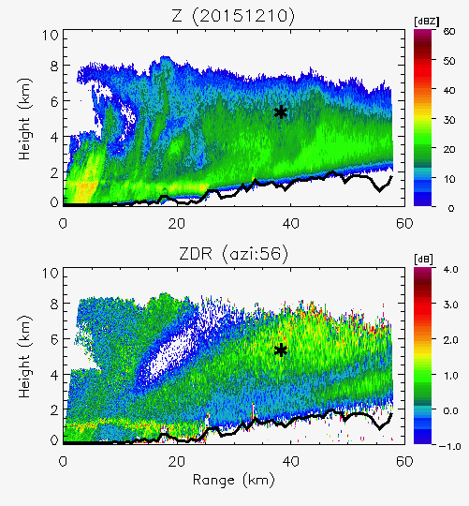
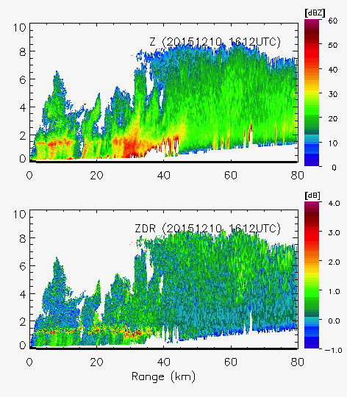
1610 UTC 10 Dec 2015 – DOW/NPOL
DOW - Z
NPOL - Z
DOW - Z_{DR}
NPOL - Z_{DR}
Notes:
Melting level variability (intensity, dipping, rising)
Down-valley flow increasingly shallow
Aggregation but little to no rime ice in Citation data
Joe will talk about evolution of DSD

Slide 17
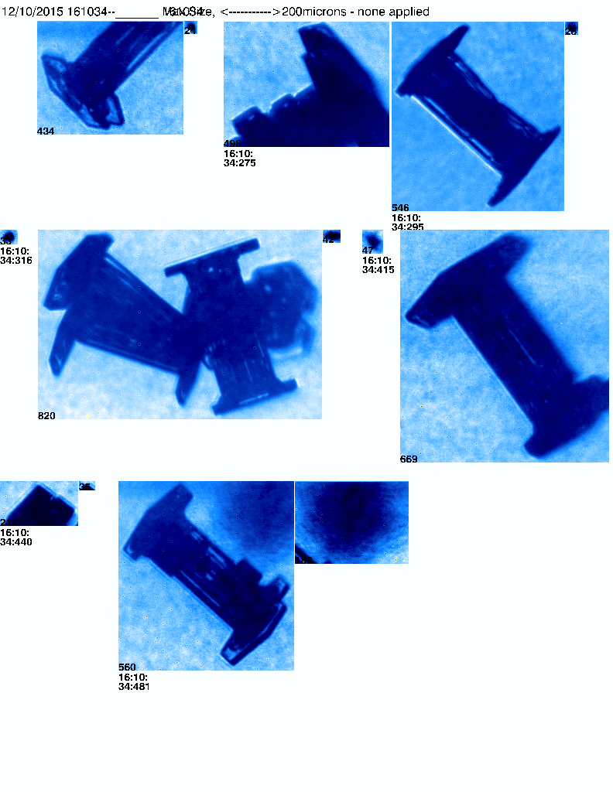
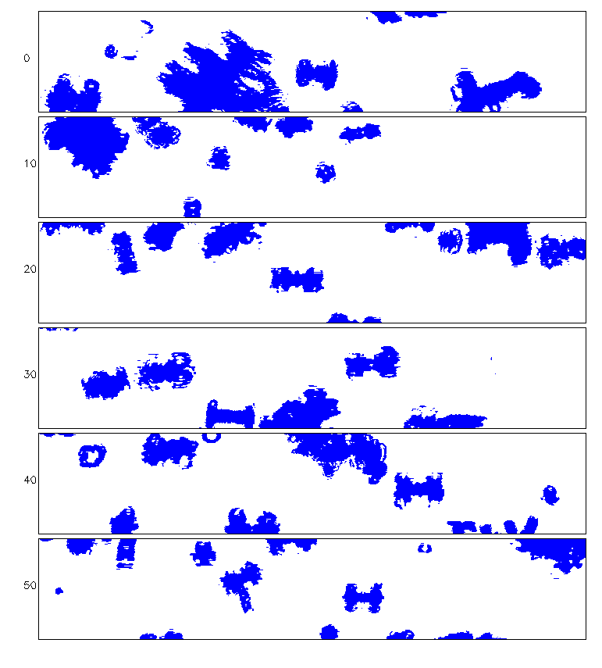
1610 UTC 10 Dec 2015 – CPI/2DS-H
2DS-H
~-30°C
CPI
Notes:
Melting level variability (intensity, dipping, rising)
Down-valley flow increasingly shallow
Aggregation but little to no rime ice in Citation data
Joe will talk about evolution of DSD

Slide 18
Conclusions & Potential Implications
3-D view with in situ data for investigating microphysical processes associated with orographic modification of precipitation
  Orographic enhancement seen in reflectivity aloft for nearly all synoptic set ups; most pronounced during warm, atmospheric river events
Variation in dominant ice particle type
  Narrow layer upper-level Z enhancement in pre-frontal stratiform: aggregating bullet rosettes
  Generating cells in warm sector stratiform: supercooled liquid water, rimed/aggregating dendrites, turbulence
  Persistent post-frontal convective systems: capped columns, graupel, turbulence, oriented particles, electrification
GPM Perspective: Can we capture systematic microphysical parameter and process variability from ocean to summit? What are systematic contributions from ice and liquid? Dependence on frontal-system regime/environment? Terrain?

Slide 19
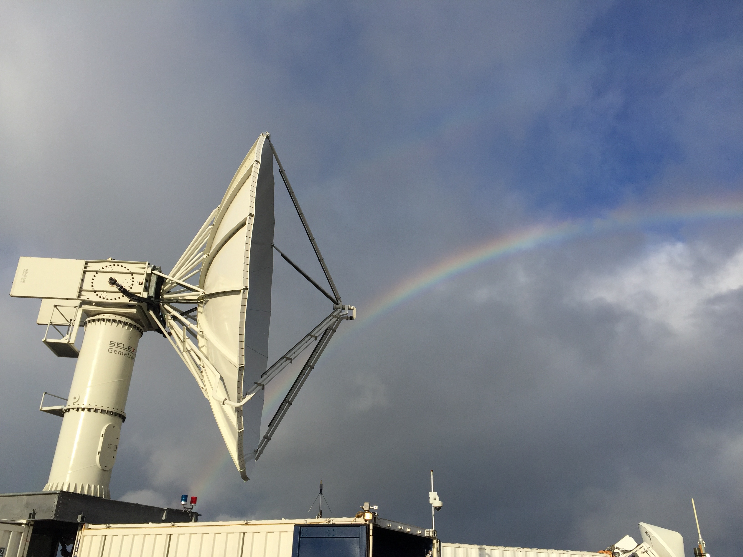
Thank you!
This work is supported by NASA Grants #NNX15AL38G, #NNX16AD75G, and NSF Grants #AGS-1503155, AGS-1657251

