Slide 1
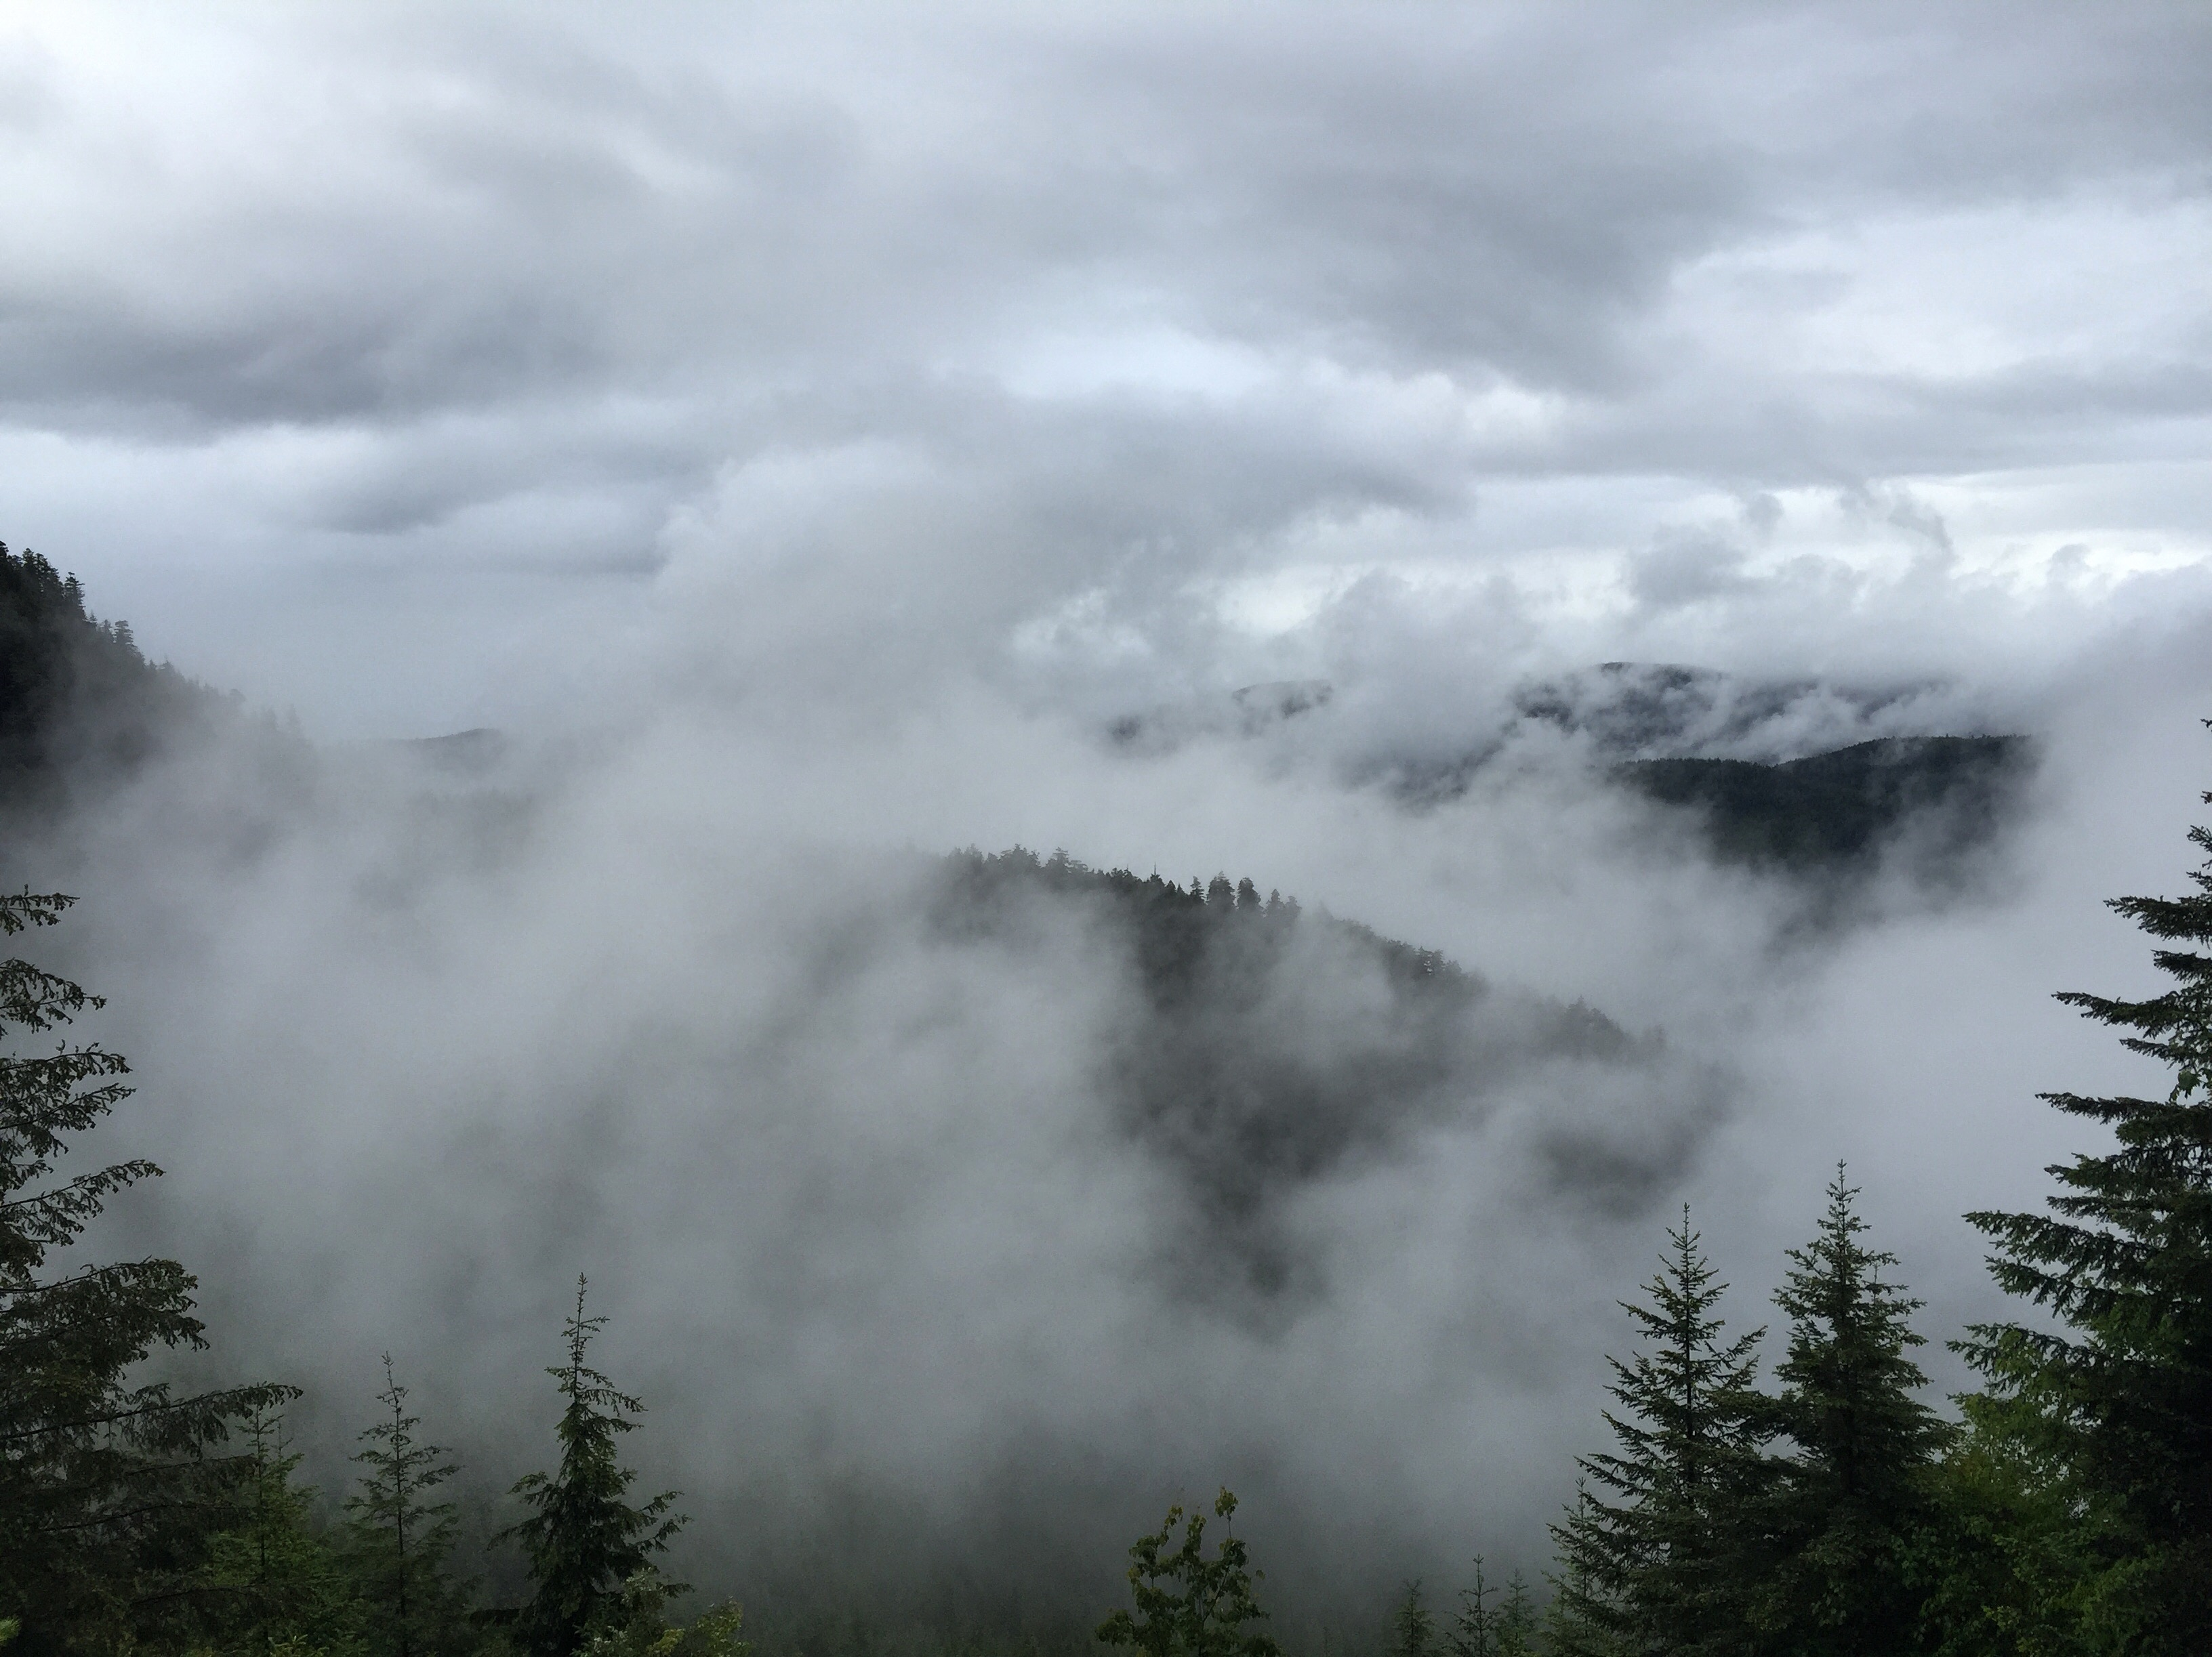
Three-dimensional Orographic Precipitation Enhancement
Observed in OLYMPEX
R. A. Houze, Jr.,
Angela Rowe,
Lynn McMurdie,
Stacy Brodzik,
Megan Chaplin
Joe Zagrodnik,
Thomas Schuldt
NOTE: This talk was prepared for the PMM Science Team Meeting but was never actually presented.
NASA PMM Science Team Meeting, San Diego, 18 October 2017

Slide 2
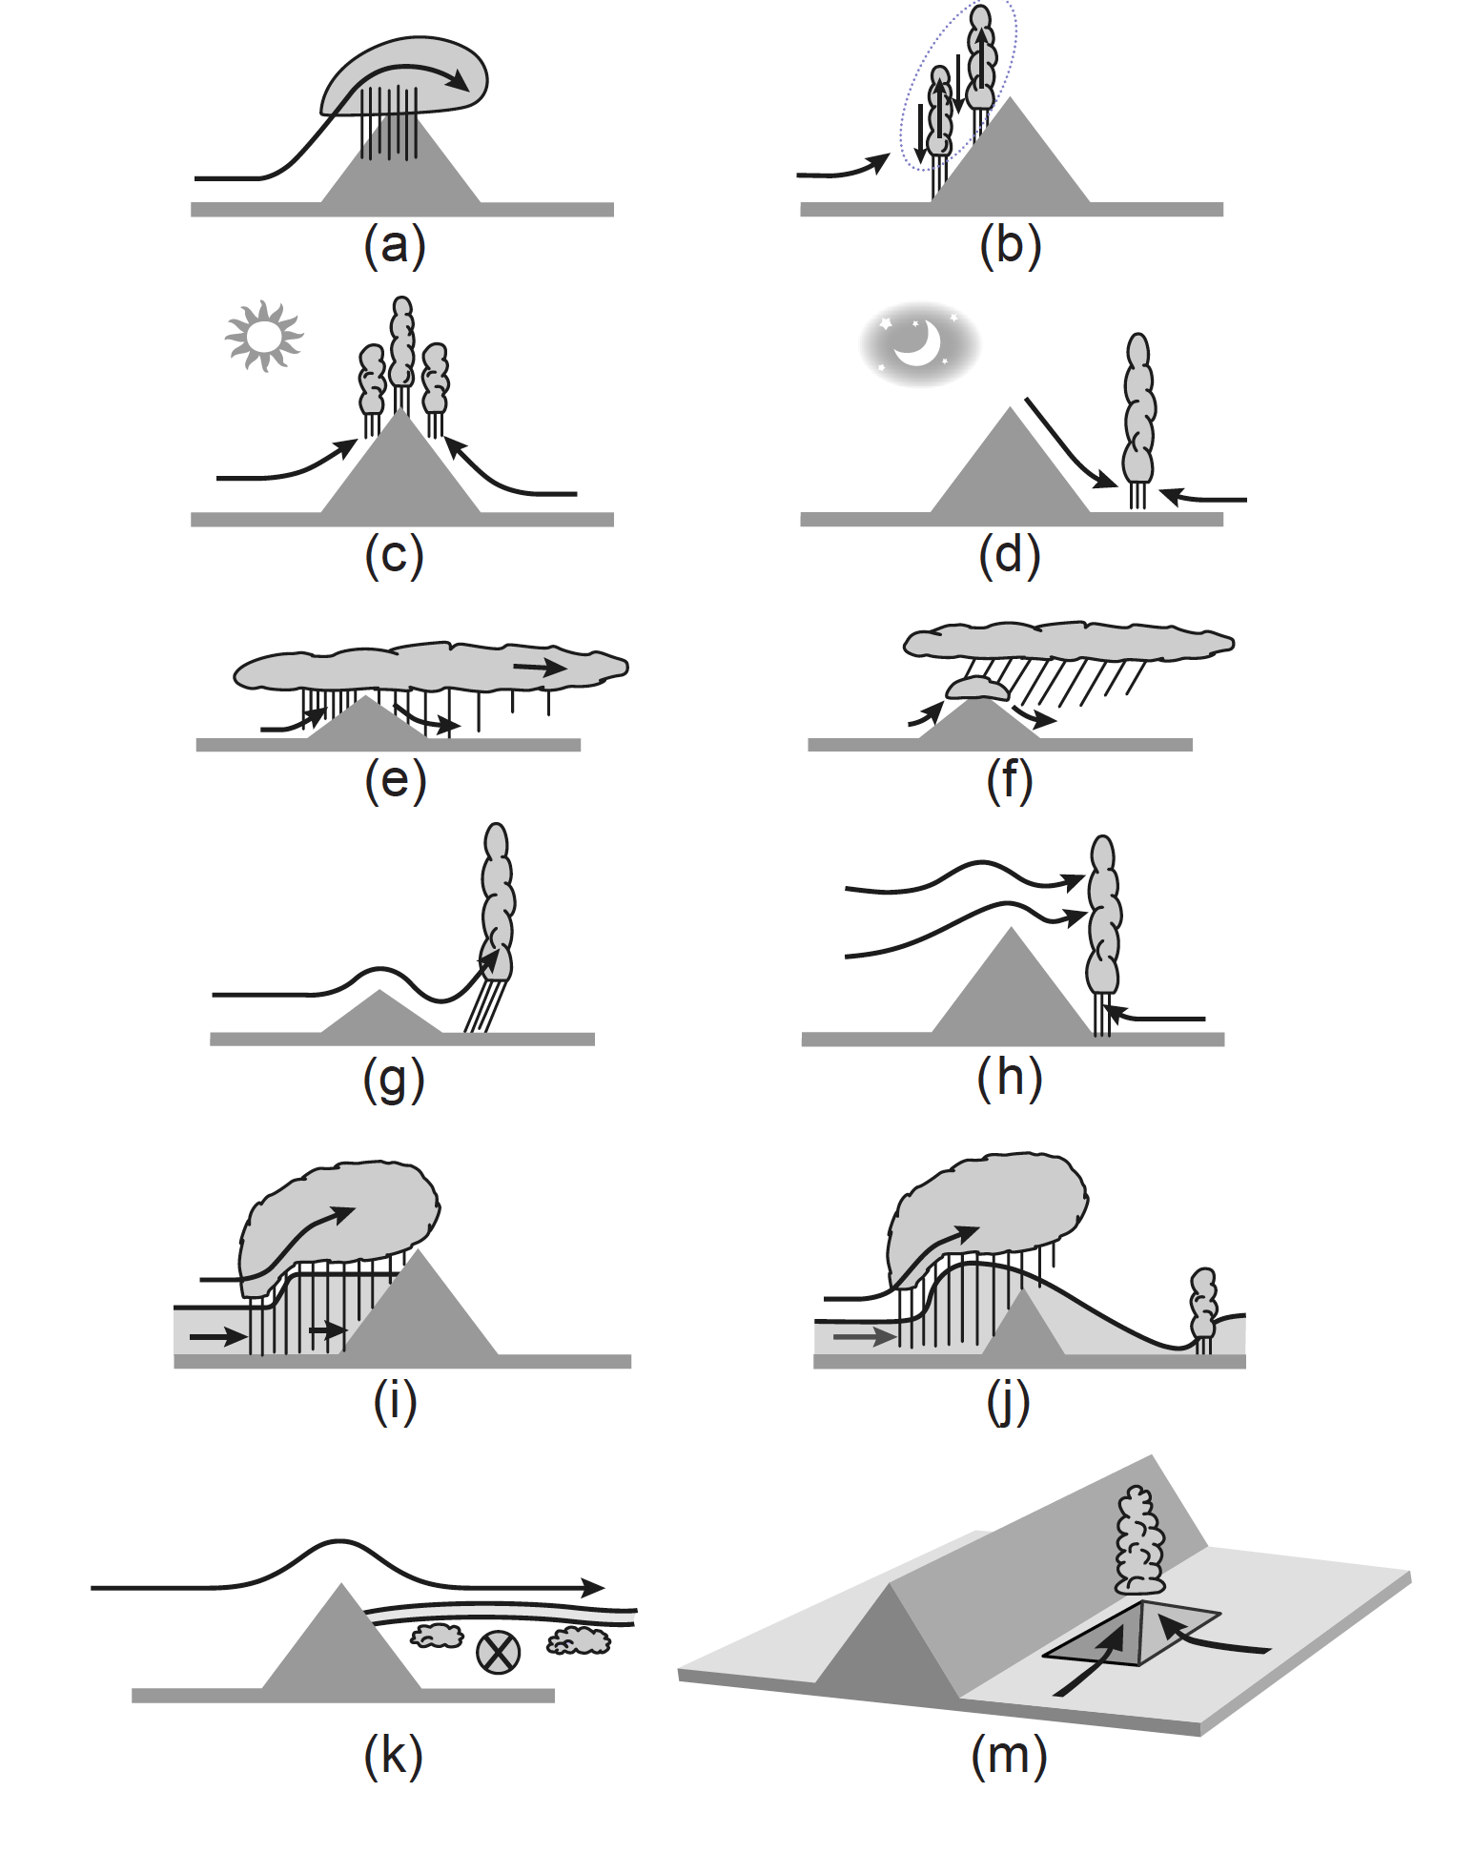
The many forms of orographic effects on precipitation
Houze,
Cloud Dynamics, 2nd Ed., 2014

Slide 3
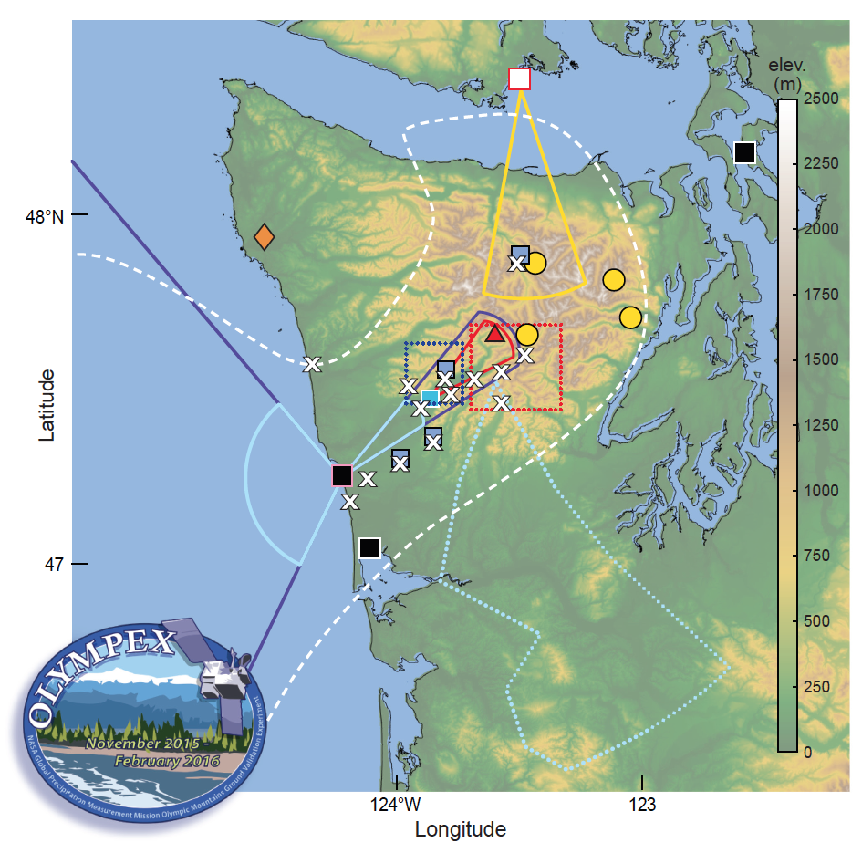
OLYMPEX
Notes:
Just to show the NPOL location and RHI sectors, along with the ground sites and elevation data

Slide 4
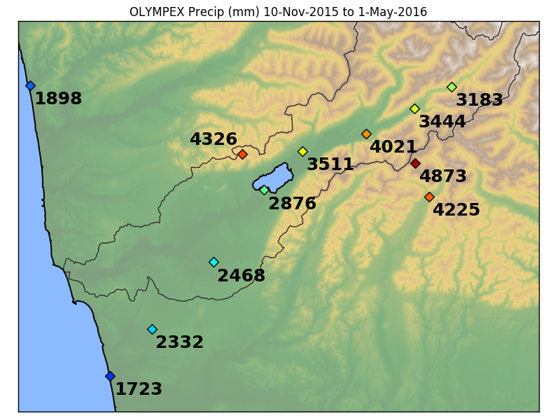
OLYMPEX Precipitation
Accumulated precipitation (mm)
10 Nov 2015 – 1 May 2016

Slide 5
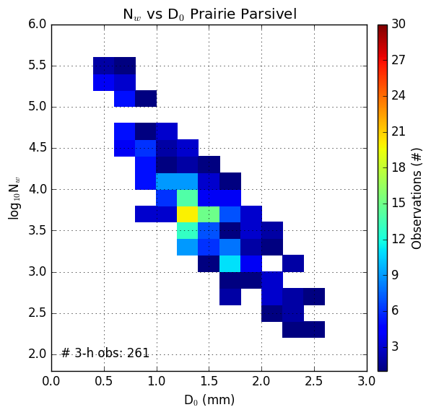
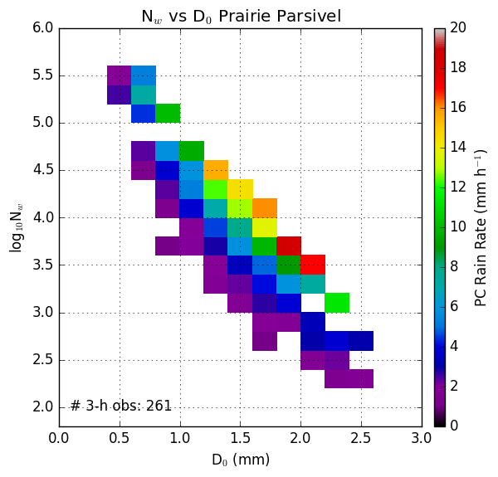
Dropsize Distributions: Diameter vs. Number
Frequency
Rain rate
Log of N_{w} – number of drops
Rain Rate – Prairie Creek
D_{o} Median Diameter (mm)
D_{o} Median Diameter (mm)
Notes:
These are for Prairie Creek (540 m). Low elevation stations similar plots, but lower rainrates and fewer instances of the extremes

Slide 6
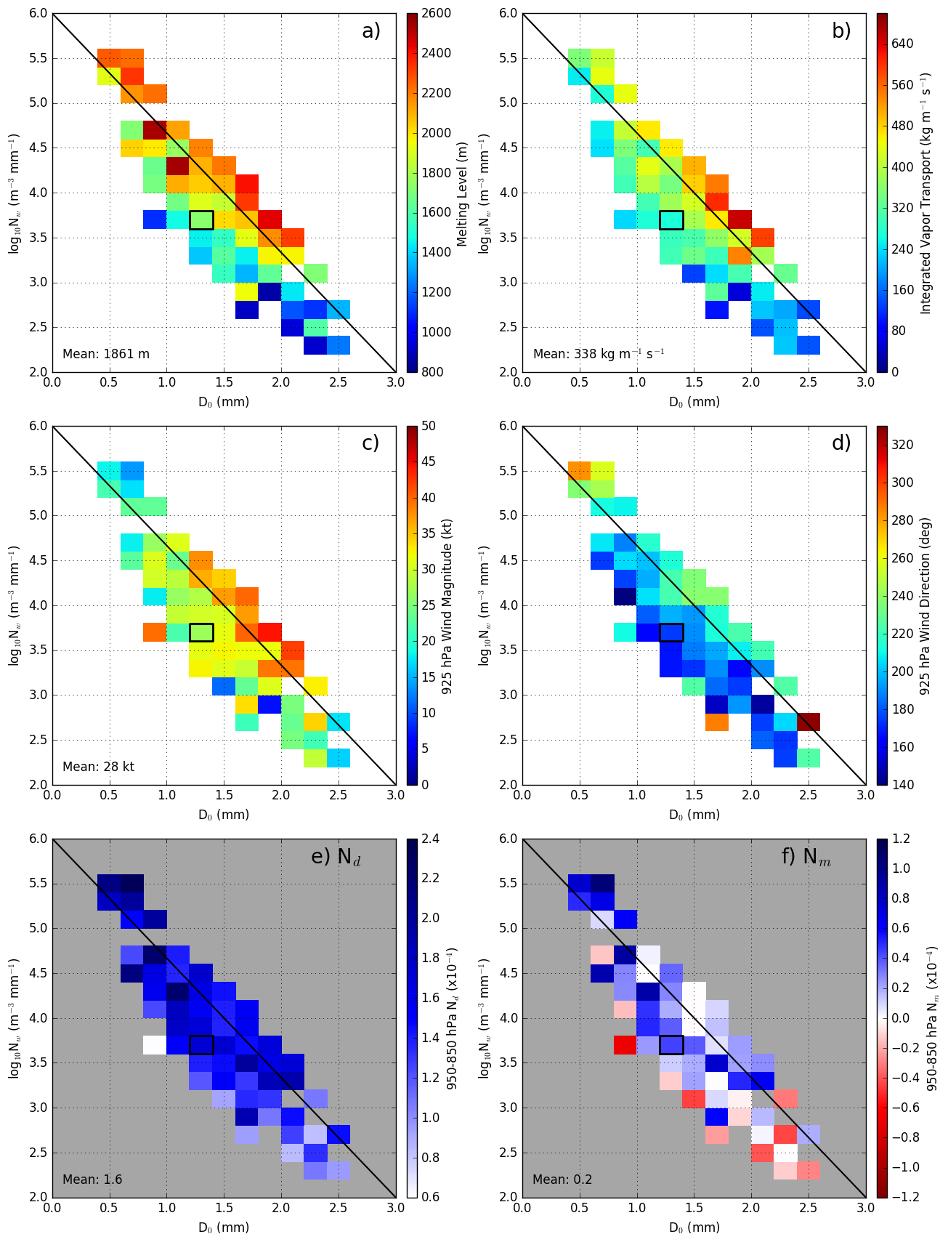
Melting Level
925hPa Wind Speed
Log of N_{w} – number of drops
D_{o} Median Diameter (mm)
IVT
925hPa Wind Direction
Moist Static Stability
Average Conditions
Lots of Small drops
Few large drops
Heavy Rain

Slide 7
What does the enhancement at upper levels look like?

Slide 8
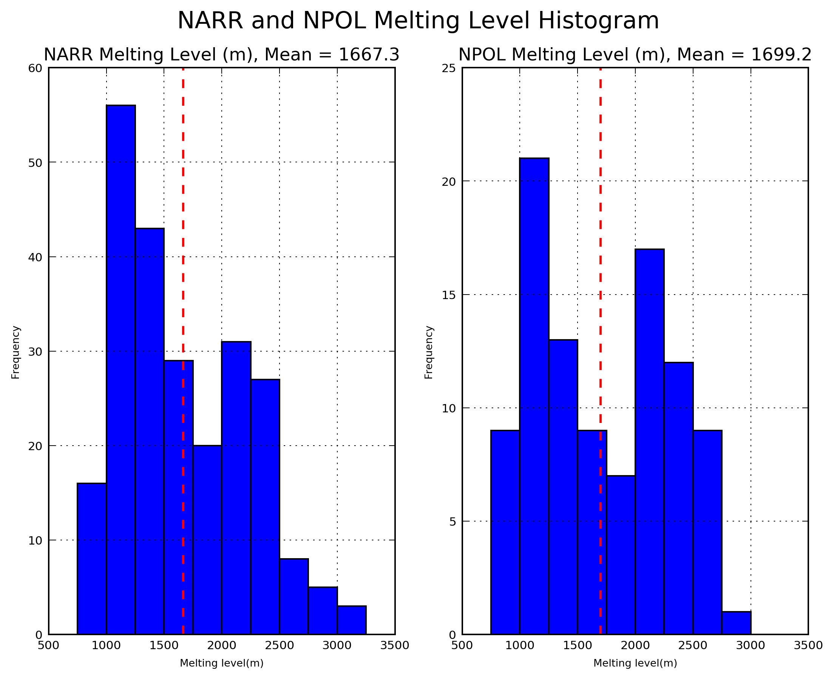
Melting Level Height in OLYMPEX

Slide 9
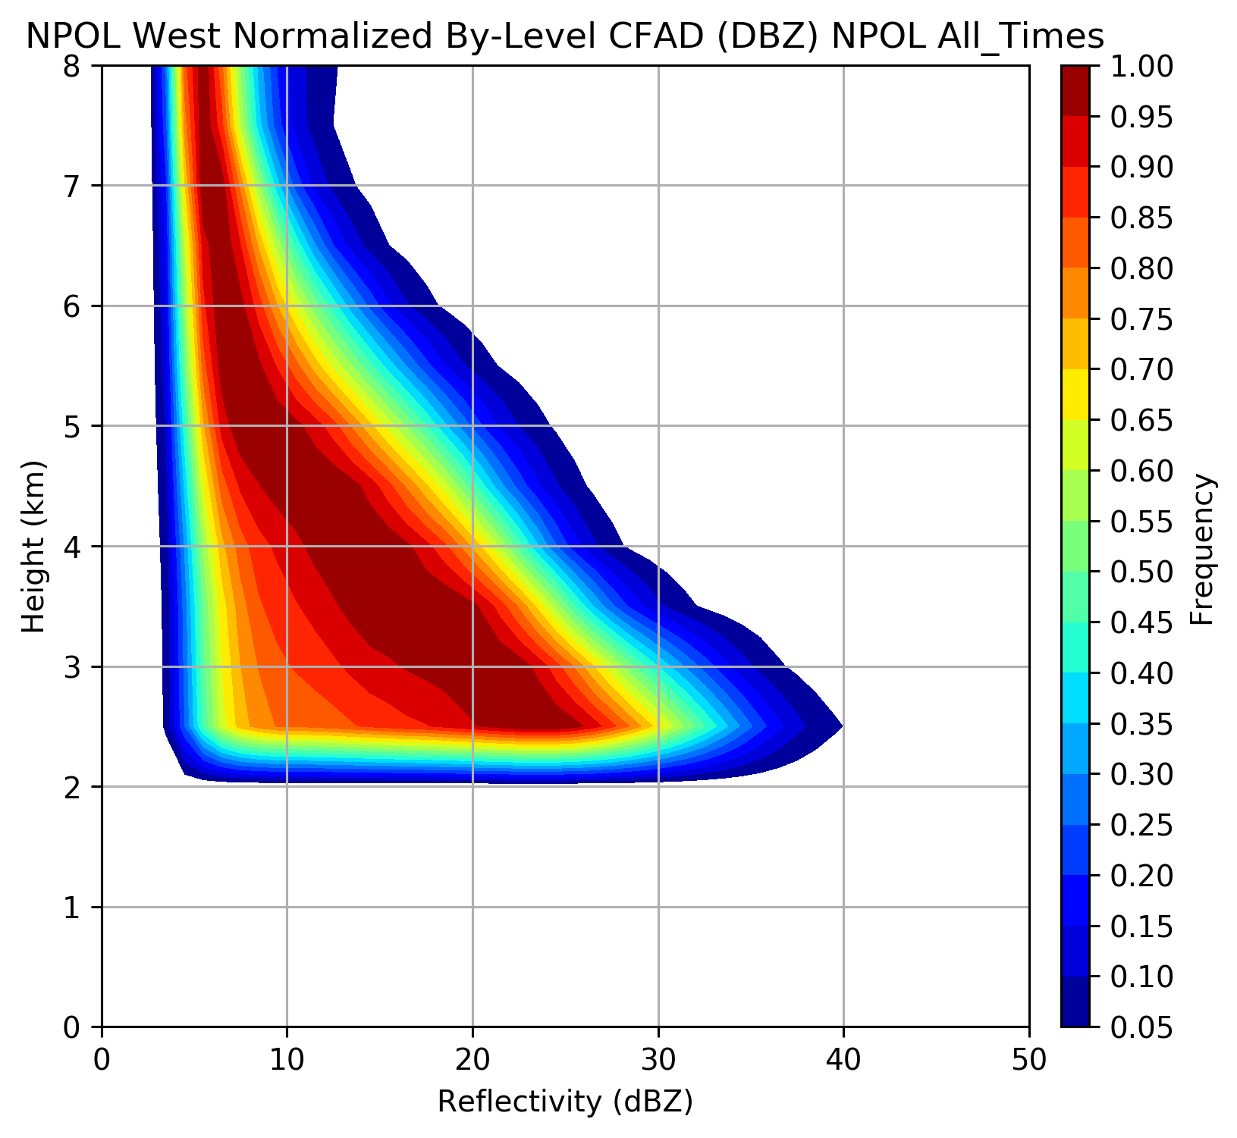
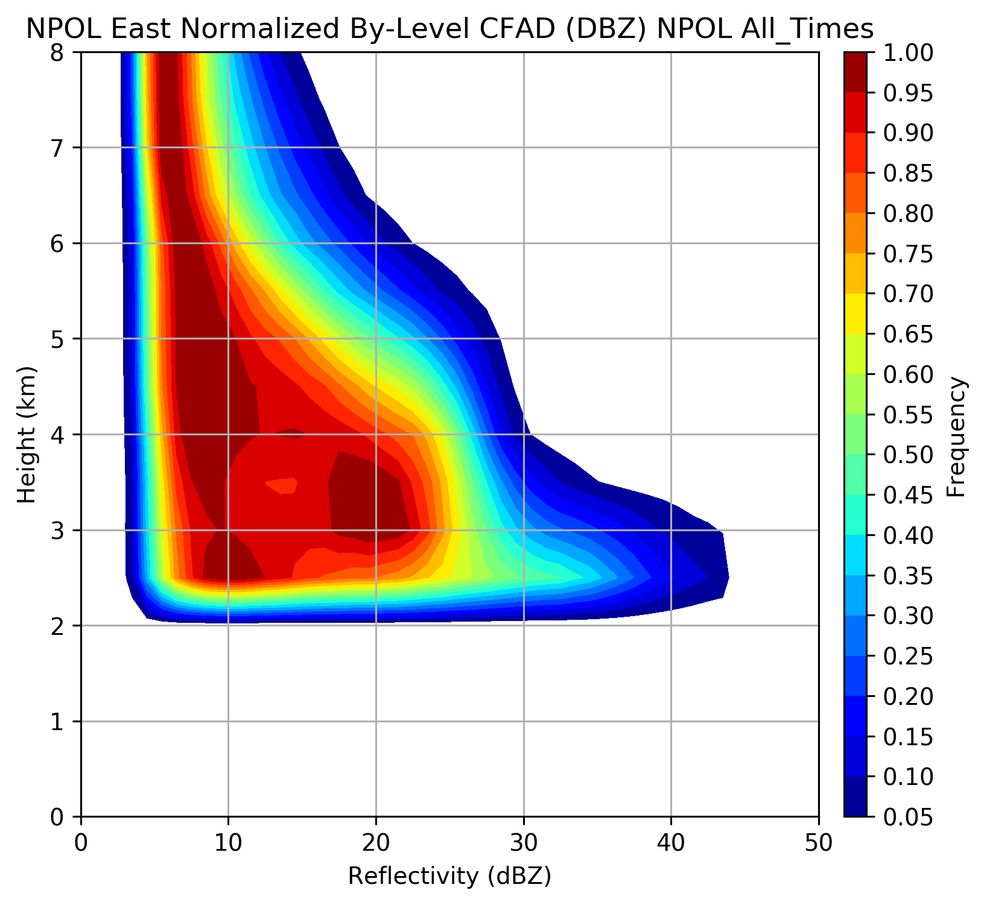
NPOL reflectivity over Ocean &Land
Ocean
Land
Height (km)
Reflectivity (dBZ)
12 Nov – 18 Dec, 3-15 Jan
Contoured Frequency by Altitude Diagrams
Frequencies normalized by level for all NPOL RHI data over ocean and land above 2 km height
Rowe et al., in prep

Slide 10
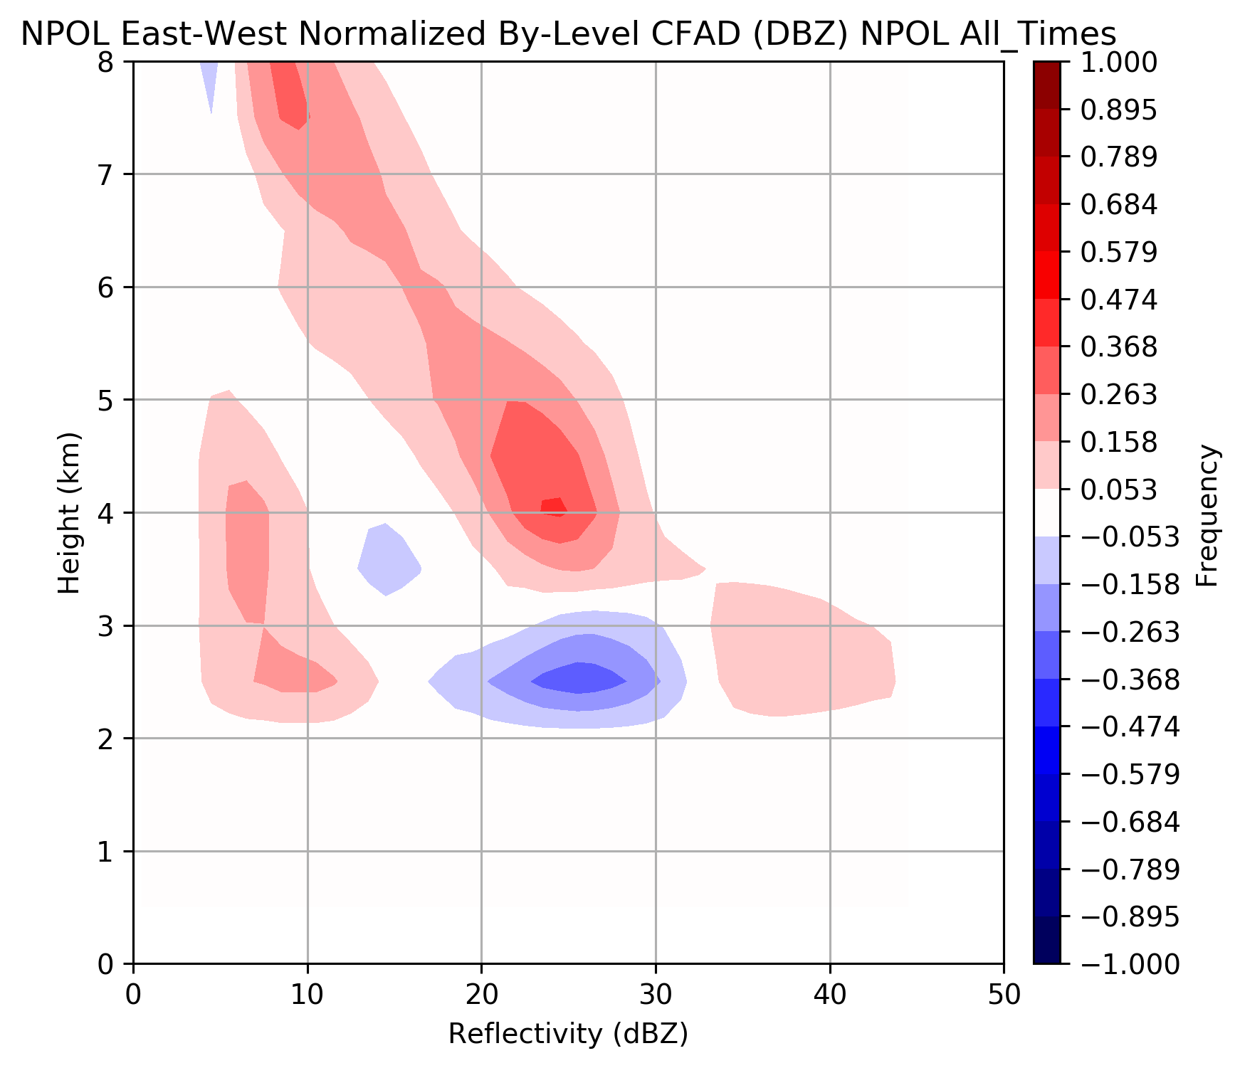
Orographic Enhancement Aloft
Land – Ocean Difference CFAD
Greater frequency of higher reflectivities at all levels over windward slopes
Shift to higher reflectivity near melting level (2-3 km during warm events)
Rowe et al., in prep

Slide 11
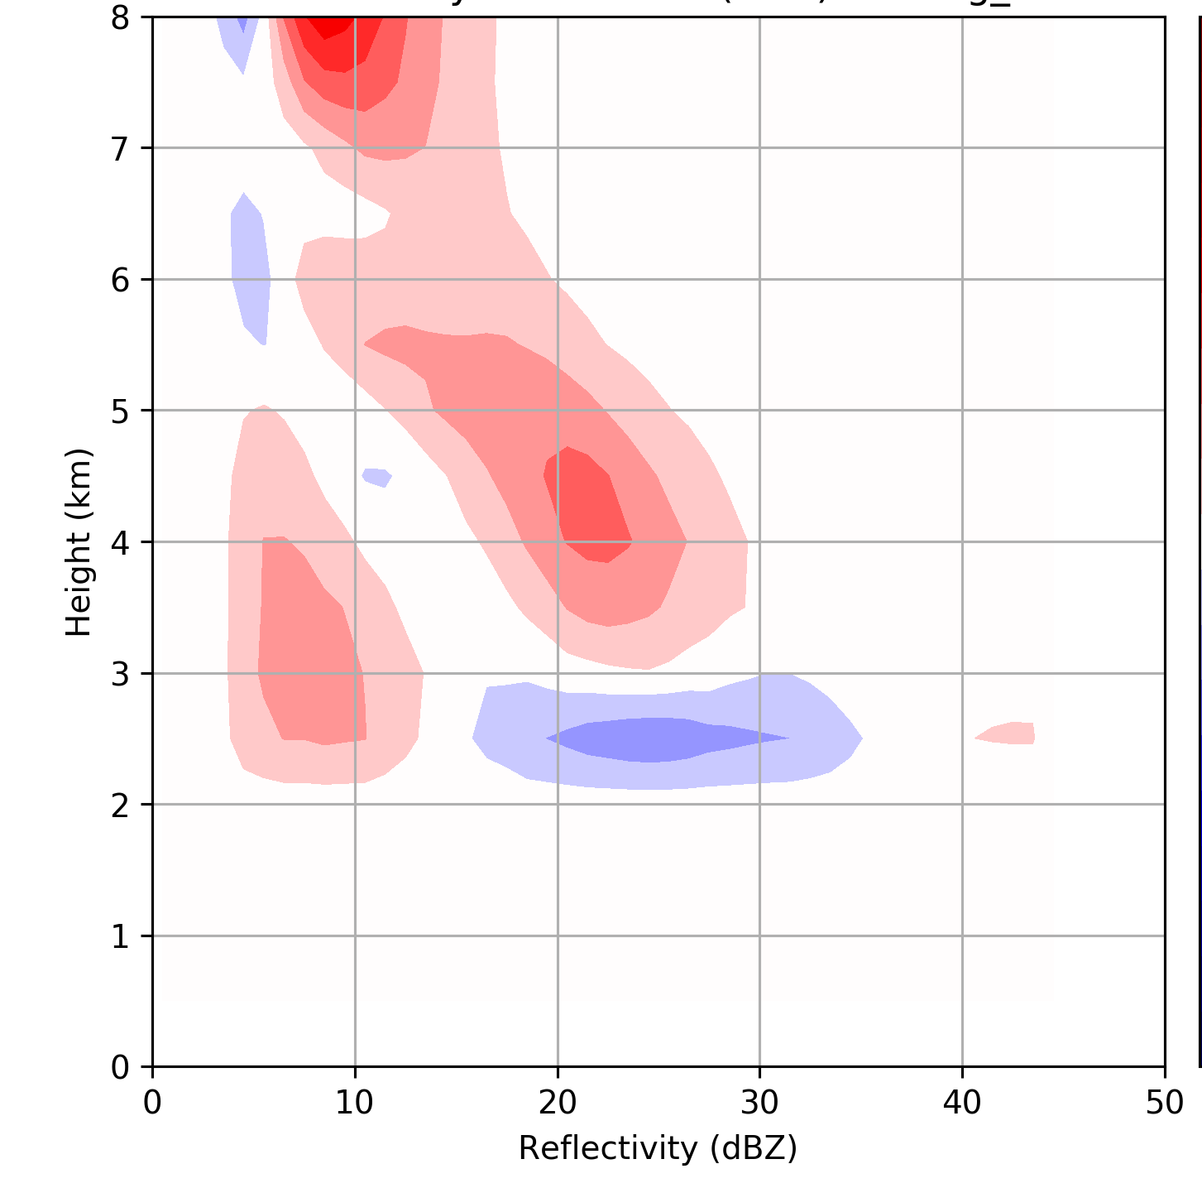
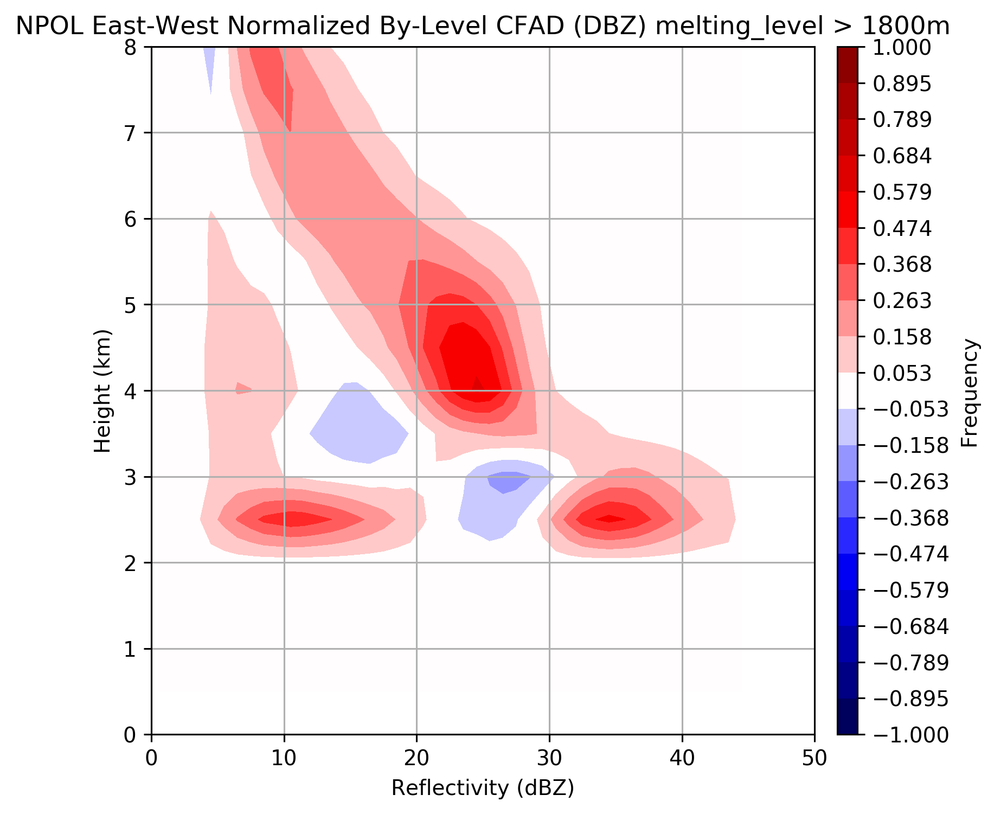
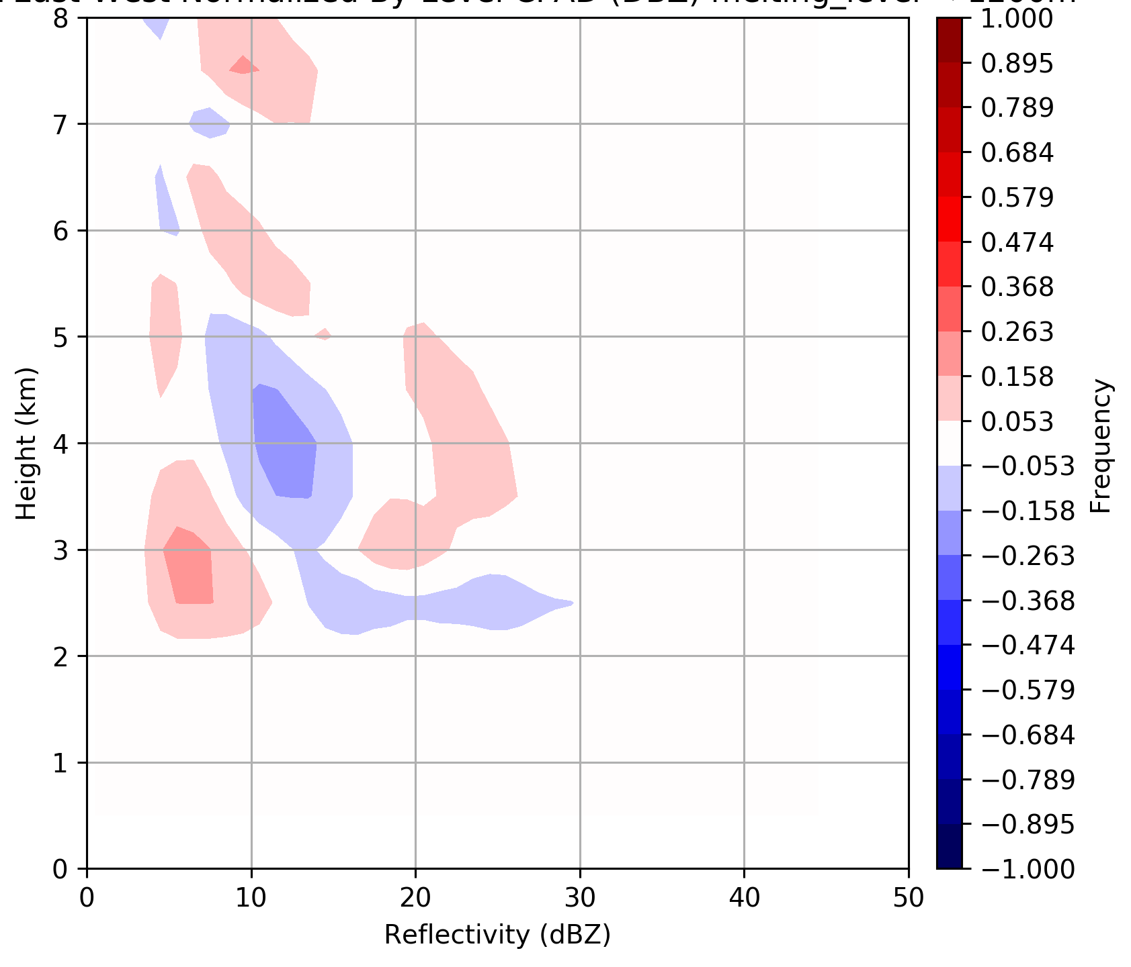
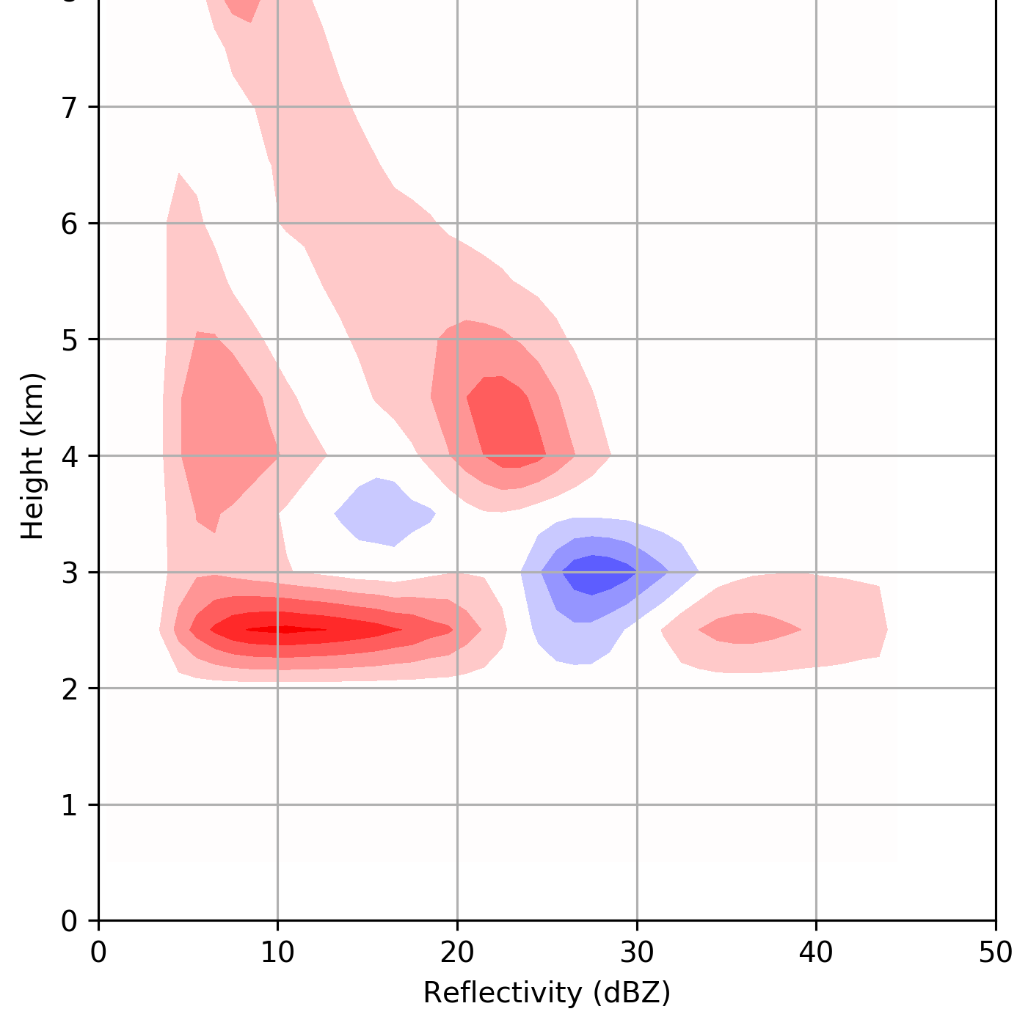
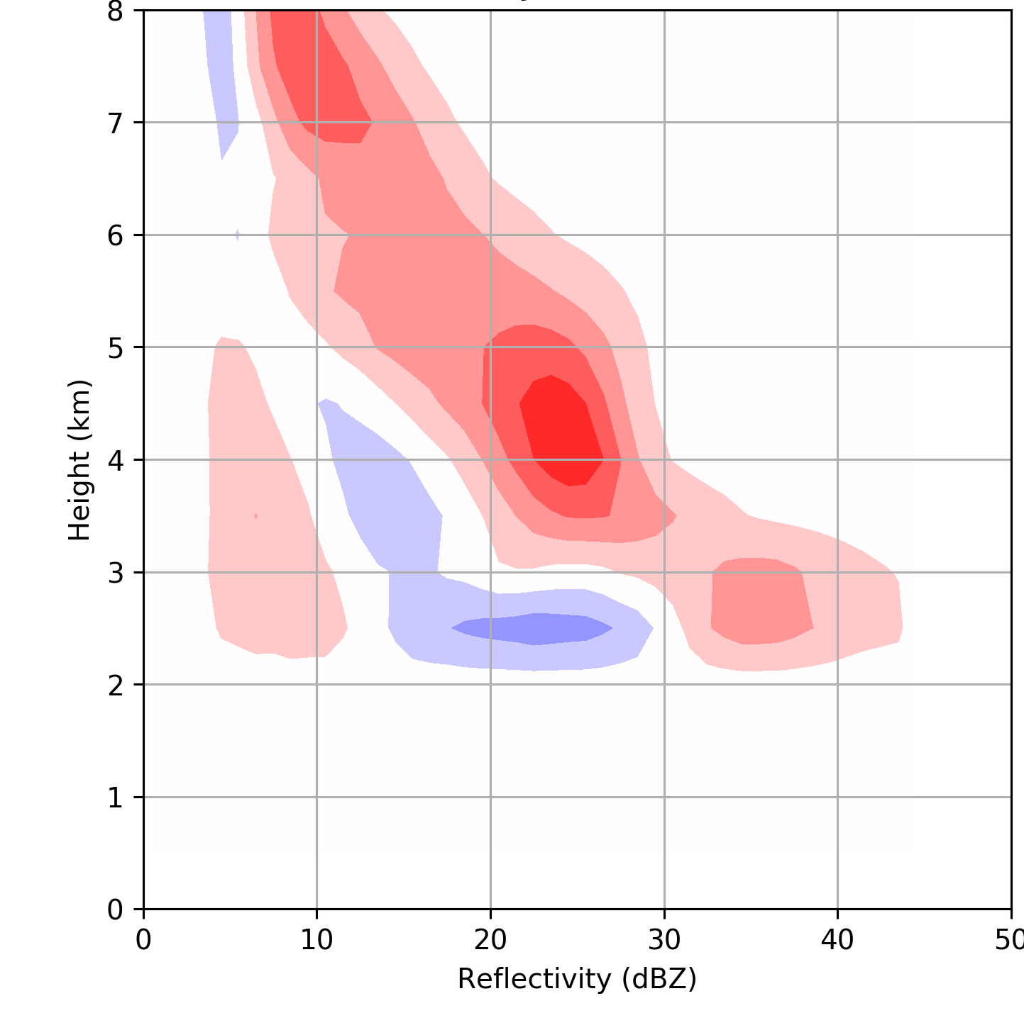
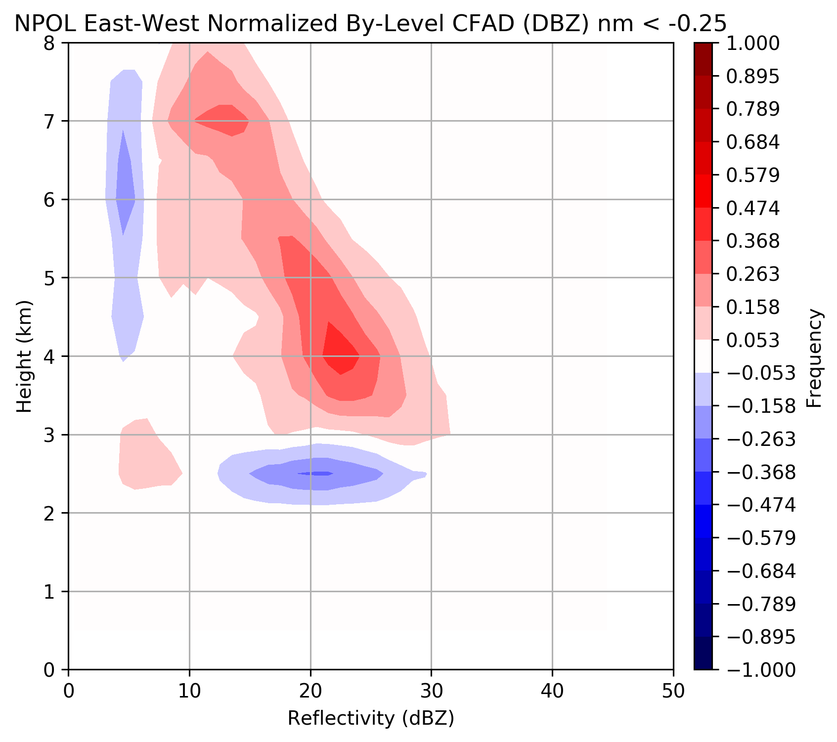
~Pre-frontal
~Warm sector
~Post frontal
25% of time
36% of time
39% of time
Melting level 1.2-1.8 km
ML > 1.8 km
ML < 1.2 km
37% of time
43% of time
20% of time
Nm stable
Nm neutral
Nm unstable
Rowe et al., in prep

Slide 12
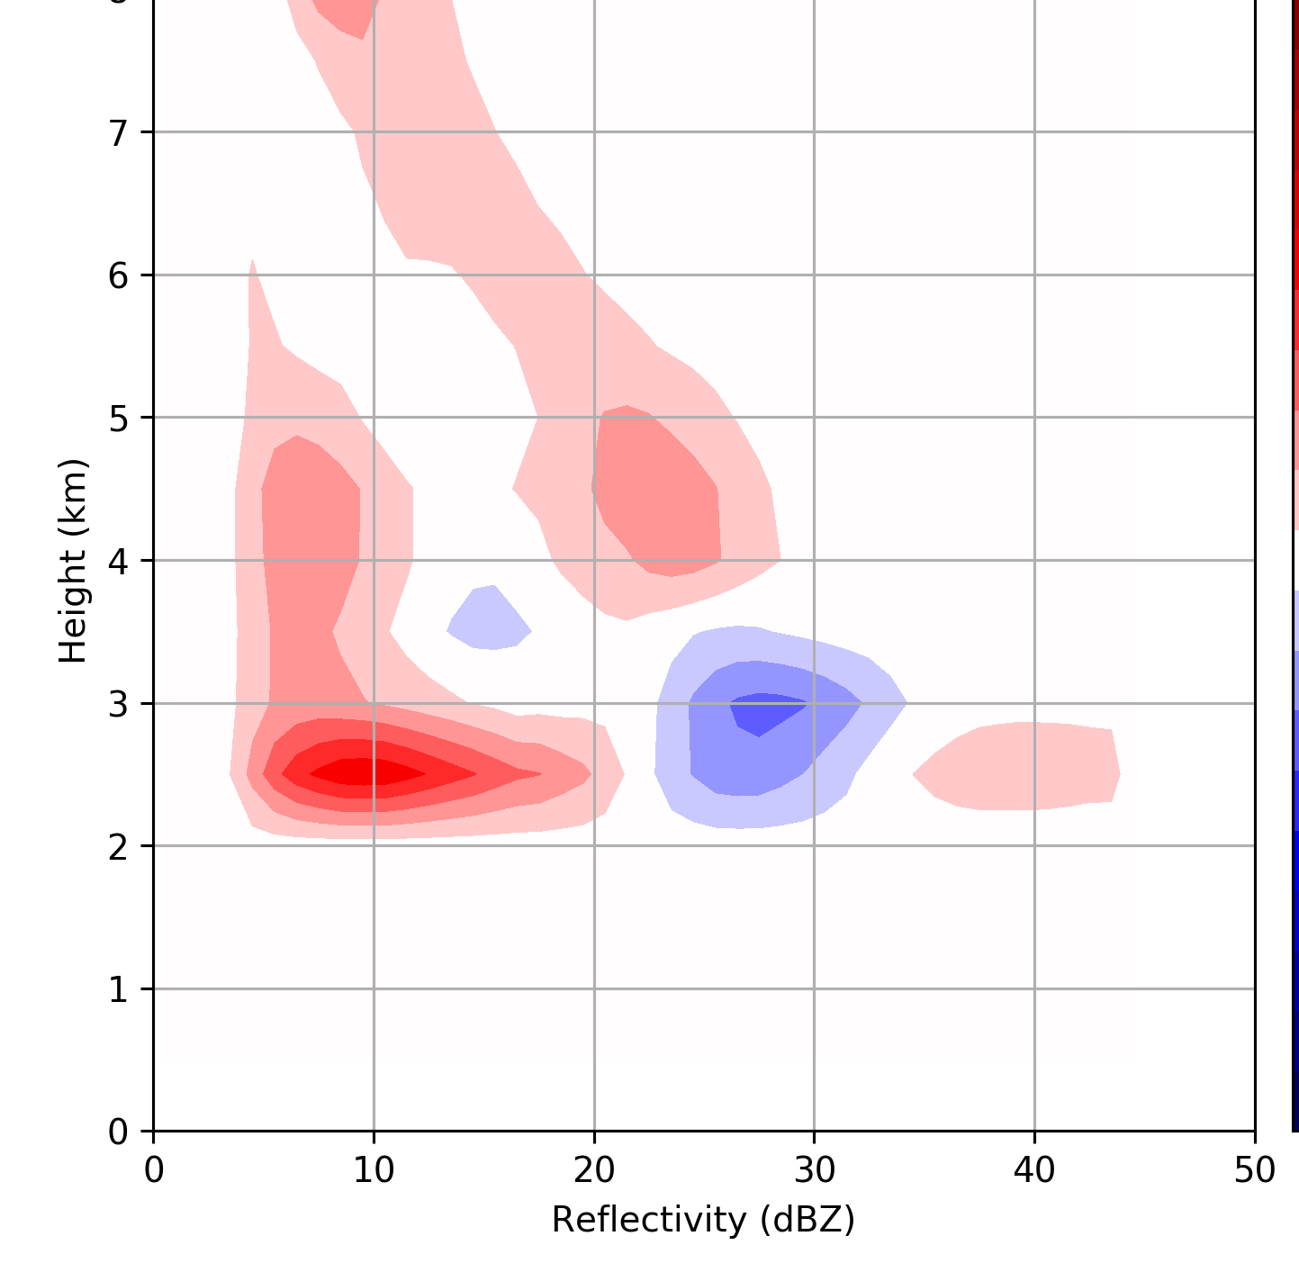
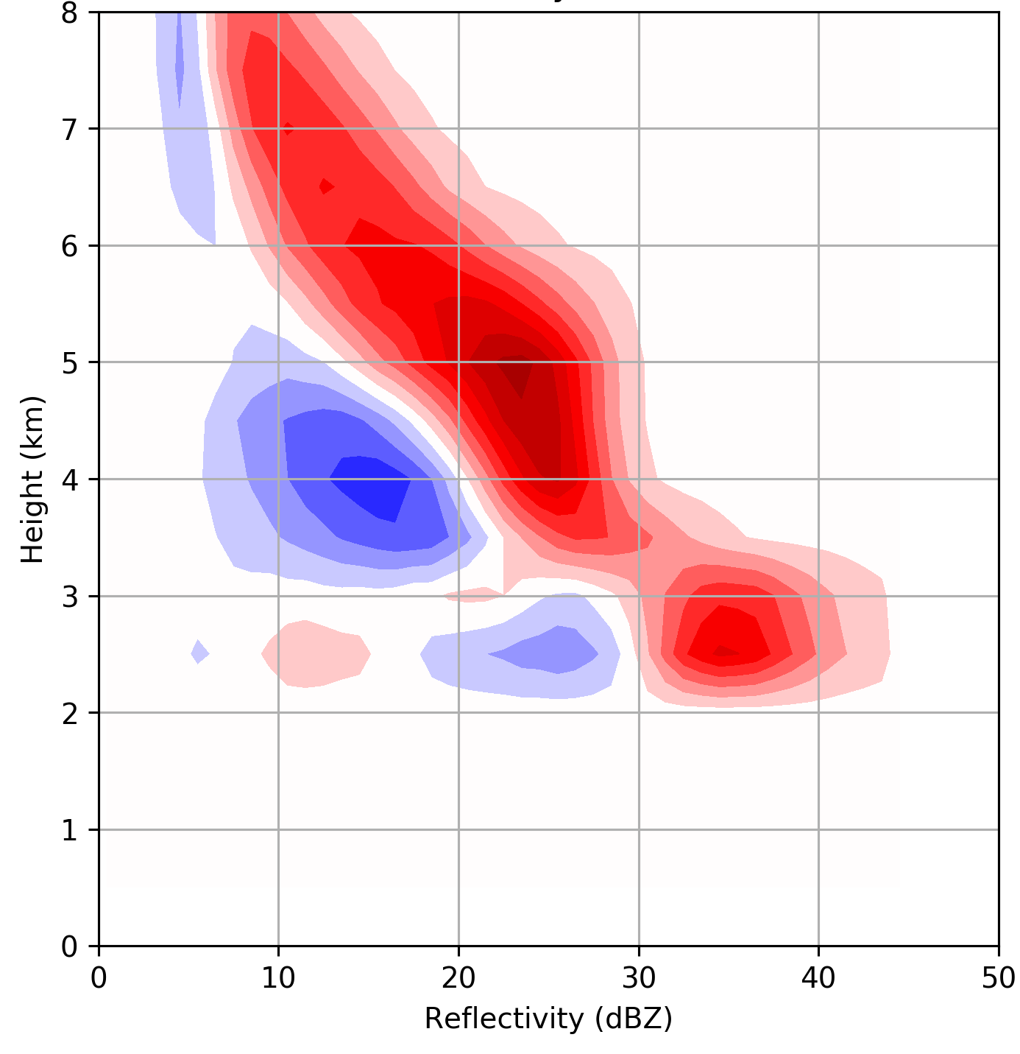
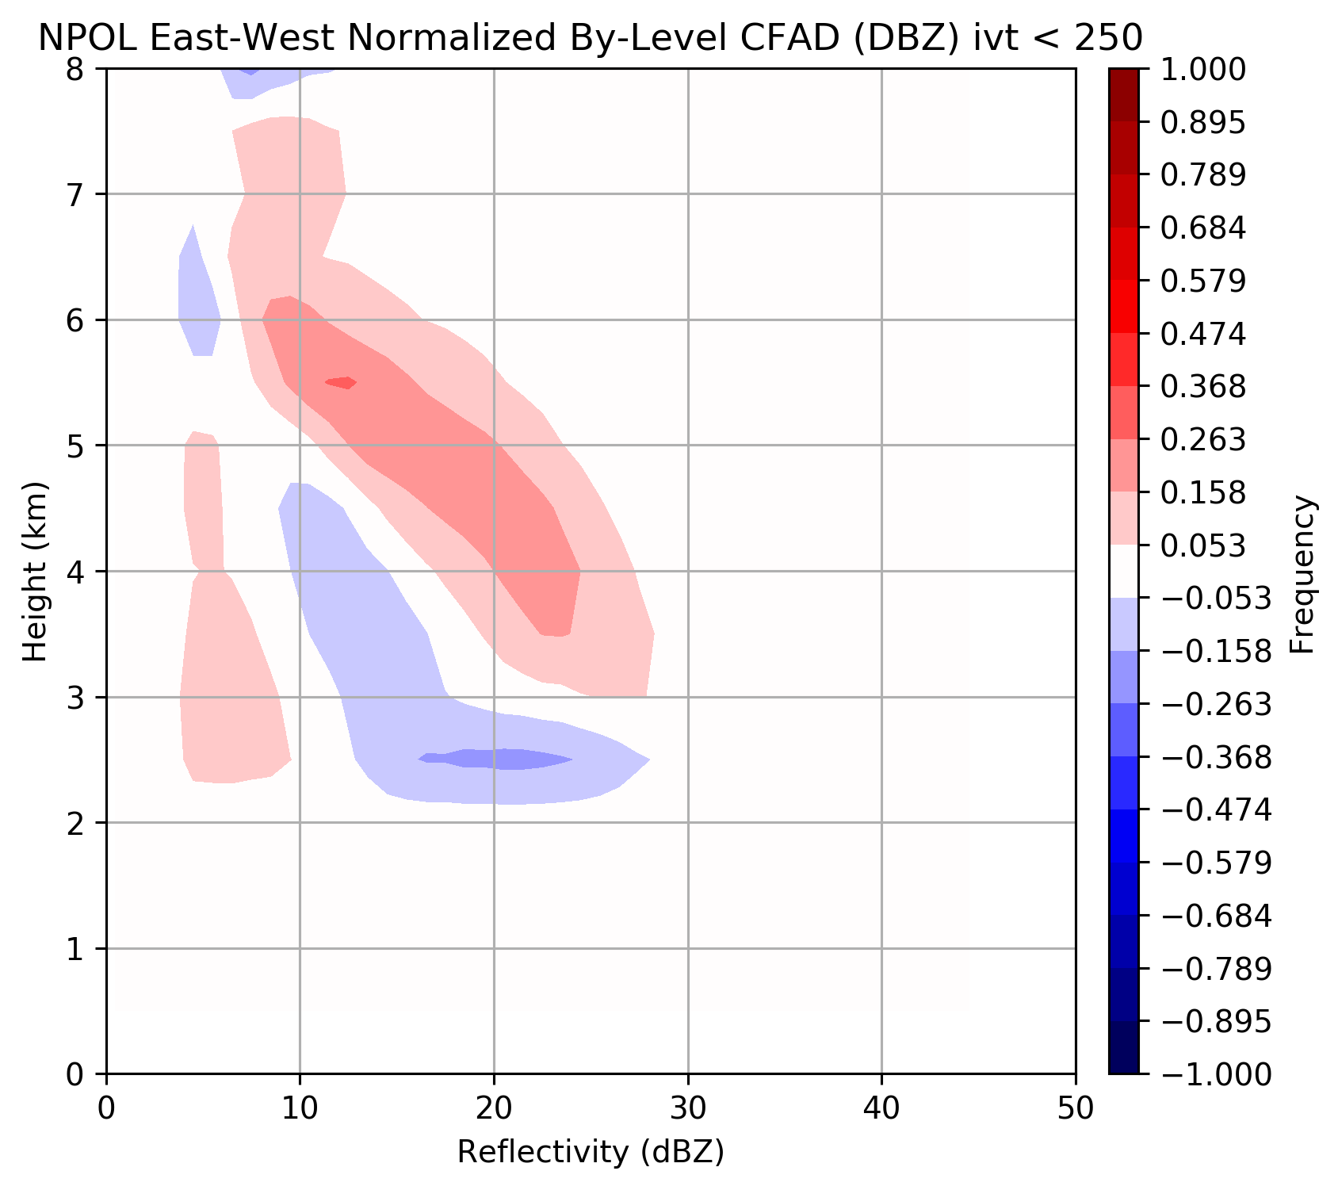
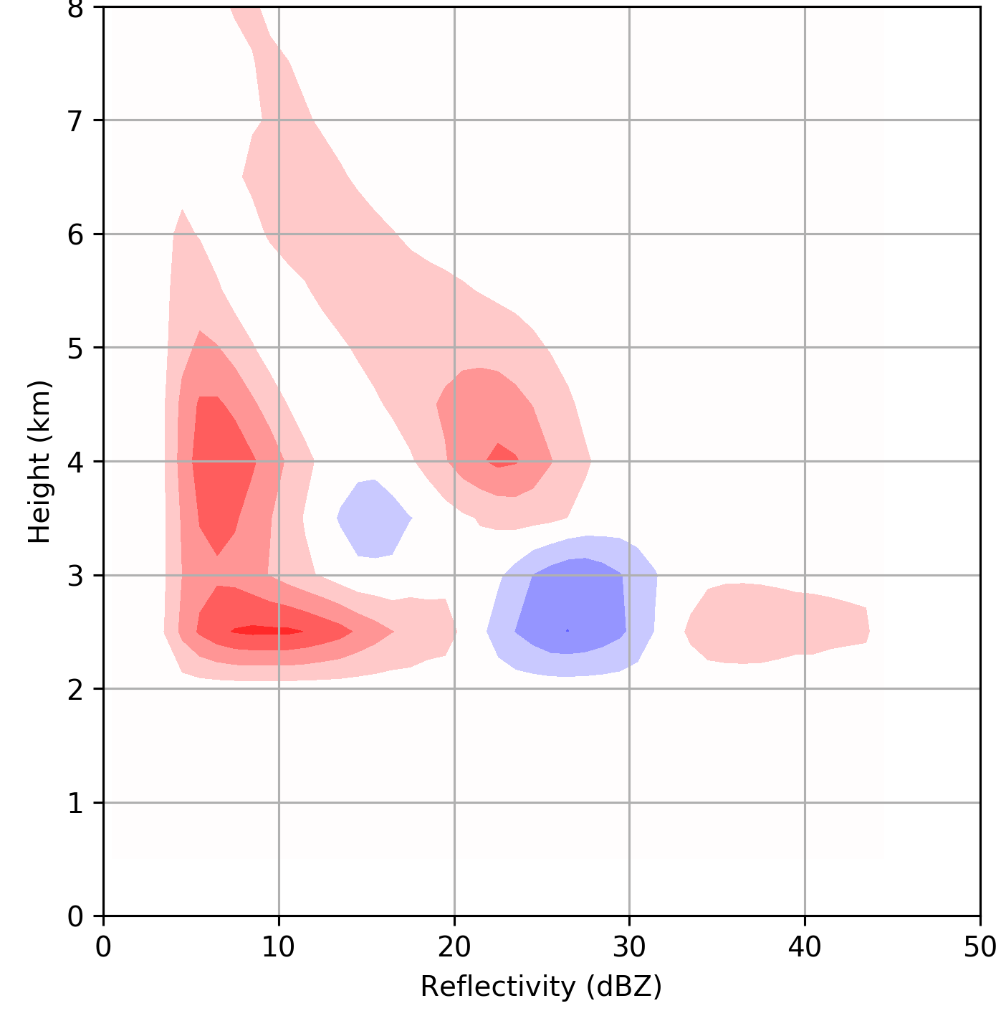
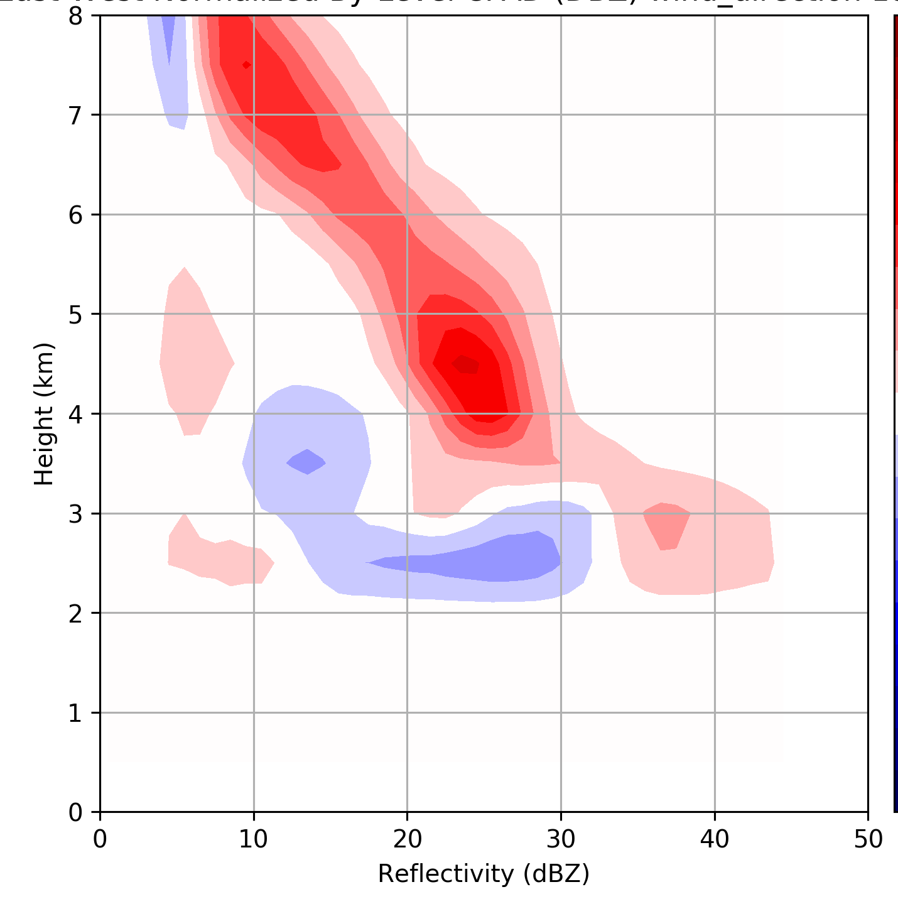
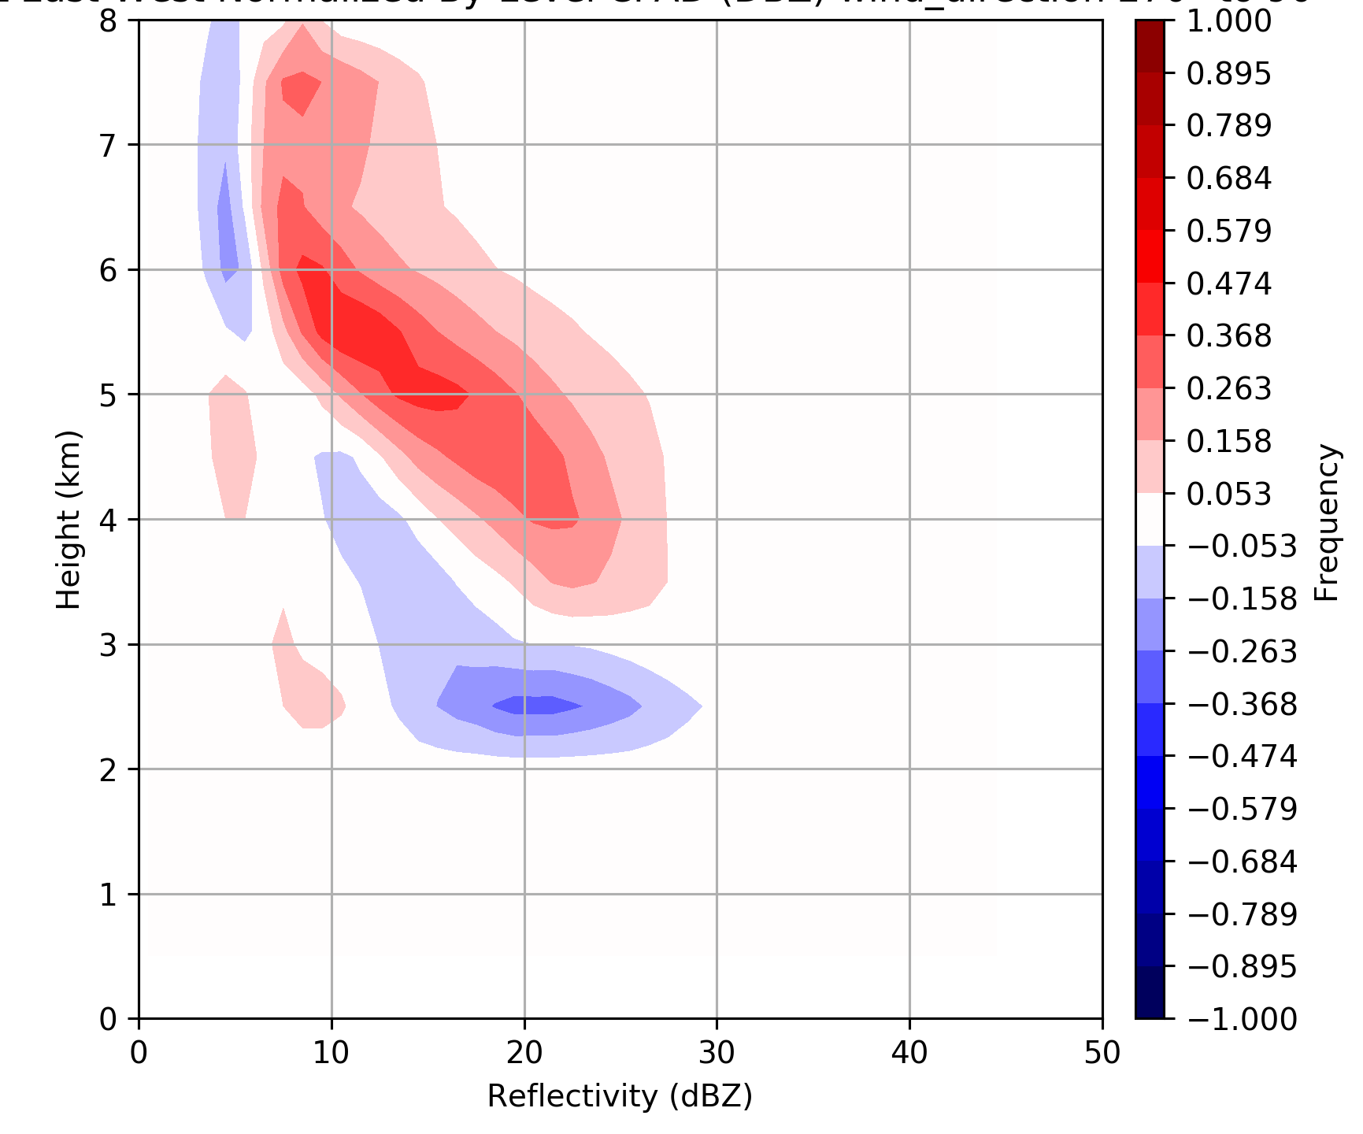
~Pre-frontal
~Warm sector
~Post frontal
20% of time
10% of time
70% of time
250 < IVT < 450 kg m⁻¹ s⁻¹
IVT > 450 kg m⁻¹ s⁻¹
IVT < 250 kg m⁻¹ s⁻¹
42% of time
29% of time
29% of time
90° < wind dir. < 180°
180° < wind dir. < 270°
270° < wind dir. < 90°
Rowe et al., in prep
Rowe et al., in prep

Slide 13
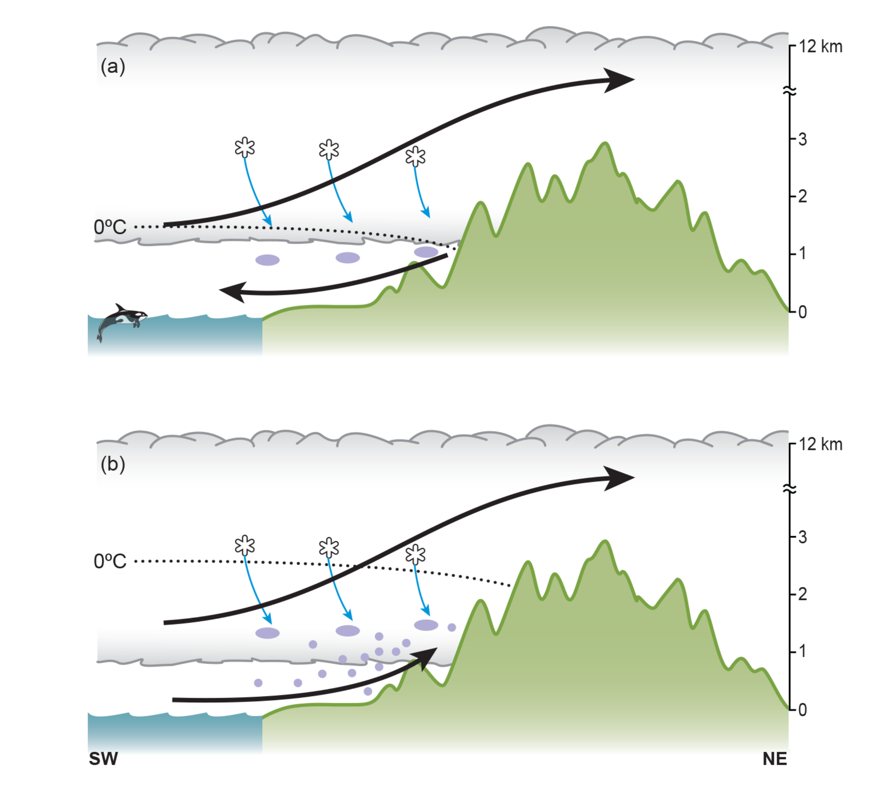
Upper-level enhancement
Big enhancement due to small drop growth at low levels
Two different enhancement modes
Upper-level enhancement
No enhancement at low levels

Slide 14
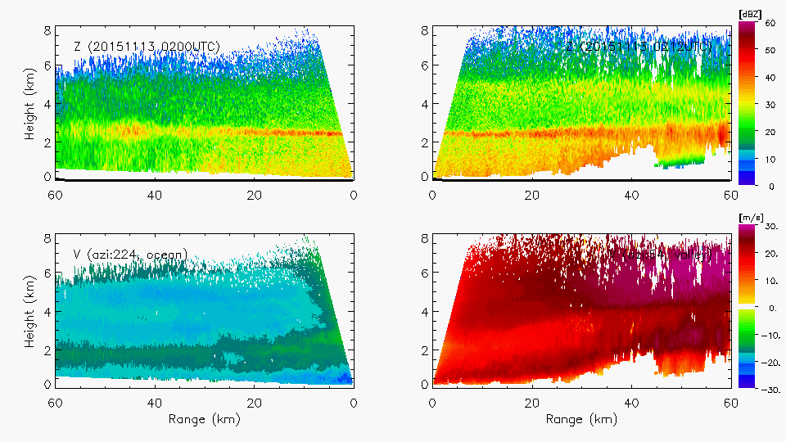
Example of enhancement at both upper and lower levels
Reflectivity (dBZ)
Reflectivity (dBZ)
Radial Velocity(dBZ)
Radial Velocity(dBZ)
Notes:
Shows both lower and upper level enhancement. Midlevel flow lifting as well as low-level.

Slide 15
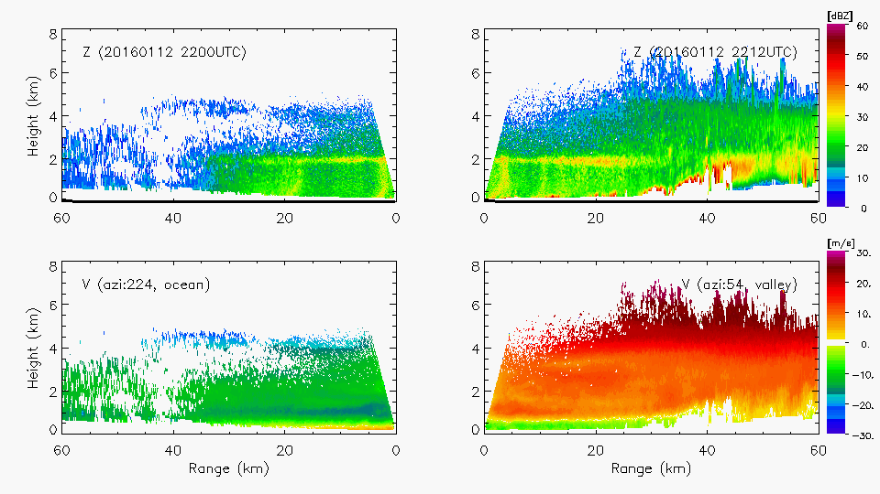
Example of enhancement at upper level only
Reflectivity (dBZ)
Reflectivity (dBZ)
Radial Velocity(dBZ)
Radial Velocity(dBZ)

Slide 16
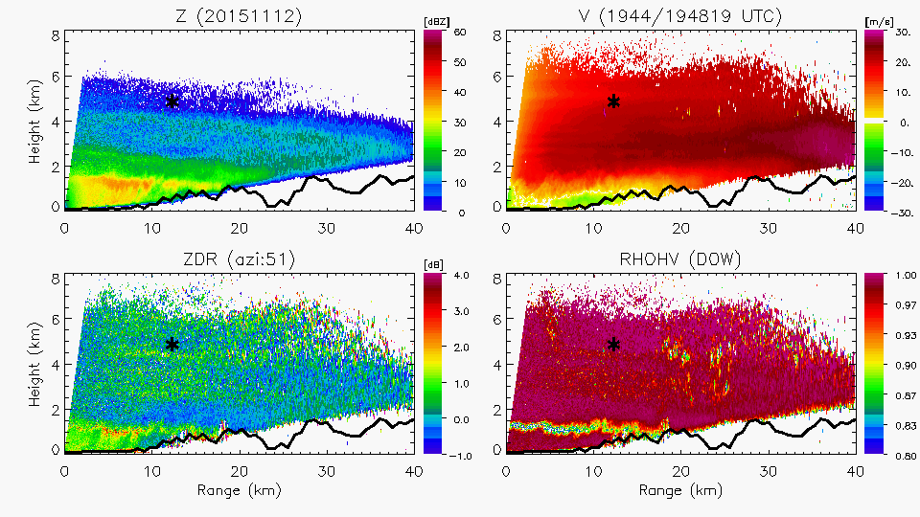
Citation Aircraft sampling over DOW radar
1948 12 Nov 2015
Citation
Z
V
Height (km)
Z_{DR}
ρ_{hv}
Range (km)
Notes:
Melting level variability (intensity, dipping, rising)
Down-valley flow increasingly shallow
Aggregation but little to no rime ice in Citation data
Joe will talk about evolution of DSD

Slide 17
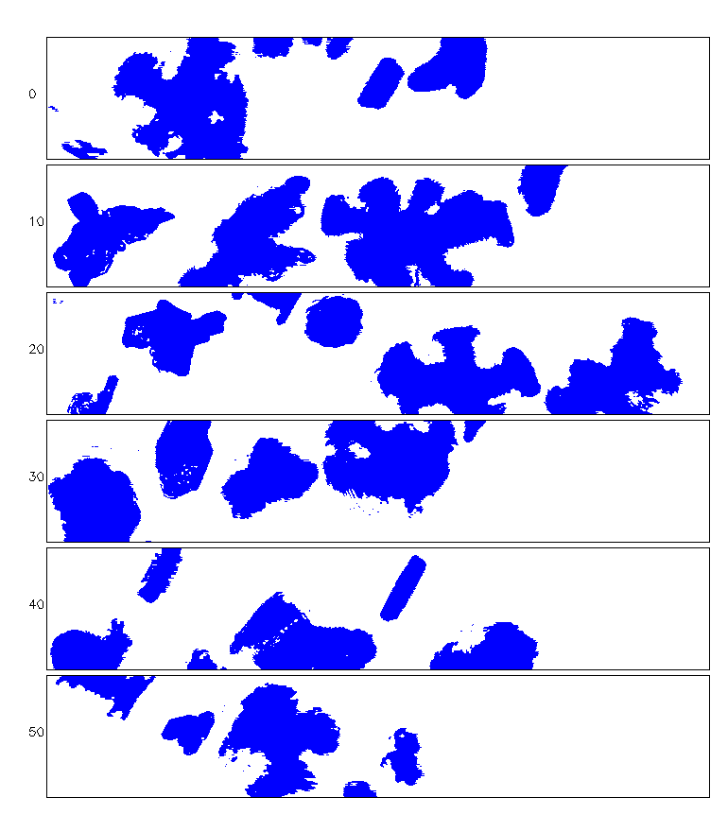
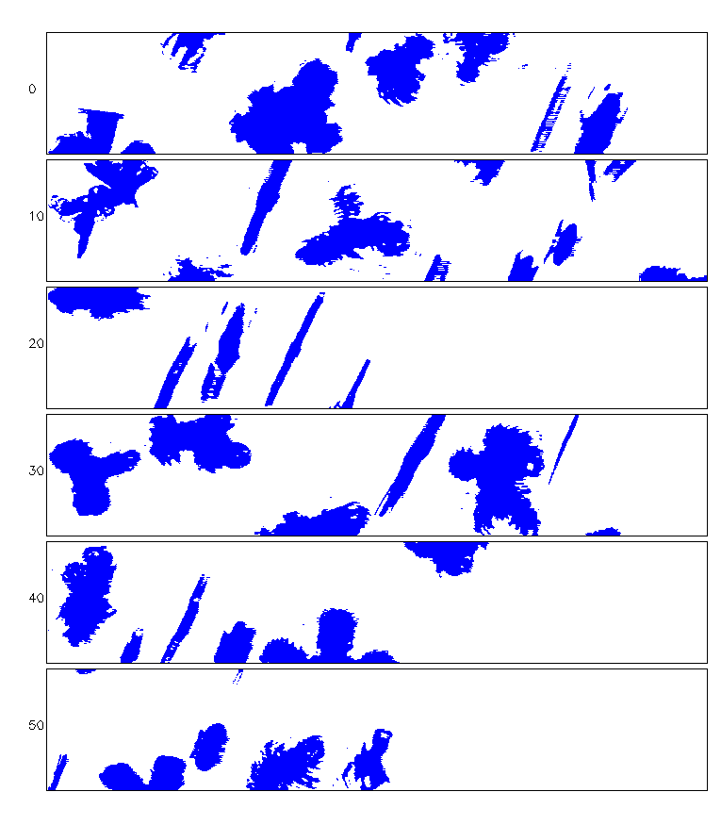
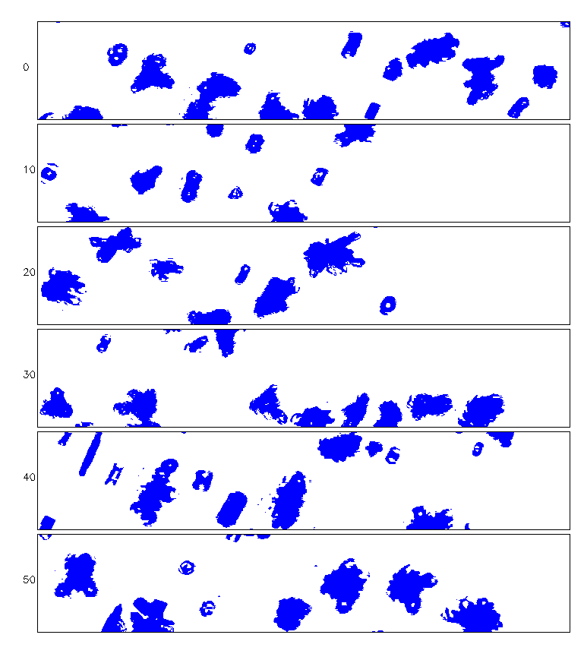
12 November
Particle types at different altitudes
–9°C
–17°C
–26°C
200 µm
2DSV: 10–1280 μm
Notes:
Overall consistent with typical stratiform behavior (schematic!)
Transition: Now I use the aircraft probe data to determine relative concentrations of the particles at different levels throughout the stratiform deck, based on size

Slide 18
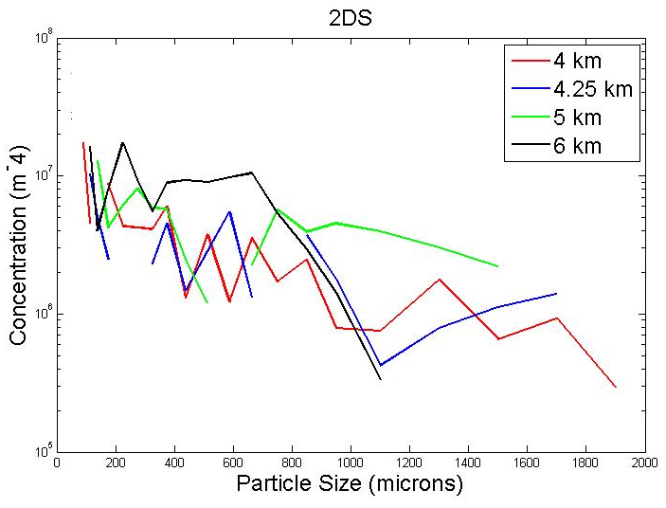
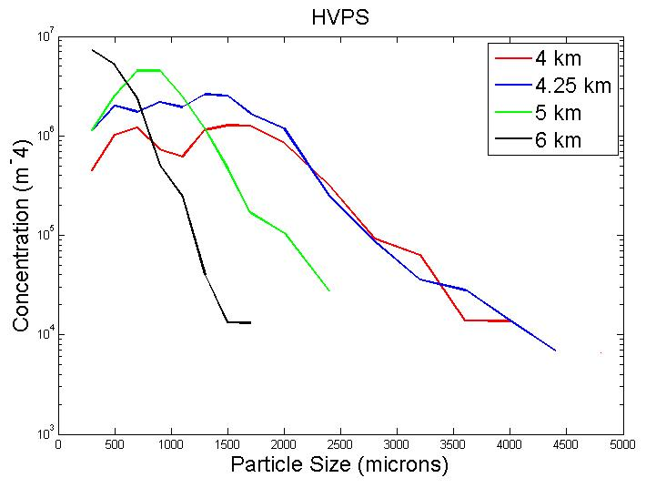
12 November
Particle Size Distributions
2DS-MEDIUM
HVPS-LARGE
Concentration (m⁻⁴)
Concentration (m⁻⁴)
Particle Size (μm)
Particle Size (μm)
  Decrease in particle size with height
  High concentrations of ice particles near cloud top
  More medium & large particle secondary Z/ZDR maximum layer
  Low LWC ( < 0.05 g m⁻³) above melting level unless embedded generating cells
Notes:
Highest concentrations at cloud top (6 km)
Larger particles at 4 and 4.25 km (Z enhancement)
Fewer large particles at upper levels (Z reduction)

Slide 19
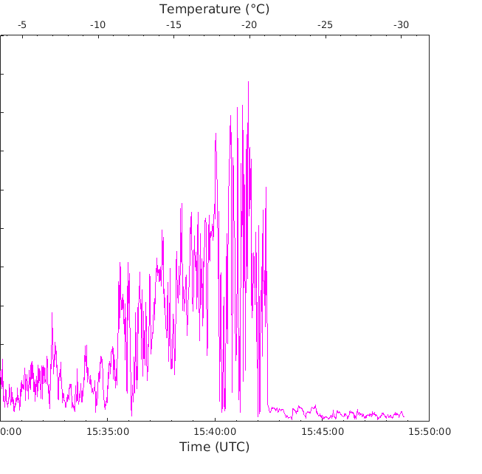
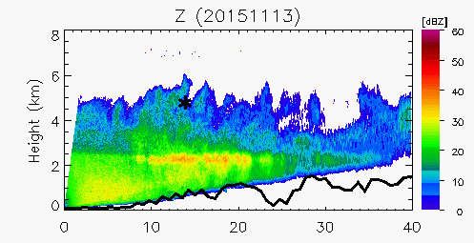
13 November 2015
Citation Data
Unstable
Layer
Dry Layer
DOW Reflectivity
0.4 g m⁻³
LWC
0.2
0.0
Time (UTC)
Notes:
Melting level variability (intensity, dipping, rising)
Down-valley flow increasingly shallow
Aggregation but little to no rime ice in Citation data
Joe will talk about evolution of DSD

Slide 20
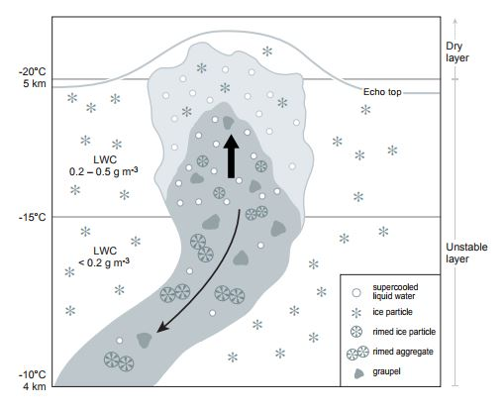
Quantification of generating cells
Notes:
Reflectivity greatest in mid-cell, collocated with reduction in ZDR (not shown)
Upper cell: high concentrations of supercooled LW, plates, and rimed plates
Near -15 (dendritic zone): rimed aggregates appear
Warmer temps/ into fall streak: Particle size increases, columns/ice particles, rimed ice particles and rimed aggregates
LWC as high as .45 g m-3
LWC decrease below -15C.
Transition: Therefore to conclude: with the data from 13 November

Slide 21
Conclusions
  OLYMPEX has provided a way for orographic precipitation to be evaluated fully
  three dimensionally
    DSDs at ground & Doppler radar—show differences between fully upslope and flows with downslope at low levels
    Radar RHI scanning—shows reflectivity enhancement aloft over the mountainsides
    A/C in situ microphysical sampling—shows differences aloft between pure stratiform and effects of embedded generating cells

Slide 22
Extra Slides

Slide 23
Figure NARR

Slide 24
Figure CFADnorm
Ocean
Land

Slide 25
CFADdiffENV (first half)
25% of time
36% of time
39% of time
Melting level 1.2-1.8 km
ML > 1.8 km
ML < 1.2 km
37% of time
43% of time
20% of time
Nm stable
Nm neutral
Nm unstable

Slide 26
Figure CFADdiff

Slide 27
CFADdiffENV (second half)
20% of time
10% of time
70% of time
250 < IVT < 450 kg m⁻¹ s⁻¹
IVT > 450 kg m⁻¹ s⁻¹
IVT < 250 kg m⁻¹ s⁻¹
42% of time
29% of time
29% of time
90° < wind dir. < 180°
180° < wind dir. < 270°
270° < wind dir. < 90°

Slide 28
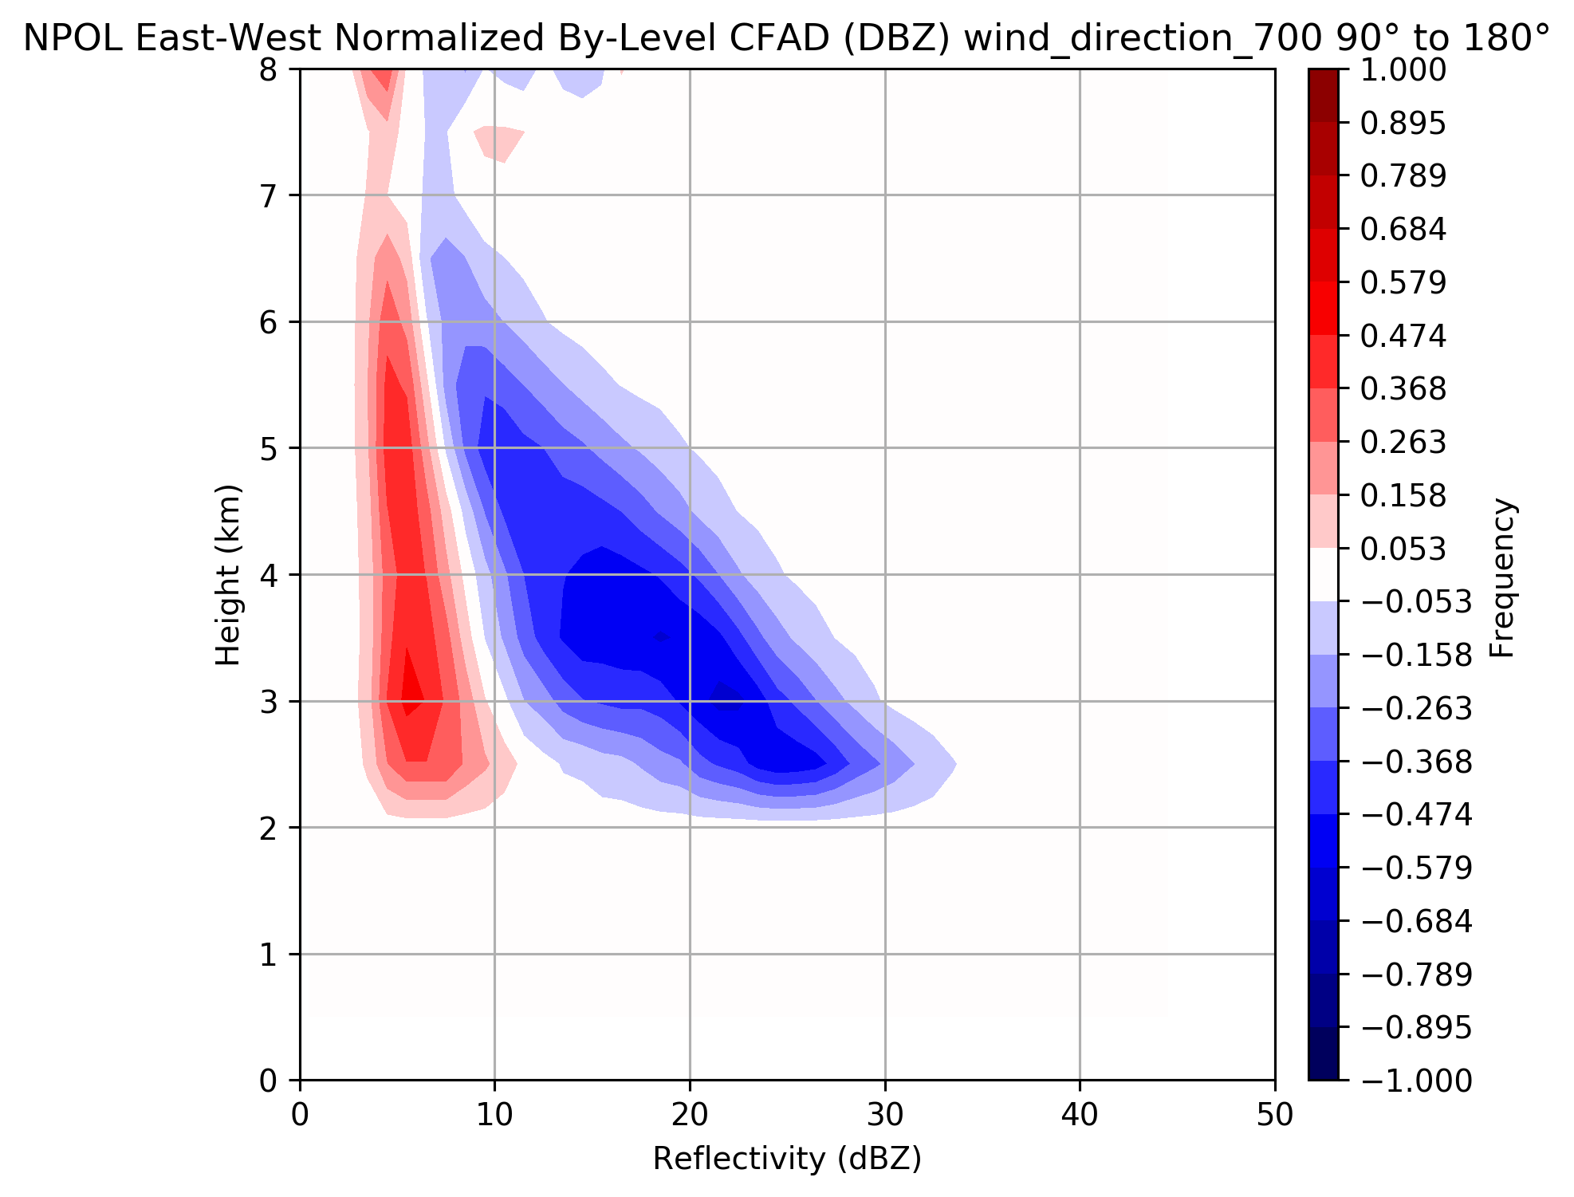
~Pre-frontal
~Warm sector
~Post frontal
20% of time
10% of time
70% of time
250 < IVT < 450 kg m⁻¹ s⁻¹
IVT > 450 kg m⁻¹ s⁻¹
IVT < 250 kg m⁻¹ s⁻¹
42% of time
29% of time
29% of time
6% (700 hPa)
90° < wind dir. < 180°
270° < wind dir. < 90°
90° < wind dir. < 180°
180° < wind dir. < 270°
Rowe et al., in prep
Rowe et al., in prep

Slide 29
OLYMPEX Precipitation

Slide 30
~Pre-frontal
~Warm sector
~Post frontal
20% of time
10% of time
70% of time
250 < IVT < 450 kg m⁻¹ s⁻¹
IVT > 450 kg m⁻¹ s⁻¹
IVT < 250 kg m⁻¹ s⁻¹
42% of time
29% of time
29% of time
90° < wind dir. < 180°
180° < wind dir. < 270°
270° < wind dir. < 90°
Rowe et al., in prep
Rowe et al., in prep

