Slide 1
Identification of Mesoscale Convective Precipitation in GPM Data
Robert Houze and Stacy Brodzik
PMM Science Team Meeting
San Diego, CA
October 16-20, 2017
This presentation was supported by NASA Grant NNX16AD75G &NSF Grant AGS-1355567

Slide 2


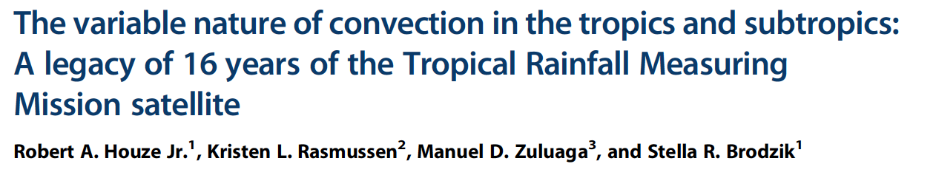
Global Distribution of Different Forms of Convection as Seen by TRMM
Robert A. Houze, Jr.
University of Washington
with: K. L. Rasmussen, M. D. Zuluaga, and S. R. Brodzik
August 2015
Notes:
Review paper

Slide 3
The TRMM study identified categories of convective and stratiform echoes based on their 3D structure

Slide 4
Object | Echo Characteristic | Height | Area
Isolated Shallow Echoes | > min detectable | < 4 km | 2 pixels
Deep Convective Cores | > 40 dBZ (strong) | > 10 km | N/A
 | > 30 dBZ (moderate) | > 8 km | N/A
Wide Convective Cores | > 40 dBZ (strong) |  | > 1000 km² at some altitude
 | > 30 dBZ (moderate) |  | > 800 km² at some altitude
Broad Stratiform Regions | Contiguous stratiform |  | > 50,000 km² (strong)
 |  |  | > 30,000 km² (moderate)
 |  |  | 30-50,000 km² (filtered)
Notes:
3D structure--thresholds: intensity, height, & area

Slide 5
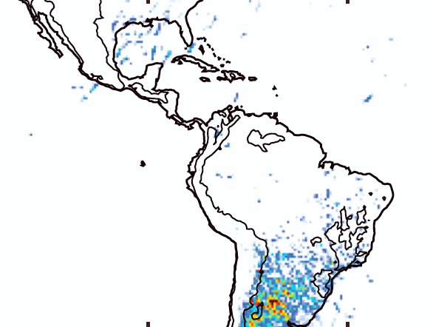
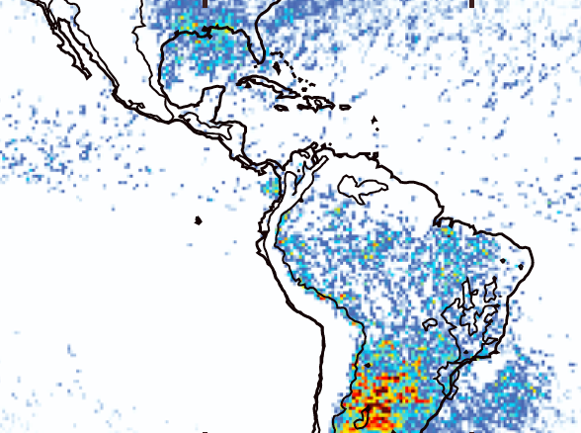
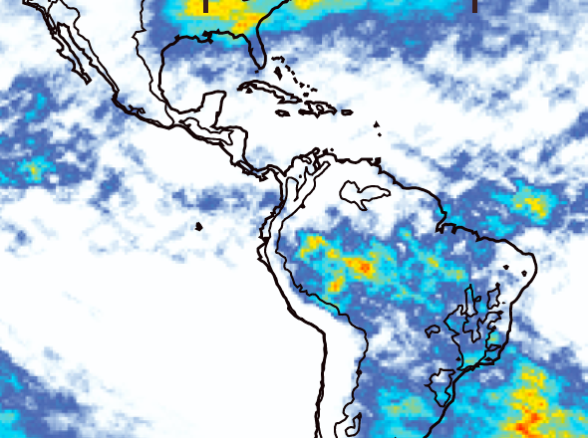
An Example of the TRMM Results
Deep Convective Cores
(strong)
Frequencies of occurrence
See Houze et al. 2015 for full low-latitude patterns of these features
DJF
Wide Convective Cores
(strong)
DJF
Broad Stratiform
(strong)
DJF

Slide 6
GPM Goal:
Extend this work to higher latitudes

Slide 7
Problem:
V4 classified a lot of Ku stratiform echo as convective
V5 corrected much of this problem

Slide 8
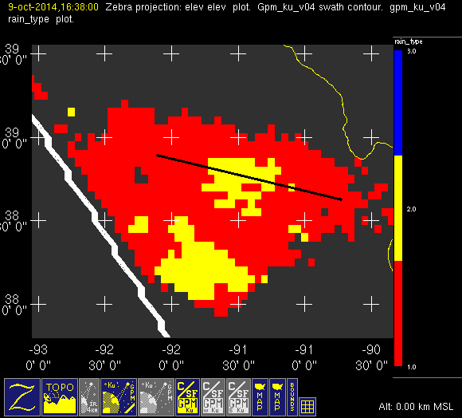
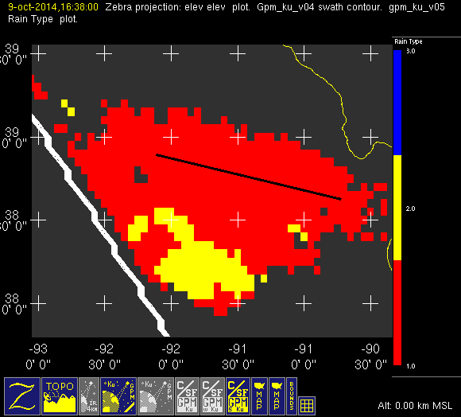
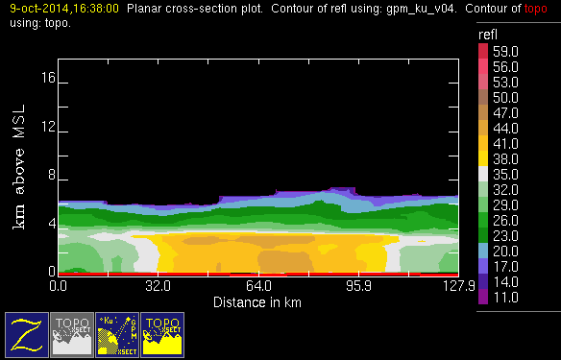
Example of successful correction
conv
stra
nasa v04
nasa v05
October
Missouri
(20141009/1637)
HUGE
improvement
Notes:
C/S algorithm shows a lot of improvement when comparing v04 to v05.

Slide 9
But problems remain

Slide 10
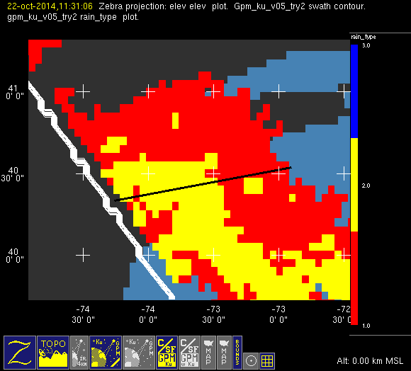
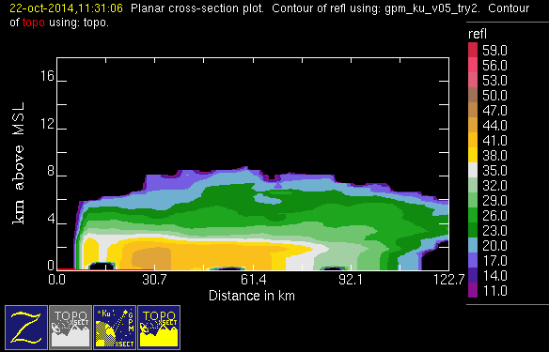
Problem case: East Coast Front
October
NE U.S.
conv
stra
nasa
v05
(20141022/1132)
Notes:
However, mis-classifications are still an issue.
The next 3 slides show obvious stratiform that is mis-classified as convective.

Slide 11
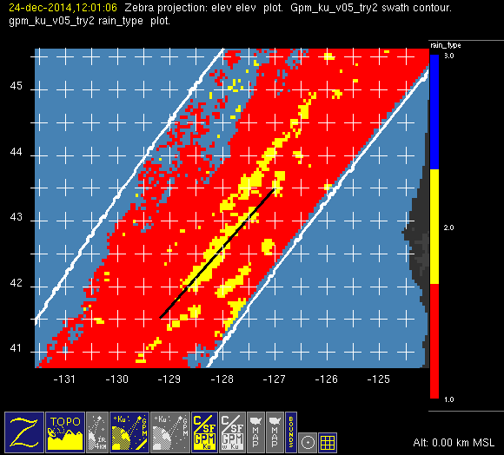
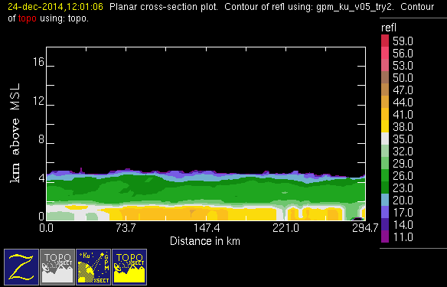
Problem case: West Coast Front
December
NW coast of U.S.
nasa
v05
conv
stra
(20141224/1202)

Slide 12
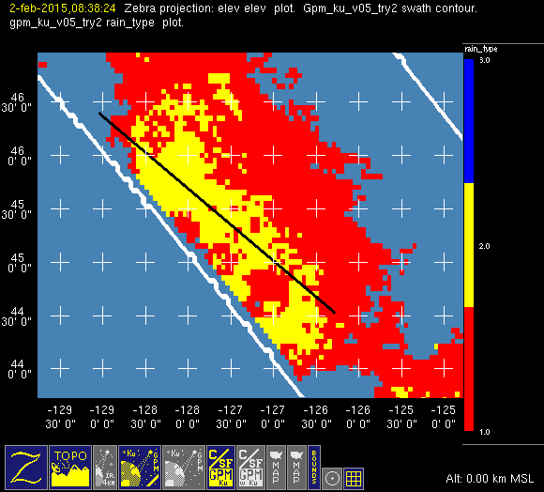
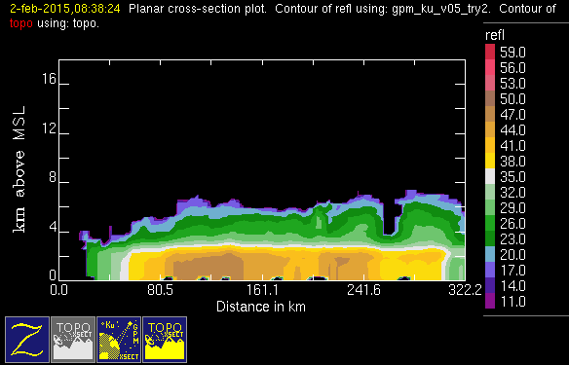
Problem case: North Pacific
February
North Pacific
conv
stra
nasa
v05
(20150202/0839)

Slide 13
Solving this remaining problem is
critical to all applications that depend on convective/stratiform classification
(latent heating, PSD, …)

Slide 14
Complicating factors in identifying stratiform echo in GPM data:
Melting level height varies
Bright band is often >40 dBZ
Melting level is not always a sharp peak in dBZ
Key indicator of SF is a strong drop off in reflectivity above melting level

Slide 15
UW add-on to V5 C/S algorithm

Slide 16
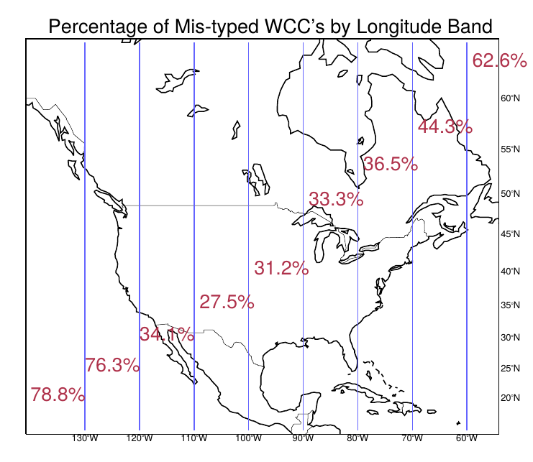
Test Area
Notes:
These charts are based on STRONG thresholds for WCC’s.
Largest percent of mis-classifications occur:
– at higher latitudes
– at longitudes containing large amounts of ocean
– in DJF
The last plot shows areal differences between the WCC’s and is just another way to look at the differences.

Slide 17
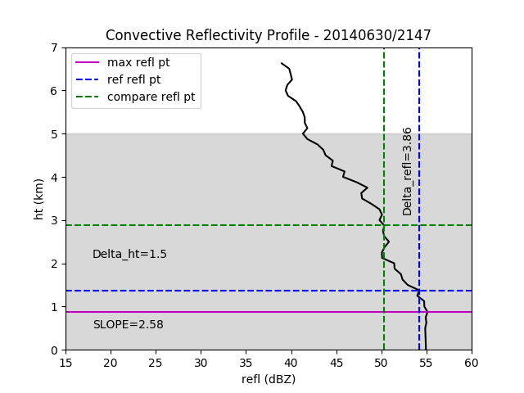
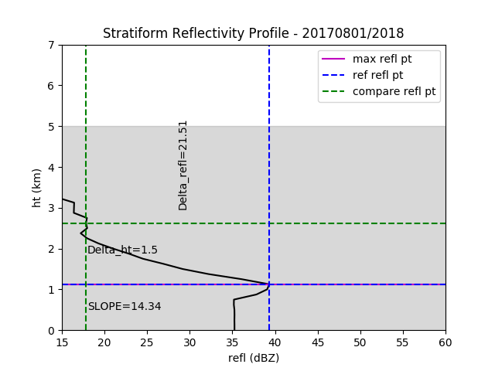
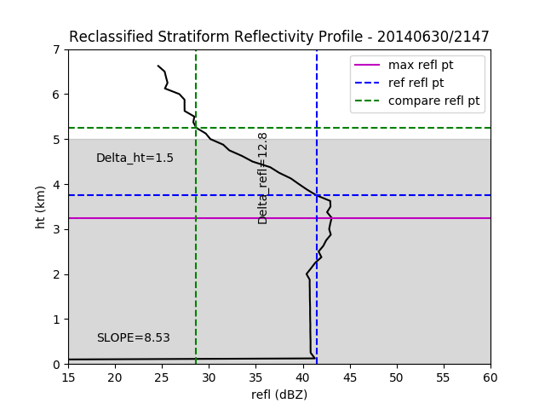
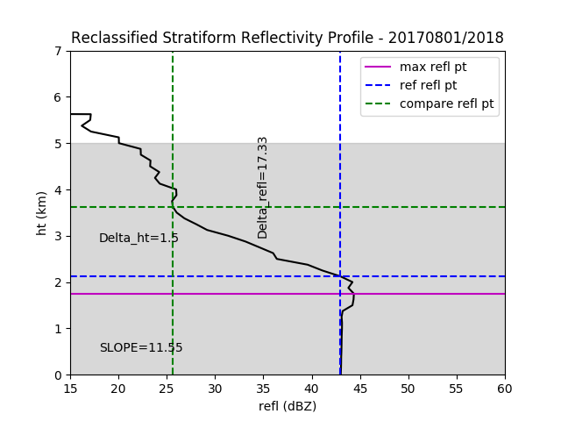
Notes:
These are profiles of columns of gridded data.
The top two are prototypical of conv and stra refl.
The bottom two are problem profiles for the v05 c/s alg.
Problems: Melting level height varies, bright band is often >40 dBZ, melting level is not always a sharp peak in dBZ, key indicator of SF is a strong drop off in reflectivity above melting level
In each frame:
Magenta line represents ht of max refl in column
Blue lines represent highest point above max refl within +/- 2dBZ of max refl (I call this the reference point)
Green lines represent refl/ht that is 1.5 km above the reference point (I call this the compare point)
Reference point must be within shaded gray area (we chose a max BB ht of 5km) to run our algorithm to completion.
UW ALG: For each conv point, we compute slope between reference and compare points. If greater than 7.5dBZ/km (delta refl > 11.25, we reclassify it as stra.
Upper left is 2.6/km, upper right is 14.5/km, lower-left is 8.5/km, lower-right is 11.5/km.

Slide 18
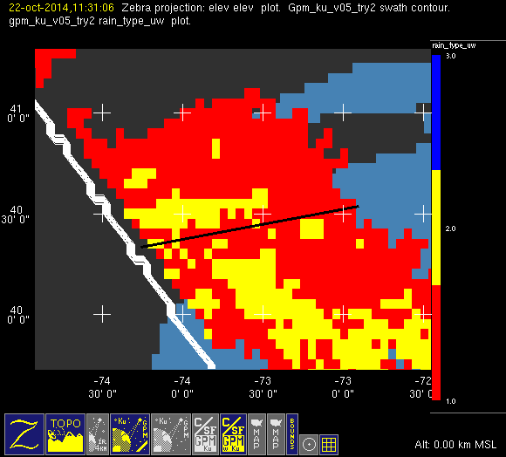
Problem case: East Coast Front
nasa
v05
uw
conv
stra
October
NE U.S.
(20141022/1132)
Notes:
The next three slides show the NASA v05 c/s field as compared to our modified one.
These are the same three cases that we showed in slides 3-5.

Slide 19
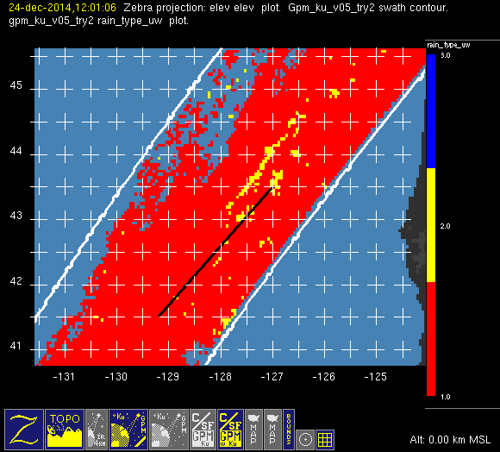
Problem case: West Coast Front
nasa
v05
uw
conv
stra
December NW U.S.
(20141224/1202)

Slide 20
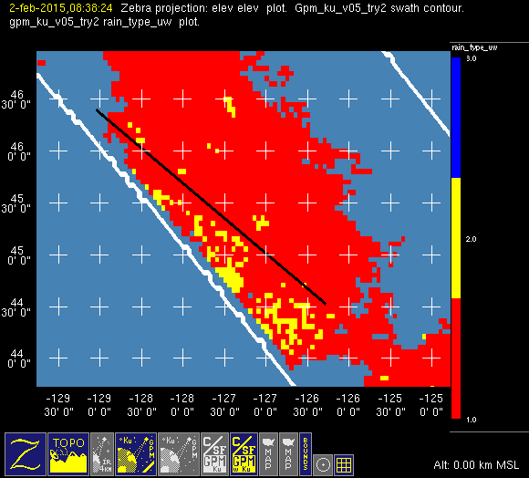
Problem case: North Pacific
nasa
v05
uw
conv
stra
February
North Pacific
(20150202/0839)

Slide 21
Object | Echo Characteristic | Height | Area
Isolated Shallow Echoes | > min detectable | < 4 km | 2 pixels
Deep Convective Cores | > 40 dBZ (strong) | > 10 km | N/A
 | > 30 dBZ (moderate) | > 8 km | N/A
Wide Convective Cores | > 40 dBZ (strong) |  | > 1000 km² at some altitude
 | > 30 dBZ (moderate) |  | > 800 km² at some altitude
Broad Stratiform Regions | Contiguous stratiform |  | > 50,000 km² (strong)
 |  |  | > 30,000 km² (moderate)
 |  |  | 30-50,000 km² (filtered)
Notes:
3D structure--thresholds: intensity, height, & area

Slide 22
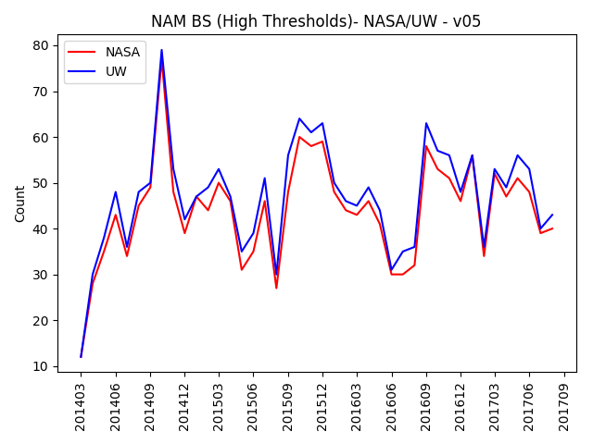
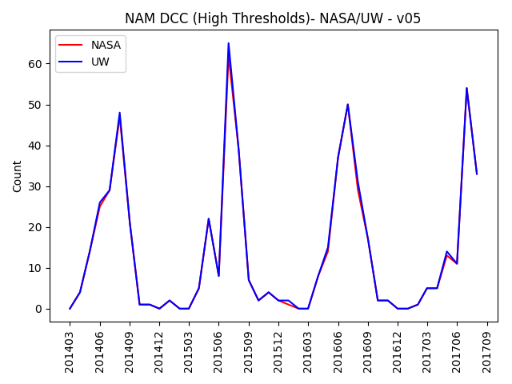
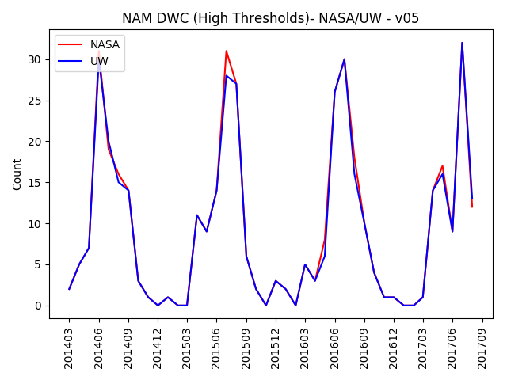
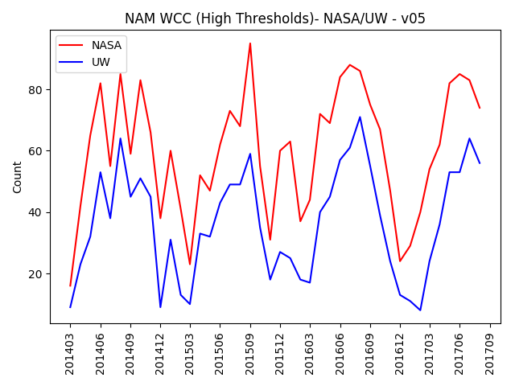
Comparison of v05 Counts
NASA/UW (strong thresholds)
BS
DCC
D&W
WCC

Slide 23
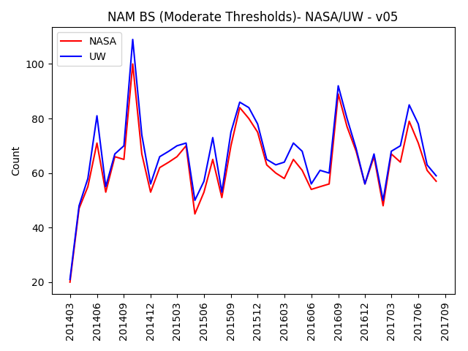
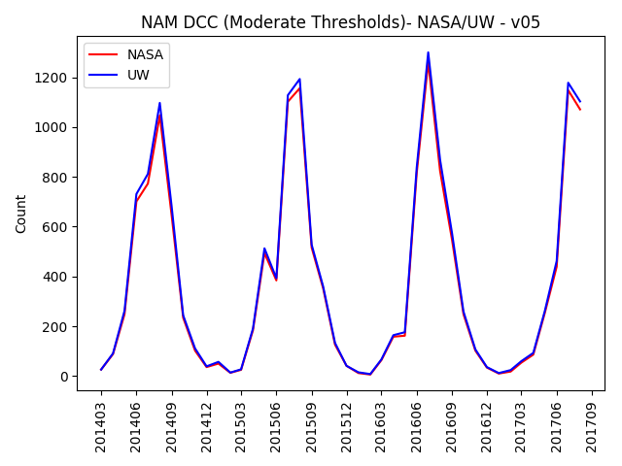
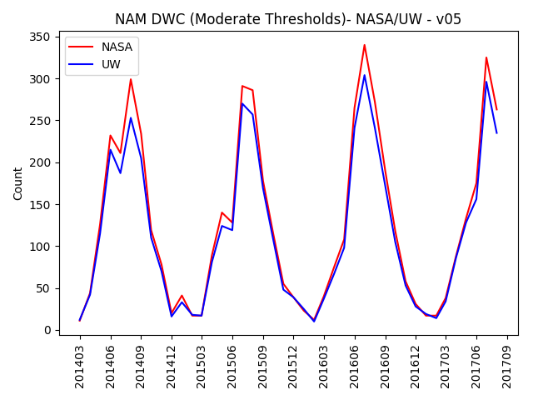
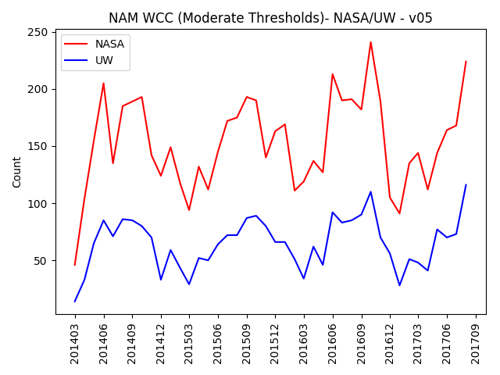
Comparison of v05 Counts
NASA/UW (moderate thresholds)
BS
DCC
D&W
WCC

Slide 24
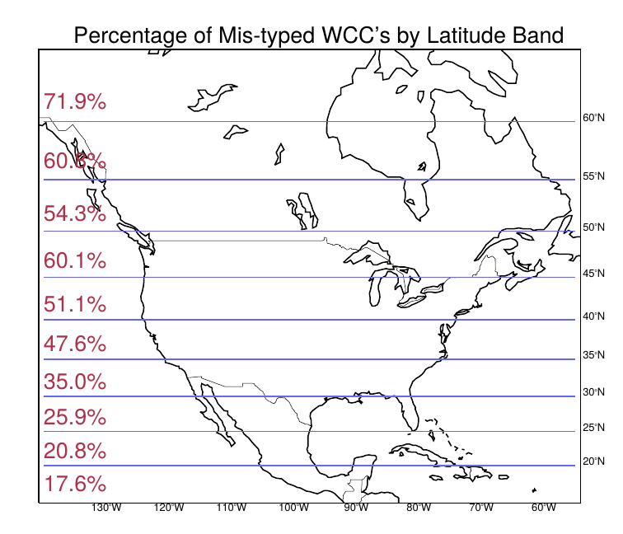
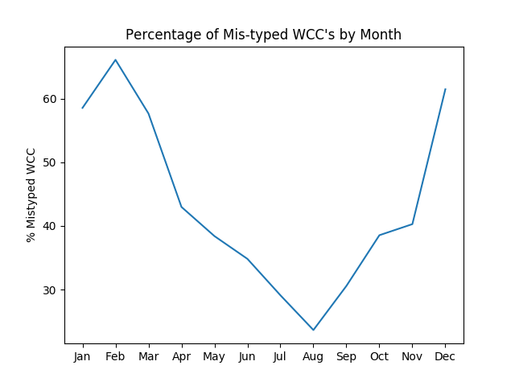
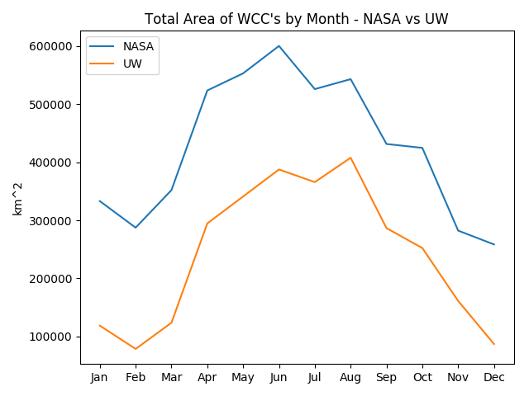
Percentage of WCCs reclassified by UW add-on
(strong threshold cases)
Percent of number of WCCs reclassified by month
V5
Area covered by WCCs by month
UW
Jan
Jul
Dec
Jan
Jul
Dec
Notes:
These charts are based on STRONG thresholds for WCC’s.
Largest percent of mis-classifications occur:
– at higher latitudes
– at longitudes containing large amounts of ocean
– in DJF
The last plot shows areal differences between the WCC’s and is just another way to look at the differences.

Slide 25
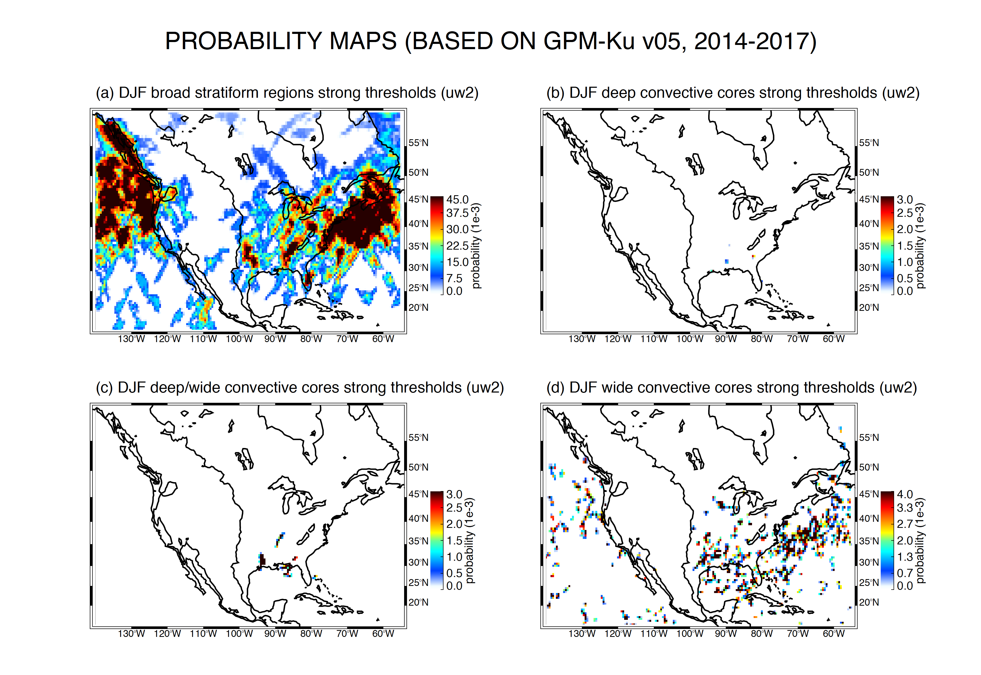

Slide 26
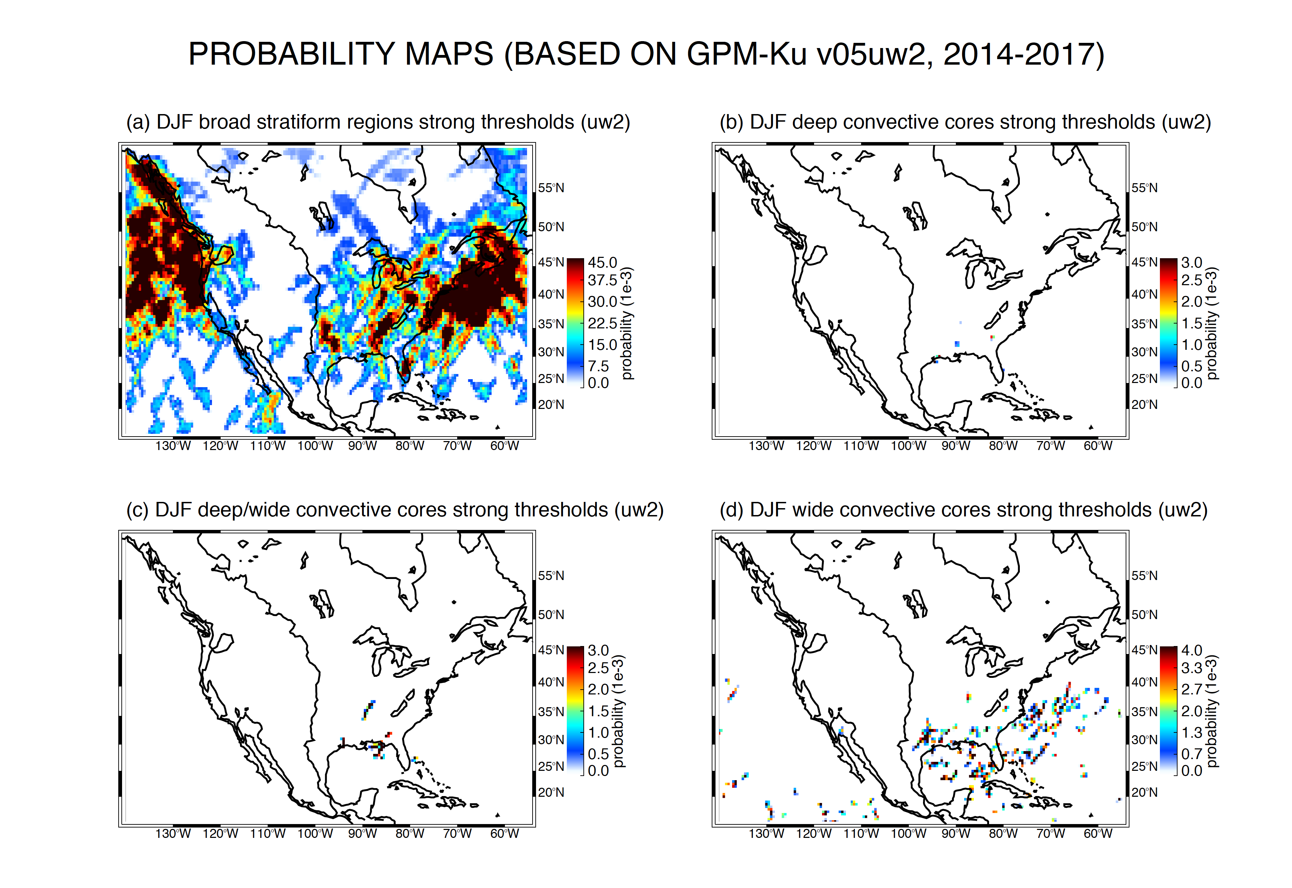

Slide 27
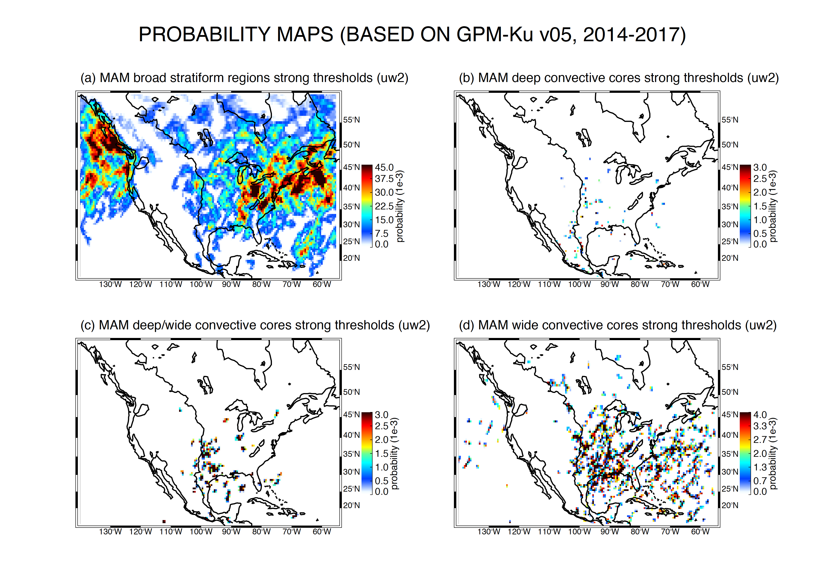
Notes:
The next eight slides compare probability maps for our classifications – BS, DCC, DWC, WCC – based on first NASA v05 c/s field and then the UW modified c/s field.
They are in groups of 3 months starting with MAM.
The most notable differences are in the WCC (lower right corner) maps, especially in DJF.

Slide 28
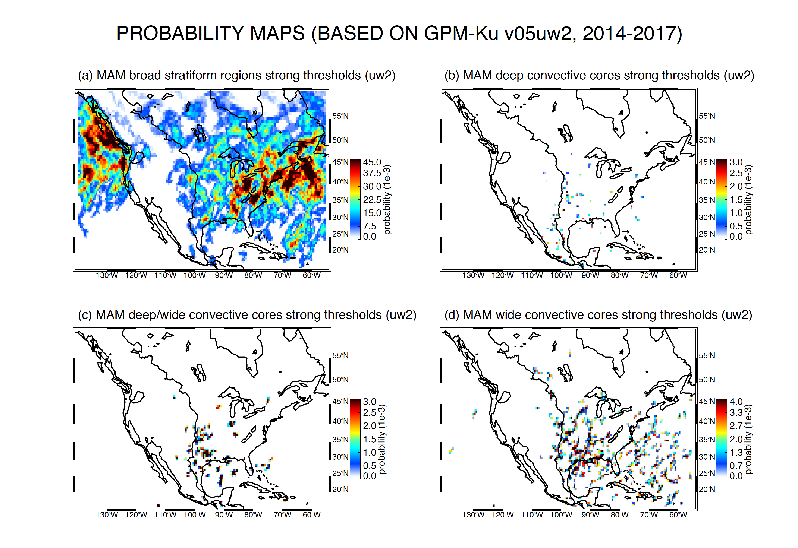
Notes:
28

Slide 29
Conclusions
V5 performs better than V4 but still indicates a lot of stratiform as convective → overestimation of convective latent heating
An algorithm based on the dropoff of reflectivity above the maximum dBZ eliminates most of the problem
Over the North America sector, the problem is greatest in winter and spring, at higher latitudes, & over the ocean
Notes:
This is for you to fill in:-)

Slide 30
Extra Slides

Slide 31
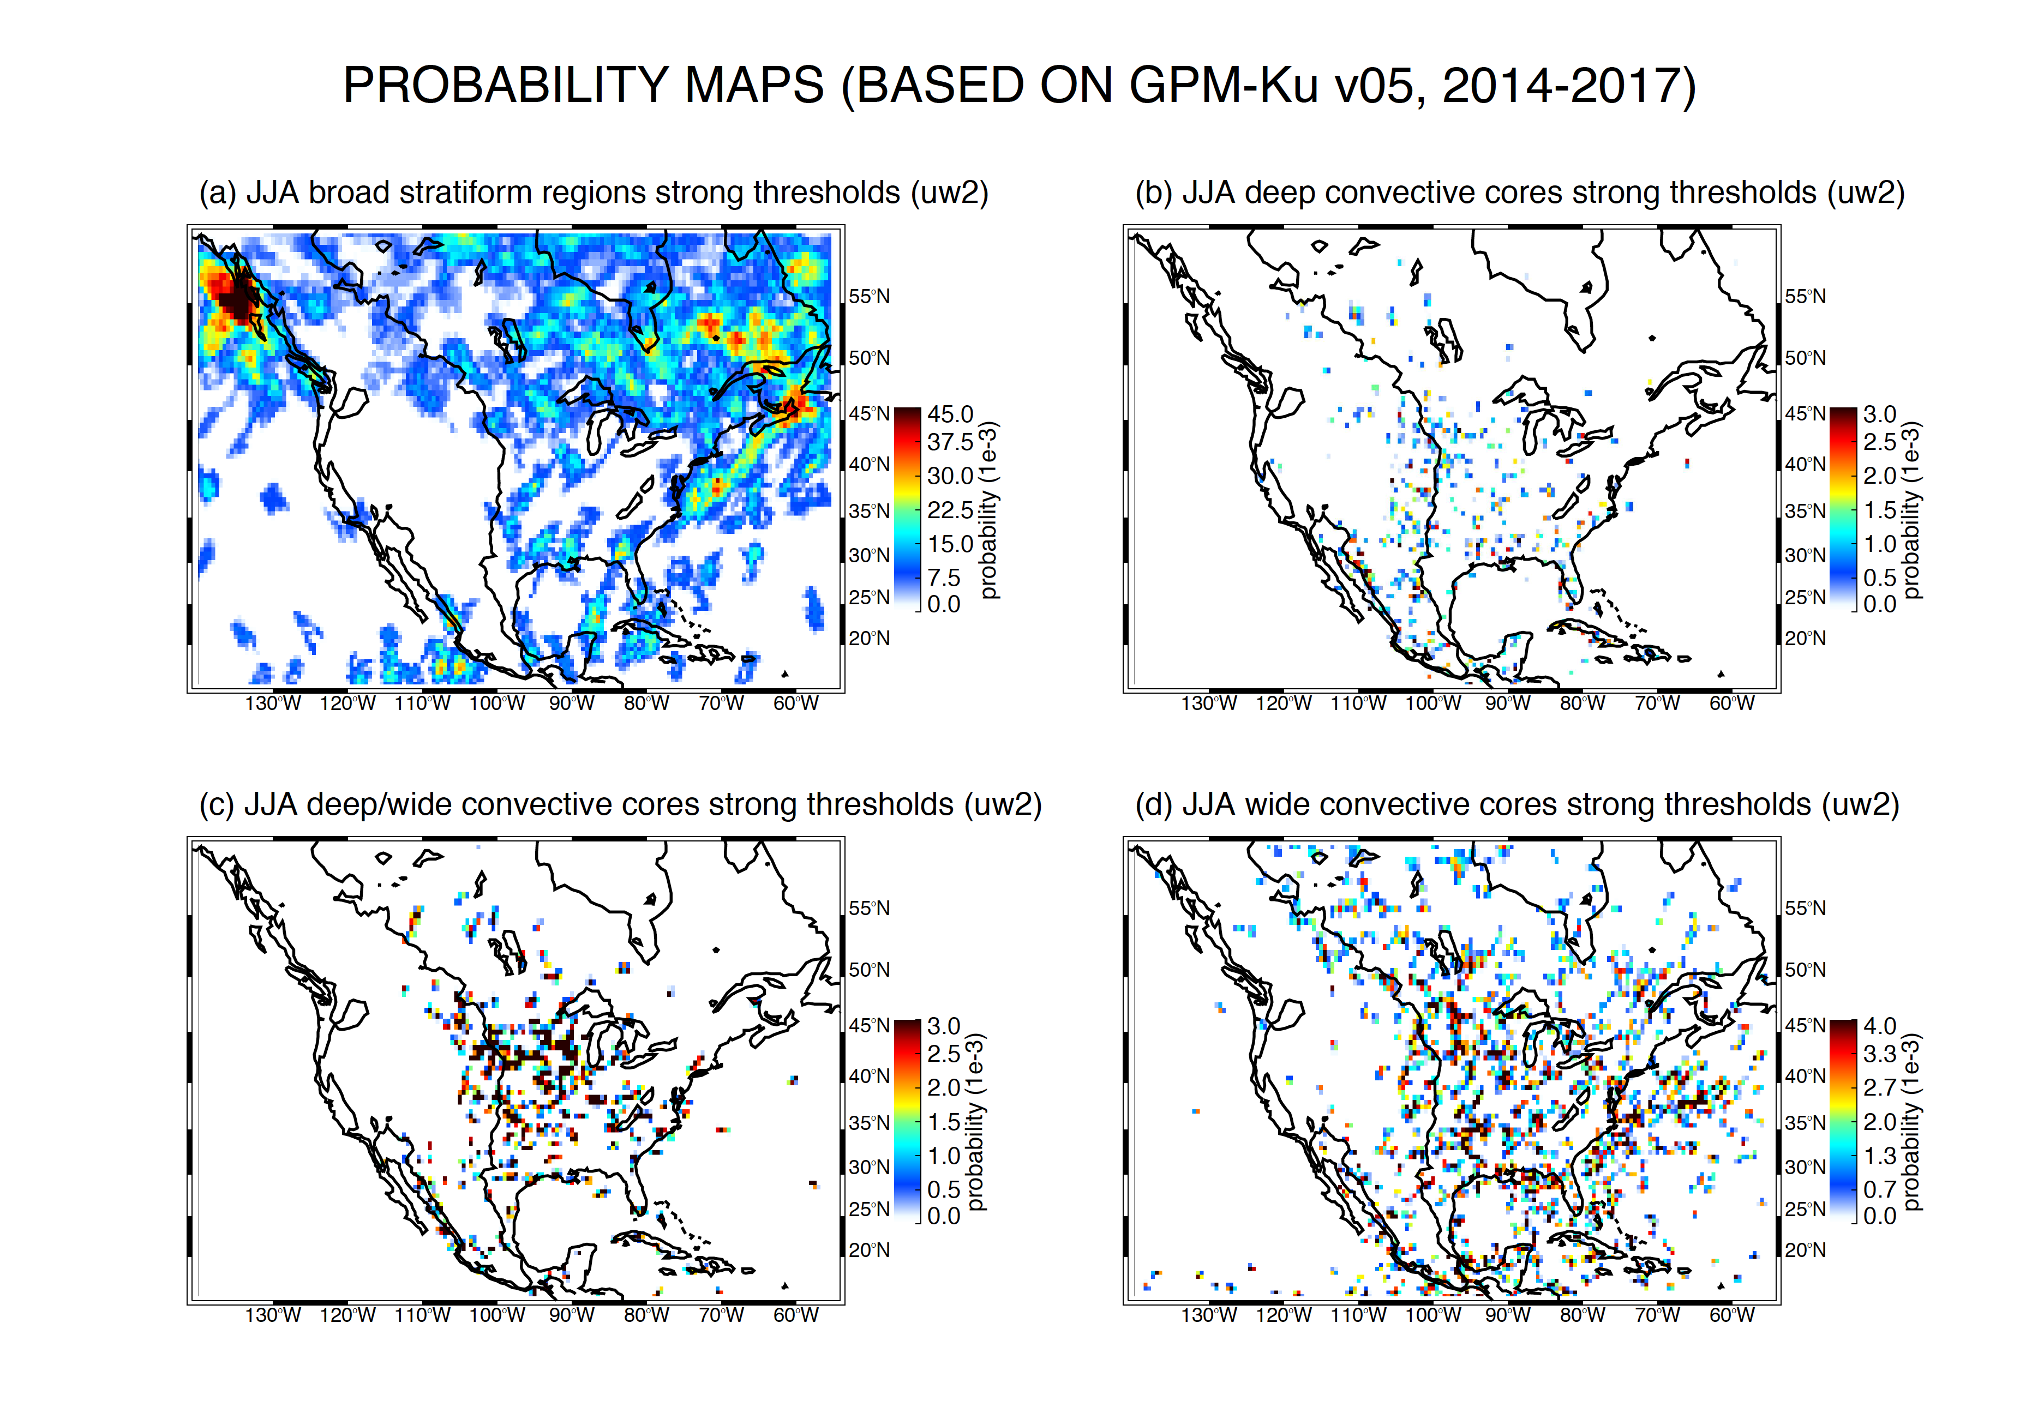

Slide 32
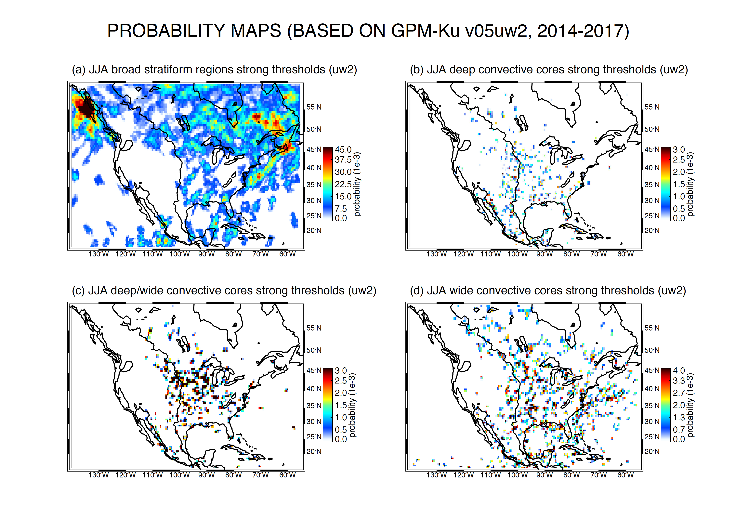

Slide 33
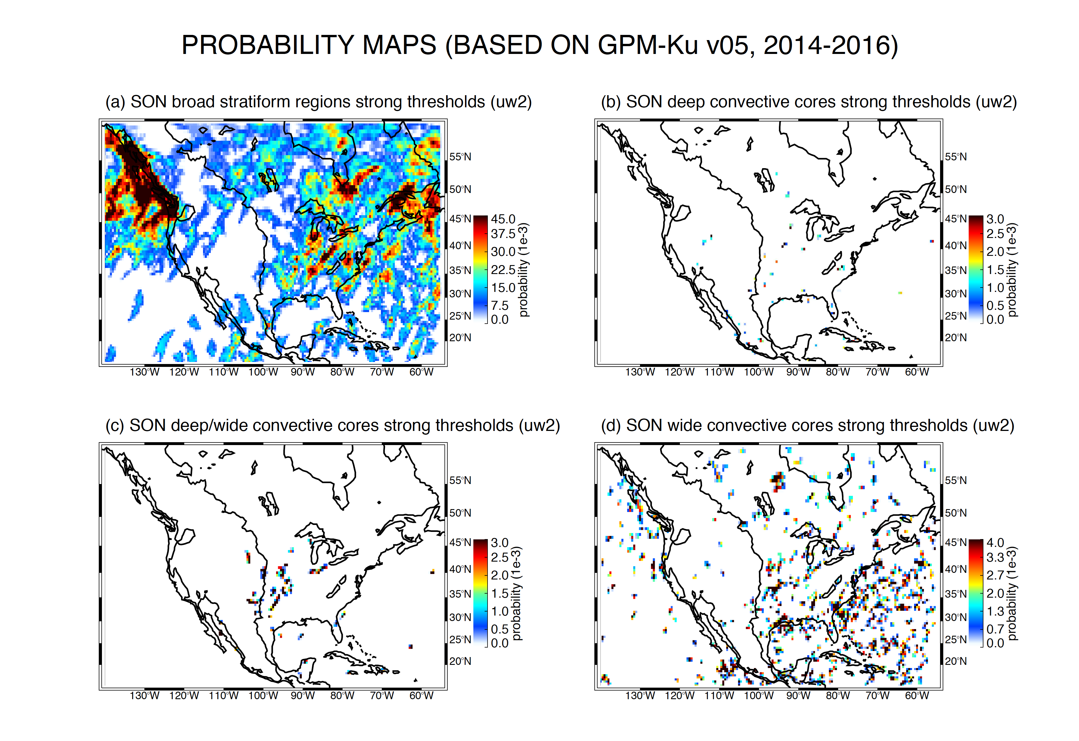

Slide 34
