Slide 1
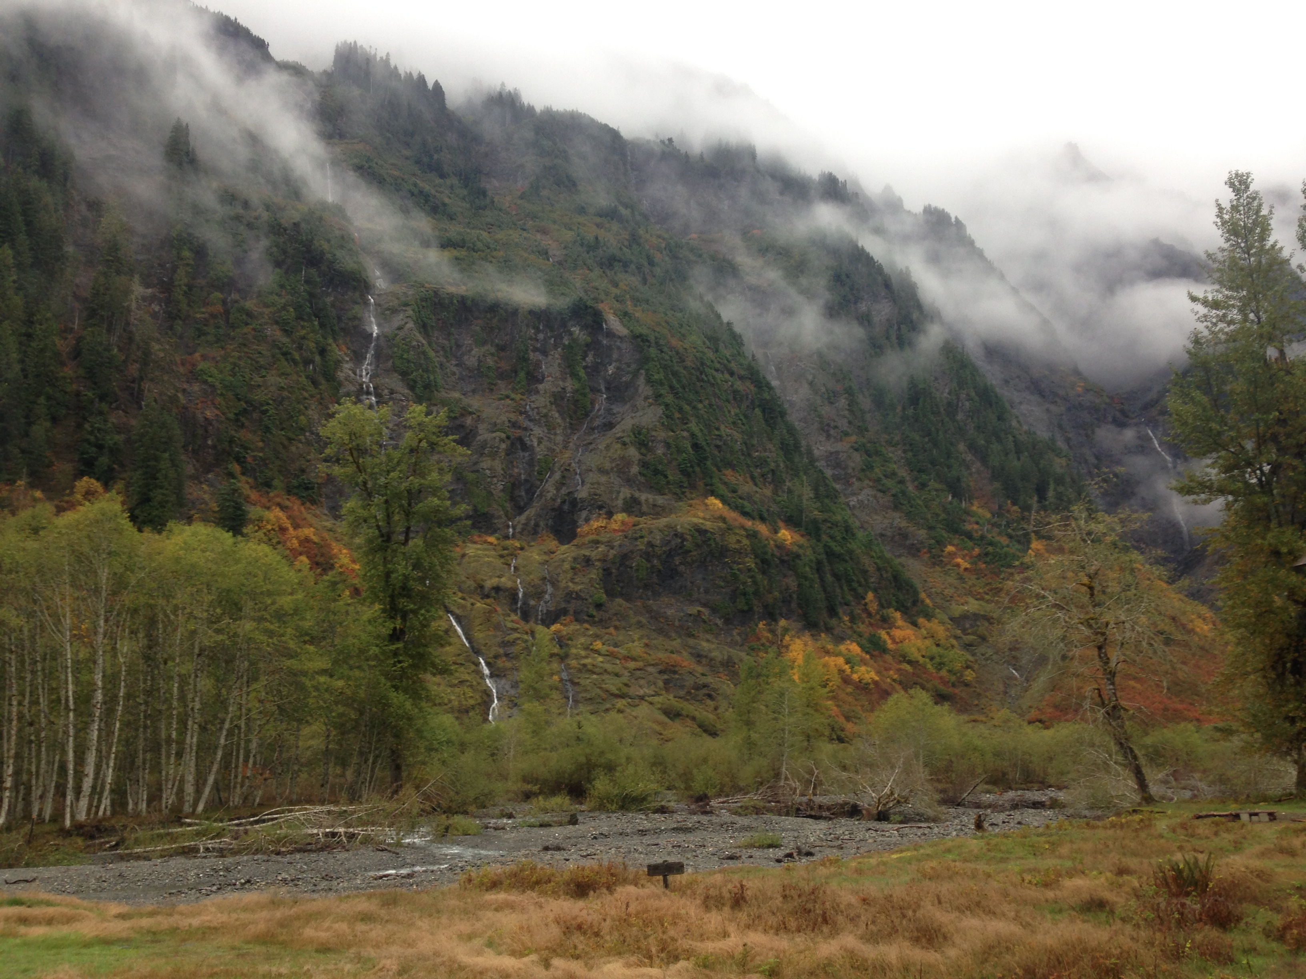
Orographic Precipitation Breakout Session Results from OLYMPEX
Lynn McMurdie, Bob Houze, Joe Zagrodnik,
Angela Rowe, Stacy Brodzik, Tom Schuldt, Megan Chaplin, and Joe Munchak
PMM Science Meeting, Orographic Breakout, 16 October 2017, San Diego
The UW research in this presentation was supported by NASA Grants
NNX16AD75G , NNX15AL38G and NNX16AK05G, NSF Grant AGS-1503155

Slide 2
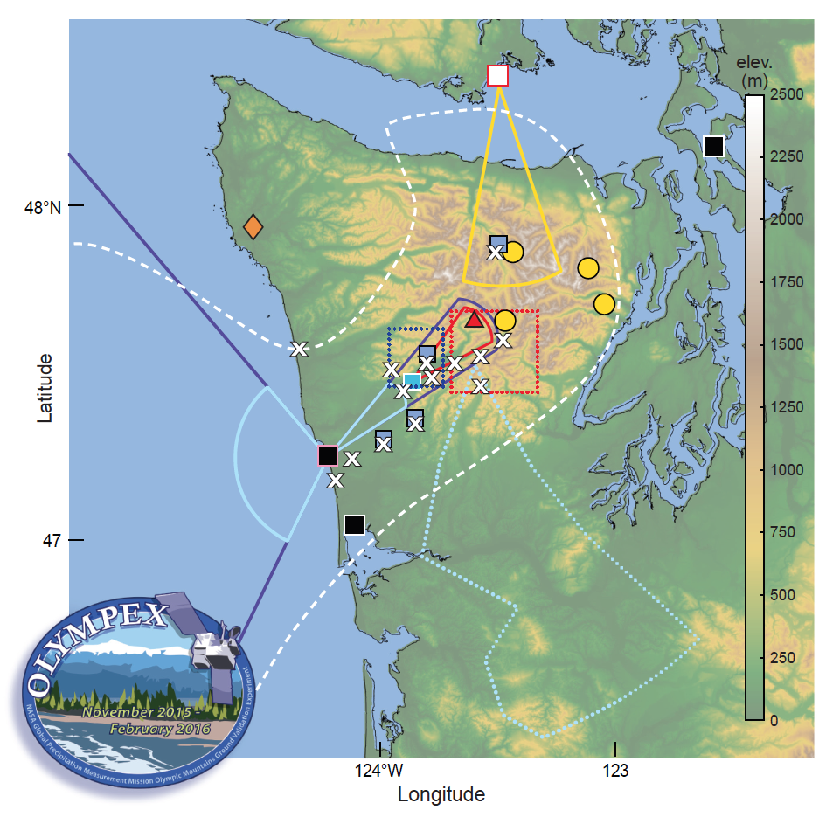
OLYMPEX documented 3-D orographic enhancement on windward slopes and precipitation reduction on leeward side
Highlight results from NPOL, disdrometers, Citation and DC-8
What are implications for measuring precipitation from space over complex terrain?

Slide 3
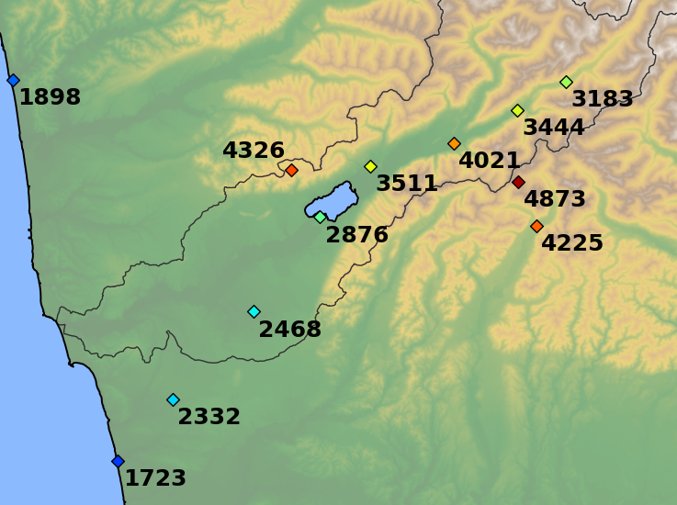
OLYMPEX Precipitation
Prairie Creek
Elevation 540m
Fisheries
Elevation 50 m
Accumulated precipitation (mm) 10 Nov 2015 – 1 May 2016

Slide 4
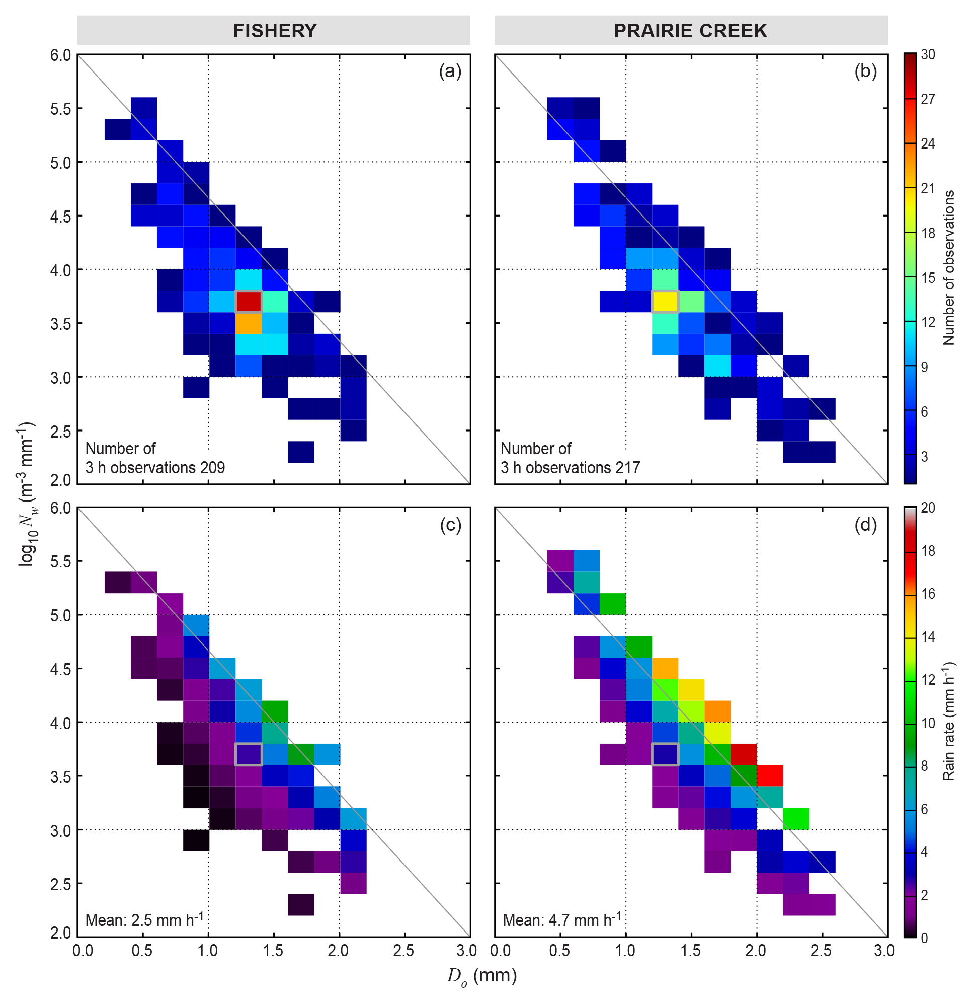
FISHERIES – Low Elev.
PRAIRIE CREEK – Mid Elev.
Frequency
Frequency
Stratiform Precipitation
Number of Drops N_{w}
Full Season
3 hr DSDs
At least 1mm hr⁻¹ at one of the stations
Continuous precipitation
No showers
Environmental parameters calculated from NARR at NPOL location
Rain Rate
Rain Rate
Dropsize D_{o}

Slide 5
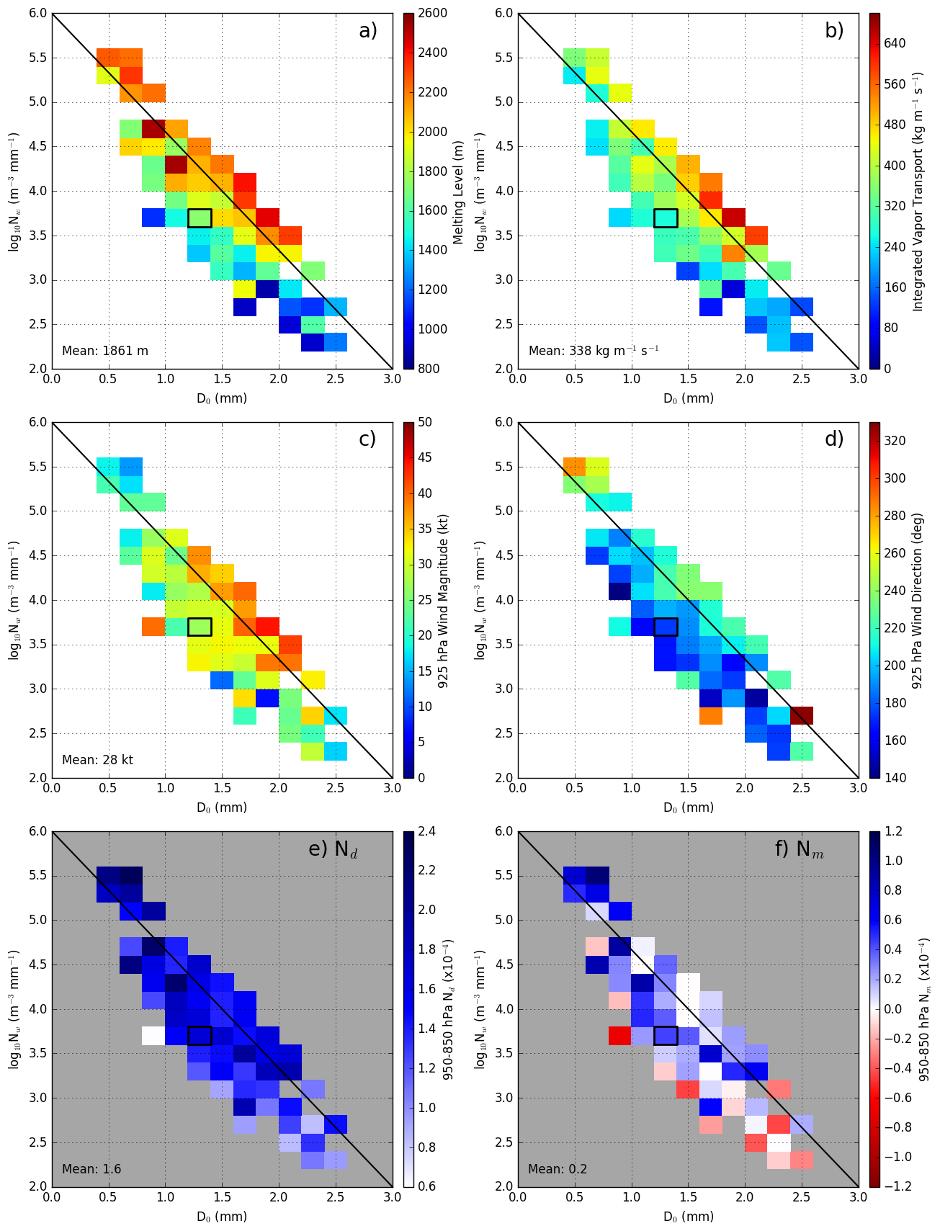
PRAIRIE CREEK – Mid Elev.
Melting Level
925hPa Wind Speed
Log of N_{w} – number of drops
D_{o} Median Diameter (mm)
IVT
925hPa Wind Direction
Moist Static Stability
Average Conditions
Lots of Small drops
Few large drops
Heavy Rain
Only Steady Stratiform Precipitation!!

Slide 6
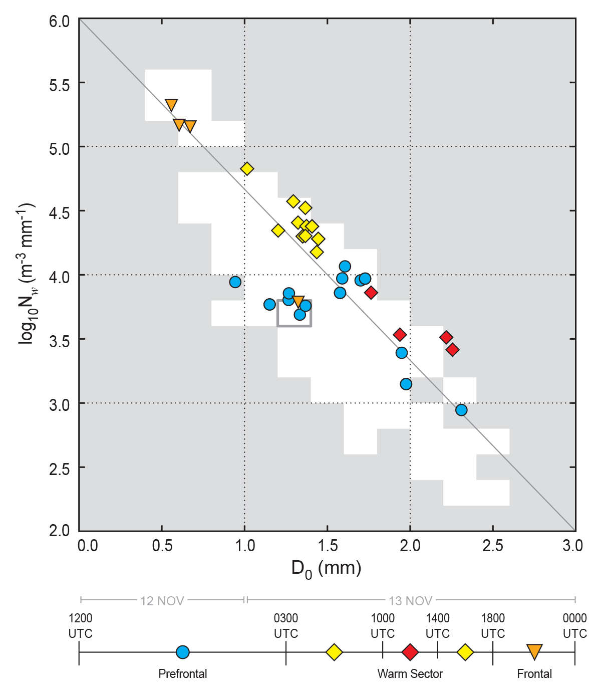
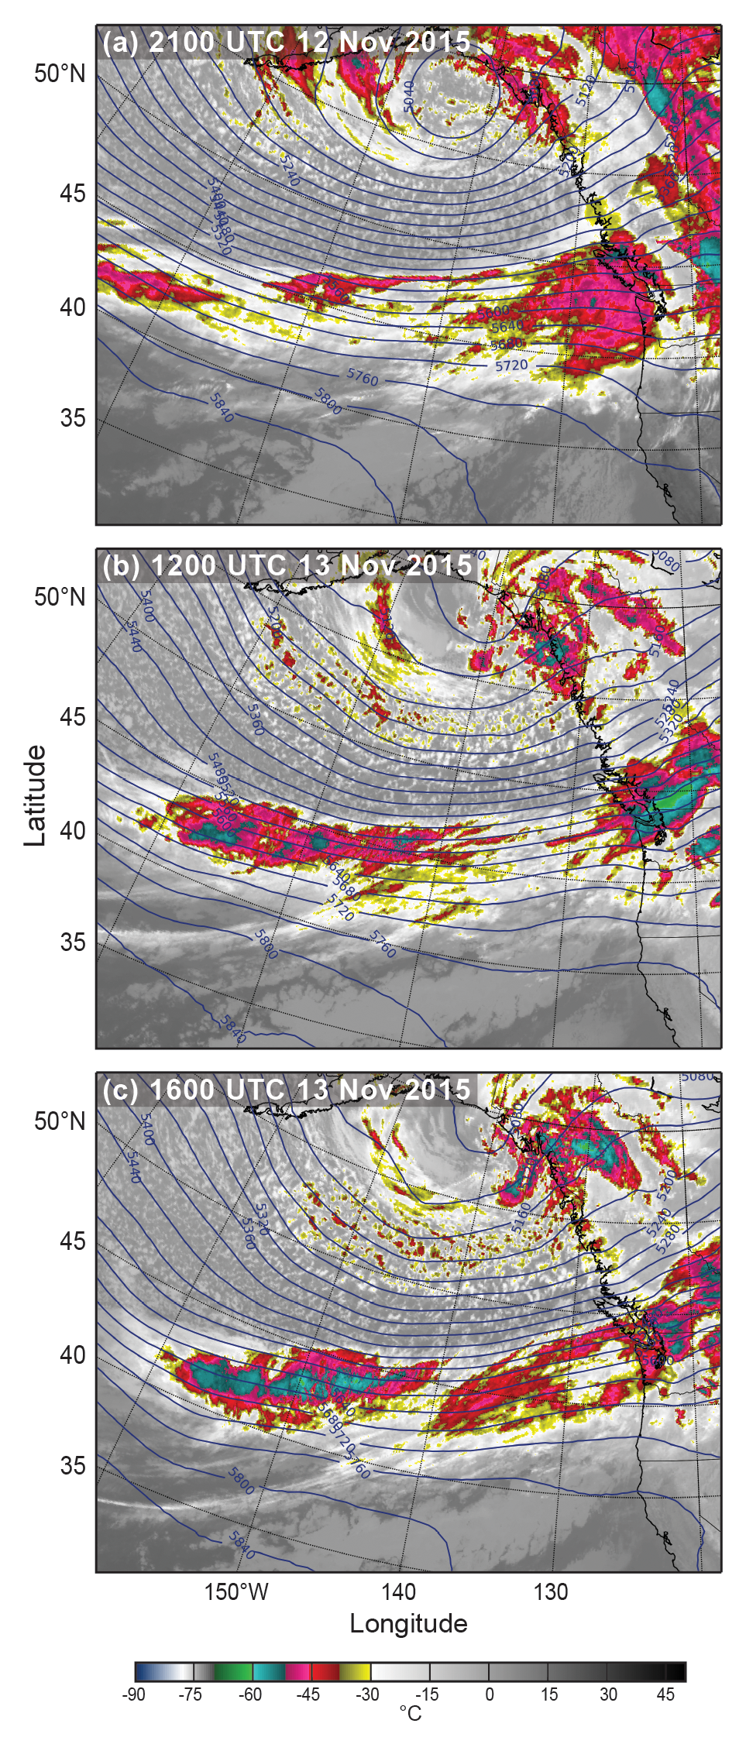
A single event can have shifts in DSDs

Slide 7
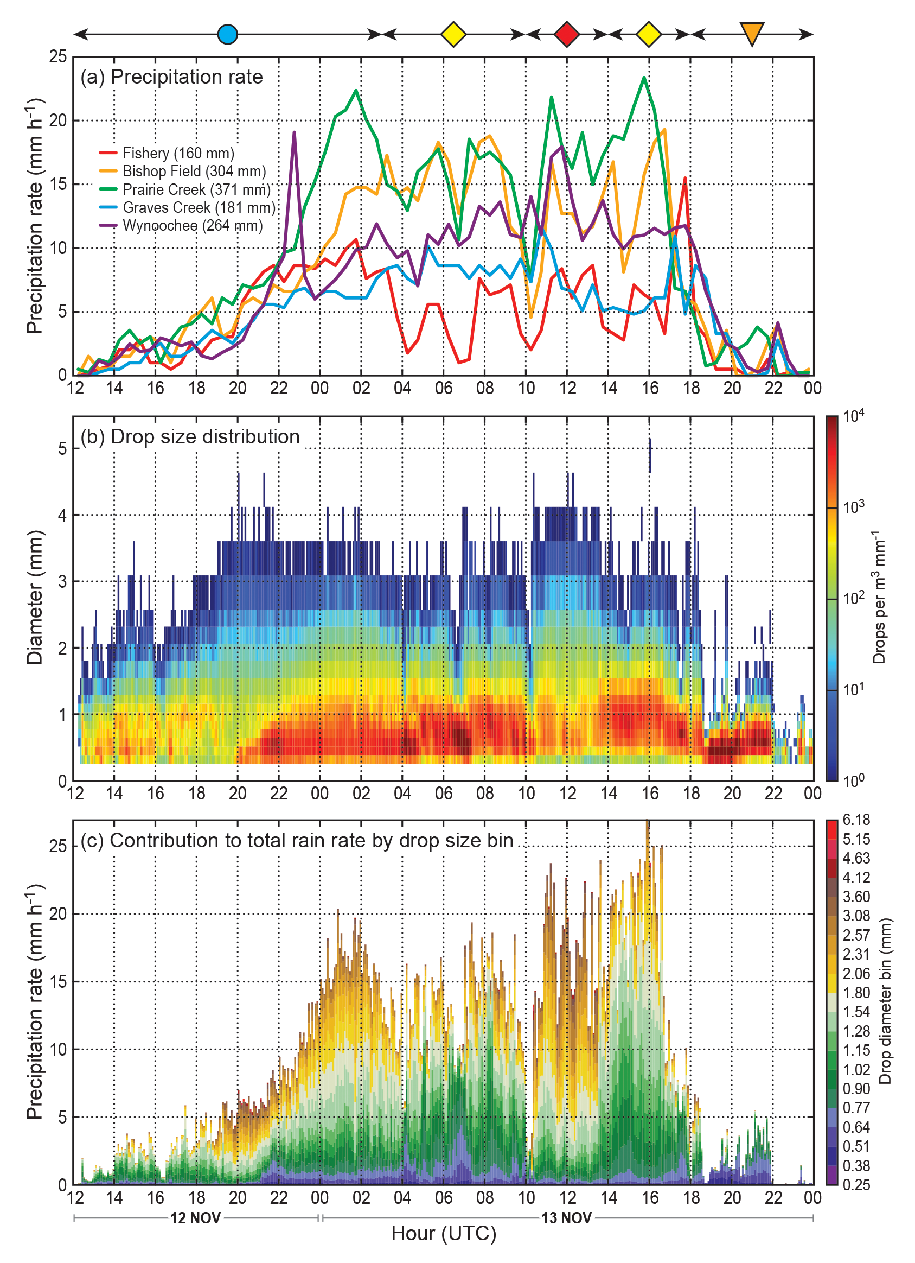
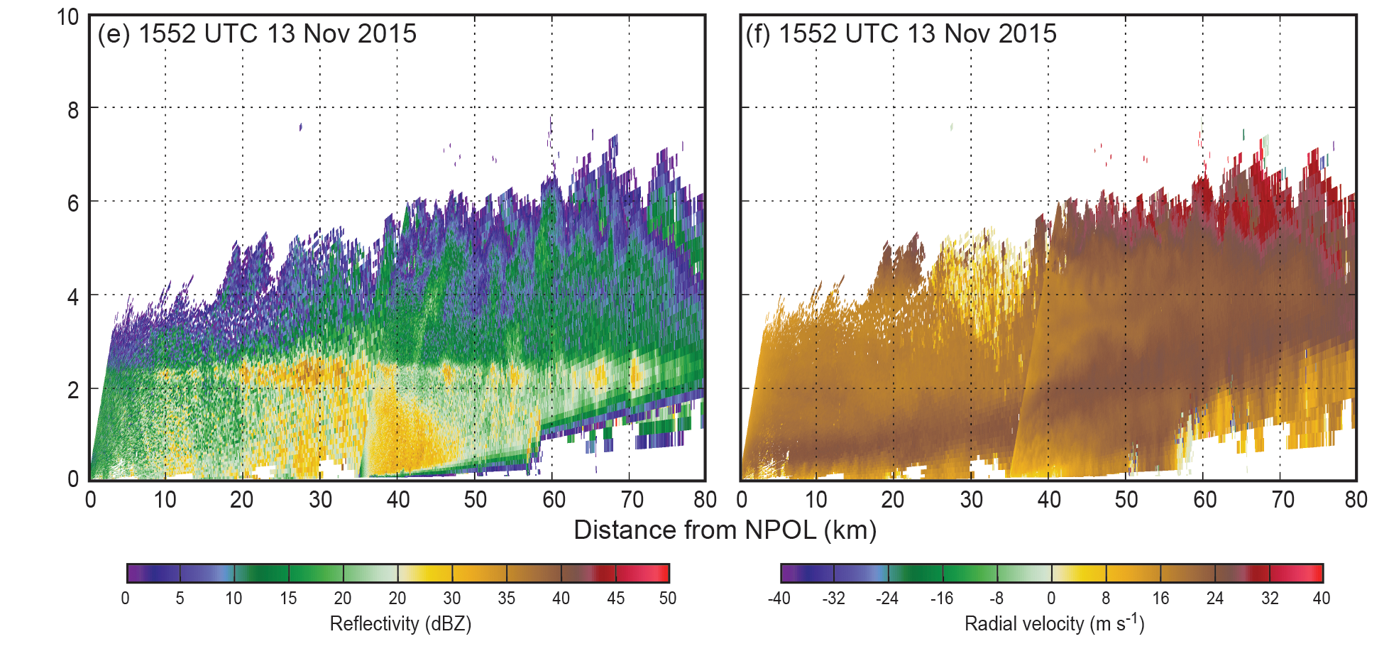
Orographic enhancement in warm sector
Orographic enhancement associated with large quantities of <1.5 mm drops.
These drops are responsible for the majority of the increase in rain rate.
Small drops from lifting of low-level jet below brightband (~2.5km for warm events)
Terrain

Slide 8
Implications for GPM
Unique DSDs for particular combinations of environmental conditions
Higher elevation stations show broader range of DSDs
Heavy rain periods can have both large drops and large quantities of small drops at higher elevation stations
Warm processes below the brightband important contributor to precipitation production – may be hard to detect from space

Slide 9
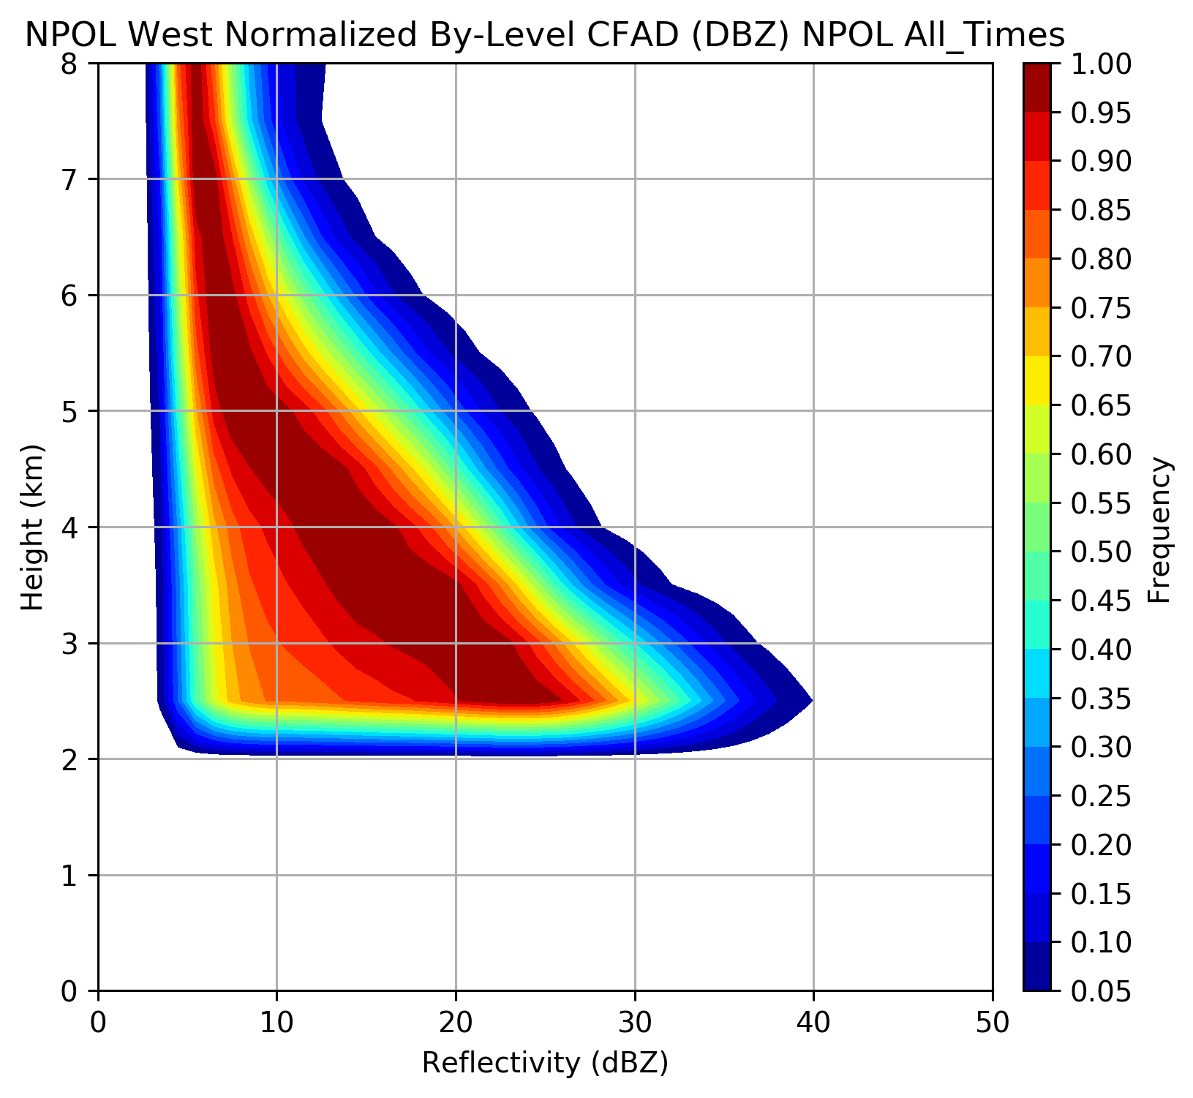
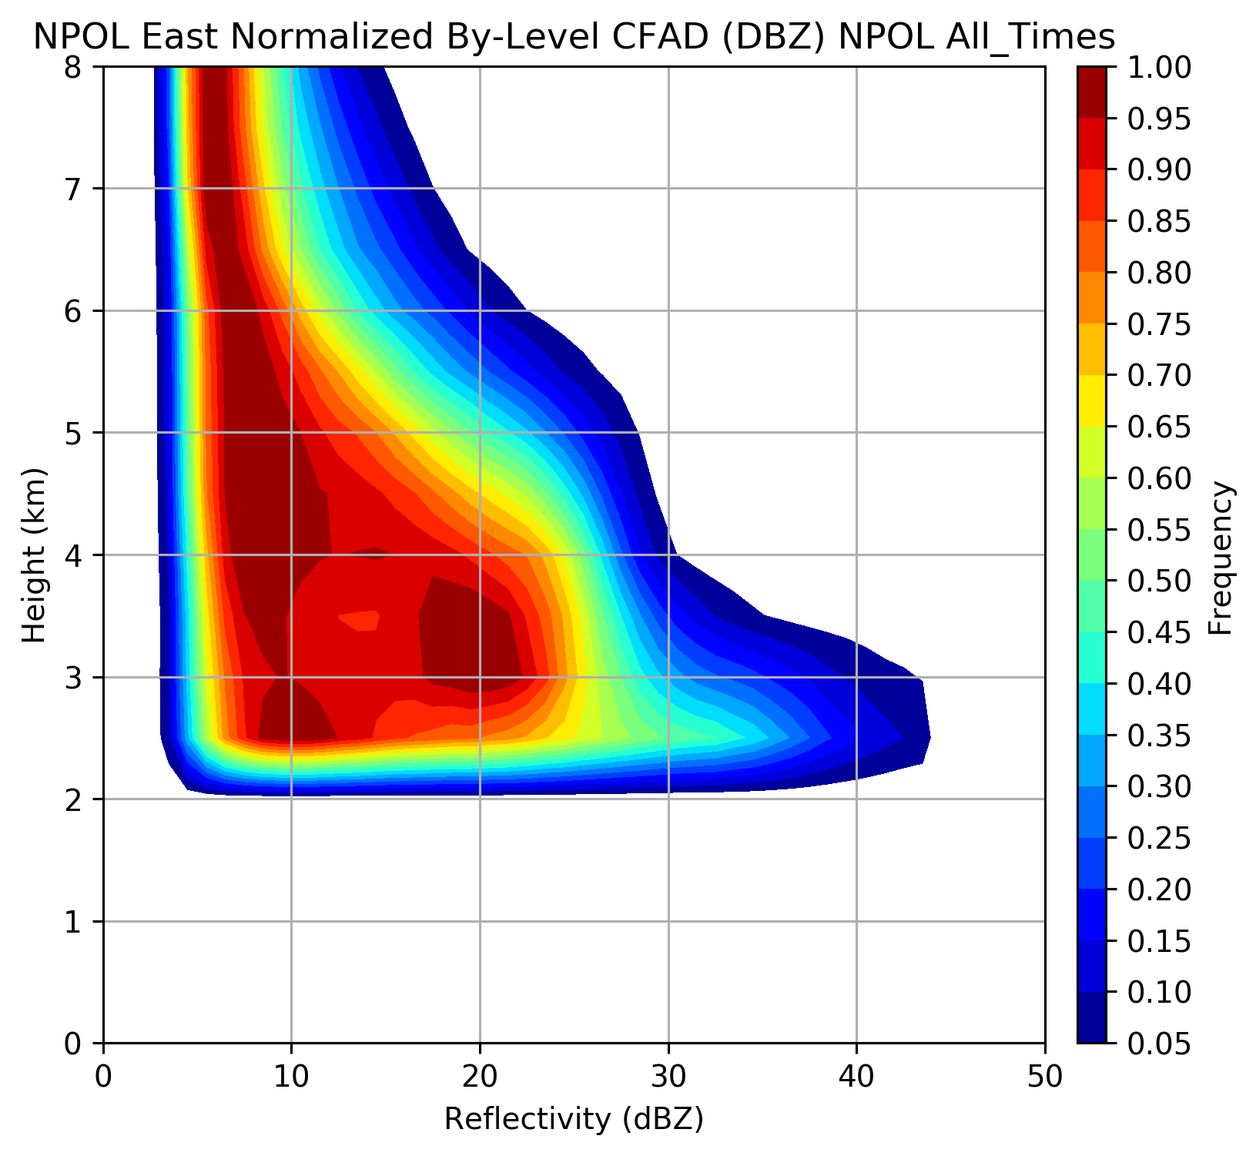
NPOL reflectivity over Ocean &Land
Ocean
Land
Height (km)
Reflectivity (dBZ)
12 Nov – 18 Dec, 3-15 Jan
Contoured Frequency by Altitude Diagrams
Frequencies normalized by level for all NPOL RHI data over ocean and land above 2 km height
Rowe et al., in prep

Slide 10
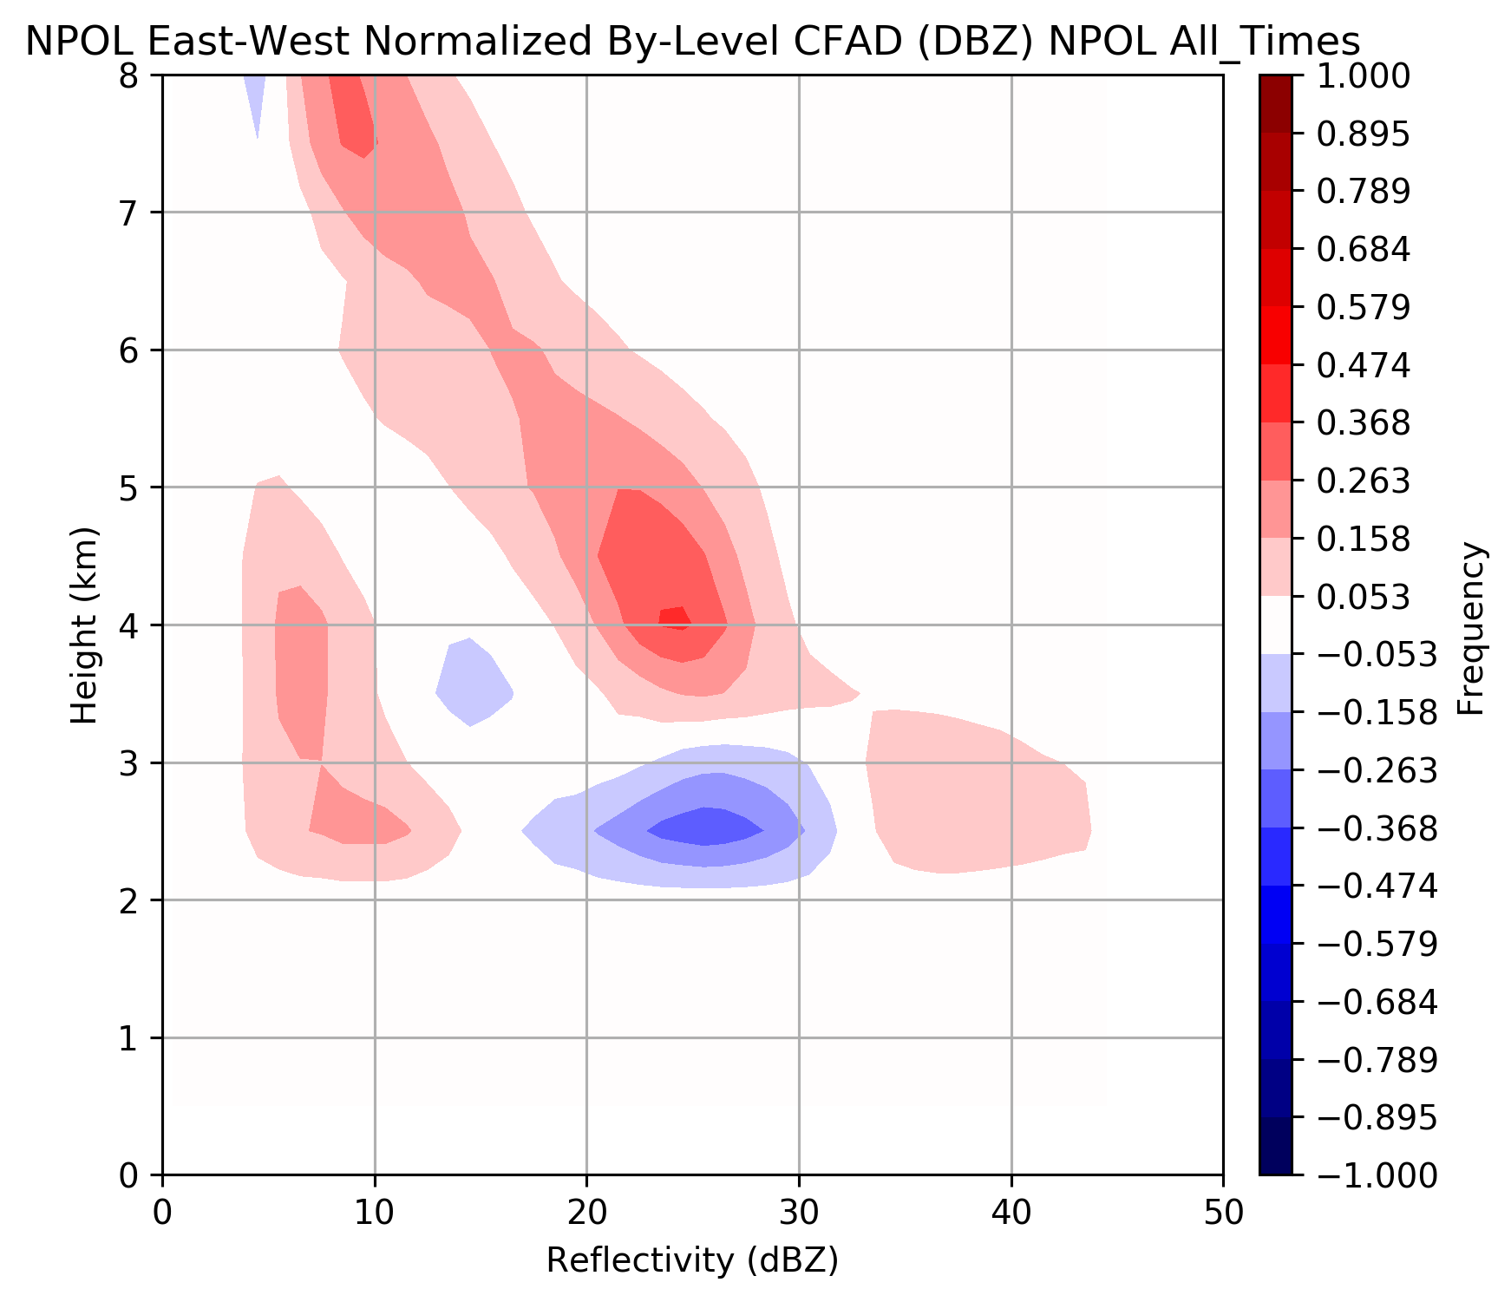
Orographic Enhancement Aloft
Land – Ocean Difference CFAD
Greater frequency of higher reflectivities at all levels over windward slopes
Shift to higher reflectivity near melting level (2-3 km during warm events)
Rowe et al., in prep

Slide 11
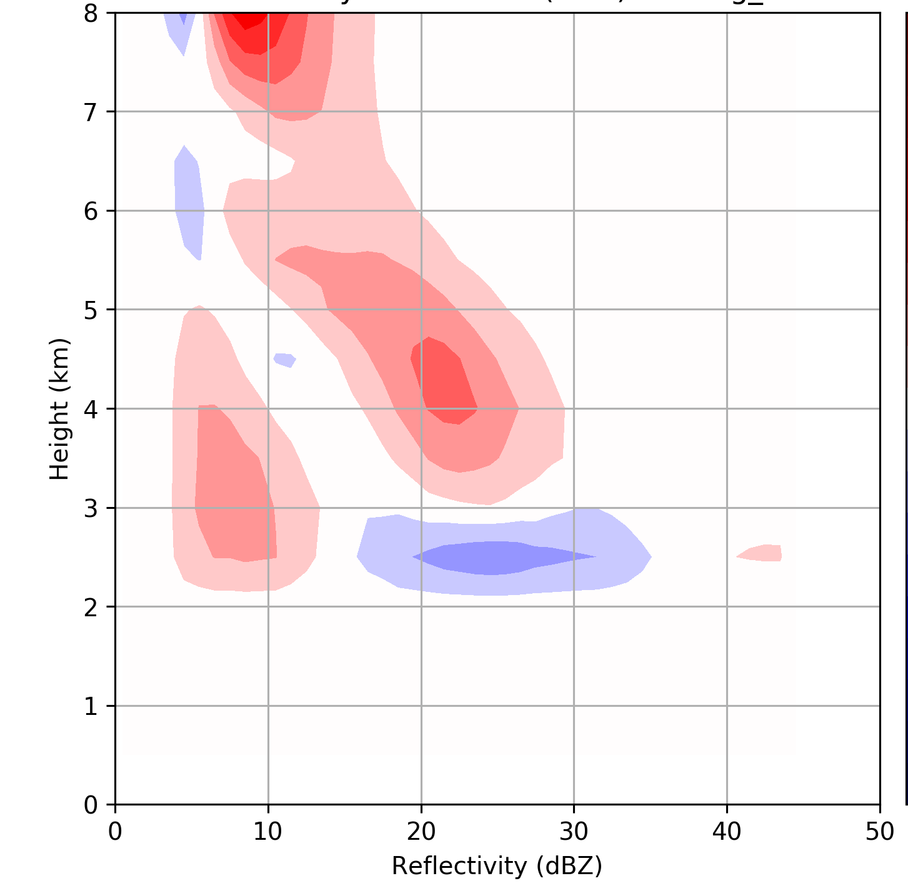
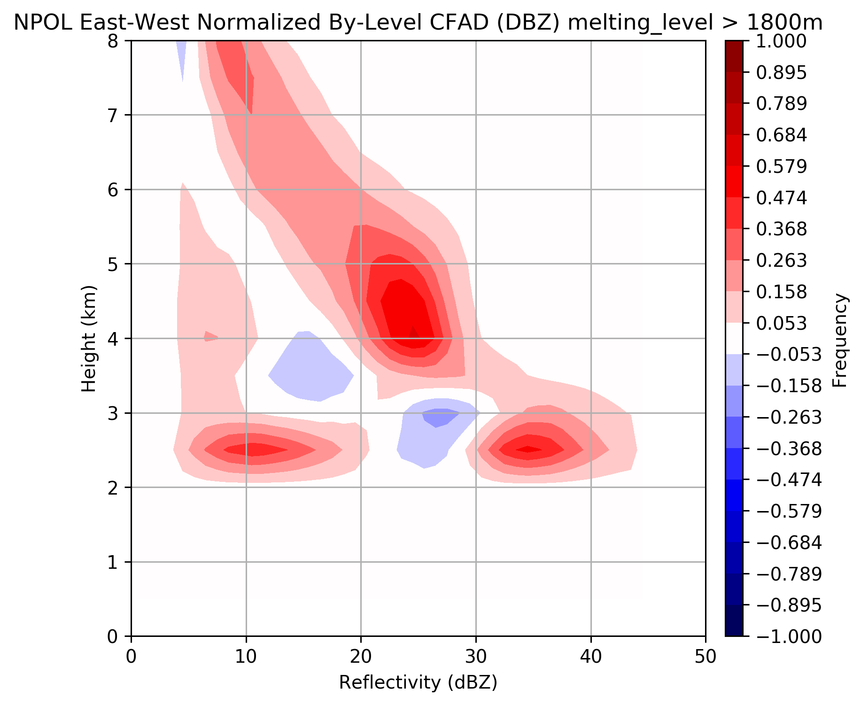
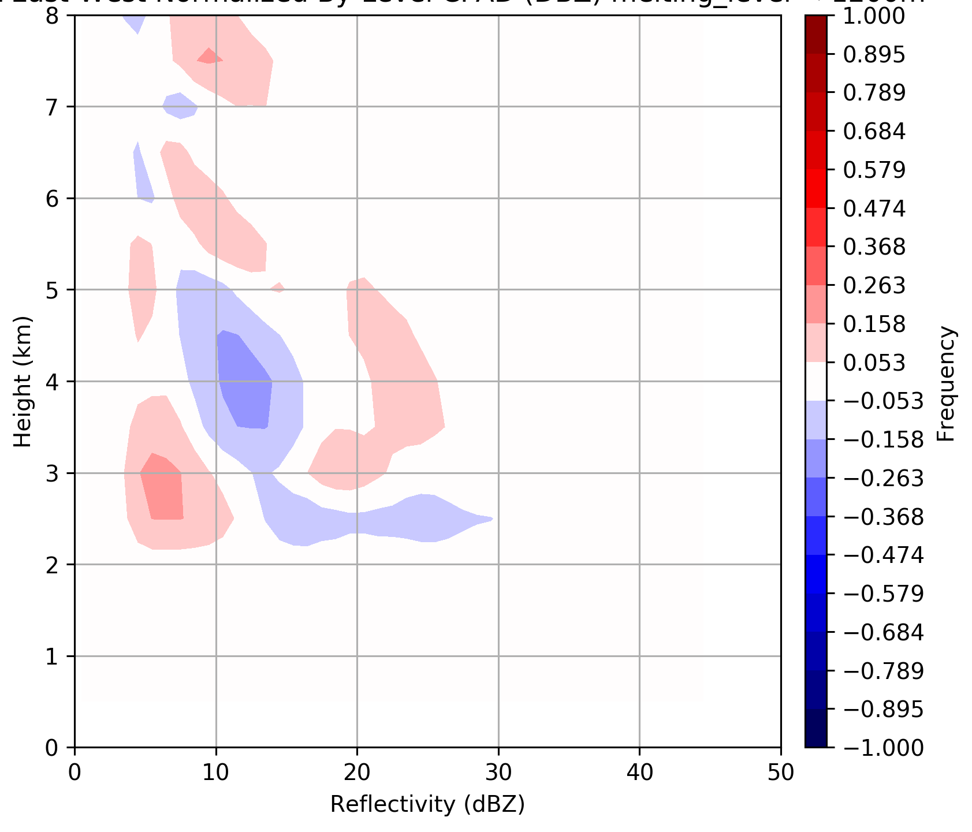
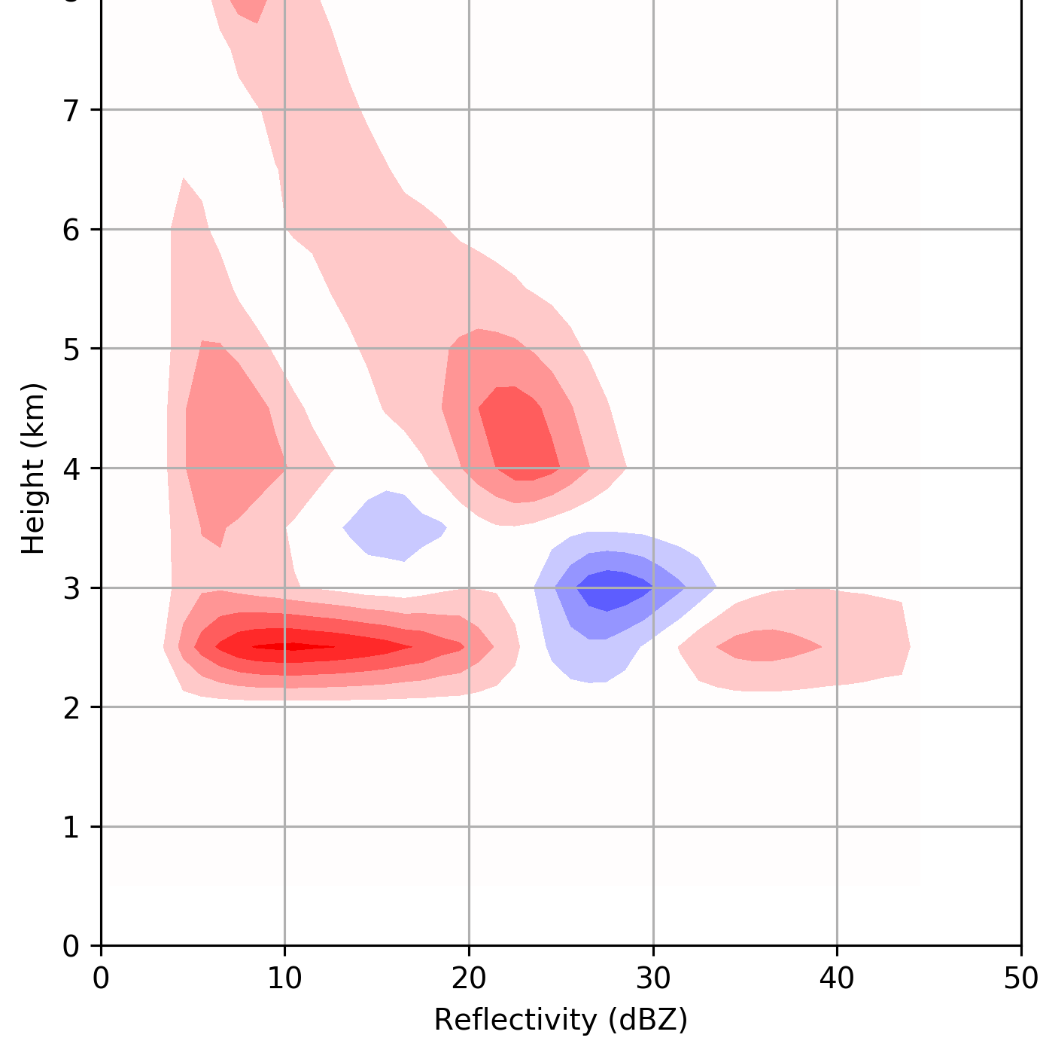
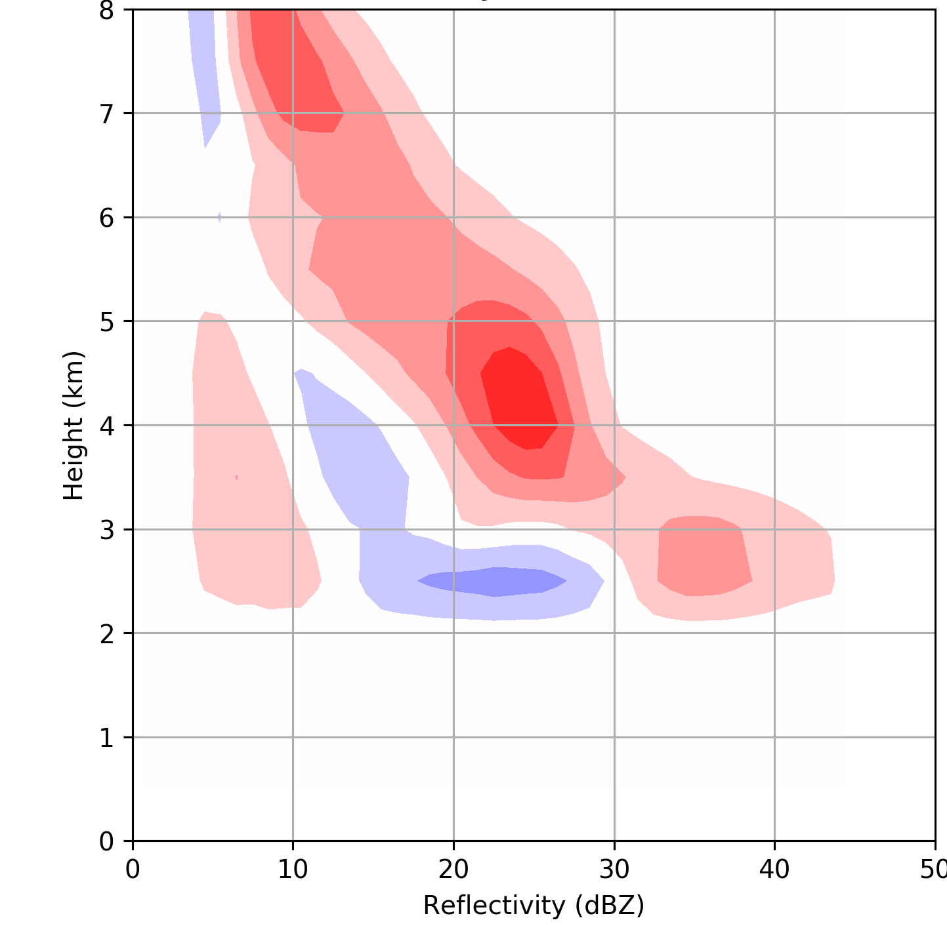
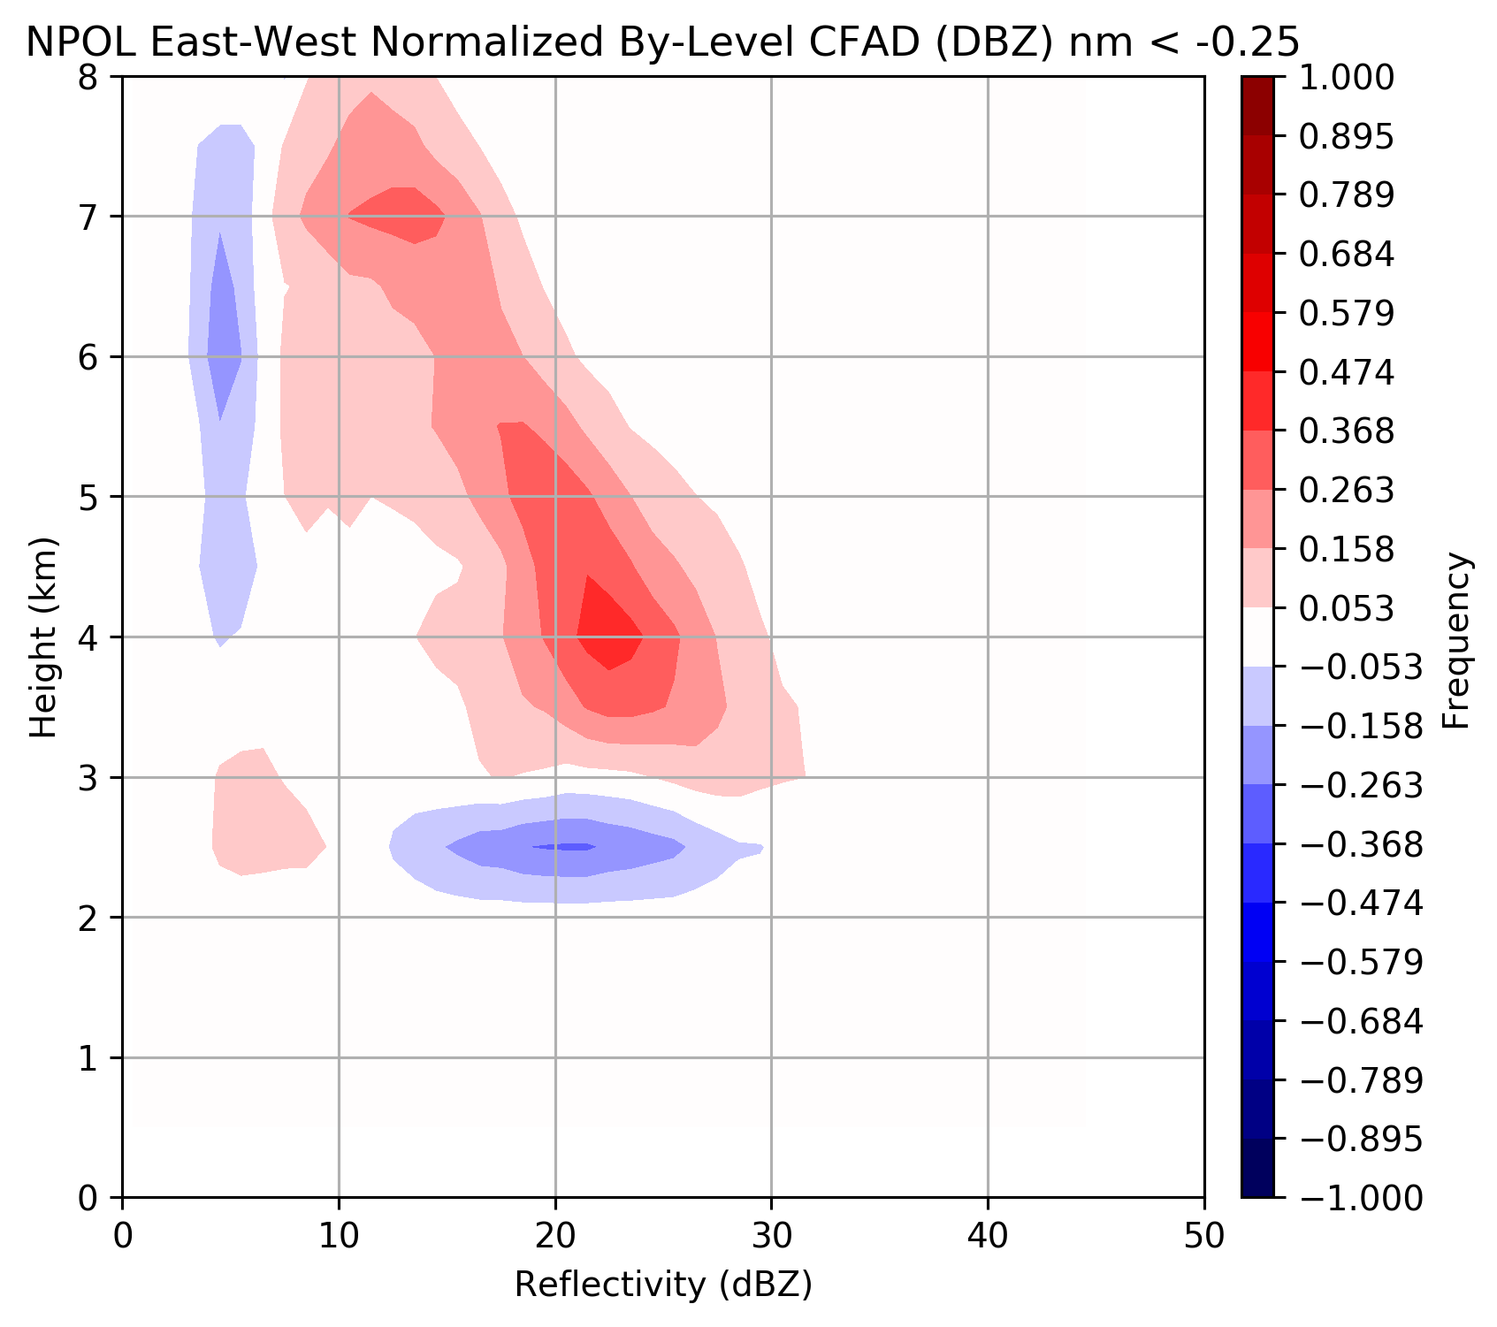
~Pre-frontal
~Warm sector
~Post frontal
25% of time
36% of time
39% of time
Melting level 1.2-1.8 km
ML > 1.8 km
ML < 1.2 km
37% of time
43% of time
20% of time
Nm stable
Nm neutral
Nm unstable
Rowe et al., in prep

Slide 12
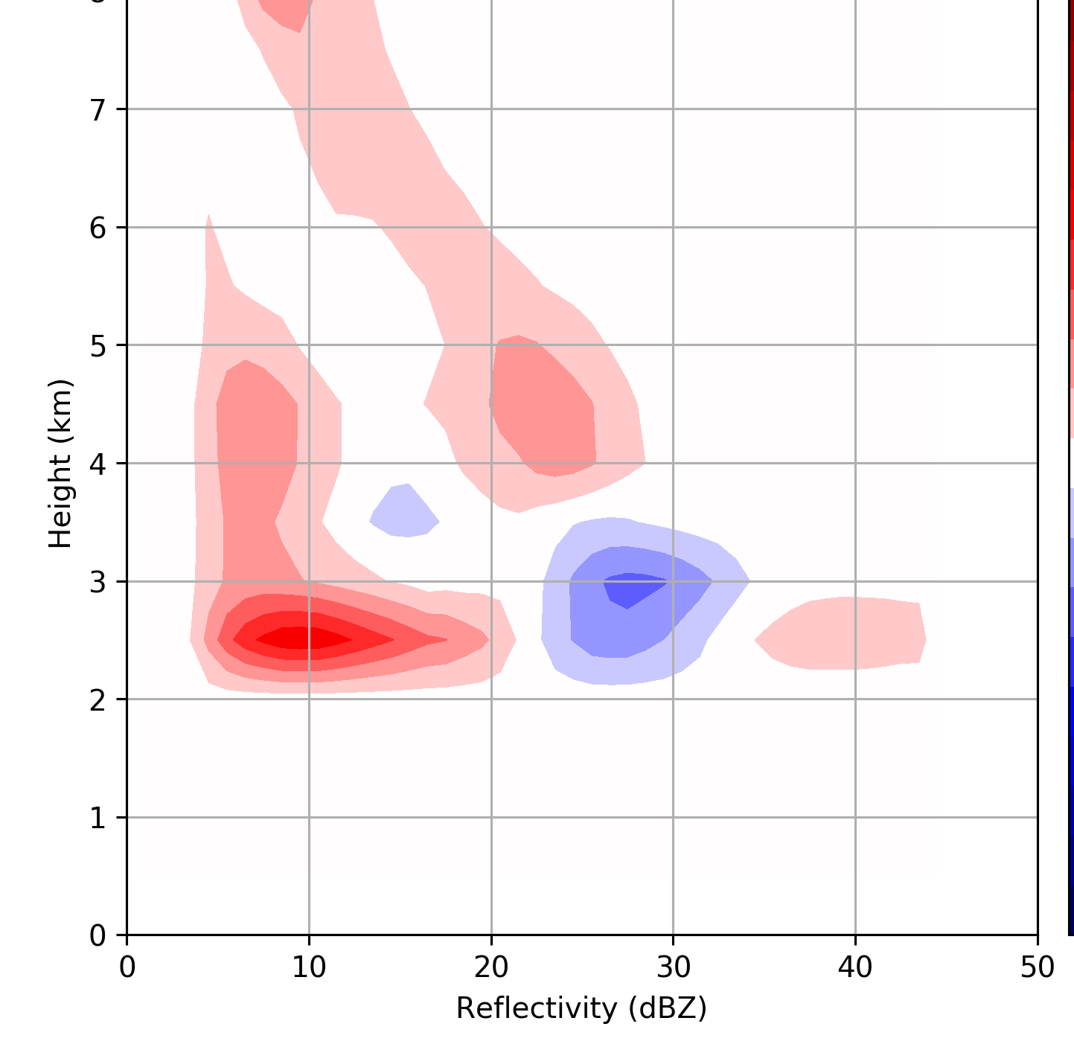
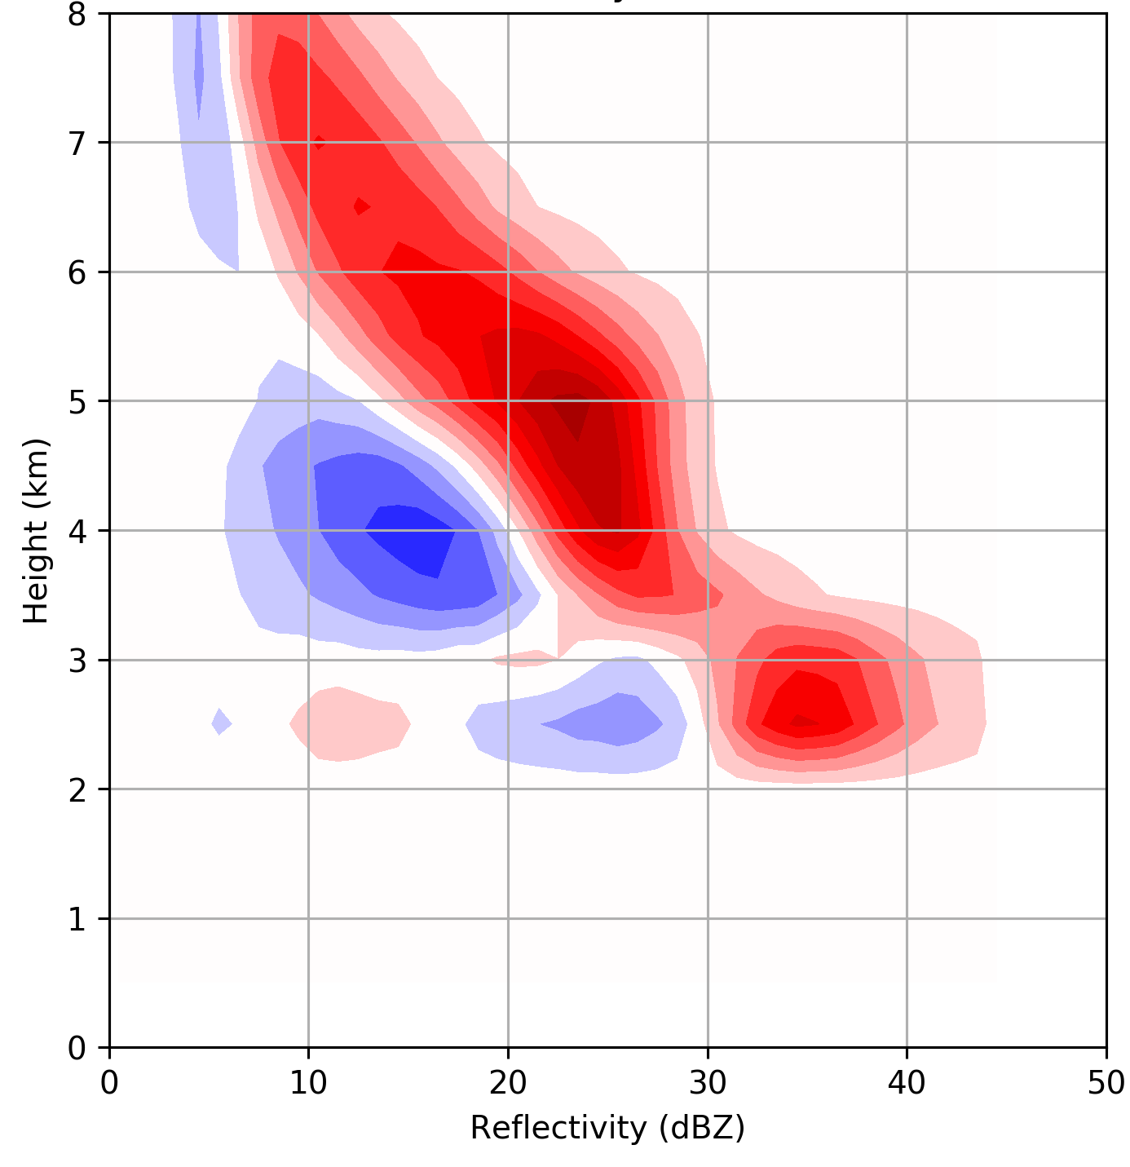
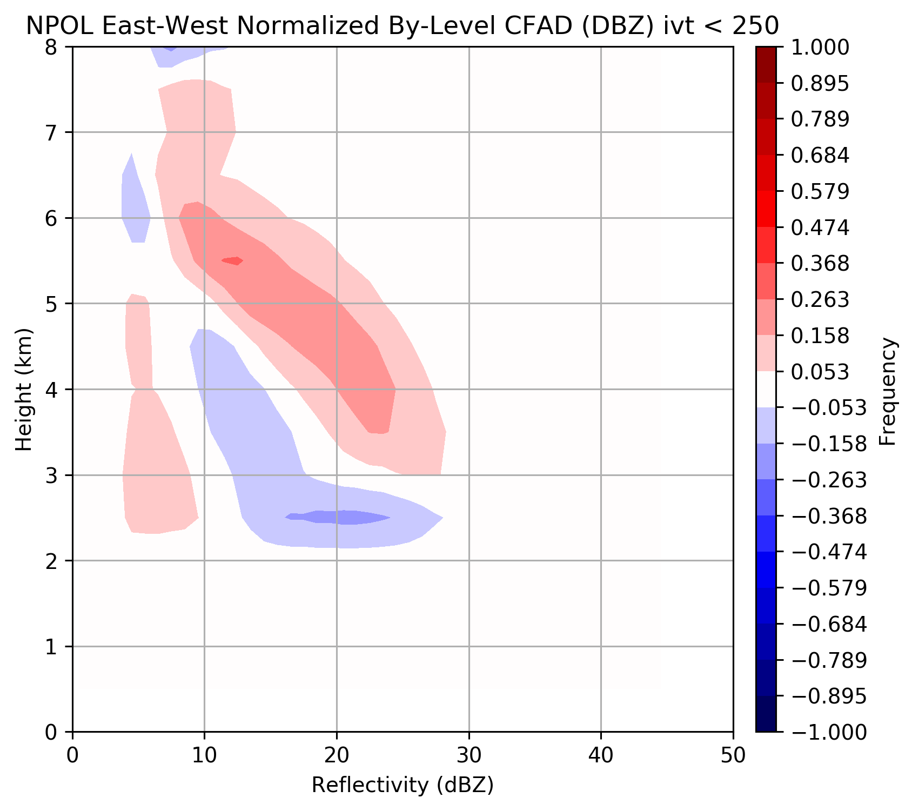
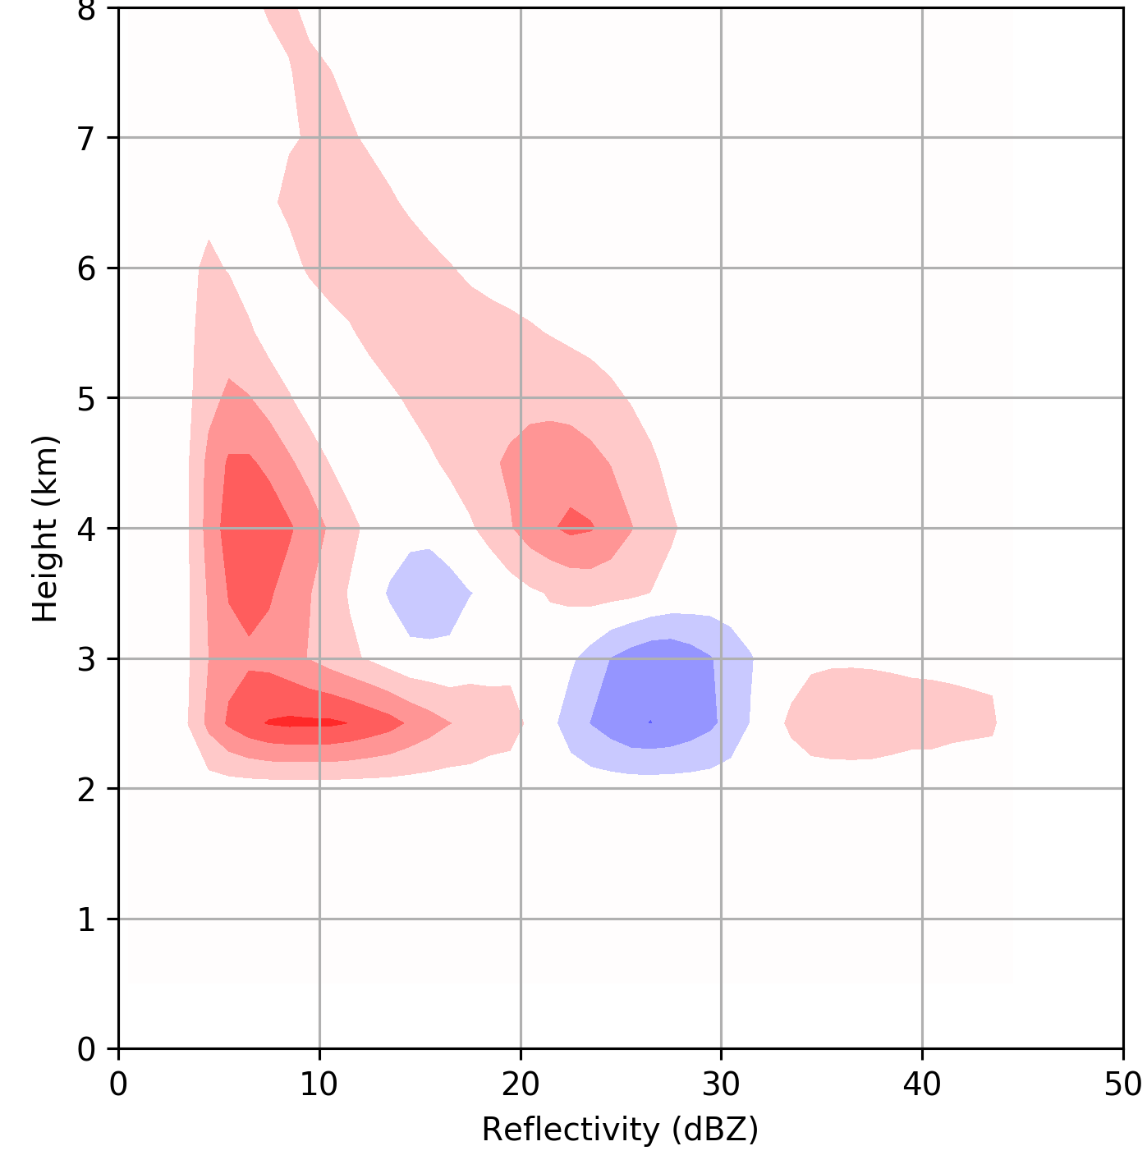
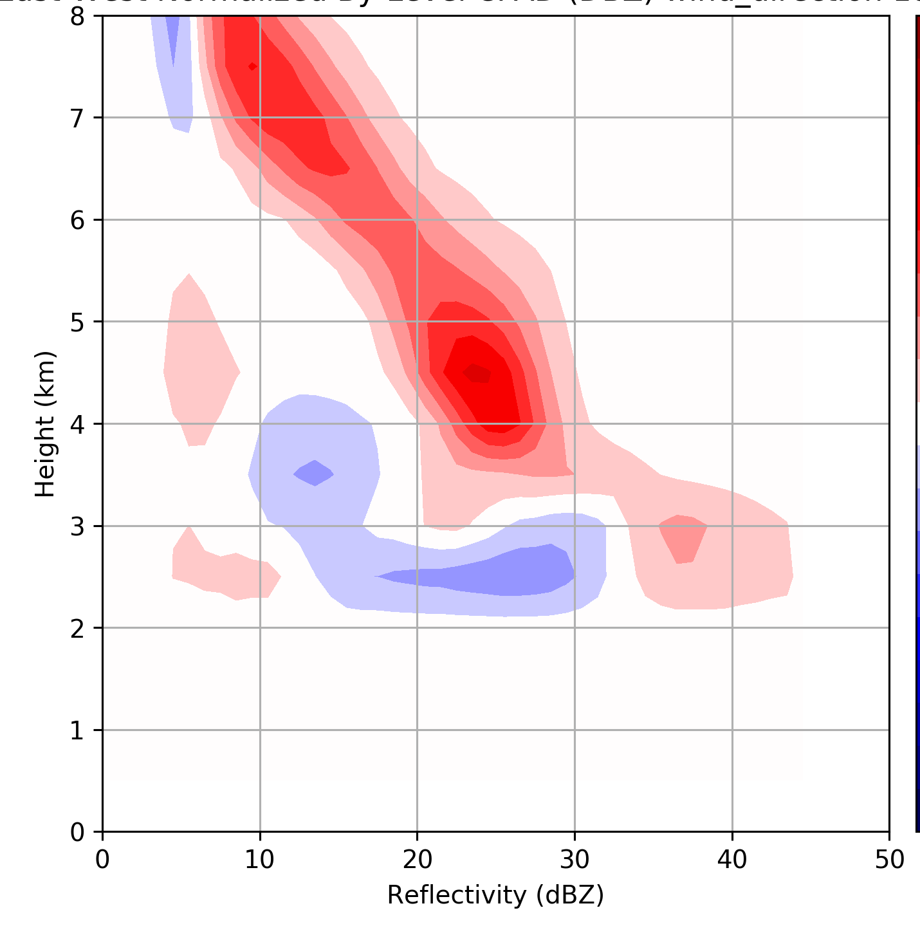
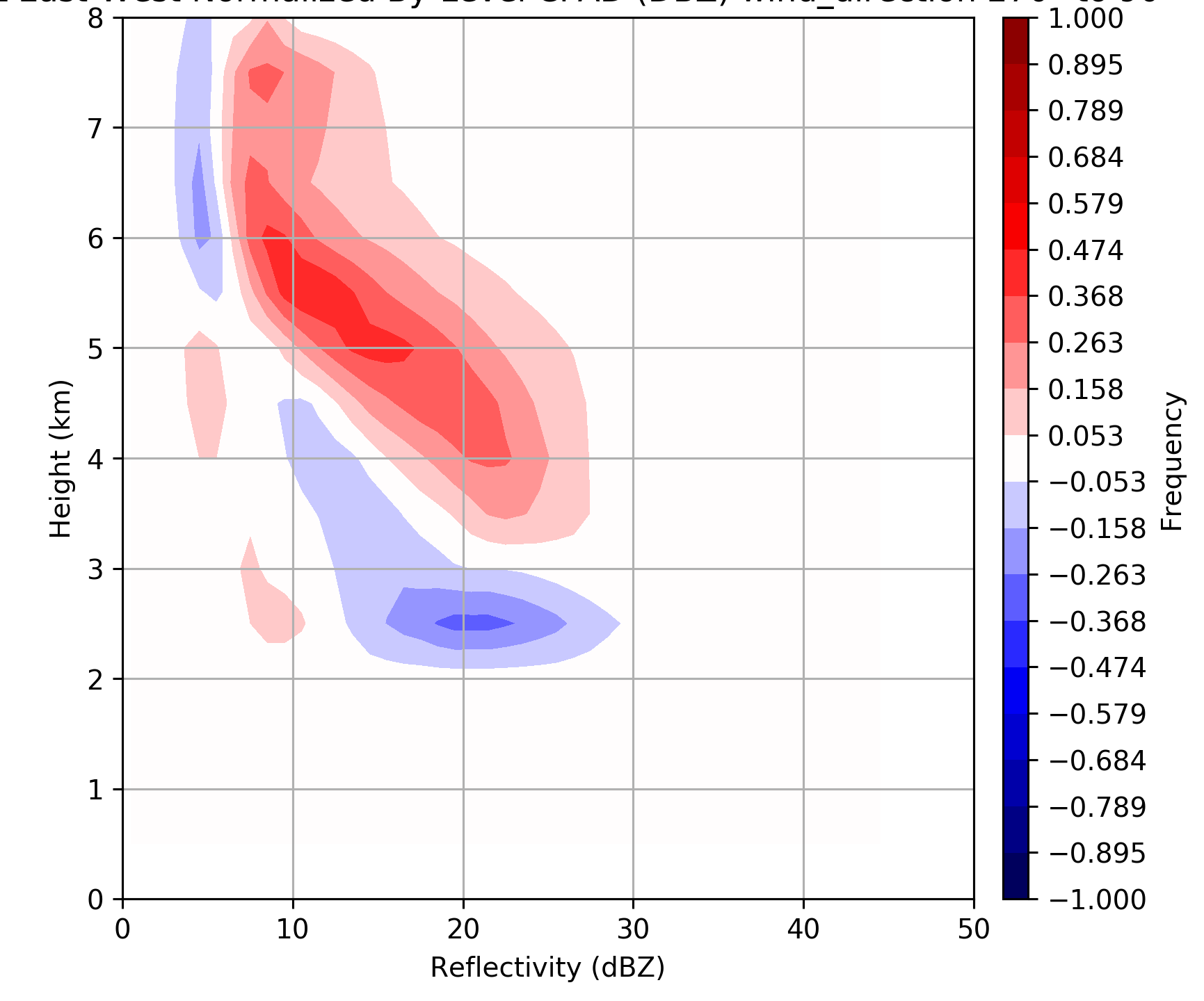
~Pre-frontal
~Warm sector
~Post frontal
20% of time
10% of time
70% of time
250 < IVT < 450 kg m⁻¹ s⁻¹
IVT > 450 kg m⁻¹ s⁻¹
IVT < 250 kg m⁻¹ s⁻¹
42% of time
29% of time
29% of time
90° < wind dir. < 180°
180° < wind dir. < 270°
270° < wind dir. < 90°
Rowe et al., in prep
Rowe et al., in prep

Slide 13
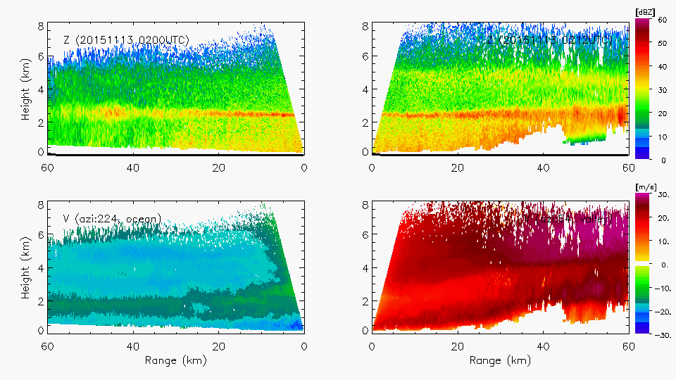
Example of enhancement at both upper and lower levels
Ocean
Land
Reflectivity (dBZ)
Reflectivity (dBZ)
Radial Velocity(dBZ)
Radial Velocity(dBZ)
Warm Sector – 13 November 2015
Notes:
Shows both lower and upper level enhancement. Midlevel flow lifting as well as low-level.

Slide 14
Implications for GPM
Enhancement at heights (>2km) can be seen by GPM – OLYMPEX can be a standard
Can use environmental parameters (melting level height, etc.) as constraints (do not necessarily need to determine storm sectors for each event)

Slide 15
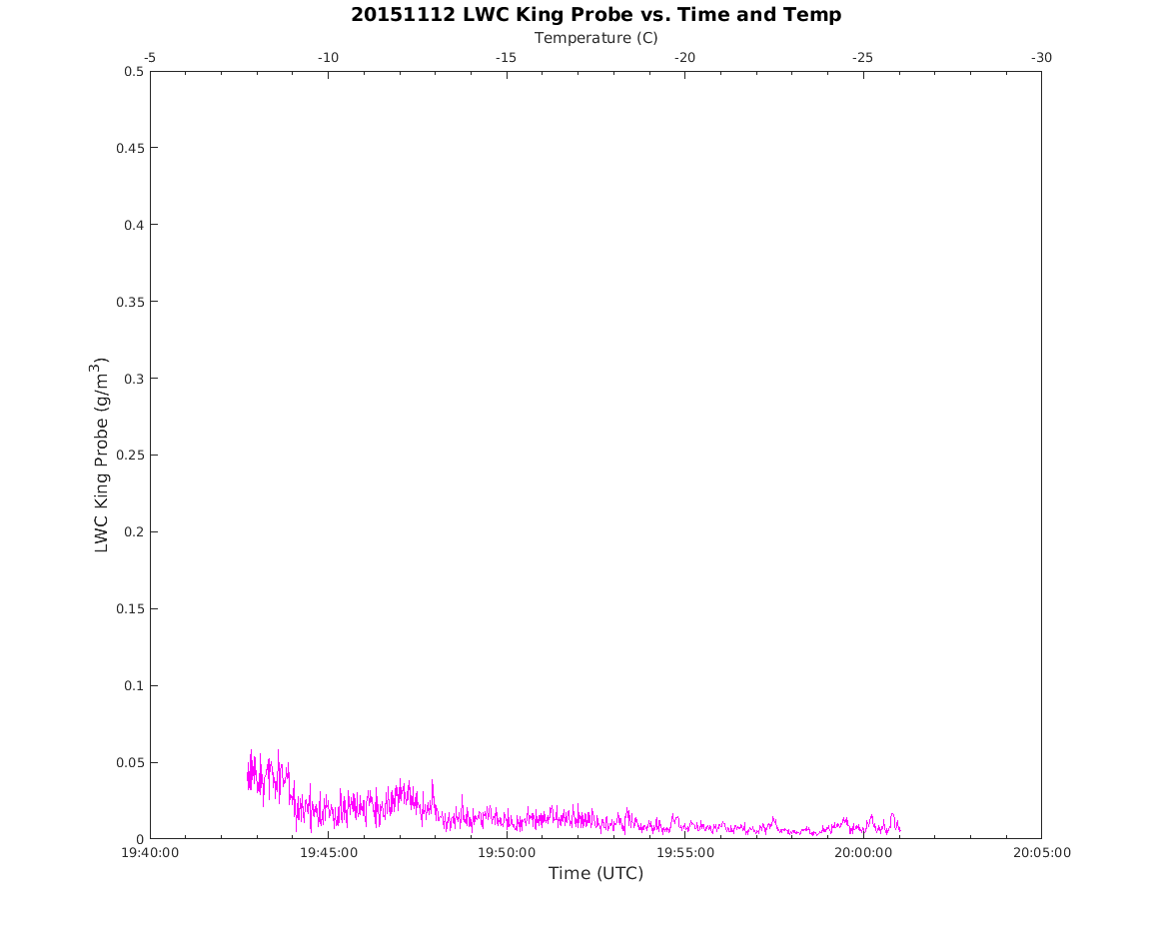
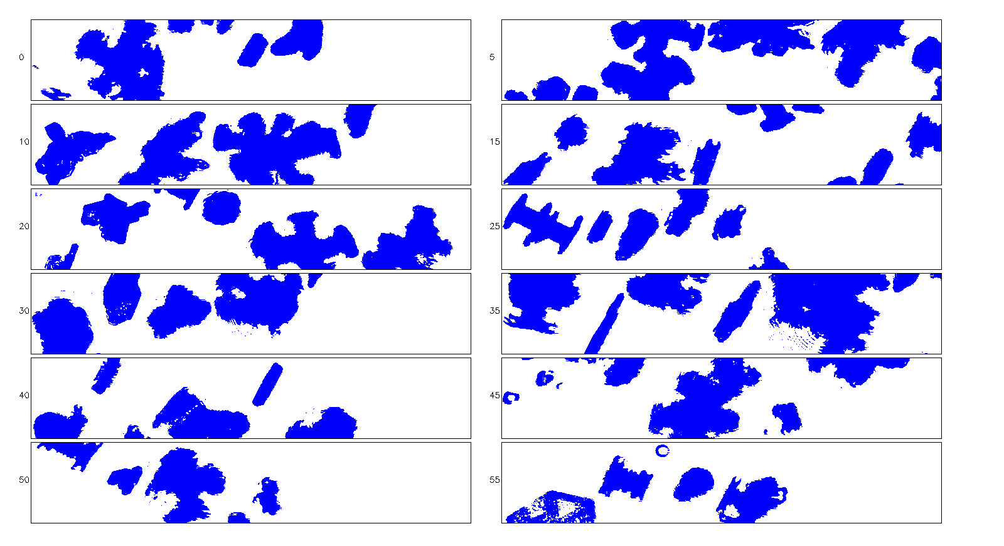
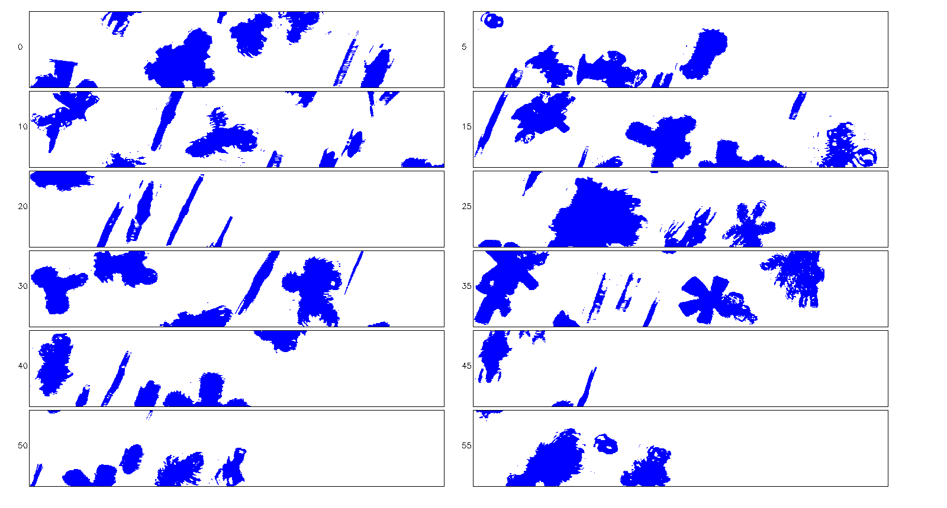
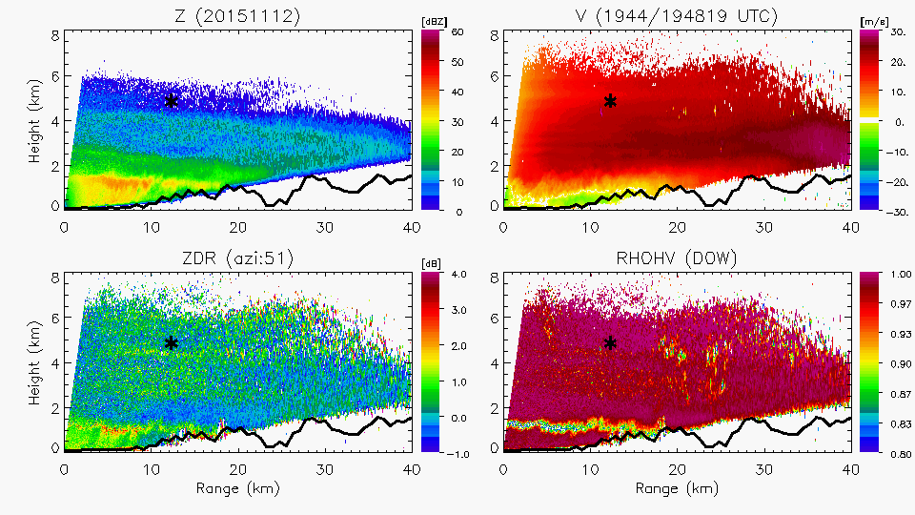
Liquid Water from King Probe on Citation during Spiral Ascent 1944 UTC 12 November
Citation location near secondary reflectivity and Zdr maximum aloft
2DSV: 50-1900mm at 1944 UTC

Slide 16
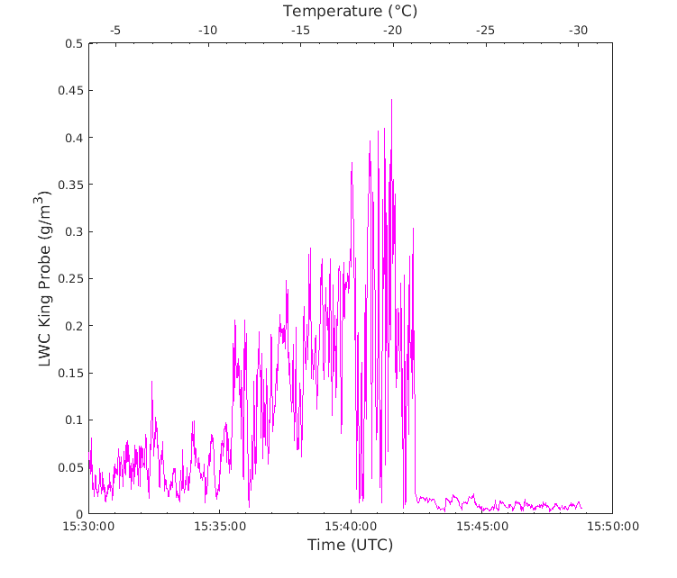
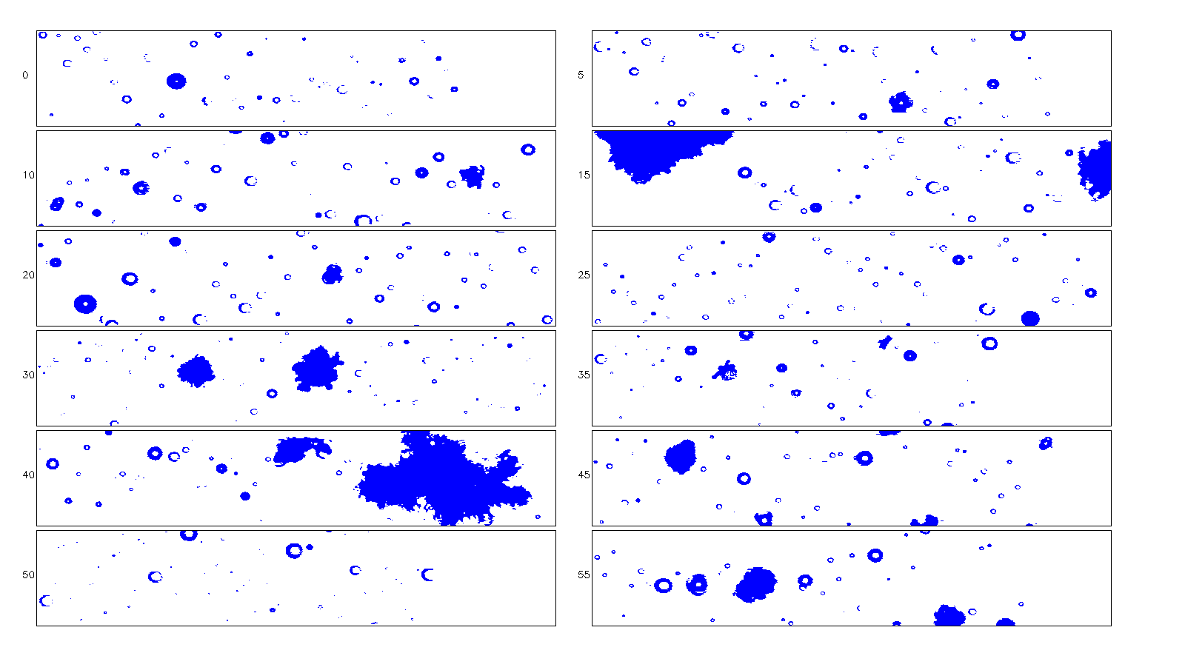
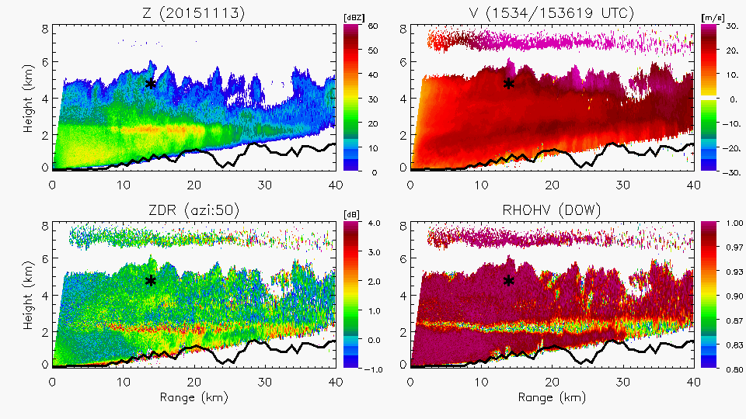
Unstable
Layer
Dry Layer
0.4 g m⁻³
Lots of super-cooled liquid water – temperatures ~-20°C
Generating Cells

Slide 17
Implications for GPM
There are differences aloft in in situ microphysics between purely stratiform and generating cells
Secondary reflectivity/Zdr enhancement aloft seen over terrain associated with horizontally oriented plates/rosettes/etc with increase in particle size and concentration
Enhanced upward motion in generating cells has high liquid water content and rimed particles above bright band

Slide 18
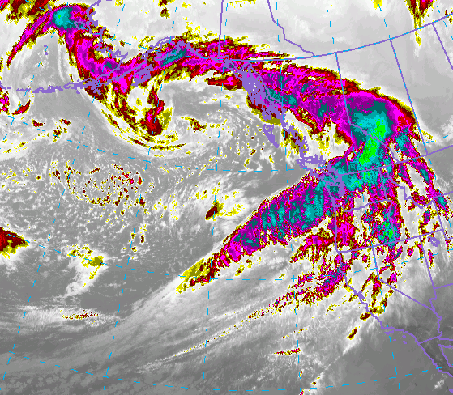
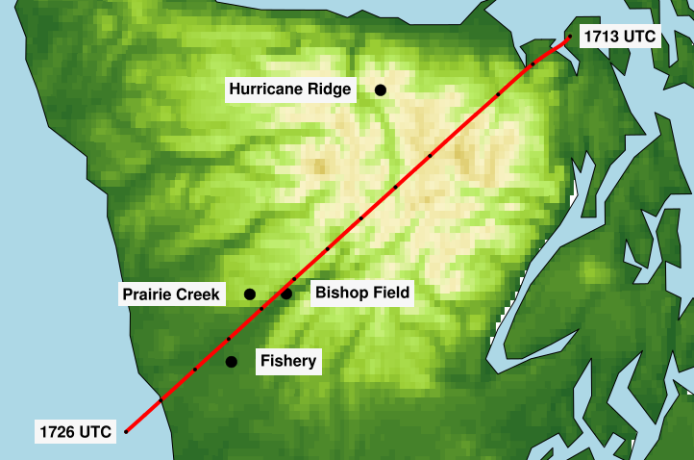
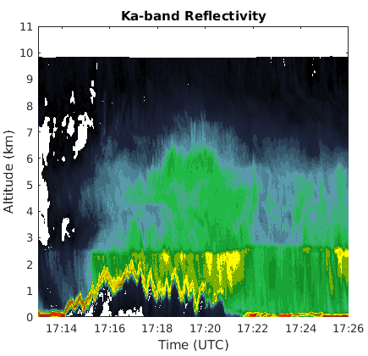
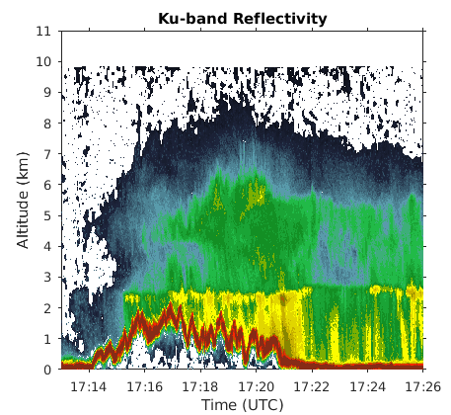
Leeside precip structure – APR3
1713—1726 UTC 8 Dec 2015
1700 UTC 8 Dec 2015
Ka- band Windward
Ku- band Windward

Slide 19
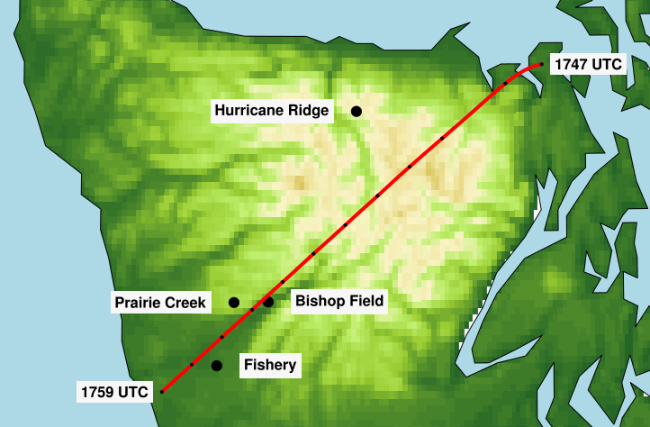
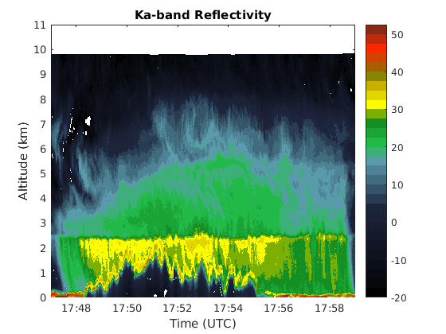
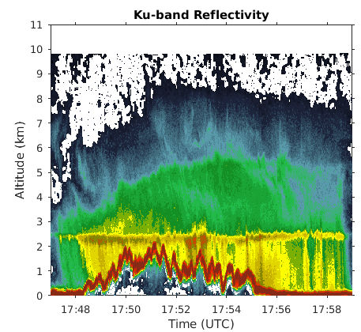
1747—1759 UTC 8 Dec 2015
1700 UTC 8 Dec 2015
Ku- band Windward
Ka- band Windward

Slide 20
Implications for GPM
Can GPM get both enhancement on windward slopes and de-enhancement in lee?
Strongest precipitation enhancement on windward slopes, and occasionally over high terrain
Decrease of precipitation in lee – from synoptic conditions??

Slide 21
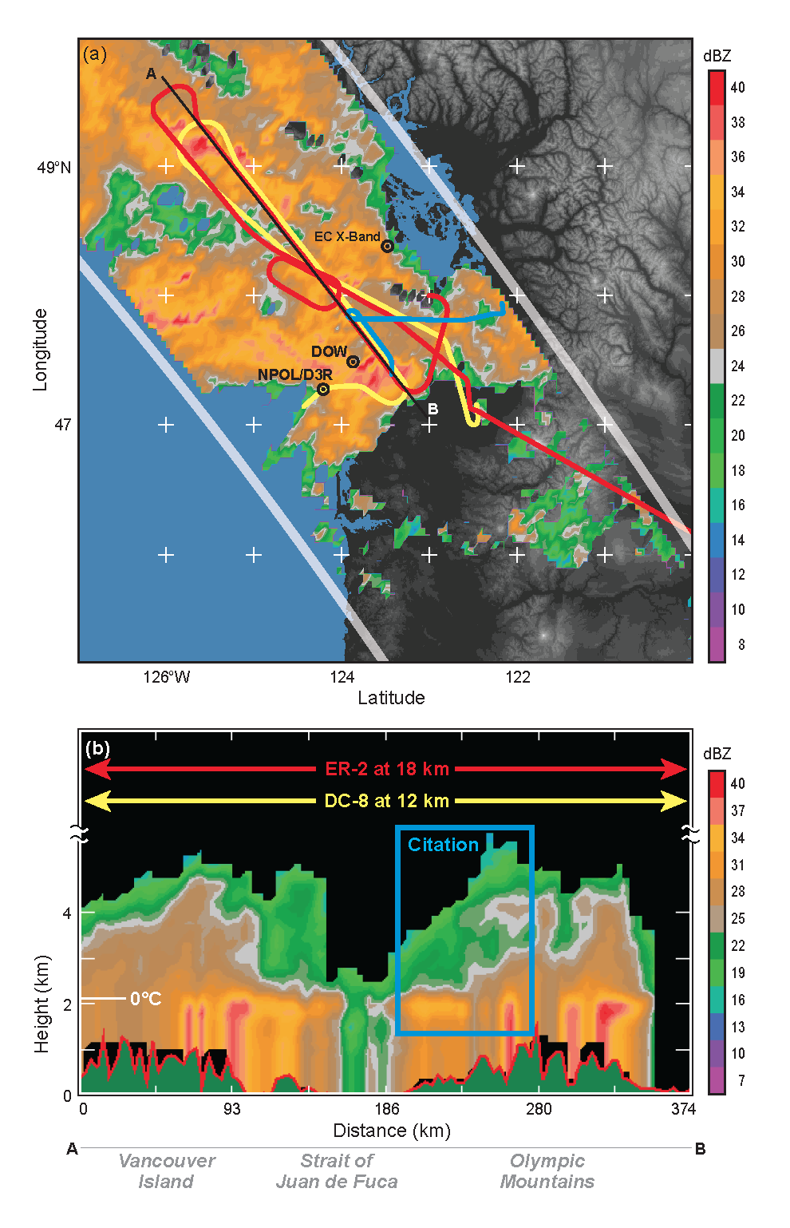
3 December GPM overpass and 3 stacked aircraft
Results from APR3 from Joe Munchak
Steve Nesbitt and group

Slide 22
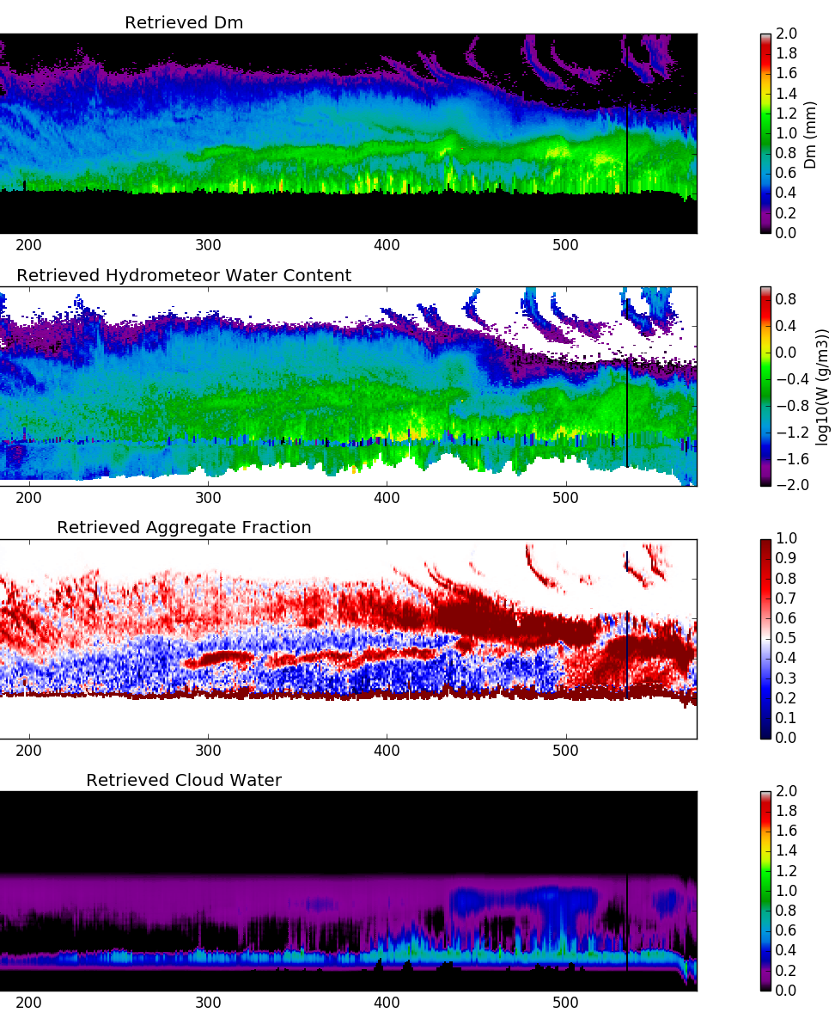
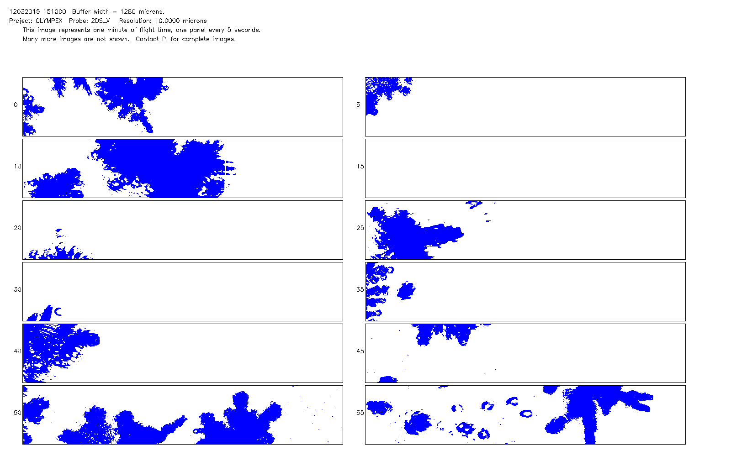
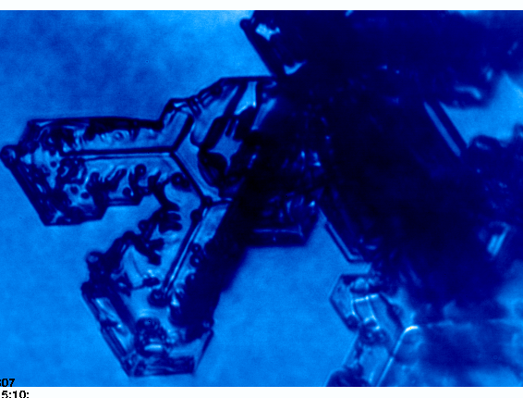
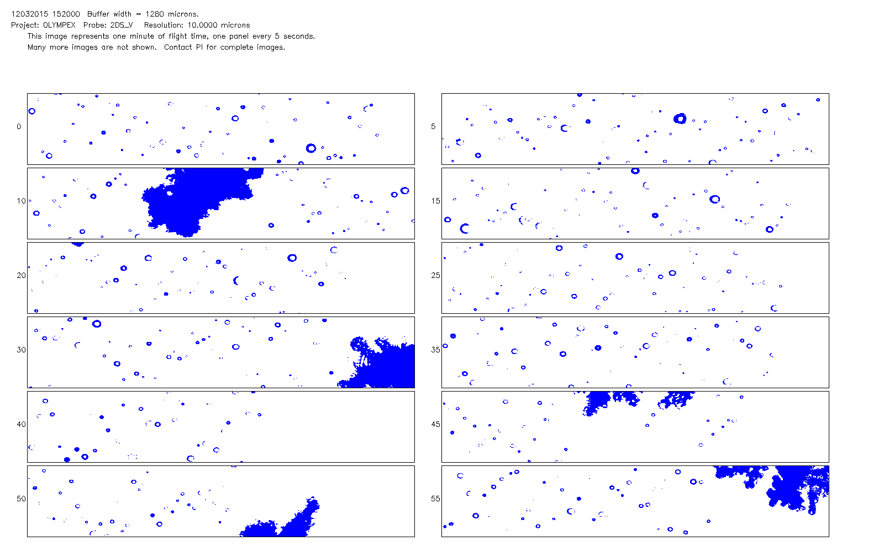
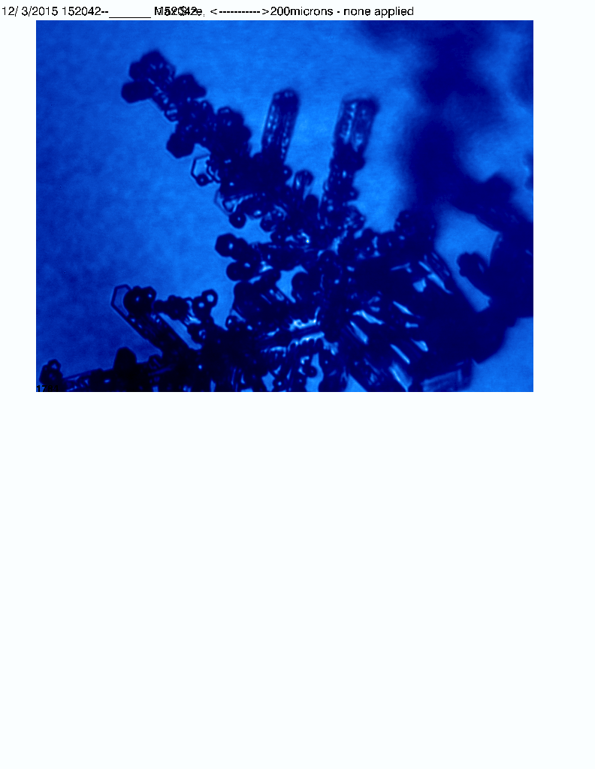
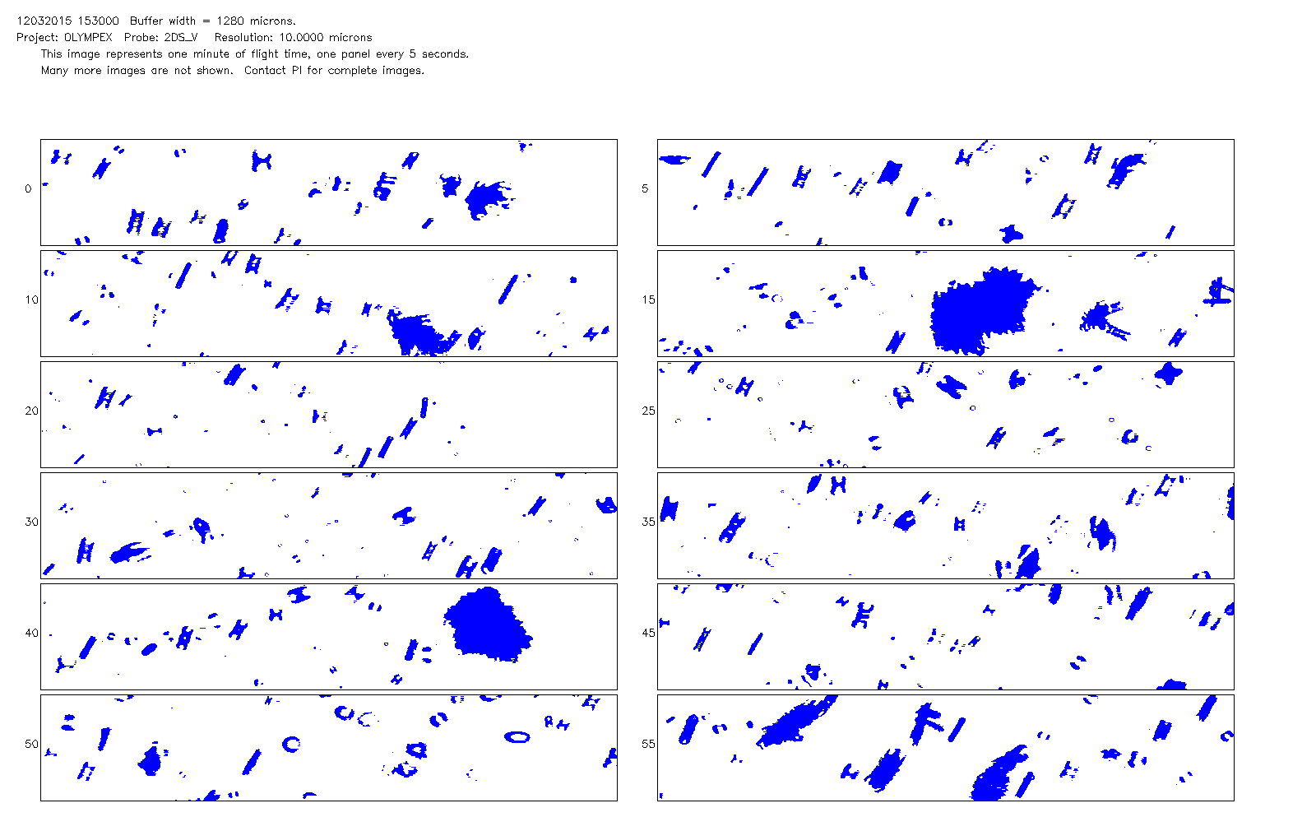
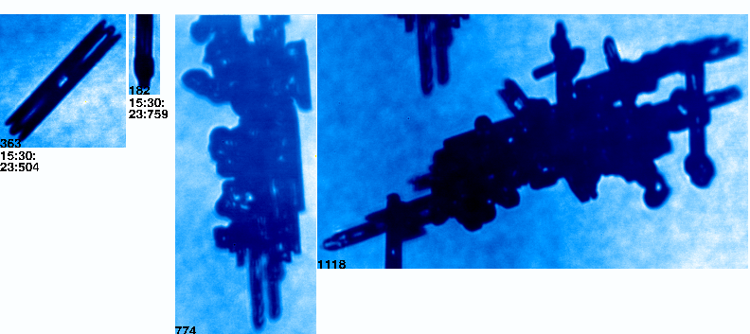
Dec 3 Case – APR3 retrieval preliminary results
A
A
A
B
C
A
A
B
C
B
A
B
C
C
A
B
C
J. Munchak/I. Adams

Slide 23
Chase et al., to be submitted
Notes:
Coincident measurements from 3 Dec Atmospheric River case are presented. This flight leg perpendicular to the mountains under the GPM overpass reveals a complex structure above the melting level, with an enhancement in W-Band reflectivity and high values of Ka-W band dual frequency ratio along the flight leg.

Slide 24
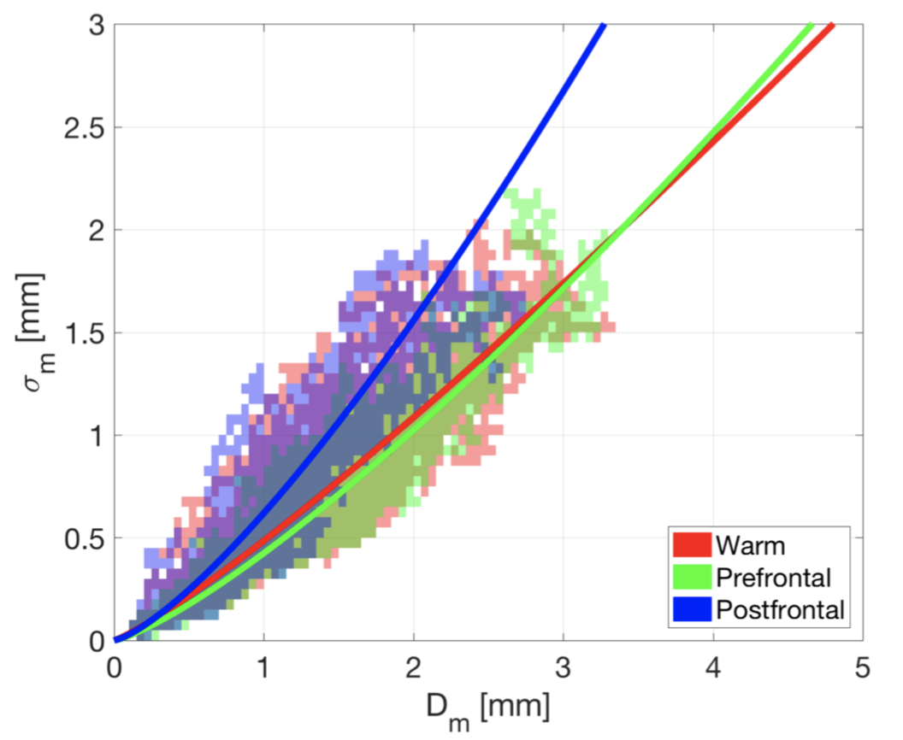
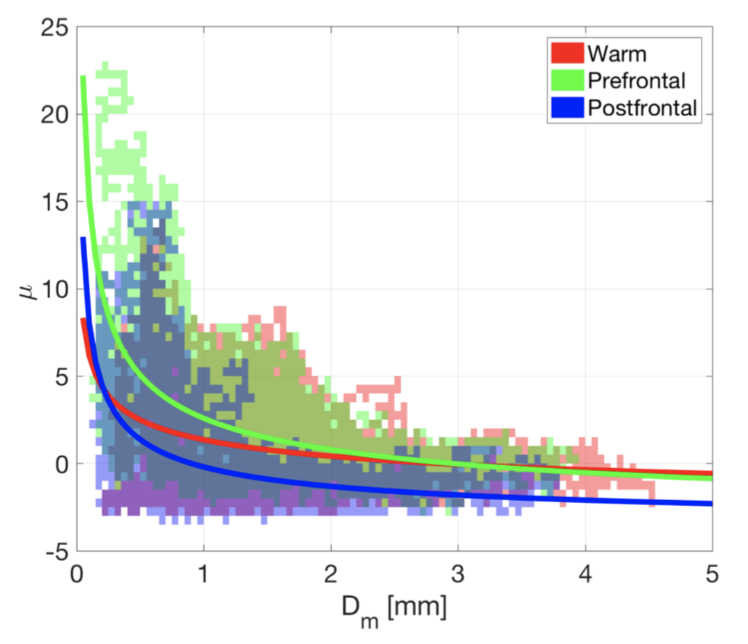
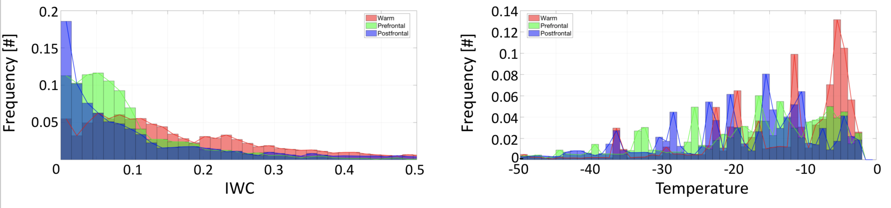
Examination of UND particle size distribution characterization from UND Citation measurements across OLYMPEX weather system regions (Borque et al., in preparation)
Warm and pre-frontal cases have similar modal distributions of PSD characteristics to GCPEx (separate study - Borque et al., to be submitted), although a separate cloud of higher μ values exists around 1.5 – only exists over land flight legs – potentially a fingerprint of orographic processes (large N₀ coexistent with large Dm)
Post-frontal has much narrower mass spectrum and lower IWCs, extremely broad size distributions (negative μ) at large Dm)

Slide 25
University of Illinois OLYMPEX Activities
Nesbitt, Borque, Chase, Finlon, McFarquhar (now at CIMMS/U. Oklahoma)
Talk Wednesday:
Evaluation of Triple-Frequency Radar Retrieval of Snowfall Properties using Coincident Airborne In-Situ Observations during OLYMPEx (Chase et al., to be sumbitted) – next slide
Poster Wednesday:
Constraining mass in ice clouds using aircraft-radar matching during MC3E and OLYMPEx (Finlon et al., in prep)
Not presented at this meeting:
Statistical representation of in-situ properties of ice and snow particles during The Olympic Mountain Experiment – OLYMPEX (Borque et al., in prep) – third slide

Slide 26
Discussion Topic: How does (can we?) we move forward on the problem of orographic precipitation estimation?
Broader context: Do we need a separate orographic precipitation working group or do we pass questions to existing WGs, Algorithm teams, and GV? If we need a new WG- do we start now or after the next ROSES call?
Questions/Ideas/discussion thus far:
1. Direct/Empirical Data: Baselined, broadly applicable, routinely available validation datasets are needed. (e.g., Tailored MRMS with long term adjustment to PRISM etc.). Suggestion that forecast models/reanalyses may do a better job than observations in this regard- can we benchmark (ERA5, MERRA2, GANAL etc.)? What time/space scale?
Physical: Can we use GV datasets to establish systematic profile behaviors (Precip top heights, PSD, water contents/rates, precipitation ice to liquid water path/rain rate, microphysical profiles etc.) above and within clutter-contaminated regions to constrain algorithm profiles? Test with OLYMPEX and IPHEX data- to include focused testing of observational findings in algorithm code.

Slide 27
Discussion Topic: How does (can we?) we move forward on the problem of orographic precipitation estimation?
Broader context: Do we need a separate orographic precipitation working group or do we pass questions to existing WGs, Algorithm teams, and GV? If we need a new WG- do we start now or after the next ROSES call?
Questions/Ideas/discussion thus far:
Continued
3. Physical: Match systematic dynamics including scale parameters like flow direction vs. barrier orientation, barrier height, thermodynamic instability (cf. Houze, Shige's, Mass' work and others), Aerosol background etc. to observed profile/precip behavior and to larger scale regime/geography/class of orography (e.g., Shige and Kummerow, 2016 approach for other regions)? Implies a "regime" approach to algorithm use- and again, focused testing of observational findings in algorithm code.

