Slide 1
Microphysical Mechanisms in Stratiform Precipitation as Observed in OLYMPEX
Megan Chaplin
M.S. Presentation
10 August 2017
Funding for this work was from the National Aeronautics and Space Administration (Grant: NNX16AD75G) and the National Science Foundations (Grant: AGS1503155).

Slide 2
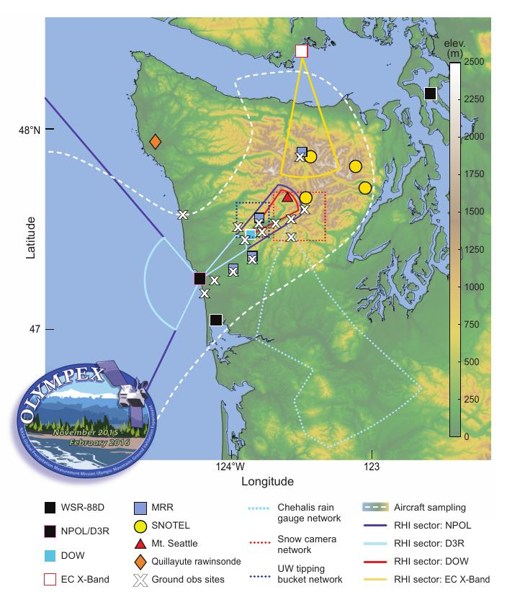
OLYMPEX
Extensive observational dataset
Precipitation processes in extratropical cyclones
Storms passing over Olympic mountains
Notes:
Describe OLYMPEX (GPM, time of year)
Describe figure (ground obs, soundings, ground radar, flight area)
Focus on Citationflight microphysical data through stratiform precipitation areas
What is stratiform?

Slide 3
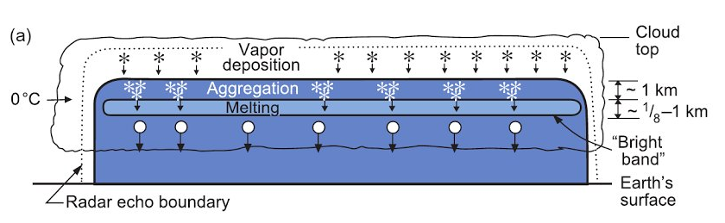
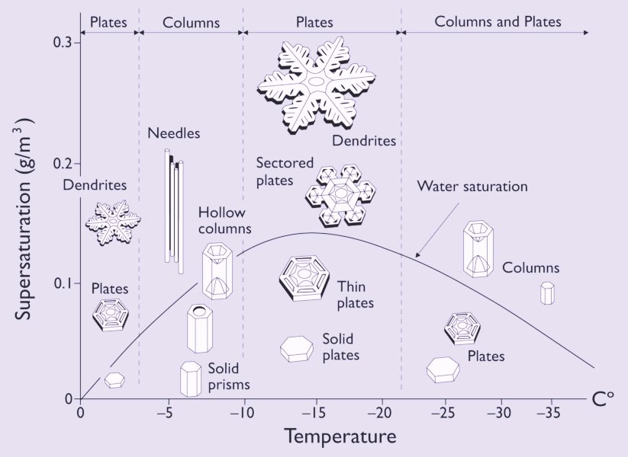
STRATIFORM PRECIPITATION
Houze (2014)
Houghton (1968), Wexler and Atlas (1959), & many earlier studies
Ice crystal process
Growth by vapor deposition
Aggregation above bright band
Supercooled water content
< 0.1 g m⁻³
Rogers and Yao (1989)
Crystal habit dependent on:
  temperature
  supersaturation
Notes:
Describe stratiform schematic in more detail (because 12th builds off this)
Previous studies show…
Low LWC due to weak vertical motions (why?)
Within stratiform, specific cloud microphysics and crystal habit dependent on temp
Diagram shows change through echo
Transition: Also common in stratiform precipitating areas, are generating cells..

Slide 4
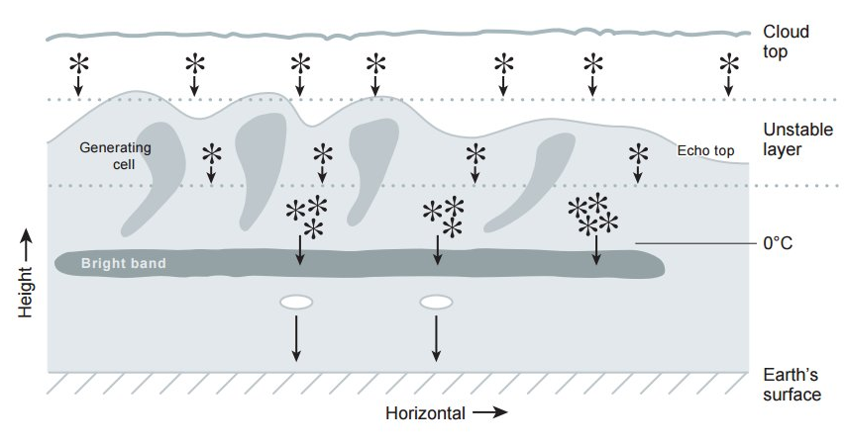
STRATIFORM PRECIPITATION
Houze (2014)
GENERATING CELLS
Locally enhance:
  Ice particle concentration
  Cloud liquid water
  ~0.1–0.2 g m⁻³
Adapted from Houze (2014)
Notes:
Formation of generating cells (local vertical motions within region of instability)
From lab experiments, early radar data, eventually aircraft measures
These studies have inferred that cells locally enhance..
But these studies either had radar observations or used lab experiments with early aircraft observations, many ideas of concentration/habit/LWC based on inferences, not actual values
Transition: But with OLYMPEX now have both the state of the art radar data and in-situ aircraft microphysical measurements, and the most up to date particle probe data.. So what is missing from this schematic and what will this study add?

Slide 5
GOAL
  Advance knowledge of ice particle concentrations, particle habit, and liquid water content in relation to
    Basic layered stratiform precipitation
    Generating cells
METHOD
  Use simultaneous
    In-situ aircraft microphysical measurements
    Dual-polarization radar data
Notes:
Schematic does not have specific amounts or particle types throughout the stratiform
Advance knowledge with COINCIDENT and RELIABLE/high quality measurements – actual values in context of the radar data
Transition: The aircraft data that I use is..

Slide 6
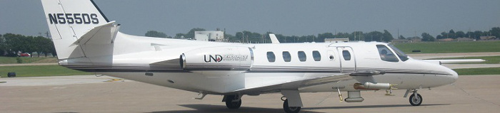
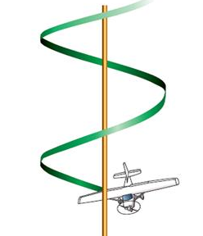
Univ. of North Dakota Citation
“SPIRAL” FLIGHT TRACKS
Vertical profiles within ground-based radar domain
In-situ data with improved vertical resolution
Microphysical properties at various cloud temperatures
Notes:
Flew in “helical flight paths” (constant radius) within ground-based radar domain (research comm calls spirals)
Vertical profiles of microphysical properties (f (T))
High resolution
Transition: What types of measurements?

Slide 7
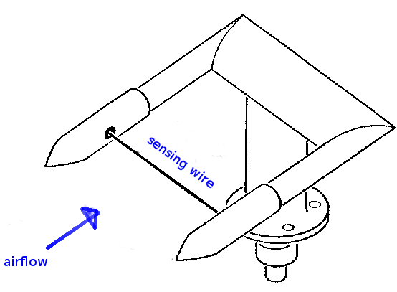
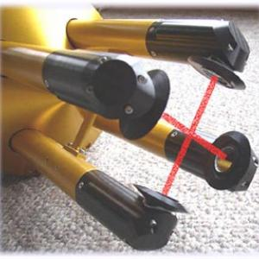
CITATION MICROPHYSICAL PROBES
King probe
2DS probe
Cloud liquid water content (LWC), ice particle concentration
Particle imaging and measurements with different scales of resolution
Notes:
Describe how probes work from photos
King (airflow through sensing wire)
2DS: Particles pass through light beams, cast shadow, in H and V plane, creates ‘shadowgram’
Interpretation of ‘shadows’
Transition: These probes have different scales of resolution

Slide 8
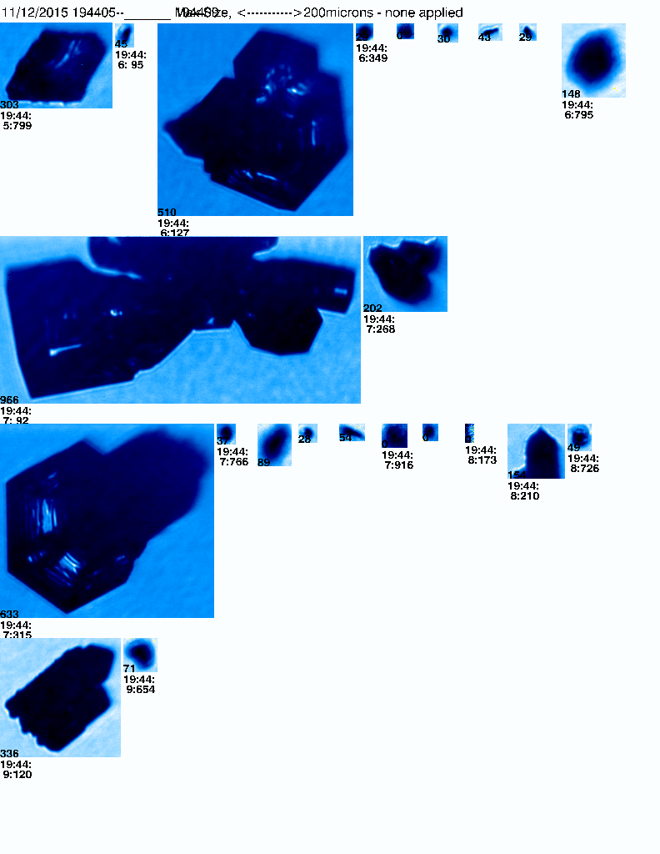
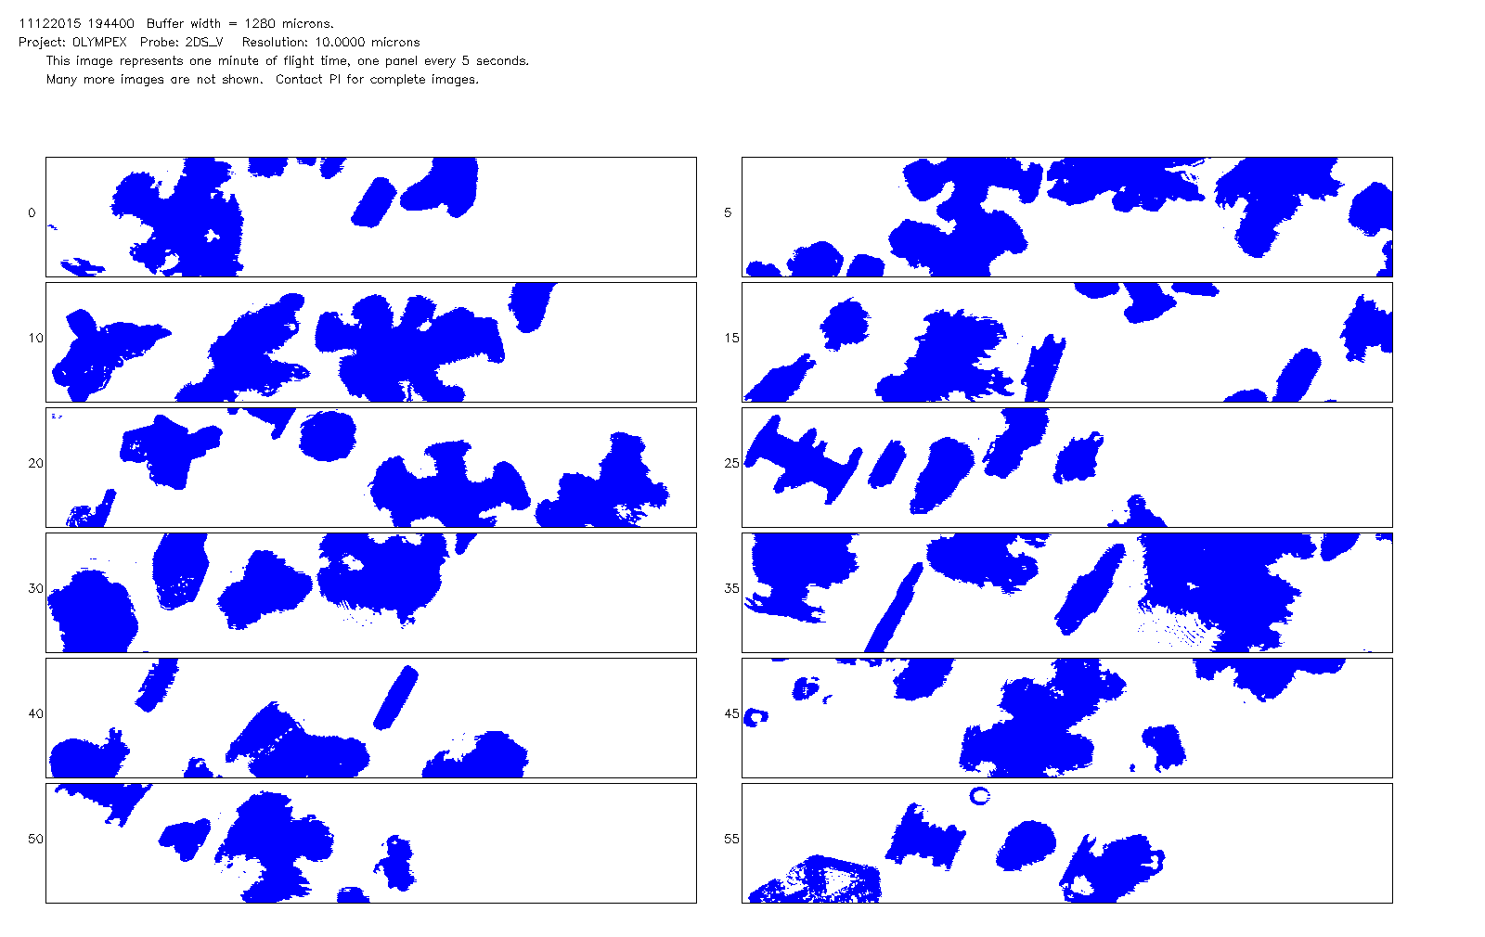
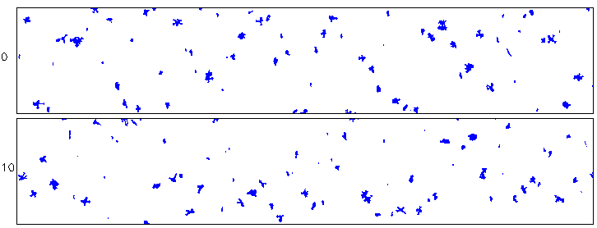
CITATION MICROPHYSICAL PROBES
CPI
15–2500 µm
200 µm
CDP
SMALL
Concentrations only
2–50 µm
MEDIUM
2DSV
10–1280 µm
200 µm
LARGE
HVPSV
150 µm–1.92 cm
200 µm
Notes:
Shadow gram, (time period)
Overlap
Interpretation of particle type
Different resolutions → distinguish between particle type and evolution
Difficulty in interpretation
Transition: Use this to determine particle type and concentration, but use this in conjunction with radar data to relate back to in-cloud dynamical and microphysical processes

Slide 9
CITATION MICROPHYSICAL PROBES
CPI
15–2500 µm
200 µm
MEDIUM
2DSV
10–1280 µm
200 µm
LARGE
HVPSV
150 µm–1.92 cm
200 µm
Notes:
Shadow gram, (time period)
Overlap
Interpretation of particle type
Different resolutions → distinguish between particle type and evolution
Difficulty in interpretation
Transition: Use this to determine particle type and concentration, but use this in conjunction with radar data to relate back to in-cloud dynamical and microphysical processes

Slide 10
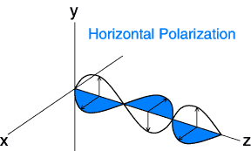
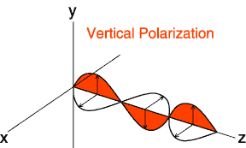
DUAL-POLARIZATION DOPPLER RADAR
Radial Velocity (V) – Velocity along beam of radar
Reflectivity, Z – Intensity (concentration, size)
Differential Reflectivity, Z_{DR} – Ratio of horizontal and vertical reflectivity (shape, size)
Correlation Coefficient, ρ_{hv} – Correlation between horizontal and vertical reflectivity (variability)
Notes:
Use DP-doppler radar
Measures H and V polarization of a volume of particles in an electric field
Transition: The specific radar I use is the Doppler on Wheels DOW radar?

Slide 11
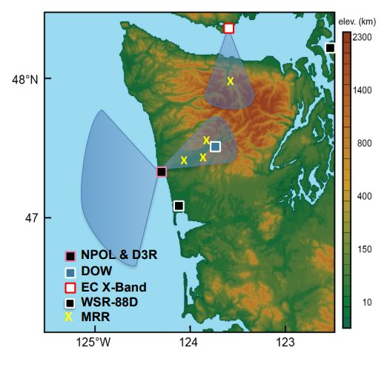
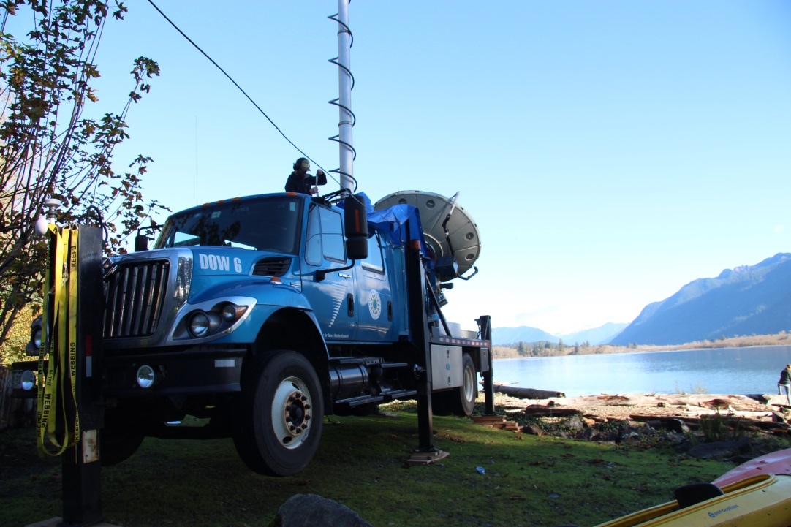
DOPPLER ON WHEELS (DOW) RADAR
Notes:
Location relative to peninsula
Data in swaths up valley , collocated with Citation spiral flight paths
Provides coincident ground based measurements and aircraft measures therefore more information where the spiral flew
Link between lower and upper levels
Transition: These coincident measurements can provide the utmost detail on the extratropical storms that passed over the Olympic mountains

Slide 12
CASE STUDY
Notes:
Focus on one case study, in which there were two citation spiral flights

Slide 13
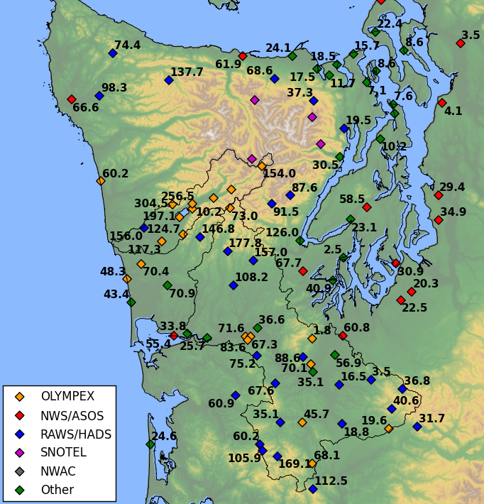
Pacific Storm of
12–13 NOVEMBER 2015
Notes:
Major rain producing frontal system that occurred from 12-13 Nov.
Chose this study to add to Joe Zagrodnik et al’s study, which focused on the detail at low and ground levels of this system.
With this study, using DOW and Citation data → fill details of upper levels (eventually fill in from ground to upper)
Two spiral flights over the DOW
Transition: What did this look like synoptically?

Slide 14
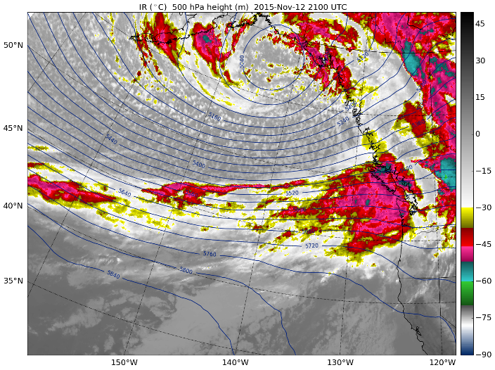
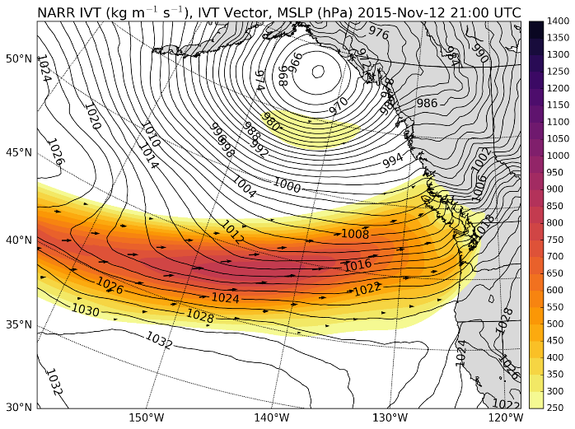
12 NOVEMBER
2100 UTC
PRE-FRONTAL
IR
IVT
Notes:
Pre-warm frontal passage
Large trough/cloud band
Large moisture flux impinging
Transition: What was occurring over Olympic Peninsula?

Slide 15
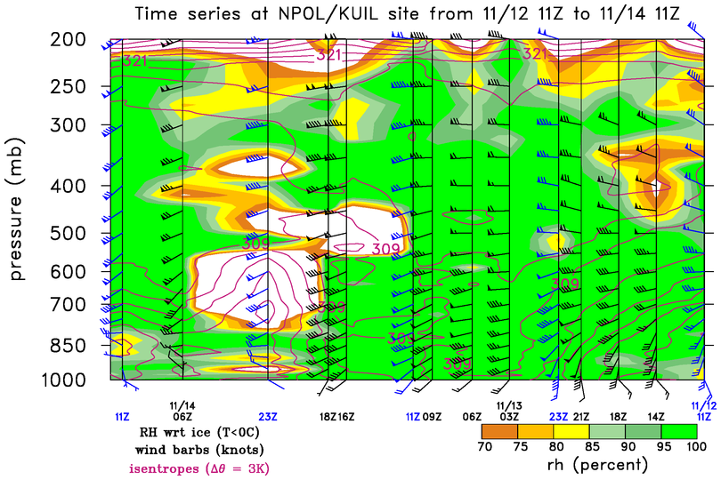
21 UTC 12 NOV
DEEP, MOIST ATMOSPHERE
Notes:
Time height cross section of soundings from (NPOL/QUILLAYUTE on COAST) (right to left)
Deep, moist atmosphere on 12 November during pre-warm frontal sector
Transition: Where and when did Citation fly on 12 Nov?

Slide 16
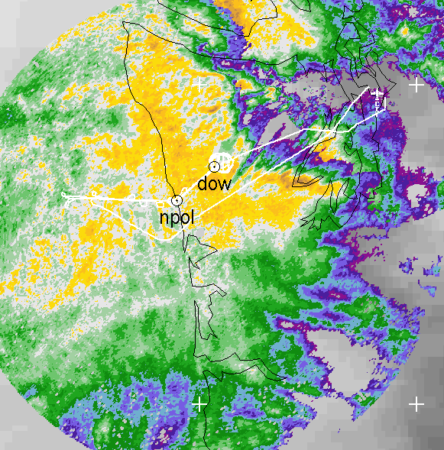
12 NOVEMBER
SPIRAL ASCENT: 1942 – 2001 UTC
Notes:
Citation spiral within ground based DOW domain
Snapshot reflectivity from NEXRAD (end of flight)
Trans: So what did this precipitating area look like from the DOW radar at ground levels?

Slide 17
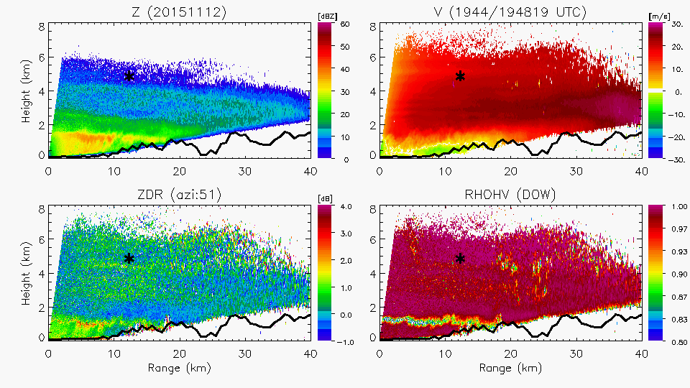
12 NOVEMBER
1948 UTC
WIDESPREAD STRATIFORM
Z
V
Height (km)
Z_{DR}
ρ_{hv}
DOW
Range (km)
Notes:
Brightband
2ndary maximum
Overall stratiform, with layering
Spiral from 3.3 – 6.5
Transition: Previous studies have inferred particle types given polarimetric signatures, but in this study, the particle imagery from the Citation obs show by direct sampling which particle types are associated with these radar signatures…So what did the citation observe?

Slide 18
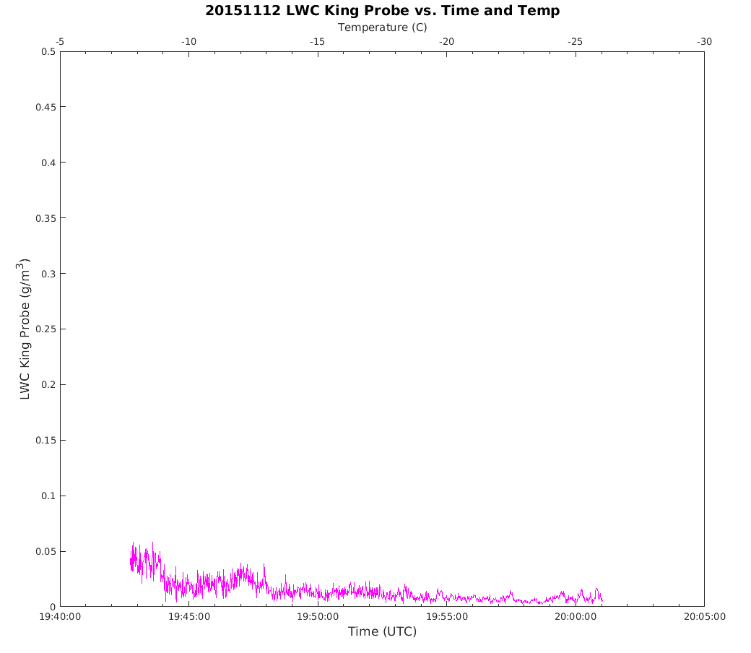
12 NOVEMBER
King Probe Liquid Water Content
LWC < 0.05 g m⁻³
Notes:
This figure shows the measured cloud LWC as during the aircraft spiral through the stratiform region. (Time on x, LWC on y).
Shows < 0.05 g m-3 above melting level→ consistent with previous lit. on stratiform.
Transition: Dual pol radar data by the DOW provide details on this stratiform region and offer context for the in situ aircraft data.

Slide 19
12 NOVEMBER
1944 UTC
Z
Height (km)
SPIRAL ASCENT
Temperature: –9°C, Altitude: 4 km
Range (km)
200 µm
200 µm
2DSV: 10–1280 μm
CPI: 15–2500 μm
Notes:
In secondary maximum
Bullets, aggregates, sectored plates, graupel?
Larger particles
Transition: Above the band of enhanced Z , there is a relative decrease in Z, which would suggest a decrease size and amount of. What did aircraft observe?

Slide 20
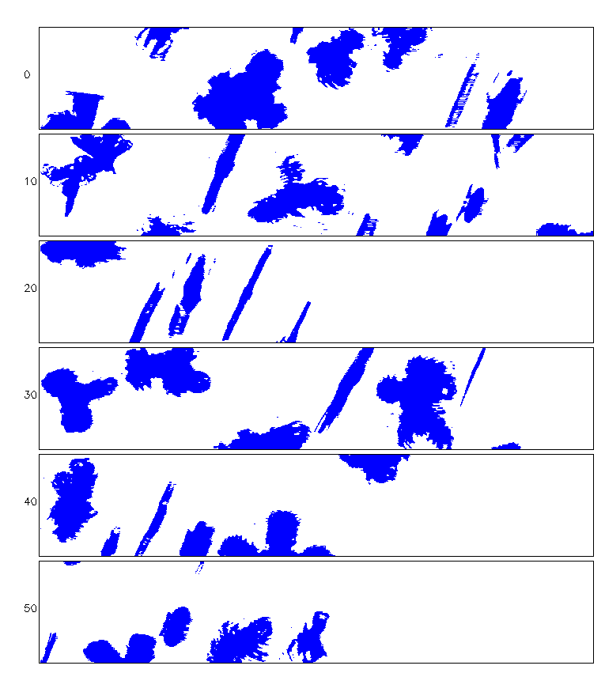
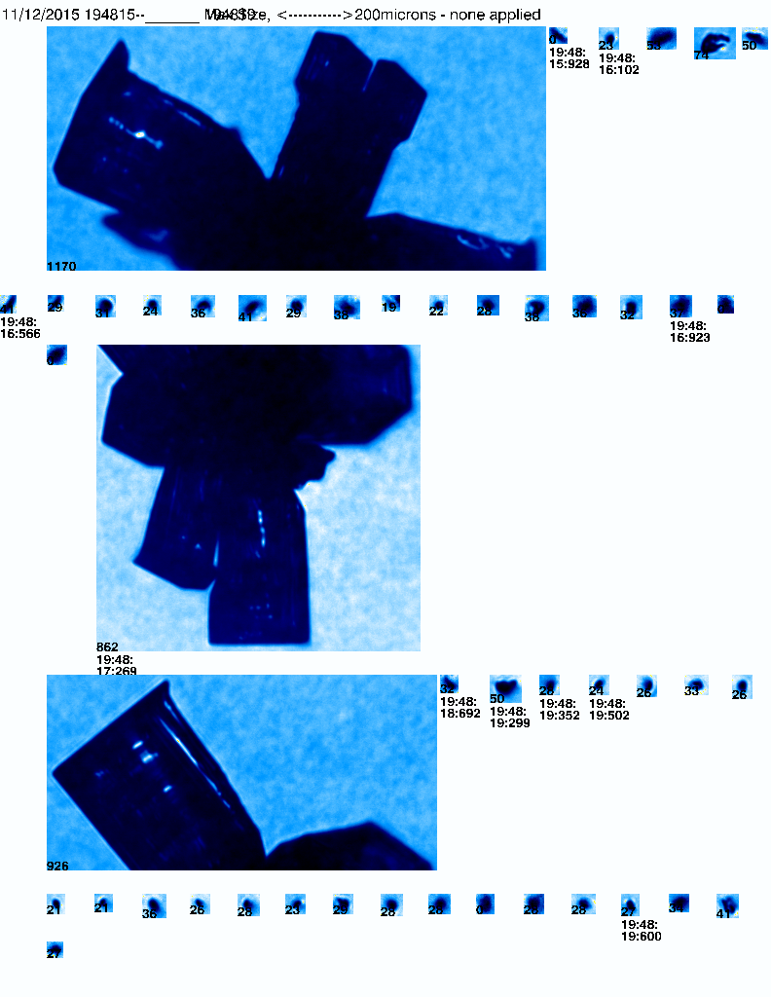
12 NOVEMBER
1948 UTC
Z
Height (km)
SPIRAL ASCENT
Temperature: –17°C, Altitude: 5 km
Range (km)
200 µm
200 µm
2DSV: 10–1280 μm
CPI: 15–2500 μm
Notes:
Particles associated with temp
Particle type seen
Decrease in size
Transition: As the aircraft continued to ascend.. Relectivity remained relatively low and decreased even more

Slide 21
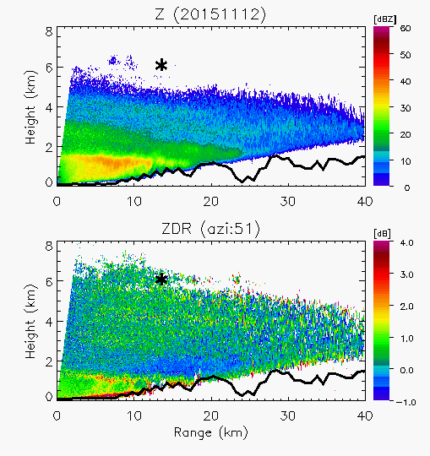
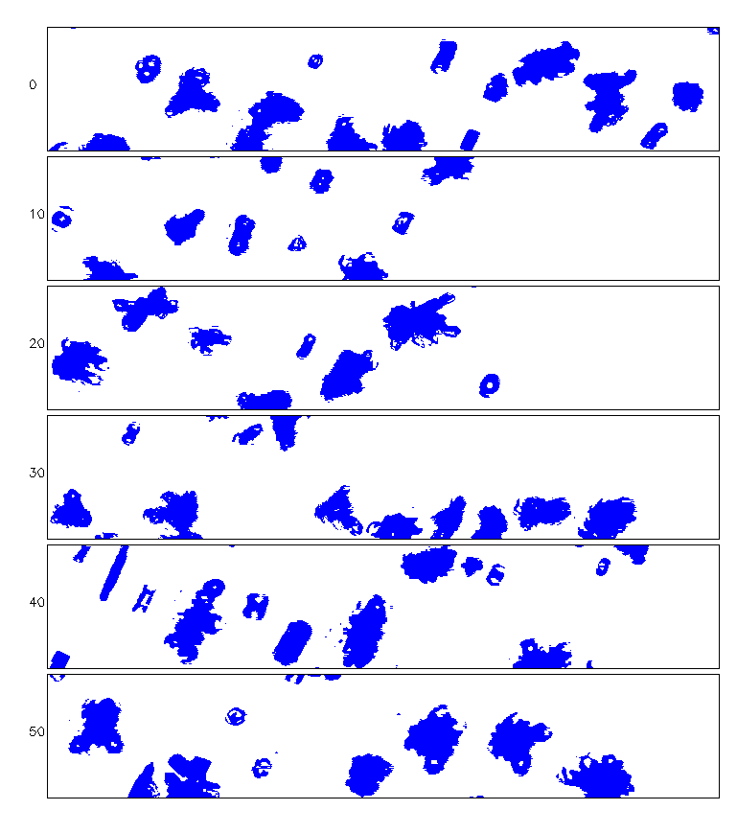
12 NOVEMBER
1957 UTC
SPIRAL ASCENT
Temperature: –26°C, Altitude: 6 km
Z
Height (km)
Z_{DR}
200 µm
Range (km)
2DSV: 10–1280 μm
Notes:
Messy mix of particles, irregular ice
Particles can’t explain Z and ZDR in this case
Z decreases, particles appear smaller and possible decrease in concentration.
But schematic expect increase..
Transition: What do particle concentrations indicate?

Slide 22
12 NOVEMBER
Particle Evolution
–9°C
–17°C
–26°C
200 µm
2DSV: 10–1280 μm
Notes:
Overall consistent with typical stratiform behavior (schematic!)
Transition: Now I use the aircraft probe data to determine relative concentrations of the particles at different levels throughout the stratiform deck, based on size

Slide 23
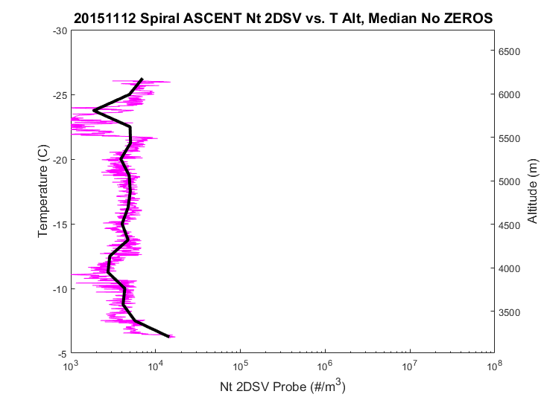
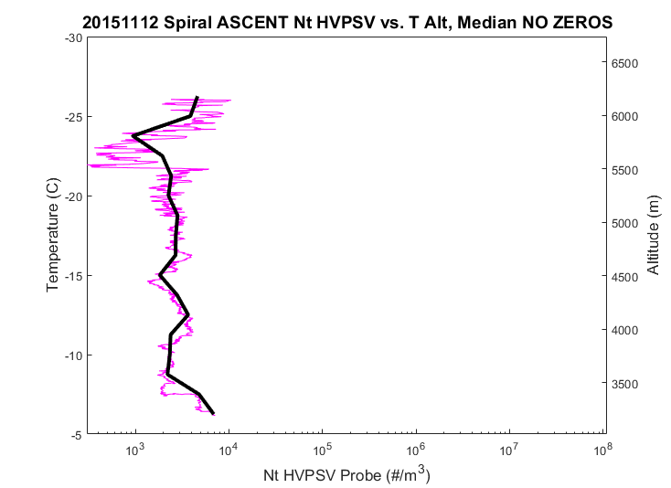
12 NOVEMBER
Particle Concentrations
2DS-MEDIUM
HVPS-LARGE
Temperature (°C)
Altitude (m)
Temperature (°C)
Altitude (m)
Concentration (m⁻³)
Concentration (m⁻³)
Increased medium and large particles
Z
Height (km)
Range (km)
Notes:
Log scale vs. T, alt. Greatest small particles (2 orders)
Overall increase in ice particle concentration near cloud top
Secondary Z max coincident with increase in medium and large particles
Transition: So far I’ve filled in detail on particle habit, and ice concentration. The third variable important for cloud microphsyical processes is the Cloud liquid water content

Slide 24
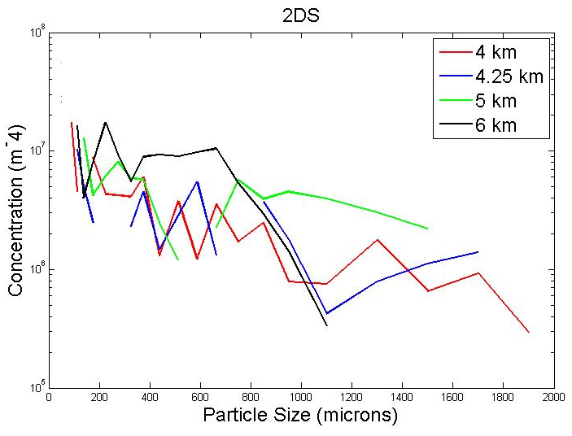
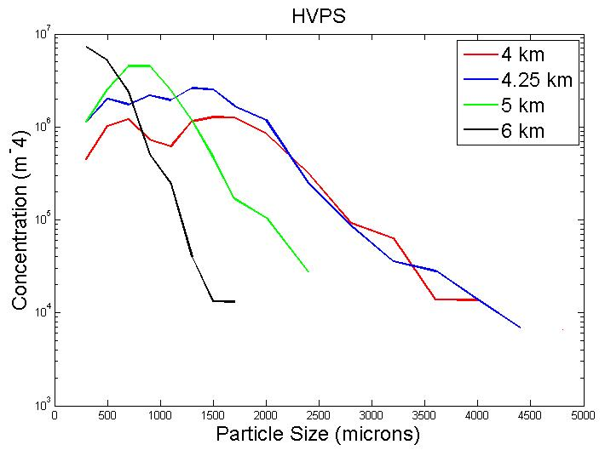
12 NOVEMBER
Particle Size Distributions
2DS-MEDIUM
HVPS-LARGE
Concentration (m⁻⁴)
Concentration (m⁻⁴)
Particle Size (μm)
Particle Size (μm)
Notes:
Highest concentrations at cloud top (6 km)
Larger particles at 4 and 4.25 km (Z enhancement)
Fewer large particles at upper levels (Z reduction)

Slide 25
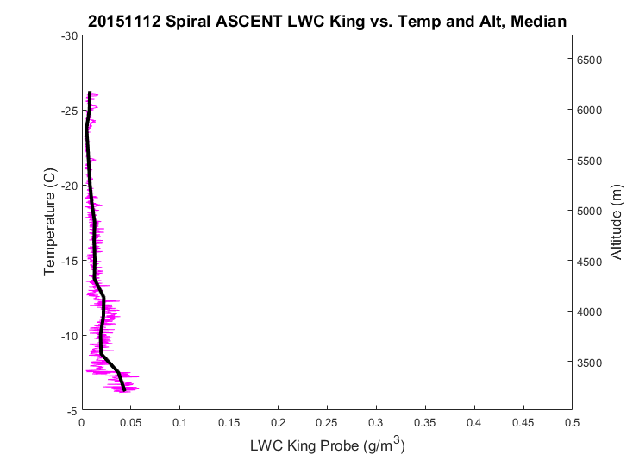
12 NOVEMBER
King Probe LWC
VERY LOW
LWC < 0.05 g m⁻³
Temperature (°C)
Altitude (m)
LWC (g m⁻³)
Notes:
Typical LWC in stratiform is < 0.01 g m-3 above 0C. Weak vertical motions.
LWC very low in this stratiform → expected
Transition: The lack of LWC suggests the dominance of vapor deposition for ice particle growth at upper levels as expected in basic layered stratiform

Slide 26
12 NOVEMBER
Conclusions
Basic layering of stratiform precipitation mechanisms, with:
  Decrease in particle size with height, secondary Z maximum associated with relative increase in medium/large particles
  High concentrations of ice particles near cloud top
  Low LWC ( < 0.05 g m⁻³) above melting level
Notes:
Unlike the 12th of November which followed the basic stratiform cloud microphysics, The 13 November spiral flight paths (ascent and descent) occurred under a much different environment and cloud microphysical conditions

Slide 27
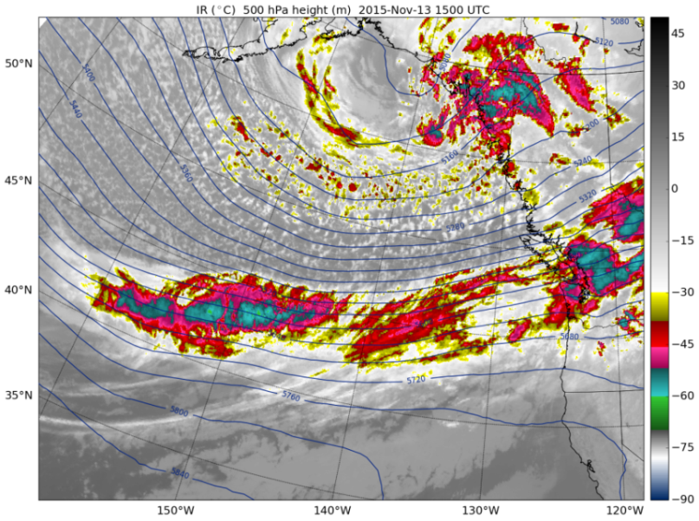
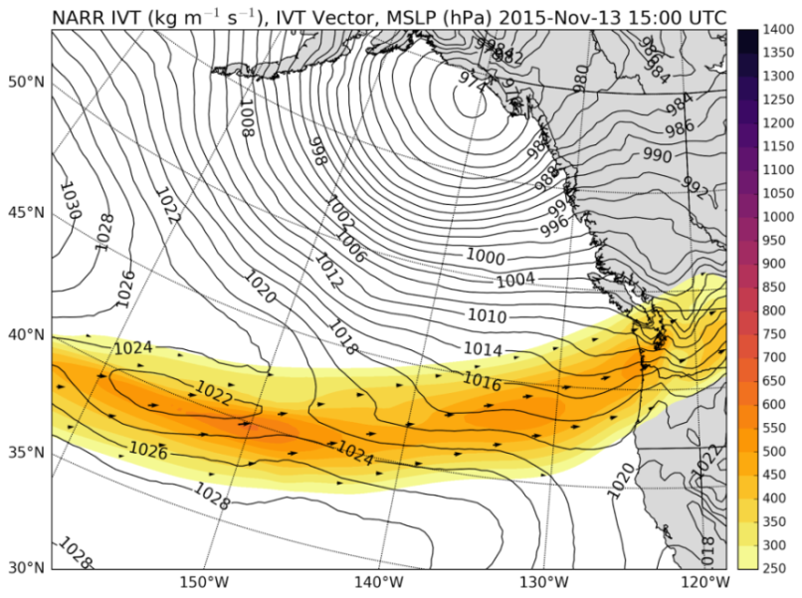
13 NOVEMBER
1500 UTC
  WARM SECTOR
IR
IVT
Notes:
Long duration warm sector passage
Still broad cloud band and moisture flux into peninsula
Cloud top heights cooler → enhancement
Transition: What does the atmosphere look like with these changes?

Slide 28
15 UTC 13 NOV
DRY LAYERS IMPINGING
Notes:
Dry air impinging into atmosphere over peninsula instead of deep and moist
Transition: How did this affect the stability of the atmosphere?

Slide 29
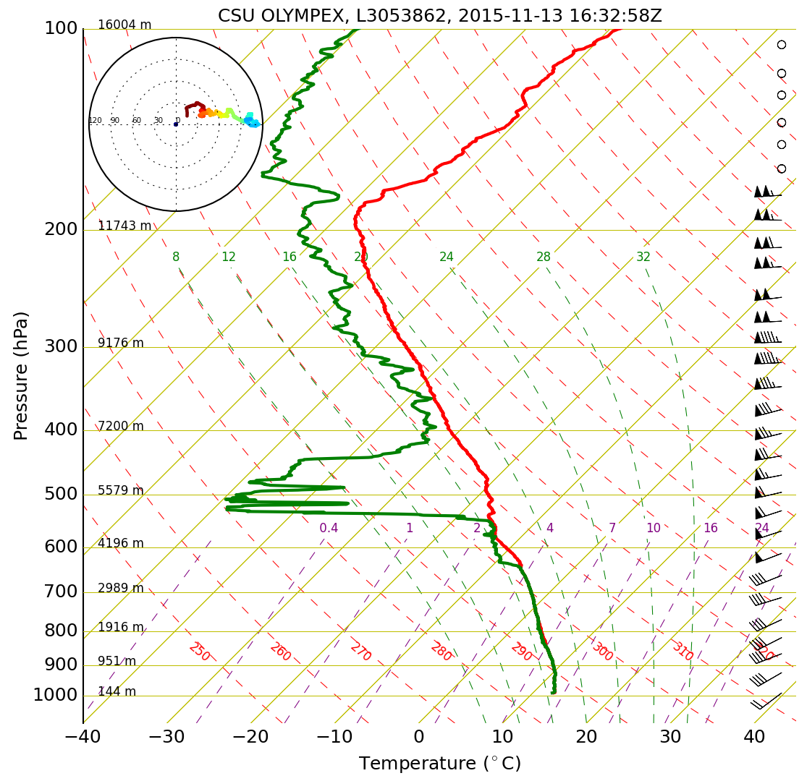
13 NOVEMBER
1632 UTC
DRY
CONDITIONALLY UNSTABLE
MOIST
Notes:
Sounding at NPOL
Between moist and dry → UNSTABLE LAYER
In stratiform schematic w/ unstable layer → development of embedded convection
Transition: Where and when did Citation fly on the 13th of November?

Slide 30
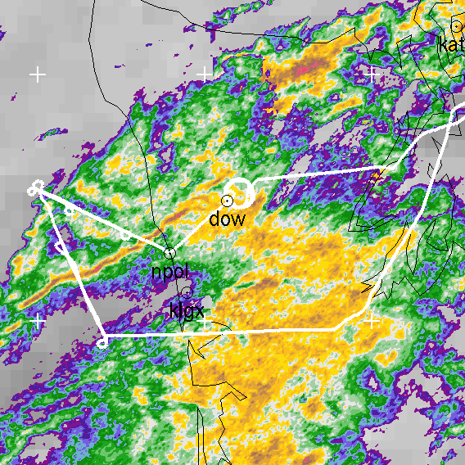
13 NOVEMBER
SPIRAL ASCENT: 1530 – 1548 UTC
SPIRAL DESCENT: 1548 – 1610 UTC
Notes:
Spiral ascent followed by descent again in domain of ground based radar DOW
What did Joe /ground measurements observe?
Transition: What did the DOW ground radar observe during the flight?

Slide 31
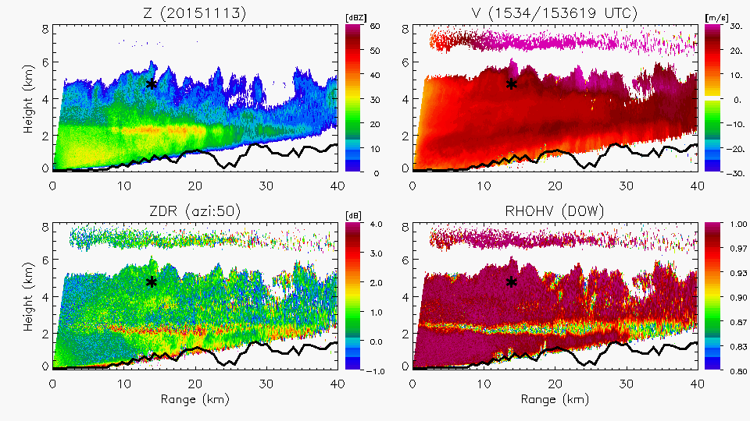
13 NOVEMBER
1536 UTC
GENERATING CELLS
Z
V
Height (km)
Z_{DR}
ρ_{hv}
DOW
Range (km)
Notes:
Enhanced BB,
What’s especially different on the 13th is the presence of small scale vertically oriented turrets (or generating cells) at the echo top of the stratiform layer
Relative increases and decreases in Z and ZDR in/near cells.
Previous studies inferred presence of LW with generating cells, and likely riming occurring in upper layer… these studies did not have or had limited in situ aircraft and radar observations..
With coincident and highest quality data.. Can better determine LWC, particle habit, and particle concentration within generating cells
Transition: First, LWC..

Slide 32
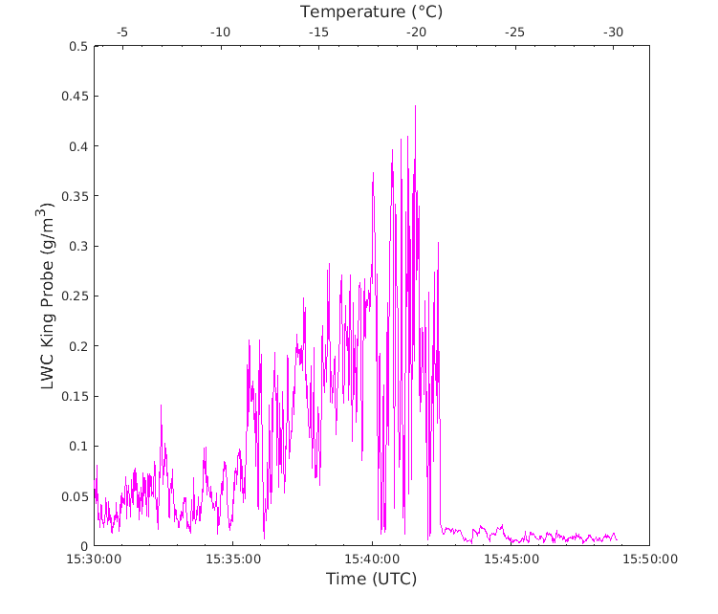
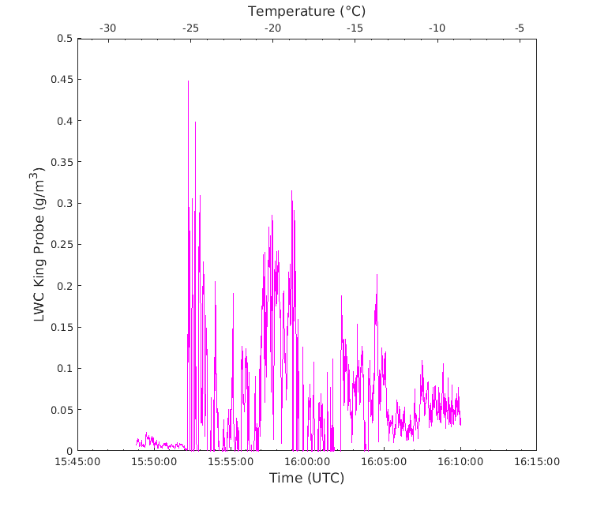
13 NOVEMBER
King Probe LWC
LWC max: 0.45 g m⁻³
ASCENT
DESCENT
MOIST
UNSTABLE
DRY
DRY
UNSTABLE
MOIST
LWC (g m⁻³)
LWC (g m⁻³)
Time (UTC)
Time (UTC)
Notes:
Maximized in cells → Greatest LWC in all spirals
Increase in LWC into unstable layer/base of turrets
Previous studies measured and inferred LWC 0.1- 0.2 g m-3
Transition; I use the particle probe images and DOW dual-pol radar to provide further insight into the processes in this system that led to the unexpectedly high LWC in the generating cells

Slide 33
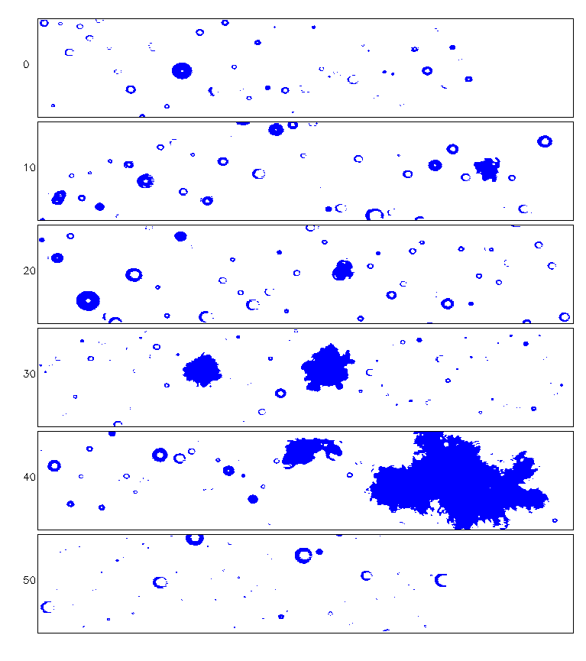
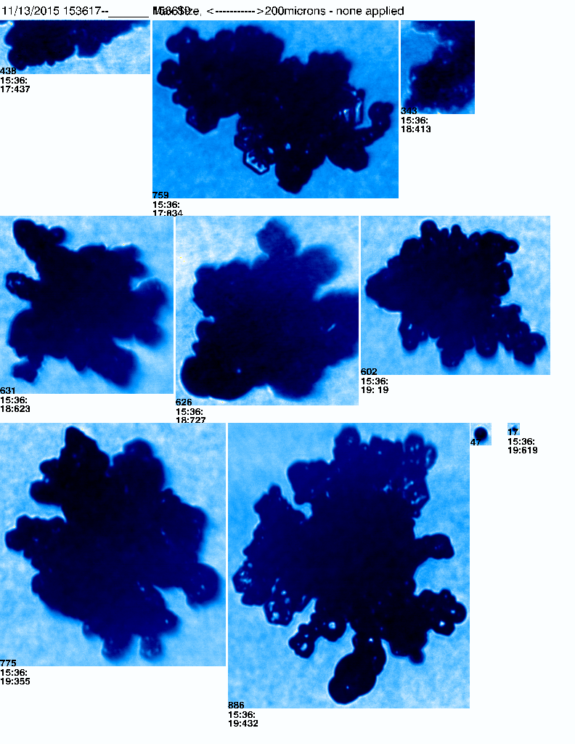
13 NOVEMBER
1536 UTC
Z
Height (km)
SPIRAL ASCENT
Temperature: –11°C, Altitude: 4.5 km
Range (km)
200 µm
200 µm
2DSV: 10–1280 μm
CPI: 15–2500 μm
Notes:
Enhanced Z, decreased ZDR in middle of cell
Plates, LW (upward motions)
Rimed plates, graupel, rimed particles aggregating
Transition: As the citation spiraled further into the generating cell,

Slide 34
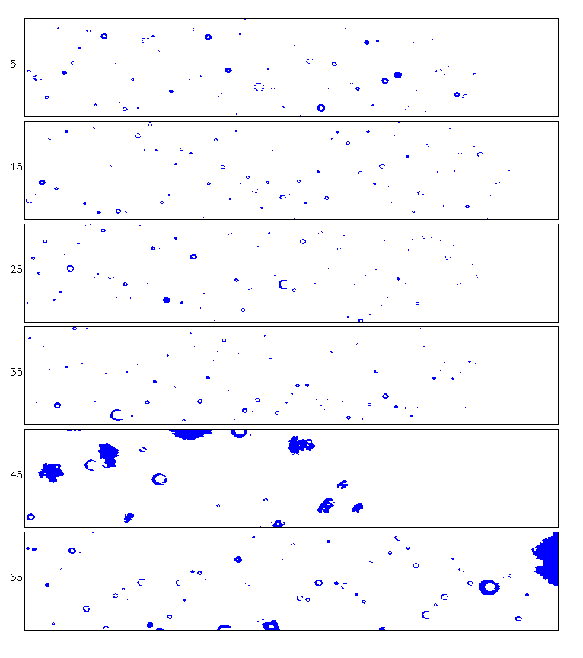
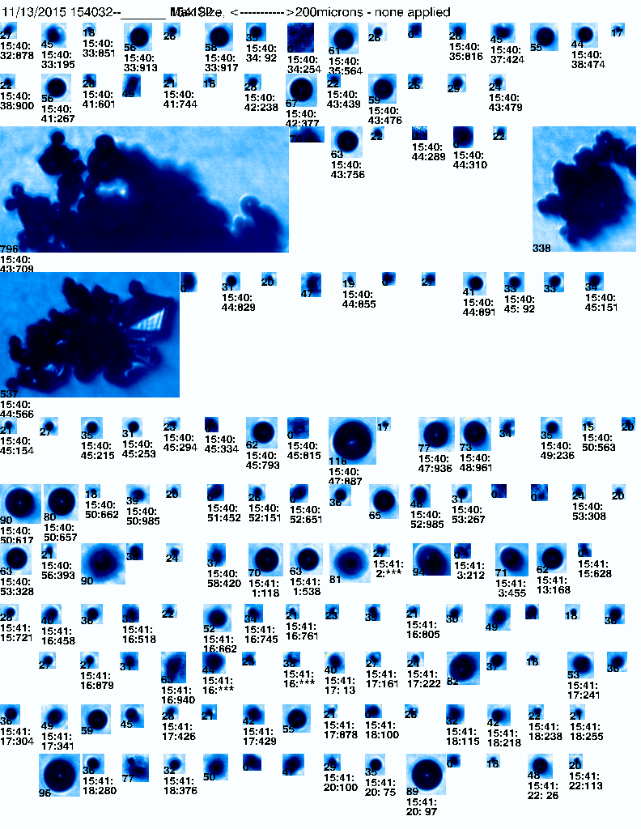
13 NOVEMBER
1541 UTC
Z
Height (km)
SPIRAL ASCENT
Temperature: –18°C, Altitude: 5 km
Range (km)
200 µm
200 µm
2DSV: 10–1280 μm
CPI: 15–2500 μm
Notes:
Smaller Plates and LW (LWC maximized here)
Rimed particles
Enhanced Z, decreased ZDR in middle of cell → was inferred to be due to riming, aggregation, or both in cells.
Images show rimed particles (more spherical—decreasing ZDR and increase diameter– increasing Z)
flight scientists noted turbulence and some aircraft icing → upward motions in unstable layer → increase LWC and promote riming
Transition: What happened during spiral descent back through generating cells?

Slide 35
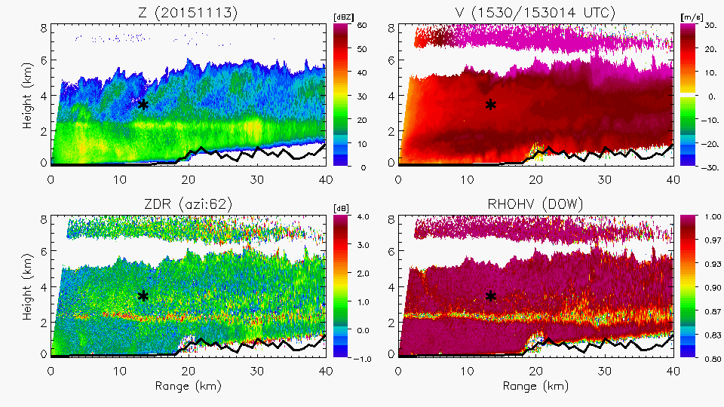
13 NOVEMBER
1607 UTC
Z
V
Height (km)
Z_{DR}
ρ_{hv}
DOW
Range (km)
Notes:
Gif for transient nature of turrets
Transformation of radar echo: lowered, no longer localized enhancements
Turrets less distinct and collapsing due to transient nature of generating cells
Transition: What crystal habits did the Citation observe as it returned to the stratiform deck below the generating cells?

Slide 36
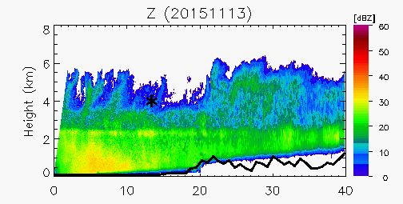
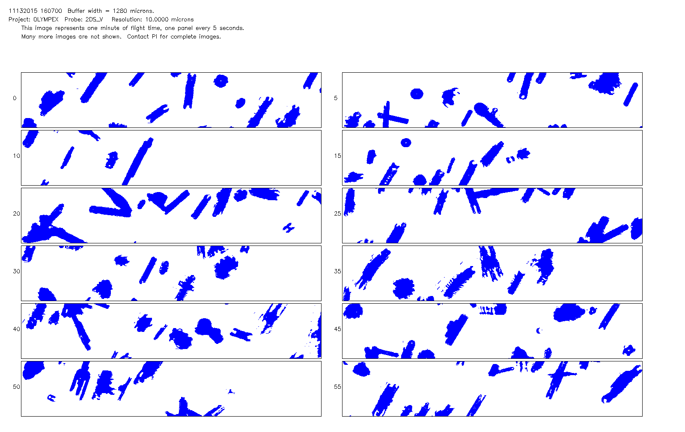
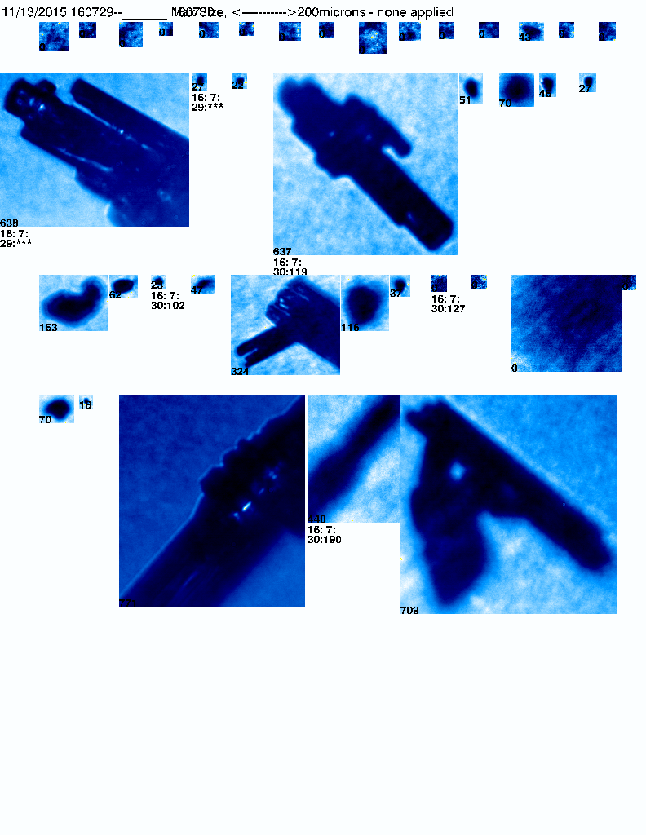
13 NOVEMBER
1607 UTC
Z
Height (km)
SPIRAL DESCENT
Temperature: –10°C, Altitude: 4.25 km
Range (km)
200 µm
200 µm
2DSV: 10–1280 μm
CPI: 15–2500 μm
Notes:
Columns, some small plates, and few liquid water droplets and rimed columns.
Consistent with typical habit vs temp, but include rimed particles due to cells
(CHANGE TO ZDR? Bc further into deck)

Slide 37
13 NOVEMBER
Particle Evolution
ASCENT
–11°C
ASCENT
–18°C
DESCENT
–10°C
200 µm
2DSV: 10–1280 μm
Notes:
Base of cell: small plates, rimed plates, rimed aggregates (and liquid water)
In cell: smaller particles, smaller rimed particles
Below cell in fallstreak: columns, rimed particles, few plates
Upward motions generating supercooled liquid water prevent glaciation and ice particle growth within cells due to riming
Transition: Using citation probe observations we can see what the particle concentrations are wrt cells.

Slide 38
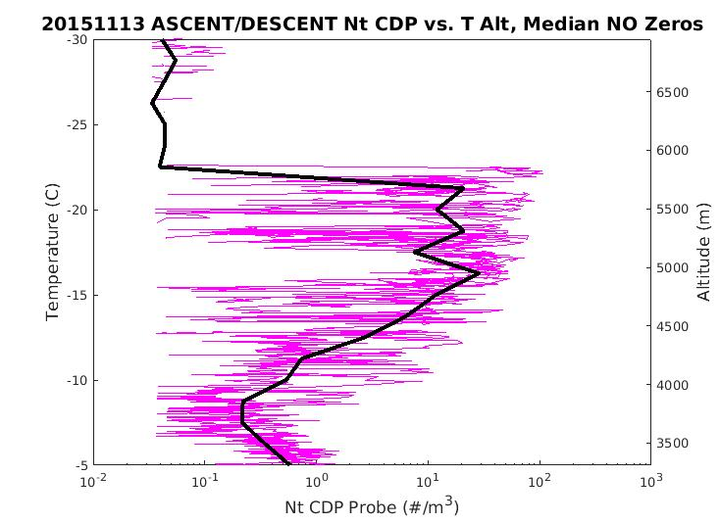
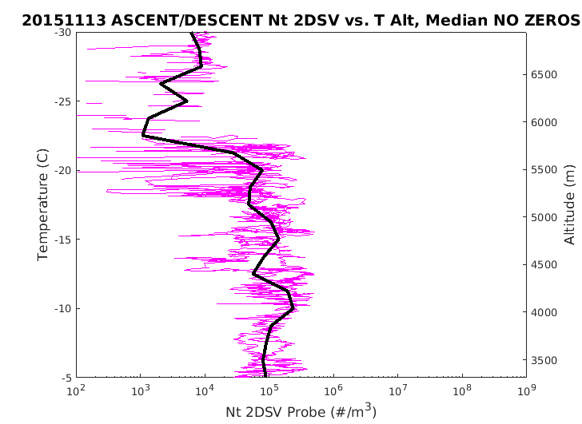
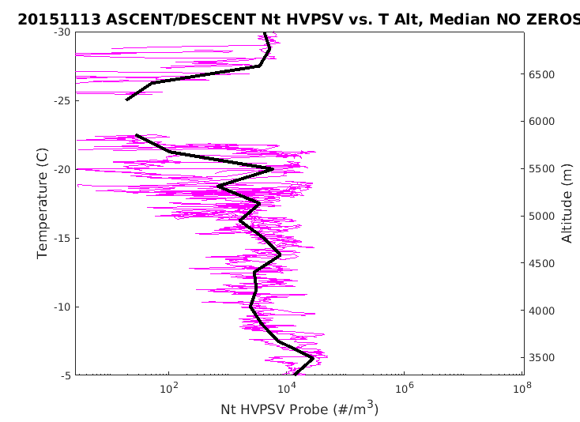
13 NOVEMBER
Ascent and Descent Particle Concentrations
CDP-SMALL
2DS-MEDIUM
Temperature (°C)
Temperature (°C)
Altitude (m)
Altitude (m)
Concentration (m⁻³)
Concentration (m⁻³)
HVPS-LARGE
Temperature (°C)
Altitude (m)
Concentration (m⁻³)
Notes:
Log scale, concentration vs. temp and altitude (ascent AND descent)
Small droplets increase and maximize in generating cell (greater than near ML)
Variations in medium and large droplets, still forming ice particles in cells
Transition: Variability in Nt also see variability in LWC in cells

Slide 39
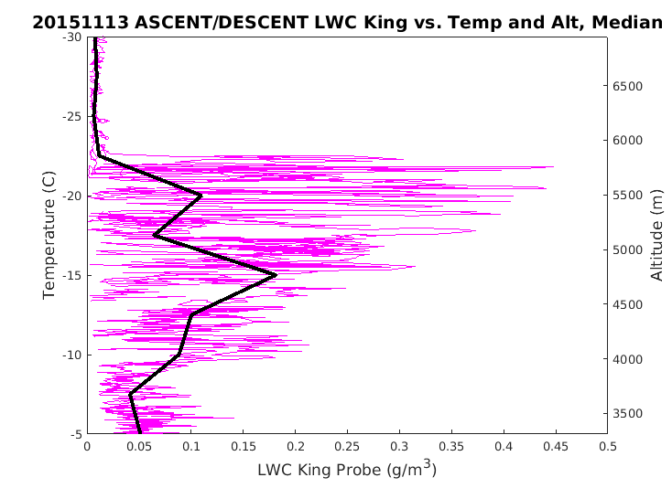
13 NOVEMBER
Ascent and Descent King Probe LWC
LWC MAX: 0.45 g m⁻³
Temperature (°C)
Altitude (m)
LWC (g m⁻³)
Notes:
Black lines are median values of the cloud LWC based T
Median values maximize at -15 (transient cells) and within cells
Transition: So now I have shown you the particle habit within the generating cell, the ice particle concentrations, cloud liquid water content, as well as the polarimetric signatures. With these I have created a schematic of a generating cell.

Slide 40

GENERATING CELLS
Notes:
Reflectivity greatest in mid-cell, collocated with reduction in ZDR (not shown)
Upper cell: high concentrations of supercooled LW, plates, and rimed plates
Near -15 (dendritic zone): rimed aggregates appear
Warmer temps/ into fall streak: Particle size increases, columns/ice particles, rimed ice particles and rimed aggregates
LWC as high as .45 g m-3
LWC decrease below -15C.
Transition: Therefore to conclude: with the data from 13 November

Slide 41
13 NOVEMBER
Conclusions
Generating cells have:
LWC max 0.45 g m⁻³
Supercooled liquid water droplets, rimed particles in cells→ increase Z, decrease Z_{DR}
Plate-like, columnar, and rimed particles below cells
Notes:
OLYMPEX observations show:
High LWC due to strong upward motions preventing ice particle growth
Riming in cells → anticorrelation in Z/ZDR
Plates, cols, and rimed particles from cell into fallstreak

Slide 42
CONCLUSIONS
Ice concentration, liquid water content, and particle habit adhered to basic layering of stratiform precipitation mechanisms on 12 November
High concentrations of supercooled liquid water and plate-like crystals in generating cells led to riming in both the turret and fallstreak below
Notes:
And overall To conclude:
12 Nov (expected and actual values for Nt,LWC,habit)
13 Nov –microphysical detail on generating cells

Slide 43
FUTURE ANALYSIS
Link between ground observations and upper levels, windward and leesides
  High resolution aircraft radar data
Study other spiral flight tracks
  Ocean vs. land
  Warm vs. cold
  Pre vs. post-frontal

Slide 44










Slide 45
THANK YOU!
QUESTIONS?

Slide 46
Extra

Slide 47



