Slide 1
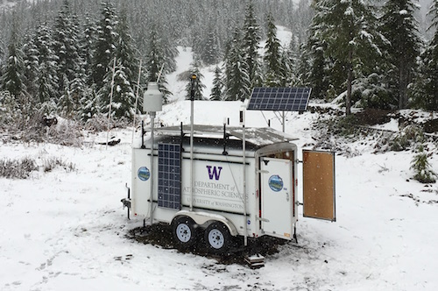
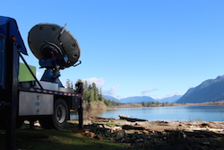
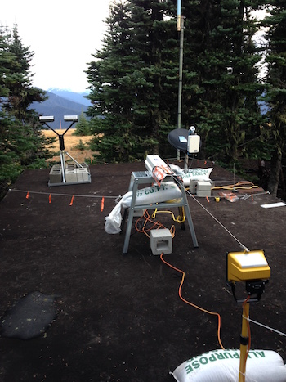

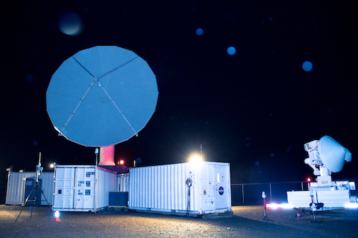

Orographic Effects on Precipitation as observed during The Olympic Mountains Experiment (OLYMPEX)
Lynn McMurdie, Robert A. Houze, Jr., and Joseph Zagrodnik
University of Washington
(with input from S. Brodzik, T. Schuldt and A. Rowe)
AMS San Diego, 27 July 2017
Houze et al. 2017, Zagrodnik et al. 2017

Slide 2

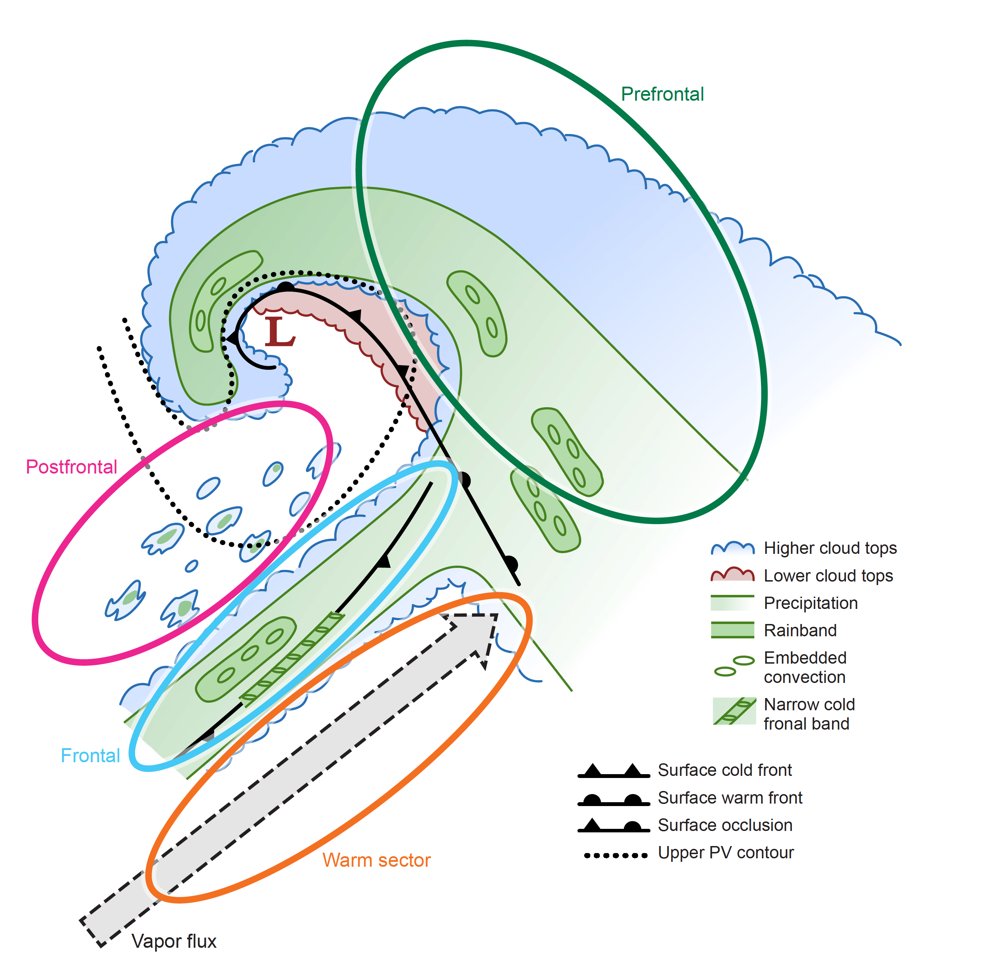
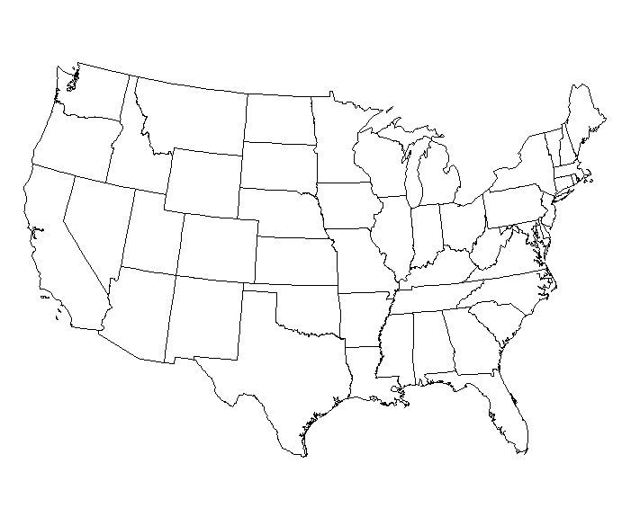
OLYMPEX Goals
Physical validation to support Global Precipitation Measurement (GPM) algorithms
Orographic effects on frontal precipitation
Facilitates statistical analysis
OLYMPEX sampled many (~65) frontal systems from Oct 2015 – April 2016

Slide 3
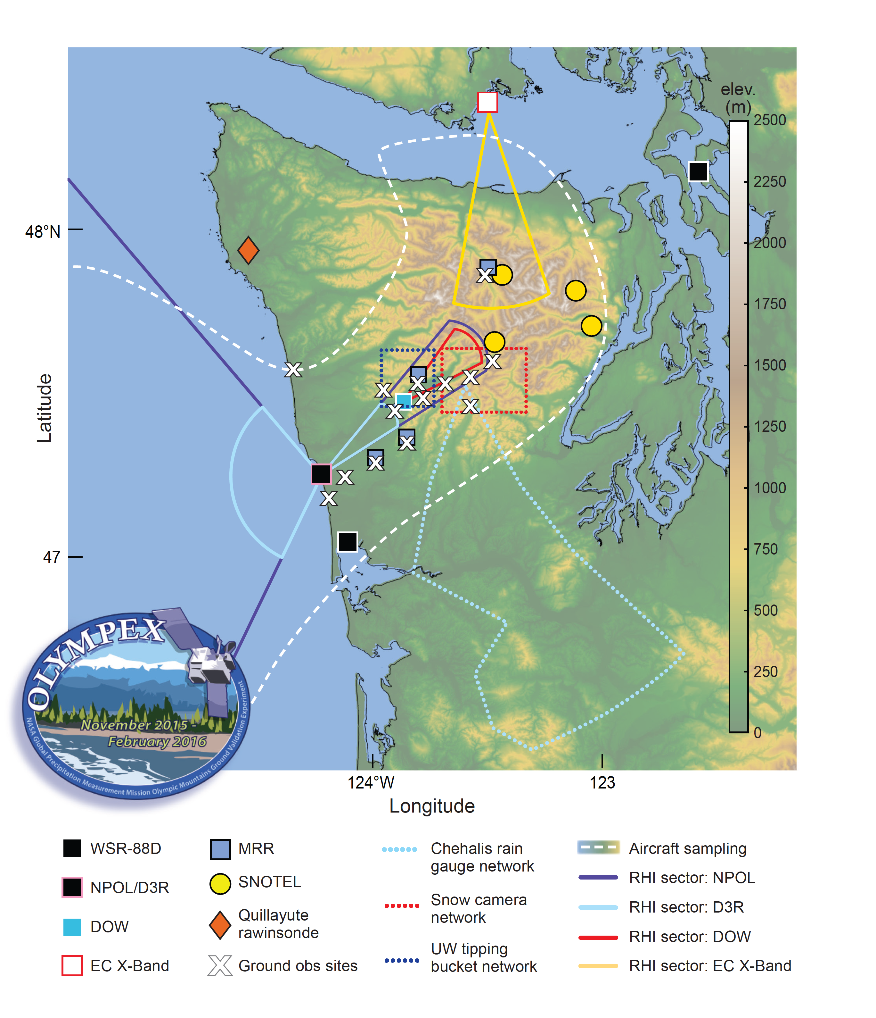
The Observational Network
Fall 2015 – Winter 2016
NPOL: S-Band Dual Polarization Doppler Radar
  RHI Scans
  Over Ocean
  Over Windward slopes
Ground network of rain gauges and Parsivel Disdrometers
NPOL

Slide 4
Vertical Structure of Radar reflectivity Ocean vs. Windward Slopes
Created CFADs (Contoured Frequency by Altitude Diagram) of reflectivity (above 2 km) when NPOL was operating (12 Nov – 18 Dec, 3—15 Jan) for all RHI scans over Ocean vs. all RHI scans over windward slopes
Partitioned by environmental parameters as calculated at NPOL location using North America Regional Reanalysis
  Melting level height
  Integrated vapor transport (IVT)
  Low level (925hPa) flow direction
  Moist Static Stability
Enhancement aloft

Slide 5
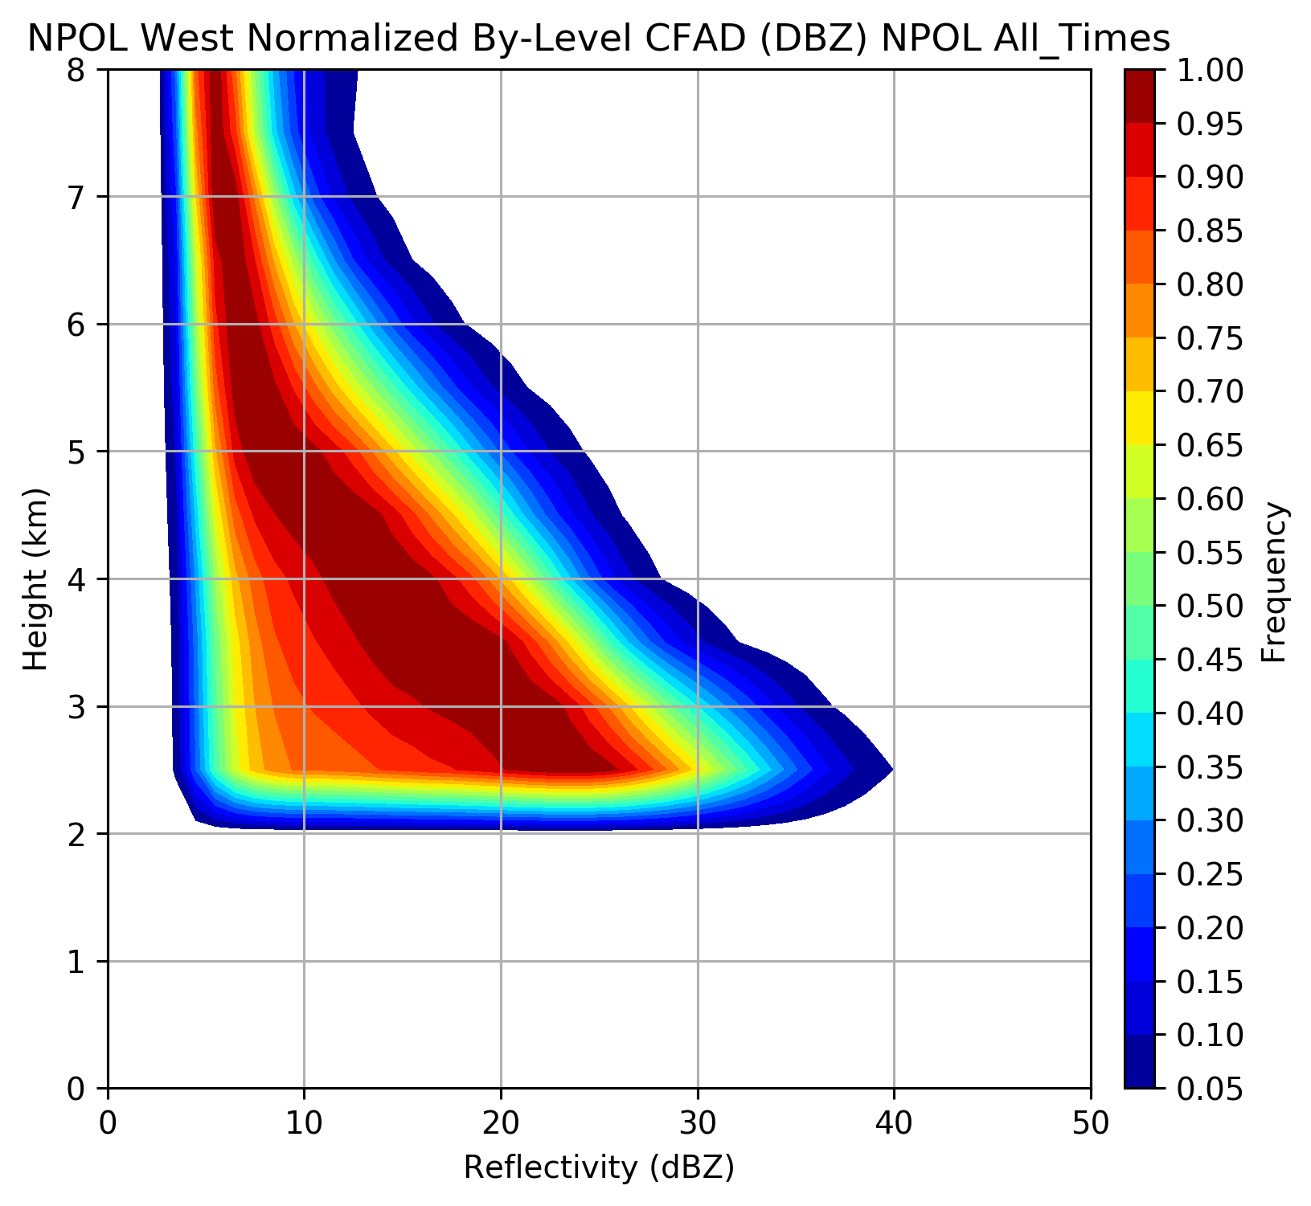
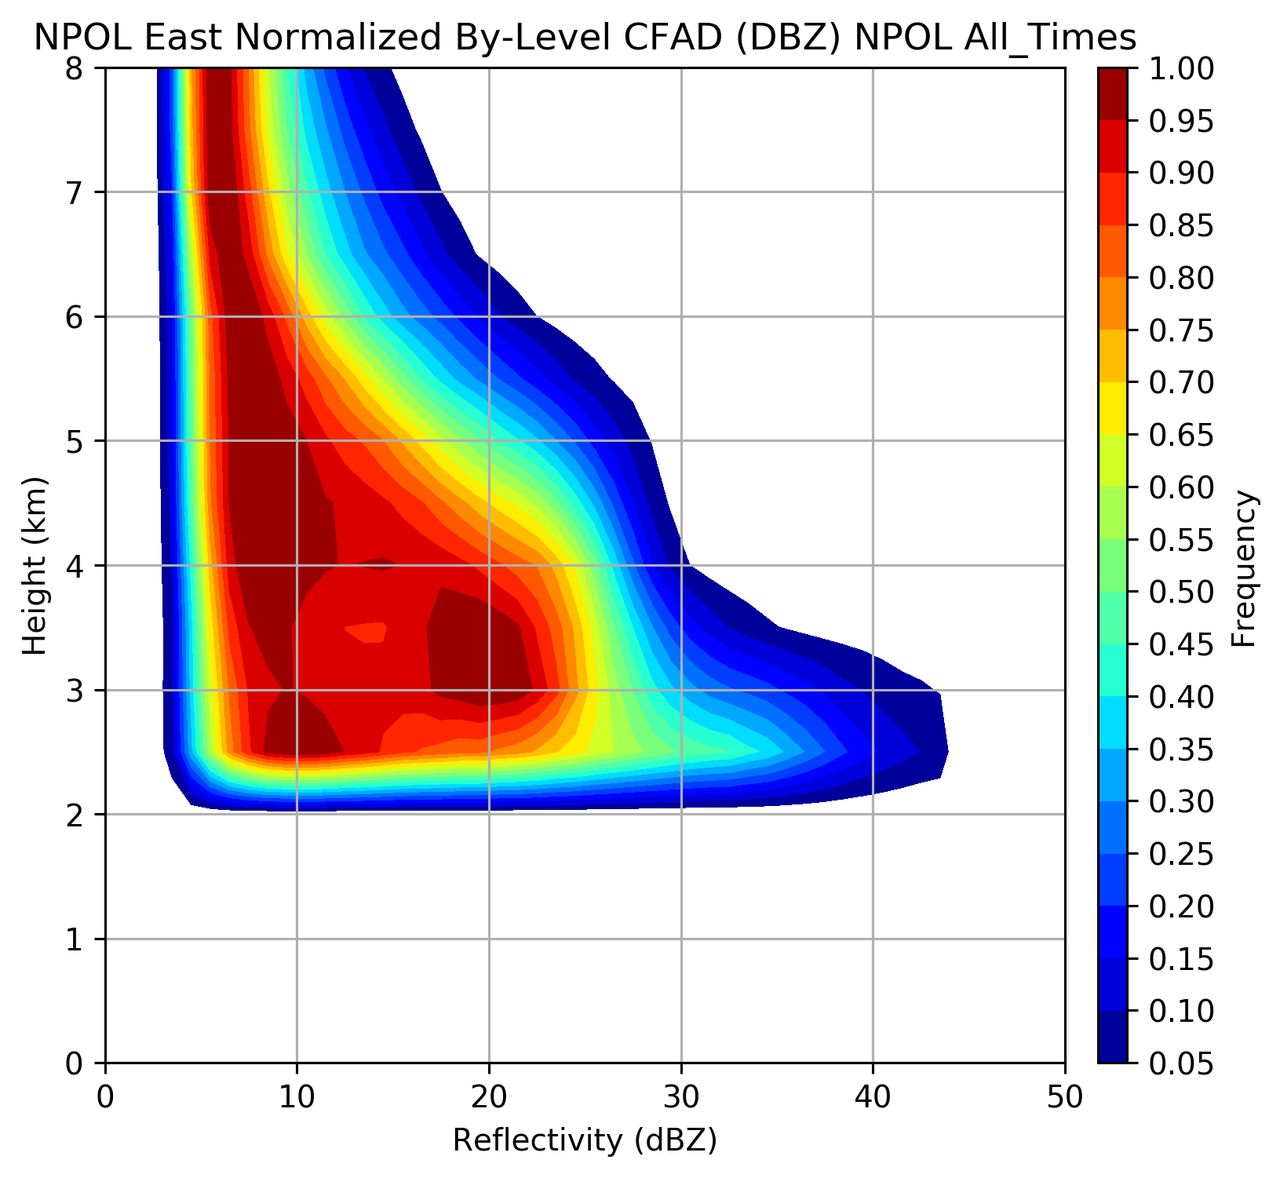
Ocean
Land
CFAD (Contoured Frequency by Altitude Diagram)
Eliminated region below 2km – clutter, beam angle
Higher reflectivity at brightband (~2 – 2.5 km) over land (windward slopes)
Higher reflectivity at ~4.5 – 5 km over land

Slide 6
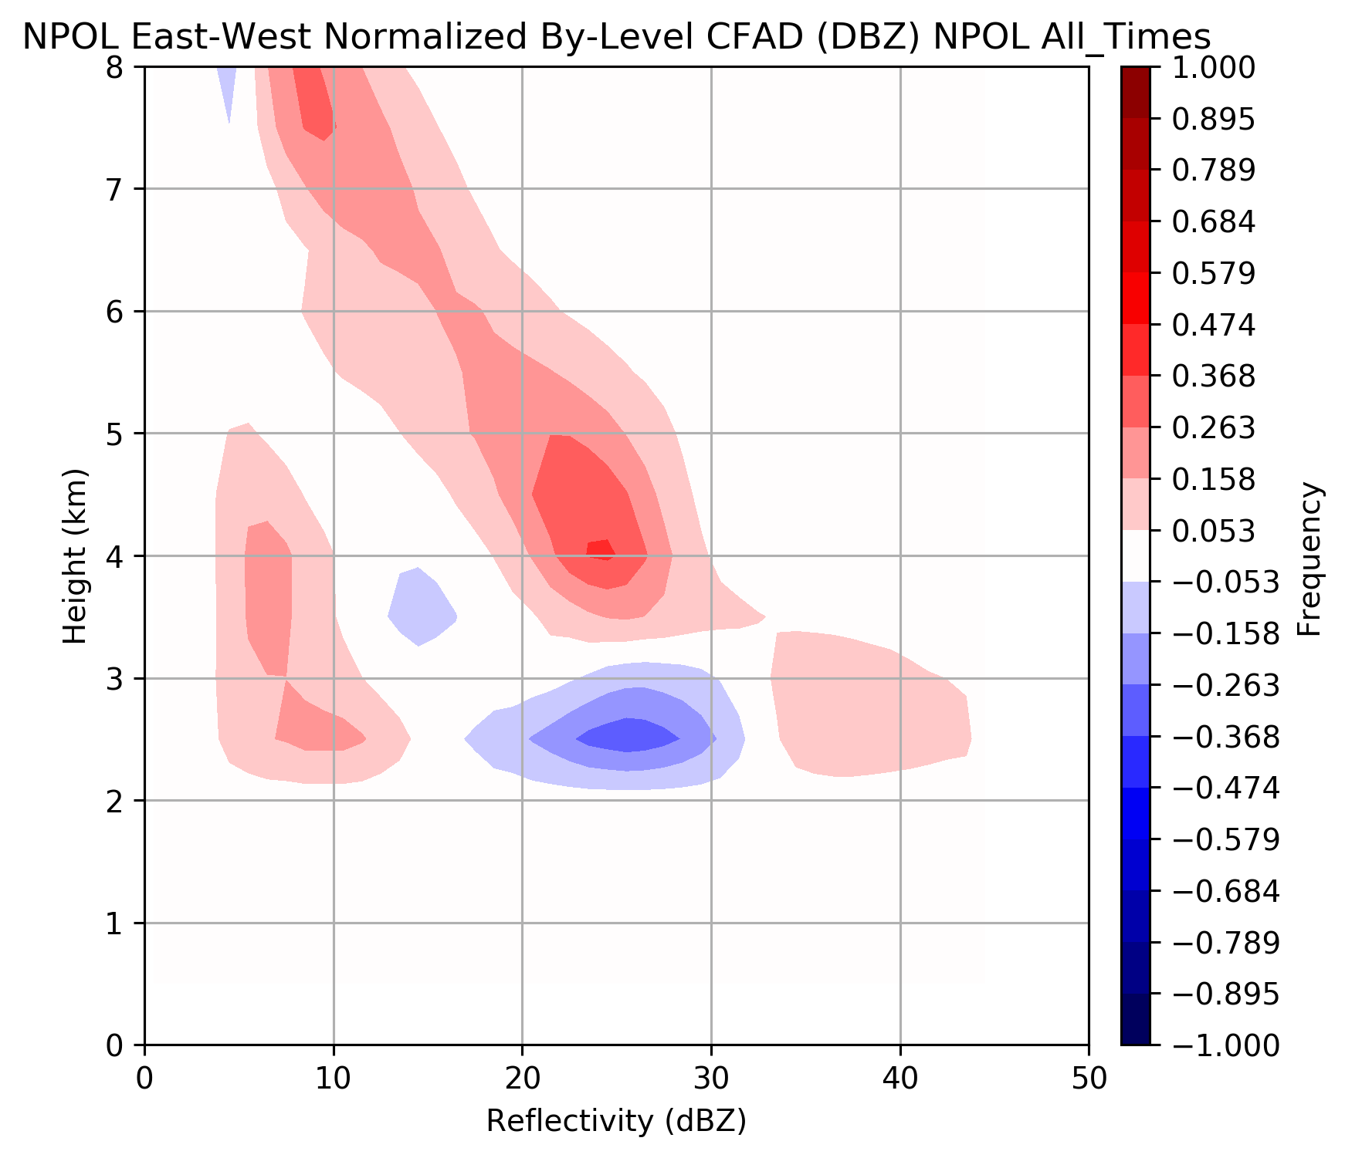
Difference – Land minus Ocean
Higher frequency over land at all levels
Shift towards higher dBz near Bright band
Red areas = land has higher frequency than ocean

Slide 7
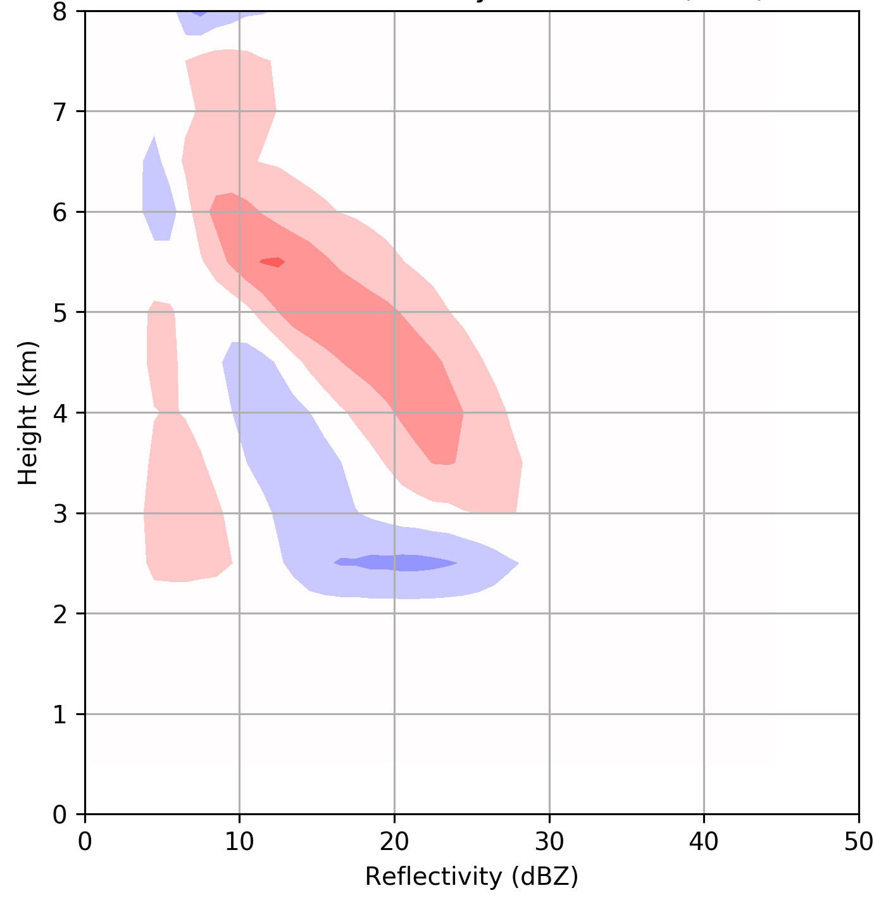
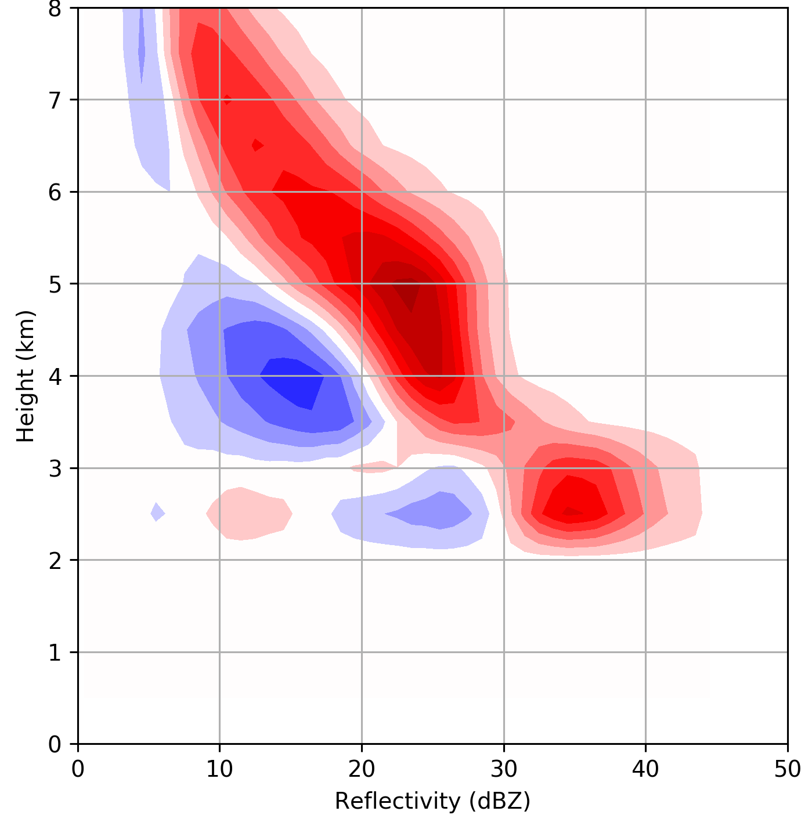
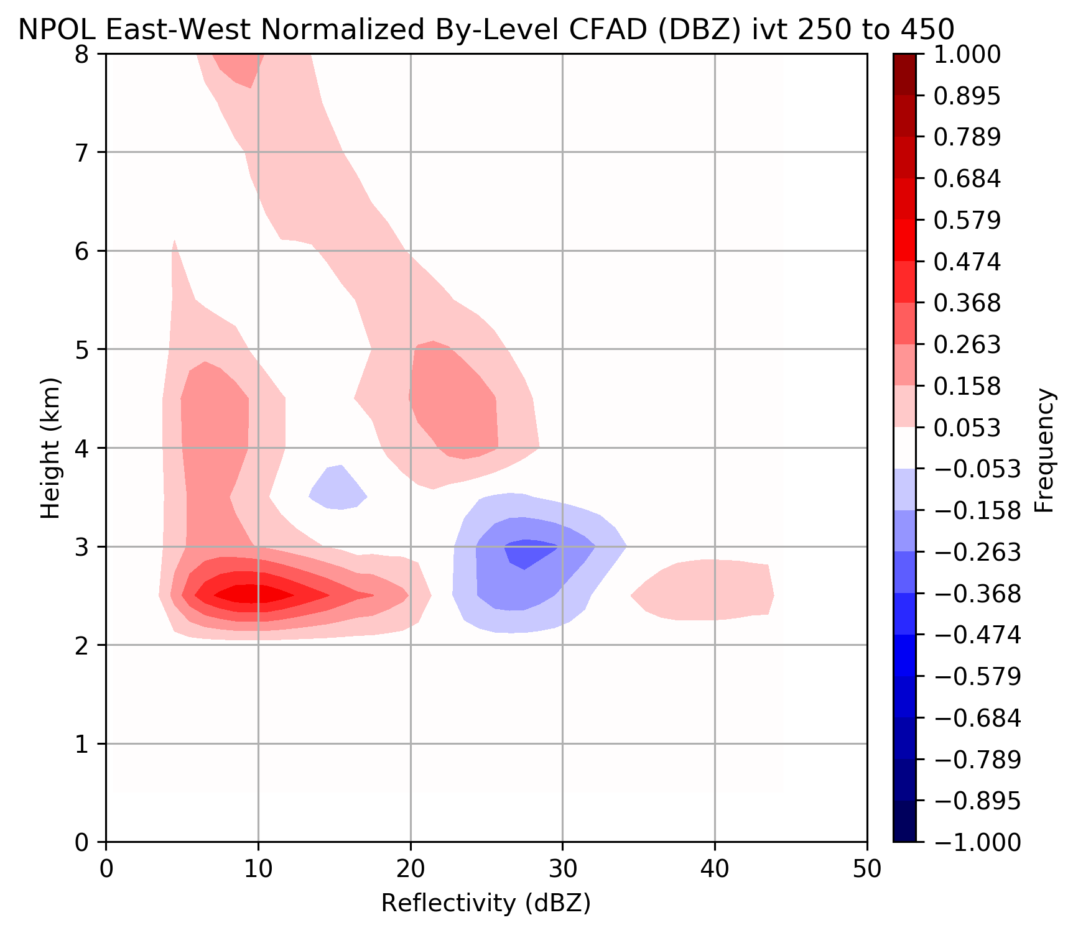
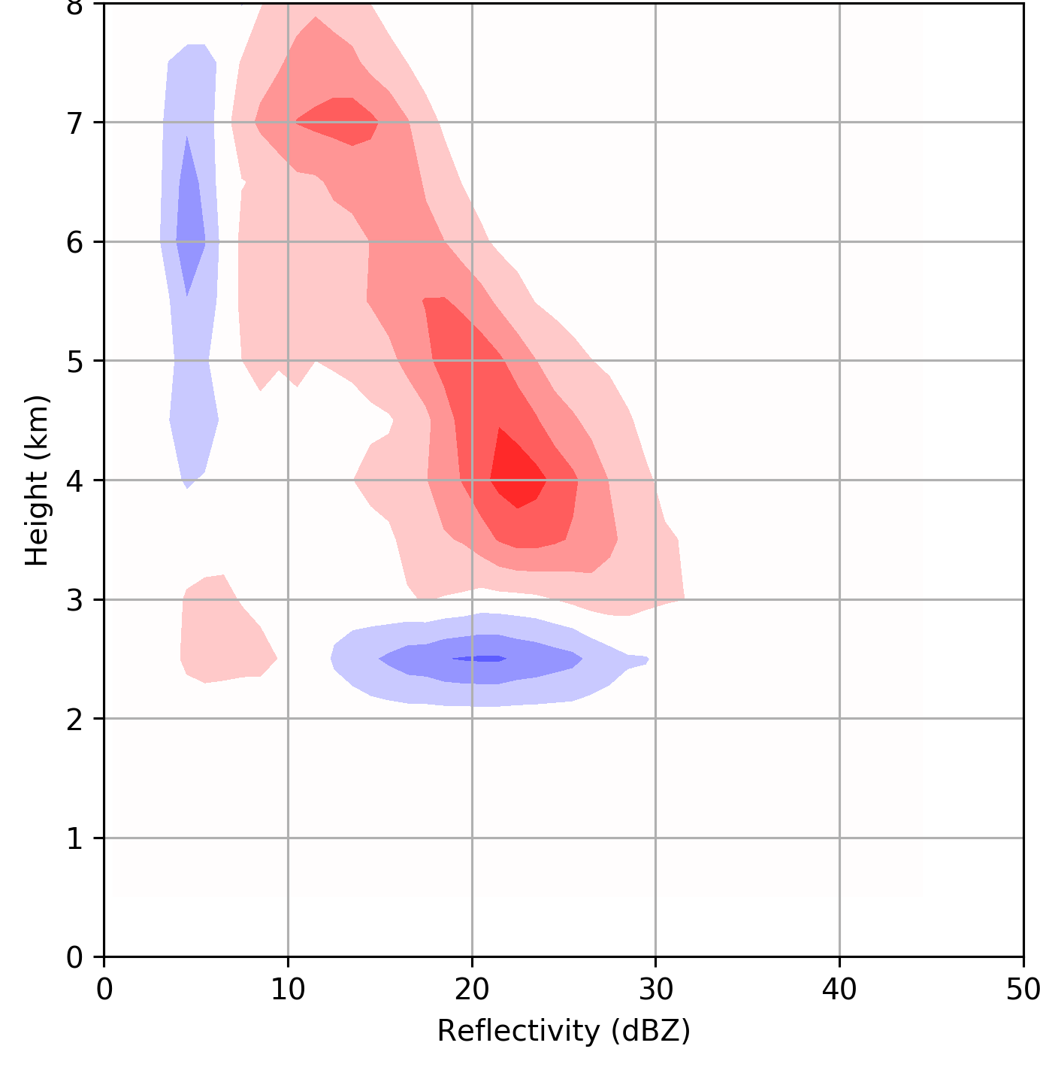
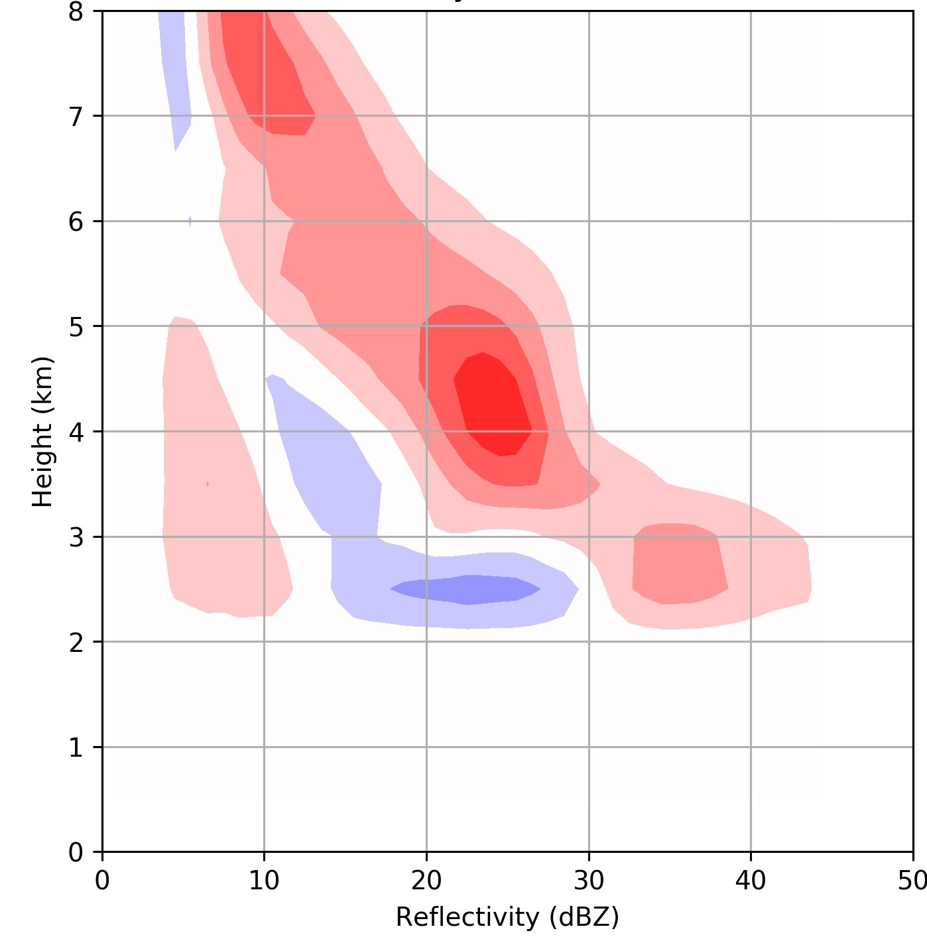
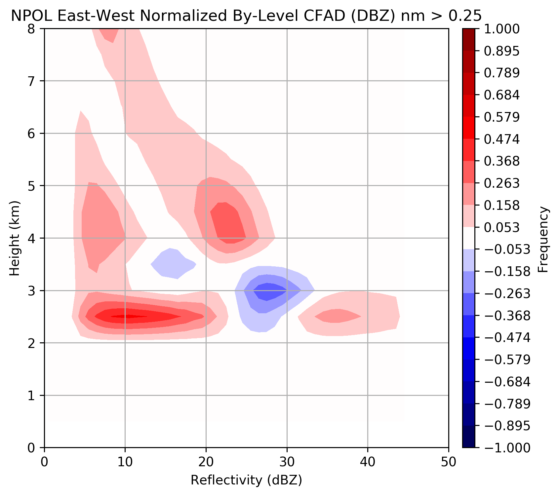
~Post-Frontal
~Warm Sector
~Pre-Frontal
70% of total time
10% of total time
20% of total time
IVT<250 kg m⁻¹ s⁻¹
450<IVT
250<IVT<450
20% of total time
43% of total time
37% of total time
Nm unstable
Nm neutral
Nm stable

Slide 8
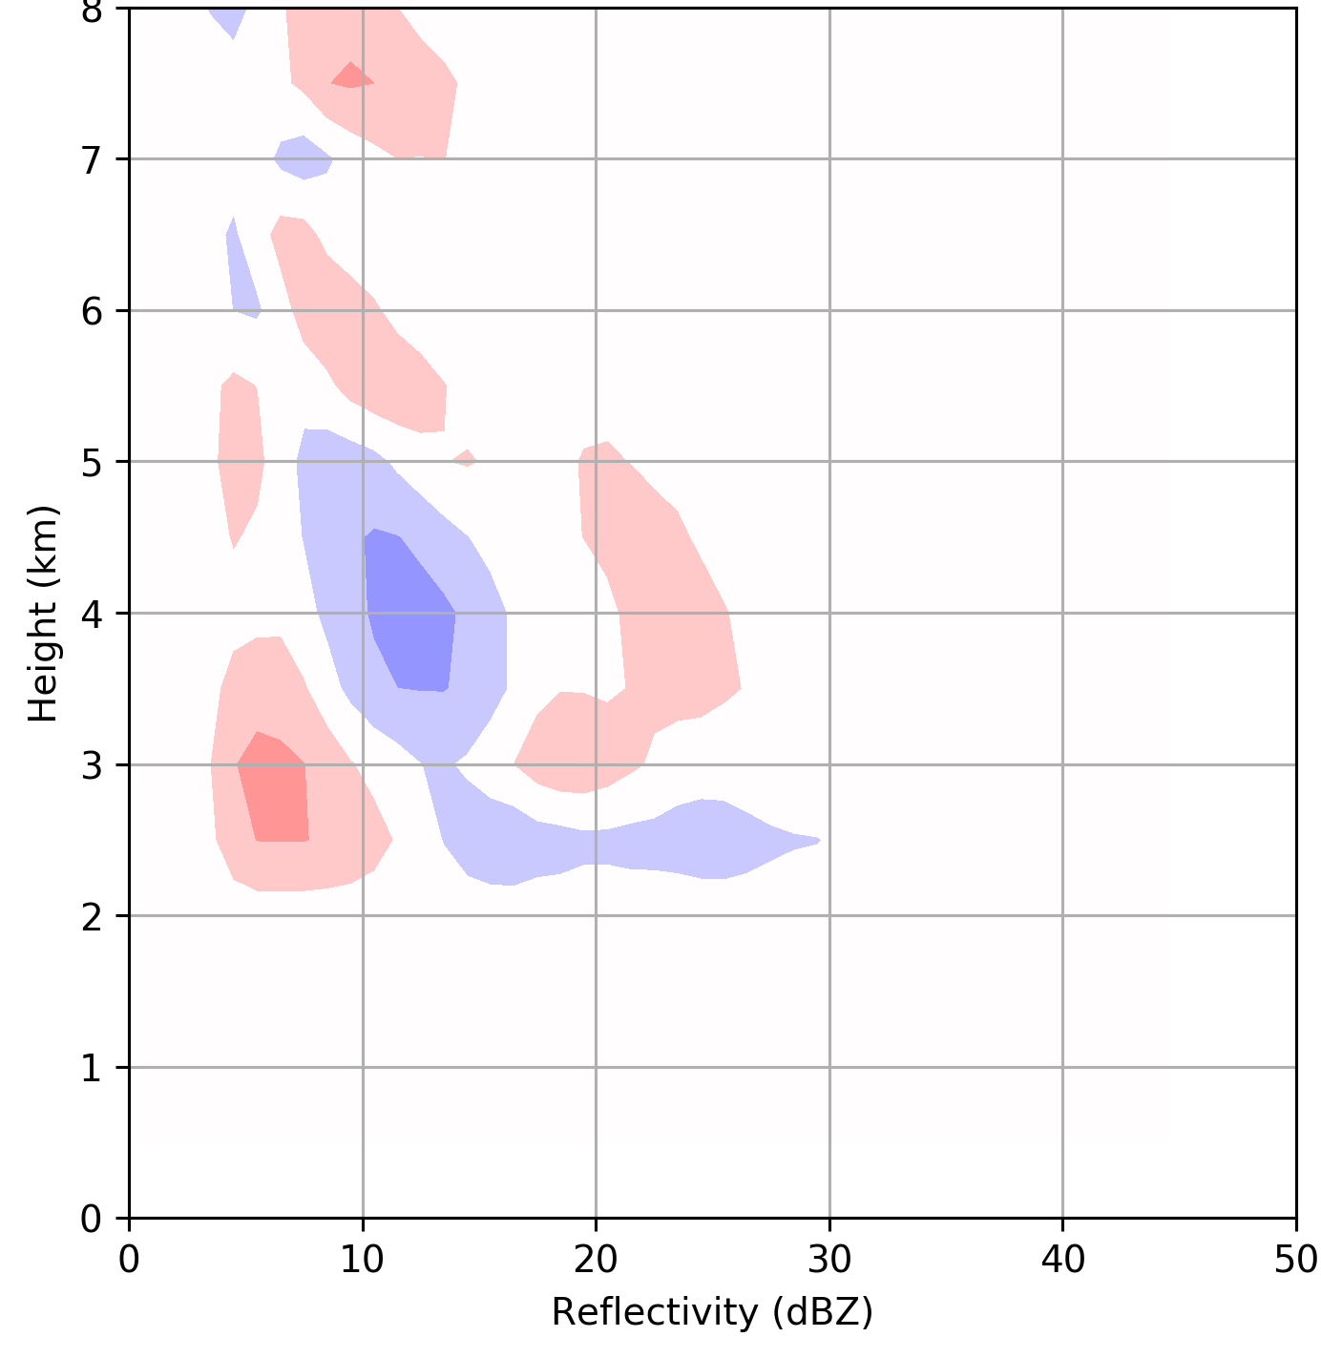
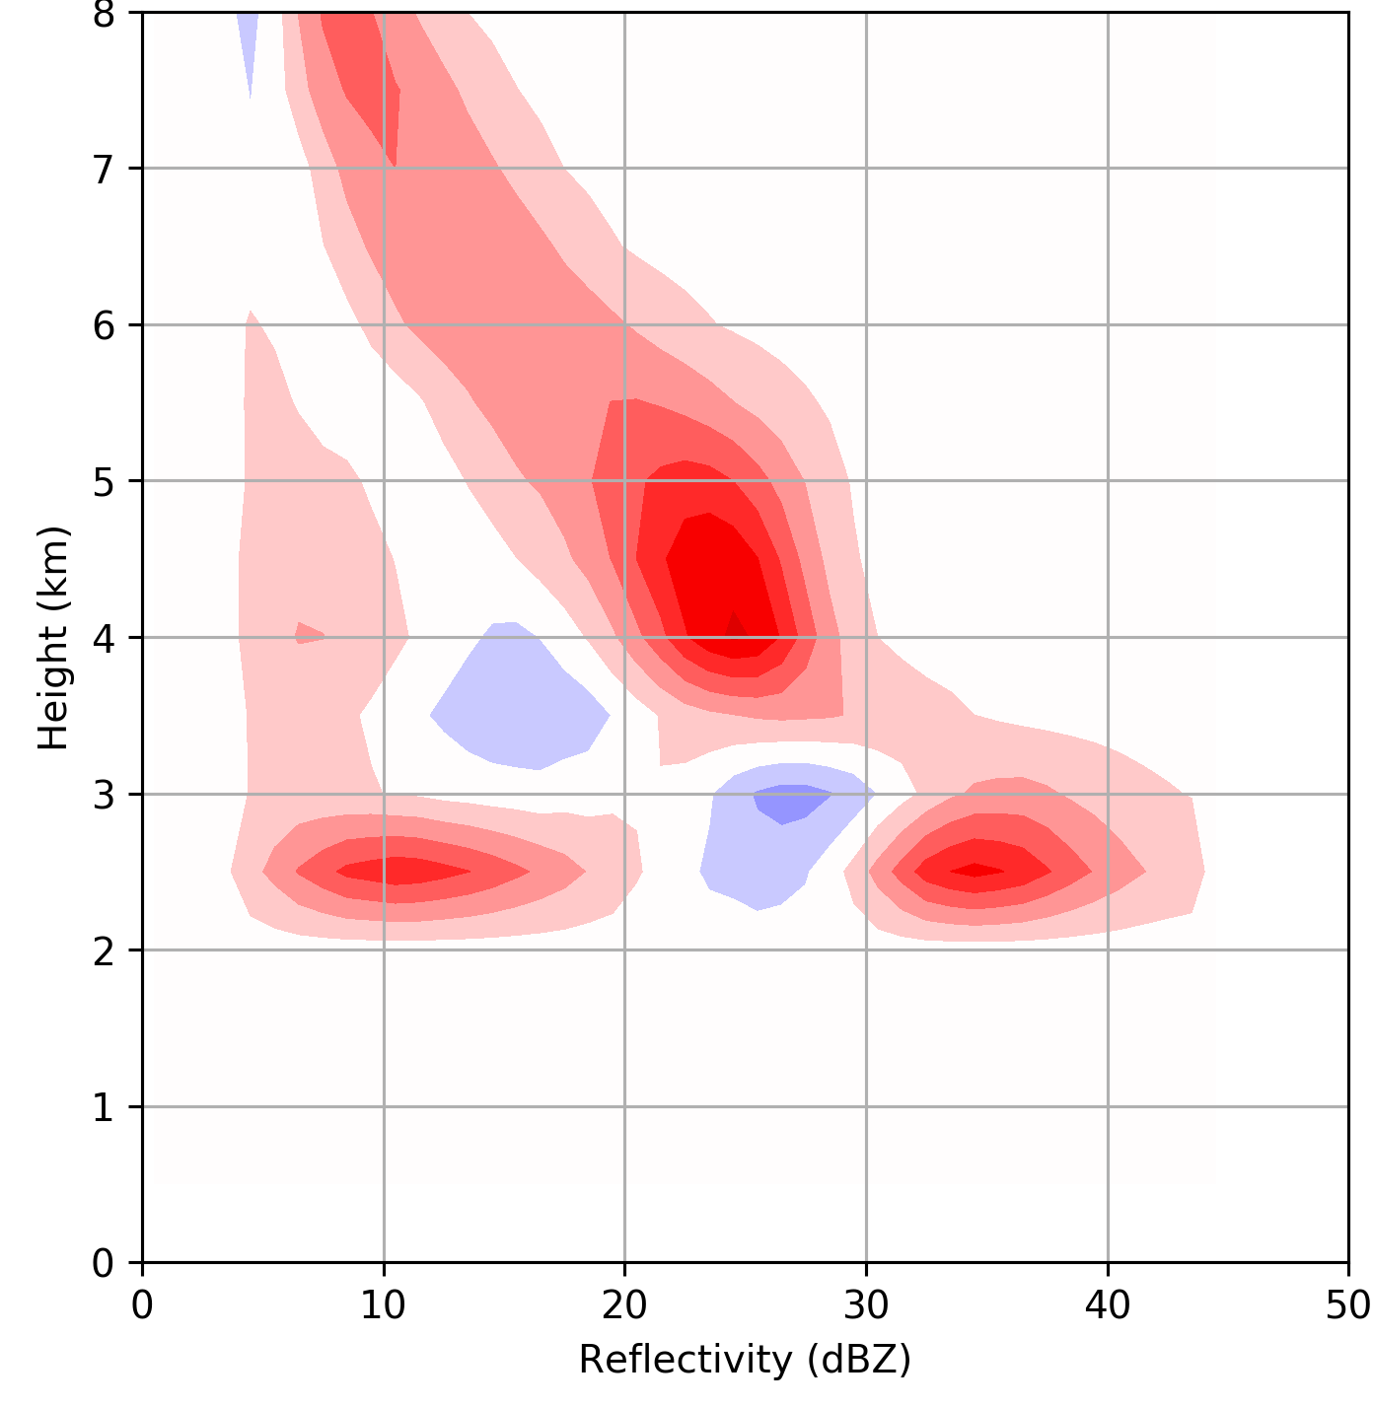
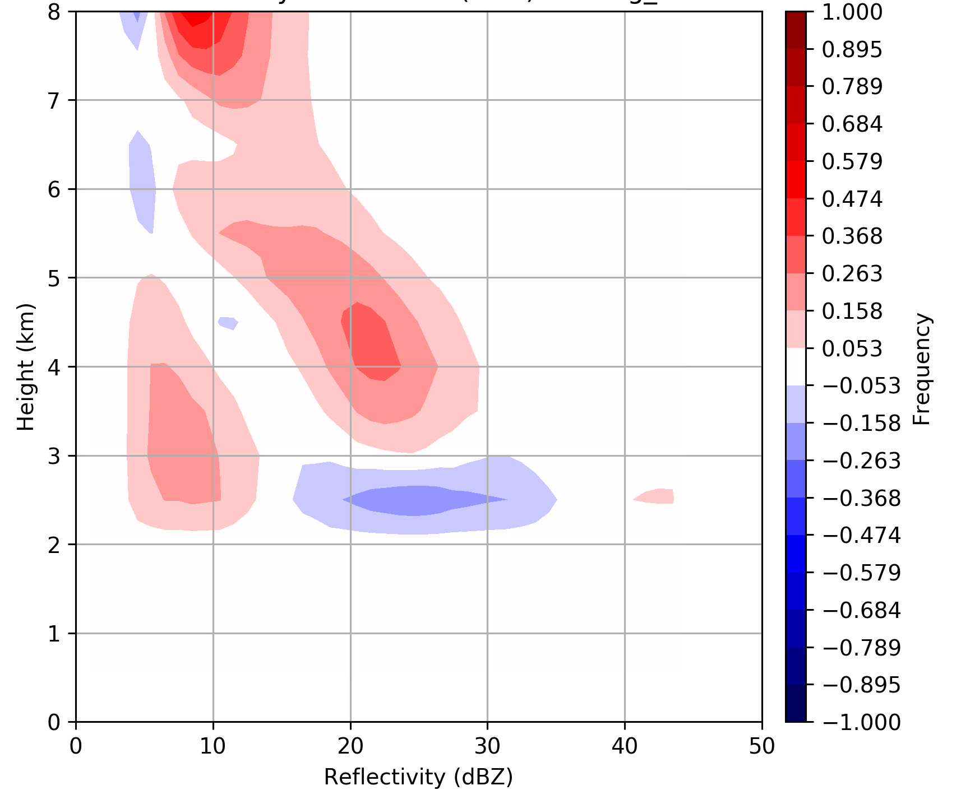
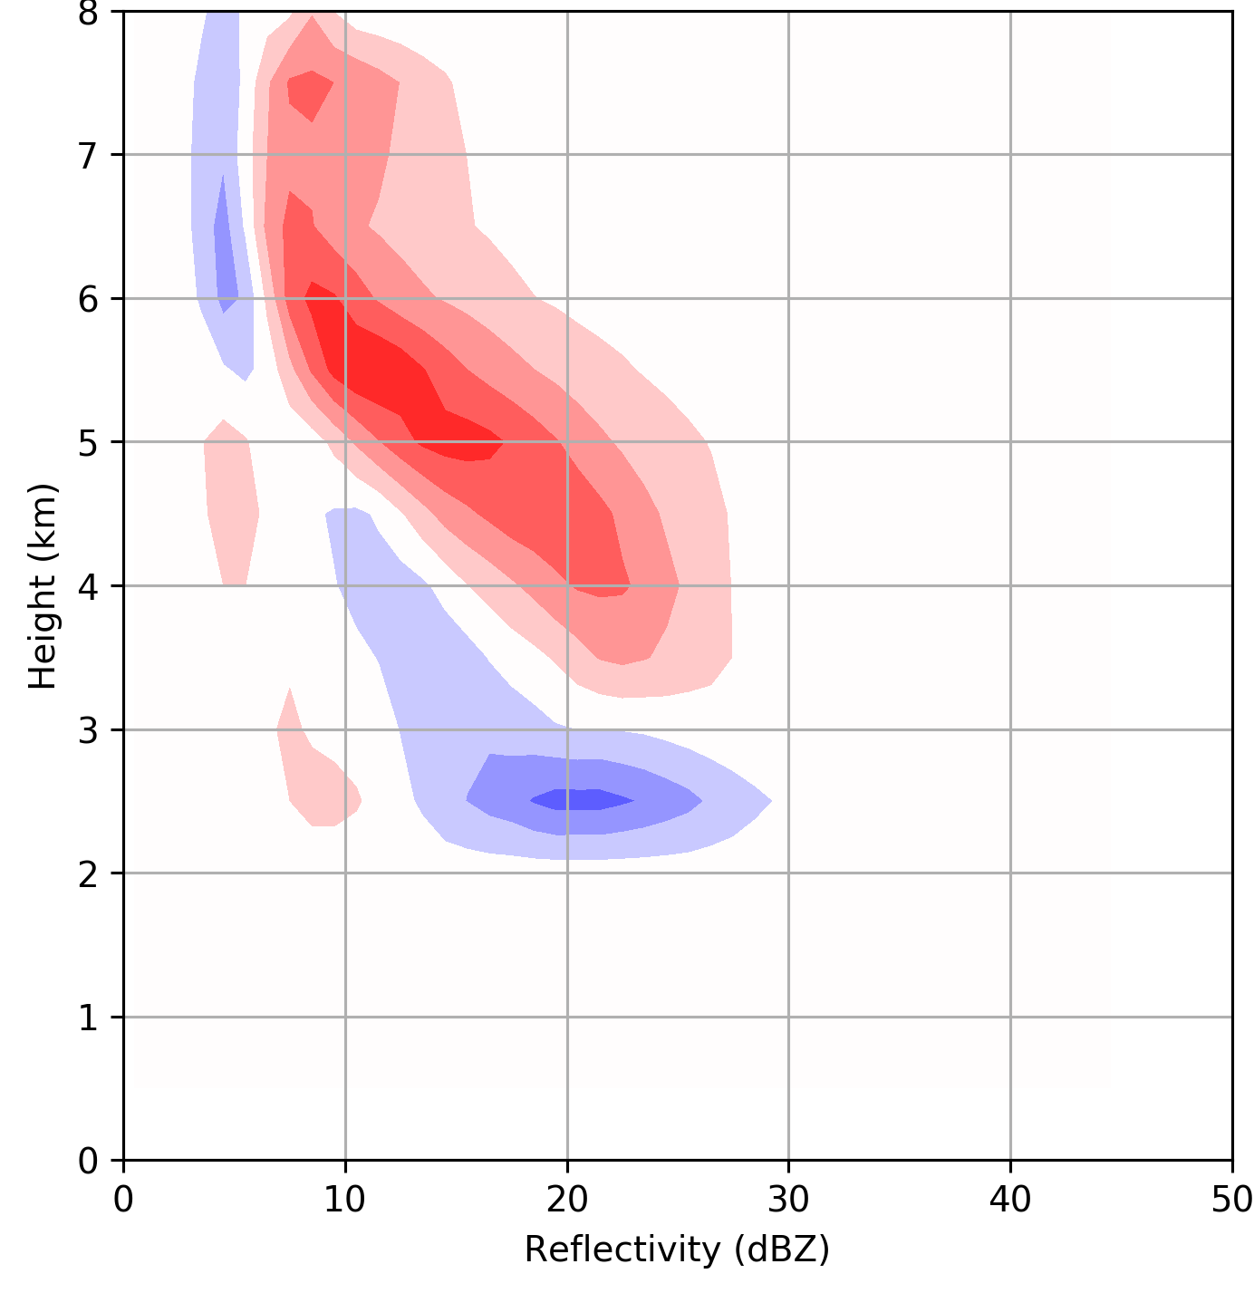
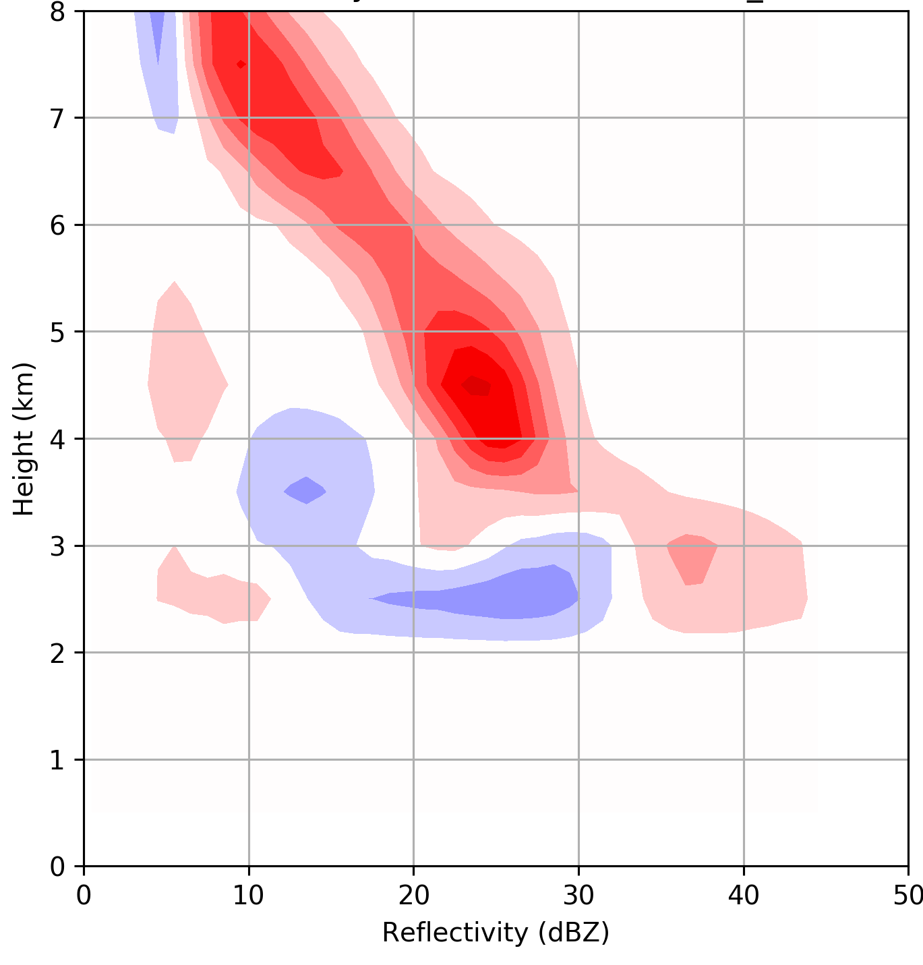
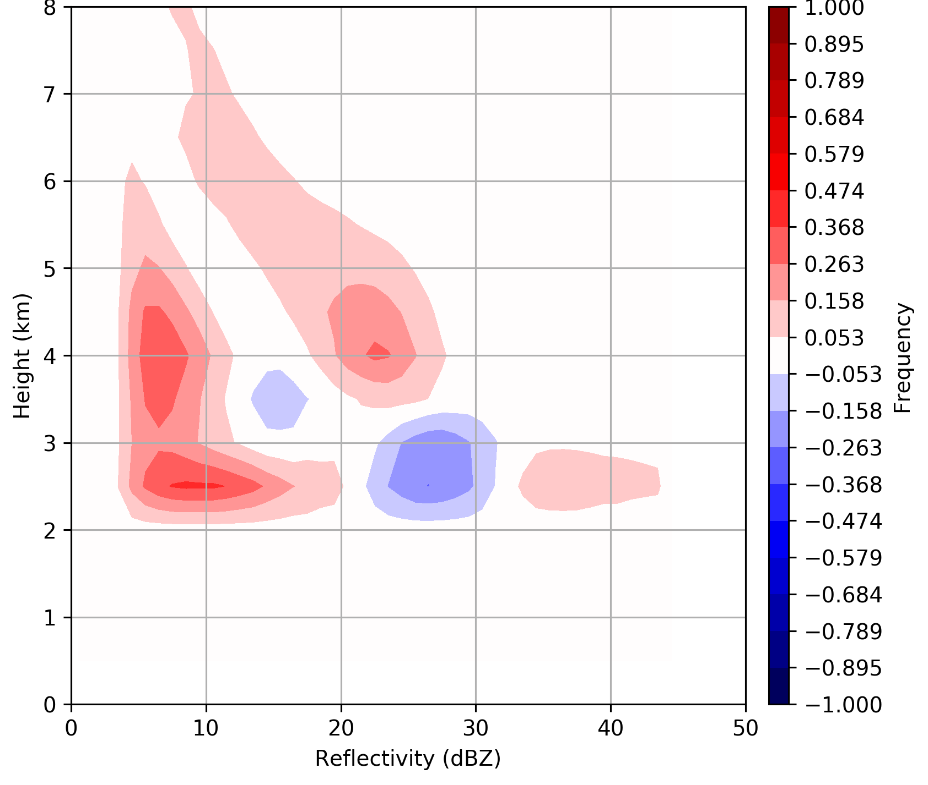
~Post-Frontal
~Warm Sector
~Pre-Frontal
25% of total time
36% of total time
39% of total time
Melting level <1200m
450<IVT
1800m < Melting level
1200m < Melting level <1800m
29% of total time
29% of total time
42% of total time
270° < wind dir. < 90°
180° < wind dir. < 270°
90° < wind dir. < 180°

Slide 9
Subset of full season data: Stratiform raining periods, mostly during prefrontal/warm sector portions
All storms Oct 7, 2015 – April 30 2016
Postfrontal and periods with < 1 mm/h rain rate at Prairie Creek removed.
3-hr periods of Parsivel, Rain Gauge, and NARR data for environmental parameters
North America Regional Reanalysis (NARR) data from the 32 km grid box closest to NPOL
Enhancement at the surface

Slide 10
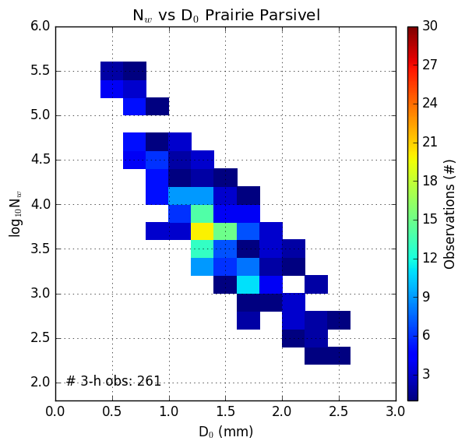
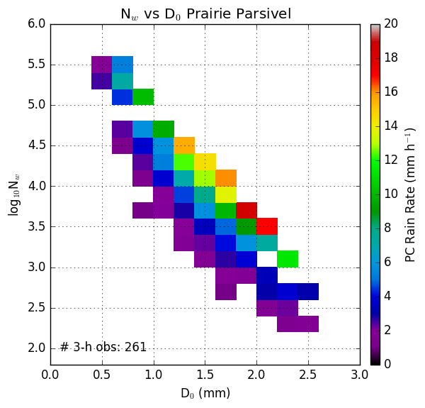
Dropsize Distributions: Diameter vs. Number
Frequency
Rain rate
Log of N_{w} – number of drops
Rain Rate – Prairie Creek
Log of N_{w} – number of drops
D_{o} Median Diameter (mm)
D_{o} Median Diameter (mm)
These are for Prairie Creek (540 m). Low elevation stations similar plots, but lower rainrates and fewer instances of the extremes

Slide 11
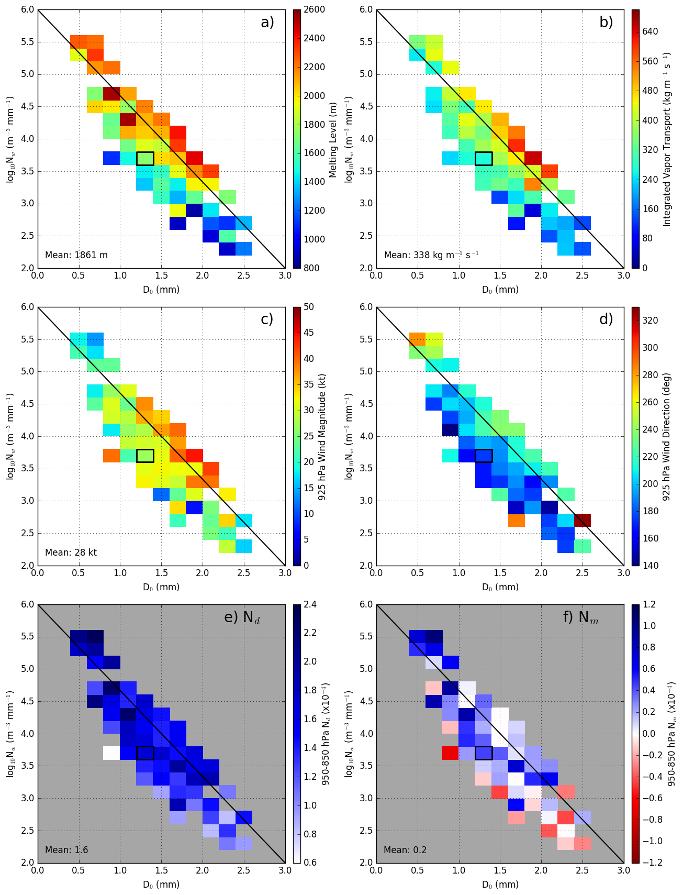
Melting Level
925hPa Wind Speed
Log of N_{w} – number of drops
D_{o} Median Diameter (mm)
IVT
925hPa Wind Direction
Moist Static Stability
Average Conditions
Lots of Small drops
Few large drops
Heavy Rain

Slide 12
The high rain rate, high melting level, high IVT, moist neutral and strong winds at 925 hPa periods tend to be associated with atmospheric river type storms. Now will look at an example storm.

Slide 13
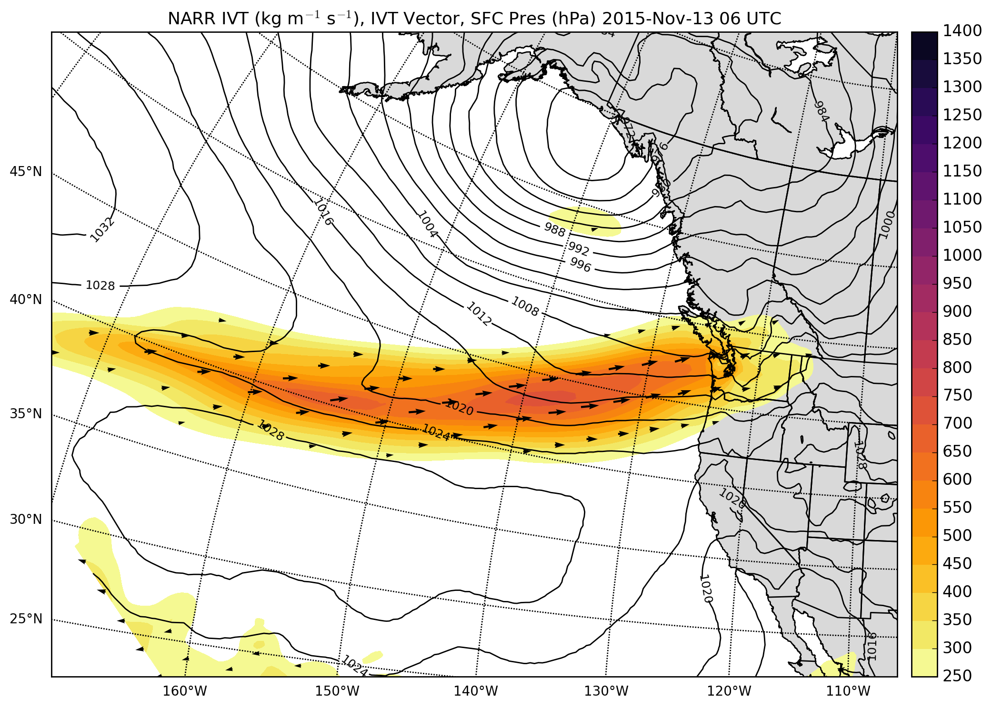
12 – 13 November 2015
Integrated Vapor Transport
Strong vapor transport

Slide 14
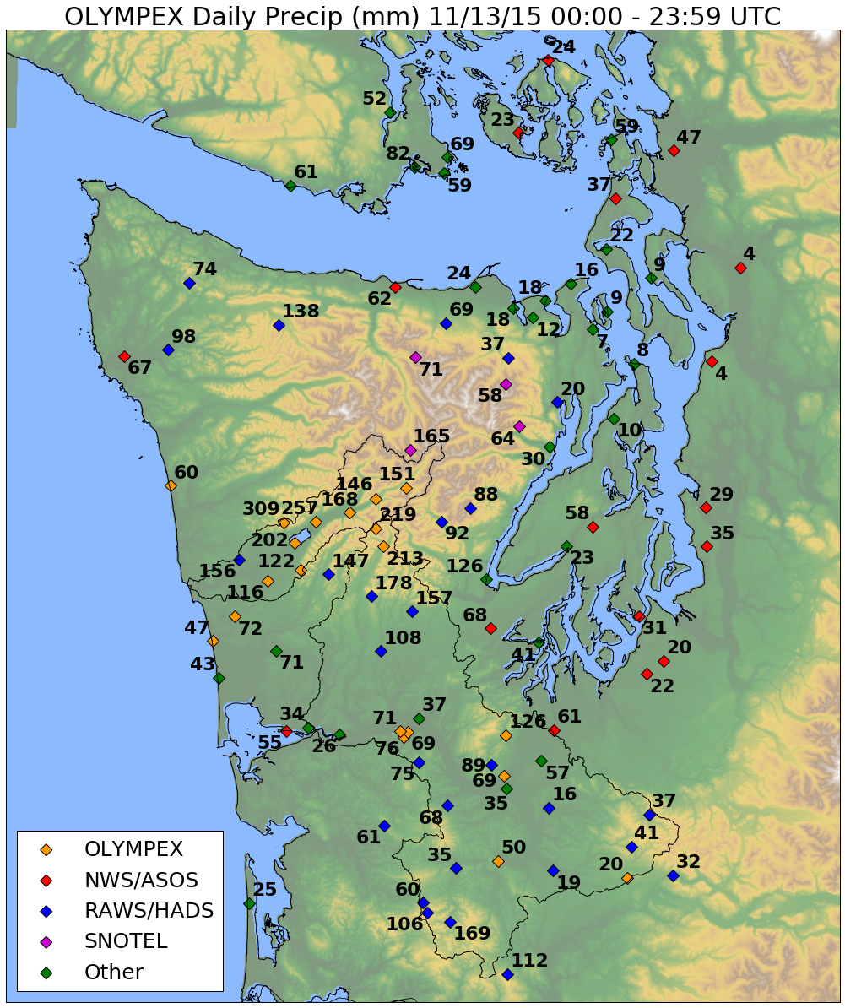
12 – 13 November 2015
Observed Precipitation Totals – Nov 13
High Terrain less than forward slopes
Enhancement different than seasonal norm
For full cold season, enhancement factor only 1.5—2
Factor 4 -5 Enhancement
Next plot of DSD from Prairie Creek site located here – elevation 540 m

Slide 15
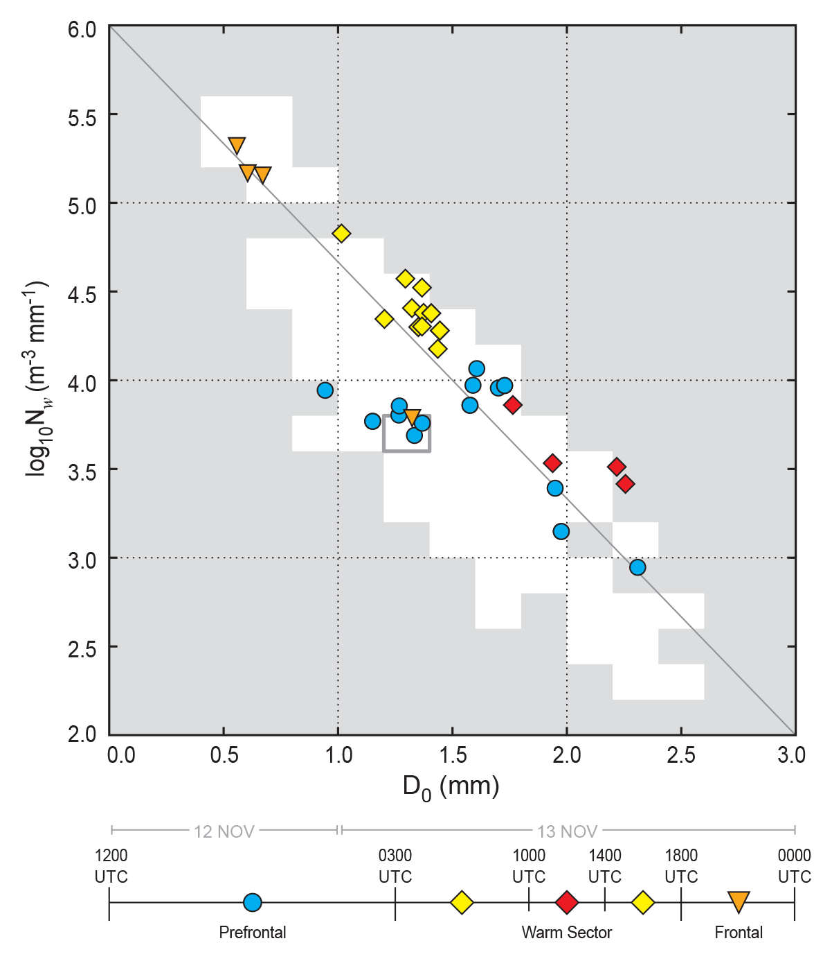
During the course of one event – Dropsize Distributions can shift from one regime to another

Slide 16
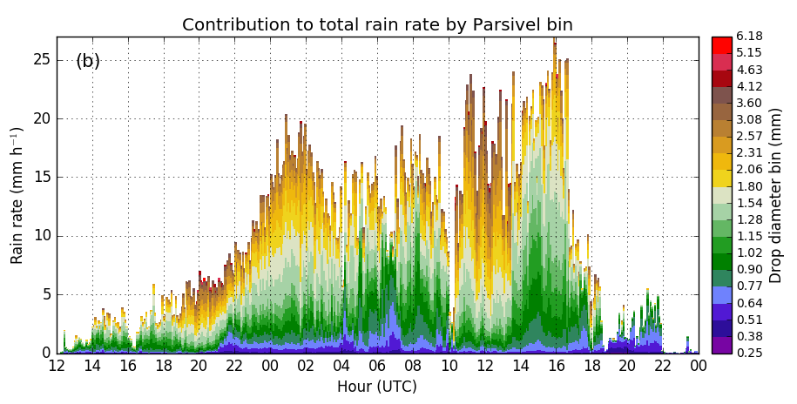
12 – 13 November 2015
Increase in big drops
Increase in rain rate due to increase of small drops
Back to small drops
Locations near coast do not have this increase of small drops in warm sector

Slide 17
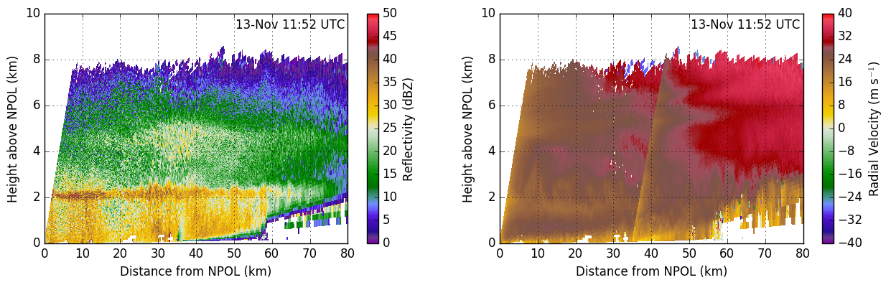
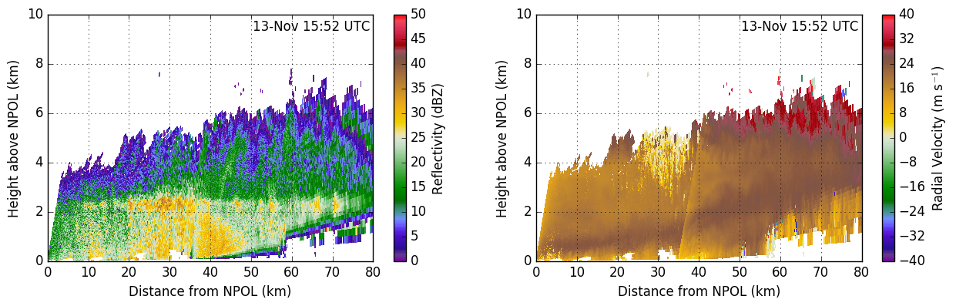
NPOL+DOW
Warm Sector during period of big drops – secondary enhancement at 4km
Brightband
Warm Sector during period of small drops – low level jet lifting
Notes:
Figure RHI: Combined NPOL-DOW RHI images of reflectivity (a,c,e,g) and radial velocity (b,d,f,h) for (a-b) 12-Nov 21:52 UTC, (c-d) 13-Nov 06:52 UTC, (e-f) 13-Nov 11:52 UTC, and (g-h) 13-Nov 12:52 UTC. The NPOL RHI is the 52 degree azimuth and the DOW RHI is the 58.4 degree azimuth.

Slide 18
Implications
Atmospheric river/heavy rain over orography events
  Both ice-phase and warm-rain processes present during periods of heavy rain (CFADS, DSDs)
  Relative contribution of warm-processes and ice-processes can shift with meso- synoptic conditions
  Lifting of warm, moist-neutral jet is dominate process during heavy rain
DSD regimes alone cannot be used to partition convective/stratiform rain
  Heavy rain regime labeled as convective in past studies
  Large quantities of small drop regime labeled as ‘warm convective’ in other studies (Bringi et al. 2009, Thompson et a. 2015)
Satellite retrievals of precipitation over terrain
  Difficult problem due to complexities of PSD regimes that change rapidly within same storm
lynnm@uw.edu

Slide 19
Acknowledgments
Work supported by:
NASA grants NNX15AL38G, NNX16AD75G and NNX16AK05G
NSF grants AGS-1503155, AGS-1657251

Slide 20
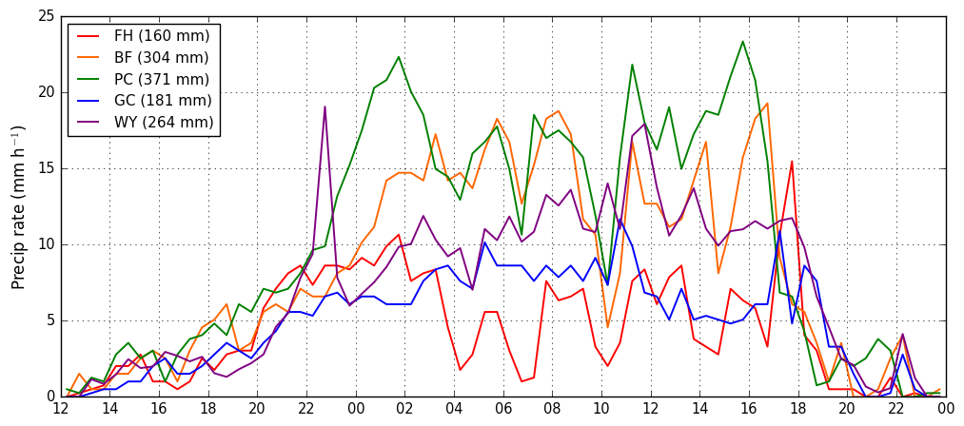
Notes:
Figure RHI: Combined NPOL-DOW RHI images of reflectivity (a,c,e,g) and radial velocity (b,d,f,h) for (a-b) 12-Nov 21:52 UTC, (c-d) 13-Nov 06:52 UTC, (e-f) 13-Nov 11:52 UTC, and (g-h) 13-Nov 12:52 UTC. The NPOL RHI is the 52 degree azimuth and the DOW RHI is the 58.4 degree azimuth.

Slide 21
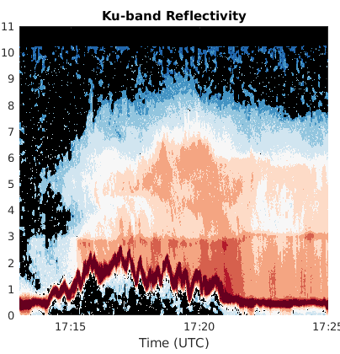
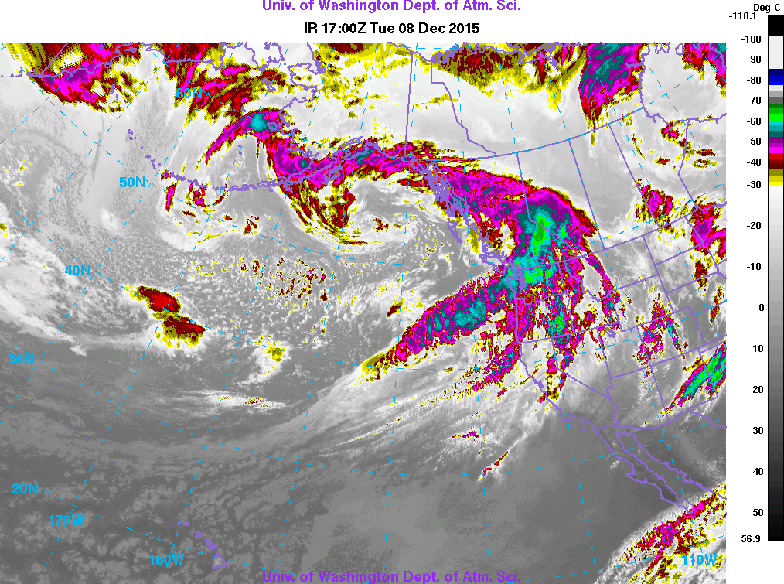
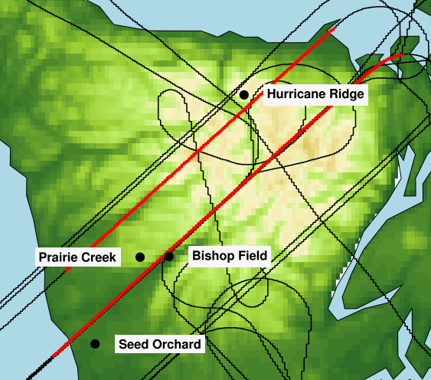
Southern Leg
NE
SW
December 8 – AR event. APR3 from the DC-8 Aircraft
Largest reflectivity on windward slopes and not high terrain
Echo top height decrease in lee
Melting level variability

Slide 22
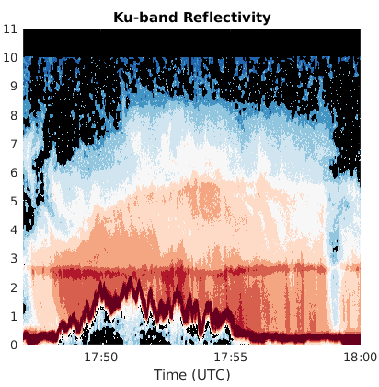
Southern Leg
Windward
NE
SW
Largest reflectivity on windward slopes and initial high terrain
Frontal wave fills in leeside echo tops

Slide 23
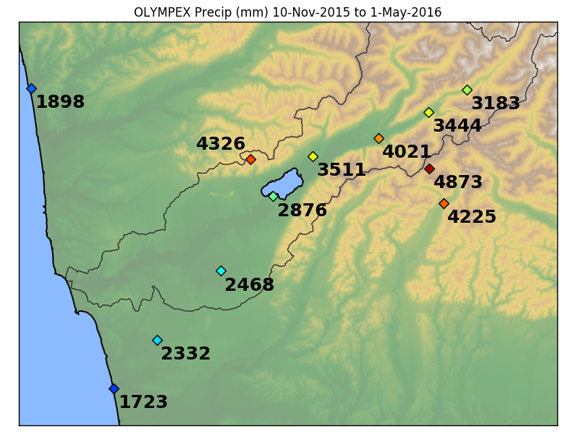
Seasonal Precipitation totals
Orographic enhancement factor
~ 1.5 – 2 from coast to inland
Prairie Creek – 540m
CRN – 115 m
Wynoochee 1000m
Beach House – 3 m

Slide 24
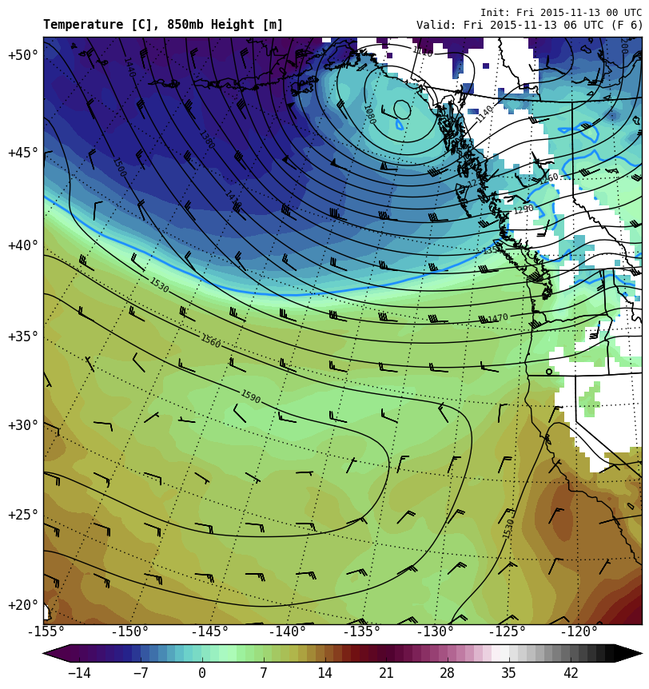
12 – 13 November 2015
850 hPa Heights + Temp
0600 UTC 13 Nov
Strong low-level onshore flow. Very warm airmass

