Slide 1


Mesoscale Convective Systems--What are they, and what aspects need parameterizing?
Robert A. Houze, Jr.
University of Washington and Pacific Northwest National Laboratory
The Future of Convection Parameterization, Delft, Netherlands, 11 July 2017
Notes:
My role here is to talk about observational aspects of organized convection. I’m going to focus on mesoscale organized deep convection, and I will provide a summary from an observational perspective, i.e. I will deal with the first question. I will leave answering the second question to those of you who are experts on modeling.

Slide 2
Some History
Notes:
OC can mean different things to different people. I’m just going to make the assumption that we are referring to MCSs.

Slide 3
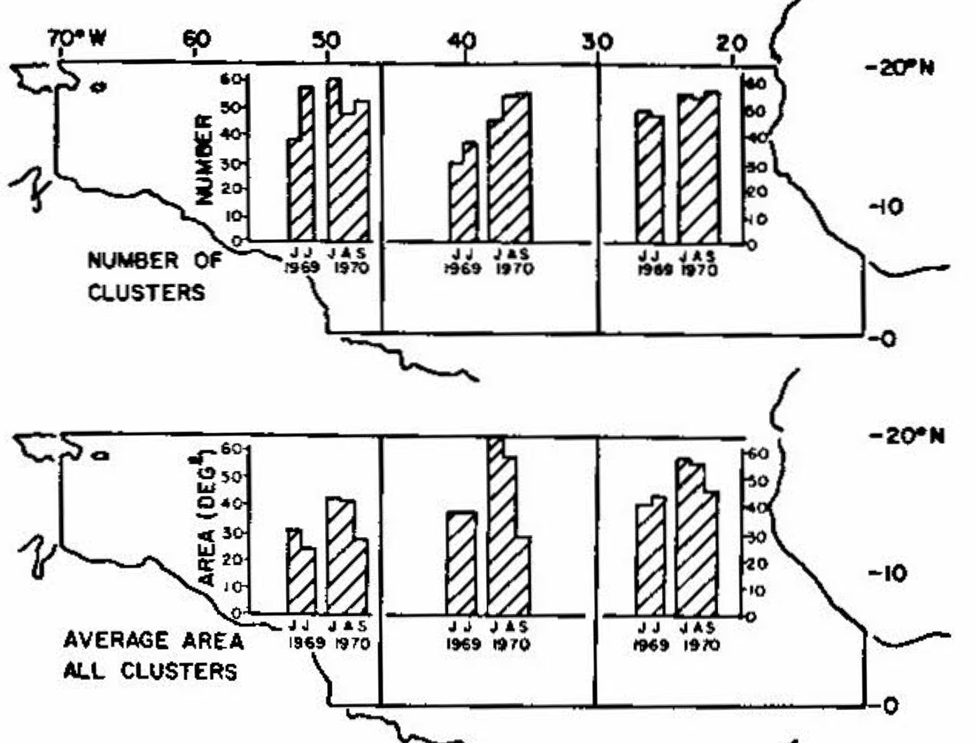
“Cloud Clusters” discovered in early visible satellite imagery
Martin and Karst (1969)
Martin and Suomi (1972)
Analyzed digitally enhanced visible images
Clusters identified as trackable patches of high cloud, averaging
3000-7000 km in scale
3-6 days
Bright cores within clusters
300-700 km in scale
1-4 hours
Validated against radar data
Moved slower than clusters
Banding noted
Notes:
Visible imagery

Slide 4
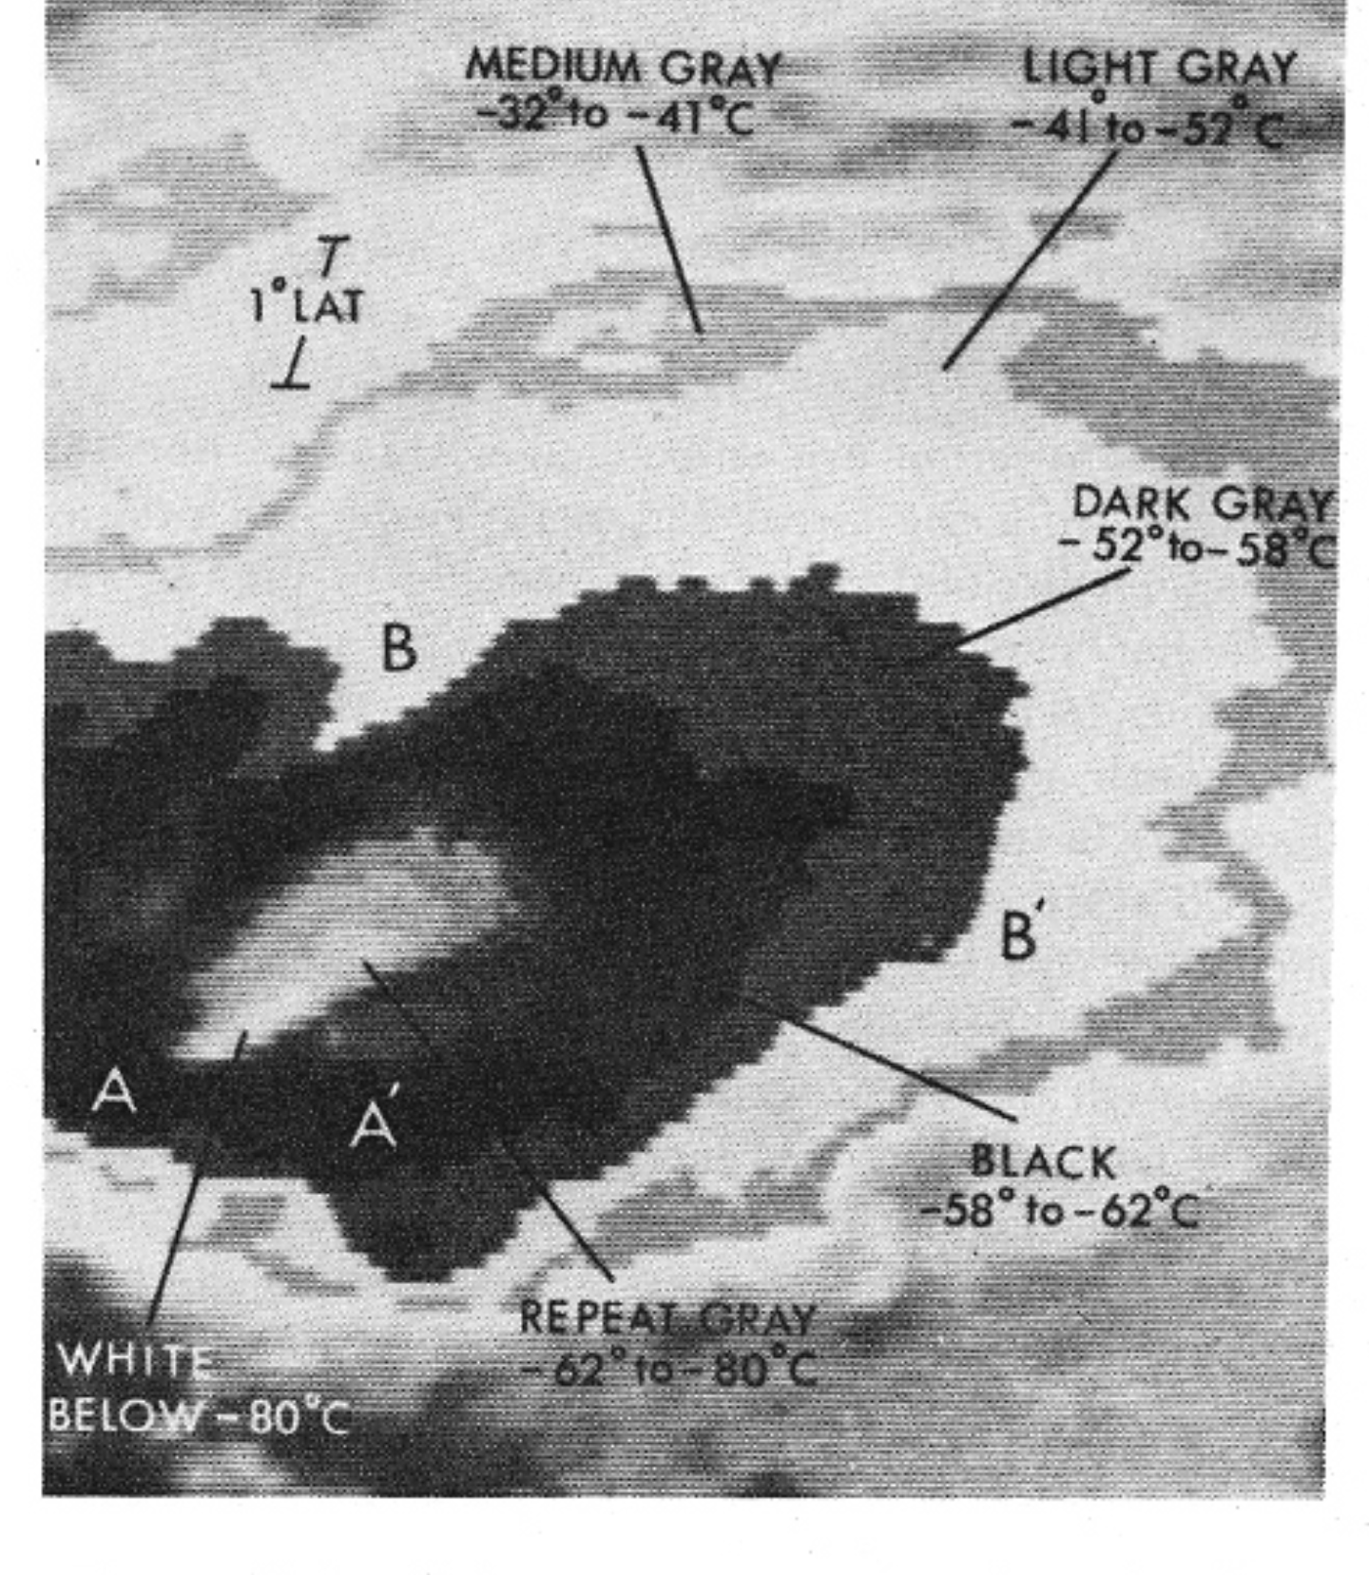
“Mesoscale Convective Complexes (MCCs)” ” identified in early IR imagery
Maddox (1980)
Used IR imagery
Large, circular, cold tops
–32°C over 100,000 km²
–52°C over 50,000 km²
Notes:
MCSs were brought to prominence by Maddox in the early days of satellite meteorology. In the

Slide 5
Summary of MCS characteristics
Large cold top
Large rain area
Some of the rain is deep convective
Account for a large portion of tropical & warm season rainfall
Based on Maddox (1980) and many others

Slide 6
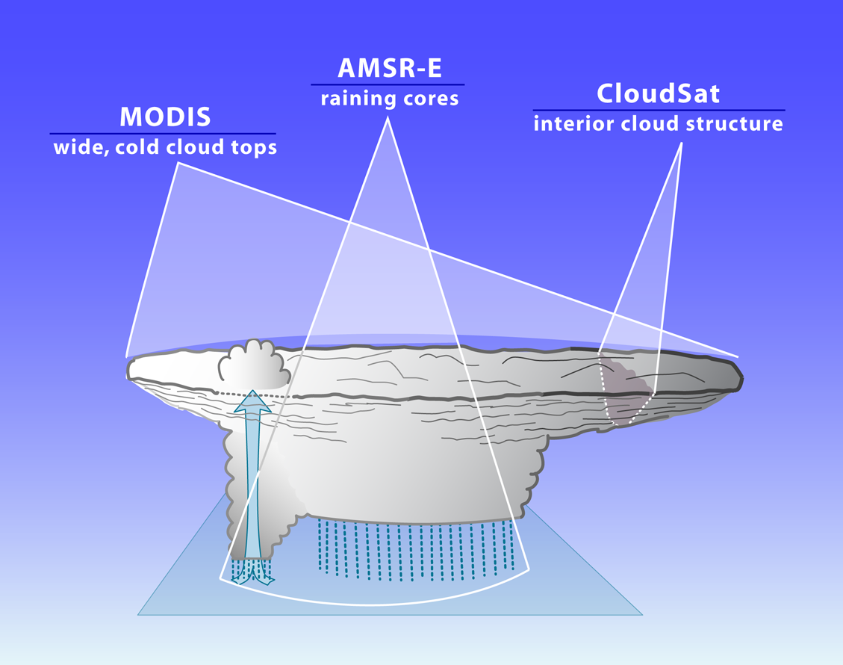
A-Train and TRMM satellites made it possible to further quantify MCS characteristics
2
3
1
A-Train criteria for MCS
Min cloud top temperature ≤ 220 K
Rain area
≥ 2000 km² with intense cells
=> 56% of all tropical rain
Yuan and Houze (2010)
~1000 km
“Anvil”
~100-300 km
Stratiform
Convective
Notes:
A-Train offers the ability to see all 3 characteristics simultaneously. We take advantage of this ability.

Slide 7
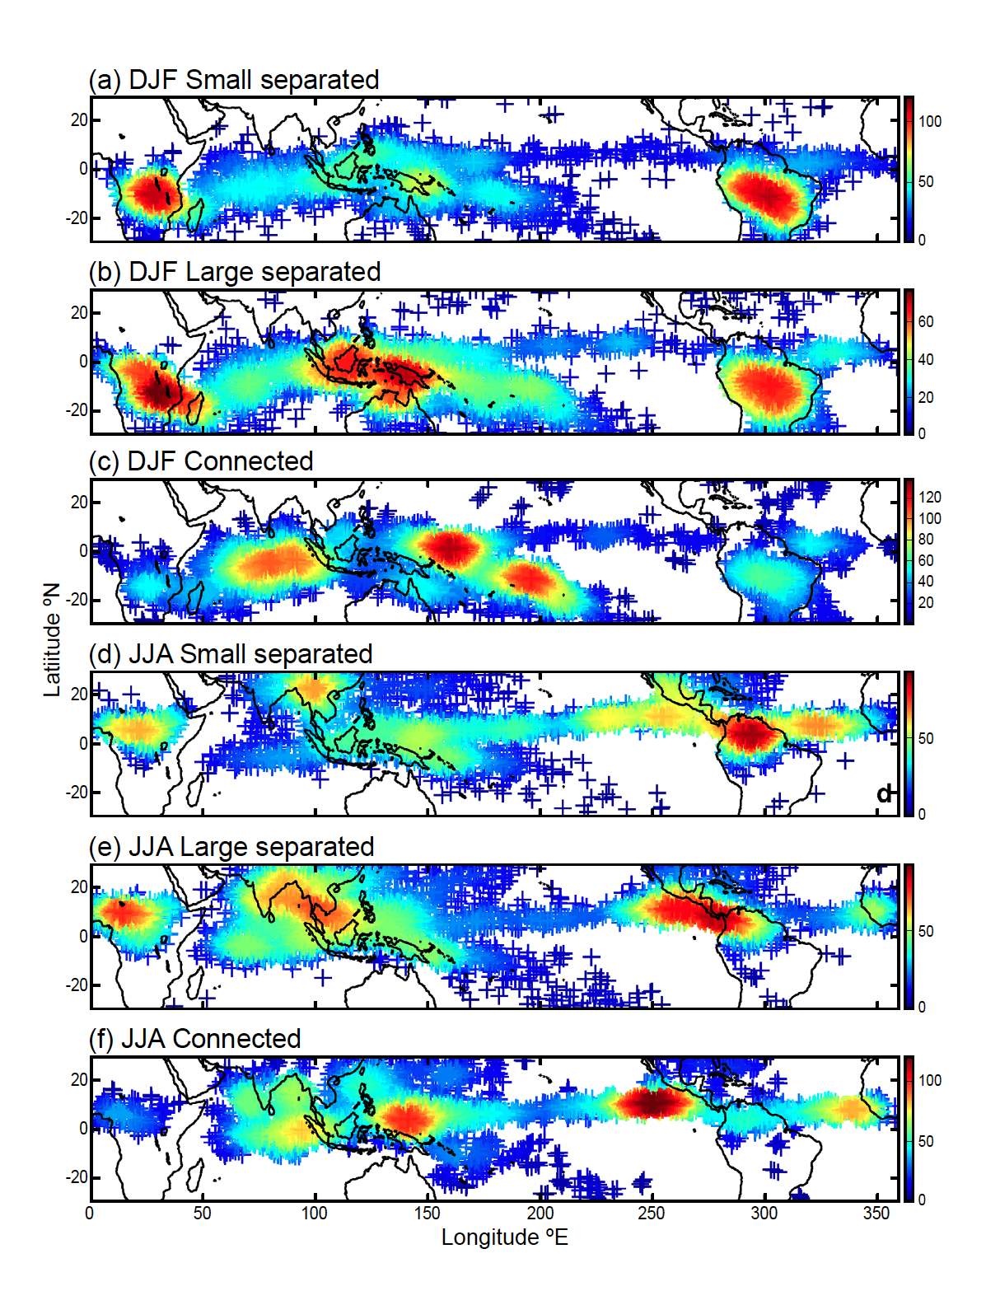
Mature MCSs in the Tropics as seen by A-Train
Smallest 25% (<12,000 km²)
Largest 25% (>40,000 km²)
“Superclusters”
Yuan and Houze (2010)

Slide 8
Where do these MCSs form?
I.e.,
Where do intense convective elements first group into contiguous mesoscale units?

Slide 9
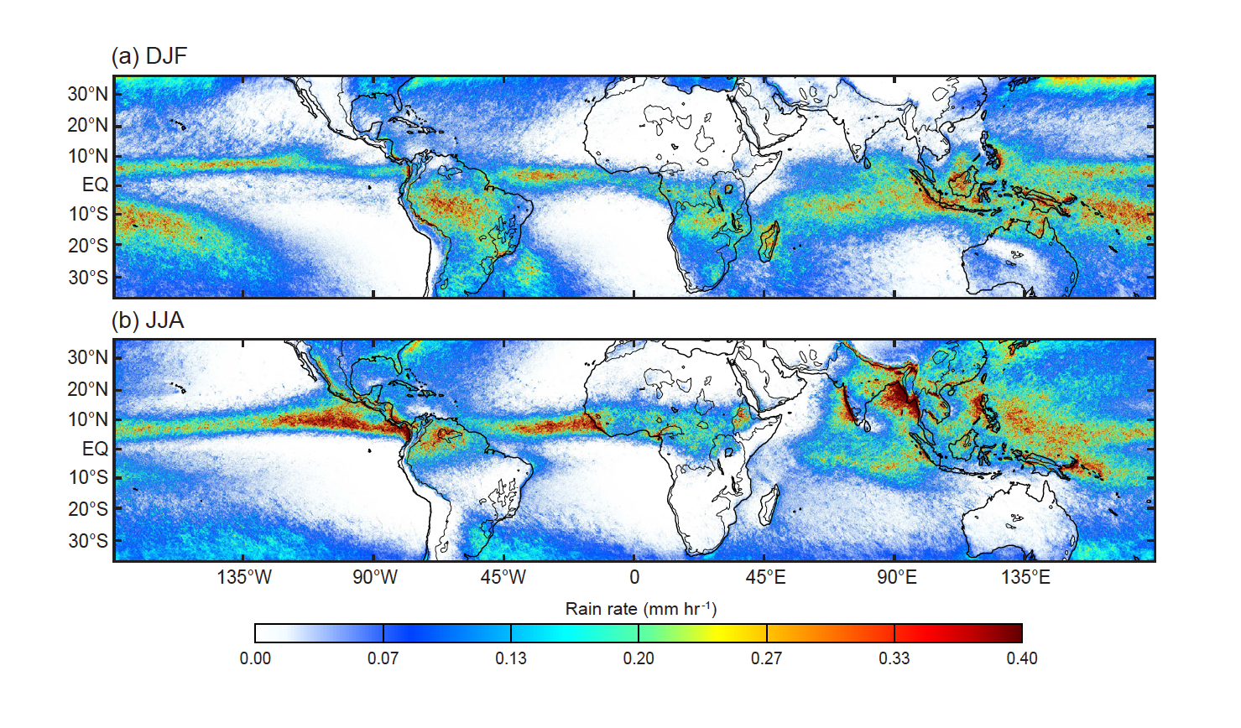
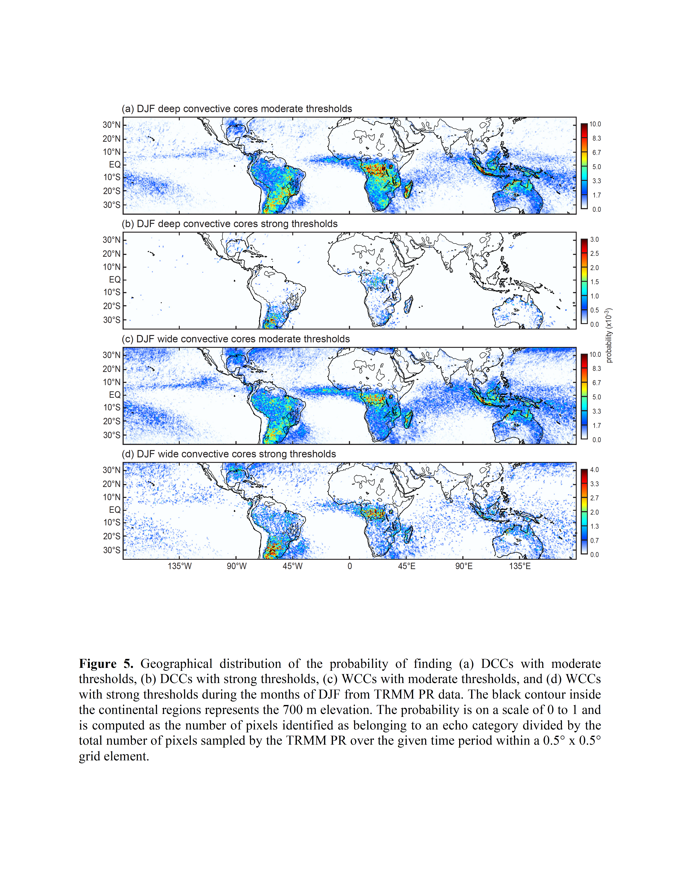
TRMM Rainfall
Deep Convection Mesoscale Convection
Rainfall from TRMM PR
rainfall from TRMM PR
0
Mean Rain Rate
Rain Rate (mm h^{–1})
0.4
Deep
40 dBZ
> 10 km
Probability (x10^{–3})
Wide
40 dBZ
> 1000 km²
Probability (x10^{–3})
Houze et al. (2015)
Notes:
Specifically, we are looking at rain shown by the TRMM PR—not other sensors.
→ Allows us to look at characteristics of the systems producing the rain

Slide 10
TRMM Rainfall
Deep Convection Mesoscale Convection
Rainfall from TRMM PR
rainfall from TRMM PR
0
Mean Rain Rate
Rain Rate (mm h^{–1})
0.4
Deep
30 dBZ
> 8 km
Probability (x10^{–3})
Wide
30 dBZ
> 800 km²
Probability (x10^{–3})
Houze et al. (2015)

Slide 11
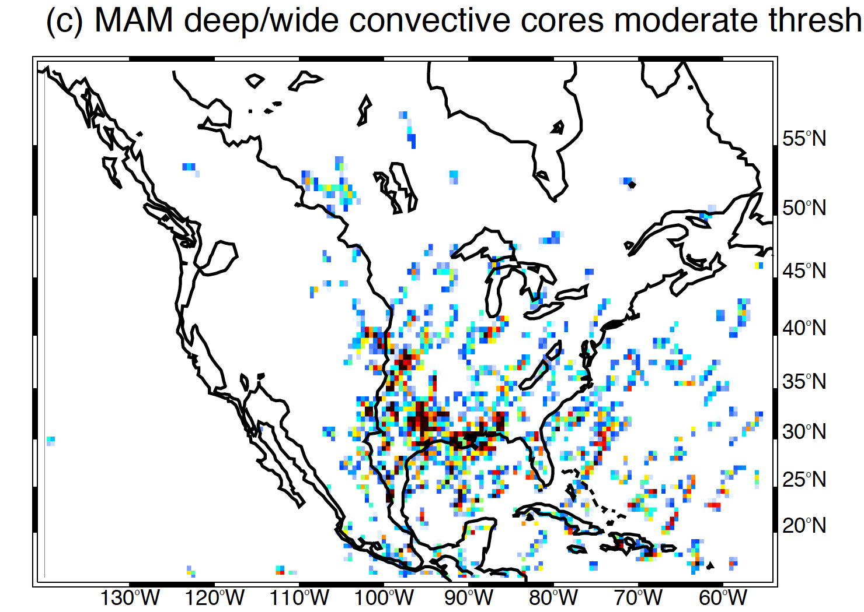
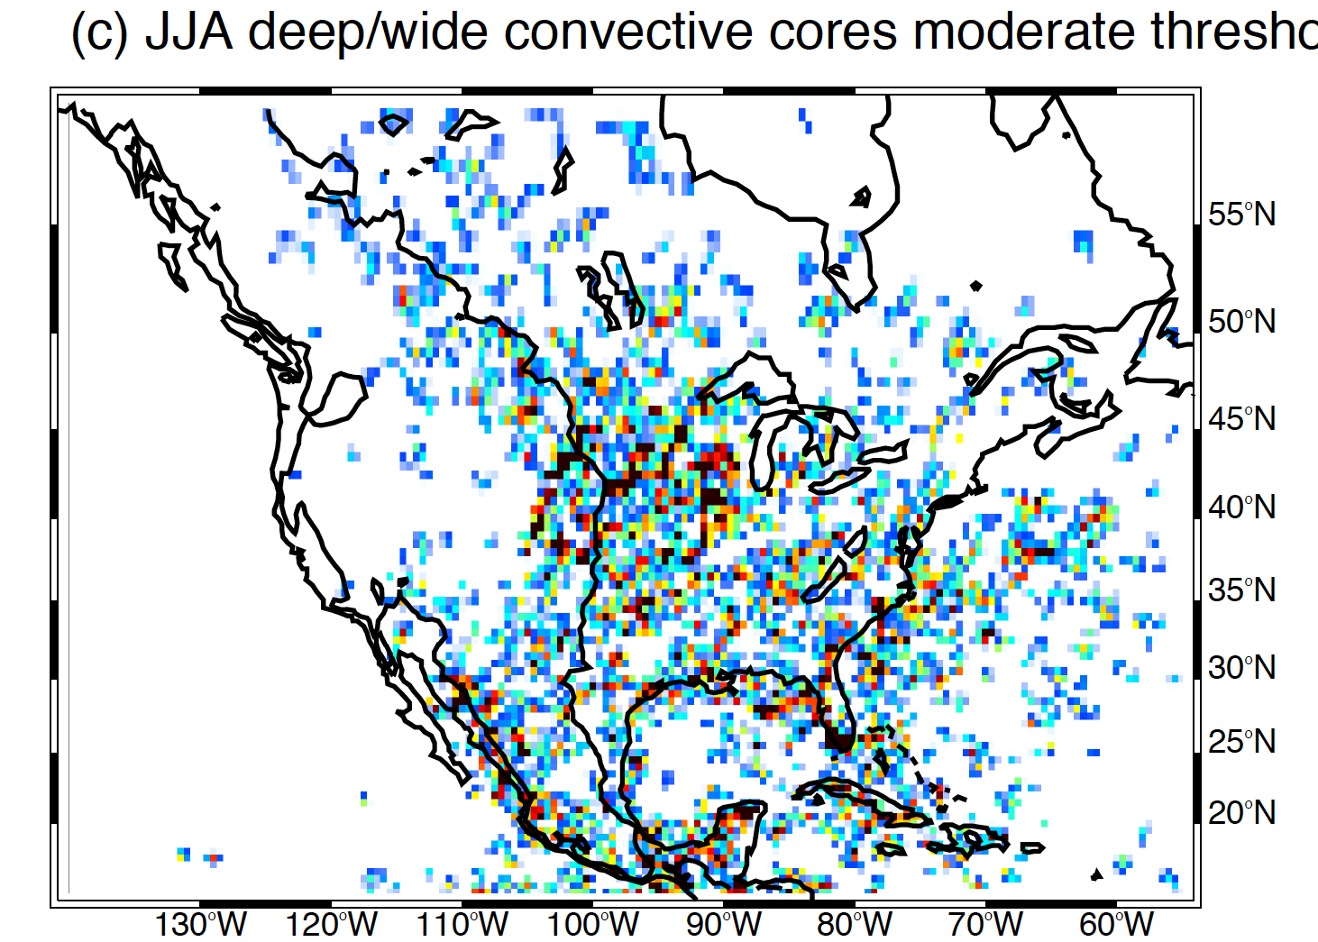
From GPM
Mesoscale Convection over North America
Note apparent relation to jet, mountains, ocean

Slide 12
What factors might determine mesoscale grouping of deep convection?
Self aggregation (radiative feedback)
Cold pools
Fronts
Sea/land breezes
Gravity wave response to convection
Surface conditions
Orography
Other…

Slide 13
Relationship to the Large-scale Environment

Slide 14
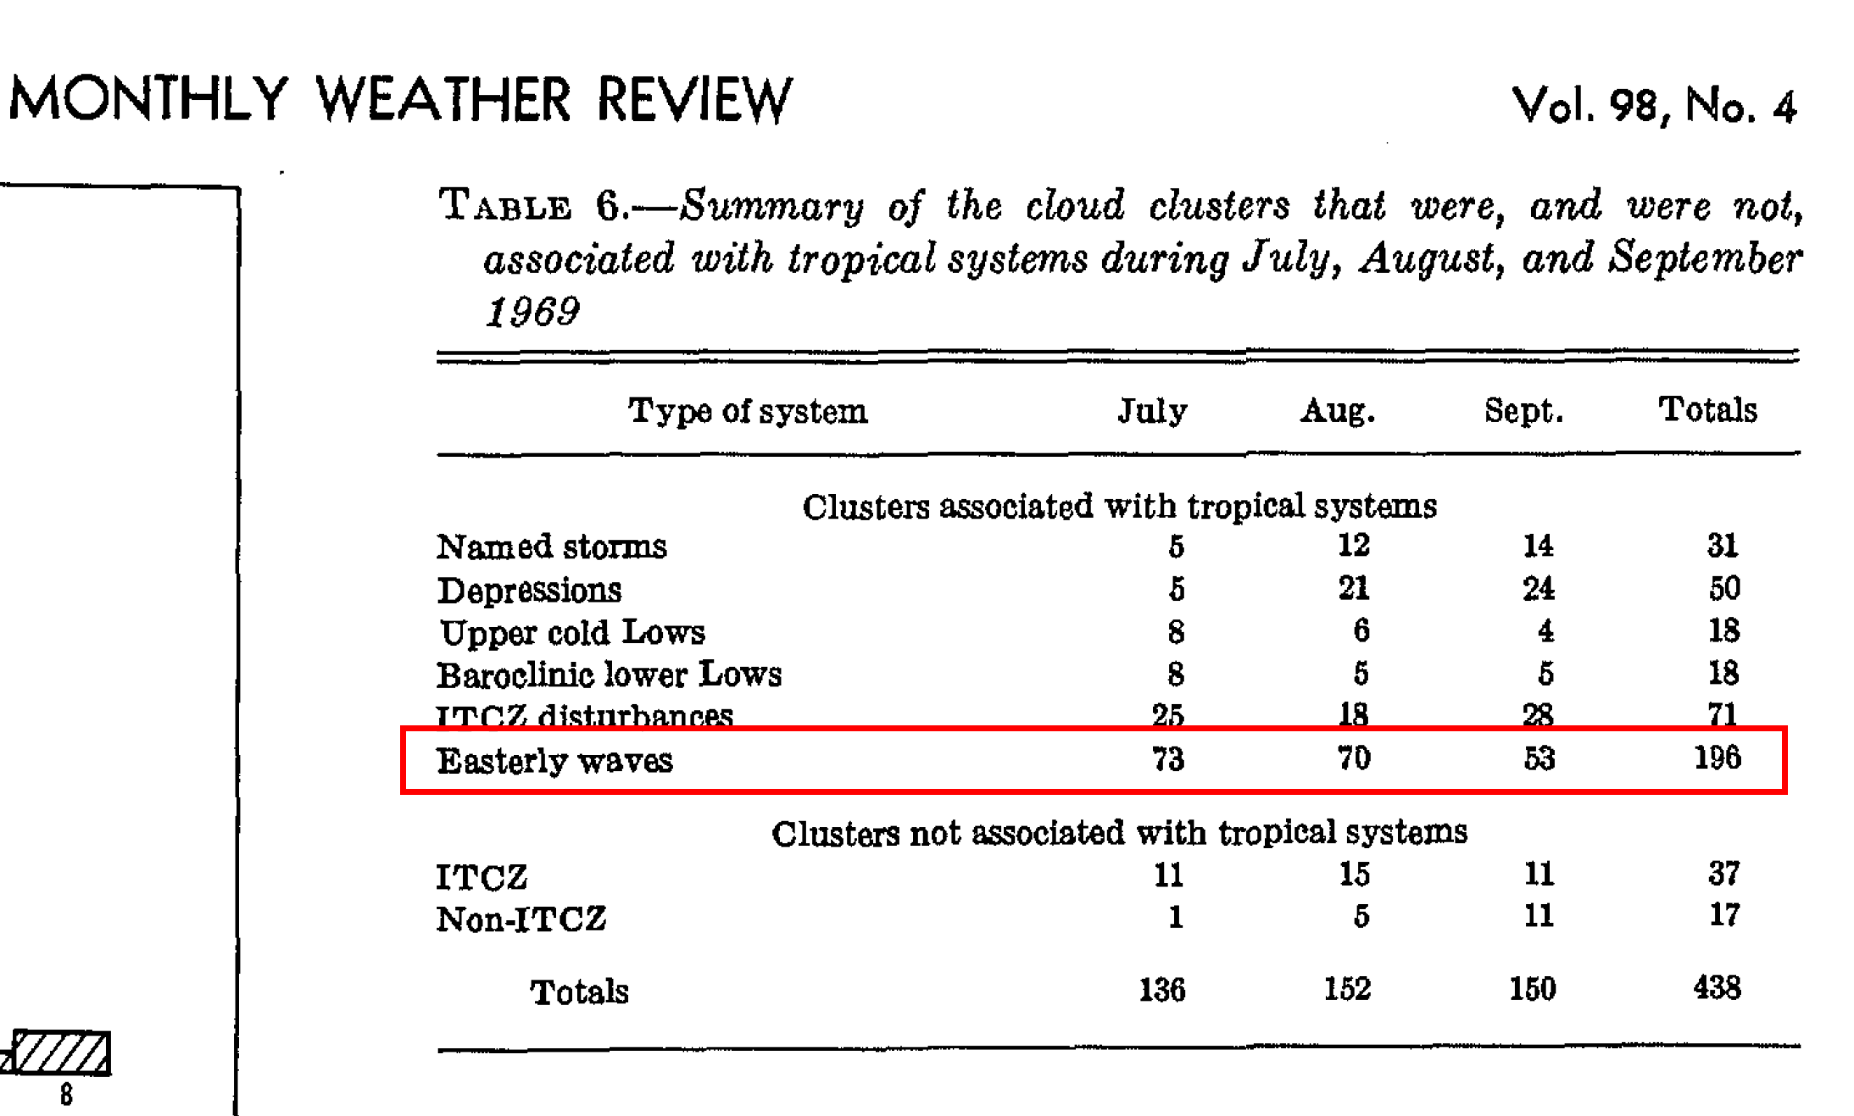
Tropical Easterly Wave Connection to MCSs
N. L. Frank, (1970)— In one of the earliest satellite studies found that “Cloud clusters” were systematically found in troughs of synoptic-scale easterly waves

Slide 15
Near equatorial MCSs
Nakazawa (1988)
MCSs develop in the context of favorable conditions provided by equatorial wave dynamics and the MJO.
(MJO)
“ “
(aka MCS)
Notes:
A super cluster is defined as an ensemble of cloud clusters having
different life stages with an observed horizontal scale of several thousand kilometers found near the
equator during the active phase of intraseasonal variations (ISVs) . Super clusters move eastward with a
phase speed of about 10-15 ms-1. GMS IR data reveal that the life time of each cloud cluster within a
super cluster is about 1-2 days and its phase propagation is westward along the equator. Although each
cloud cluster moves westward, a super cluster moves eastward due to the successive formation of a
new cloud cluster ellst of the matur e-stage cloud clus ter. The above results suggest the existence of a
hierarchy of convective activity in the tropical atmosphere.
During the onset phase of the 1986/87 ENSO event

Slide 16
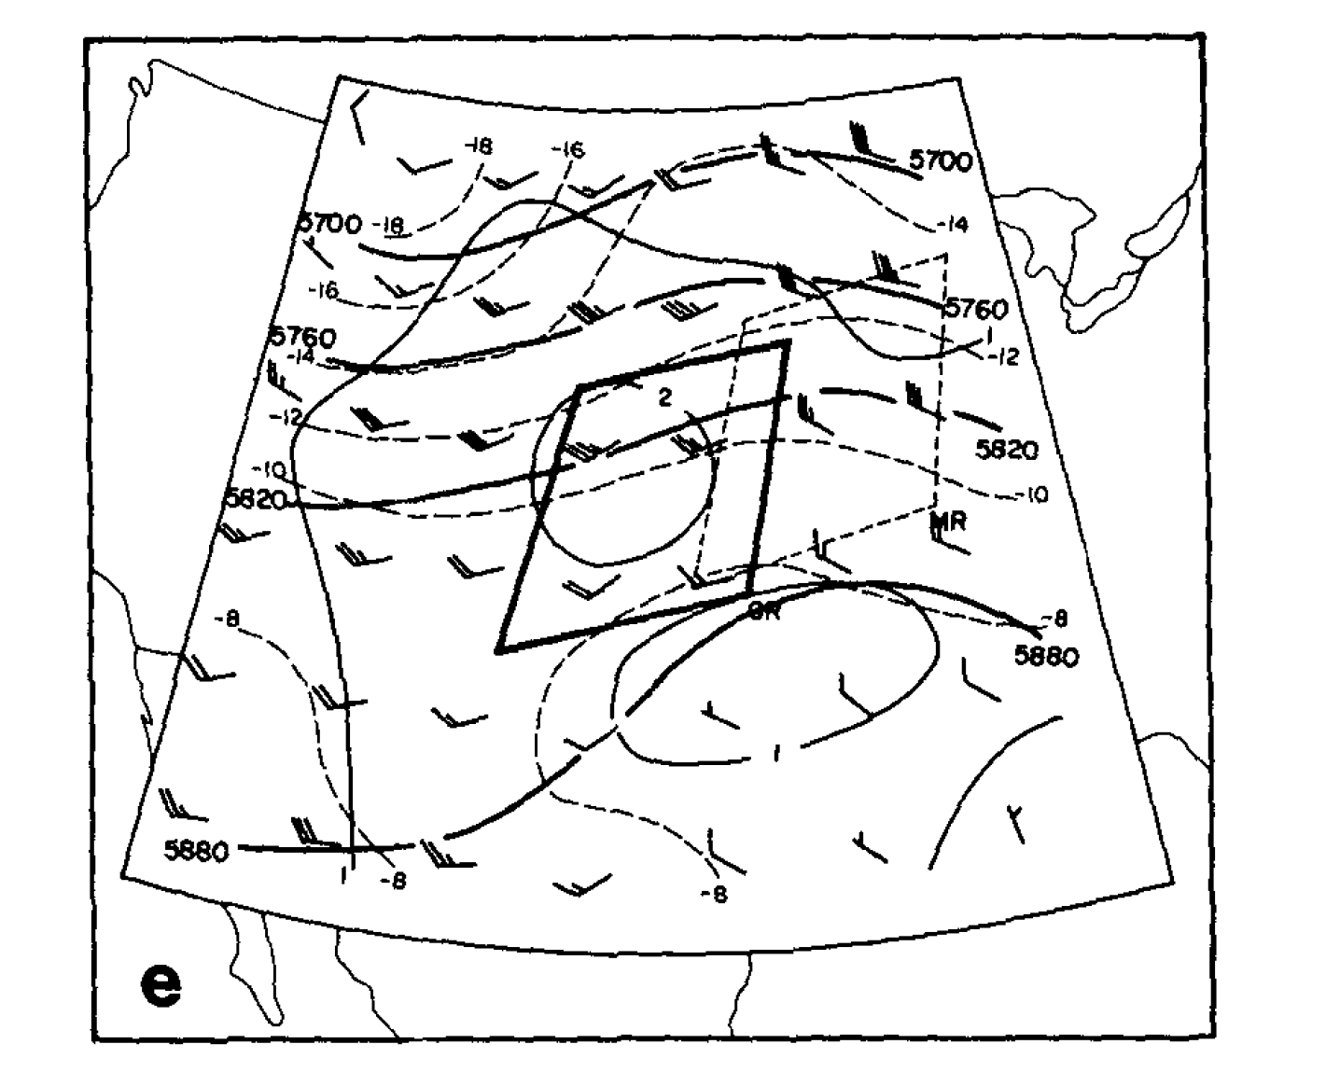
Midlatitude Wave Connection to MCSs—an early study
Maddox (1983)
Midlatitude MCCs form in SW flow ahead of a trough
500 mb Composite Conditions at time of MCC formation

Slide 17
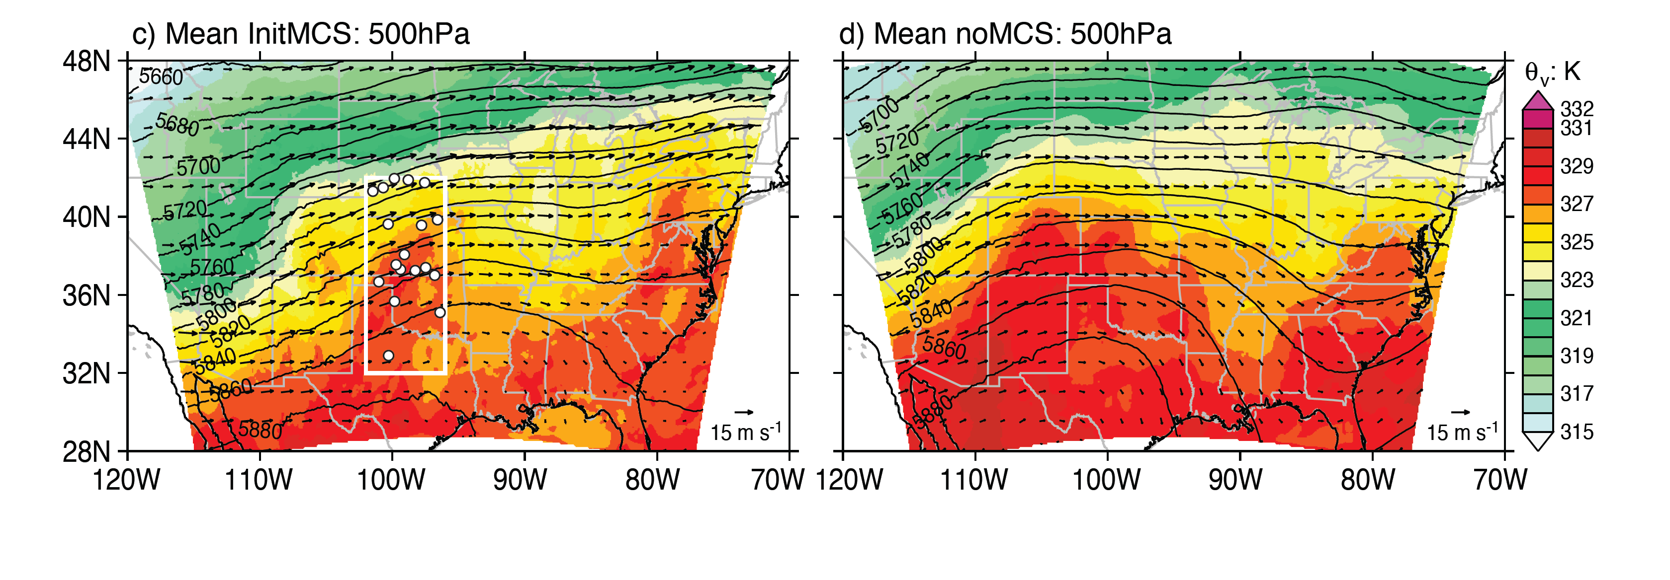
Midlatitude Wave Connection to MCSs—a recent study
Yang et al. (2017)—in review
Modeling study
WRF run for 2 complete warm seasons—4 km resolution, 2011 and 2012
MCSs realistic compared to WSR-88D data
Statistics of model MCSs consistent with WSR-88D radar data for MCS forming in central U.S.
→MCSs initiating in SW flow ahead of troughs is statistically robust

Slide 18
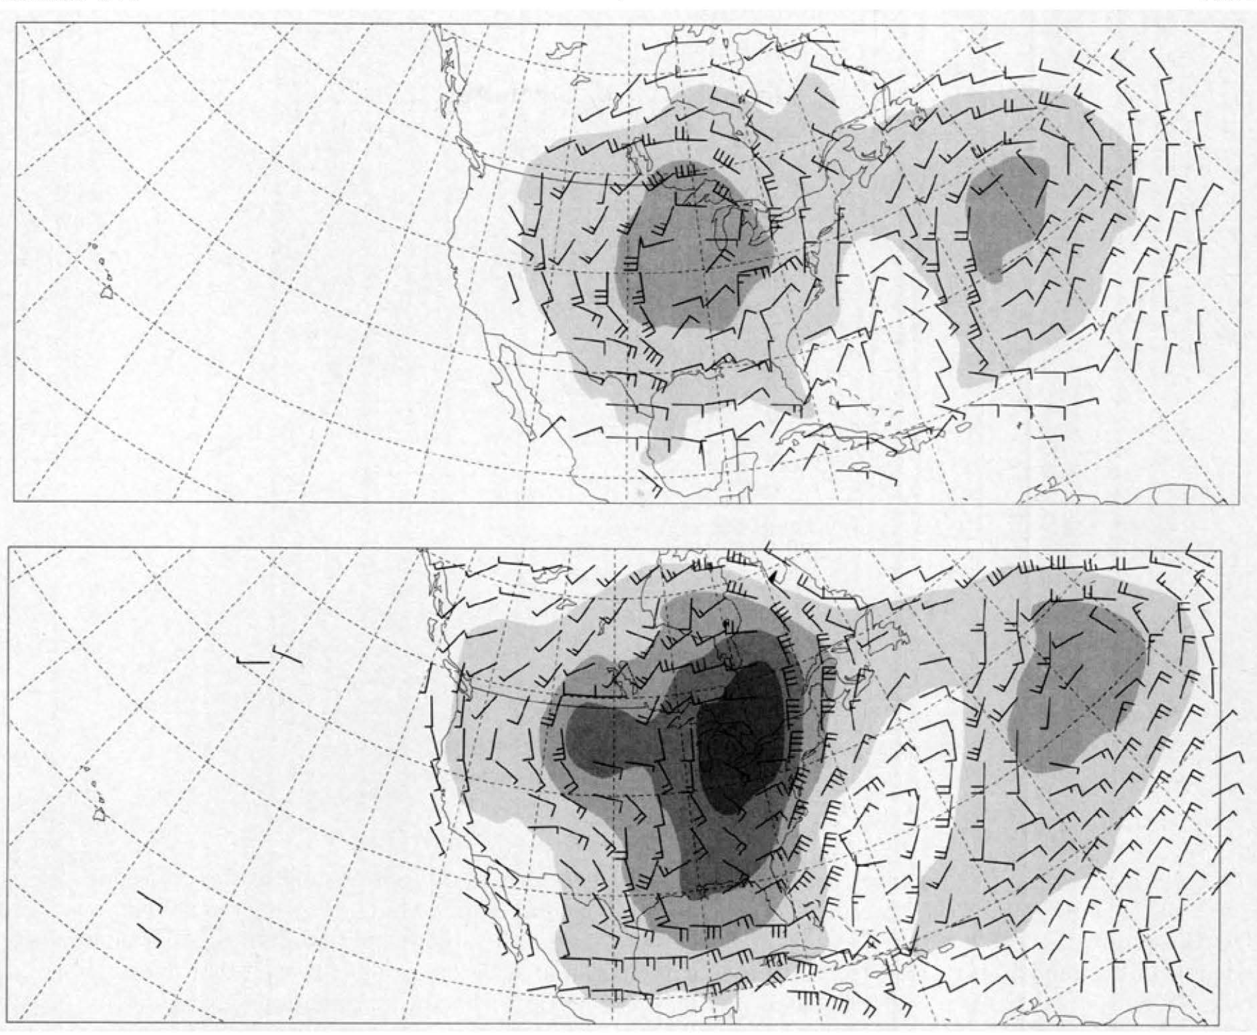
MCS Feedback to larger scale—an early study
Difference fields, diabatic –no diabatic
Stensrud (1996)
At mid/upper-levels: latent heating due deep convection alters distribution of potential vorticity and makes major changes to large-scale flow regime…in regions of persistent convection
48 h
200 mb
96 h
200 mb

Slide 19
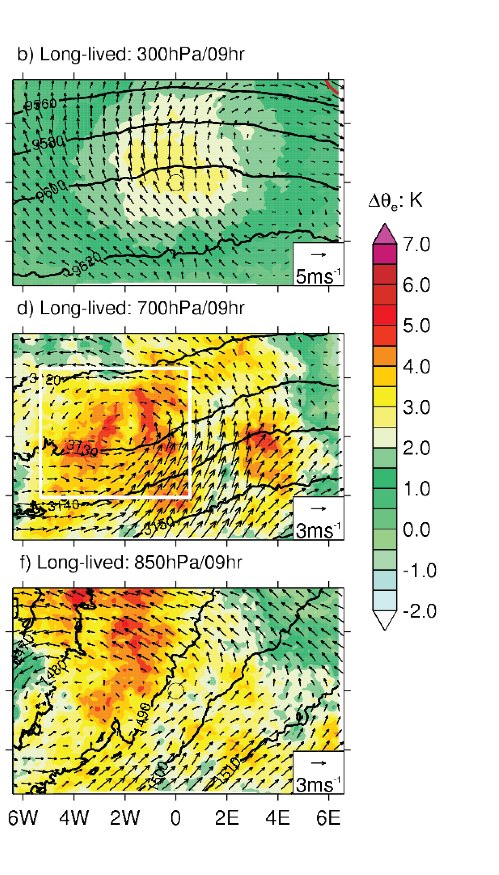
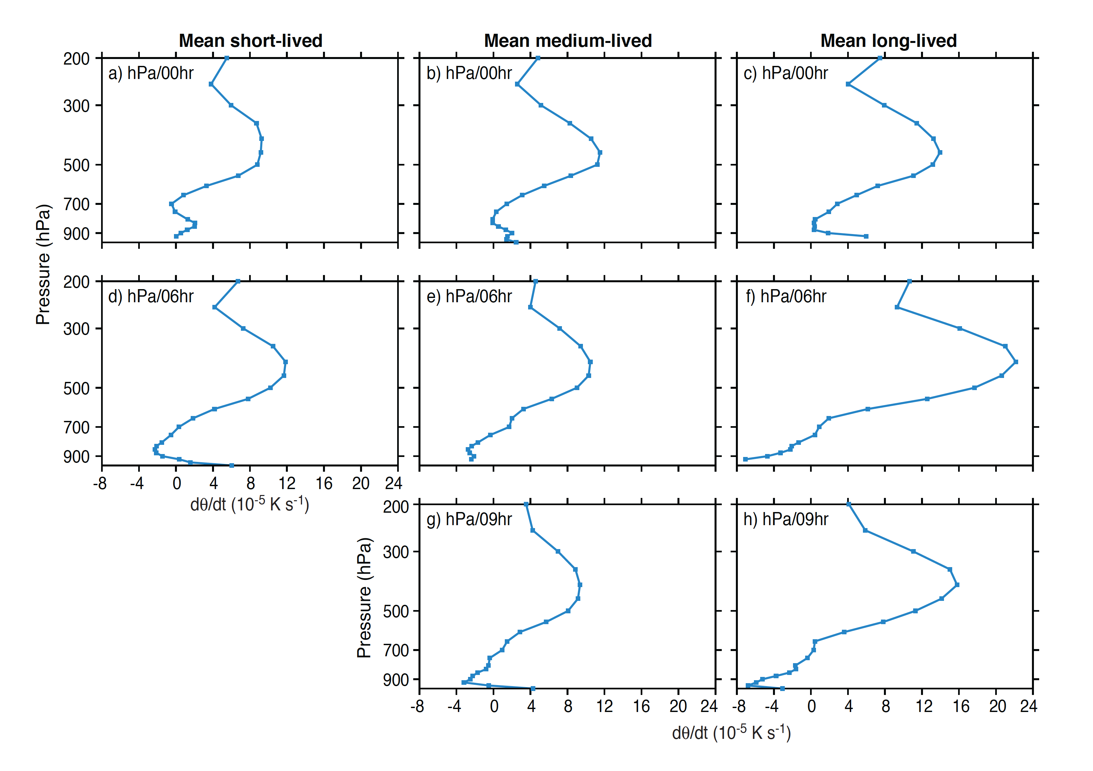
MCS Feedback to larger scale—a recent study
Yang et al. (2017)—in review
Composite flow anomaly for all long-lived MCSs simulated over warm season
Mid level vortex forms at midlevels where vertical gradient of heating is maximum

Slide 20
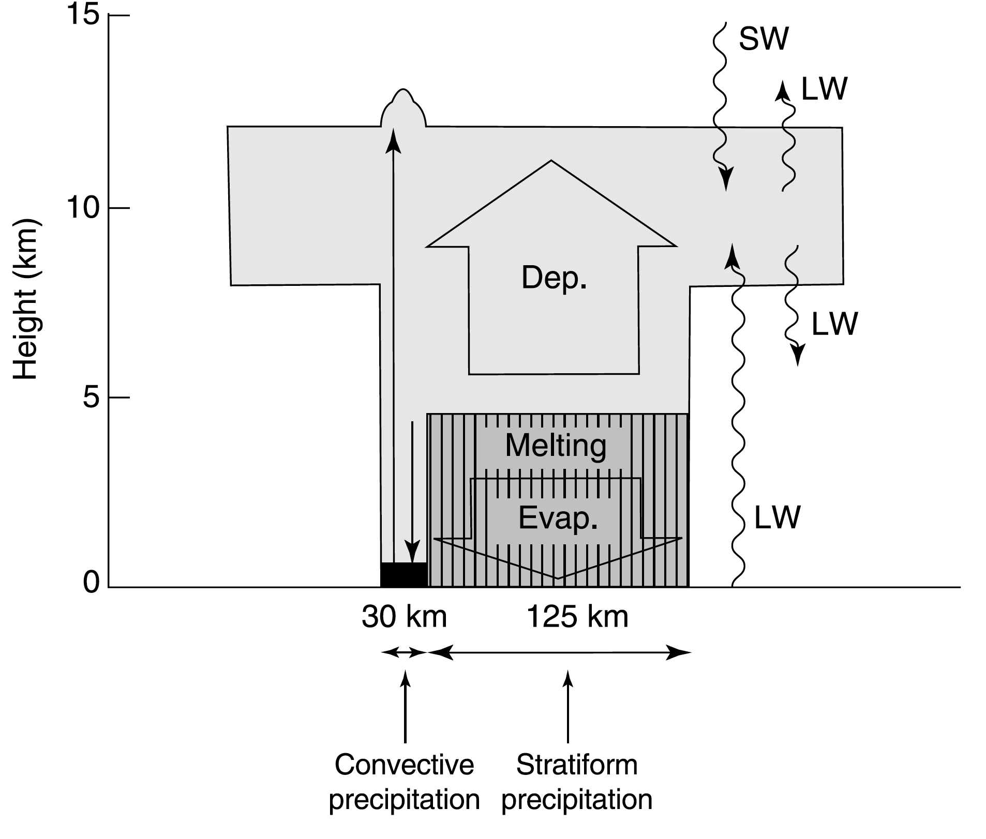
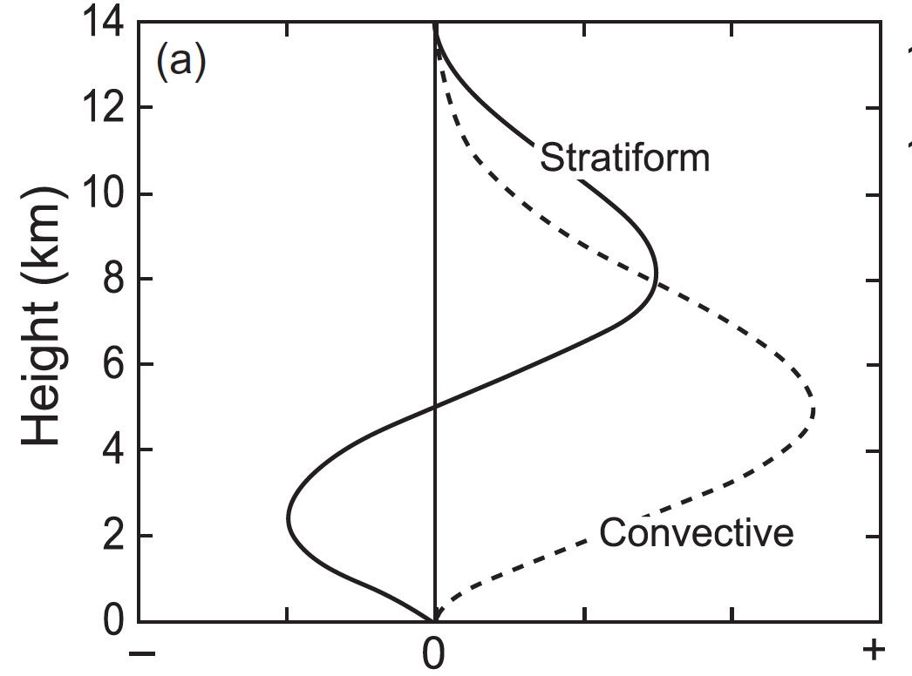

Convective, stratiform, and anvil components
Houze (1982, 1989)
MCSs have top-heavy heating because of their stratiform precipitation zones
=> Potential Vorticity Generation in midlevels
Non-dimensional heating rate

Slide 21
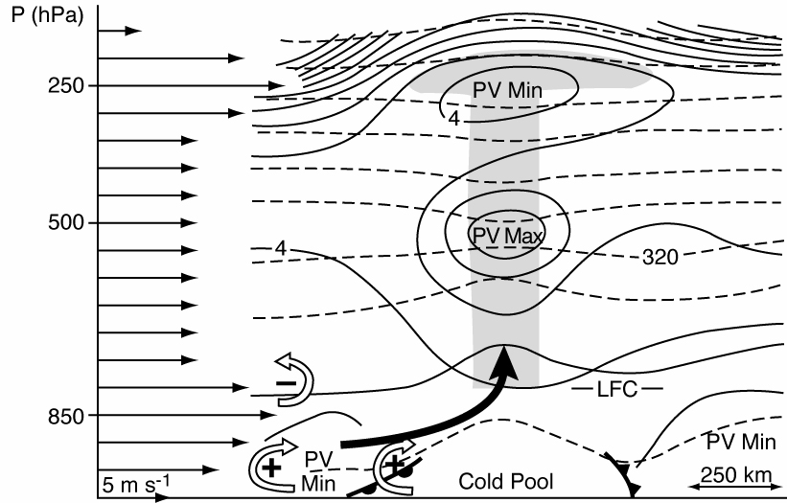
PV generated by an MCS
Fritsch et al. (1994)
MCS

Slide 22
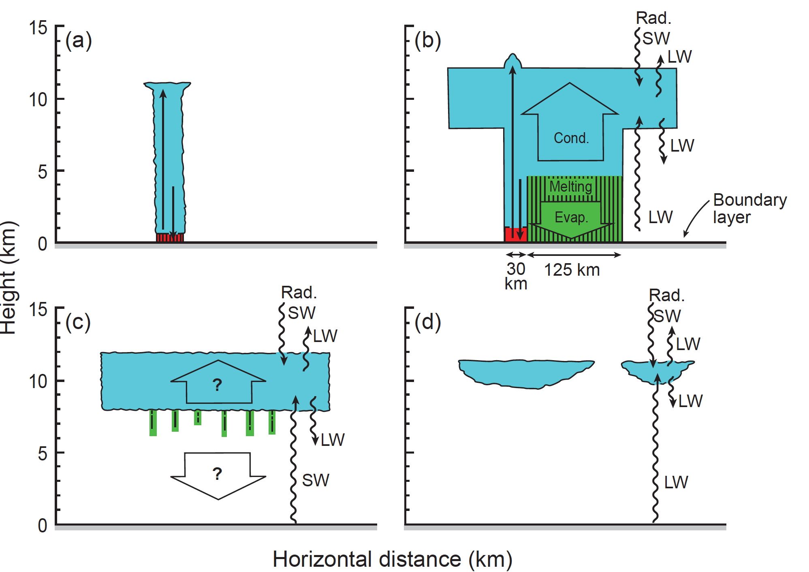
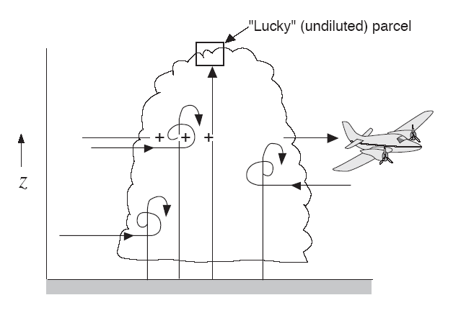
MCS lifecycle
Long lasting & rising
More complicated, stratiform region develops adjacent to deep convection, and get layered overturning on mesoscale,
Entraining plumes rising from the boundary layer
Adapted from
Houze (1982, 2014)

Slide 23
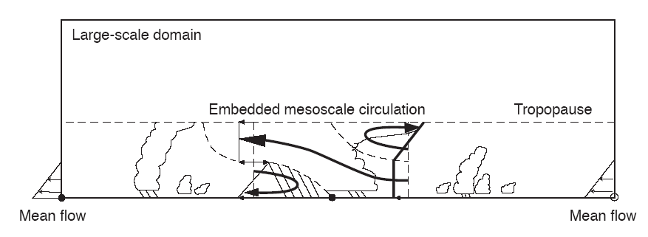
Moncrieff’s Model of MCS Layered Airflow
Moncrieff (1992), and several of his earlier and later papers)
Mesoscale layered overturning
Simultaneous adjustment to stability and shear of the environment

Slide 24
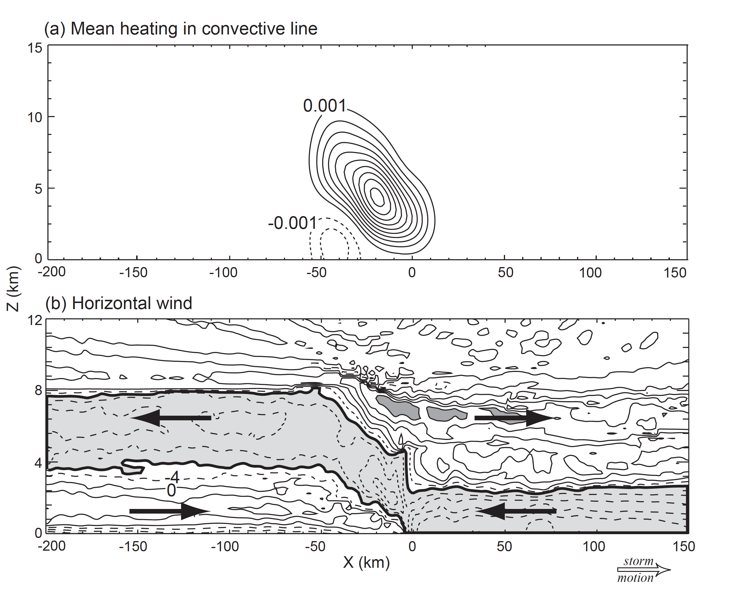
How does the layer overturning come about?
Pandya and Durran (1996)
Layered overturning is a gravity wave response to the net heating in the convective region

Slide 25
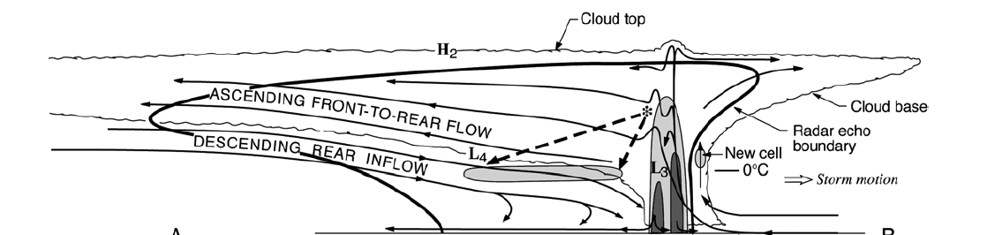
Multiscale Airflow
Often MCSs have these sloping structures, but with convective elements superimposed
Cold pool
Layer of inflow
Gust front
Storm motion
Sheared flow leads to older convective elements being advected rearward SF precipitation area is to the rear.
Houze et al. (1989)
Houze et al. 1989

Slide 26
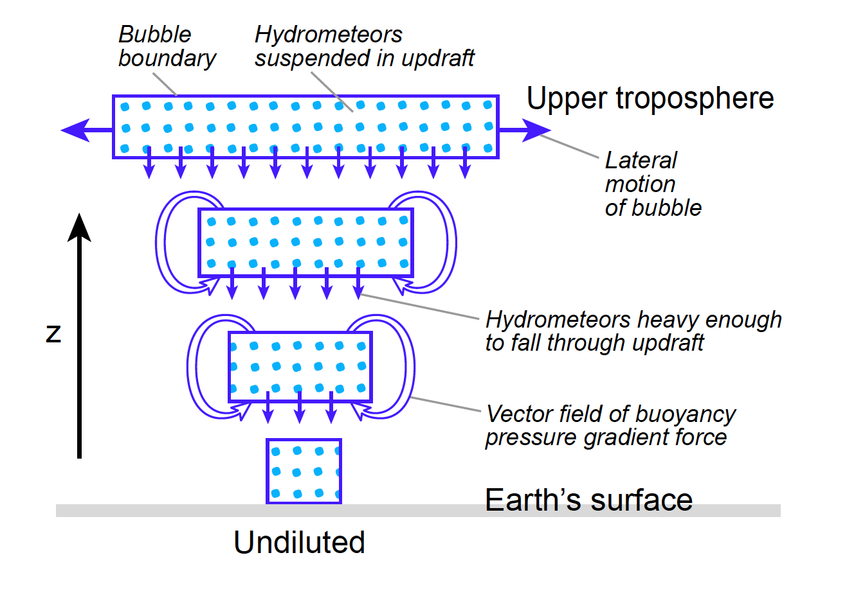
Individual Buoyant Element with Growing Hydrometeors
Yuter & Houze (1995)

Slide 27
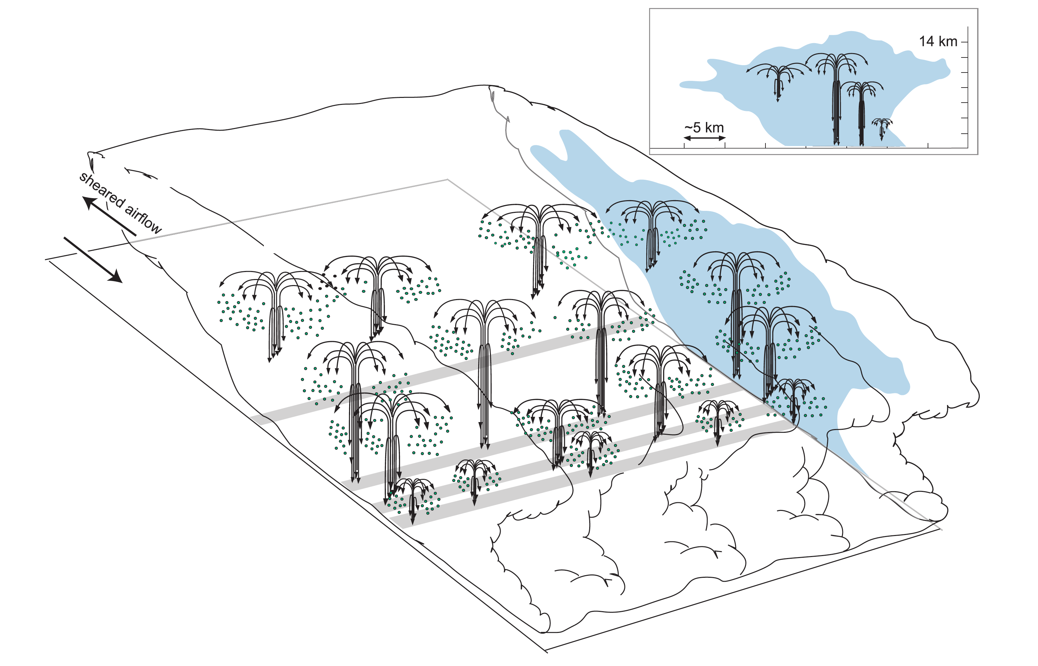
Buoyant Elements in Layered Flow
Yuter & Houze (1995)

Slide 28
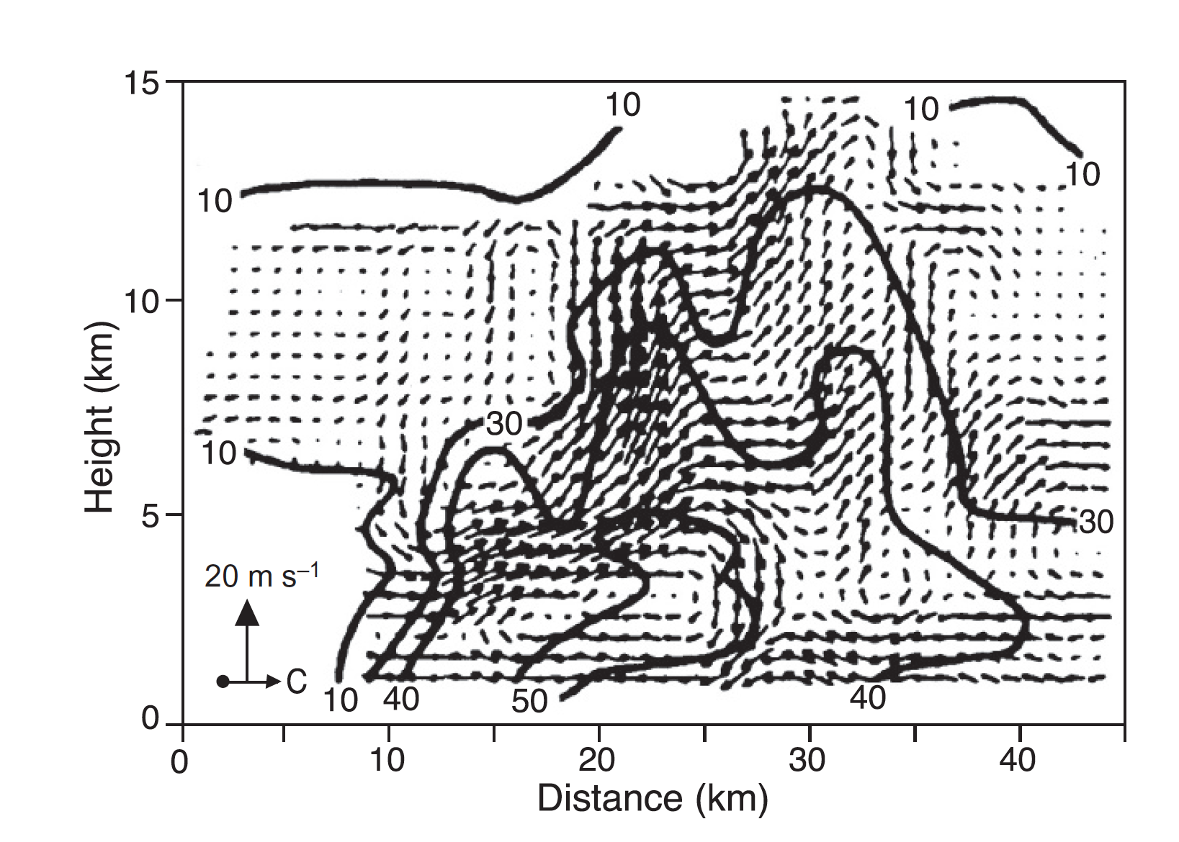
Dual-Doppler showing both the layer flow and superimposed convective elements in the convective zone in a real case
Storm motion
Roux 1988

Slide 29
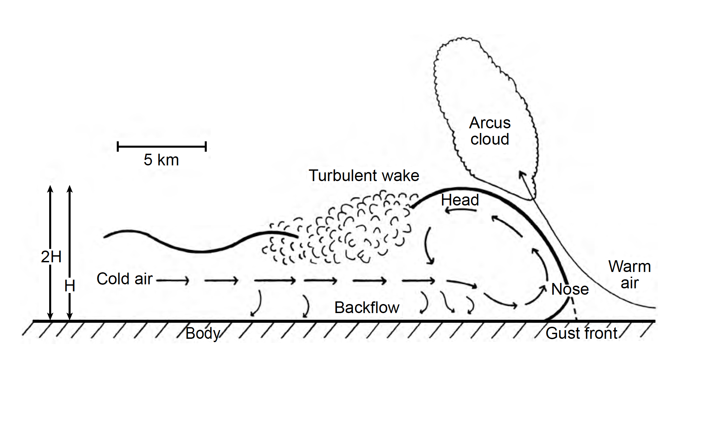
Cold Pool & Gust Front Structure
LFC
KH waves
Cyclostrophic Low
Hydrostatic High
Dynamic High
Charba 1974; Droegemeier and Wilhelmson 1987

Slide 30
Horizontal Patterns
(Are they important?)

Slide 31
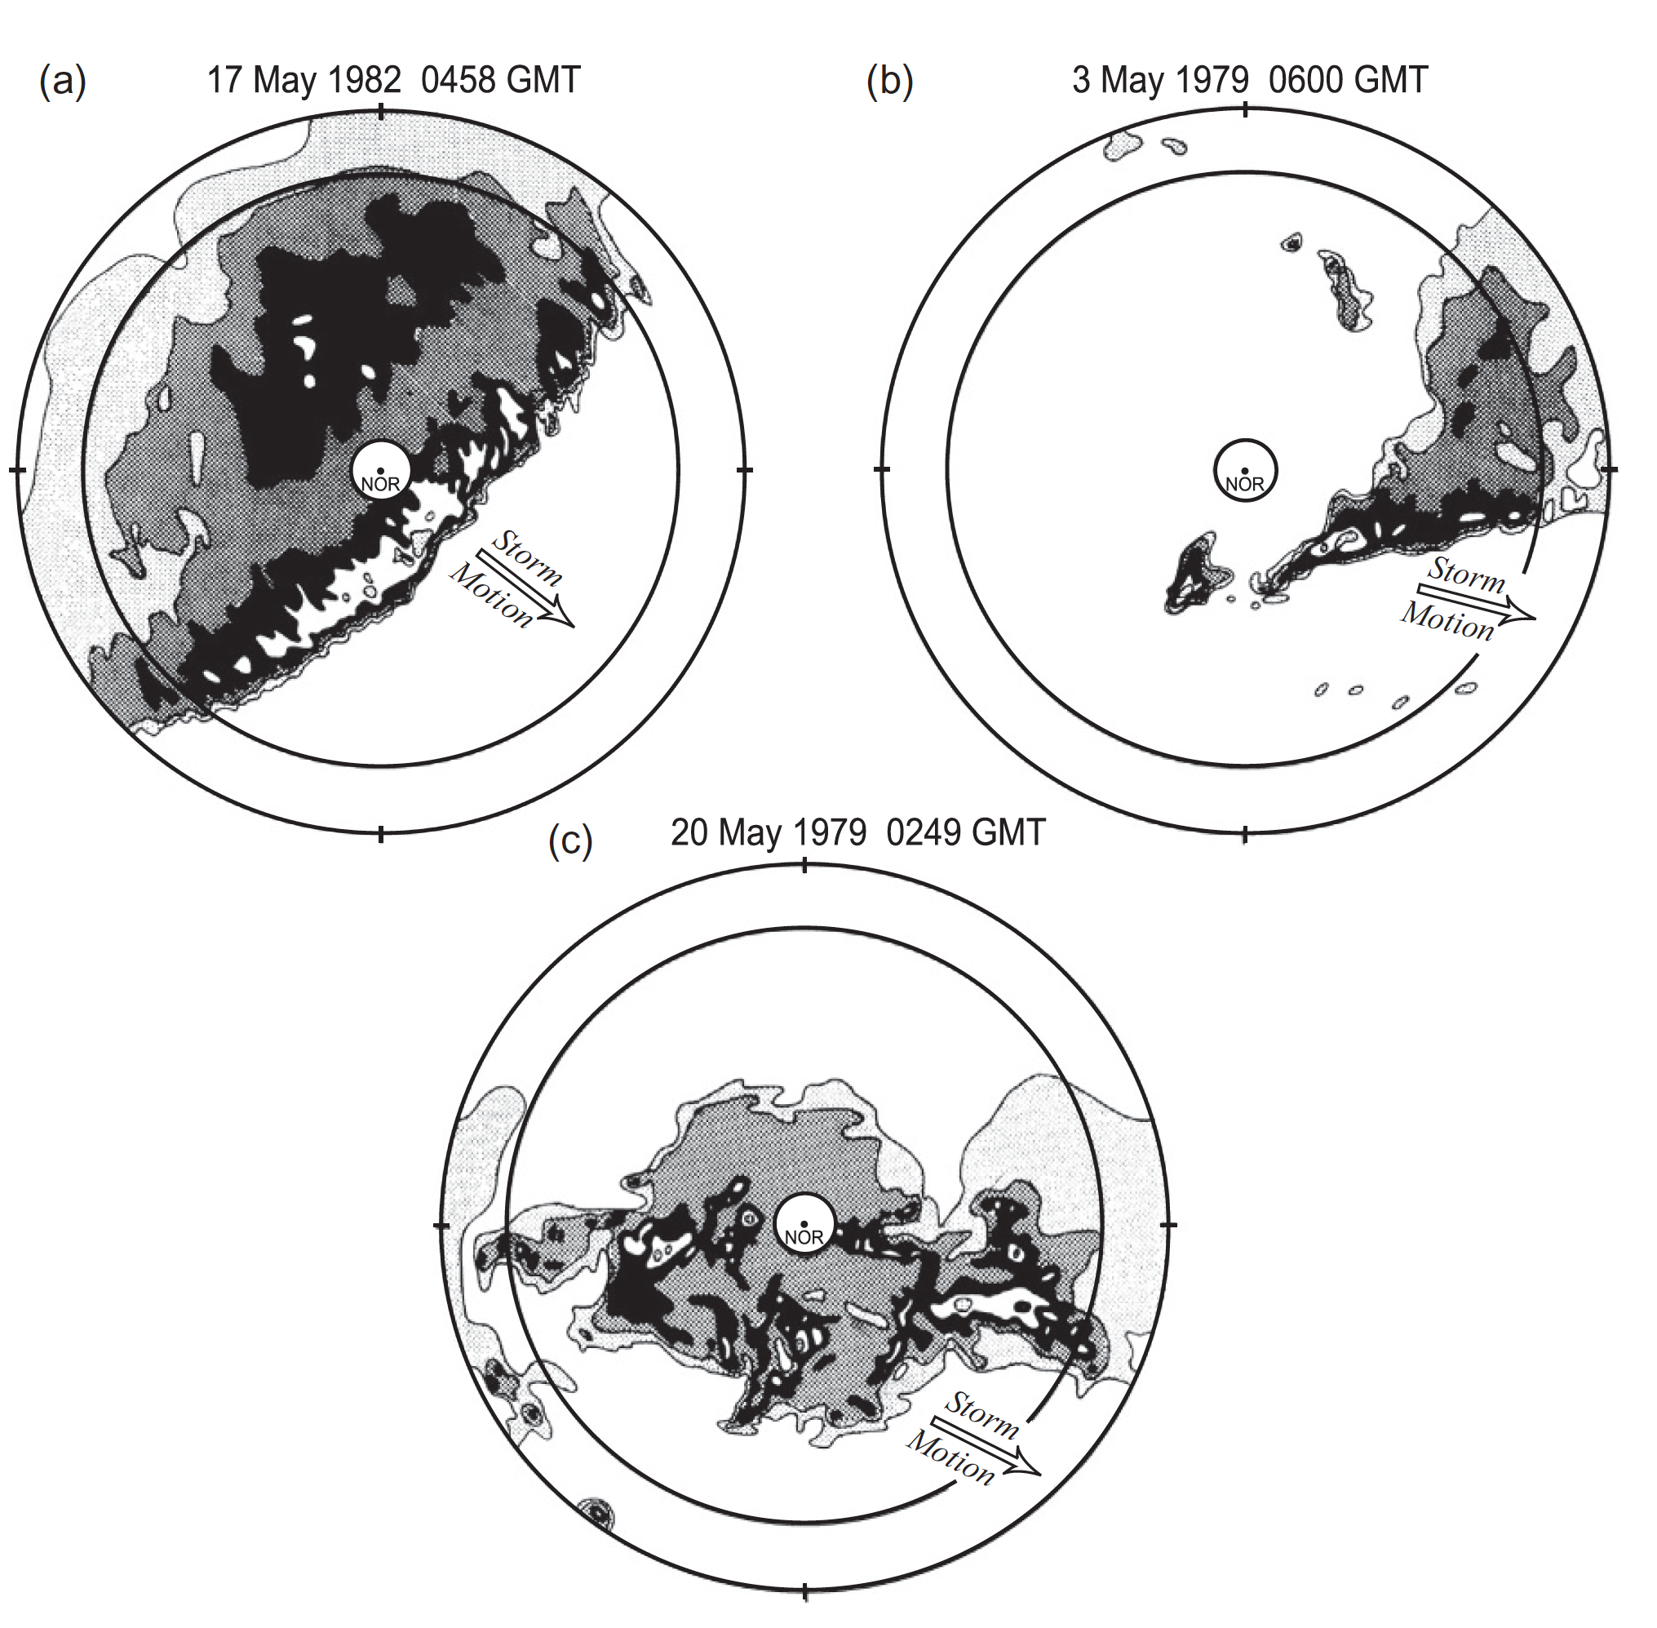
Typical Horizontal Patterns
Squall lines
Houze et al. (1990)
Springtime rainstorms in Oklahoma
Uncharacterizable
Houze et al. (1990)

Slide 32
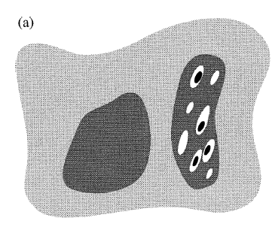
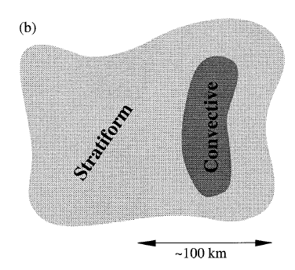
Inflow can come from any direction
Possible inflows to convective regions
Possible Inflows to stratiform regions
“rear inflow”
100 km

Slide 33
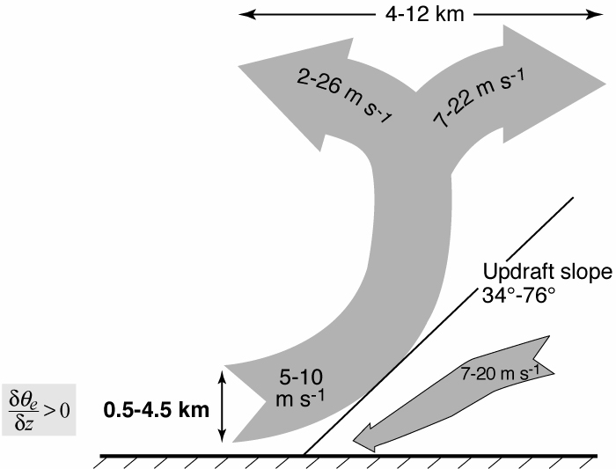
TOGA COARE
Airborne Doppler Observations of MCSs
25 convective region flights
<
Kingsmill & Houze (1999)

Slide 34
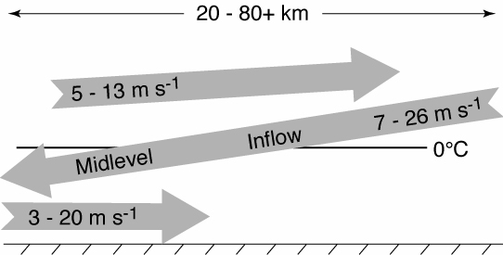
TOGA COARE
Airborne Doppler Observations of MCSs
25 stratiform region flights
Direction of inflow determined by direction of large-scale flow—not orientation of a convective line
Kingsmill & Houze (1999)

Slide 35
Summary
Mesoscale Convective Systems (MCSs) …cold top, large precipitation area, some intense precipitation, large lingering rising ice cloud (anvil) aloft
Form when deep convection aggregates: Mechanisms—need to be sorted out
Strong relation to synoptic-scale waves: Form ahead of troughs, long-lived MCSs strengthen troughs via PV feedback, PV feedback concentrated in stratiform regions
Multiscale air motions: Superposition of deep convective elements, layered overturning, and boundary-layer cold pools
Convective and mesoscale elements not always in squall-line configuration: Horizontal patterns vary, inflow layers can be from any direction

Slide 36
End
Supported by NSP Grant AGS-1355567 and NASA grants NNX13AQ37G and NNX16AD75G

