Slide 1
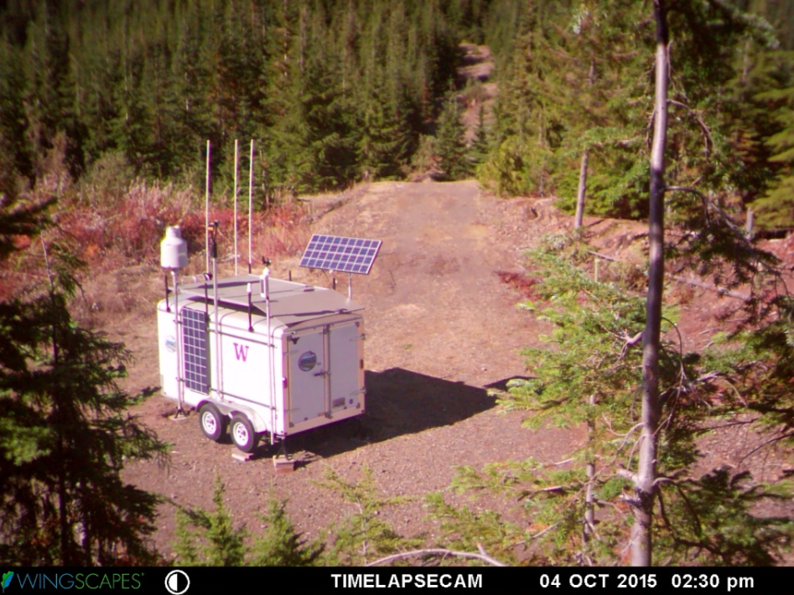
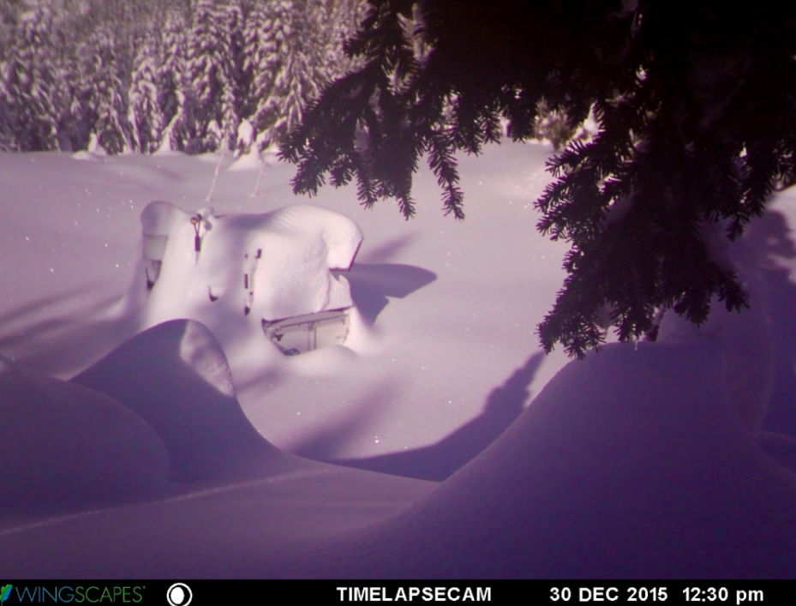




Stratiform Precipitation Processes in Cyclones Passing over the Olympic Mountains
Joe Zagrodnik
Lynn McMurdie, Robert A. Houze
OLYMPEX Science Meeting
22 March 2017
Thanks to:
Olympic National Park (Bill Baccus and C.J. Urnes)
NASA (Matt Wingo, Ali Tokay, many others)

Slide 2
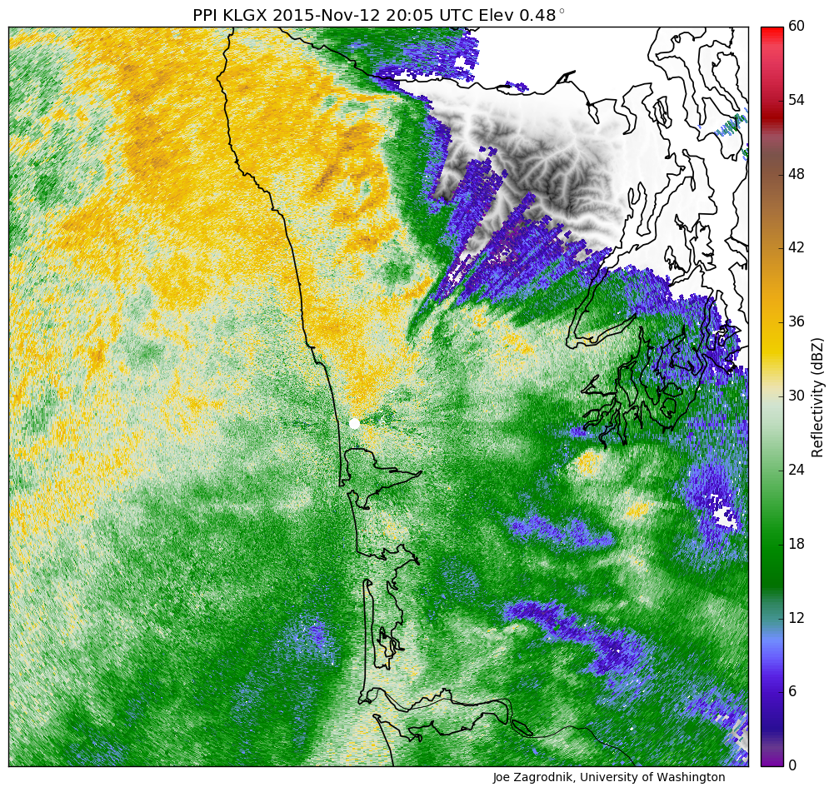
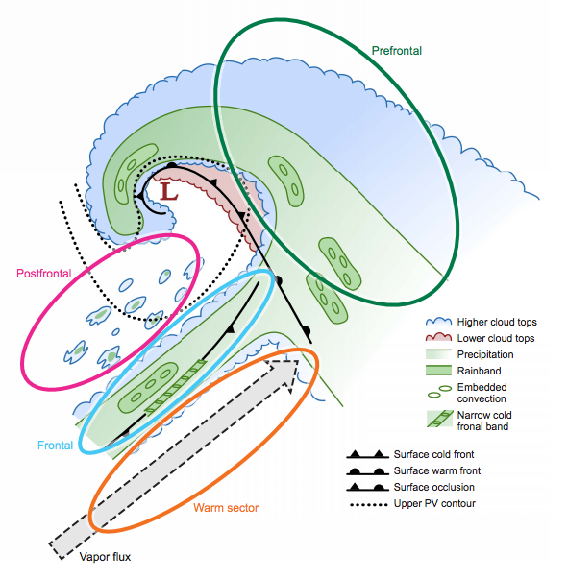
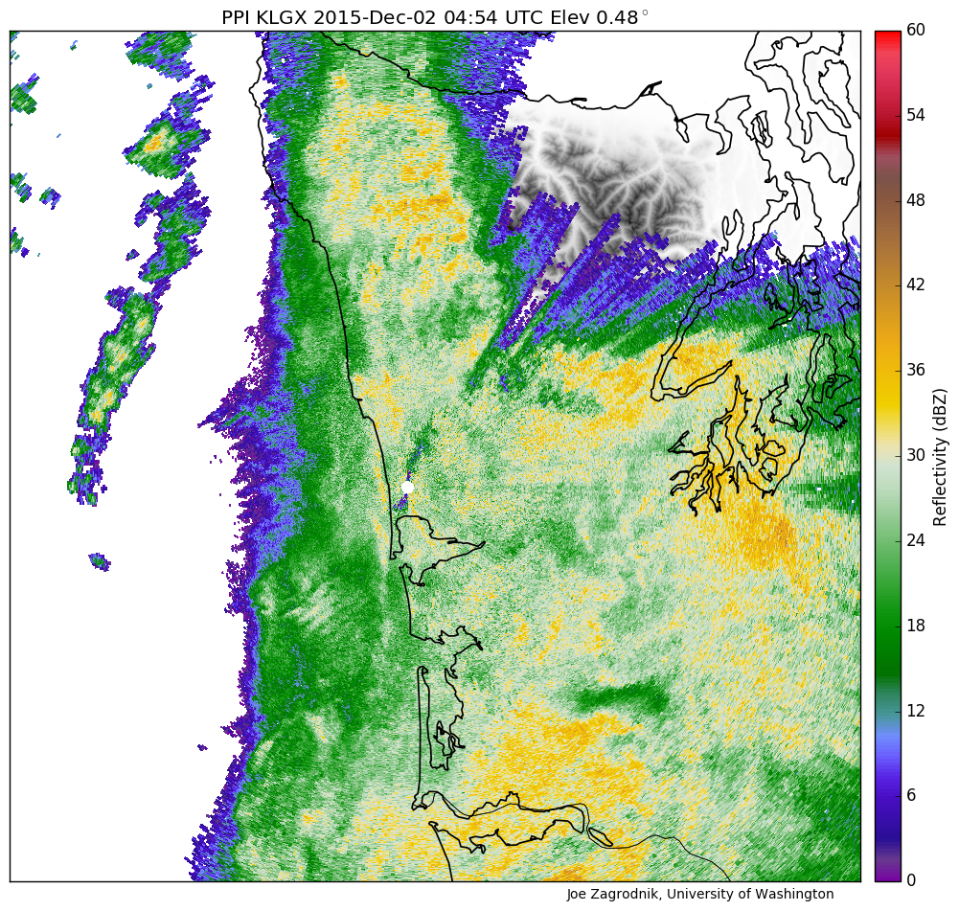
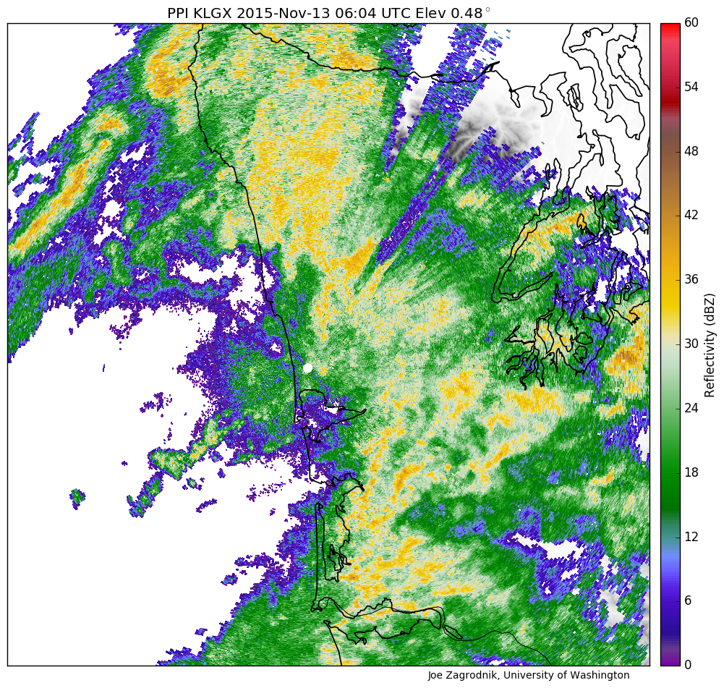
Most precip on the Olympic Peninsula is nearly-continuous stratiform rain
X
Notes:
Transition:

Slide 3
Goal of this Presentation:
Relate large-scale environmental factors affecting orographic enhancement to precipitation processes:
  Flow:
    Low-level moisture flux (IVT—Integrated Vapor Transport)
  Thermodynamics:
    Melting level height
    Static Stability
  Cloud/Precipitation Microphysics:
    Drop size distribution (DSD) and rainfall distribution at a variety of locations/elevations

Slide 4
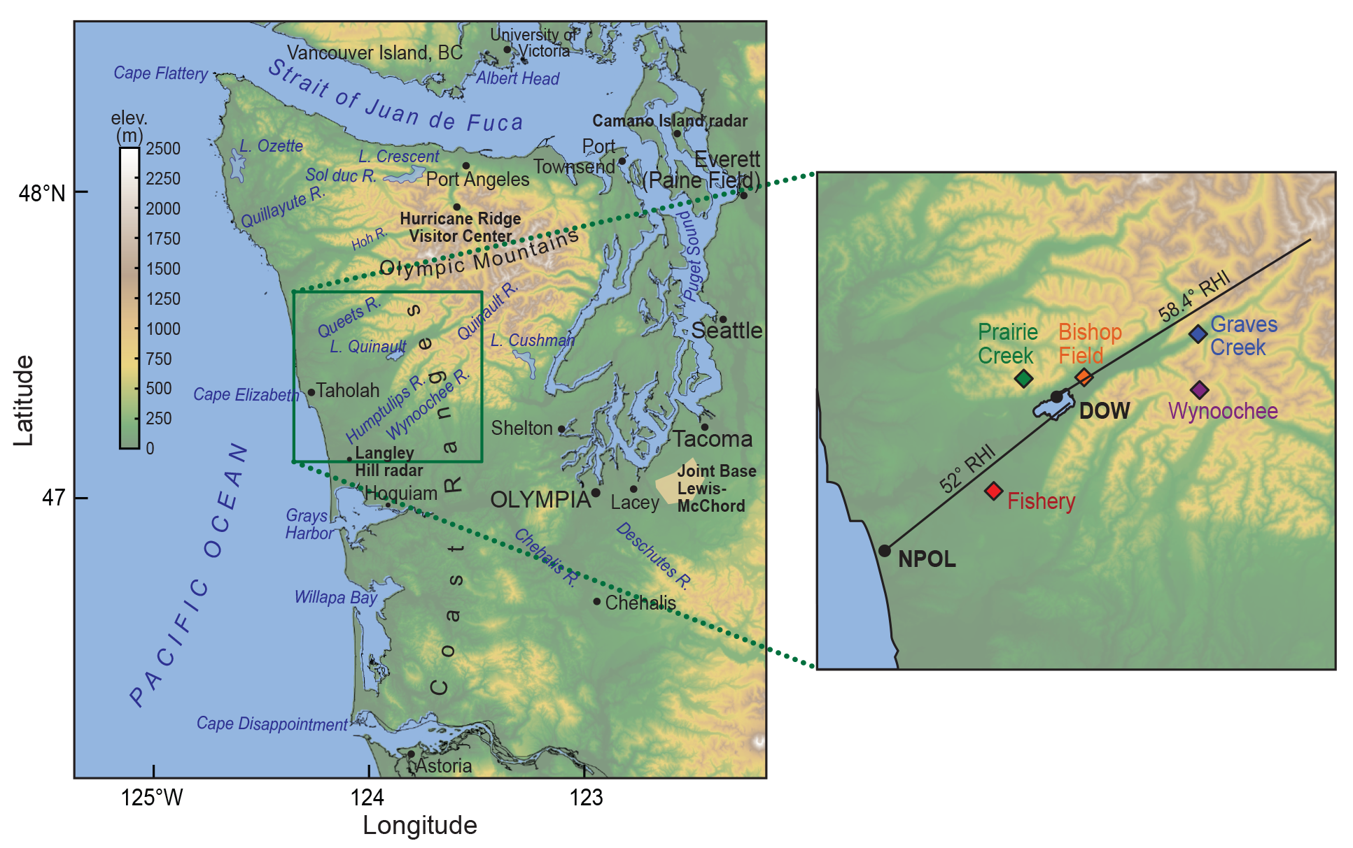
Site Locations
Ground Site | Elevation (m)
Fishery | 52
Bishop Field | 85
Prairie Creek | 543
Graves Creek | 180
Wynoochee | 1020

Slide 5
Statistical Analysis
All storms Oct 2015 – Apr 2016
Postfrontal and < 1 mm h⁻¹ rain rates removed
Divide everything into 3-hour periods centered on North American Regional Reanalysis (NARR) times (00, 03, 06 UTC etc)
  Drop size distribution (DSD) at Prairie Creek
  Precipitation gauges at 5 ground sites with varying elevation/distance from coast

Slide 6
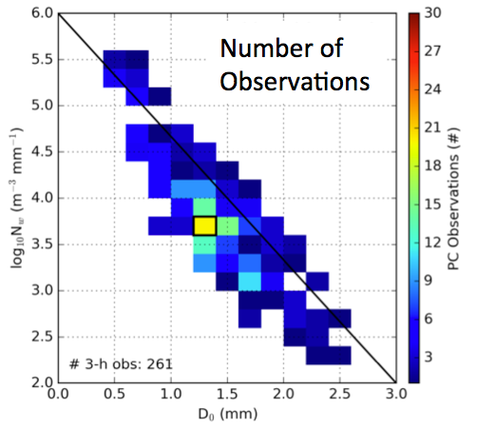
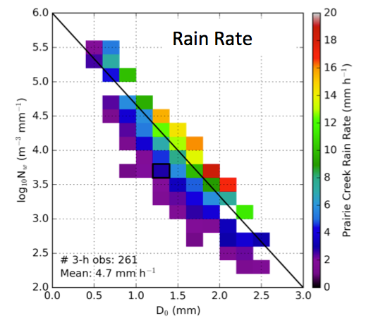
Drop Size Distribution at Prairie Creek
Histograms of Drop Diameter vs. Drop Number:
Increase in size and number
Heavy rain
Normalized Intercept (N_{W})
Number of Drops (N_{W})
Most frequent DSD
Average Rain Rate
Median Drop Size (D₀)
Median Drop Size (D₀)
Similar DSD at near-coastal site (Fishery) but less outliers
Notes:
-Wide range of possibilities
-Most frequent regime: modest size and number, light rain rate (near climatology)
-Heavy rain regime: increased size and number (some variability), max observed rain rates

Slide 7
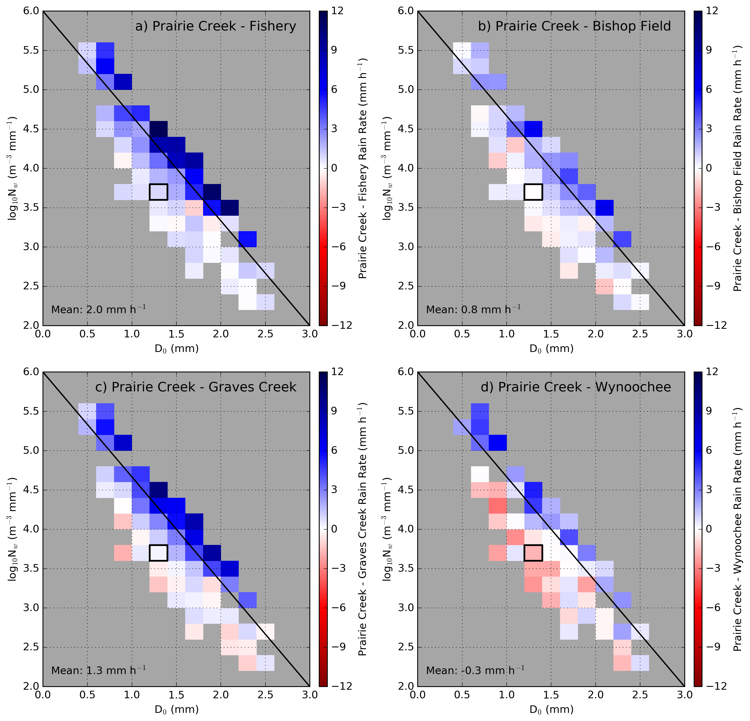
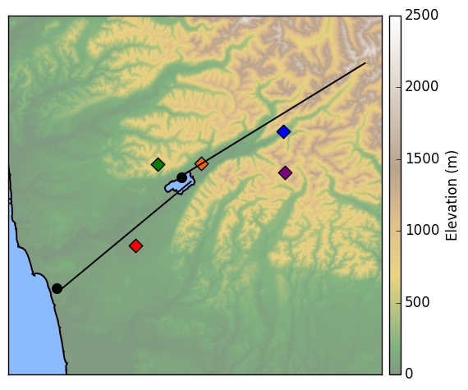
Prairie Creek DSD vs. Orographic Enhancement
Prairie - Fishery
Prairie - Bishop
Graves Creek
Bishop Field
Prairie Creek
Wynoochee
Fishery
Normalized Intercept (N_{W})
For a given Prairie Creek DSD:
Blue = more precip at Prairie Creek
Red = less precip at Prairie Creek
White = same at both sites
Prairie – Graves Creek
Prairie – Wynoochee
Median Drop Size (D₀)
Overall: more precip at Wynoochee
Notes:
Most frequent DSD = Very little difference in rainfall, except at highest elevation. Dominates in seasonal statistics

Slide 8
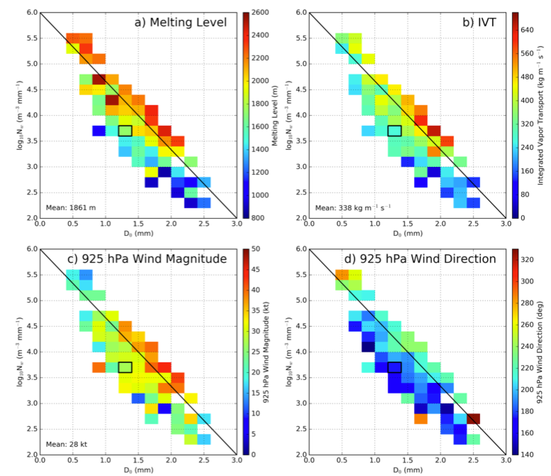
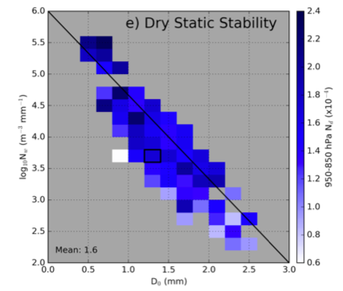
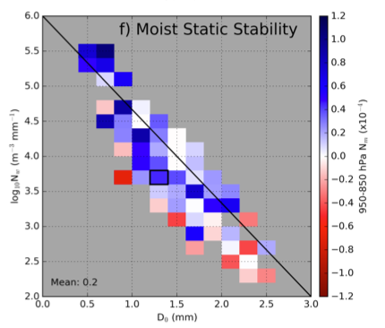
Prairie Creek DSD vs. Synoptic Environment
950-850 hPa
Normalized Intercept (N_{W})
950-850 hPa
Median Drop Size (D₀)
Most Frequent
Lots of Small Drops
Few Large Drops
Heavy Rain

Slide 9
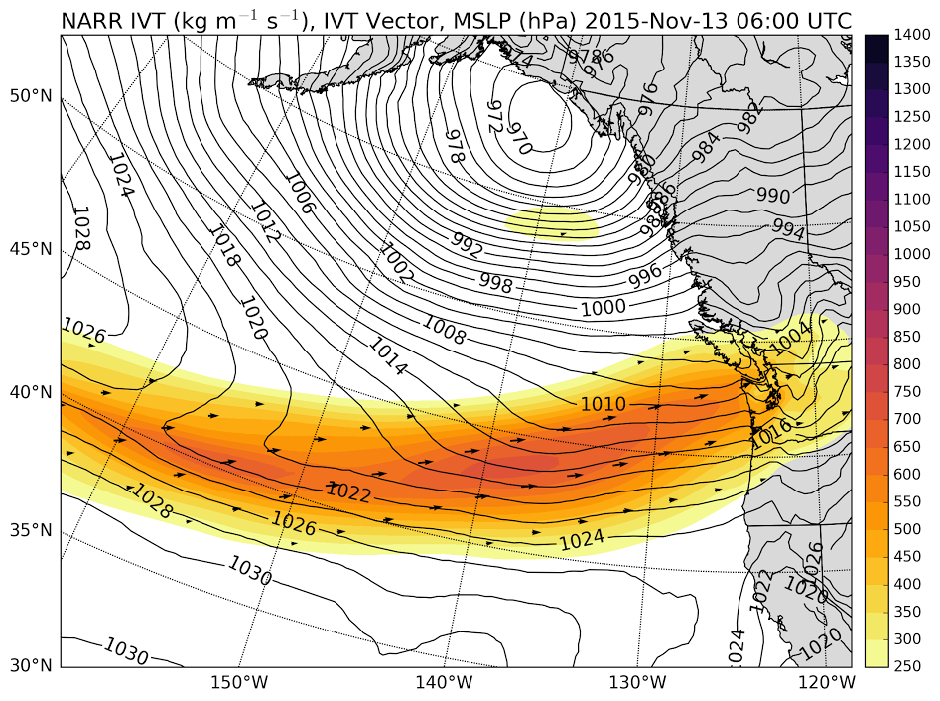
Quick look at a case study:
Nov 12-13, 2015 “Atmospheric River”
High melting level
Strong 925 hPa winds and IVT
Moist-Neutral Stability
Integrated Vapor Transport (IVT)

Slide 10
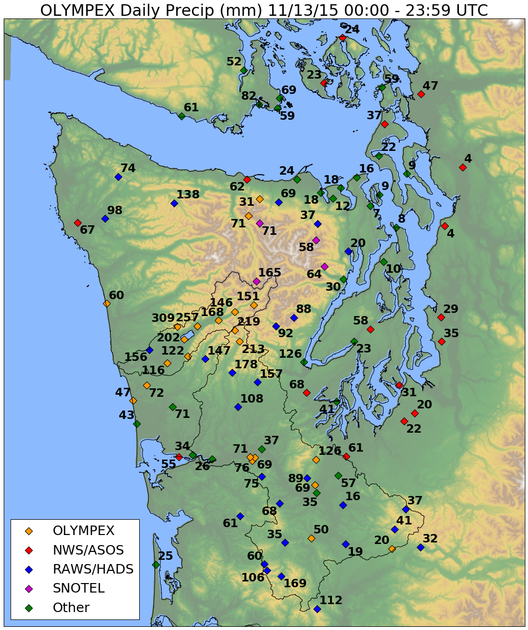
High terrain less than windward slopes
Factor of 4-5 enhancement between coast and Lake Quinault
Different than climatology!

Slide 11
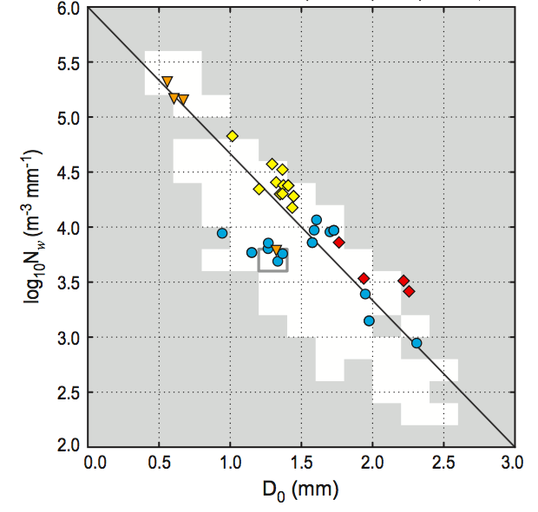

All 4 DSD Regimes were observed in this event at Prairie Creek
Prairie Creek
1-hour DSDs
Transitions in DSDs matched changes in storm sector
Warm
Front
NCFR
Prefrontal Warm Sector Frontal

Slide 12
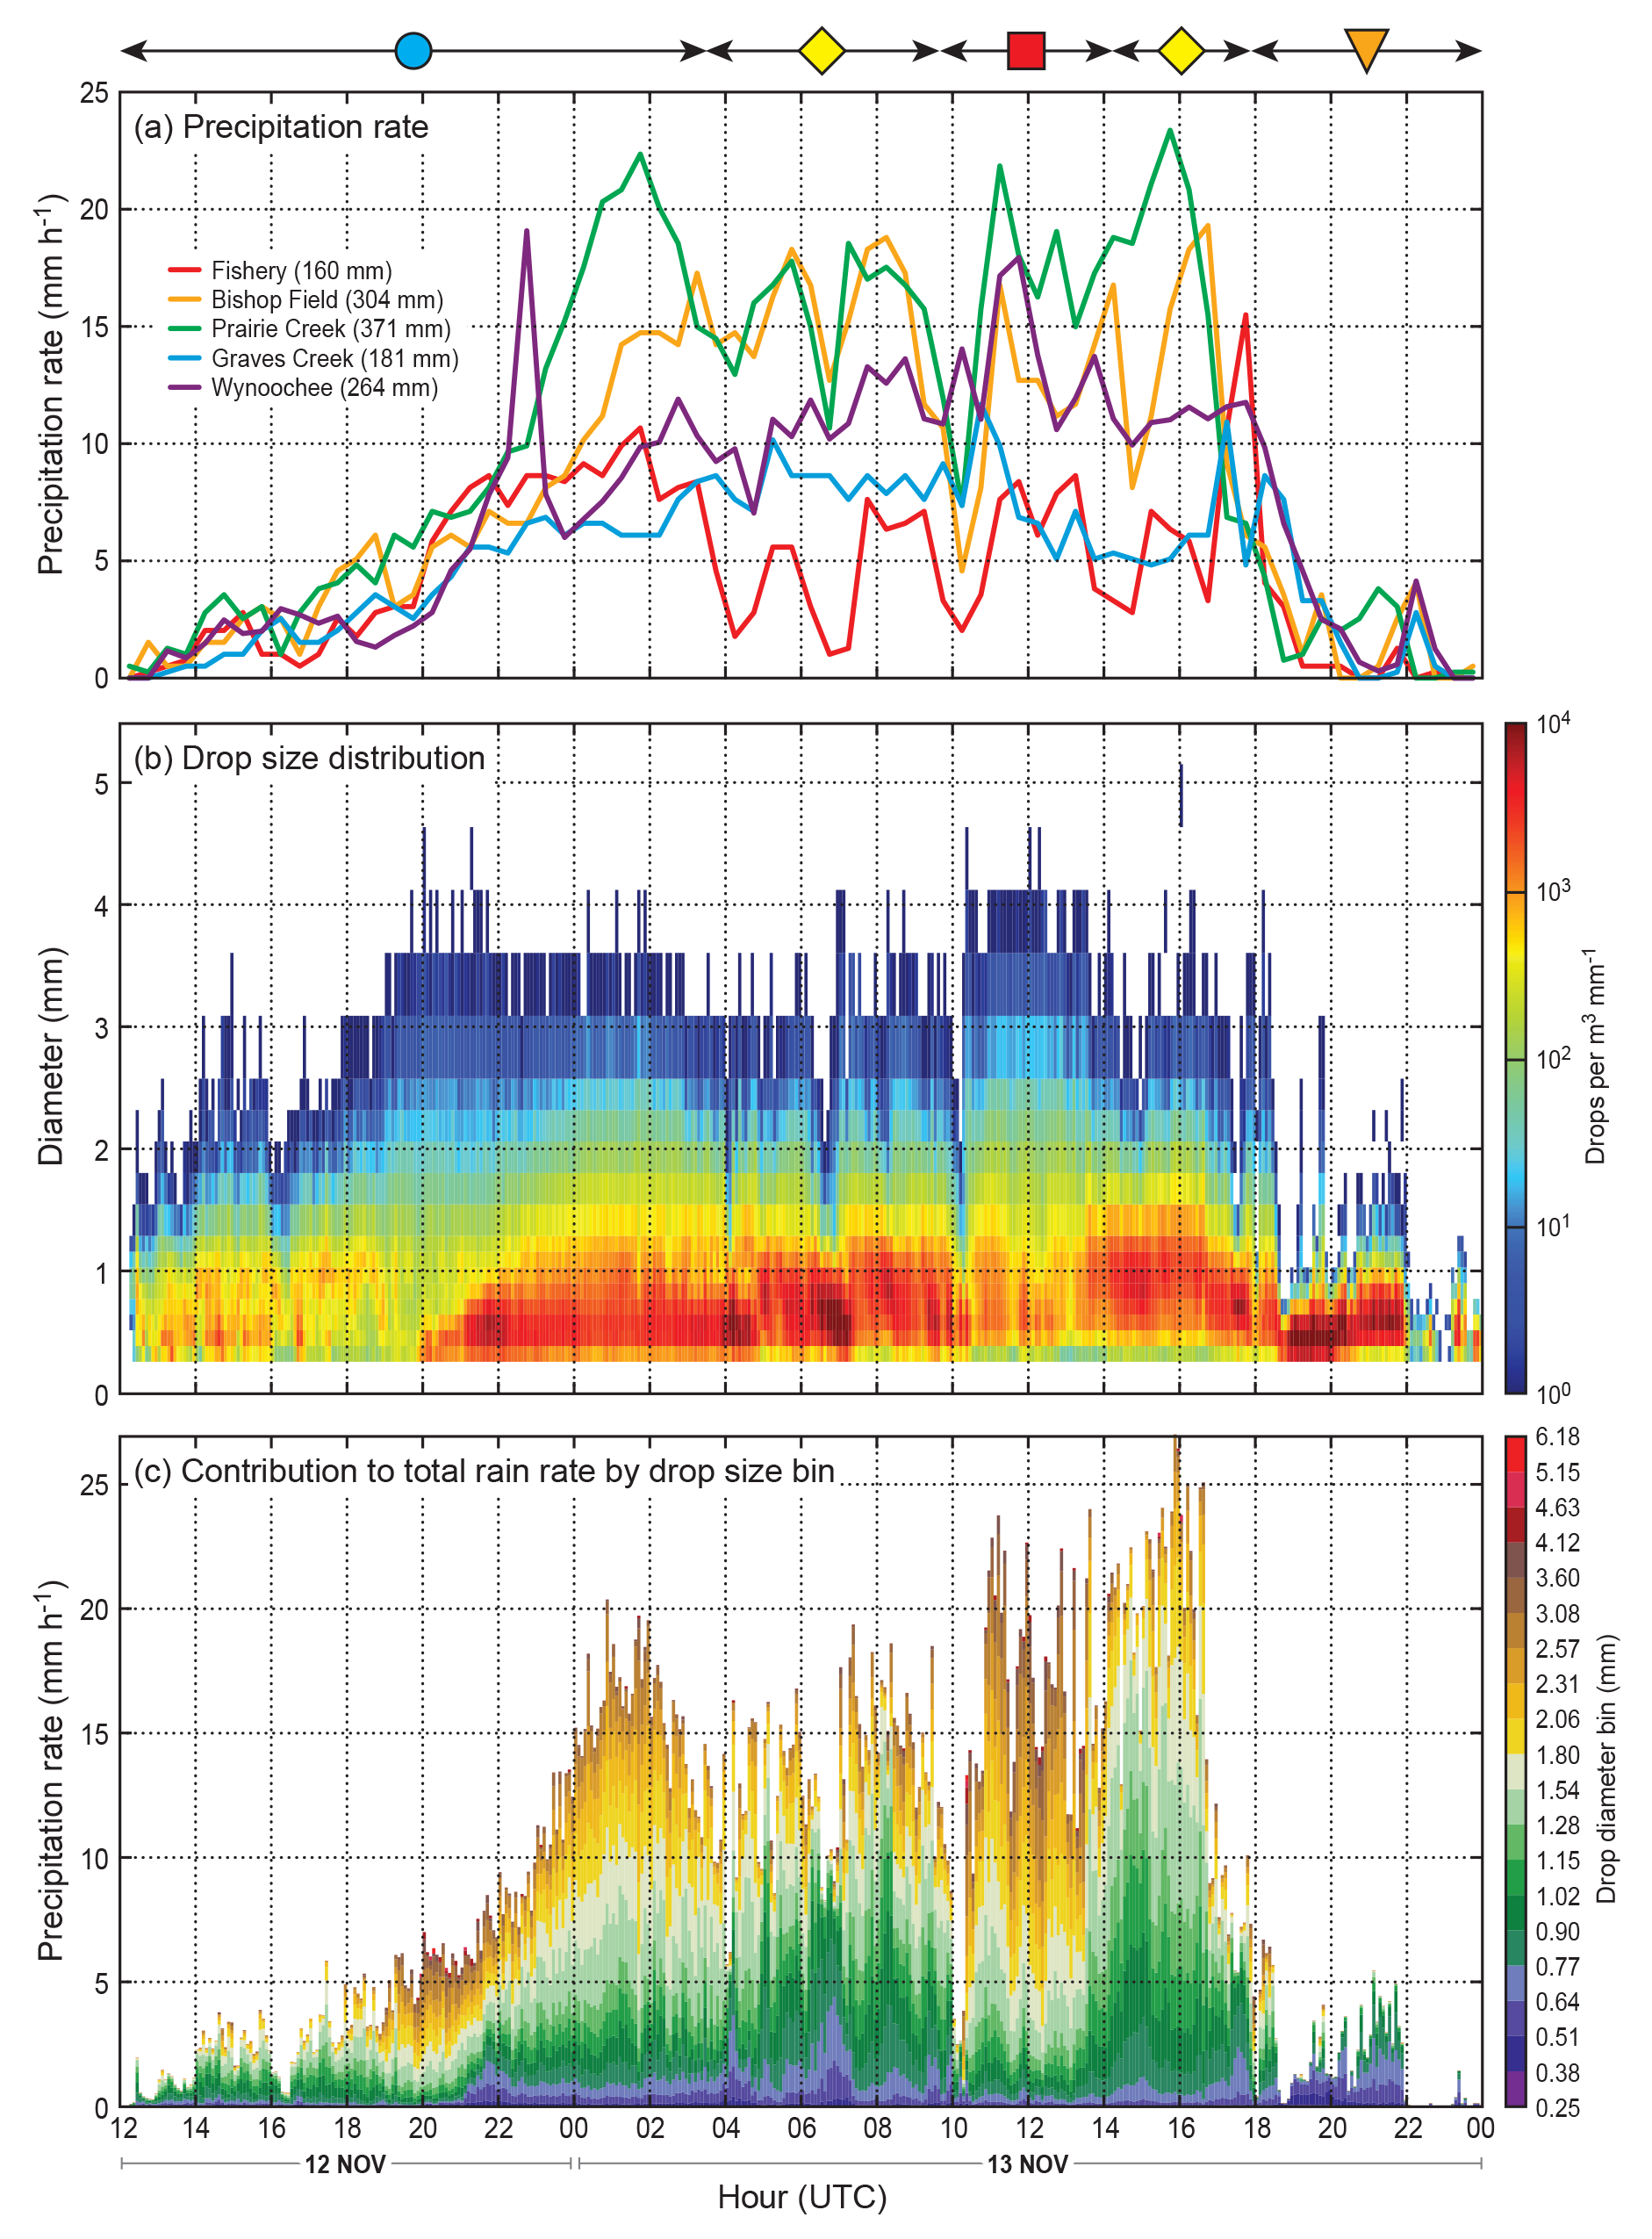
Time Series
12-13 November 2015
Precip Rate
Warm Sector
Long period of orographic enhancement associated with warm sector.
Event begins with most frequent DSD. Negligable orographic enhancement.
Prairie Creek DSD
Drops per m³ mm⁻¹
4-hour period of larger drops in warm sector.
Small-to-medium
(< 1.8 mm) drops become dominant during transition to warm sector.
Contribution to rain rate by drop size bin
Drop Diameter Bin (mm)

Slide 13
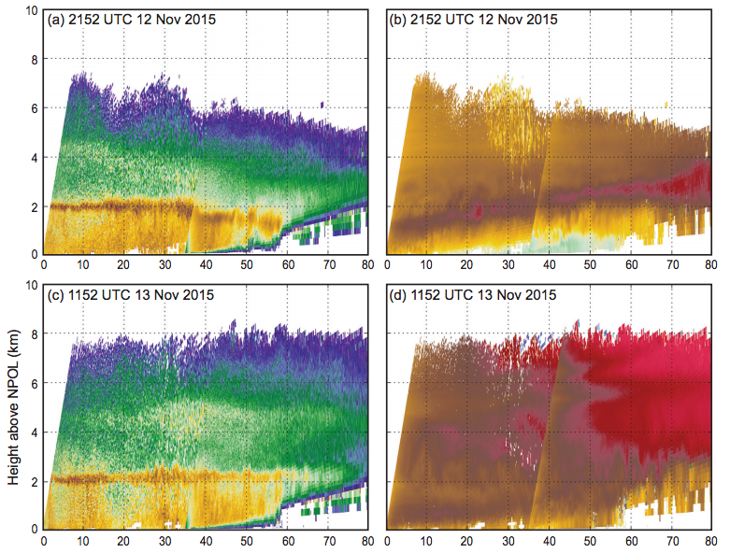
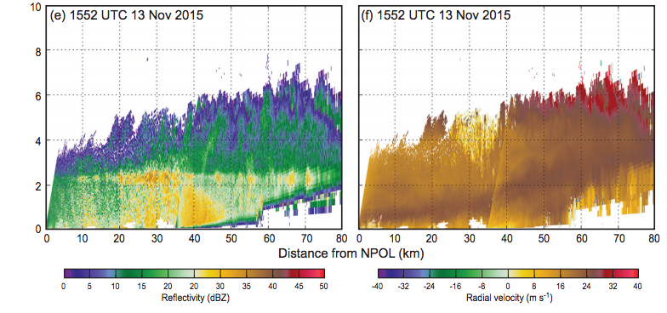
Prefrontal
NPOL+DOW Combined RHIs
Prefrontal:
-Toward-radar flow below 1 km
12-Nov 2152 UTC
Fishery: 8 mm h⁻¹
Prairie: 10 mm h⁻¹
“Most frequent” DSD
LLJ
Warm sector (deep)
Warm Sector:
-Low-level jet lifts over initial windward slopes
-Low-level enhancement in reflectivity
-Rain rate not significantly affected by ice processes!
13-Nov 1152 UTC
Fishery: 7 mm h⁻¹
Prairie: 18 mm h⁻¹
Mostly large drops
Warm sector (prior to NCFR)
Coast
Mountains
13-Nov 1552 UTC
Fishery: 6 mm h⁻¹
Prairie: 23 mm h⁻¹
Mostly small drops
Prairie Creek
Fishery
Reflectivity
Radial Velocity

Slide 14
Summary
Seasonal time scale: most precip over higher elevations (lots of weak storms)
Warm, heavy rain events (Atmospheric Rivers) have most precip at low-to-mid elevations
  Rain consists of mostly small-to-medium sized drops
  Formed by condensation/collision-coalescence
  Related to moist-neutral lifting of low-level jet
Surprising result: warm precipitation processes can generate heavy rain without significant contributions from seeding by ice crystals (seeder-feeder) or shear-generated turbulence.
Thanks to:
NASA Grants NNX15AL38G, NNX16AK05G, AND NNX16AD75G, NSF Grant AGS-1503155

