Slide 1
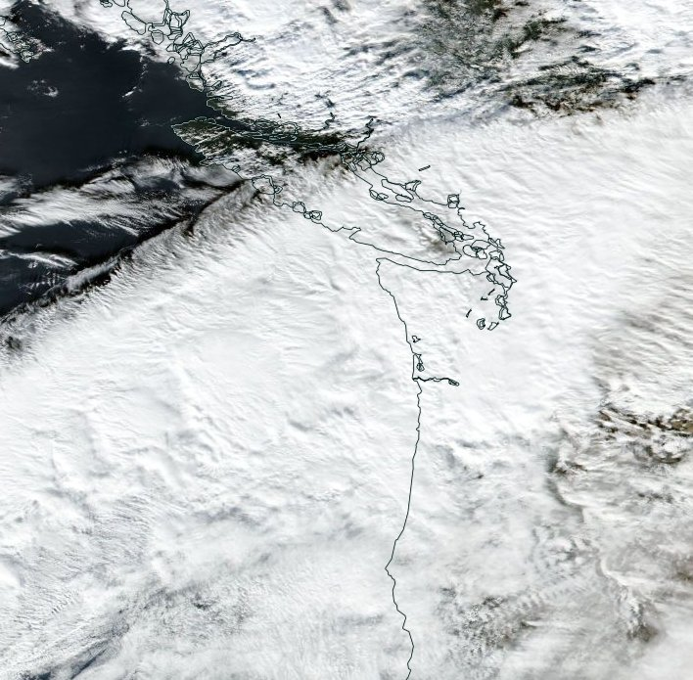
Airborne Doppler radar observations of mid-latitude storms during OLYMPEX
Jennifer DeHart
OLYMPEX Workshop
3.22.17
NASA grants: NNX15AN52H, NNX13AG71G, NNX15AL38G, NNX16AD75G
NSF grant: AGS-1503155

Slide 2
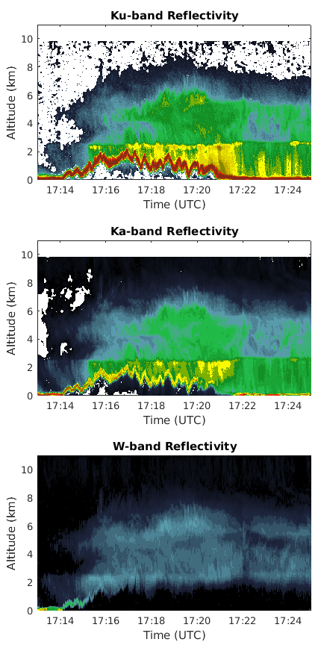

APR-3
Ku/Ka/W bands, but today I’ll be showing Ku/Ka data
Goal: document the radar reflectivity structure around the Olympics and compare with surface measurements
Notes:
Same as GPM, mention

Slide 3
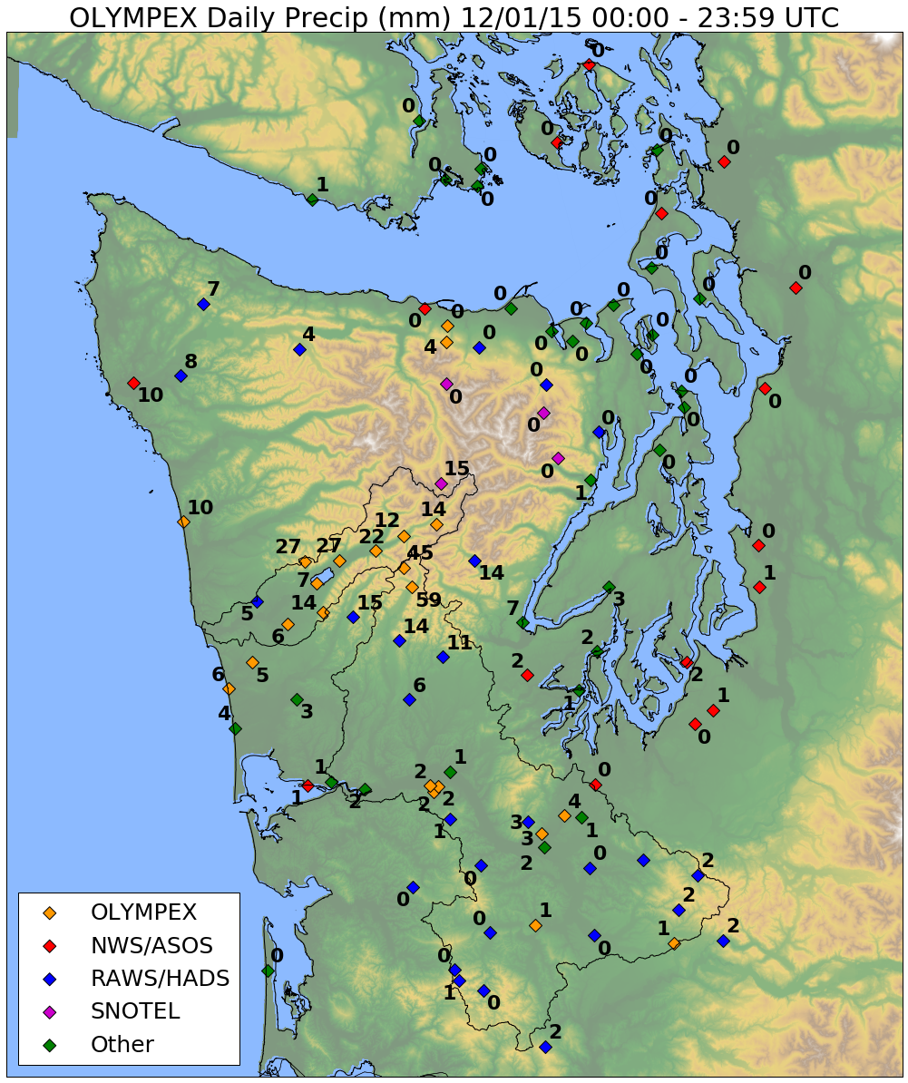
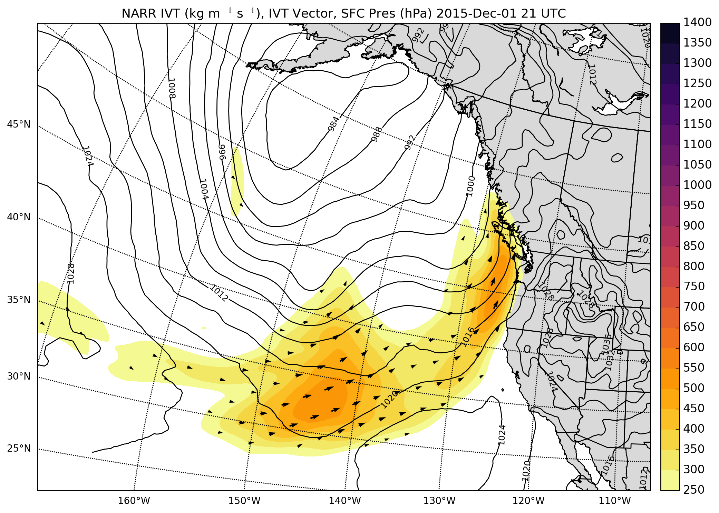
1 Dec. 2015
NARR integrated vapor transport and precipitation
c/o Joe Zagrodnik

Slide 4
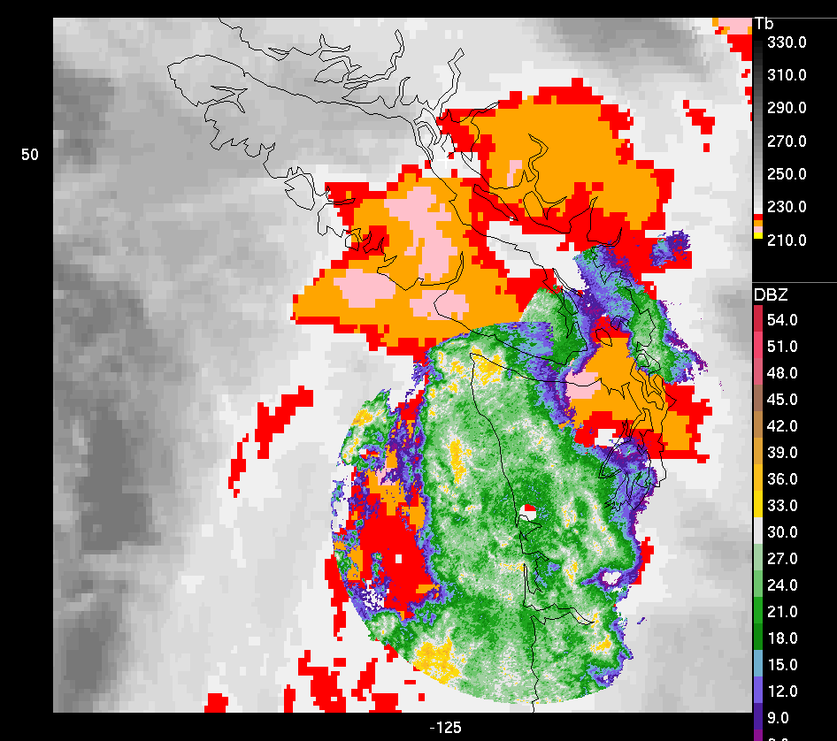
IR Satellite and LGX/ATX Radar
12/1 - 23:15

Slide 5
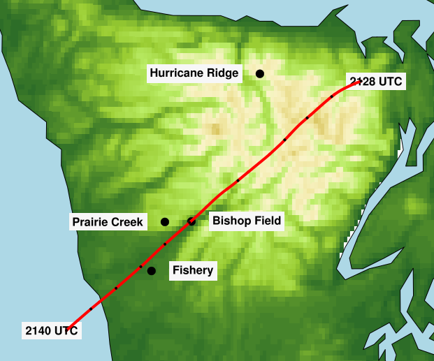
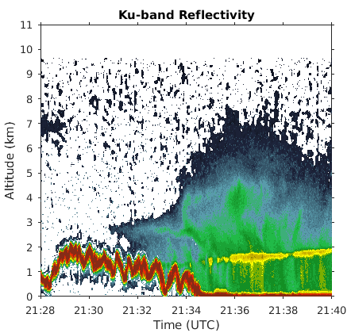
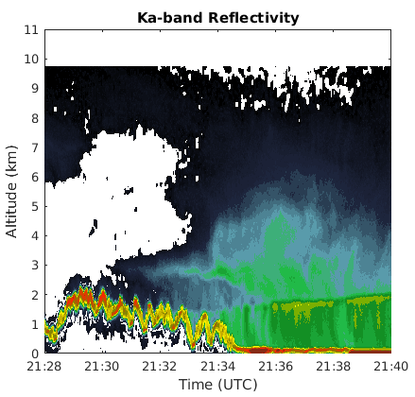
12/1 : 2128 – 2140 UTC
Cloud deepens ahead of terrain
Enhanced reflectivity between 2-3 km pushes inland
Echo top height (Ku) decreases with height inland, hole present in Ka reflectivity field
Windward

Slide 6

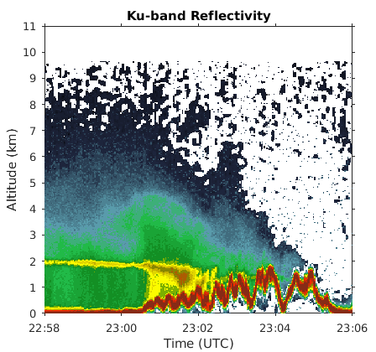
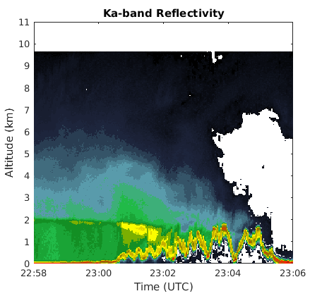
12/1 : 2258 – 2306 UTC
Intense bright band and enhanced reflectivity along windward slopes
Radar echo extends further inland
Windward

Slide 7
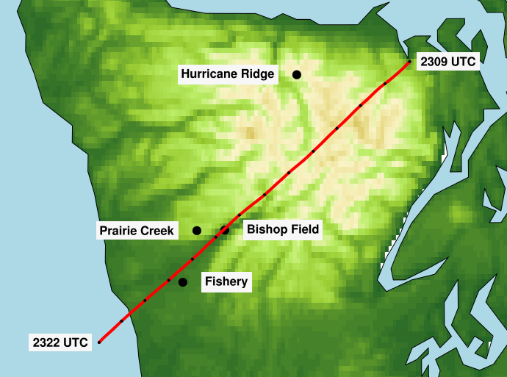
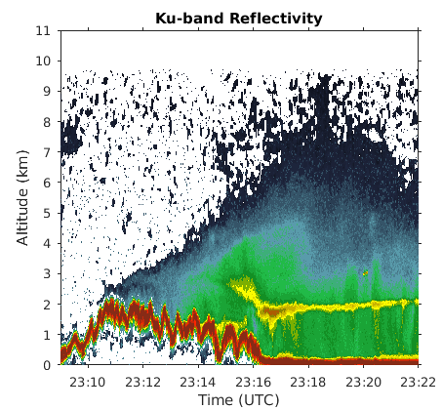
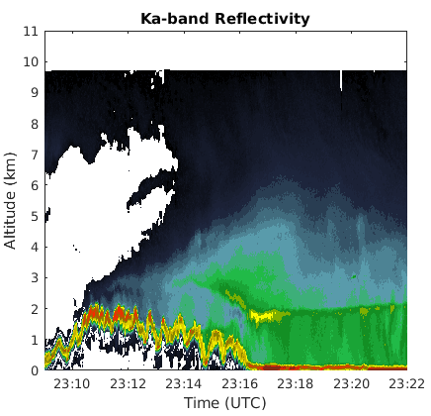
12/1 : 2309 – 2322 UTC
Radar echo continues inland progression
Enhanced region of radar reflectivity curves up alongside terrain
Despite intense bright band, enhanced reflectivity doesn’t extend to surface
Windward

Slide 8
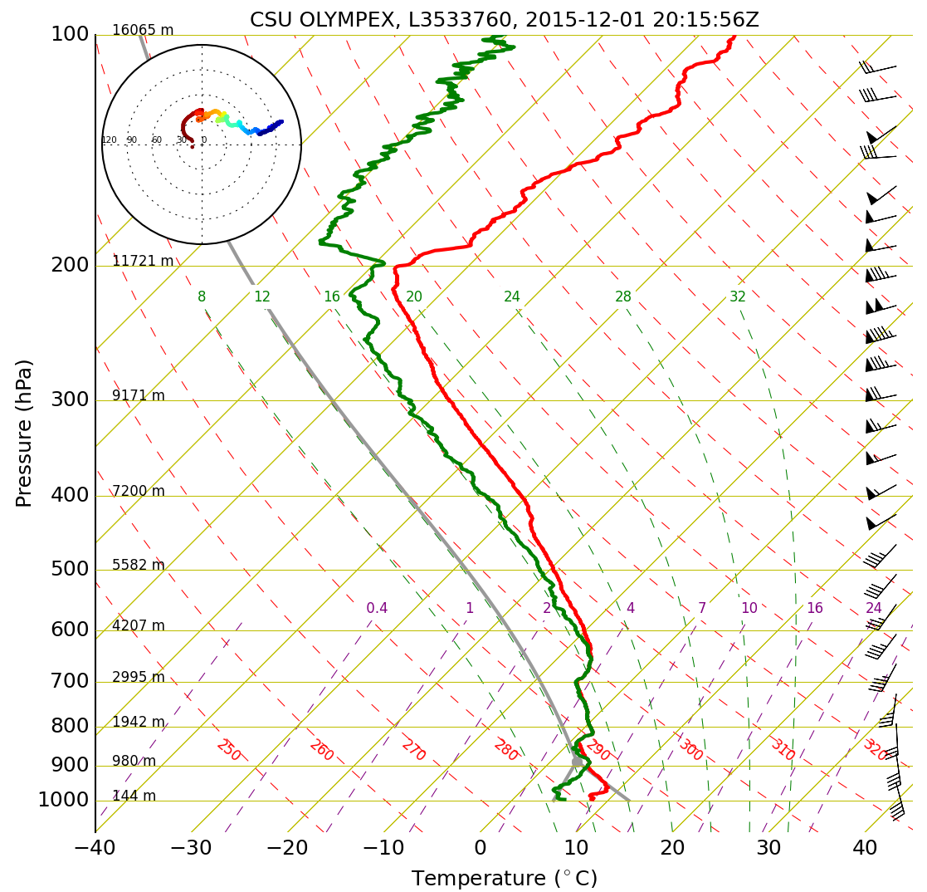
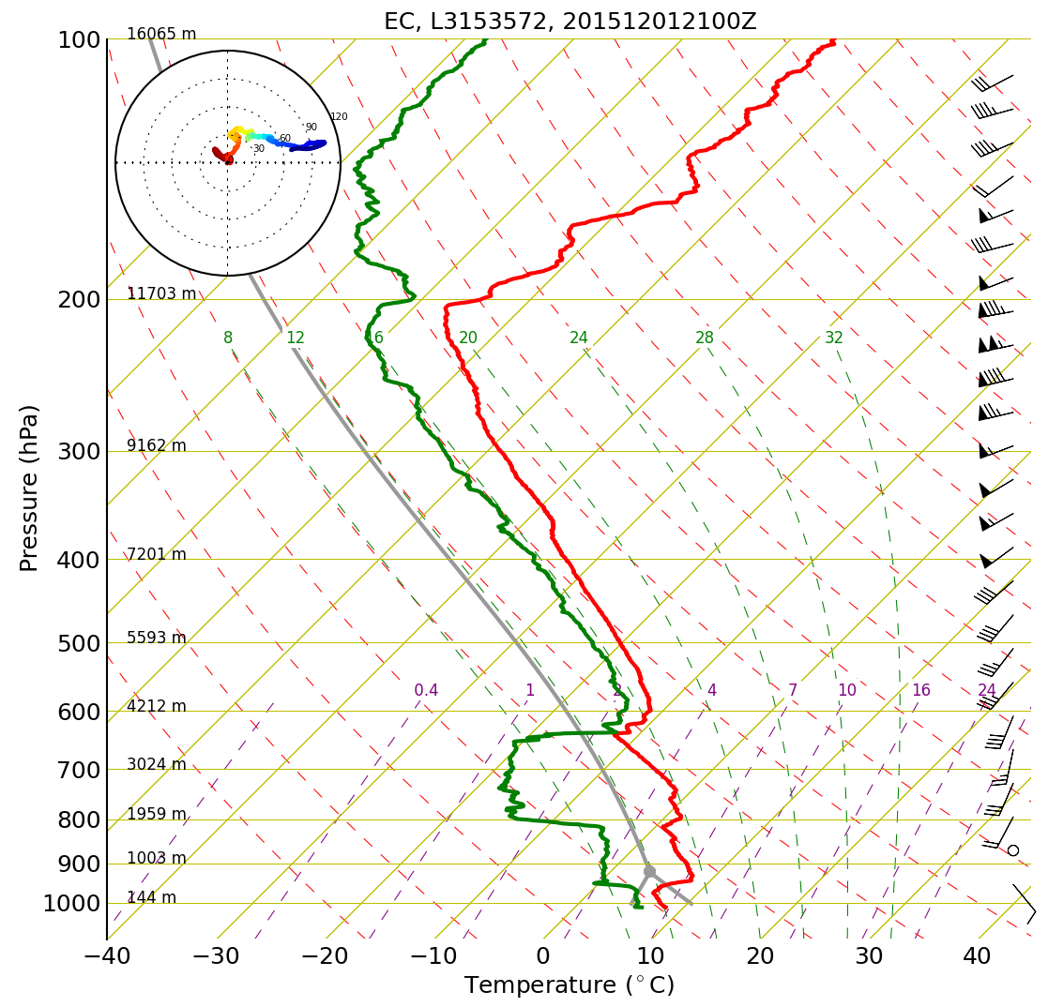
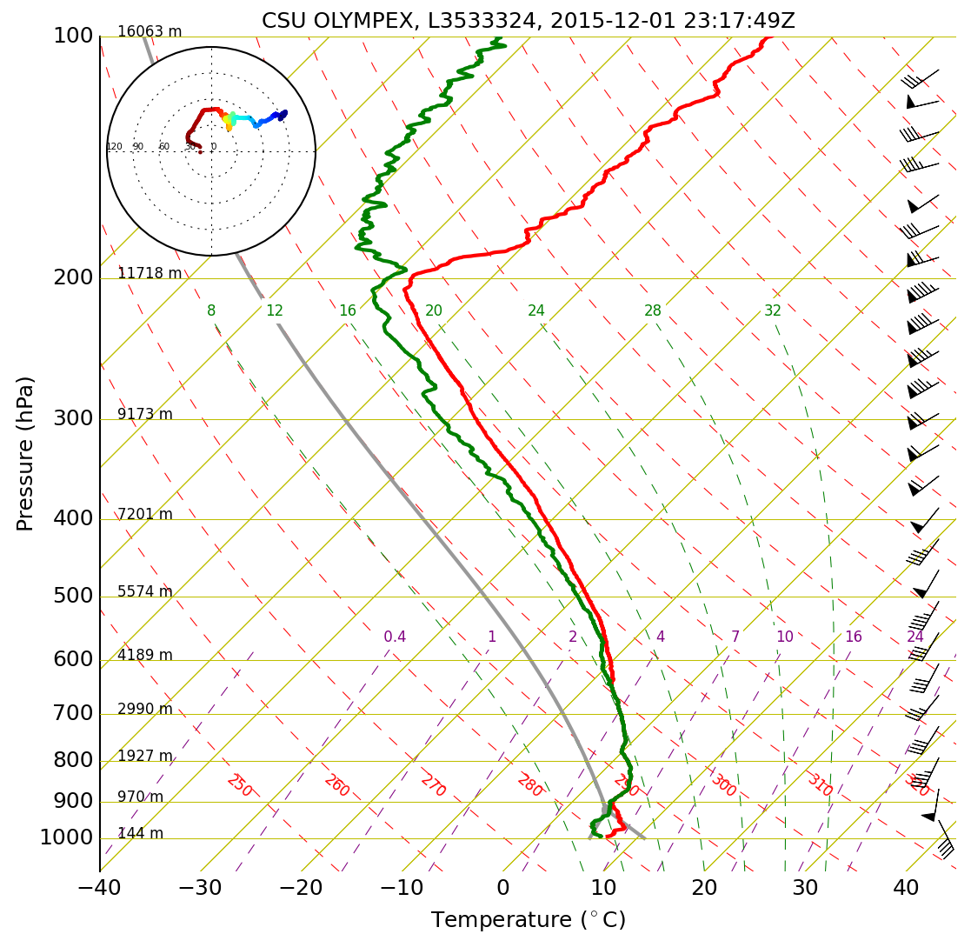
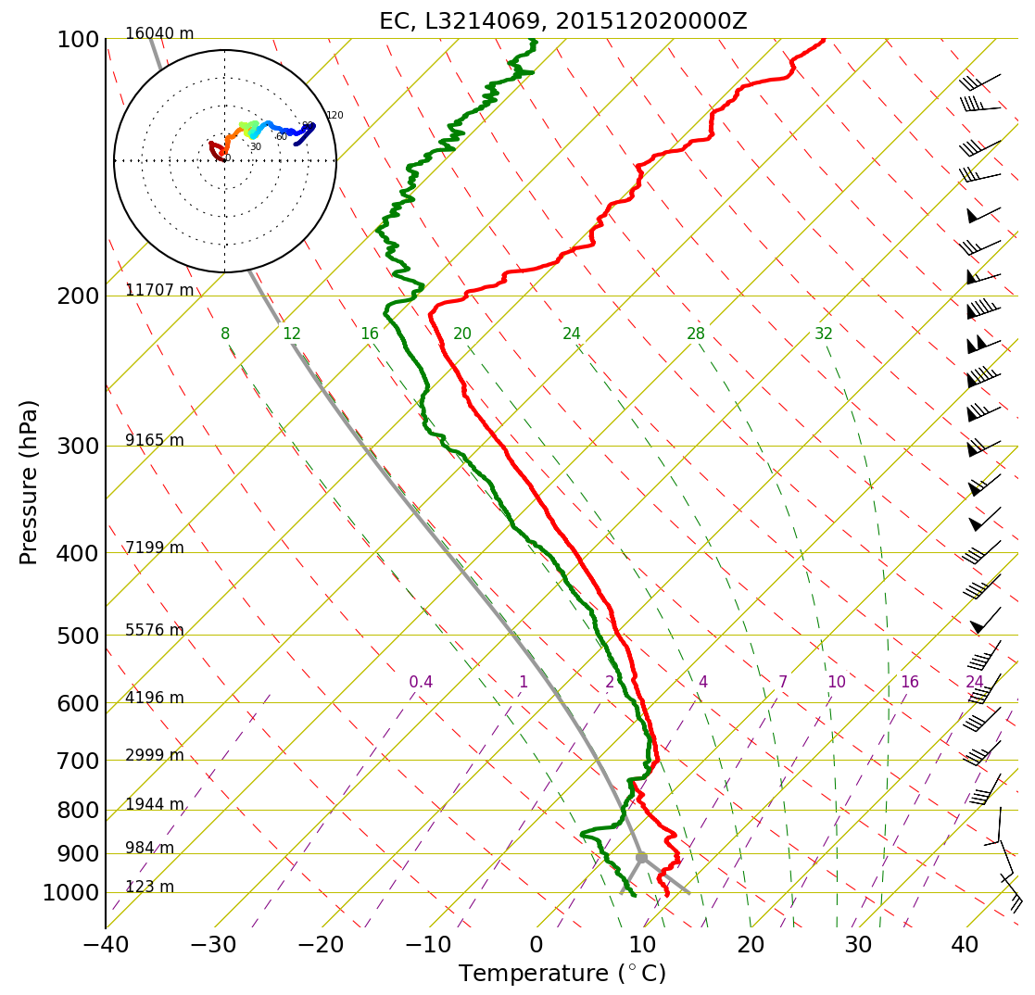
NPOL - windward
EC - lee

Slide 9
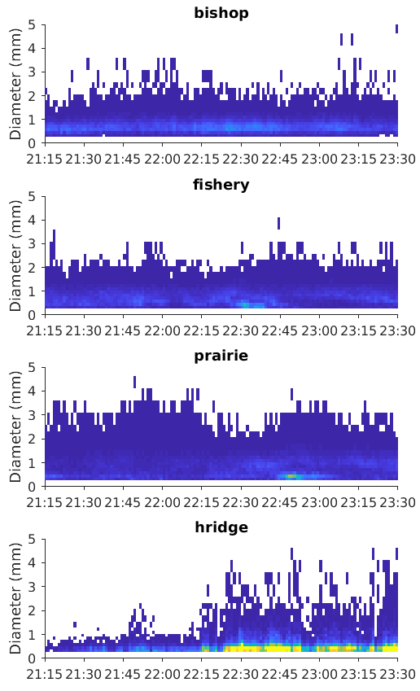
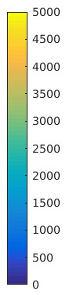
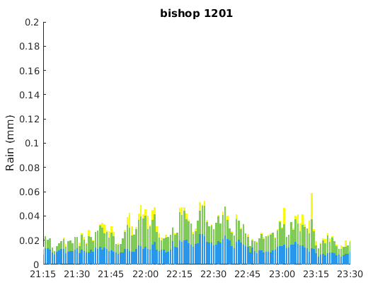
Weak near surface reflectivity manifests itself in a narrow distribution at Bishop Field
~ < 2 mm
Slightly more drops smaller than 1 mm
Rain rates fairly weak

Slide 10
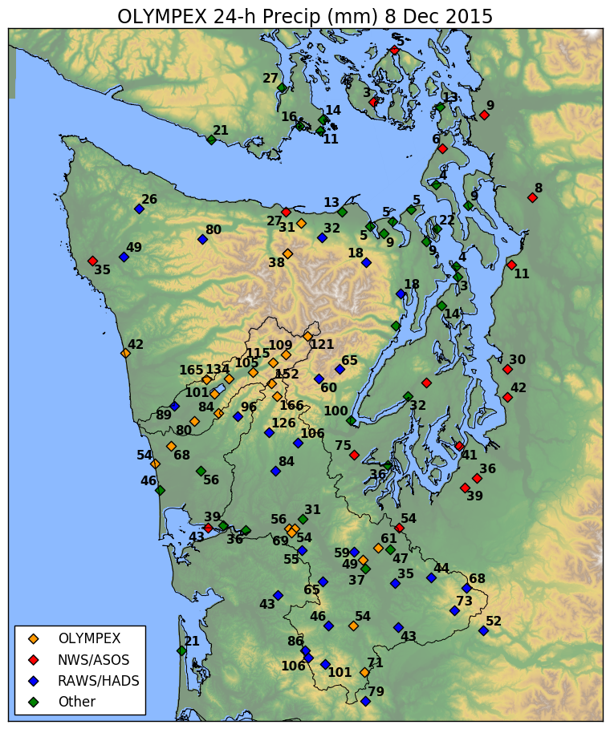
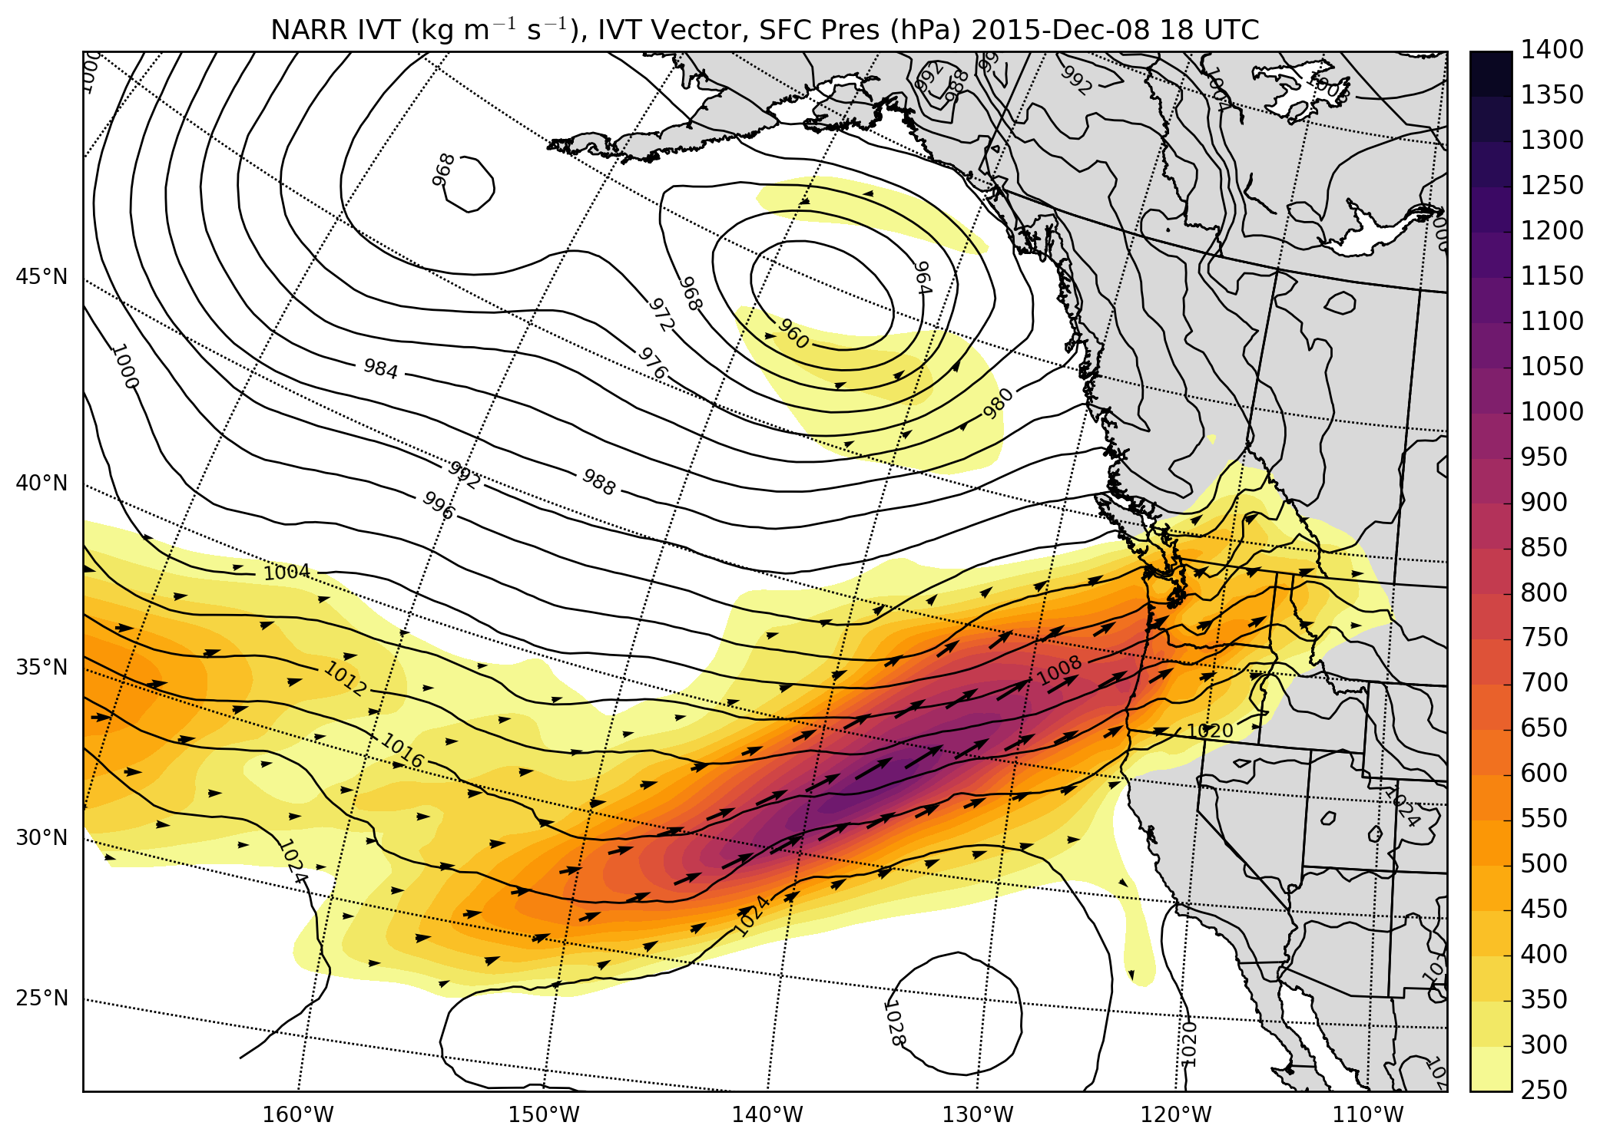
8 Dec. 2015
NARR integrated vapor transport and precipitation
c/o Joe Zagrodnik

Slide 11
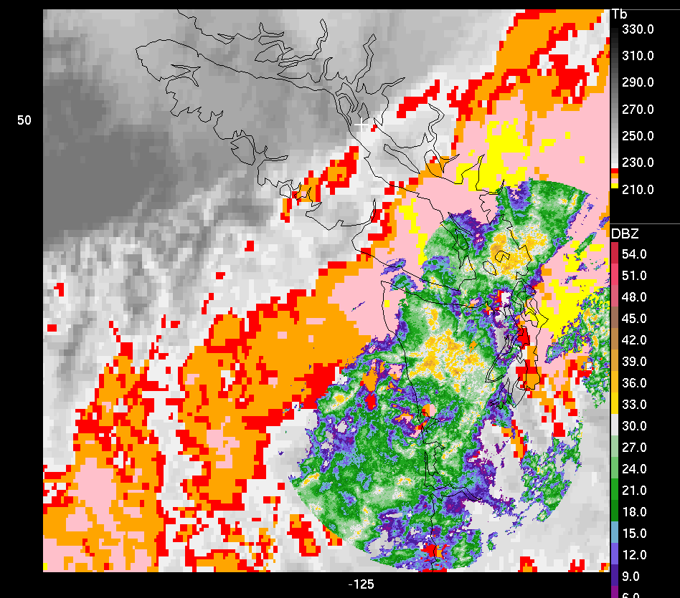
IR Satellite and LGX/ATX Radar
12/8 - 17:15

Slide 12
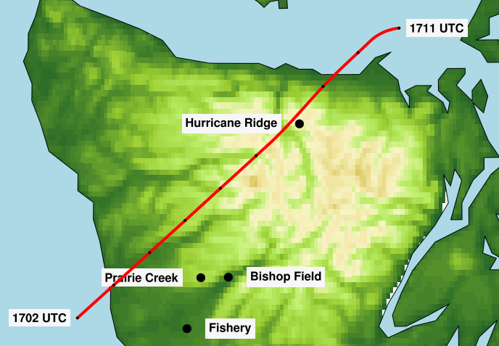
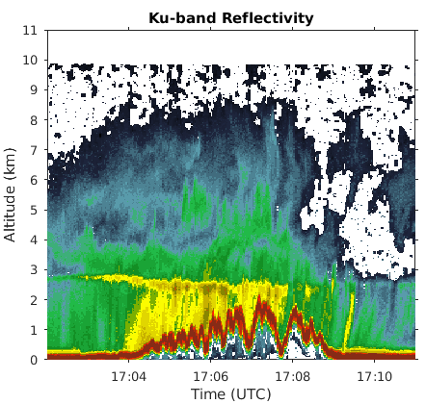
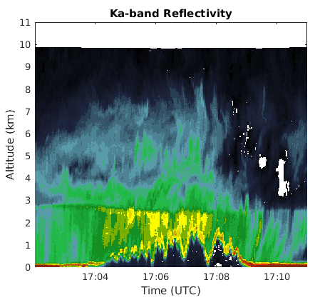
12/8 : 1702 – 1711 UTC
Reflectivity echo extends NE of Olympics, though is weak without bright band
Low-level enhancement on windward side
Windward

Slide 13

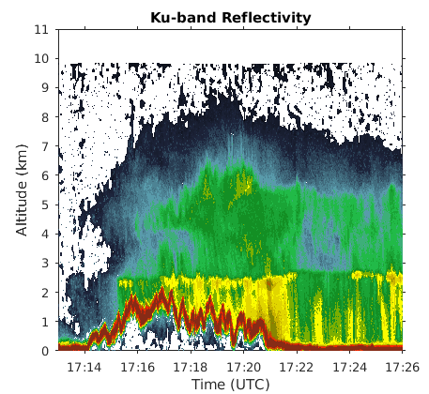
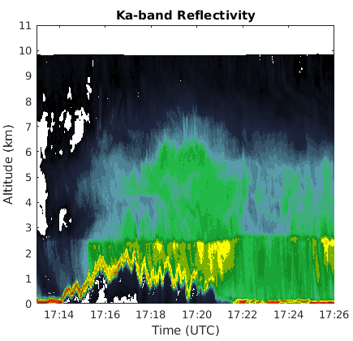
12/8 : 1713 – 1726 UTC
Low-level enhancement below bright band and between 4-6 km
NE side of peninsula has reduced echo intensity
Windward

Slide 14
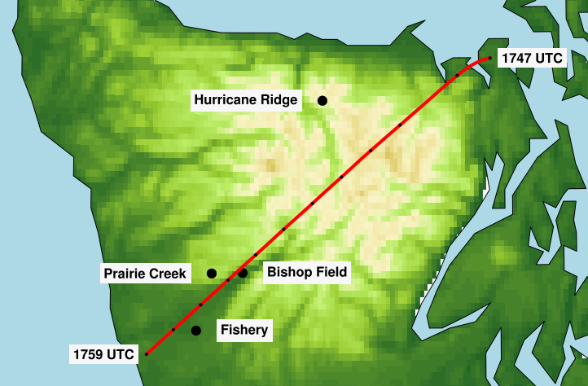
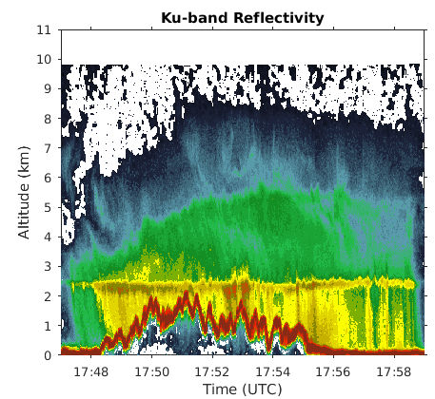
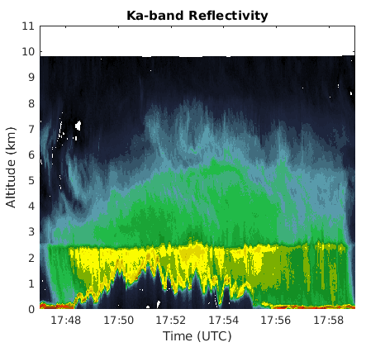
12/8 : 1747 – 1759 UTC
30 minutes after previous cross-section
Upper-level enhancement has weakened and lowered
Still see descent of echo top height, but strong stratiform processes present
Windward

Slide 15
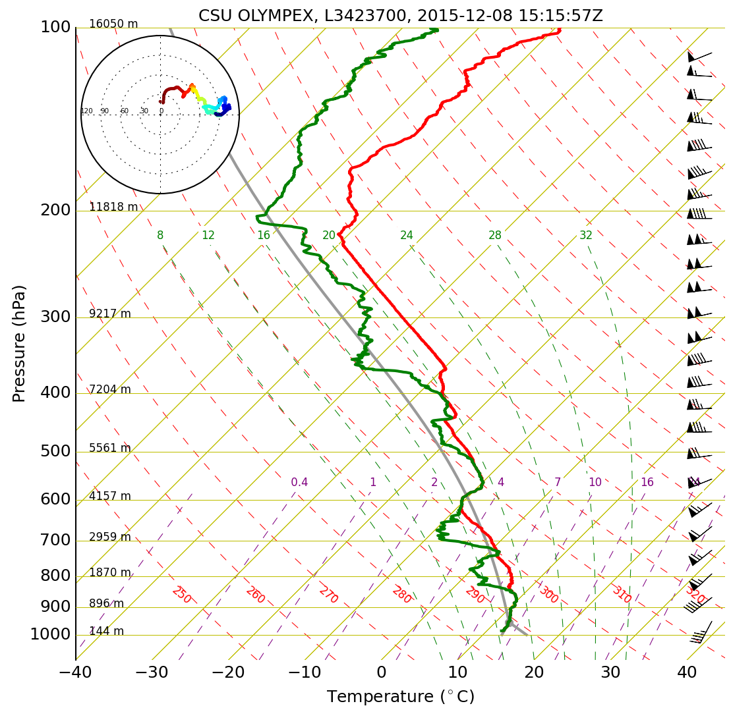
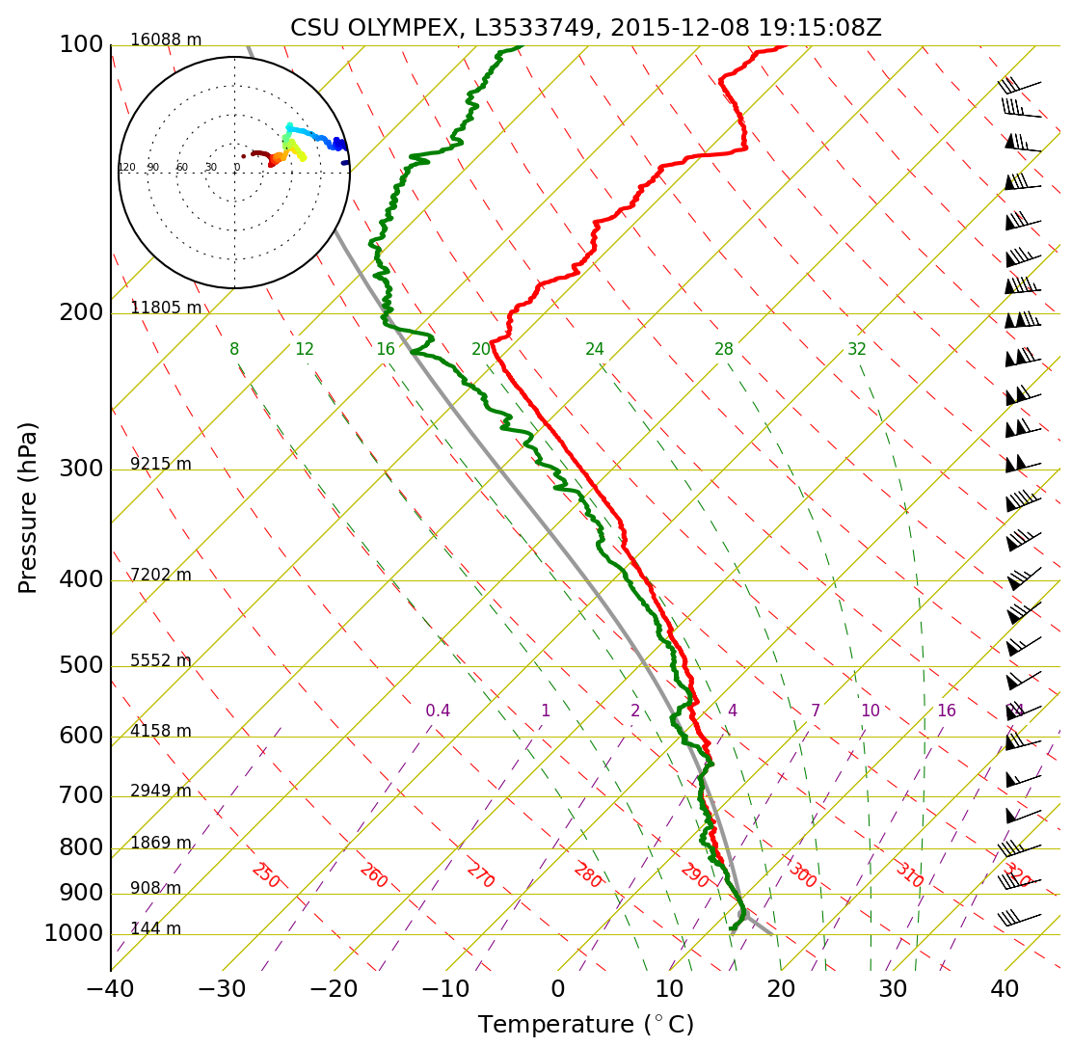

Slide 16
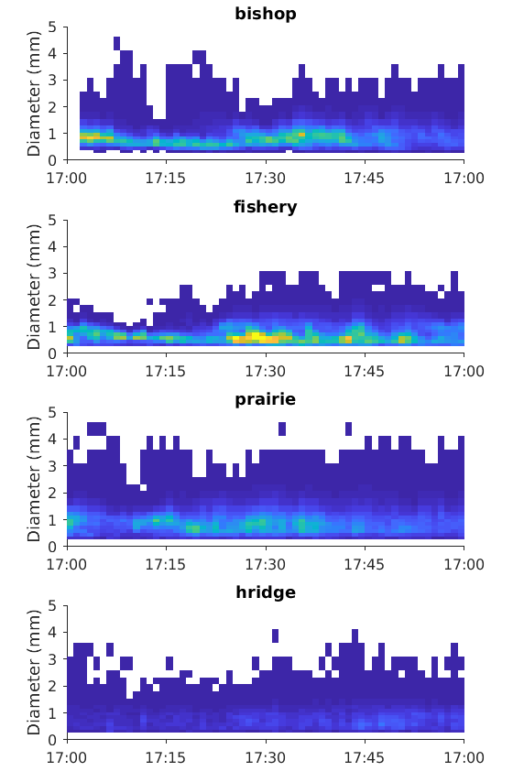
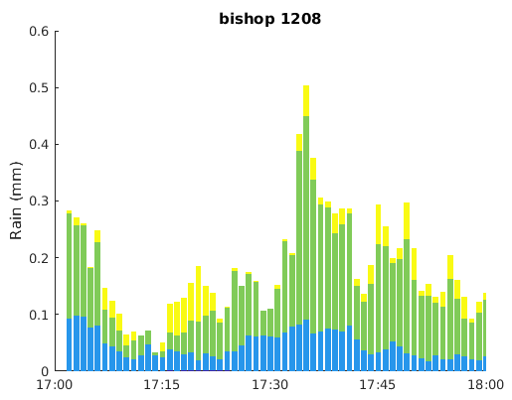
DSD at Bishop Field exhibits strong variations
Greater concentrations of small/medium drops than 12/1
Leg 1: broad distribution and larger number of smallest drops
Leg 2: smallest drops less frequent, but slightly more medium drops

Slide 17
Conclusions
APR-3 provides view around the Olympic peninsula, especially over high terrain
Strong spatial and temporal variability, but enhancement preferentially along windward slopes
Synoptic conditions exert strong control over pattern of orographic modification at the surface

Slide 18
Backup slides

Slide 19
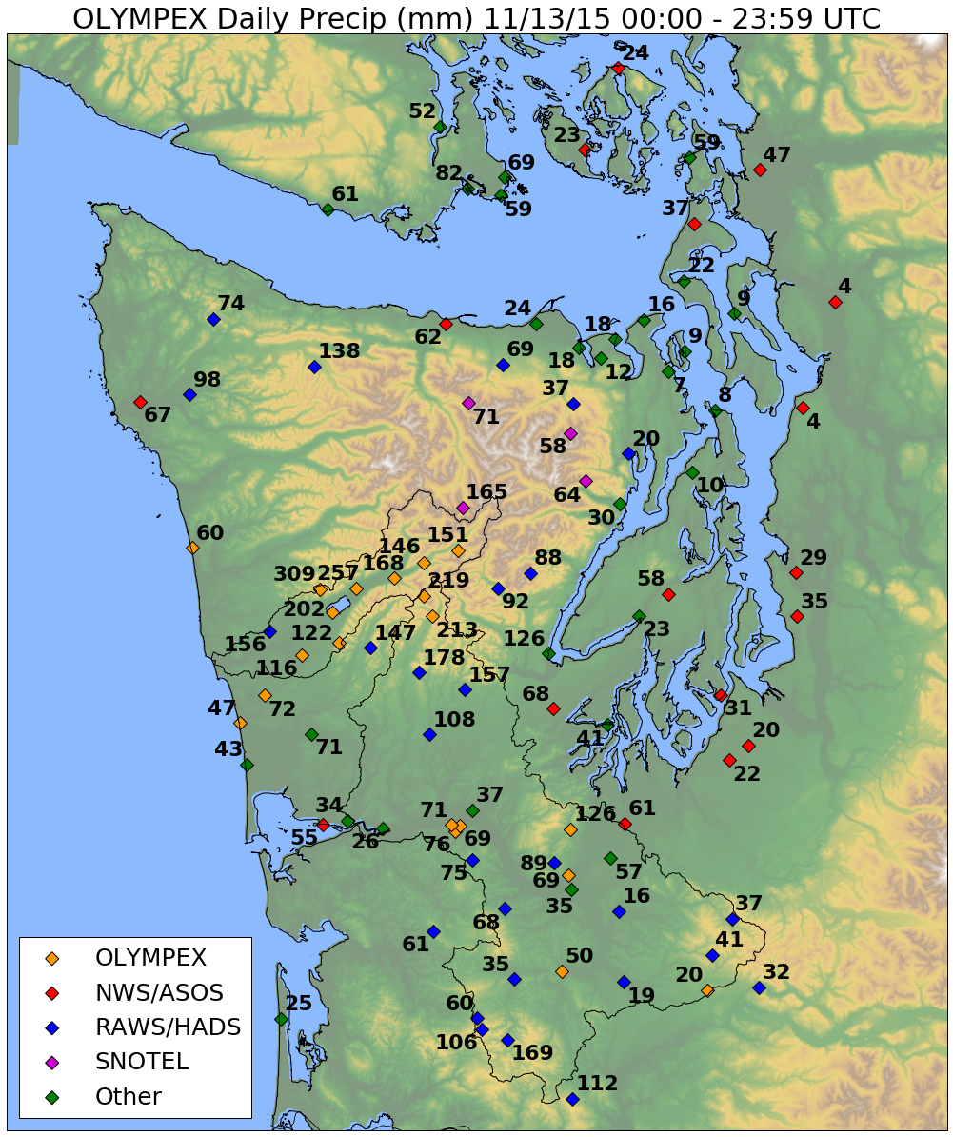
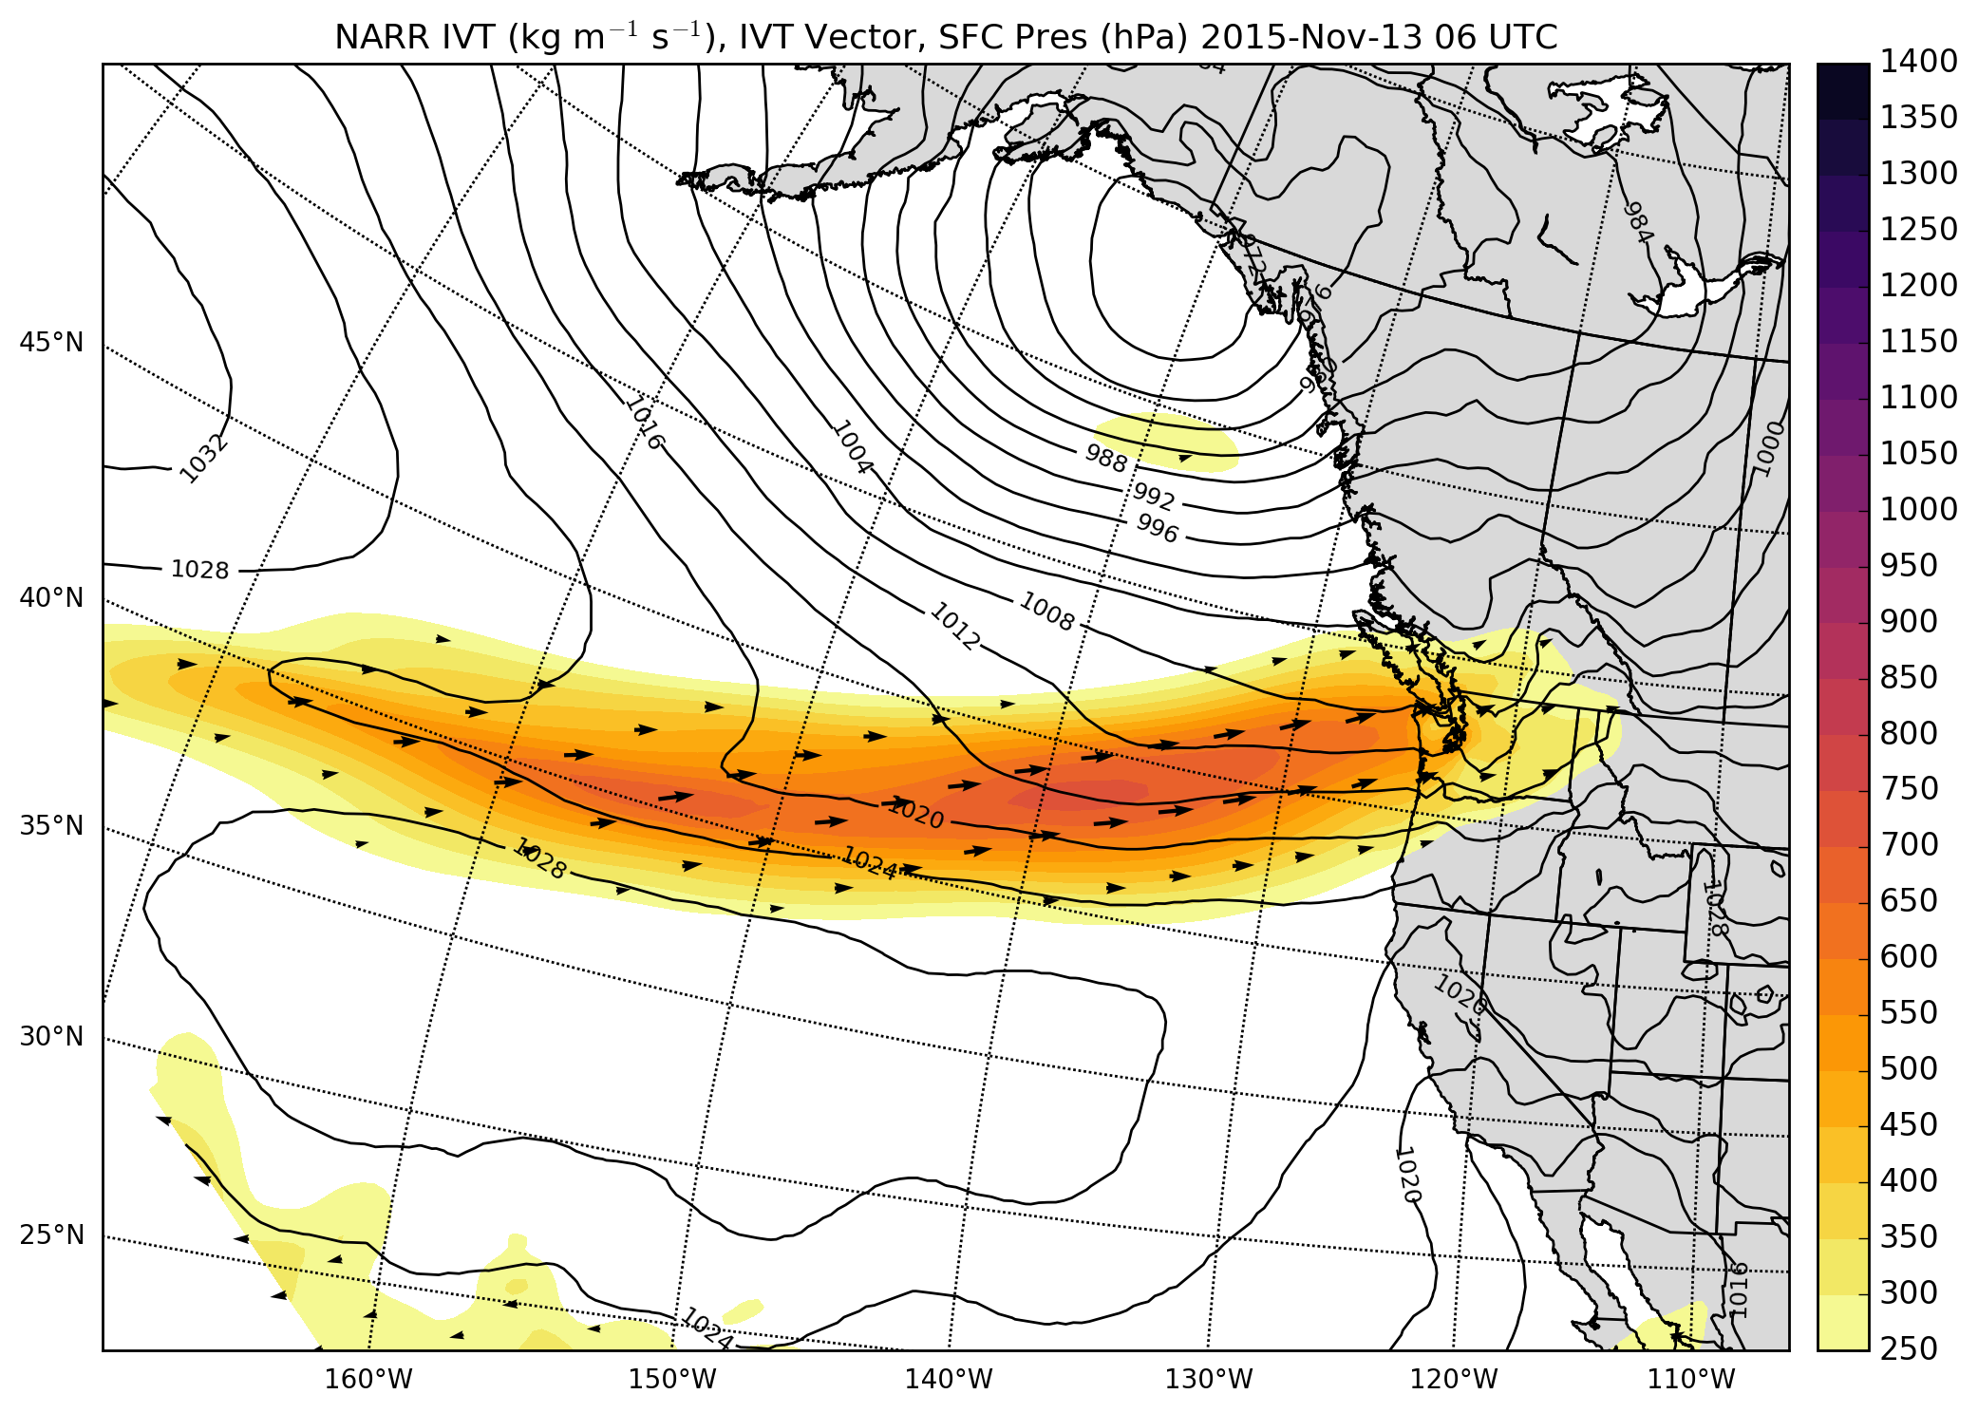
13 Nov. 2015
NARR integrated vapor transport and precipitation
c/o Joe Zagrodnik

Slide 20
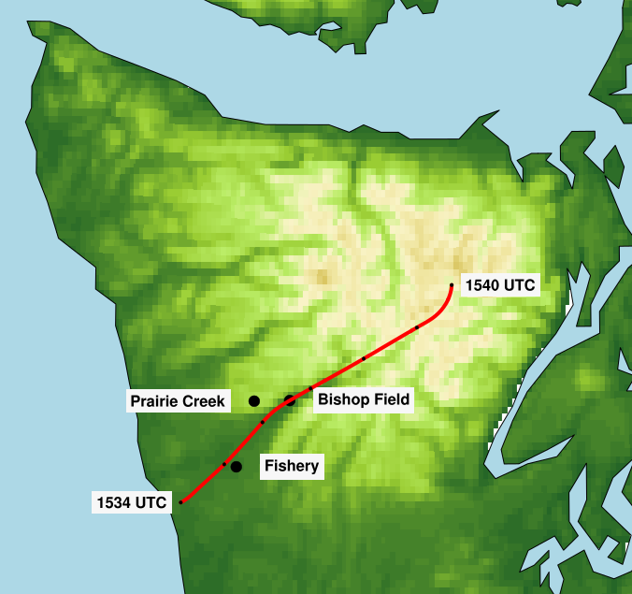
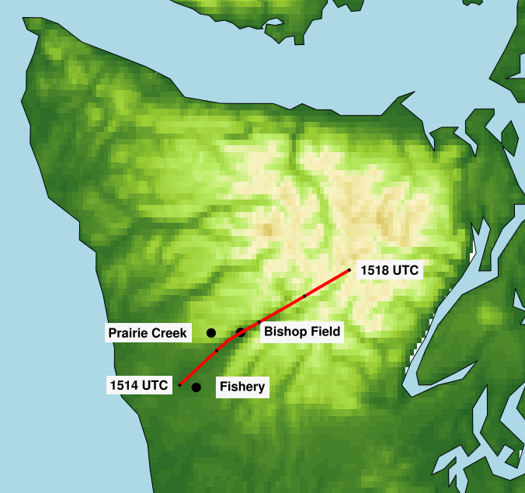
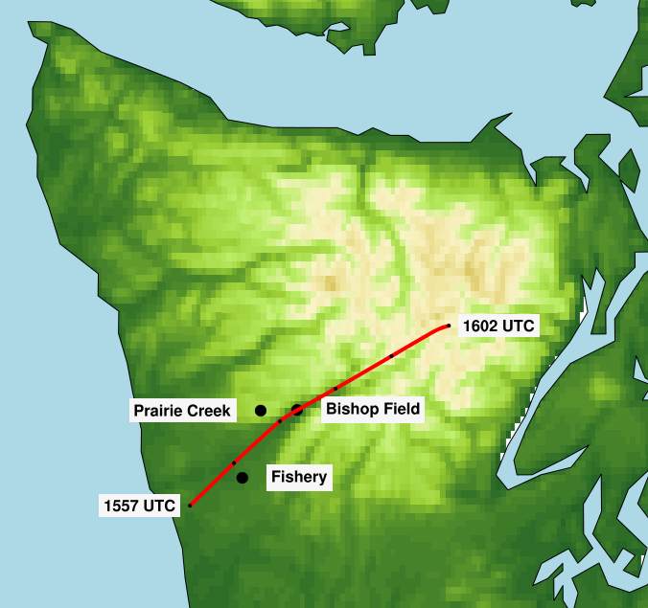
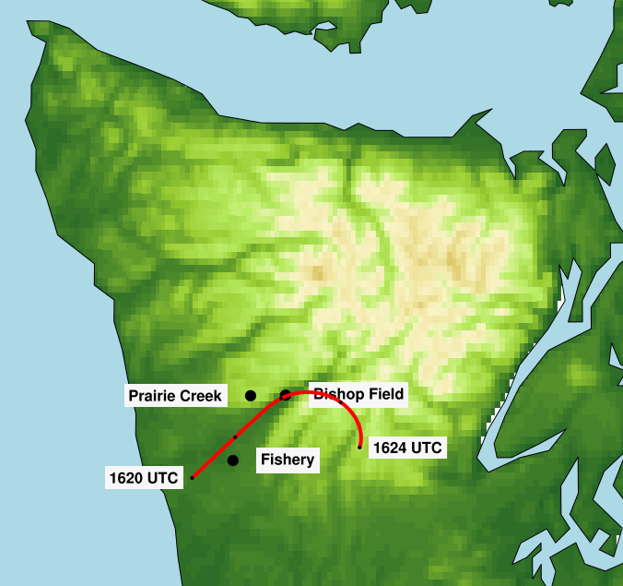
12 Nov

Slide 21
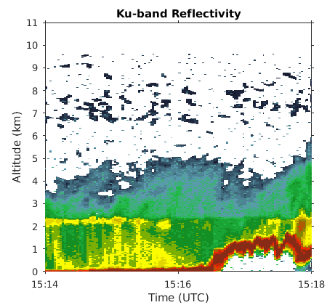
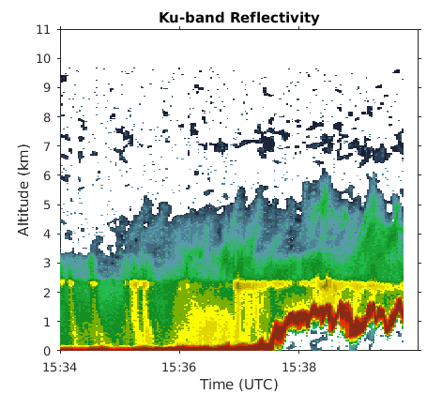
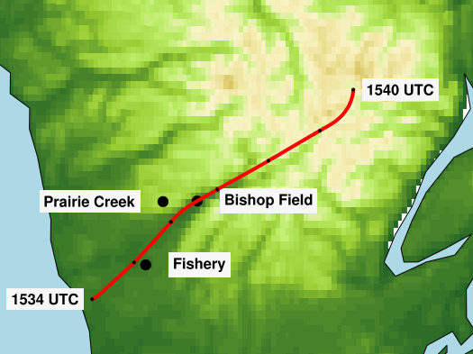
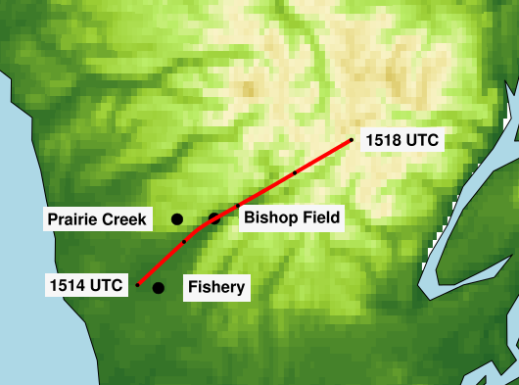
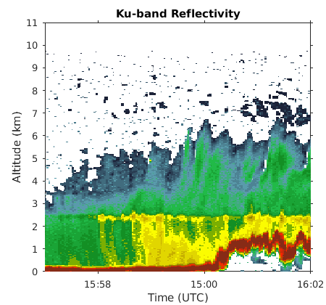
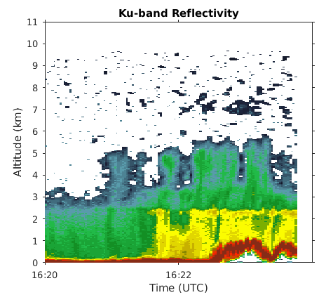
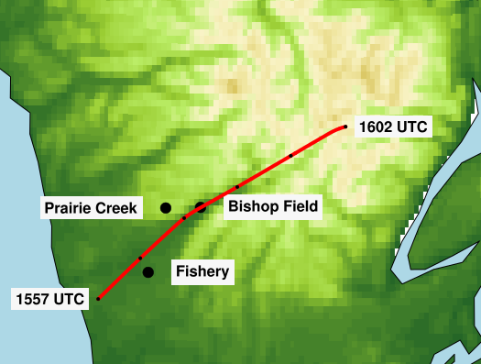
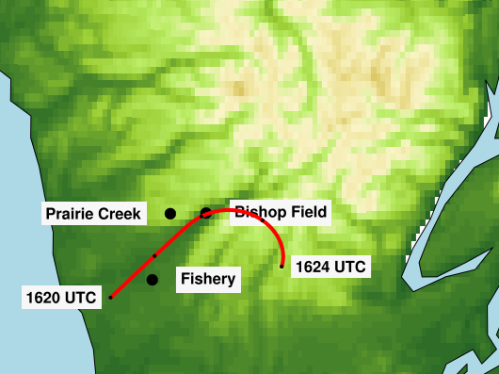

Slide 22
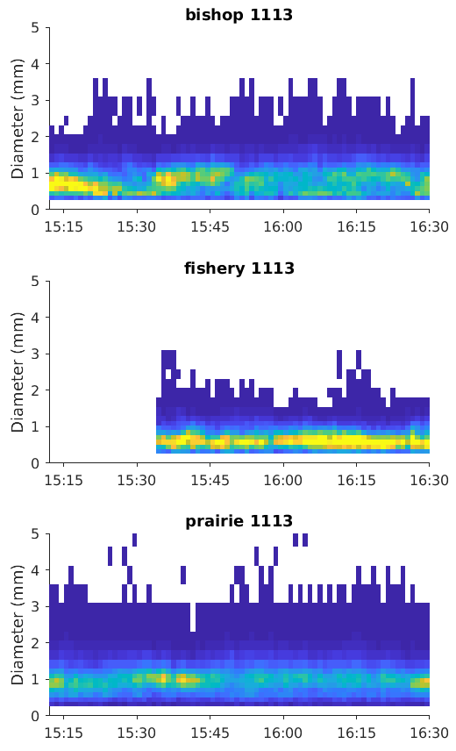

Slide 23


Slide 24


