Slide 1
Citation Data Comparison
Megan Chaplin
21 March 2017
OLYMPEX Workshop
Seattle, WA
Notes:
Hi, my name is Megan Chaplin, most of my work with for the OLYMPEX field campaign pertains to the UND citation aircraft data. Today I am going to show you a first look comparison between a dataset from Illinois and NCAR that use the citation data and other schemes/relationships to calculate the Ice water content and total particle number concentrations.

Slide 2
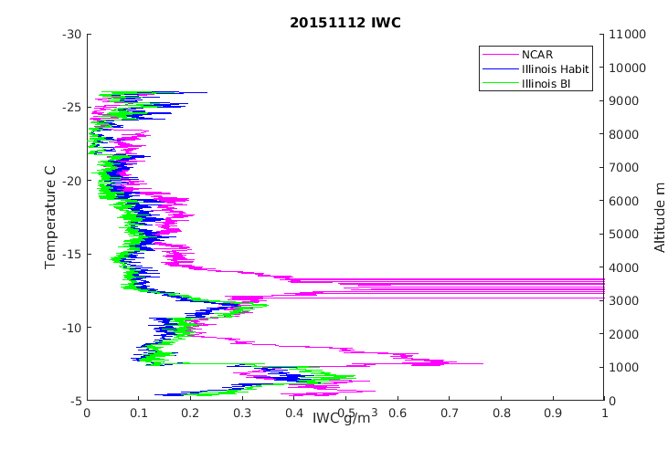
Ice Water Content
UIOPS
M-A from Baker and Lawson (2006)
Habit-specific M-D
All for particles > 0.01 cm
NCAR
From Heymsfield et al. (2004)
M-D relationship appropriate for aggregates
Notes:
Main variable that we’ve taken a first look at is the calculated Ice Water Content from the Illinois dataset and the NCAR datase tor the Spiral Ascent on November 12 2015 , and it was all above the melting level .
Both datasets have different assumptions, and we are curious about how they compare.
As we saw in the previous presentations by Greg and Andy- they use different relationships to calculate the Ice water content, as well as total number concentrations.
The Illinois dataset used a mass-area relationship from Baker and Lawson, and they also use a habit specific mass diameter relationship.
Ncar also uses an MD relationship to make the calculations but is best for aggregates and doesn’t perform with other ice habits or in temperatures greater than O C.
The plot on the right is of the calculated IWC versus temperature and altitude during a the citation’s spiral ascent on November 12th 2015. The pink data is NCAR, green is the Illinois with the MA relationship, and blue is the Illinois habit specific IWC.
From this we initially noticed two main discrepancies between the Illinois and NCAR datasets. (Point)
Transition:

Slide 3
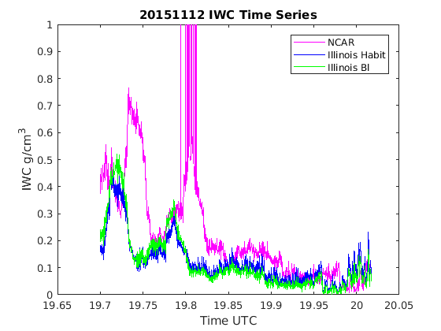
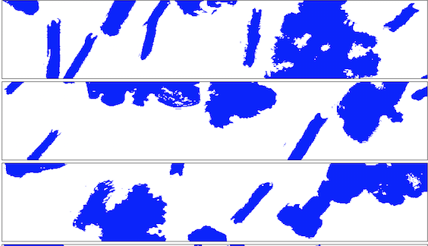
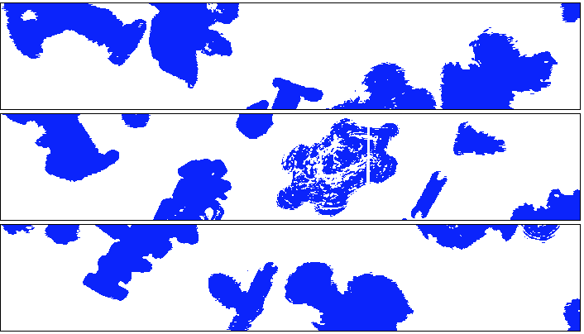
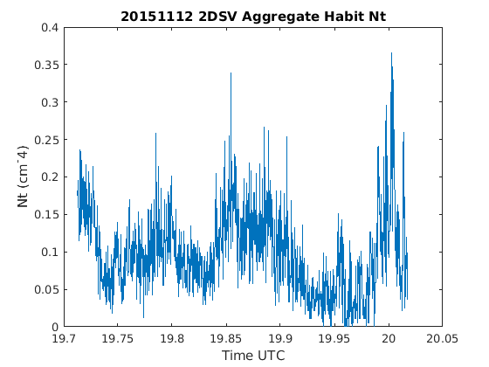
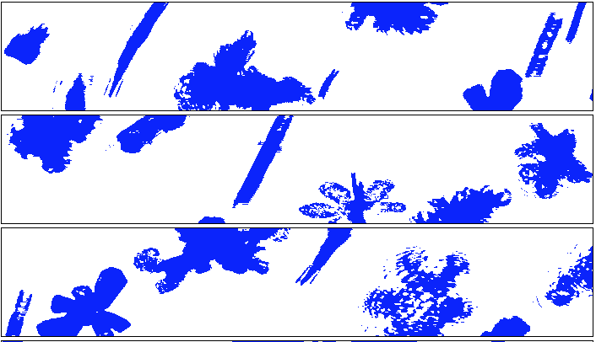
1942 UTC
1944 UTC
1948 UTC
Notes:
So to look at these discrepancies more closely throughout the spiral ascent this is a plot of the IWC over the entire spiral ascent. Again, note the discrepancies in the data sets in these two main regions.
Because the NCAR (pink) dataset is dependent on aggregate concentration I’ve also plotted the number concentration of aggregates over the spiral ascent from the Illinois habit specific dataset
Another way to account for the discrepancies is to also take an objective and manual standpoint, by looking at the particle images relevant to these spiral ascent times.
Prior to the first discrepancy , we see needles, oriented particles, and few aggreggates- shown in particle image at 1942 UTC.
During first boxed period, aggregates decrease, which we also note in the particle imagery at 1944 UTC– where there are more notable and separated particle habits
-but note that aggregates slowly increase before the second data gap, and the IWC measures are similar between the 3 datasets.
During the next boxed period, the amount of aggregates decreased , which was even more notable in the particle imagery as shown on the right at 1948 UTC– much fewer aggregates /more defined particle habits.
So what we would have initially expected from this is that these discrepancies in the NCAR/ILLinois data sets are dependent on the amount of aggregates.. but later in the spiral ascent we see another decrease in aggregates—but little to no difference in Ice water content. Is this because there are fewer particles and ultimately fewer aggregates at higher elevations in colder temperatures? That is one question we have.

Slide 4
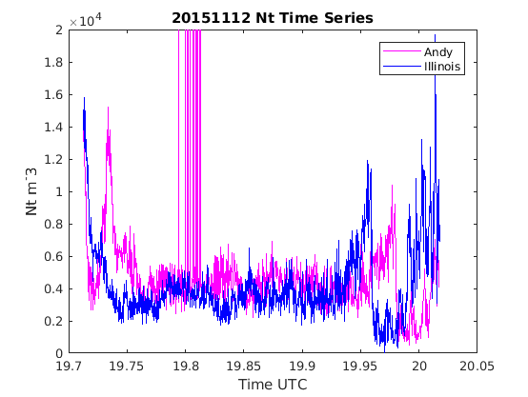
--------- NCAR
--------- ILLINOIS
Notes:
Both Greg and Andy’s group also calculated the total number concentration of particles with the relationships. This is a plot of the total Number concentration for the same spiral ascent on November 12 2015. We see the two discrepancies initially in the spiral, but what’s different here is that we now see discrepancies in the number concentration at the end of the spiral where we didn’t see differences in IWC. But this was also the time where there was the decrease in aggregates. It is unclear if this is a factor causing the discrepancies or not, but it would be something to look into.

Slide 5
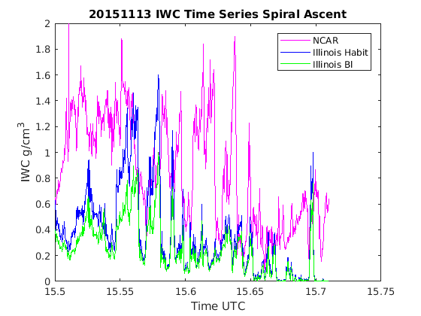
Notes:
I’ve also briefly looked at the spiral ascent on November 13 2015, and you can see that there are still discrepancies between the Illinois and NCAR datasets. But more notable here are the differences between the NCAR habit specific IWC and the Baker Lawson data.

Slide 6
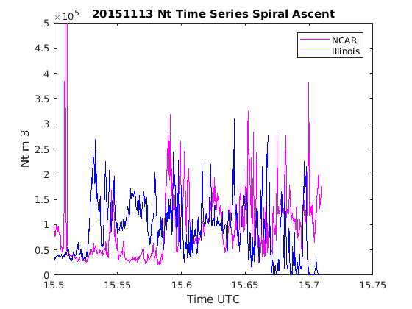
Notes:
Here is the number concentration for the November 13 spiral as well , in which we also see differences in data, but in this case a higher percent of the NCAR concentrations are less than that of Illinois which is opposite from the November 12 case.

Slide 7
Discussion Points
Discrepancies between NCAR and UIOPS (IWC, Nt)
Saw increase in IWC difference with fewer aggregates
Not the case for high altitudes (lower aggregate concentration)
What additional factors lead to the discrepancies?
How do we move forward?
Which one to use? Provide a range of uncertainty? Case dependent?
Evaluation of objective habit identification?
Notes:
Some of the takeaways from this first look at the NCAR and Illinois calculations of Ice water content and total number concentration are:
-that we saw an in increase in IWC difference when there were fewer aggregates
-but this was not the case for higher altitudes, where there were fewer aggregates but the datasets were very similar
-So what are the additional factors that might lead to these discrepancies? Is it in the calculations/relationships, or is it due to the storm characteristics itself?
→ In mine and Angela’s talk tomorrow we will describe these spiral cases (November 12 and 13) in more detail, and the type of precipitation/ storm timing may be help to explain some more of these discrepancies as we look at this more closely
Another question we have now– how to proceed with these data? Is one set better than the other, or better for certain conditions? Or do we try to use a combination?
--> It may be useful to do further evaluation of the 9 different habit identifications and make further manual comparisons with the particle images from the probes.

