Slide 1
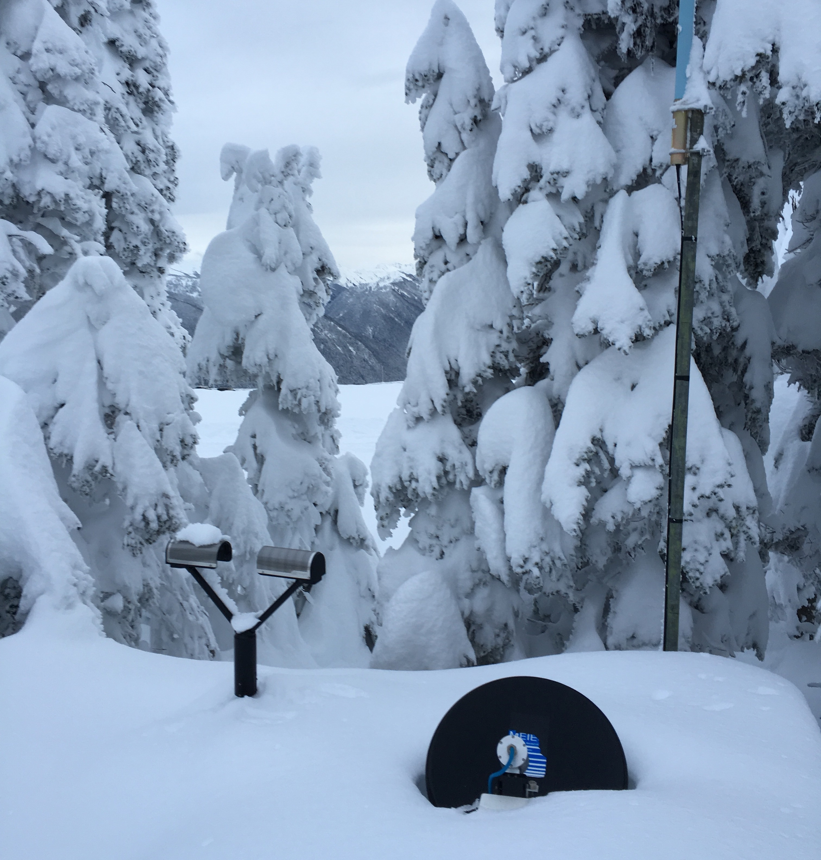
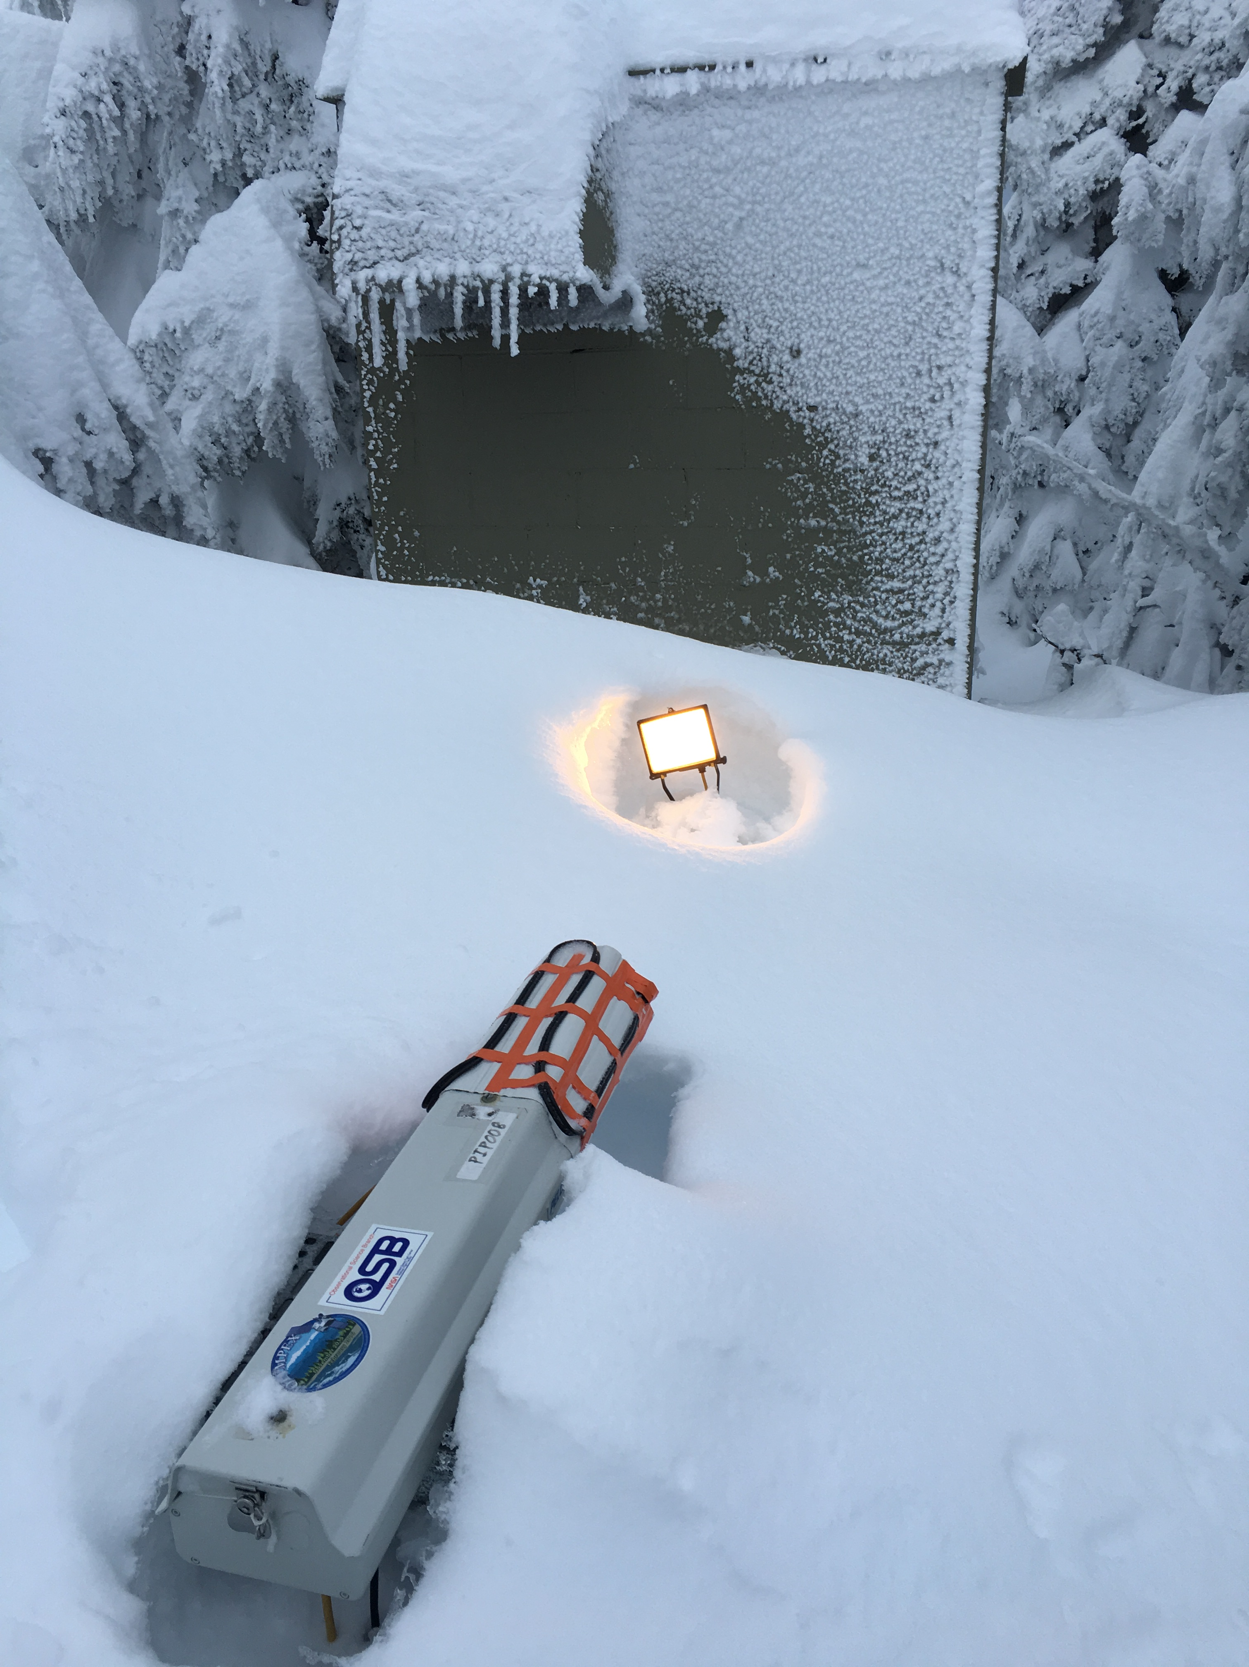
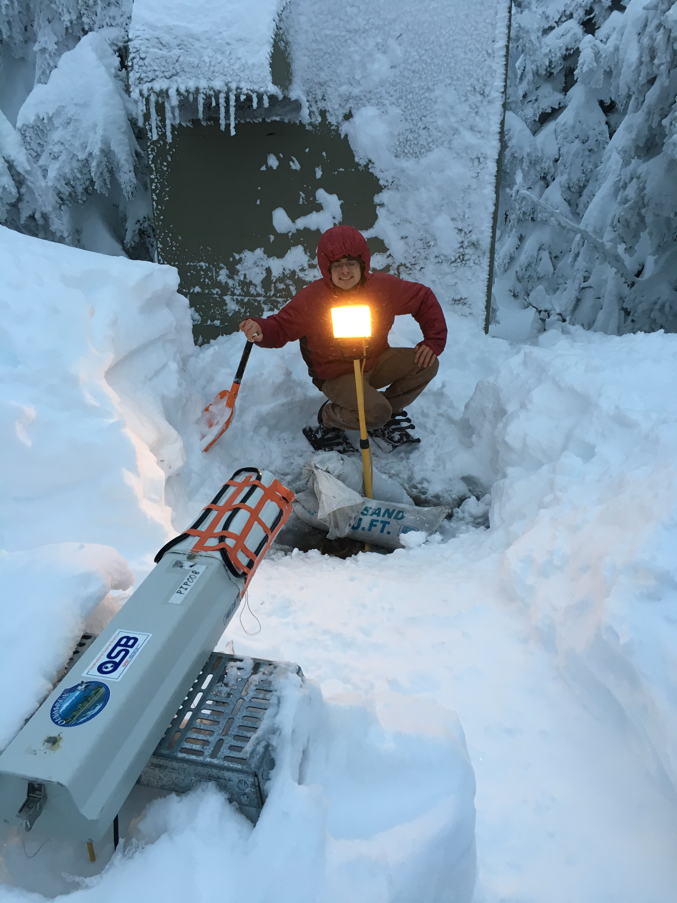



Ground Network Status
Gauge & Disdrometer Performance
Joe Zagrodnik
Lynn McMurdie, Robert A. Houze
OLYMPEX Science Meeting
21 March 2017

Slide 2
Types of Ground Data Available
Precipitation measurement:
  27 Tipping Bucket Rain Gauge Sites
  3 Pluvio Weighing Precipitation Gauges
Disdrometers:
  15 Parsivels (13 APUs)
  2 PIPs
  4 2DVDs
4 Micro Rain Radars
Lots of possible choices, but some data are better than others!

Slide 3
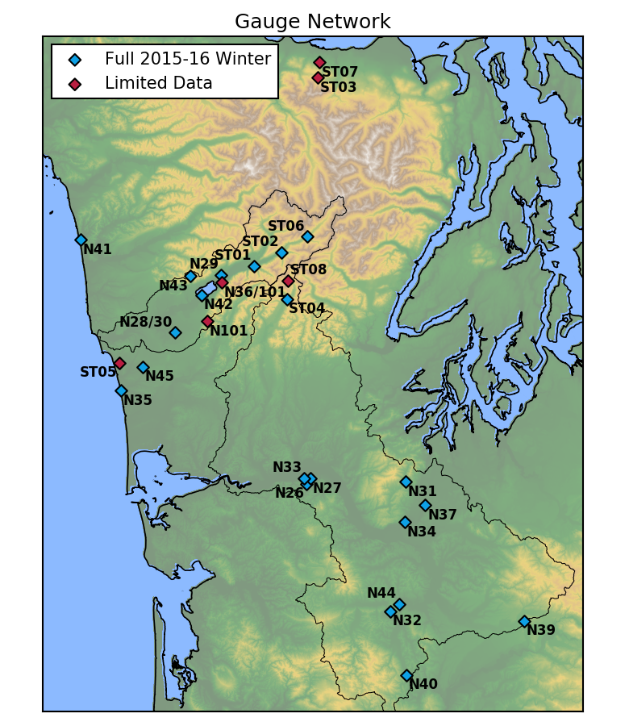
Rain Gauges
19 “Iowa” Dual-Tipping bucket sites (NASA00xx)
8 “Standalone” Dual-Tipping bucket sites (STDALNxx)
Most sites remained for full 2015-16 winter
Users need to be very careful with data—lots of minor issues.

Slide 4
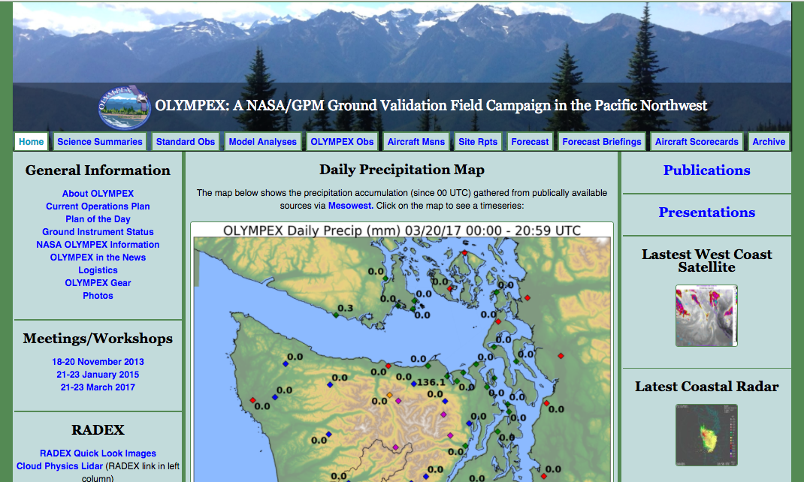
olympex.atmos.washington.edu
View preliminary (non-processed) plots of all ground data online

Slide 5
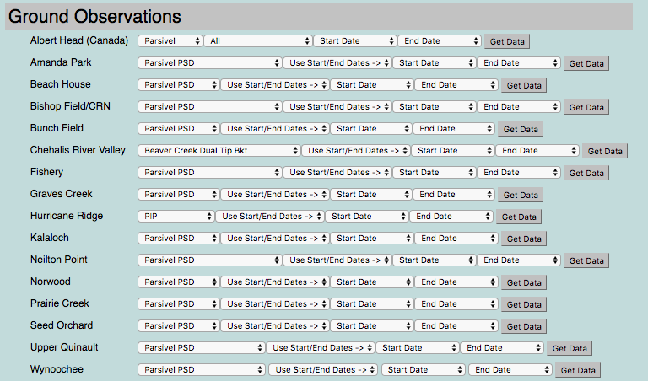
Choose plot type and time range from drop down menus:

Slide 6
olympex.atmos.washington.edu
Site status spreadsheet

Slide 7
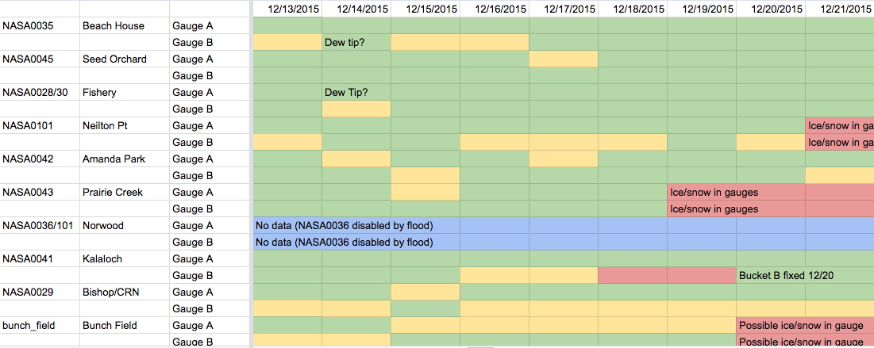
Gauge status reported in Google Doc
https://docs.google.com/spreadsheets/d/104aJ5bKUXEM_KrD4fqeIE-L2ZR2xjjjH_auXuAZs6co/
Yellow: Gauge data is available but calibration appears to be off
Red: Gauge malfunctioning or not tipping
Green: Gauge data is available and gauges "A" and "B" are within ~5% of each other
Gray: Not installed
Blue: No data available

Slide 8
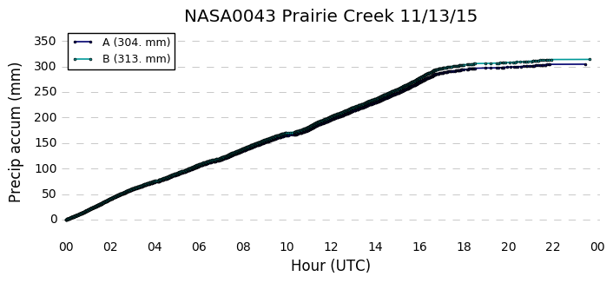
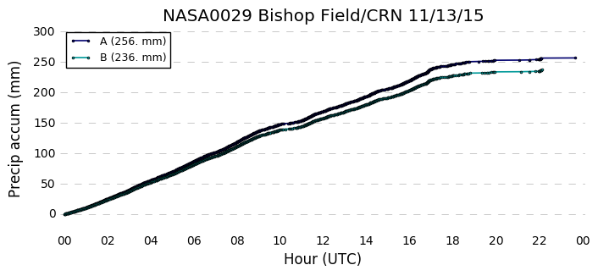
Fairly good calibration
(within 5%)
Poorly calibrated
(8% difference)

Slide 9
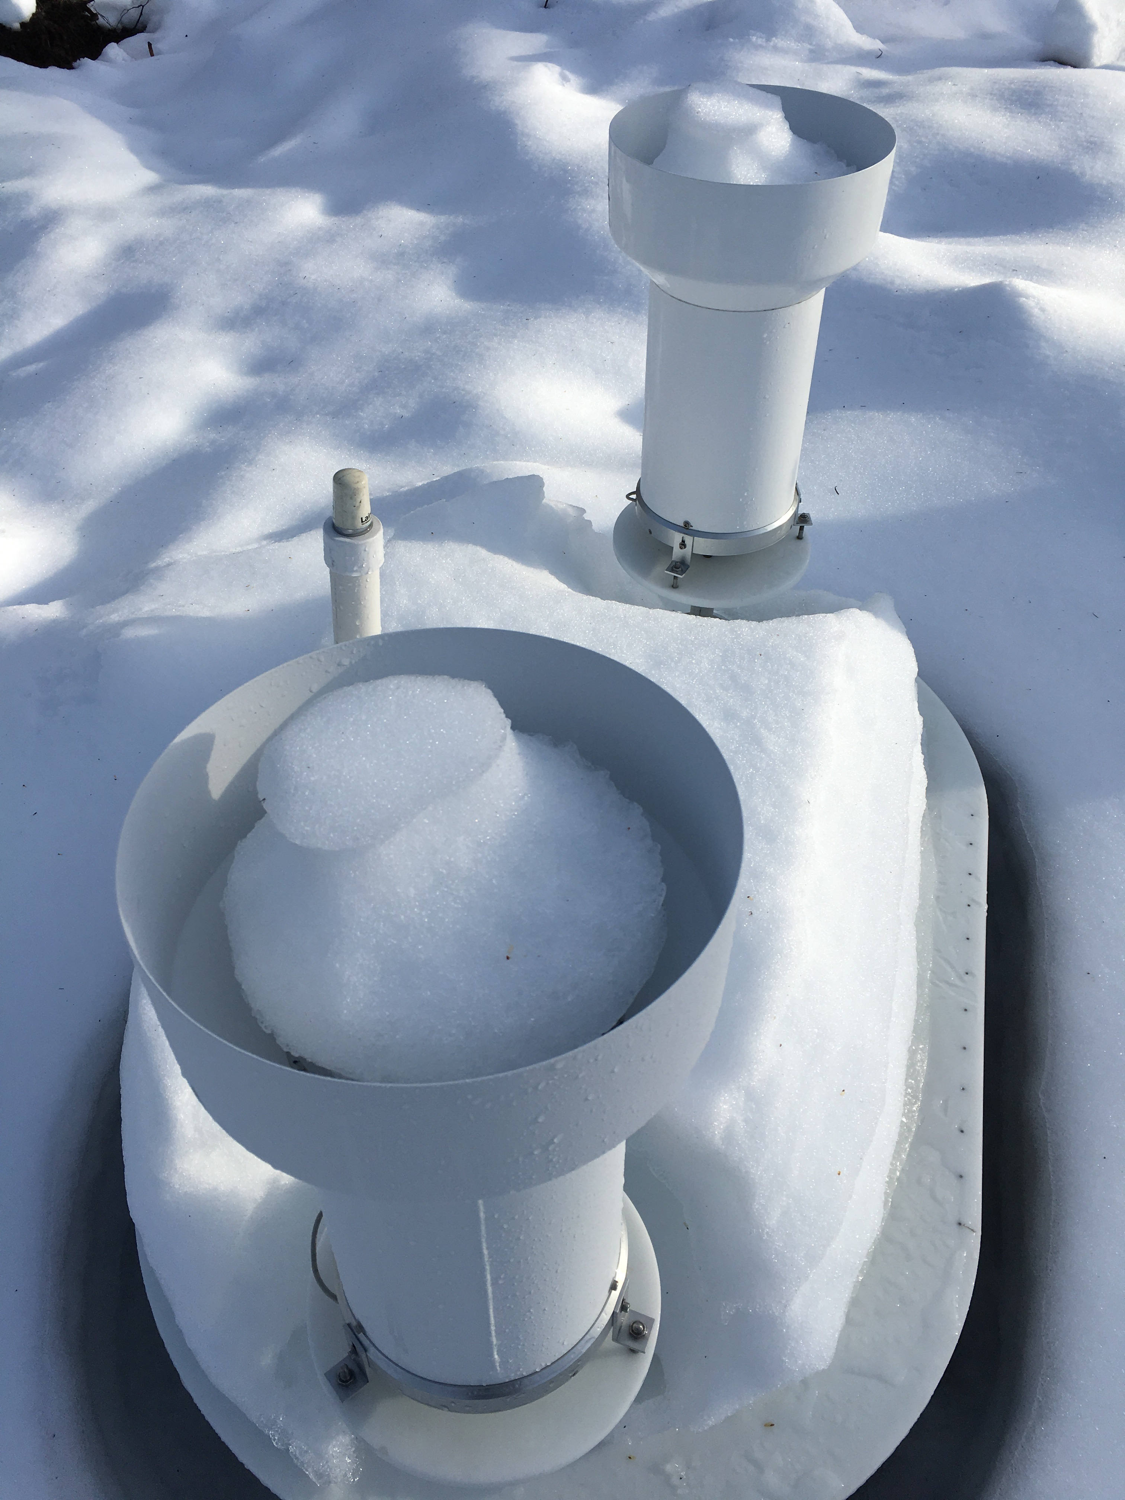
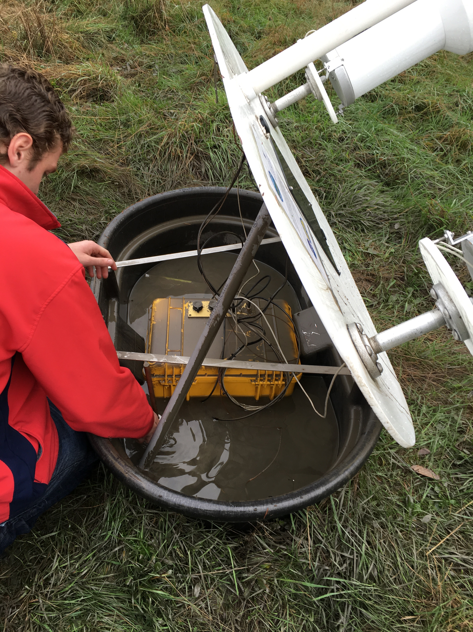
Snow in Gauges
Widespread from 20-Dec-2015 to 10-Jan-2016
Norwood Gauge Flood
17-November-2015

Slide 10
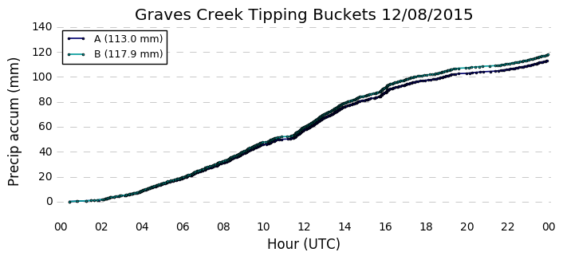
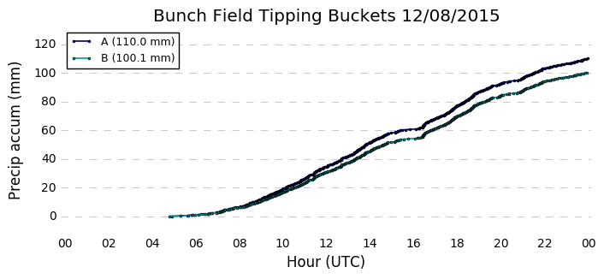
Steady precipitation incorrectly starts 4 hours early
See Google Doc for specific corrections
Only applies to 3 standalone sites
Appears to be exactly 4 or 5 hour offset

Slide 11
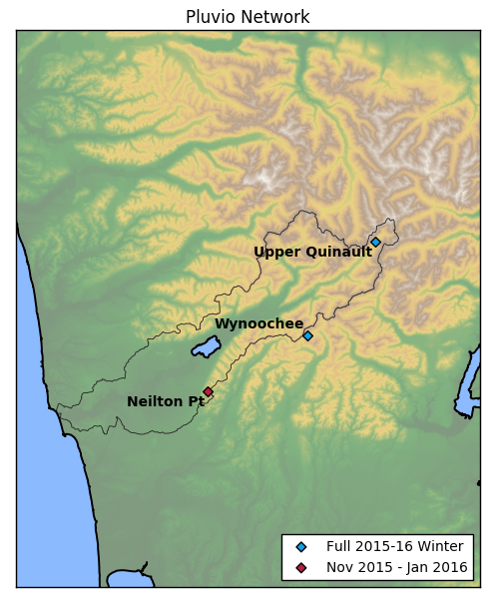
Pluvios
Three Pluvio sites
Mostly bad data at Neilton Pt (wind, power outages)
Some data missing at Wynoochee and Upper Quinault due to issues with electronics/power supply

Slide 12
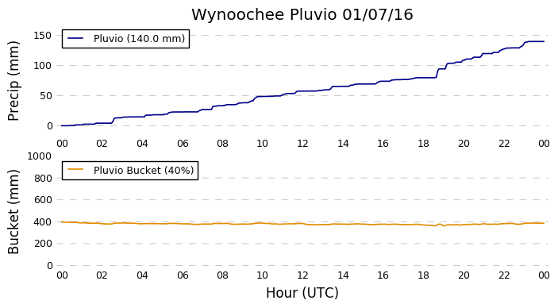
Bucket Not Secured Properly
(Wynoochee 05-27 Jan 2016)
Instrument detects 140 mm of precip
Bucket weight remains steady at 400 mm

Slide 13
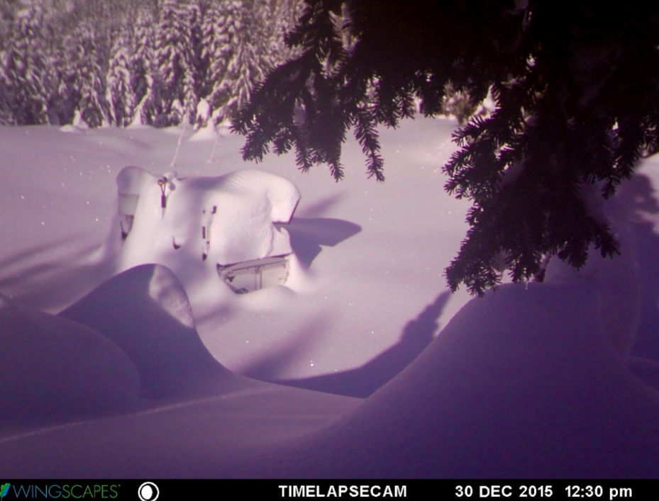
Bucket Overflowing

Slide 14
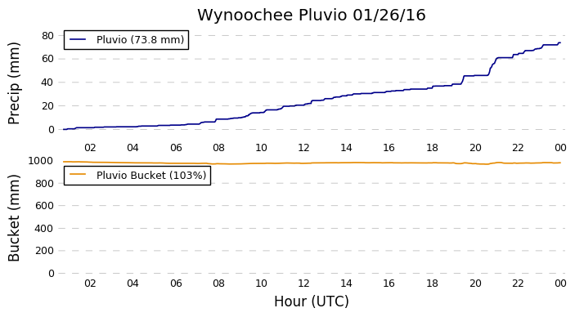
Bucket Overflowing

Slide 15
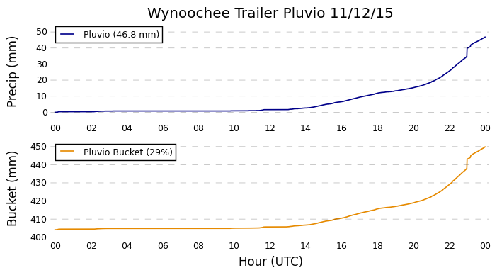
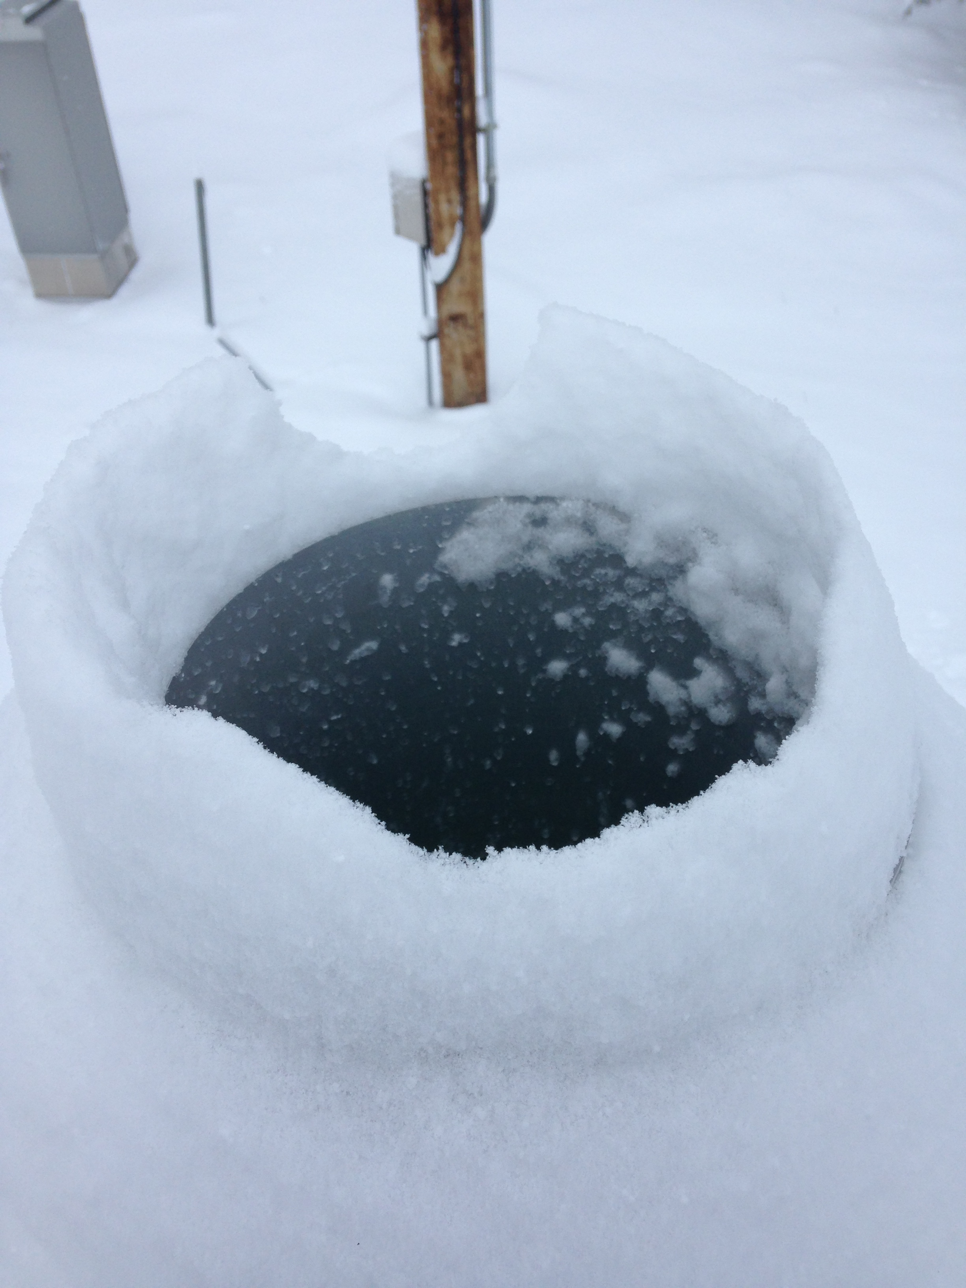
Snow dropping into bucket

Slide 16
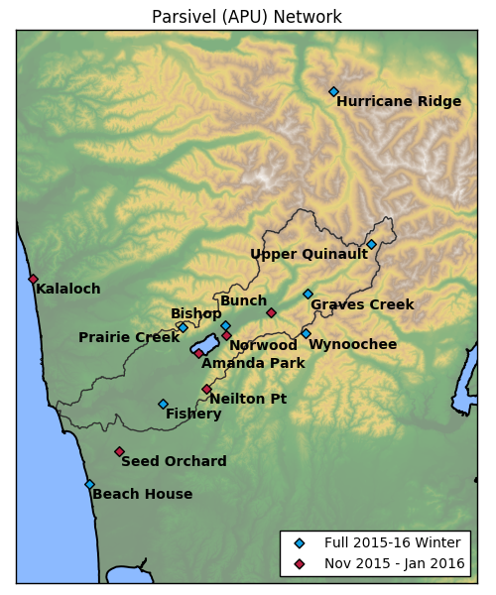
Parsivel (APU)
Albert Head, BC
HRIDGE
15 Total Sites
8 sites remained for full 2015-16 winter
Co-located 2DVDs at
  Fishery
  Neilton Pt
  Amanda Park
  Bishop
Raw (10 s) data available on TRMM-FC
Processed (1 min) data – more details in next talk (Ali Tokay)
APU10
APU11
APU30
APU09
APU07
APU08
APU13
APU06
APU05
APU04
APU03
APU02
APU01

Slide 17
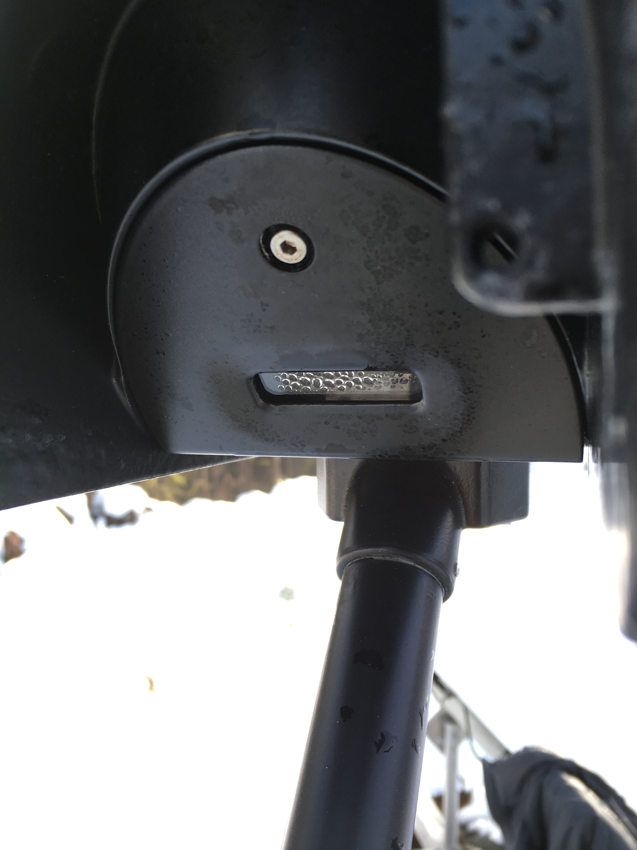
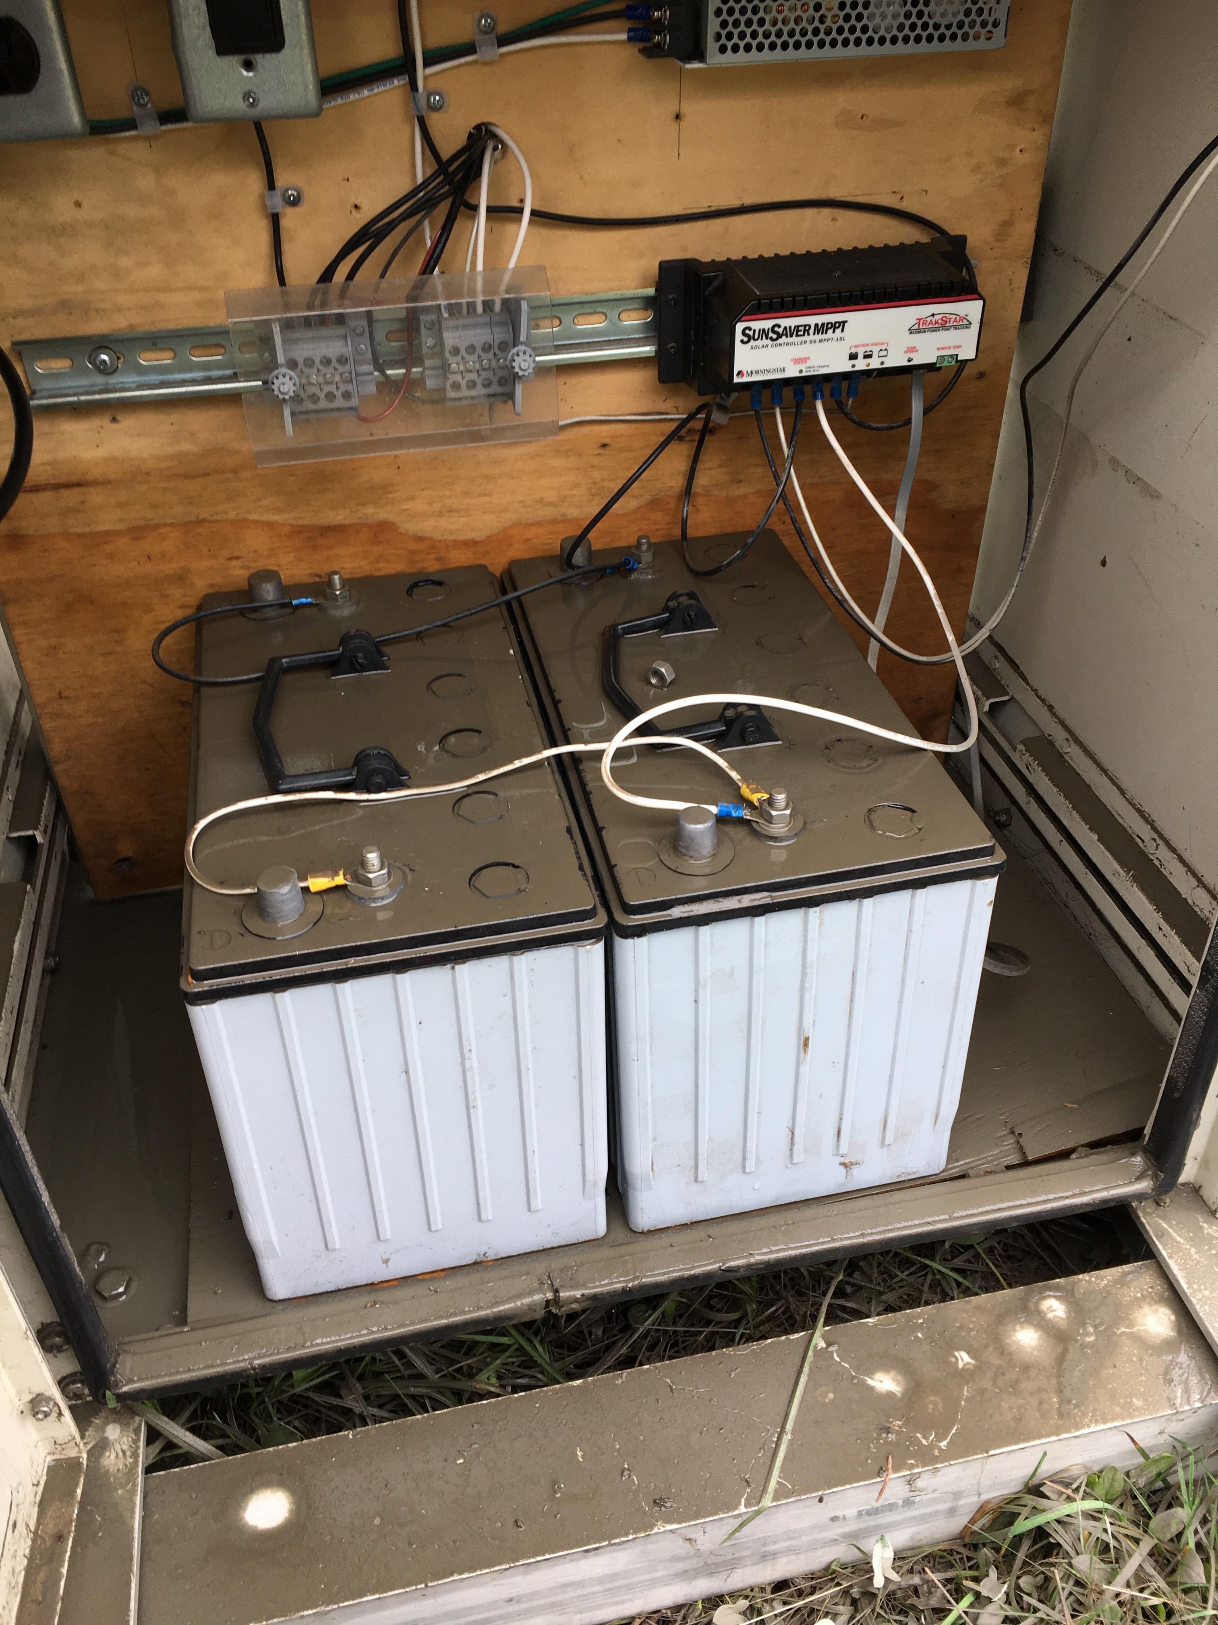
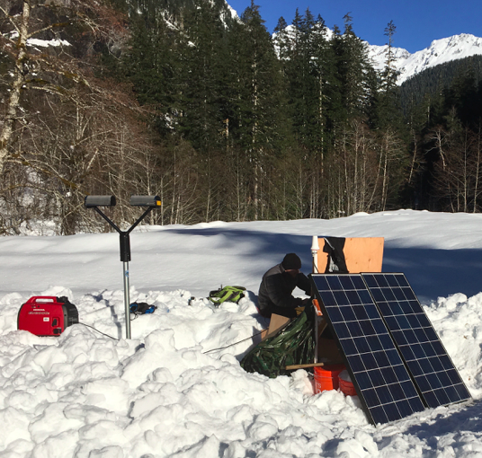
Issues with Parsivel dataset
Condensation on Optics (#1 problem)
Electronics or Dead Batteries
Snow
Wind is also an issue at exposed sites

Slide 18
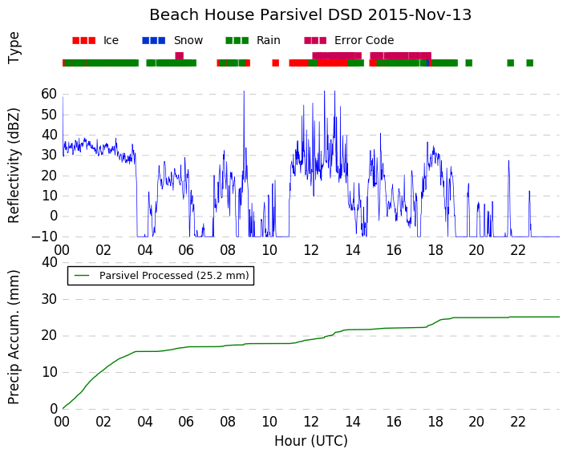
UW “Parsivel Refl” Plots
Issue: Precip type recorded as “ice” (weather code = 88)
Cause: strong winds
Issue: Error Code “3”
Cause: water blocking Parsivel optics

Slide 19
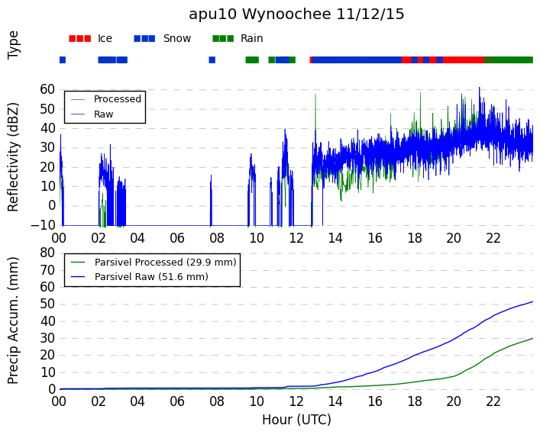
Also useful for seeing when snow occurred at higher elevations
Raw: includes snow
Processed: snow removed

Slide 20
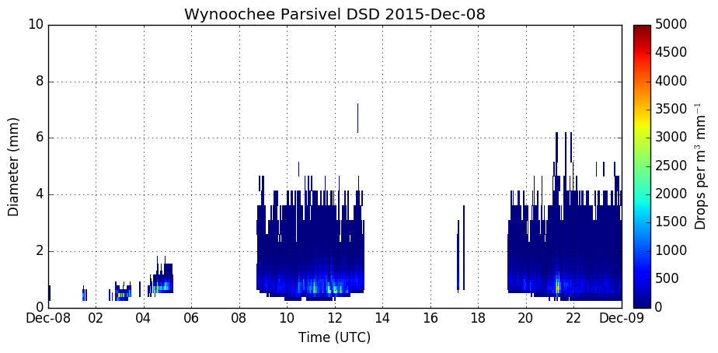
“Parsivel PSD” Plots
Error Code 3 present for most of this day
Still raining here—no drops recorded!
Smallest drop bins stop recording drops
If the issue is really bad, all data will be missing

Slide 21
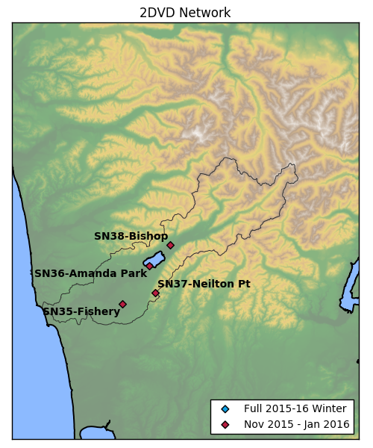
2DVD
Co-located with Parsivels (APUs)
All 2DVDs removed in Jan 2016
SN37 (Neilton Point) had major issues with wind, snow, and power outages
See next talk (Ali Tokay) for details.

Slide 22
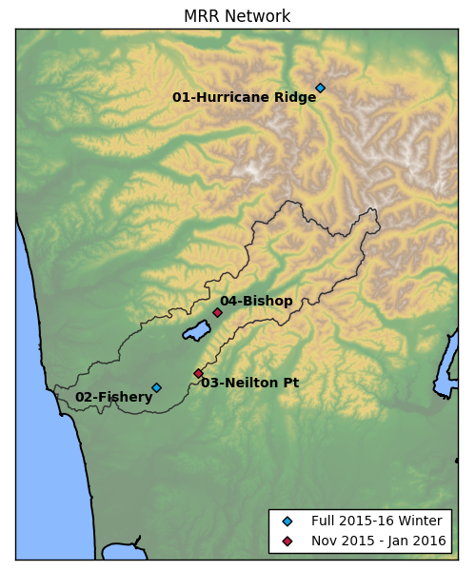
MRR
Co-located with Parsivels (all 4 sites), 2DVDs (3 sites), and PIP (2 sites)
Two sites remained for full winter
Hurricane Ridge also has data for most of 2014-15 (test winter)
Raw Spectra is not available at Fishery in Nov-Dec 2015
+PIP
+Parsivel
+Parsivel
+2DVD
+PIP
+Parsivel
+2DVD
+Parsivel
+2DVD

Slide 23
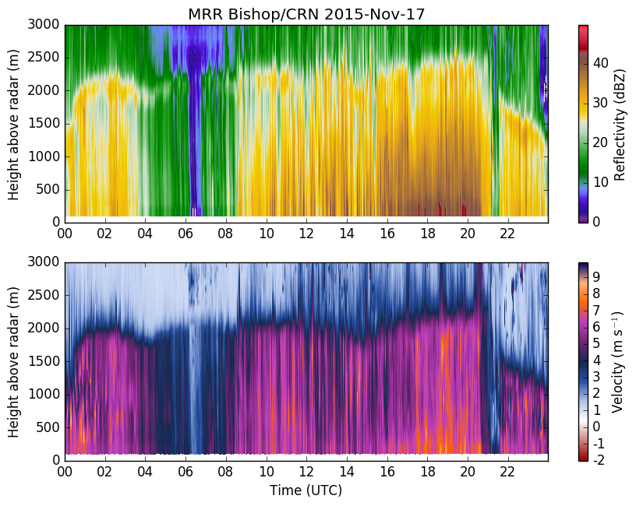
Built-in Metek “Ave” Data

Slide 24
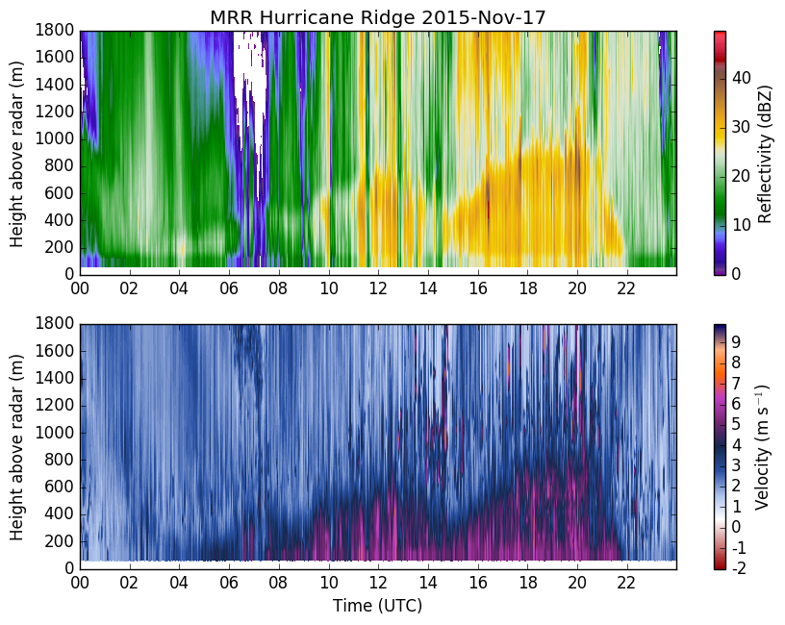
Lots of noise in velocity—likely caused by strong vertical motions
Built-in Metek “Ave” Data

Slide 25
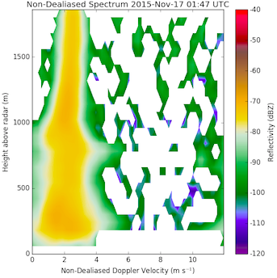
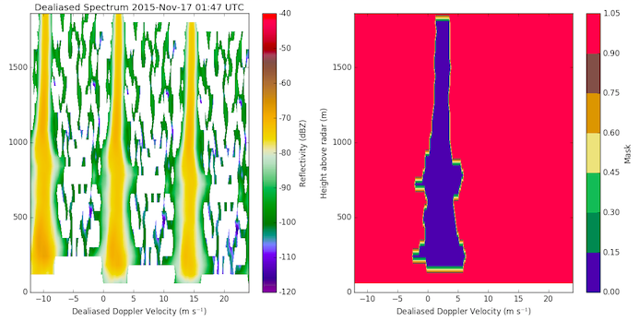
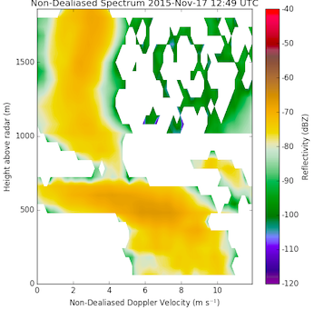
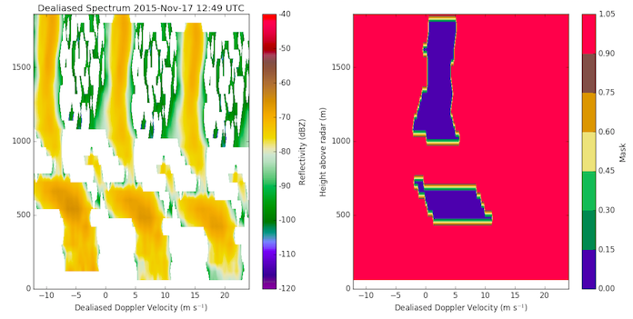
Impact on Processing Algorithms (ImProToo)
Raw Velocity Spectrum
Dealiased Velocity Spectrum
Mask (Blue = accepted data)
Correctly dealiased spectra
17-Nov 0147 UTC
Raw Velocity Spectrum
Dealiased Velocity Spectrum
Mask (Blue = accepted data)
Incorrectly dealiased spectra
17-Nov 1249 UTC

Slide 26
Summary
Data is excellent for case studies
Be careful with longer-term statistics
Use Google Doc
Use plots on UW OLYMPEX site
Email jzagrod@uw.edu with any questions

