Slide 1
OLYMPEX
DOW Status Update
Angela Rowe
Karen Kosiba, Josh Wurman, Stacy Brodzik, Andrew Frambach
OLYMPEX Workshop
Seattle, WA
21 March 2017

Slide 2
DOW IOPs
IOP | Begin | End
1 | 20151106-14Z | 20151106-19Z
2 | 20151107-04Z | 20151108-04Z
3 | 20151108-04Z | 20151109-12Z
4 | 20151111-00Z | 20151111-15Z
5 | 20151112-15Z | 20151113-22Z
6 | 20151114-15Z | 20151115-12Z
7 | 20151116-15Z | 20151118-04Z
8 | 20151118-21Z | 20151119-12Z
9 | 20151123-12Z | 20151124-20Z
10 | 20151130-18Z | 20151201-09Z
11 | 20151201-15Z | 20151202-09Z
12 | 20151202-21Z | 20151205-02Z
IOP | Begin | End
13 | 20151205-11Z | 20151206-15Z
14 | 20151208-06Z | 20151209-21Z
15 | 20151210-10Z | 20151211-12Z
16 | 20151212-12Z | 20151214-02Z
17 | 20151217-03Z | 20151219-06Z
18 | 20160104-14Z | 20160105-06Z
19 | 20160105-14Z | 20160105-23Z
20 | 20160106-08Z | 20160106-15Z
21 | 20160111-14Z | 20160112-06Z
22 | 20160112-14Z | 20160113-20Z
23 | 20160115-12Z | 20160115-22Z
Scans every 10 minutes: two RHI volumes (50-74° azimuth), one PPI sector volume (39-83° azimuth, 6 elevations: 2.8, 3.0, 5.0, 7.0, 9.0, and 11.0°), and a birdbath

Slide 3
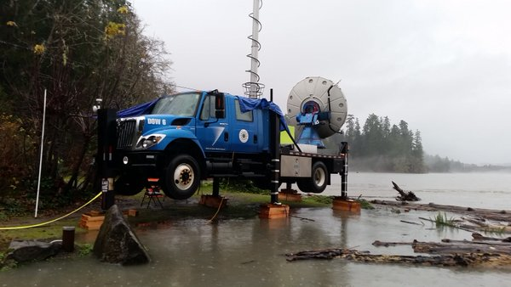
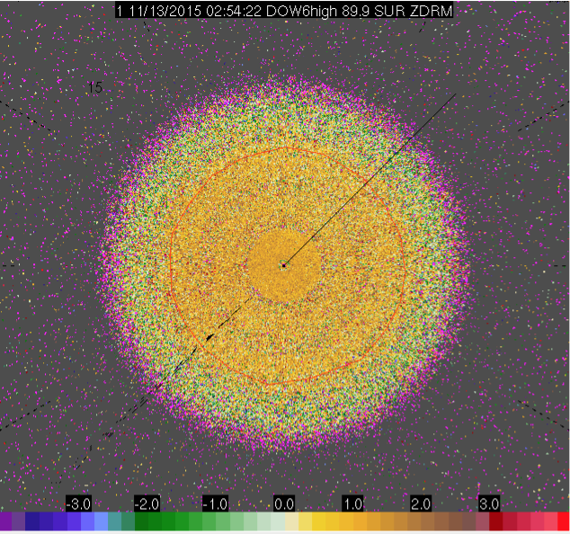
DOW - QC
V1
  Sweep/dorade files
  Retranslate data with oversampled 0.25° beam indexing
  Mitigate ground clutter (_F = filtered)
  Compare high and low frequencies for consistency when available (no high after 11/23)
  Correct navigation in headers (accounted for slight shift ~0.5° when truck lifted)
  ZDR bias correction

Slide 4
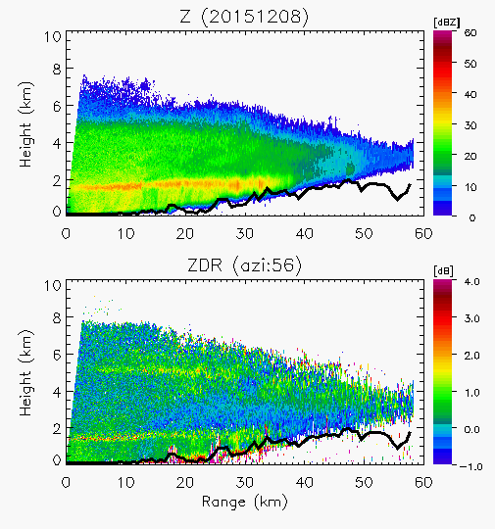
DOW - QC
ZDR bias
  Quasi-vertical scan every 10 minutes
  Apply offset when departs from 0.2-dB tolerated error
  ZDR: First guess offset in field (not great; don’t use)
  ZDRM: Measured with no offset
  ZDRC: ZDRM+offset
  Lower confidence for low dBm (less reliable at far range and cloud top)
  README/Spreadsheets for each IOP detailing exact ZDR offsets
ZDRC

Slide 5
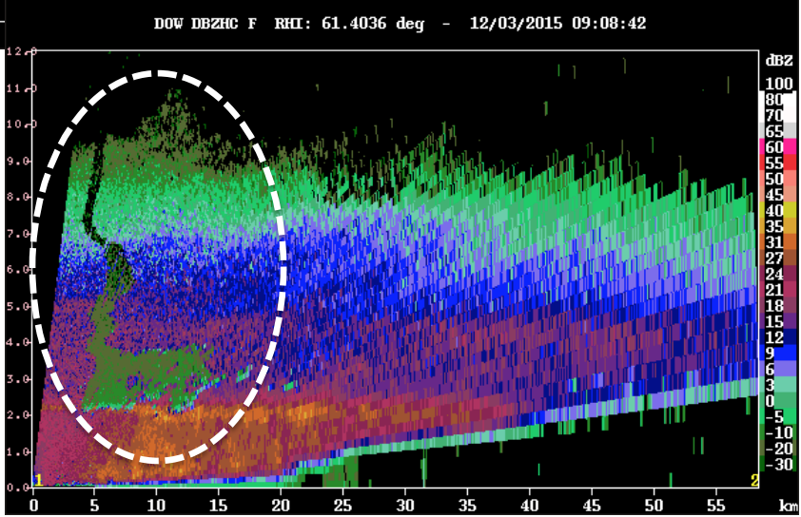
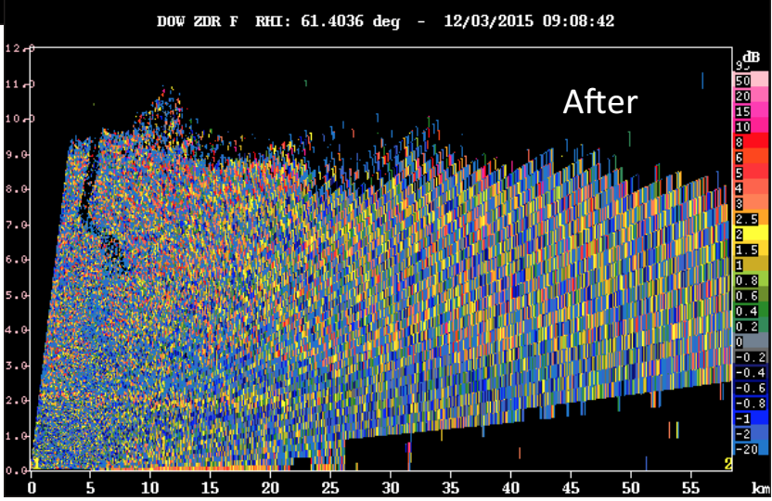
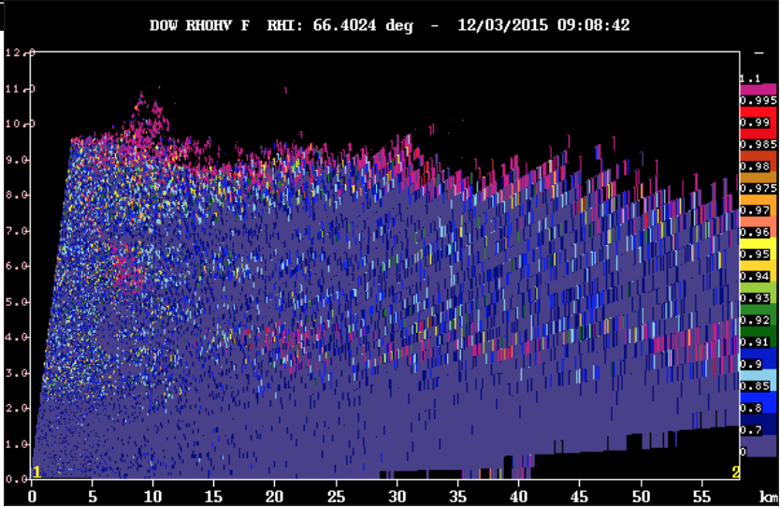
DOW - QC
Z
V2
  Corrected issues with transition sweeps, split/extra sweeps in middle of volume, under/overshooting antenna,… (retranslate data)
  All IOPs converted to CFRADIAL and available on the DAAC as Version 1A (intermediate, no current replacement date set)
  Remaining clutter, differential attenuation
  Issues with data from 2200 UTC 2 December 2015 through 1700 UTC 3 December 2015
    H/V powers OK, staggered PRT flipped during processing/recording – Correction TBD
  Reflectivity issue
ZDR
ρ_{HV}

Slide 6
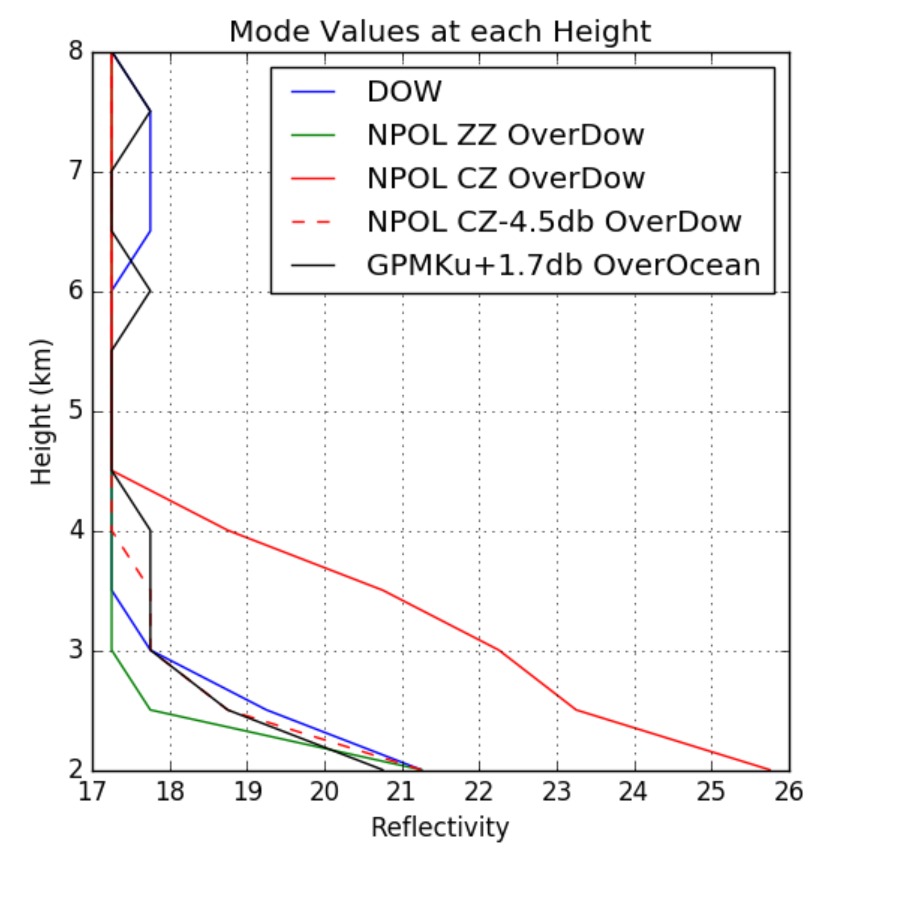
Reflectivity bias
~4.5 dB difference between NPOL and DOW
GPM: +1.07 dB (not 1.7 dB)
NPOL
  +1 dB hot when compared to GPM Ku V4, similar via self-consistency (1-2 dB depending on case) and comparison with disdrometers (applied to current version)
  Calibration consistent
  Additional checks (self-consistency) show NPOL still ~0.6 dB
DOW
  4.9 dB lower than NPOL, 3.44 dB lower than KLGX
  Not ideal overlaps!
  Re-evaluate 2.0 dB 2-way waveguide loss, transmit power?

Slide 7
Reflectivity bias
Checking DOW measurements from SNOWIE
  DOW6/7 H/L H/V
  Stuck on top of a mountain (weeks/month until additional testing)
Comparing with other radars
  Originally, look at moderate intensity (~30 dBZ) cells/structures from radars (DOWs, 88Ds, etc.) within < 1 min and create a histogram over the same area, calculating mean, mode, etc. of Z of all the gates w/in that area; comparison yielded a ~5 dBZ difference between 88D and DOW6
  Not a fair comparison - 88D sample volume (beam width + gate length) much larger than a DOW sample volume -- especially at distances of 75km (there are 10s of DOW sample volumes for ~several 88D sample volumes), so that reflectivity calculation for the 88D, in particular, likely is biased towards the larger drops, etc.
  Recently moved to taking the anti-log of Z for each sample volume before averaging
Comparisons from previous campaigns
  PECAN – summer 2015
    One warm season convective case: Agrees pretty well with 88D (-2 dB) and SPOL (-1 dB)
  MASCRAD – winter 2016 (CHILL)
    One upslope snow event: DOW (~35 dBZ) agrees well with CHILL-X (38 dBZ), but both much lower than CHILL-S (44 dBZ)
How to fairly compare different radars? Account for a dB here and there?

Slide 8
Moving Forward
Updated Version (TBD): Reflectivity correction, PID?
Follow up on 3 Dec 2015 issue
Other comments? Requests?
Contact: akrowe@atmos.uw.edu

