Slide 1
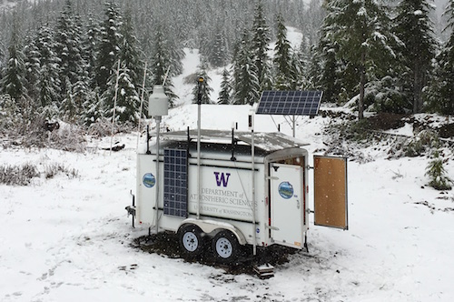
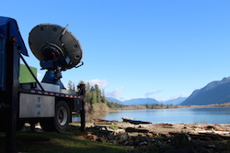
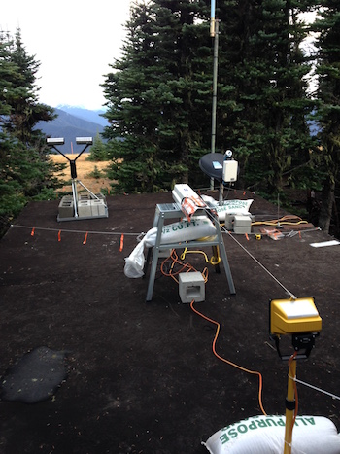
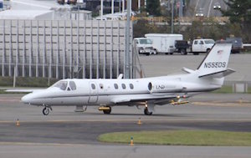
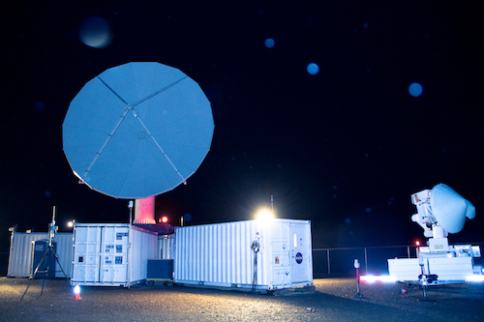

Overview of OLYMPEX storms
Lynn McMurdie
OLYMPEX Workshop, Seattle 21 March 2017

Slide 2
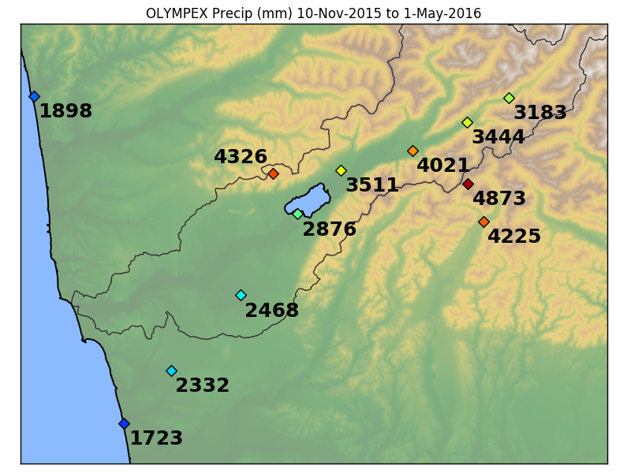
What we observed – A lot of Precipitation during ground network deployment

Slide 3
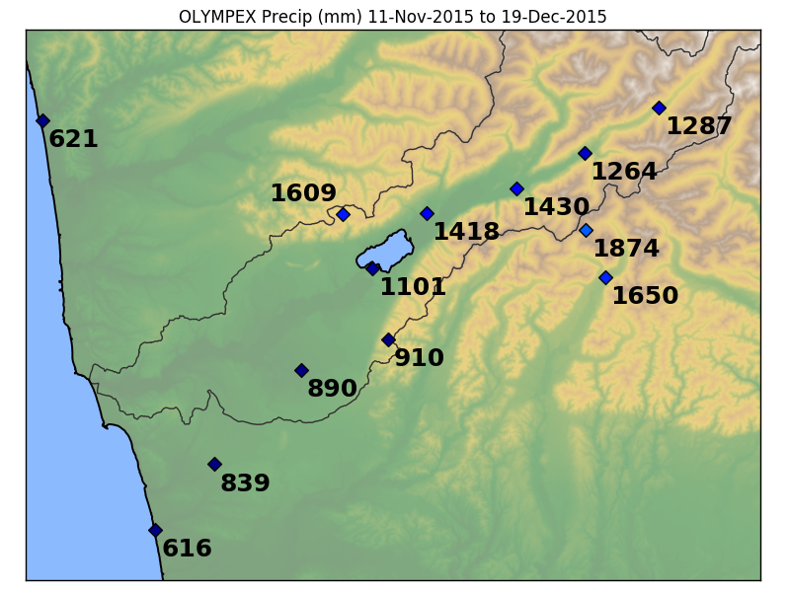
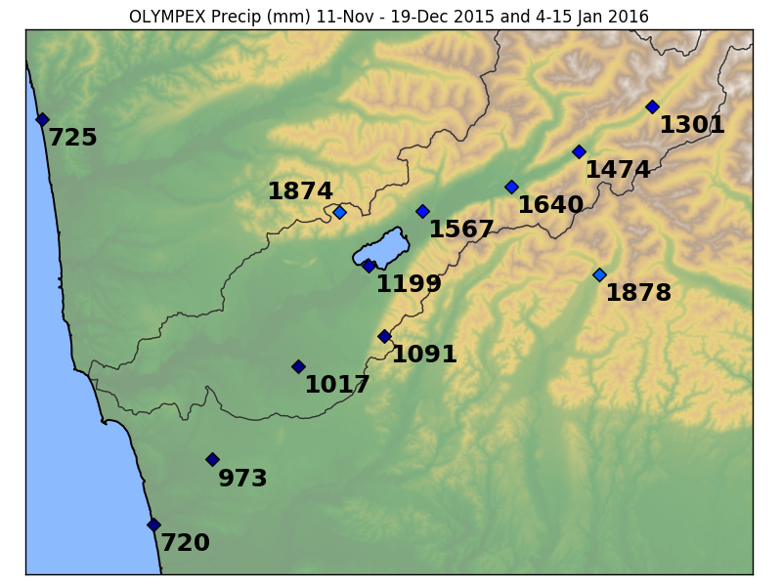
What we observed – A lot of Precipitation during radar and aircraft deployment
During aircraft deployment: 30/38 days measured precipitation
During radar deployment: 36/50 days measured precipitation

Slide 4
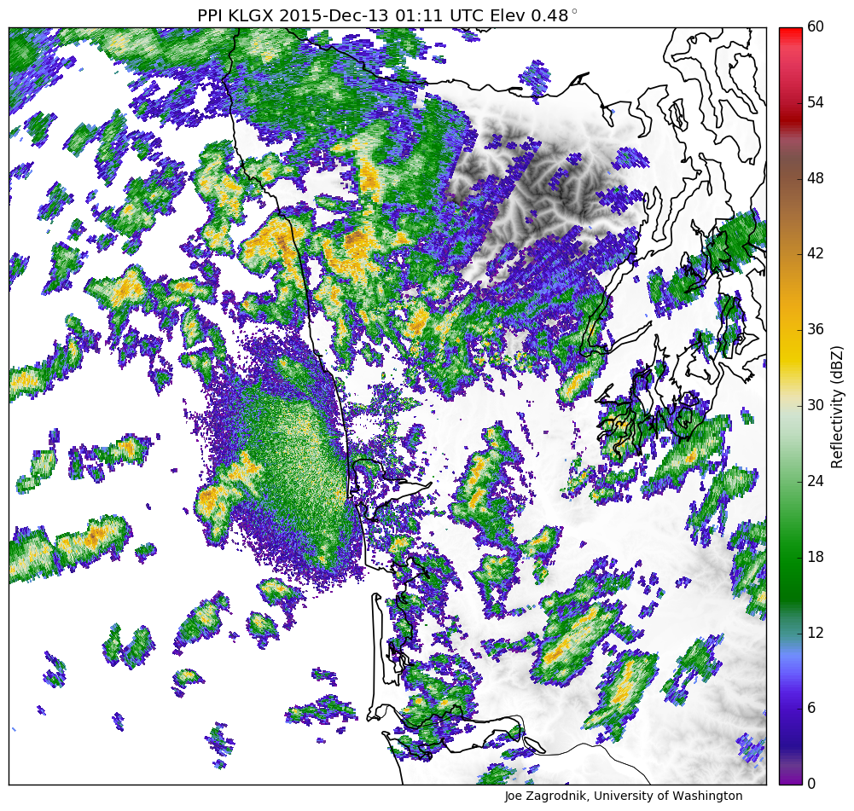
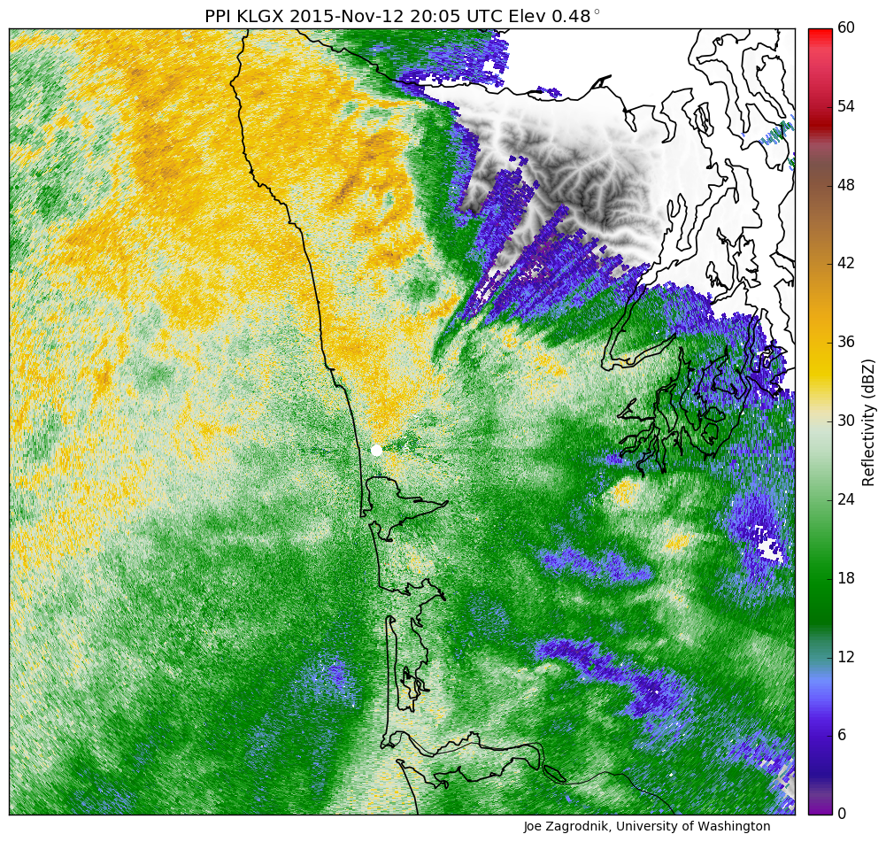
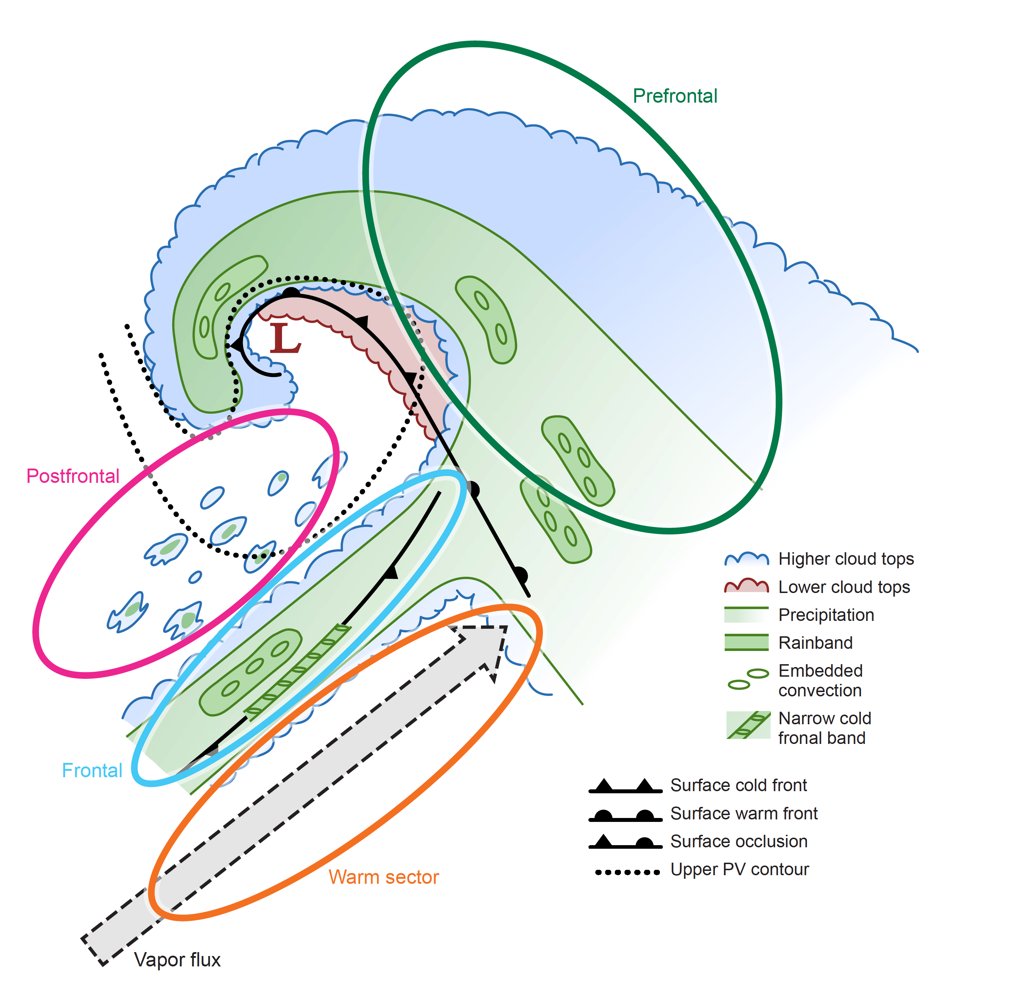
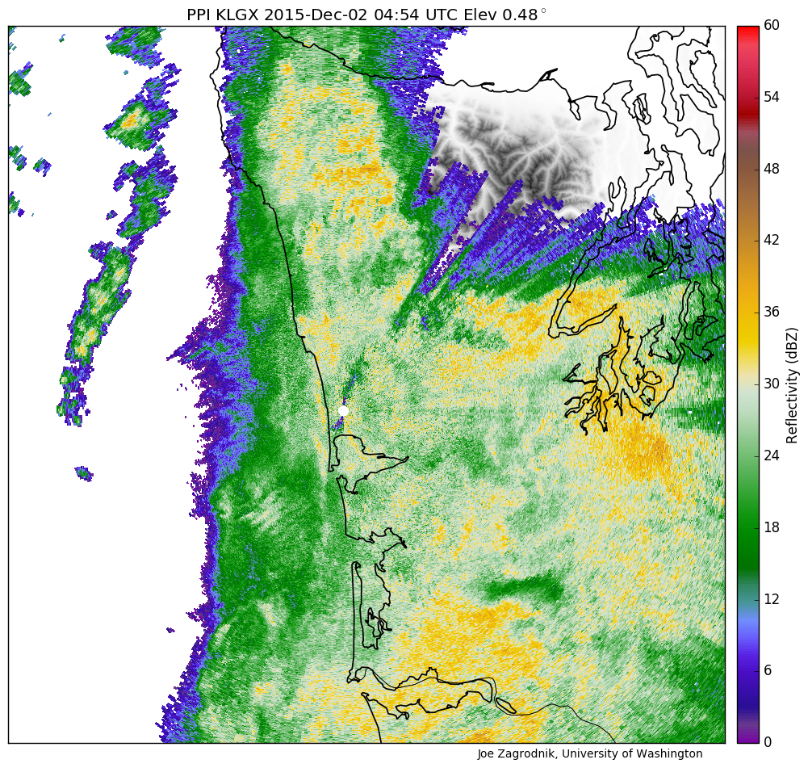
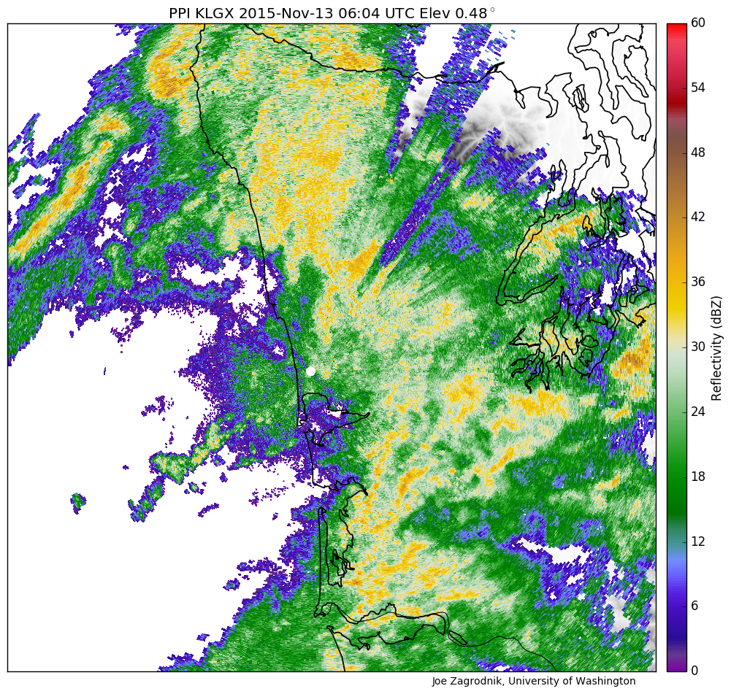
Storms sampled during OLYMPEX ~homogeneous facilitating statistics
Notes:
The dataset collected was not only huge…but also…homogeneous…facilitating…statistics
Storms passing over the OLYMPEX area all had a variation of this idealized structure…consisting of characteristic sectors…(describe)

Slide 5
10—20 November Period
Dates | Synopsis | Flights | Sector
Nov 12 | Very warm AR storm. GPM | DC-8, UND | Prefrontal, warm
Nov 13 | Same storm, NCFR | DC-8, UND | Warm, cold front
Nov 14 | Frontal wave, Chehalis, GPM | DC-8, UND | Warm, frontal wave
Nov 17 | Very strong AR storm, NCFR | No flights | Warm, Cold front
Nov 18 | Weak postfrontal, midclouds | DC-8, ER-2, UND | Post-, pre-frontal

Slide 6
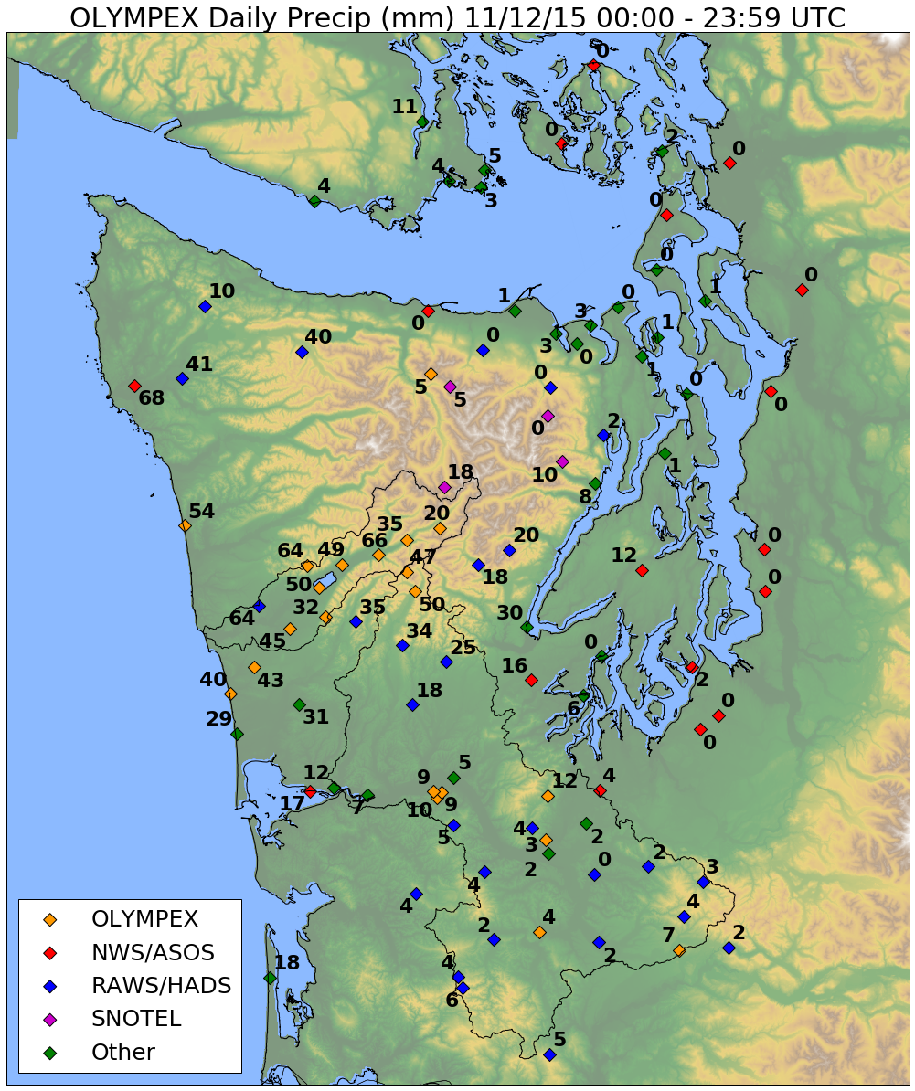
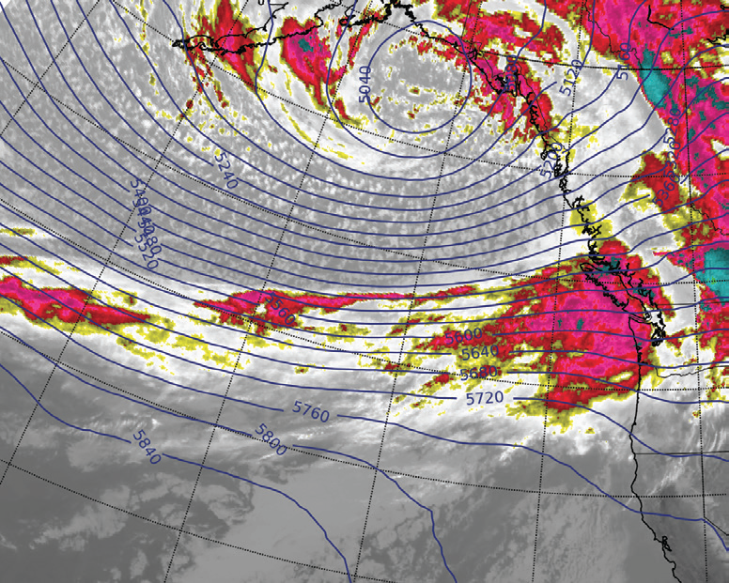
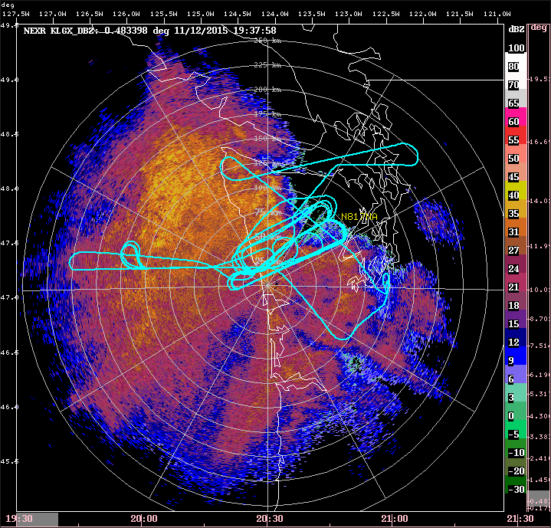
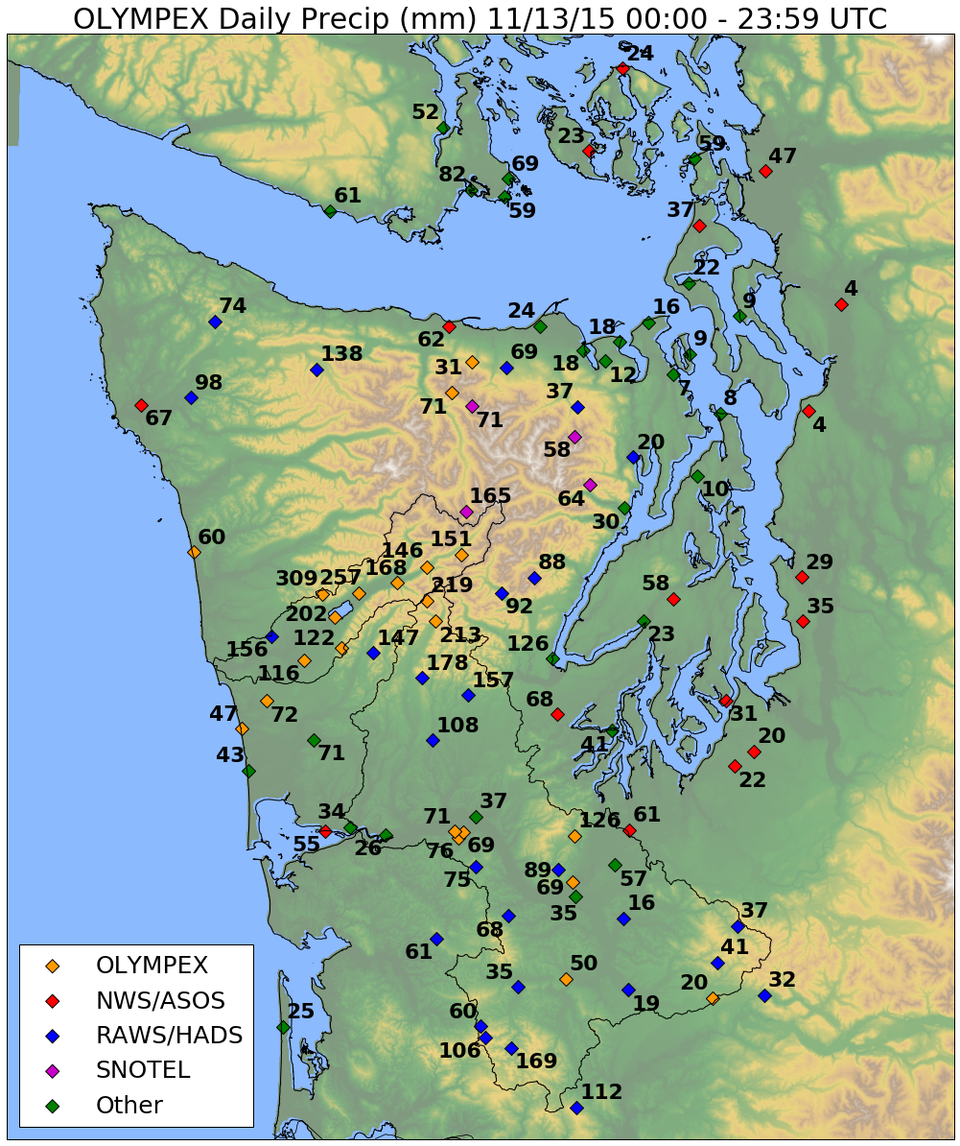
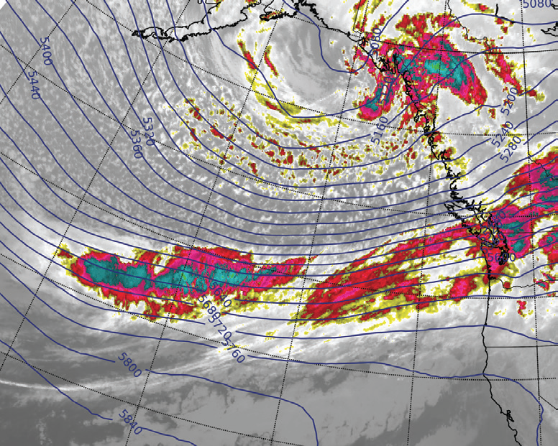
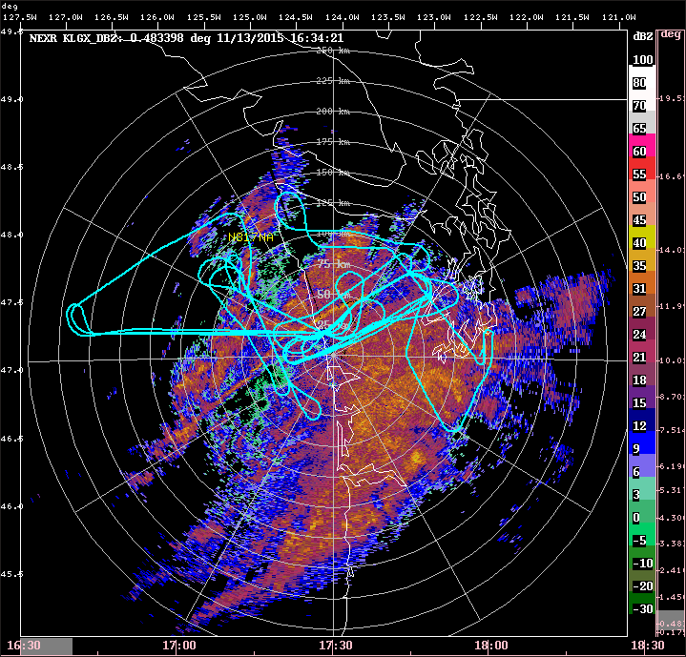
12—23 November AR Event
2100 UTC 12 November
Will hear a lot more about this event from Joe, Megan and Angela, and Robert
1600 UTC 13 November

Slide 7
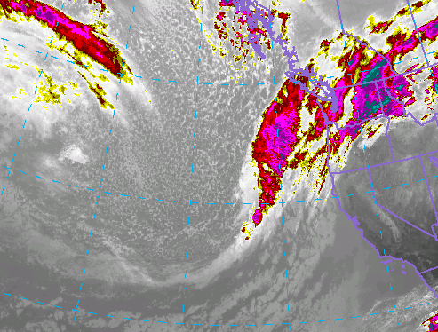

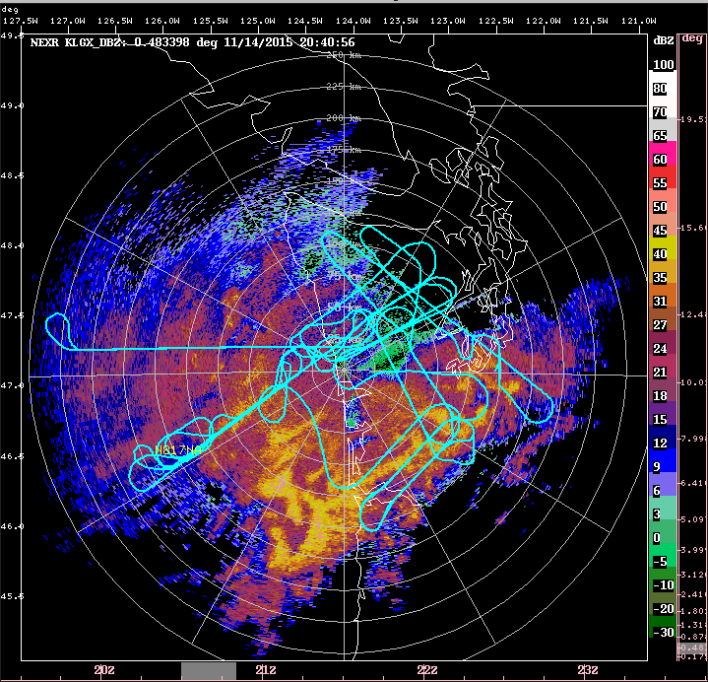
14 November 2015
2000 UTC 14 November

Slide 8
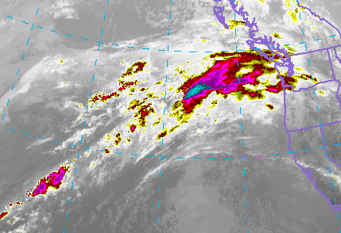
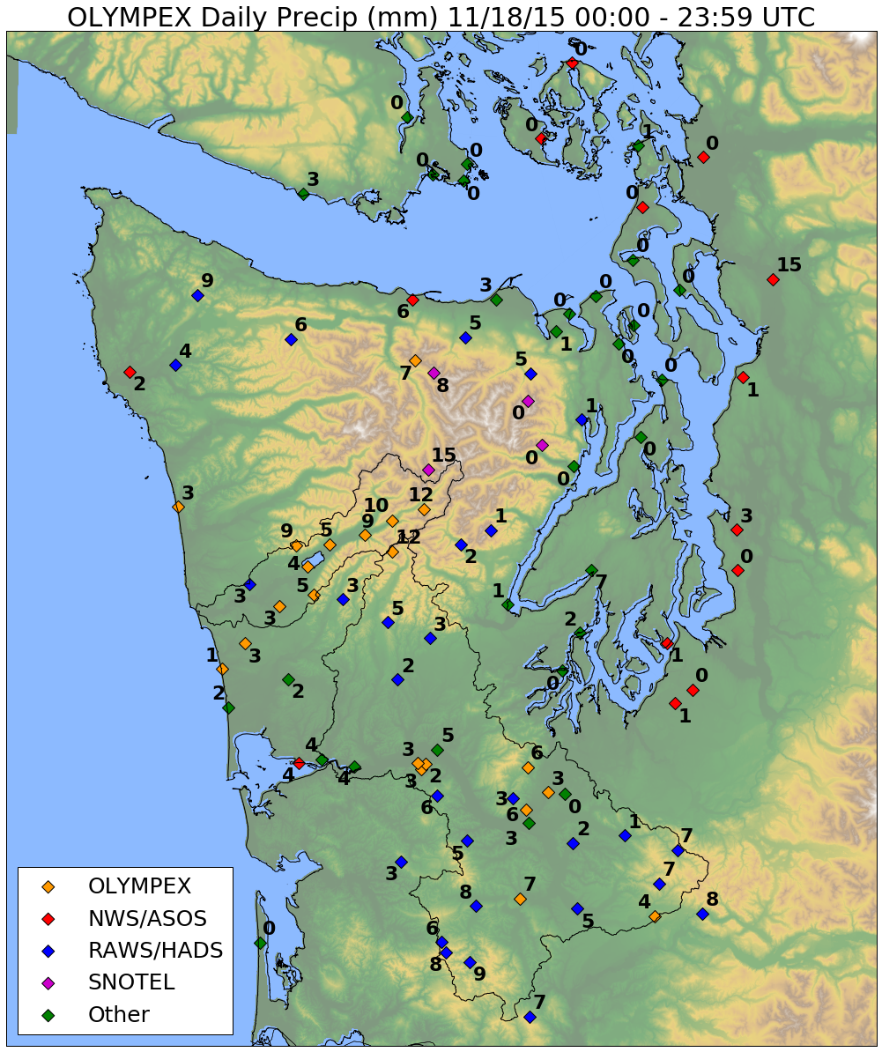
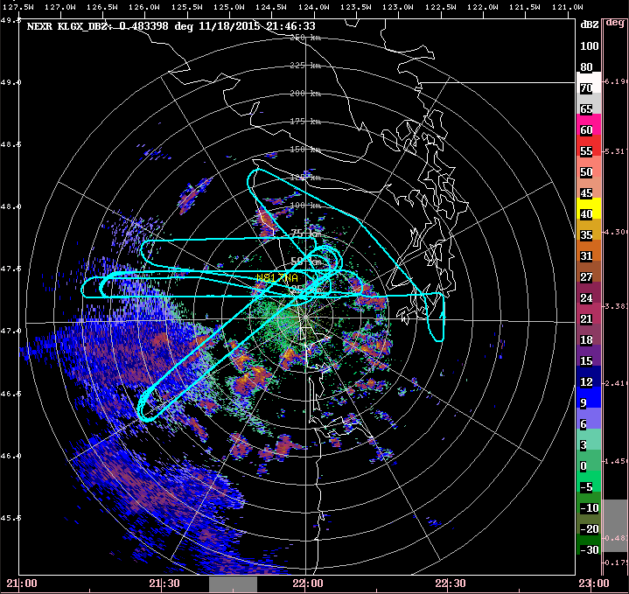
18 November 2015
2000 UTC 18 November

Slide 9
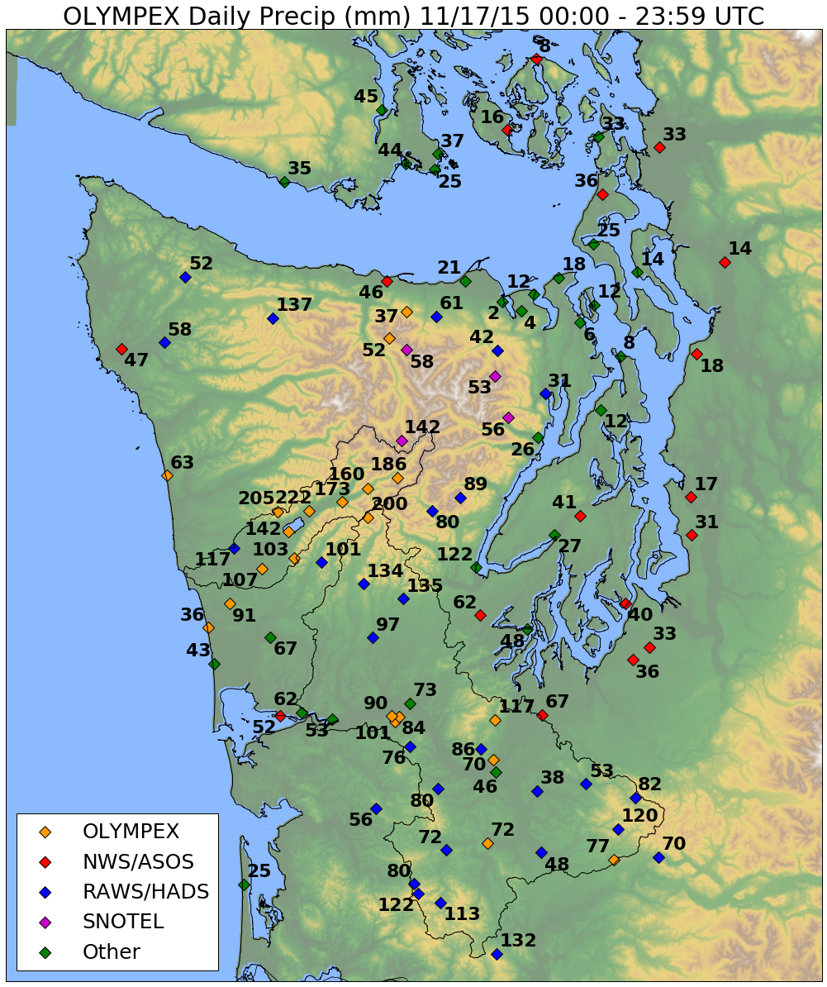
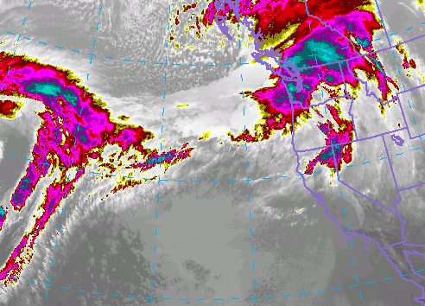

Slide 10
21—29 November Period
Dates | Synopsis | Flights | Sector
Nov 23 | Weak CF, low melting level | DC-8, ER-2, UND | Prefrontal, frontal
Nov 24 | Postfrontal, cold air outbreak | DC-8, ER-2, UND | Post-front, orographic
Nov 25 | Calibration | DC-8 | Clear air

Slide 11
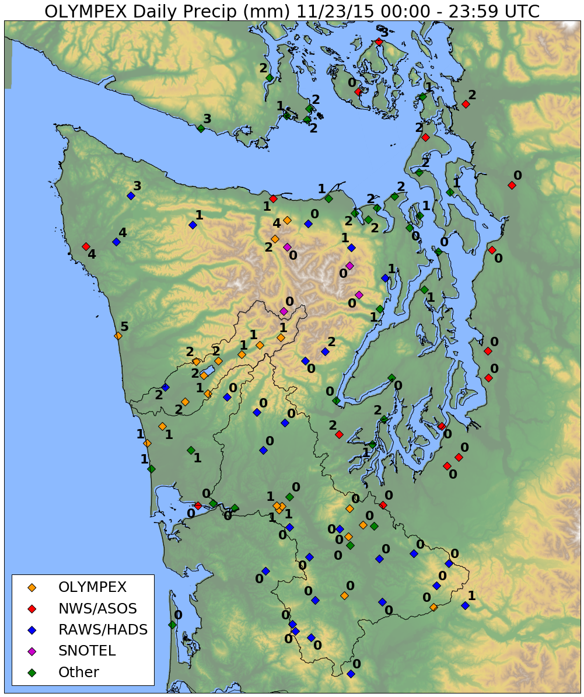
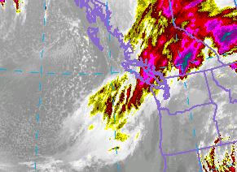
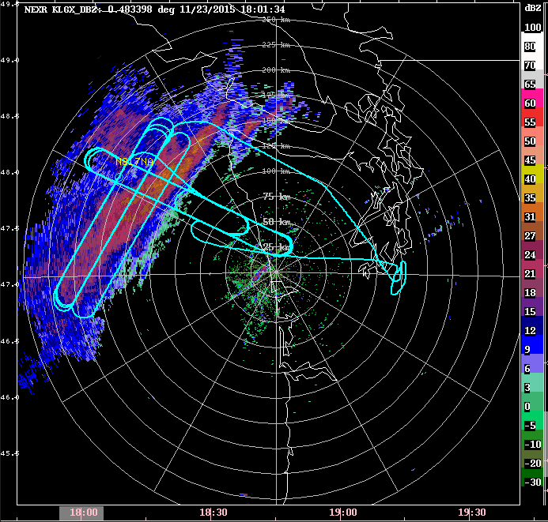
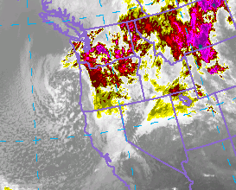
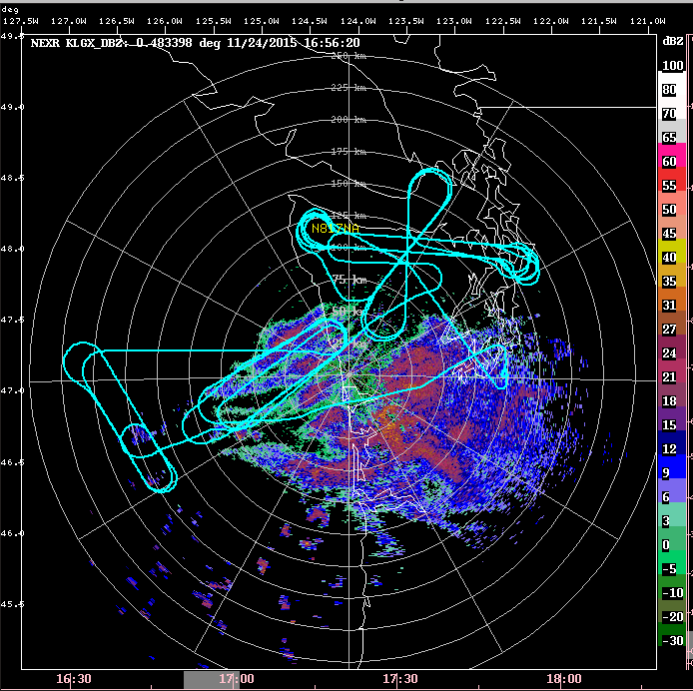

23 and 24 November 2015
1800 UTC 23 November
1800 UTC 24 November

Slide 12
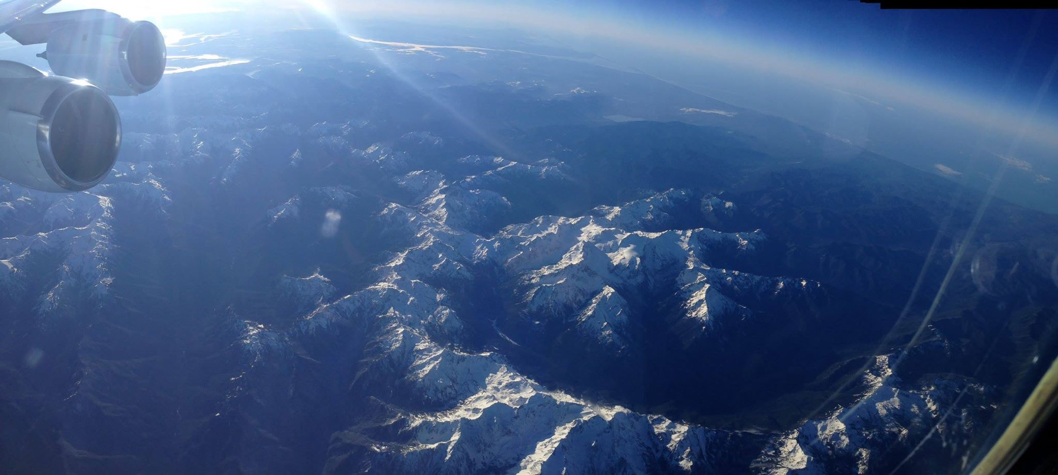
25 November Clear Air Calibration

Slide 13
30 Nov—10 December Period
Dates | Synopsis | Flights | Sector
Dec 1 | Weak storm, strat., orographic | DC-8, ER-2, UND | Prefront, warm, waves
Dec 3 | Complex storm, oro. GPM | DC-8, ER-2, UND | Prefront, warm, waves
Dec 4 | Postfrontal | DC-8, ER-2-UND | Postfrontal
Dec 5 | Warm advection, prefrontal | DC-8, ER-2, UND | Prefrontal, warm
Dec 8 | Warm AR storm, flooding, GPM | DC-8, ER-2 | Prefront, warm, waves
Dec 10 | Occluded front, postfrontal | DC-8, ER-2, UND | Postfrontal

Slide 14
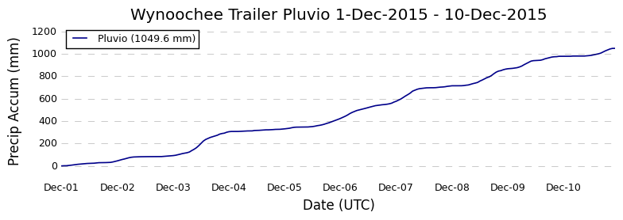
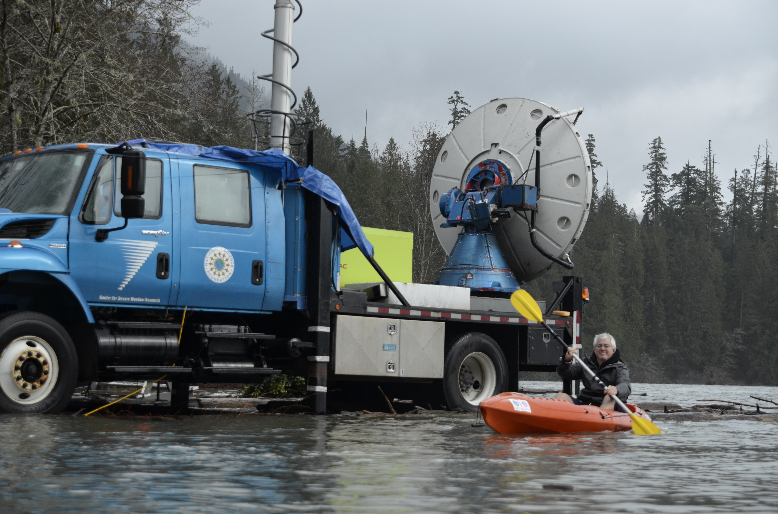

Slide 15
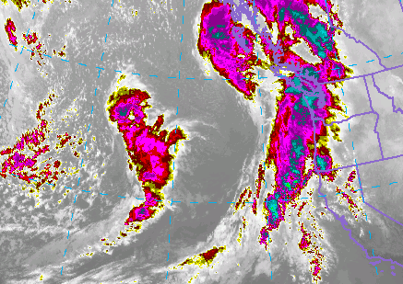
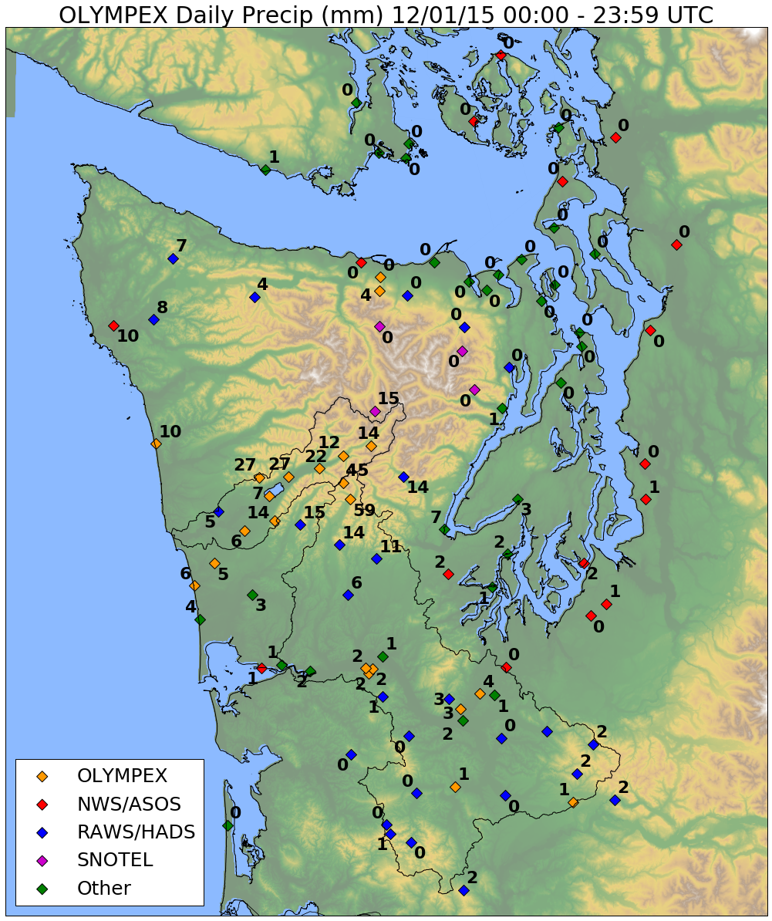
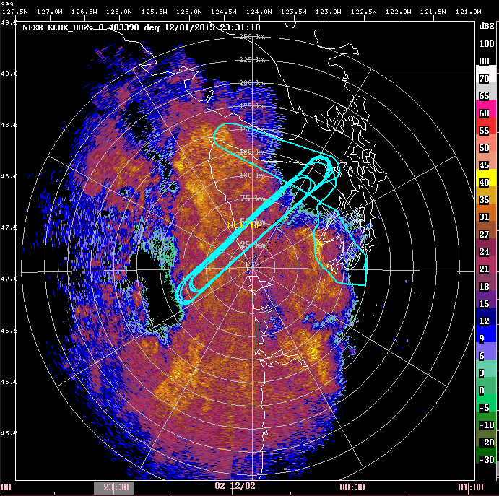
1 December 2015
2300 UTC 01 December

Slide 16
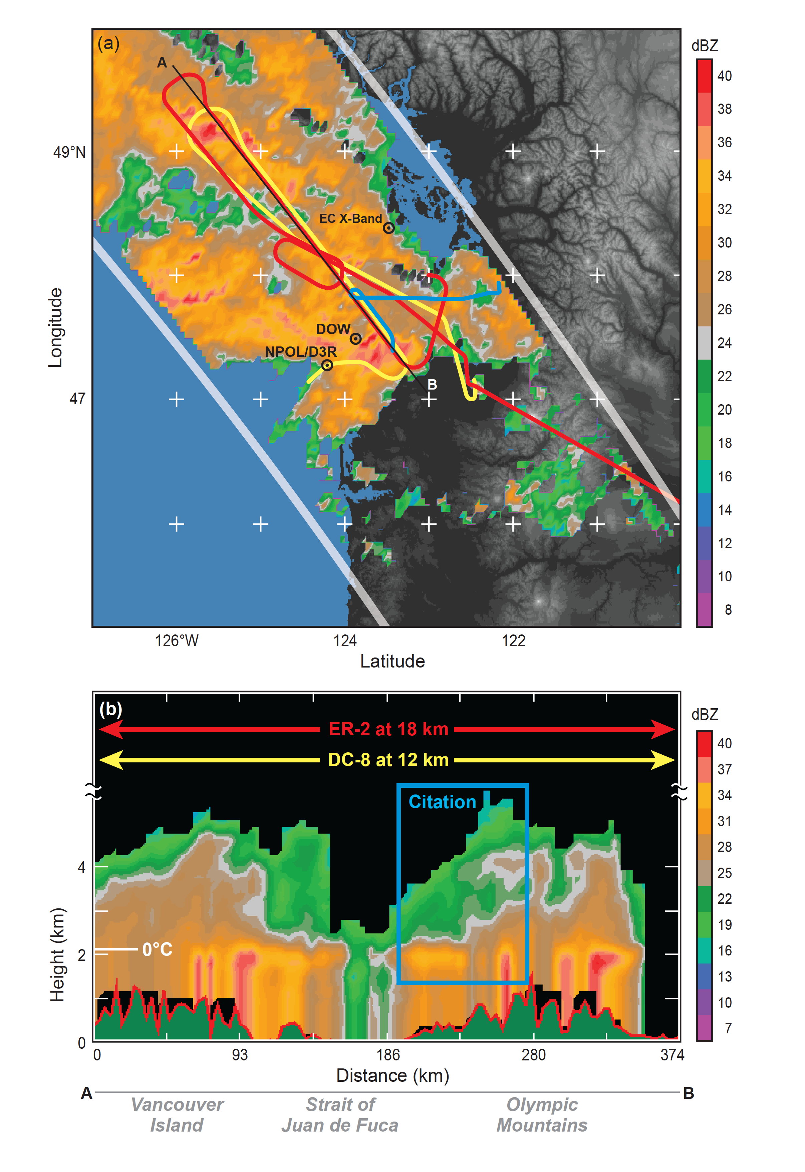
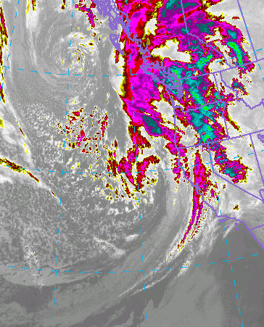
3 December 2015
1500 UTC 03 December
Coordination of 3 aircraft under GPM overpass

Slide 17
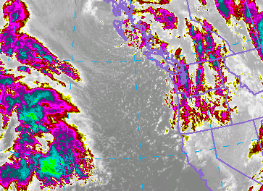
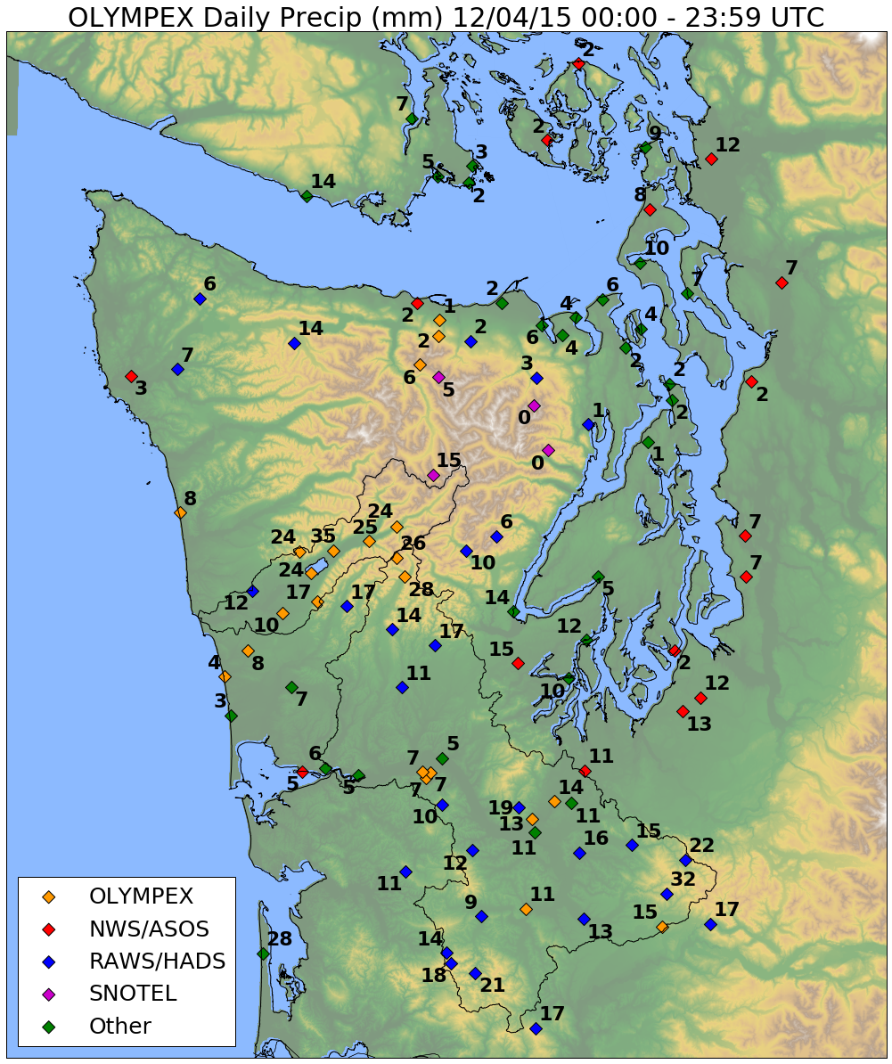
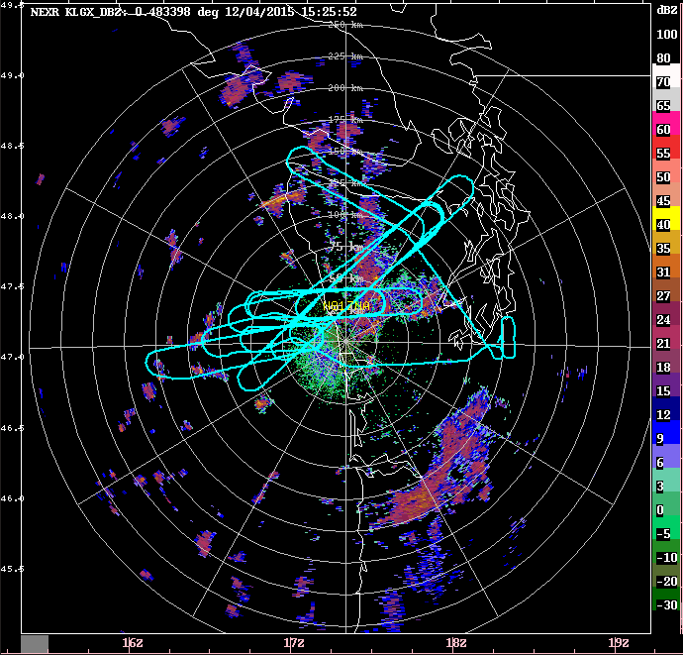
4 December 2015
1200 UTC 04 December

Slide 18
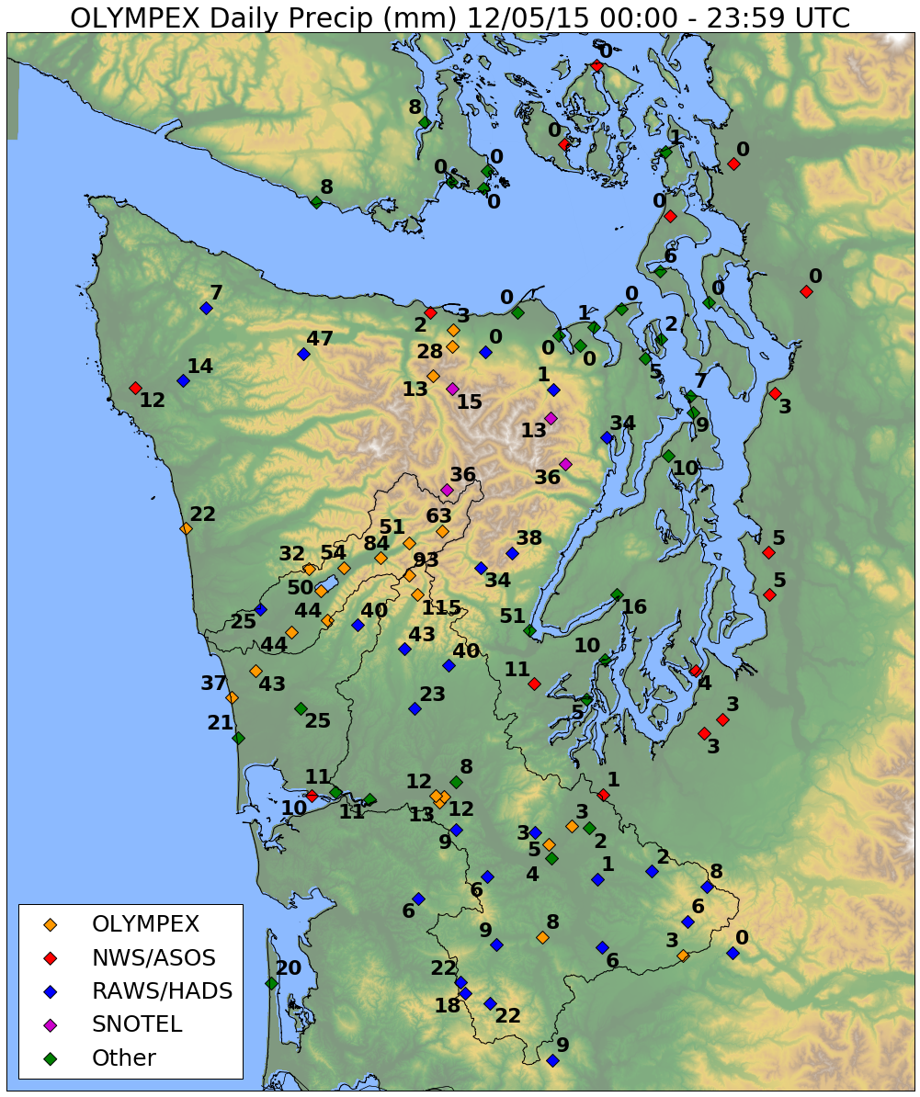
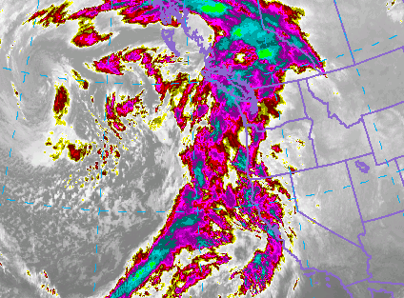
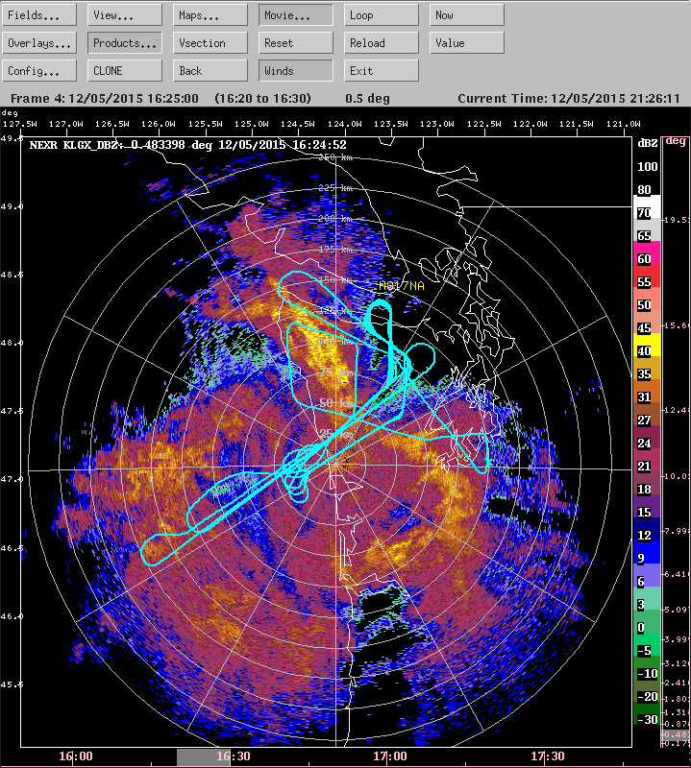
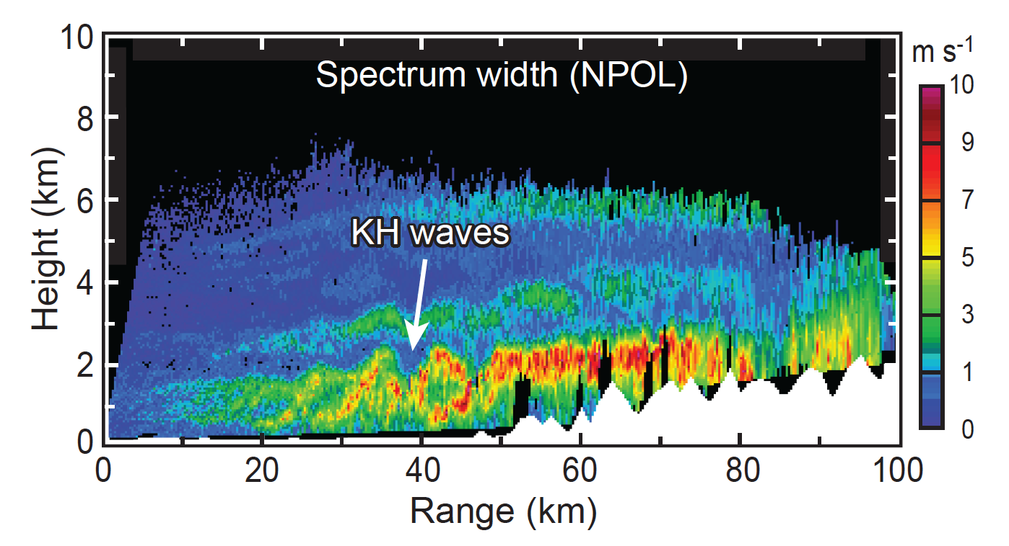
5 December 2015
1600 UTC 05 December

Slide 19
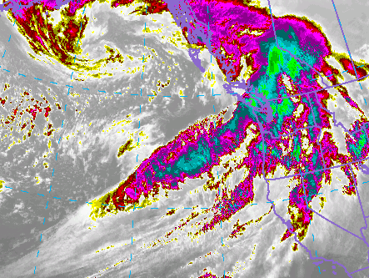

8 December 2015
1600 UTC 08 December

Slide 20
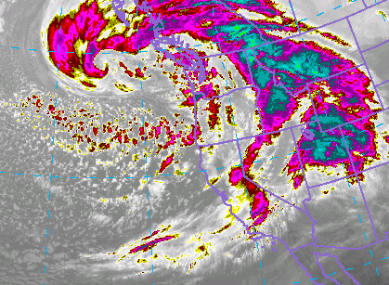

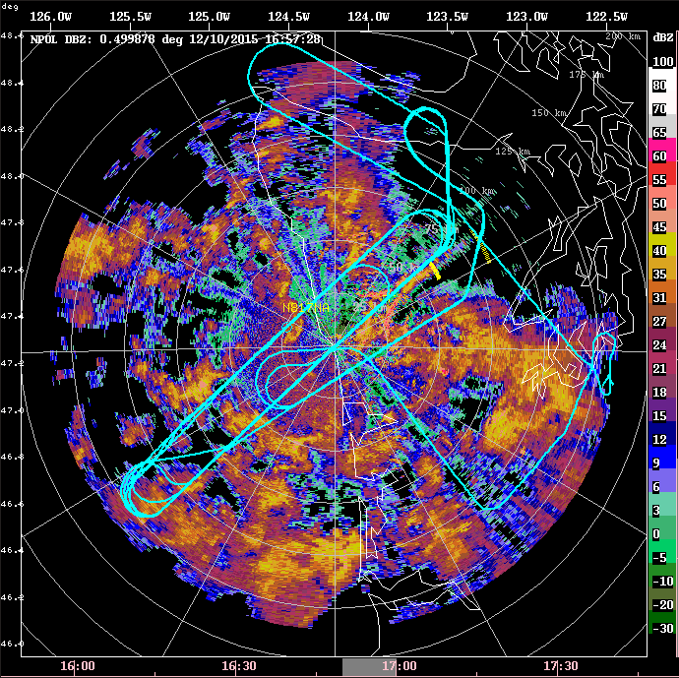
10 December 2015
1700 UTC 10 December

Slide 21
11 – 18 December Period
Dates | Synopsis | Flights | Sector
Dec 12 | Occluded front, warm sector | DC-8, ER-2, UND | Occluded front, warm
Dec 13 | Postfrontal showers | DC-8,ER-2, UND | Postfrontal
Dec 18 | Complex storm, Chehalis flood | DC-8, UND | Pre-frontal, frontal
Dec 19 | Postfrontal, GPM | DC-8, UND | Postfrontal

Slide 22
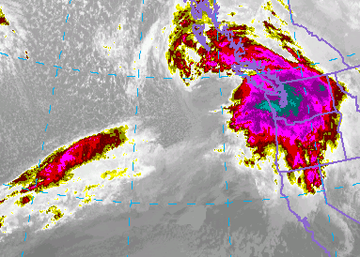


12 December 2015
1800 UTC 12 December

Slide 23



13 December 2015
1800 UTC 13 December

Slide 24




18 December 2015
0600 UTC 18 December

Slide 25



19 December 2015
0300 UTC 19 December
The Simone Special

Slide 26
Summary
About 12 different synoptic systems sampled
Prefrontal and warm sector flights = 8
Frontal passages = 2, waves = 4
Postfrontal flights = 6
Much more of everything sampled by radar and ground network
Can revisit these snapshots when we talk about potential cases

Slide 27
Acknowledgments
Work supported by:
NASA grants NNX15AL38G, NNX16AD75G and NNX16AK05G
NSF grant AGS-1503155

Slide 28
OLYMPEX Scorecard
Dates | Synopsis | Flights | Sector
Nov 12 | Very warm AR storm. GPM | DC-8, UND | Prefrontal, warm
Nov 13 | Same storm, NCFR | DC-8, UND | Warm, cold front
Nov 14 | Frontal wave, Chehalis, GPM | DC-8, UND | Warm, frontal wave
Nov 18 | Weak postfrontal, midclouds | DC-8, ER-2, UND | Post-, pre-frontal
Nov 23 | Weak CF, low melting level | DC-8, ER-2, UND | Prefrontal, frontal
Nov 24 | Postfrontal, cold air outbreak | DC-8, ER-2, UND | Post-front, orographic
Nov 25 | Calibration | DC-8 | Clear air
Dec 1 | Weak storm, strat., orographic | DC-8, ER-2, UND | Prefront, warm, waves
Dec 3 | Complex storm, oro. GPM | DC-8, ER-2, UND | Prefront, warm, waves
Dec 4 | Postfrontal | DC-8, ER-2-UND | Postfrontal
Dec 5 | Warm advection, prefrontal | DC-8, ER-2, UND | Prefrontal, warm
Dec 8 | Warm AR storm, flooding, GPM | DC-8, ER-2 | Prefront, warm, waves

