Slide 1
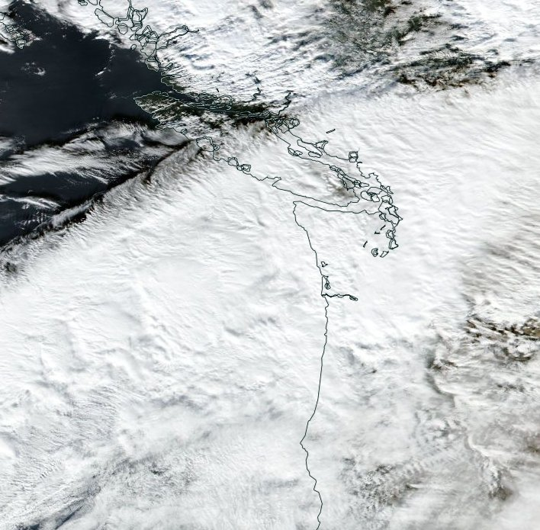
Airborne Doppler radar observations of mid-latitude storms during OLYMPEX
Jennifer DeHart and Robert Houze
Pacific Northwest Weather Workshop
3.3.17
NASA grants: NNX15AN52H, NNX13AG71G, NNX15AL38G, NNX16AD75G
NSF grant: AGS-1503155

Slide 2
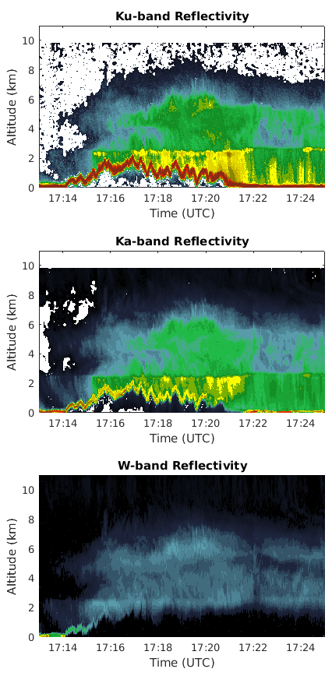

APR-3
NASA DC-8 equipped with the Advanced Precipitation Radar 3
Ku / Ka / W band
High vertical resolution
Goal: document structure around the Olympics and compare with surface measurements
Notes:
Same as GPM, mention

Slide 3
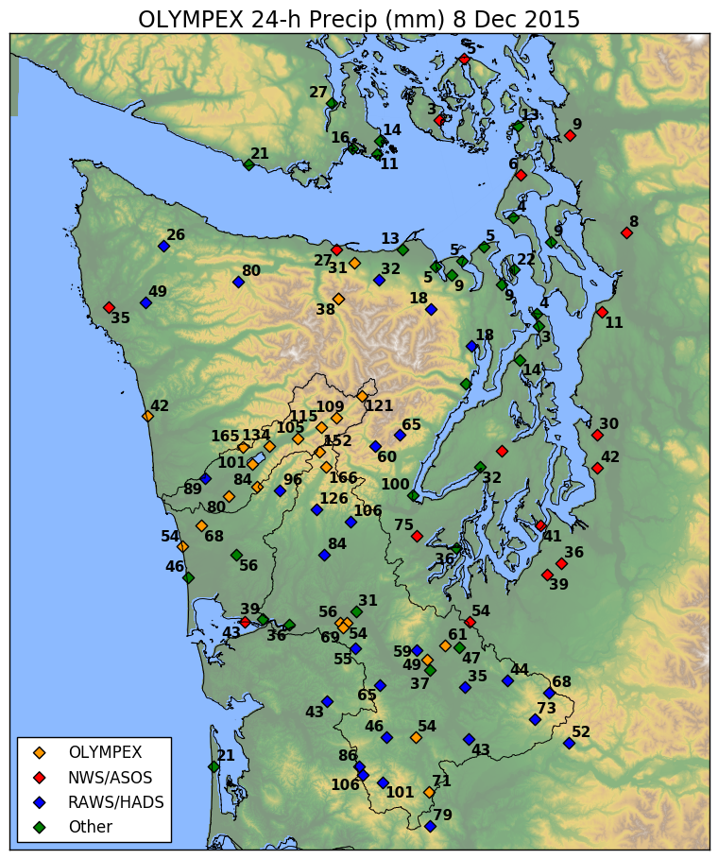
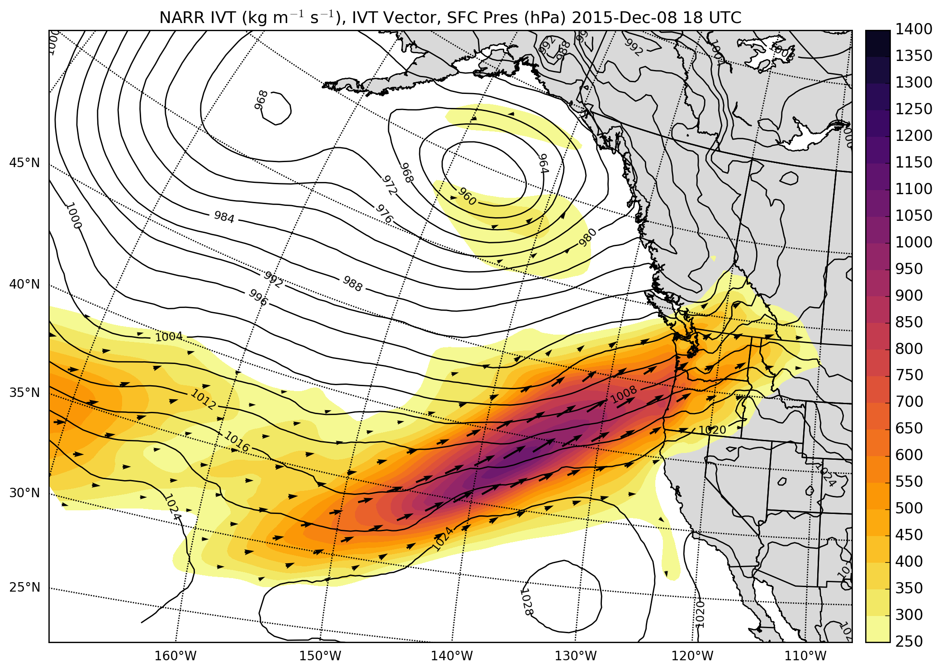
8 Dec. 2015
NARR integrated vapor transport and precipitation
c/o Joe Zagrodnik

Slide 4
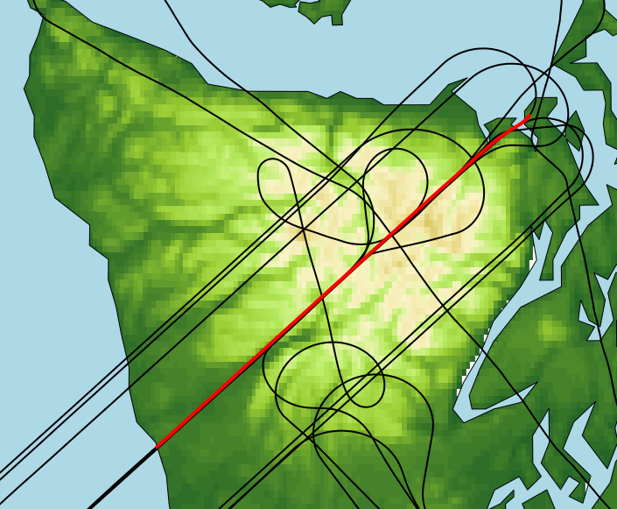
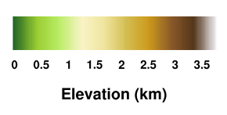
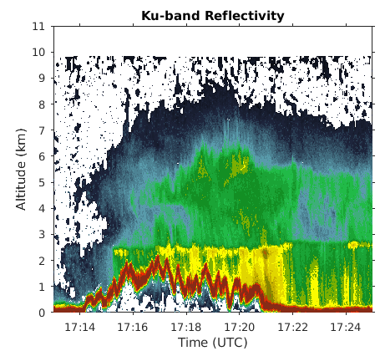
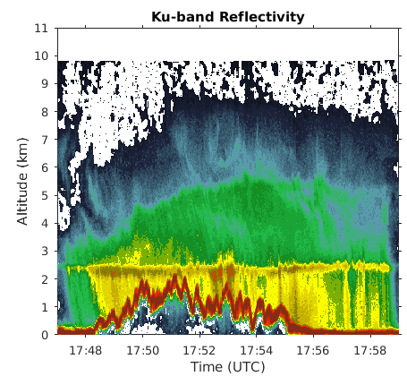
Data collection in remote regions
inland, valleys, high terrain, lee
Greatest enhancement near windward slopes
not highest terrain
Echo tops descend in lee
Windward
Windward

Slide 5
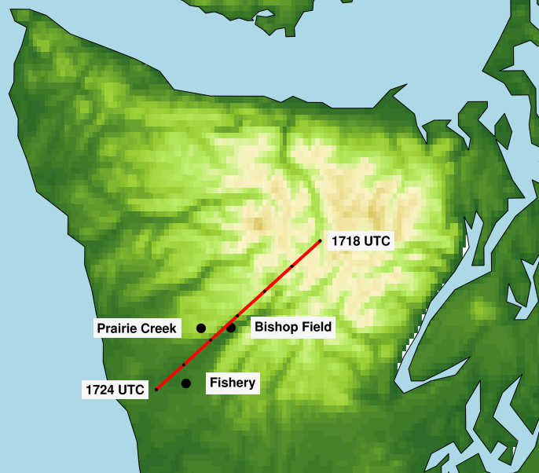
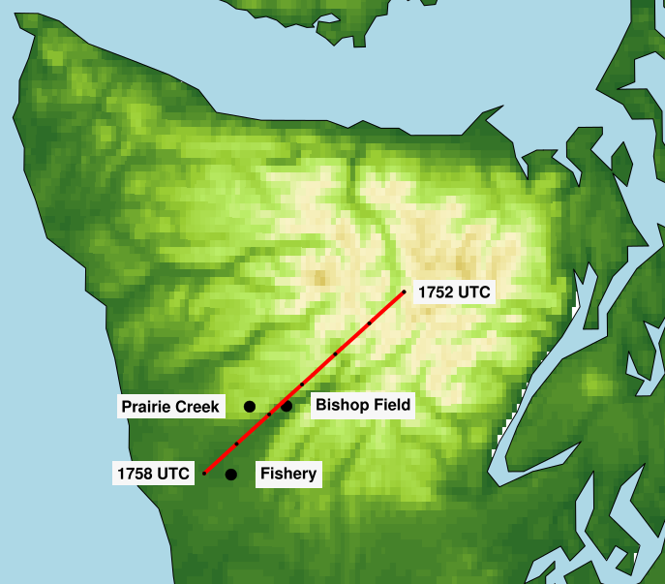
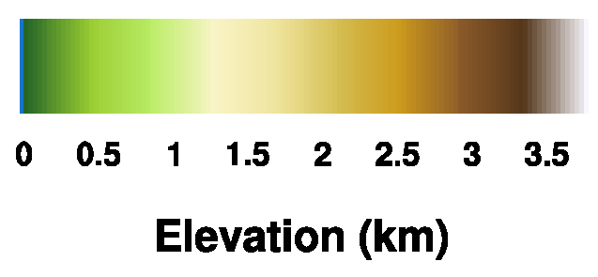
Zoom in on Quinault Valley
8 Dec

Slide 6
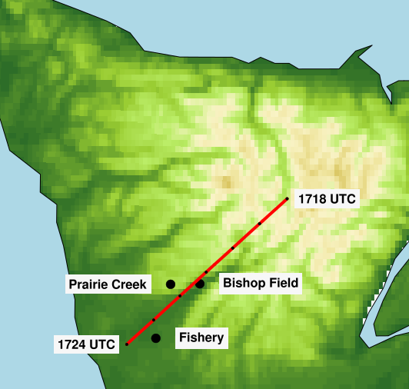
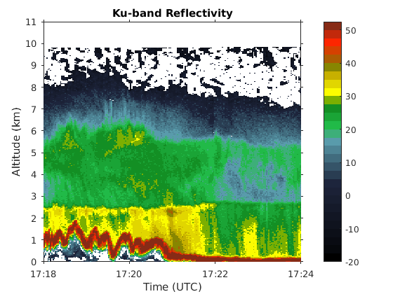
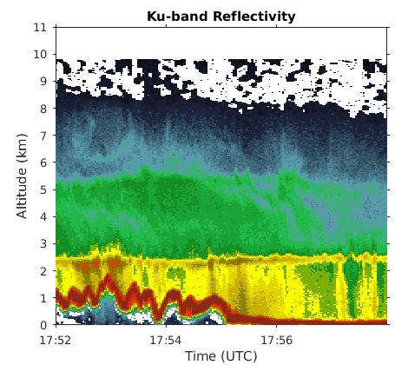
Enhancement occurs not only at low levels, but extends up through the bright band
Secondary maximum between 4 and 6 km
Windward
Windward

Slide 7
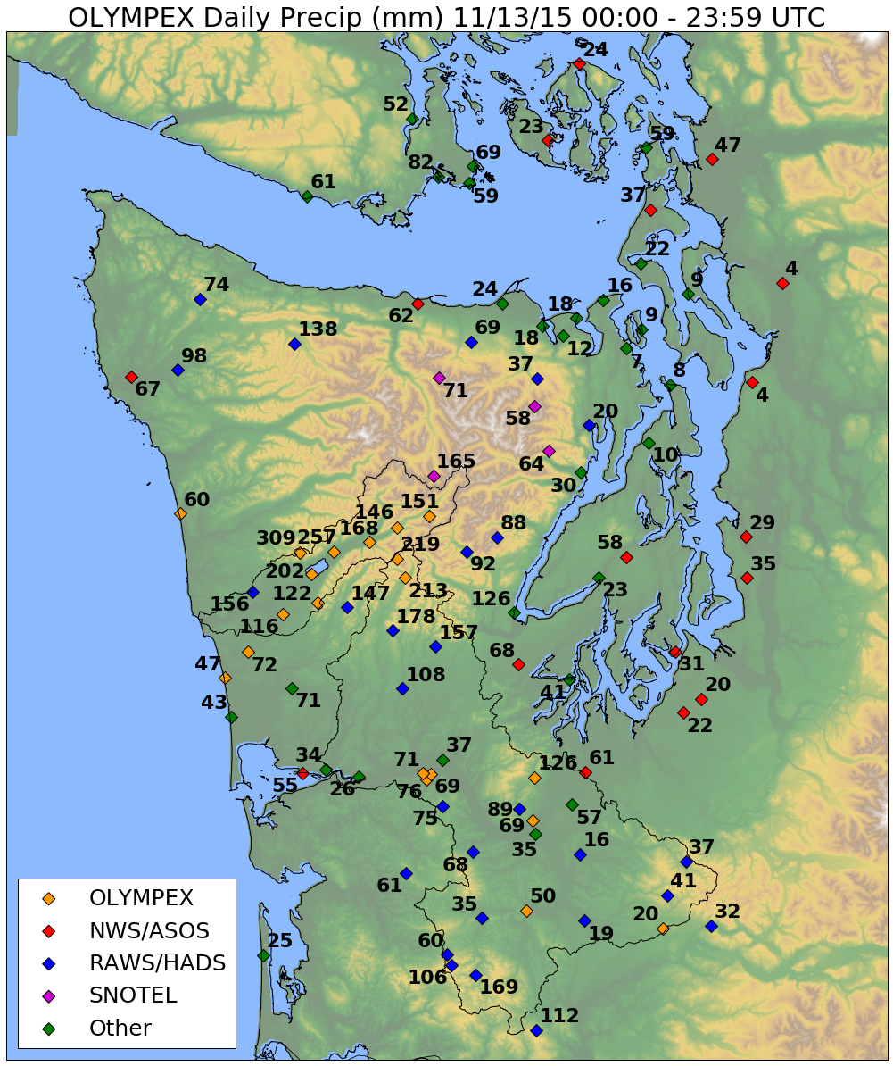
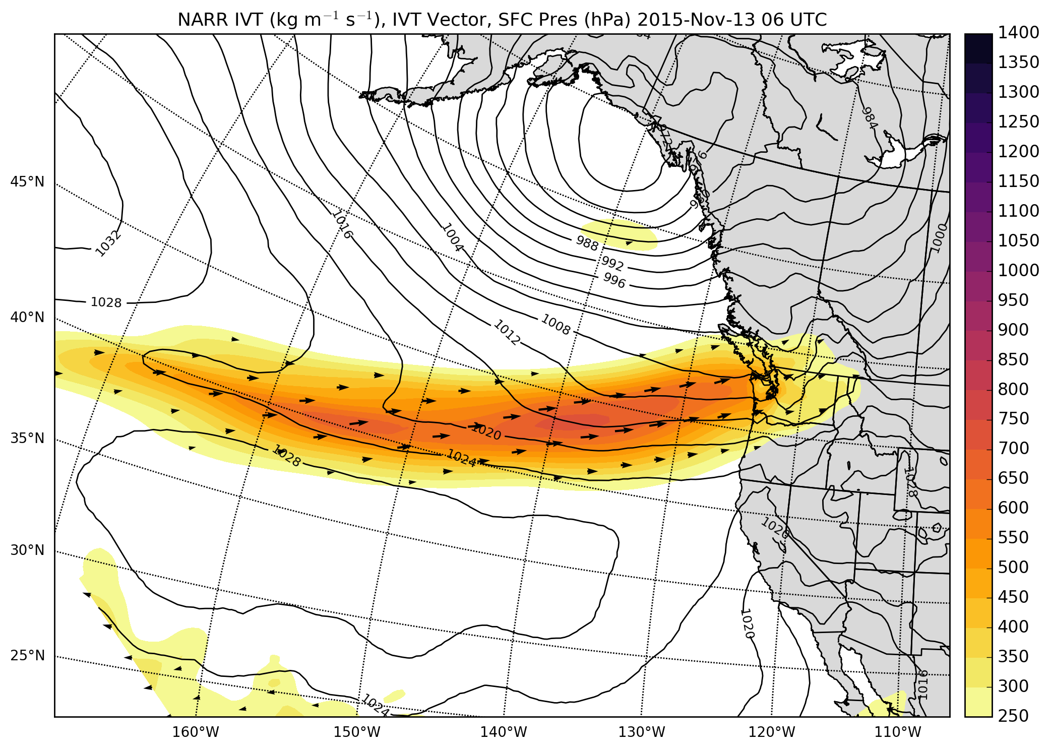
13 Nov. 2015
NARR integrated vapor transport and precipitation
c/o Joe Zagrodnik

Slide 8
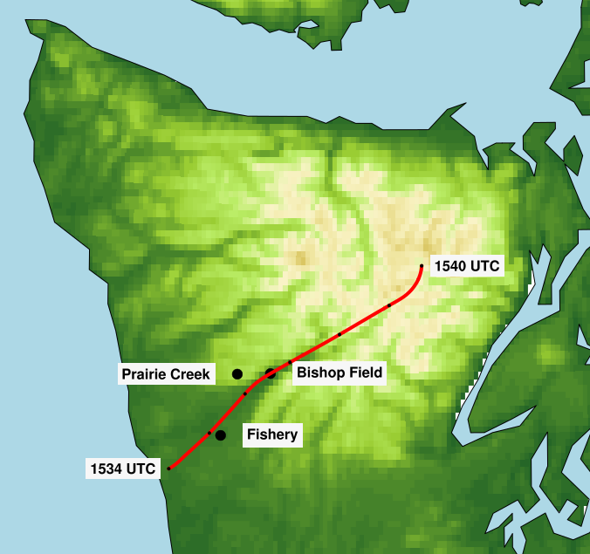
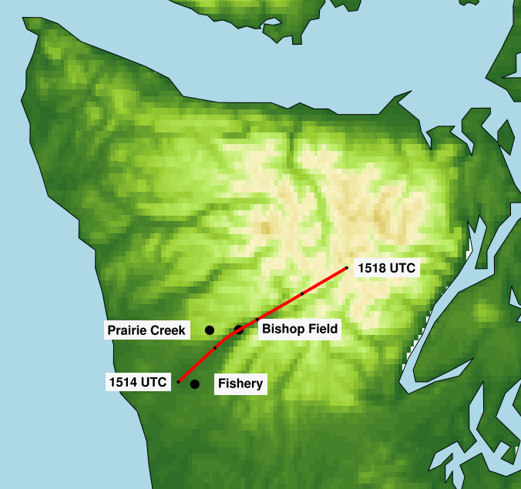
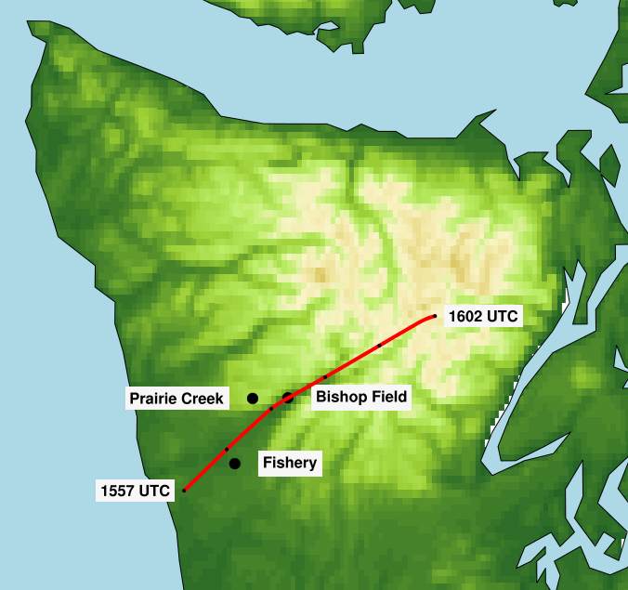
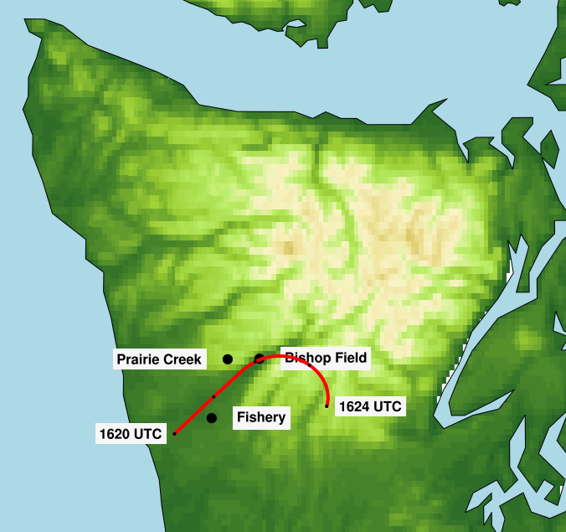
12 Nov

Slide 9
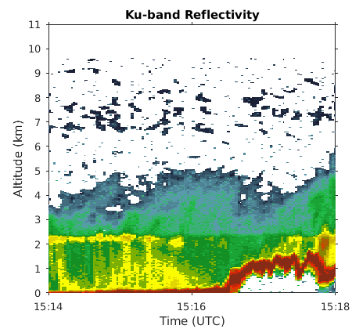
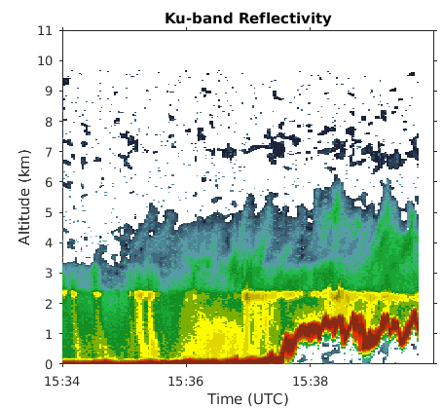
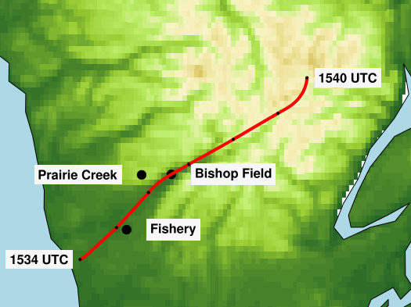
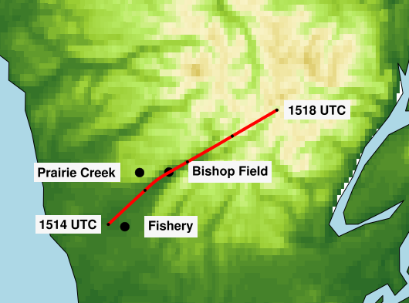
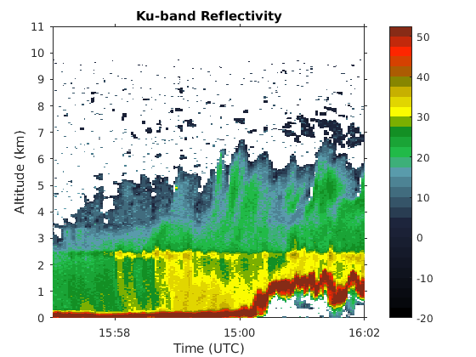
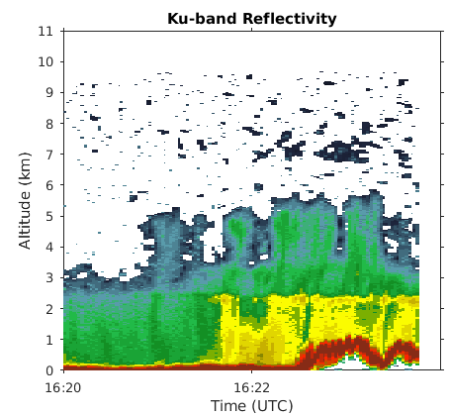
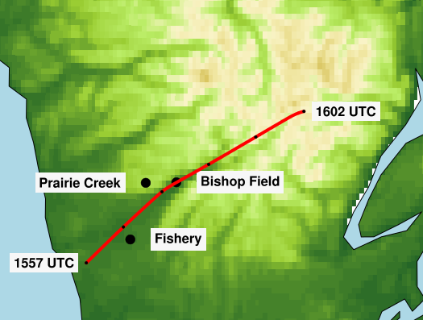
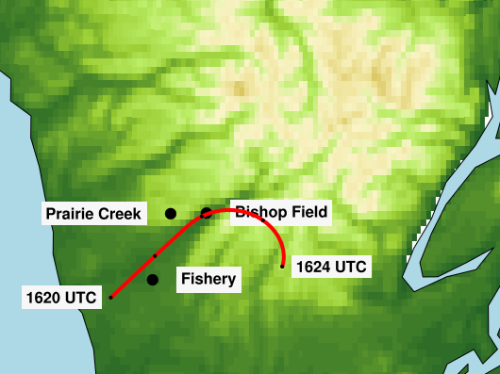

Slide 10
Different vertical structures
11/13
12/08
Low-level enhancement location similar
more intense on 12/08
lies below bright band on 11/13

Slide 11
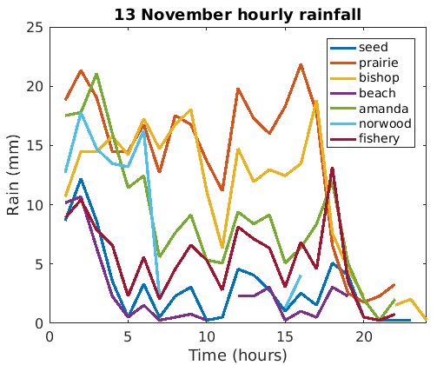
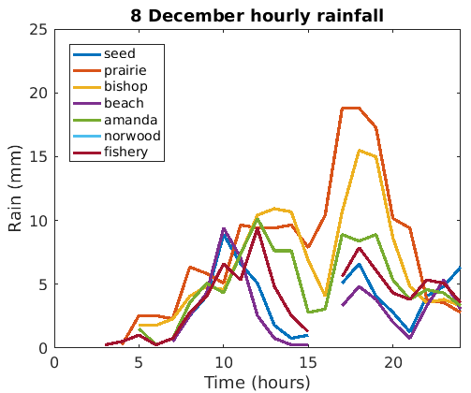
Surface rainfall
Rainfall similar on both days, despite radar reflectivity differences

Slide 12
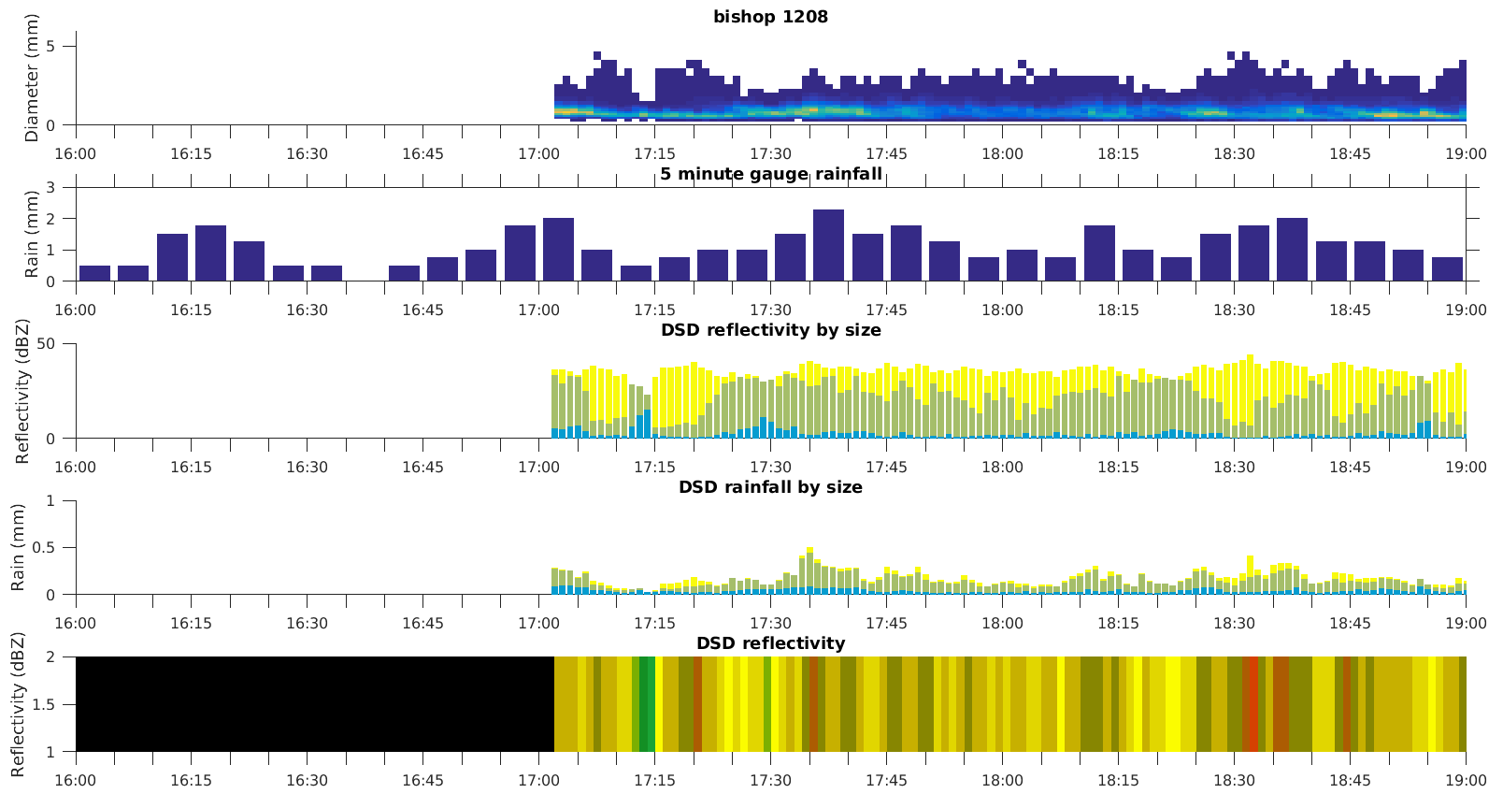
Reflectivity dominated by large diameter hydrometeors
Estimate reflectivity/rainfall from surface observations
Z and R are not perfectly correlated

Slide 13
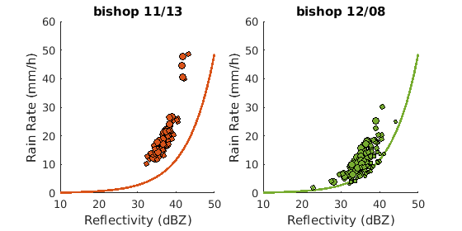
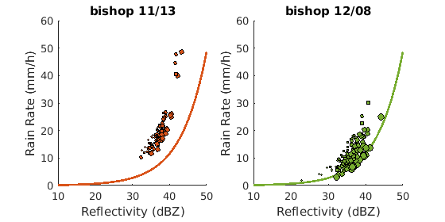
Fraction of medium drops (1-2 mm)
Fraction of large drops
(2-4 mm)

Slide 14
Conclusions
APR-3 provides view around the Olympic peninsula, especially over high terrain
Strong spatial and temporal variability, but enhancement preferentially along windward slopes
Radar cross-sections suggest that regimes dominated by small to medium drop growth may be underestimated by reflectivity

