Slide 1
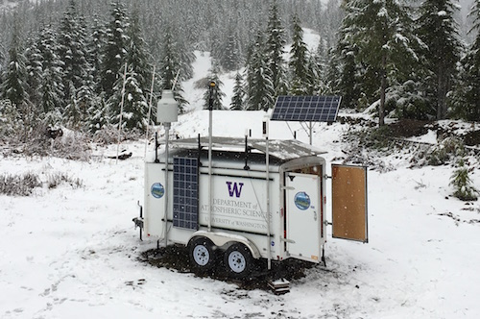
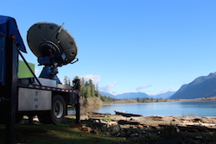
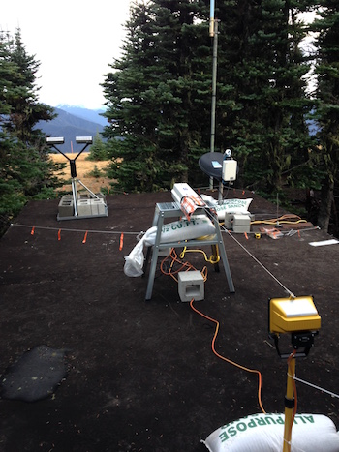



Preliminary results from the Olympic Mountains Experiment (OLYMPEX): Stratiform Precipitation Processes in Pacific Cyclones Passing over the Olympic Mountains
Lynn McMurdie, Robert A. Houze, Jr., and Joseph Zagrodnik University of Washington
AMS Seattle, 26 January 2017
Zagrodnik et al., 2017

Slide 2
Flow Regimes During OLYMPEX Intensive Field Phase
Notes:
Bob has given the overview of OLYMPEX

Slide 3
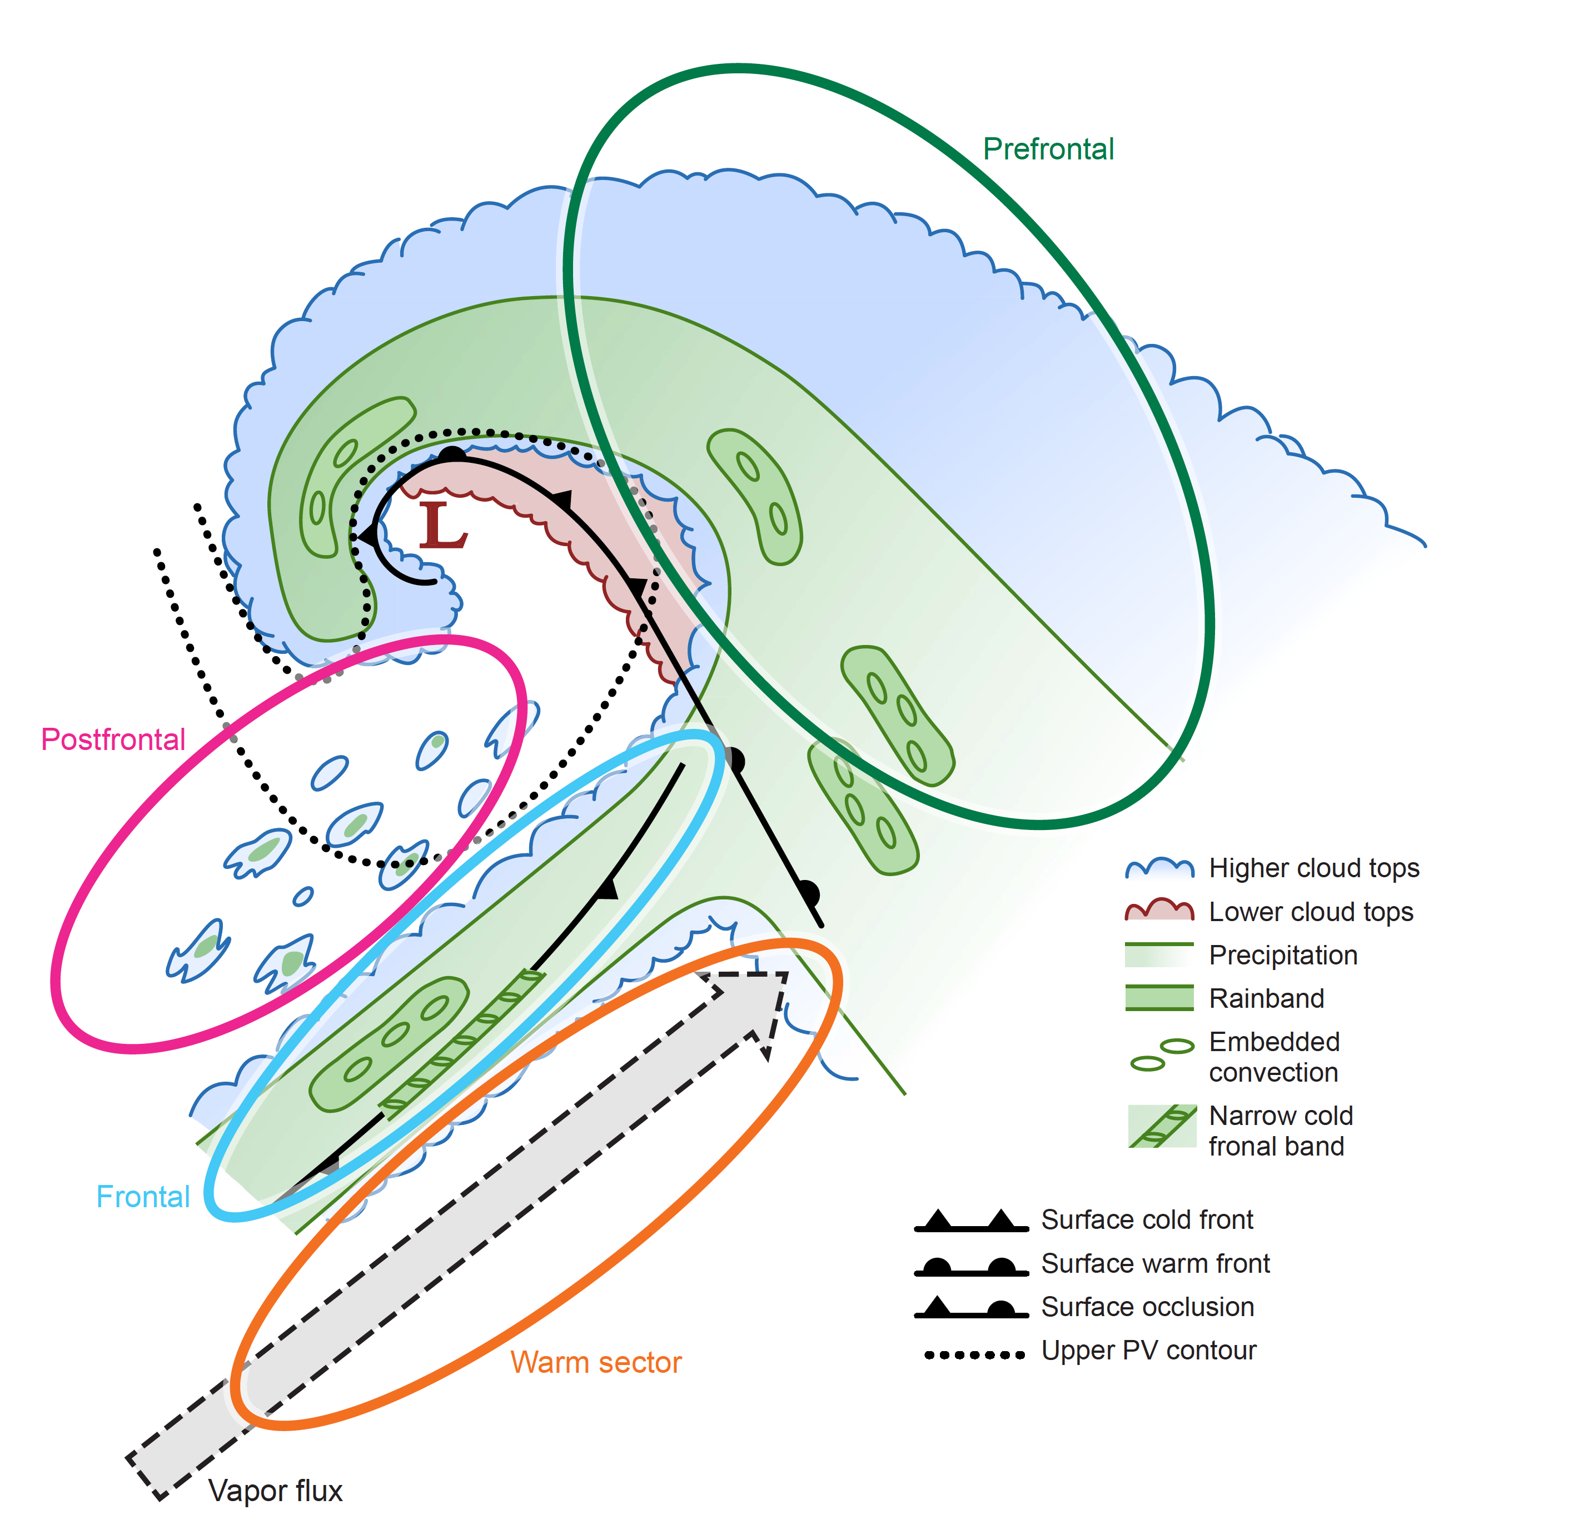
Storms sampled during OLYMPEX ~homogeneous facilitating statistics
OLYMPEX sampled many (~65) frontal systems Oct 2015 – April 2016
5 atmospheric river events
all have stratiform portions (prefrontal, warm sector, frontal)
Notes:
The dataset collected was not only huge…but also…homogeneous…facilitating…statistics
Storms passing over the OLYMPEX area all had a variation of this idealized structure…consisting of characteristic sectors…(describe)

Slide 4

This Presentation:
Relate the environmental factors affecting orographic enhancement to precipitation processes in these storms:
  Flow characteristics
    Upper level flow – steering of the storm system
    Low-level moist flow – how it impinges on Olympic Mountains
  Thermodynamic characteristics
    Melting level height
    stability
  Moisture/Cloud/Precipitation characteristics
    Depth of moist layer
    Dropsize distributions and rainfall distribution at variety of locations/elevations

Slide 5
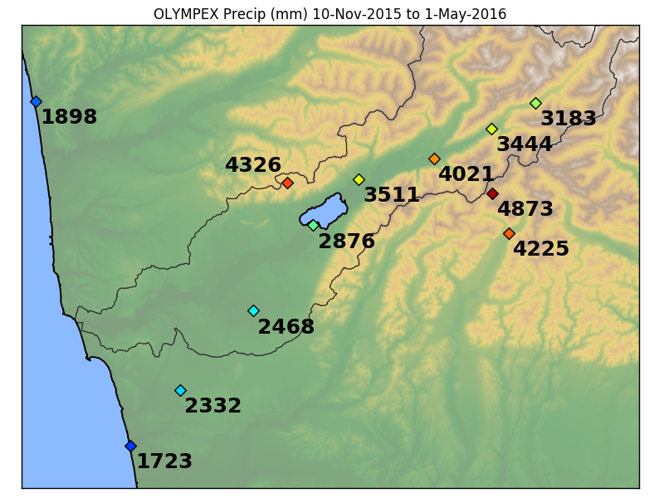
Seasonal Precipitation totals
Orographic enhancement factor
~ 1.5 – 2 from coast to inland
Prairie Creek – 540m
CRN – 115 m
Wynoochee 1000m
Beach House – 3 m

Slide 6
Focus on a subset of full season data: Steady rainy periods, mostly during prefrontal/warm sector portions
All storms Oct 7, 2015 – April 30 2016
Postfrontal and periods with < 1 mm/h rain rate at Prairie Creek removed.
3-hr periods of Parsivel, Rain Gauge, and NARR data for environmental parameters
North America Regional Reanalysis (NARR) data from the 32 km grid box closest to NPOL

Slide 7
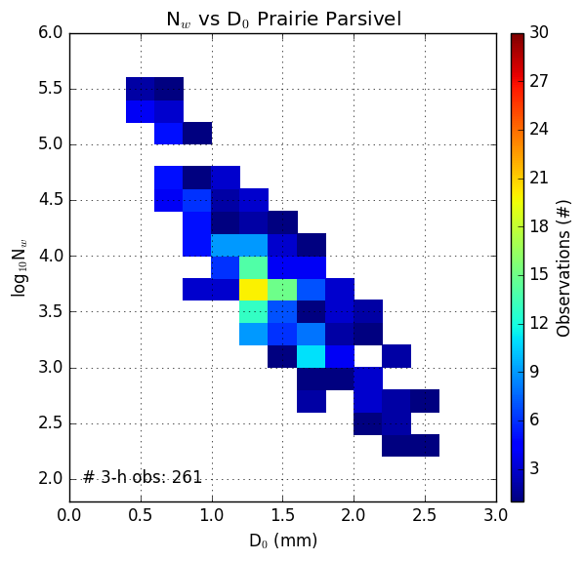
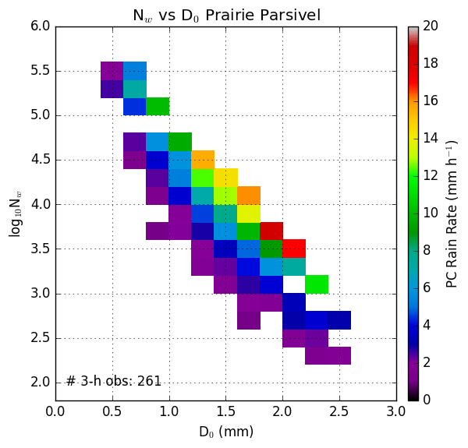
Dropsize Distributions: Diameter vs. Number
Frequency
Rainrate
Log of N_{w} – number of drops
Rain Rate – Prairie Creek
Log of N_{w} – number of drops
D_{o} Median Diameter (mm)
D_{o} Median Diameter (mm)
These are for Prairie Creek (540 m). Low elevation stations similar plots, but lower rainrates and fewer instances of the extremes

Slide 8
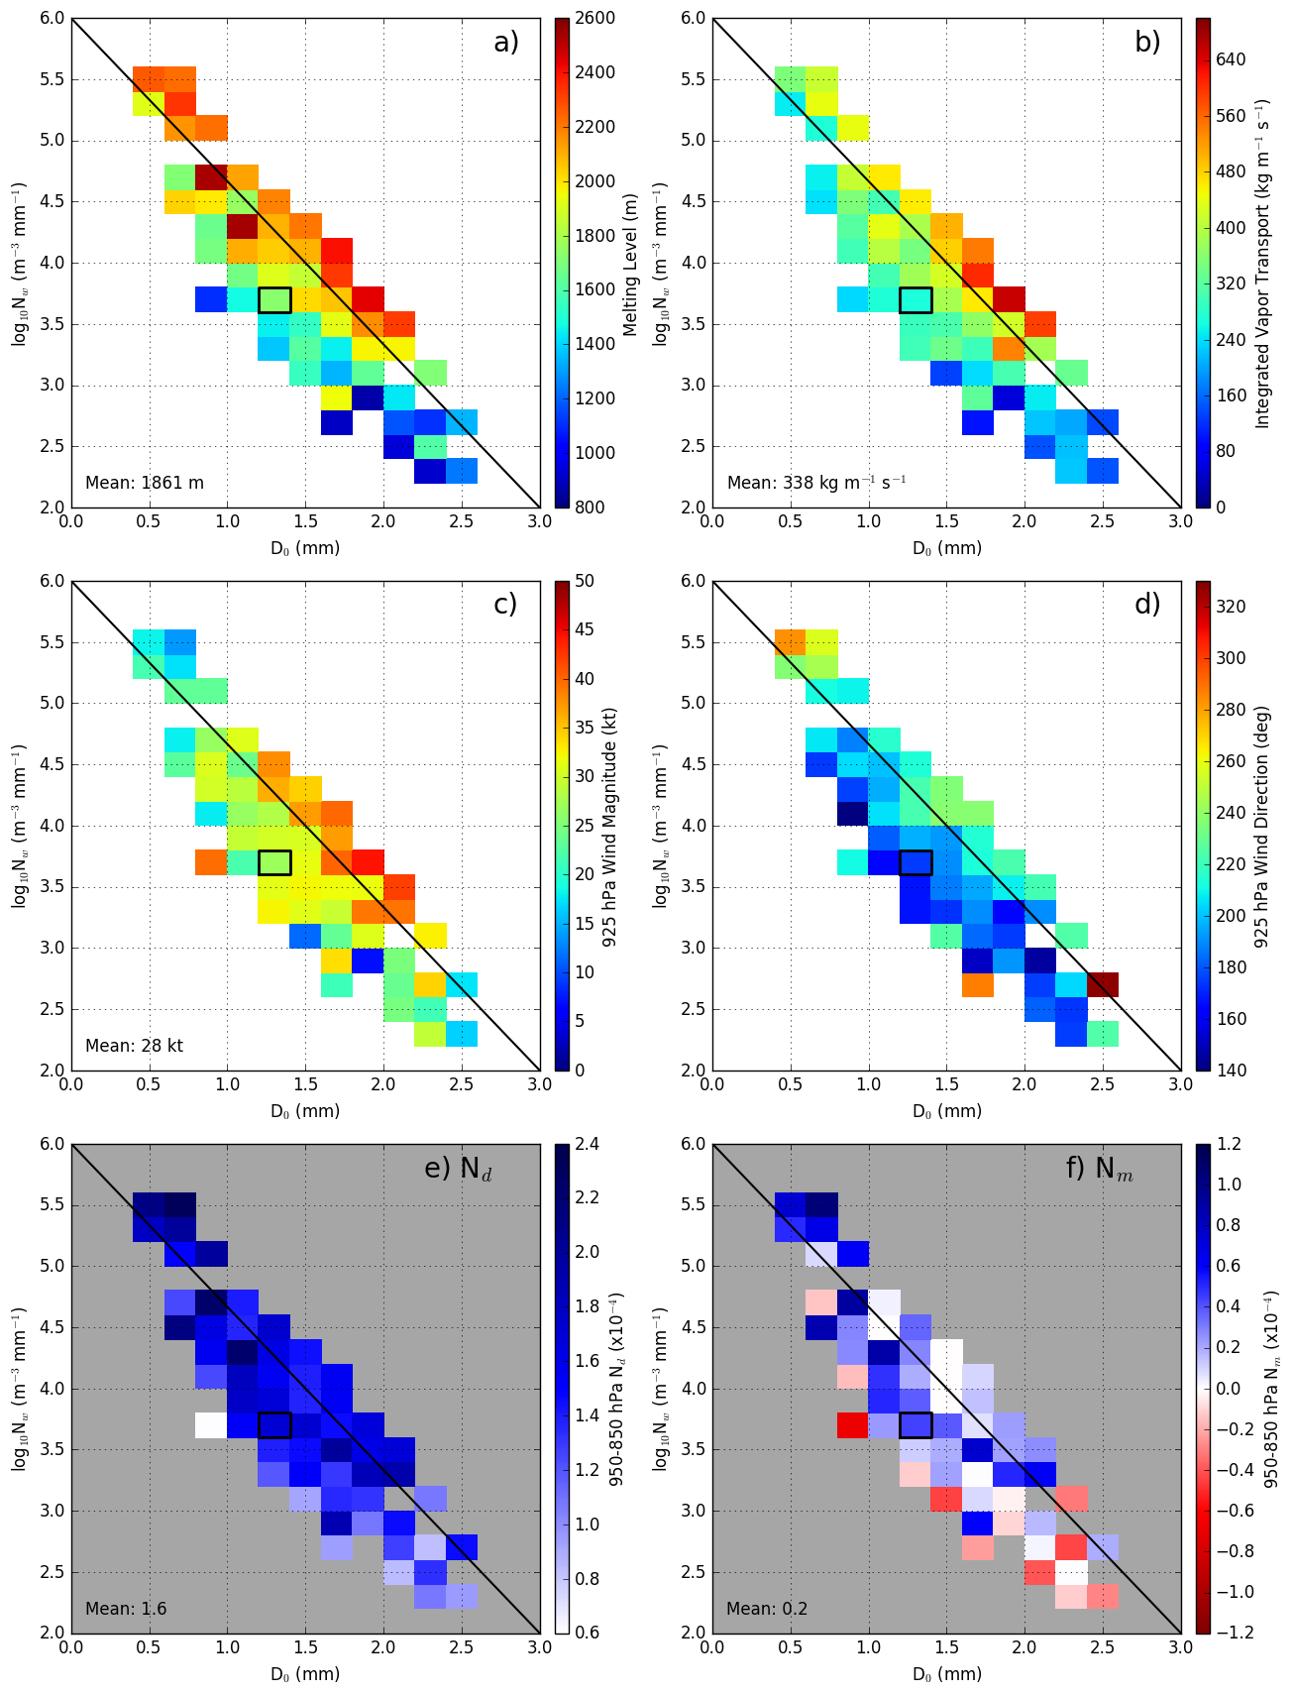
Melting Level
925H Wind Speed
Dry Static Stability
Log of N_{w} – number of drops
D_{o} Median Diameter (mm)
IVT
925H Wind Direction
Moist Static Stability
Average Conditions
Lots of Small drops
Few large drops
Heavy Rain

Slide 9
The high rain rate, high melting level, high IVT, moist neutral and strong winds at 925 hPa periods tend to be associated with atmospheric river type storms. Now will look at an example storm.

Slide 10
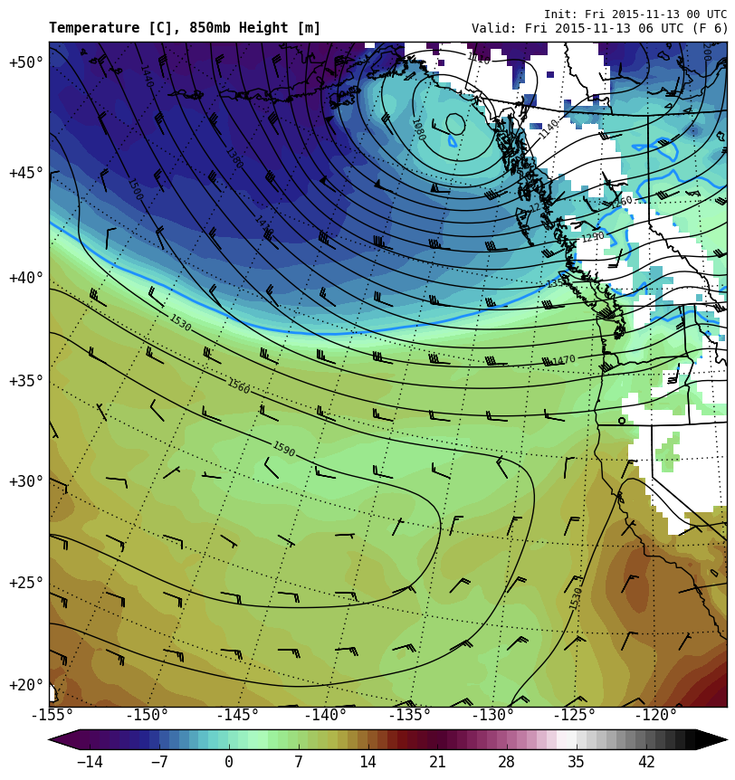
12 – 13 November 2015
850 hPa Heights + Temp
0600 UTC 13 Nov
Strong low-level onshore flow. Very warm airmass

Slide 11
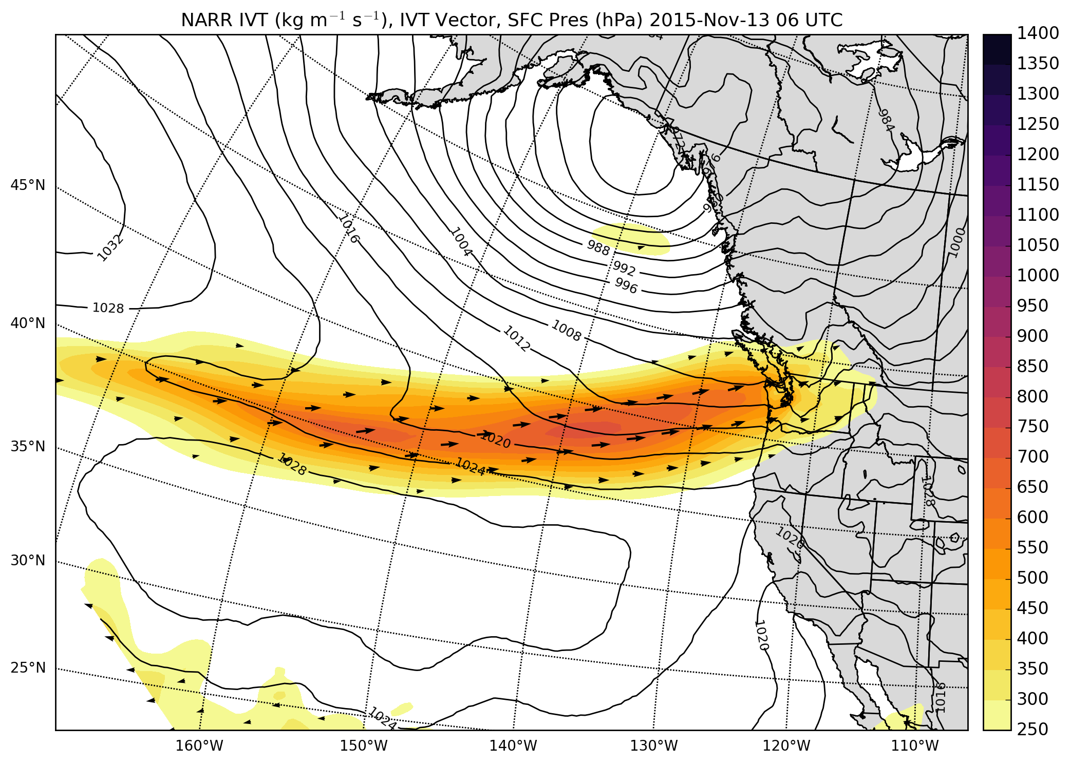
12 – 13 November 2015
Integrated Vapor Transport
Strong vapor transport

Slide 12
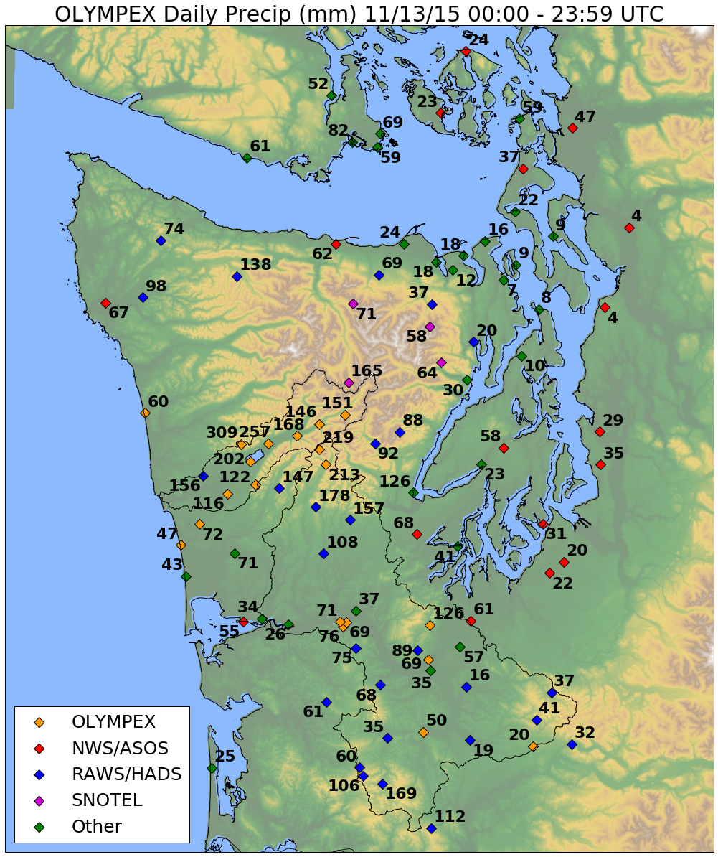
12 – 13 November 2015
Observed Precipitation Totals – Nov 13
High Terrain less than forward slopes
Factor 4 -5 Enhancement
Different than seasonal norm
Next plot of DSD from Prairie Creek site located here – elevation 540 m

Slide 13
12 – 13 November 2015
During the course of one event – Dropsize Distributions can shift from one regime to another

Slide 14
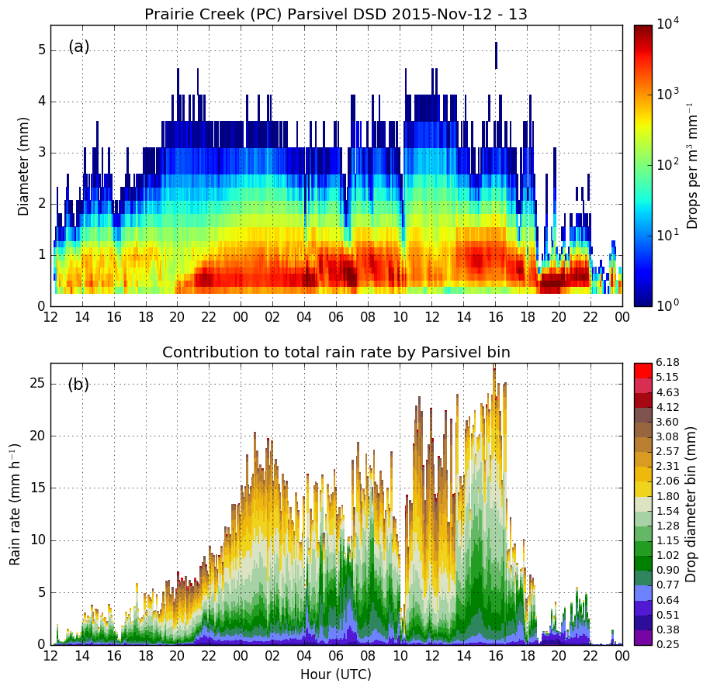
12 – 13 November 2015
Warm Sector
Increase in rain rate due to increase of small drops
Locations near coast do not have this increase of small drops in warm sector

Slide 15
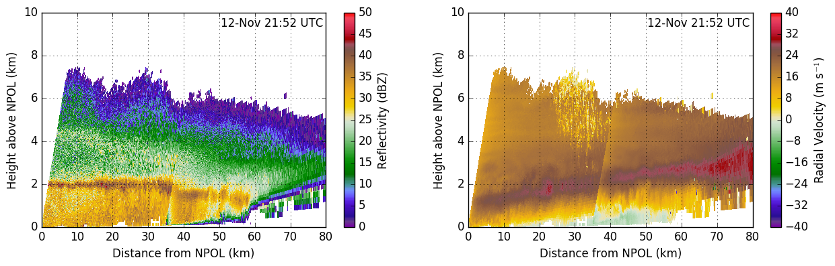
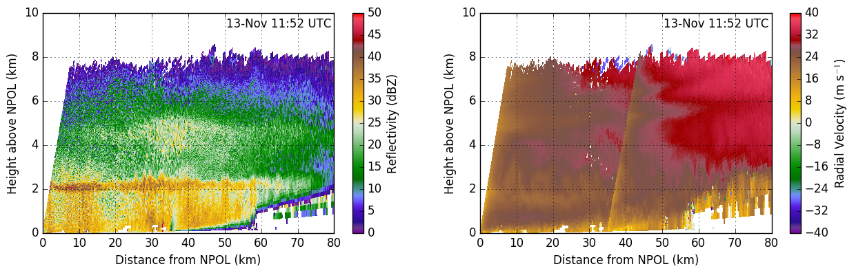
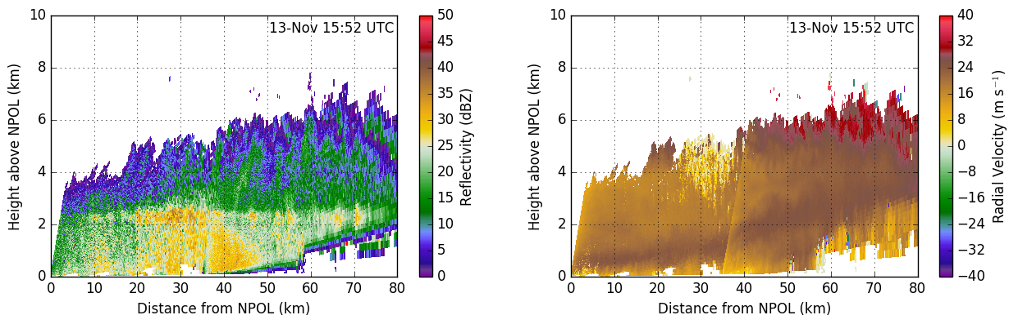
(a) (b)
NPOL+DOW
Prefrontal – low-level offshore flow
(c) (d)
Warm Sector during period of big drops – secondary enhancement at 4km
(e) (f)
Warm Sector during period of small drops – low level jet lifting
Brightband
Notes:
Figure RHI: Combined NPOL-DOW RHI images of reflectivity (a,c,e,g) and radial velocity (b,d,f,h) for (a-b) 12-Nov 21:52 UTC, (c-d) 13-Nov 06:52 UTC, (e-f) 13-Nov 11:52 UTC, and (g-h) 13-Nov 12:52 UTC. The NPOL RHI is the 52 degree azimuth and the DOW RHI is the 58.4 degree azimuth.

Slide 16
Summary
Average conditions – moderate melting level, low IVT, moderate 925hPa flow from south, stable
Period of Lots of Little Drops – high melting level, low IVT, weak 925hPa flow from SW, stable (NOT convective)
Periods with Few Big Drops – low melting level, low IVT, average-strong 925hPa flow from several directions, conditionally unstable
Periods of heavy rain – high melting level, high IVT, strong 925hPa from southwest, moist neutral
AR events have both ice-phase and warm process (due to lifting below brightband) PSDs

Slide 17
Acknowledgments
Work supported by:
NASA grants NNX15AL38G, NNX16AD75G and NNX16AK05G
NSF grant AGS-1503155

