Slide 1
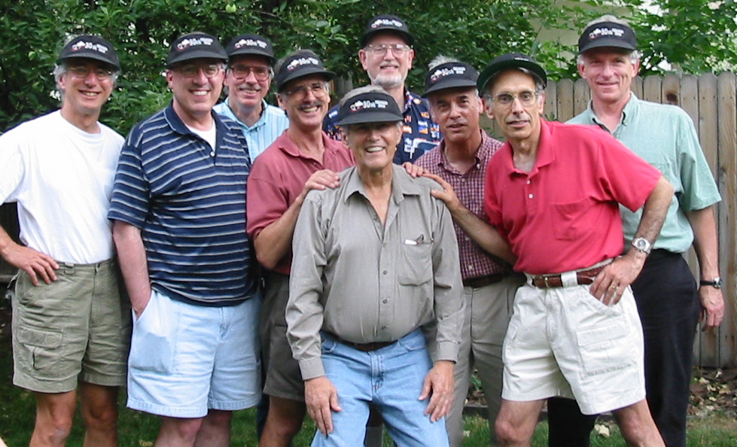
Lance Bosart's Influence on a Mesoscale Researcher: A Personal Note
Bluestein
Bosart
Zbar
Houze
Brown
Trenberth
Mudrick
Tracton
Burpee
2003

Slide 2
Nuggets of wisdom from Lance the student

Slide 3
“They don’t know any more than you do.”

Slide 4
“Just pay attention!”

Slide 5
2010
PREDICT/GRIP/IFEX
A Tropical Cyclone Genesis Field Study
Focused on tropical cyclones forming from African easterly waves moving WESTWARD over the Atlantic
Notes:
Focus was on tropical cyclones forming from African easterly waves—moving WESTWARD over the Atlantic

Slide 6
genesis
origin
Griffin and Bosart, AMS, 2013

Slide 7
Griffin and Bosart, AMS, 2013

Slide 8
Griffin and Bosart, AMS, 2013
Notes:
PKD could not be tracked back to Africa

Slide 9
Griffin and Bosart, AMS, 2013

Slide 10
Griffin and Bosart, AMS, 2013

Slide 11
Griffin and Bosart, AMS, 2013

Slide 12
My nugget:
Mesoscale analysts need to pay attention, too!

Slide 13
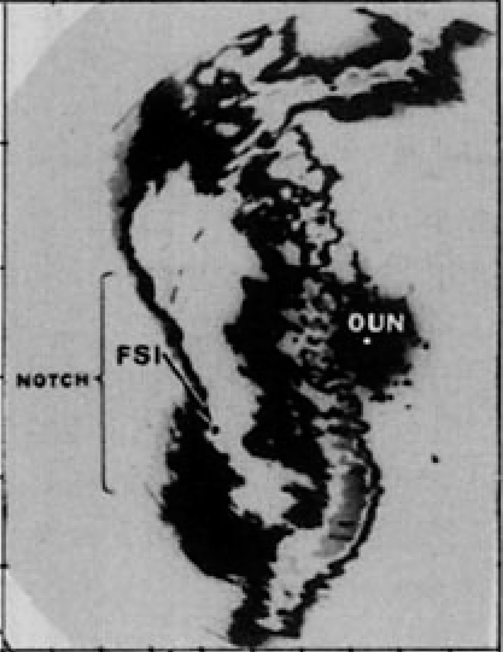

Slide 14
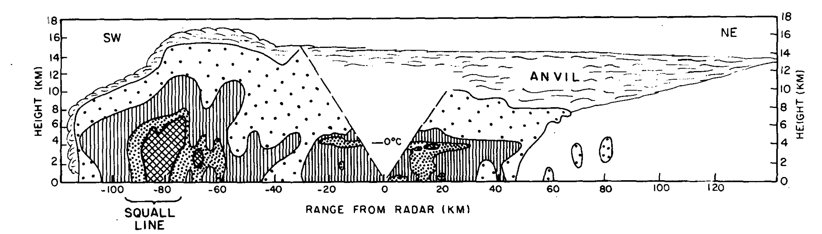
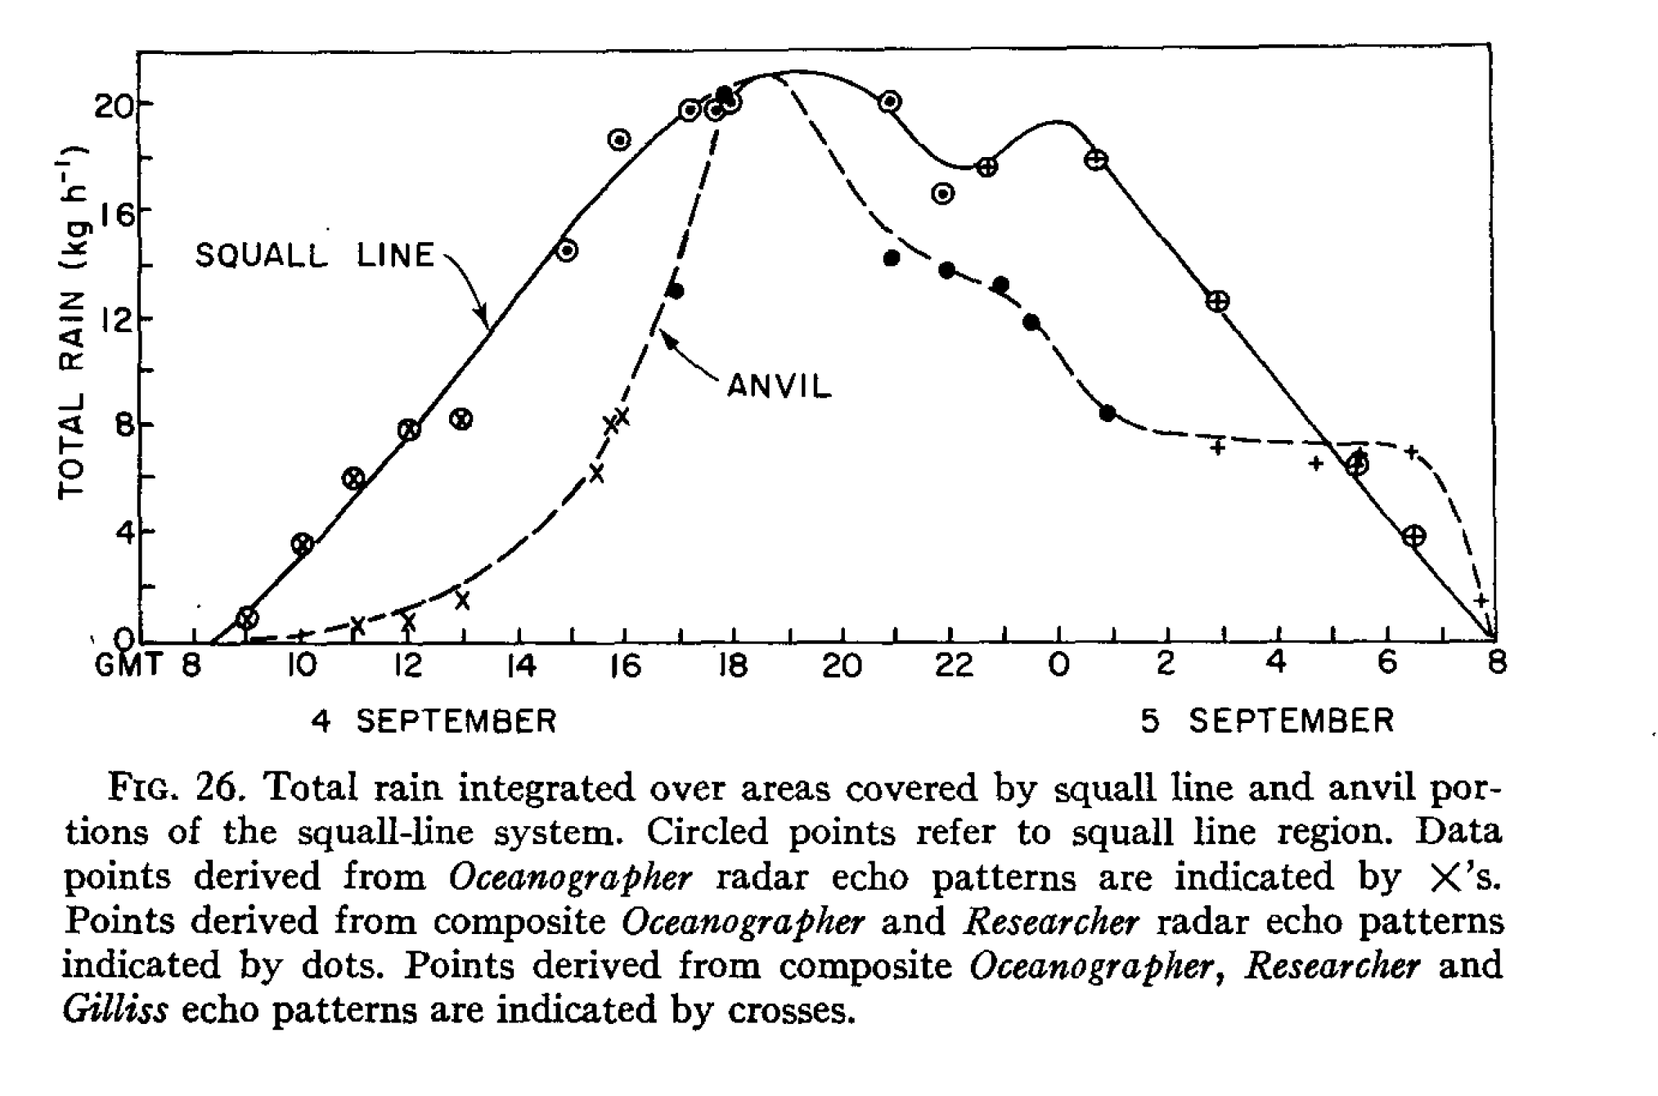
GATE 1974
Convective
rain
Stratiform
rain
Houze 1977

Slide 15
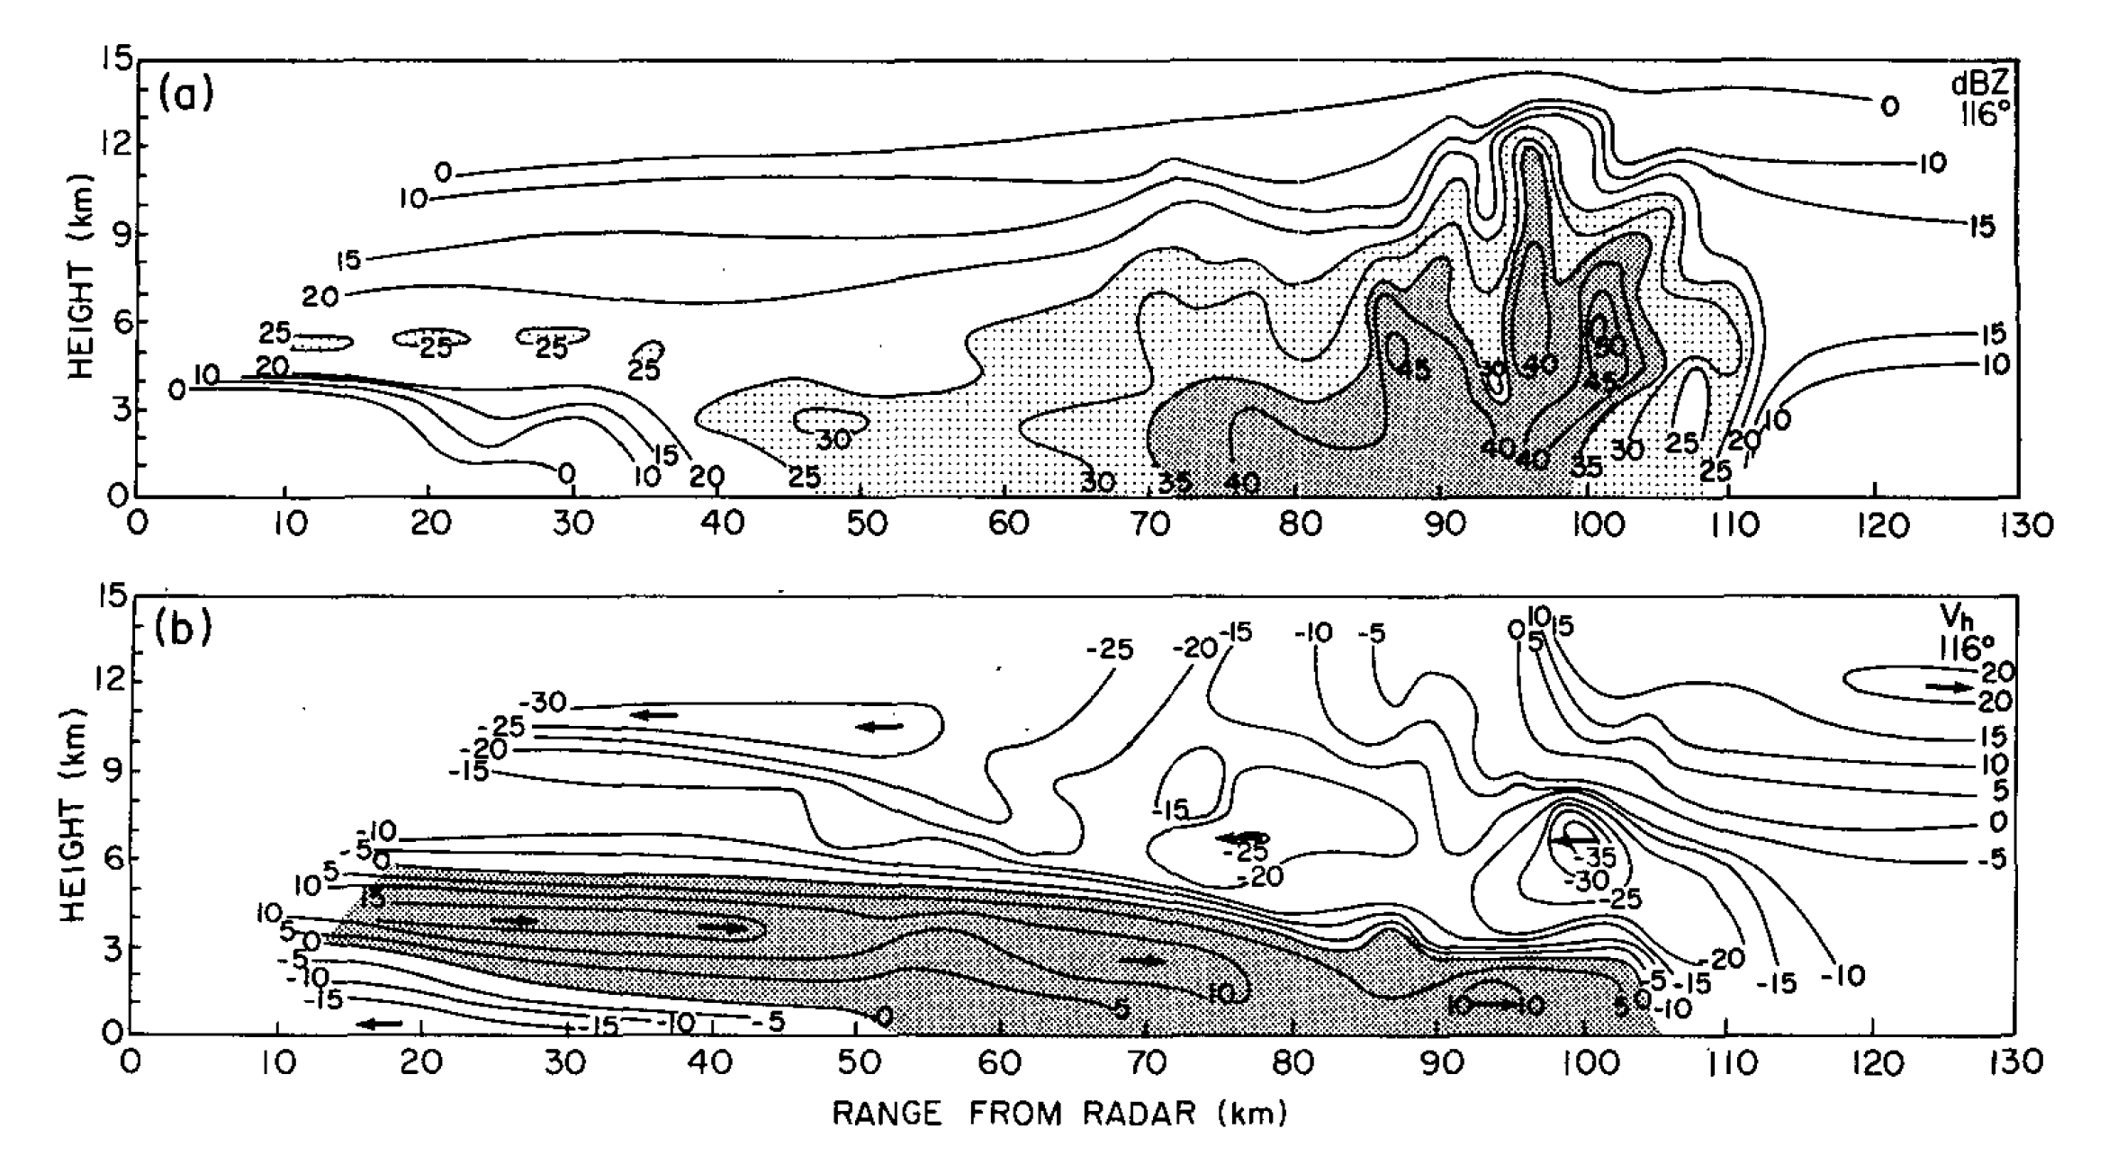
NSSL 1976
Rear inflow
Smull and Houze 1987

Slide 16
Conclusions
They don’t know anymore than you do.
Pay attention.
Smull and Houze 1987

Slide 17
End
Presented by Robert Houze
Bosart Symposium, AMS Annual Meeting, Seattle, 26 January 2017

Slide 20
Griffin and Bosart, AMS, 2013

Slide 24
Griffen & Bosart’s Conclusions

