Slide 1
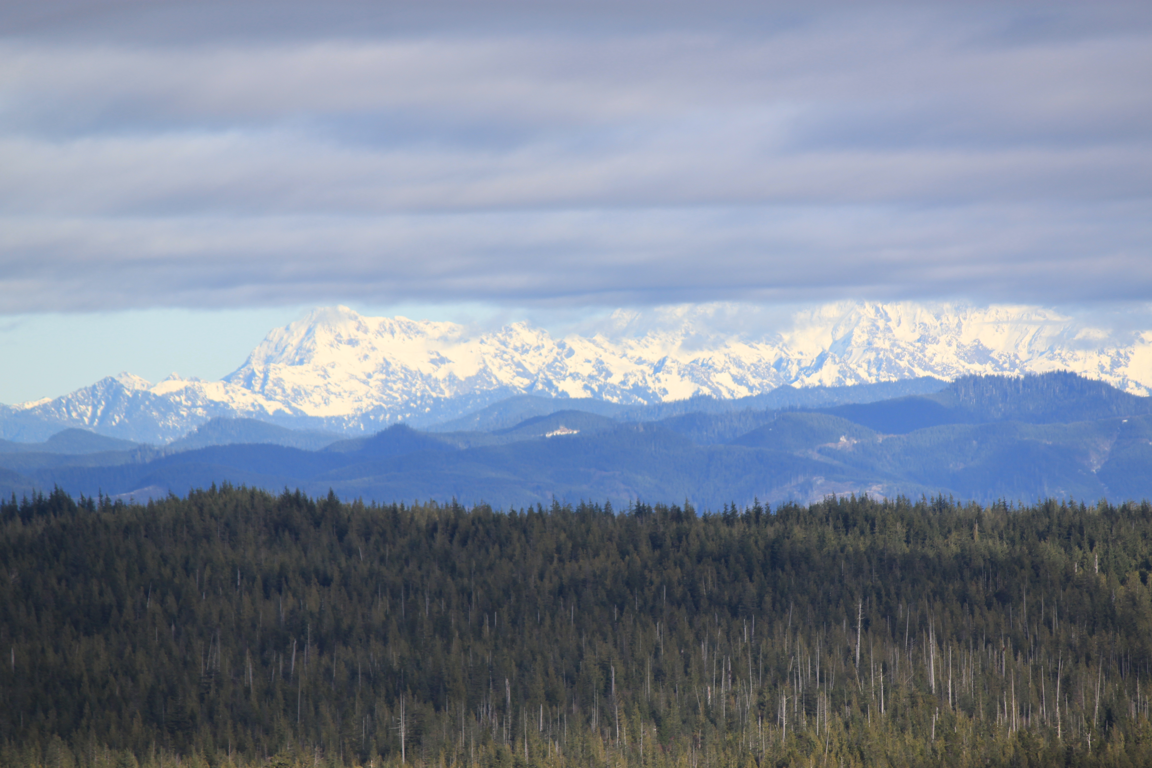
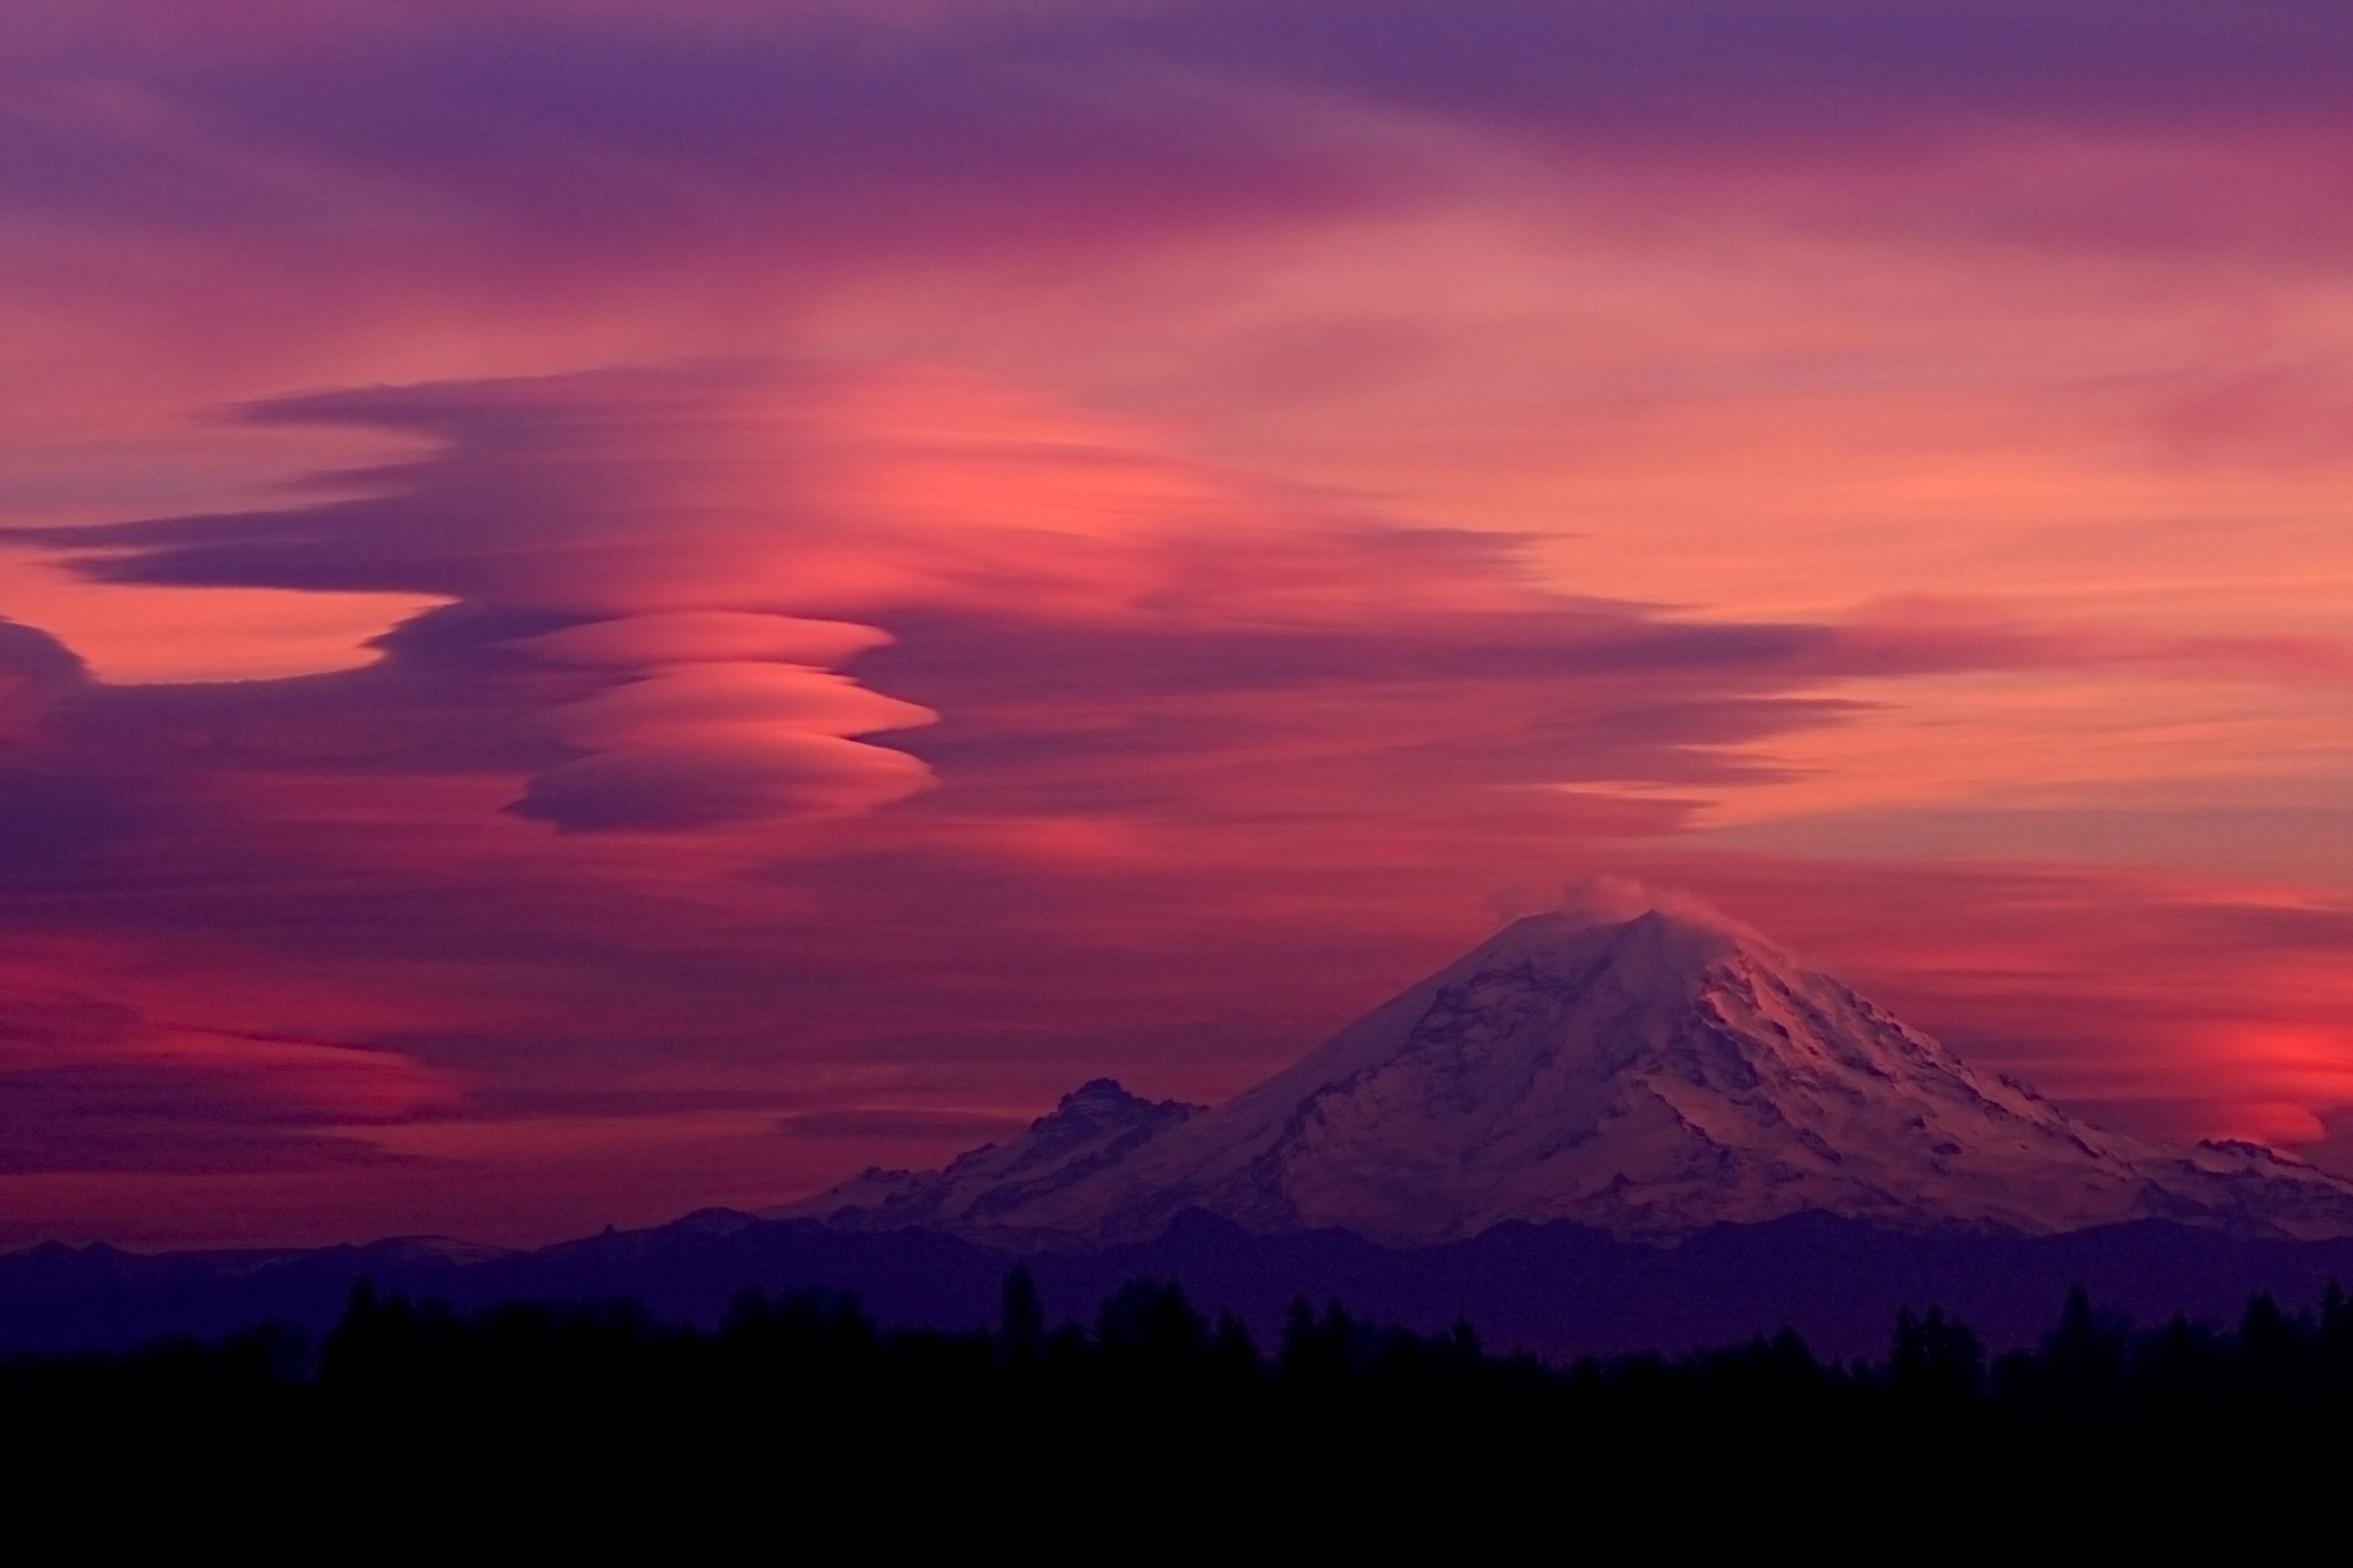
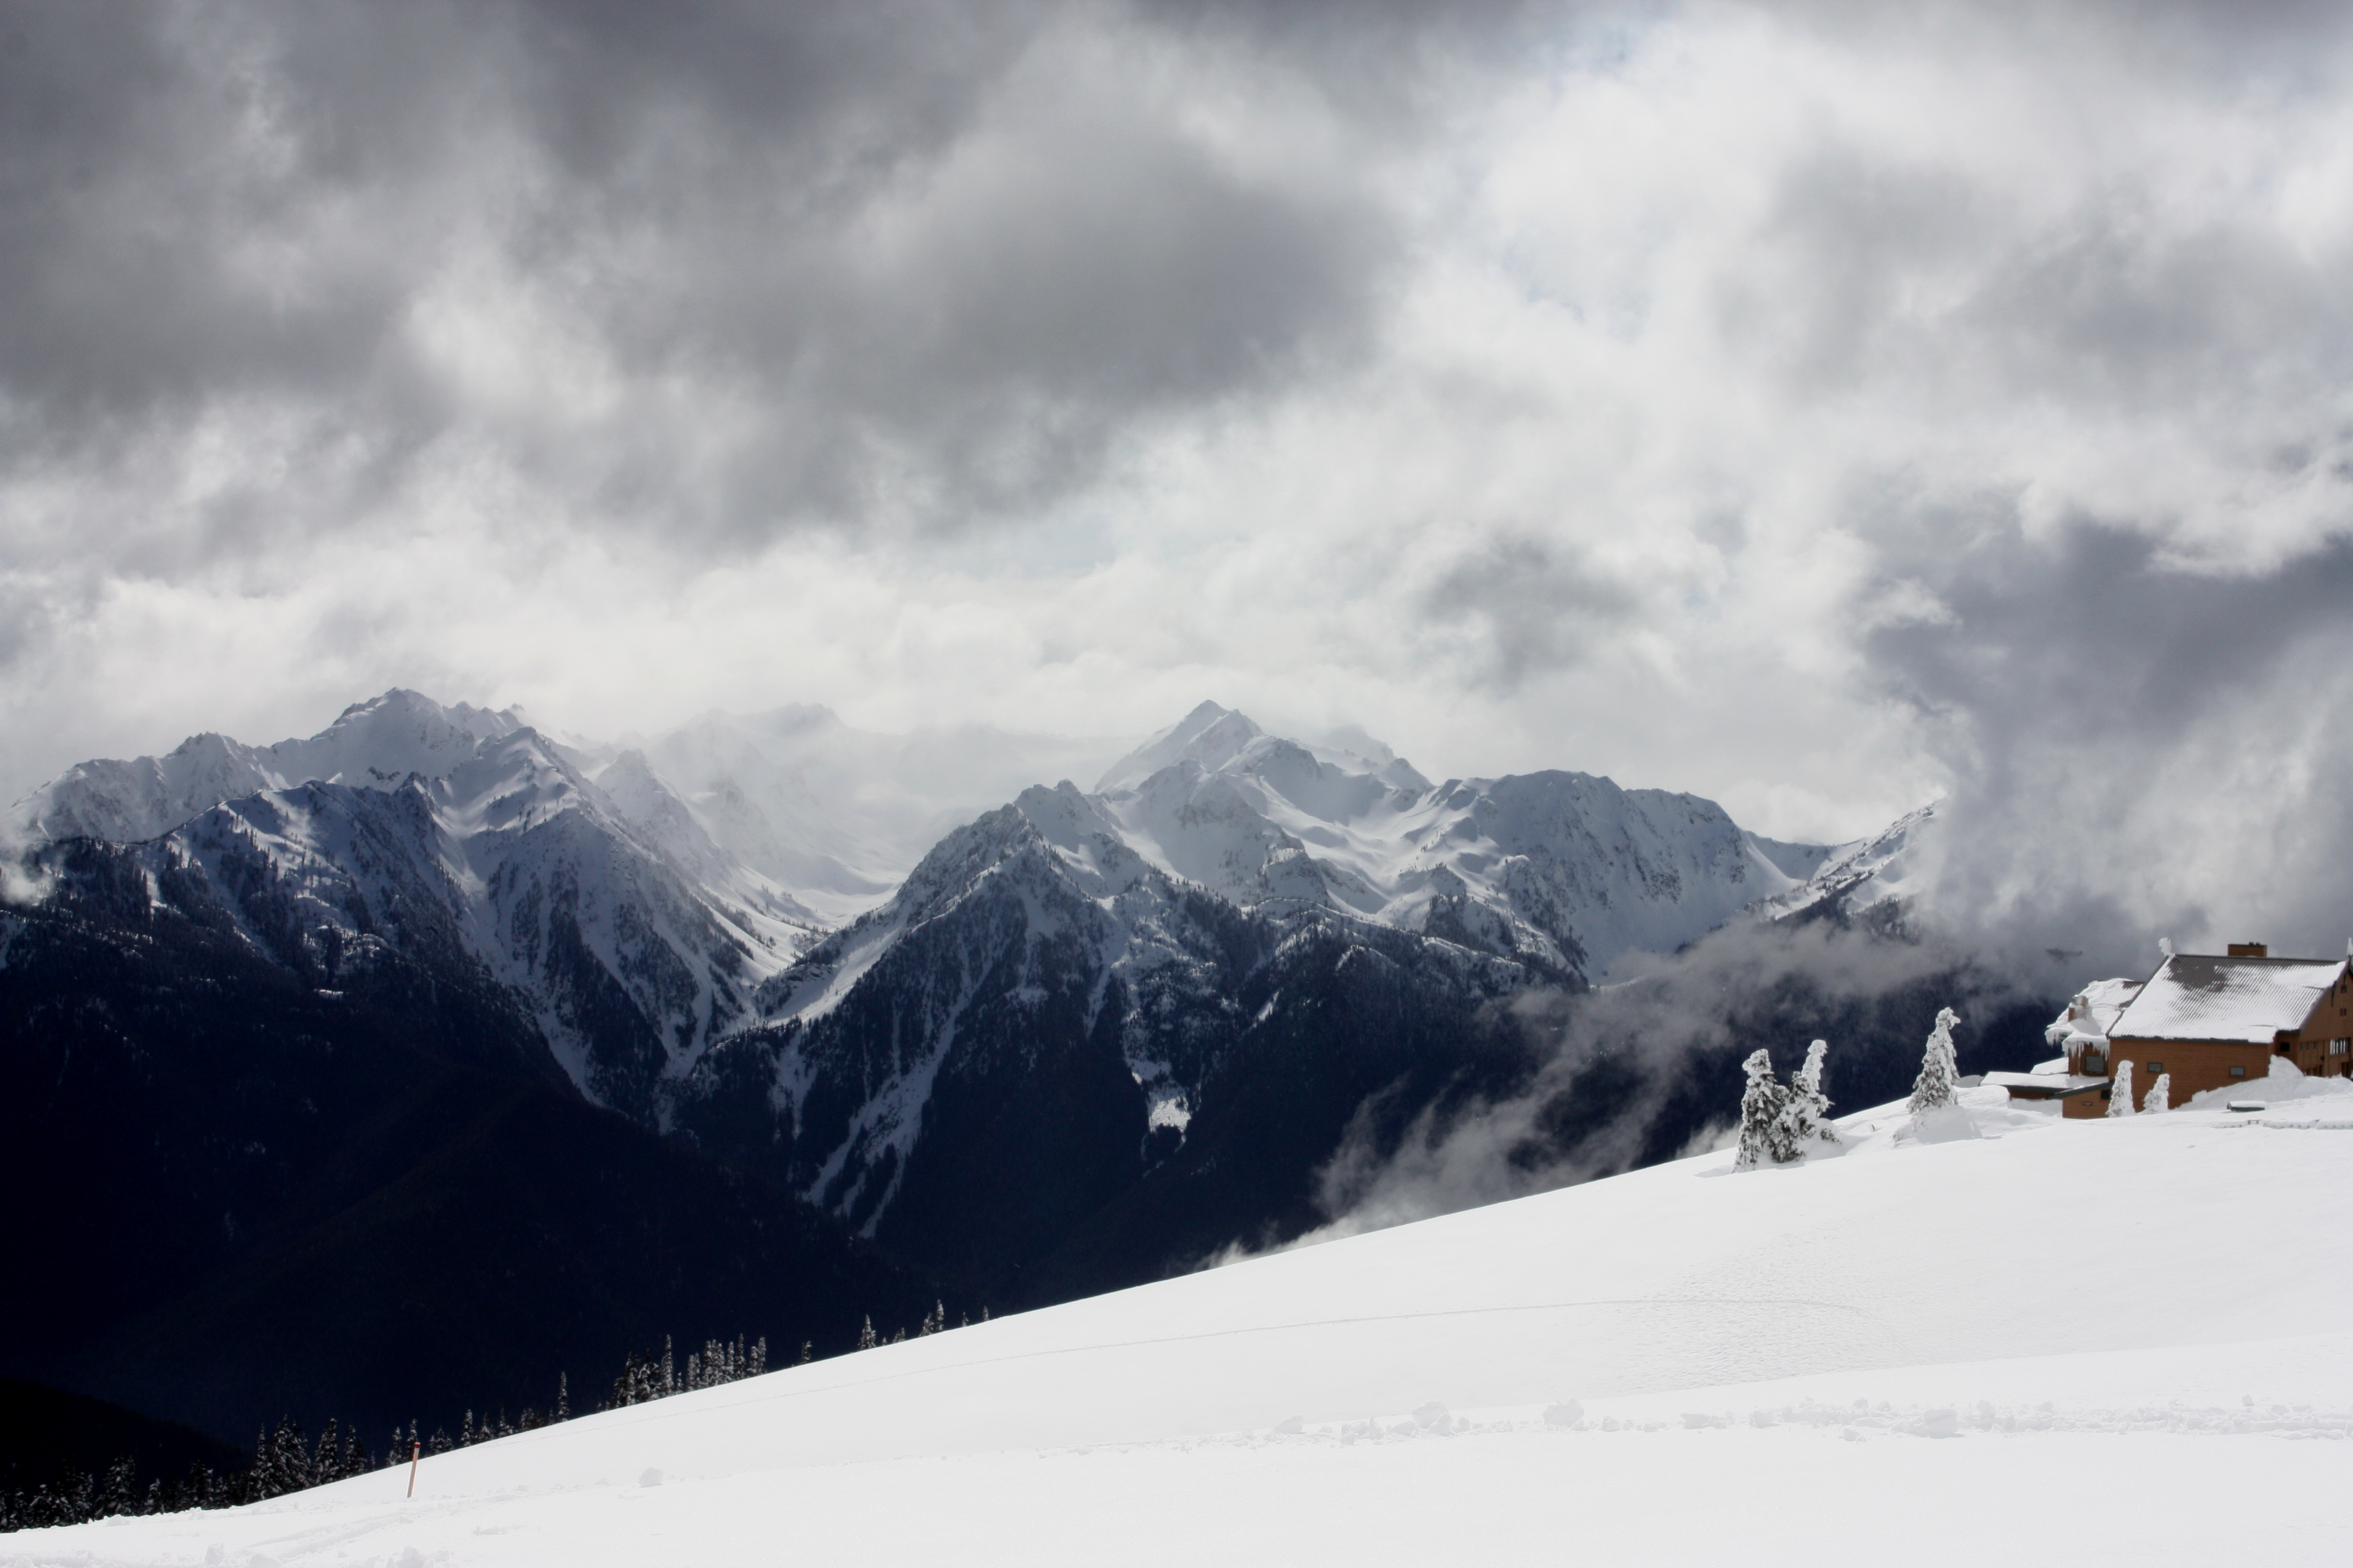
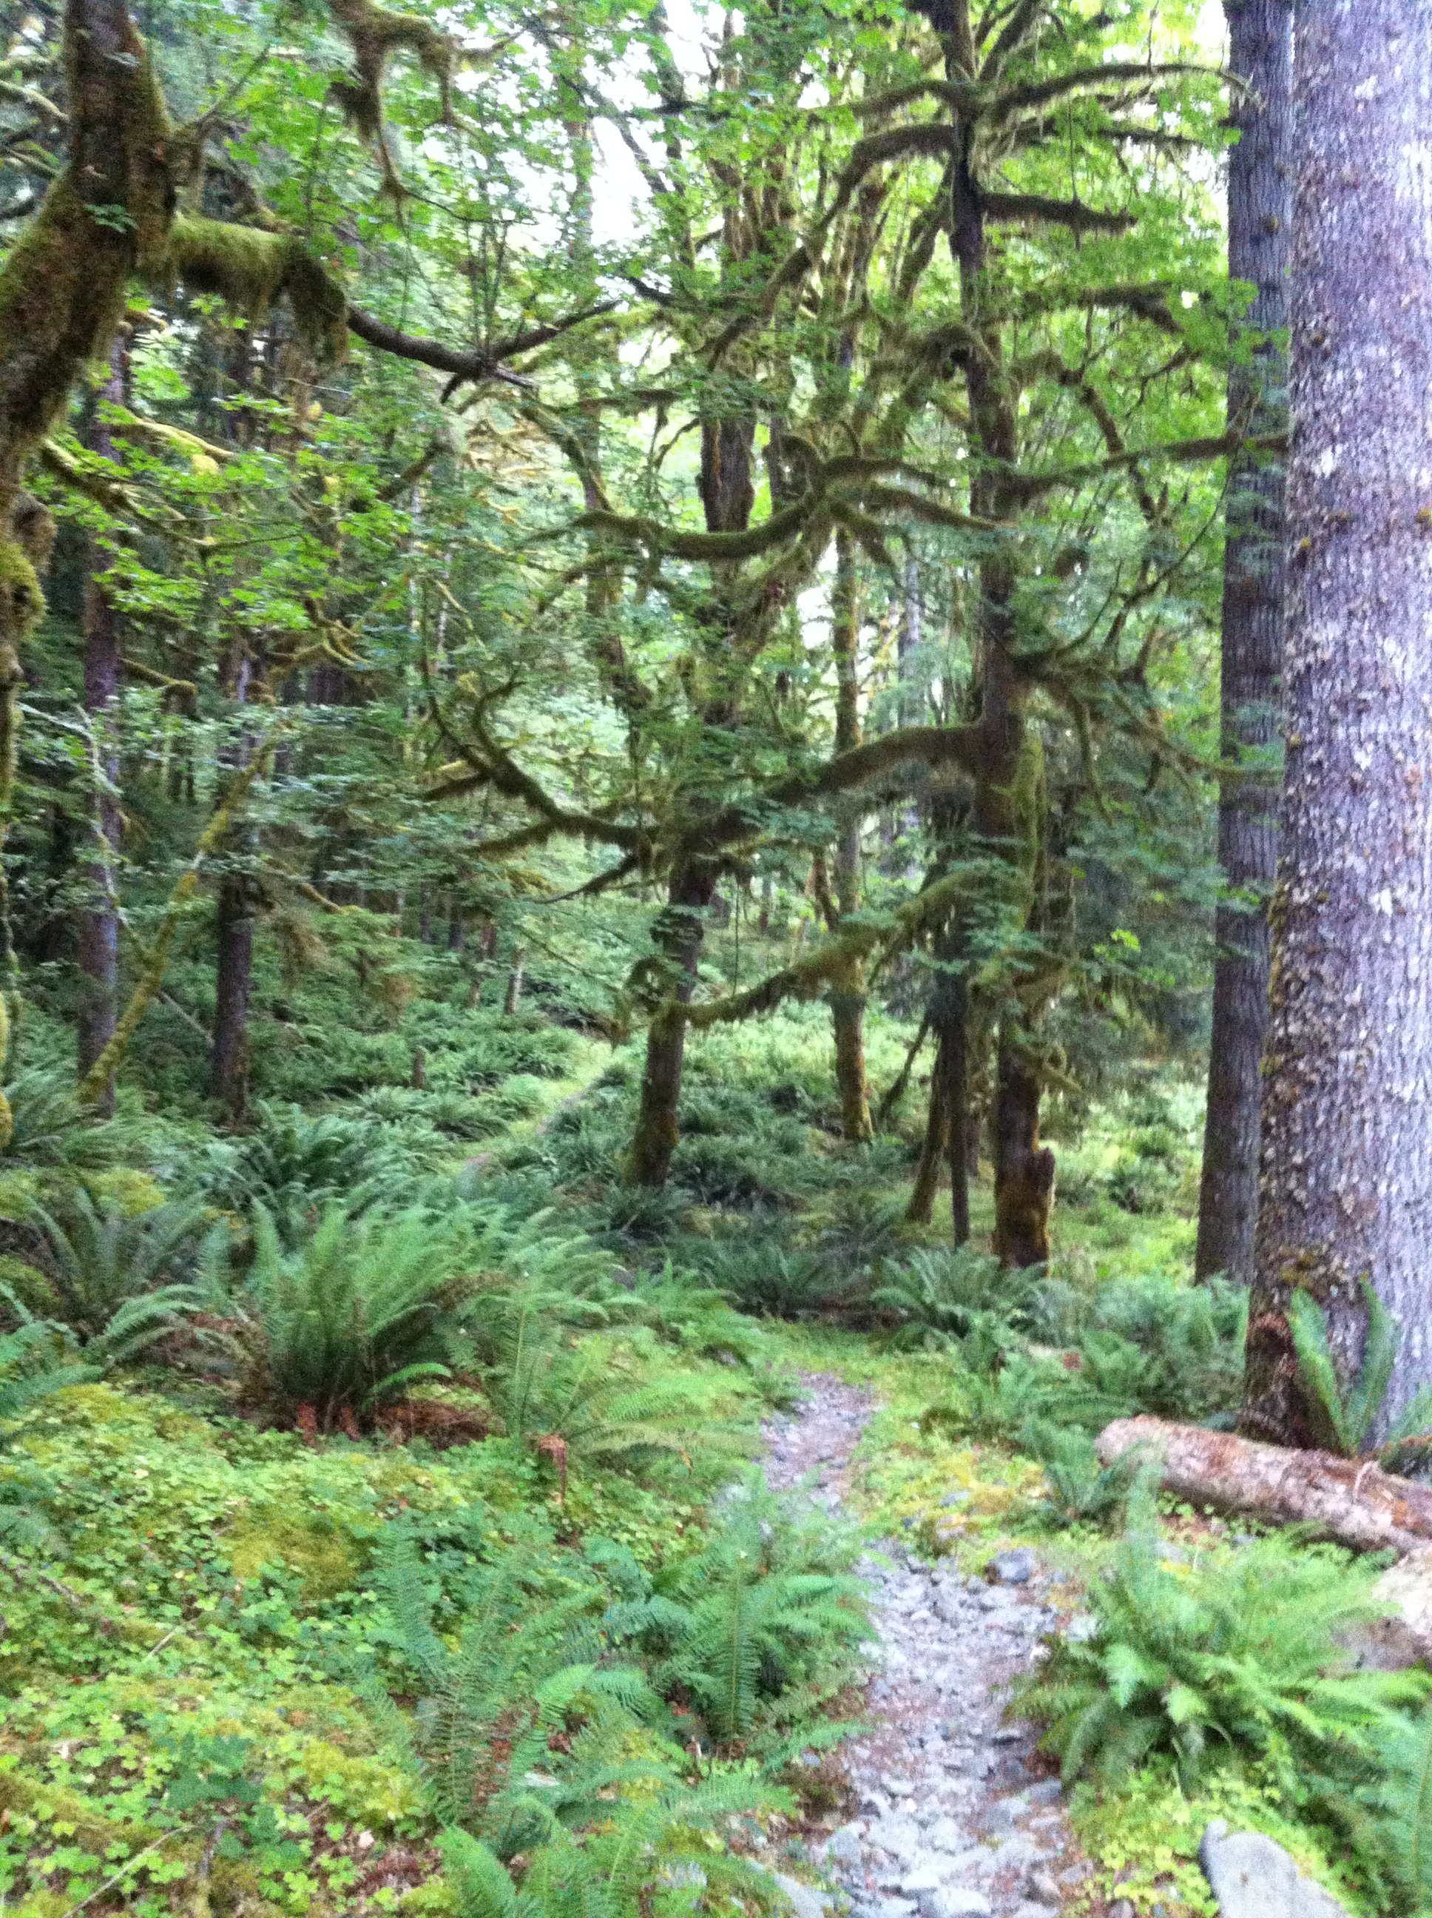
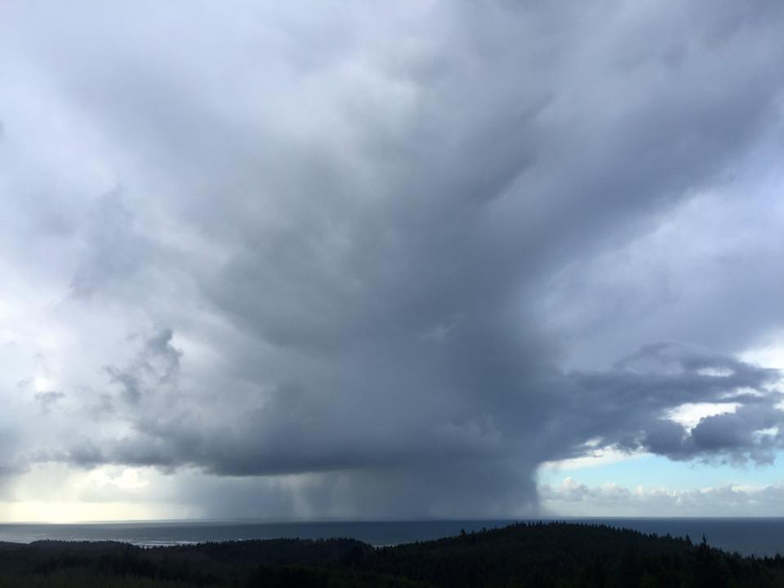
Studying the Modification of Extratropical Cyclones as they Traverse Professor Houze's
'Backyard': The Mountainous West Coast of North America
Lynn McMurdie
University of Washington
(with help from Socorro Medina)
AMS, Houze Symposium 24 Jan 2017

Slide 2
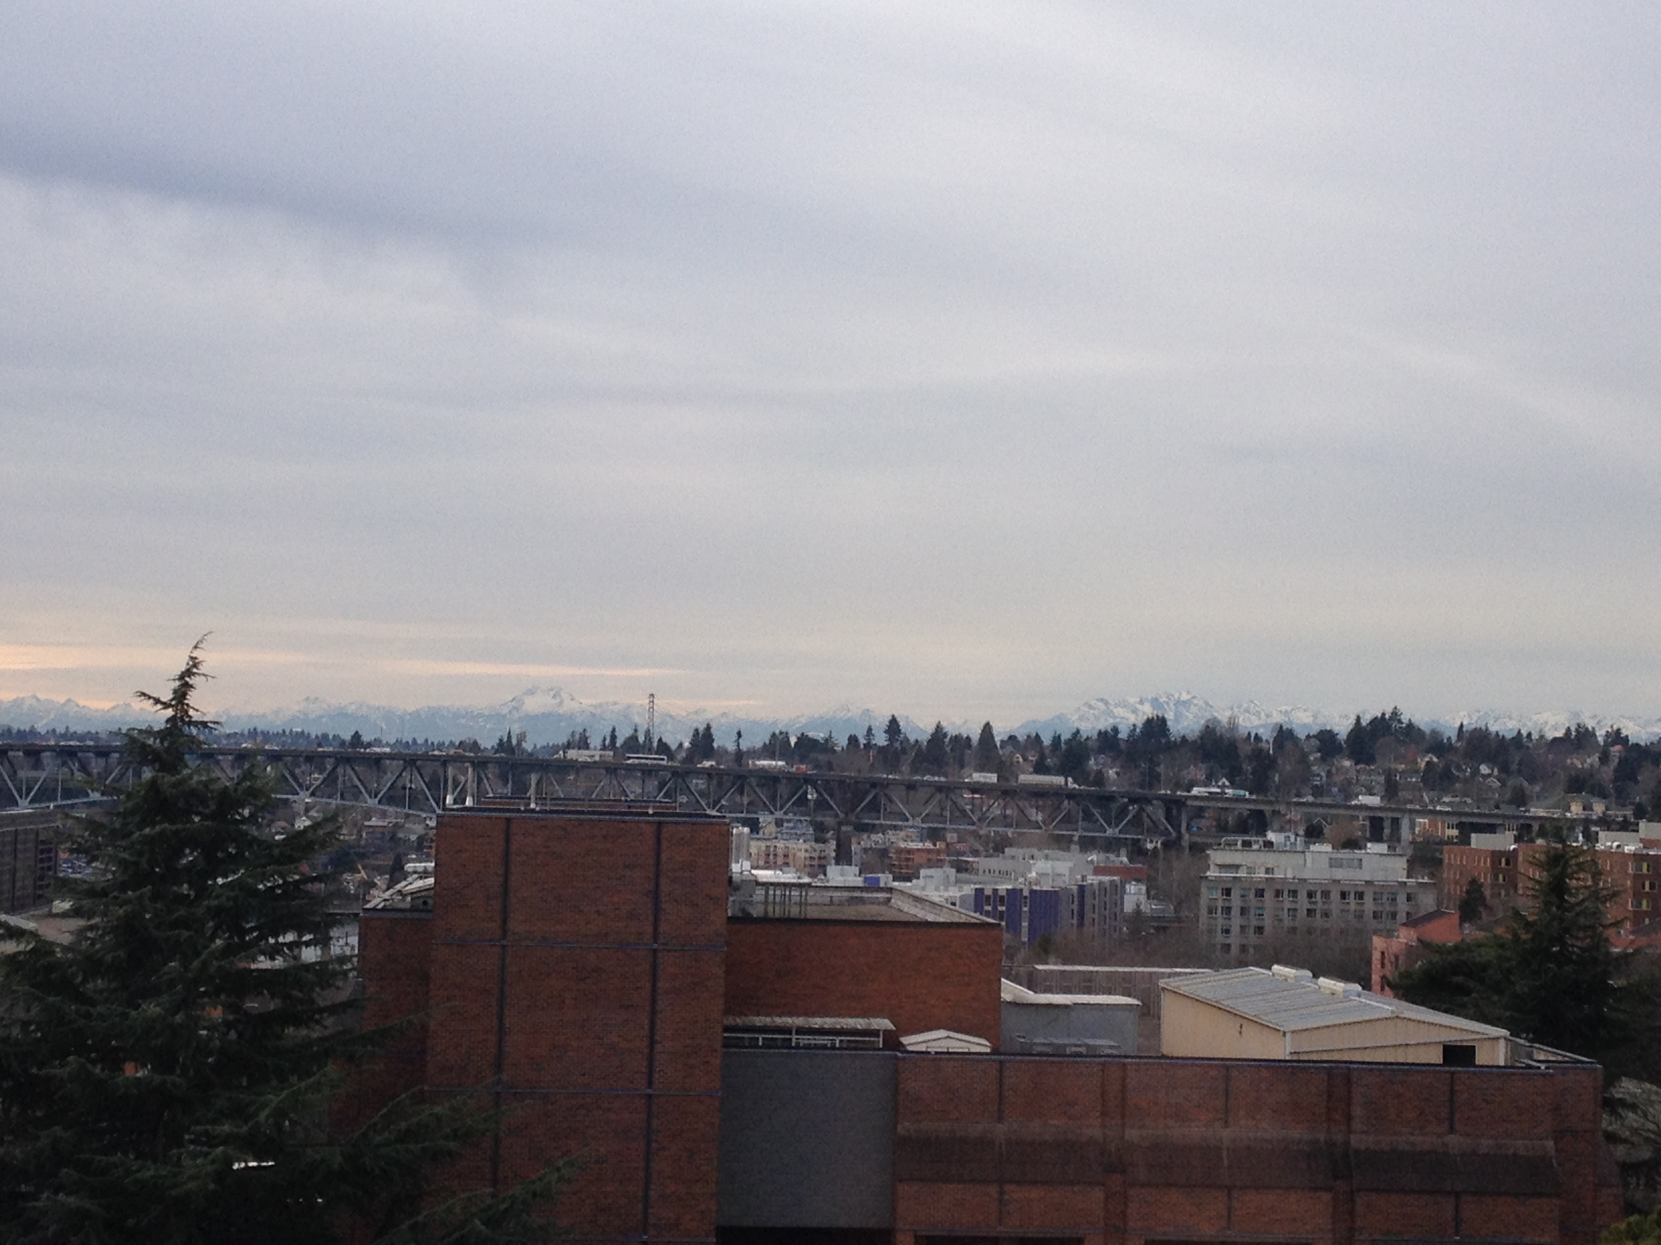
The View out Prof. Houze’s office window looking west

Slide 3
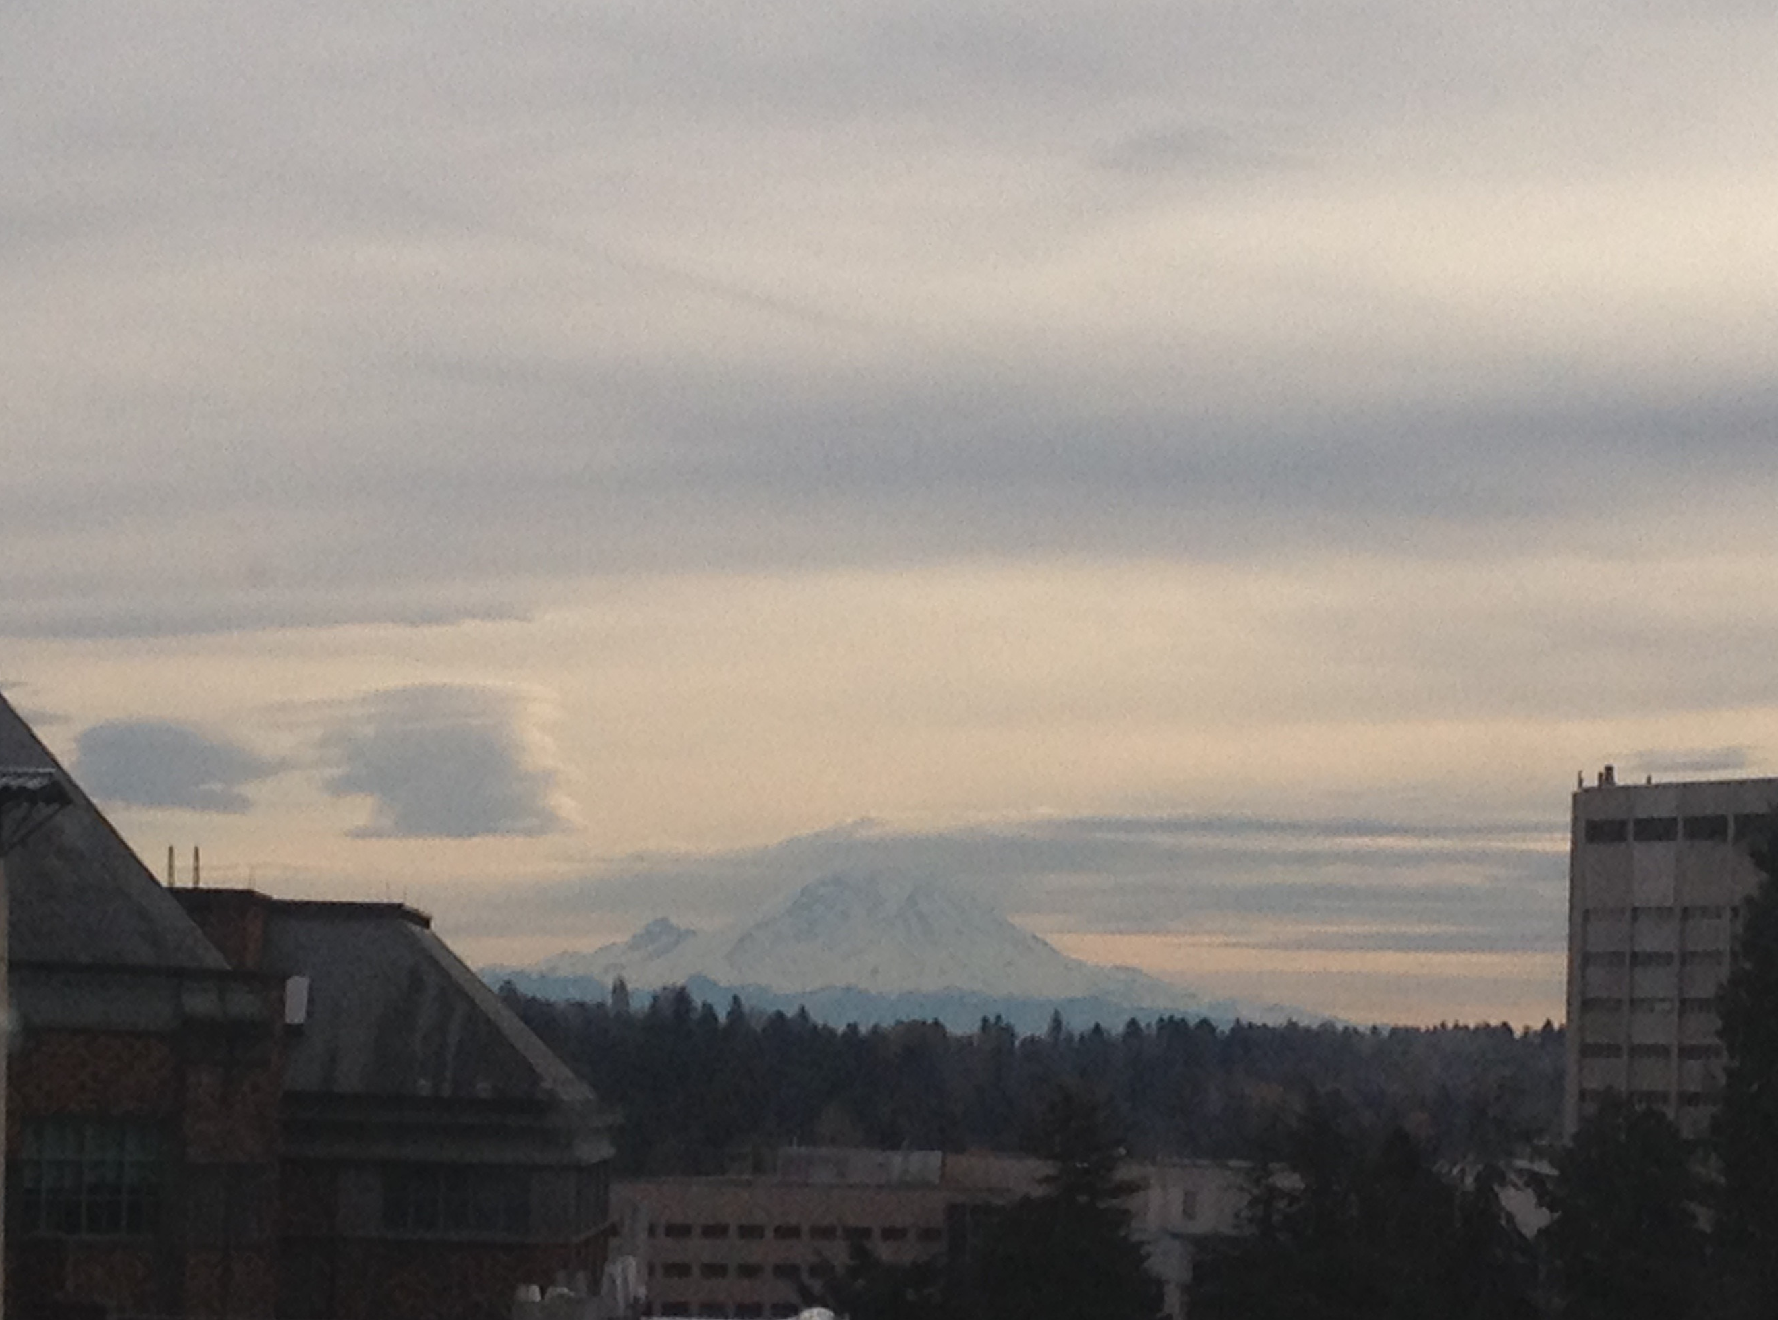
The View out Prof. Houze’s office window looking South

Slide 4
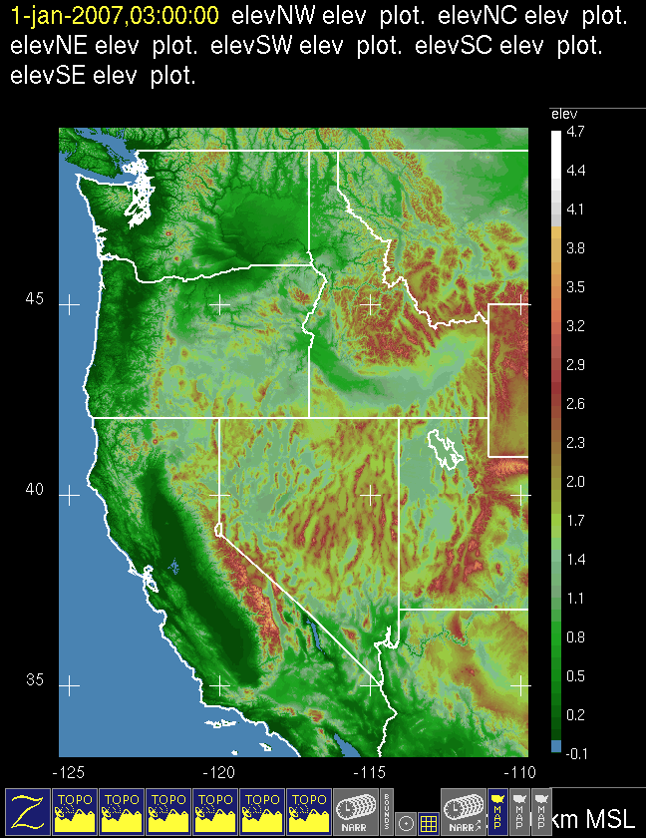
Bob’s backyard
Olympic Mountains
CYCLES
Cascades
Mt. Rainier
COAST
IMPROVE
OLYMPEX

Slide 5
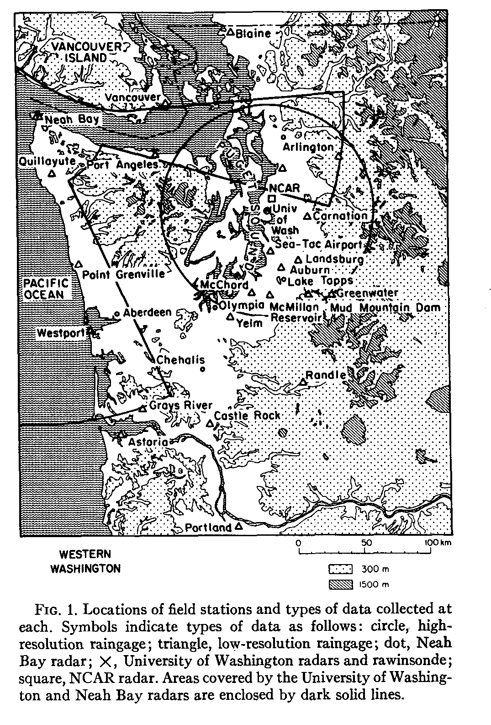
CYCLES – CYClonic Extratropical Storms
Data Collected:
Rain Gauges
Soundings
Radars
Aircraft microphysics
Multiple years 1970’s, 1980’s,
Multiple regions
‘PPI displays were recorded by time-lapse photography as displays were cycled through a series of five gain settings.’ Houze et al. 1976

Slide 6
Rainbands in Extratropical Cyclones
Matejka, Houze & Hobbs (1980, QJRMS); Houze (1981, Radio Sci.)

Slide 7
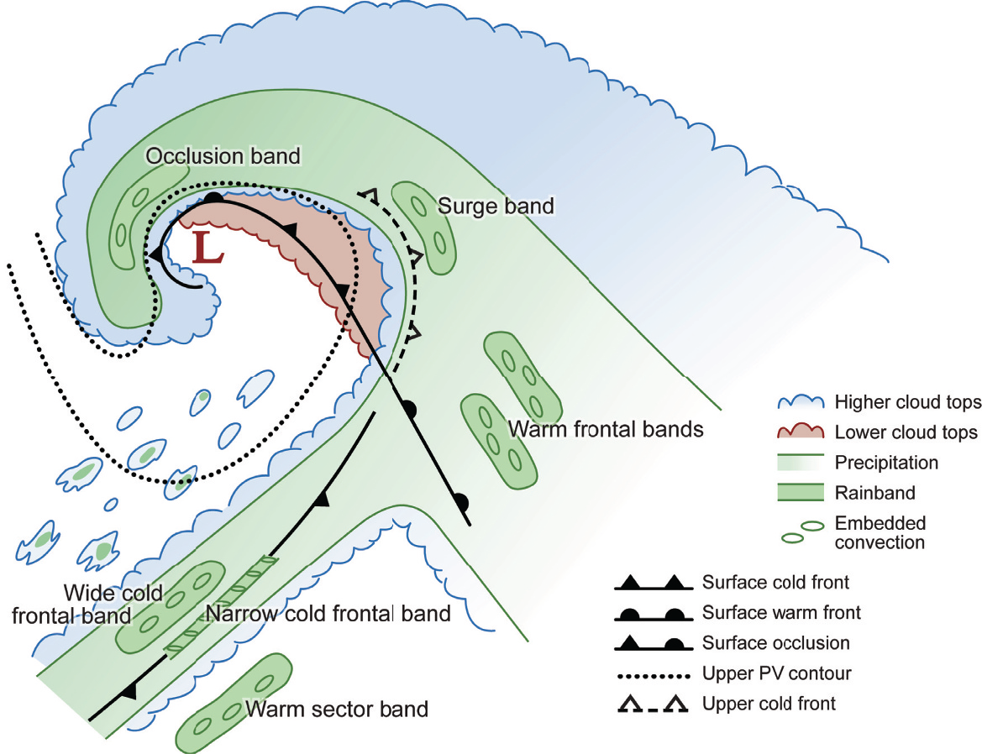
Rainbands in Extratropical Cyclones
Graphic from Cloud Dynamics, 2nd Ed., by R. A. Houze, Jr., ©Academic Press-Elsevier, 2014

Slide 8
COAST – Coastal Observation And Simulation with Topography
Purpose
Modification of flow and mesoscale structure by coastal orography
Data Collected:
Dec 1993 and Dec 1995
Soundings MFR, SLE , UIL, BFI
Wind profilers on coast
Aircraft – NOAA P-3
  tail-mounted Doppler radar: reflectivity and radial velocity
  in situ cloud microphysics
Mesoscale modeling
Key technological advancement – mesoscale modeling

Slide 9
COAST – Coastal Observation And Simulation with Topography
Key Result:
Upstream influence of coastal topography
Documentation of the modification of frontal rainbands as storm approached the Oregon coast
Braun, Houze and Smull,1997

Slide 10
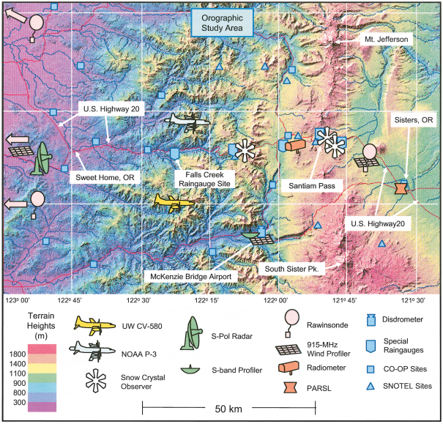
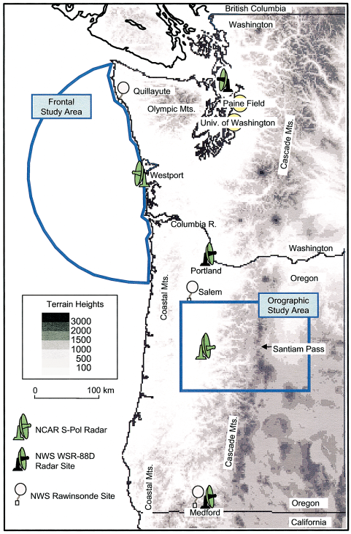
IMPROVE I and II: Improvement of Microphysical Parameterization through Observational Verification Experiment
IMPROVE II Nov- Dec 2001
Key Instrumentation – S-POL Dual Polarization radar and vertically pointing S-band radar

Slide 11
IMPROVE I and II: Improvement of Microphysical Parameterization through Observational Verification Experiment
Bob’s involvement:
Designed Scanning strategy for S-POL
Brought radar expertise
Worked at S-POL and operations center
Wrote Science summaries

Slide 12
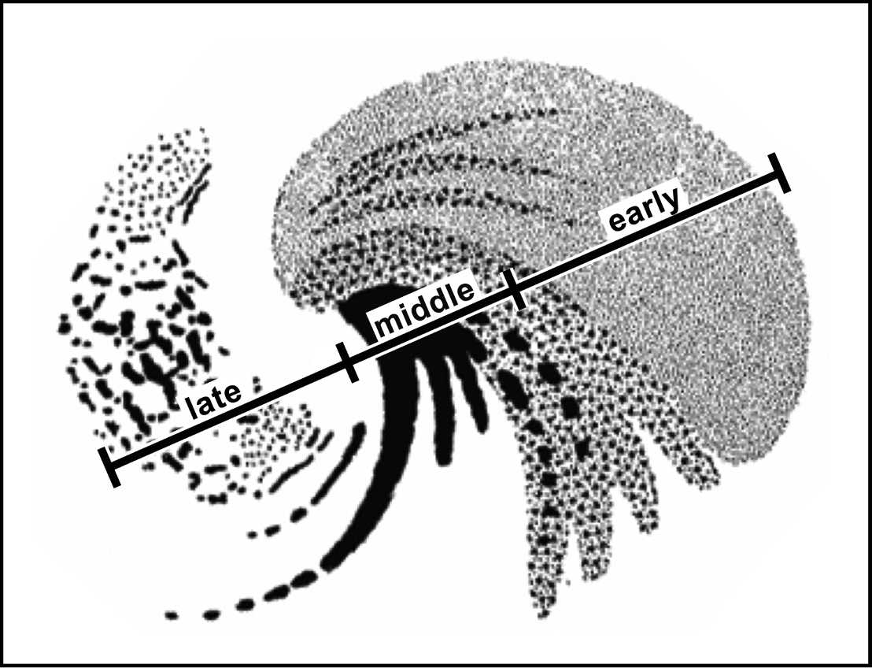
IMPROVE II:
Key results summarized in Medina et al. 2005, Medina et al. 2007
Early
Middle
Early
Middle
Late
Adapted from Nagle and Serebreny 1962

Slide 13
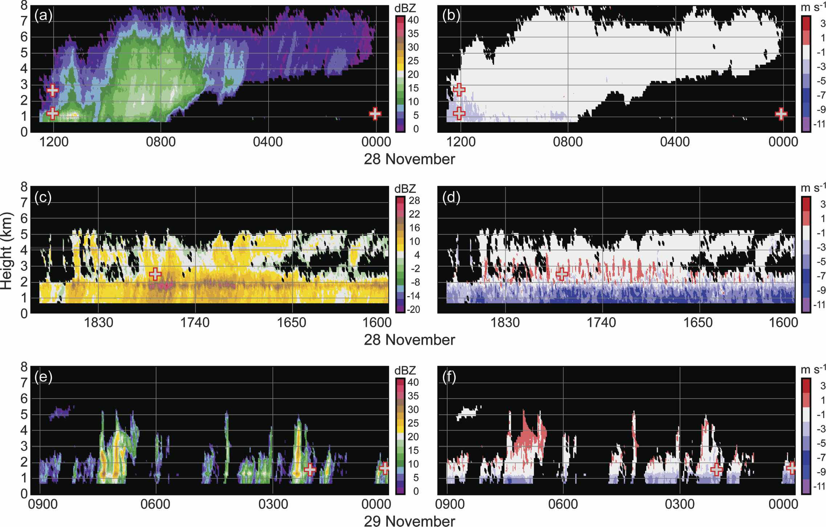
Reflectivity – S-band Vertically Pointing Radar
Vertical Velocity
Early ← Time
Middle
Late
Early: Cloud base lowers with time, little to no vertical velocity
Middle: Steady to intense precipitation, embedded convective elements, strong vertical motion possibly due to turbulence
Late: Isolated cells, pockets of significant vertical motion

Slide 14
IMPROVE II: Key results summarized in Medina et al. 2007

Slide 15
OLYMPEX: The Olympic Mountains Experiment
These prior field campaigns led to the successful OLYMPEX (2015- 2016) campaign
Next Talk and OLYMPEX session Thursday 1:30 – 3:00 NWP/WAF

Slide 16
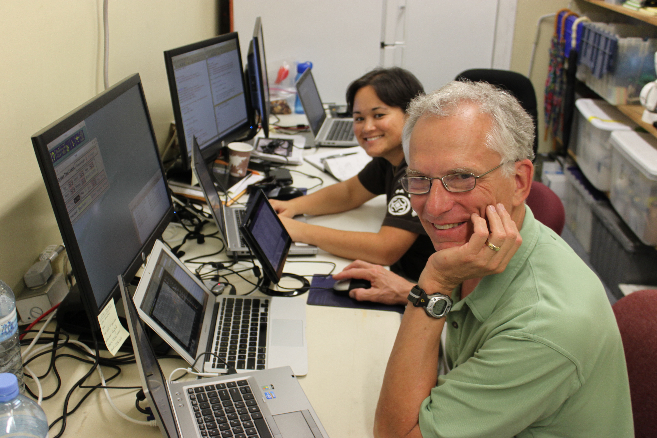
Bob’s legacy and leadership in the field
Be committed
Look at data as it happens
Write good notes
Ideas come to you in the field
Data quality vital
Bob’s secret - collect data so you can do statistics and compare to earlier results
‘Let the data lead you by the nose’
PV Hobbs

Slide 17

Acknowledgments
Work supported by:
NASA grants NNX15AL38G, NNX16AD75G and NNX16AK05G
NSF grant AGS-1503155
Photo credits: Reid Wolcott, Doug Stolz, Joe Zagrodnik, Bill Baccus, Deanna Hence

