Slide 1
OLYMPEX: A Unique and Comprehensive Dataset for Understanding Precipitation Processes in Complex Terrain
Jennifer DeHart
Angela Rowe, Joe Zagrodnik, Hannah Barnes, Lynn McMurdie, Robert Houze
University of Washington, Seattle, WA - Pacific Northwest National Laboratory, Richland, WA

Slide 2
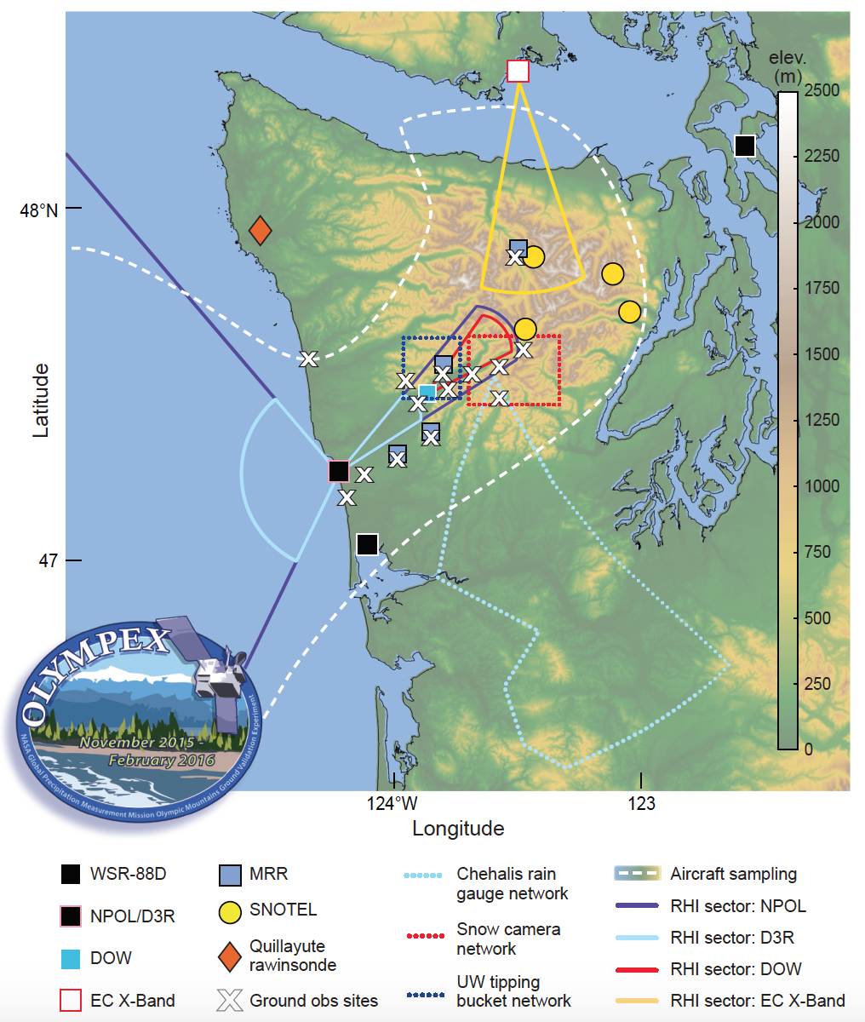
OLYMPEX
Goals
  GPM ground validation
  Expand knowledge of orographic processes
Increase in the scale of microphysical sampling
Radar coverage
Notes:
Transition: I’m going to show some preliminary highlights of work done so far.

Slide 3
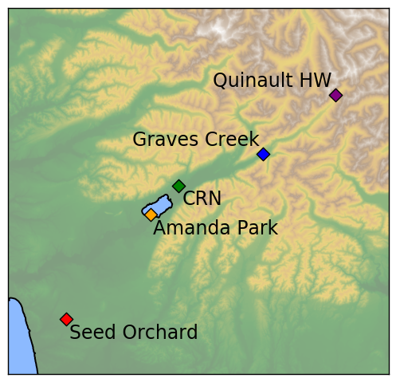
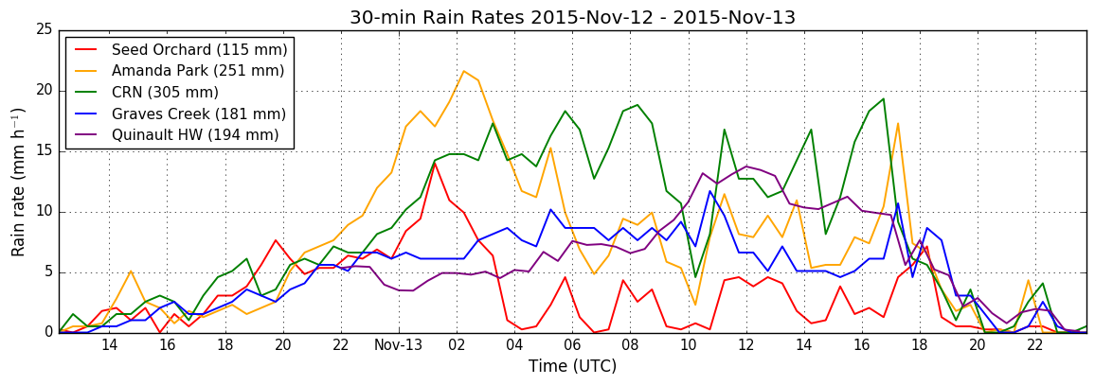
Detailed surface observations
Windward slopes heavily instrumented
Nov 12-13, 2015 : strong atmospheric river
  CRN (305 mm)
  Quinault HW (194 mm)
Zagrodnik et al. 2017, in prep
Notes:
Transition: disdrometers complement the rain gauges regarding the precipitation makeup.

Slide 4
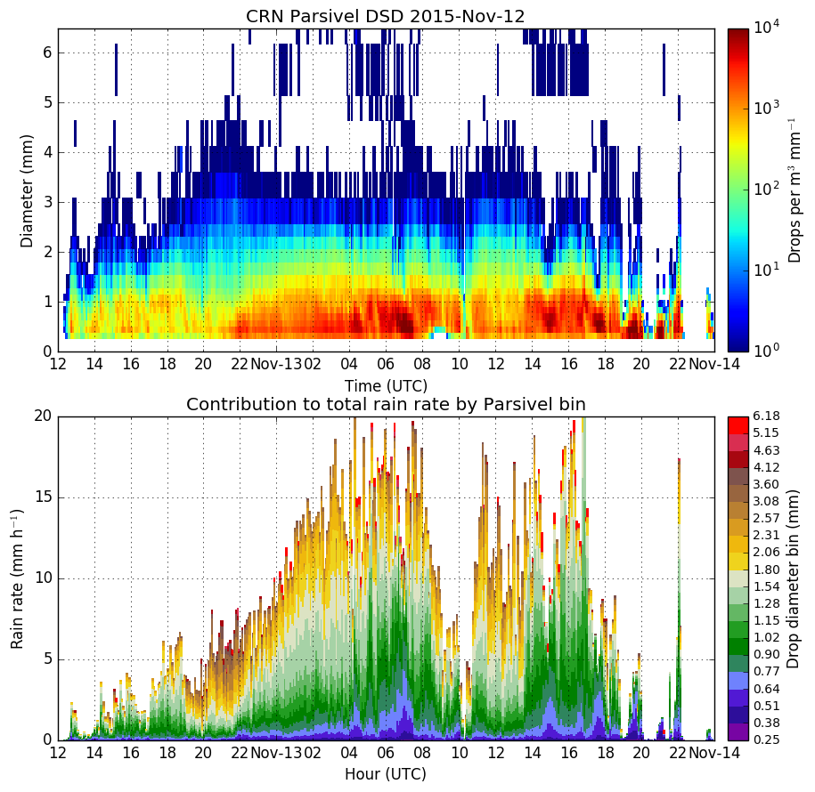
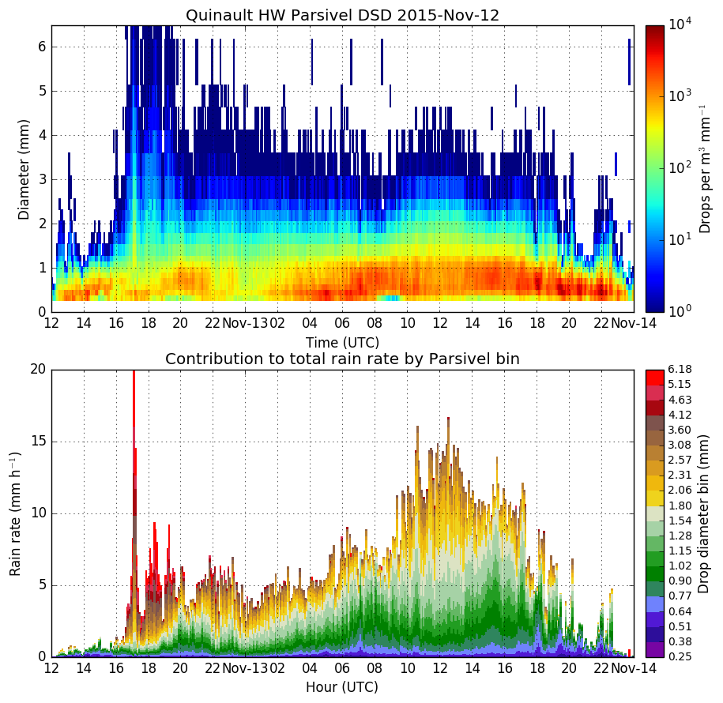
Nov 12-13:
DSD/Rain Rates
CRN
Quinault HW
CRN: small/med drops dominate max rain rates
Quinault: greater contribution from large drops
Zagrodnik et al. 2017, in prep
Notes:
Transition: finally, combining the precipitation data with the precipitation, kinematic and thermodynamic context provides additional information.

Slide 5
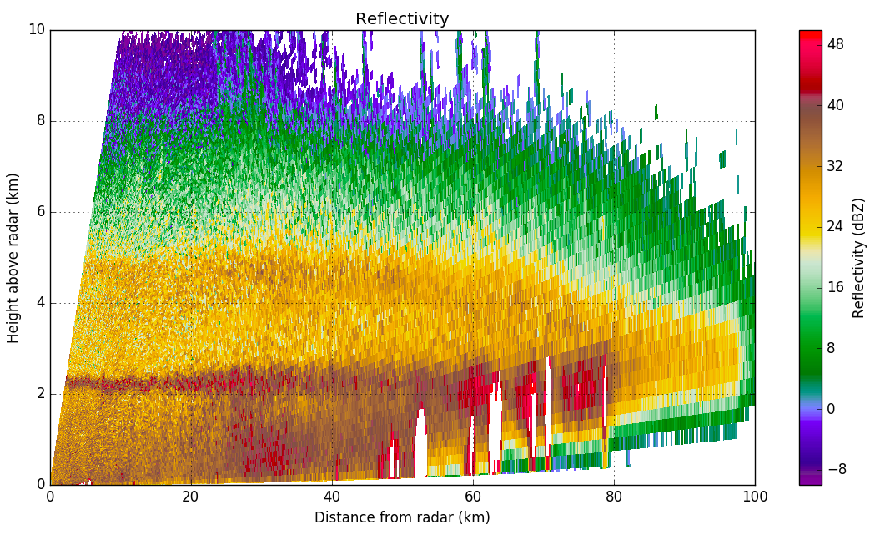
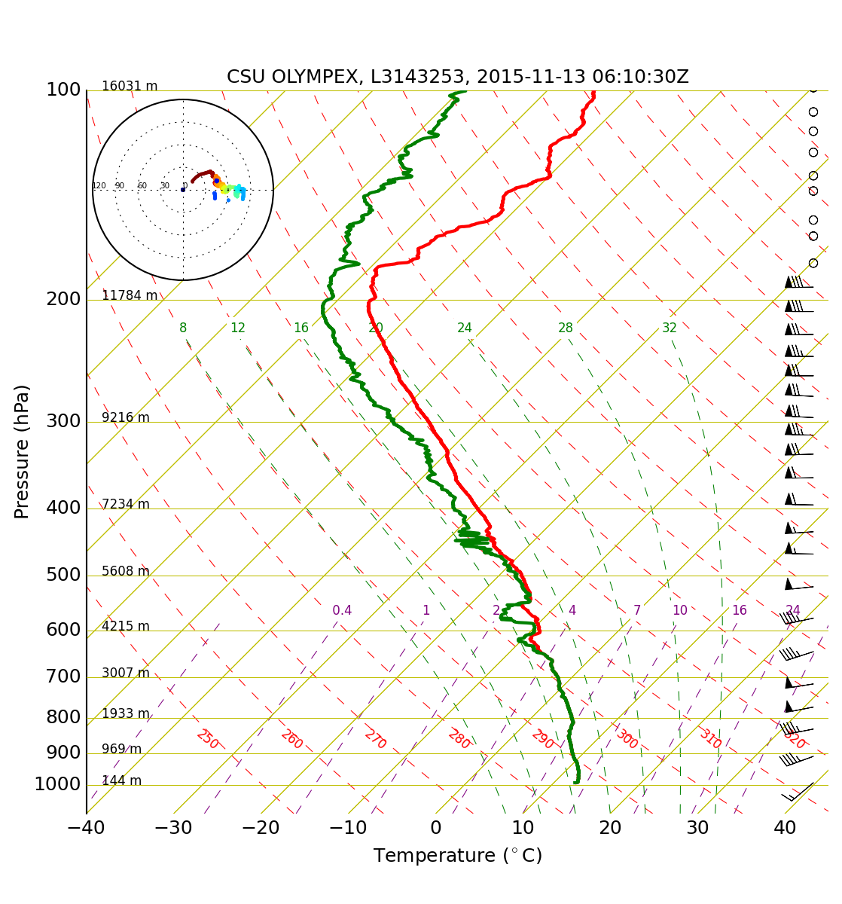
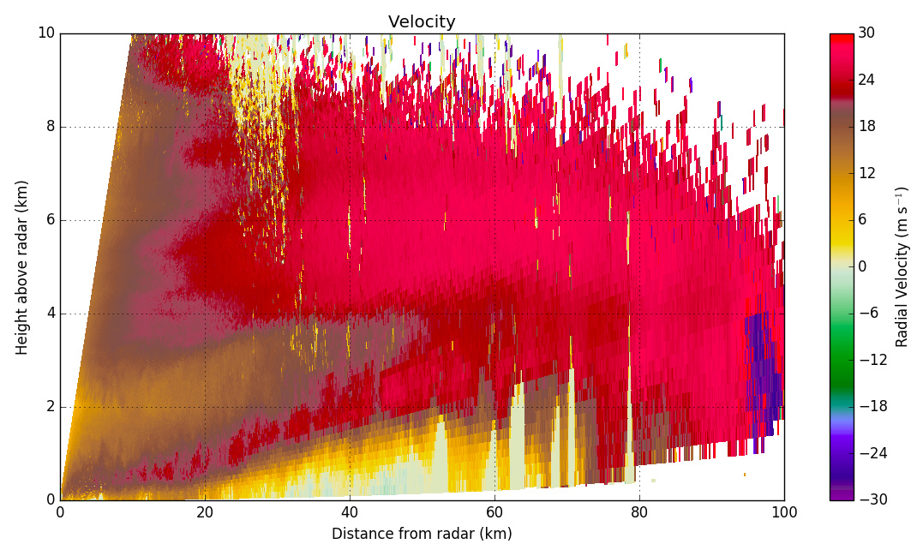
NPOL Nov 13 02:12 UTC
Reflectivity
NPOL
CRN
Quinault HW
Velocity
Combination of surface observations w/ radar and soundings provides holistic view of precipitation
Zagrodnik et al. 2017, in prep
Notes:
Transition: the combination of data sources also allowed for evaluation of prior hypothesis.

Slide 6
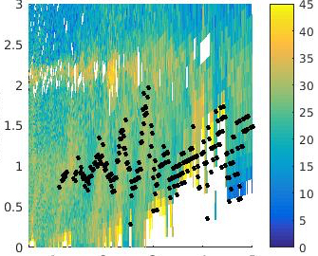
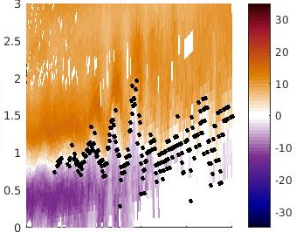
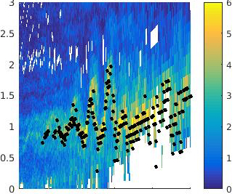
Kelvin-Helmholtz waves
Reflectivity
Velocity
Spectral Width
Dec 17, 2015
KH waves were observed above, within and below the melting level
  most visible when bright band is disturbed
Barnes et al. 2017, in prep
Notes:
Transition: KHI waves were also present in stationary data.

Slide 7
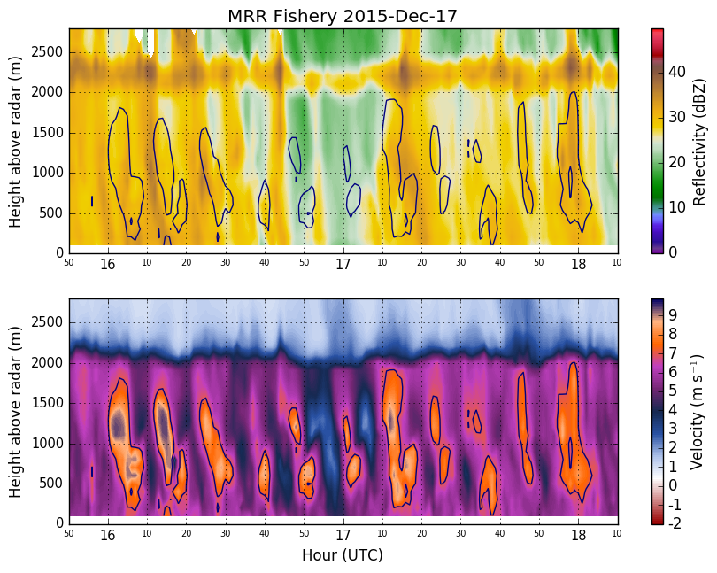
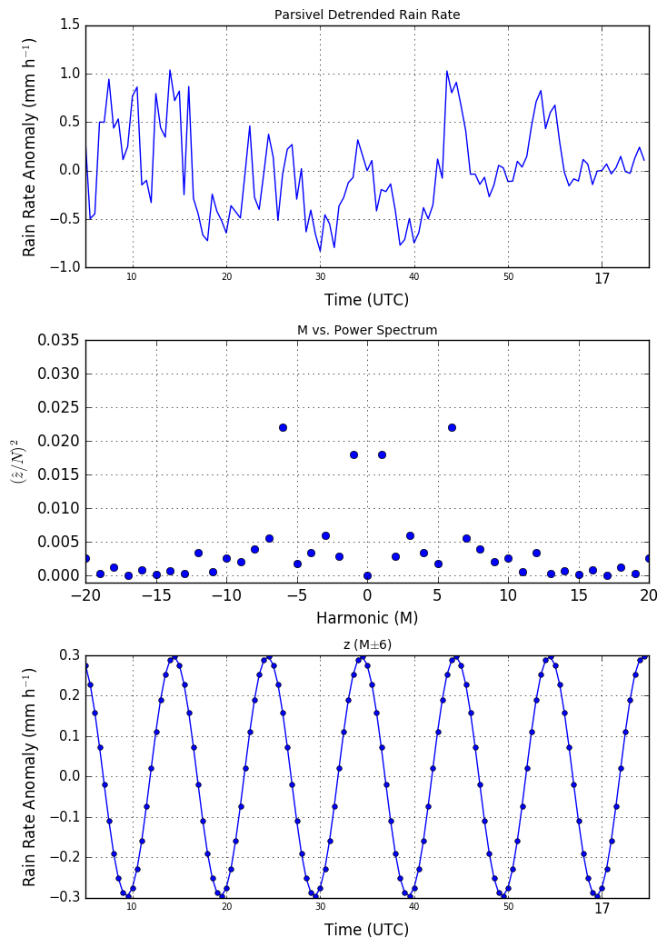
Kelvin-Helmholtz waves
10 min periodicity seen in radar profiler & occasionally rainfall
  weak signal (3 mm/h)
  often drowned out by noise
Barnes et al. 2017, in prep
Notes:
Transition: other unique data sources included the DOW, which was placed within the quinault valley underneath NPOL in order to sample valley flow patterns.

Slide 8
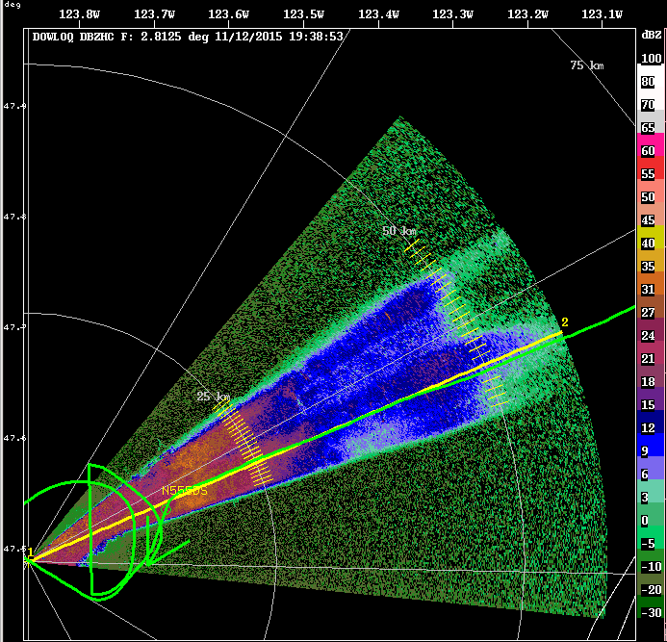
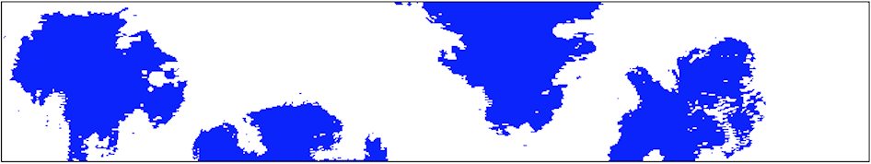
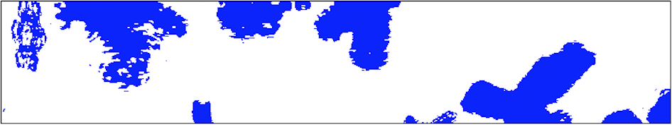
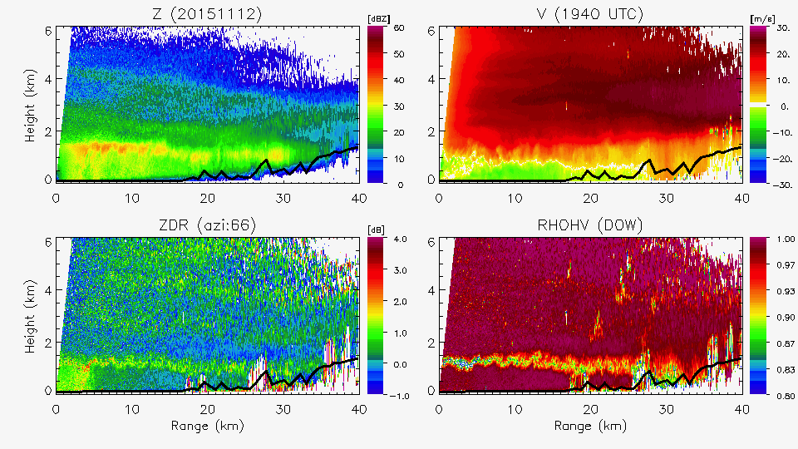
DOW
11/12/15
2DS Probe (Citation)
DOW PPI
1938 UTC
DOW RHI
Citation
1945 UTC
1949 UTC
DOW RHI – 1945 UTC
Shallow down-valley flow
Little to no liquid water aloft
Large aggregates in area of increasing Z/decreasing ZDR
Pristine stellars above at -13°C

Slide 9
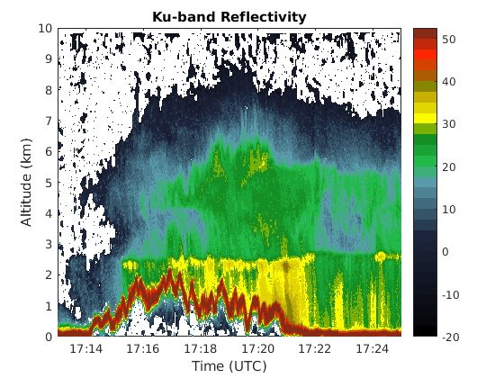
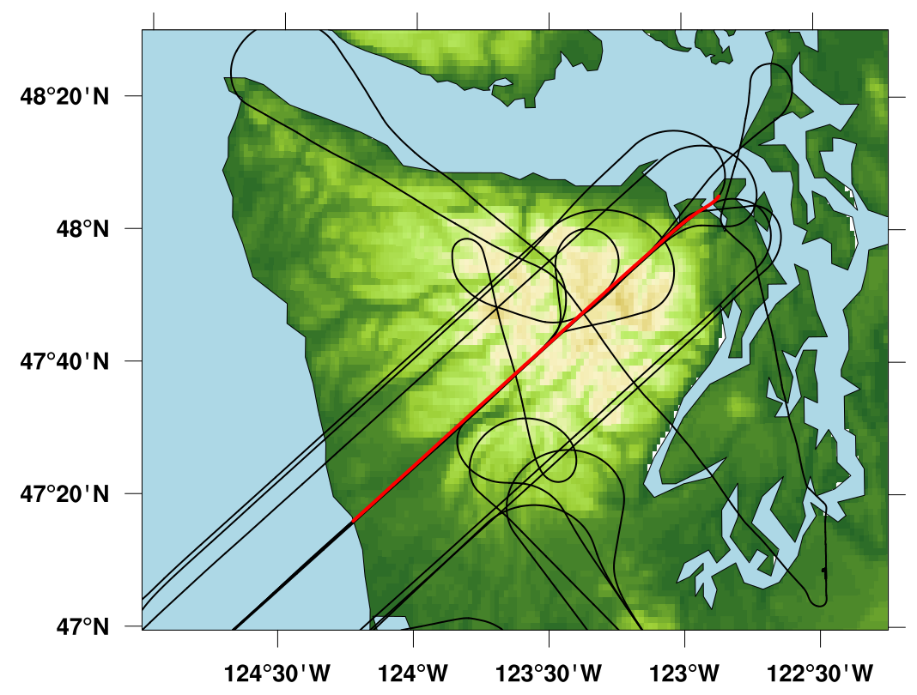
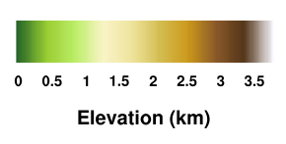
Airborne Radar
Data collection in remote regions
  inland, valleys, high terrain, lee
Greatest enhancement near windward slopes
  not highest terrain
Lifting through the bright band
Echo tops descend in lee
Notes:
Finally, in some of the highest elevations, Jessica Lundquist’s group installed several instruments to understand snowpack.

Slide 10
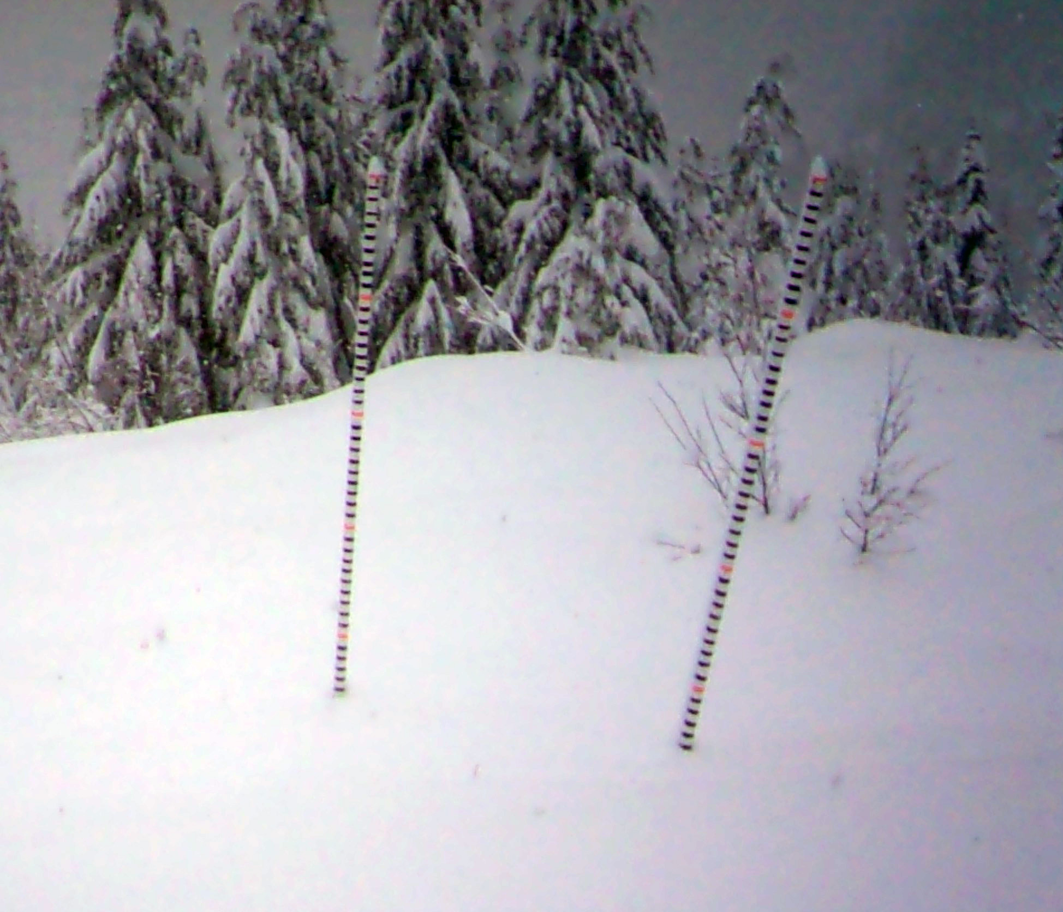
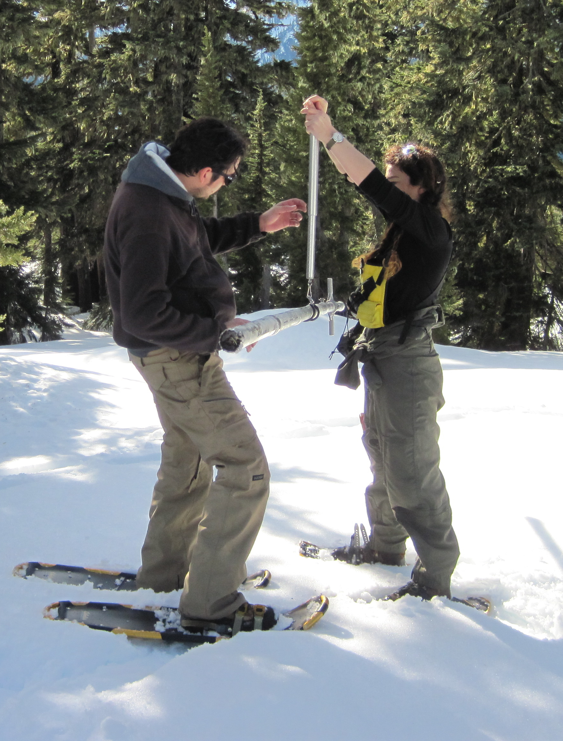
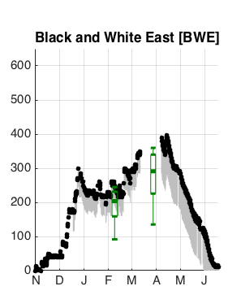
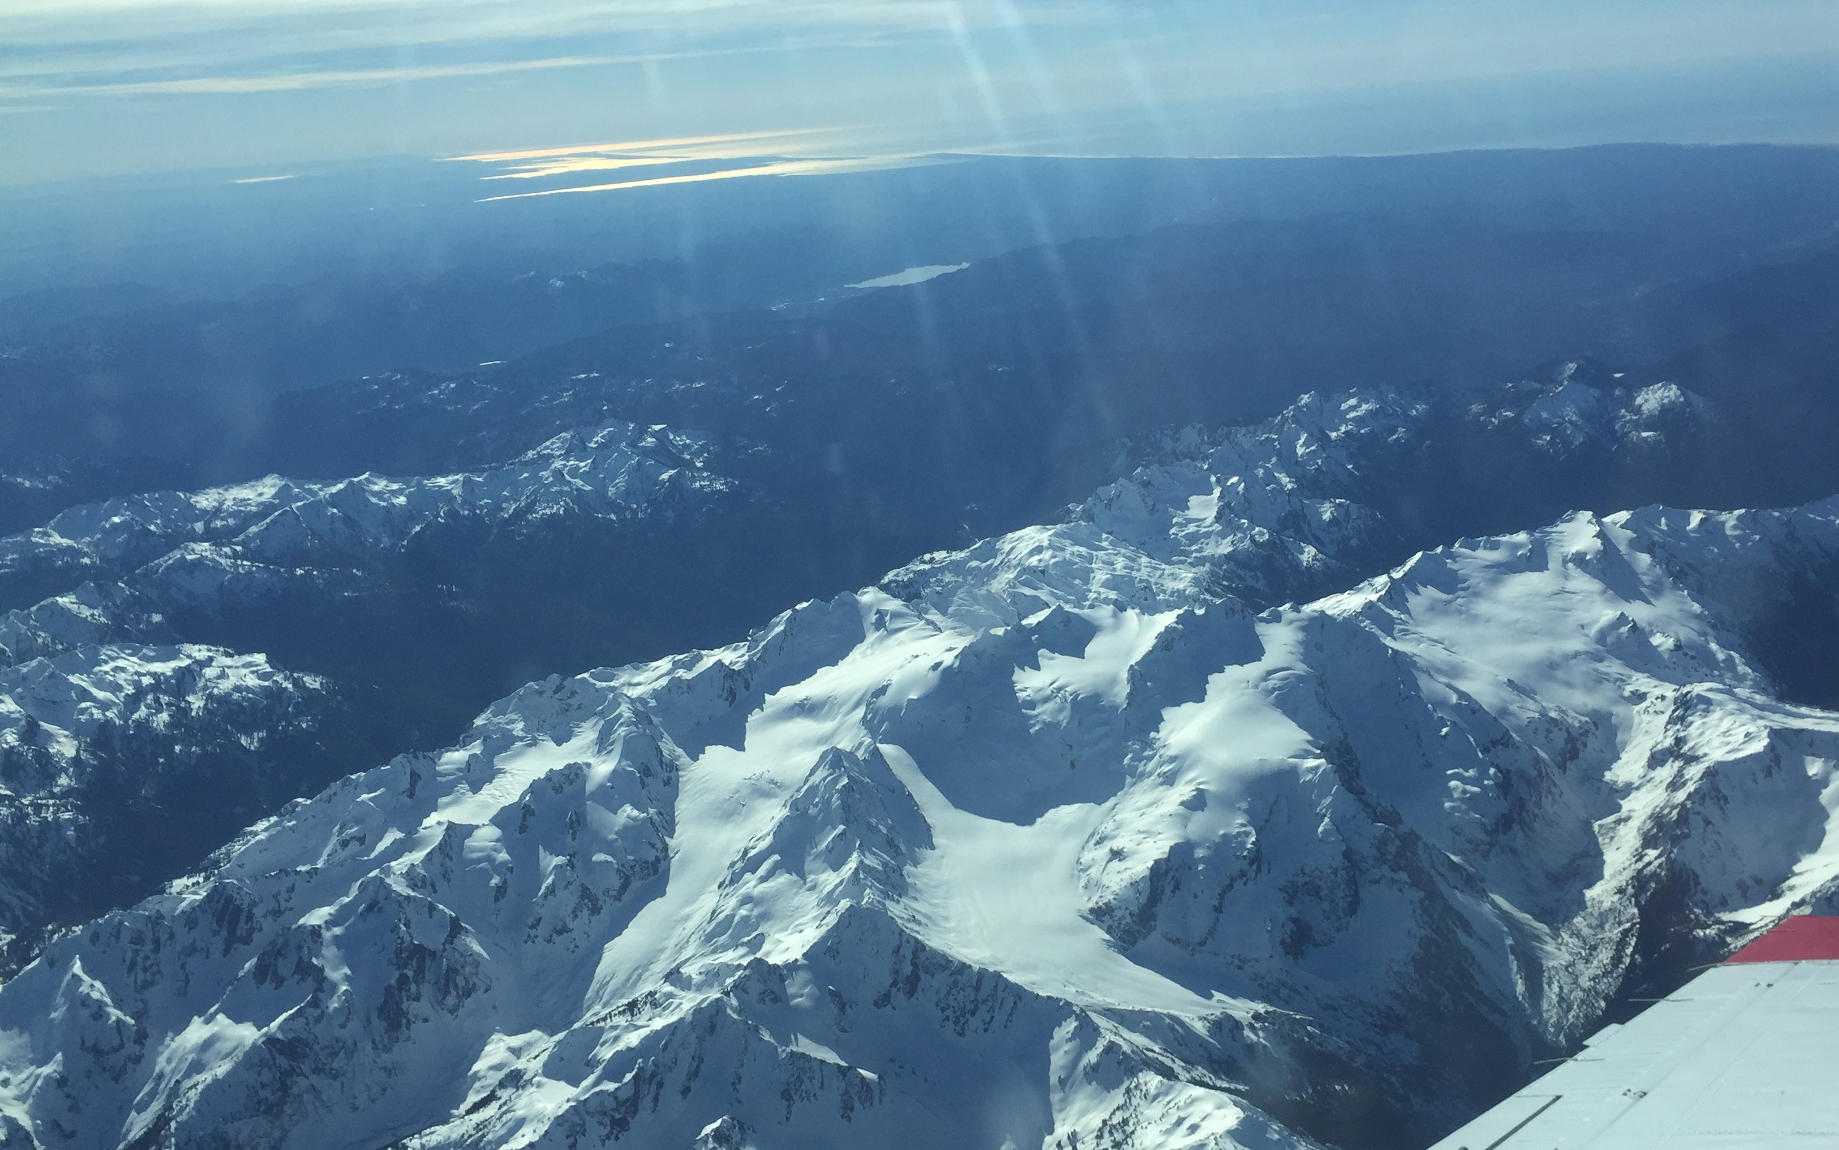
Snowpack Analysis
Snow poles + cameras provided season snow depth data
Lidar flight comparison
c/o Jessica Lundquist / Ryan Currier
Notes:
Transition: with these results in mind, OLYMPEX instrumentation was bold.

Slide 11
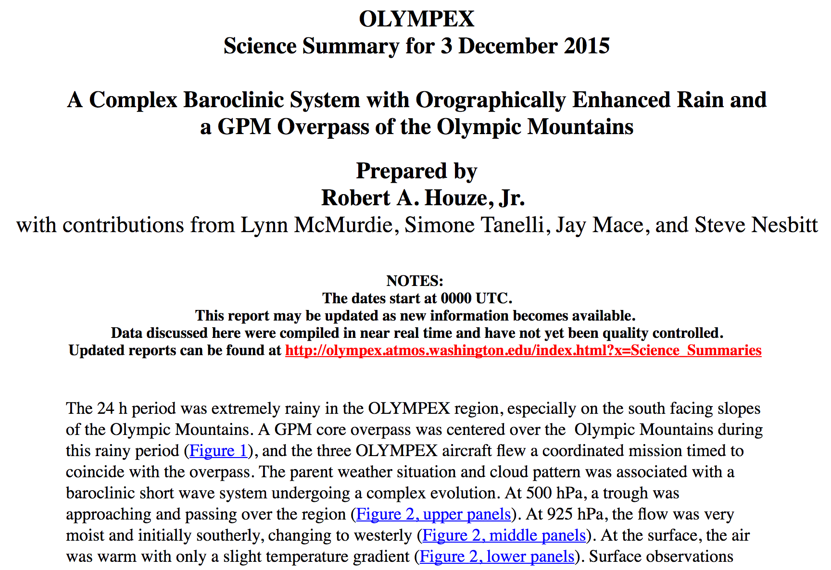
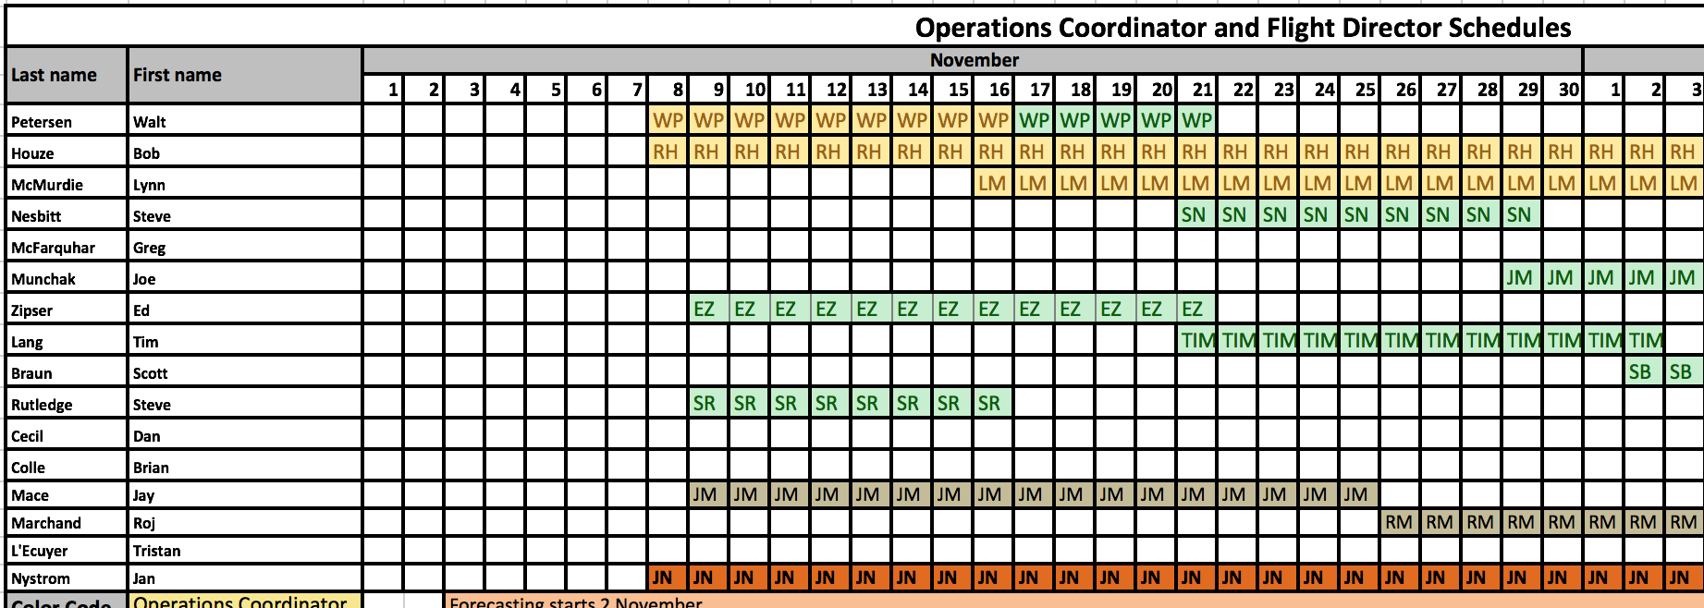
Bob as a PI
Notes:
I wanted to end this talk by returning to the observational diagram, because I think it perfectly highlights Bob’s role in this field campaign. From the years and numerous workshops spent finalizing the observational network to the coordination with numerous agencies (NASA, Environment Canada, the Park Service, the other universities), a lot of behind the scenes work is required to run a field campaign. Not to mention organizing the flight director schedules, writing the daily science summaries and running the daily briefings. All while coordinating all the instrument platforms and their scientists. Obviously, this is not the work of just Bob (Lynn and Walt were instrumental in the planning, everyone from the flight directors, to Jan Nystrom, to forecasters and many others), but his experience and ultimate goal for the campaign were vital for its success.
Design of network (3 years intensive/2009/2010 OLYMPEX)
Seasonal rain map (BAMS)
Behind the scenes planning (location discussions?)
Workshops hosted at UW (2013, 2015) – collecting input from other collaborators/PI – Jessica/other instrumentation
Vision
Park service
Recognizing good ideas
scheduling

Slide 12
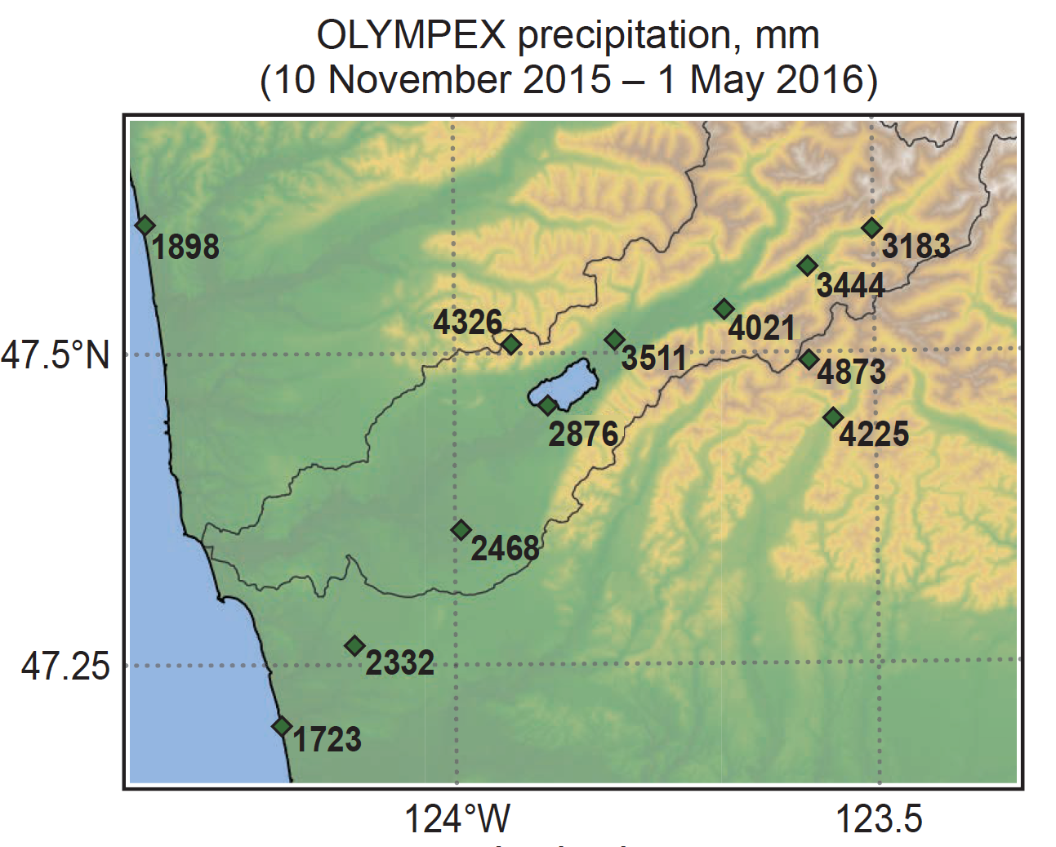
Notes:
Finally, there’s a joke (as Mike Coniglio said the other day) that the atmosphere knows when it’s being watched and often refuses to cooperate with field work. I don’t know what sort of deal Bob made with the weather gods, but he has to be one of the luckiest PIs around. OLYMPEX was no different, with the Olympics receiving 1.5 meters of precipitation at low elevations to nearly 5 meters in the higher terrain over the campaign.

Slide 13
