Slide 1
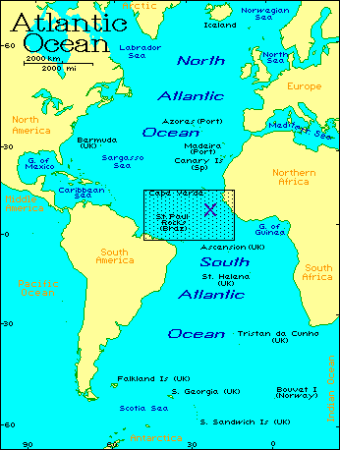

GATE 1974
Notes:
40 ships. 12 a/c

Slide 2
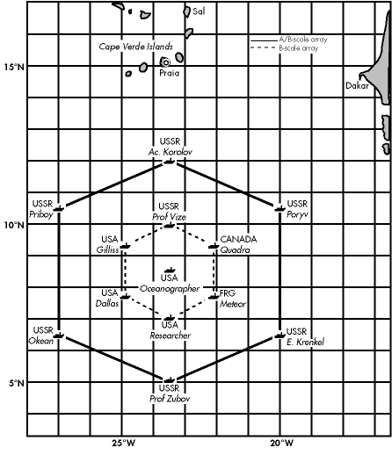
1974
40 ships!
12 aircraft!
16 sounding sites
4 shipborne scanning digital C-band radars
Notes:
40 ships. 12 a/c

Slide 3
GATE 1974

Slide 9
How did this happen?

Slide 10
The promise of global prediction
Satellites
Detente
Global Atmospheric Research Program
“ GATE ”

