Slide 1

The Olympic Mountains Experiment for GPM (OLYMPEX)
R. A. Houze, Jr., L. A. McMurdie, W. A. Petersen
AGU Fall Meeting 2016, 12 December 2016
Notes:
OLYMPEX was a field experiment that brought an unprecedented level of technology to a meteorological field campaign. GATE had the most platforms. OLYMPEX had the most technology.

Slide 2
Goals
Physical validation to support GPM algorithms
Orographic effects on frontal precipitation

Slide 3
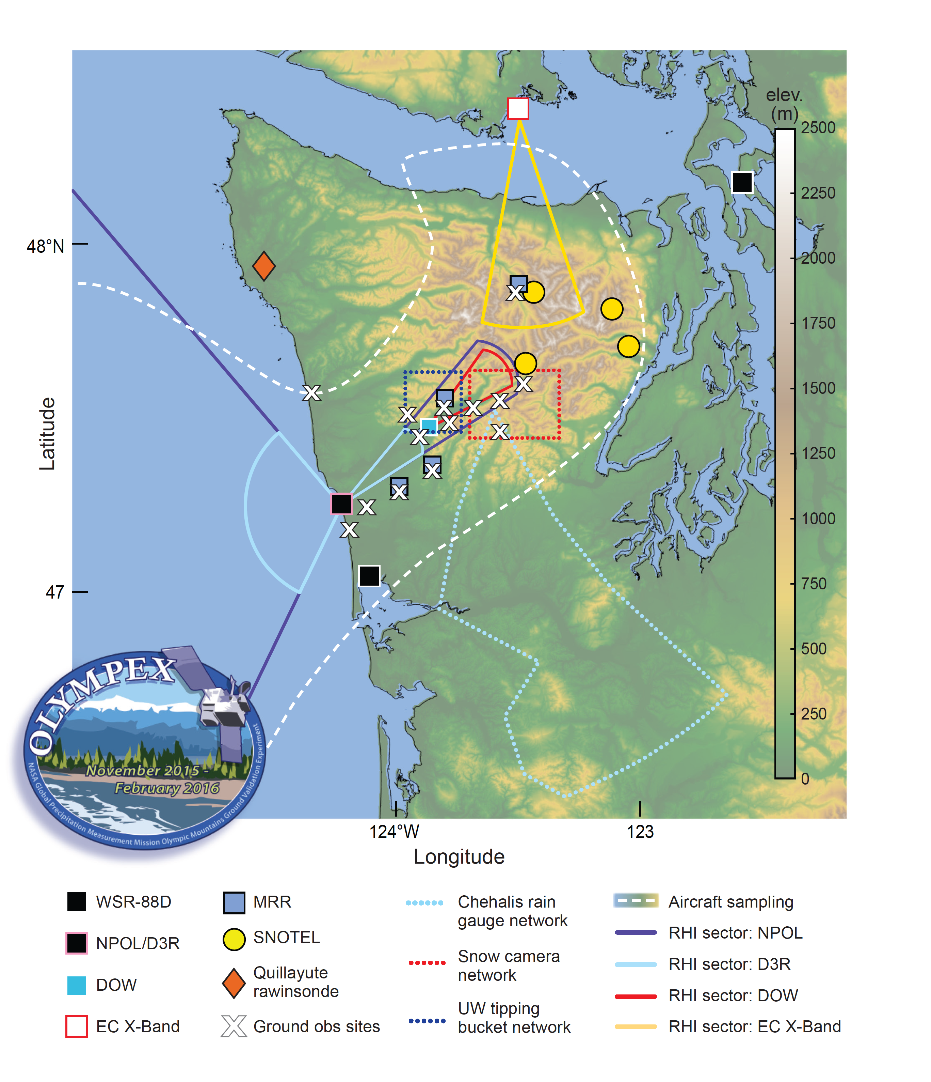
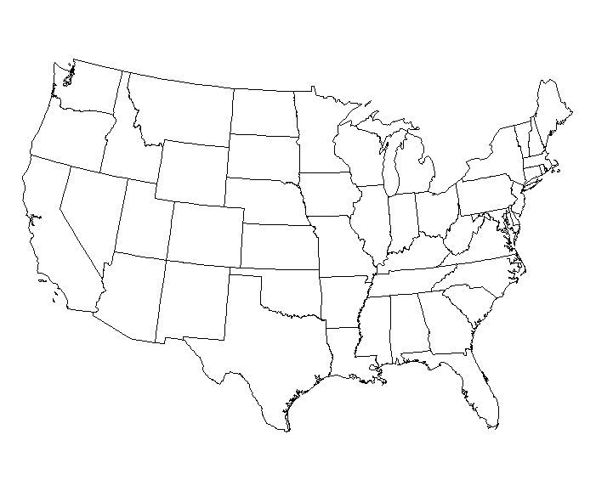
DC-8
ER-2
Citation
Notes:
OLYMPEX was carried out here.
Radar RHI sectors over the wedges; ocean, windward, lee
Surface sites: precipitation; PSDs; fall velocities
Snow poles and SNOTELs
Soundings
A/C flights on both sides of the mountains and offshore over the radars and sfc sites

Slide 4
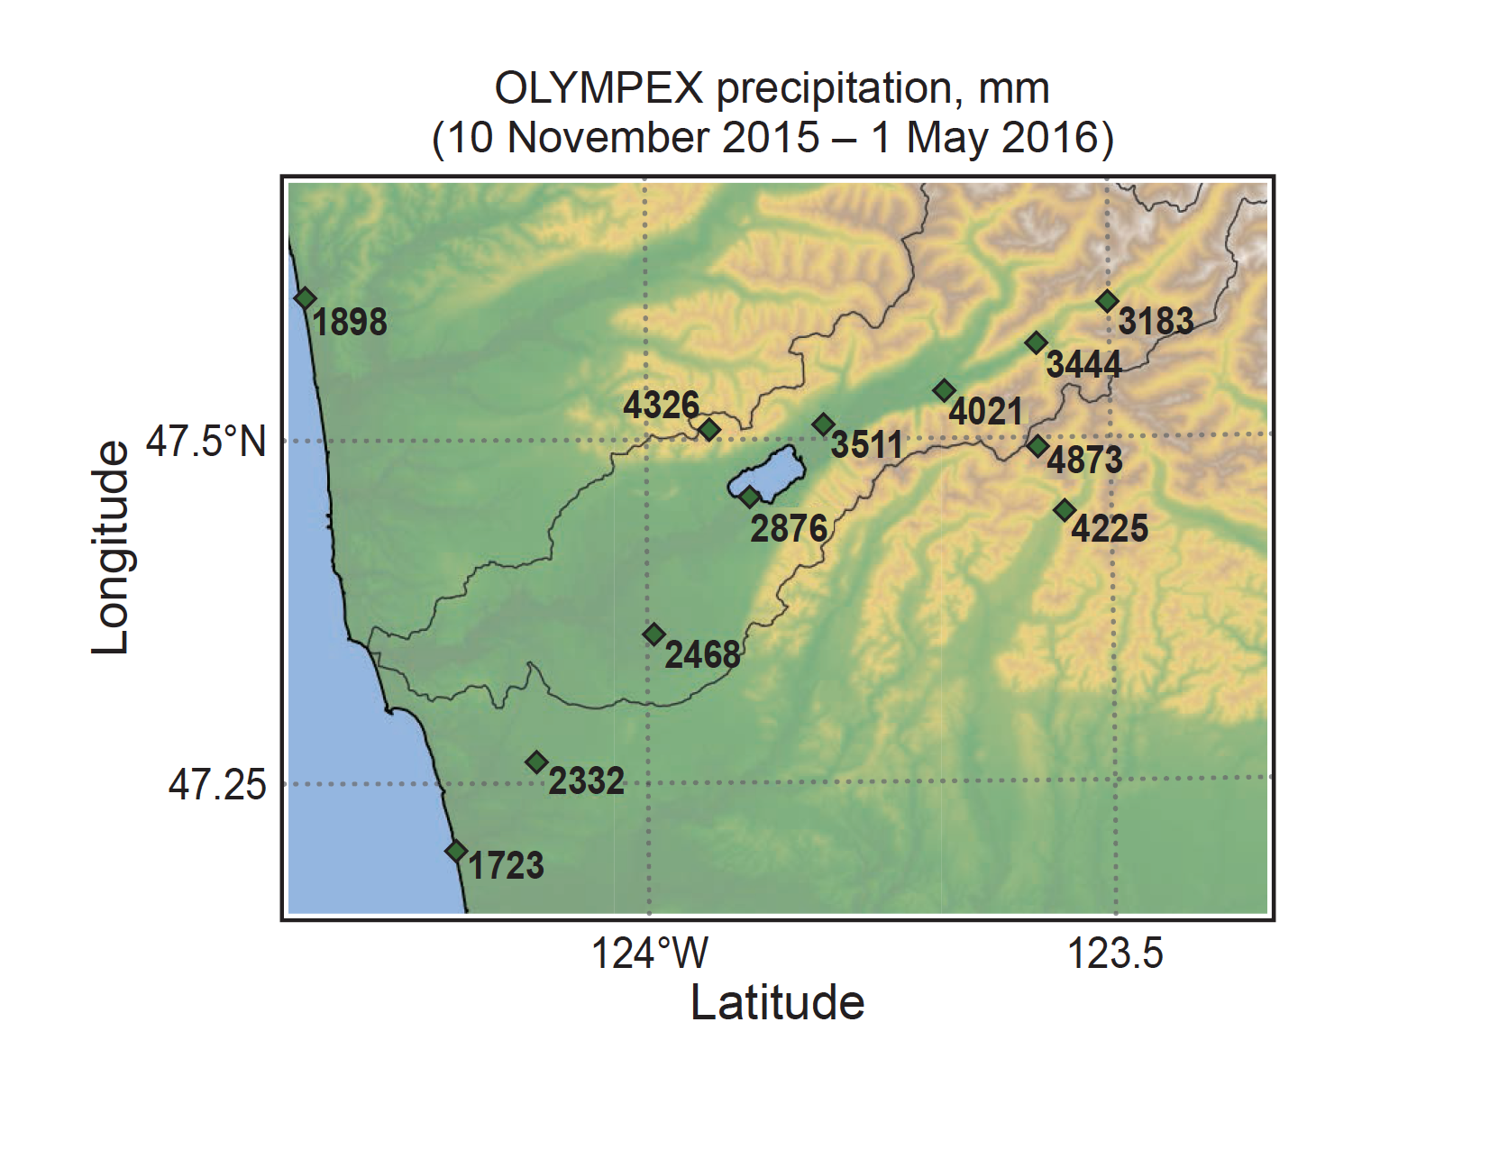
Notes:
70-150 inches of rain, enhanced over terrain

Slide 5
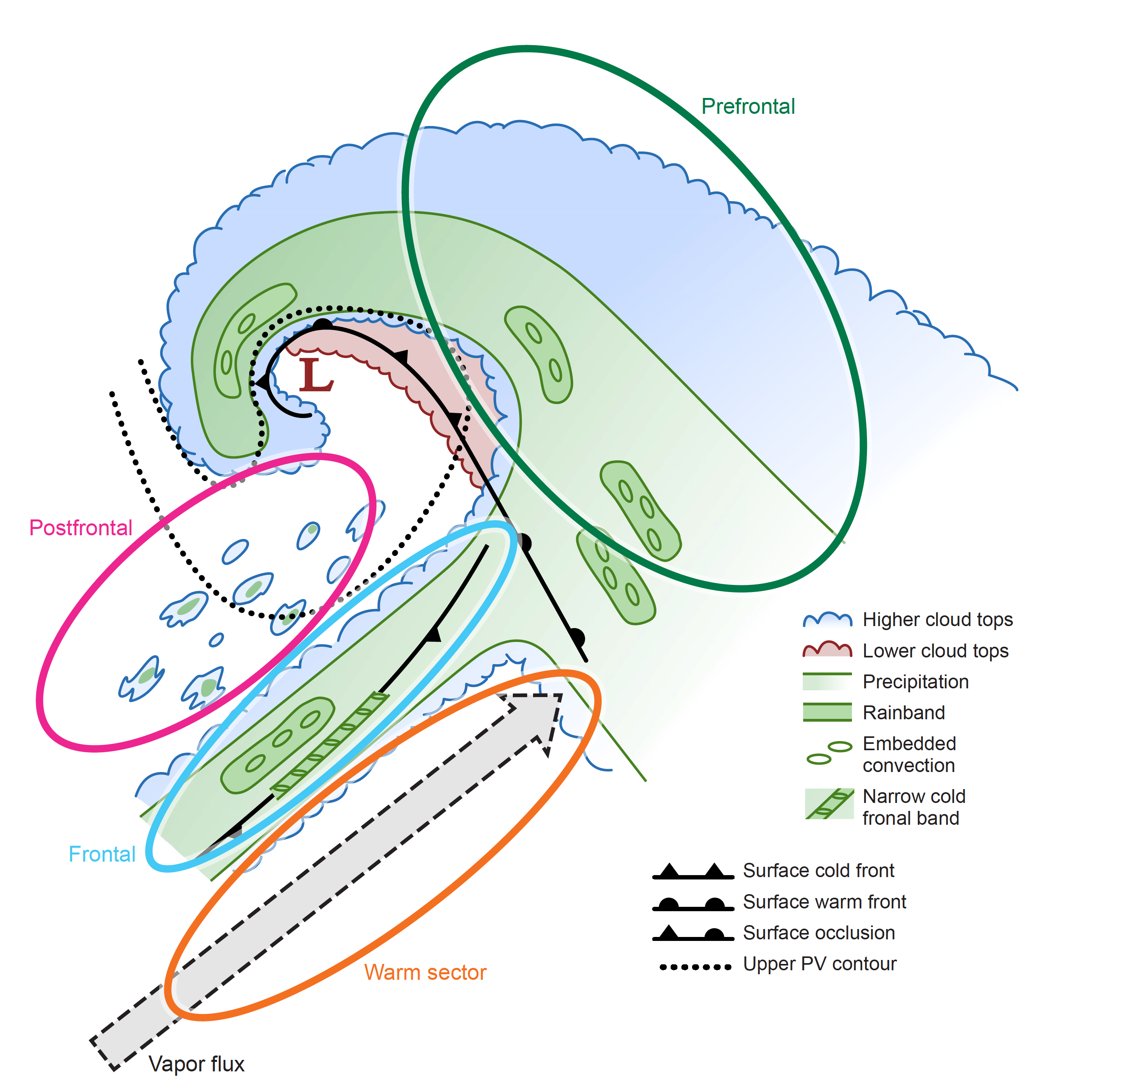
Storms passing over the Olympic Mountains
Notes:
The dataset collected was not only huge…but also…homogeneous…facilitating…statistics
Storms passing over the OLYMPEX area all had a variation of this idealized structure…consisting of characteristic sectors…(describe)

Slide 6
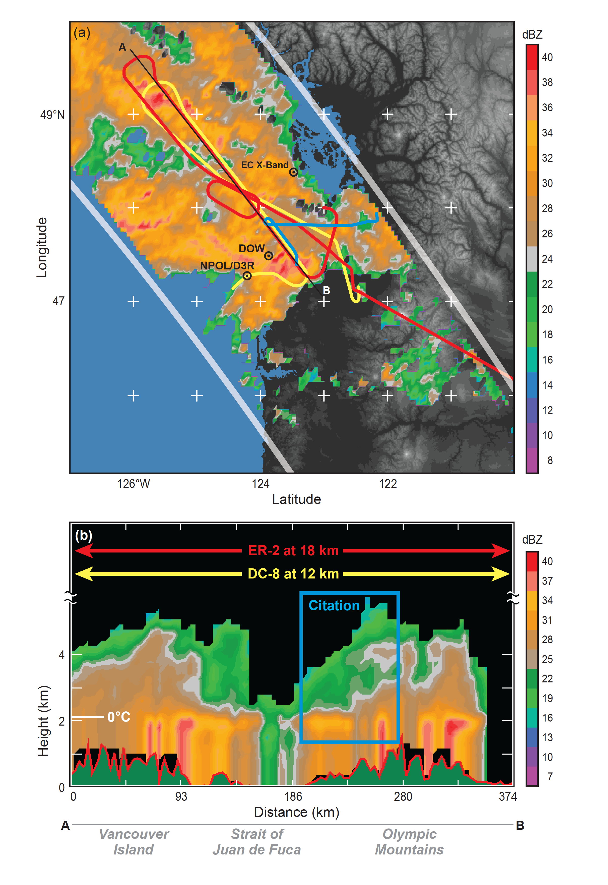
Coordination of
3 aircraft
with GPM satellite overpass
GPM radar
Notes:
All 3 aircraft coordinated with a GPM overpass

Slide 7
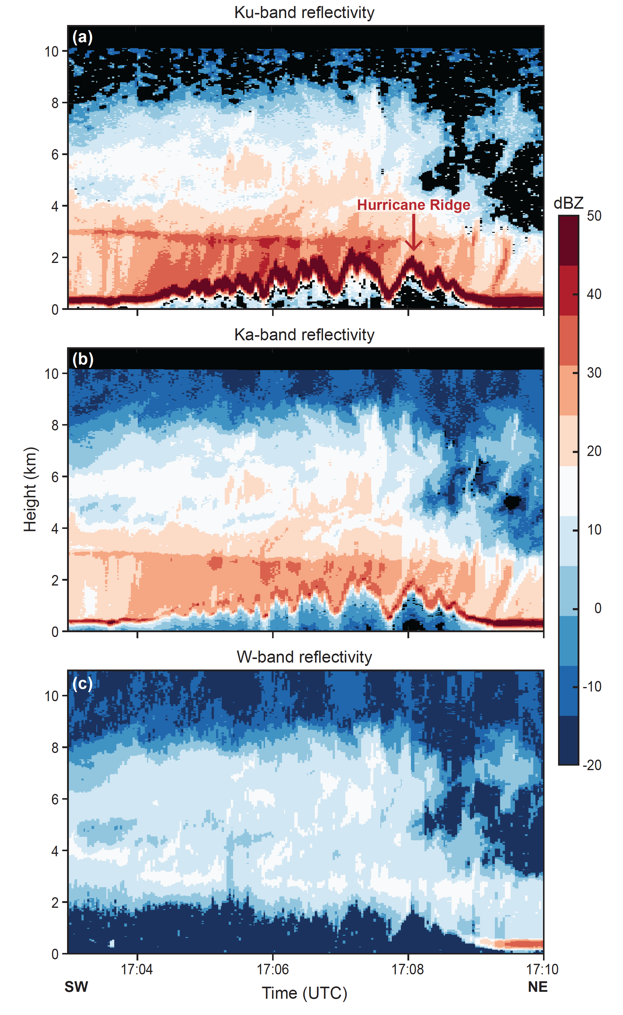
DC8 aircraft radar data at 3 different wavelengths
sees both windward and lee sides
Notes:
DC8 was key platform for comparing windward and lee structures of storms
Dec8

Slide 8
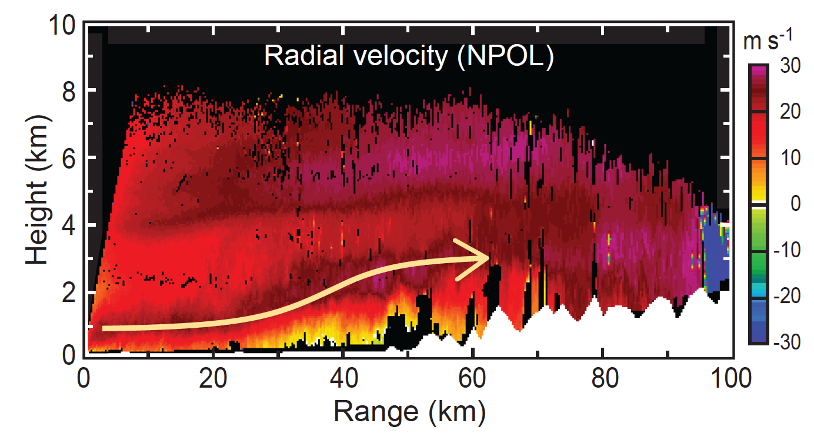
Lifting upstream of barrier

Slide 9
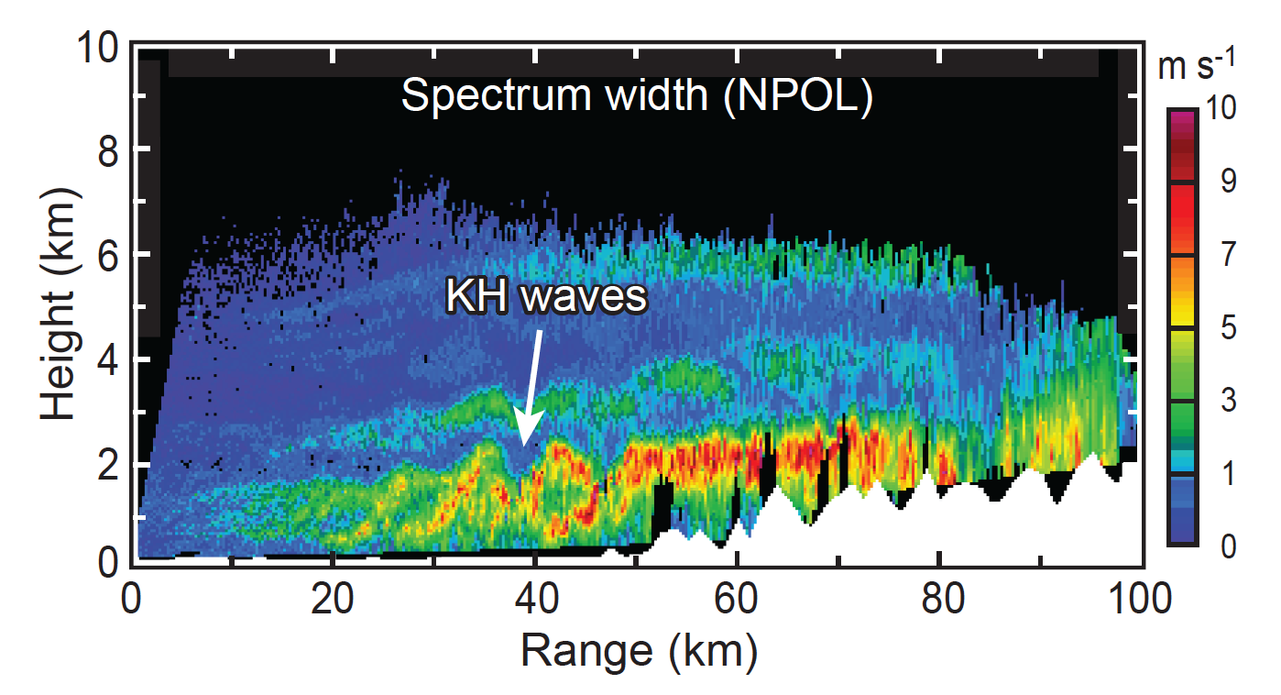

Slide 10
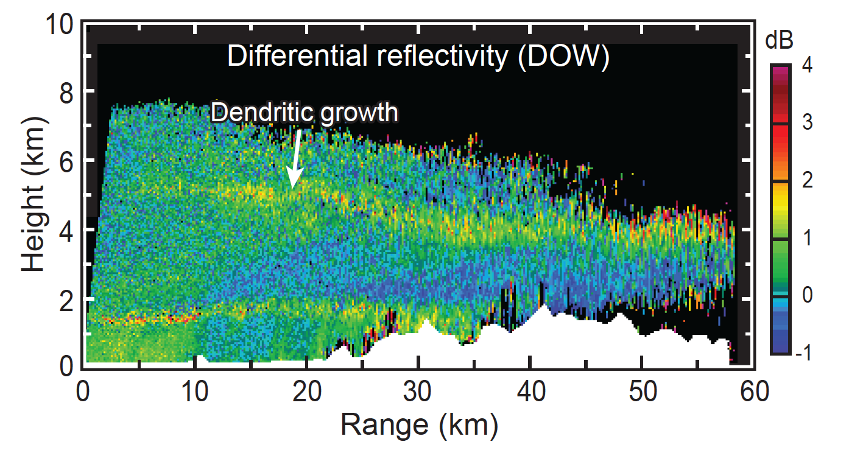
DOW X-band radar in the Quinault Valley

Slide 11
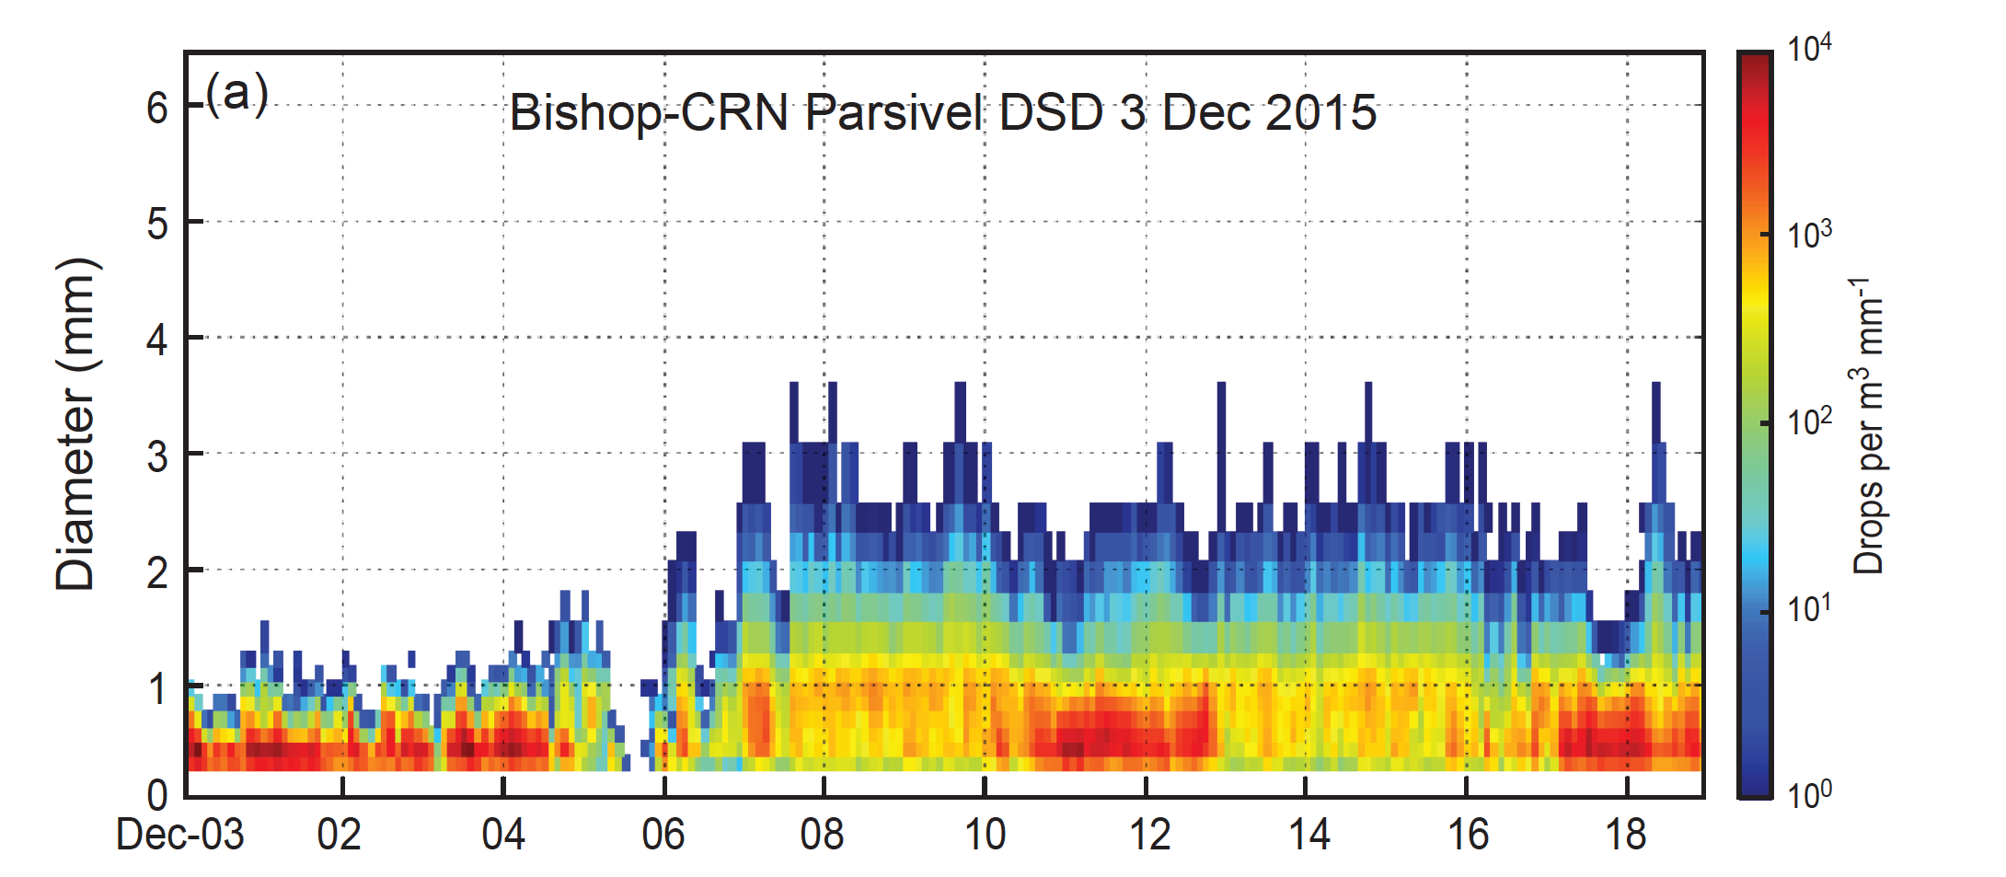
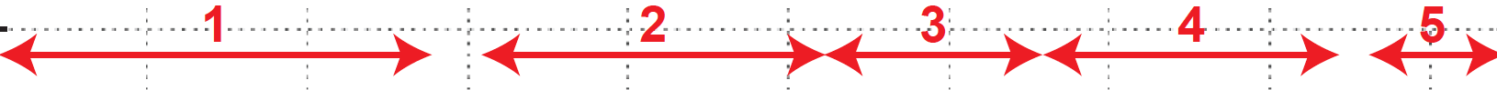
Drop size distribution at a windward site

Slide 12
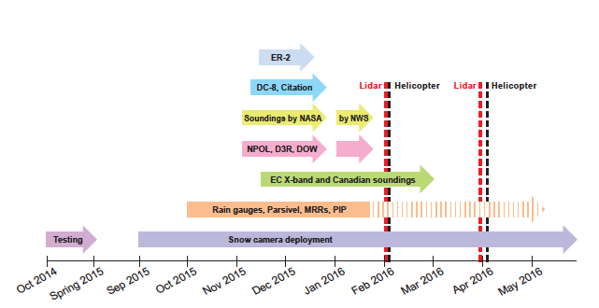
Timeline of data assets—openly available!
Notes:
Datasets nested approx. within Nov-Dec
Some measurements over the whole season
Snowpack surveys at key times

Slide 13
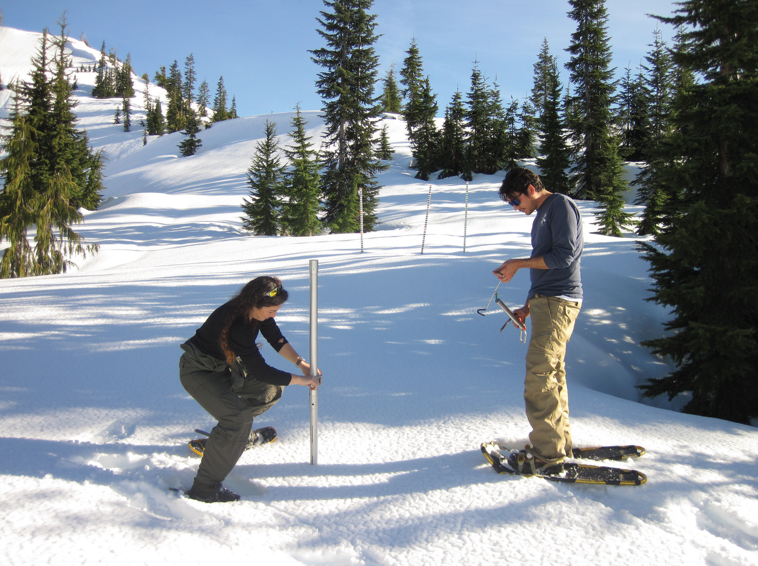
Notes:
AT high elevations the snow was monitored—both by cameras and surveys like this one

Slide 14
Summary
15 Pacific frontal systems sampled
Including 3 “atmospheric rivers”
Aircraft sampled over ocean, windward, and lee sides
Multiple radar λ’s
Lidar
Cloud physics
Coordinated with satellite
Coordinated with ground-based sites
4 research radars on land
Dual polarization
RHI sectors
Ocean, windward, lee
Surface instruments
Precipitation rate, PSD and fallspeed time series
Multiple altitudes
Windward and lee
Snow assessment
Cameras
Surveys

Slide 15
End
Supported by: NASA Grants NNX13AG71G, NNX15AL38G and NSF Grant AGS-1503155

Slide 16
Extra Slides

Slide 17
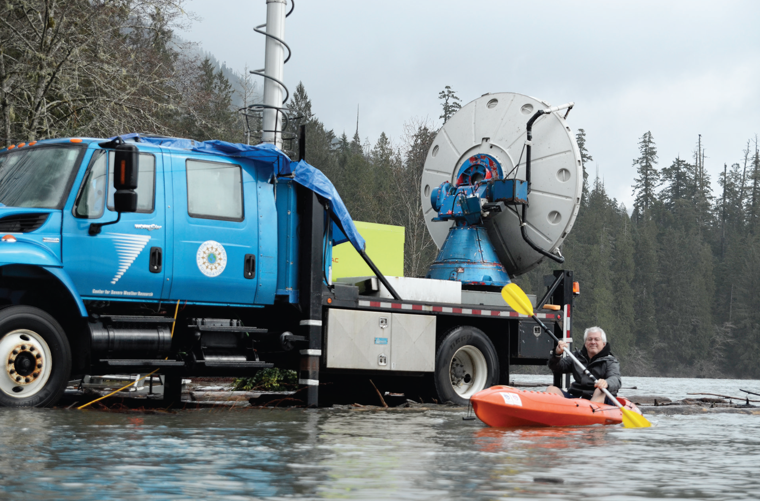
Notes:
Illustrates the amount of rain—there were overflows of Lake Quinault

Slide 18
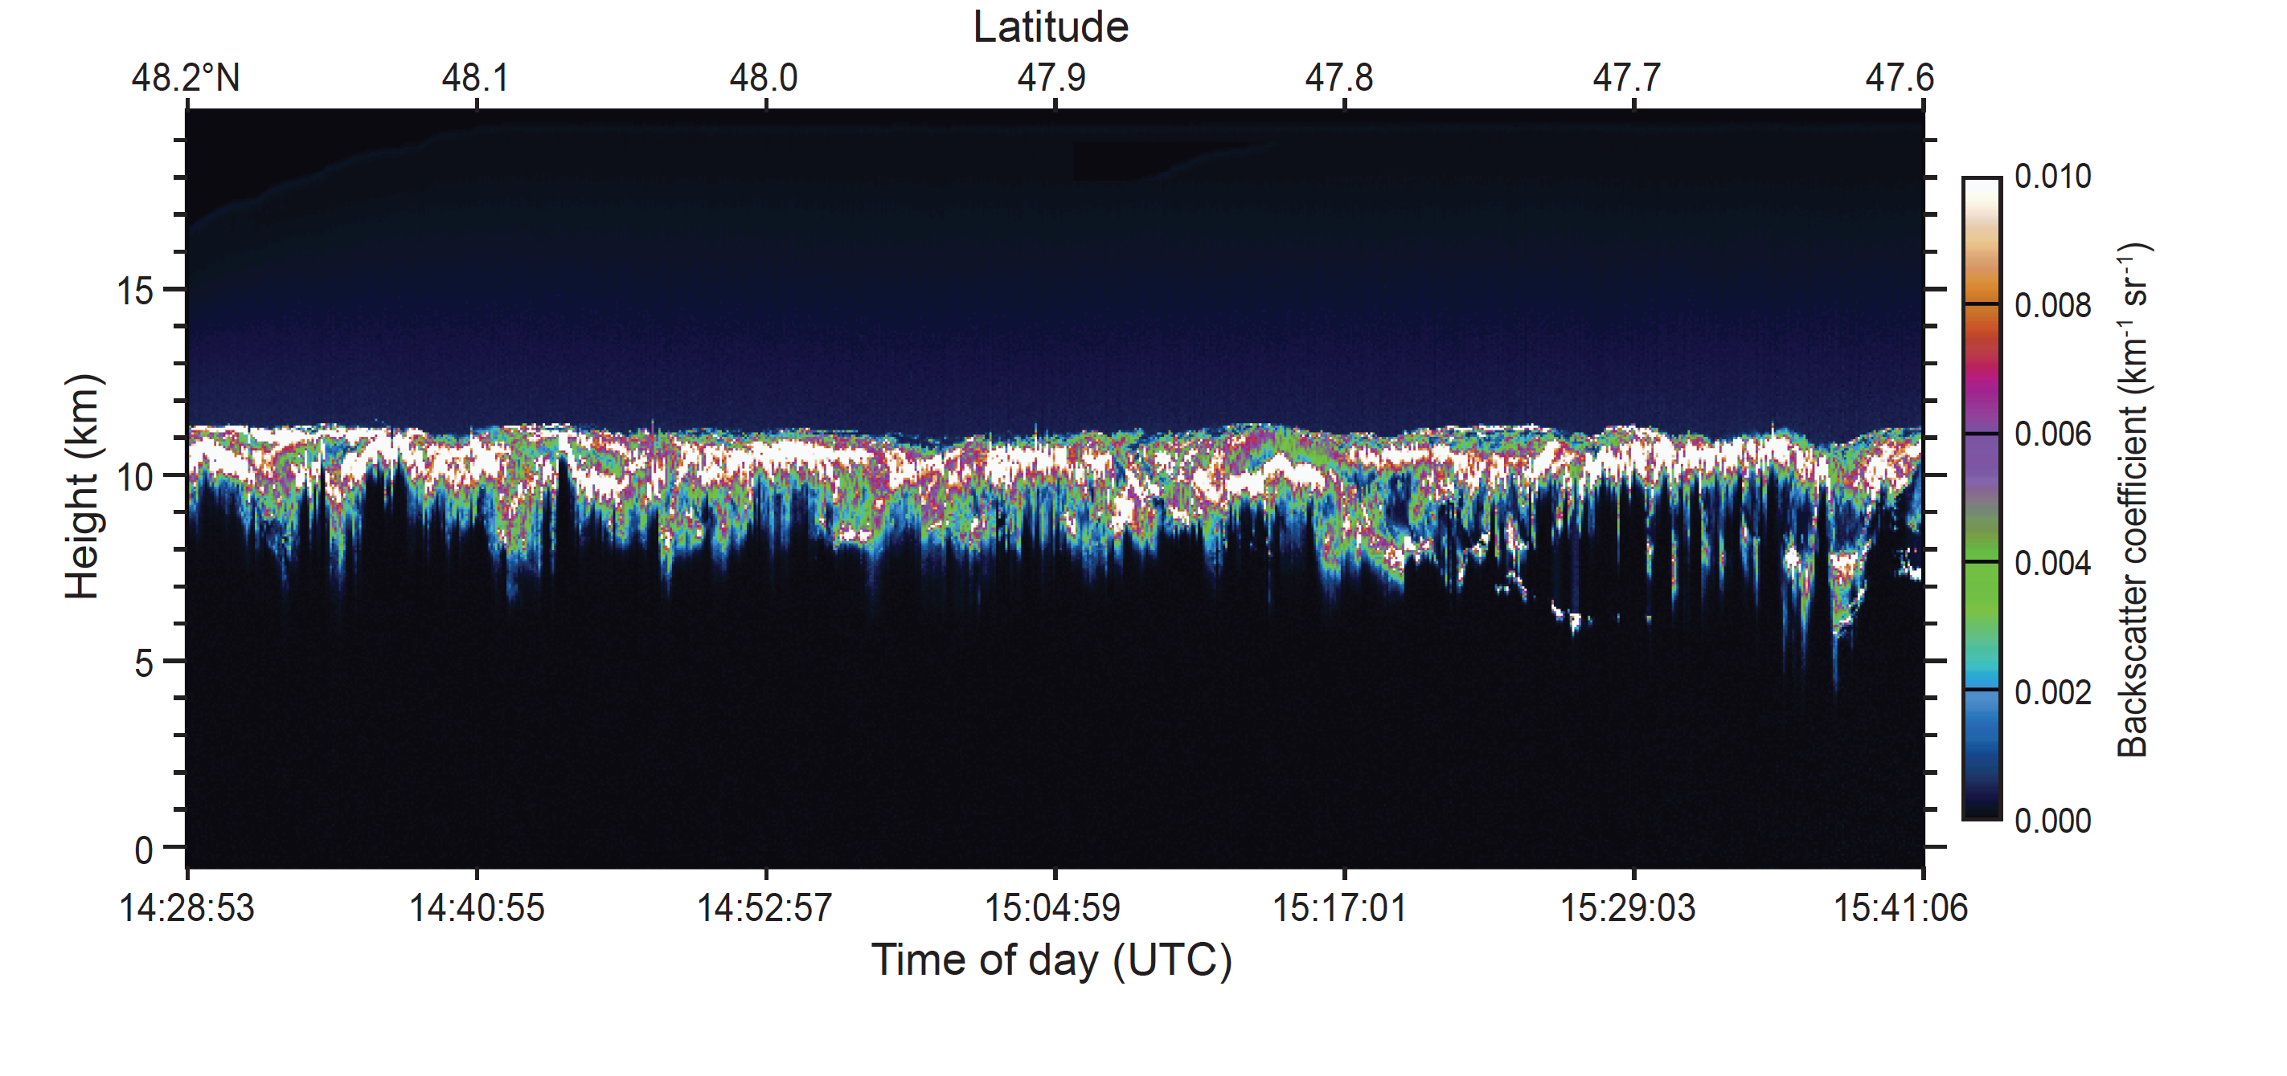
Lidar observations from ER2 showing upper level cloud
Notes:
The ER2 was able to clearly show the upper level cloud not seen by even the W-band radar on the DC8

Slide 19
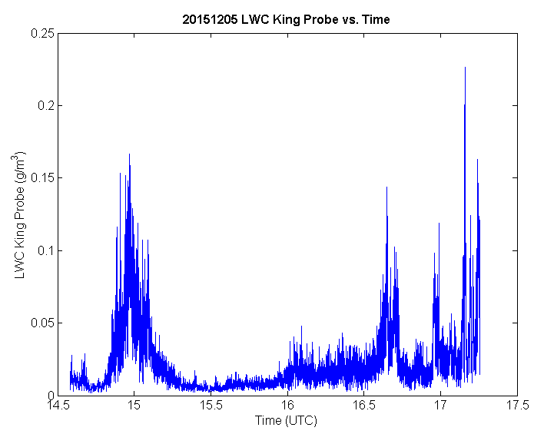
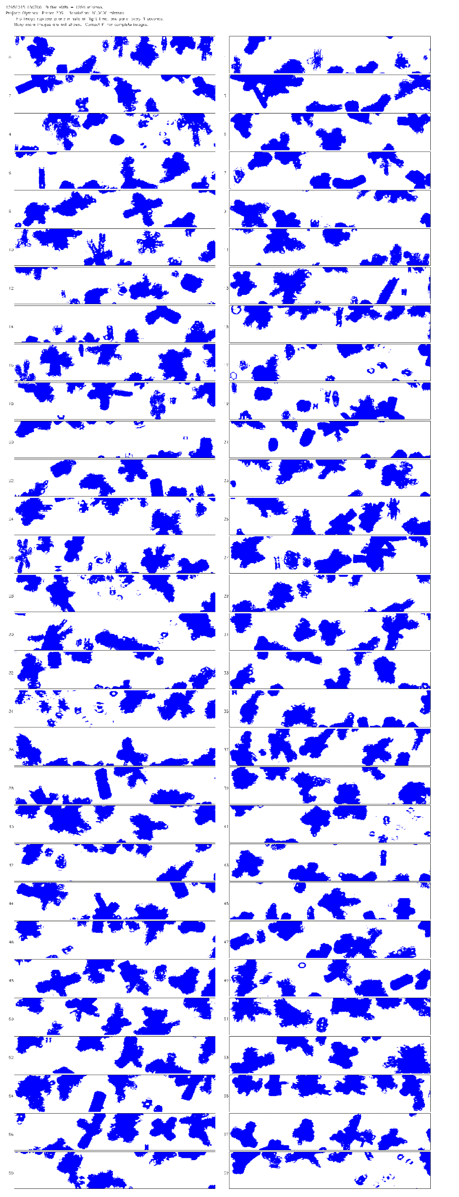
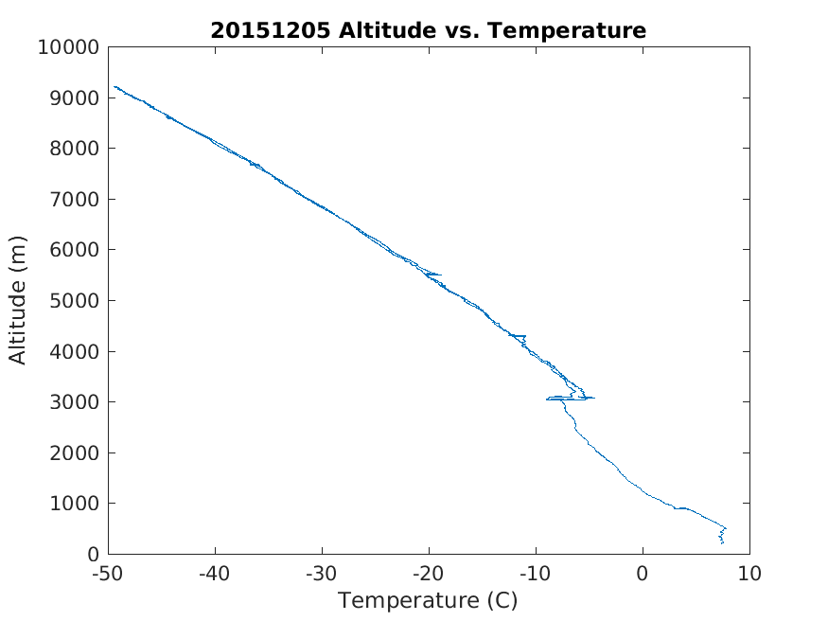
1507 UTC
Increased liquid water content
Citation A/C
Dendrites, aggregates, plates in 2DS-H probe imagery
-15°C at 4.5 km

Slide 20
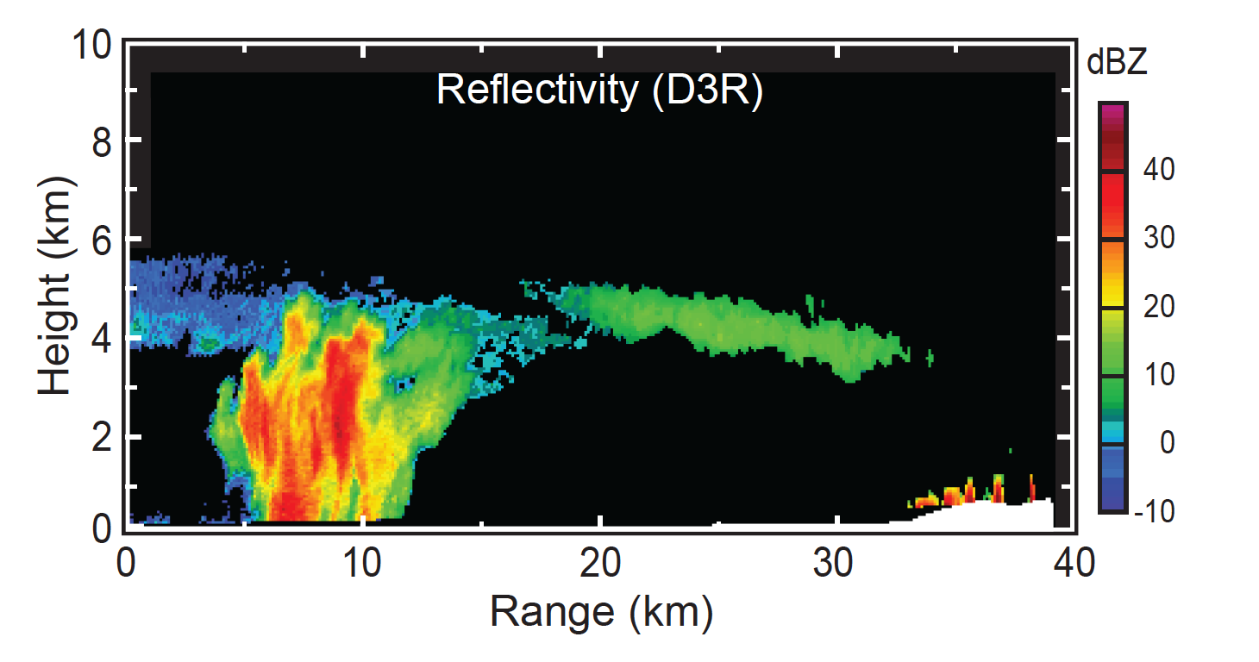
A postfrontal cell seen by Ka-band radar on the coast
Notes:
Postfrontal cell structures indicated in detail

Slide 21
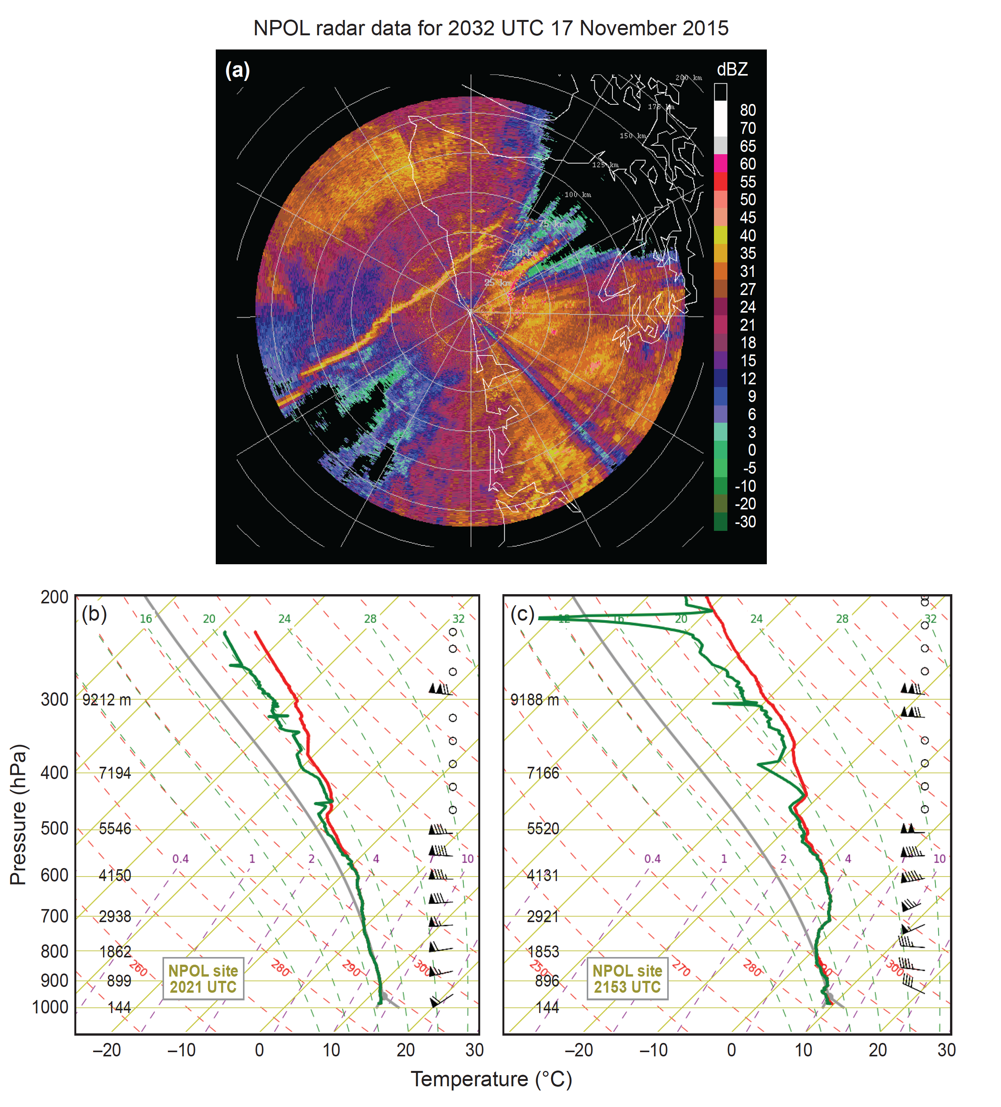
A narrow cold frontal rainband seen by the NPOL S-band radar & soundings before and after
Notes:
NCFR sampled 3 times…soundings ahead and behind

Slide 22
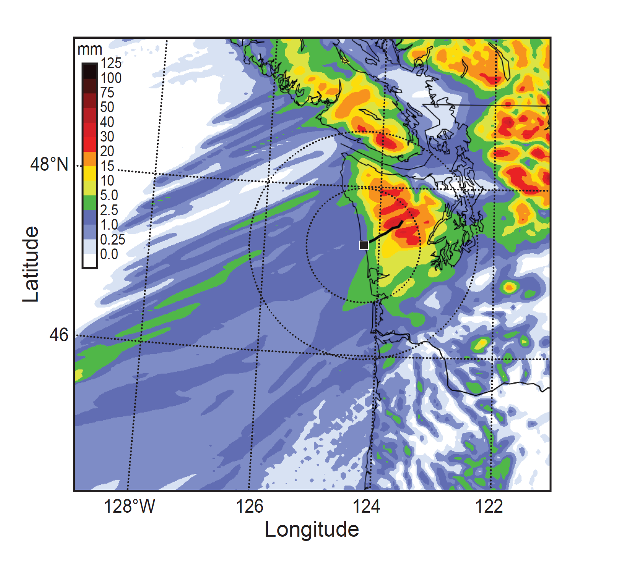
WRF 3h precipitation forecast
for an atmospheric river case
Notes:
Had 3 AR cases…well shown by model 3h forecast…windward enhancement and rain shadow seen also in sfc data

