Slide 1
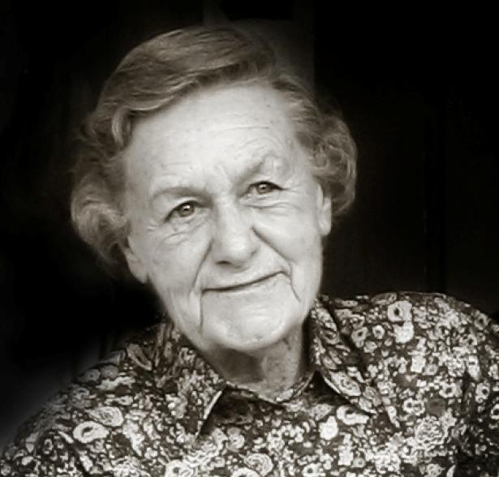
Pauline Austin
1916-2011

Slide 2
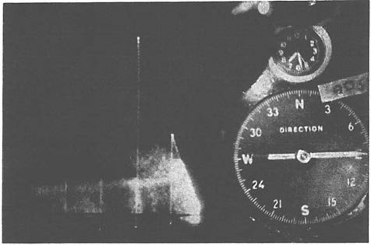
MIT 1945-1949
Height
Range

Slide 3
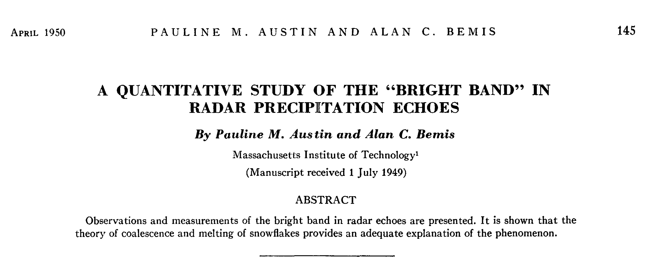
Notes:
As one of the conclusions of this study it is
suggested that the term "bright band" be reserved
for those cases where the intensification of the radar
echo is associated with melting snow.

Slide 4
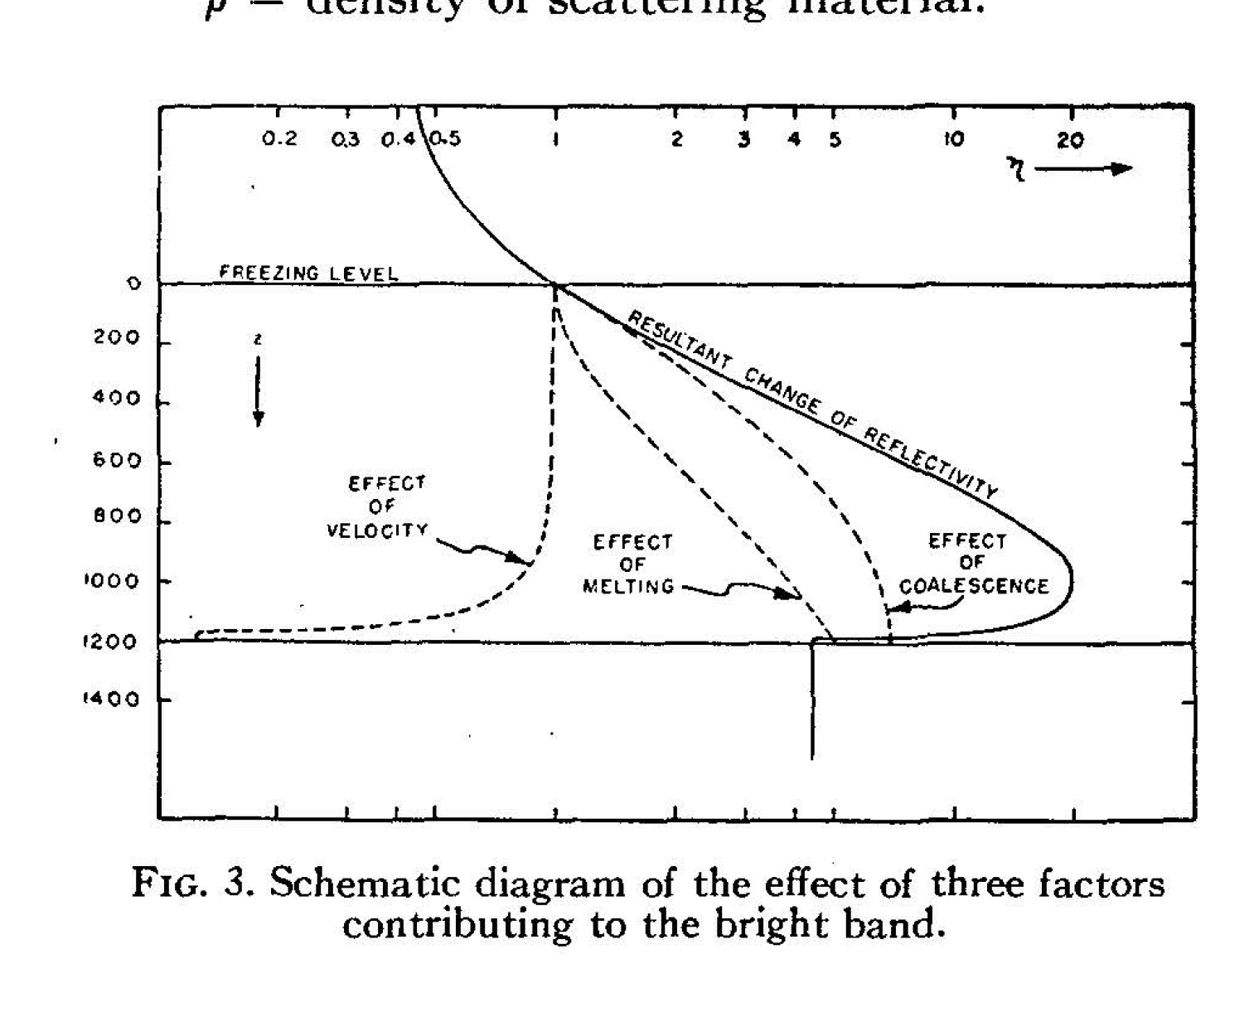
reflectivity per volume
feet

Slide 5
MIT: 1967-1972
Charney, Phillips, Lorenz, Sanders, …
Vietnam war!
Notes:
Came to MIT to study dynamics under Charney, Phillips, Lorenz, Sanders

Slide 6
Pauline Austin
Teacher
Mentor
Career long influence
Notes:
4 ways that I think of her

Slide 7
Milestones after I left MIT

Slide 8
The 1970’s
“GATE”
Tropical Atlantic Ocean
Quantitative radar in the tropics

Slide 9
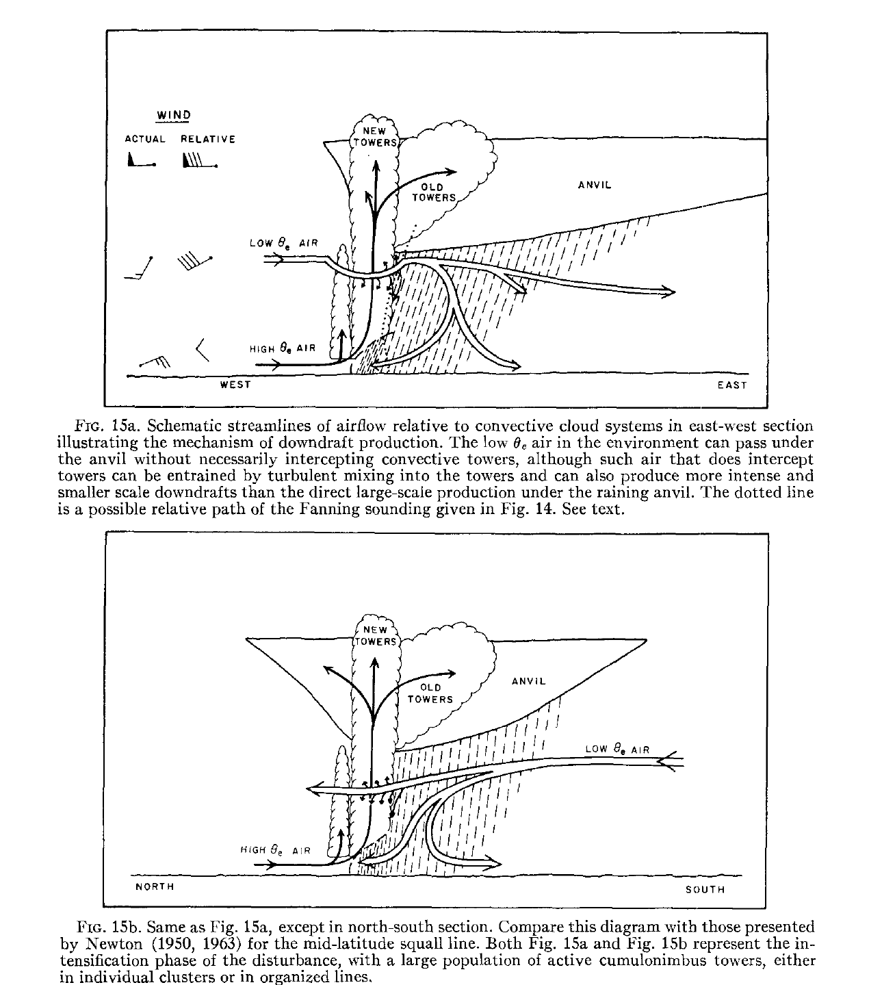
GATE 1974
Quantitative radar over equatorial Atlantic

Slide 10
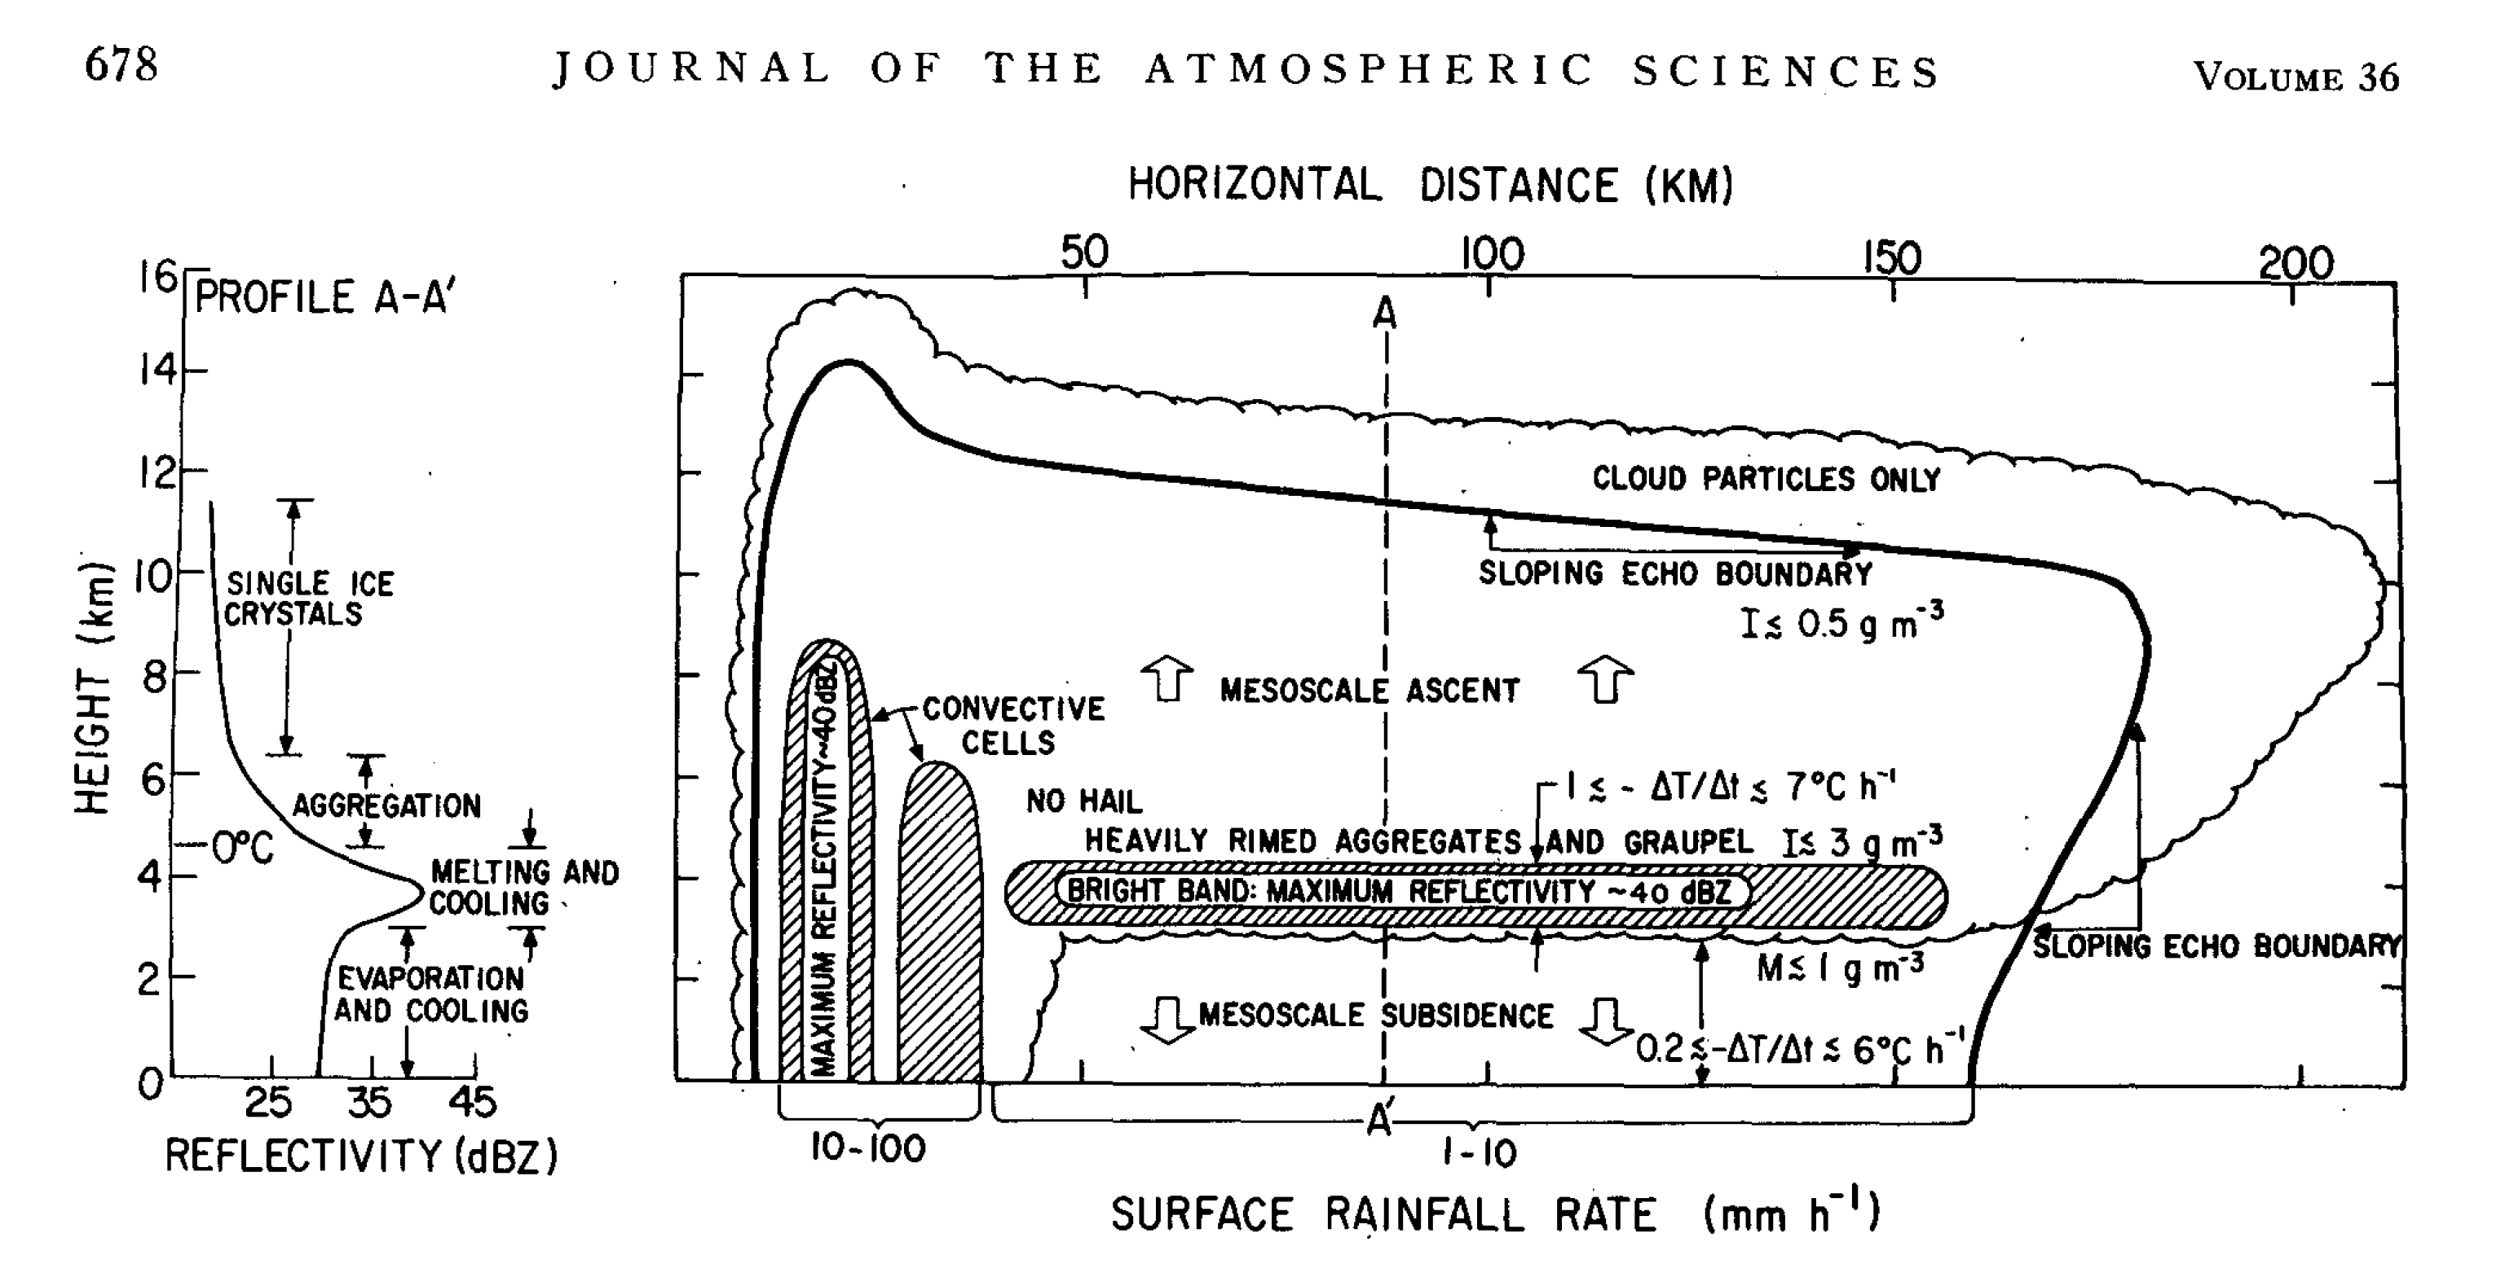
Leary and Houze (1979)

Slide 11
The 1980’s – 90’s
Doppler Radar
Kansas 1985 “PRESTORM”
West Pacific 1992-1993 “TOGA COARE”

Slide 12
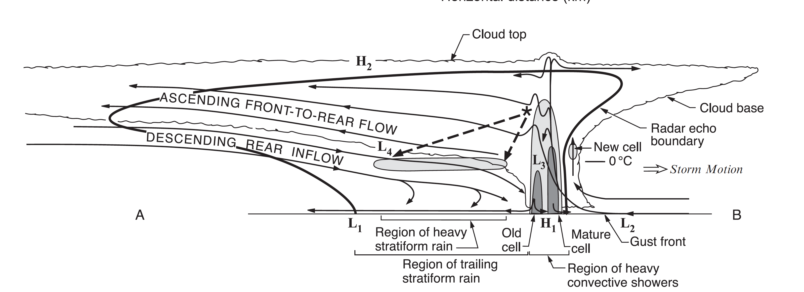

Slide 13
The 2000’s
Dual Polarization
Equatorial Indian Ocean 2011-2012
“DYNAMO”

Slide 14
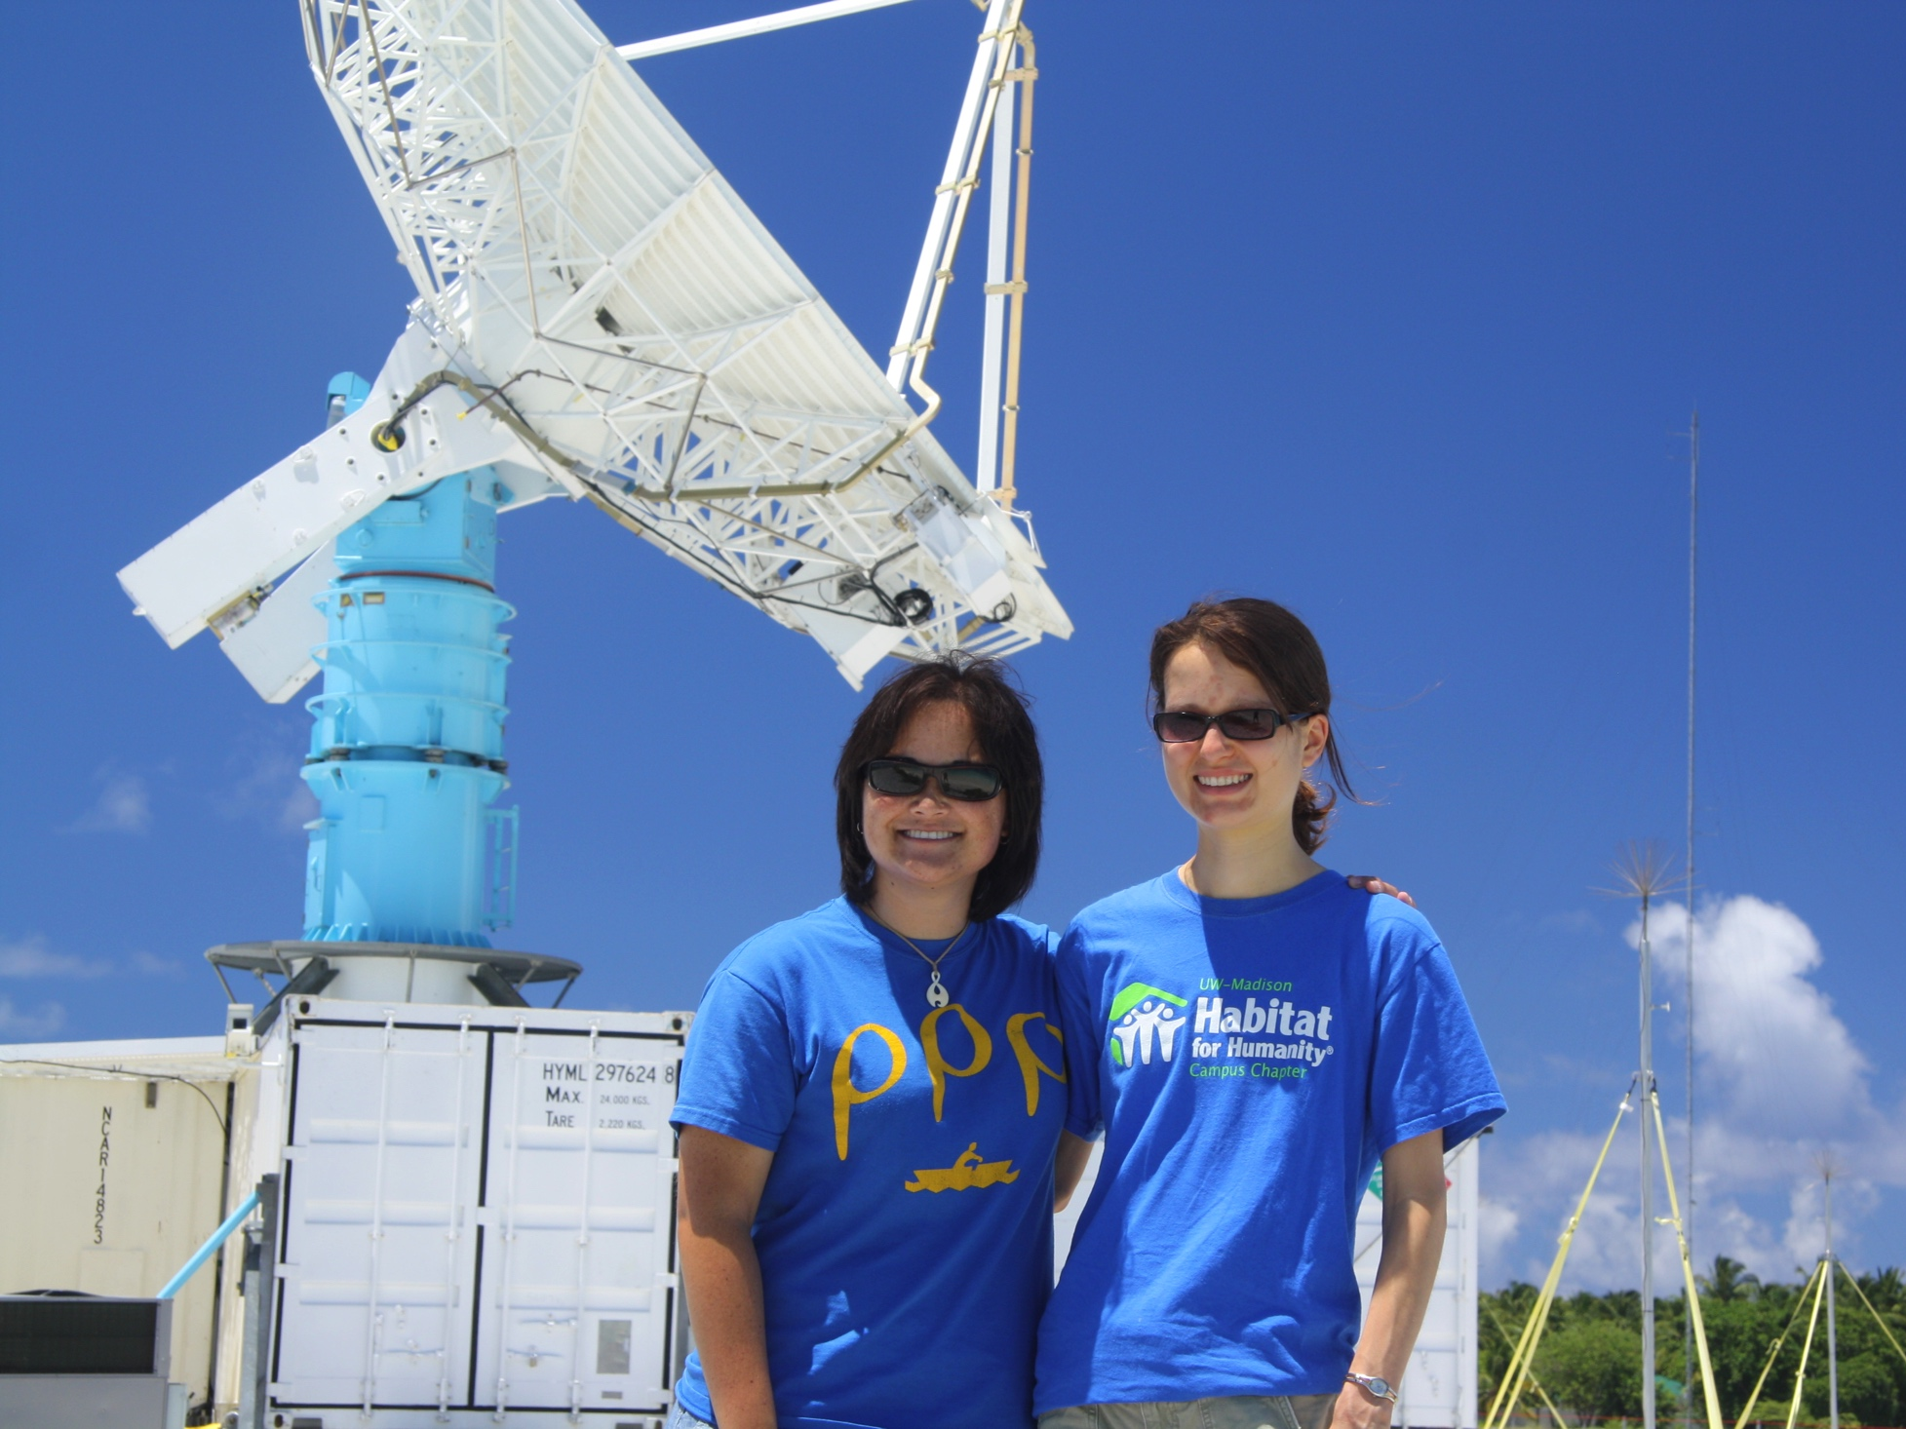
NCAR S-Pol radar in DYNAMO
Ph. D. Granddaughters

Slide 15
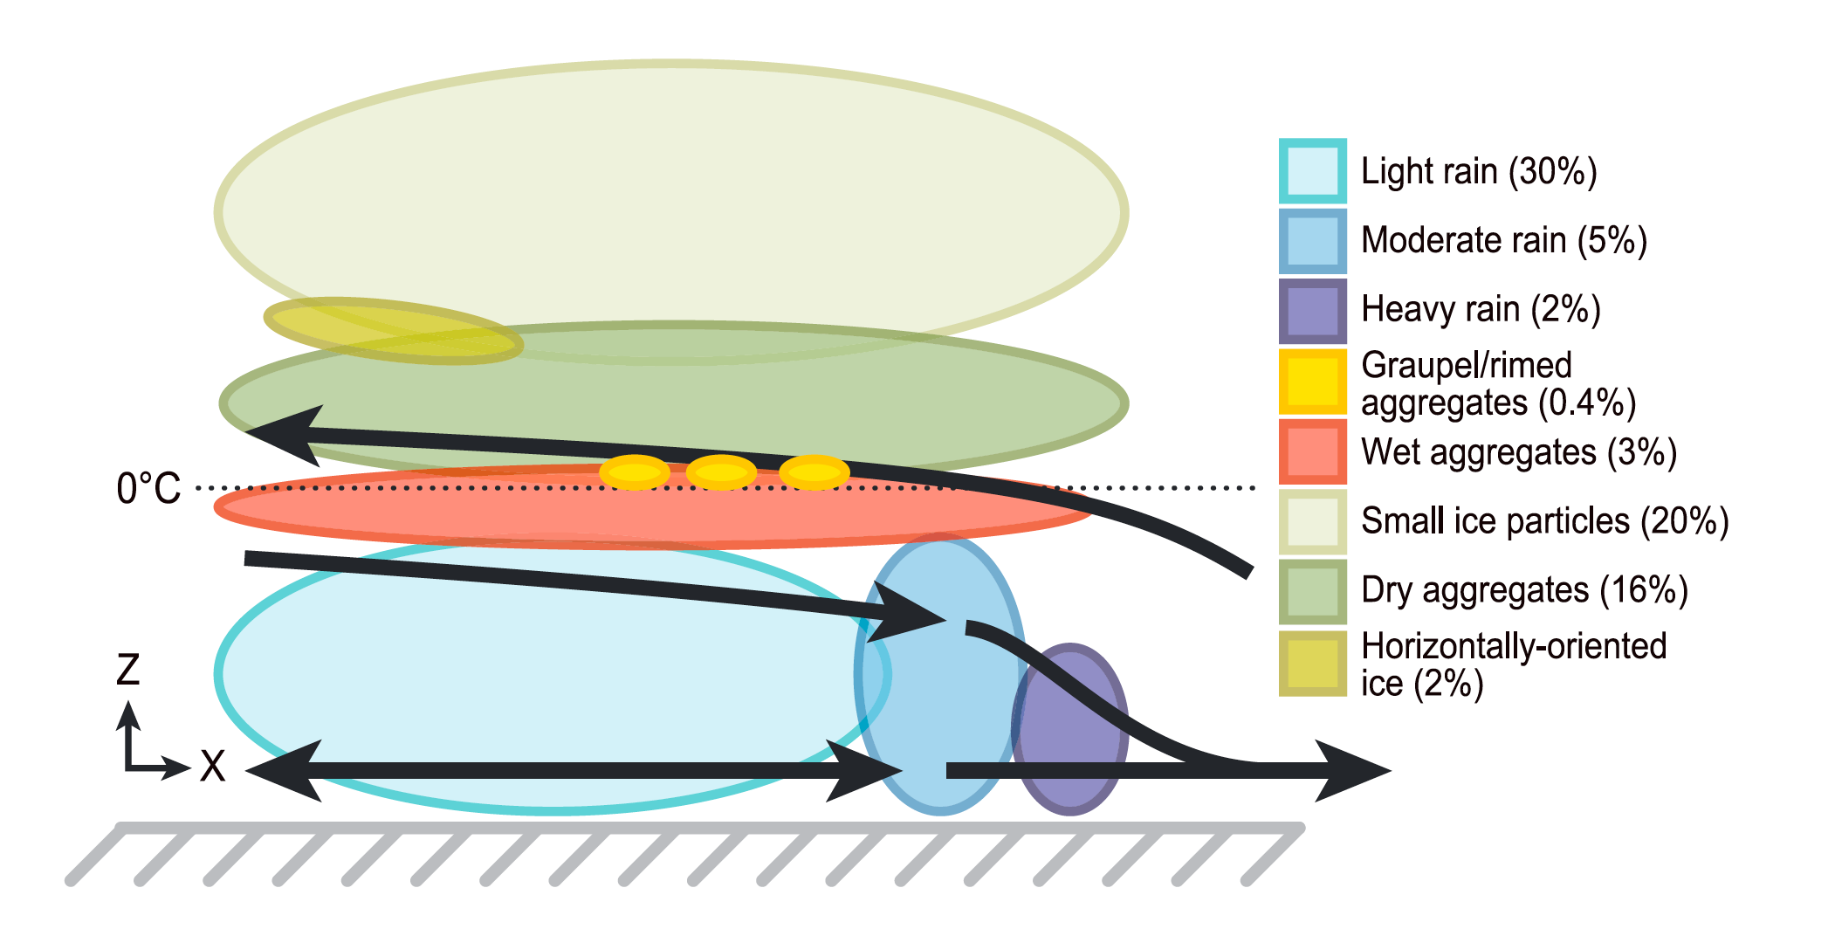
NCAR S-Pol radar in DYNAMO
Barnes & Houze 2014

Slide 16
The 2000’s (cont.)
Radars in Space

Slide 17
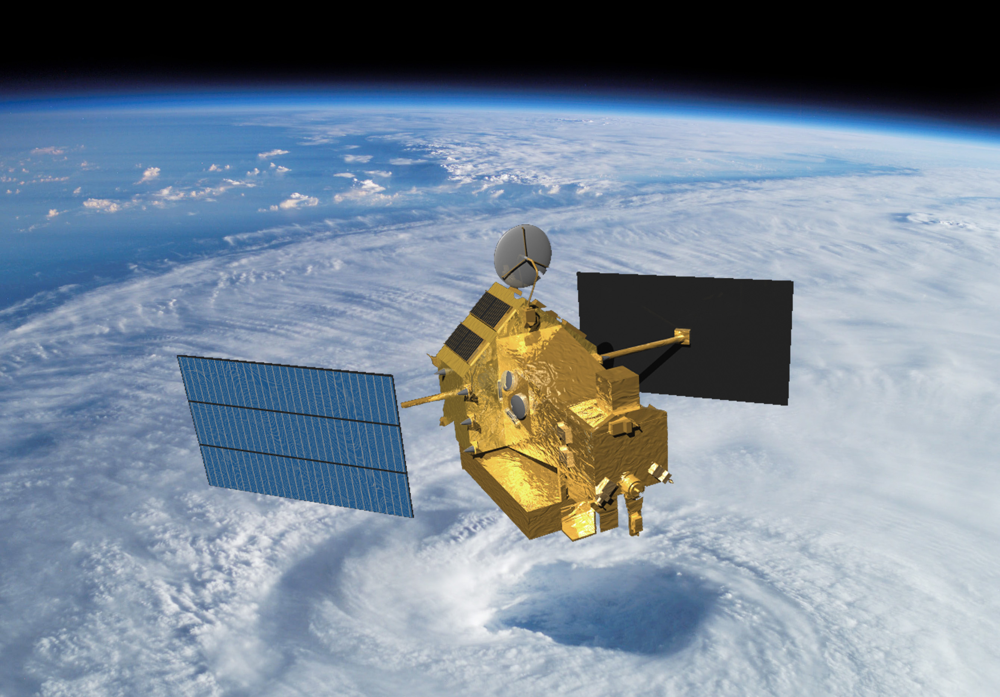
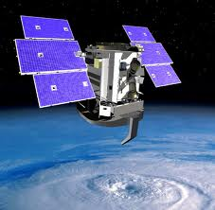
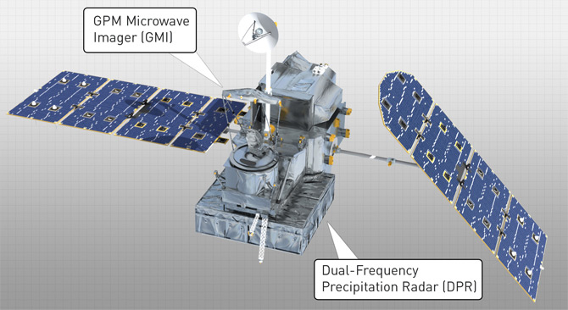
TRMM
1997-
CloudSat
2006-
GPM
2014-
Notes:
CloudSat: W-band, 94 GHz, 3 mm
TRMM: Ka-band, 13.8 GHz, 2.17 cm

Slide 18
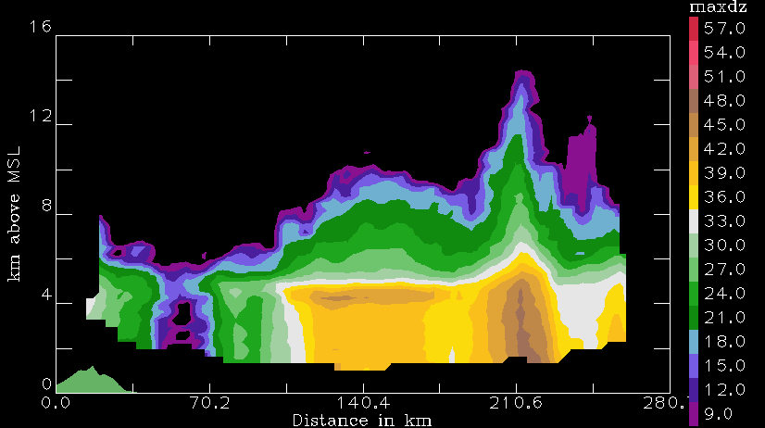
Bright band seen by TRMM over the West Pacific
Notes:
Like an RHI
See clearly conv & sf areas
TRMM algorithm→C/SF separation→imp. For latent heating calculations

Slide 19
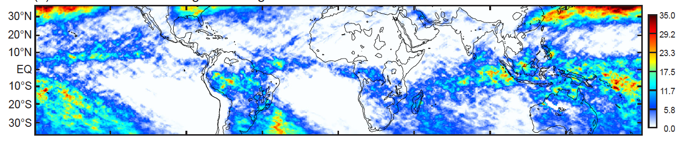
FR
Frequency of broad regions of bright band seen by TRMM radar
Houze et al. 2015
Notes:
Strong BSRs develop where moderate WCCs occur
Strong BSRs manifest more strongly over the oceans
True in both DJF and JJA
Fronts produce BSRs in winter hemispheres
Plum rain region is combination of midlatitude troughs and the westward extension of the Indian monsoon
Mei Yu, Baiu, Jangma

Slide 20
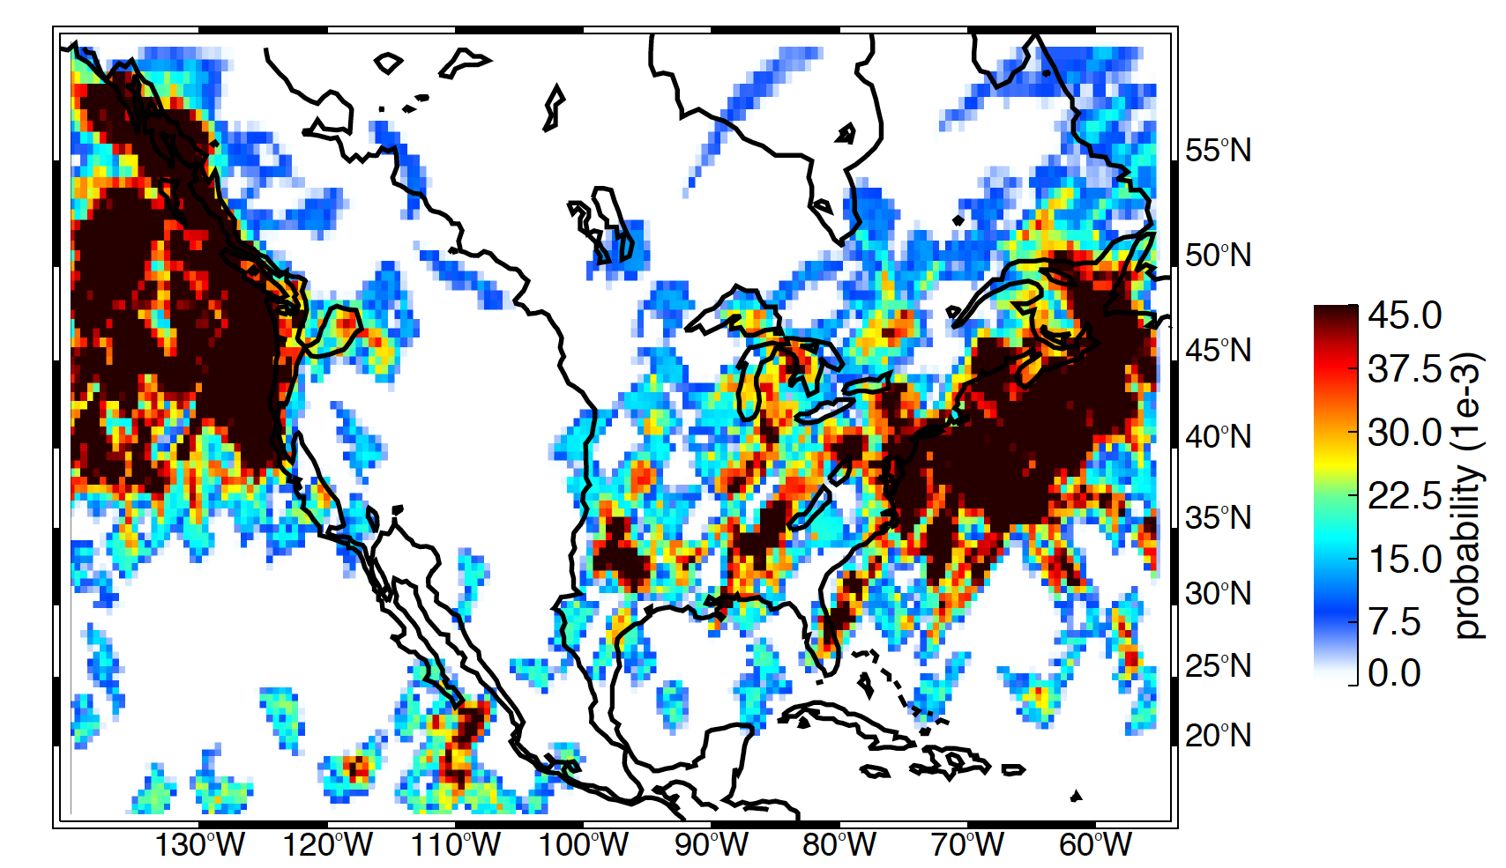
Frequency of broad regions of bright band seen by GPM radar
DJF

Slide 21
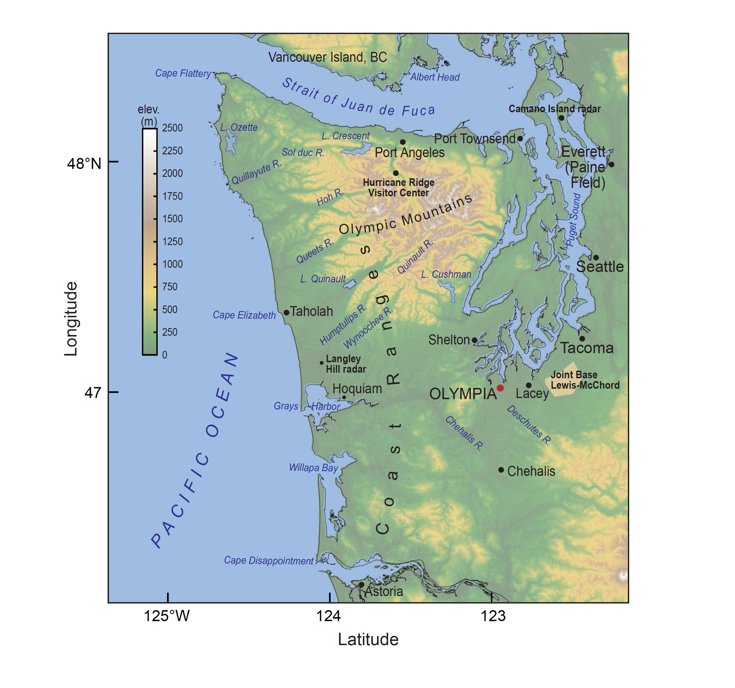

Slide 22
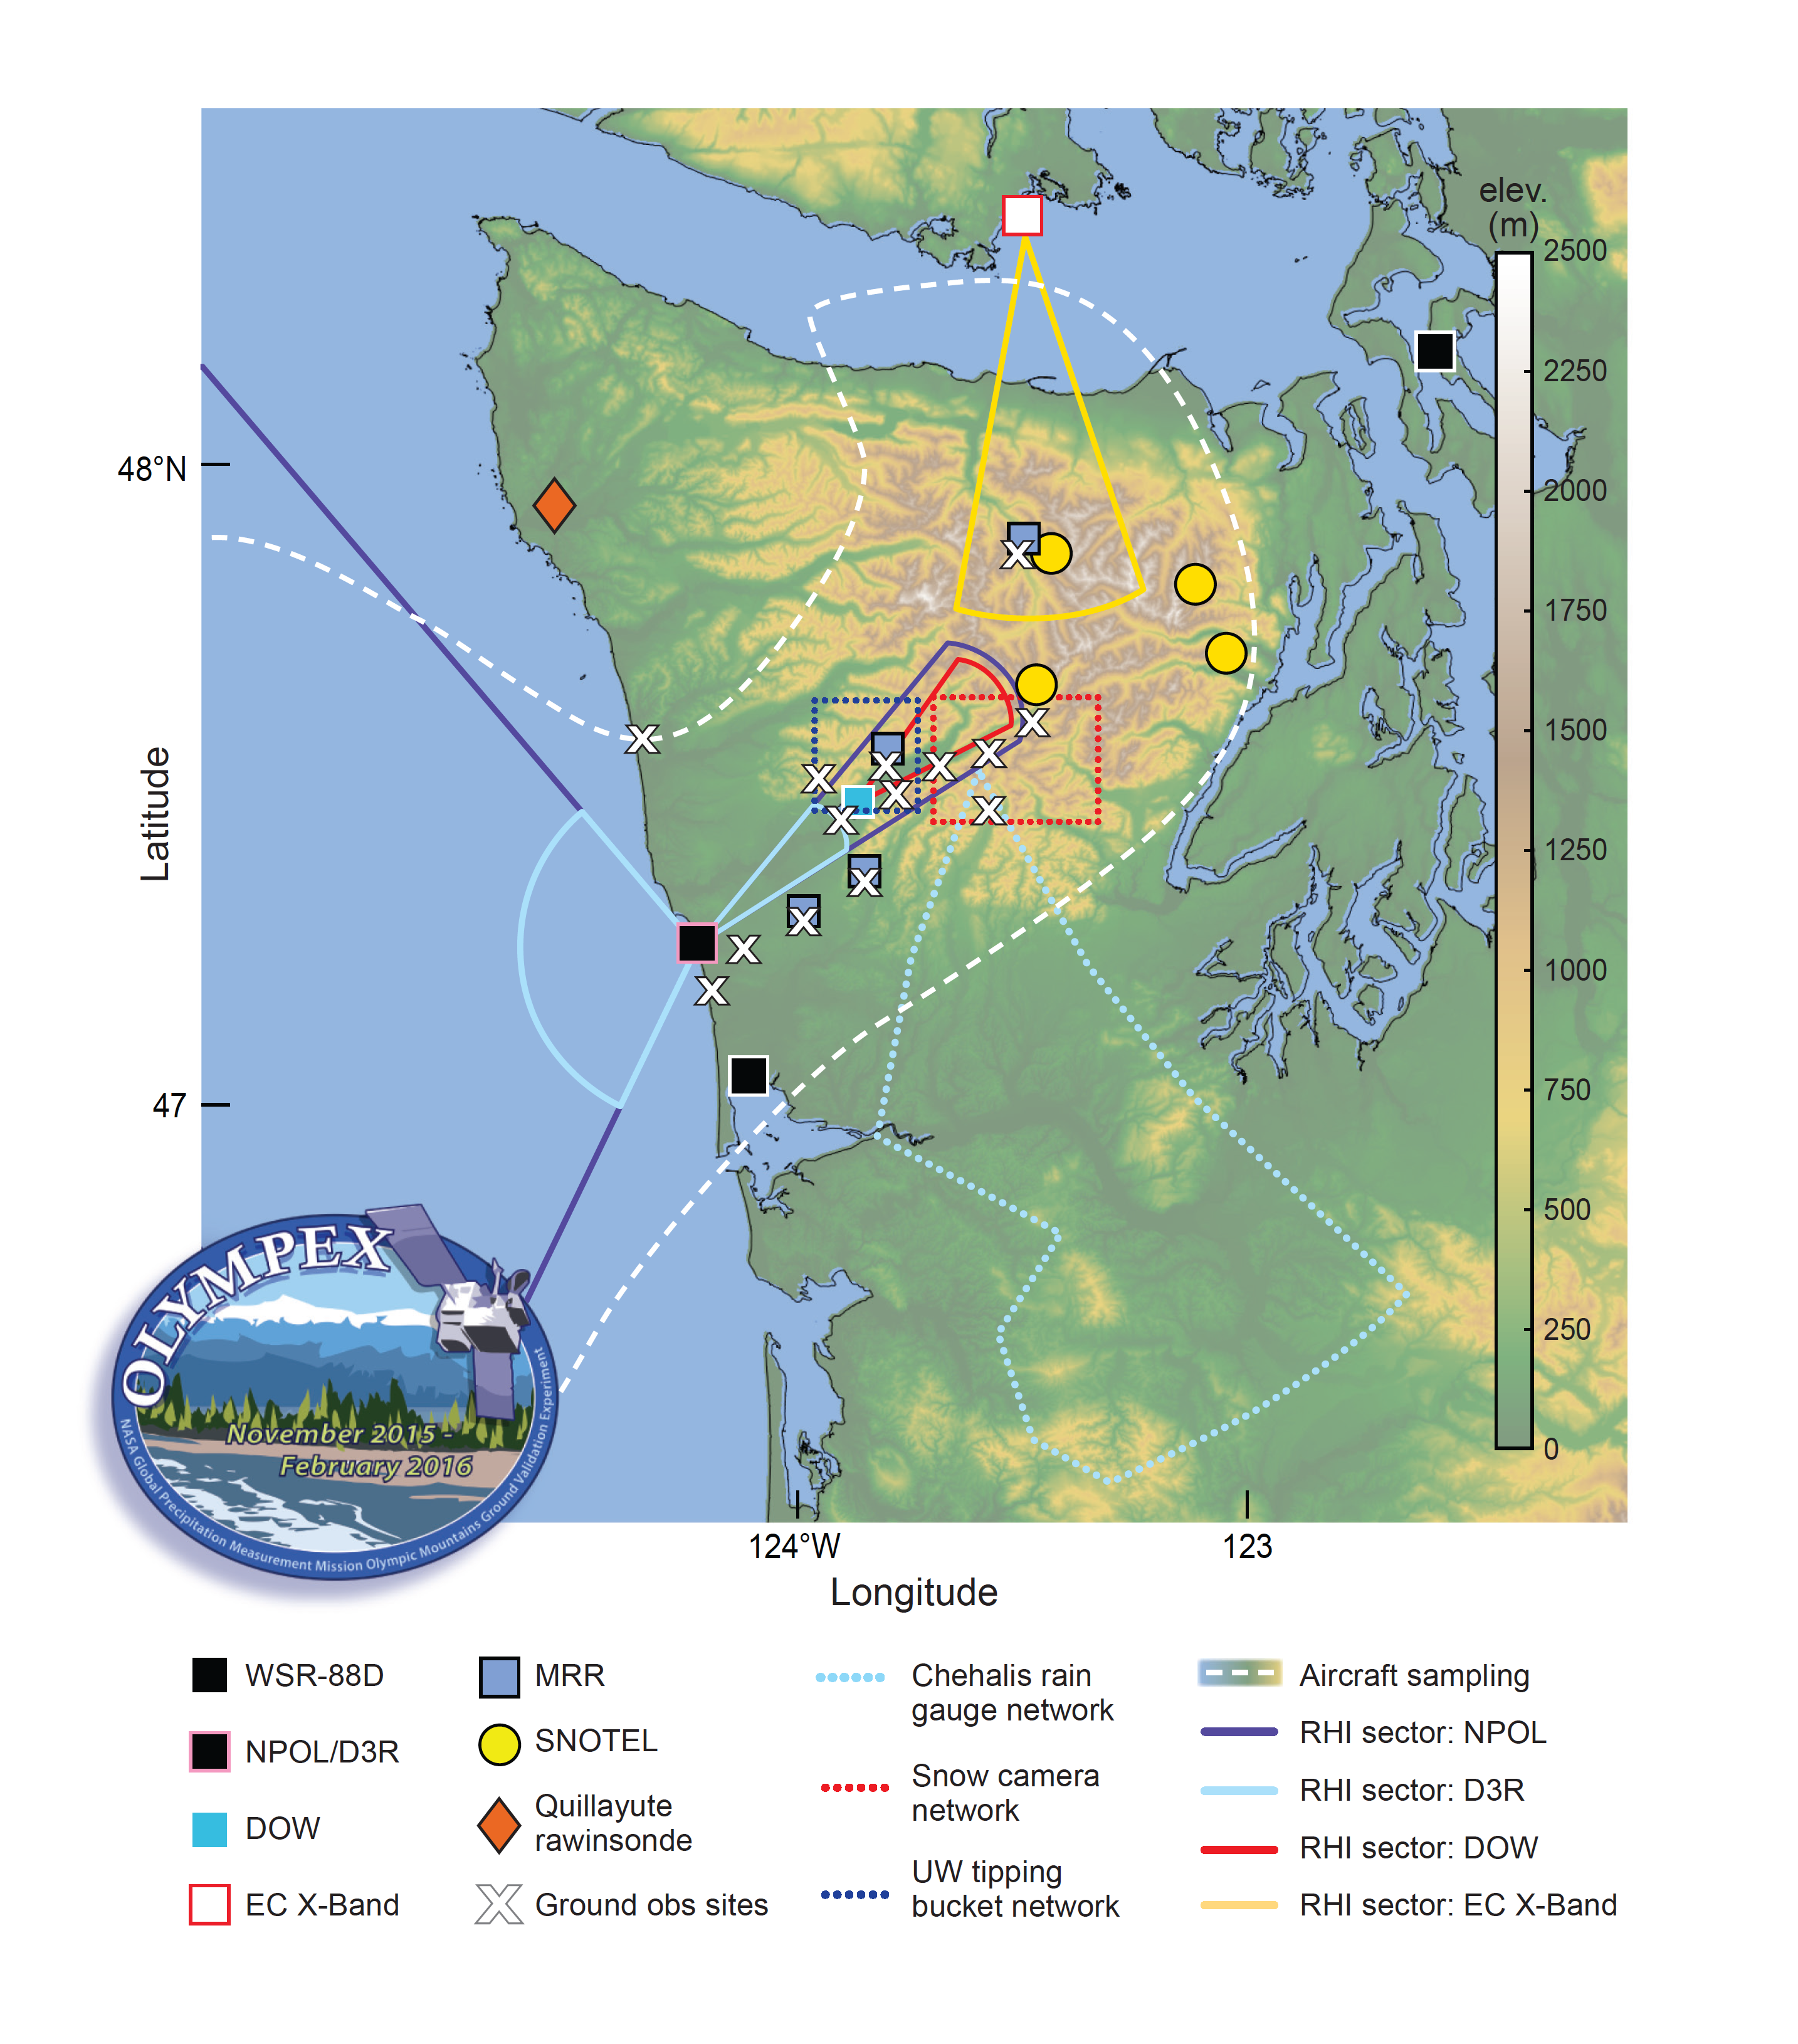

Slide 23
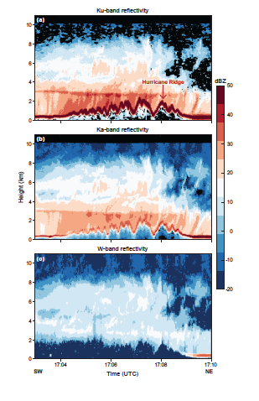

Slide 24
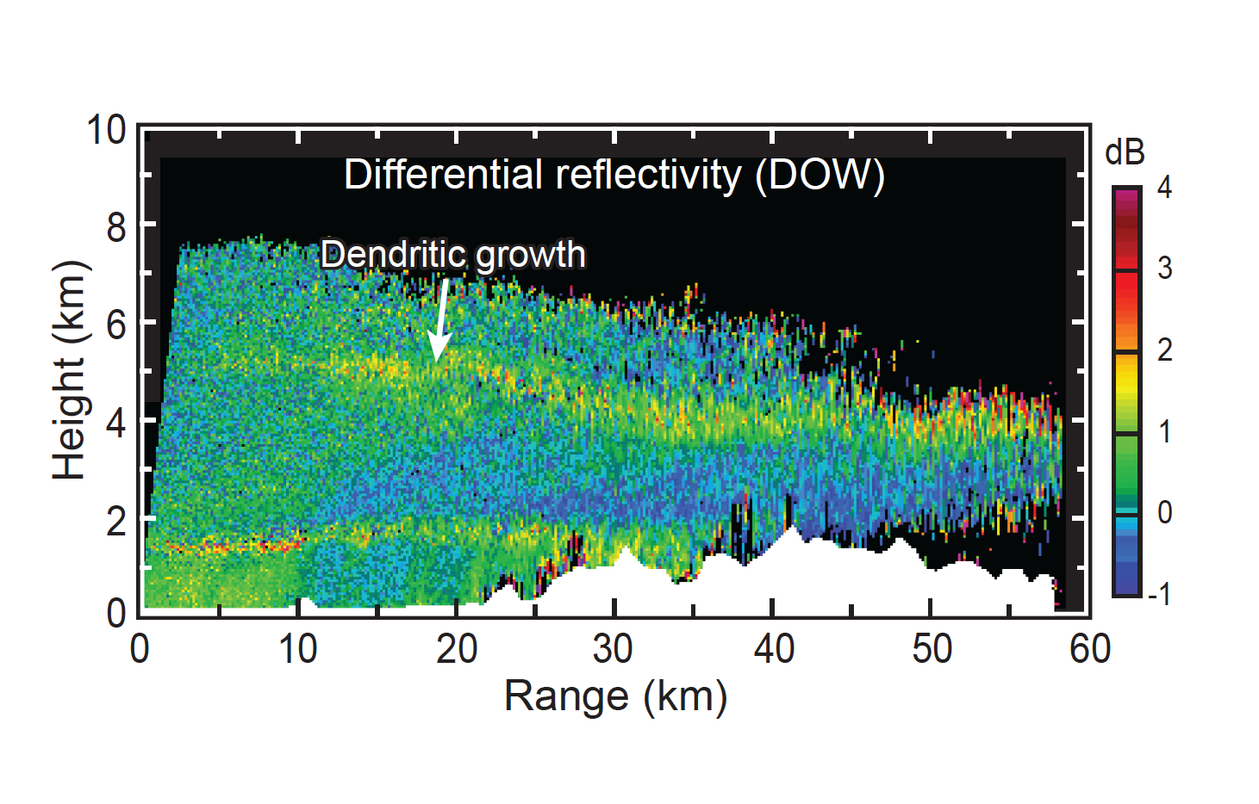

Slide 25
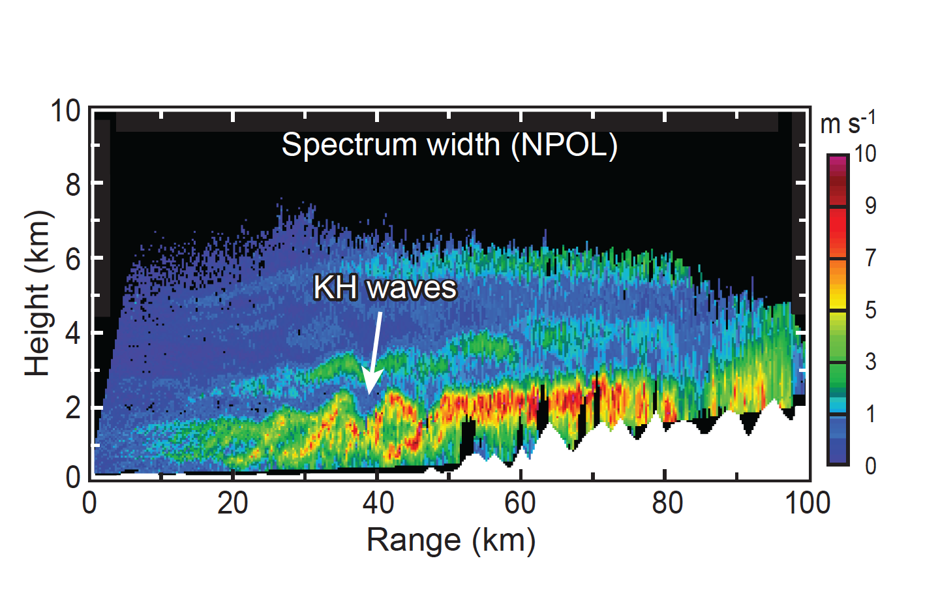

Slide 26
