Slide 1
Patterns of Convection Seen by the TRMM and GPM Satellites
Robert A. Houze, Jr. Stacy Brodzik, Kristen Rasmussen Manuel Zuluaga, Erich Stocker
University of North Dakota Seminar, Grand Forks, 10 November 2016

Slide 2

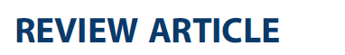
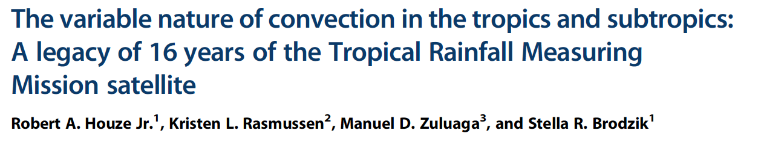
Global Distribution of Different Forms of Convection as Seen by TRMM
Robert A. Houze, Jr.
University of Washington
with: K. L. Rasmussen, M. D. Zuluaga, and S. R. Brodzik
August 2015
Notes:
Review paper

Slide 3
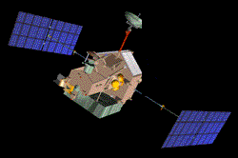
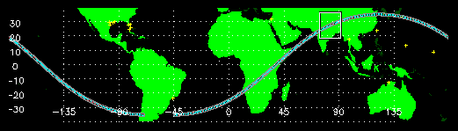
The TRMM Satellite
1997-2014
Precipitation Radar
Low altitude, low inclination orbit
Notes:
92.5 minute orbit; approximately 16 orbits per day.
Revisits specific locations 10-20 times per 30 day period (dependent on latitude).
Our data set consists of 1648 TRMM 2A23 & 2A25 rain containing orbit files from the monsoon season (June – September) in 2002 & 2003.
The TRMM 2A25 data contains corrected TRMM reflectivity data in 250 m height bins.
The TRMM 2A23 algorithm detects the presence of a bright band and categorizes precipitation as stratiform, convective or other (unclassified).

Slide 4
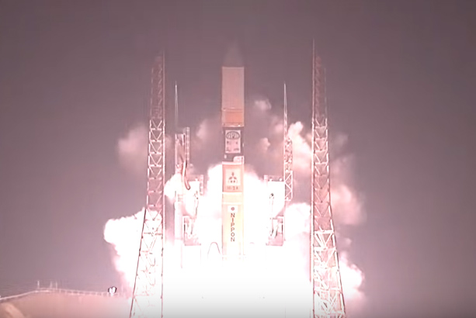
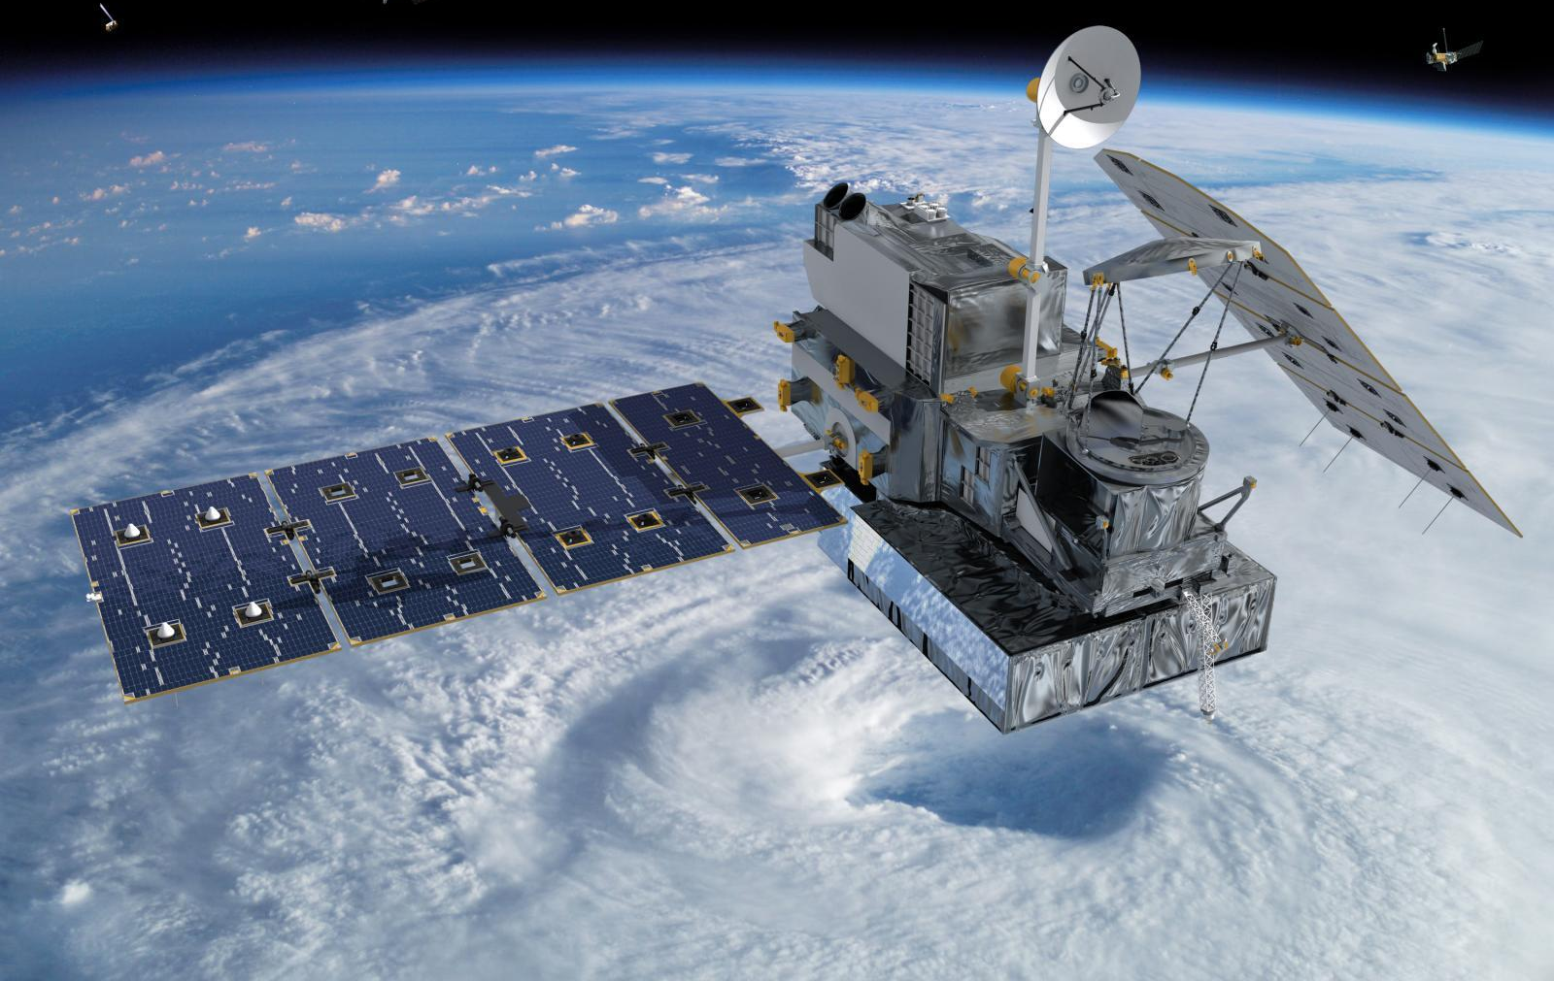

The GPM Satellite
Satellite Validation in the Pacific Northwest
27 Feb 2014

Slide 5
GPM Orbit

Slide 6
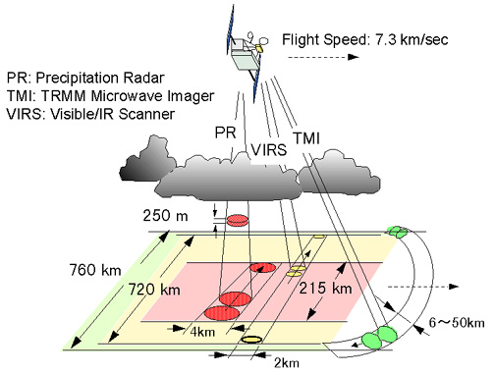
TRMM Instruments
λ= 2 cm
Important! Radar measures 3D structure of radar echoes
PR: Precipitation Radar λ = 2 cm
>
Kummerow et al, 1998
Notes:
TRMM PR is a radar; it samples a 3D volume with fine spatial resolution.
Like to look at the radar like a radar meteorologist

Slide 7
Re-map and interpolate the PR reflectivity field
Satellite
Interpolate
Geolocate
Notes:
Like any radar the data come in along beams at range gates.
Need to interpolate….
….and in the case of the TRMM PR locate the data relative to Earth

Slide 8
Use remapped & interpolated data to:
View PR data in visualization software
Objectively identify 3D echo objects indicative of convective lifecycle stage
Notes:
Interpolation serves two purposes: visualization, objective identification of objects

Slide 9
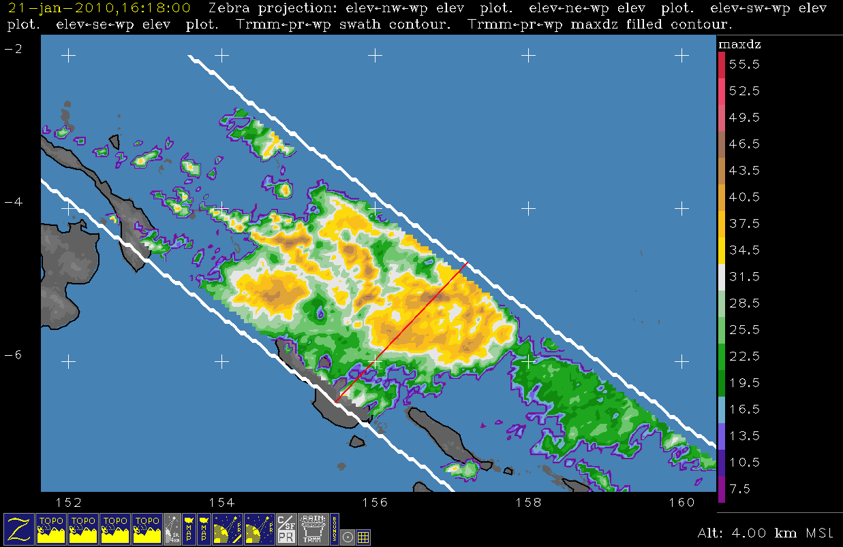
Notes:
Example
Note: altitude, red x-sec line
Important analysis tool; 1000’s of x-secs-------see example in next slide

Slide 10
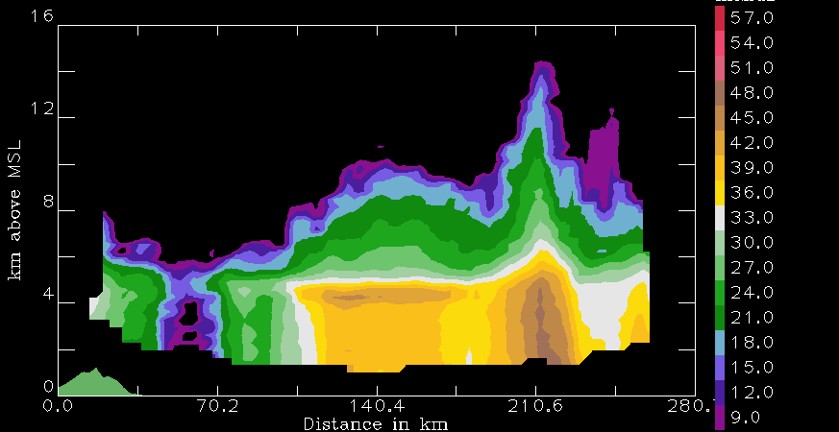
TRMM algorithm subdivisions
Other
Stratiform
Convective
Notes:
Like an RHI
See clearly conv & sf areas
TRMM algorithm→C/SF separation→imp. For latent heating calculations

Slide 11
Convective cores
3D convective echo bounded by threshold dBZ
echo core
land
Type | Threshold | Width | Height
Shallow-isolated | 17 dBZ | 2 pixels | < 5 km
Deep-strong | 40 dBZ |  | >10 km
Deep-moderate | 30 dBZ |  | > 8 km
Wide-strong | 40 dBZ | >1000 km²
Wide-moderate | 30 dBZ | >800 km²
Notes:
First—we look at convective echo structure in the TRMM data.
To do this—identify 3D echo “cores” that are EMBEDDED in larger echoes
Shallow isolated—are generally warm rain showers or small cumulonimbus clouds—fall into the category of “congestus”
Deep cores—associated with young, extremely vigorous convection
Wide cores—indicate where intense convection is aggregating and growing upscale into mesoscale systems
Two categories
strong categories are better indicators of processes over land
moderate better over oceans

Slide 12
Broad stratiform regions
Look for ones that are broad and contiguous
Stratiform echo volume
land
Type | Width
Strong | > 50,000 km²
Moderate | > 30,000 km²

Slide 13
Terminology:
ISE—isolated shallow echoes
DCC—deep convective cores
WCC—wide convective cores
BSR—broad stratiform regions

Slide 14
More terminology:
We call a contiguous radar echo a “storm”
Note:
A storm may or may not contain a DCC, WCC, or BSR
For example:
Radar echo “STORM”
DCC
Notes:
Interested in how much of the low-latitude rainfall is due to storms with and without storms containing these extreme forms of convective & sf echo
Next-----------------how much of low-lat rain is due to storms containing DCC, WCC, or BSR

Slide 15
TRMM

Slide 16
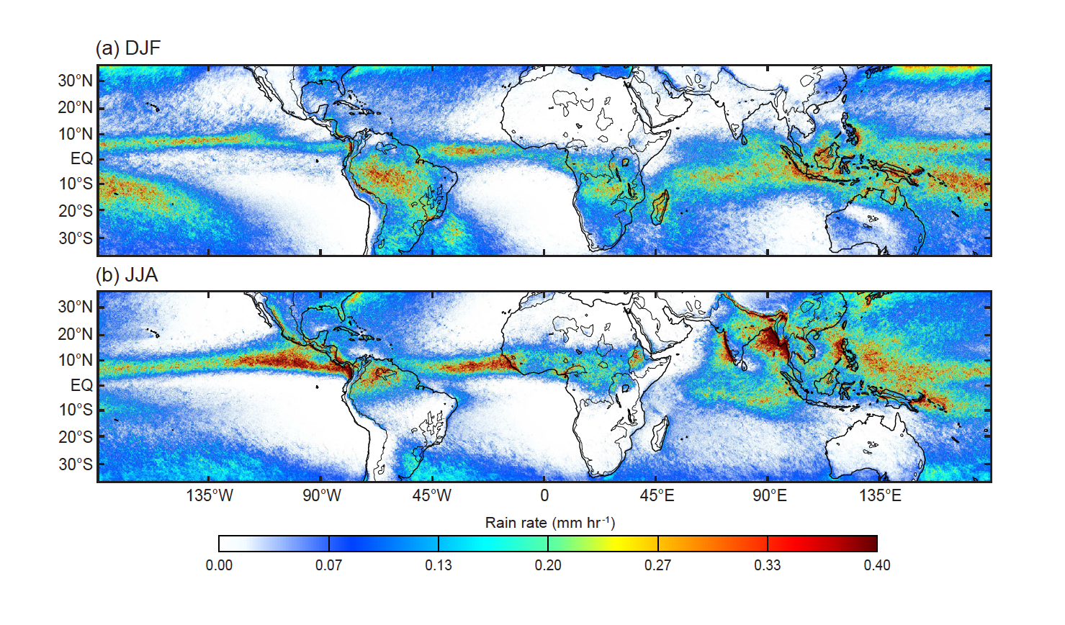
Rainfall from TRMM PR
Notes:
Did a good job of measuring the rain
Now well known from TRMM
Major features: ITCZ, SPCZ, MC, Africa, tropical S. America
NOTE ESP: Amazon and MC in DJF, S. Asian monsoon in JJA

Slide 17
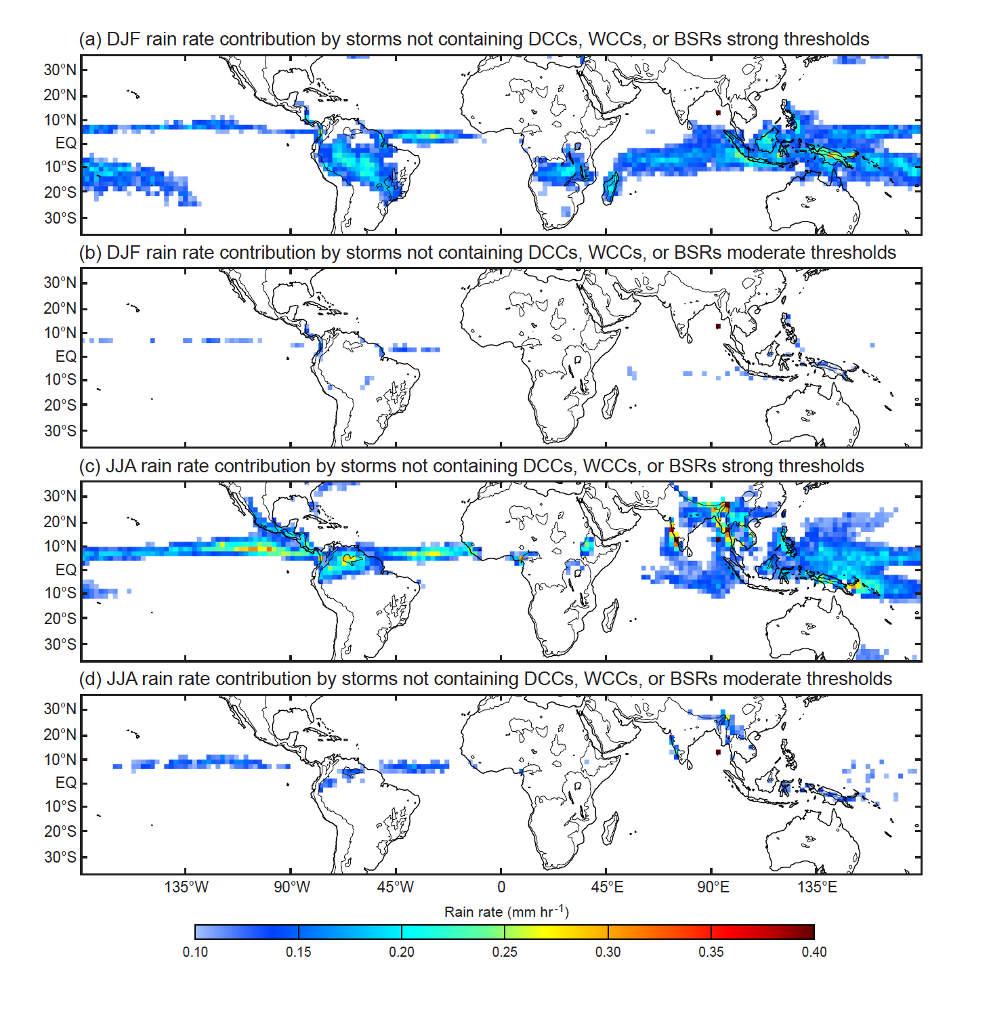
Storms with extreme echo features explain most of the precipitation in low latitudes
Notes:
Storms containing features defined by strong thresholds account quit a bit of total rain, but certainly not all
Storms containing features defined by moderate thresholds account for nearly all precipitation
Slight exceptions—ITCZ and monsoon

Slide 18
GPM

Slide 19
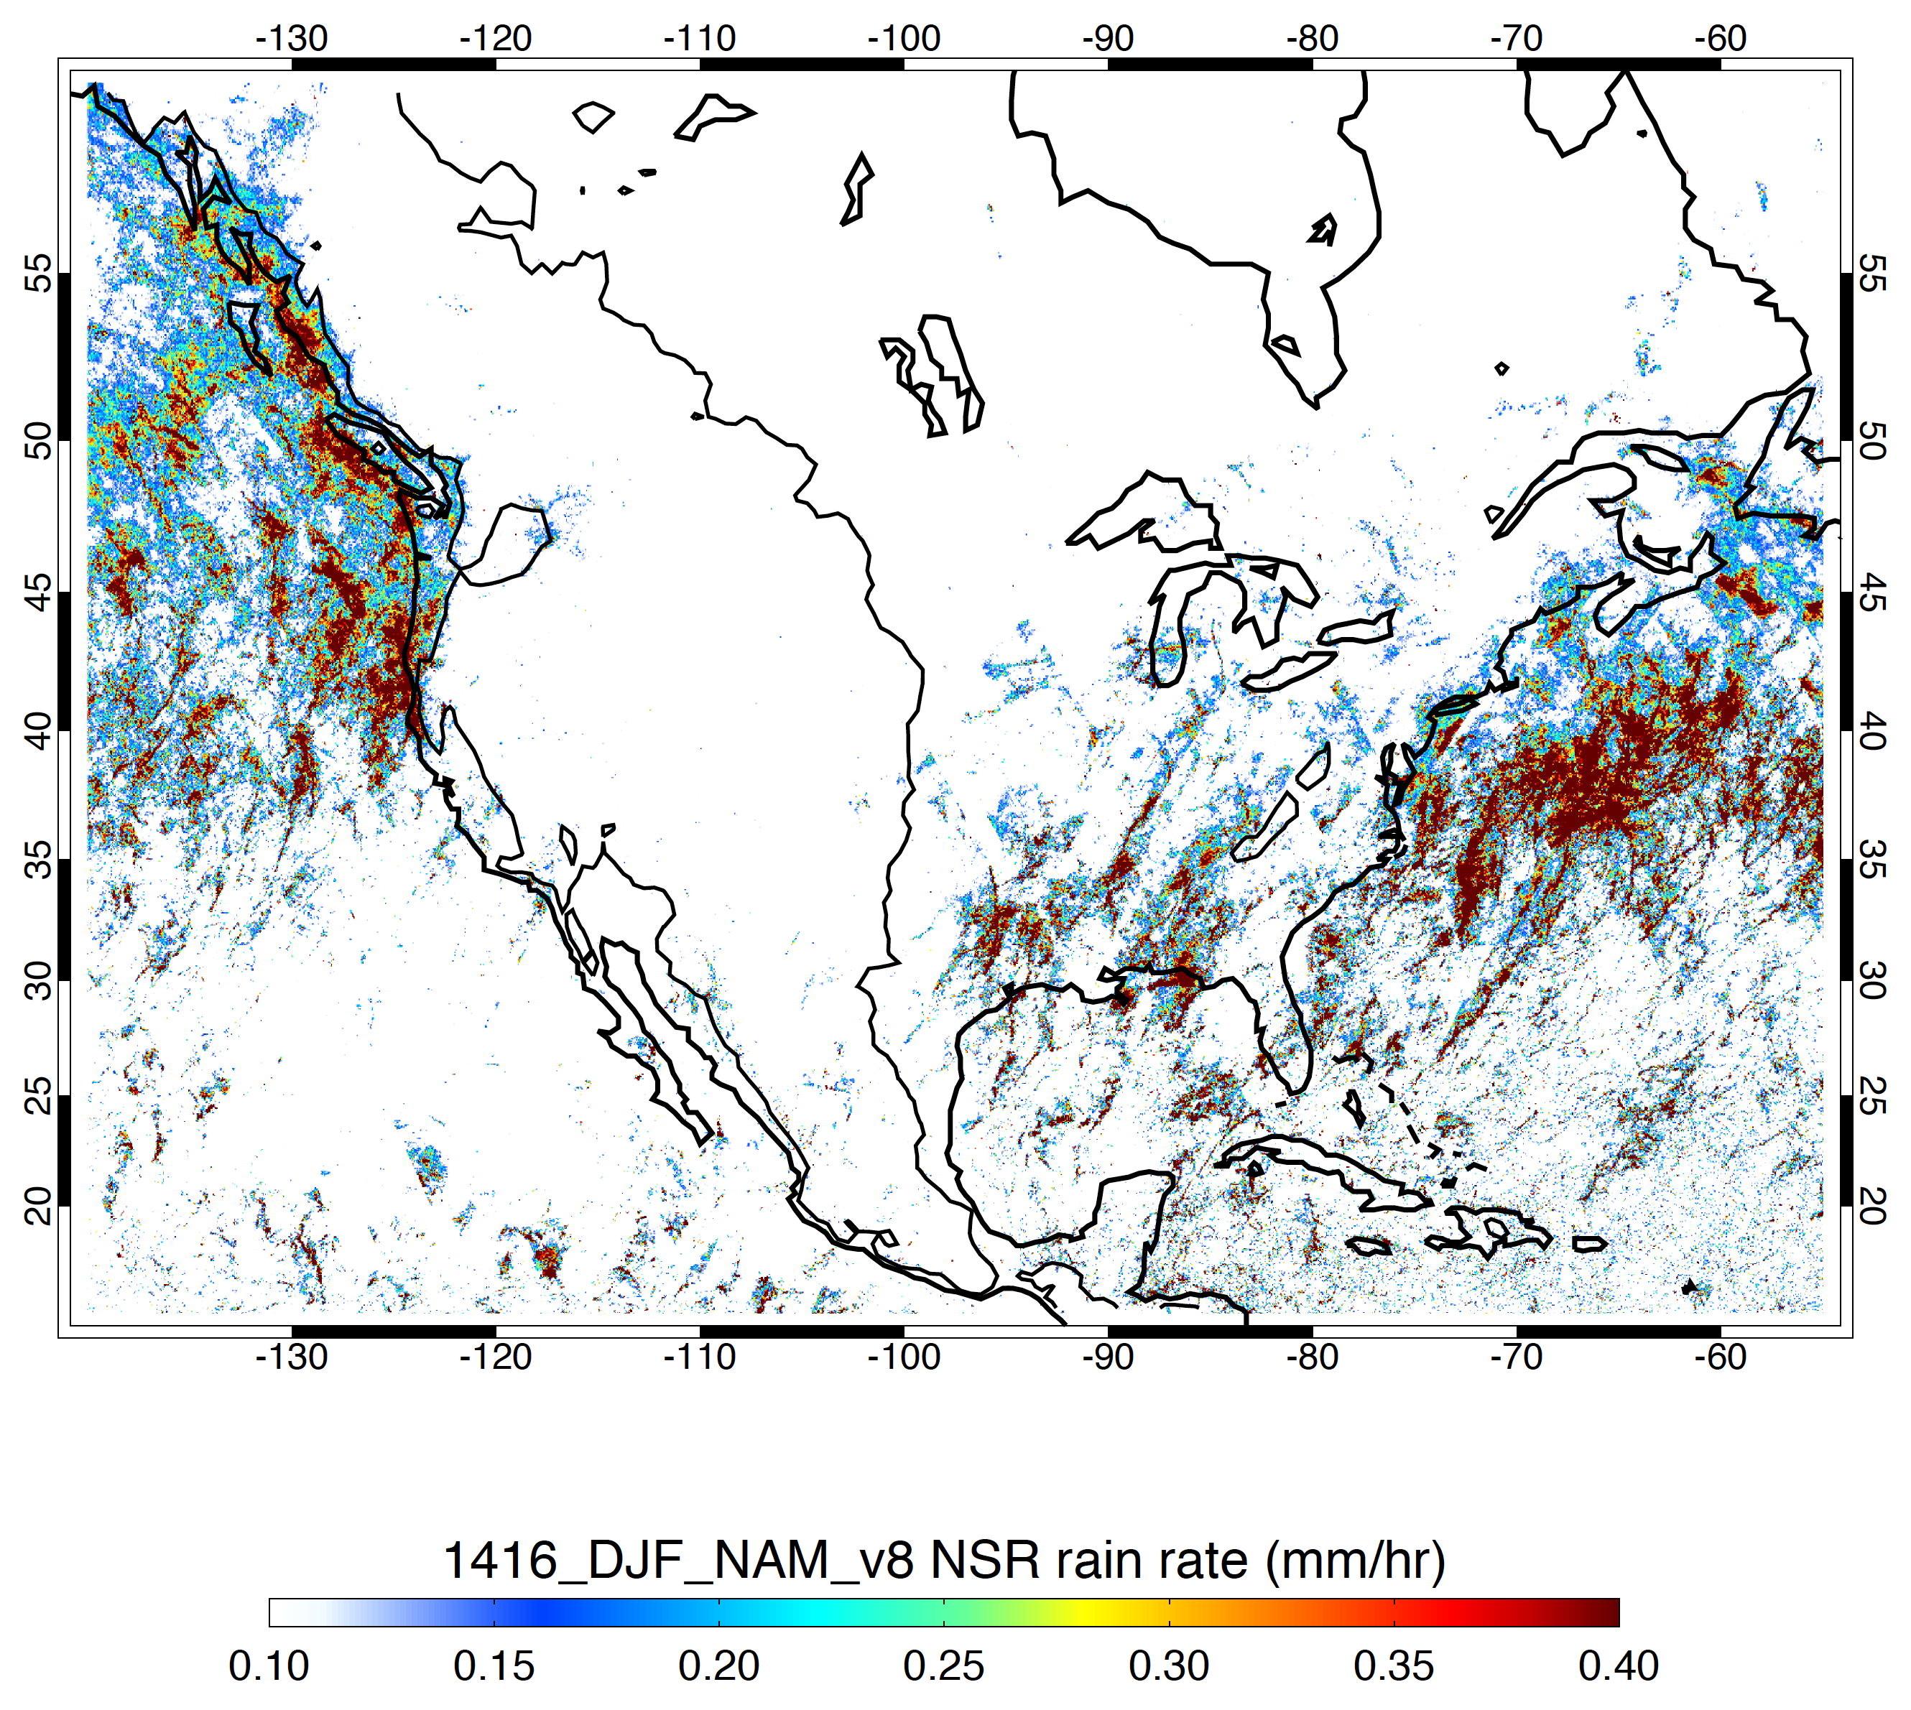
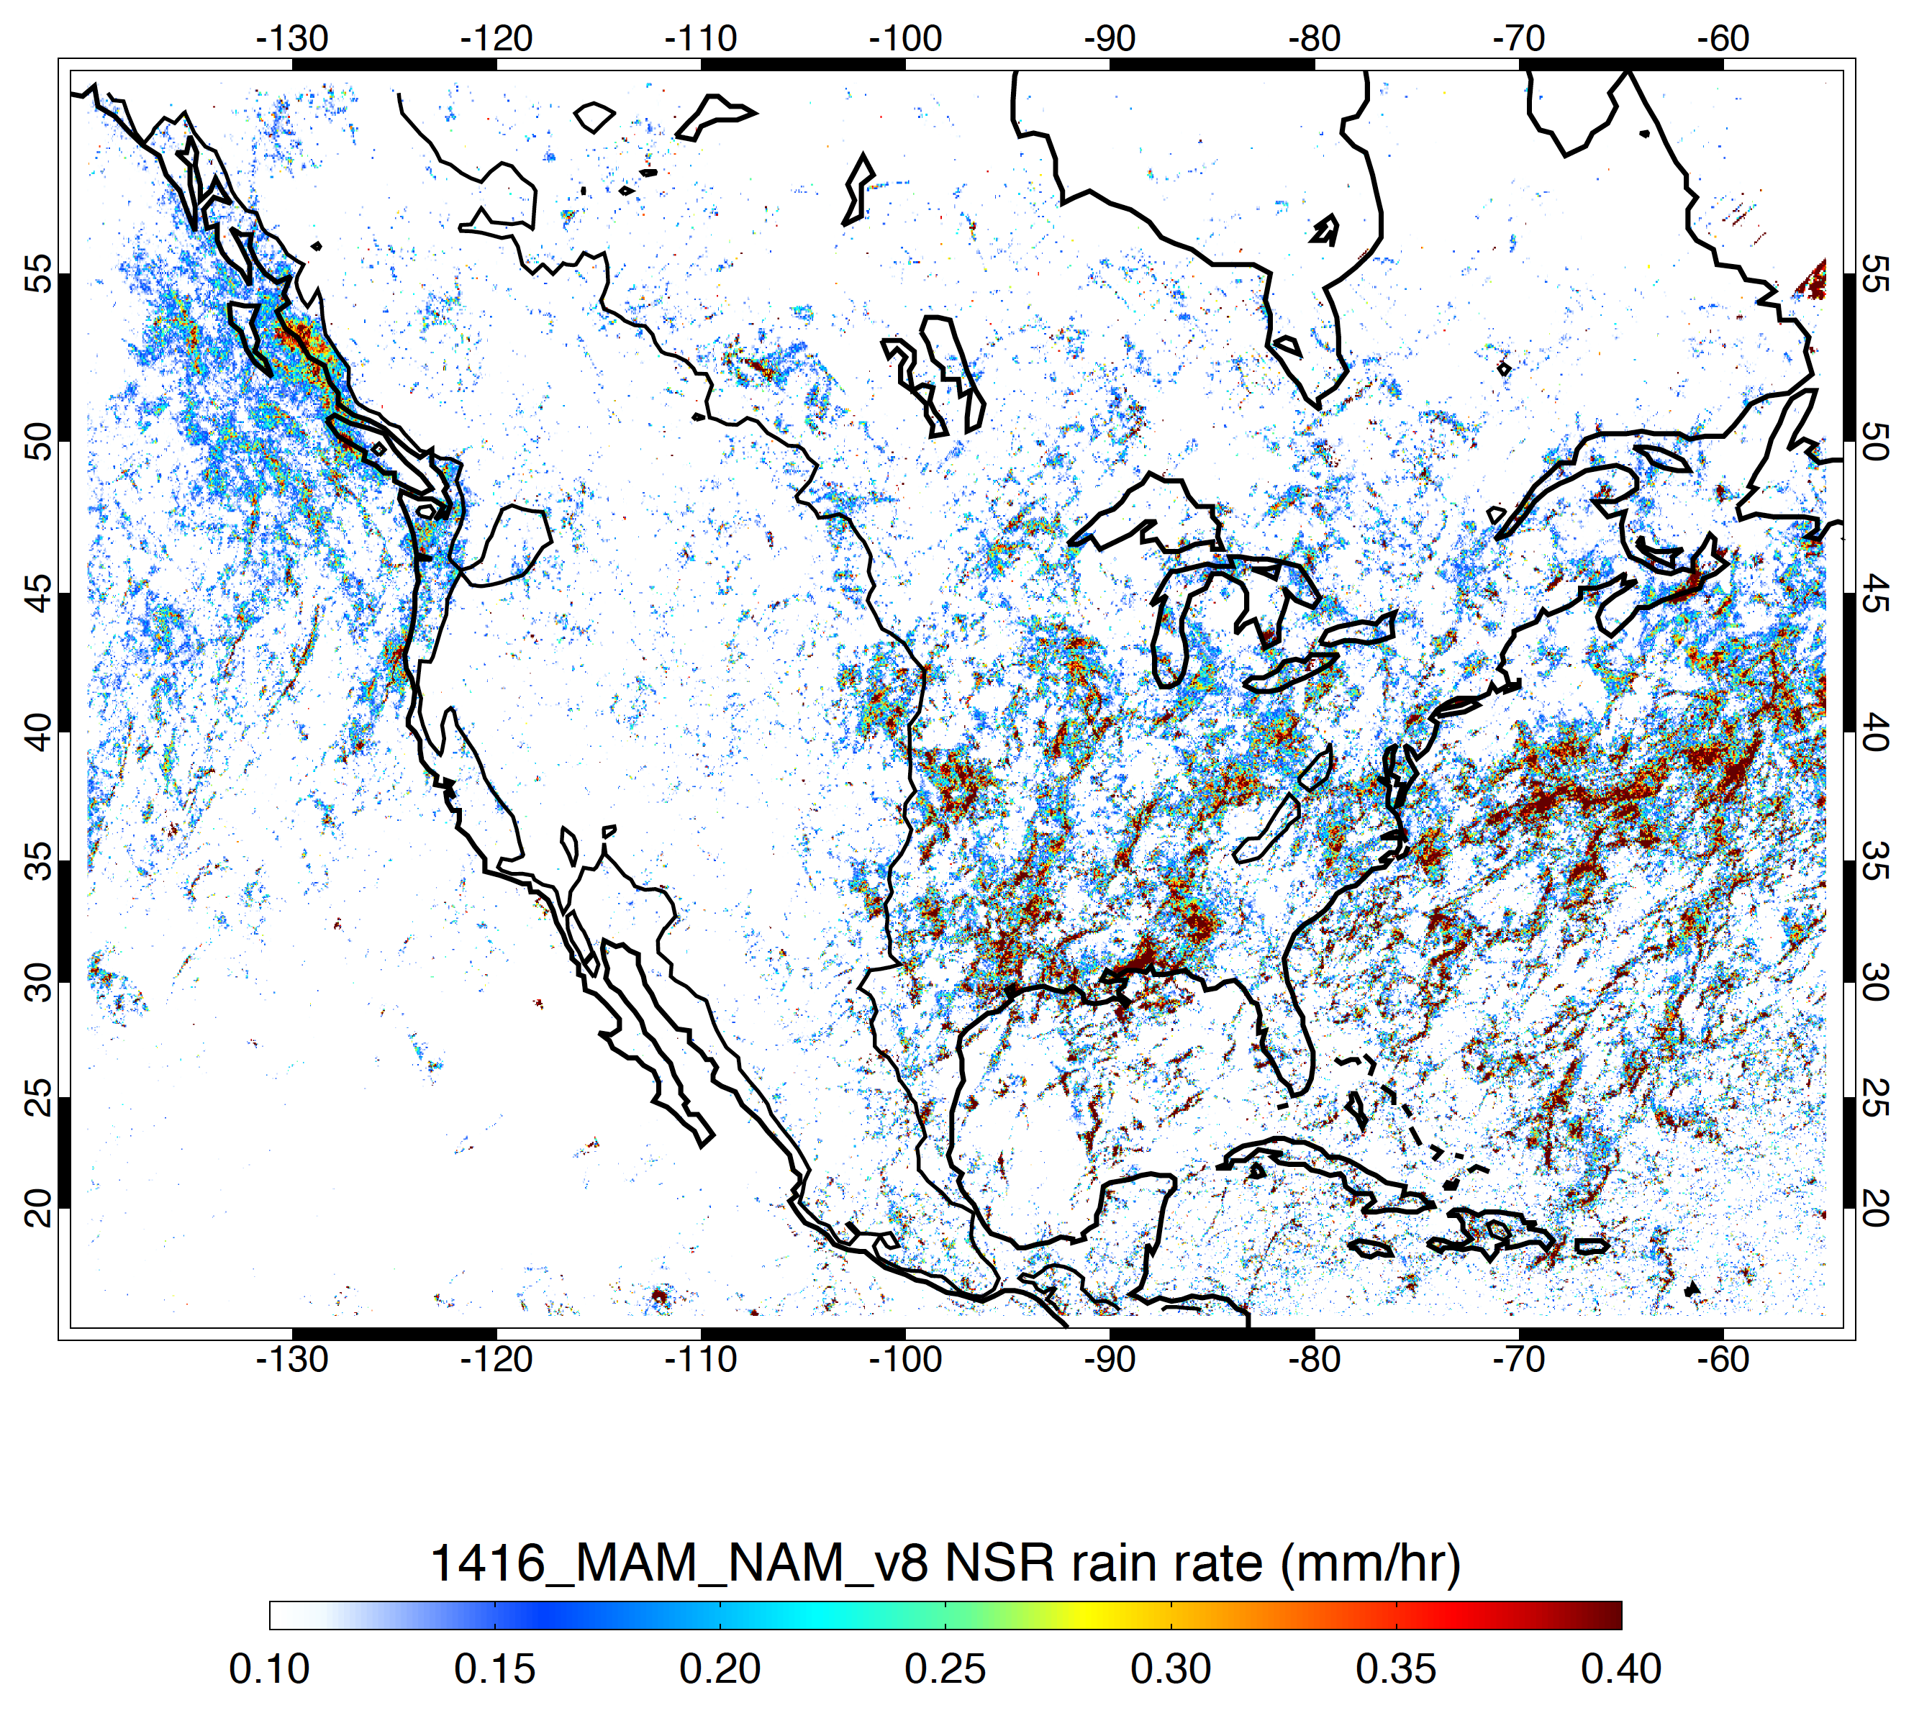
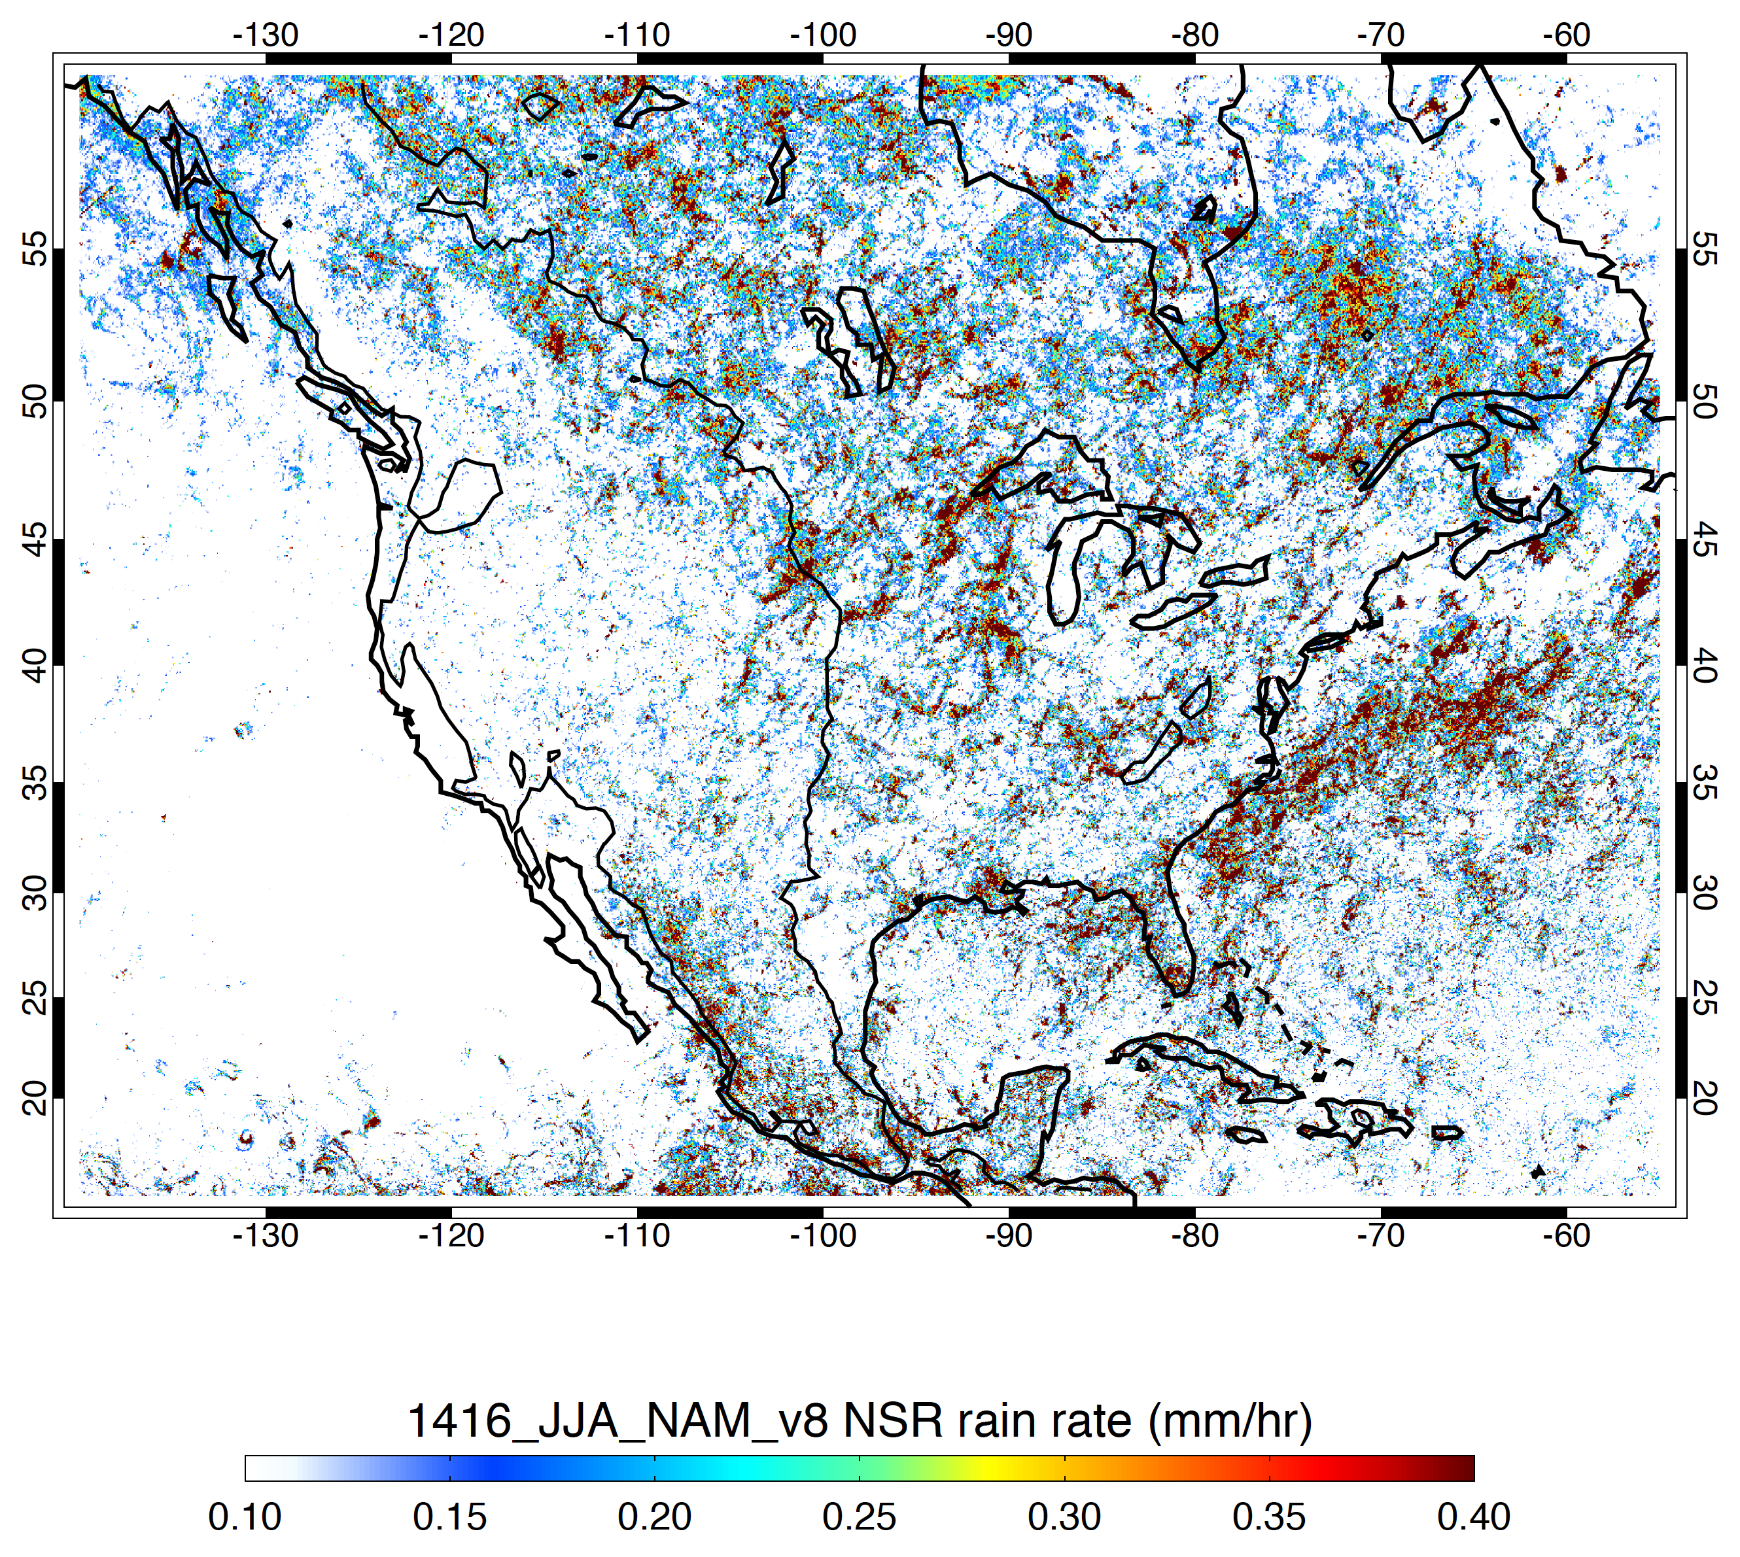
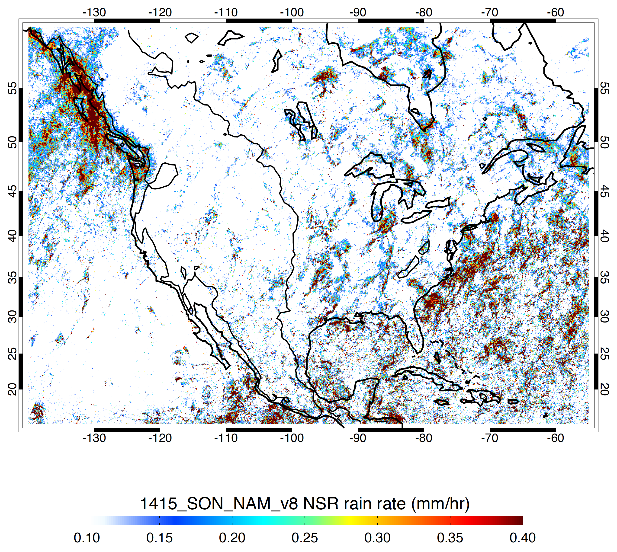
Overall Mean Rain Rate (mm/h)
DJF
MAM
JJA
SON

Slide 20
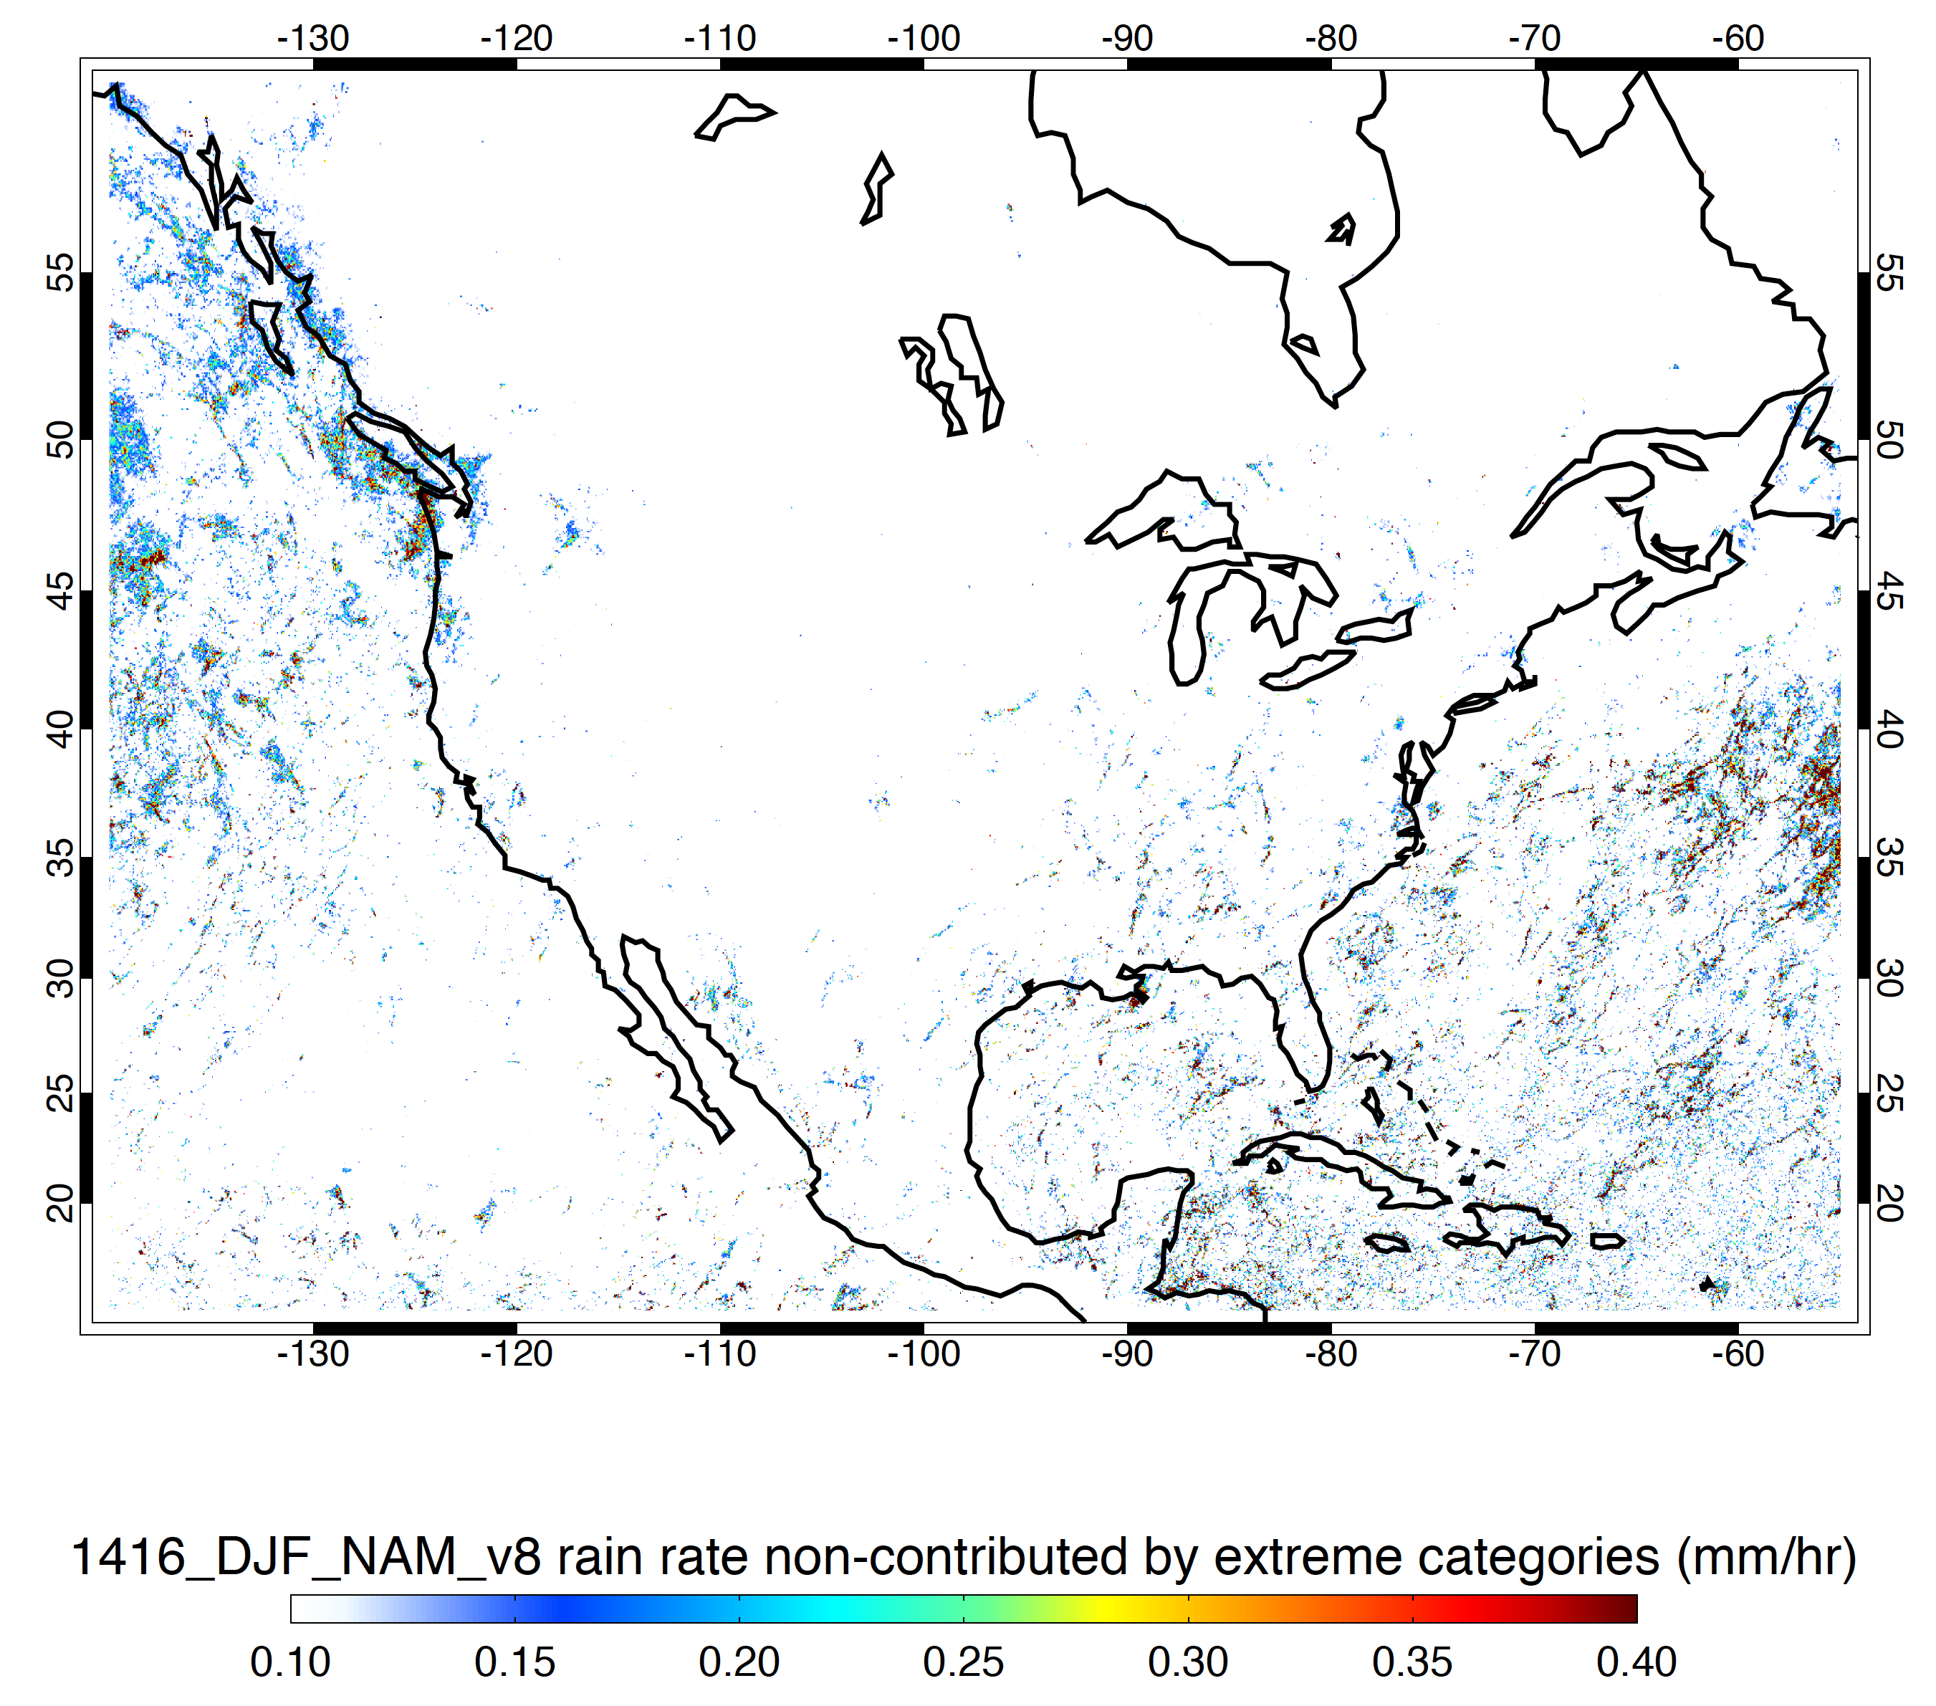
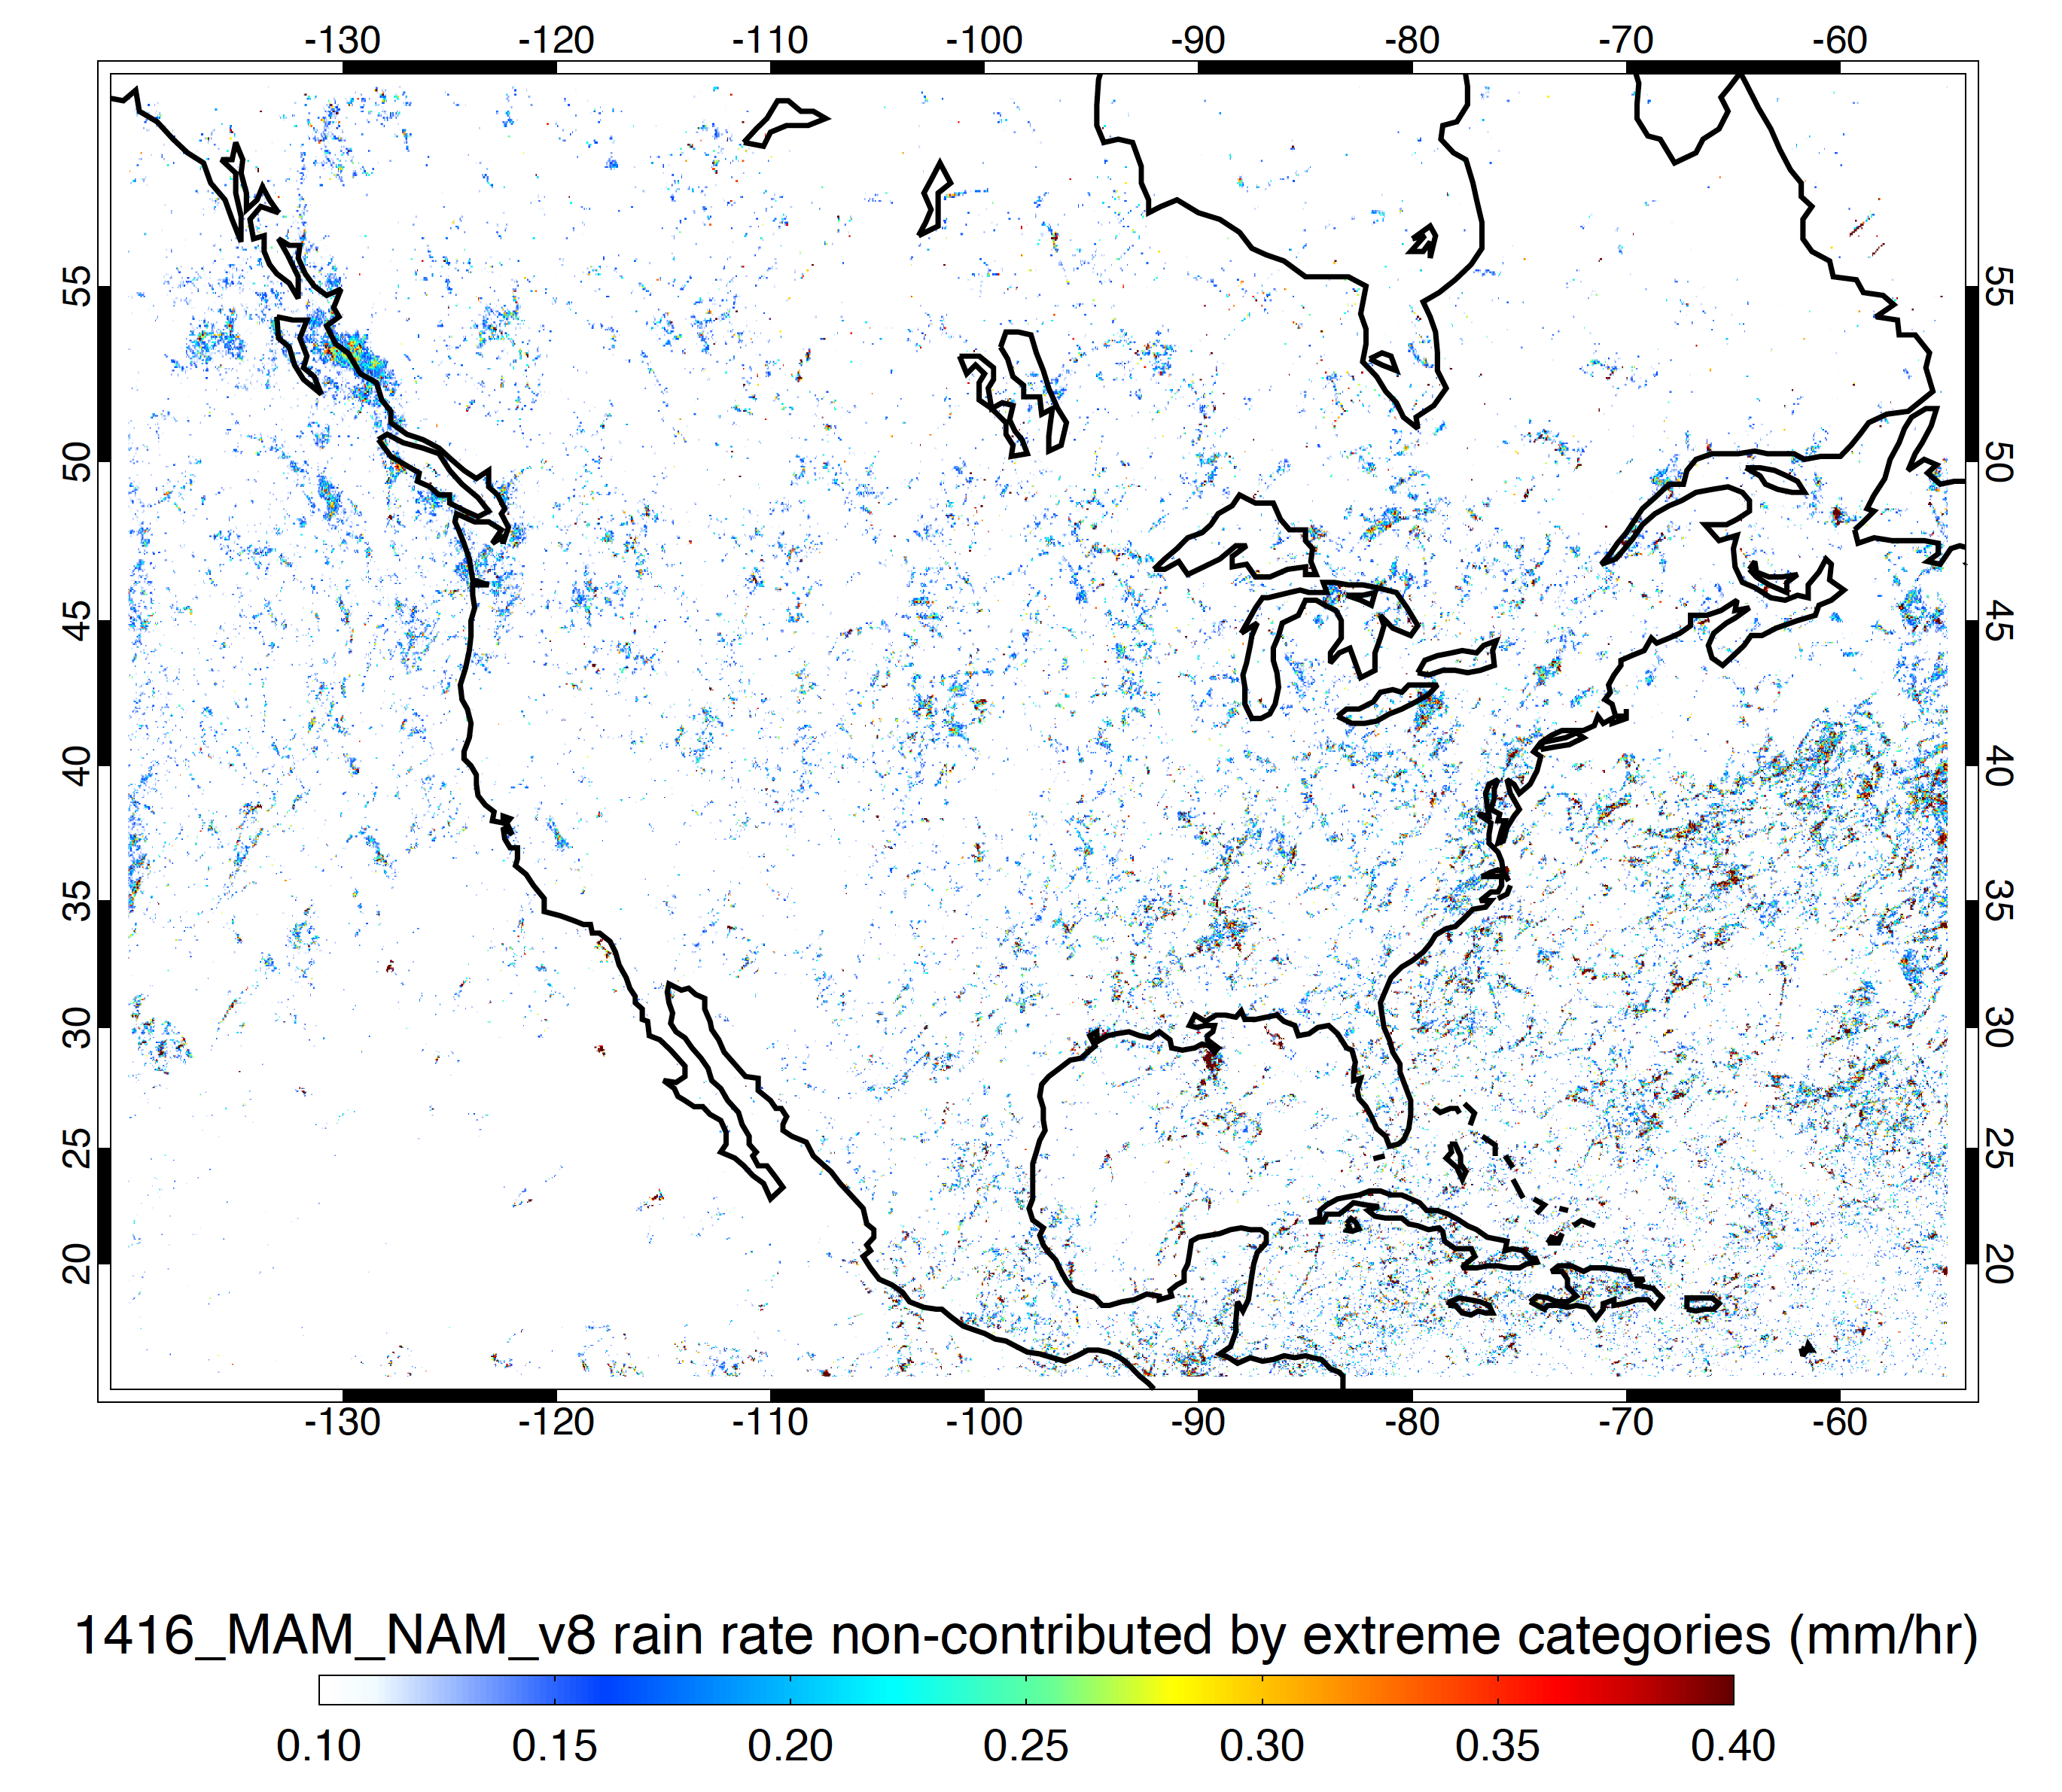
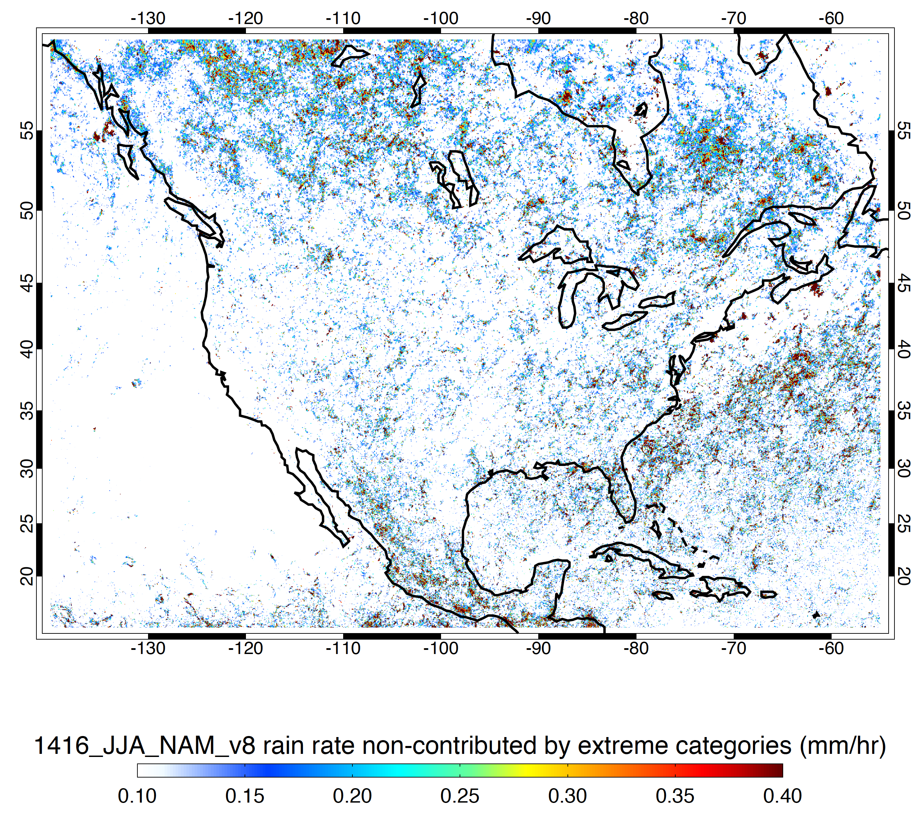
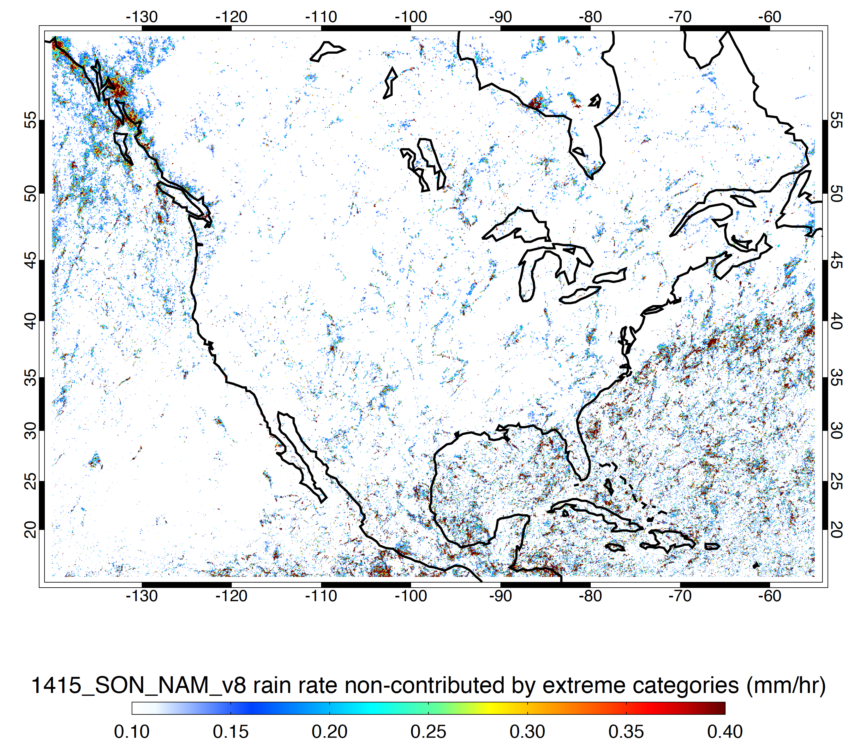
Minus Storms Containing Strong Threshold Features
DJF
MAM
JJA
SON

Slide 21
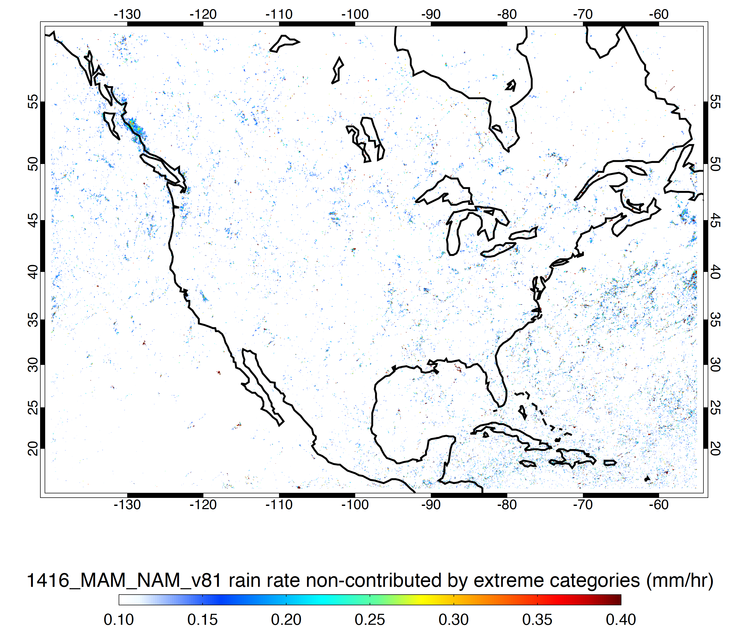
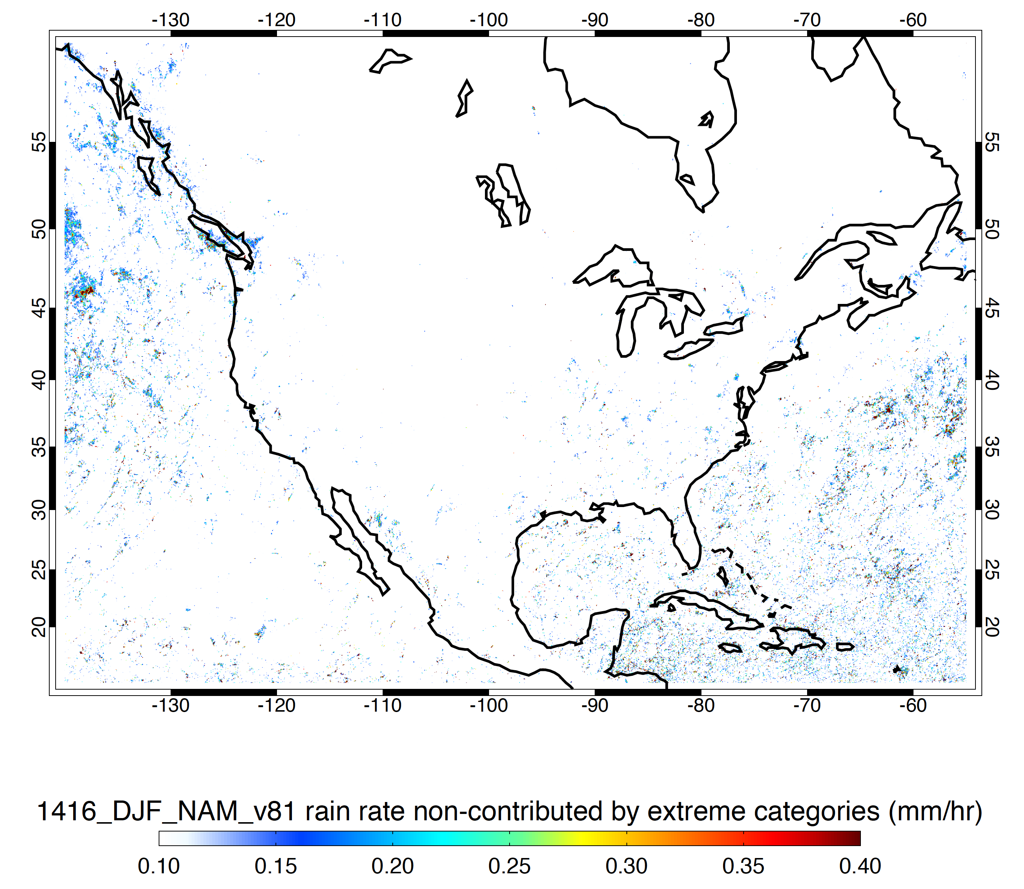
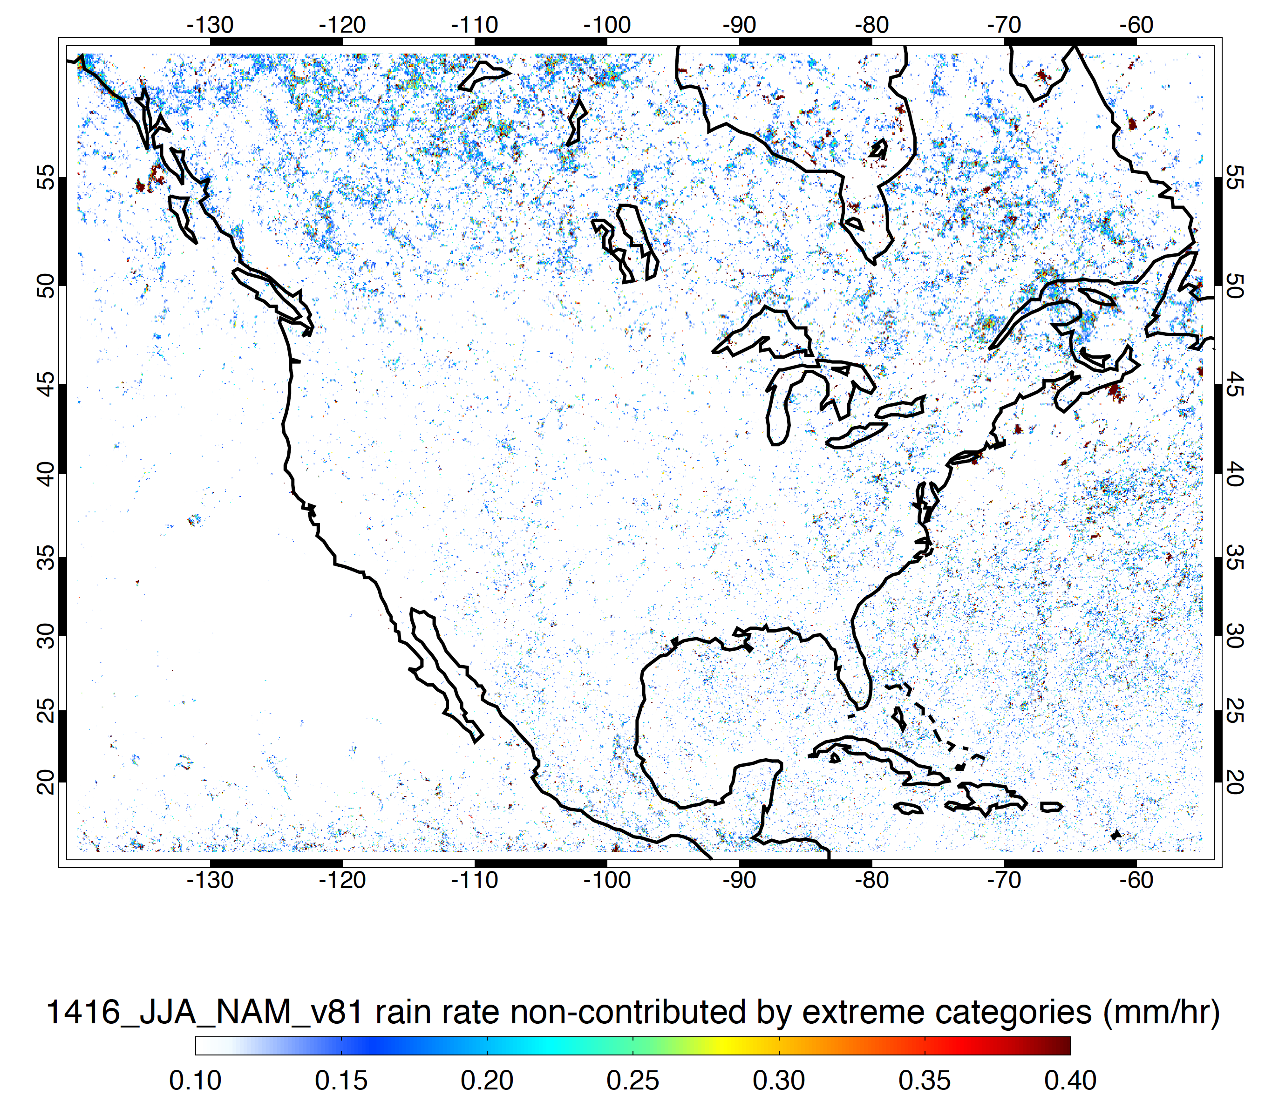
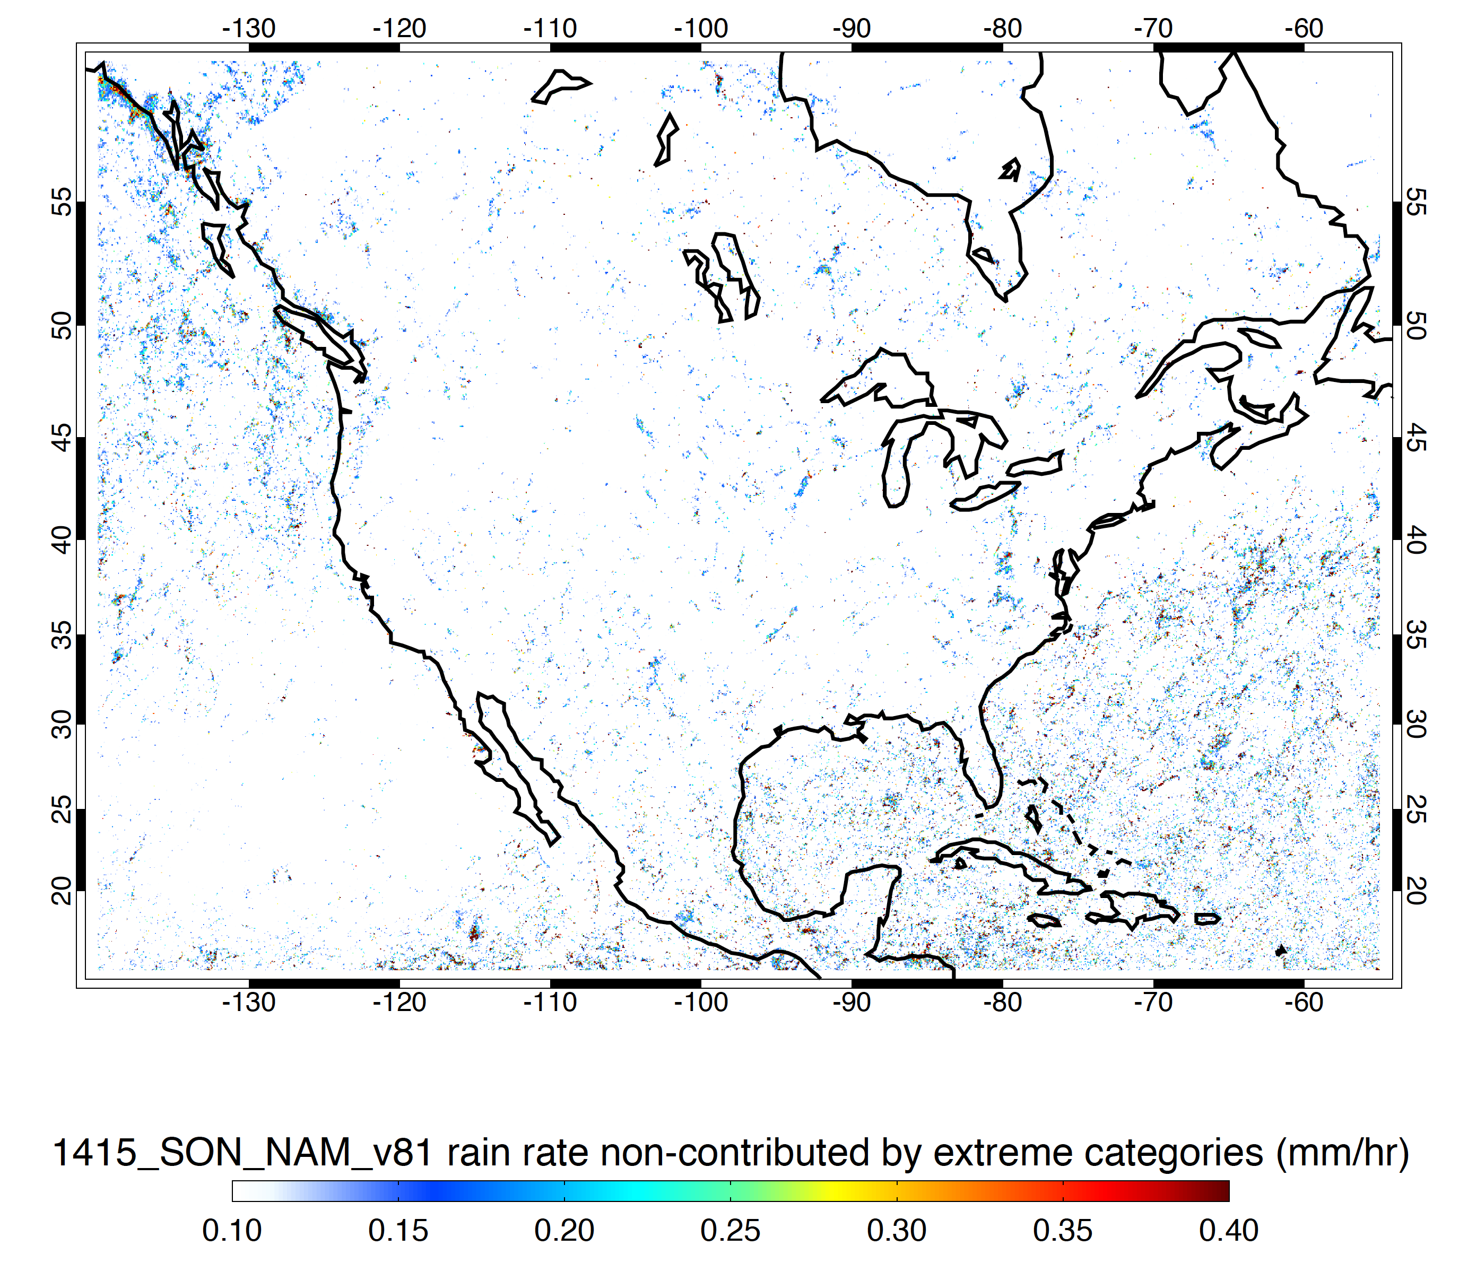
Minus Storms Containing Moderate Threshold Features
DJF
MAM
JJA
SON

Slide 22
The next few slides are maps of the frequency of occurrence of ISEs, DCCs, WCCs , and BSRs defined by both the strong and moderate thresholds

Slide 23
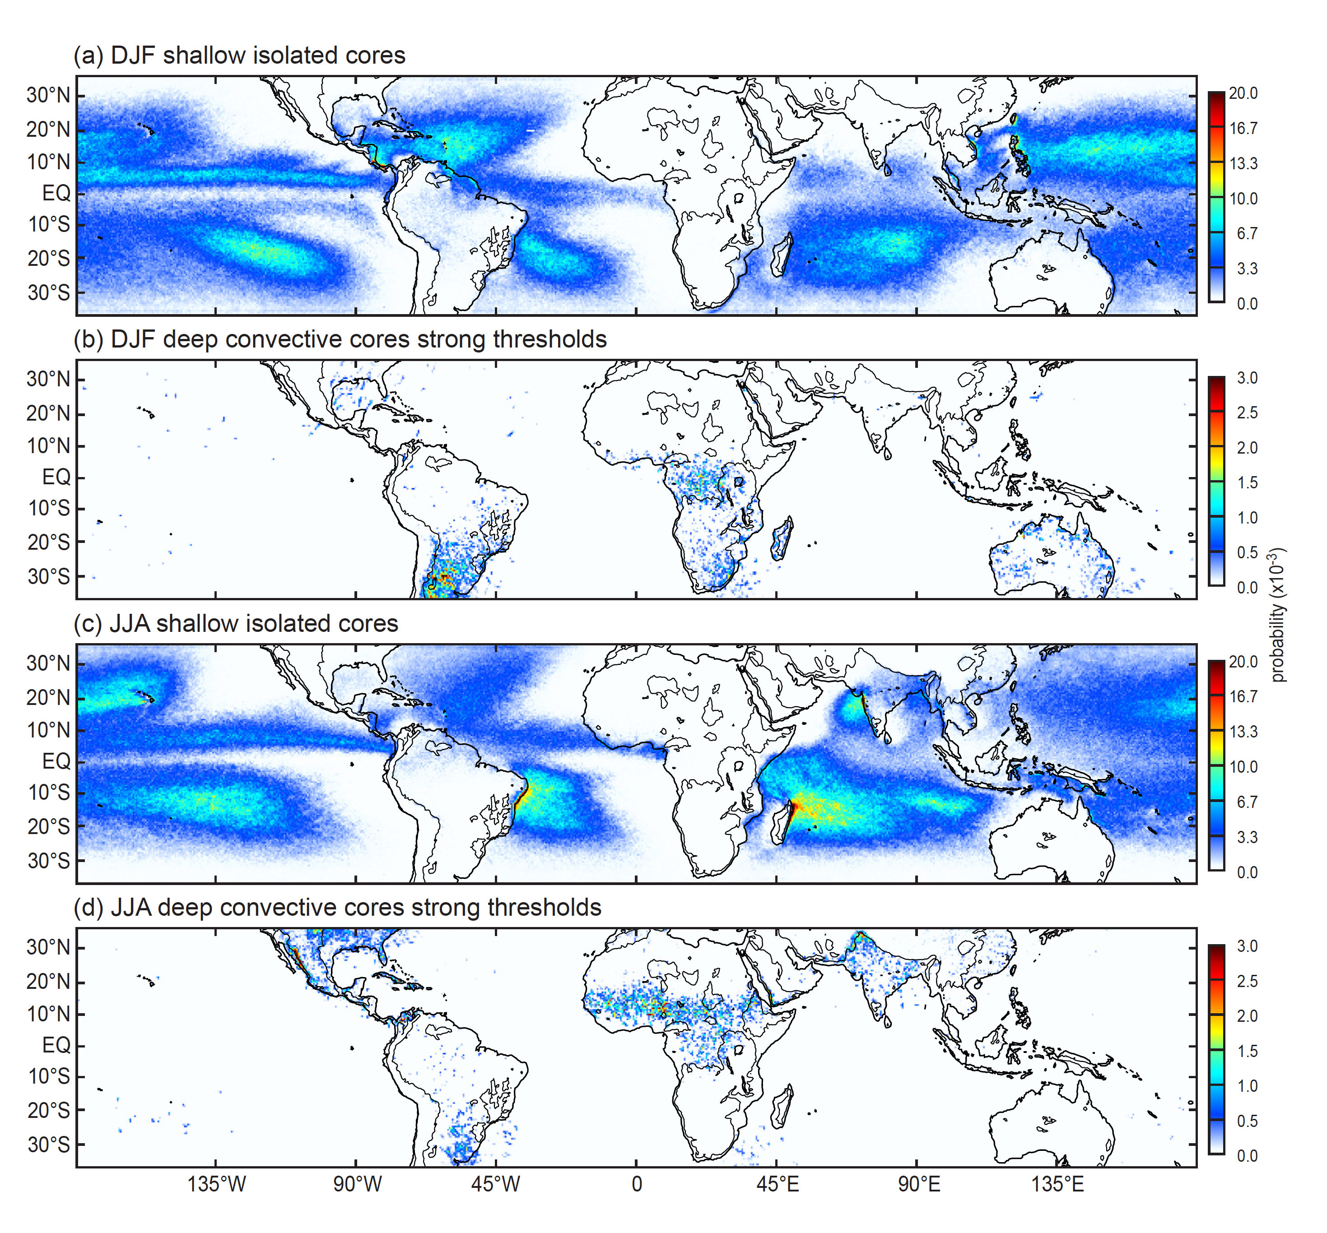
ISEs are oceanic; strong DCC echoes are continental
Notes:
ISE—oceanic
DCC, strong—continental
NOTE→DCC, strong—absent not only over open oceans but also Amazon, and Maritime Continent
Concentrations of ISEs at coastlines of S. America, Madagascar, and to a lesser extent India & Burma

Slide 24
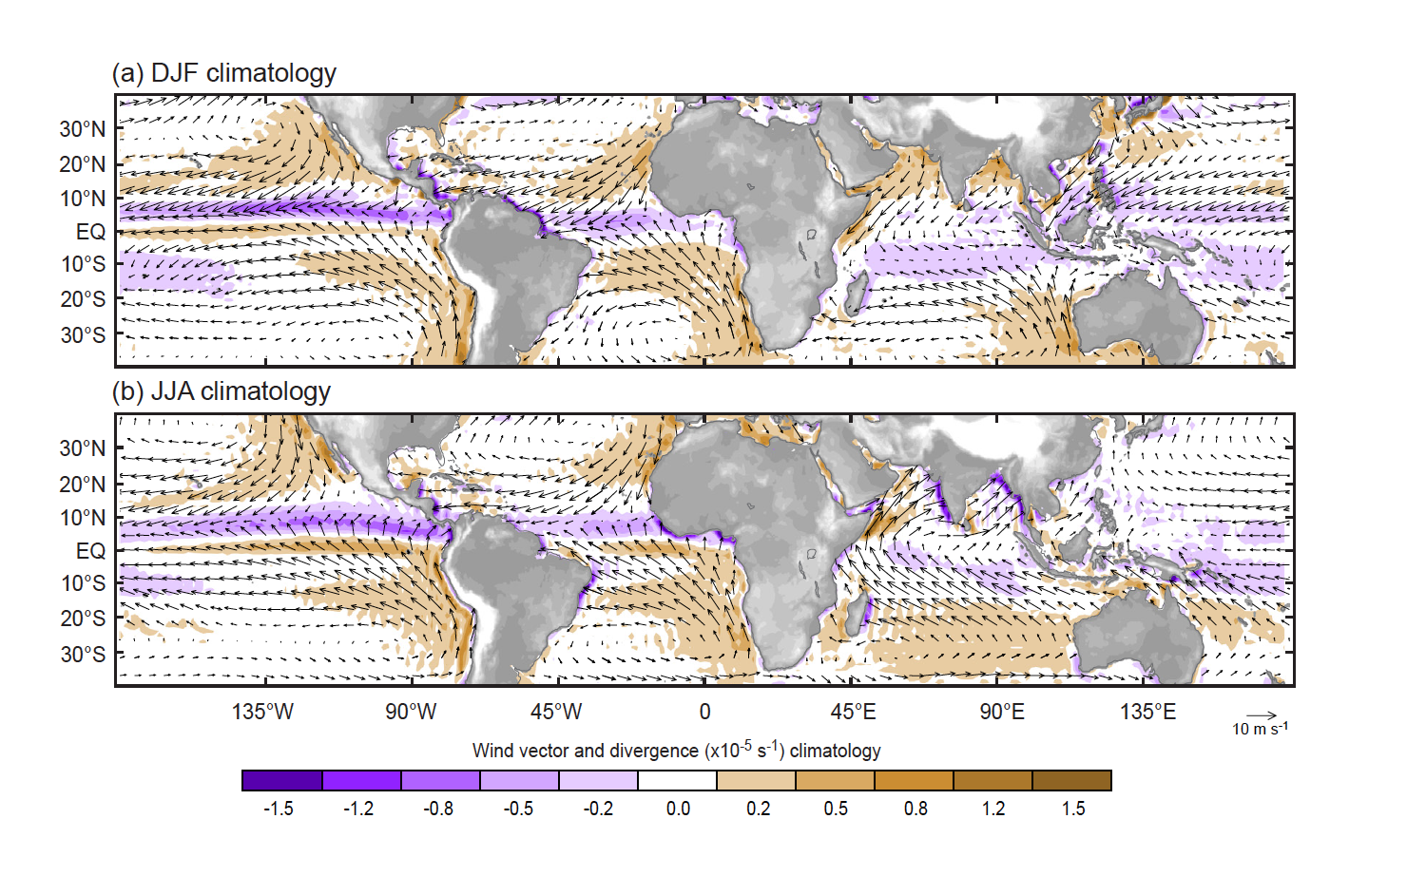
1000 hPa Climatology
Notes:
NOTE:
Convergence on on coast of South America, India, and Burma
Monsoon flow reversal

Slide 25
Recall
Rainfall from TRMM PR
Notes:
How do intensity of convection and mesoscale organization relate to this rain pattern?
In this rain map, note;
Amazonia and MC in DJF—WET
Argentina –DRY

Slide 26
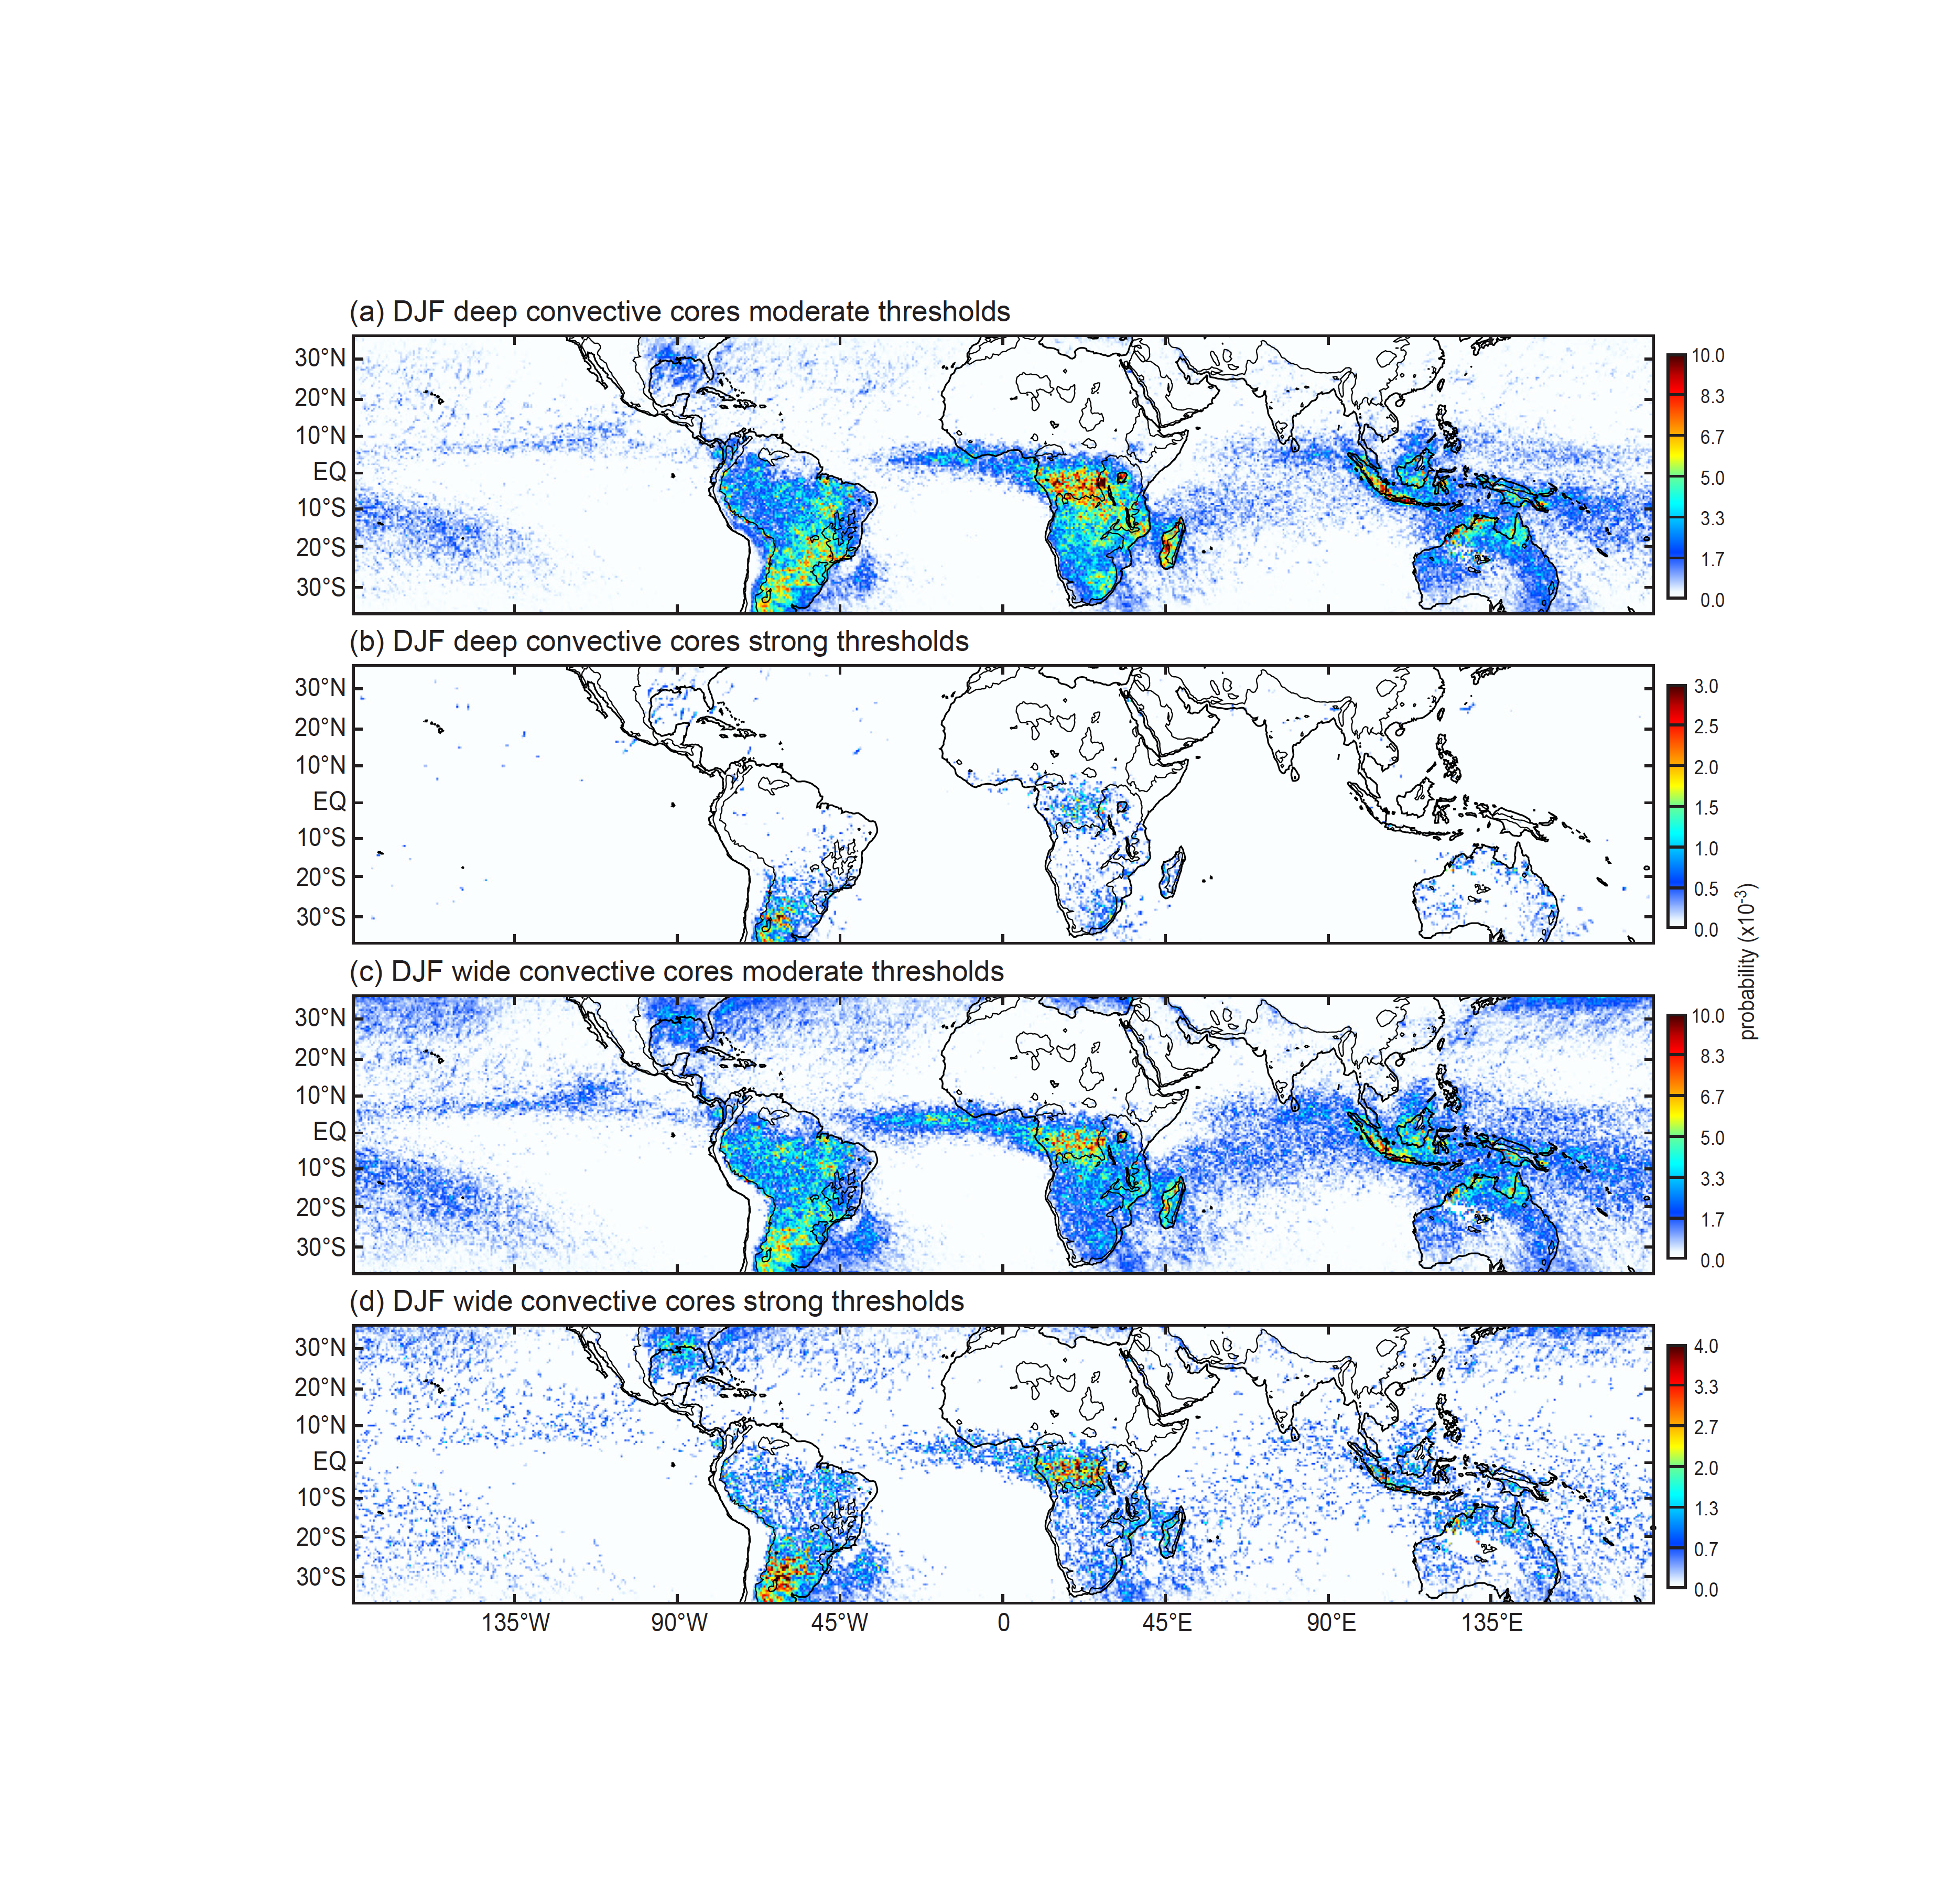
Deep and wide convective cores in DJF
Raininess is associated with
mesoscale organization
but not
intensity of convection
Notes:
WCC by moderate thresholds look most like the rain map
Moderate & strong WCCs all in same places—more over ocean with moderate thresholds
DCC strong—same as previous slide comparing with ISE—
Lacks any correspondence to the rain map don’t occur in all the same places as WCCS
Esp. over Amazon & MC & oceans
→ rainfall and mesoscale system occurrence don’t depend on having the strongest convection

Slide 27
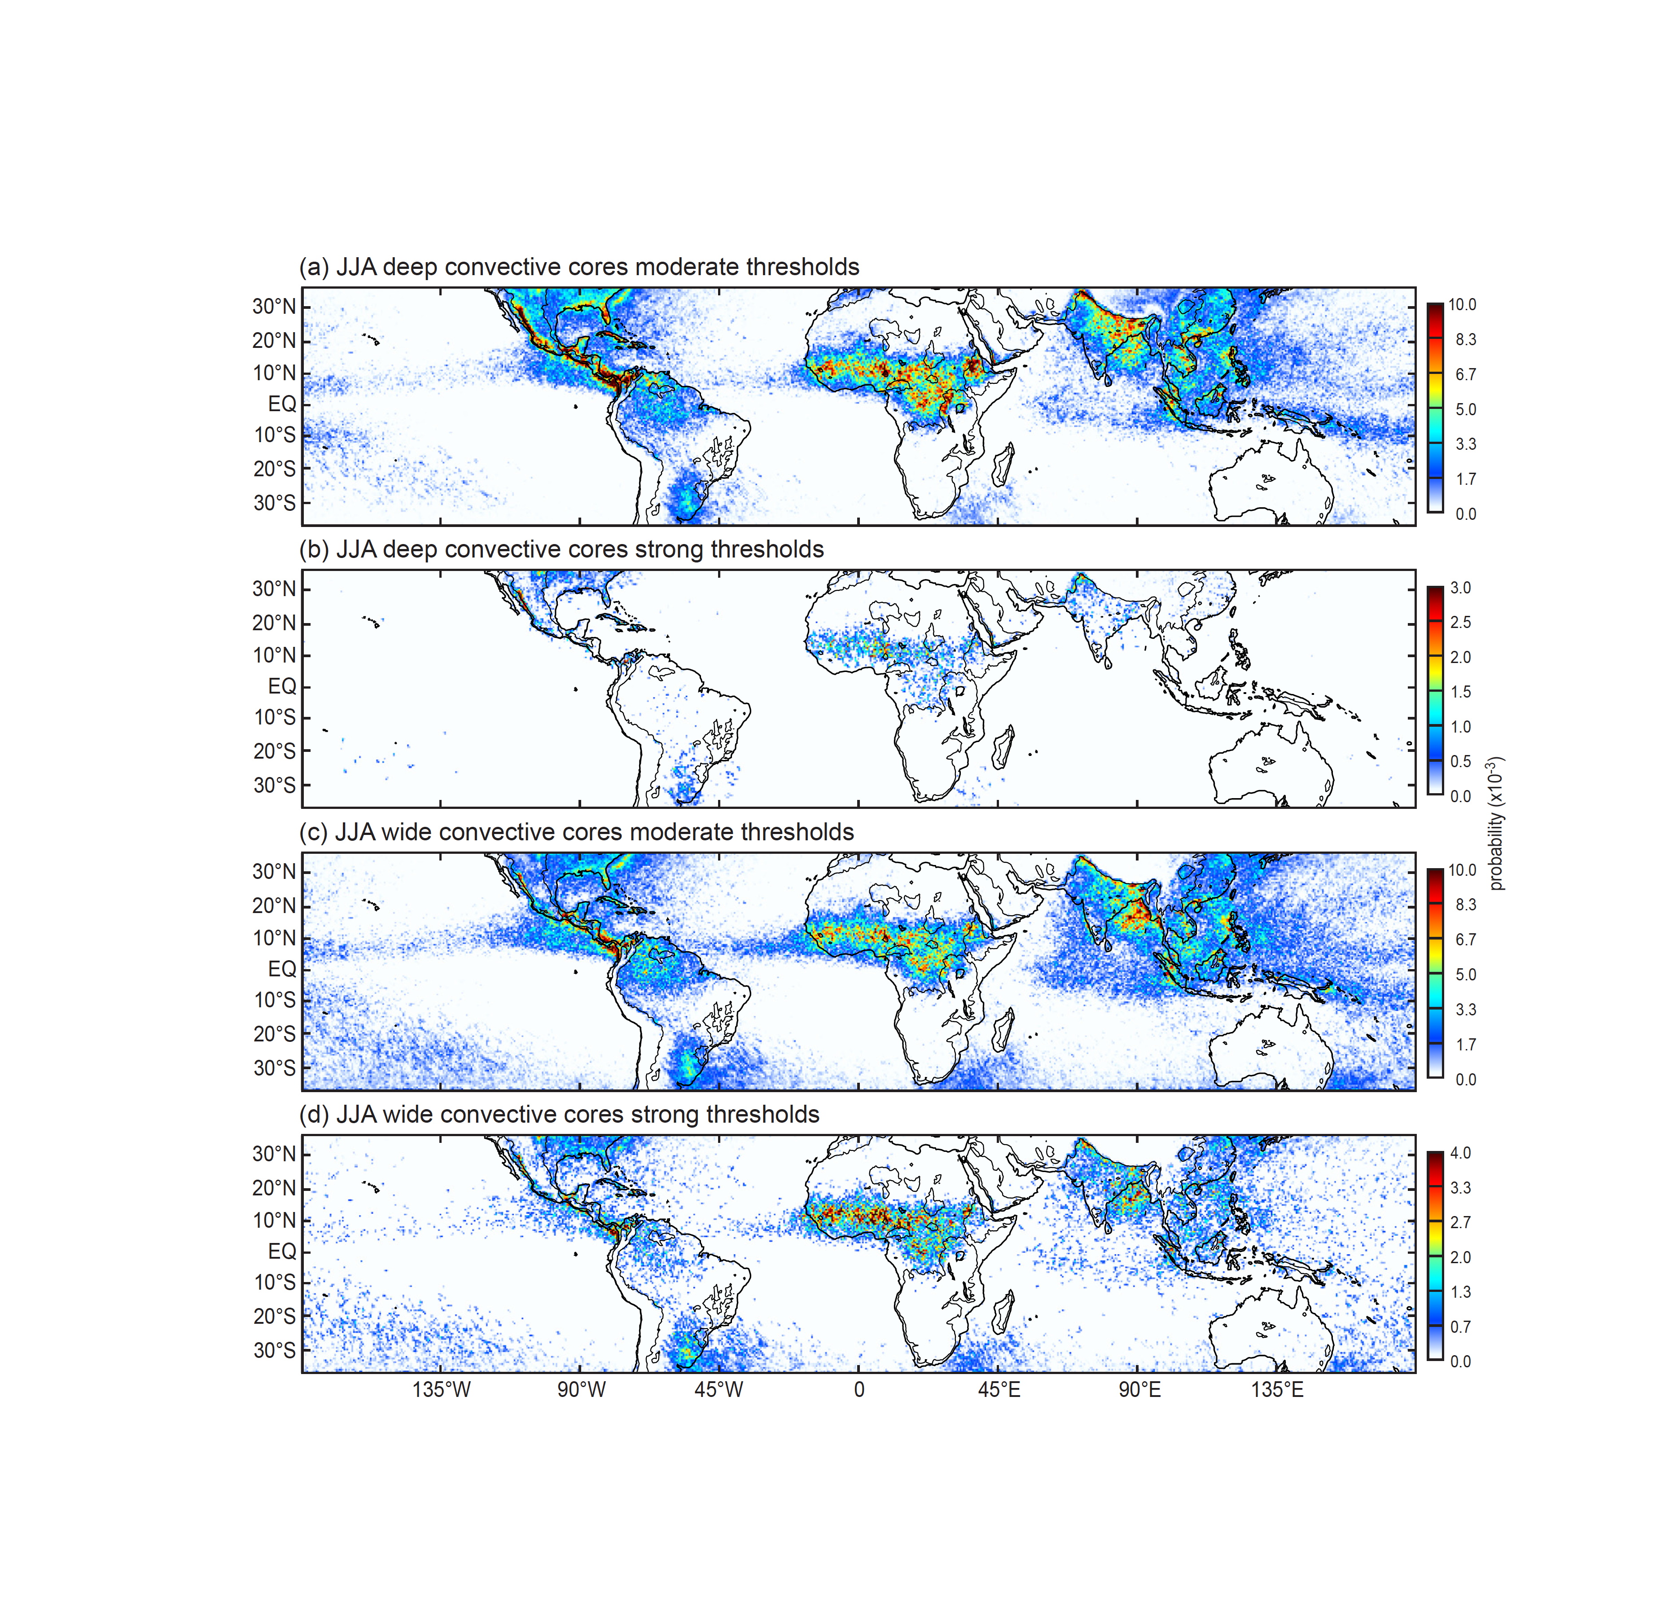
Deep and wide convective cores in JJA
JJA has additional features associated with monsoons
Notes:
Generally similar behavior with some additional features in monsoons of America and Asia
WCCs in both monsoon zones, both moderate and strong
NW subcontinent gets DCC of the strong threshold type—not so much in Bangledesh, where the DCCs are of the moderate type
Hard to see what’s going on in Mesosamerica—zoom in…

Slide 28
Extensive stratiform precipitation regions develop when well organized mesoscale convective systems reach a mature stage.
BSRs occur in regions where upscale development of mesoscale convection occurs
Is that all?

Slide 29
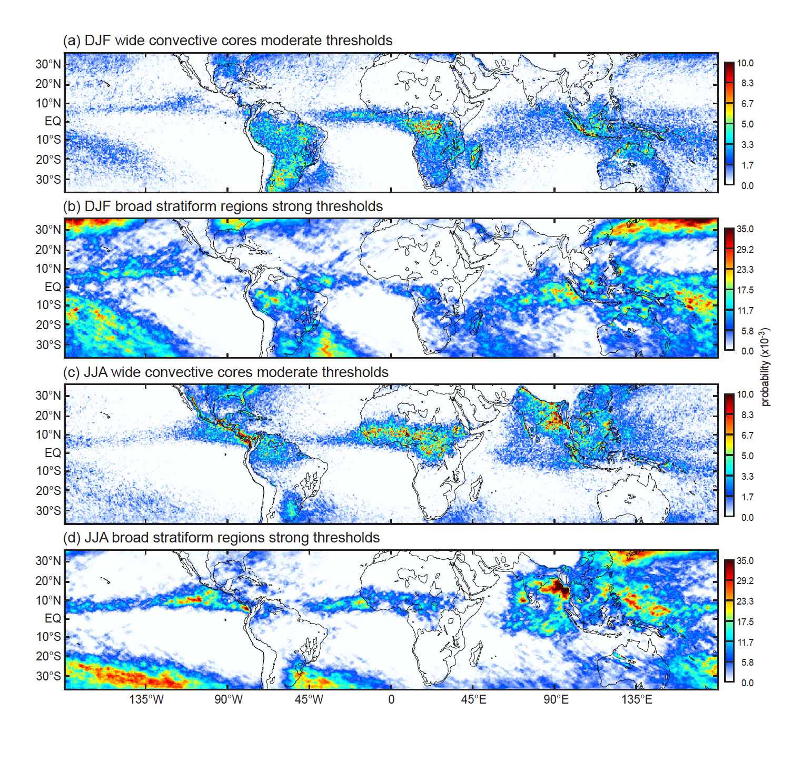
Strong BSRs develop from WCCs
Fronts produce BSRs in winter in subtropics
Manifest more strongly over oceans
Monsoon regions different?
“Plum rain” region in JJA: monsoon + baroclinic effects
Notes:
Strong BSRs develop where moderate WCCs occur
Strong BSRs manifest more strongly over the oceans
True in both DJF and JJA
Fronts produce BSRs in winter hemispheres
Plum rain region is combination of midlatitude troughs and the westward extension of the Indian monsoon
Mei Yu, Baiu, Jangma

Slide 30
Conclusions from TRMM:
The nature of convection varies across low latitudes!
Convective cores
Shallow isolated echoes—oceanic
Deep intense cores—continental, not in rainiest zones
Concentrated on upstream side of coasts and/or mountains
Upscale growth of convection (“aggregation,” “organization”)
Mesoscale organization coincides with rainiest areas
Mesoscale organization associated with less deep & intense convection
Stratiform development
Wherever mesoscale aggregation occurs
Manifests most strongly over oceans
Stratiform structure varies!
Mesoscale system type—over open tropical oceans
Widespread cellular form—in ITCZ and monsoonal coastal regions
Frontal—over subtropical oceans in winter

Slide 31
Now apply categories to GPM

Slide 32
Object | Echo Characteristic | Height | Area
Isolated Shallow Echoes | > min detectable | < 4 km | 2 pixels
Deep Convective Cores | > 40 dBZ (strong) | > 10 km | N/A
 | > 30 dBZ (moderate) | > 8 km | N/A
Wide Convective Cores | > 40 dBZ (strong) |  | > 1000 km² at some altitude
 | > 30 dBZ (moderate) |  | > 800 km² at some altitude
Broad Stratiform Regions | Contiguous stratiform |  | > 50,000 km² (strong)
 |  |  | > 30,000 km² (moderate)
 |  |  | 30-50,000 km² (filtered)
Notes:
3D structure--thresholds: intensity, height, & area

Slide 33
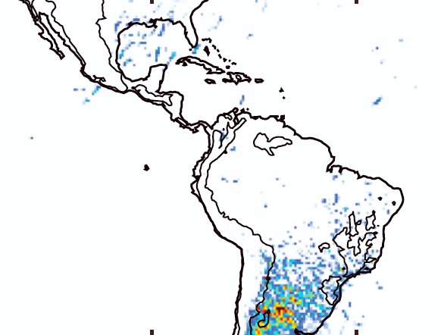
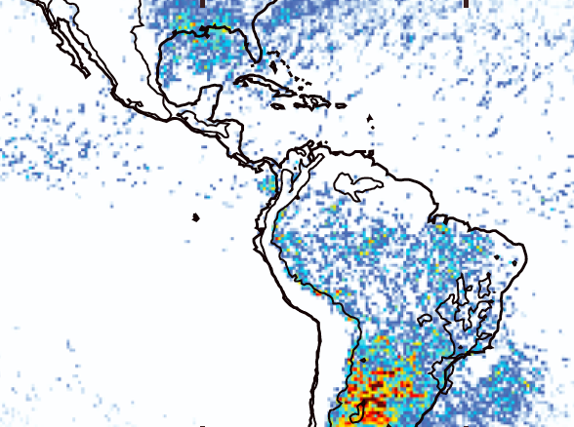
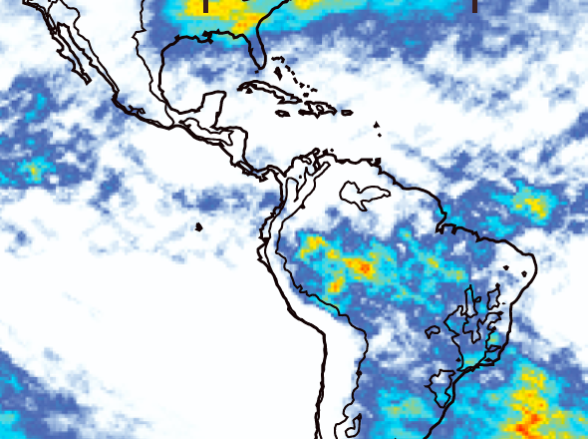
Recall TRMM South America Results
Deep Convective Cores
(strong)
Frequencies of occurrence
See Houze et al. 2015 for full low-latitude patterns of these features
DJF
Wide Convective Cores
(strong)
DJF
Broad Stratiform
(strong)
DJF

Slide 34
Now…
Look at North America with GPM

Slide 35
Probability of Shallow Isolated Echoes

Slide 36
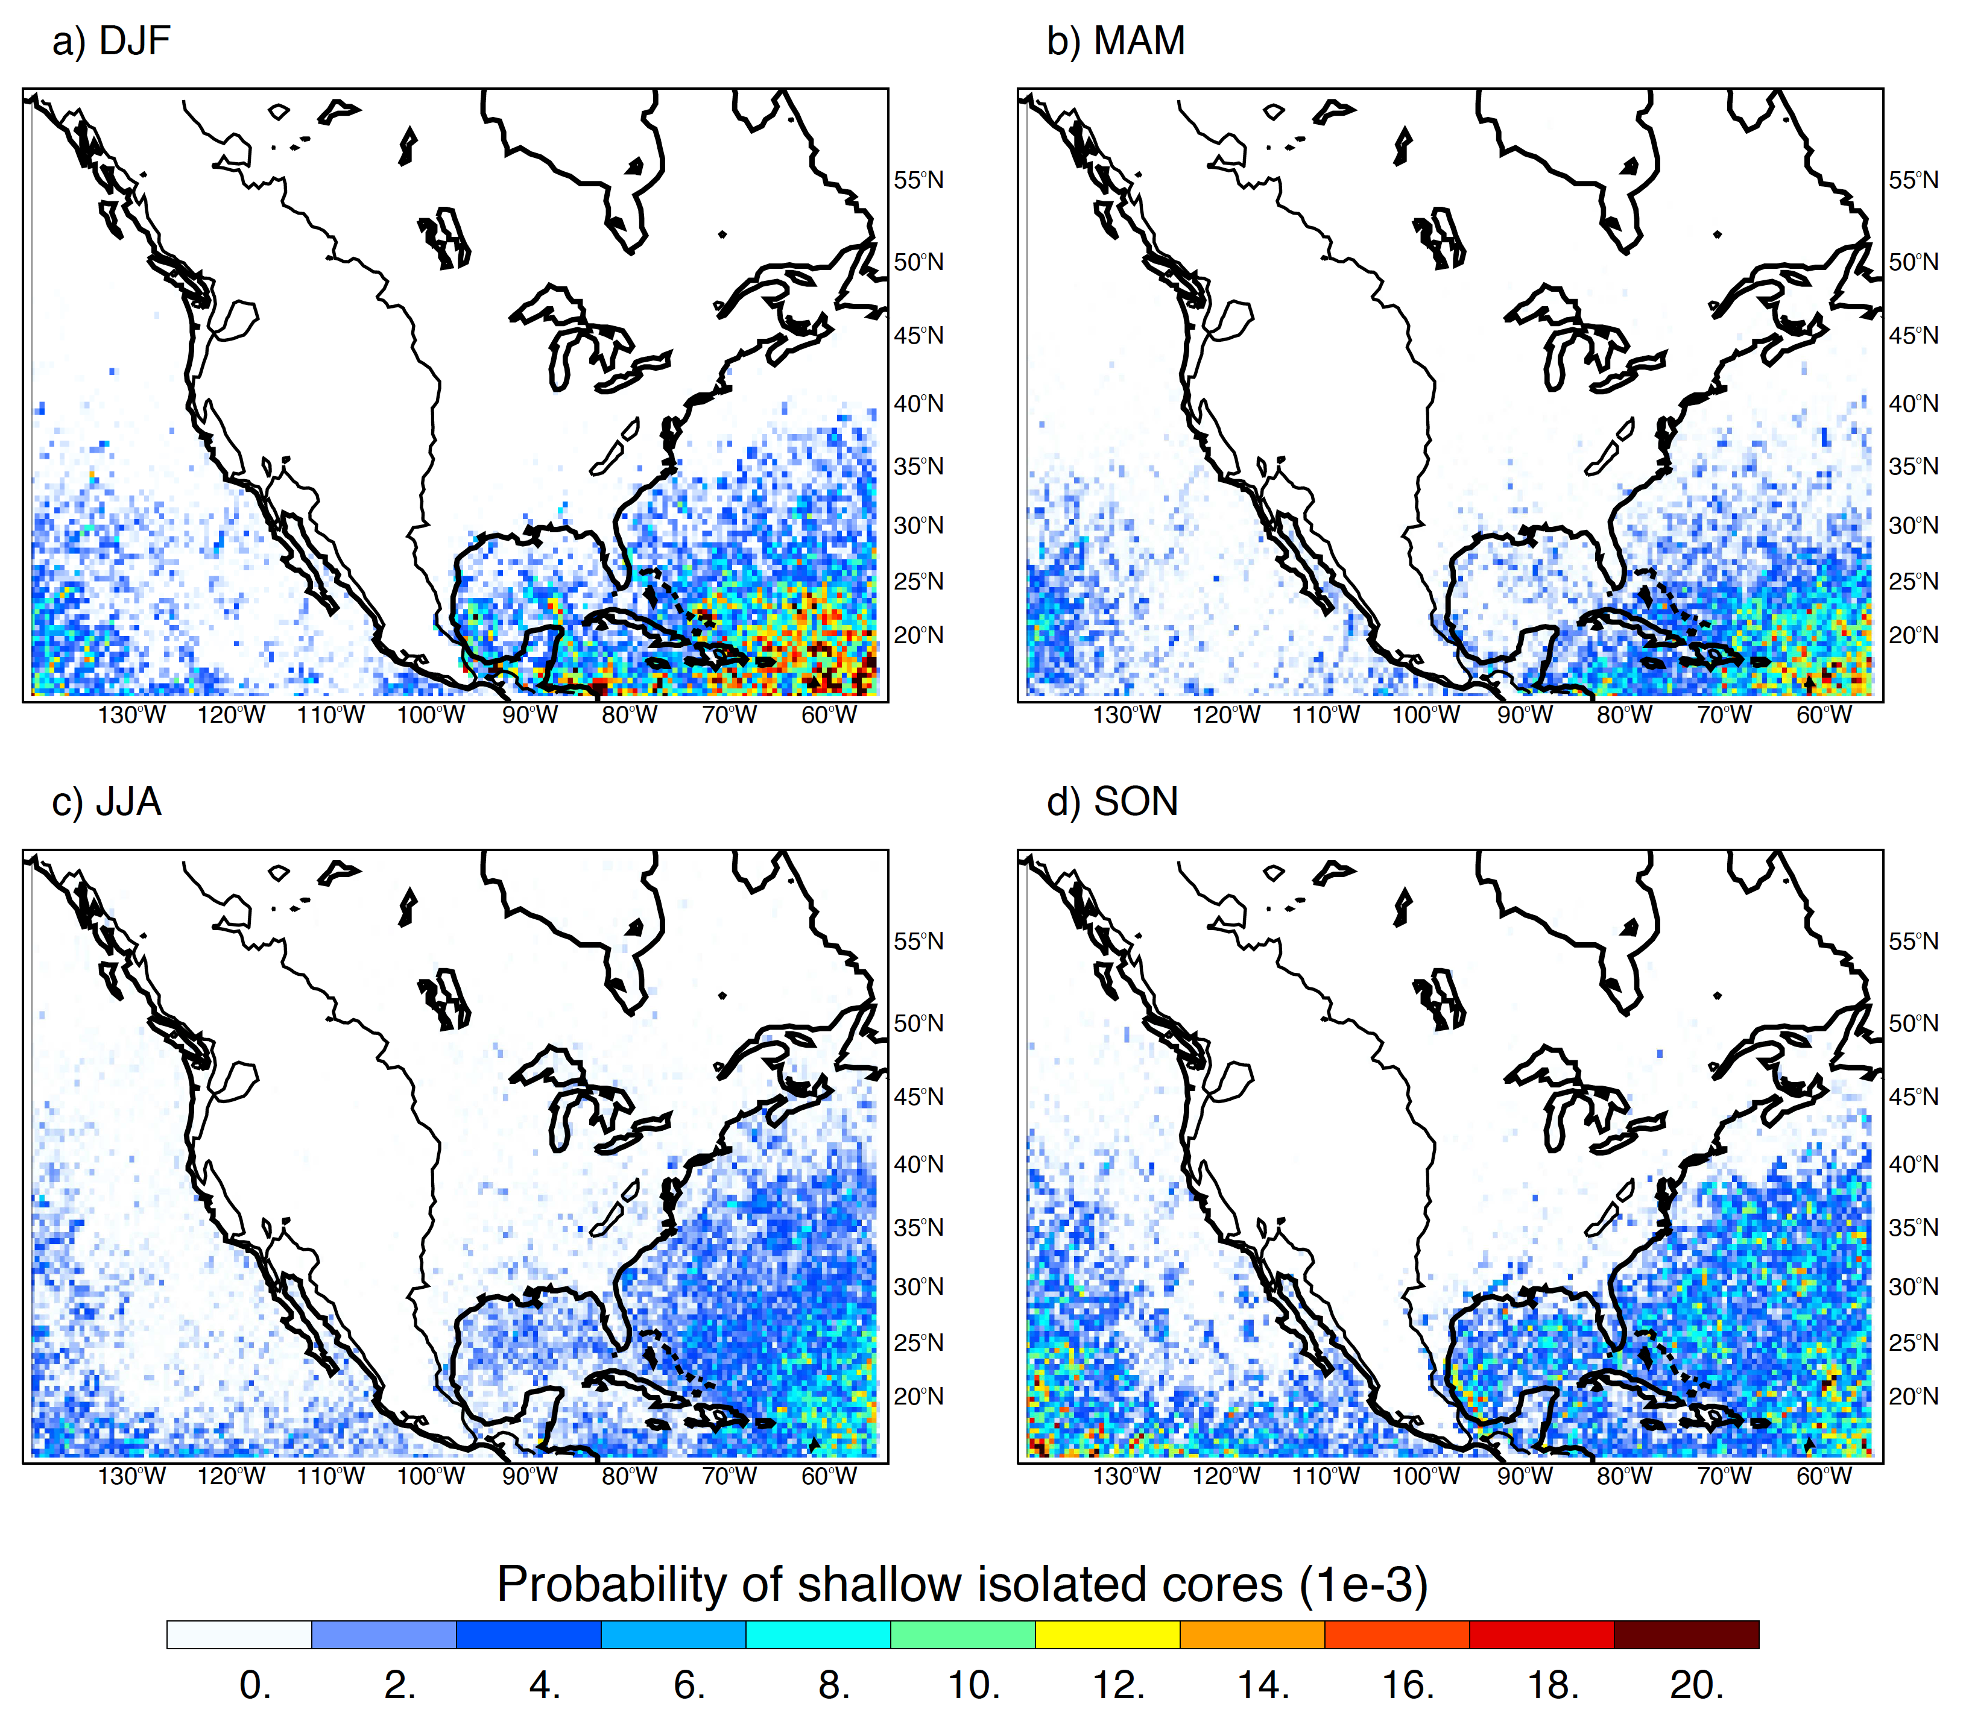

Slide 37
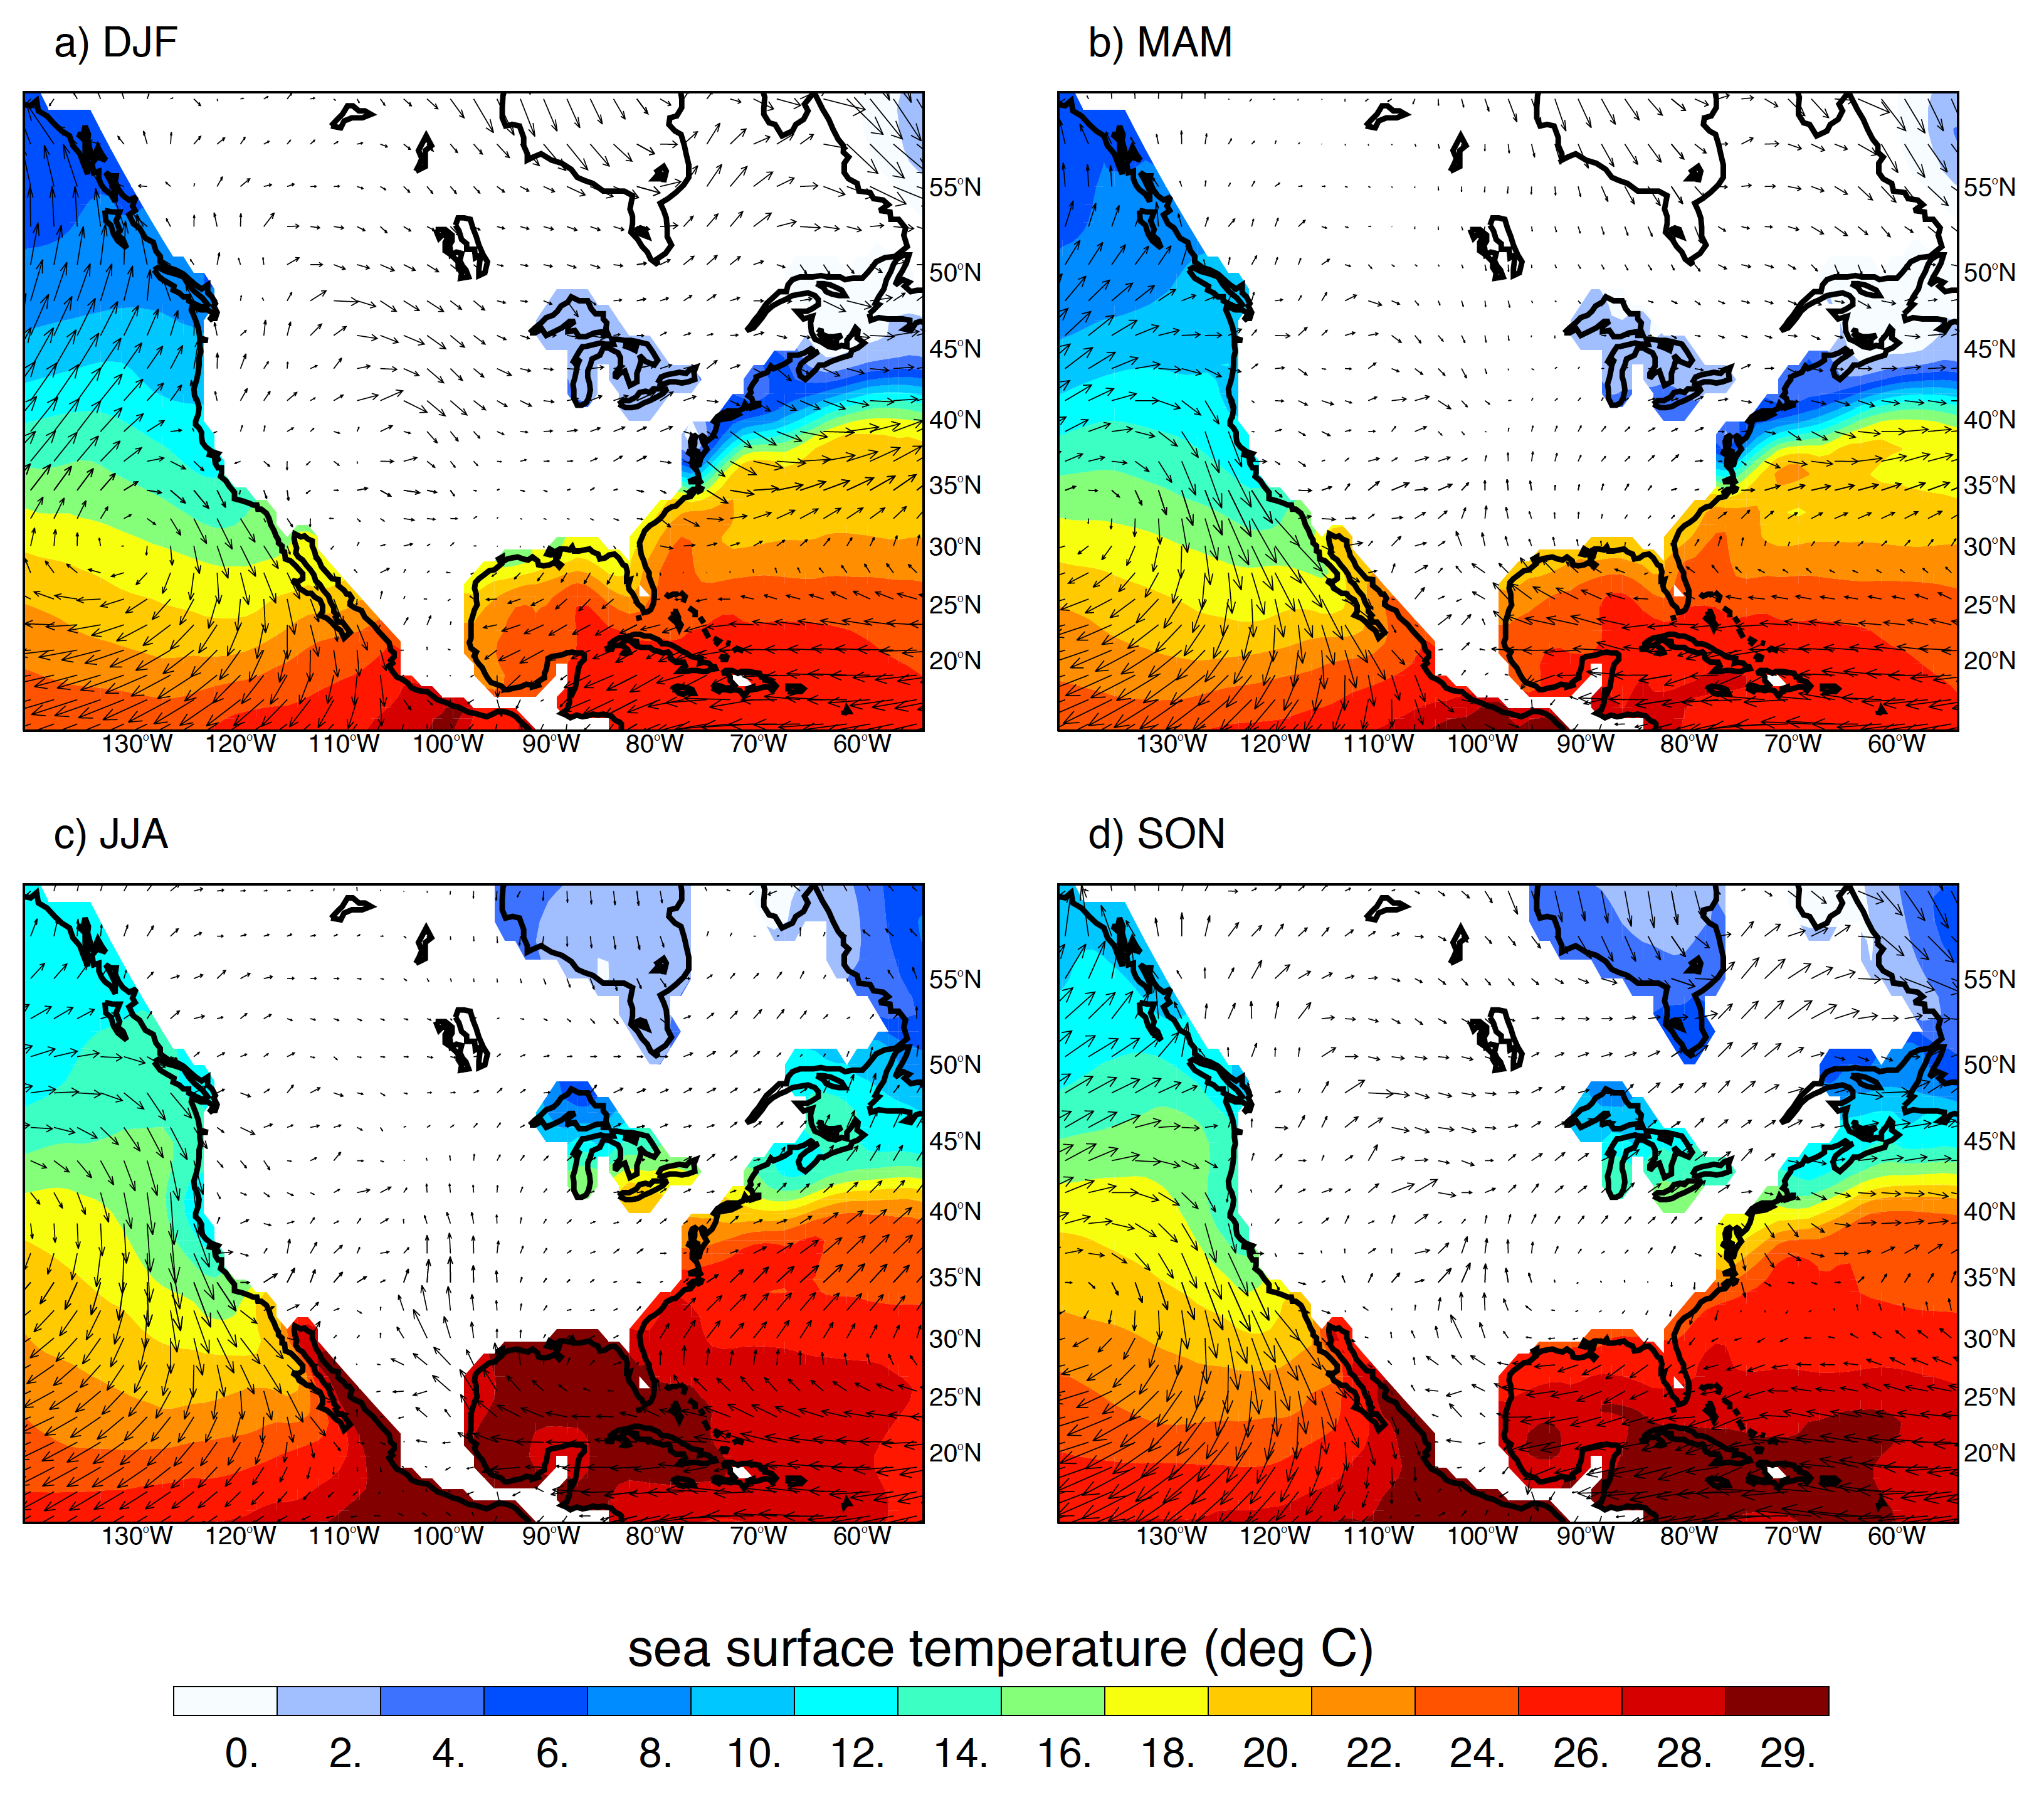

Slide 38
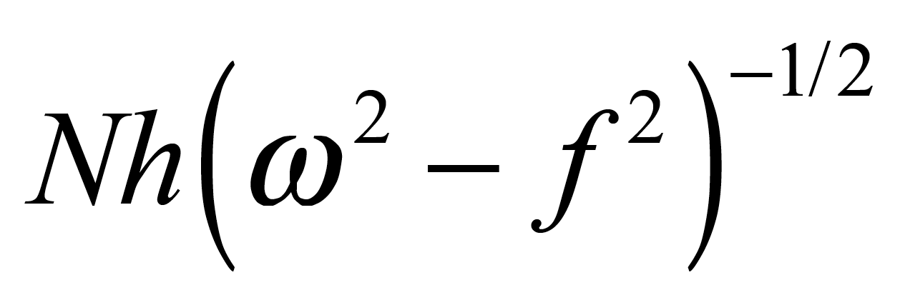
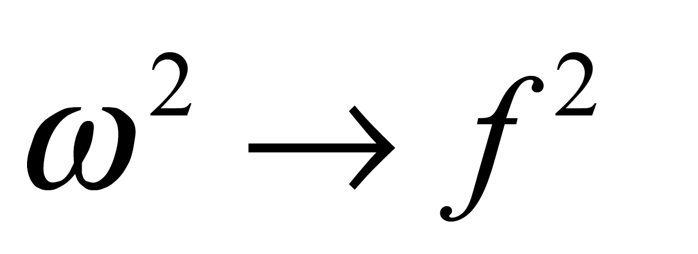
Rotunno (1983) showed that the horizontal extent of a sea breeze is given by
Diurnal frequency
and
as latitude
30°

Slide 39
Probability of Extreme Convection
Deep Conv.
Wide Conv.
Broad SF
(using moderate thresholds)

Slide 40
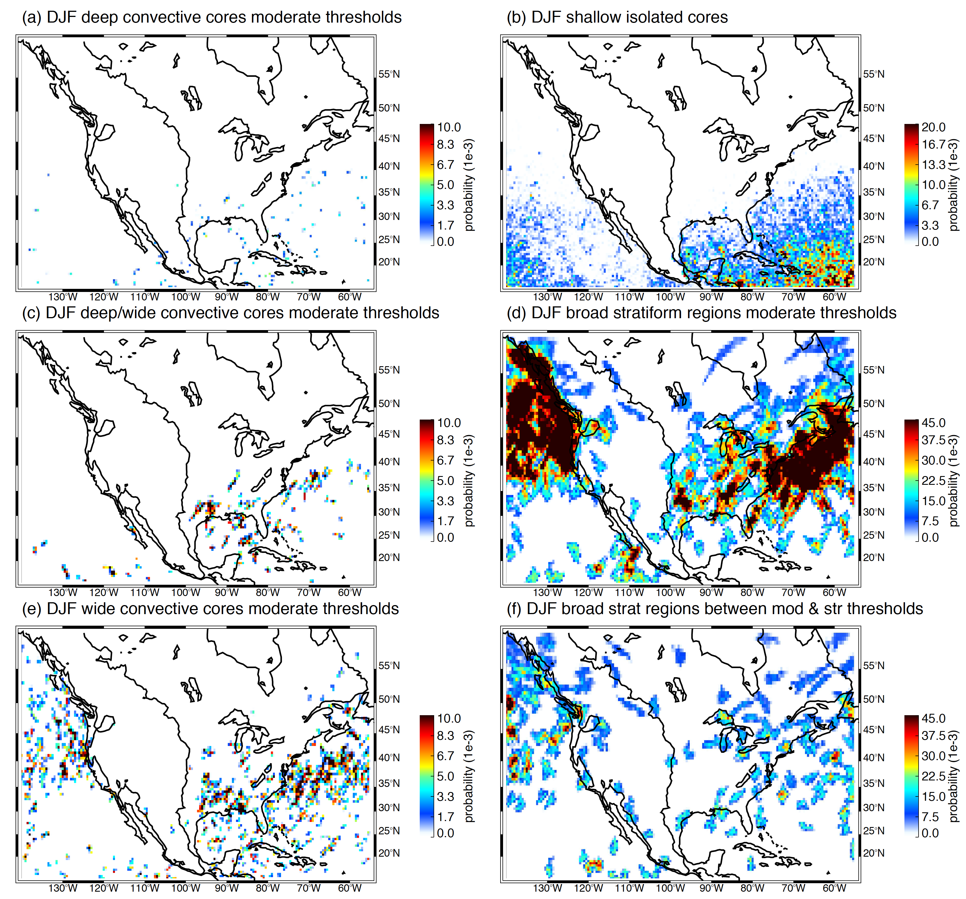
DJF
deep
ise
d/w
bsr
wide
bsr/f

Slide 41
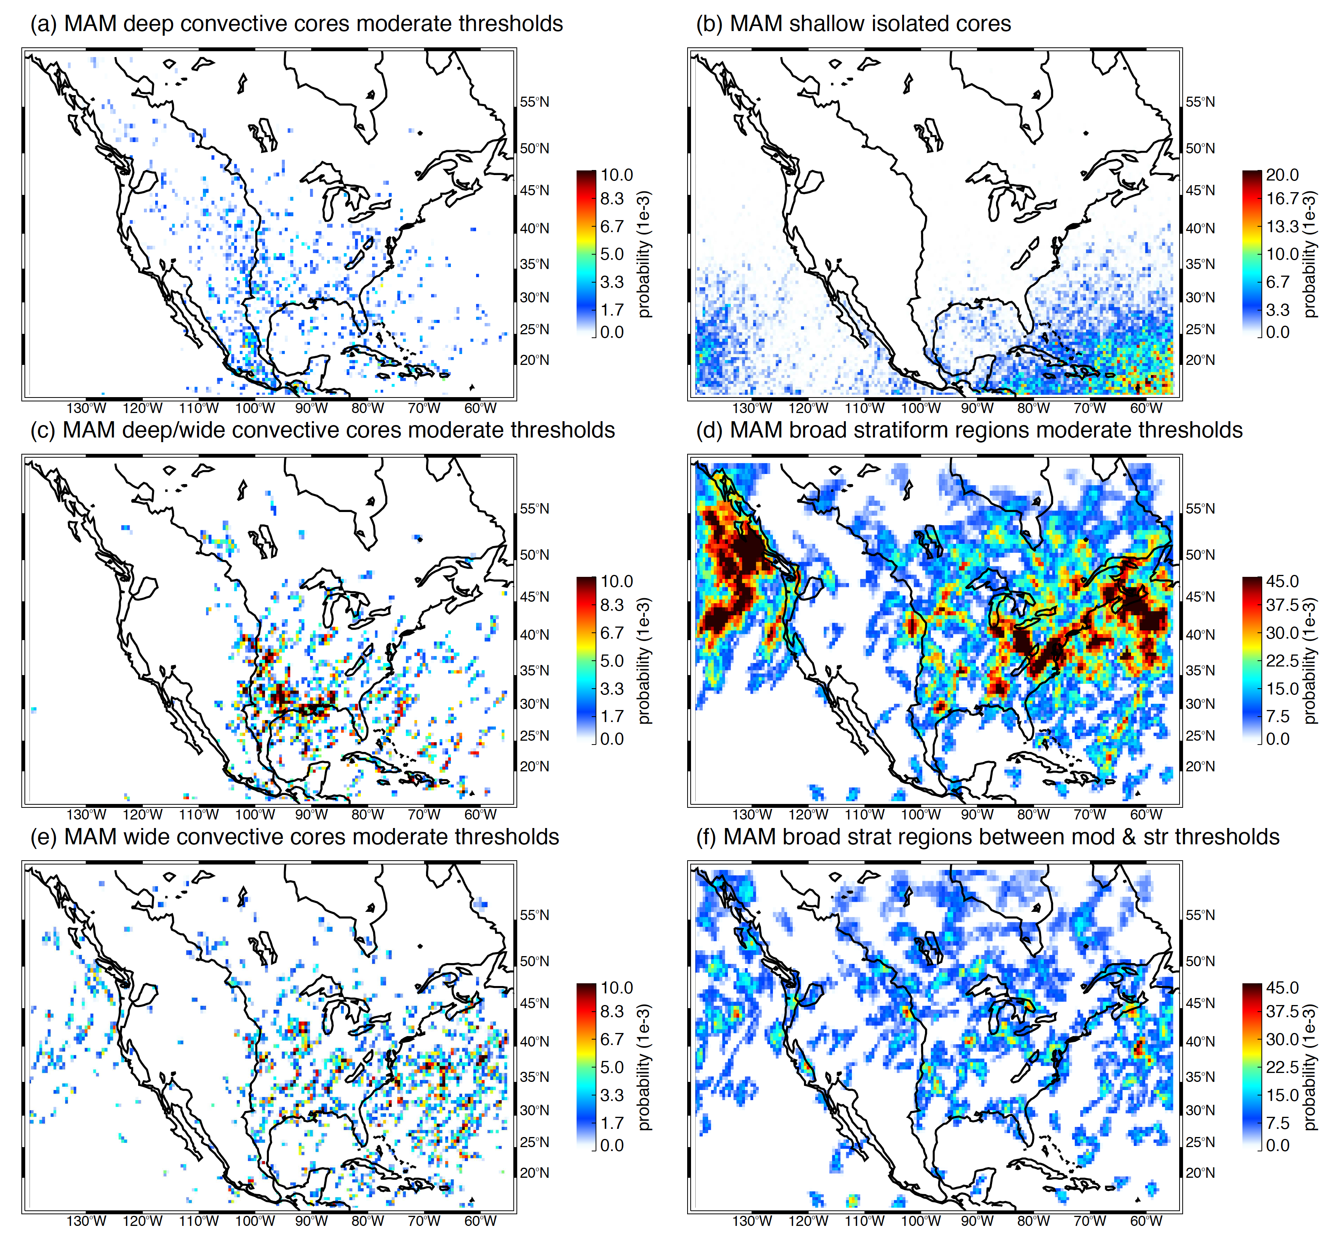
MAM
deep
ise
d/w
bsr
wide
bsr/f

Slide 42
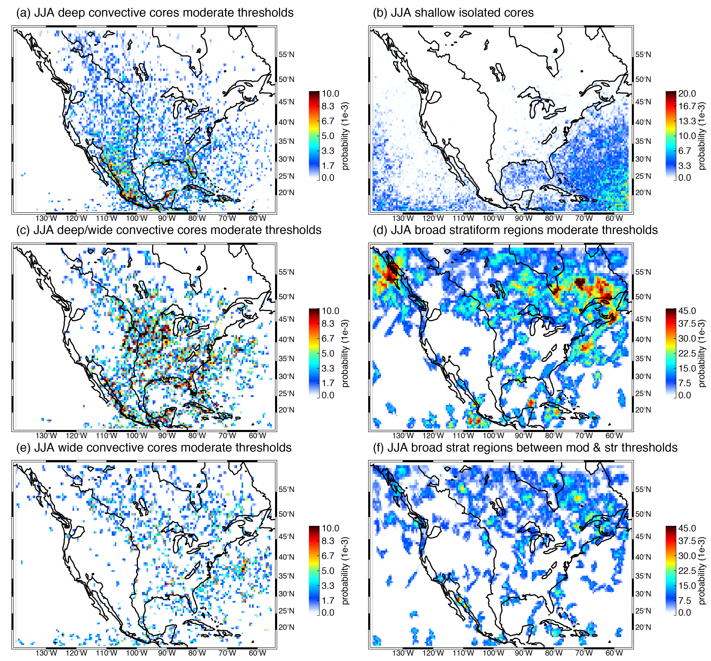
JJA
deep
ise
d/w
bsr
wide
bsr/f

Slide 43
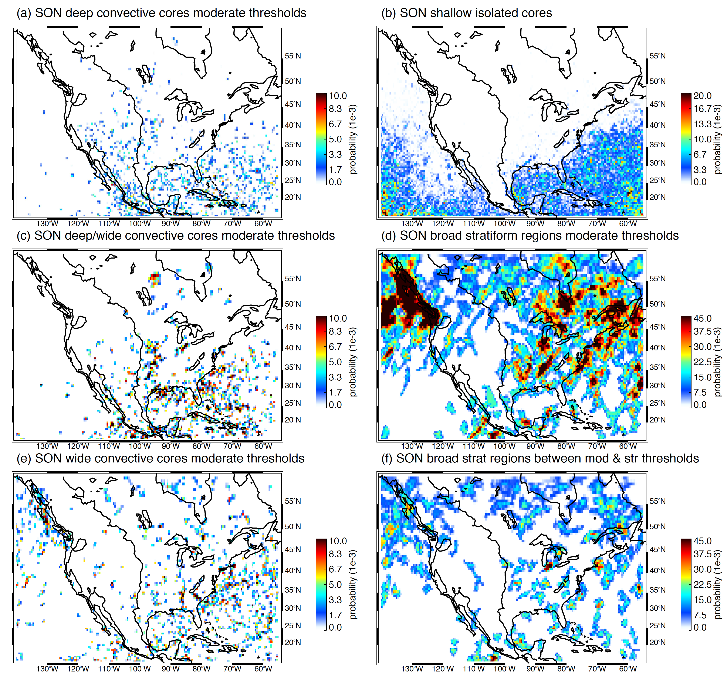
SON
deep
ise
d/w
bsr
wide
bsr/f

Slide 44
Conclusions from Early GPM data:
Seasonal shifting of all categories
Shallow isolated echoes nearly all over ocean and sort of follow SST
Frontal BSRs show strong seasonal migration
WCC formation in the westerly belt, shifting N in summer, & coastlines
Mountain and near-mountain convection
Much deep convective activity directly over mountains—unlike Andes and Himalayas
Mesoscale development occurs slightly west of Rockies but in a less focused pattern than over Argentina
Coastal convection
Prominent coastal patterns, especially near mountains (Mexico)
Sea/land breeze pronounced along Gulf Coast (30°N)
Stratiform regions
BSR development from convection is generally weak—as over other landmasses
Dominated by frontal activity
Some frontal stratiform misidentified as convective

Slide 45
Database of
Contiguous Echo Objects
Based on 3D Structure
for TRMM & GPM radars
available from
http://trmm.atmos.washington.edu

Slide 46
END
Supported by NASA grants NNX16AD75G, NNX15AL38

