Slide 1

Precipitation processes and their modulation by synoptic conditions and complex terrain during the Olympic Mountains Experiment (OLYMPEX)
Lynn McMurdie
University of Washington
Key co-conspirators: Robert Houze, Walt Petersen, Matt Schwaller,
Joe Zagrodnik, Angela Rowe, Jen DeHart, Stacy Brodzik and Megan Chaplin
UW Dynamics Seminar, 2 November 2016

Slide 2
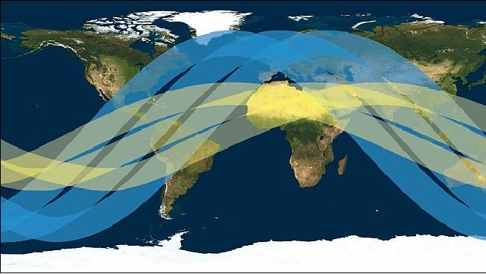
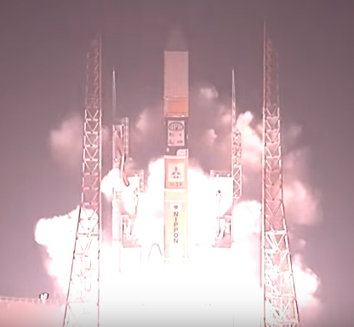
Goals of OLYMPEX
Validate GPM satellite radar and passive microwave instruments measurements of precipitation
GPM
TRMM
GPM Satellite launch 28 Feb 2014

Slide 3
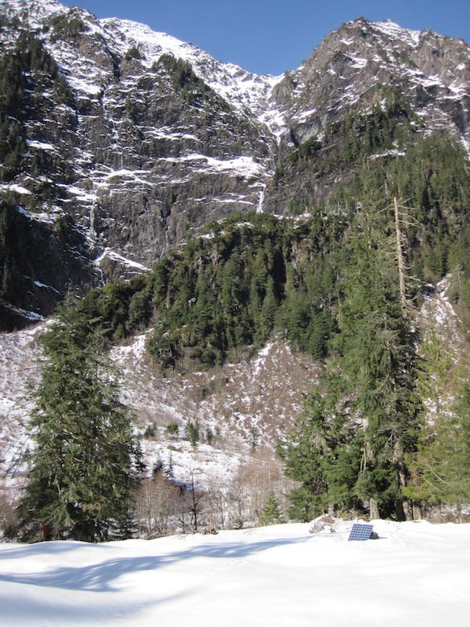
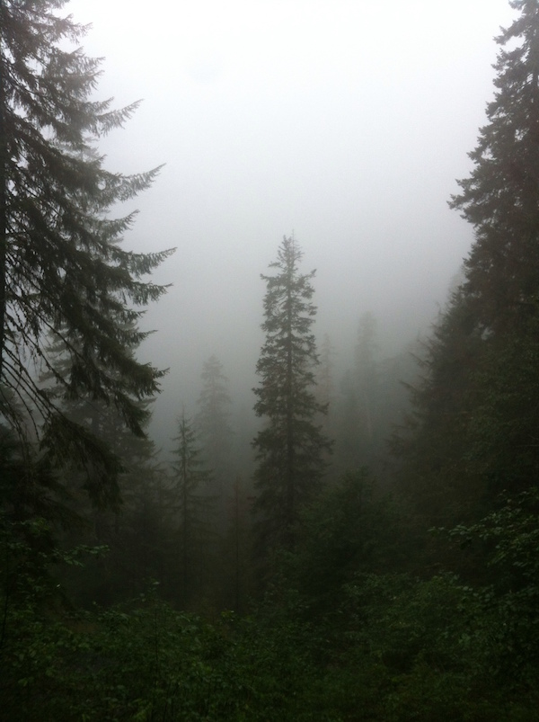
Goals of OLYMPEX
Determine the orographic effects on precipitation processes

Slide 4
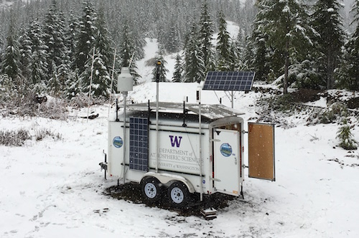
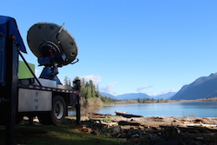
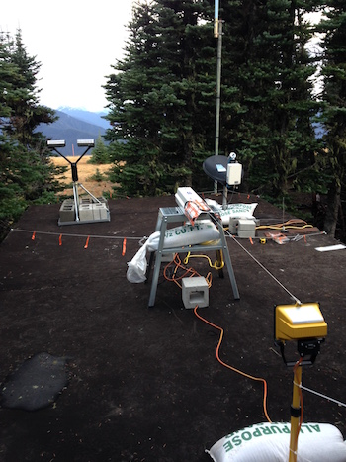

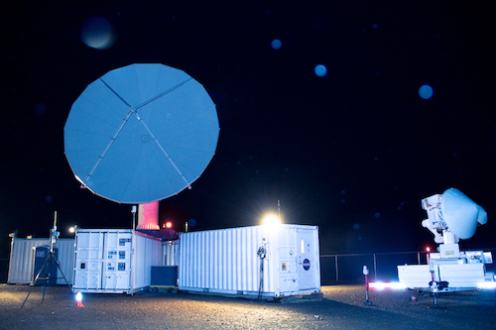
Goals of Presentation: Convey
Magnitude of experiment
Heroic Efforts
Most technologically advanced field program measuring precipitation to date
Preliminary results from the robust sampling of midlatitude storms

Slide 5
The Olympic Peninsula

Slide 6
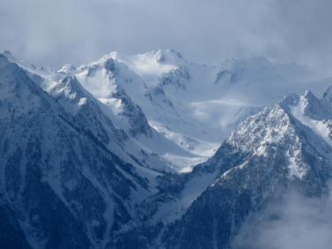
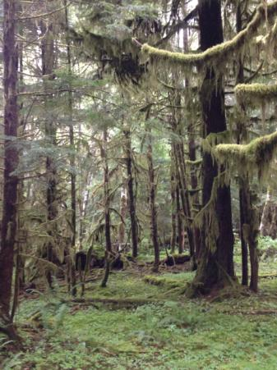
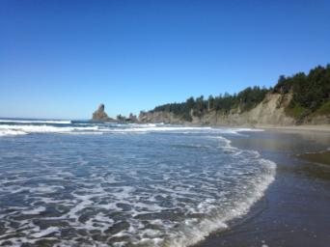
The Olympic Peninsula
High Terrain
Valley
Rain Forest
Ocean

Slide 7
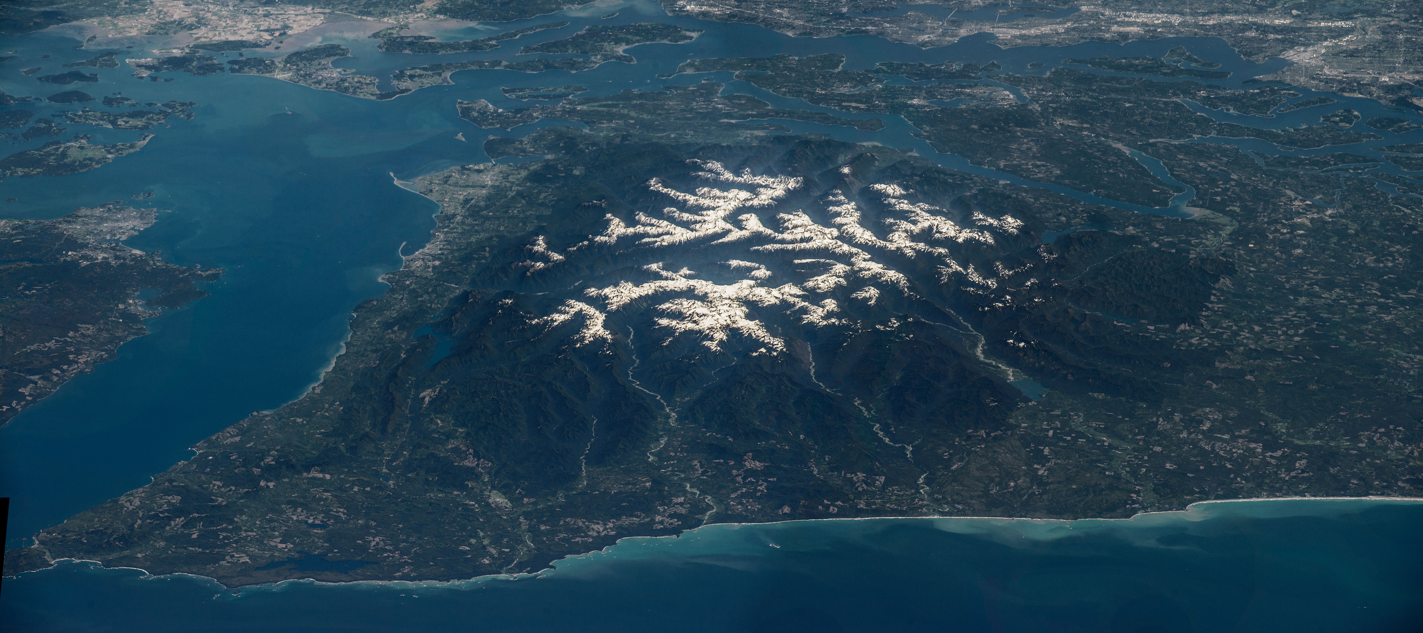
Unique features of Olympic Peninsula
Mountains are a circular barrier

Slide 8
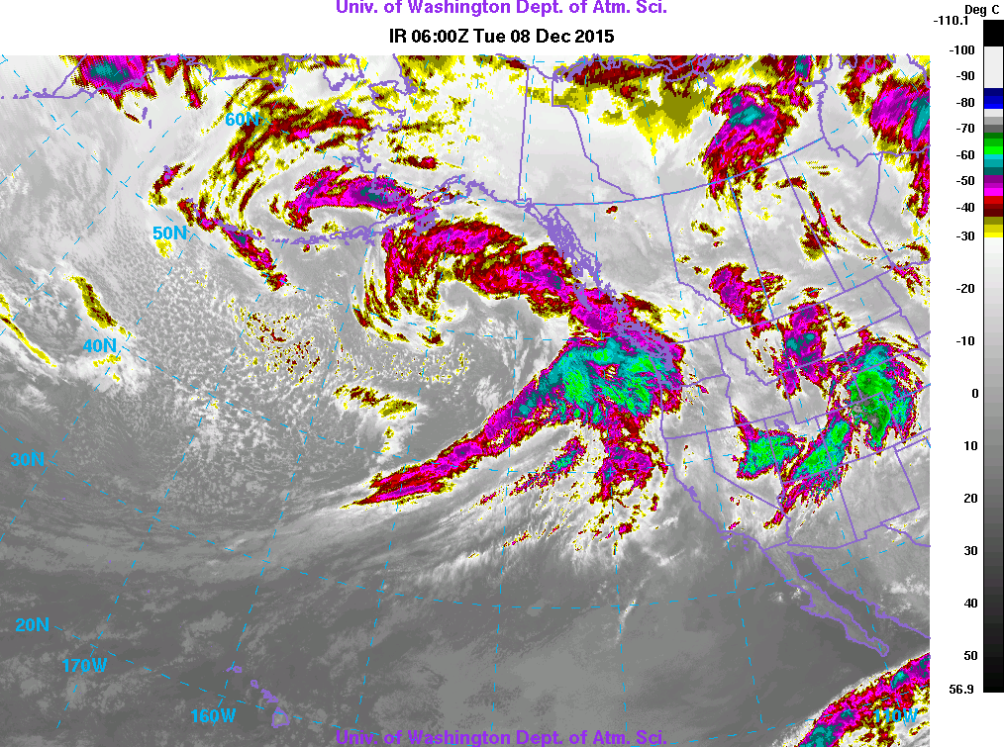
Unique features of Olympic Peninsula
Mountains are a circular barrier
Precipitation comes from land-falling winter-time midlatitude frontal cyclones

Slide 9
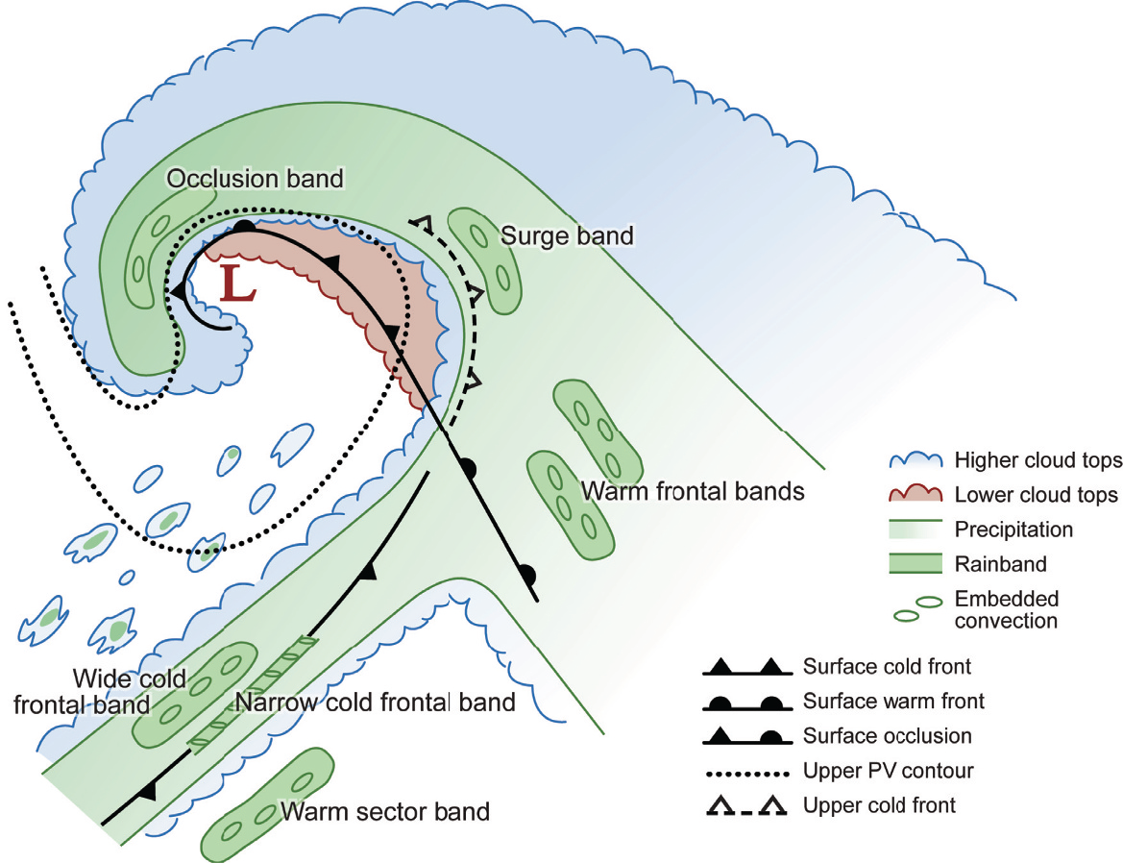
Storm Sectors of Midlatitude Storms
Prefrontal
Graphic from Cloud Dynamics, 2nd Ed., by R. A. Houze, Jr., ©Academic Press-Elsevier, 2014
Postfrontal
Warm Sector
Frontal

Slide 10
Magnitude of Operations

Slide 11
The OLYMPEX Strategy
Aircraft
ER2 & DC8—over the top
Citation—through the clouds
Radars for 3D structure
RHI sectors at 4 different wavelengths
Dual polarization
Doppler
Upper air
Supplemental soundings in events
Windward and leeside stations
Surface
Particle sizes and fallspeeds
Rain and snow amounts
Snow cameras

Slide 12

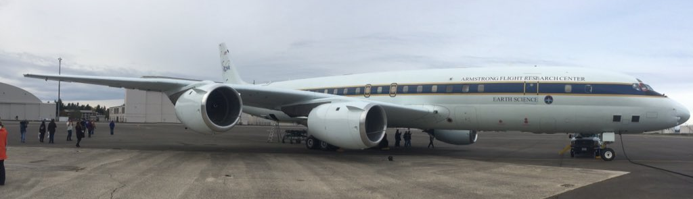

Aircraft
Above Clouds
ER-2 – Radars, Passive Radiometers
DC-8 – Radars, Passive Radiometers
Above Clouds
In Clouds
Citation – Cloud Physics

Slide 13
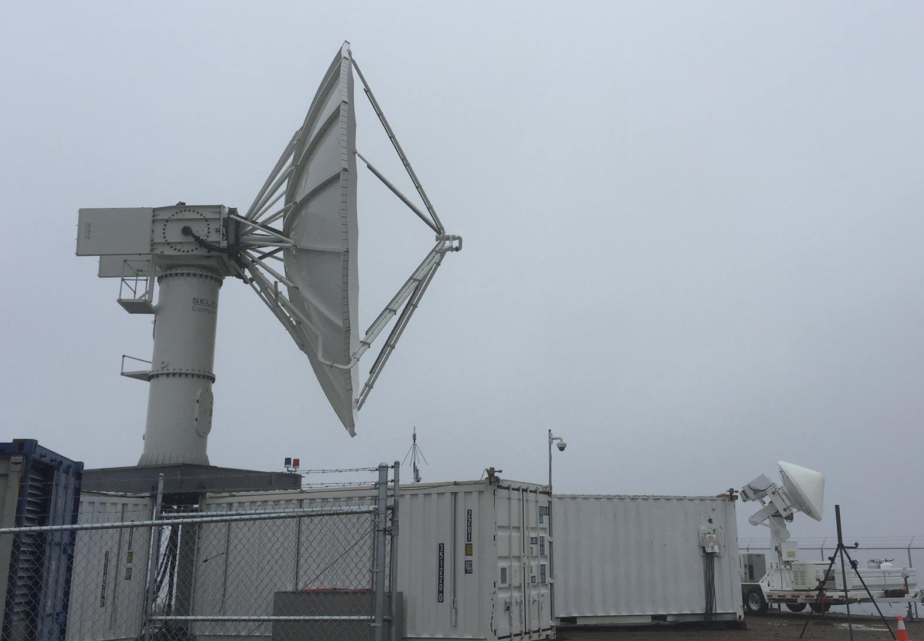
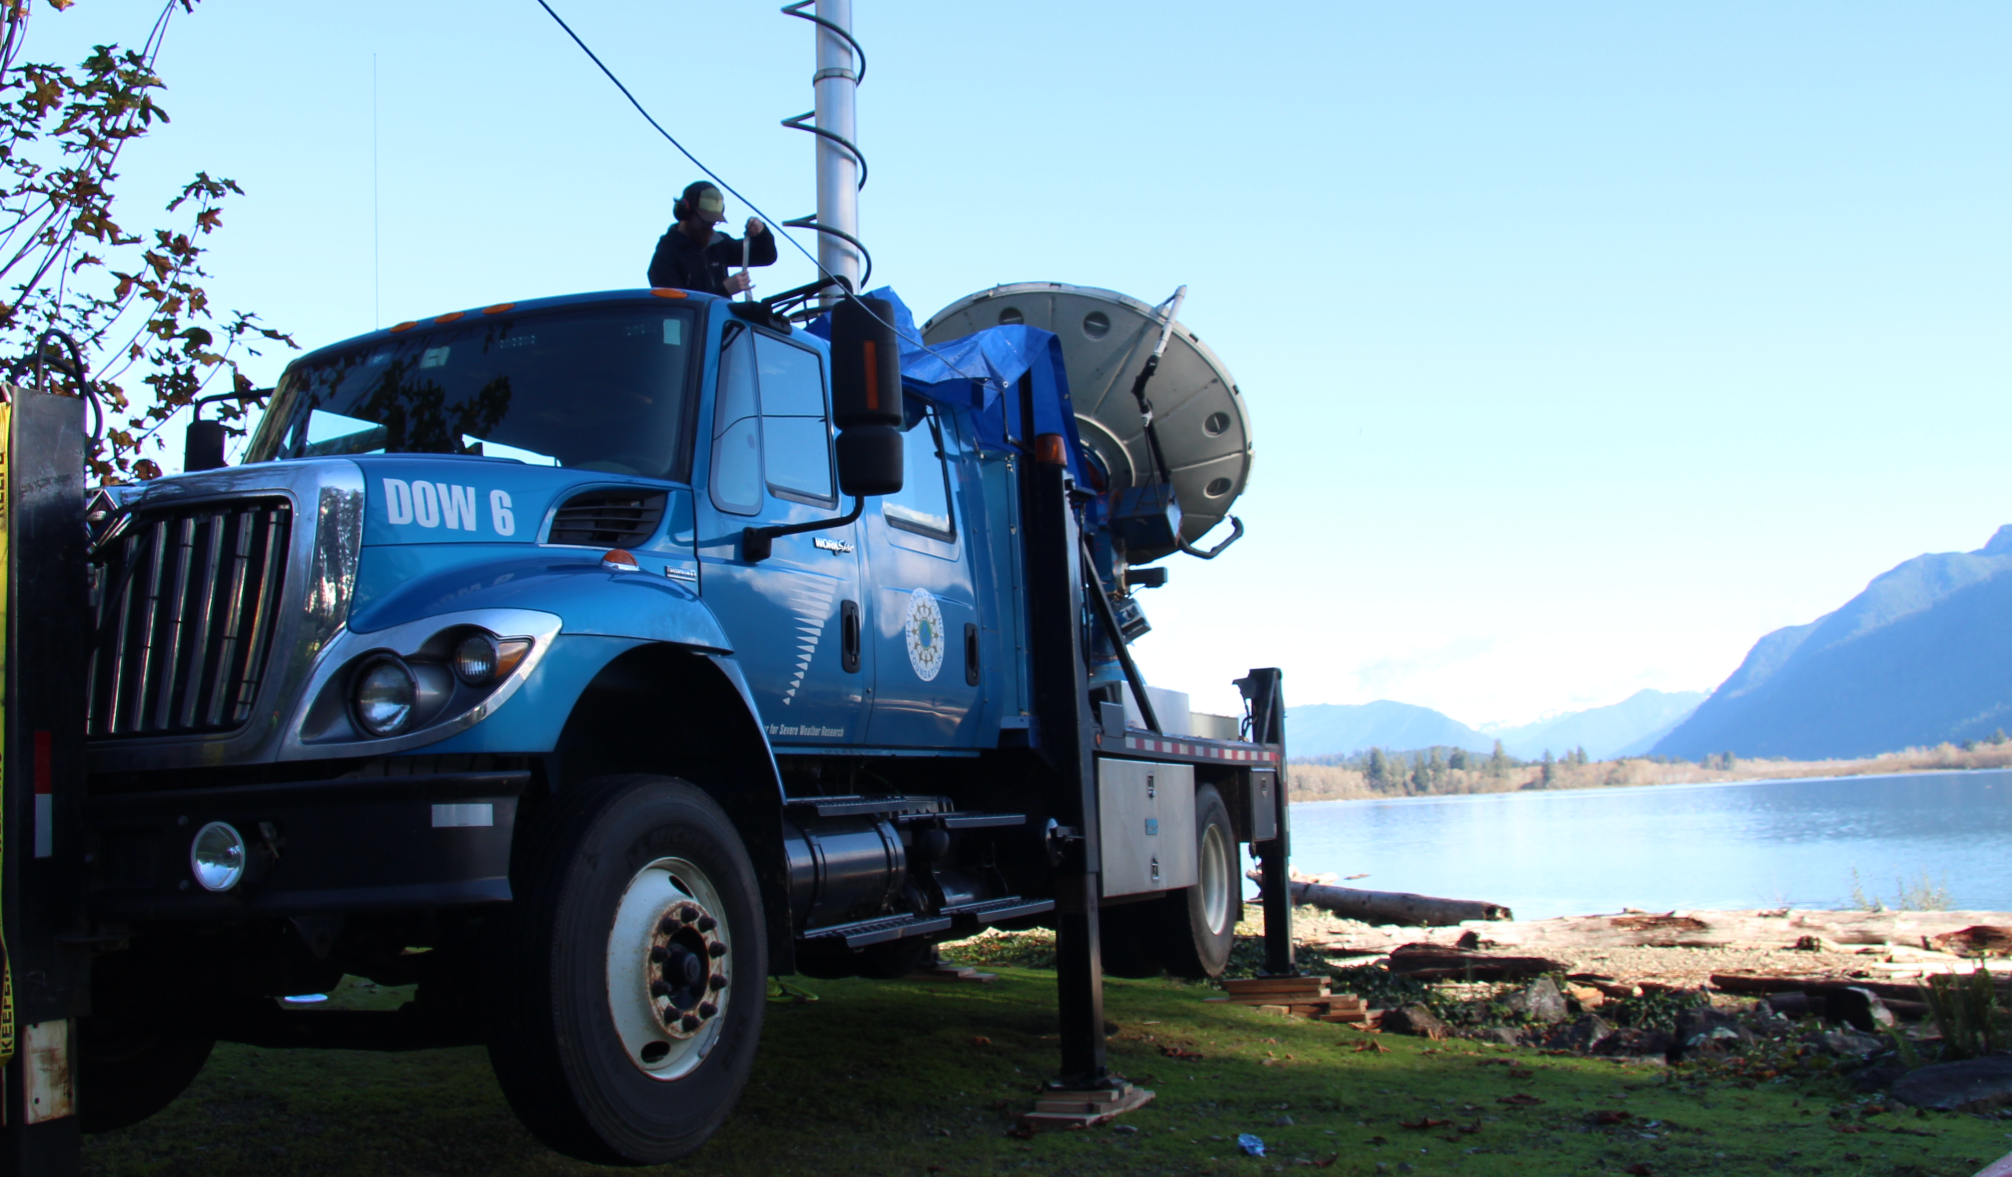
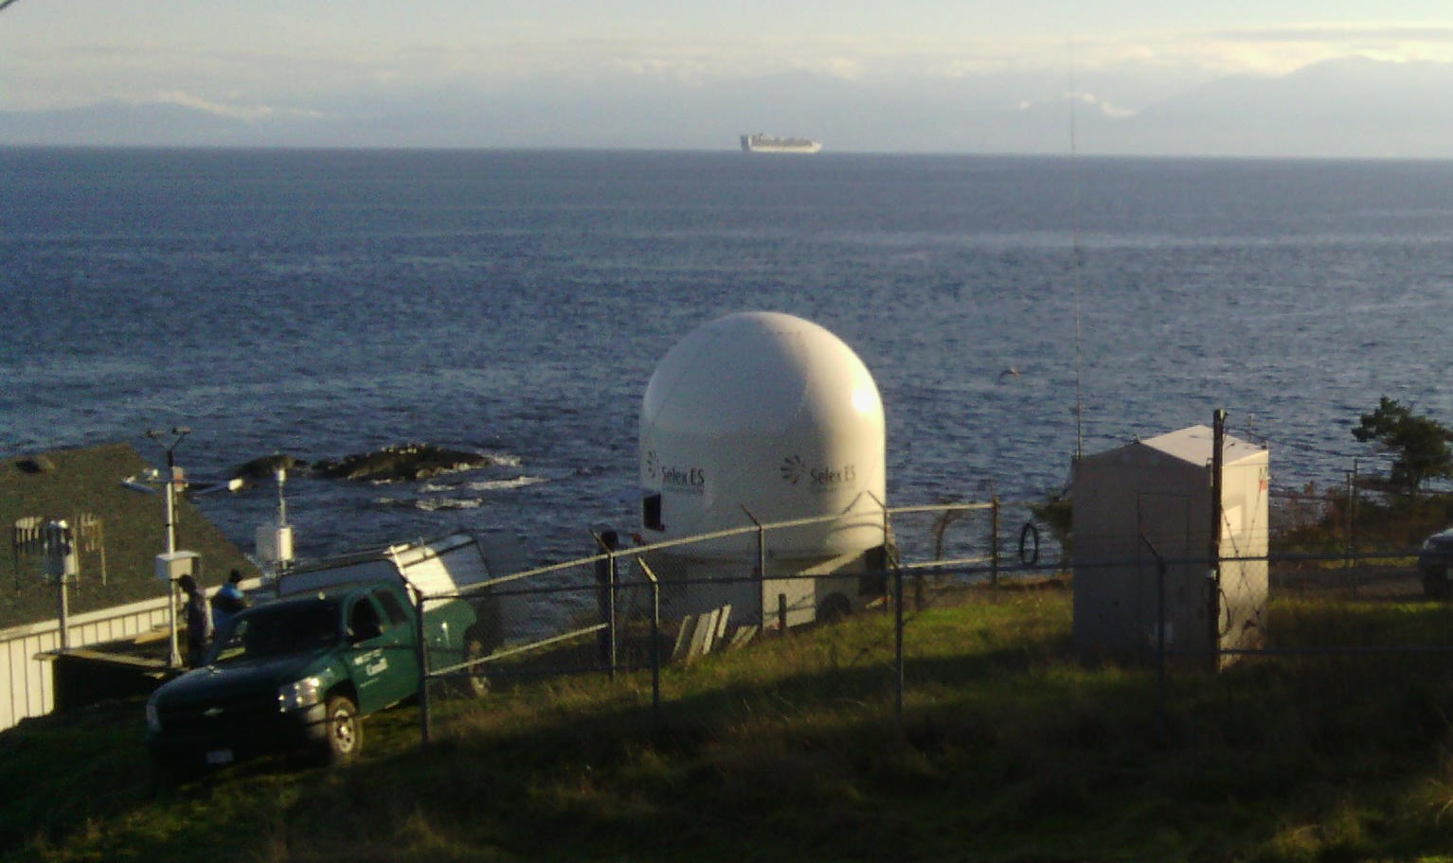
Radar RHI sectors
NPOL
S-band
D3R Ku- Ka-band
DOW X-band
EC-Xband

Slide 14
Ground Sites

Slide 15
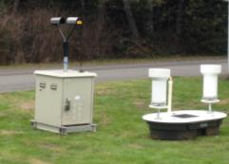
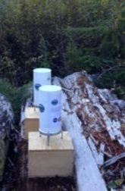

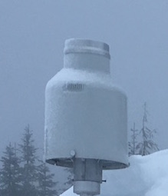
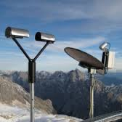
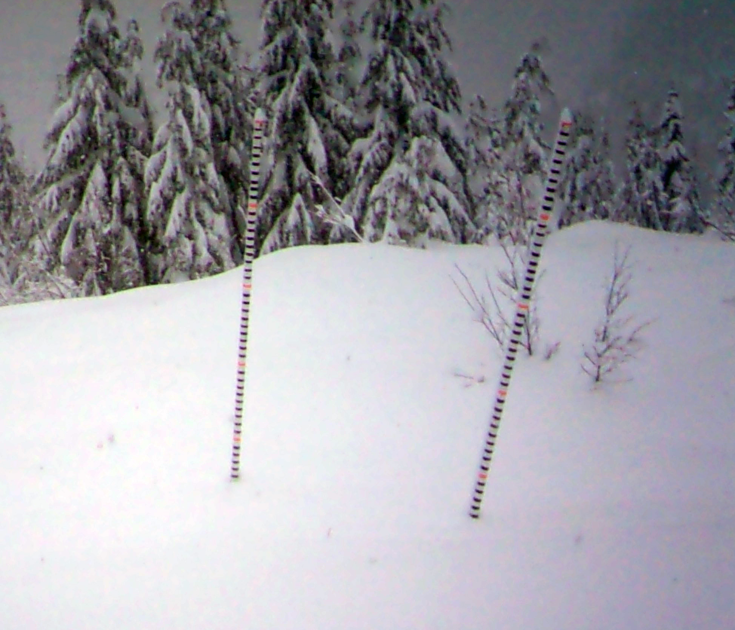
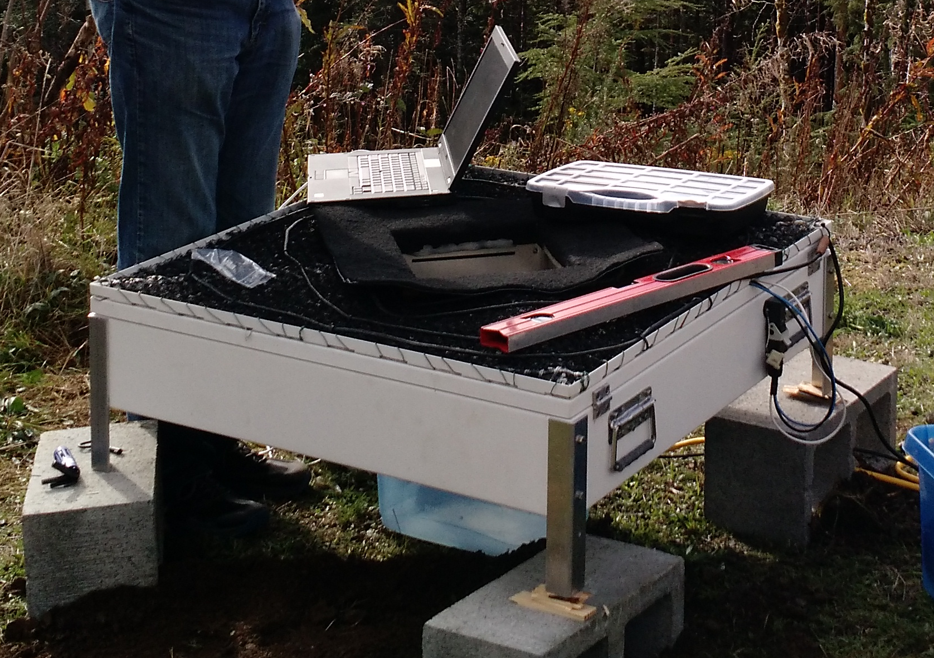
Elevation 5000 feet
Ground Instruments
Tipping Buckets
PIP
Tipping Bucket
Pluvio
Parsivel
Parsivel
Snow Poles and Cameras
2DVD
Micro Rain Radar

Slide 16
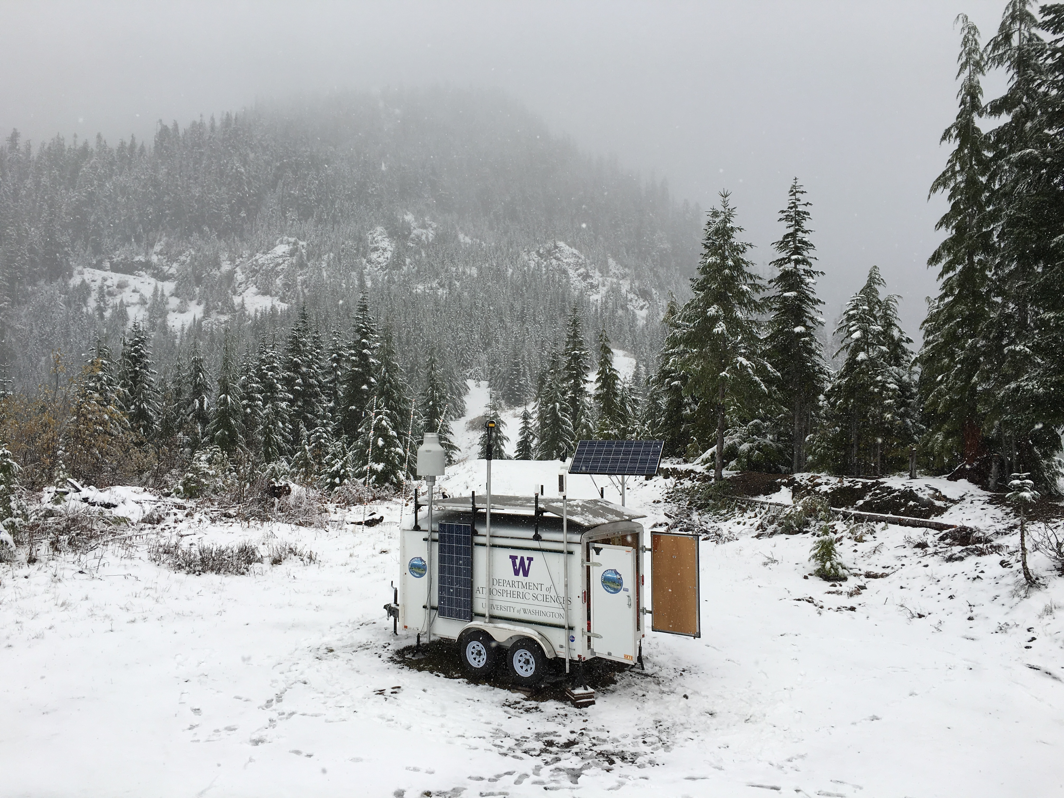
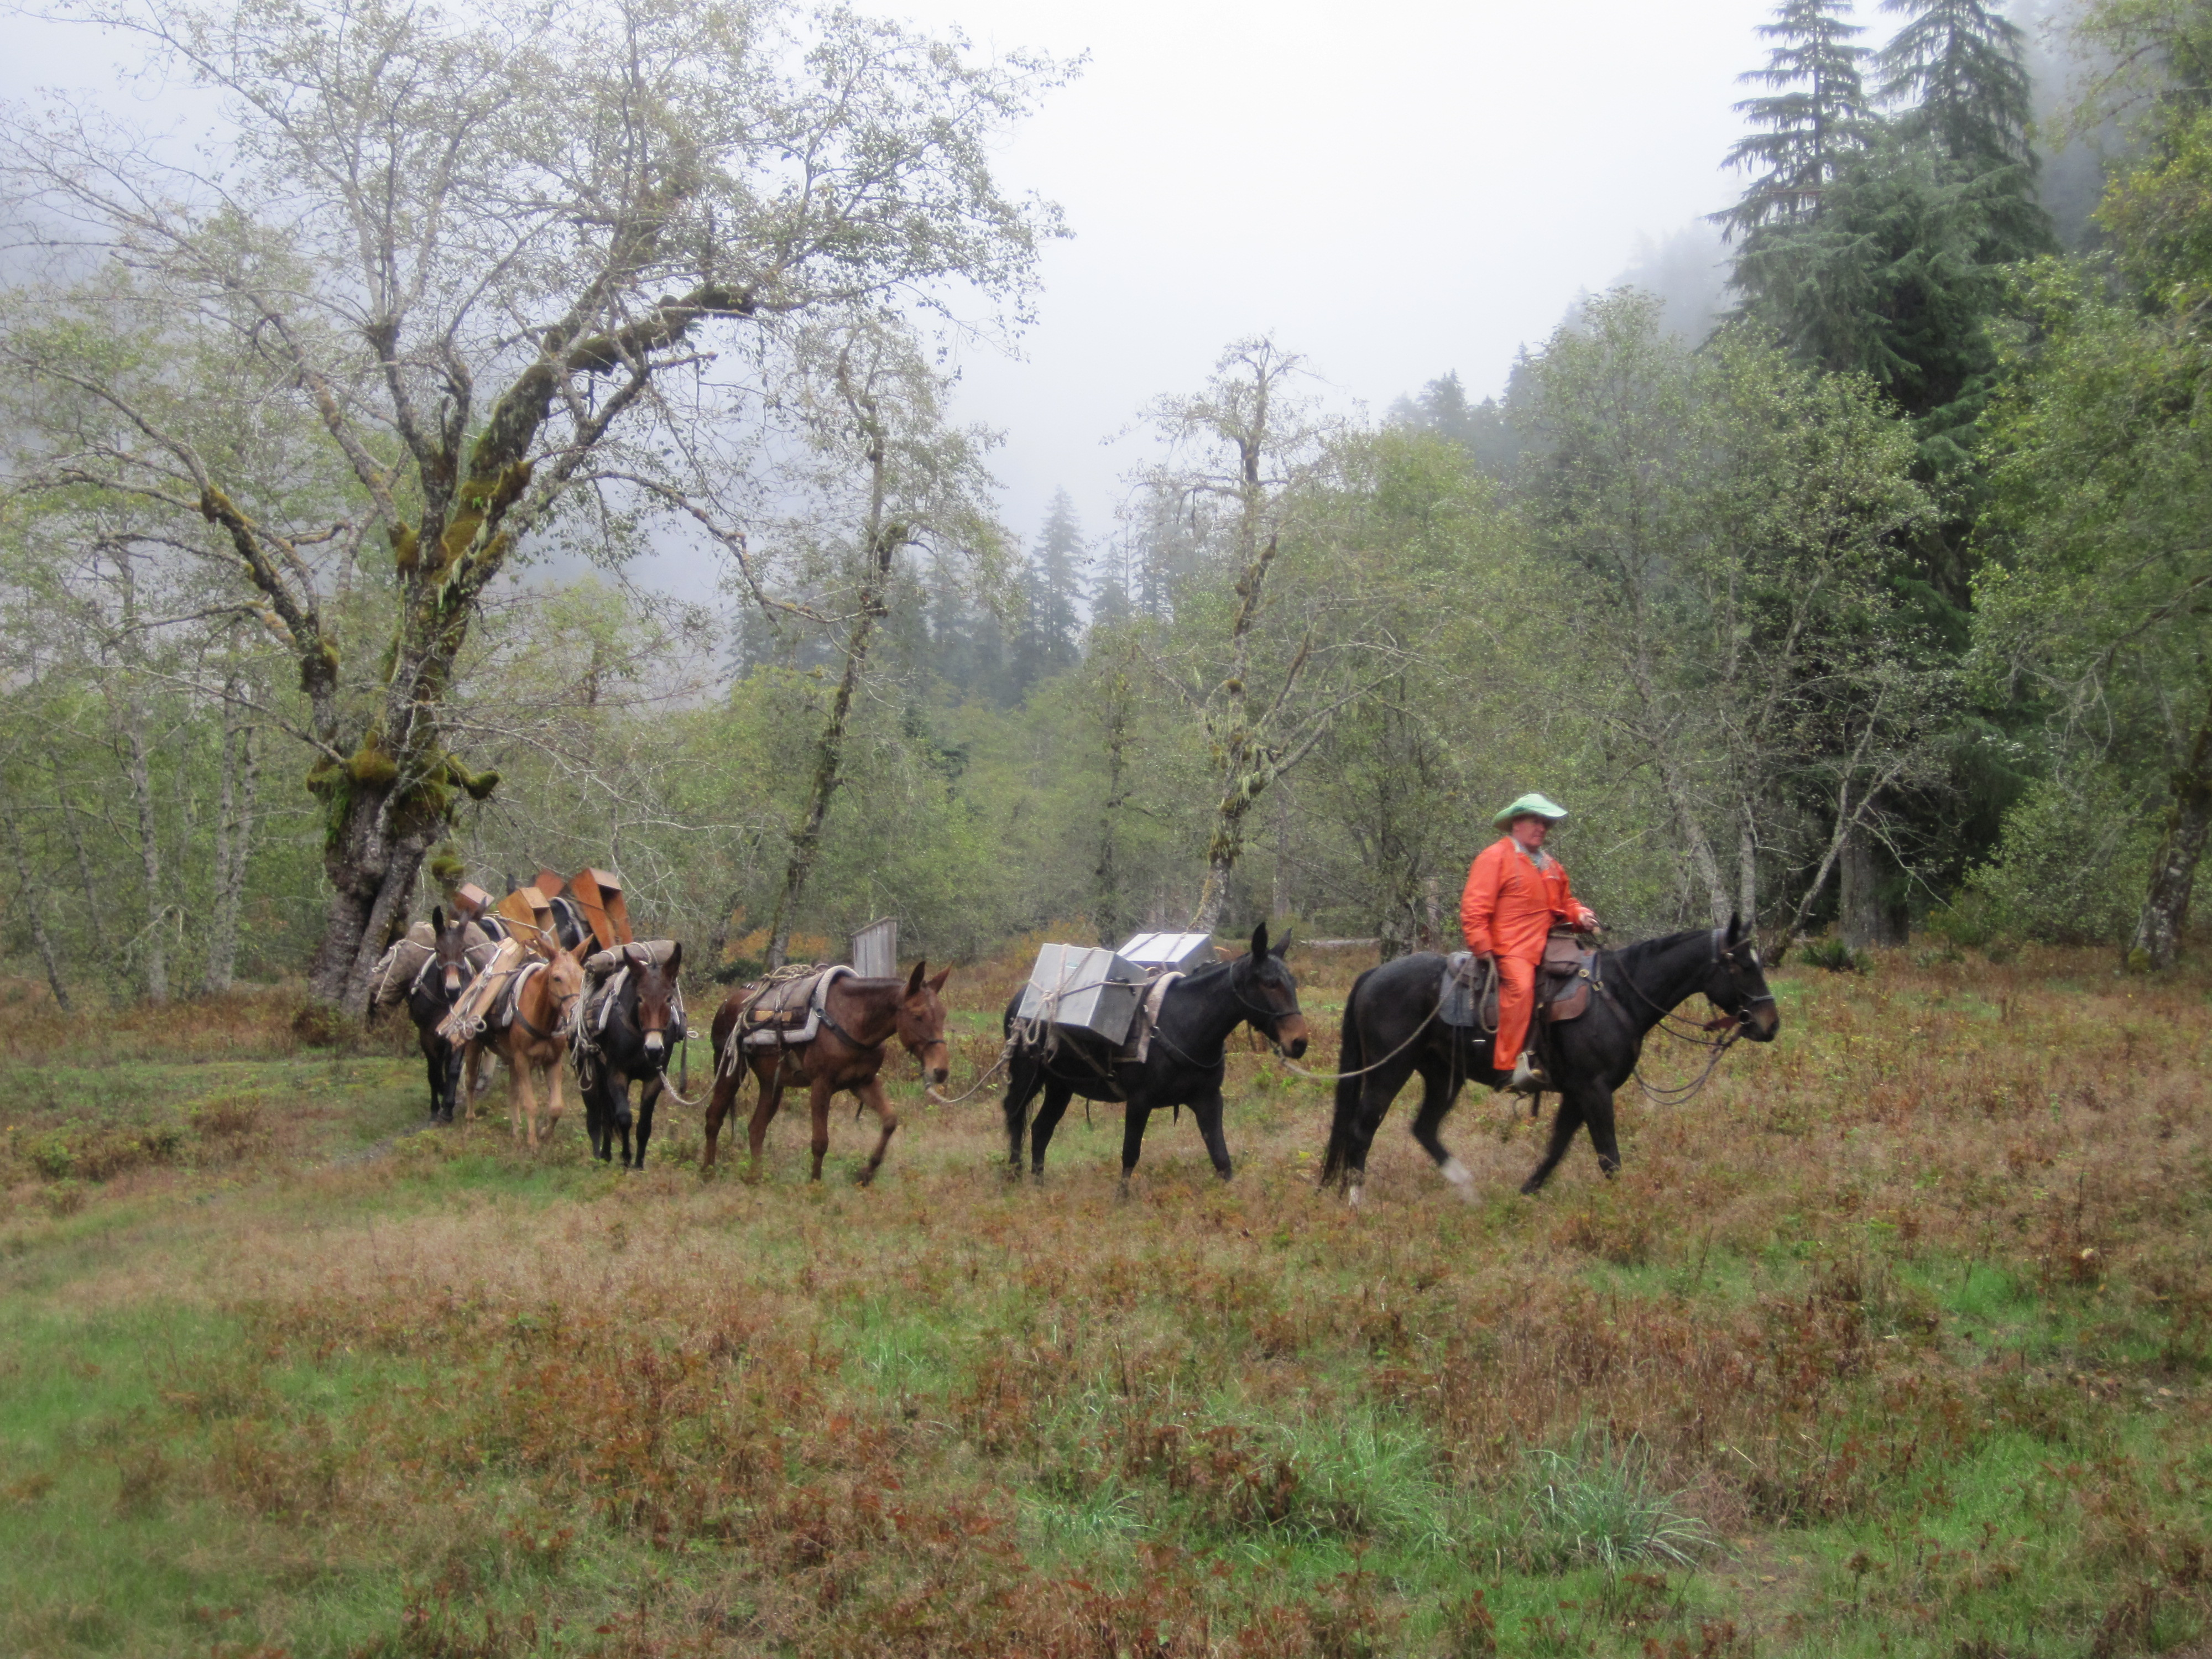
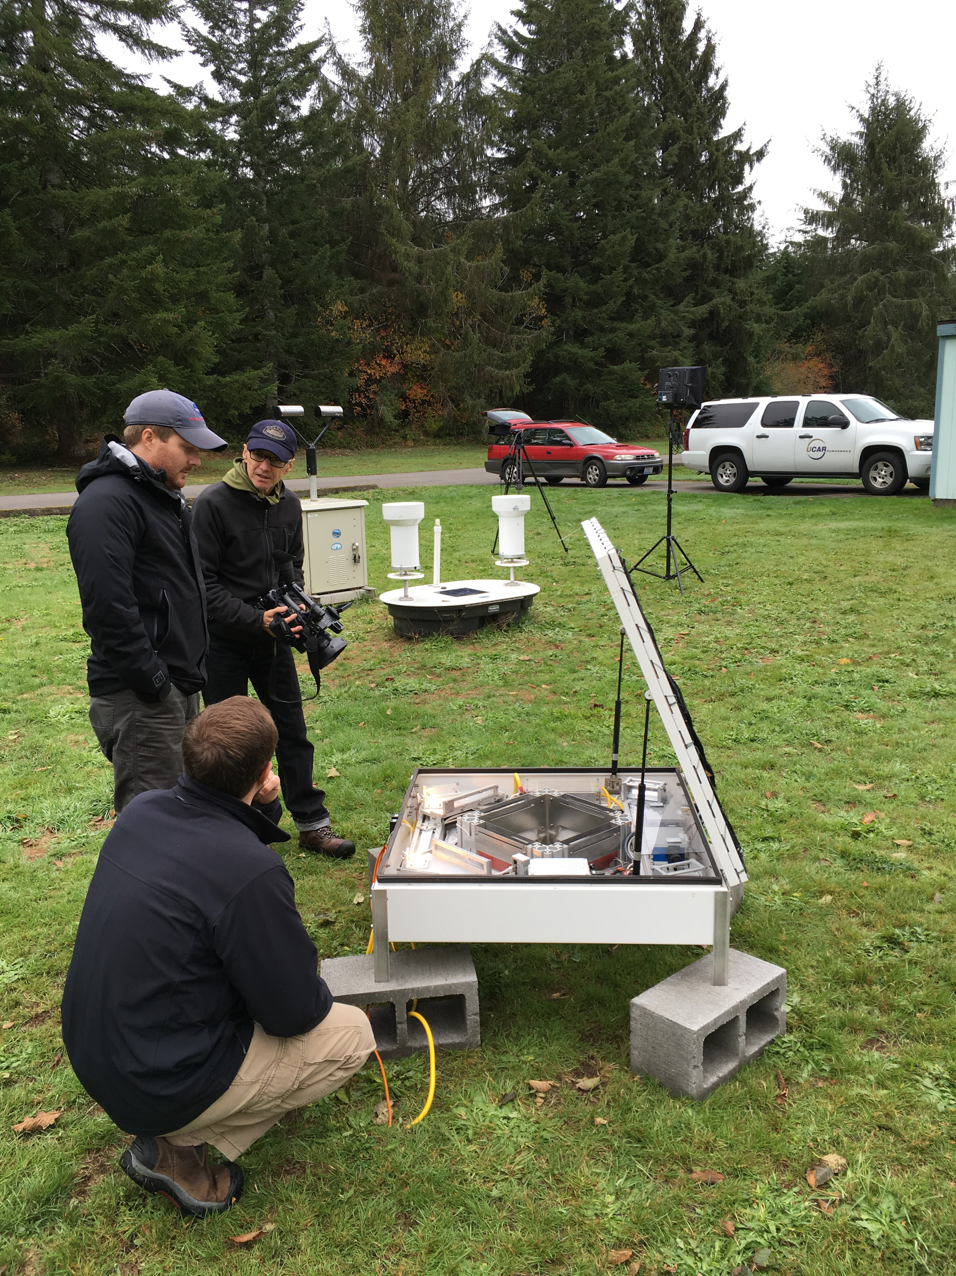
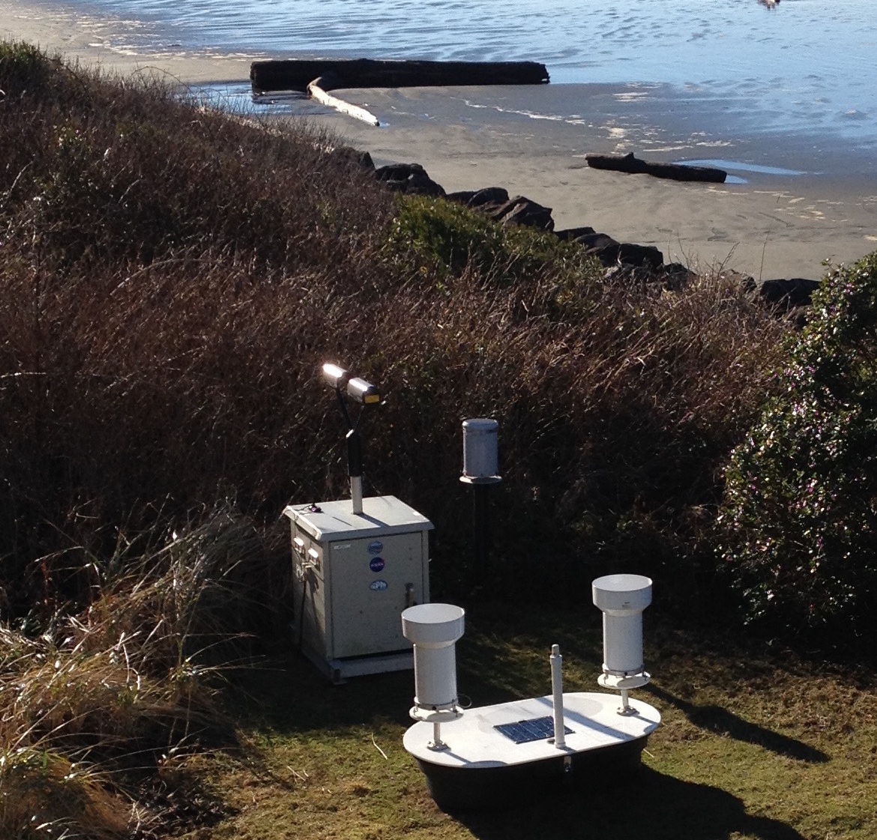
Ground Instruments
3000 feet
To the Upper Quinault
Lower valley
On the beach

Slide 17
Timeline of Operations
Snow Measurements
Aircraft
Soundings
Soundings
EC X-band Operations
NPOL and DOW Operations
NPOL,DOW
Testing
Ground sites collecting data – Raingauges and Parsivel and MRR’s
Dec 2015
April 2016
Oct 2014
Spring 2015
Oct 2015
Nov 2015
Jan 2016
Feb 2016
Intensive operations – all platforms
Ground, radar and soundings only

Slide 18
Heroic Efforts

Slide 19

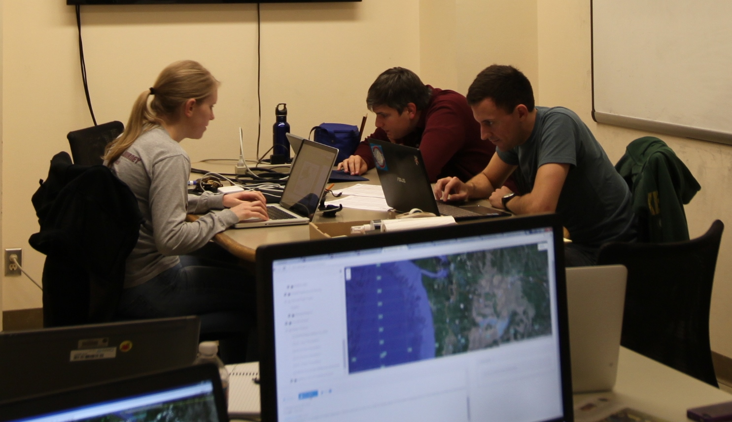
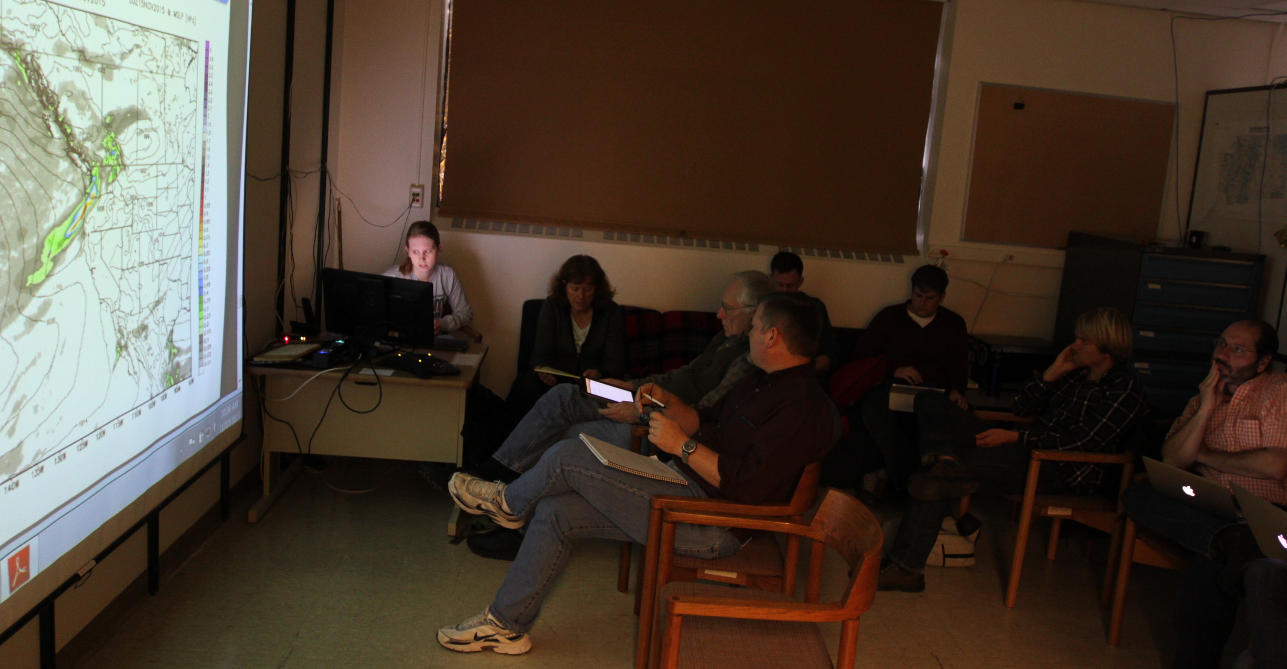

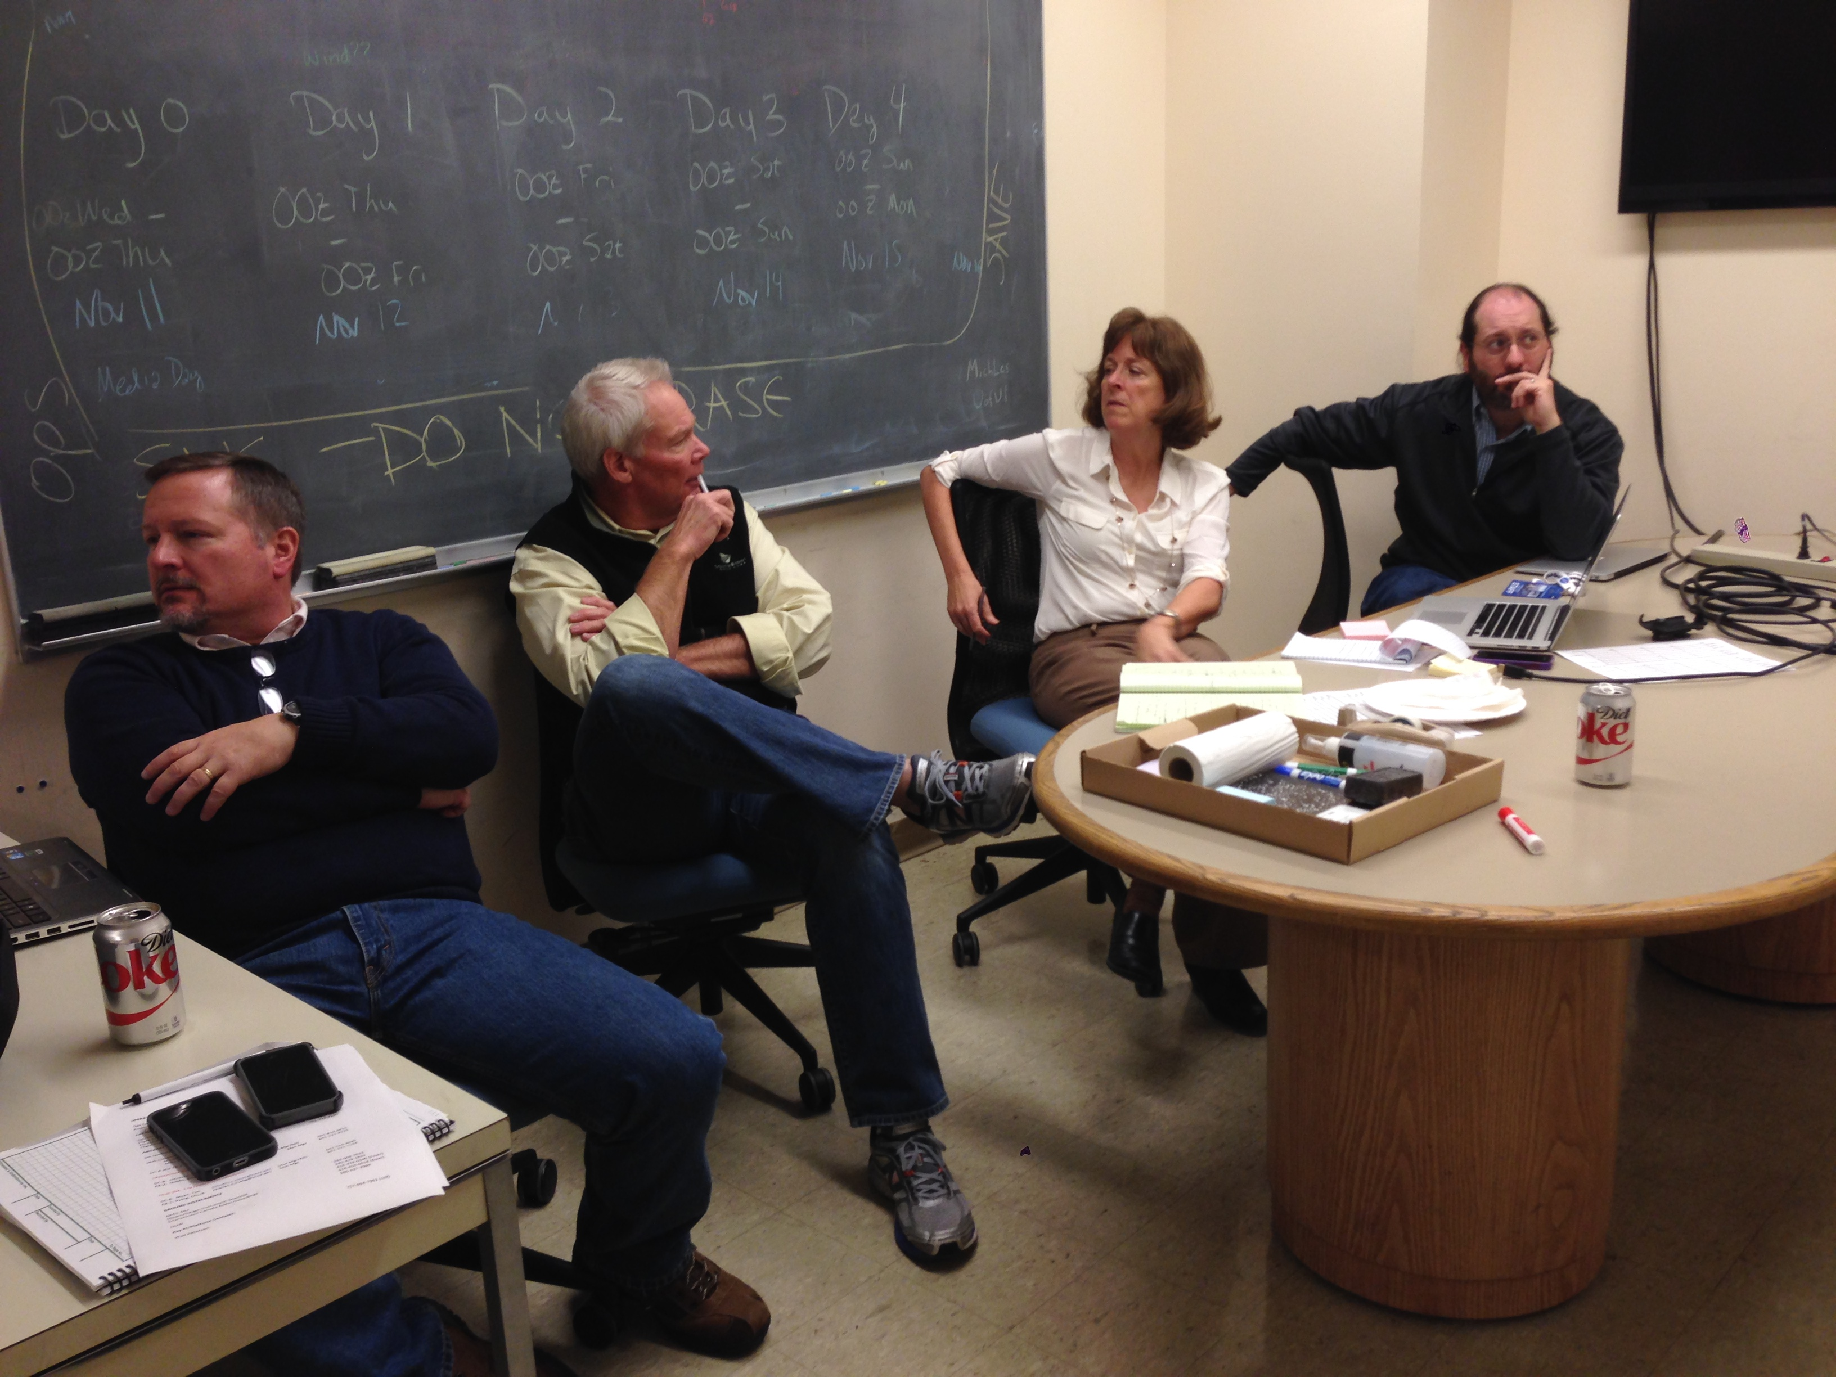
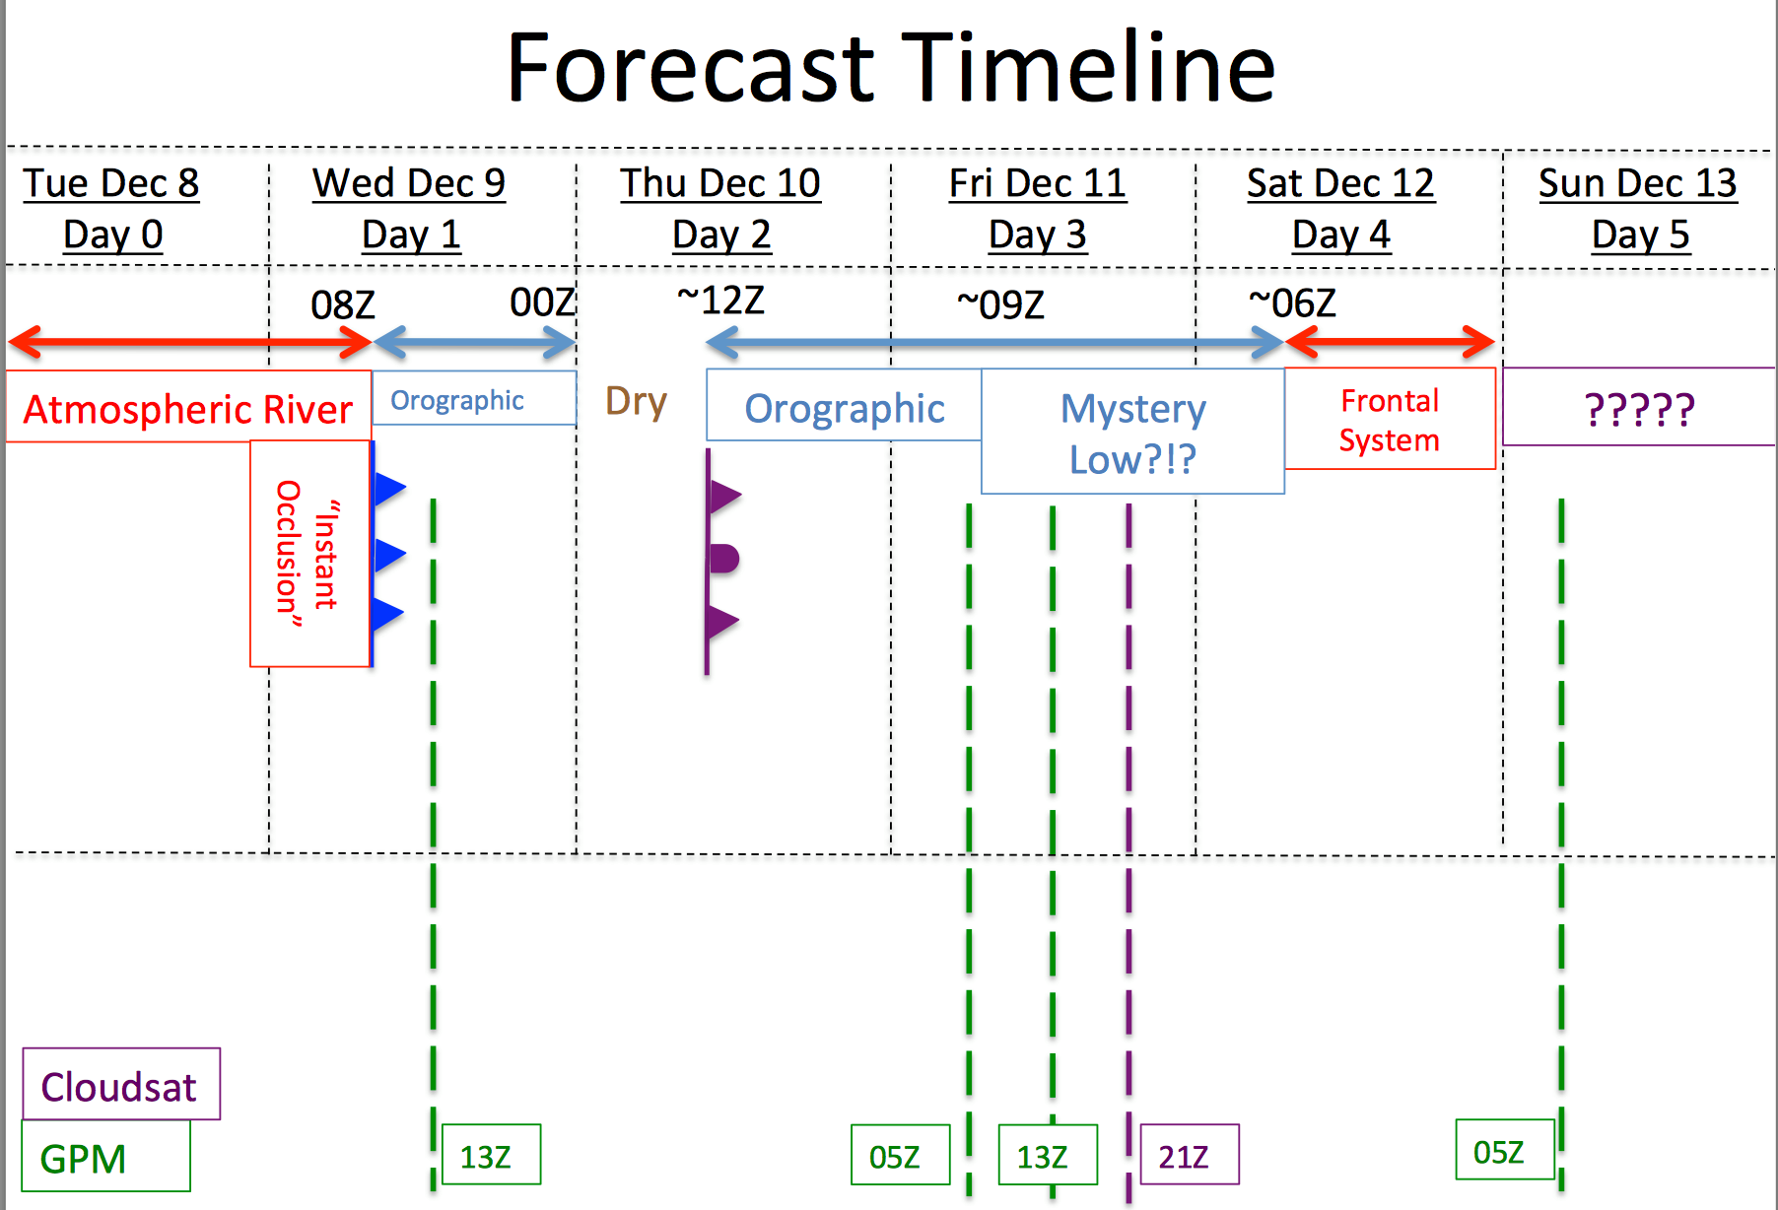

Operations Center at the UW
Forecasters
Jan Nystrom – Flight Coordinator

Slide 20
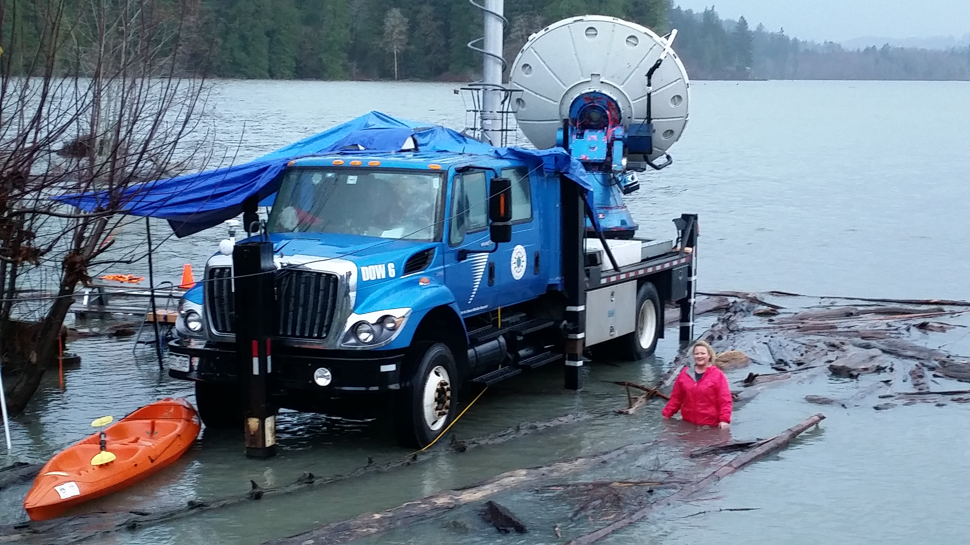
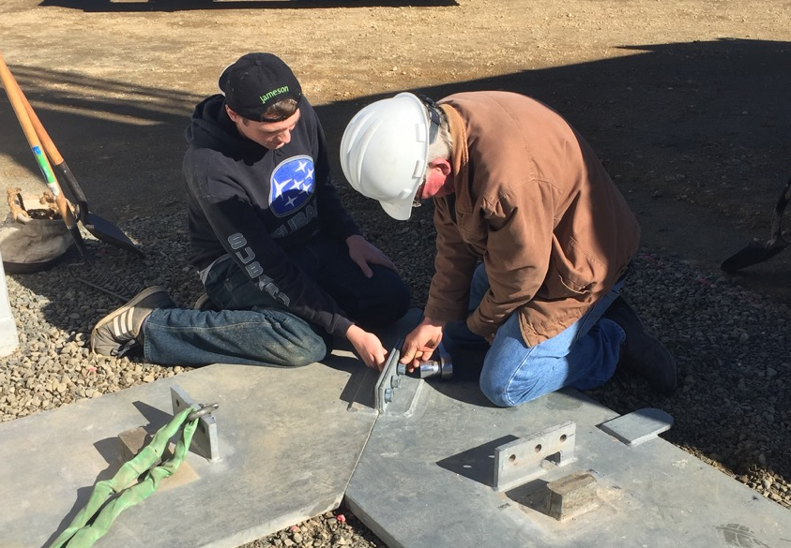
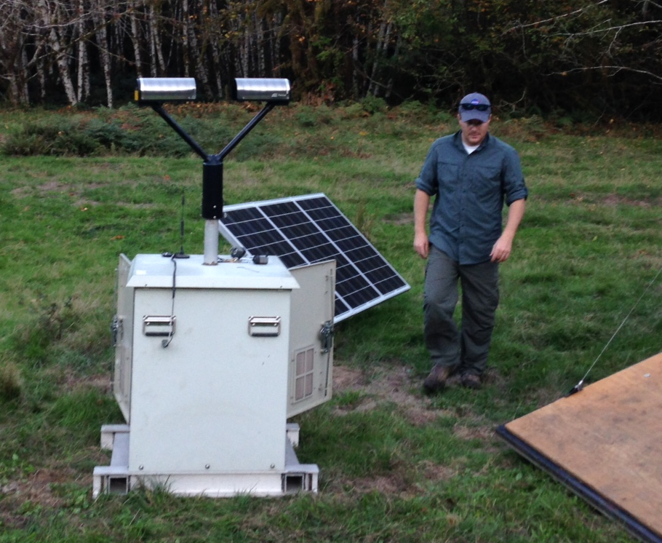
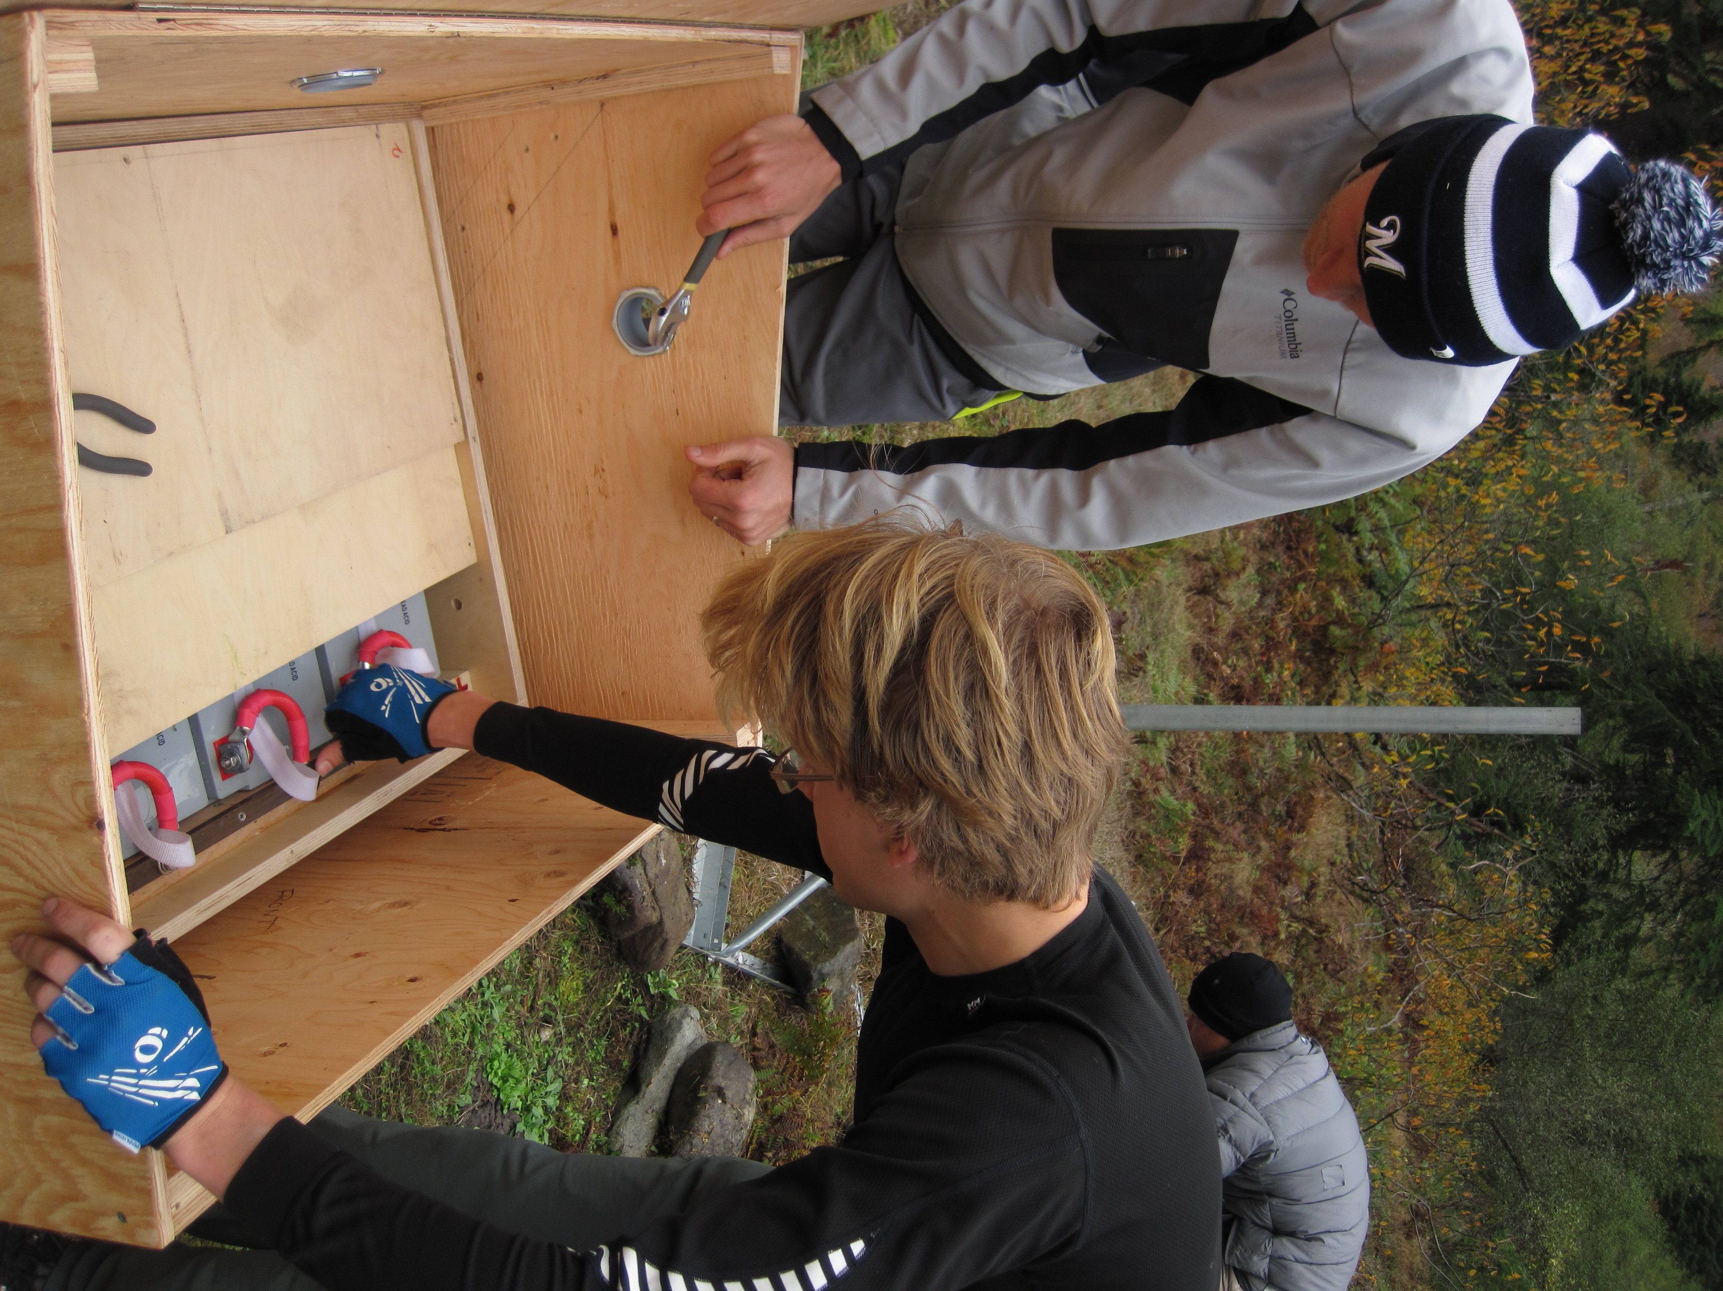
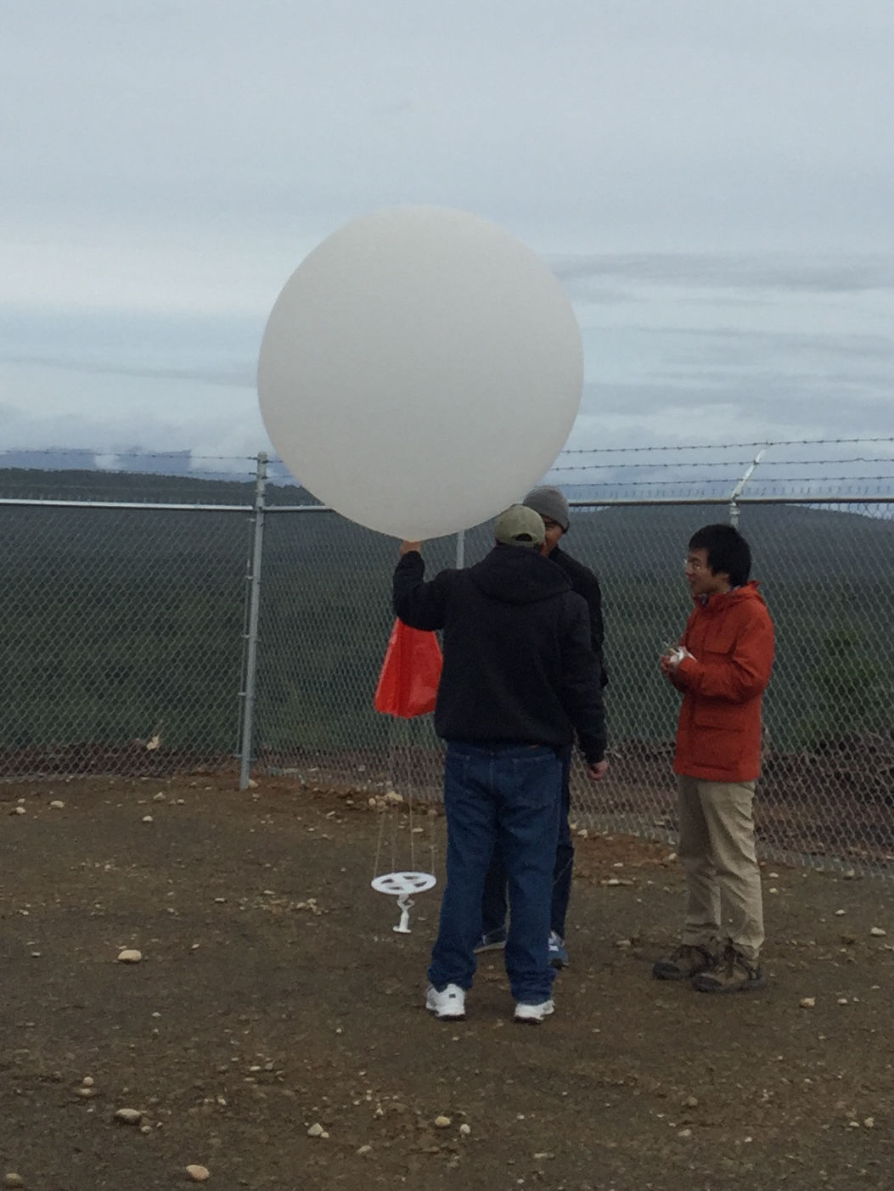
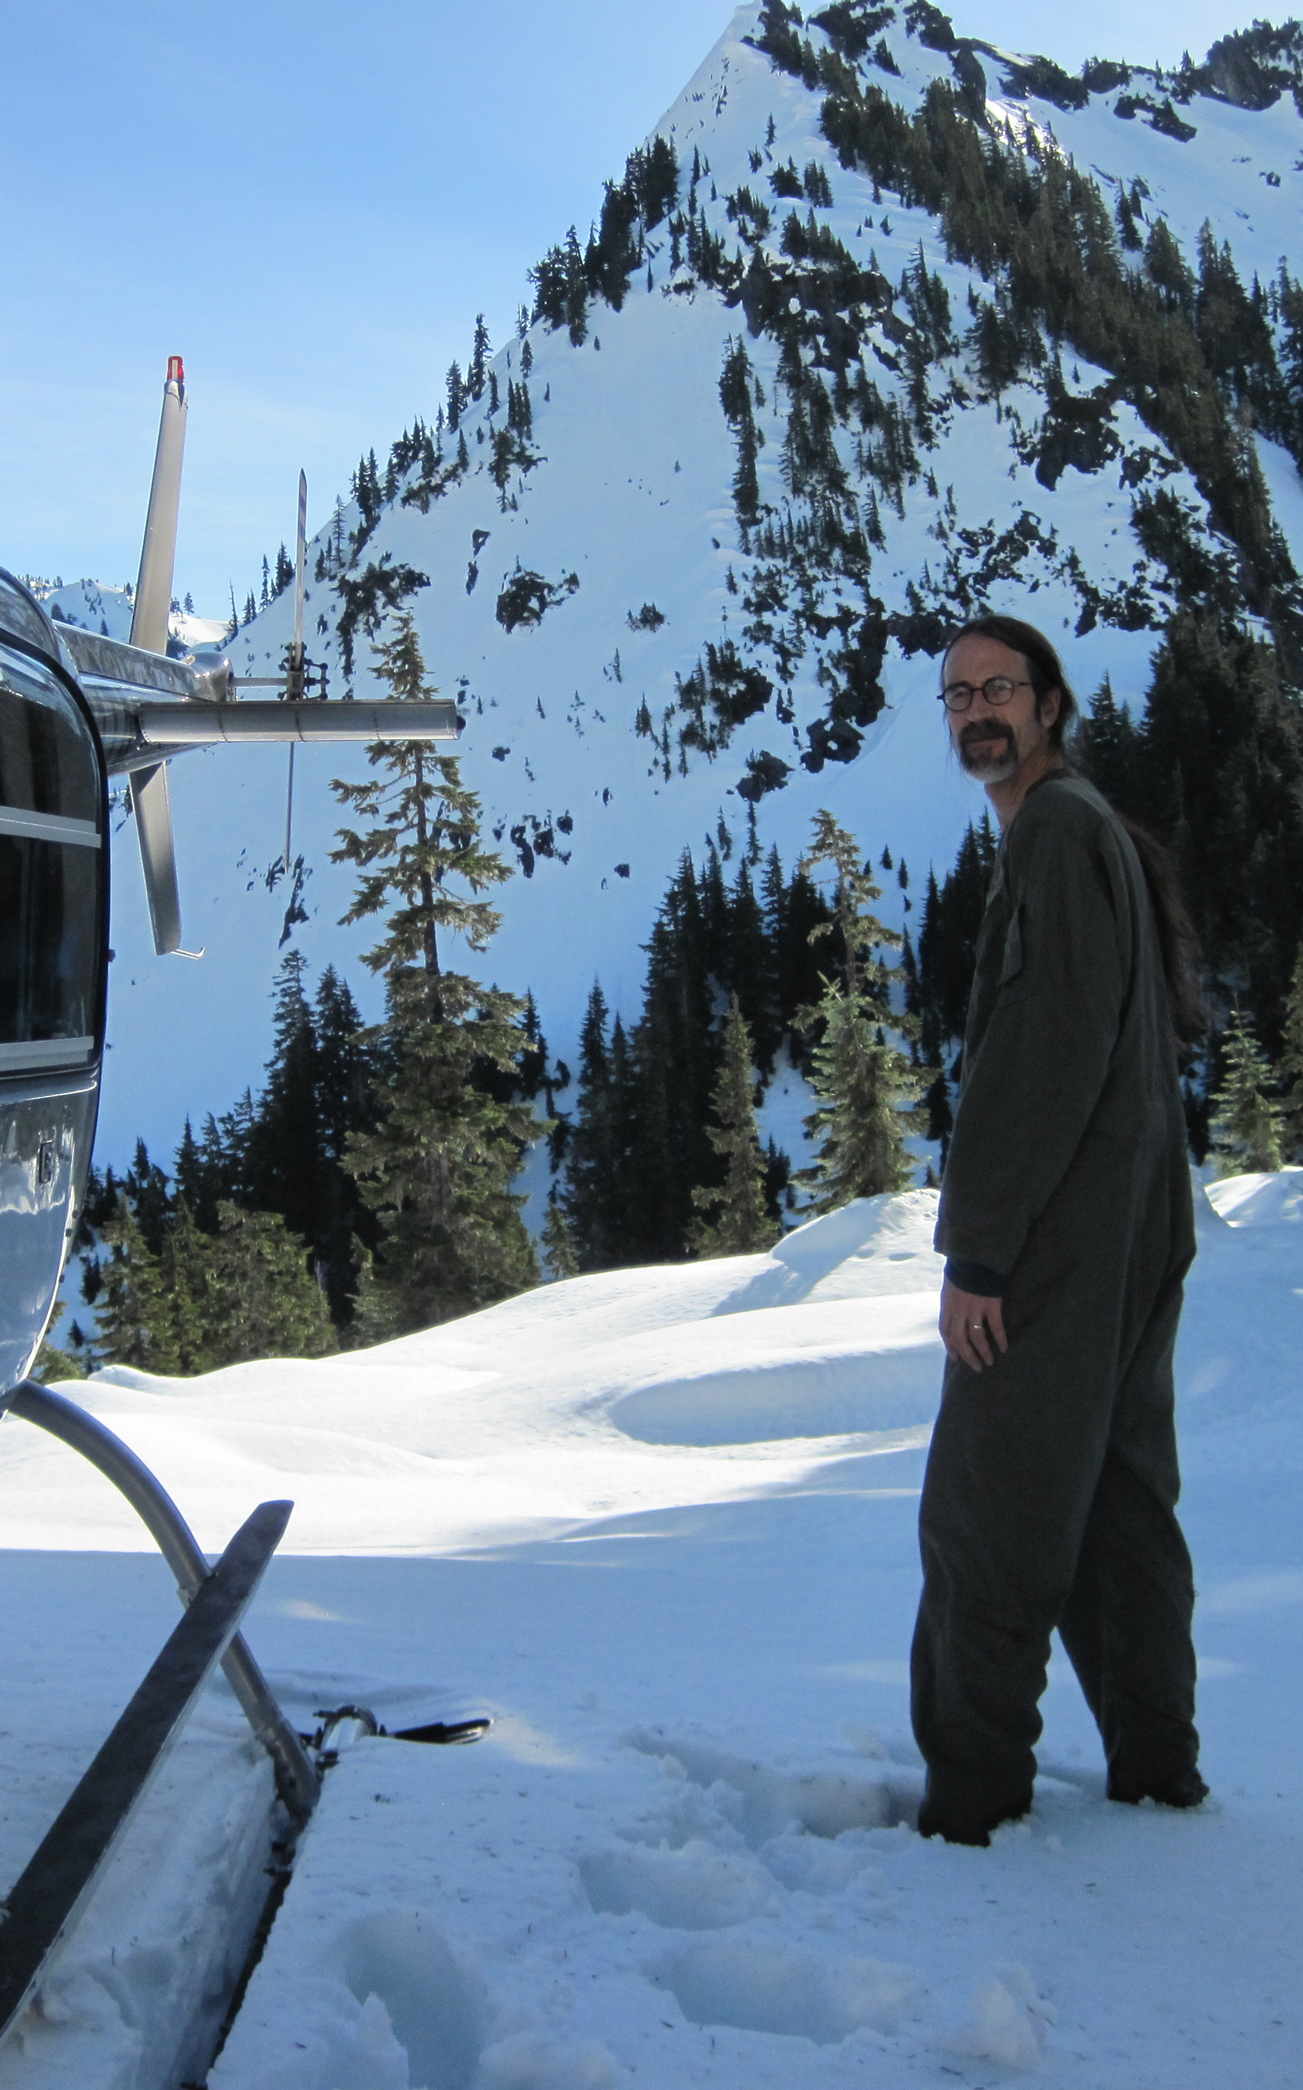
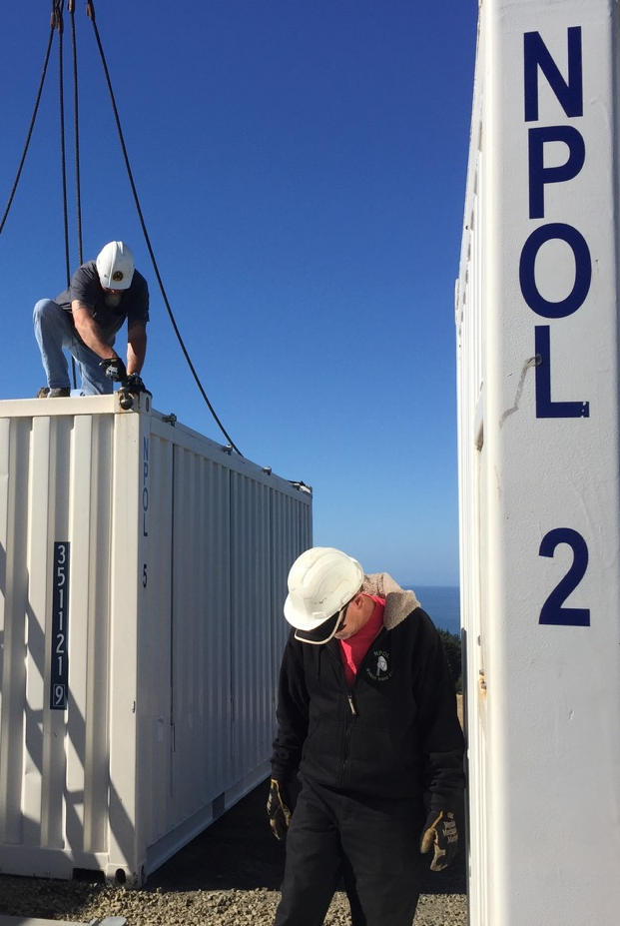


Installing and Keeping instrumentation running
Matt Wingo and crew
DOW operators
Mike Watson + NPOL crew
Launching Balloons
Olympic National Park Service – Bill Baccus and CJ Urnes

Slide 21
What We Observed

Slide 22
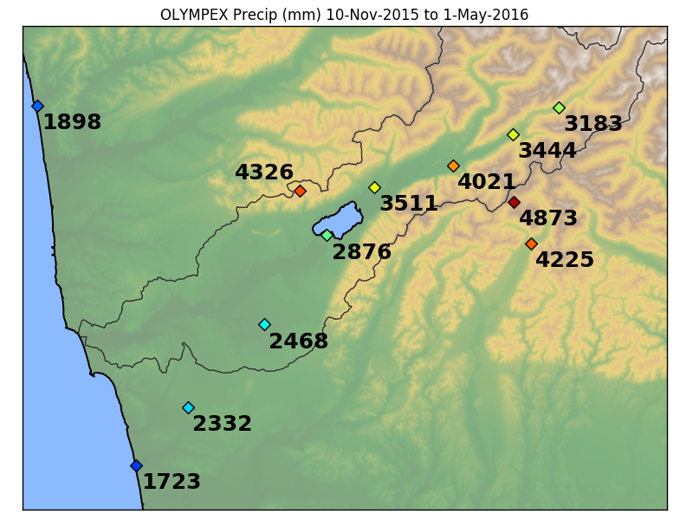
Orographic enhancement – seasonal pattern
Decrease further interior
Elevation 190mft
Elevation 115m
Elevation 540m
Highest at our higher terrain sites
Increase towards interior
Elevation 1020m and 280m
Elevation 0m
The OLYMPEX Season Totals
Factor of 1.5 - 2.5 enhancement
2015-2016 Season Totals

Slide 23
Focus on 2 Events
Observed by aircraft, radars and ground network
Warm, long-lived atmospheric river type events with large precipitation amounts
Work in progress
Questions:
What are patterns of precipitation enhancement?
What are the roles of warm rain vs. ice processes in orographic precipitation production?
How does synoptic environment influence orographic precipitation?
Notes:
Melting level > climo for moist onshore flow = 1.4 km
The above sets the stage for precipitation, but have criteria of long period of precip to show that there is a mechanism for lift to produce precipitation

Slide 24
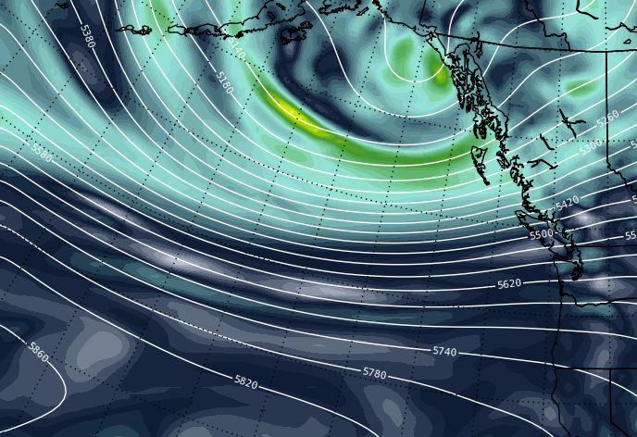
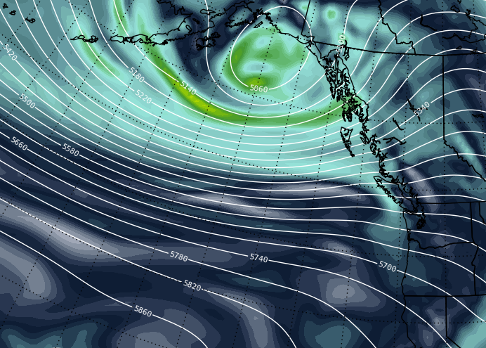
12 – 13 November 2015: Synoptic overview: 500 hPa Hghts + Vort
WSW Flow: Strong Jet across Pacific
0600 UTC 13 Nov
1800 UTC 12 Nov

Slide 25
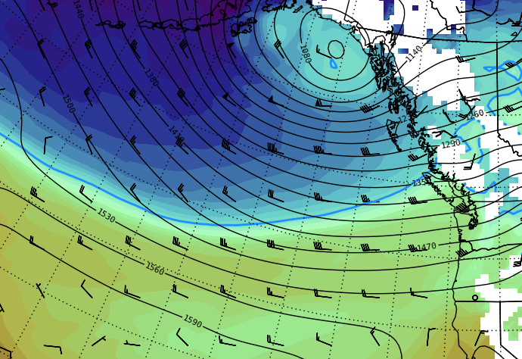
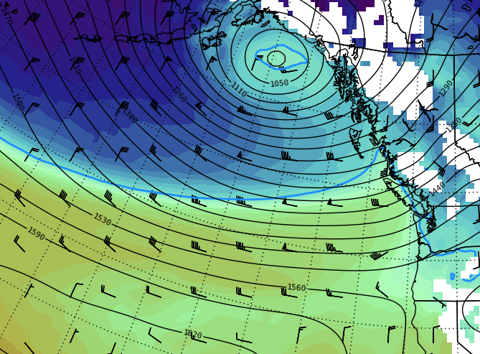
12 – 13 November 2015: Synoptic overview: 850 hPa Hghts + Temp
0600 UTC 13 Nov
1800 UTC 12 Nov
Strong low-level onshore flow. Very warm airmass

Slide 26
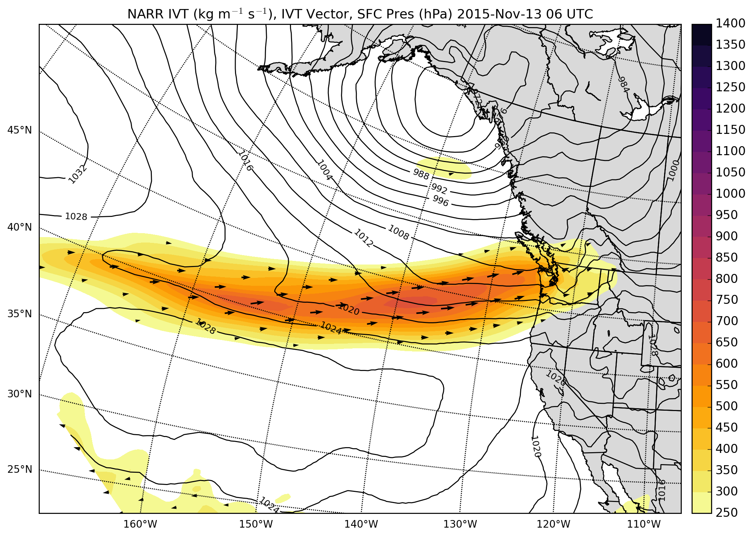
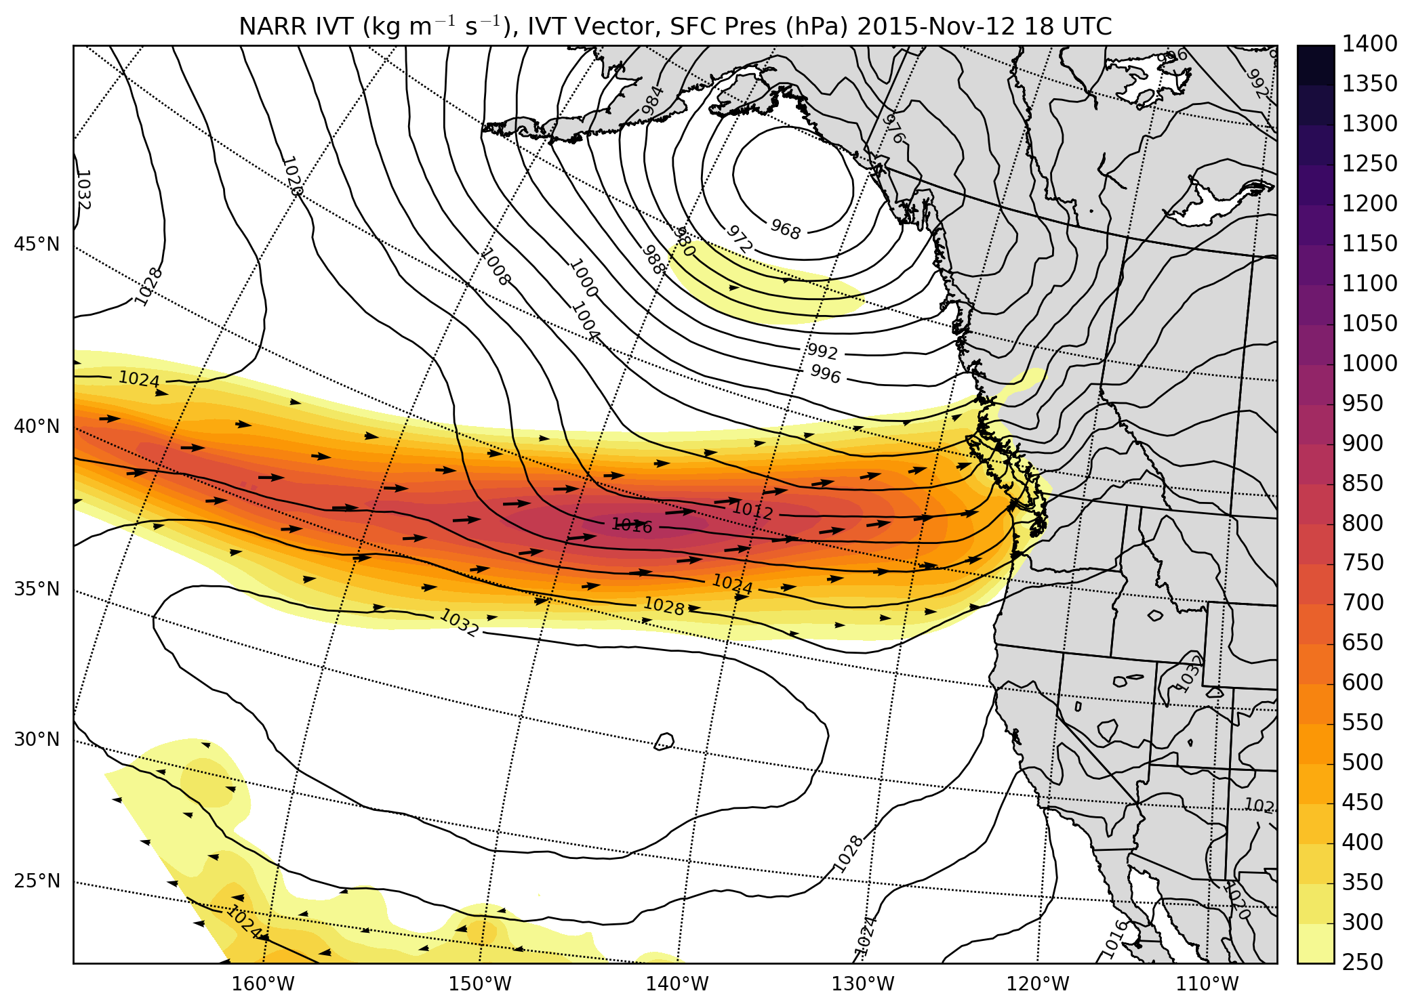
12 – 13 November 2015: Synoptic overview: Integrated Vapor Transport
Strong vapor transport

Slide 27
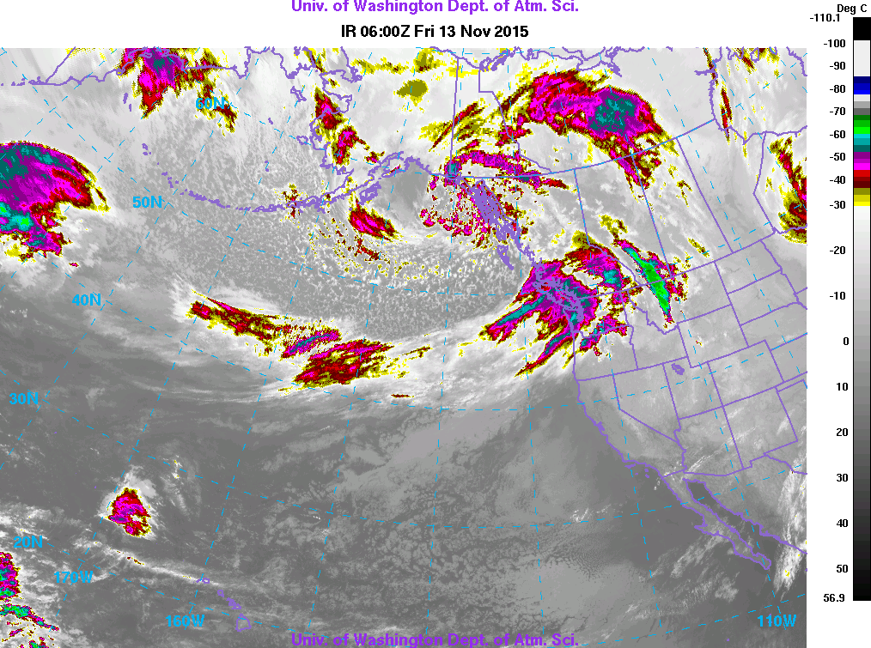
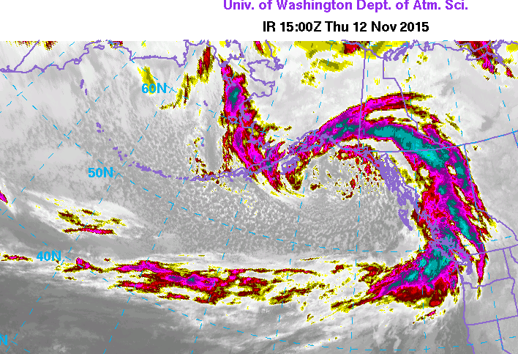
12 – 13 November 2015: Synoptic overview: Satellite

Slide 28
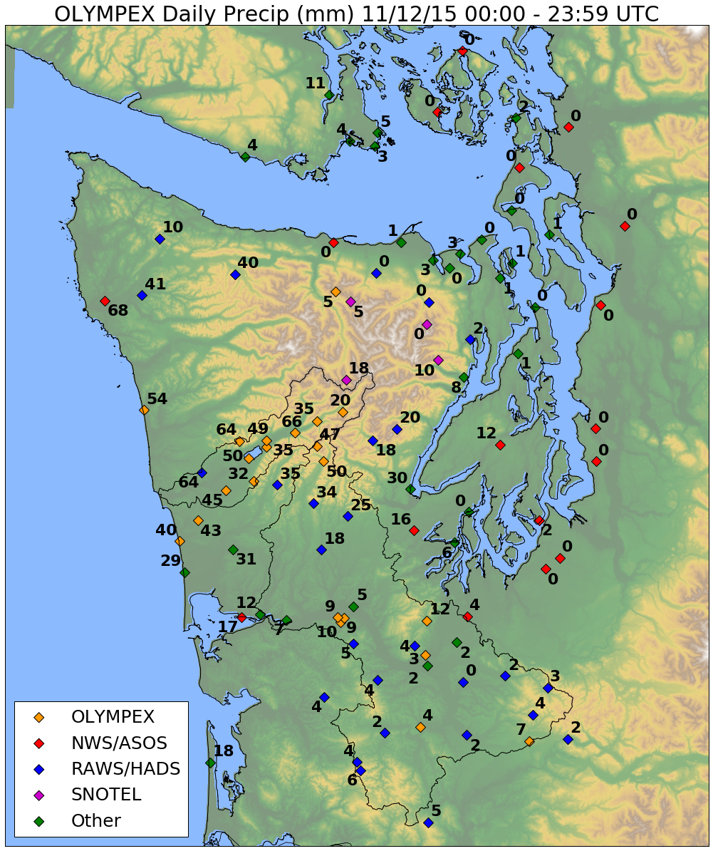
12 – 13 November 2015: Observed Precipitation Totals Nov 12

Slide 29
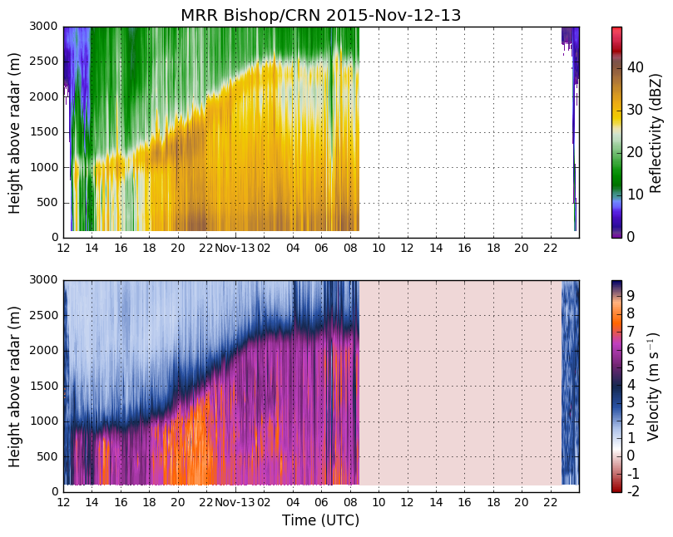

“Pre-frontal” – Rising melting level
No data (power outage)
Weaker bright band
MRR
Citation Spirals over CRN/DOW region
Big drops falling fast
Notes:
Fall velocity: not increasing—so any drop growth being obscured by small drop production.
Get flight path of citation from webpage

Slide 30

What are origins of the ‘big drops’?
Enhanced ZDR – enhanced aggregation?
ZDR = differential reflectivity = log ratio of power sent and received in horizontal to that received in the vertical – NOT final QC
Notes:
Look up zdr again – oblateness of particles – plates are oblate

Slide 31

What are origins of ‘big drops falling fast’?

Slide 32


What are origins of ‘big drops falling fast’?
Citation measured at layer of enhancement in ZDR:
Maximum vertical velocity
Maximum particle concentration
Temps -12°C
Maximum turbulence
Maximum liquid water
Remaining questions:
Was this enhancement zone observed over ocean? No?
Enhancement caused by flow lifted over mountains? ?
Enhancement caused by synoptic forcing? ?

Slide 33
Prefrontal environment of ‘big drops falling fast’ during 12 Nov event
What are patterns of precipitation enhancement?
Similar to climatology
What are the roles of warm rain vs. ice processes in orographic precipitation production?
Looks like ice processes contributed strongly to the precipitation production of ‘big drops falling fast’
How does synoptic environment influence orographic precipitation?
Frontogenesis? Lifting by terrain only? Always present?

Slide 34

12 – 13 November 2015: Observed Precipitation Totals – Nov 13
High Terrain less than forward slopes
Factor 4 -5 Enhancement

Slide 35

Nov 12-13 Rain rates
~18 hour period of orographic enhancement
More rain at low-elevation CRN site compared with interior/higher elevation sites
Warm Sector

Slide 36

Warm Sector
Diameter (mm)
Drops per m³ mm⁻¹
Orographic enhancement associated with large quantities of < 1.5 mm drops
RHI
These small-medium sized drops are responsible for the majority of the increase in rain rate
Rain Rate (mm/h)
Drop Diameter bin (mm)
Time (UTC)

Slide 37



NPOL RHI 13-Nov 02:12 UTC
50° Azimuth
Reflectivity
Low-level jet is within 1 km of the surface near NPOL and starts lifting around 20 km from radar.
Drop formation + growth occurs below melting level ahead of high terrain.
Jet lifting decreases 50-60 km from radar.
NPOL
CRN
Graves
Velocity
Brightband
NPOL
CRN
Graves
Notes:
During period of max orographic enhancement!!!
----- Meeting Notes (6/23/16 15:10) -----
white arrows
jet lifting below brightband
drops form and fall out quickly
don't have time to grow
Mention wind direction (make barb)

Slide 38
Warm Sector – 13 Nov Event
What is the pattern of orographic enhancement?
Enhancement bigger than climatology and strongest on initial slopes of Olympic Mountains, less enhancement over interior
What are the roles of warm rain vs. ice processes in orographic precipitation production?
Warm rain processes important
How does synoptic environment influence orographic precipitation?
Low-level lifting of strong onshore flow caused the highest rainfall totals at CRN site vs. interior sites
Lifting of low-level jet below brightband contributed to warm rain processes

Slide 39

Impacts
Nov 12-13

Slide 40


Slide 41


November Atmospheric Rivers

Slide 42

8 – 9 December: Synoptic Overview – 500 hPa Heights and Vorticity
18 UTC 8 Dec 2015
About the 7th event in 8 days during a ‘Stampede of Shortwaves’
Strong SW Flow across Pacific

Slide 43

8 – 9 December: Synoptic Overview – 850 hPa Heights and Temperature
18 UTC 8 Dec 2015
SW Flow
Sounding: 40kt jet at 925 hPa

Slide 44

8 – 9 December: Synoptic Overview – Integrated Water Vapor Transport
PW = 28.8 mm

Slide 45
8 – 9 December: Synoptic Overview – Satellite perspective: multiple frontal waves
A
B
C
D
E
Notes:
Make loop of satellite images – main precip pulses 12z 18z 8 dec 6z 9 dec, gap near 00 z – or put labels for each wave?

Slide 46

8 – 9 December: Synoptic Overview – Satellite perspective: multiple frontal waves
A
B
C
D
E
Notes:
Make loop of satellite images – main precip pulses 12z 18z 8 dec 6z 9 dec, gap near 00 z – or put labels for each wave?

Slide 47

8 – 9 December: Synoptic Overview – Satellite perspective: multiple frontal waves
A
B
C
D
E
Notes:
Make loop of satellite images – main precip pulses 12z 18z 8 dec 6z 9 dec, gap near 00 z – or put labels for each wave?

Slide 48

8 – 9 December: Synoptic Overview – Satellite perspective: multiple frontal waves
B
C
D
E
Notes:
Make loop of satellite images – main precip pulses 12z 18z 8 dec 6z 9 dec, gap near 00 z – or put labels for each wave?

Slide 49

8 – 9 December: Synoptic Overview – Satellite perspective: multiple frontal waves
C
D
E
F
G
Notes:
Make loop of satellite images – main precip pulses 12z 18z 8 dec 6z 9 dec, gap near 00 z – or put labels for each wave?

Slide 50

8 – 9 December: Synoptic Overview – Satellite perspective: multiple frontal waves
D?
E
F
G
Notes:
Make loop of satellite images – main precip pulses 12z 18z 8 dec 6z 9 dec, gap near 00 z – or put labels for each wave?

Slide 51

8 – 9 December: Synoptic Overview – Satellite perspective: multiple frontal waves
E?
F
G
Notes:
Make loop of satellite images – main precip pulses 12z 18z 8 dec 6z 9 dec, gap near 00 z – or put labels for each wave?

Slide 52

8 – 9 December: Synoptic Overview – Satellite perspective: multiple frontal waves
F
G
Notes:
Make loop of satellite images – main precip pulses 12z 18z 8 dec 6z 9 dec, gap near 00 z – or put labels for each wave?

Slide 53

8 – 9 December: Synoptic Overview – Satellite perspective: multiple frontal waves
F
H
G
Notes:
Make loop of satellite images – main precip pulses 12z 18z 8 dec 6z 9 dec, gap near 00 z – or put labels for each wave?

Slide 54

(Missing data)
(Missing data)
DC-8 Flight legs 14-18 UTC
Notes:
Two periods with high bright band. Reduction in low-level reflectivity enhancement when the bright band is lowered between the two waves.

Slide 55


APR-3
NASA DC-8 equipped with the Advanced Precipitation Radar 3
Ku / Ka / W band
Cross-track scanning strategy
High vertical resolution
Documents structure around the Olympics (ocean, windward, high terrain and leeside)
SW
8 Dec
NE

Slide 56




Northern Leg
Southern Leg
SW
NE
NE
SW
Largest reflectivity on windward slopes and not high terrain
Echo top height decrease in lee
Melting level variability
Windward

Slide 57



Northern Leg
Southern Leg
SW
NE
NE
SW
Largest reflectivity on windward slopes and initial high terrain
Frontal band fills in leeside echo tops
Reflectivity reduction southern leg – evap?
Windward

Slide 58

DC-8 Flight legs 16-18 UTC
Diameter (mm)
Drops per m³ mm⁻¹
(Missing data)
Similar DSD compared with other cases, just less intense
RHI #1
RHI #2
Rain Rate (mm/h)
Drop Diameter bin (mm)
Small drop production goes away for about 6 hours starting
22 UTC 08-Dec
(Missing data)
Time (UTC)
Notes:
Plotted on a log scale to emphasize contribution from larger drops

Slide 59


RHI #1: NPOL RHI 08-Dec 17:32 UTC 58° Azimuth
Onshore flow, weaker LLJ than 12-13 Nov case.
RHI #2: NPOL RHI 09-Dec 01:52 UTC 58° Azimuth
Offshore directed radial velocity after passage of wave. No small drop production.

Slide 60
Complex 8 – 9 December Event
What is the pattern of orographic enhancement?
Strongest enhancement on initial slopes of Olympic Mountains, less so over high terrain
What are the roles of warm rain vs. ice processes in orographic precipitation production?
Warm rain processes important
How does synoptic environment influence orographic precipitation?
Frontal wave can provide period of increased precipitation on leeside
When frontal waves induced a periods of low-level offshore flow, production of small droplets stopped

Slide 61


Impacts
Dec 8-9

Slide 62

The Doppler on Wheels (DOW)

Slide 63

The Doppler on Wheels (DOW)

Slide 64

The Doppler on Wheels (DOW)
Water

Slide 65
Warm events with strong low-level onshore flow (i.e. warm sector):
Precipitation enhancement is strongest on the initial windward slopes of the Olympics
Warm rain processes important
Synoptic environment (strength, direction and lift of low-level flow) exerts strong influence on precipitation production
Ice-processes also present (‘hybrid’)

Slide 66



Documenting Orographic Enhancement
Ocean
Terrain
Comparison of West (Ocean) and East (Terrain) reflectivity from NPOL over the whole campaign (Nov – Jan)

Slide 67
OLYMPEX was hugely successful
Unprecedented data collected by state-of-the art instruments:
multiple radar at multiple wavelengths,
extensive documentation of the characteristics and distribution of falling precipitation
Able to perform GPM physical validation for midlatitude winter-time storm systems
Able to investigate modification of precipitation by synoptic conditions and complex terrain
You will hear more from Joe, Jen, Megan, Angela, etc. in coming months on the research topics presented today

Slide 68



OLYMPEX Outreach
Social Media day
Nov 11, 2015 – over 40 people at UW operations center and McChord, 15 went to Peninsula
Ranked #1 most engaging US Government Twitter accounts
#1 trending on Nov. 11
School/public talks: Angela Rowe, Shannon O’Donnell, Lynn McMurdie
Countless press interviews
Prof. Houze explains OLYMPEX at Social Media Day
At NPOL on media day
Students Visit the DOW

Slide 69
What’s next…
Warm sector precipitation – look at all events, not just atmospheric rivers
Post-frontal also has strong orographic signature, but what are processes at play? Added complexity of convective elements
Weak events – still have orographic enhancement? Warm rain processes?
Much much more …..(snow pack, lee side, GPM algorithm)

Slide 70
Find out more at olympex.atmos.washington.edu

Slide 71
Acknowledgments
Work supported by:
NASA grants NNX15AL38G, NNX16AD75G and NNX16AK05G
NSF grant AGS-1503155

Slide 72

Sounding 0600 UTC 13 Nov

Slide 73




What’s next… Postfrontal showers

Slide 74



Windward
Largest reflectivity on windward slopes and initial high terrain
Echo top height decrease in lee

Slide 75
The Olympic Peninsula

Slide 76
“Warm Sector”
No data (power outage)
Weaker bright band
Near-surface dBZ remains constant
Fall velocity nearly constant w/ height

