Slide 1
Convection over North America as Shown by GPM
Robert A. Houze, Jr.
Stacy Brodzik, Kristen Rasmussen
Manuel Zuluaga, Erich Stocker
PMM Science Team Meeting, Houston, 26 October 2016

Slide 2
Categories of
Contiguous Echo Objects
Based on their 3D Structure
See Houze et al. (2015, Rev. Geoph.)
http://trmm.atmos.washington.edu
brodzik@uw.edu

Slide 3
Object | Echo Characteristic | Height | Area
Isolated Shallow Echoes | > min detectable | < 4 km | 2 pixels
Deep Convective Cores | > 40 dBZ (strong) | > 10 km | N/A
 | > 30 dBZ (moderate) | > 8 km | N/A
Wide Convective Cores | > 40 dBZ (strong) |  | > 1000 km² at some altitude
 | > 30 dBZ (moderate) |  | > 800 km² at some altitude
Broad Stratiform Regions | Contiguous stratiform |  | > 50,000 km² (strong)
 |  |  | > 30,000 km² (moderate)
 |  |  | 30-50,000 km² (filtered)
Notes:
3D structure--thresholds: intensity, height, & area

Slide 4
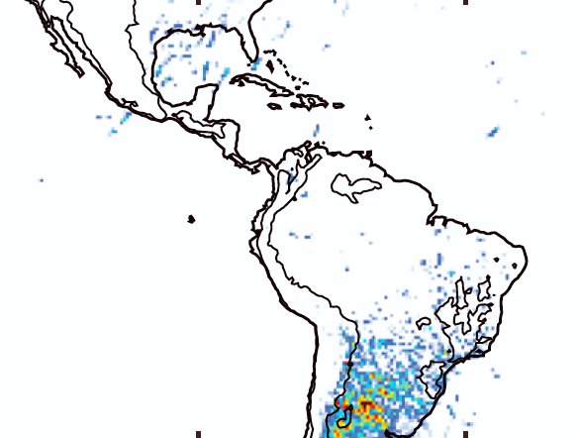
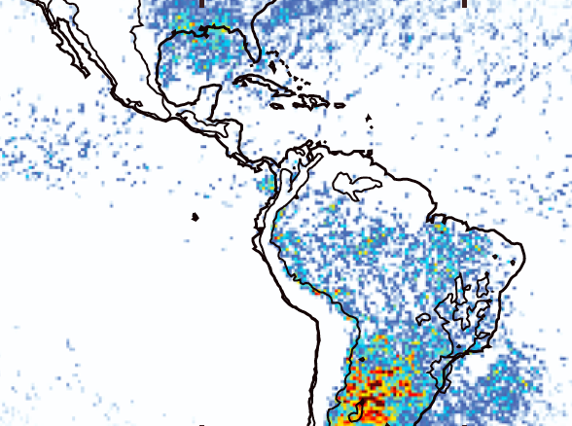
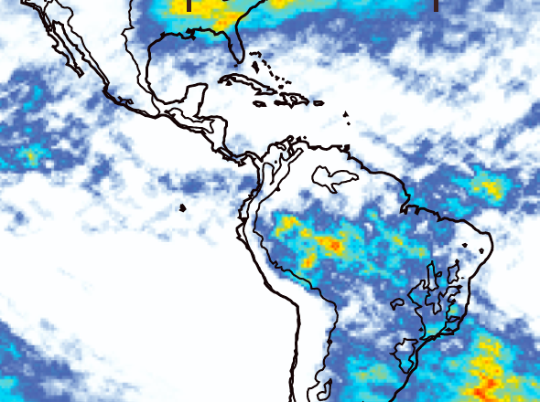
Recall TRMM South America Results
Deep Convective Cores
(strong)
Frequencies of occurrence
See Houze et al. 2015 for full low-latitude patterns of these features
DJF
Wide Convective Cores
(strong)
DJF
Broad Stratiform
(strong)
DJF

Slide 5
Using GPM Over N. America
How Much Rain is Explained by Storms Containing Extreme Categories?

Slide 6
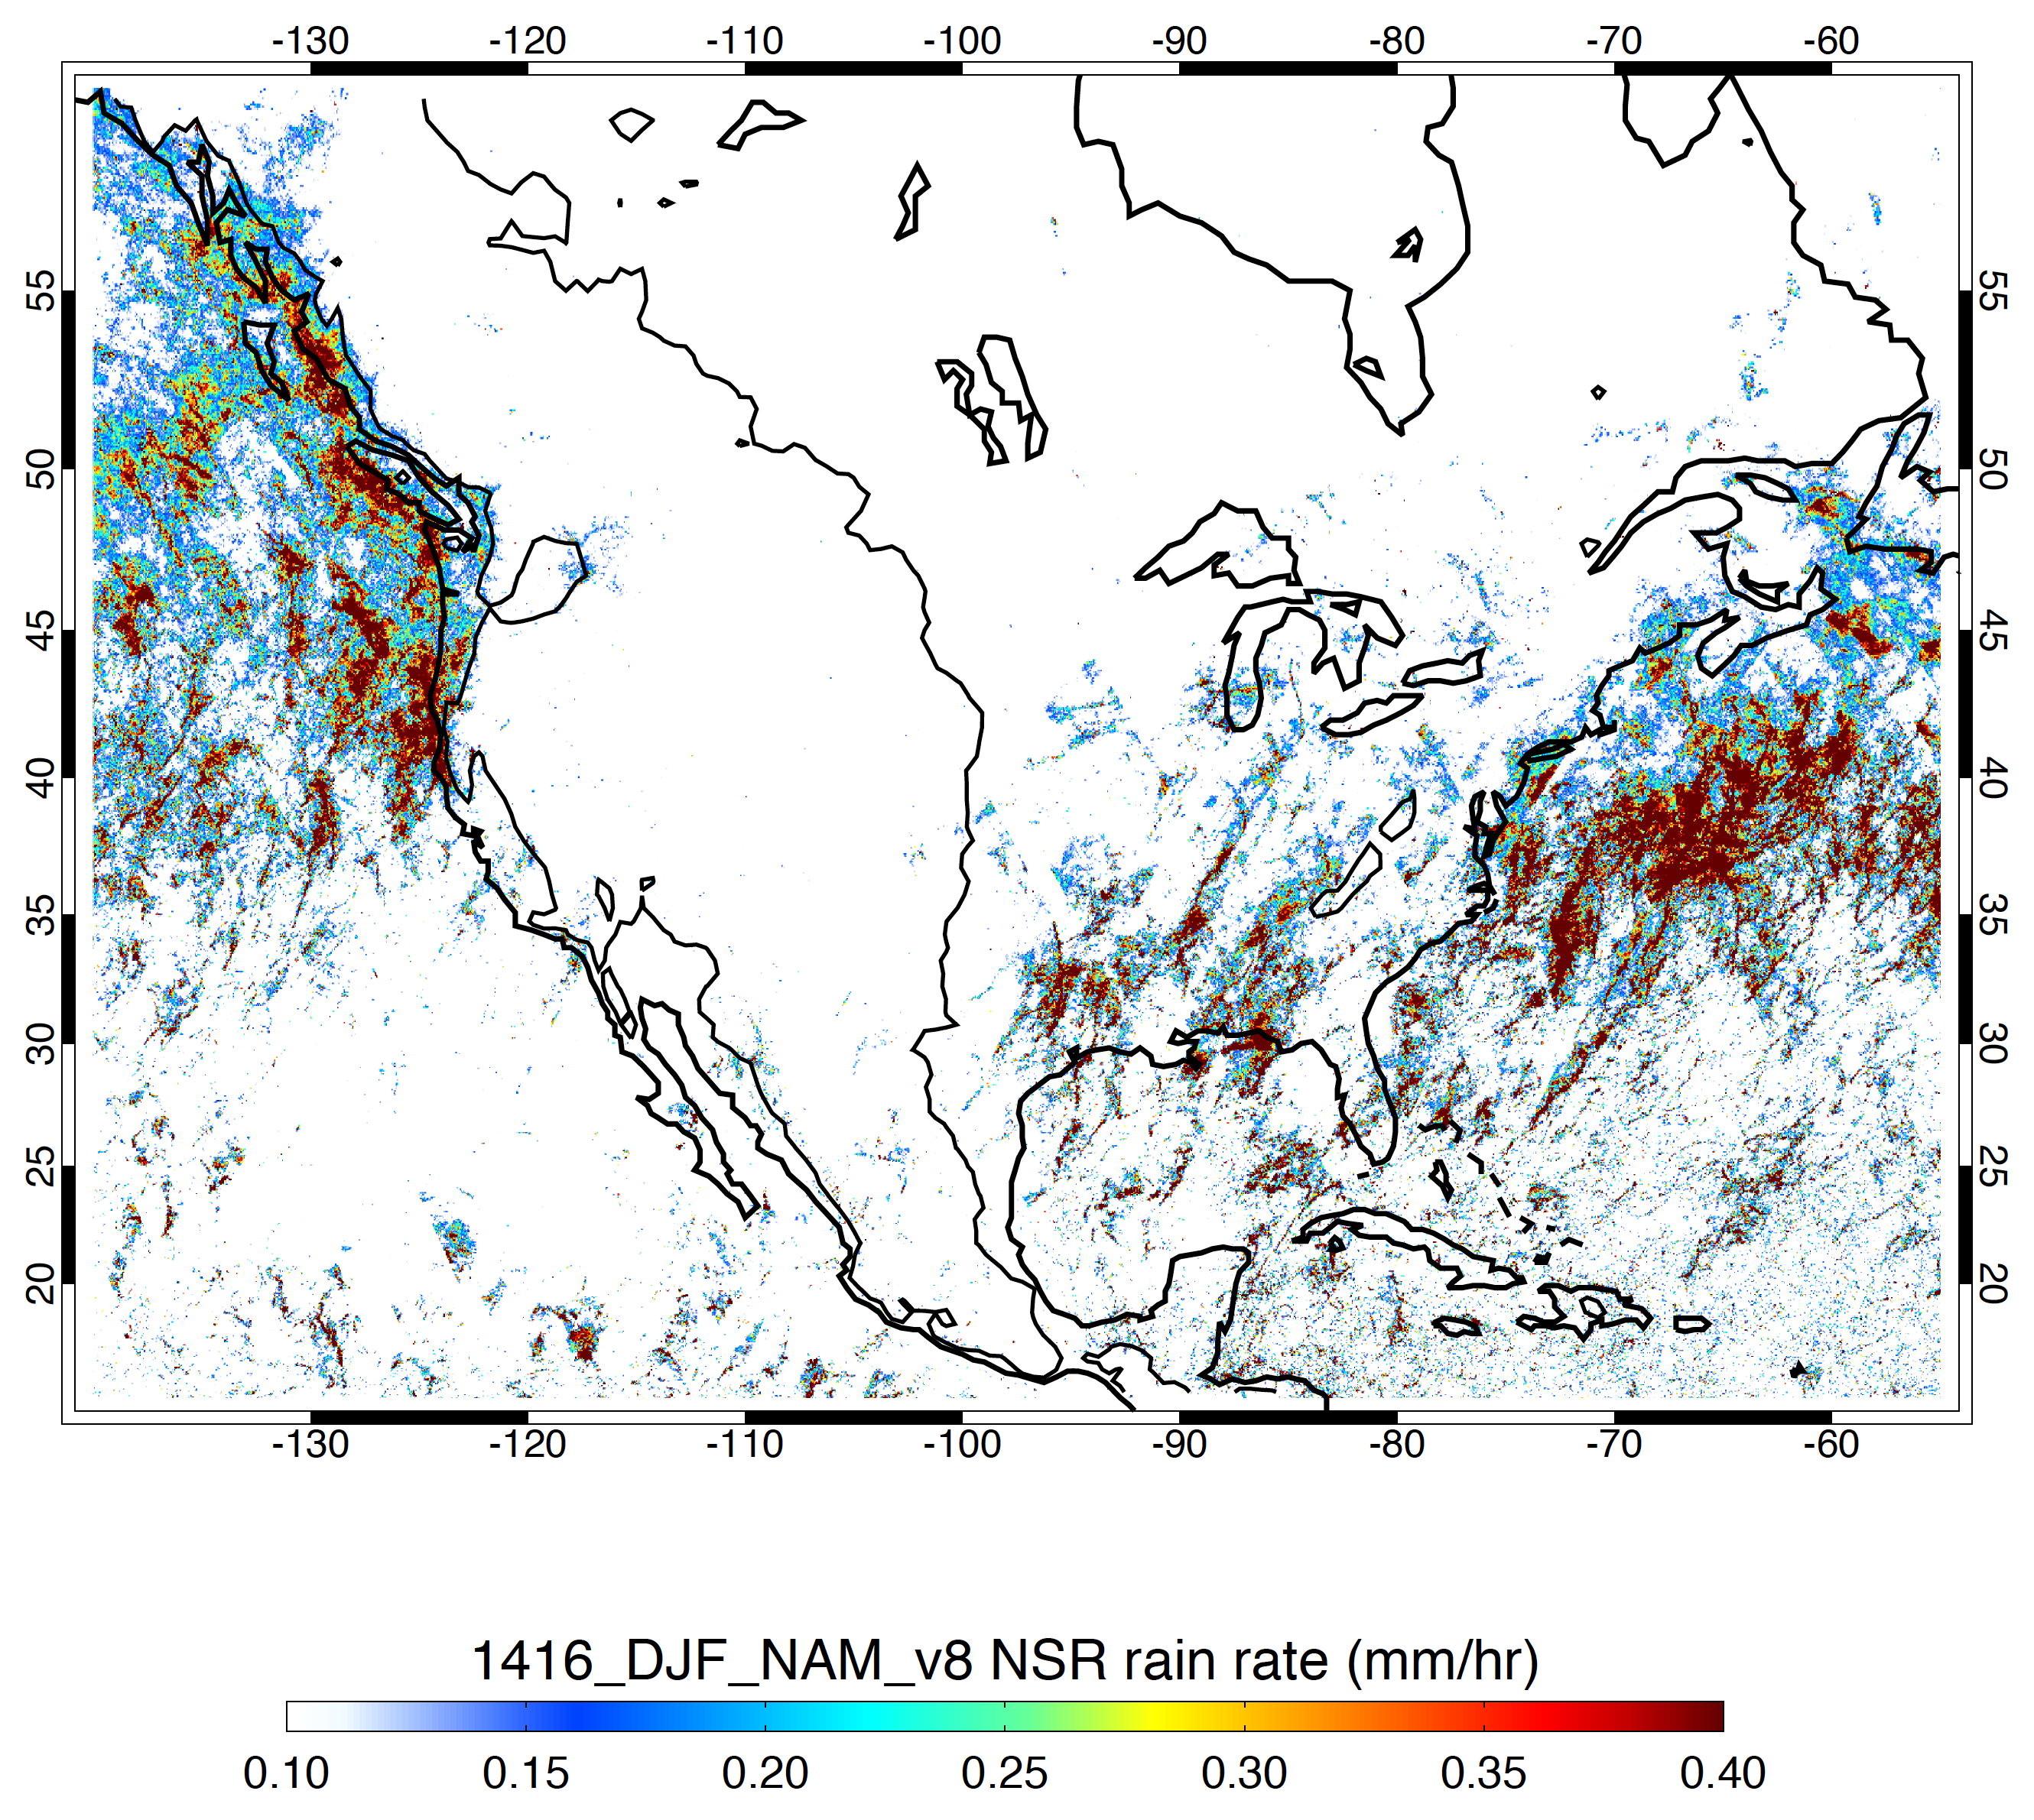
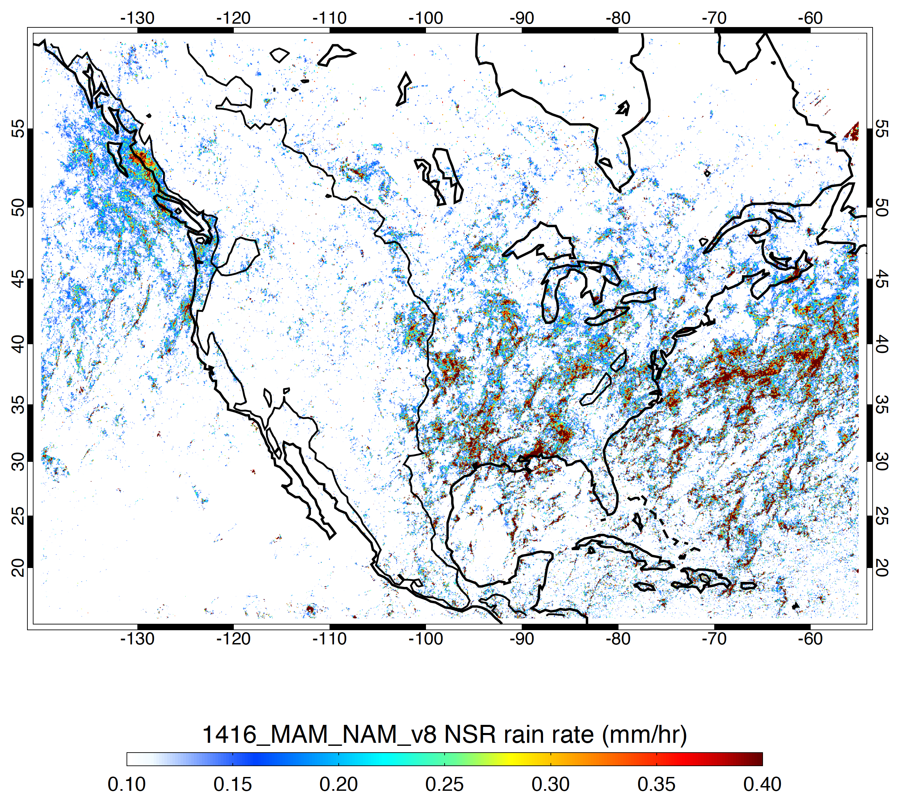
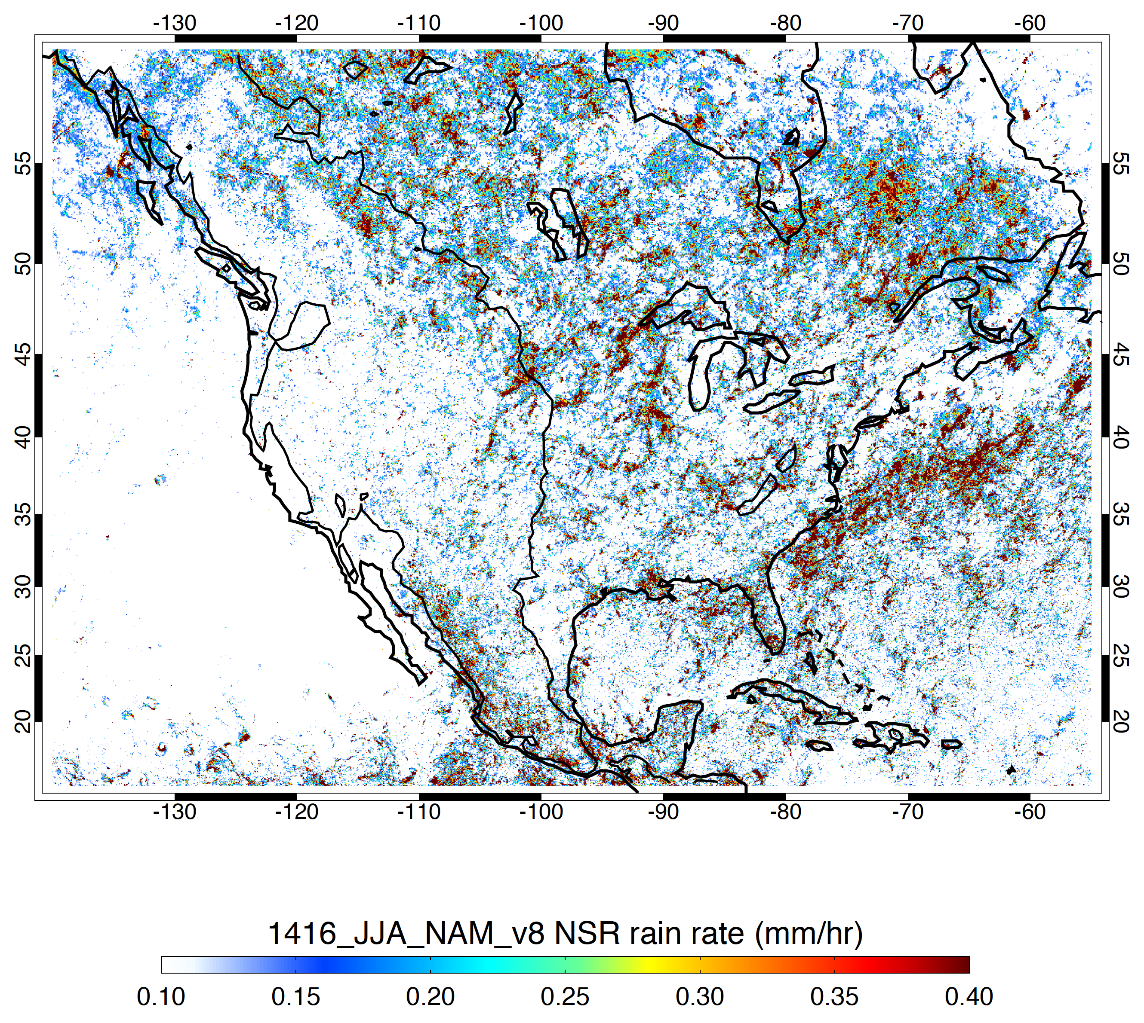
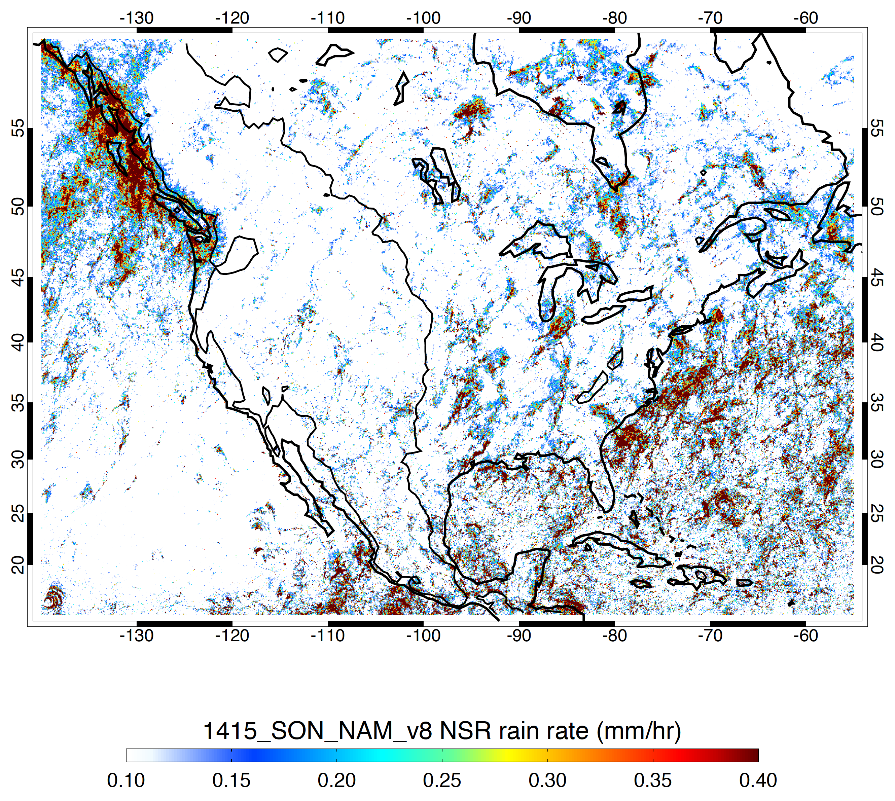
Overall Mean Rain Rate (mm/h)
DJF
MAM
JJA
SON

Slide 7
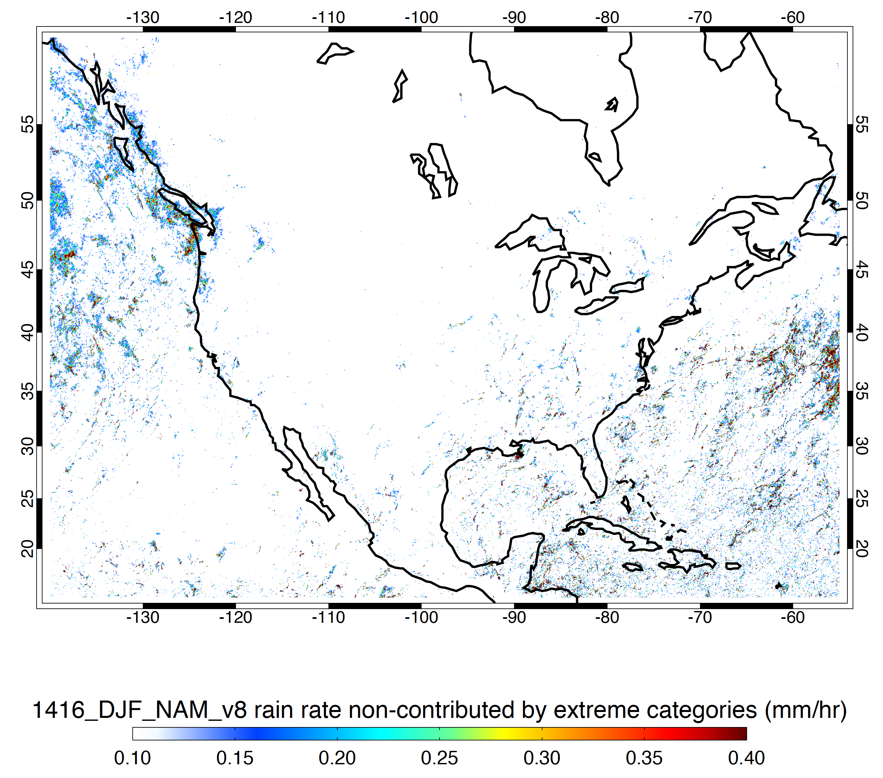
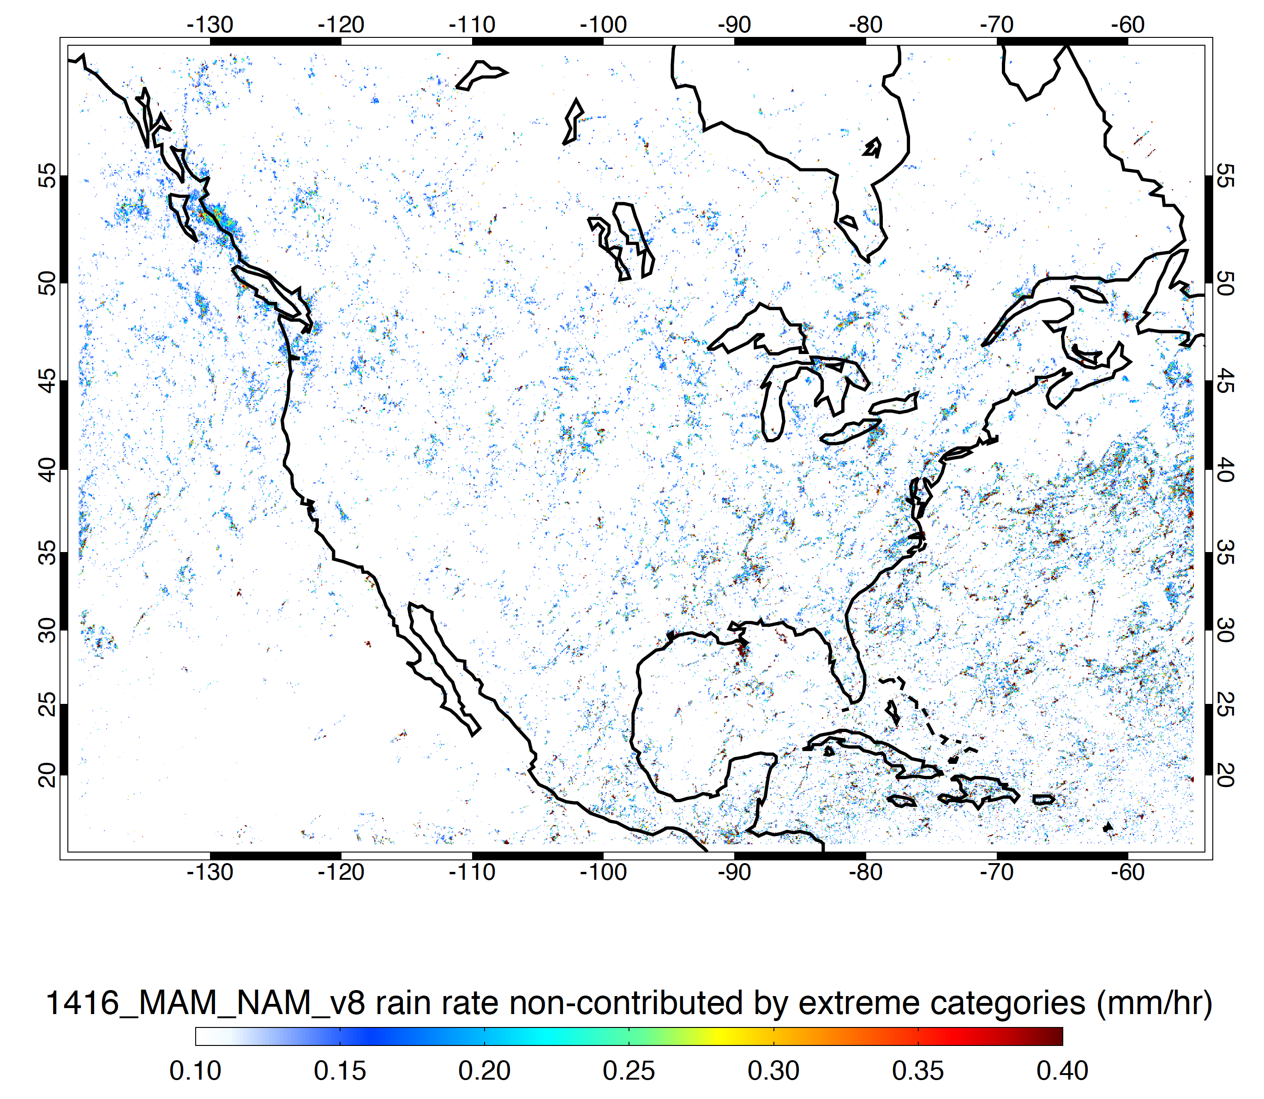
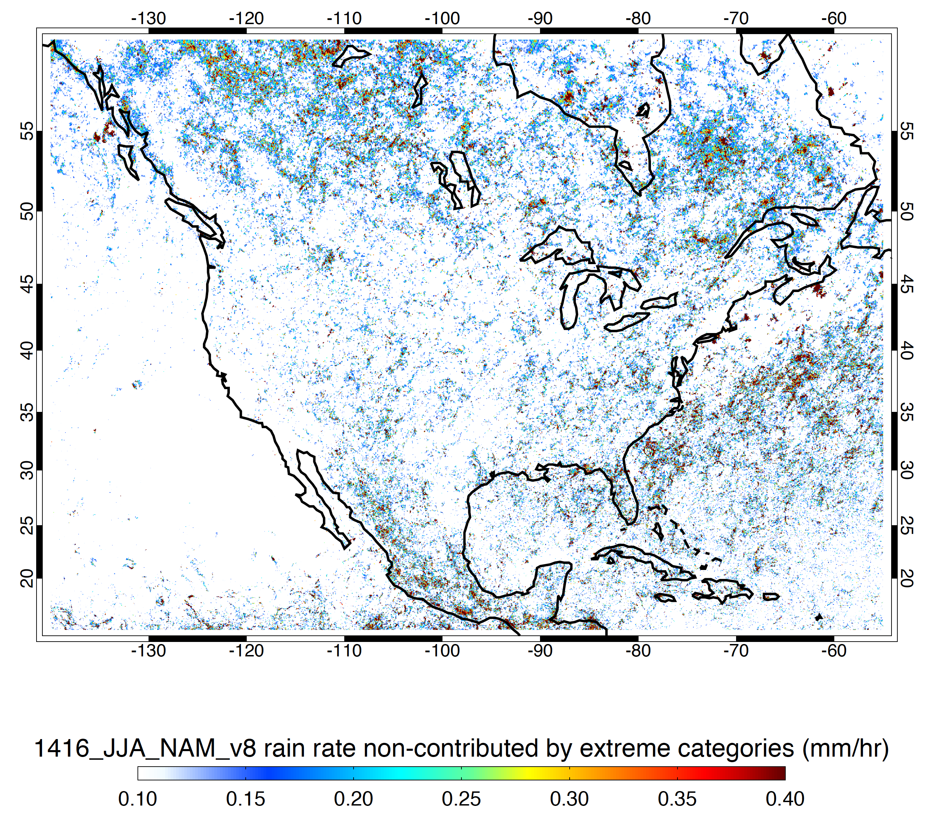
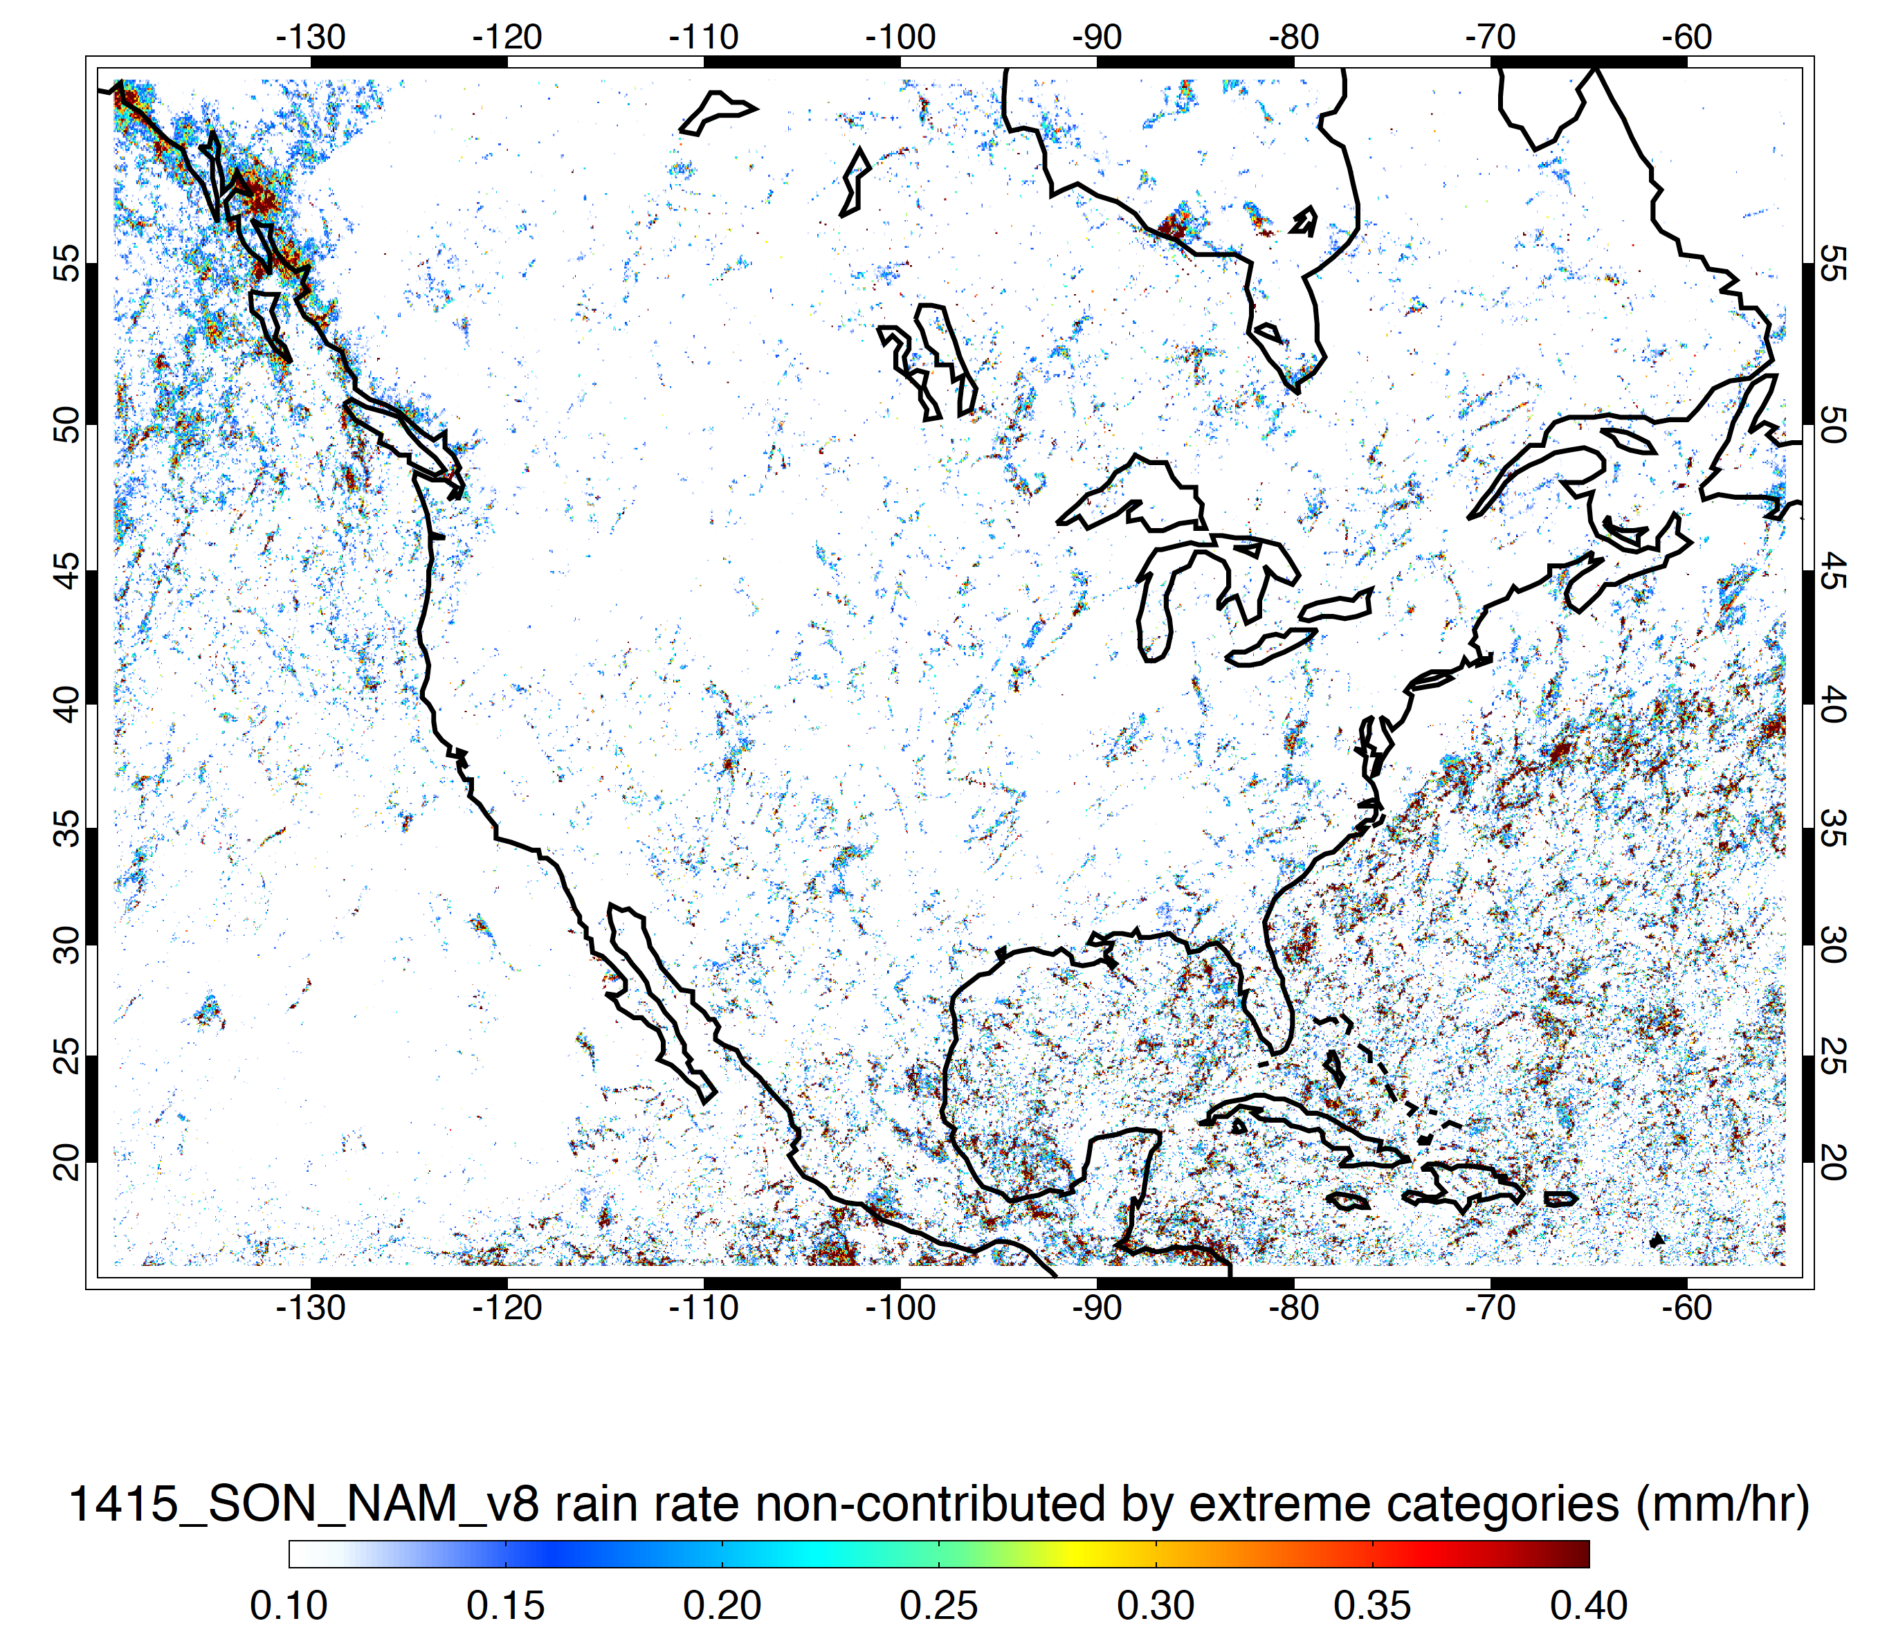
Minus Storms Containing Strong Threshold Features
DJF
MAM
JJA
SON

Slide 8
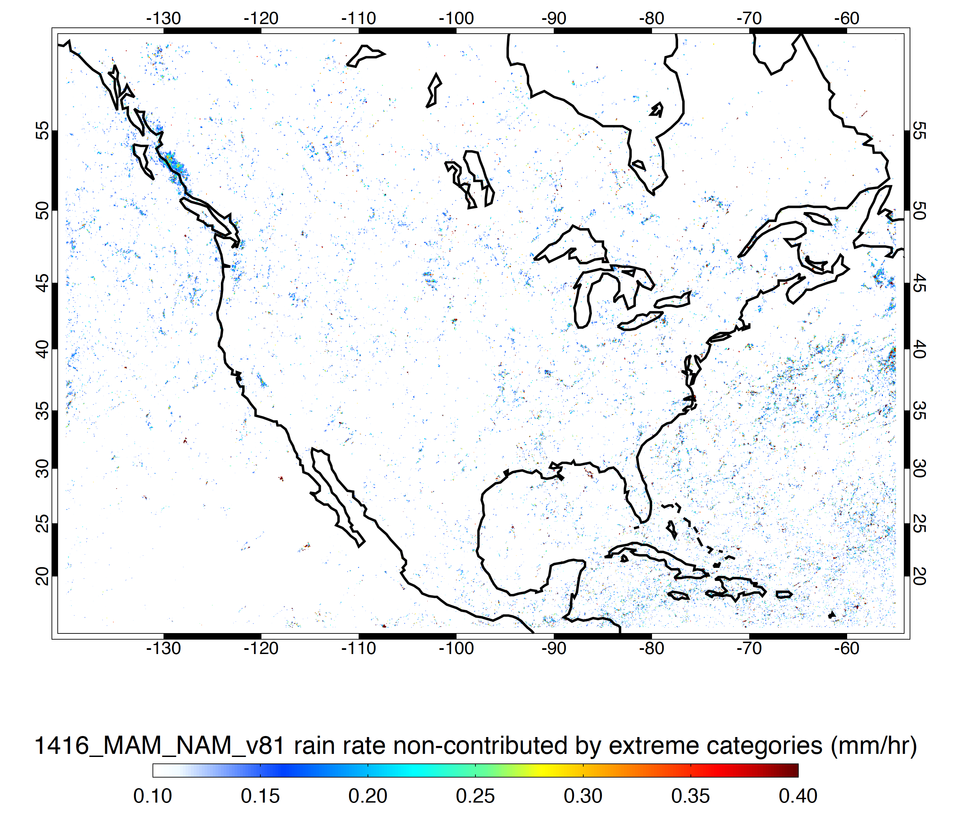
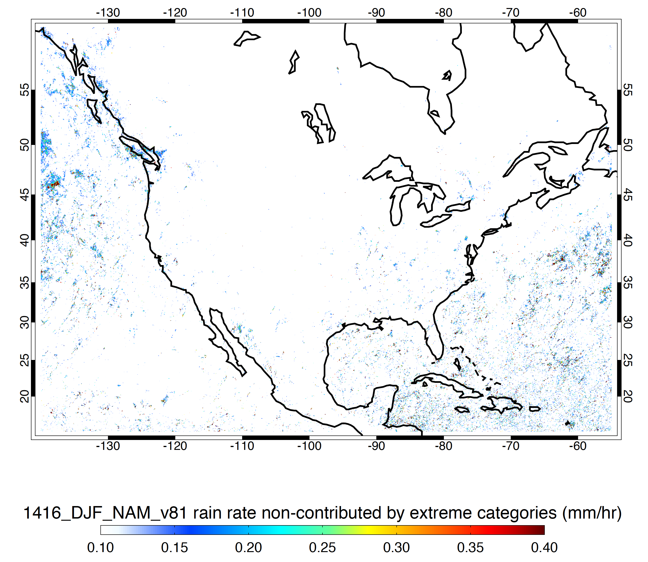
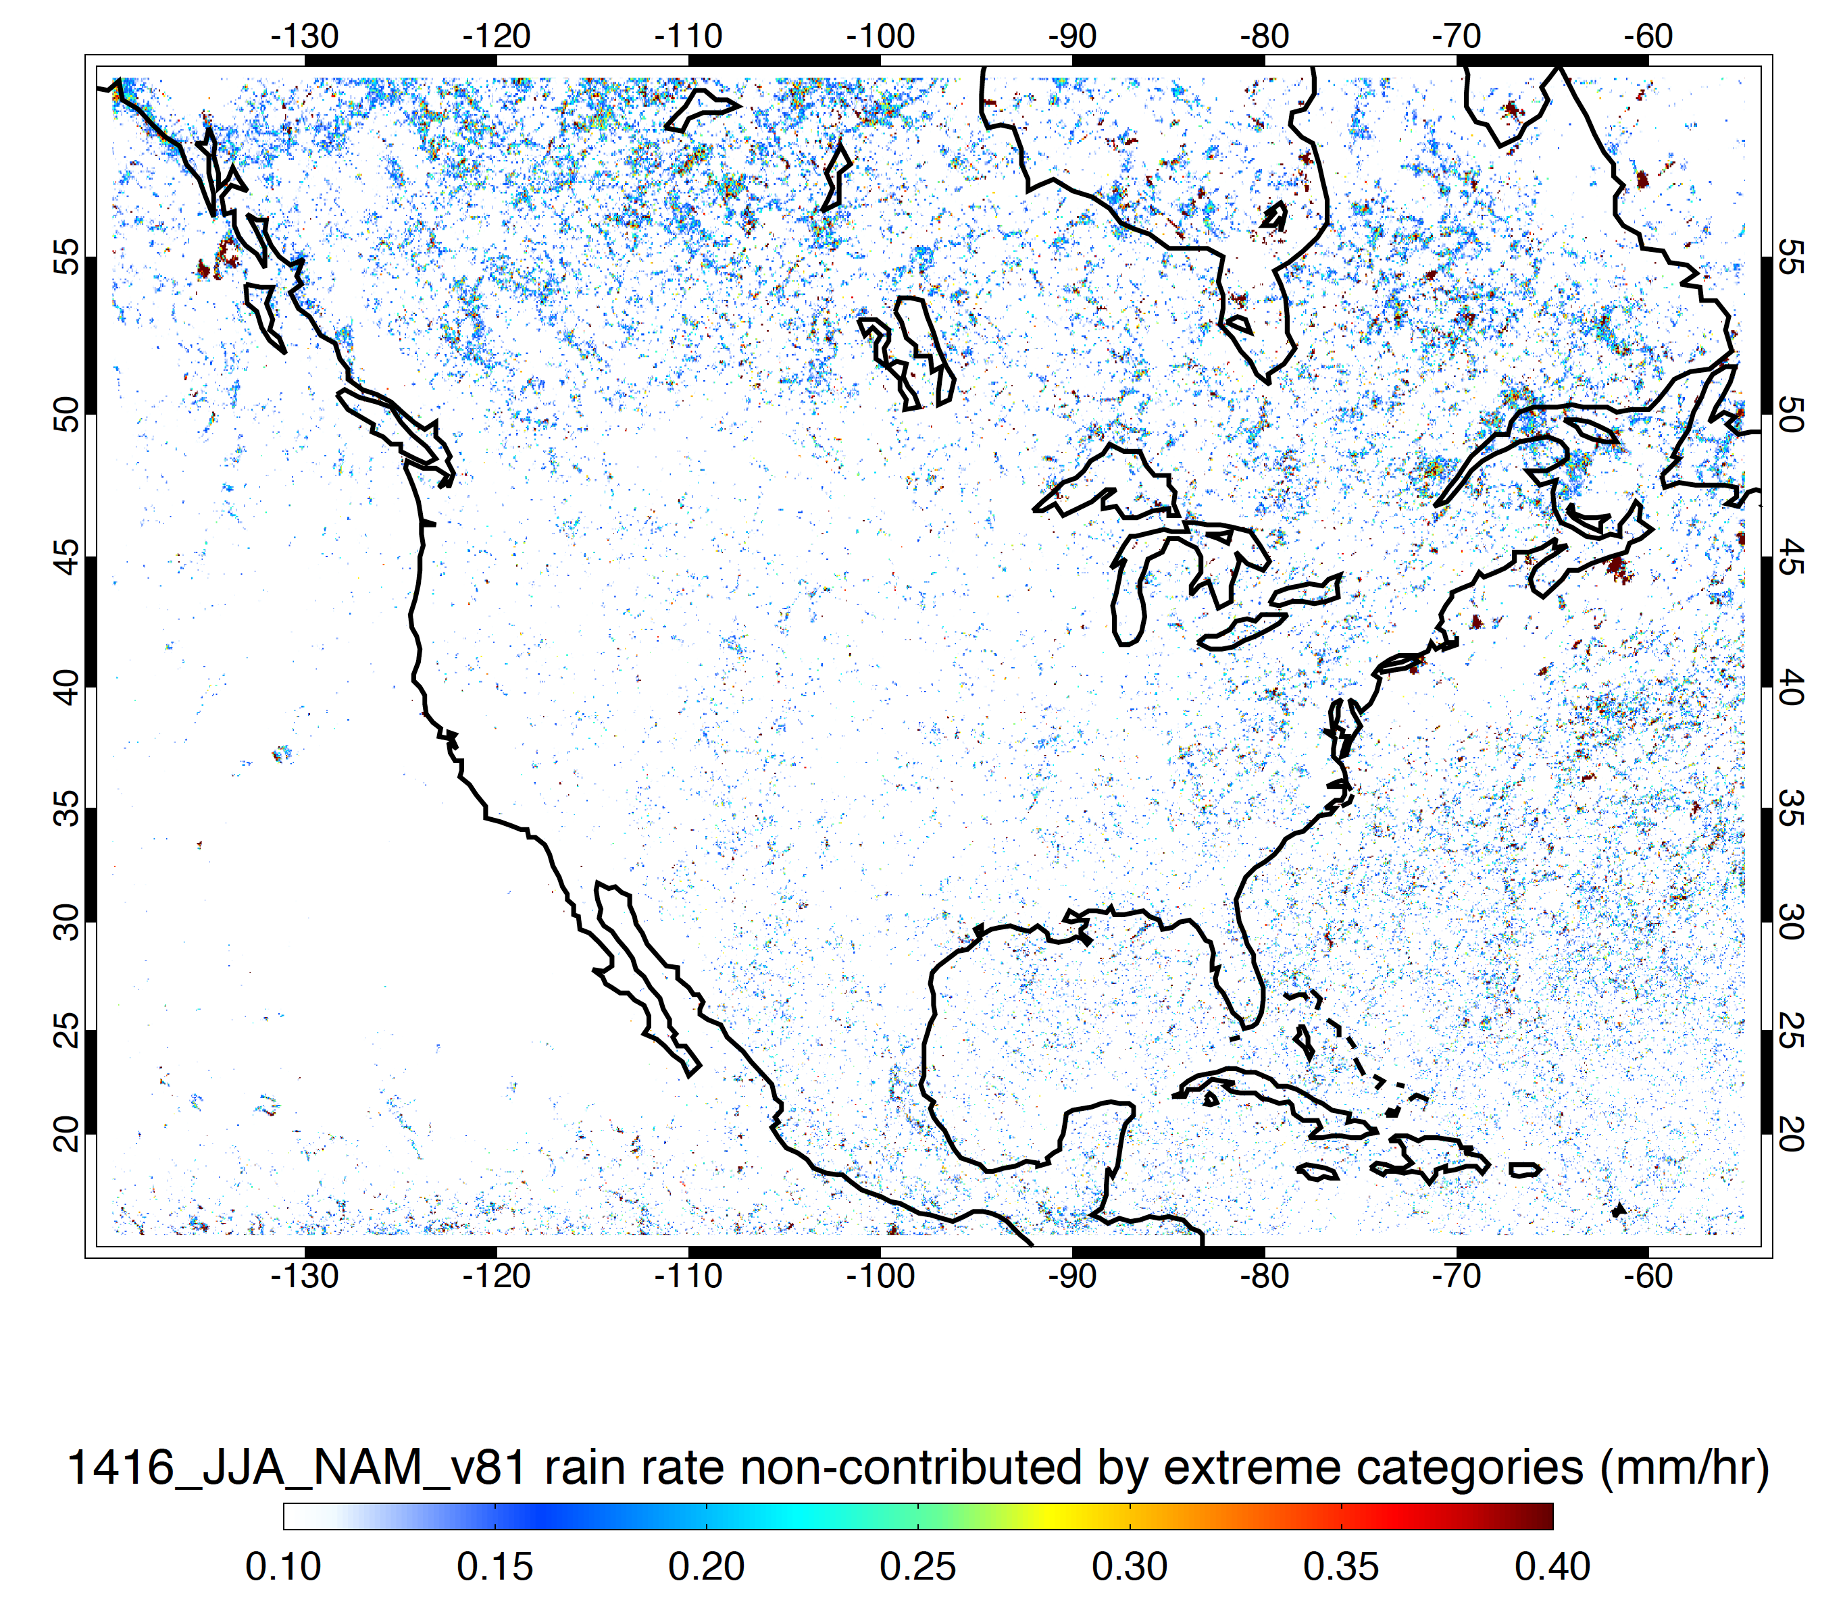
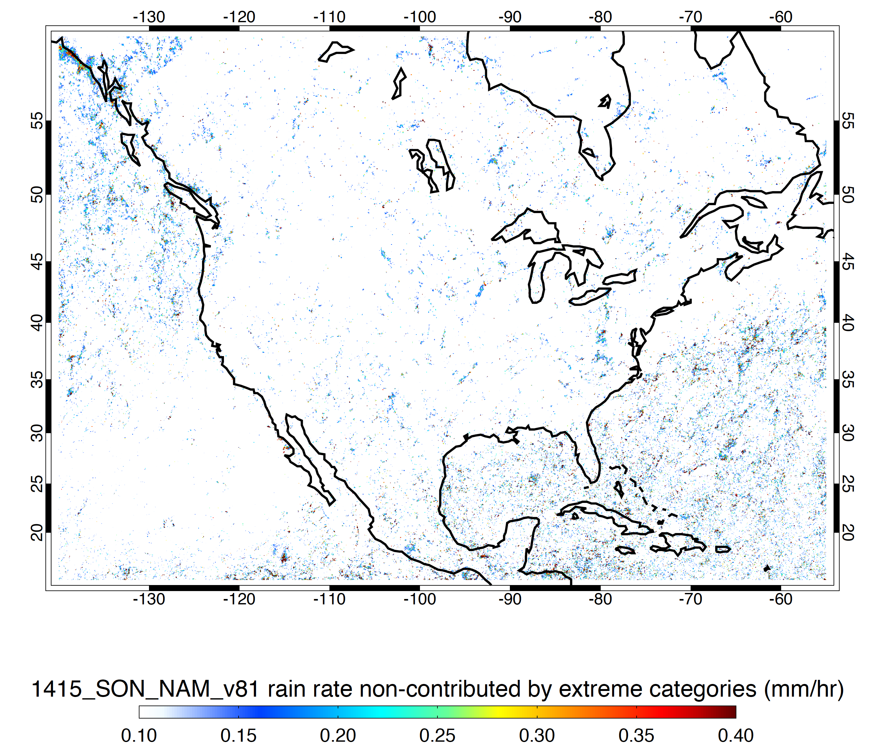
Minus Storms Containing Moderate Threshold Features
DJF
MAM
JJA
SON

Slide 9
Now Look at Probability of Occurrence of
Isolated Shallow Echoes
Deep Cores
Wide Cores
Deep and Wide Cores
Broad Stratiform Regions

Slide 10
Probability of Shallow Isolated

Slide 11
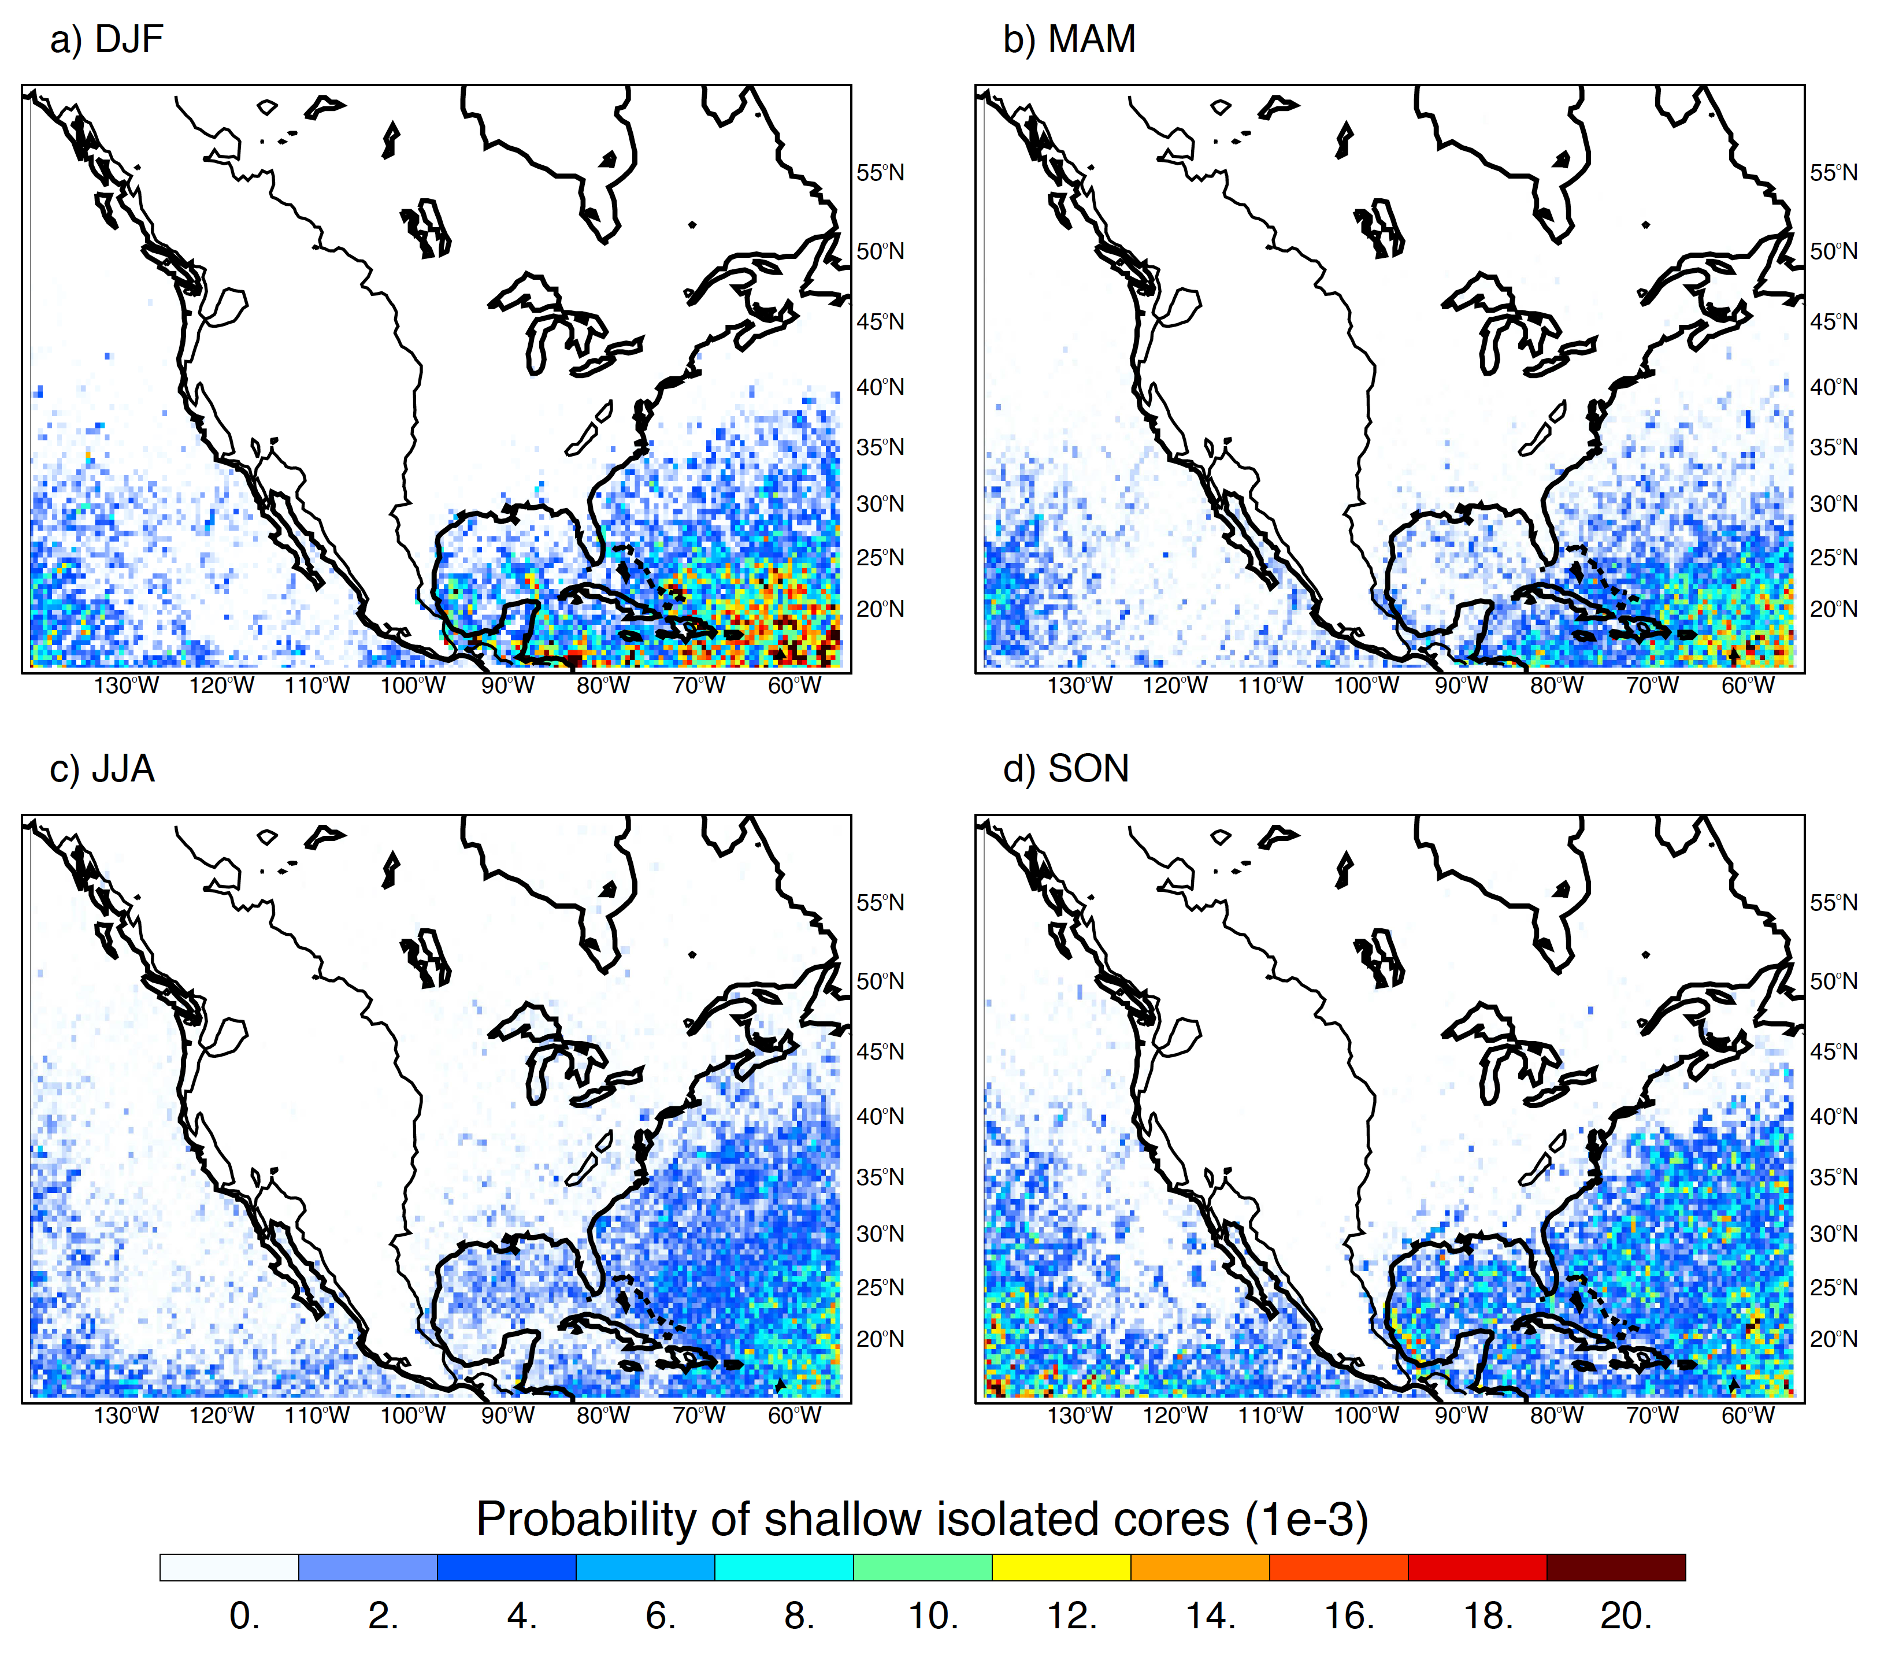

Slide 12
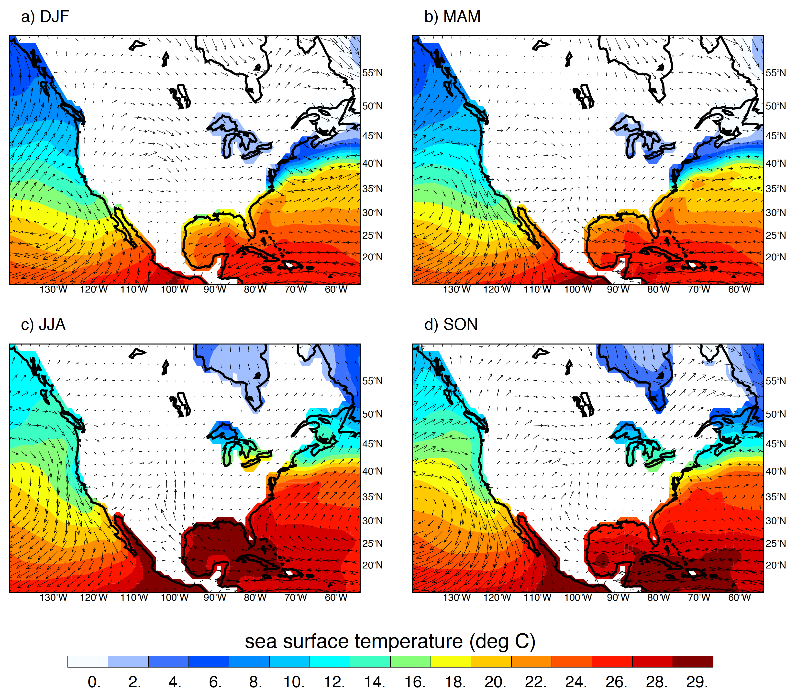

Slide 13
Probability of Intense Convection
Deep Conv., Wide Conv., & Broad SF
(moderate thresholds)

Slide 14
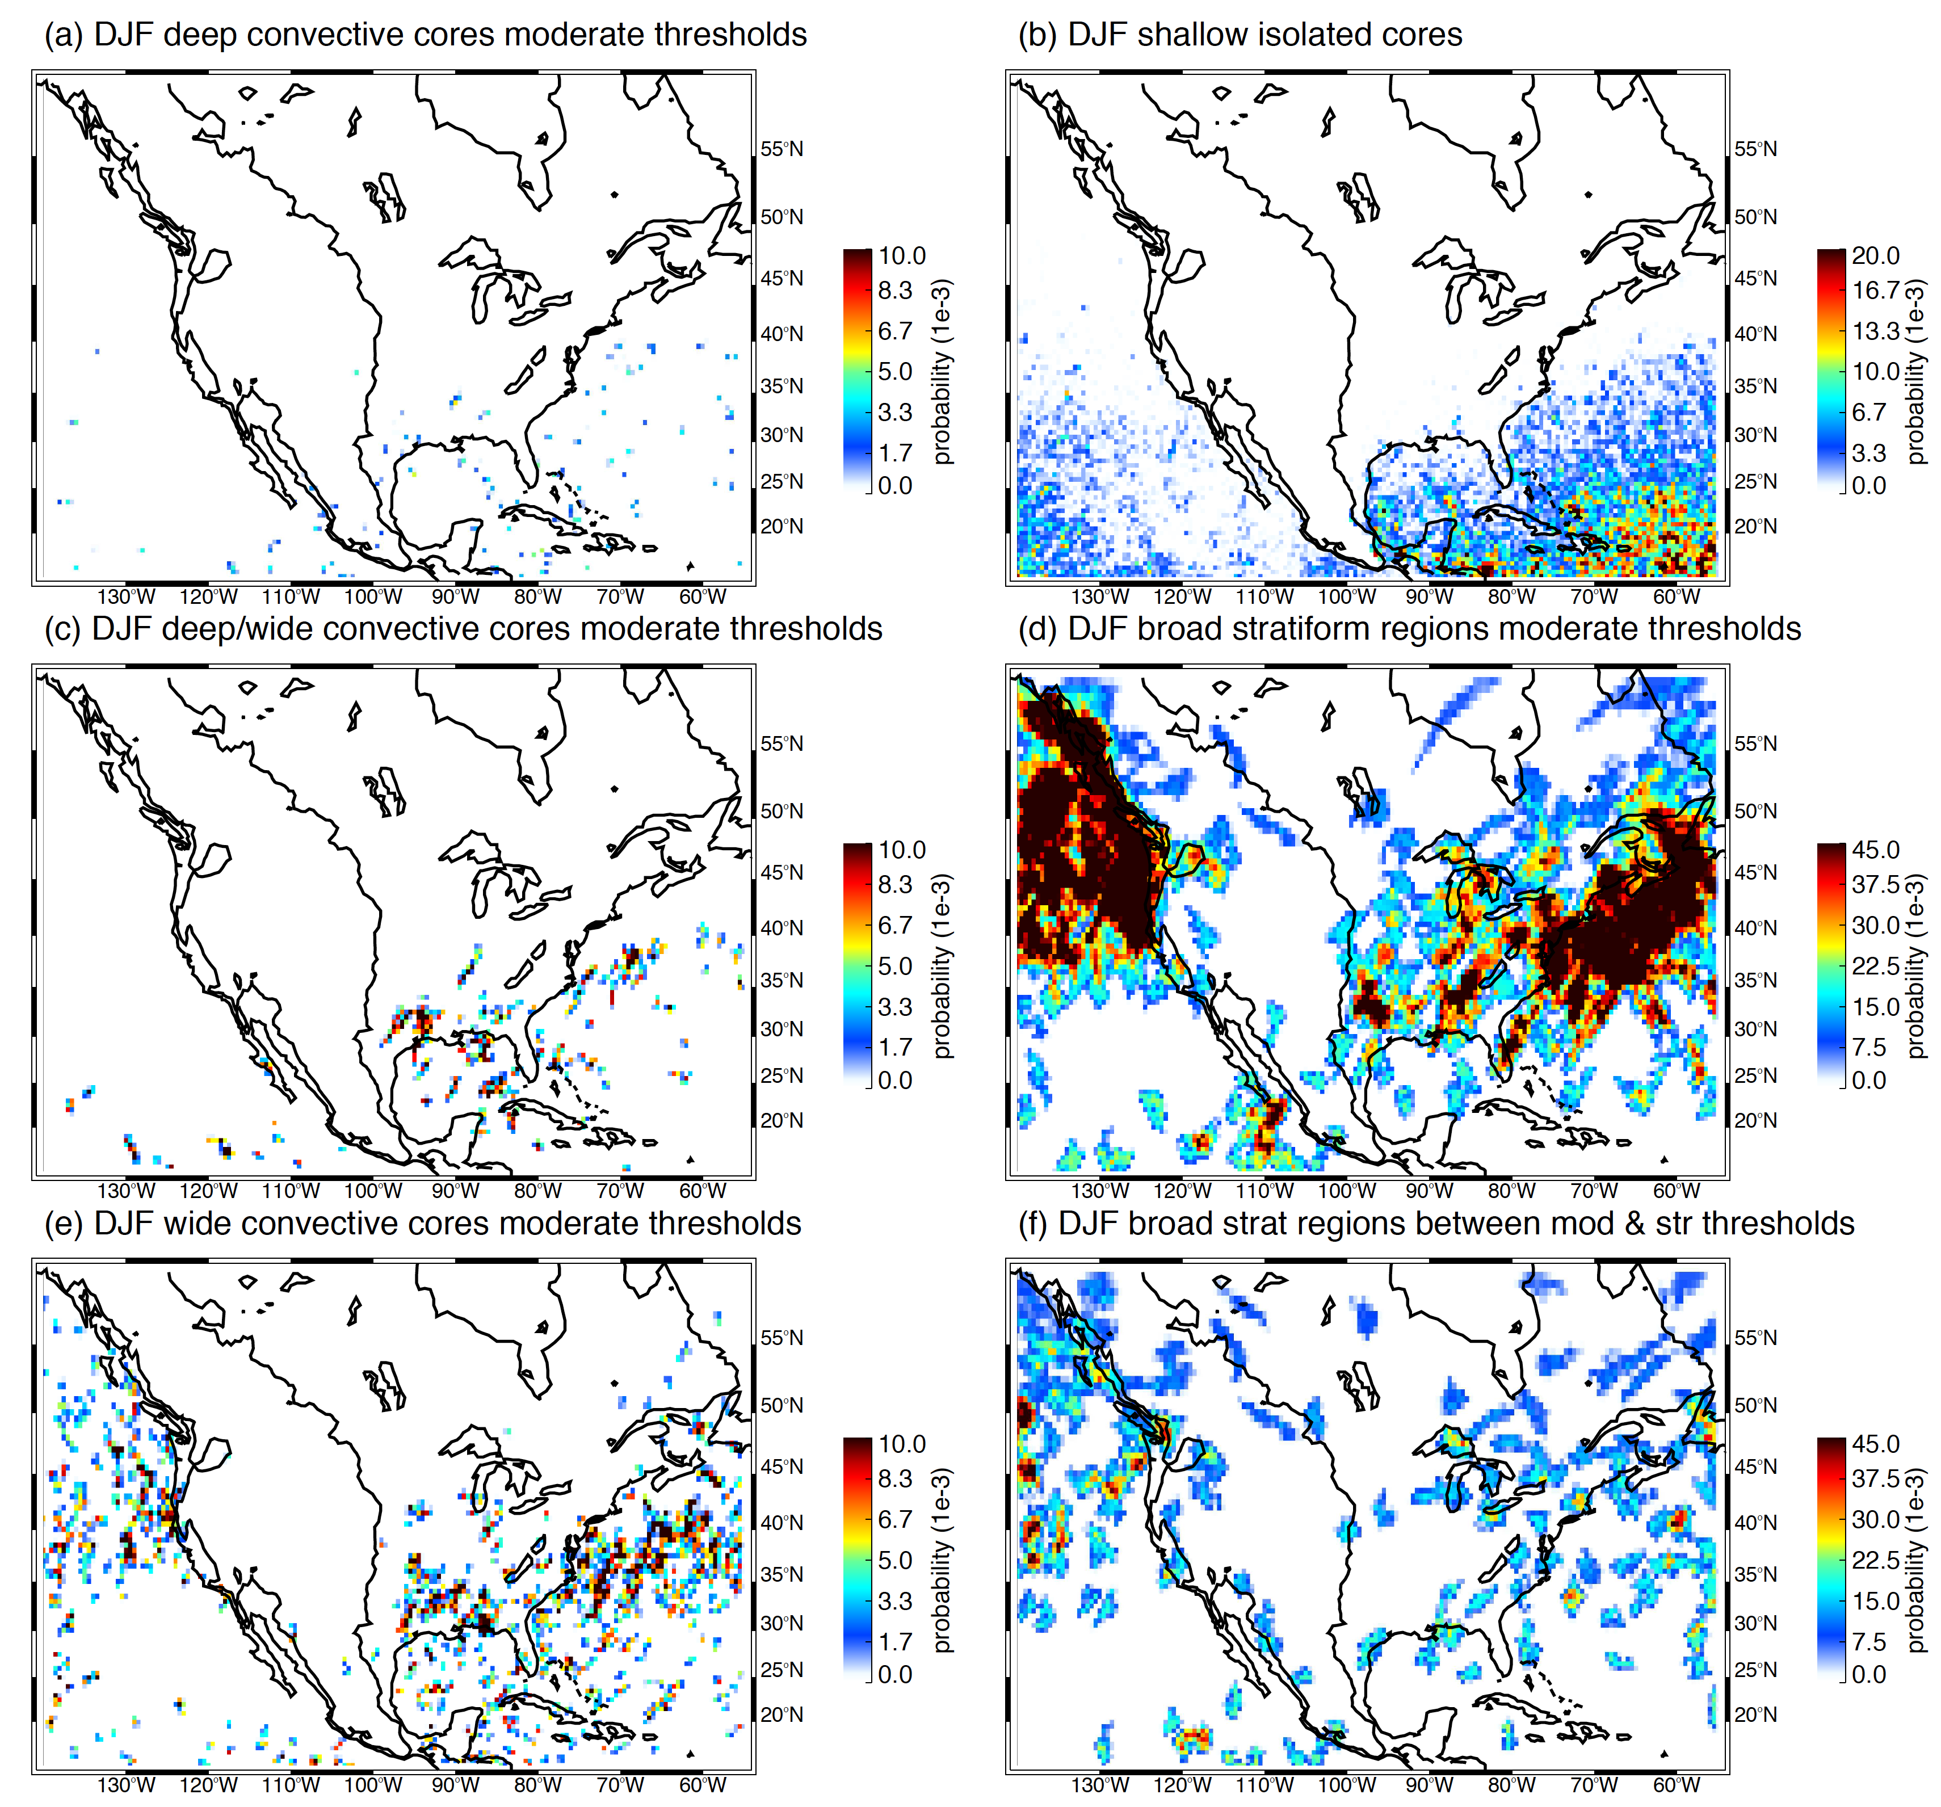
DJF
deep
ise
d/w
bsr
wide
bsr/f

Slide 15
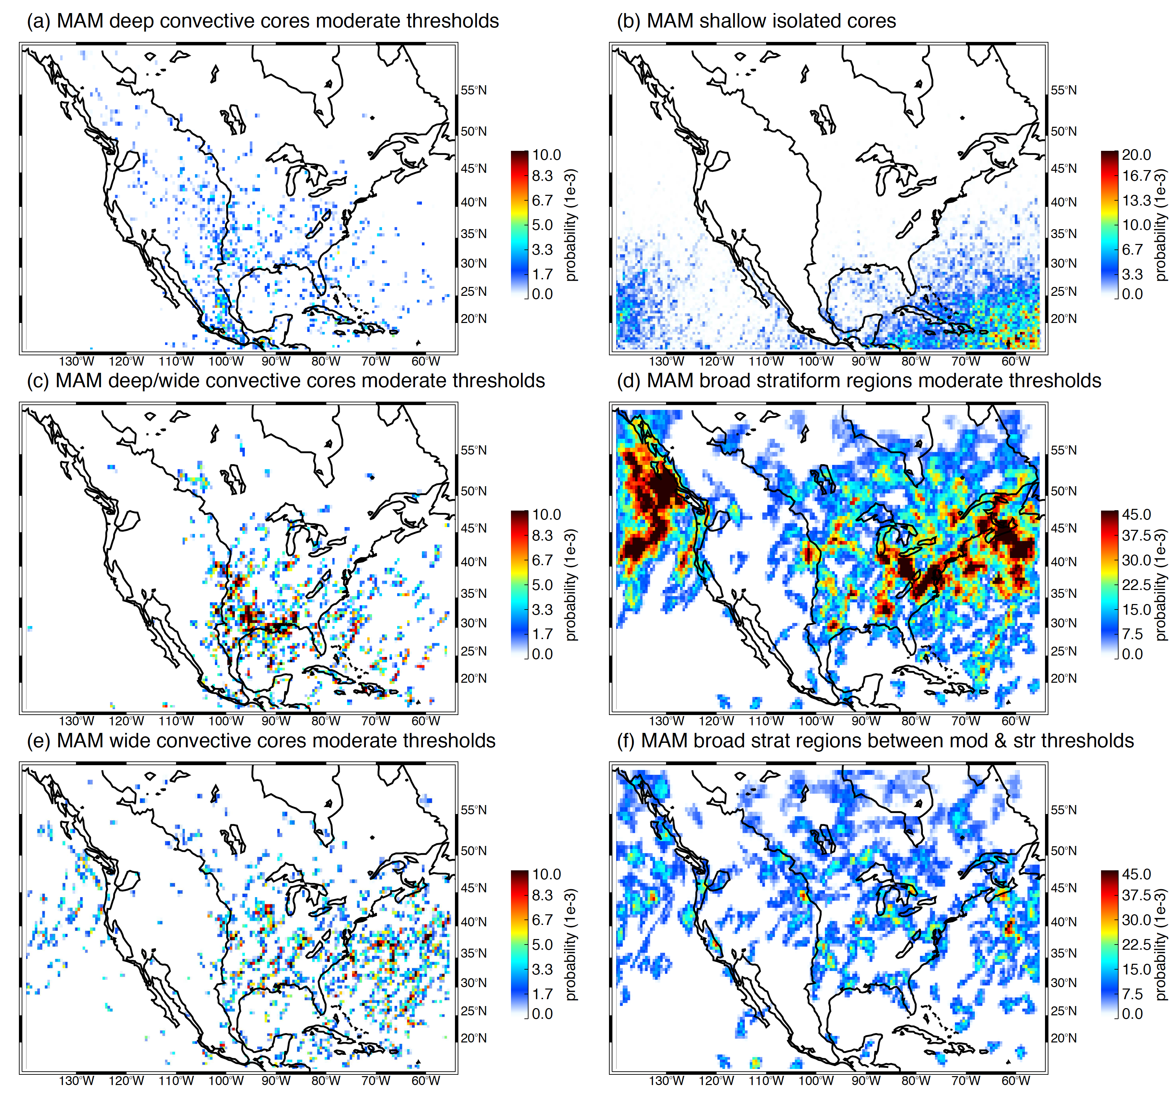
MAM
deep
ise
d/w
bsr
wide
bsr/f

Slide 16
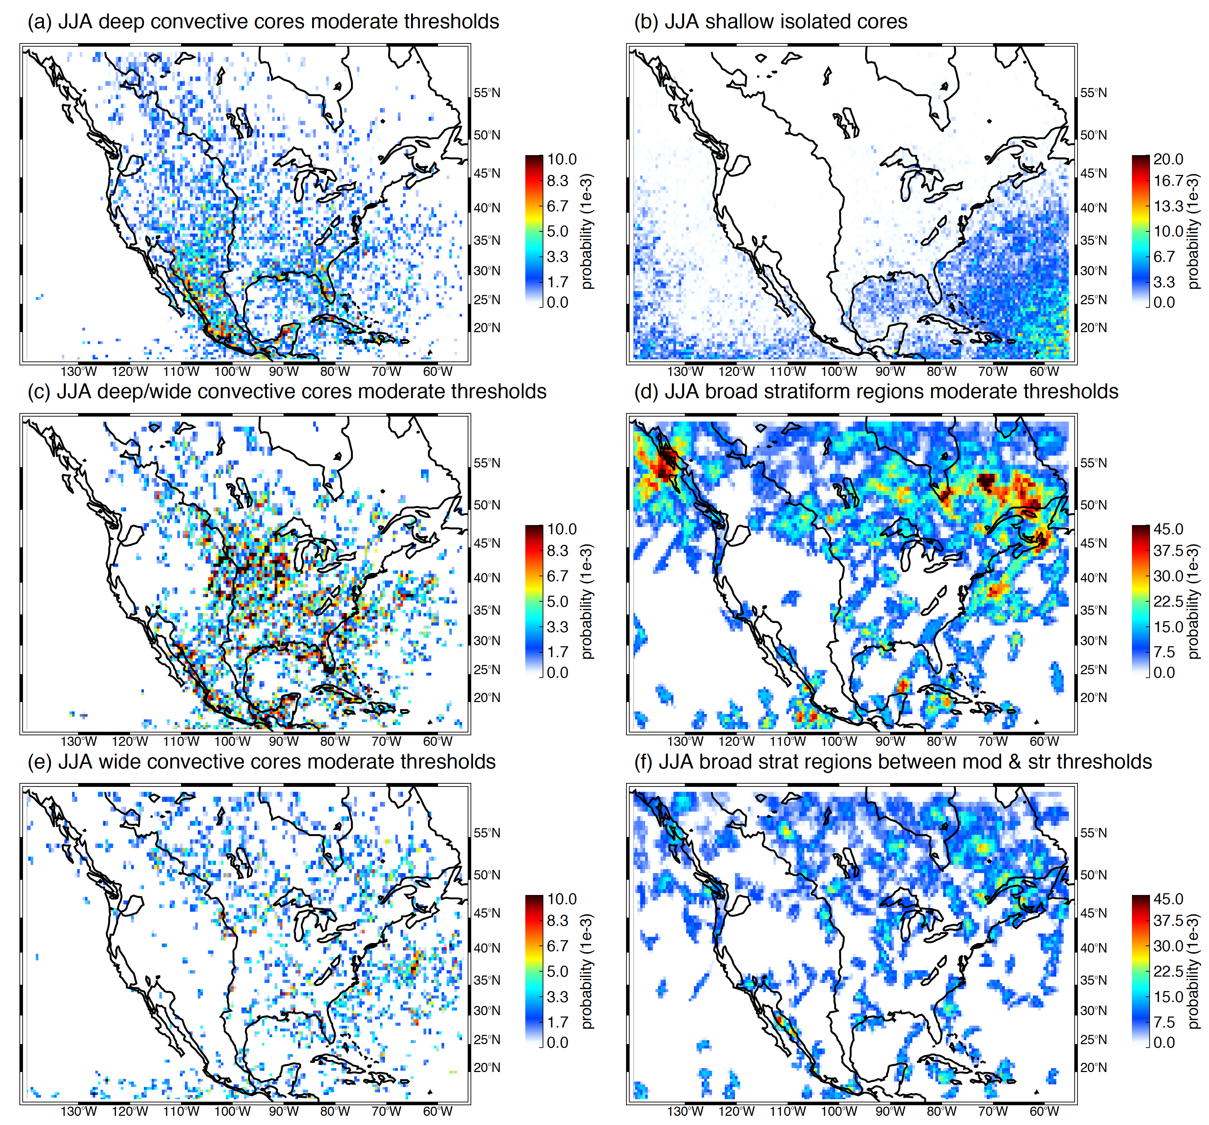
JJA
deep
ise
d/w
bsr
wide
bsr/f

Slide 17
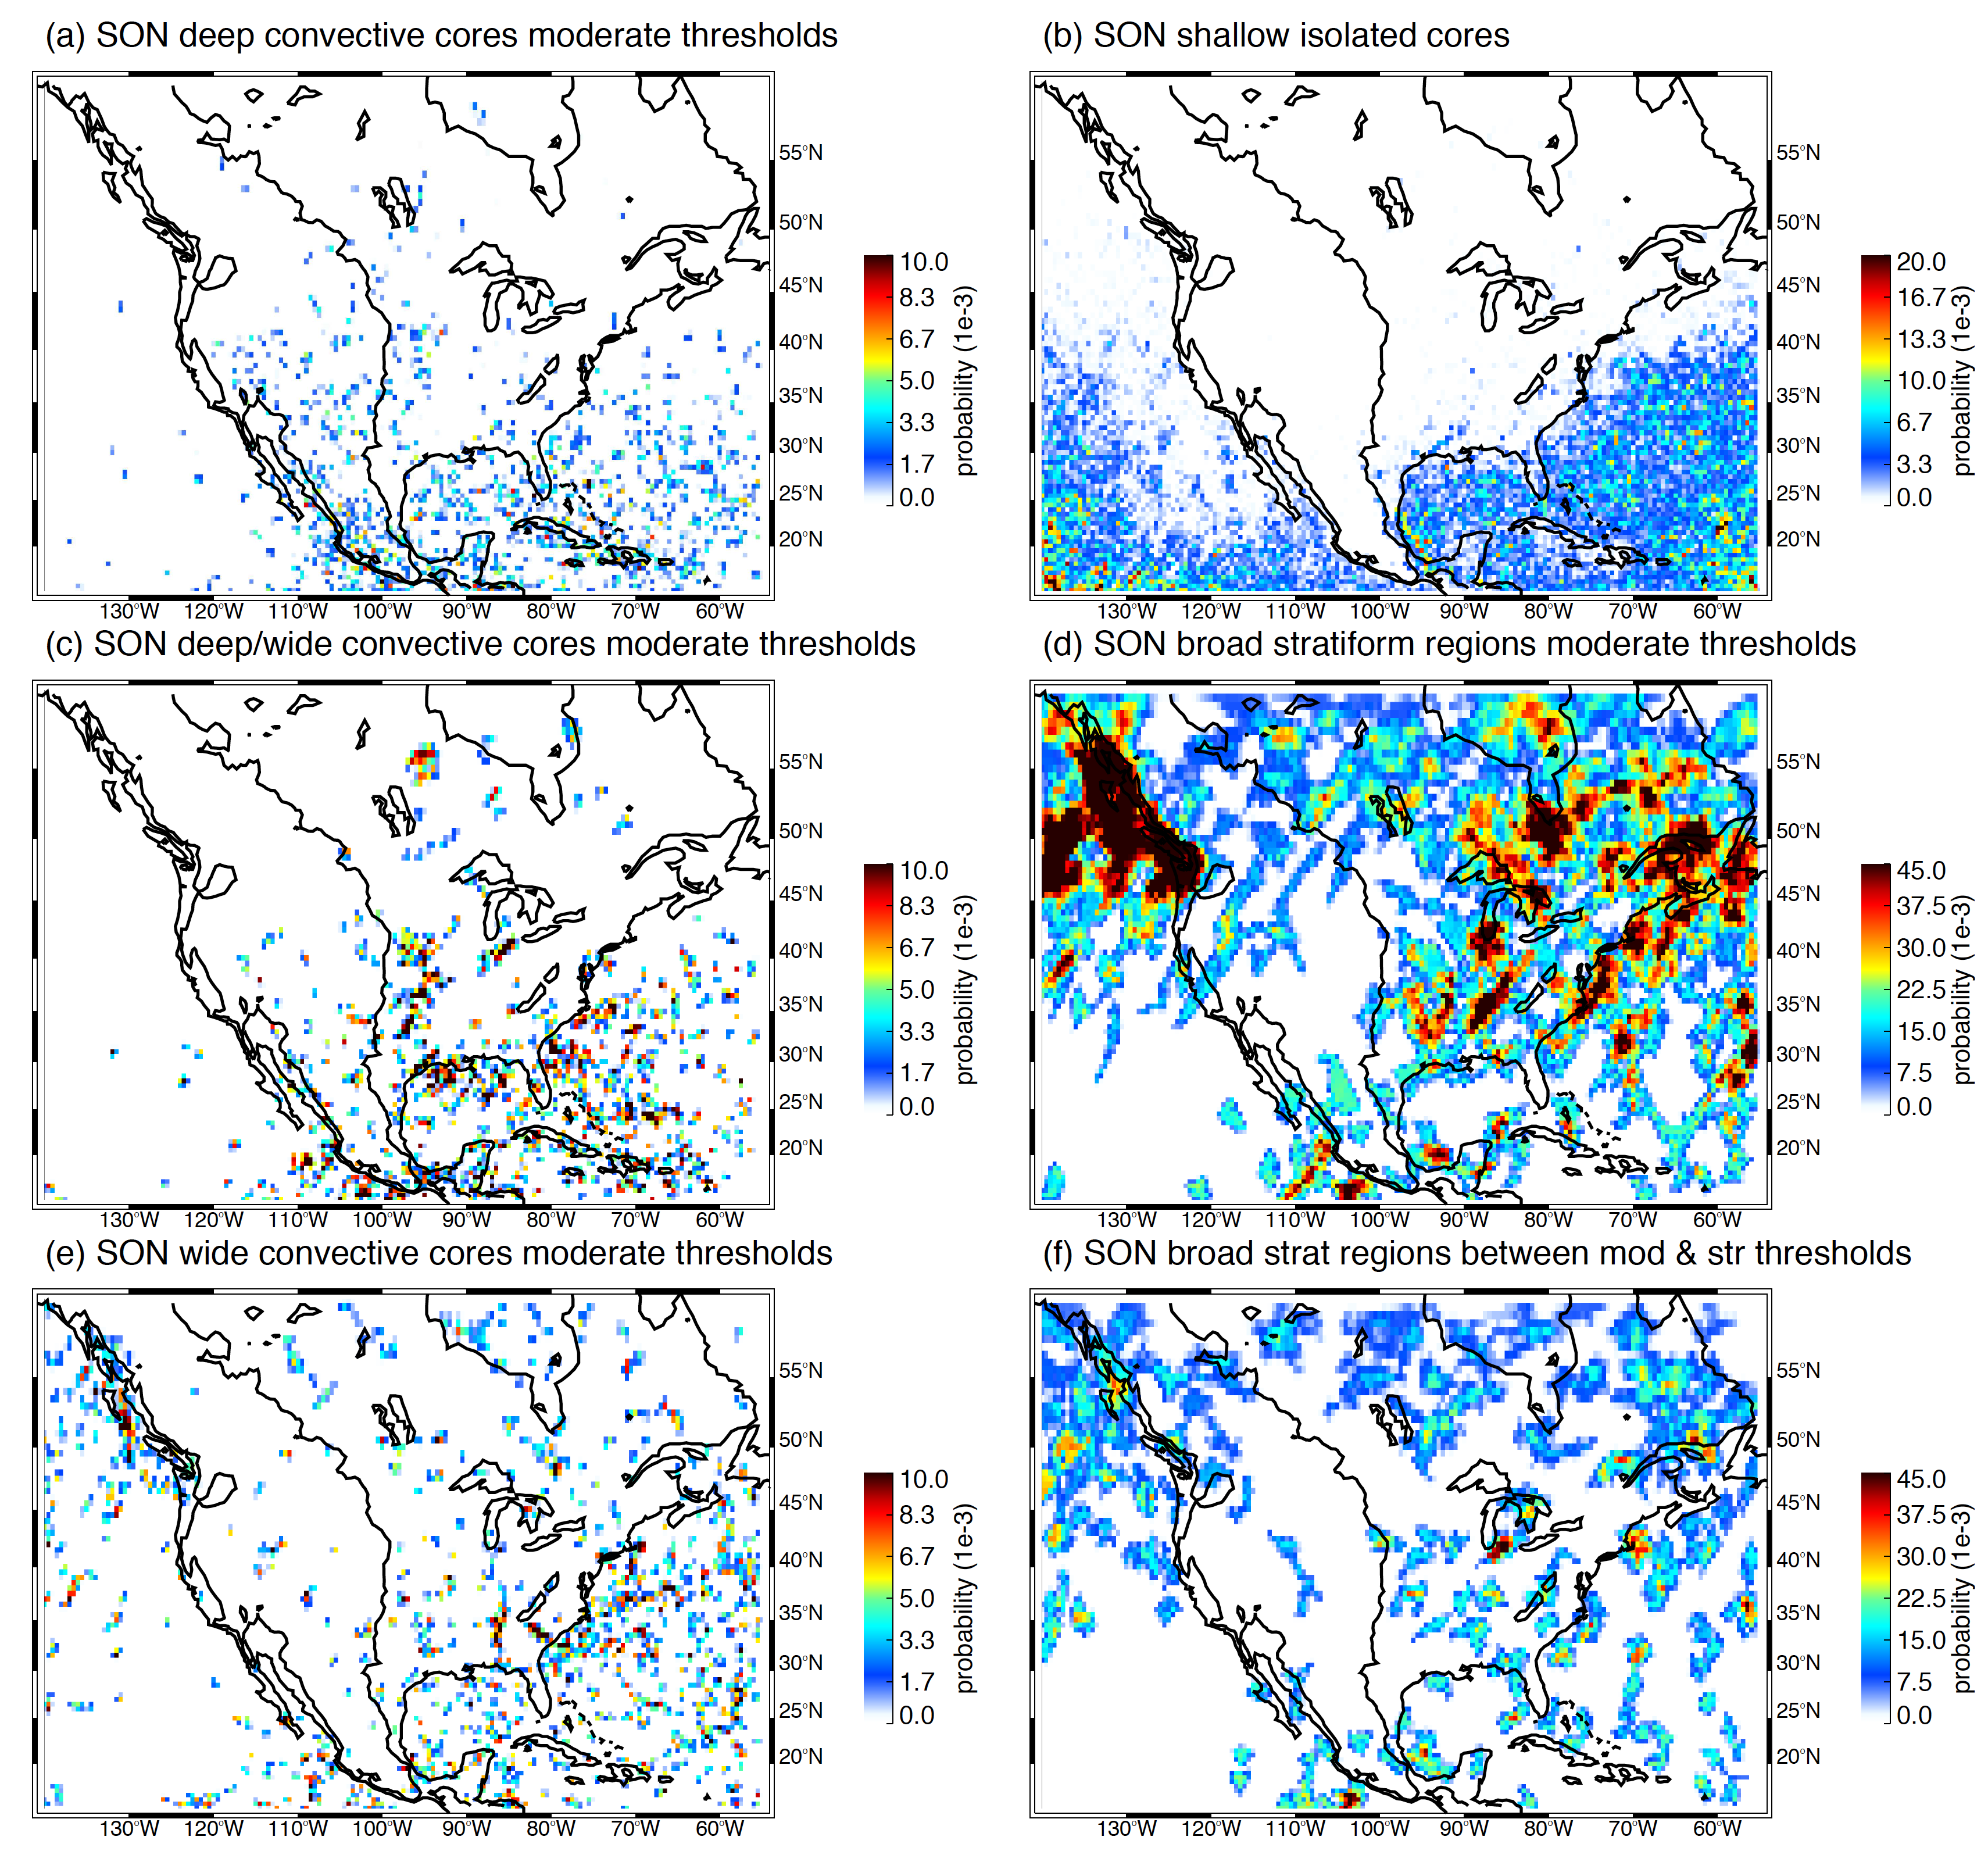
SON
deep
ise
d/w
bsr
wide
bsr/f

Slide 18
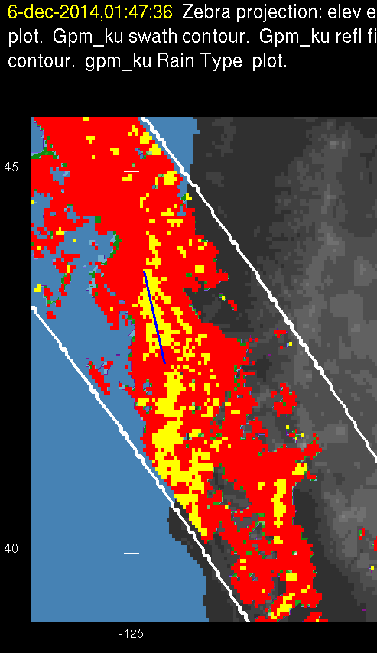
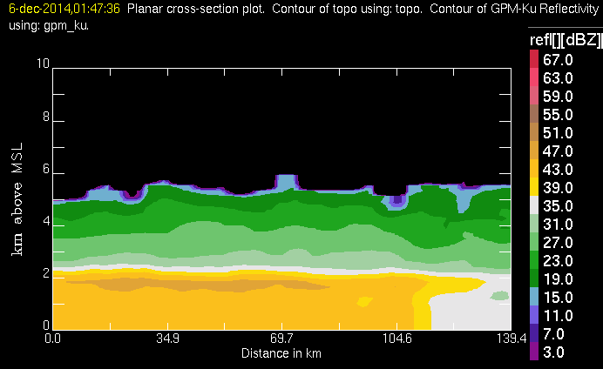
Example of frontal echo identified as convective by GPM algorithm
Conv.
Strat.

Slide 19
Conclusions
Seasonal shifting of all categories
    Shallow isolated echoes nearly all over ocean and sort of follow SST
    Frontal BSRs show strong seasonal migration
  WCC formation in the westerly belt, shifting N in summer, & coastlines
Mountain and near-mountain convection
  Much deep convective activity directly over mountains—unlike Andes and Himalayas
  Mesoscale development occurs slightly west of Rockies but in a less focused pattern than over Argentina
Coastal convection
  Prominent coastal patterns, especially near mountains (Mexico)
  Sea/land breeze pronounced along Gulf Coast (30°N)
Stratiform regions
  BSR development from convection is generally weak—as over other landmasses
  Dominated by frontal activity
  Some frontal stratiform misidentified as convective

Slide 20
END
Supported by NASA grants NNX16AD75G, NNX15AL38

