Slide 1
OLYMPEX
Radar Update
Angela Rowe (UW)
Stacy Brodzik, David Wolff, Jason Pippitt, Walt Petersen, Andrew Frambach, Josh Wurman, Karen Kosiba, Rob Beauchamp, V. Chandrasekar, David Hudak, Peter Rodriguez
OLYMPEX Breakout
PMM Science Team Meeting
Houston, TX
25 October 2016

Slide 2
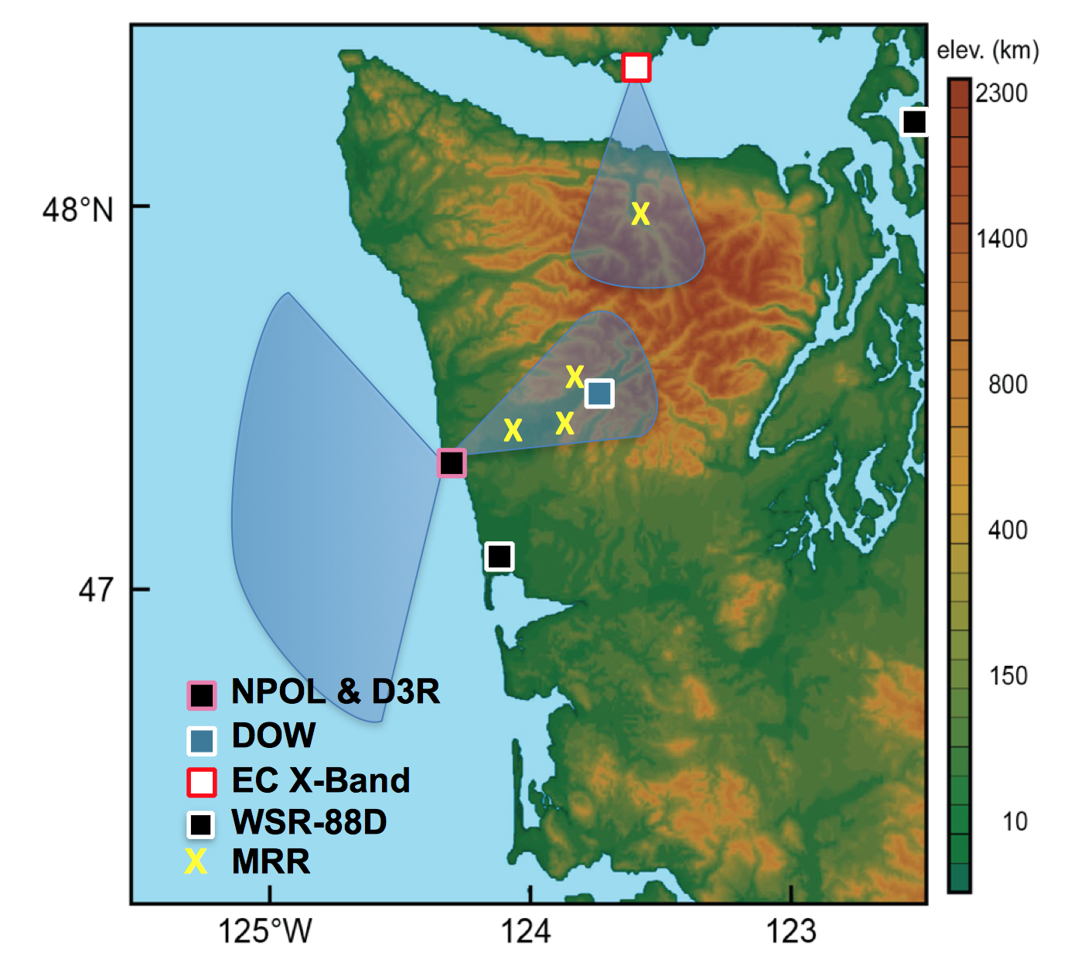
OLYMPEX Radar Network

Slide 3
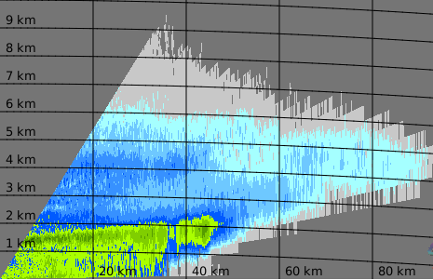
Environment Canada X-band
Level 1A dataset forwarded to NASA
1 file per parameter
Data format: SELEX Rainbow5 system
Issue with converting file format
Converting from Rainbow to cfradial via PyART/ARTView (version incapability)
NASA SELEX system (RainCONVERT: blackbox, for a price)
Rainbow5 to ODIM H5 converter (packing volume and multi-parameters into various data formats) with proposed CFRadial 2.0 team member guidance (Peter Rodriguez)
Level 1B in progress
Multiparameter repacking
PHIDP filtering, KDP, dual-pol based attenuation correction

Slide 4
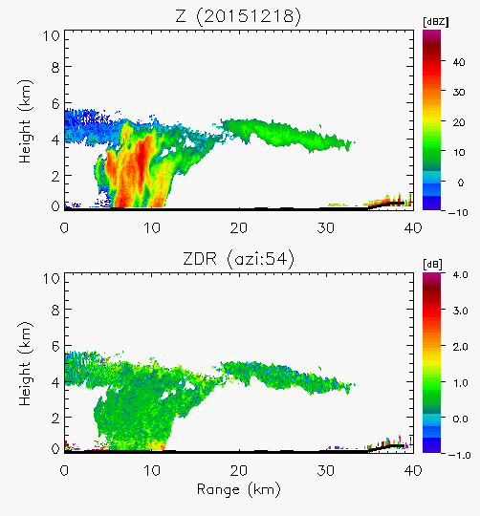
D3R (CSU)
Data Processing Details (available from DAAC)
Quick-look images (png)
netCDF4 files, one scan per file (converted to cfradial locally at UW by Stacy Brodzik)
Ground clutter will be present; request filtering if needed
Noise correction (power-based moments)
ZDR bias corrected daily (accurate within 0.2 dB)
Reflectivity calibration within 1 dB

Slide 5
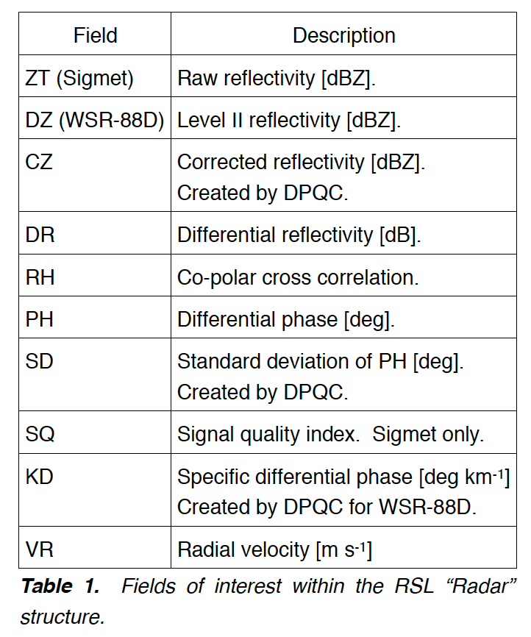
NPOL (NASA)
V1 (Jan 2016)
12 Nov 2015 – 19 Dec 2015; 03 - 05 Jan 2016
DPQC Quality Control algorithm (Pippitt et al. 2013, 2015)
Z, ZDR bias corrections (GPM DPR, 2DVD comparisons, birdbaths)
DROPS2 polarimetrically tuned and hybrid rain rate estimations
CSU HID
KDP (Wang and Chandra’s adaptive spectral technique)
DSD (D0, Dm, Nw, N2)
No blockage correction

Slide 6
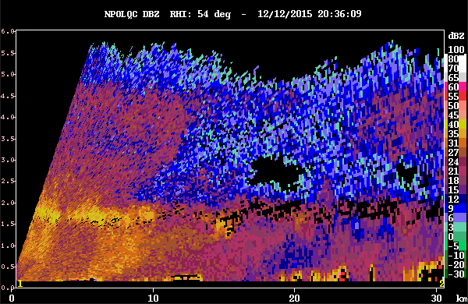
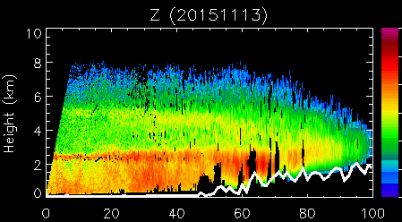
NPOL (NASA)
Issue with V1
RSL Plotting routine (masked holes) – used smaller fraction of beamwidth (1/6 instead of 1/2)
Too aggressive quality control

Slide 7
NPOL (NASA)
V2 (coming soon)
Maximum QC height set well below melting level (RUC sounding data not always reliable – manual inspection of RHIs)
Allowed for SD(PHIDP) thresholding without applying other QC thresholds (helpful for removing sea and mountain clutter)
Some clutter contamination remains (user can be more aggressive using var(PhiDP) method if desired)
Waiting for decision on new DSD equations
To-do:
Compare with other HID/PID?

Slide 8
DOW (CSWR)
IOP | Begin | End
1 | 20151106-14Z | 20151106-19Z
2 | 20151107-04Z | 20151108-04Z
3 | 20151108-04Z | 20151109-12Z
4 | 20151111-00Z | 20151111-15Z
5 | 20151112-15Z | 20151113-22Z
6 | 20151114-15Z | 20151115-12Z
7 | 20151116-15Z | 20151118-04Z
8 | 20151118-21Z | 20151119-12Z
9 | 20151123-12Z | 20151124-20Z
10 | 20151130-18Z | 20151201-09Z
11 | 20151201-15Z | 20151202-09Z
12 | 20151202-21Z | 20151205-02Z
IOP | Begin | End
13 | 20151205-11Z | 20151206-15Z
14 | 20151208-06Z | 20151209-21Z
15 | 20151210-10Z | 20151211-12Z
16 | 20151212-12Z | 20151214-02Z
17 | 20151217-03Z | 20151219-06Z
18 | 20160104-14Z | 20160105-06Z
19 | 20160105-14Z | 20160105-23Z
20 | 20160106-08Z | 20160106-15Z
21 | 20160111-14Z | 20160112-06Z
22 | 20160112-14Z | 20160113-20Z
23 | 20160115-12Z | 20160115-22Z

Slide 9
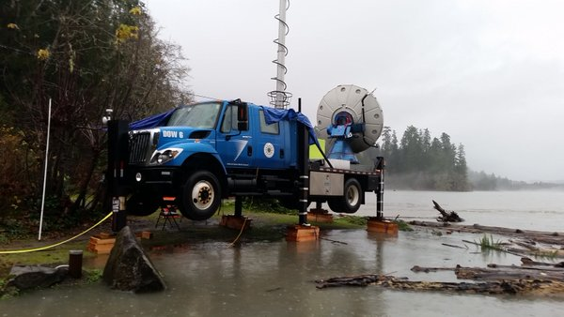
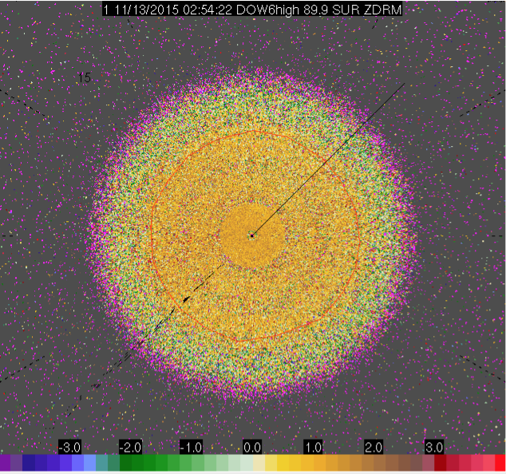
DOW (CSWR)
V1
Sweep/dorade files
Retranslate data with oversampled 0.25° beam indexing
Mitigate ground clutter (_F = filtered)
Compare high and low frequencies for consistency when available (no high after 11/23)
Correct navigation in headers (accounted for slight shift ~0.5° when truck lifted)
ZDR bias correction

Slide 10
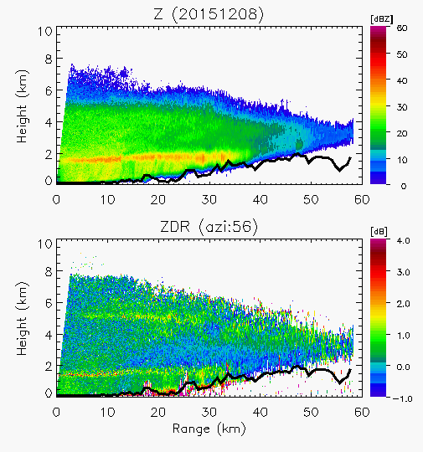
DOW (CSWR)
ZDR bias
Quasi-vertical scan every 10 minutes
Apply offset when departs from 0.2-dB tolerated error
ZDR: First guess offset in field (not great; don’t use)
ZDRM: Measured with no offset
ZDRC: ZDRM+offset
Lower confidence for low dBm (less reliable at far range and cloud top)
README/Spreadsheets for each IOP detailing exact ZDR offsets
ZDRC

Slide 11
DOW (CSWR)
V2
Corrected issues with transition sweeps, split/extra sweeps in middle of volume, under/overshooting antenna,… (retranslate data)
All IOPs locally (UW) downloaded and converted to CFRADIAL
Remaining clutter, differential attenuation
To Do:
Finish downloading/converting data
Upload CFRADIAL V2 to DAAC
HID/PID: Which one?
ZDRC

