Slide 1
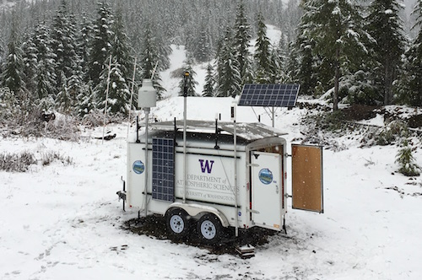
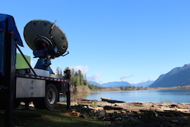
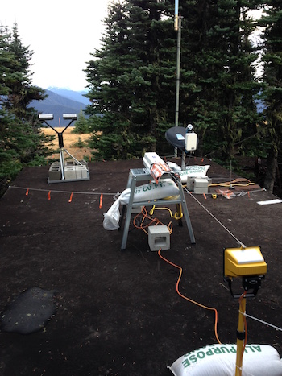
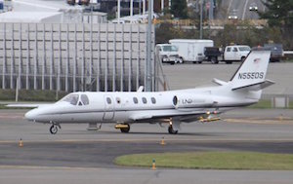
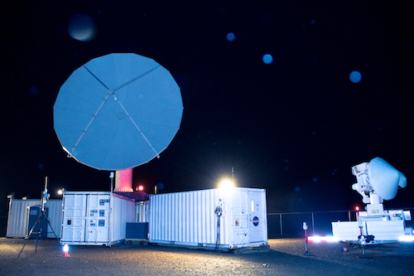

OLYMPEX – A Success Story
L. McMurdie, R. Houze, W. Petersen, M. Schwaller, & many others
PMM Houston, Oral Session, 25 October 2016

Slide 2
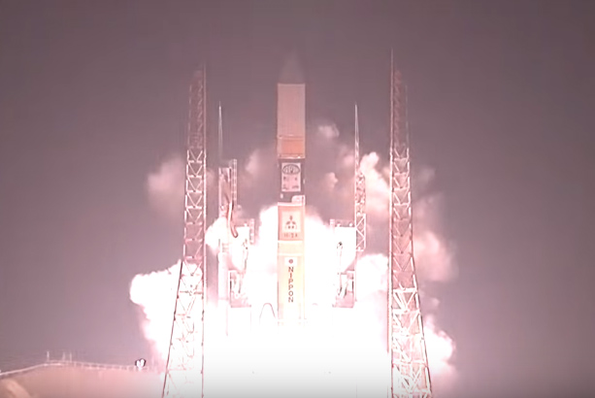
GPM over OLYMPEX

Slide 3
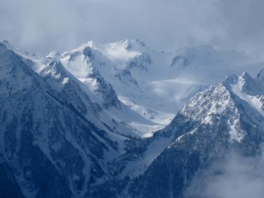
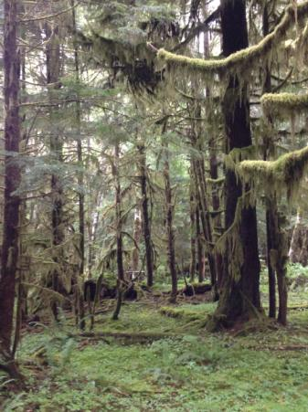
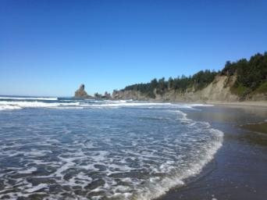
The Olympic Peninsula
High Terrain
Valley
Rain Forest
Ocean

Slide 4
Goals of OLYMPEX
Validate satellite radar and passive microwave instruments
Determine the orographic effects on precipitation processes

Slide 5
Goals of Presentation: Convey
Magnitude of experiment
Heroic Efforts
Most technologically advanced field program measuring precipitation to date
Robust sampling of midlatitude storms

Slide 6
Magnitude of Operations

Slide 7
The OLYMPEX Strategy
Aircraft
ER2 & DC8—over the top
Citation—through the clouds
Surface
Particle sizes and fallspeeds
Rain and snow amounts
Snow cameras
Upper air
Supplemental soundings in events
Windward and leeside stations
Radars for 3D structure
RHI sectors at 4 different wavelengths
Dual polarization
Doppler

Slide 8
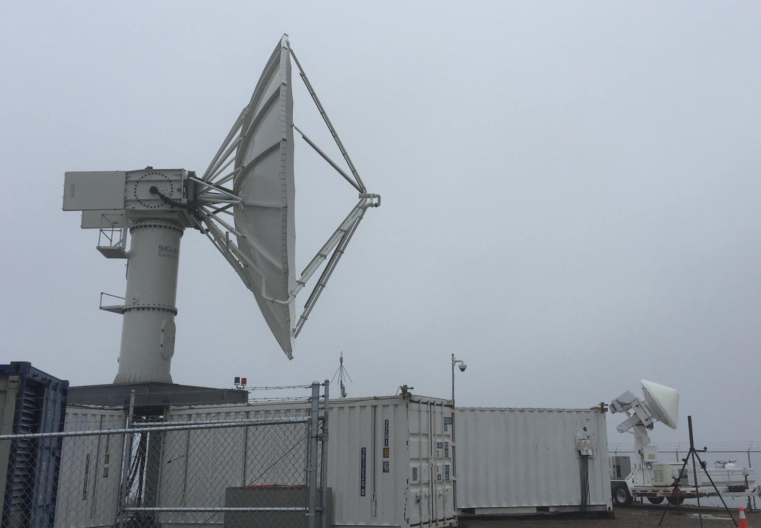
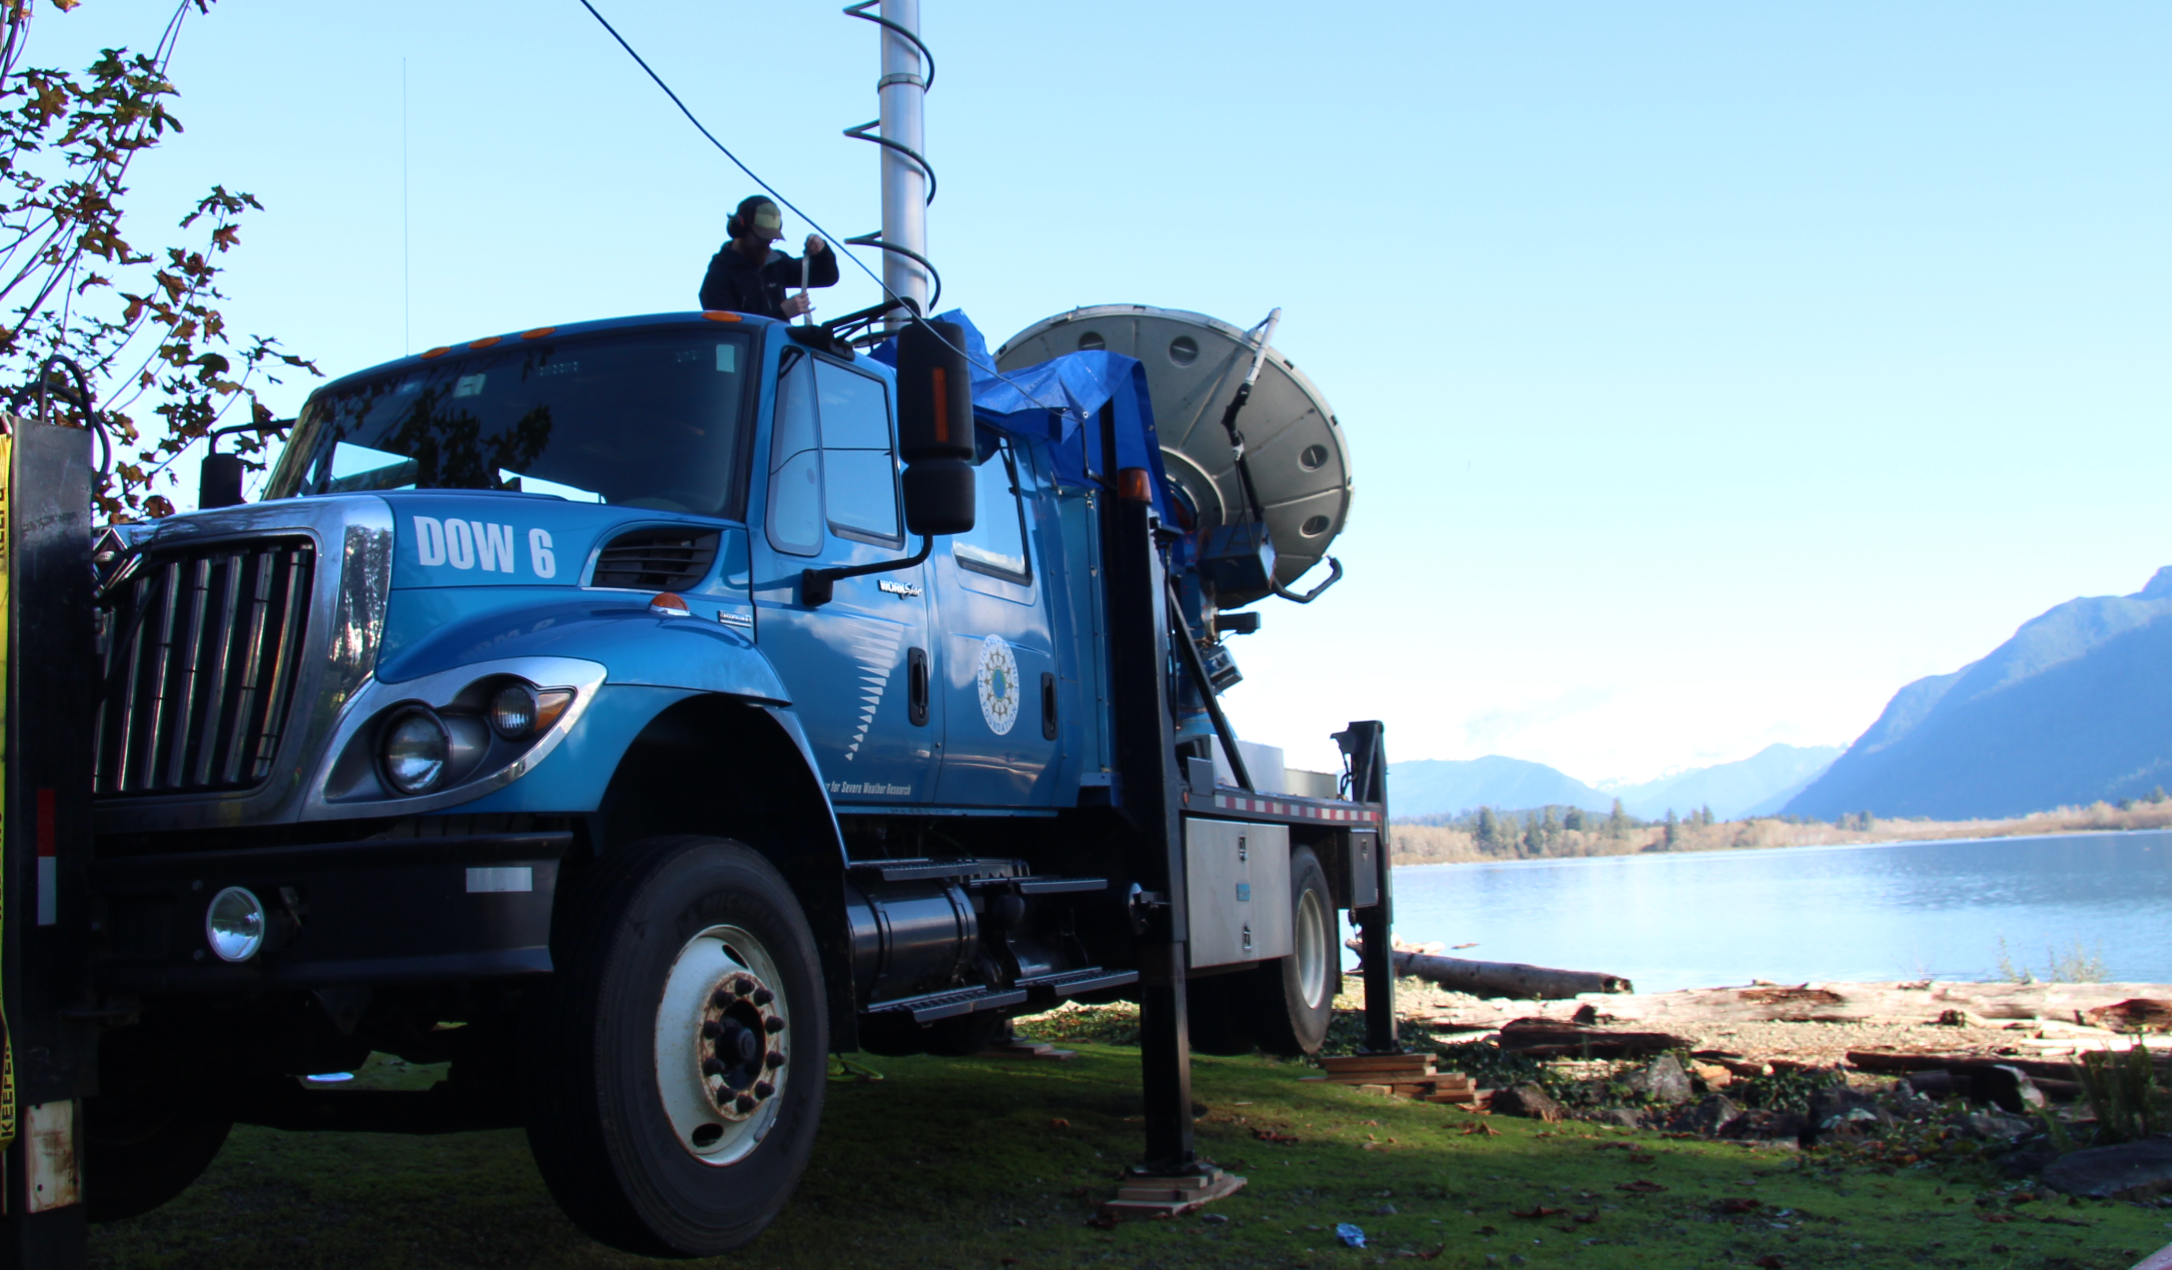
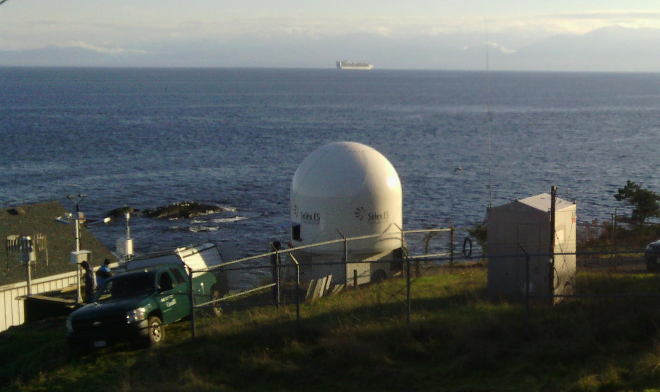
Radar RHI sectors
NPOL
D3R
DOW
EC-Xband

Slide 9
Ground Sites

Slide 10
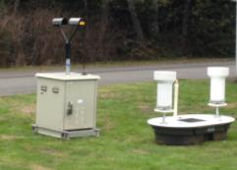
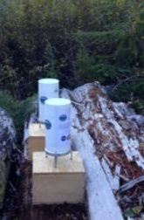

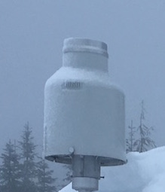
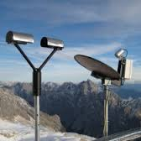
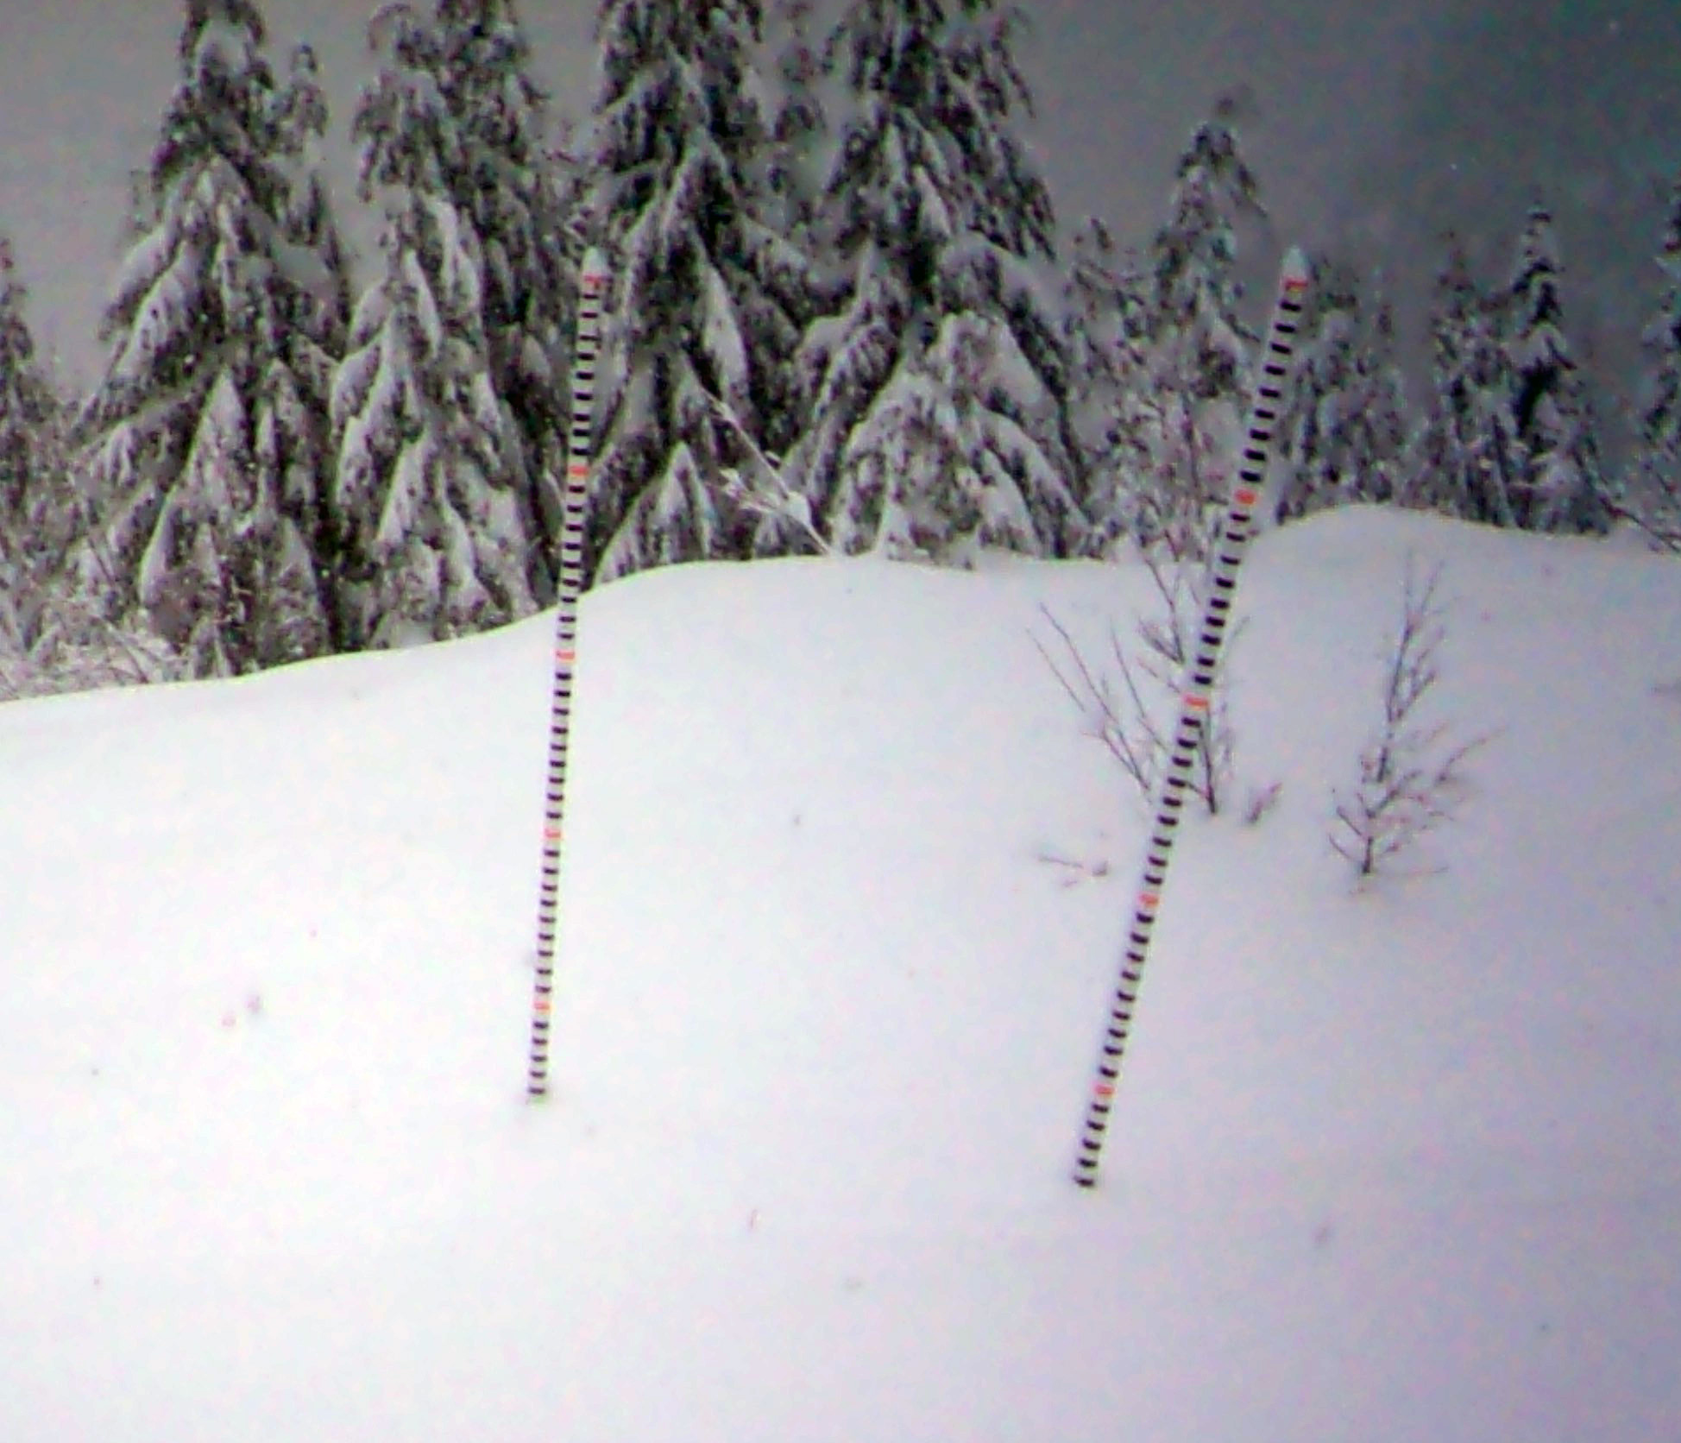
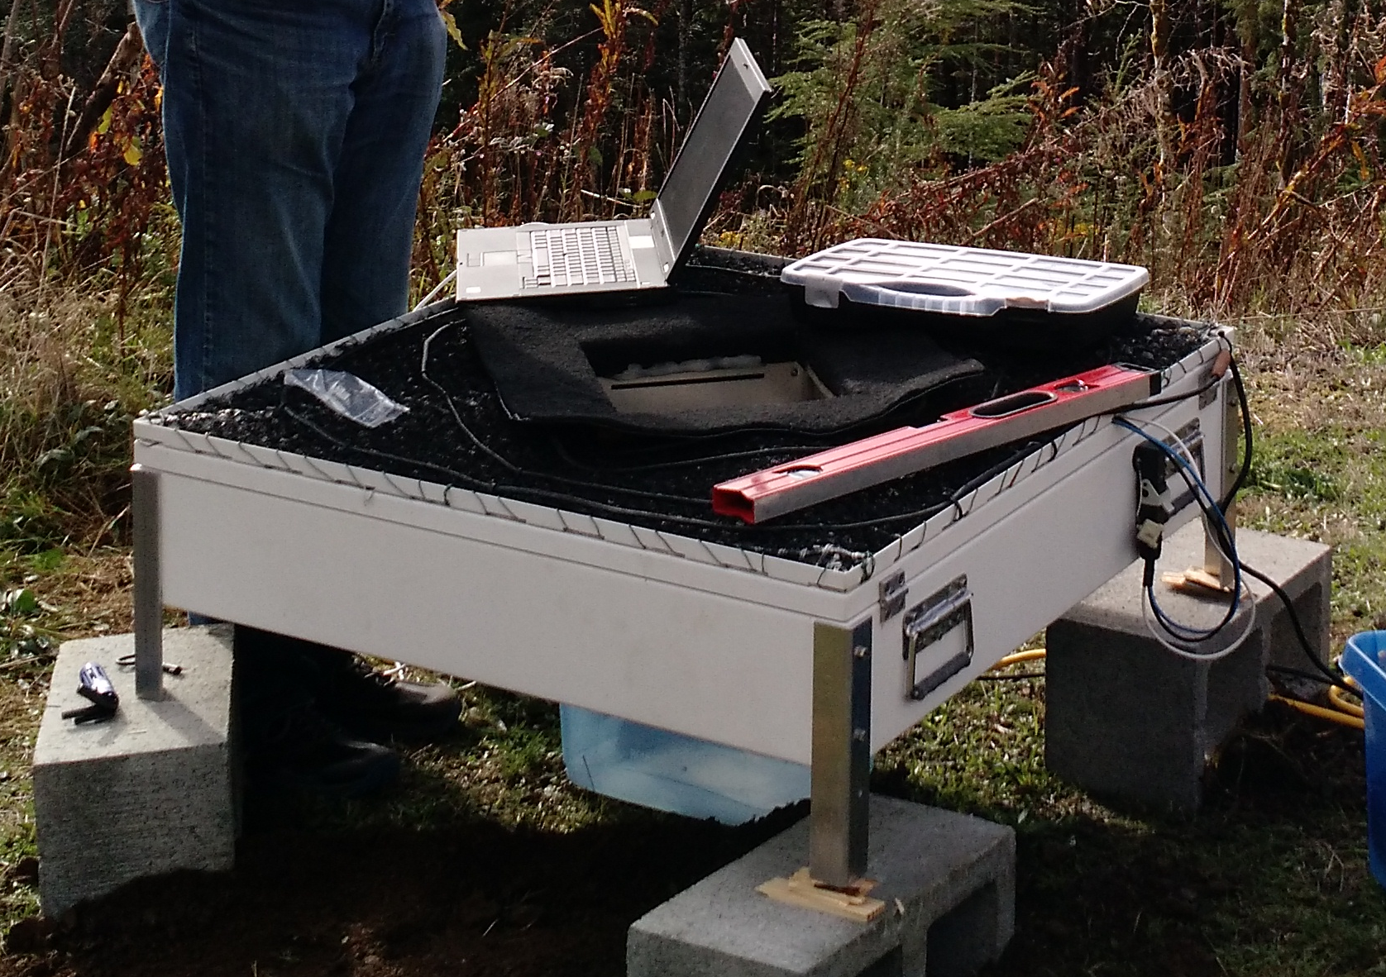
Elevation 5000 feet
Ground Instruments
Tipping Buckets
PIP
Tipping Bucket
Pluvio
Parsivel
Parsivel
Snow Poles and Cameras
2DVD
Micro Rain Radar

Slide 11
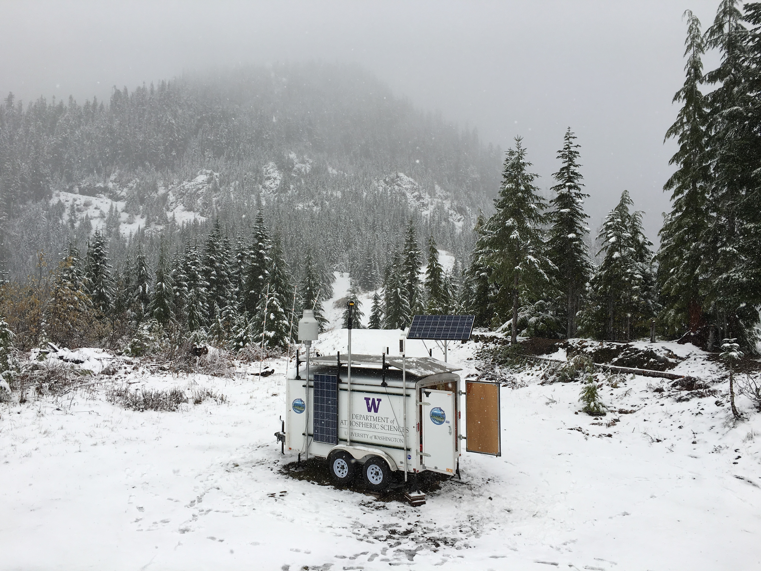
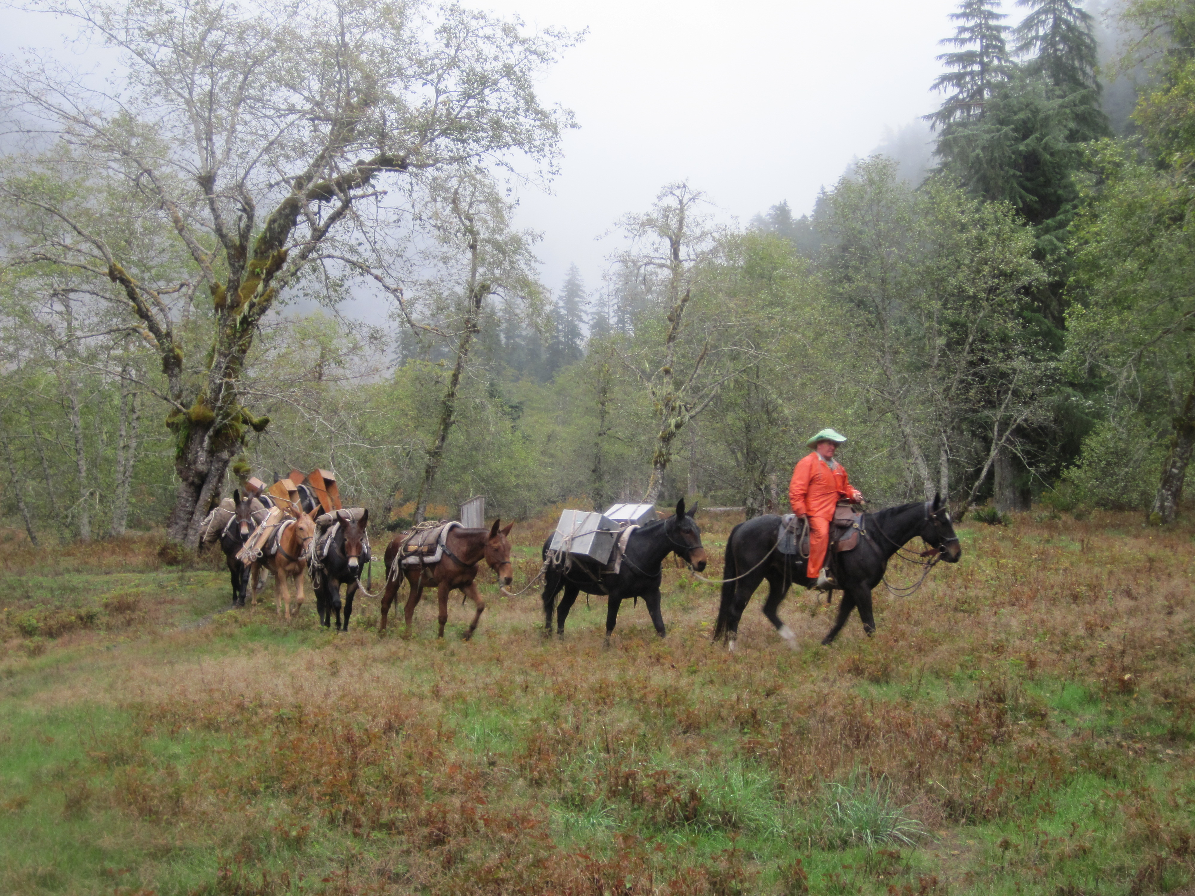
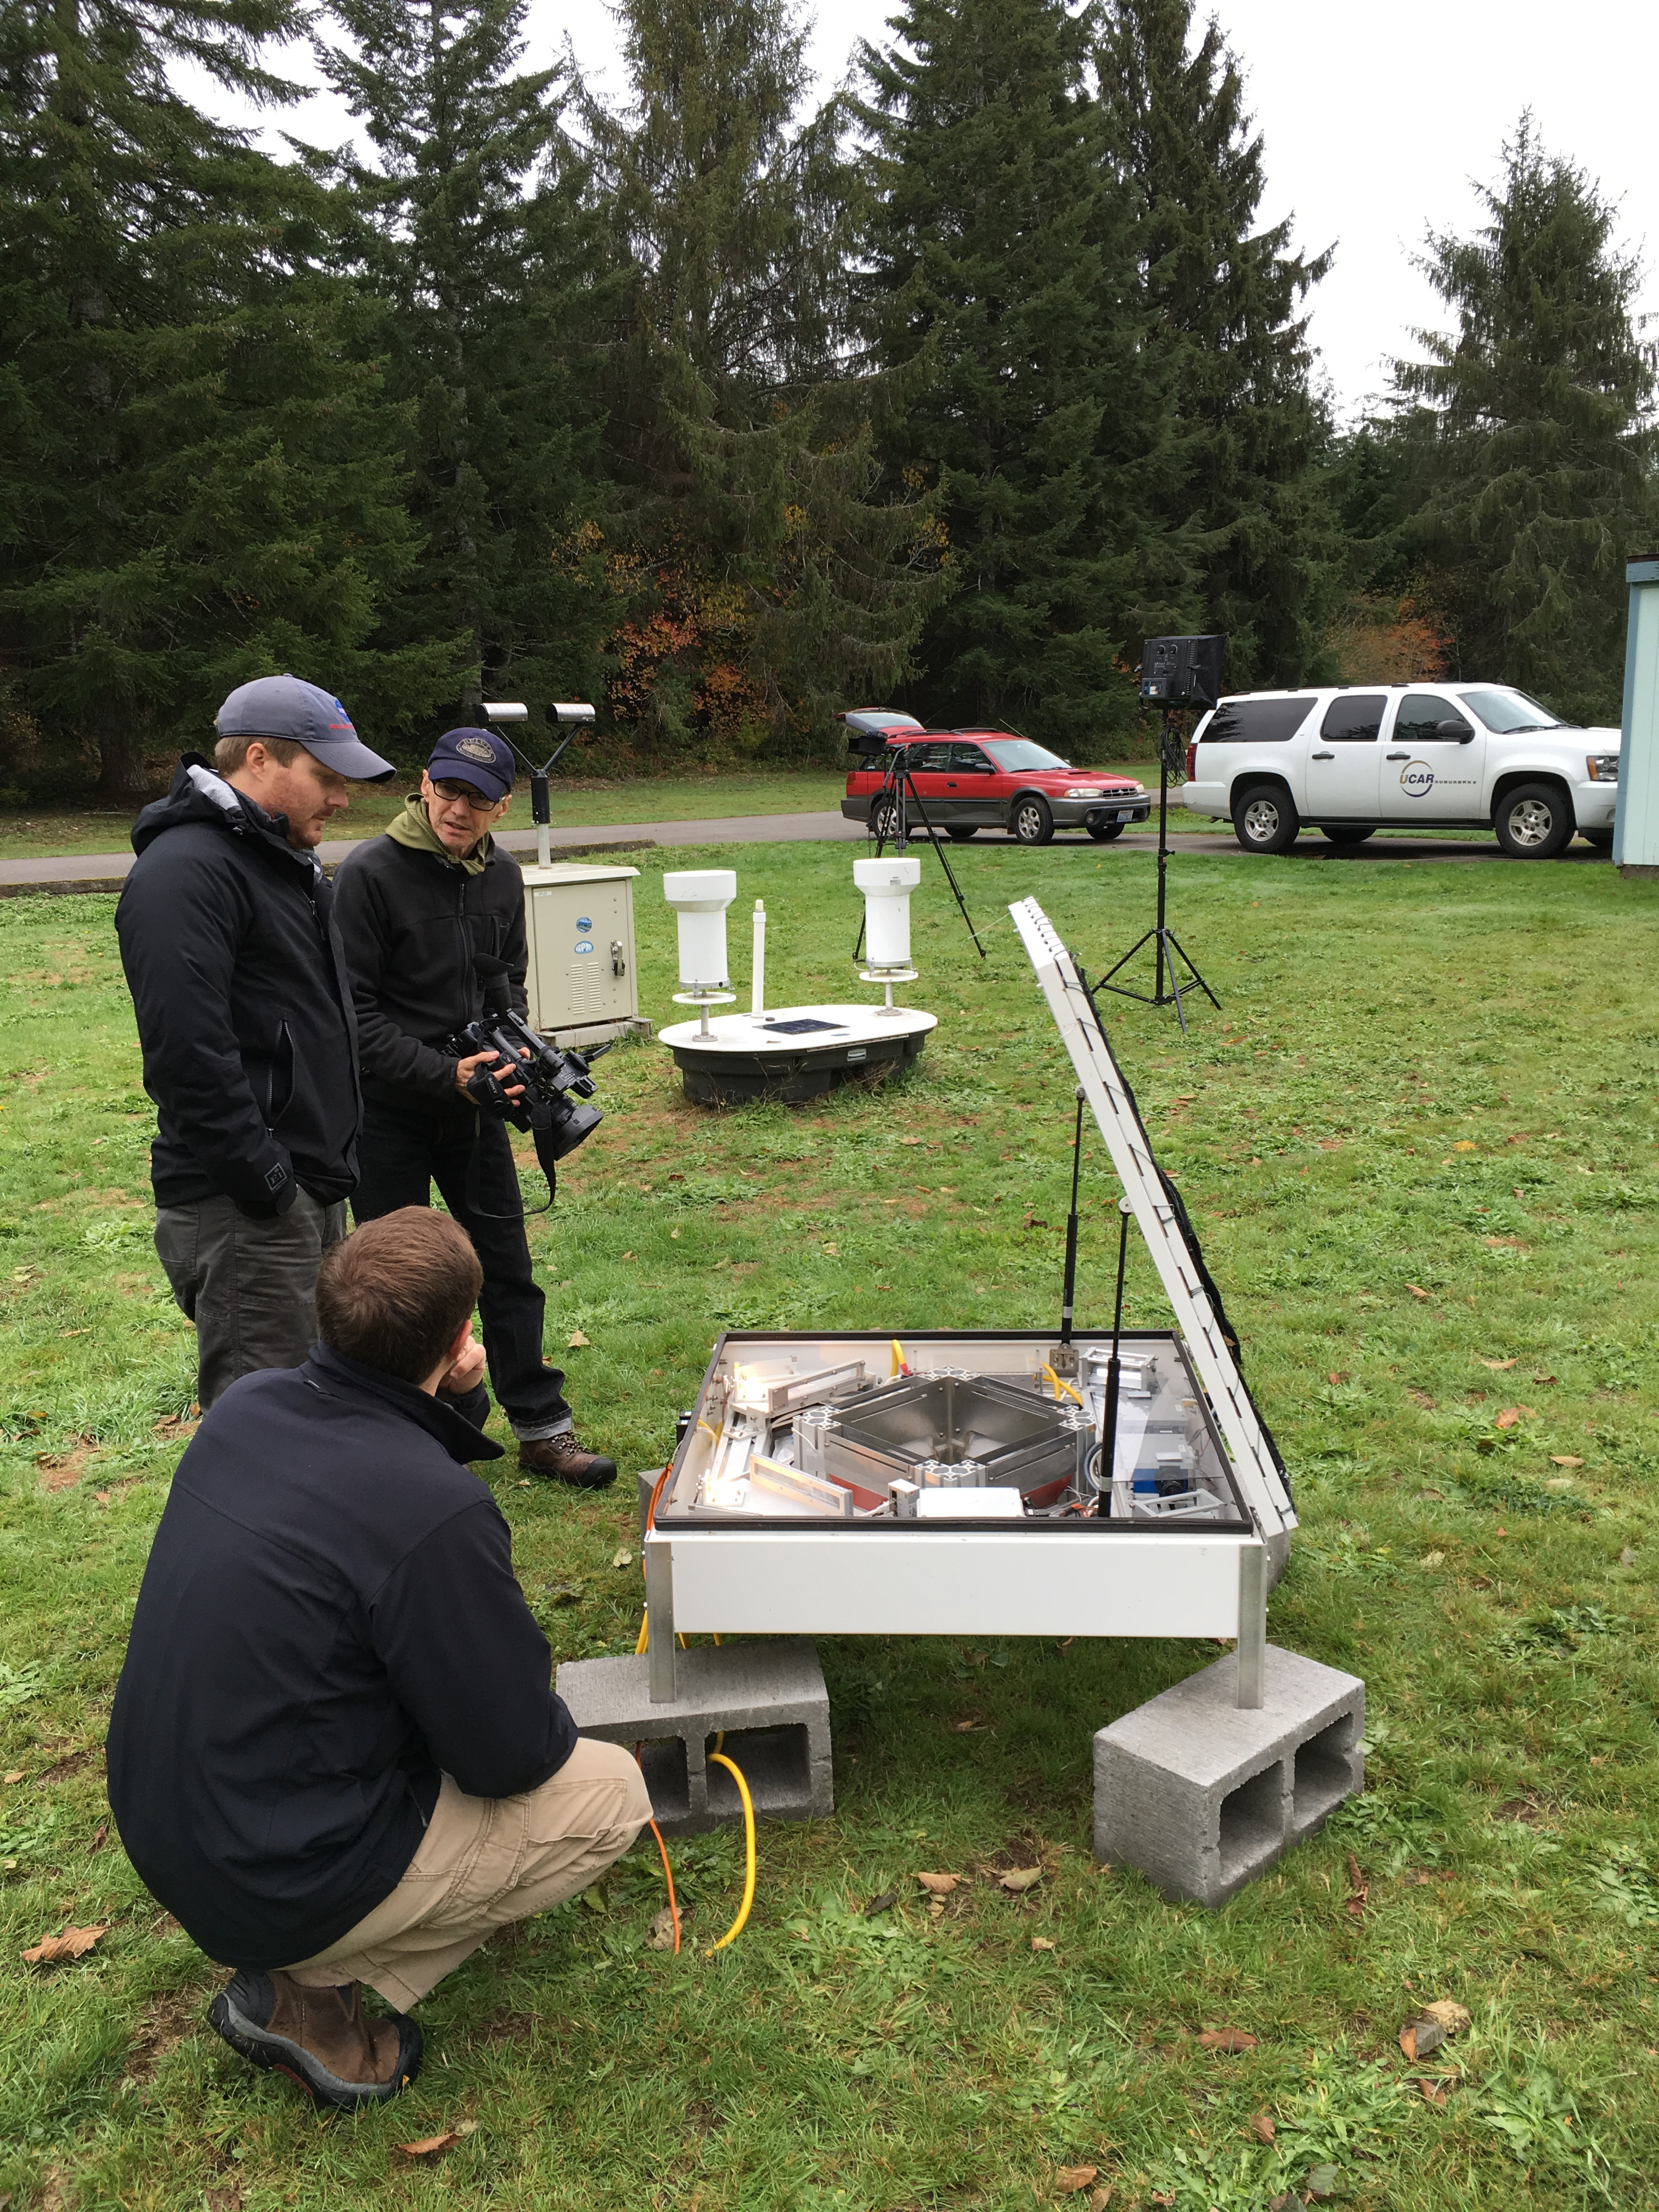
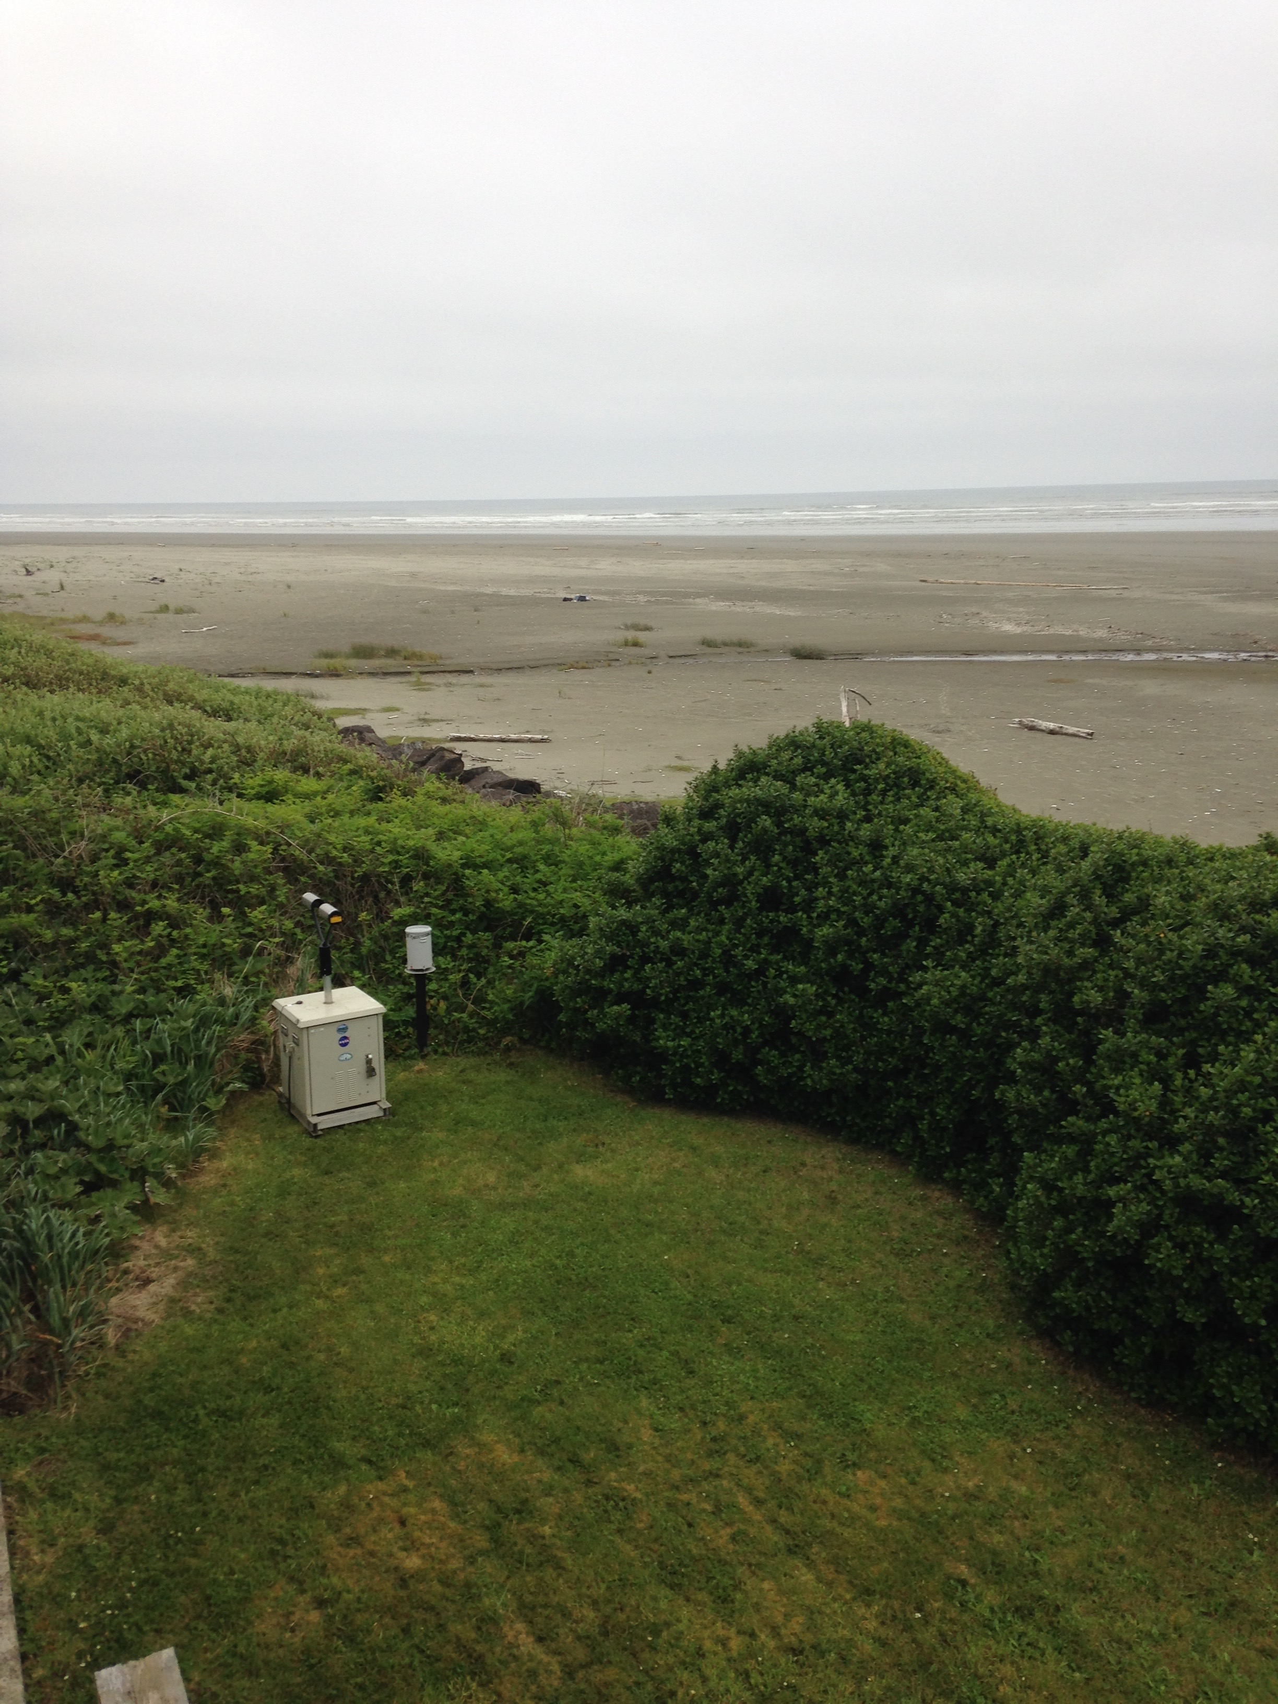
Ground Instruments
3000 feet
To the Upper Quinault
Lower valley
On the beach

Slide 12
Timeline of Operations
Snow Measurements
Aircraft
Soundings
Soundings
EC X-band Operations
NPOL and DOW Operations
NPOL,DOW
Testing
Ground sites collecting data – Raingauges and Parsivel and MRR’s
Dec 2015
April 2016
Oct 2014
Spring 2015
Oct 2015
Nov 2015
Jan 2016
Feb 2016
Intensive operations – all platforms
Ground, radar and soundings only

Slide 13
Heroic Efforts

Slide 14
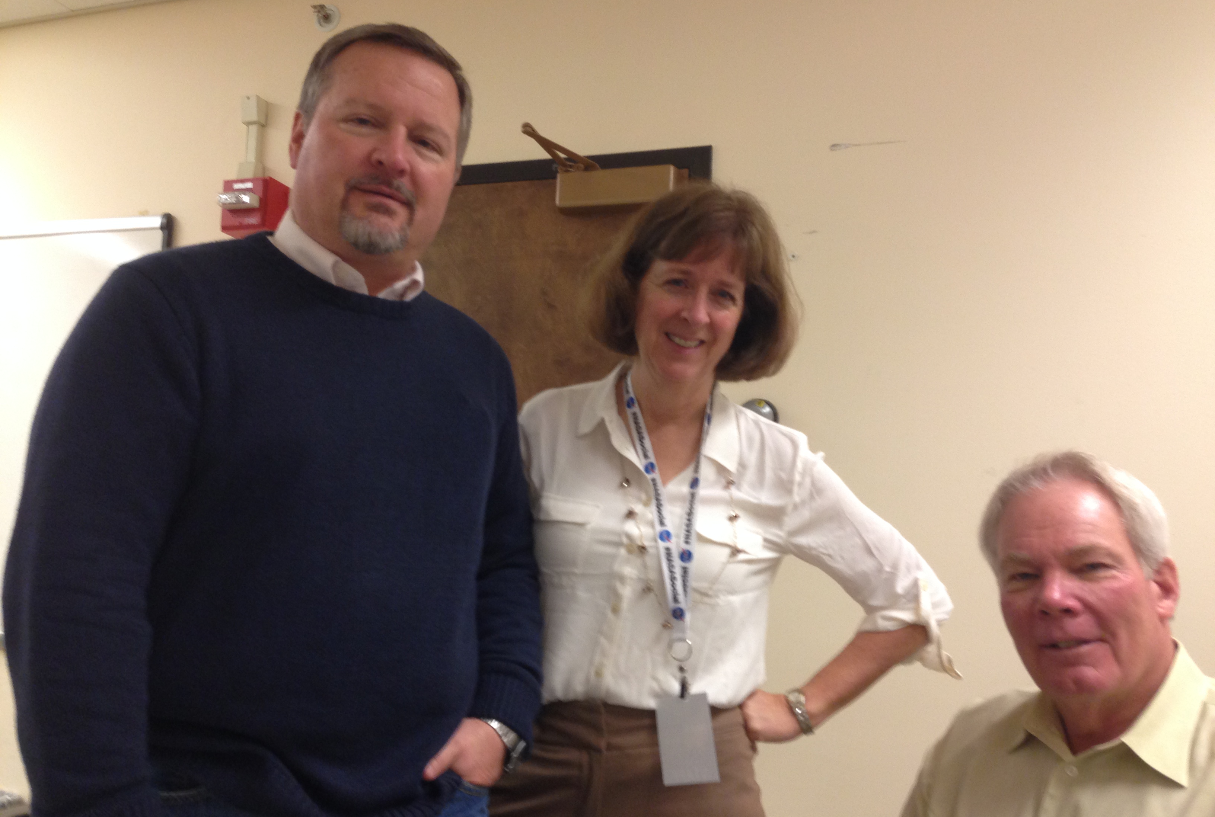
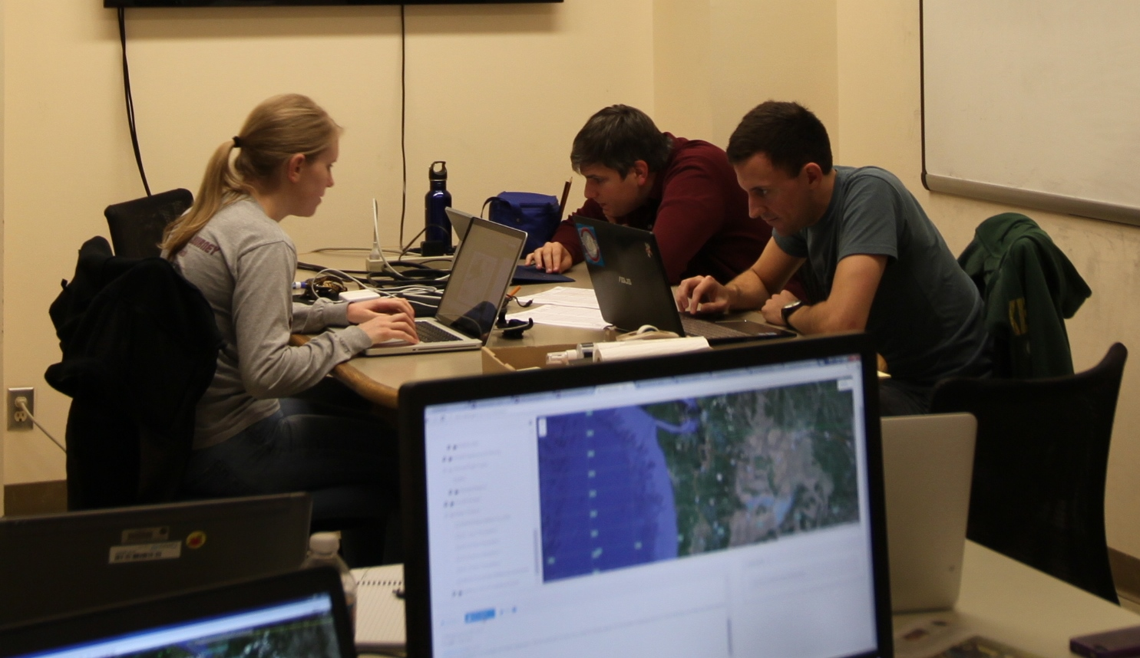
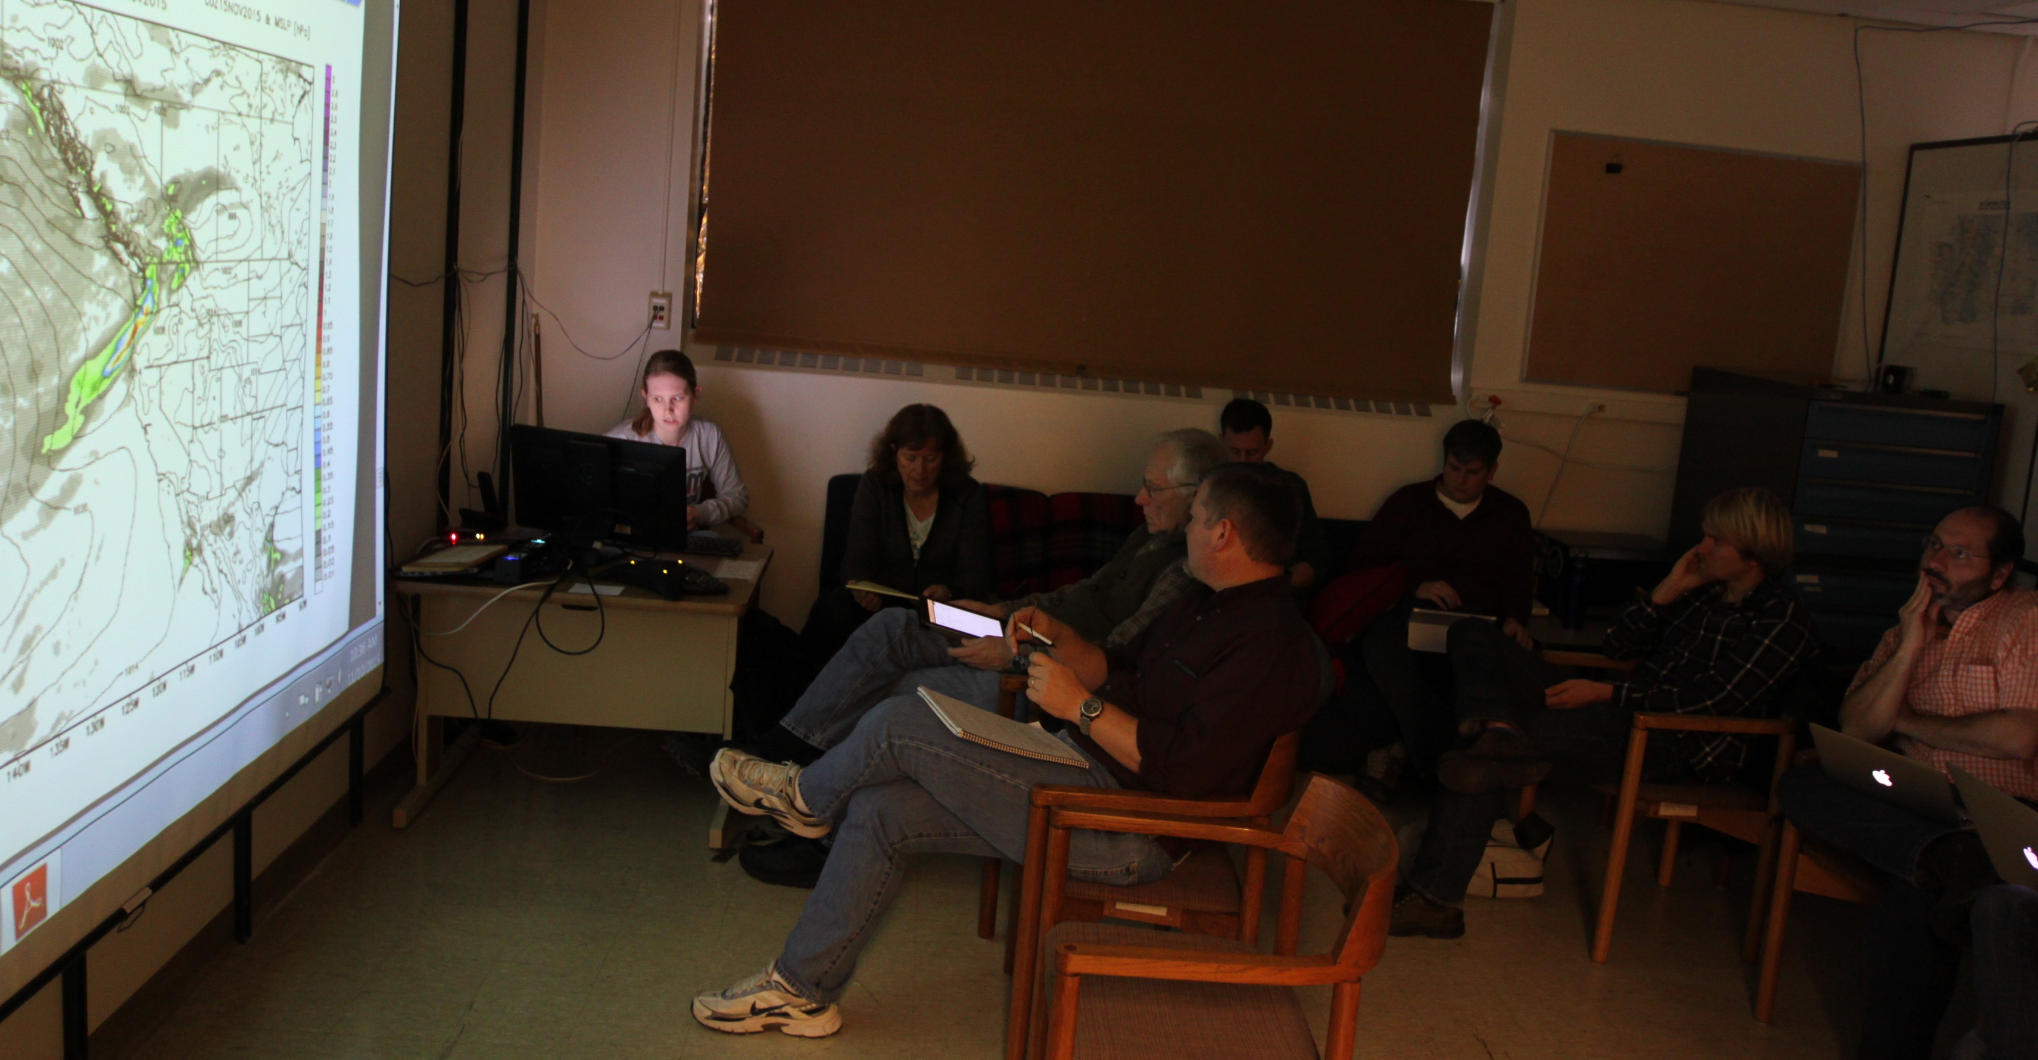
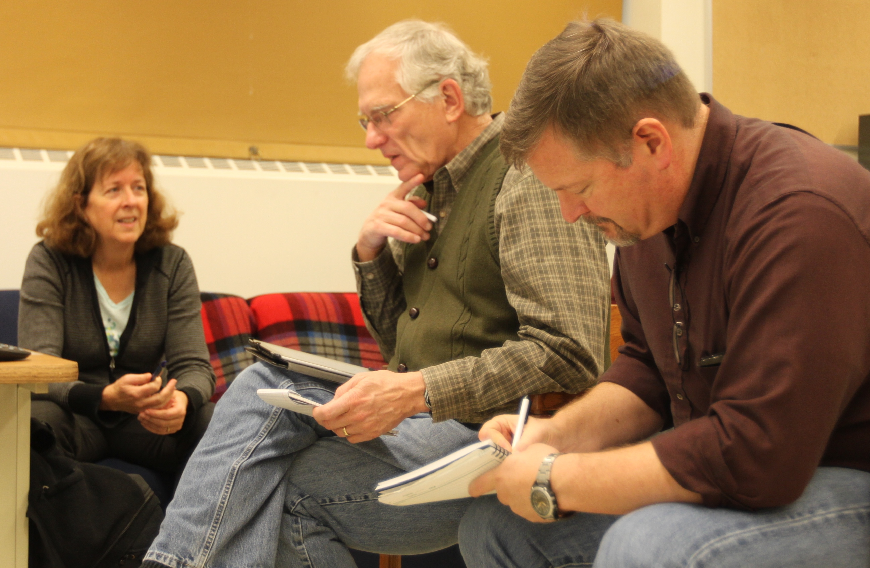
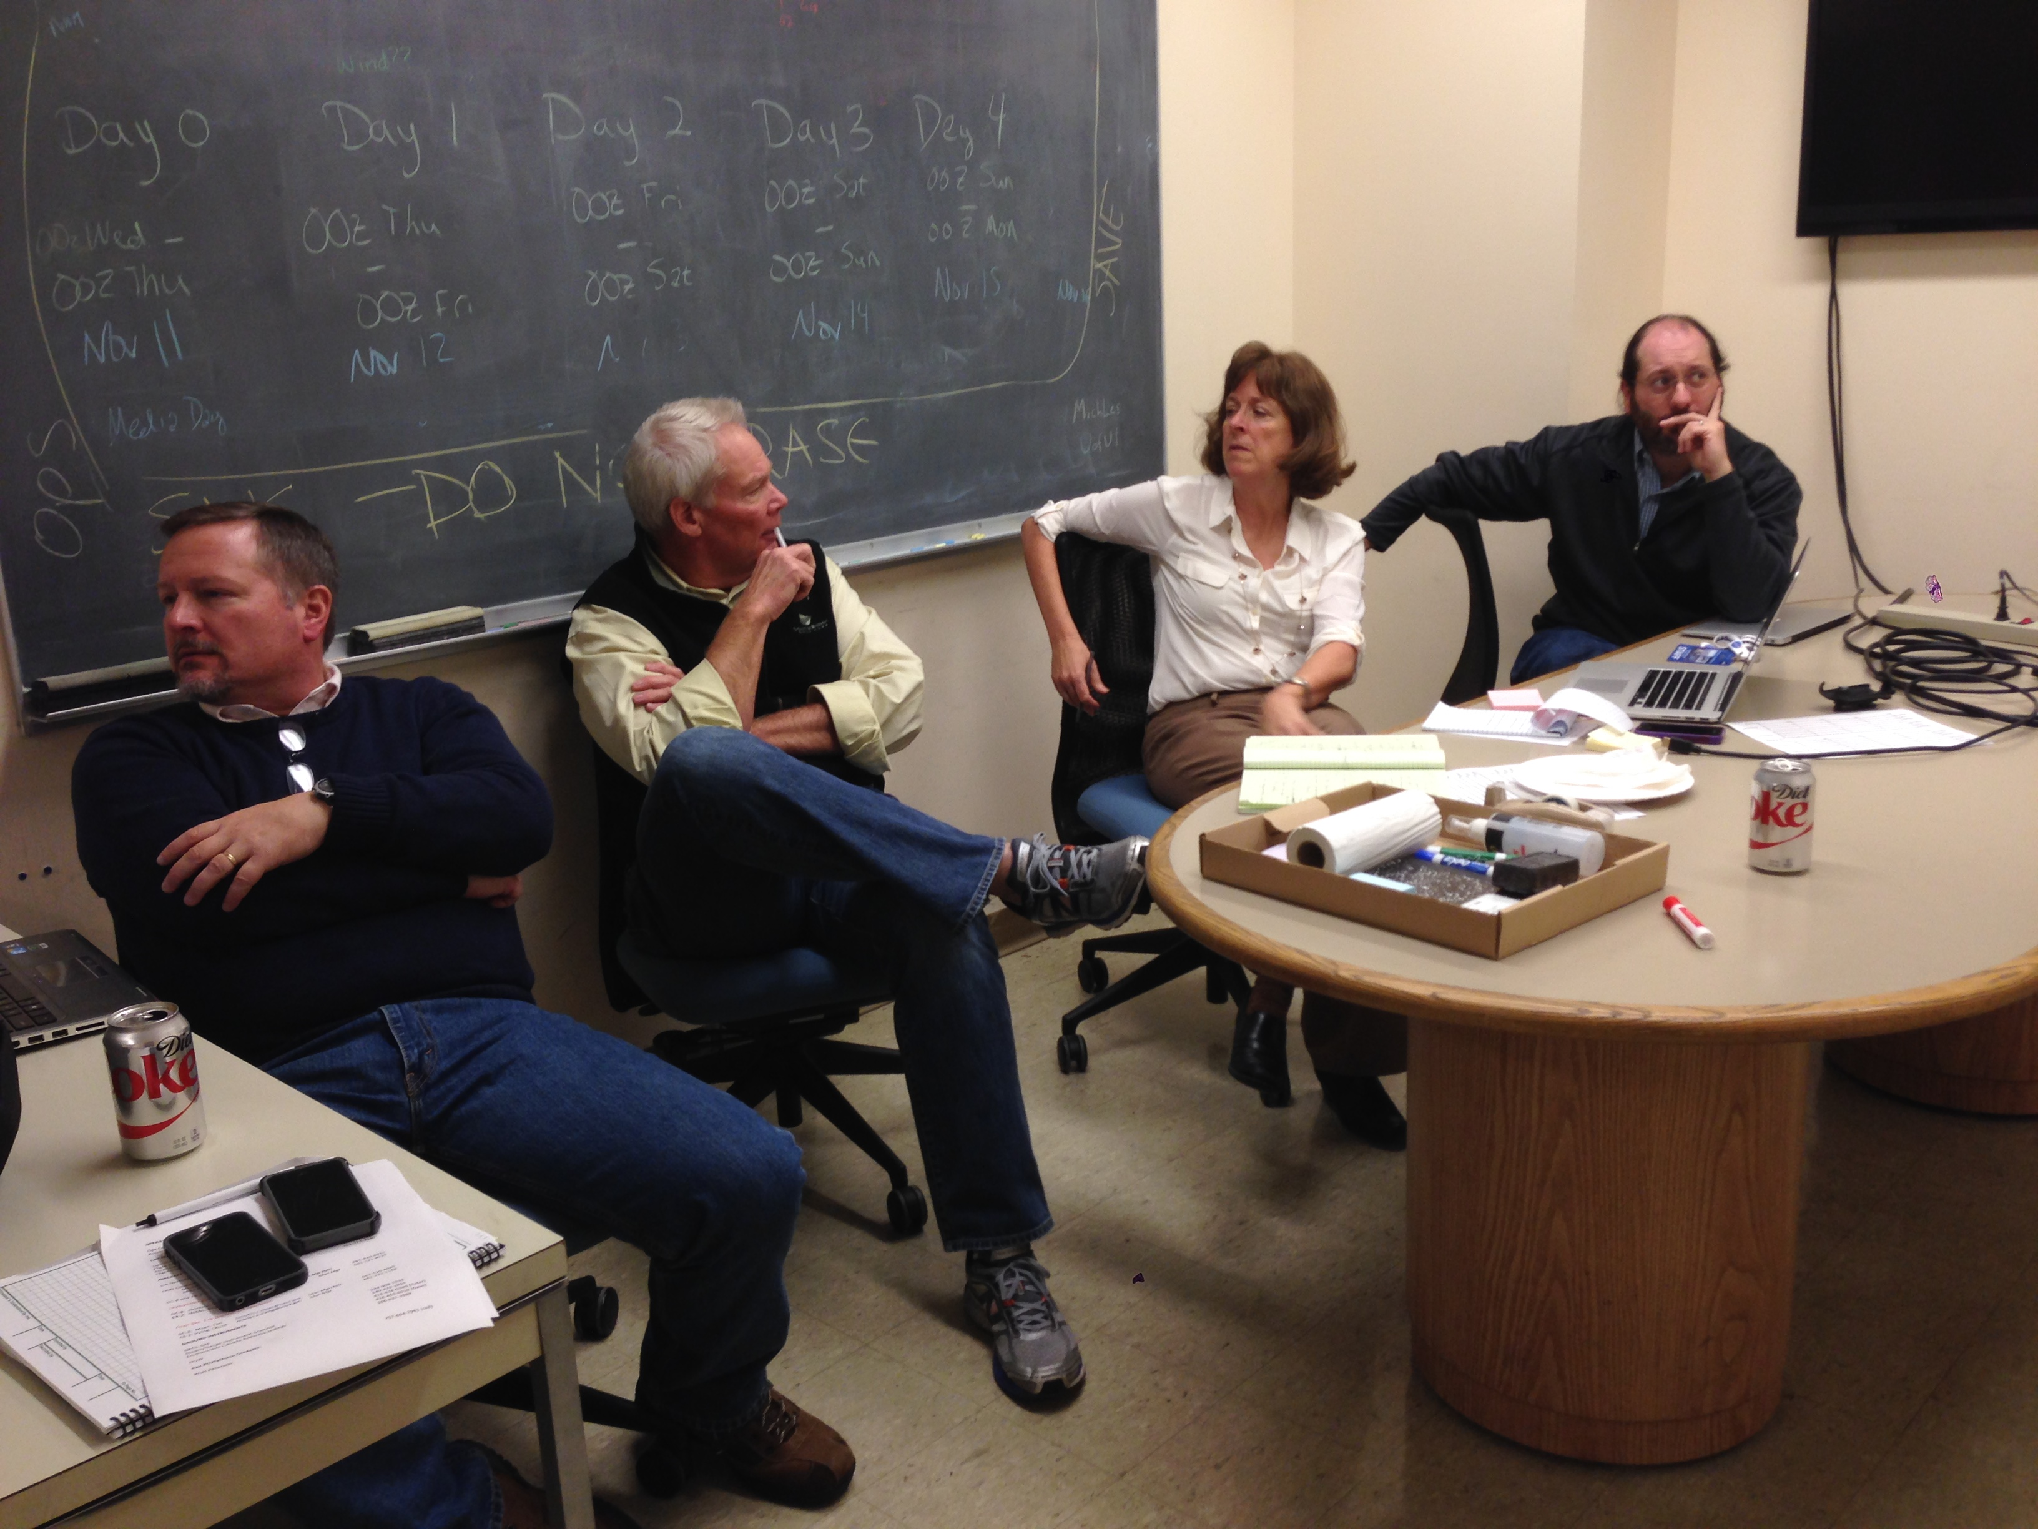
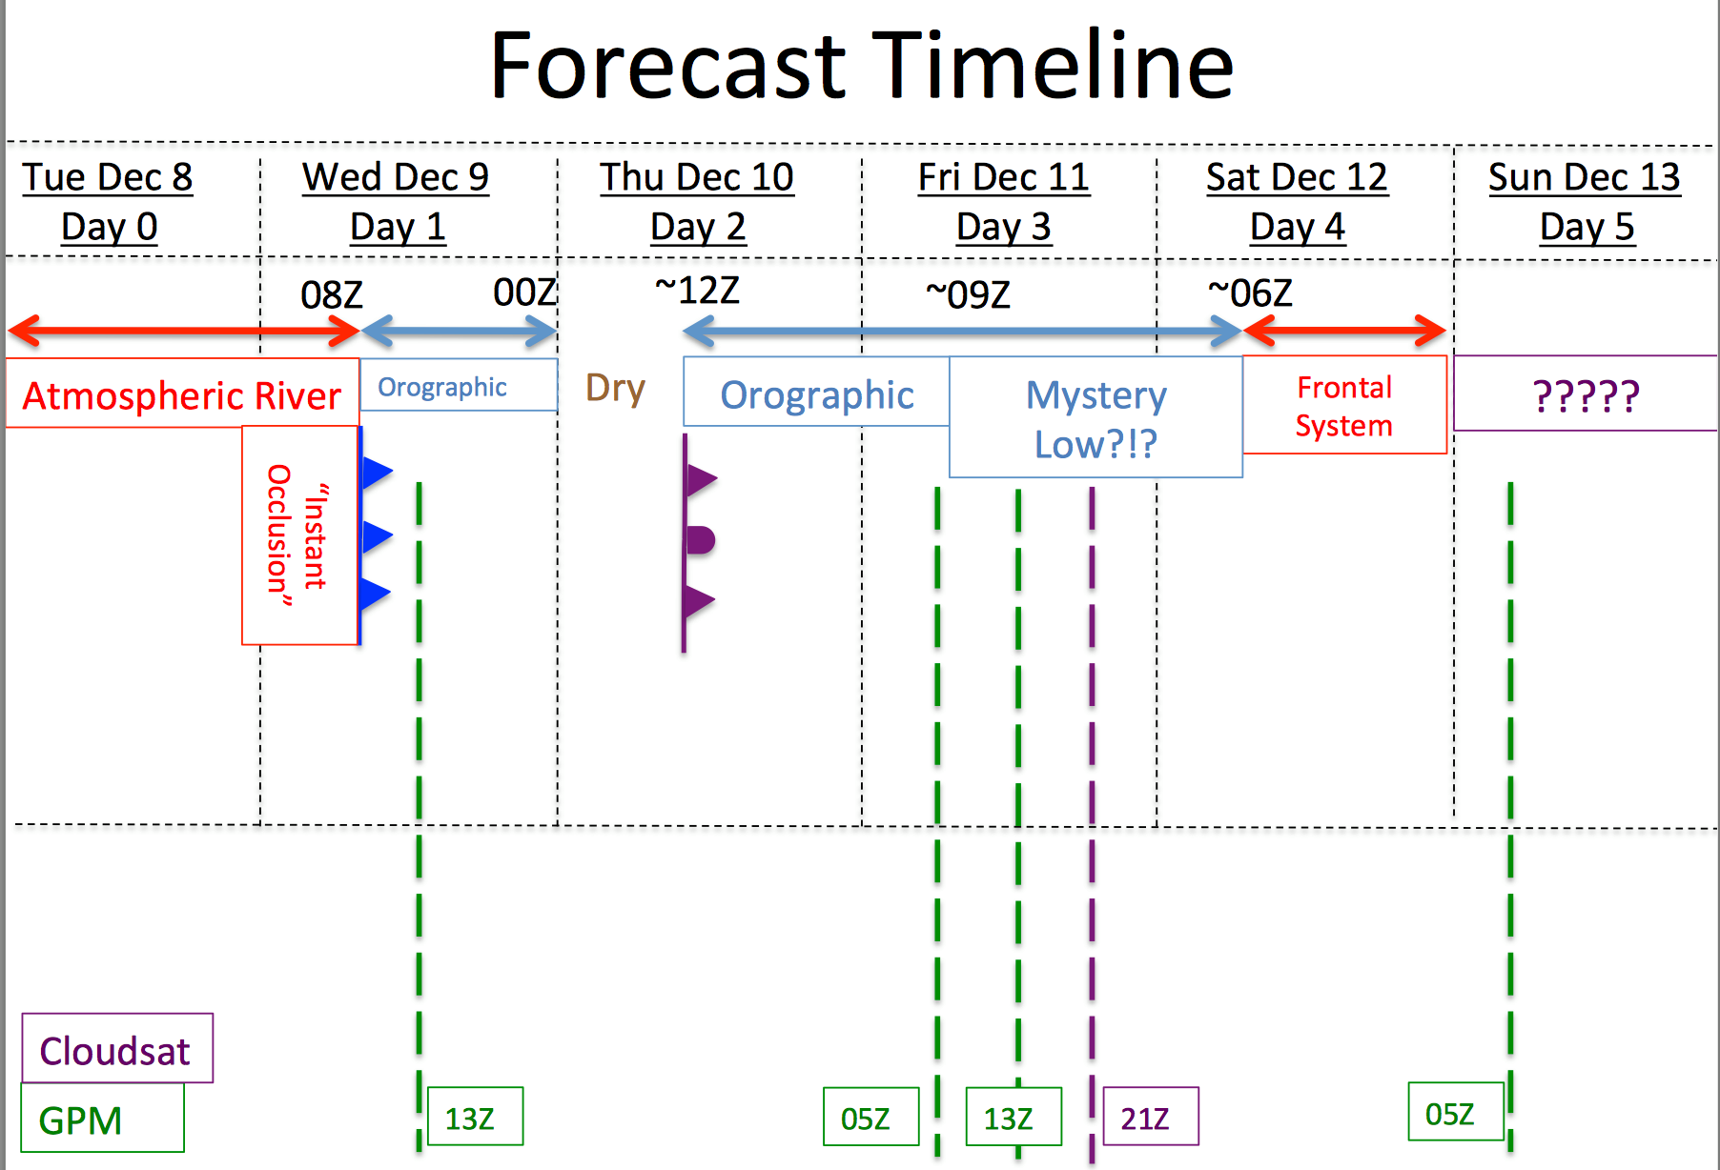
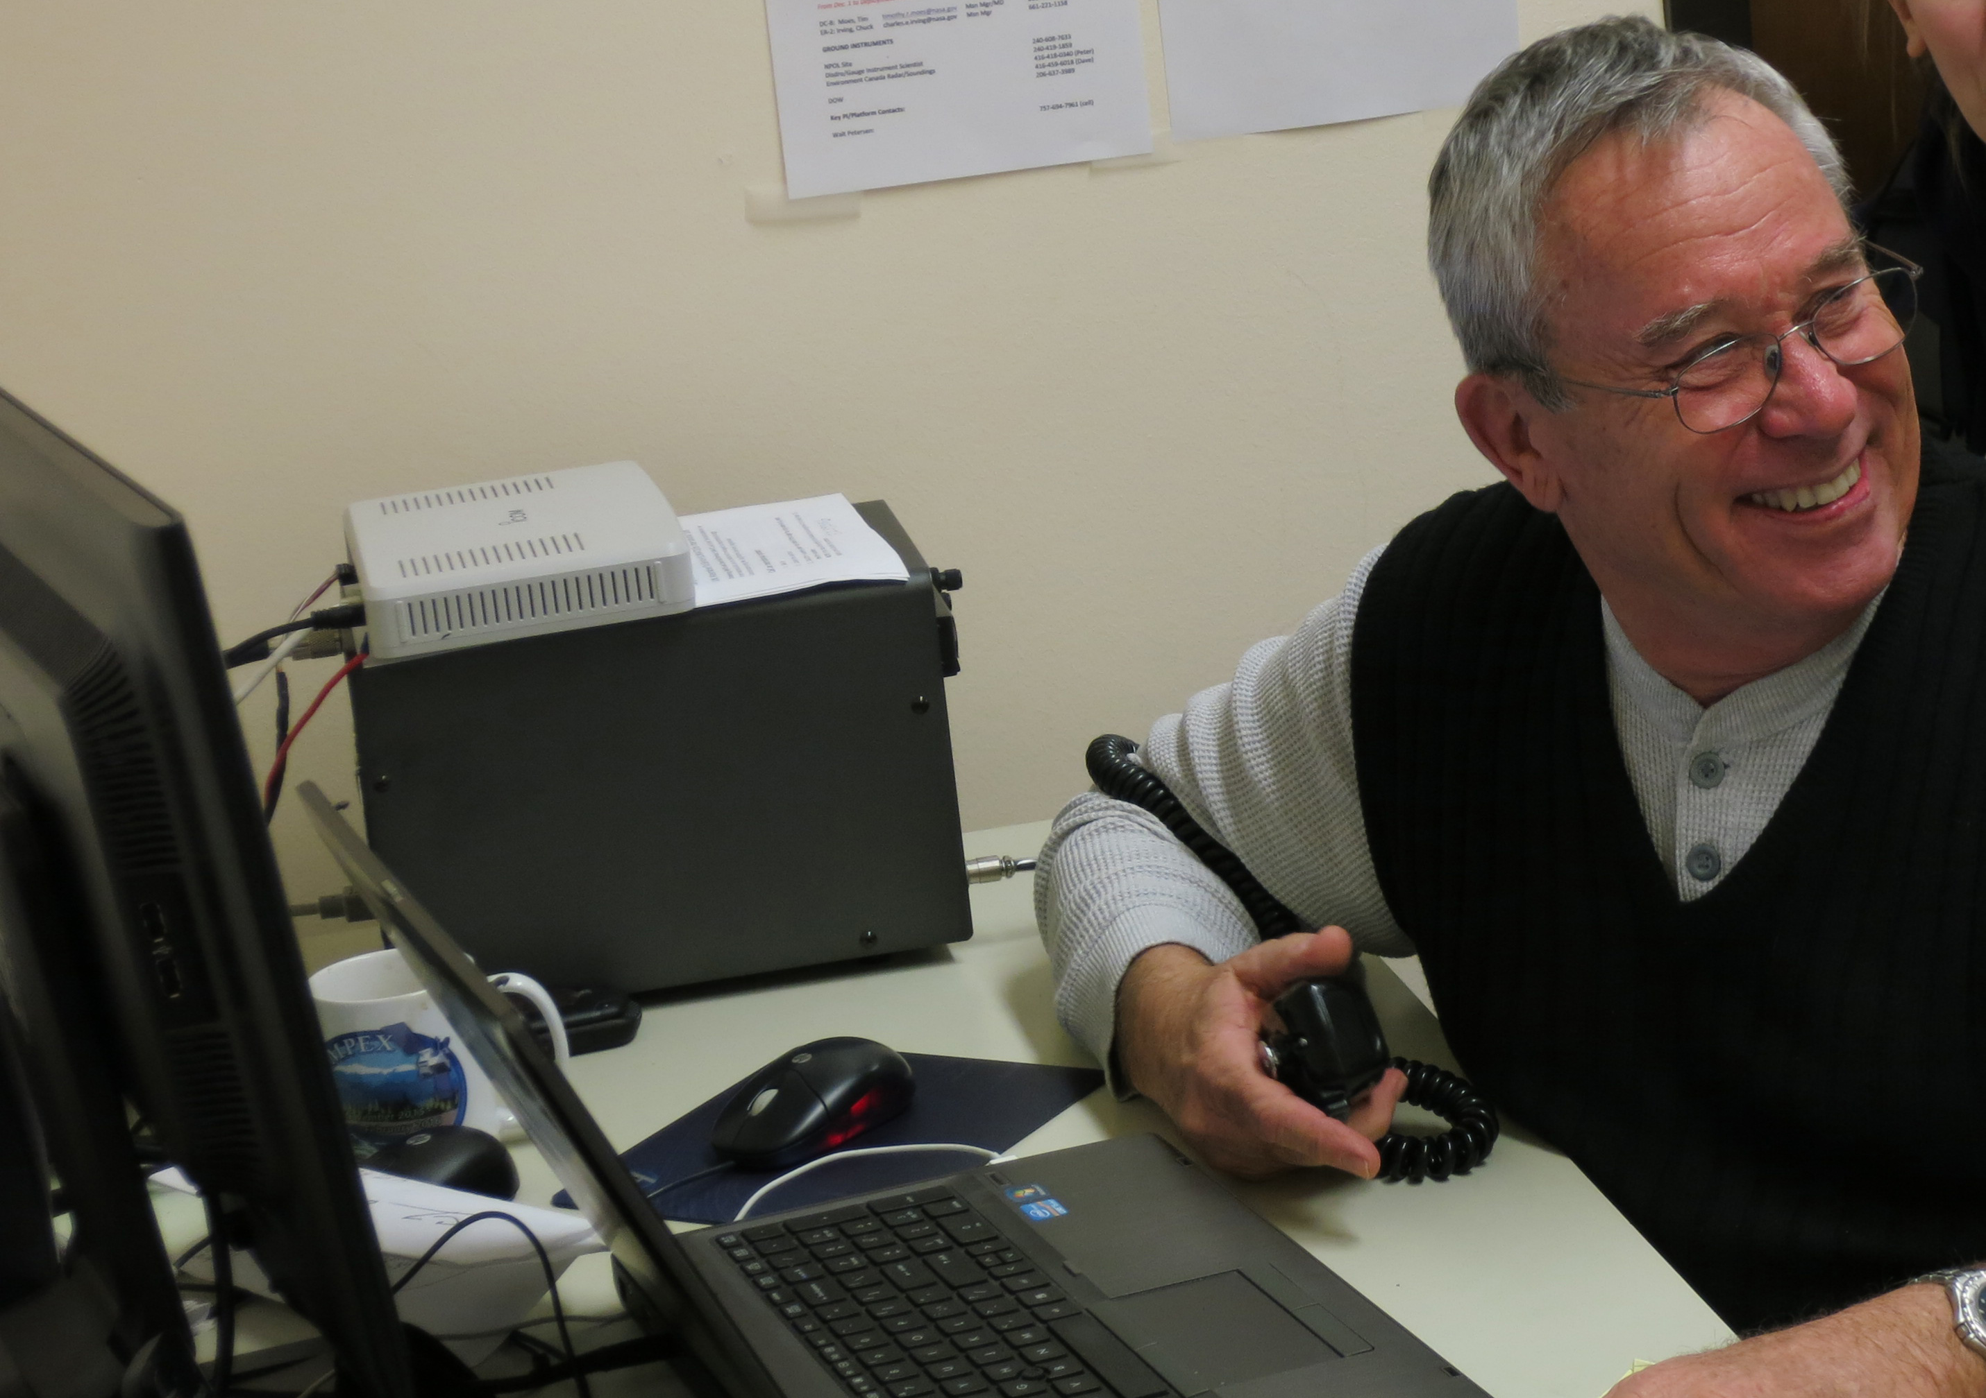
Operations Center at the UW
Forecasters
Jan Nystrom – Flight Coordinator

Slide 15
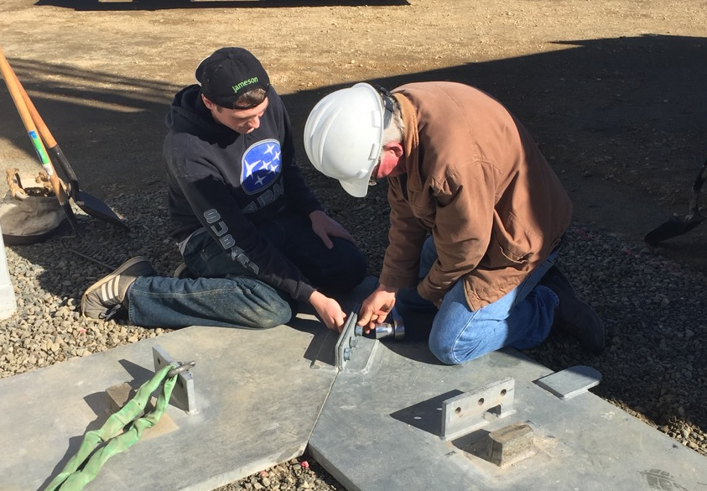
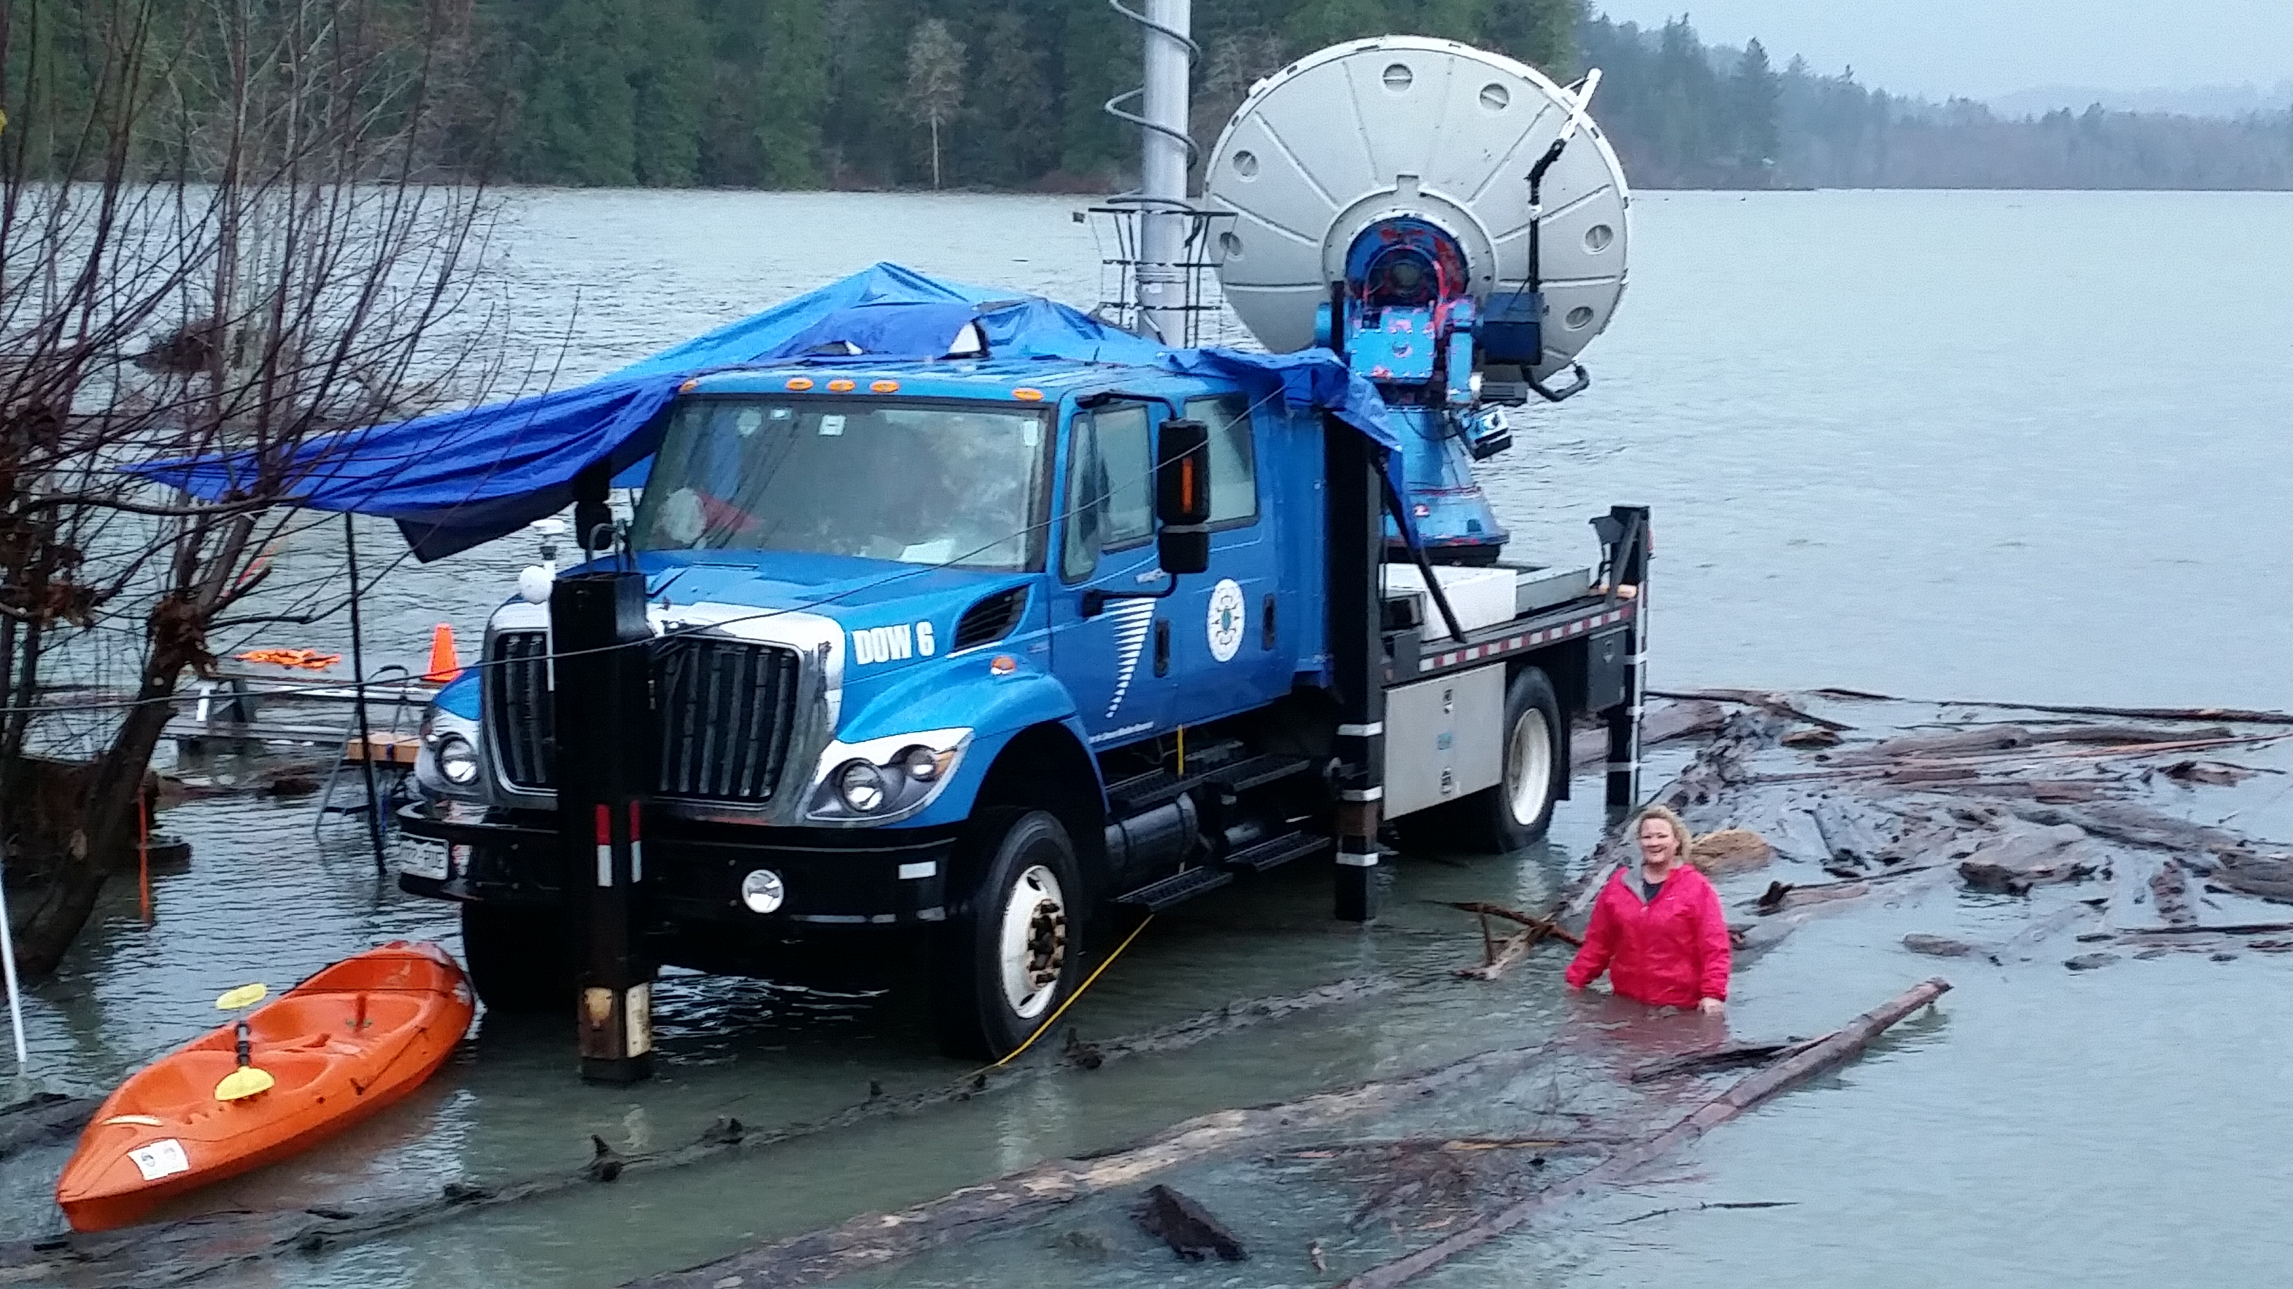
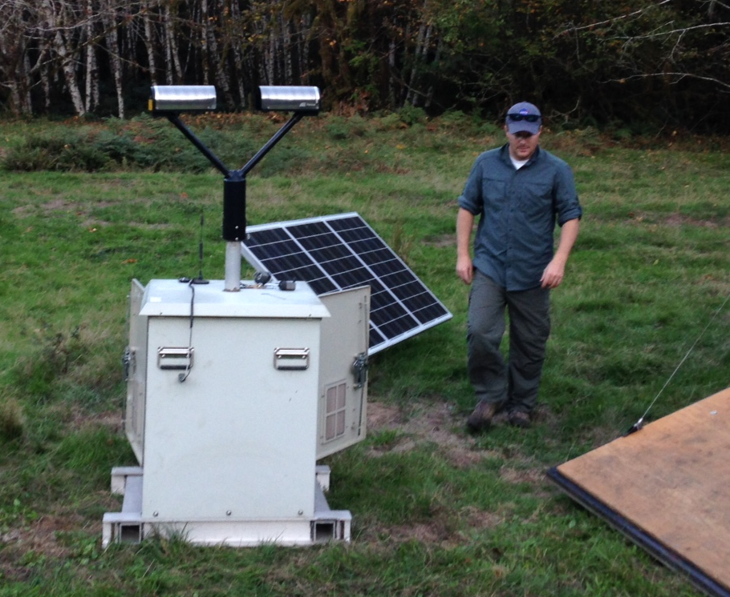
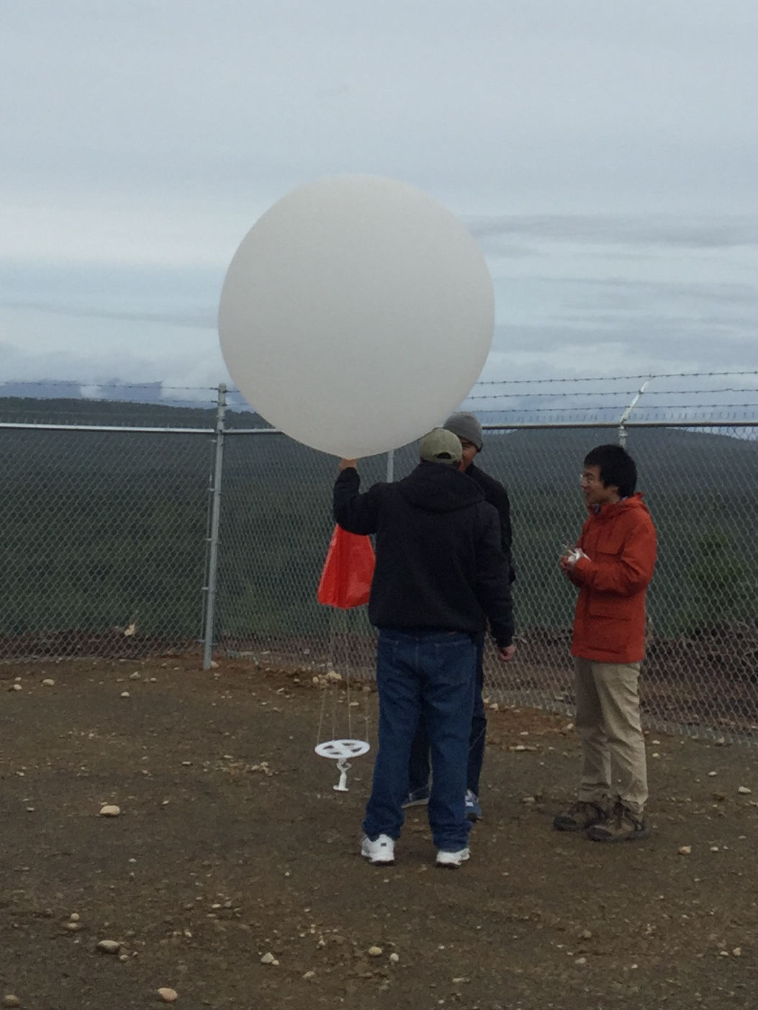
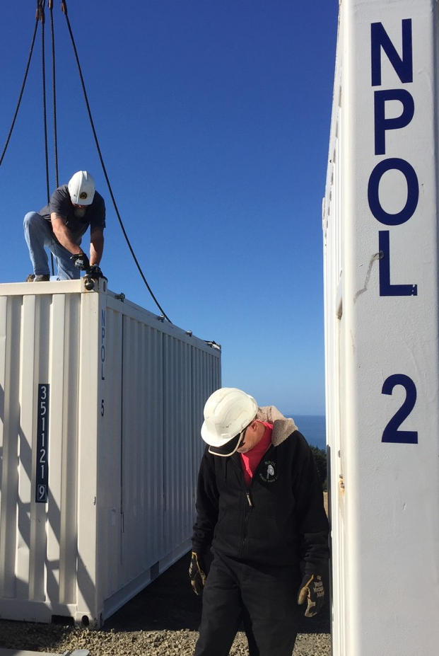
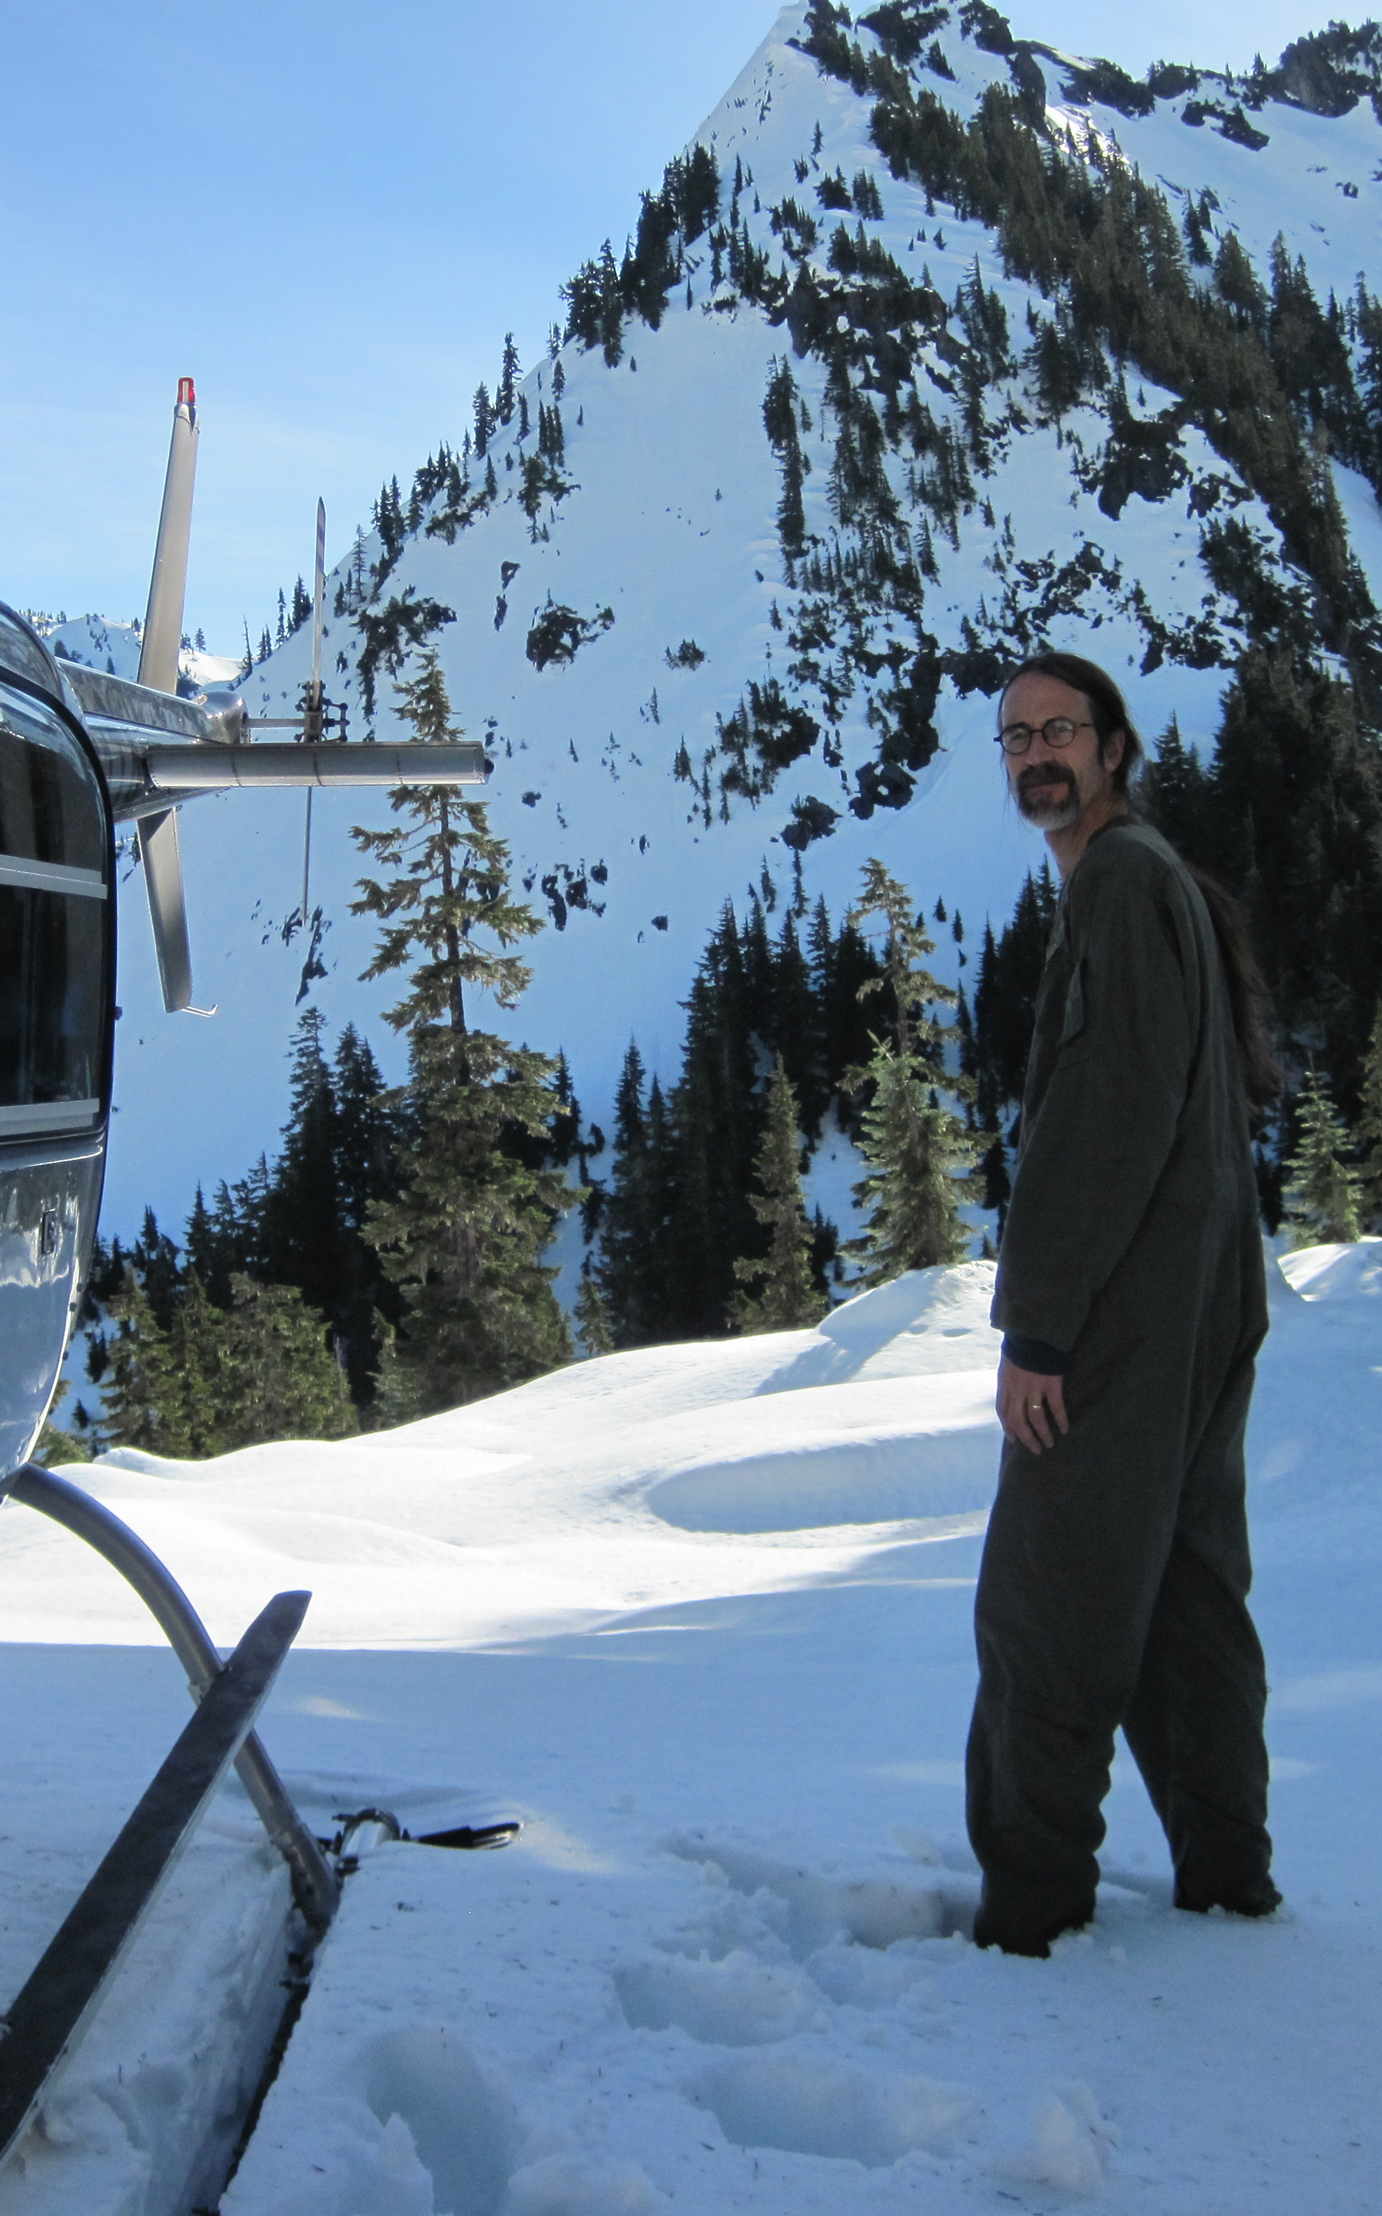
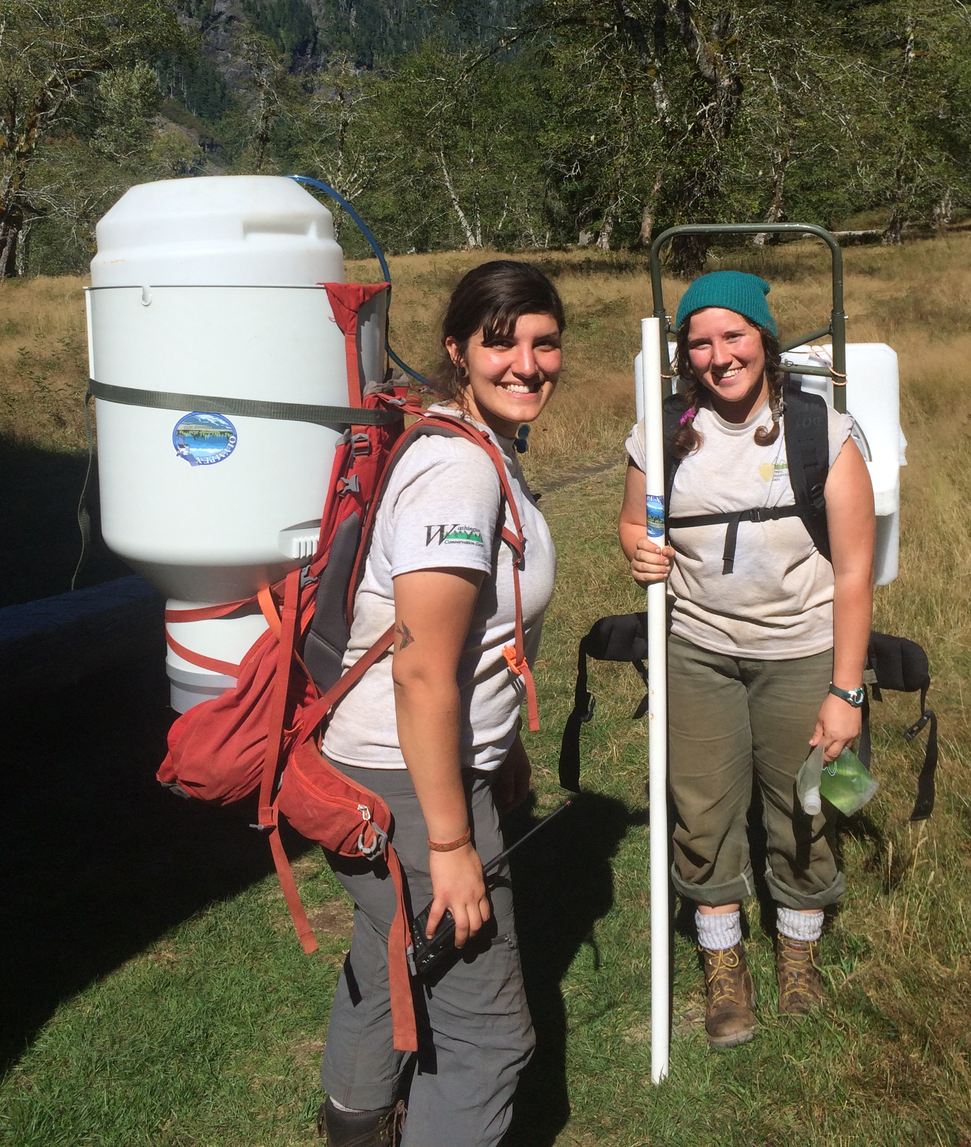
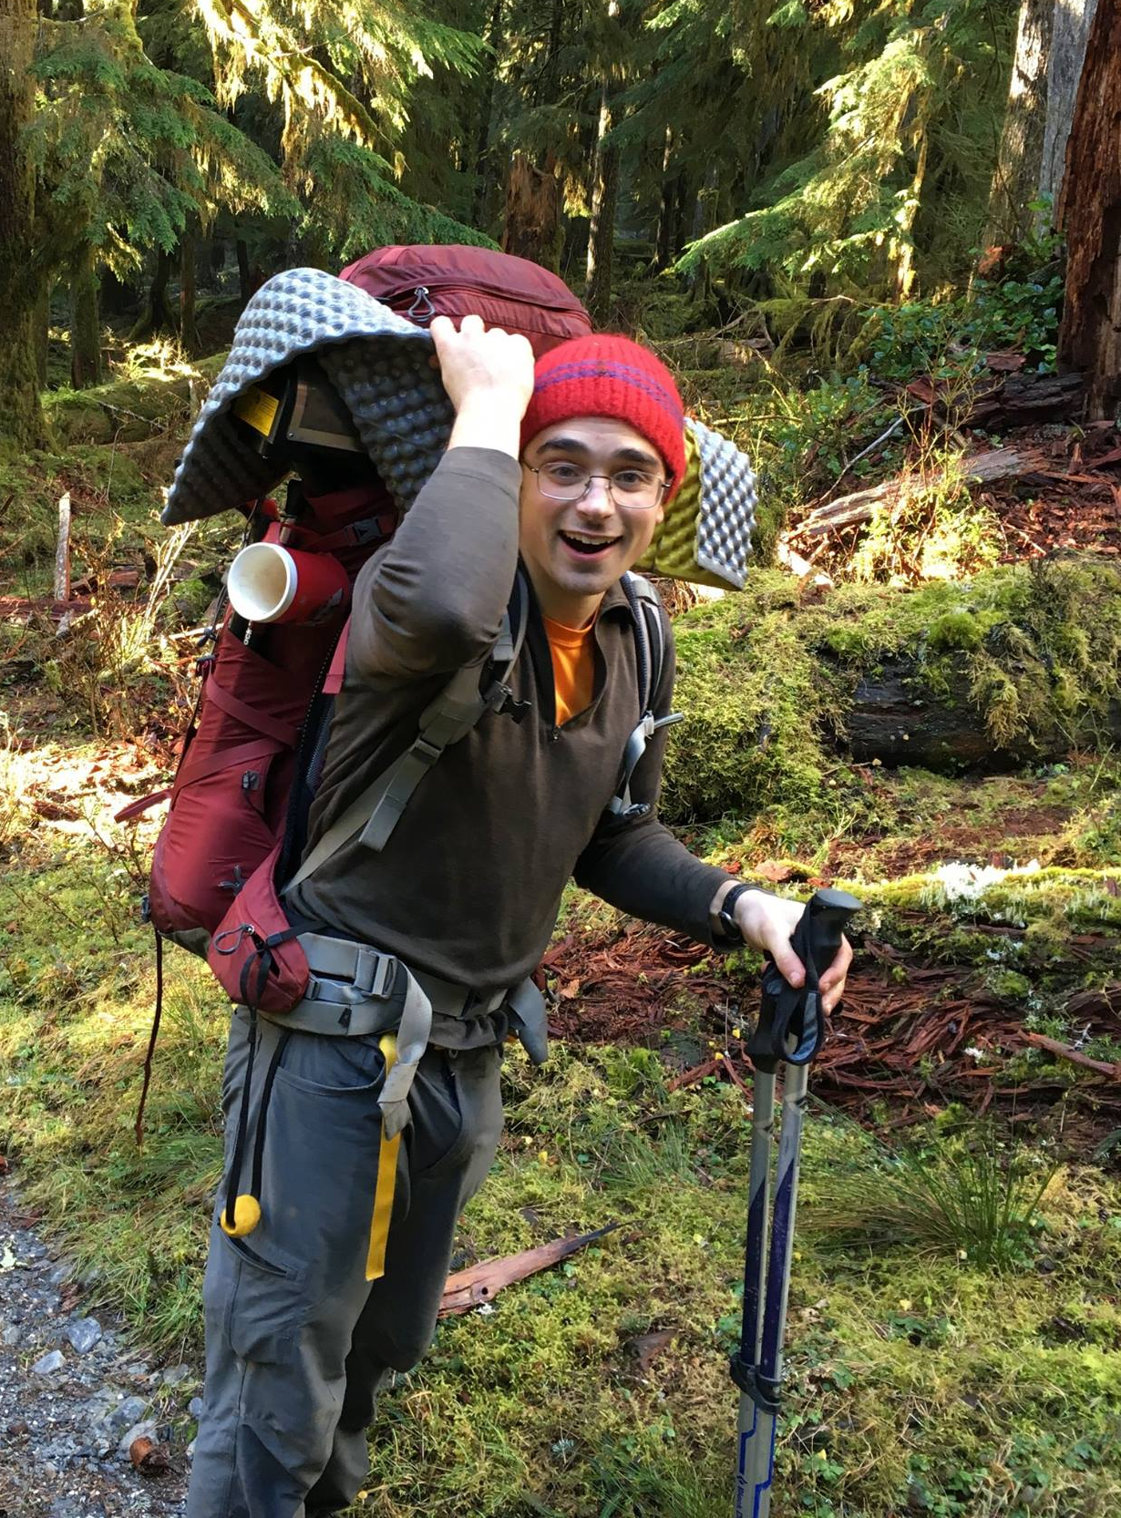
Installing and Keeping instrumentation running
Matt Wingo and crew
Mike Watson + NPOL crew
DOW operators
Launching Balloons
Olympic National Park Service – Bill Baccus and CJ Urnes

Slide 16
What We Observed

Slide 17

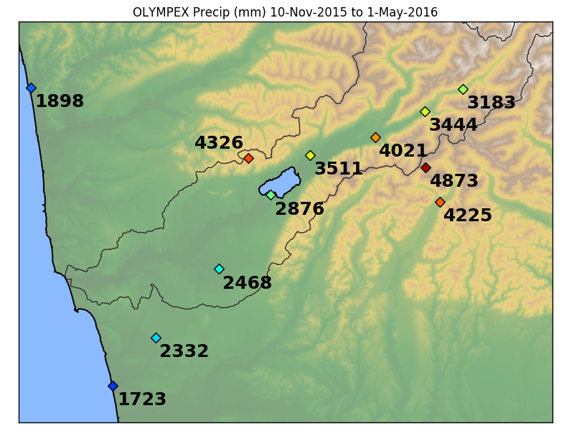
A lot of precipitation
Decrease further interior
Elevation 190mft
Elevation 115m
Elevation 540m
Highest at our higher terrain sites
Increase towards interior
Elevation 1020m and 280m
Elevation 0m
The OLYMPEX Season Totals
Factor of 1.5 - 2.5 enhancement
2015-2016 Season Totals
Orographic enhancement – seasonal pattern

Slide 18
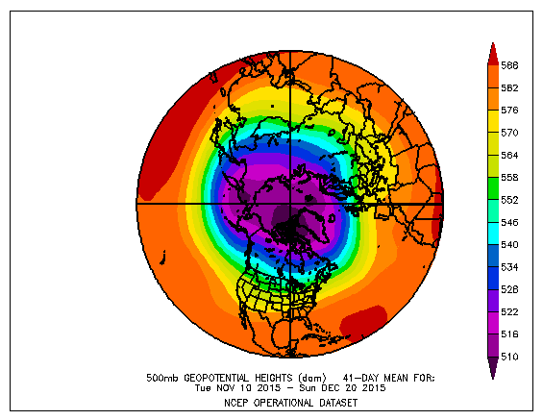
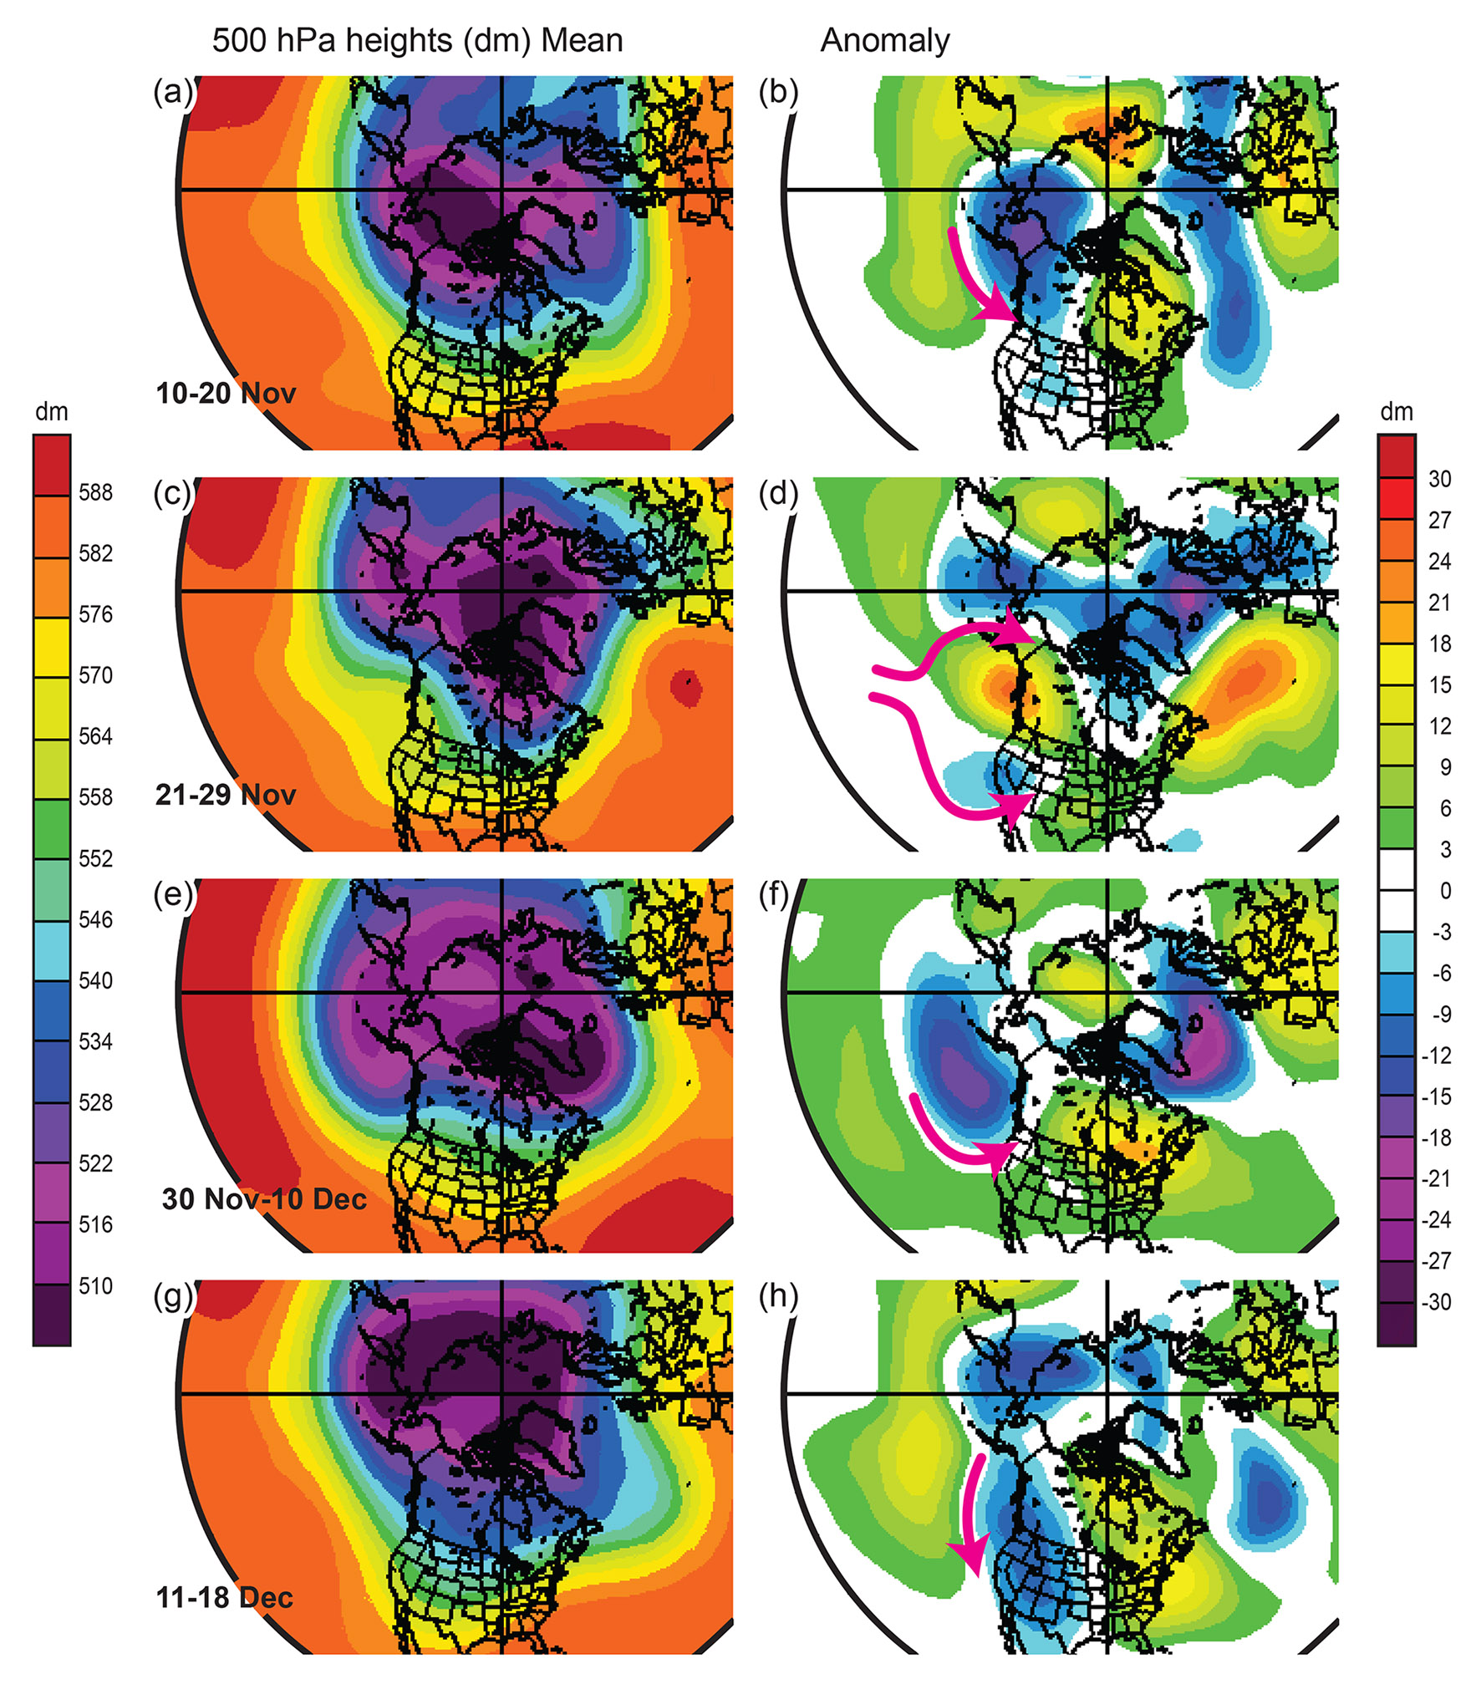
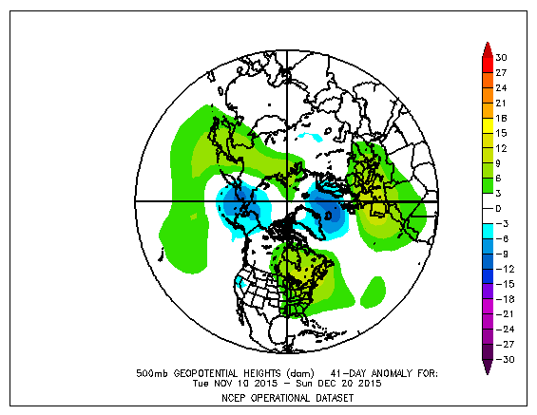

What We Observed 10 – 20 Nov
Strong westerly flow
Rapid moving cold front 11 Nov
Atmospheric River 12 – 13 Nov
Frontal wave and Chehalis flooding 14 Nov
Westerly AR, Narrow CF rainband, strong winds 17 Nov
Post frontal showers 18 – 19 Nov

Slide 19
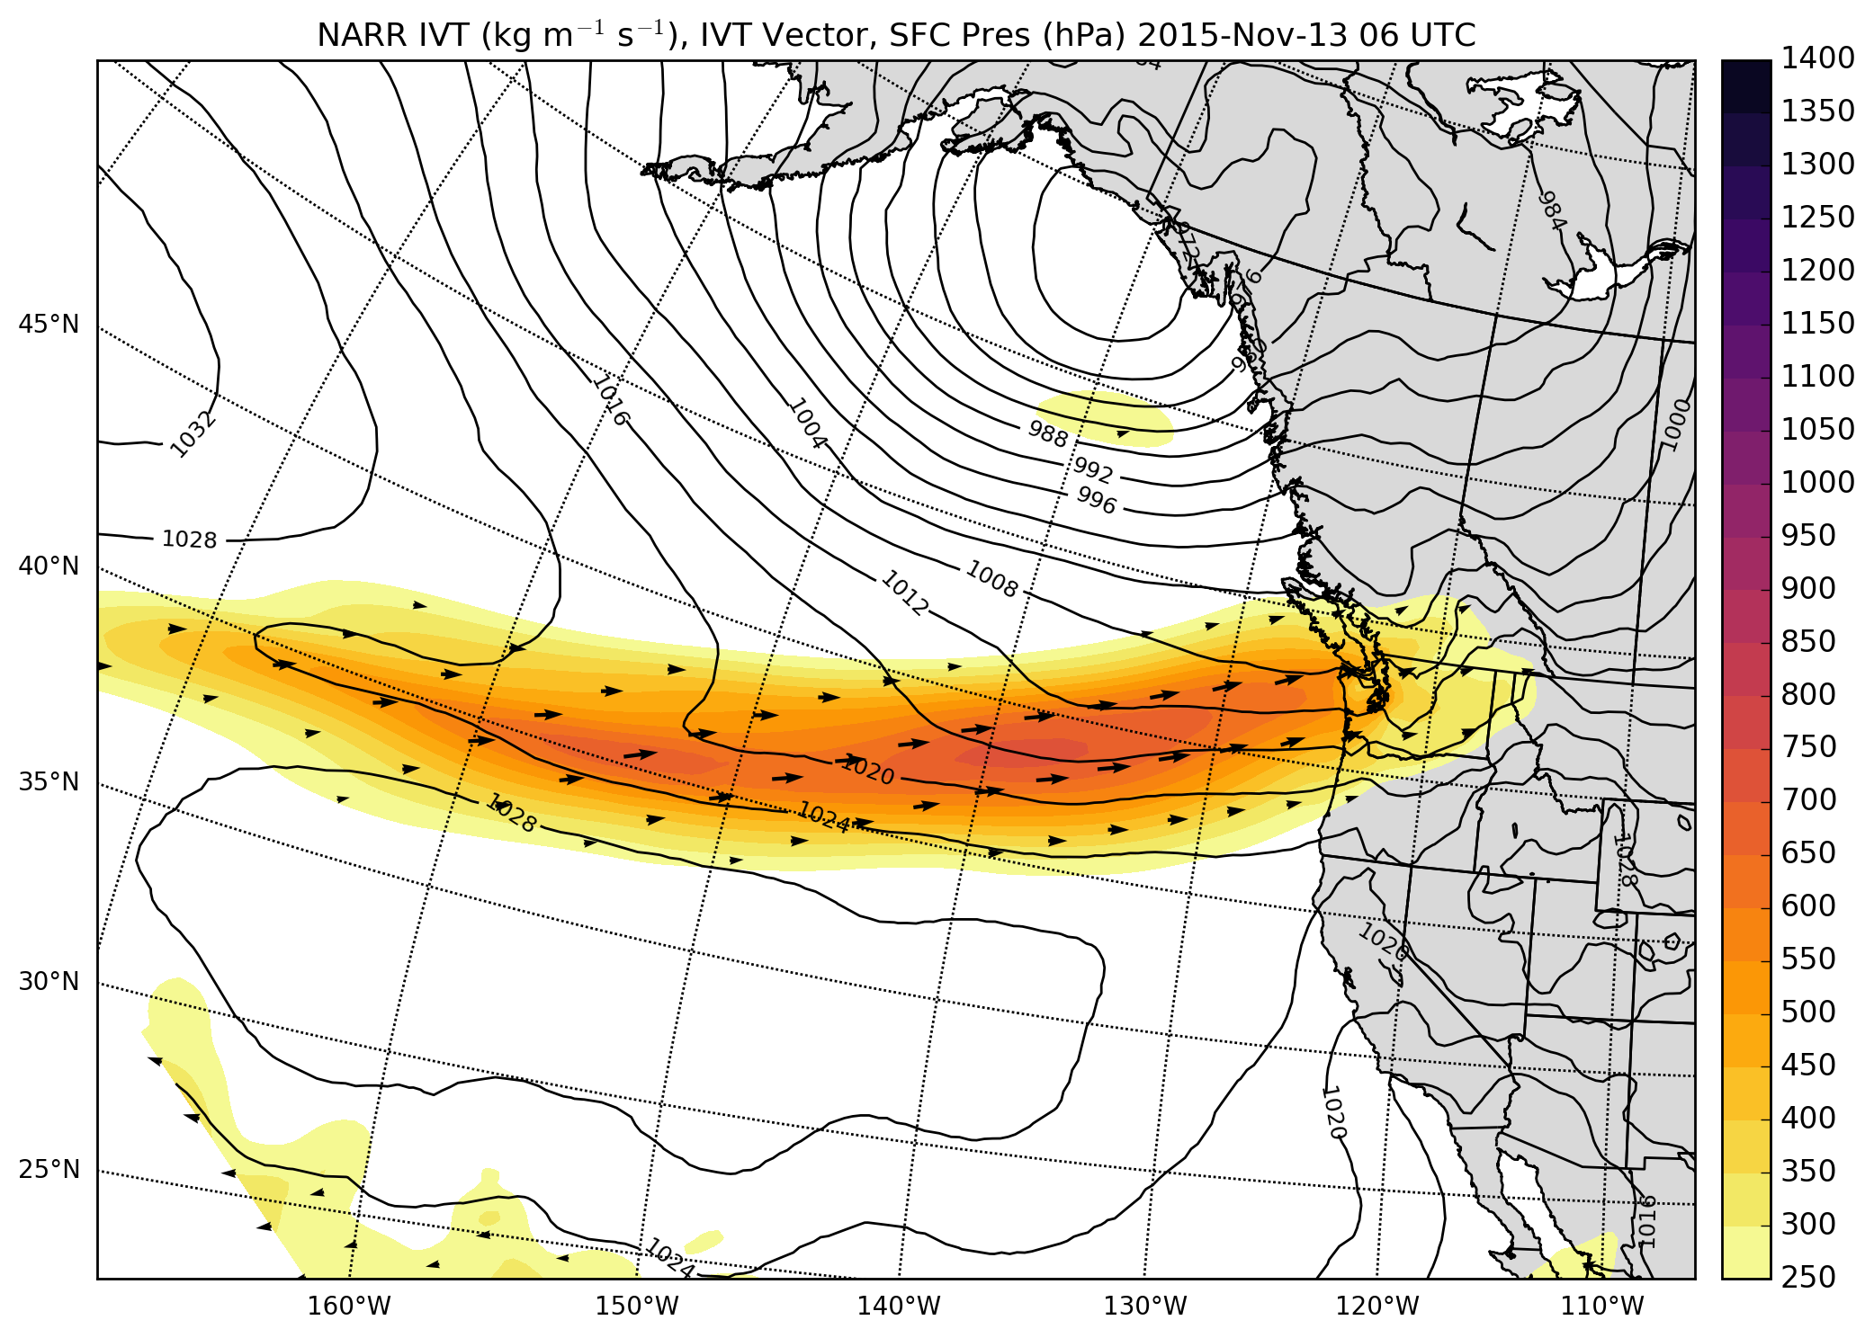
Atmospheric River Event 12 – 13 Nov
Integrate Vapor Transport0600 UTC 13 November 2015

Slide 20
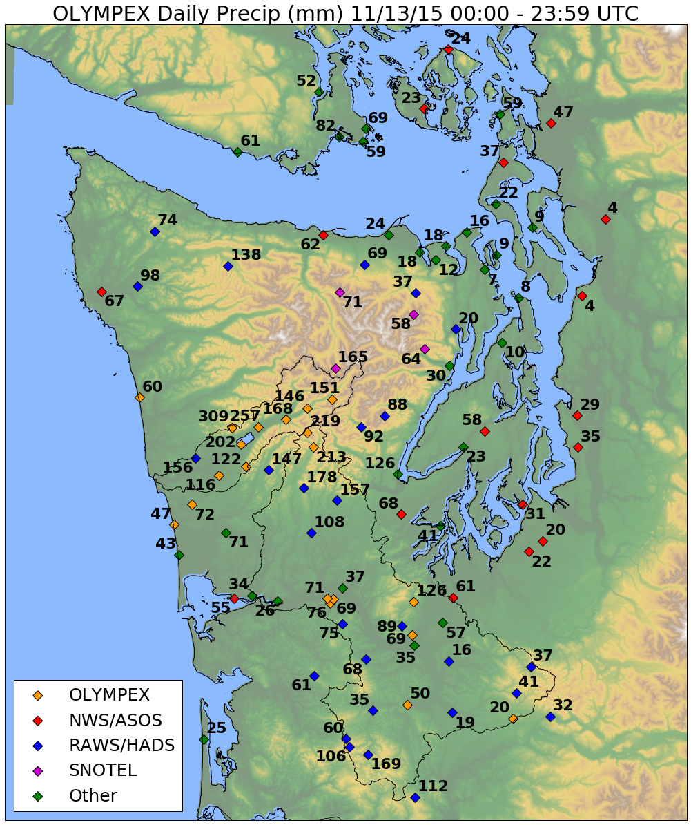
12 – 13 November 2015: Observed Precipitation Totals – Nov 13
High Terrain less than forward slopes
Factor 4 -5 Enhancement

Slide 21
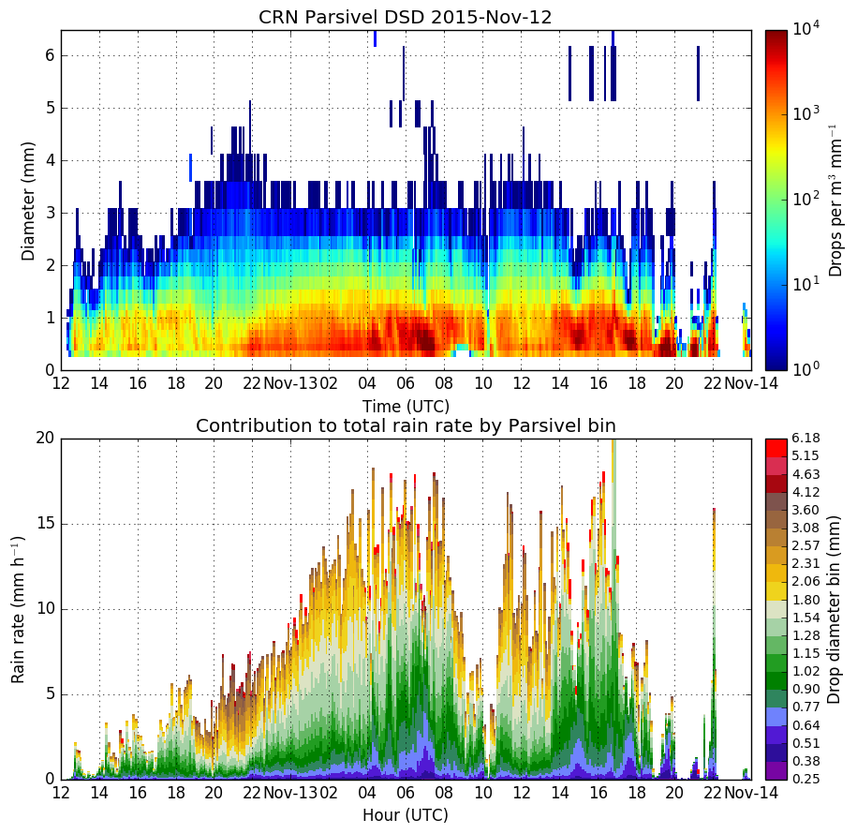
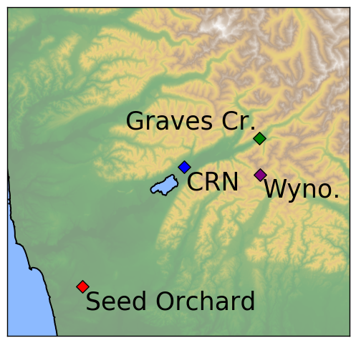
Warm Sector
Diameter (mm)
Drops per m³ mm⁻¹
Orographic enhancement associated with large quantities of < 1.5 mm drops
RHI
These small-medium sized drops are responsible for the majority of the increase in rain rate
Rain Rate (mm/h)
Drop Diameter bin (mm)
Time (UTC)

Slide 22
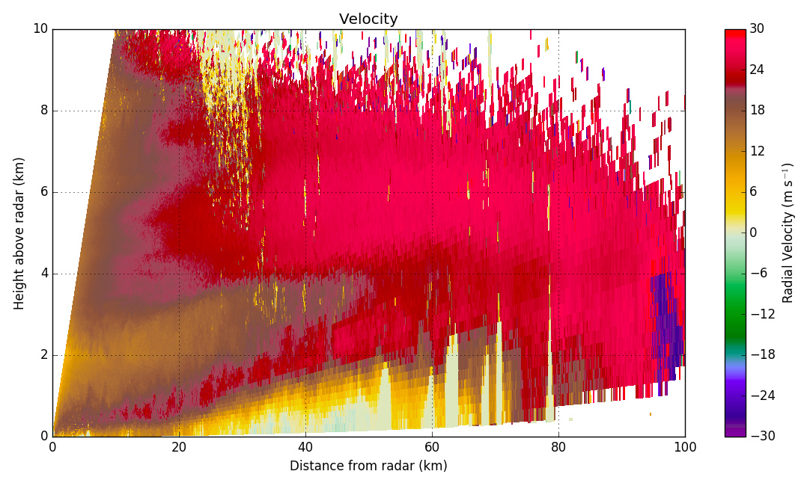
NPOL Radial Velocity
NPOL RHI 13-Nov 02:12 UTC
50° Azimuth
Velocity
Brightband
NPOL
CRN
Graves
Low-level jet is within 1 km of the surface near NPOL and starts lifting around 20 km from radar.
Drop formation + growth occurs below melting level ahead of high terrain.
Jet lifting decreases 50-60 km from radar.
Notes:
During period of max orographic enhancement!!!
----- Meeting Notes (6/23/16 15:10) -----
white arrows
jet lifting below brightband
drops form and fall out quickly
don't have time to grow
Mention wind direction (make barb)

Slide 23

What We Observed 21 – 29 Nov
The Death Ridge!!
Weakening frontal system 23 Nov
Diving trough, cold air outbreak, NE flow 24 Nov
Clear air calibration flight 25 Nov
Down day for everyone on Thanksgiving 26 Nov

Slide 24
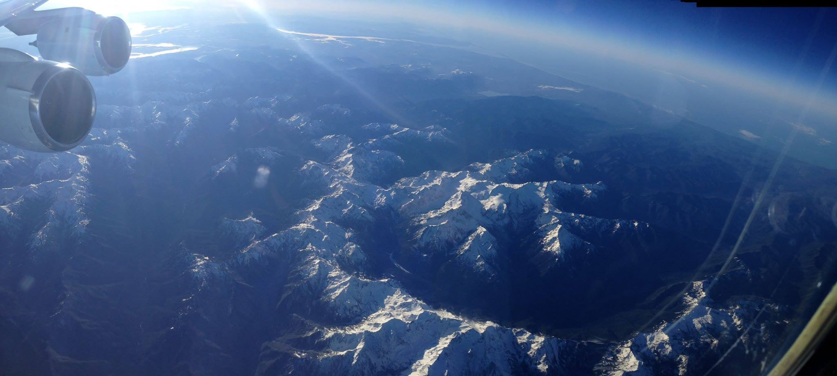
Calibration Flight 25 Nov 2015

Slide 25
What We Observed 30 Nov – 11 Dec
South-southwesterly flow
Frontal system Dec 1
Complex frontal system, GPM 3 – 4 Dec
Broad frontal system 5 – 6 Dec
2 Quick moving short waves 7 Dec
Atmospheric River event 8 – 9 Dec
Occluded Front 10 Dec

Slide 26
Coordination of 3 aircraft under GPM overpass – Dec 3
A
B
GPM Ku-band reflectivity

Slide 27
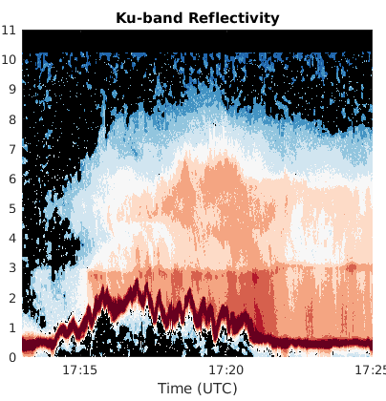
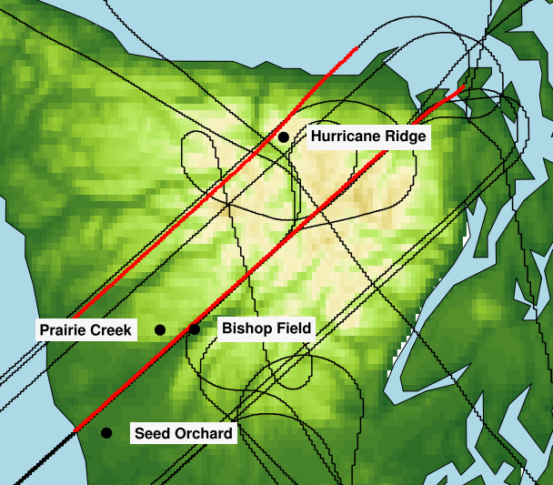
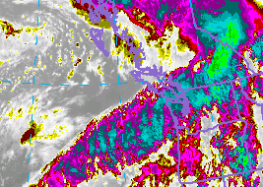
Dec 8 – DC-8 flight through AR event – APR-3 Ku-band reflectivity
Southern Leg
Largest reflectivity on windward slopes and not high terrain
Echo top height decrease in lee
Melting level variability
NE
SW
Windward

Slide 28
What We Observed 11 Dec – 18 Dec
Troughing over Western NA
Occluded frontal system 11 - 12 Dec
Post Frontal convection and orographic precipitation 13 – 14 Dec
Weak warm frontal precipitation with K-H structure 17 Dec
Occluded frontal system 18-19 Dec

Slide 29




Post Frontal convection 13 Dec
DOW up valley RHI
DOW up valley RHI

Slide 30
Comparison of NPOL to GPM – an OLYMPEX Goal

Slide 31




NPOL vs GPM Ku- and Ka-band CFADS
NPOL
GPM Ku
Missing low reflectivity
Lacking echo aloft
GPM Ka-band – Ku-band
Lack of echo aloft and reflectivity < 12 DBZ.
GPM Ka-band only slightly more sensitive than the Ku-band
Attenuation at higher reflectivity.
Explanations are being investigated

Slide 32
OLYMPEX was hugely successful
Unprecedented data collected by state-of-the art instruments:
multiple radar at multiple wavelengths,
extensive documentation of the characteristics and distribution of falling precipitation
Able to perform GPM physical validation for midlatitude winter-time storm systems
Able to investigate modification of precipitation by synoptic conditions and complex terrain

Slide 33



OLYMPEX Outreach
Social Media day
Nov 11, 2015 – over 40 people at UW operations center, 15 went to Peninsula
Ranked #1 most engaging US Government Twitter accounts
#1 trending on Nov. 11
School/public talks: Angela Rowe, Shannon O’Donnell, Lynn McMurdie
Countless press interviews
Prof. Houze explains OLYMPEX at Social Media Day
At NPOL on media day
Students Visit the DOW

Slide 34
OLYMPEX future events
Tonight Breakout Session 6pm – Apollo Room
Pizza available $5/person– BUT TELL ME so we order enough
OLYMPEX presentations at meetings:
AGU (Dec 2016 San Francisco)
AMS (Jan 2017)
Weather Fest (Sunday)
Houze Symposium (Tuesday TRMM/GPM/OLYMPEX)
NWP/WAF session (Wednesday)
OLYMPEX Workshop, Seattle, WA 21-23 March , 2017
BAMS article (in prep)

Slide 35
Acknowledgments
Work supported by NASA grants NNX15AL38G, NNX16AD75G and NNX16AK05G
NSF grant AGS-1503155

